Slide 1
Where are we?
Oscar Schofield on behalf of many
oscar@marine.rutgers.edu

Slide 2
Themes to be covered
History and status
Basic system
Science Potential
Procedures For Data Quality

Slide 3
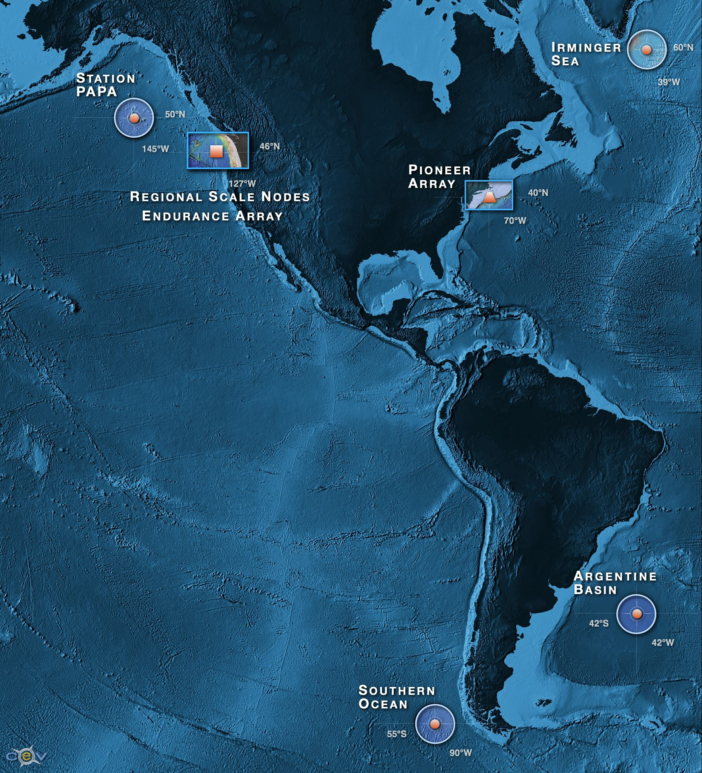
What is being built?
A distributed network of fully open access data for sustained periods open to anyone with open access to the web the democratization of oceanography
Ability to characterize the importance of episodic versus seasonal, annual variability over eddy, shelf and plate scales
>800 unique sensors deployed at any given time on the network
A network capable of absorbing new sensors as they are developed by the wider scientific community
A scalable cyber infrastructure providing a service orientated architecture
A system that provides web service data management with visualization
An integrated education and public engagement suite of tools that can be directly integrated into undergraduate education modules
After an RFA that gave input from 48 white papers from 130 academic institutions (representing 550 investigators) followed by community meetings across all ocean disciplines (lithosphere to atmosphere) identified: 1) high latitude sites that could be afforded (2 in north and south Pacific and Atlantic), 2) coastal regimes (eastern boundary short continental and western boundary broad continental shelves), and 3) a plate scale lithospheric plate encompassing gas hydrate-vent field-repository from the upper ocean.

Slide 4
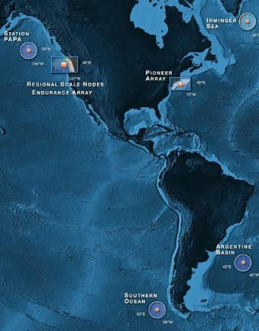
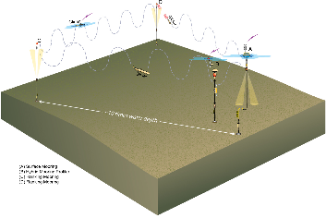
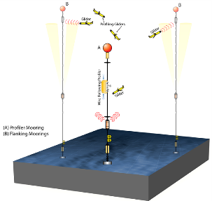
OOI Components: Global Component
Four Global Sites
  Flanking Moorings
  Profiler Mooring
  Gliders (5)
  Acoustics

Slide 5
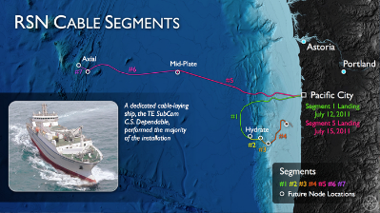
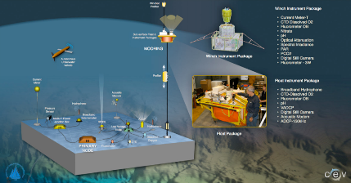
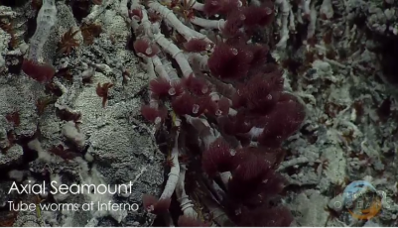
OOI Components: Cabled Array
Moorings
Profilers
HD Video
Met Data

Slide 6
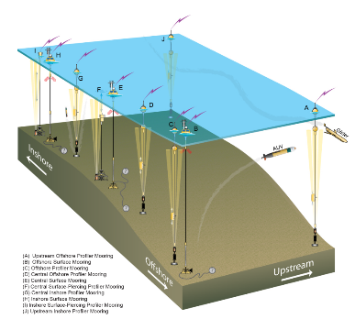
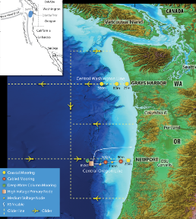
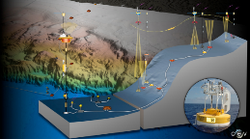
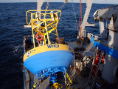
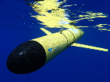
OOI Components: Coastal Component
West Coast: Endurance Array
East Coast: Pioneer Array
Portable
Glider AUVs
REMUS AUVs
Moorings
Profilers
Met Data

Slide 7
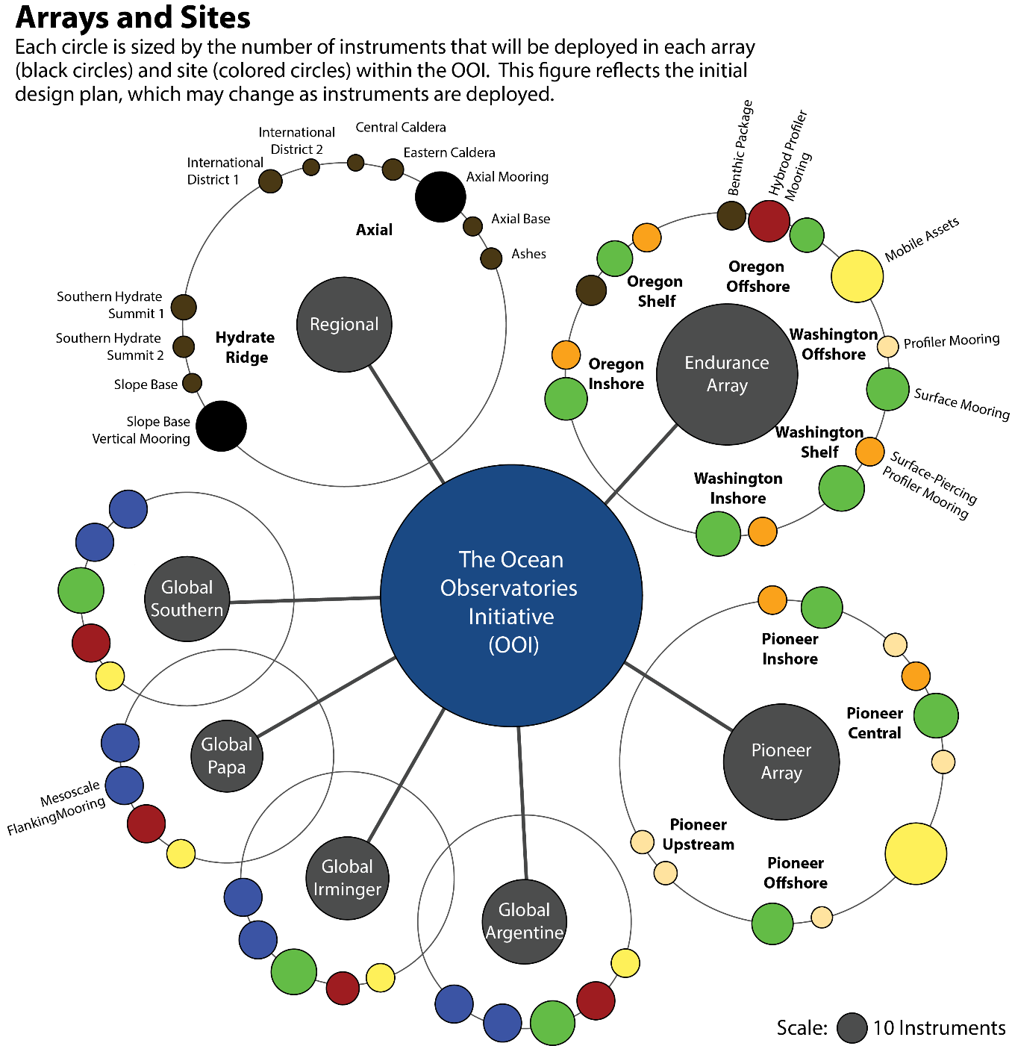
256
704
319
490
192
308
314

Slide 8
Deployed Scope of OOI (over 800 instruments distributed over all moorings, benthic packages, seafloor nodes, gliders and AUVs)
Global Arrays
Coastal Arrays
Cabled Arrays
Cyberinfrastructure
Computing platforms, software applications, storage, and high speed network equipment
Cyber Points of Presence (CyberPoPs)
  Acquisition Points
  Distribution Points
Integrated Observatory Network – OOI Net
  Hardware / Software
Redundant computing environment
Connected by 880km of seafloor cable, with 10KW power, internet connectivity between 7 primary nodes, multiple secondary nodes, and all distributed instrumentation
Extensive details about each component can be found on the OOI website (http://oceanobservatories.org)

Slide 9
Data Products from NE Pacific observatories

Slide 10
Data Products from NE Pacific observatories

Slide 11
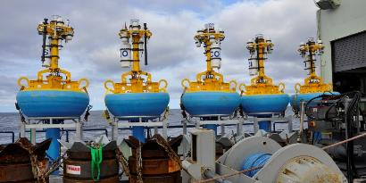
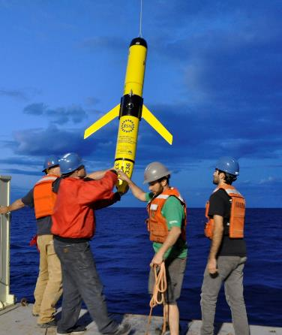
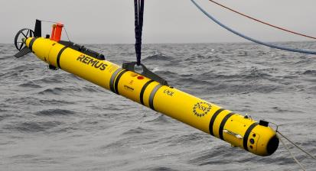
Pioneer Array: deployments
Pioneer surface moorings, Fall 2014.
Ocean glider deployments, Spring 2015.
REMUS 600 AUV Testing at Pioneer, May 2015.

Slide 12
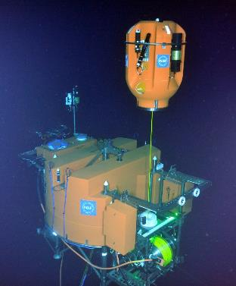
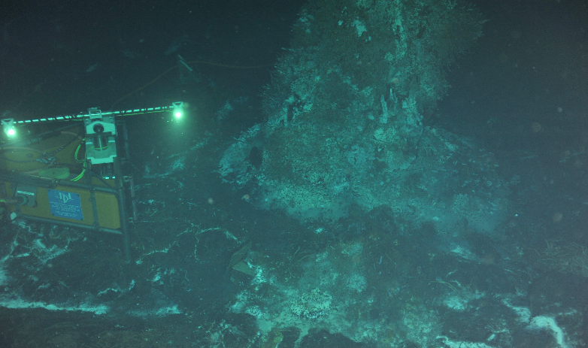
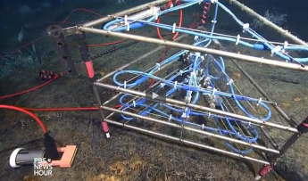
Cabled Observatory: deployments
Digital Still Camera, summer 2014).
Shallow Profiler platform on a 2700 m-tall, 2 legged mooring hosting acoustic doppler current profilers, a digital still camera, and chemical and biological sensors (summer 2015).
3D Temperature Sensor, summer 2015.

Slide 13
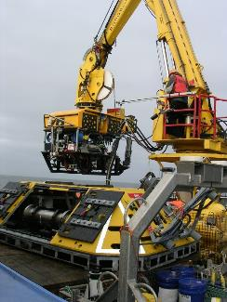
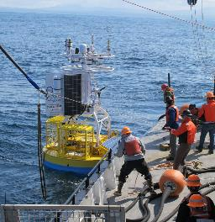
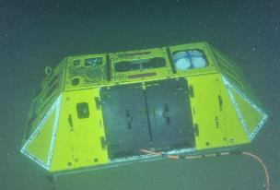
Endurance Array: deployments
ROPOS ROV and Benthic Experiment Package pre- deployment, summer 2014.
Benthic Experiment Package (ADCP visible on top), summer 2014.
Endurance surface mooring deployment, July 2015.

Slide 14
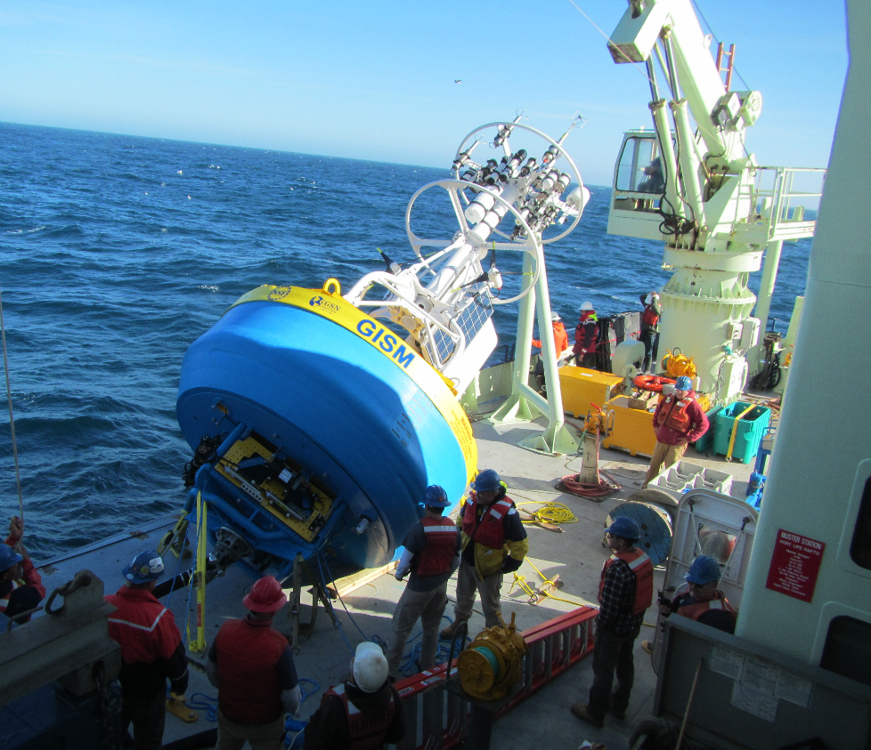
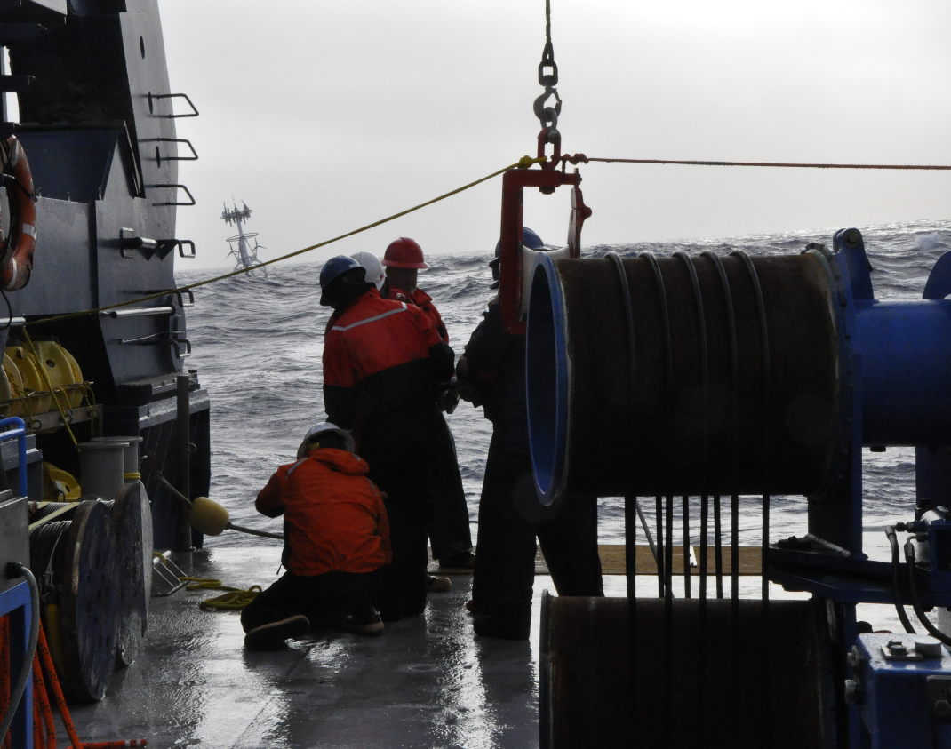
Global Array: deployments
Irminger Surface Mooring, Winter 2014.
Southern Ocean, July 2015.

Slide 15
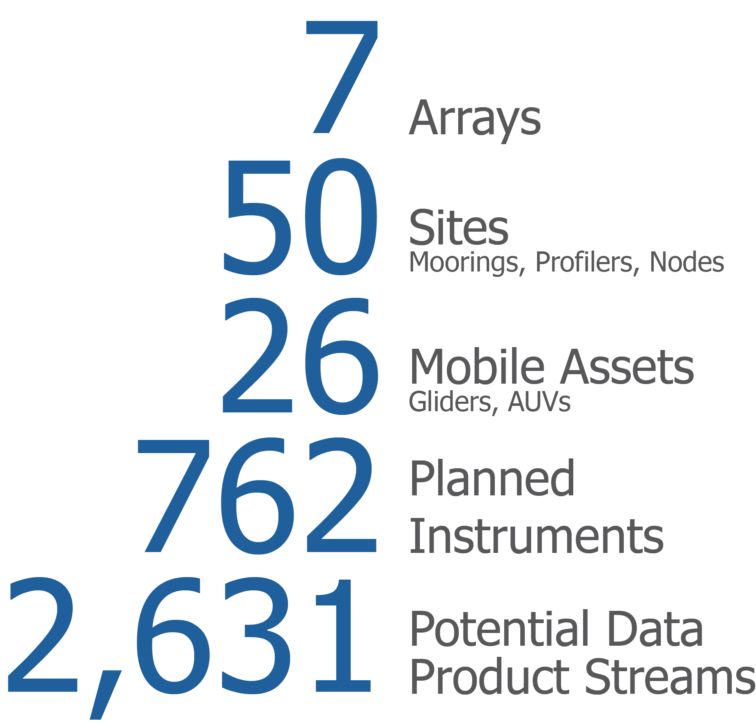
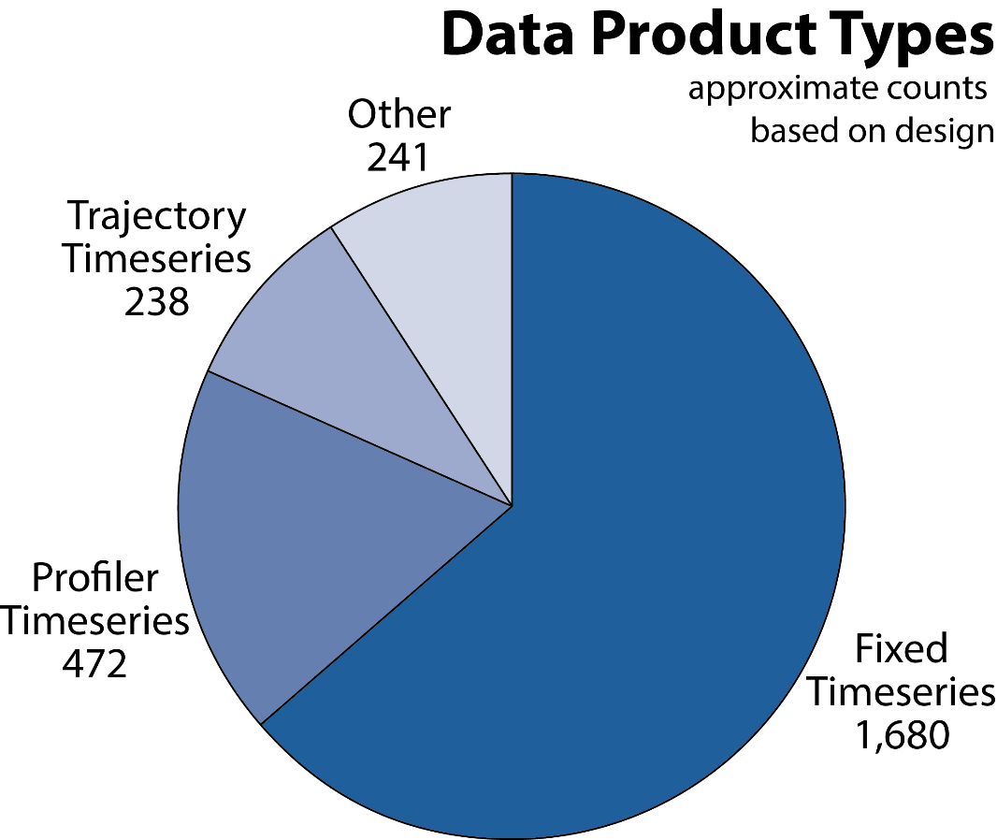
OOI By the Numbers
(2,583 yesterday)

Slide 16
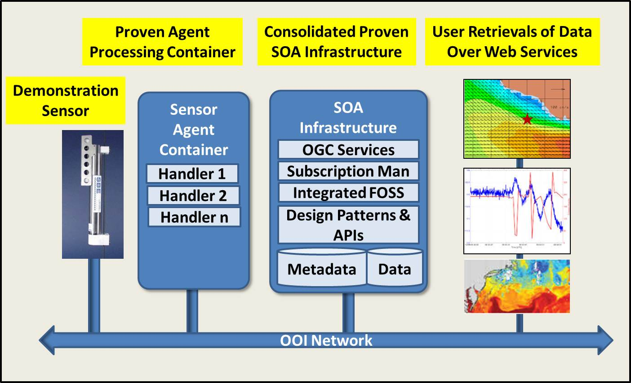
Web based services
Technical Approach Uses Proven SOA Infrastructure to Integrate OOI Data

Slide 17
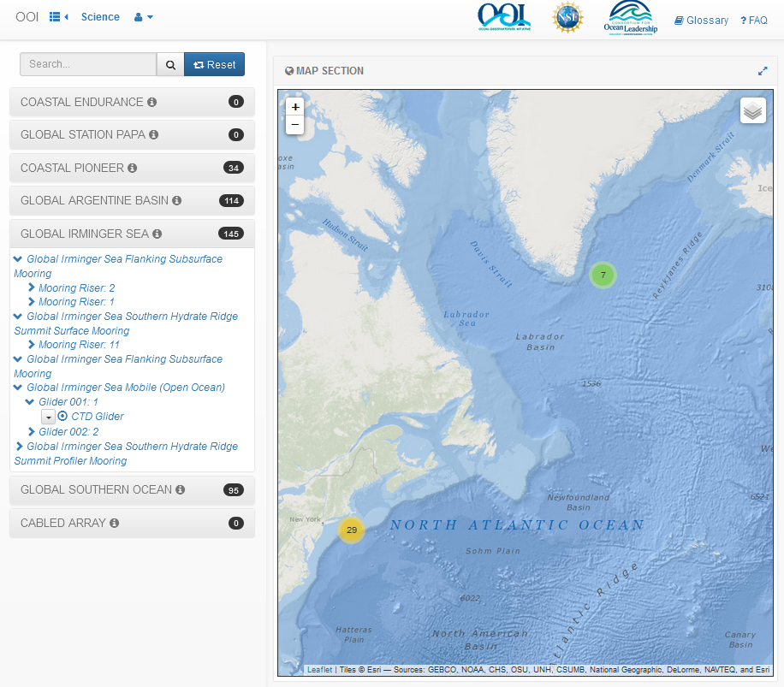
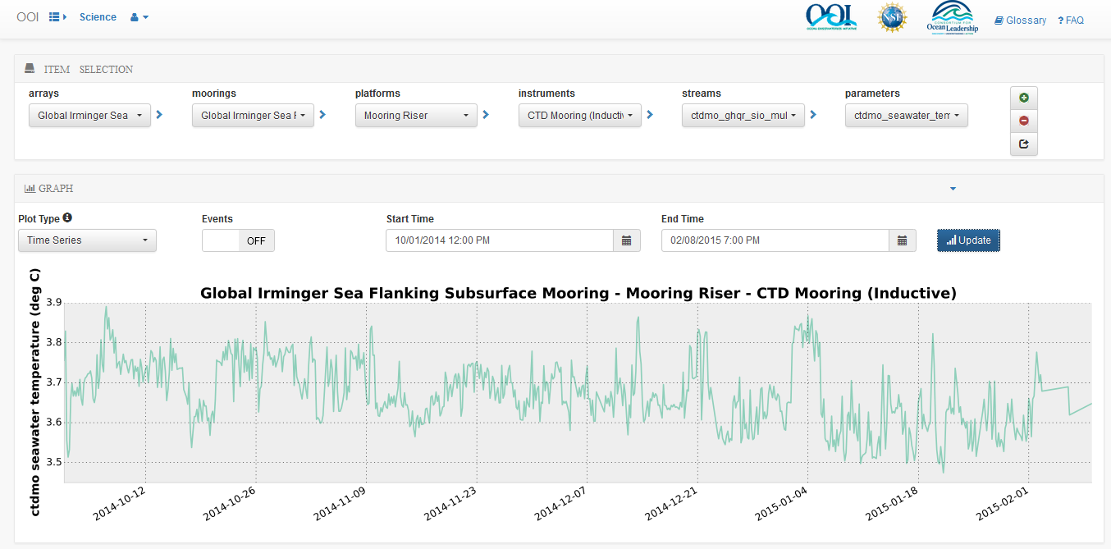
Data Access
    Time Series

Slide 18
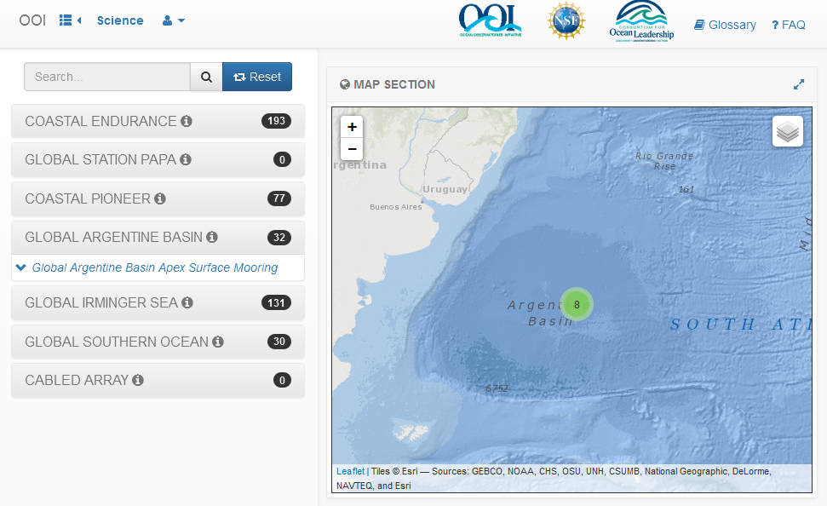
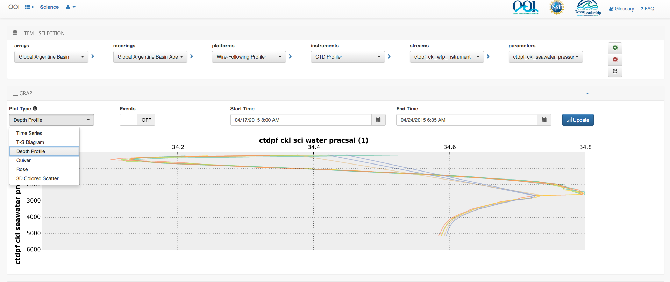
Data Access
    Available Plots
      Time Series
      T-S Diagrams
      Depth Profiles
      Quiver
      Rose
      3D Colored Plots

Slide 19
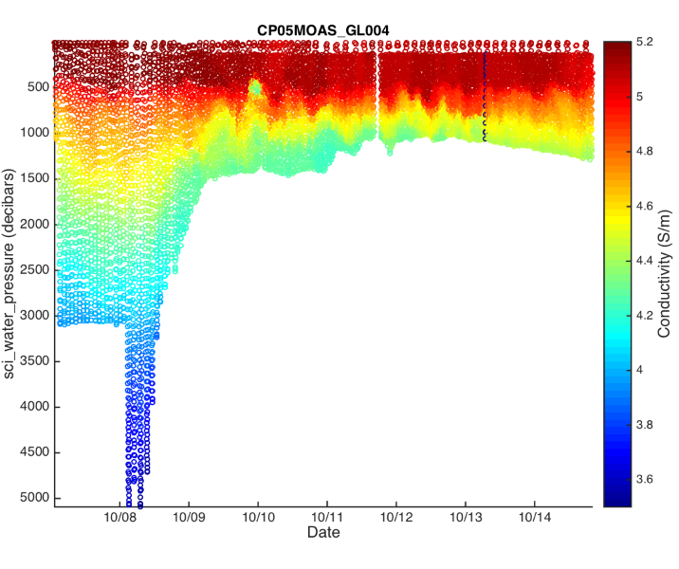
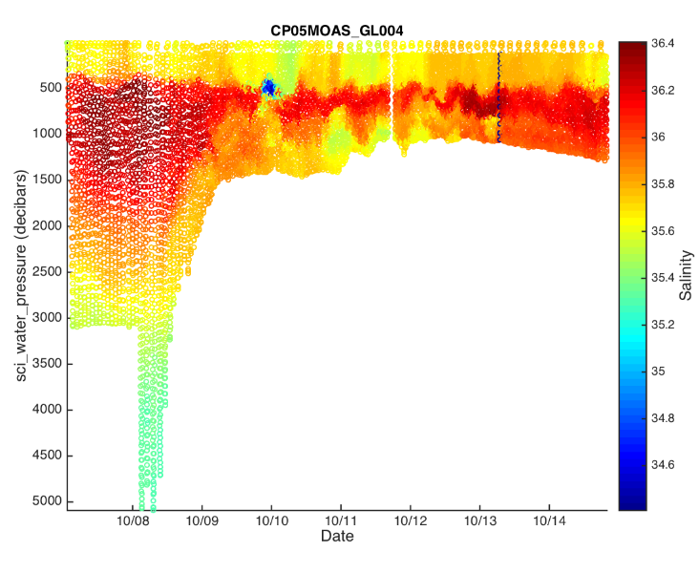
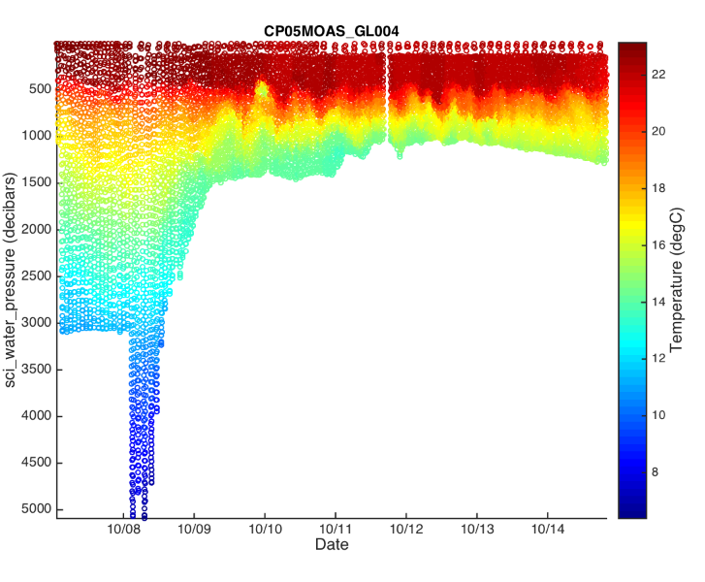
Data Access
    Pioneer Glider Time Series Cross Sections

Slide 20
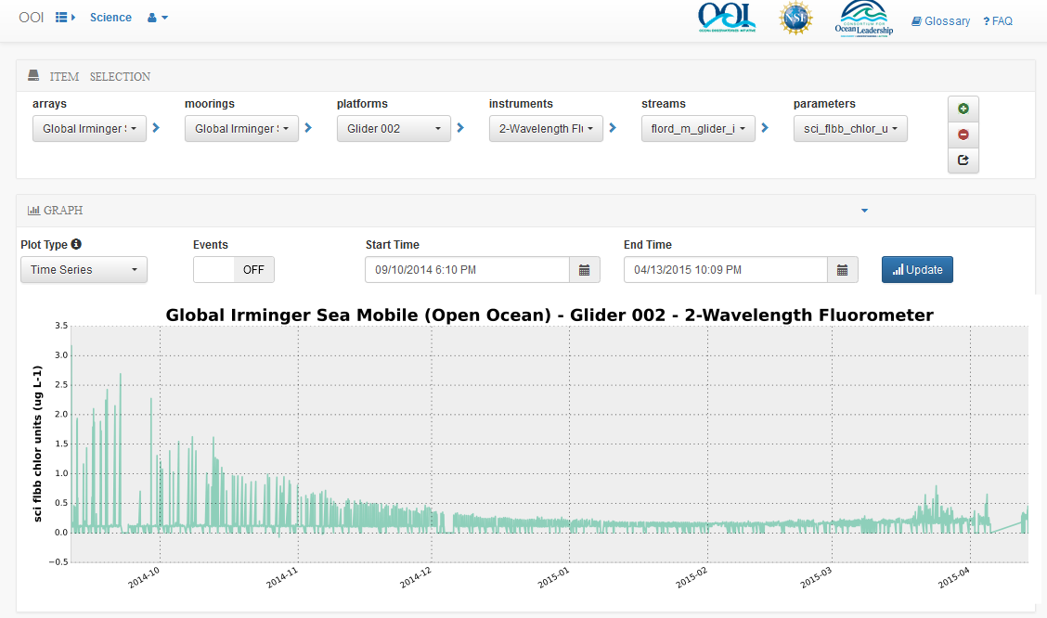
Data Access
    Data are available through a GUI to display or download
    Data are also available through web services for automatic download
    NetCDF, JSON & csv available

Slide 21
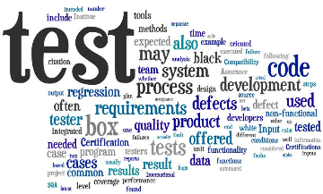
Software Testing
    Upcoming software tests of the OOI GUI and web services used to access scientific (L0, L1, L2), engineering and meta data:
Alpha 2 Test: Early August, 2015
    25 selected users testing GUI
Beta Test: Early September, 2015
    ~30 users expanding outside OOI Project
Final Test: End September, 2015
    Numerous testers from the community
Data tests (reasonable, acceptable, etc, more to follow)
Surface Moorings: Late September, 2015
PH & PCO2: October, 2015
Sea Floor Sensors: October 2015

Slide 22
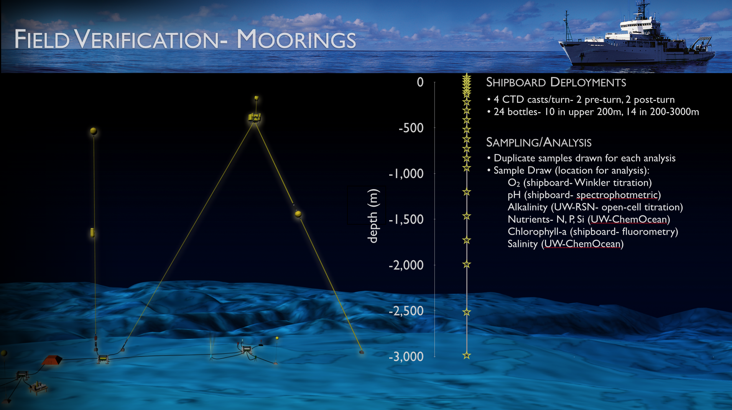
Ship and Shore-based sensor verification

Slide 23
At-sea protocols
Deployment and post-deployment procedures
Deployment documentation
Pre-deployment checklists [CP02PMUI-00001_checklist.pdf]
Mooring deployment logs [CP02PMUI-00001_deployment-log.pdf]
Post-deployment data assessment
Adjacent CTD cast(s) (temp,sal,oxy,chl,turb) [see quick look report]
Shipboard systems (met, surface t-sal, ADCP) [SCS_WSPD.gif, SCS_WDIR.gif]
Water samples and lab analysis (sal,oxy,chl,etc) [Pioneer1_salinity_oxygen.xlsx]

Slide 24
At-sea procedures
Post-deployment procedures
Deployment documentation
Pre-deployment checklists [CP02PMUI-00001_checklist.pdf]
Mooring deployment logs [CP02PMUI-00001_deployment-log.pdf]
Post-deployment assessments
Adjacent CTD cast(s) (temp,sal,oxy,chl,turb) [see quick look report]
Shipboard systems (met, surface t-sal, ADCP) [SCS_WSPD.gif, SCS_WDIR.gif]
Water samples and lab analysis (sal,oxy,chl,etc) [Pioneer1_salinity_oxygen.xlsx]
Quick-look report [3204-00023_Poineer_1_Quick_Look_Cruise_Report.pdf]
Lessons learned [internal working documents]

Slide 25
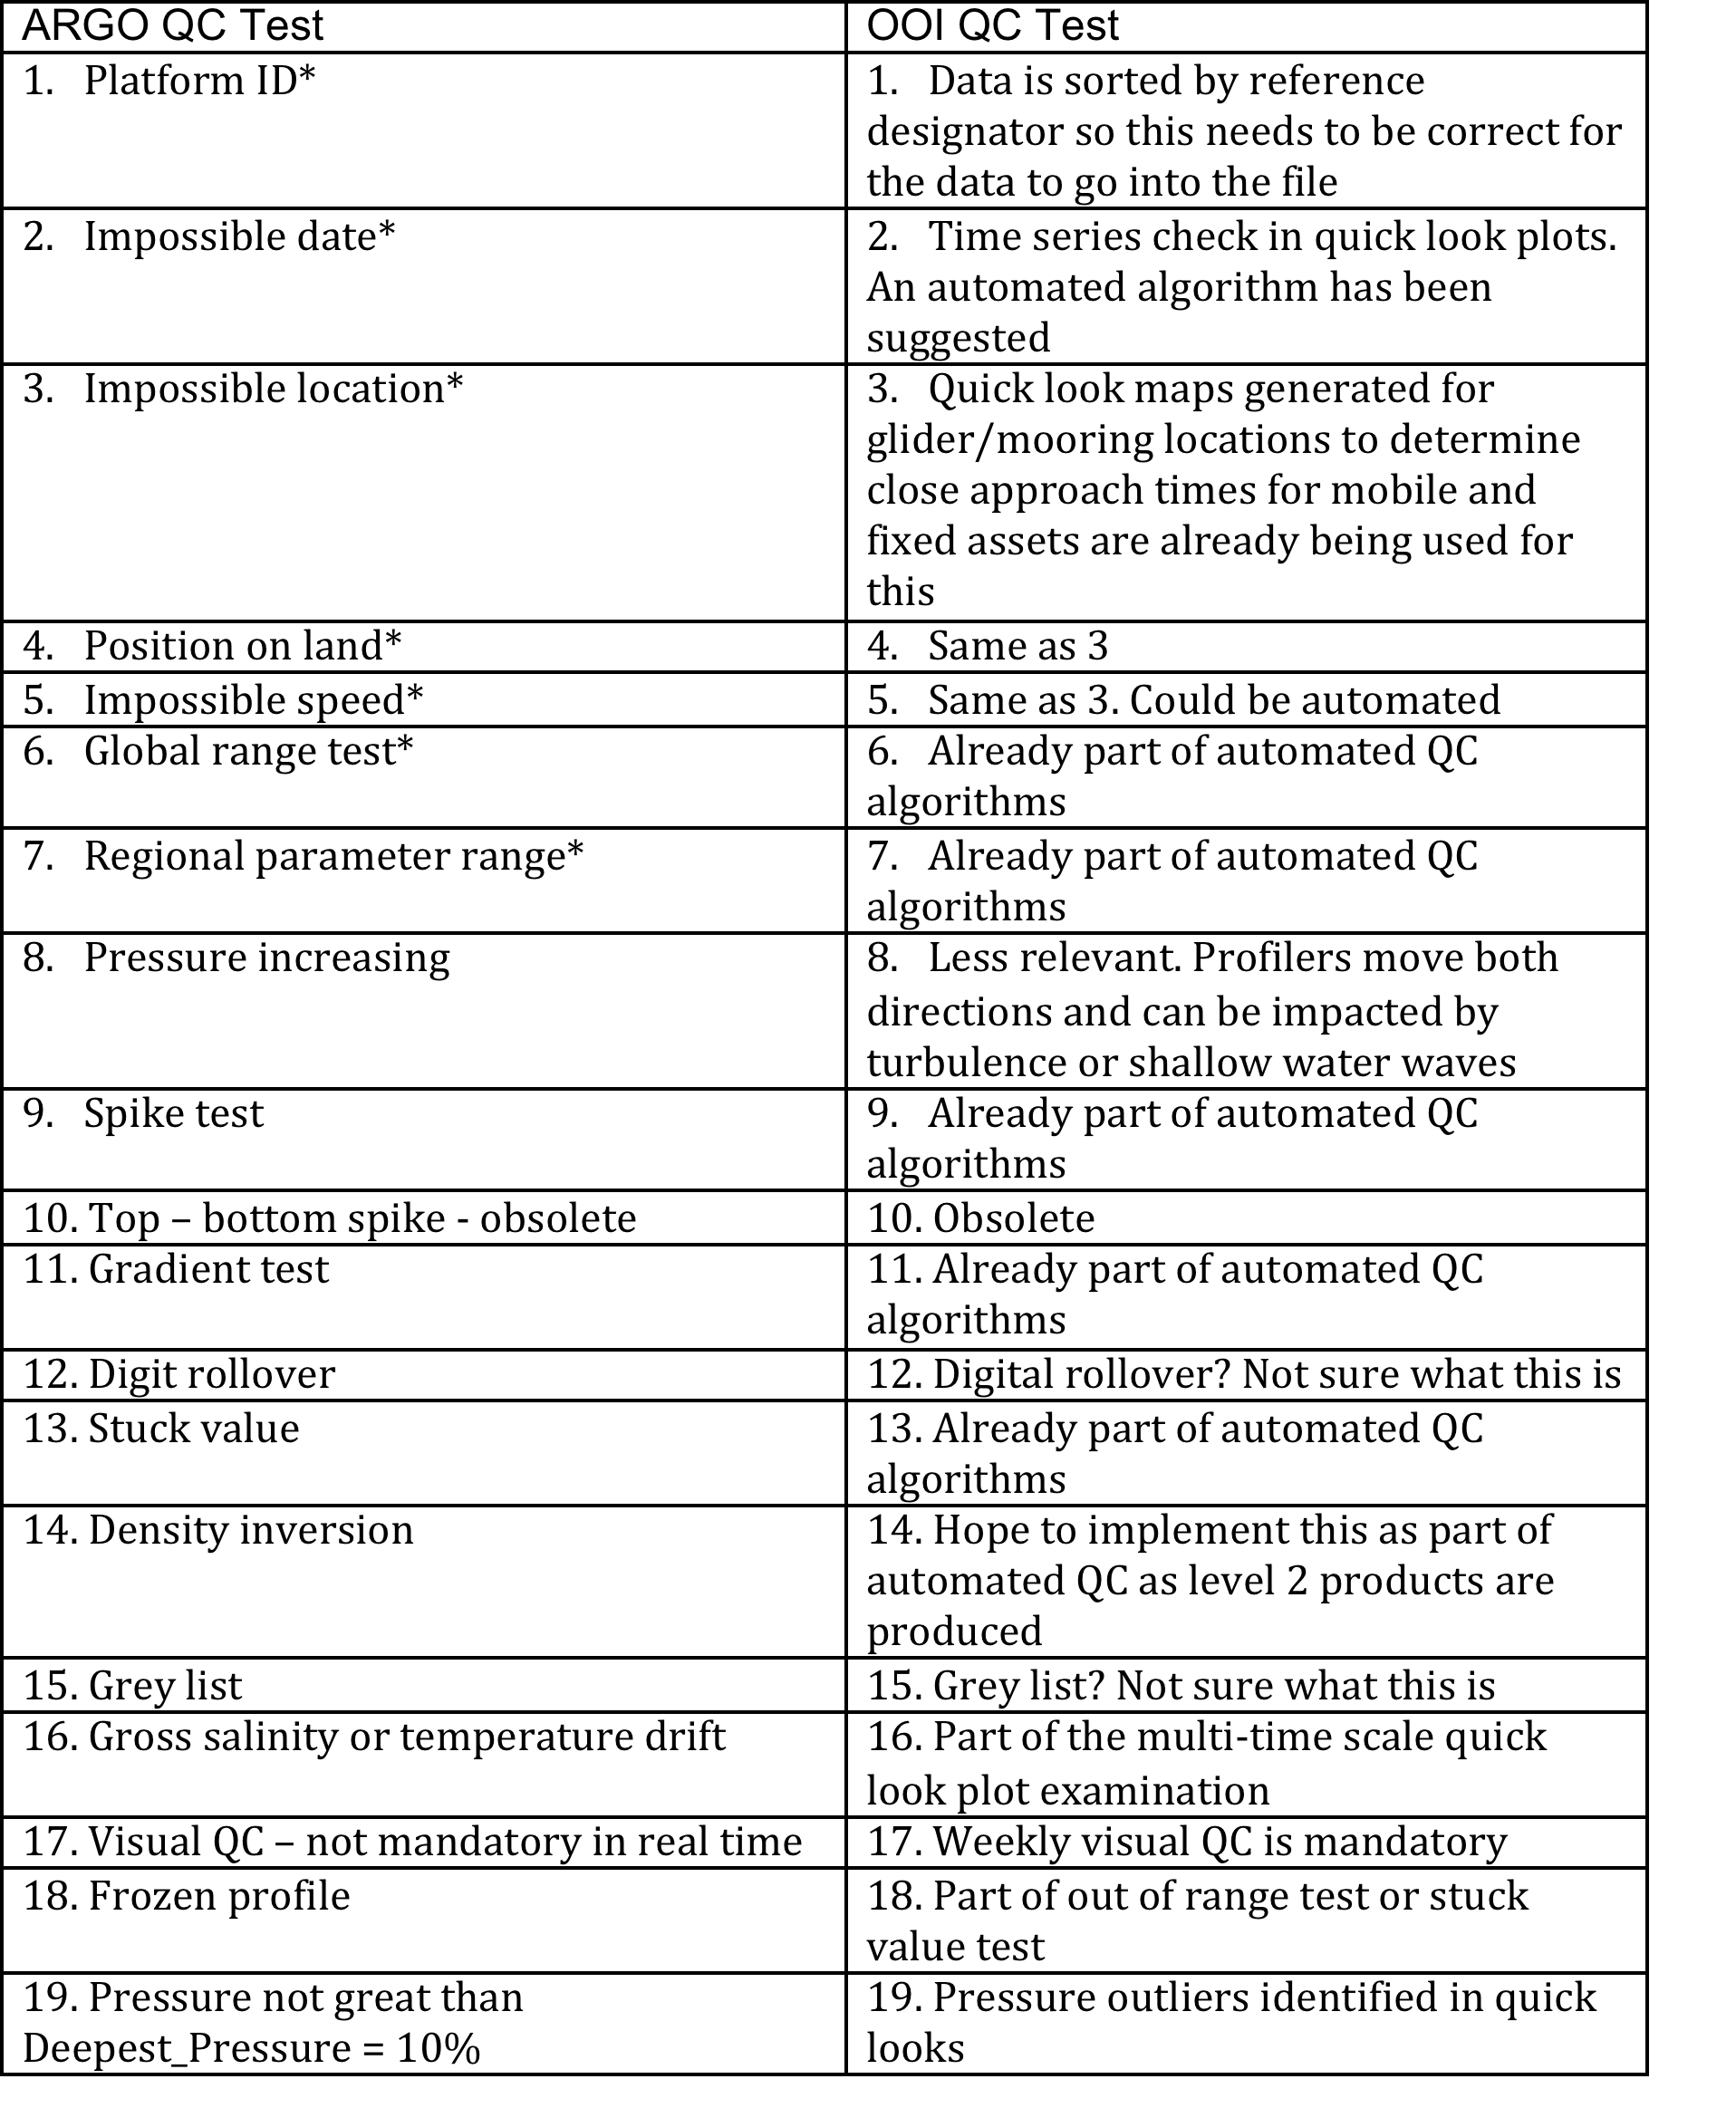
Aligning with accepted community standards
AUTOMATED QC tests
Global Range
Local Range
Spike Test
Gradient Test
Trend Test
Stuck Value Test
FOLLOWED BY HUMAN IN THE LOOP
-flagged data linked to data products

Slide 26
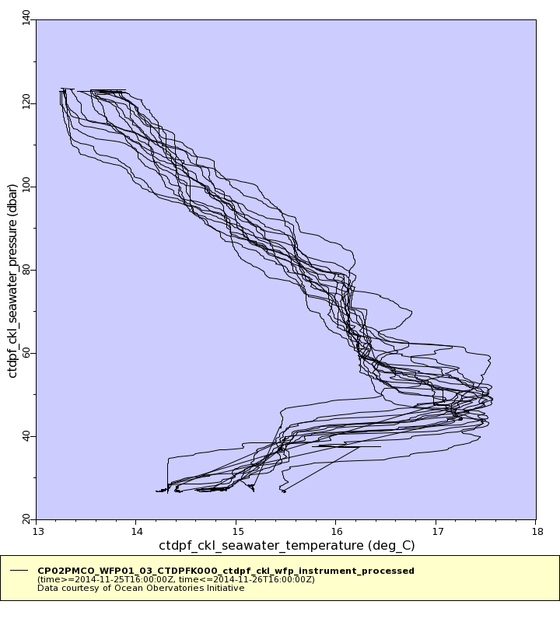
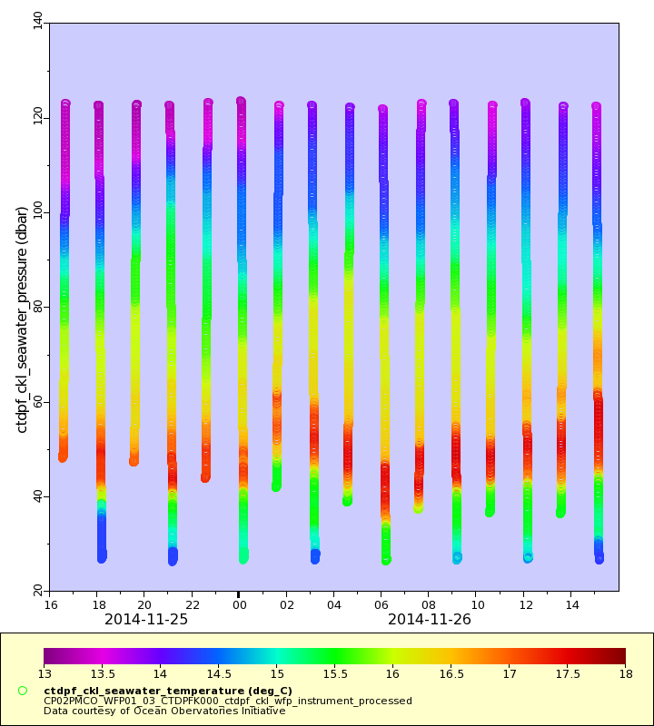
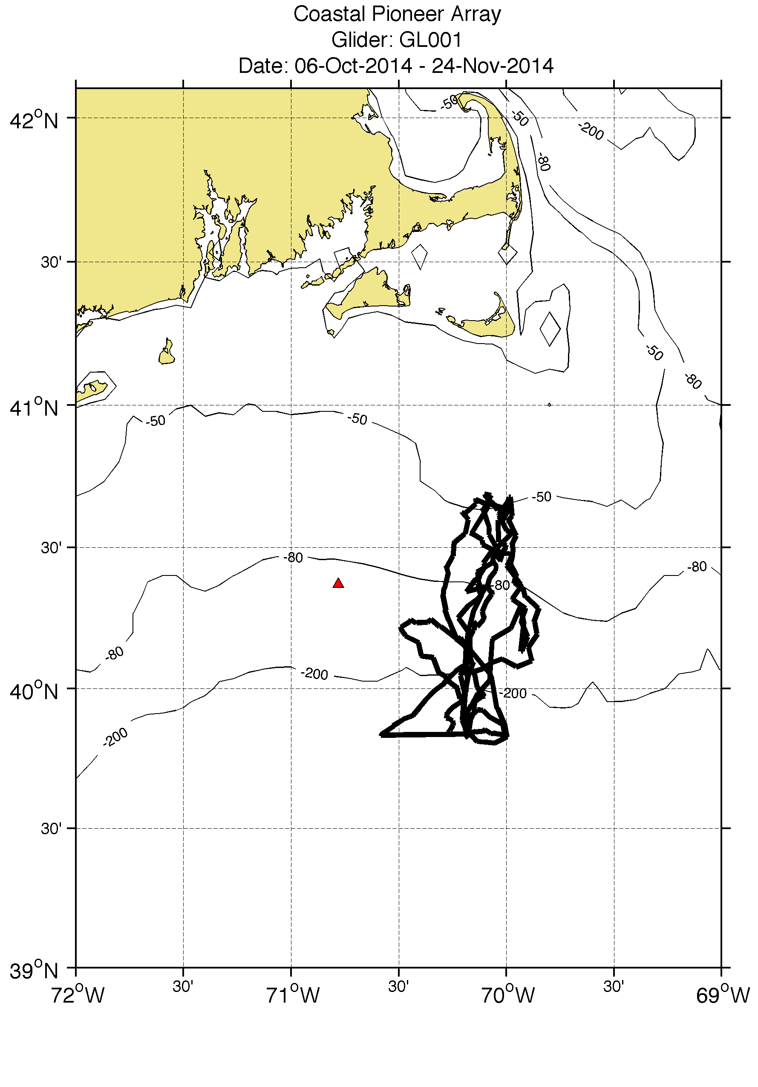
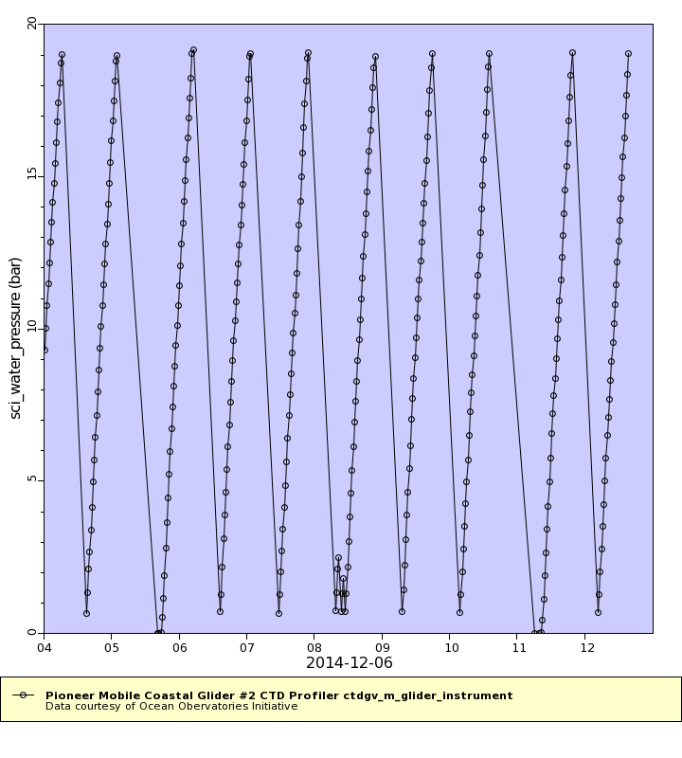
Data Qa/Qc is ongoing using uFrame tools now running at Rutgers
Science data flowing from in-water assets through OOInet
Data is provided to scientist available through a series of quick look plots
Science and engineering data is then used to identify issues warranting a “deep dive”
Wire following profile pioneer array
Glider pioneer array

Slide 27
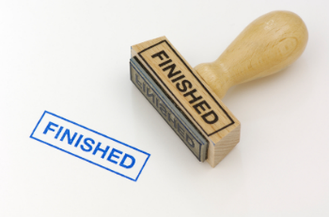
OOI Commissioning Schedule
    Construction of the OOI will be completed this fall. Final commissioning of the arrays is as follows:
Irminger Sea & Station Papa: 1st week of October
Southern Ocean, Argentine & Endurance: mid October
Cabled Array: Late October
Pioneer Array: End October

Slide 28

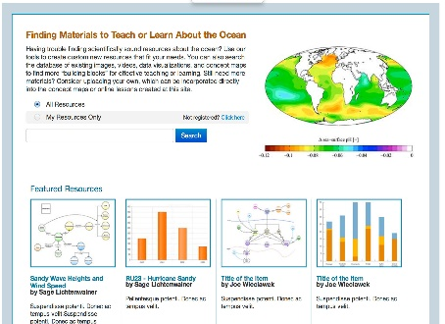

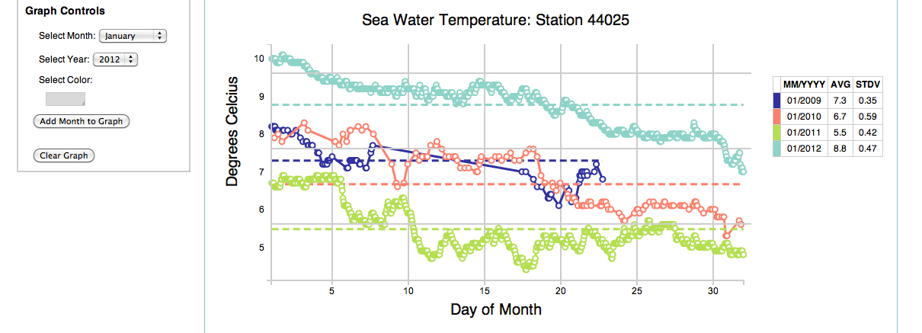
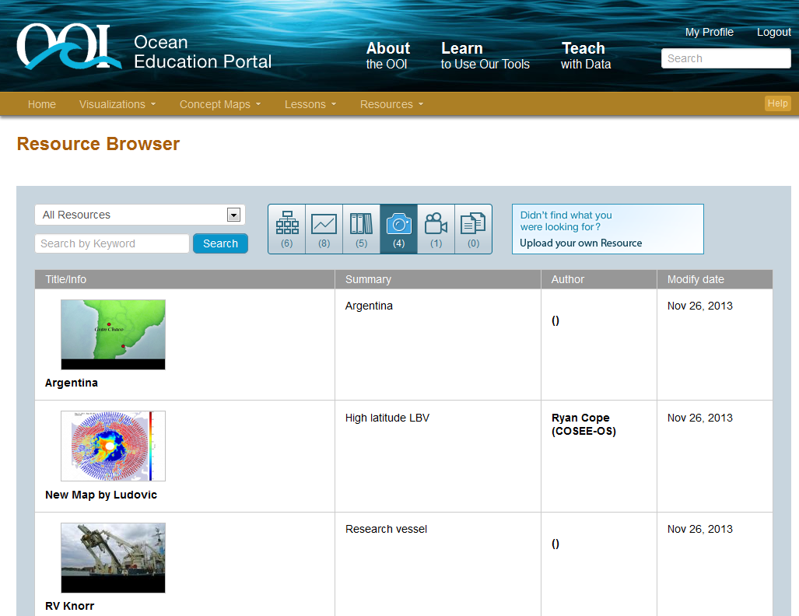
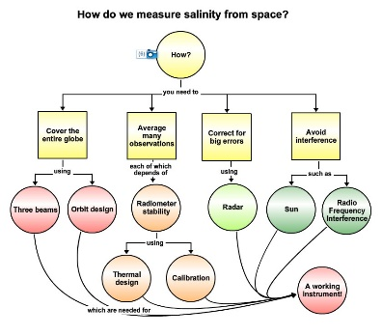


EPE System Architecture
Three primary tools, accessible through a single website, and sharable through a resource database:
Data Investigation Builder
Single Integrated Web-based Portal
OOI Data
External
Data
Resource Database
Visualization
Concept Maps
27
Notes:
27

Slide 29
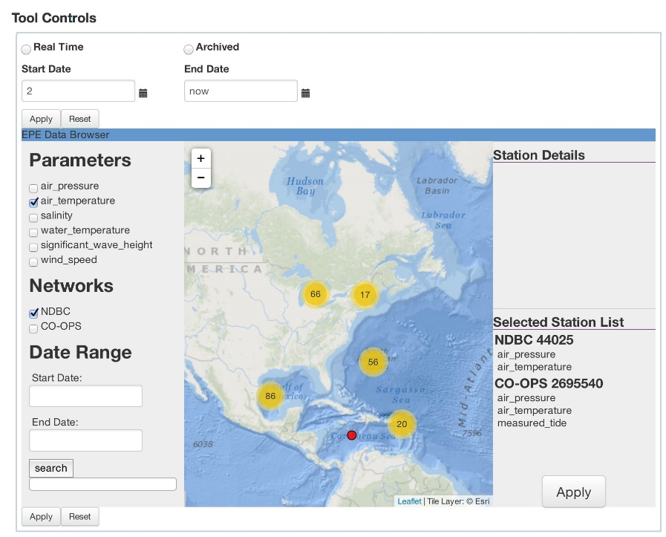
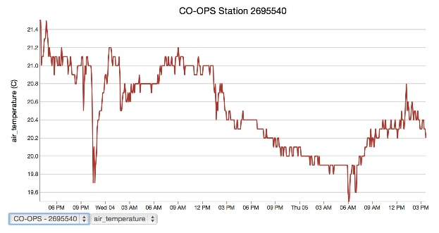
Educational Visualization Service
Building flexible and customizable visualization tools
Focused on time series and profiles
Goal is to balance capability and usefulness
Multiple entry points (teacher, student, developer)
28

Slide 30
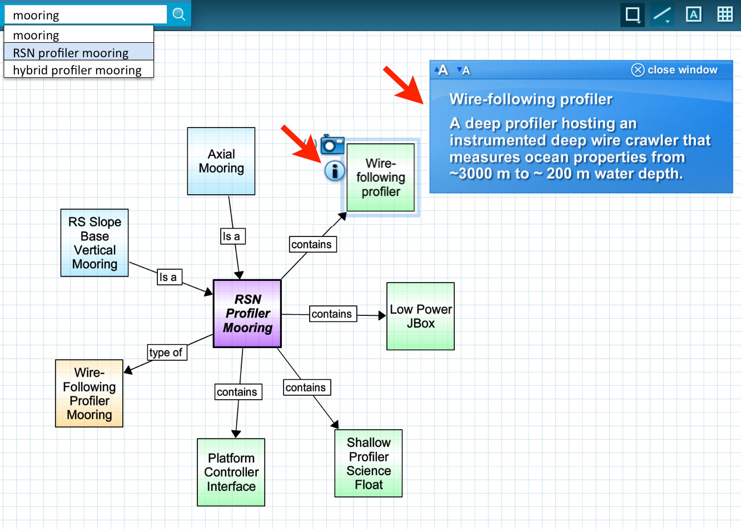
Concept Mapper
Concept Map Builder (create & edit) and Viewer
Concept & linking phrase suggestions (ontologies)
Embedded content resources such as descriptions, data visualizations, photos & videos from OOI & outside resources
29

Slide 31







Data Investigation Builder
Community library of lessons
Online lesson template
Lesson Builder Wizard (step by step design process)
EPE resource integration

Slide 32

Website: http://oceanobservatories.org

Slide 33



4/23/2015 (Capturing an Earthquake)
Seafloor pressure (red detided)
Special thanks to Al Herrington, William Chadwick, John Delaney, Deb Kelly, and William Wilcock

Slide 34
Conclusions
Open access high frequency diverse data for sustained periods of time
Ability to enable science as is, provide a infrastructure to expanded by investigators, and can provide leverage to other programs
Coupled to tools to enable teaching and shared community education resources

