Slide 1
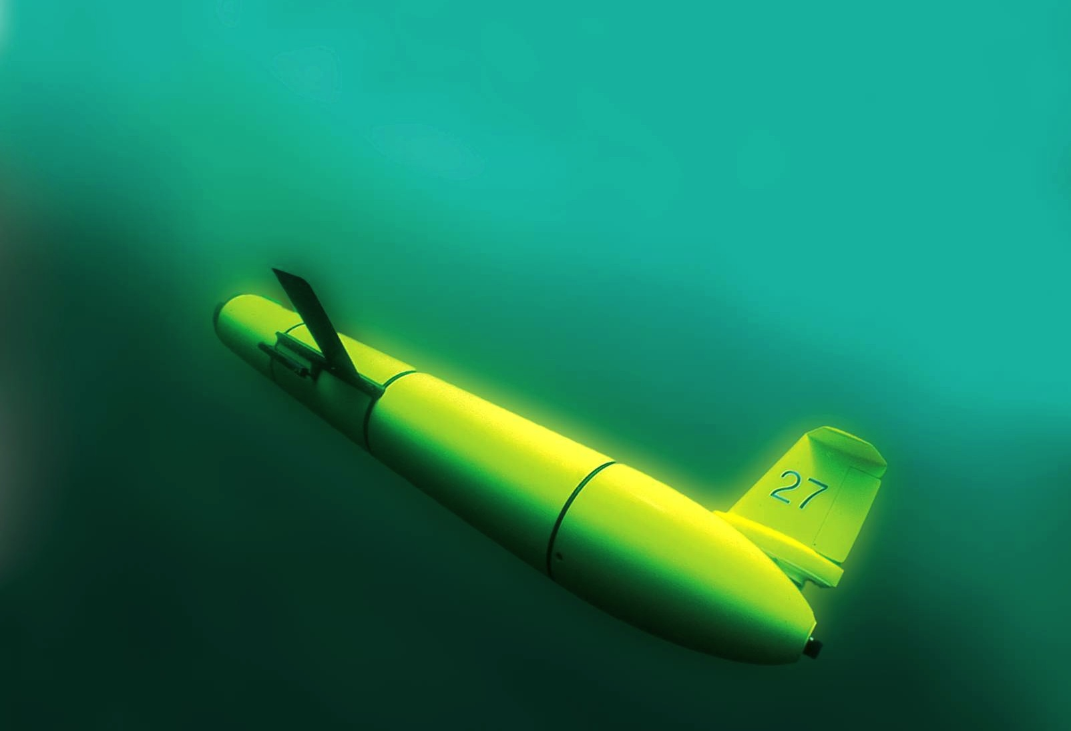
The Ocean is Our Classroom:
A 4-Year Research Track for
Undergraduate Exploration, Research and Discovery in Oceanography
Scott Glenn, Oscar Schofield, Grace Saba, Travis Miles, Hugh Roarty & Josh Kohut Rutgers University

Slide 2
The Ocean is Our Classroom:
A 4-Year Research Track for
Undergraduate Exploration, Research and Discovery in Oceanography
Why it matters
Some global-scale technologies
Use in our classroom
Scott Glenn, Oscar Schofield, Grace Saba, Travis Miles, Hugh Roarty & Josh Kohut Rutgers University

Slide 3
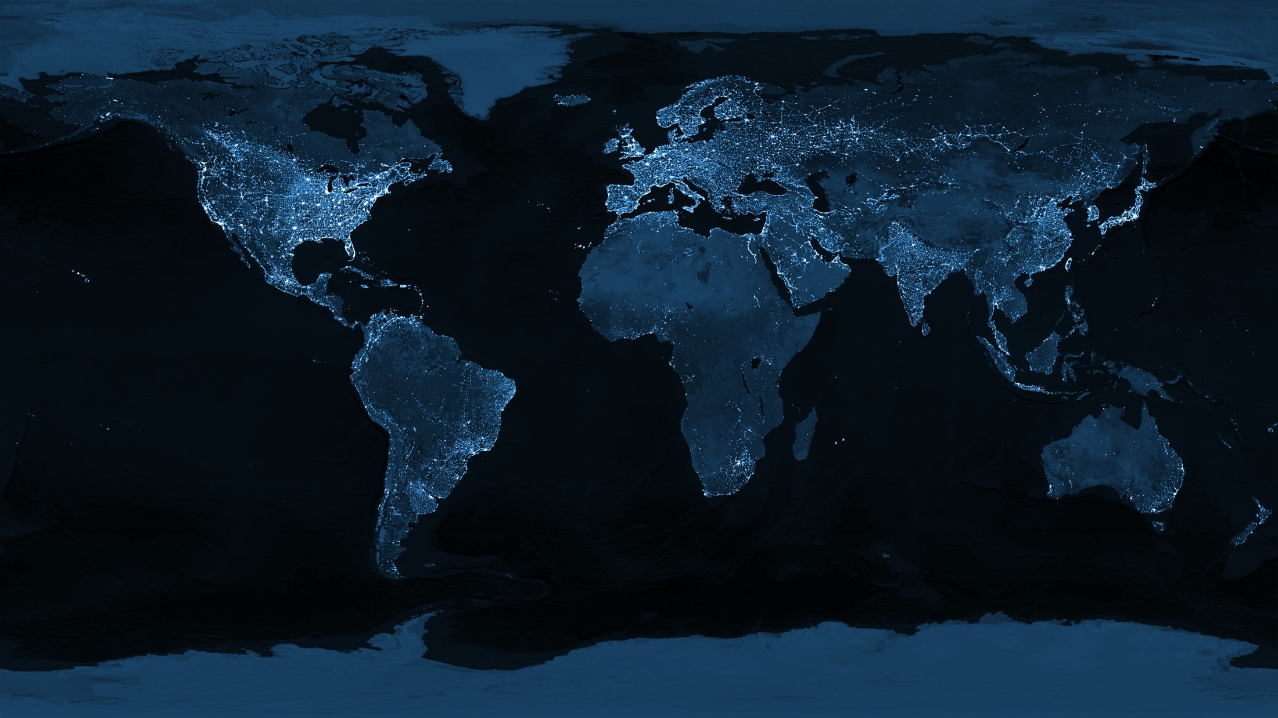
Our Student’s Grand Challenge: Transform This World
“The Earth at Night” as Observed from Space
Data Source: Defense Meteorological Satellites Program

Slide 4
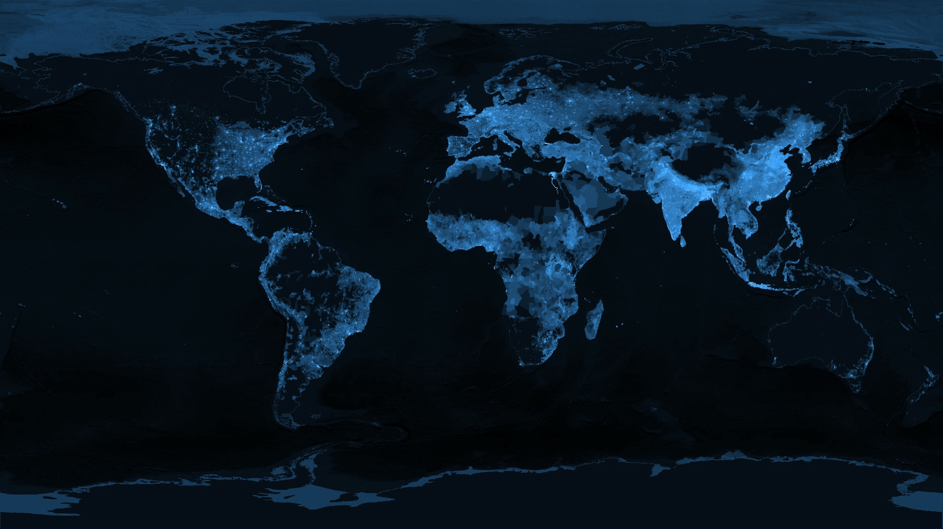
Into This World
“The Earth at Night” based on Global Population
Data Source: SEDAC

Slide 5
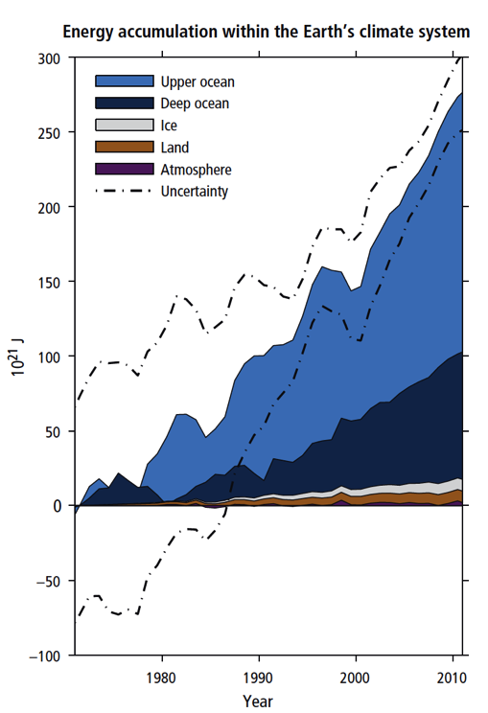
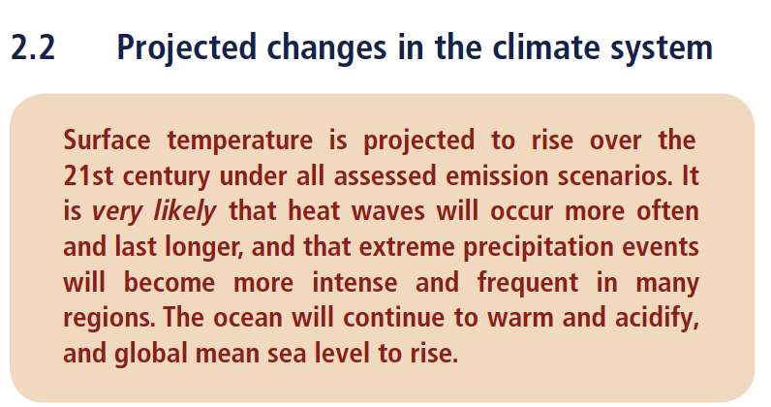
While the Earth is Changing
“Warming of the climate system is unequivocal”
“Ocean warming dominates the increase in energy stored in the climate system”
IPCC Fifth Assessment Report (AR5)

Slide 6
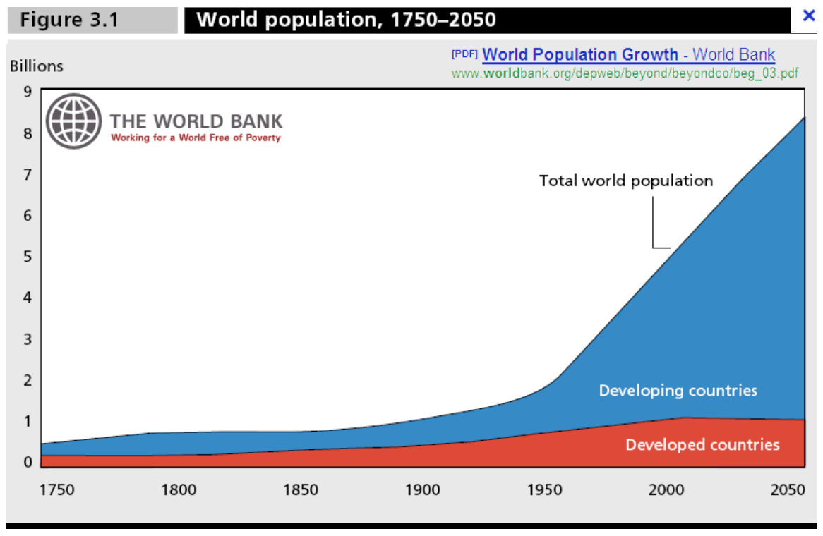
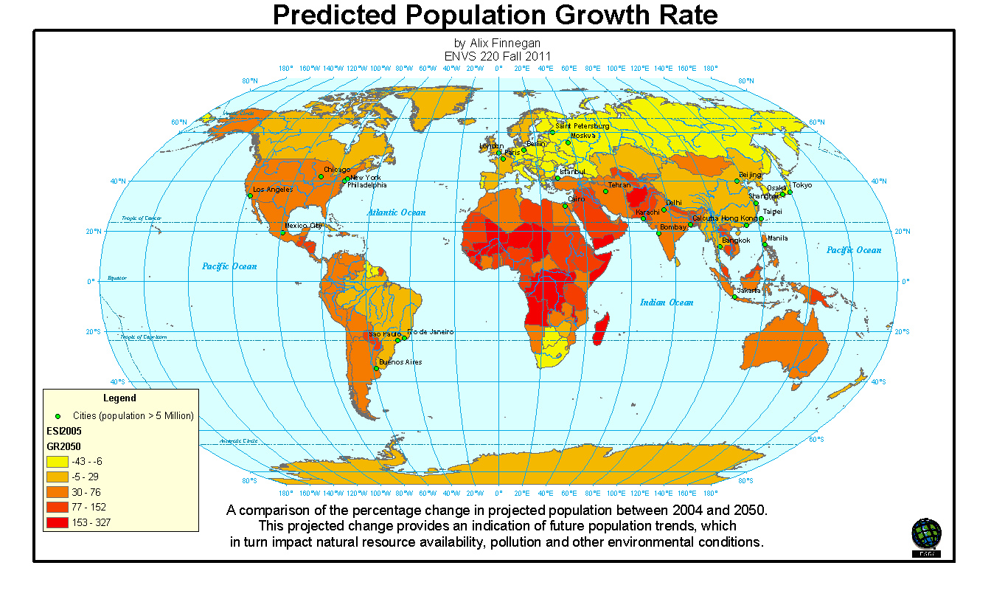
And the Population is Growing

Slide 7
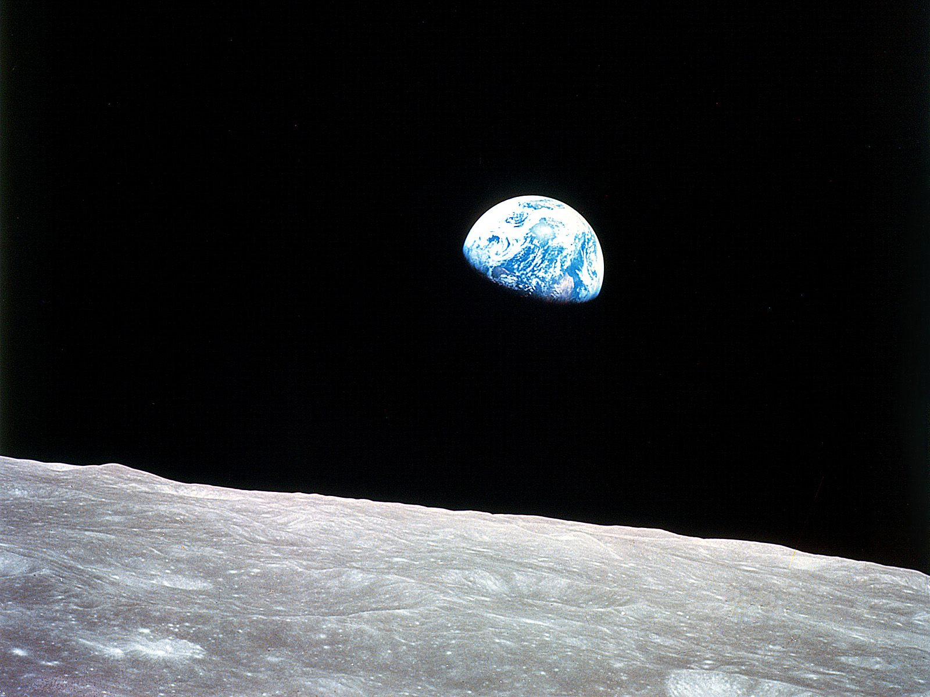
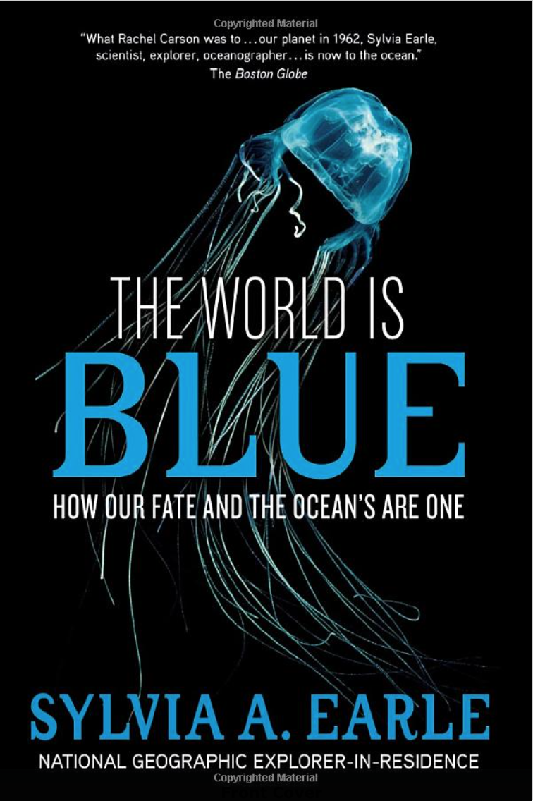
The Solutions we Seek
will involve the Sea

Slide 8
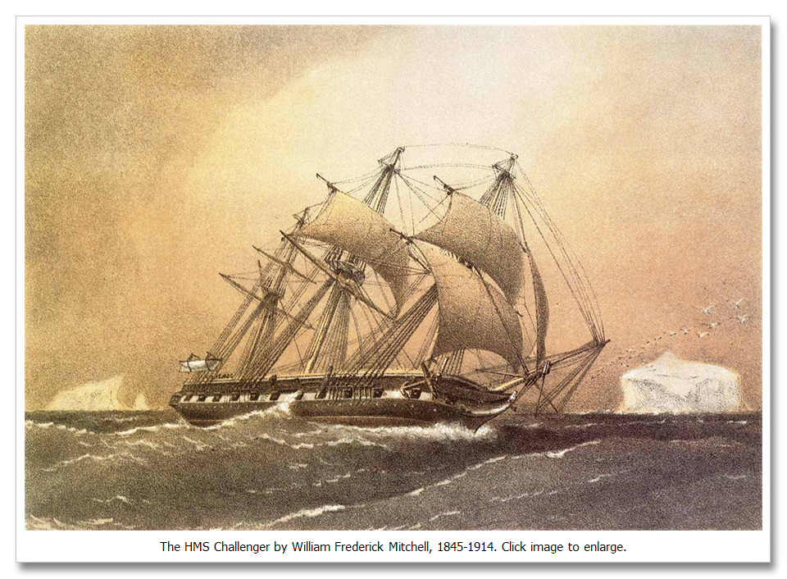
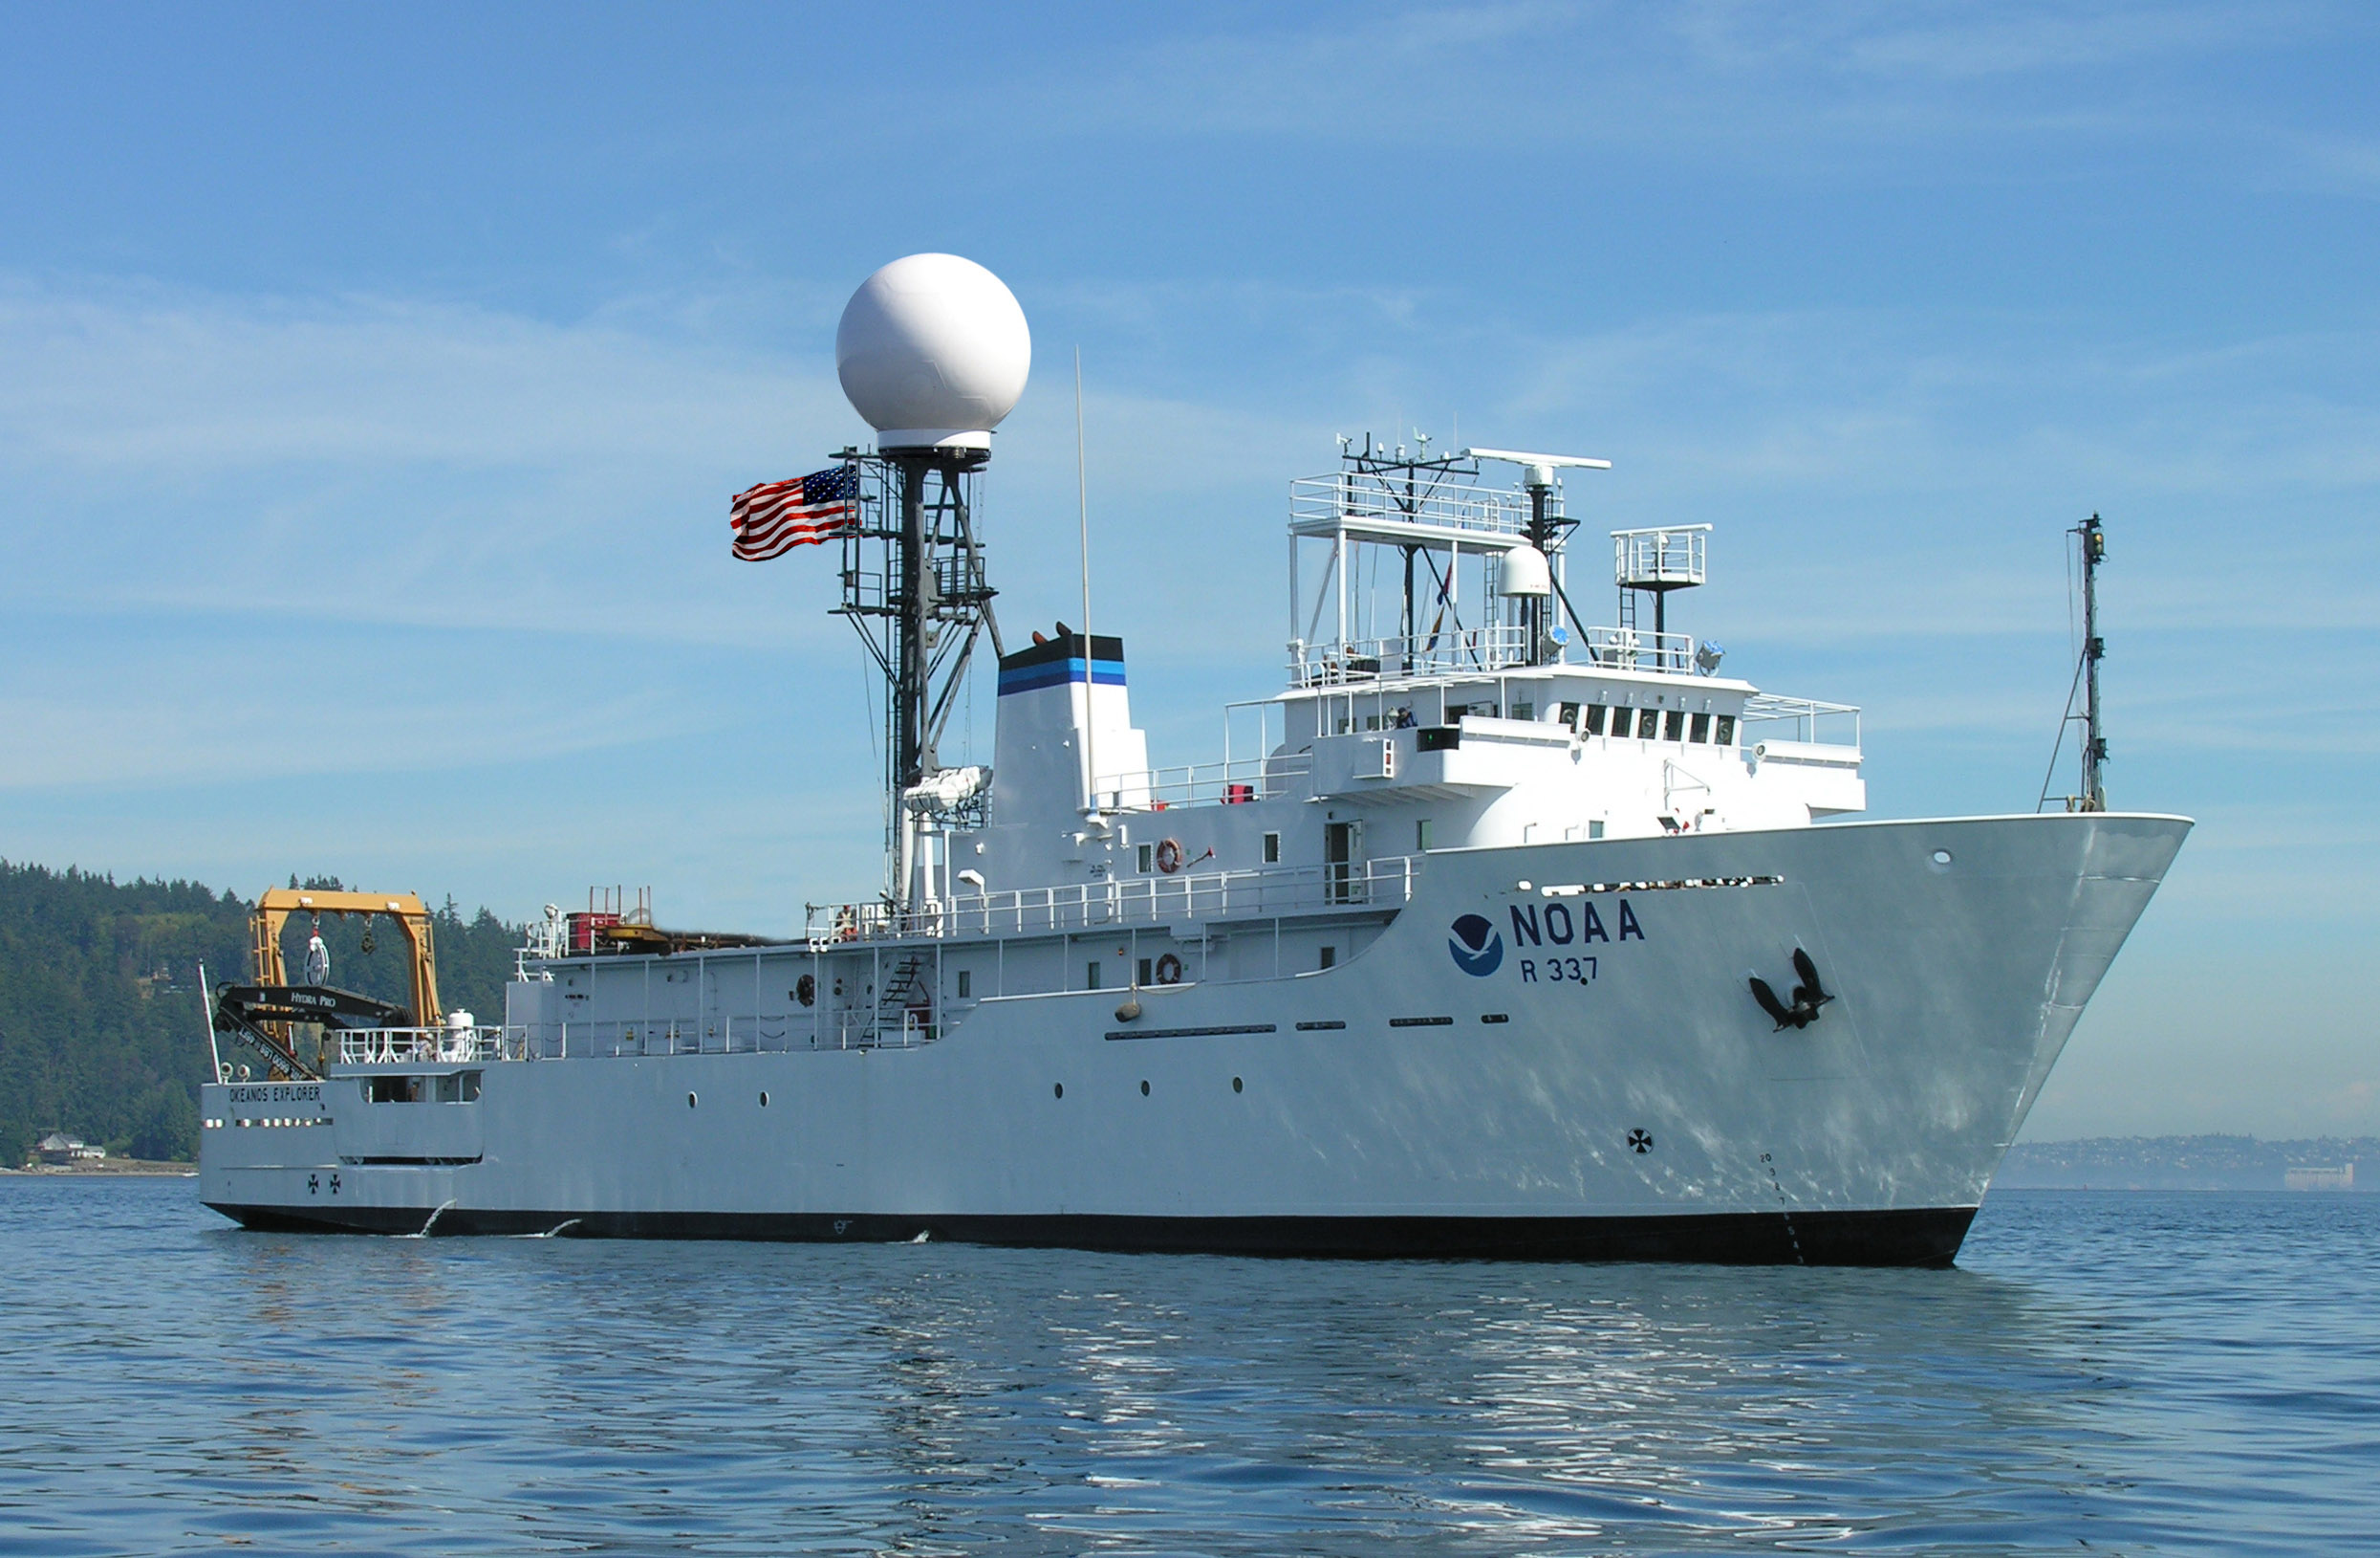
95% of the Ocean remains Unexplored
HMS Challenger
1872-1876
Telegraph
First Ocean Science Circumnavigation
Okeanos Explorer
2010 -> Future
Telepresence

Slide 9
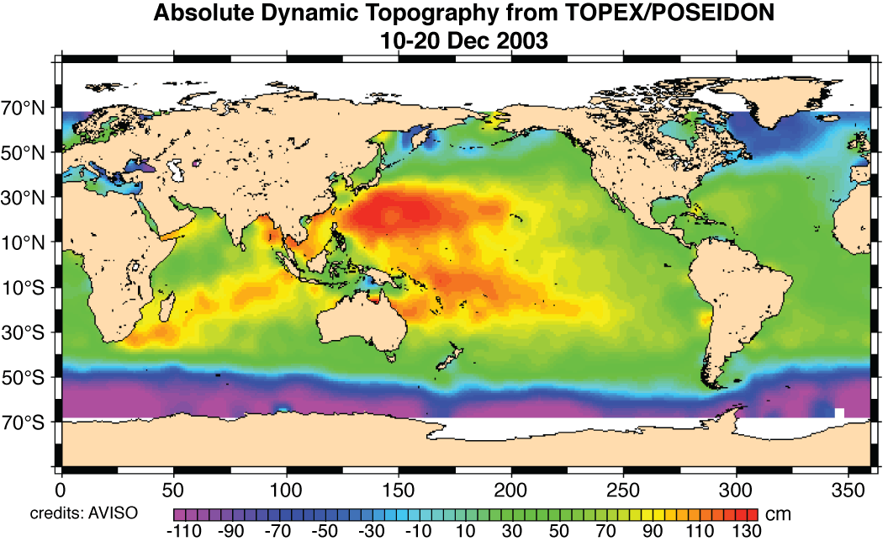
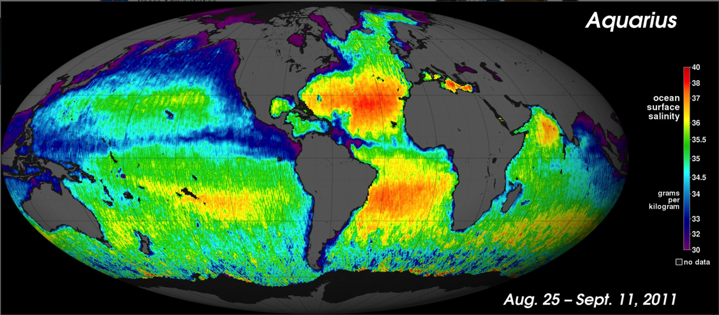
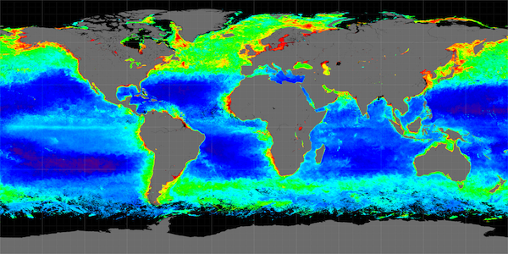
Satellite Revolution: Global coverage of the ocean surface
Sea Surface Temperature - SST
Sea Surface Height - SSH
Sea Surface Salinity - SSS
Near Surface Chlorophyll
Below the surface requires
in-water observations

Slide 10

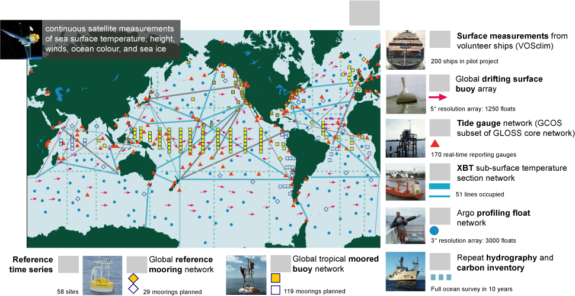
Global Ocean Observations for Climate

Slide 11
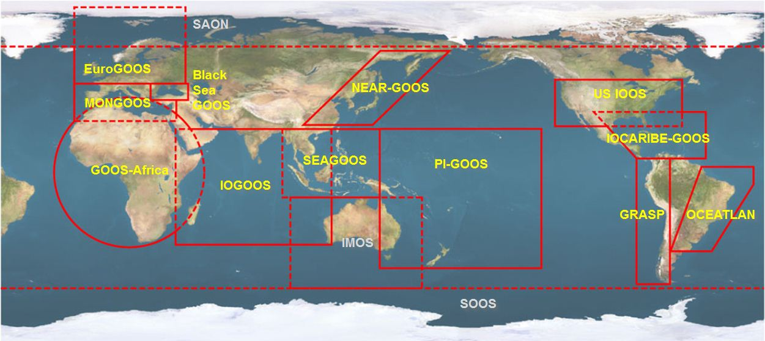




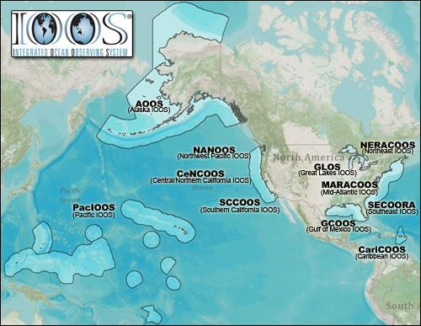













U.S. Integrated Ocean Observing System (IOOS)
Global Component
National Component
Regional Component
15 Regional Alliances in GOOS
Vessels -
Satellite
Satellite
CODAR
Ships/ Vessels
Glider
REMUS
Data Vis.
Modeling
Security
Leadership
Education
11 Regional Associations
17 U.S. Federal Agencies
Serving Society & Science
http://ioos.gov

Slide 12
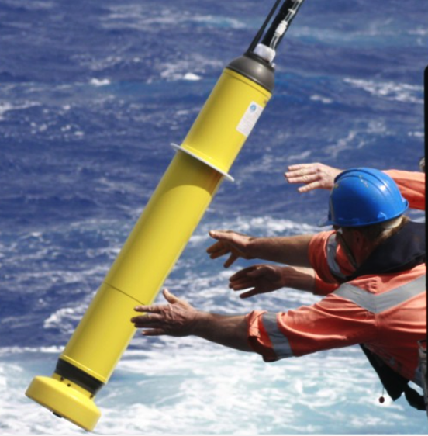
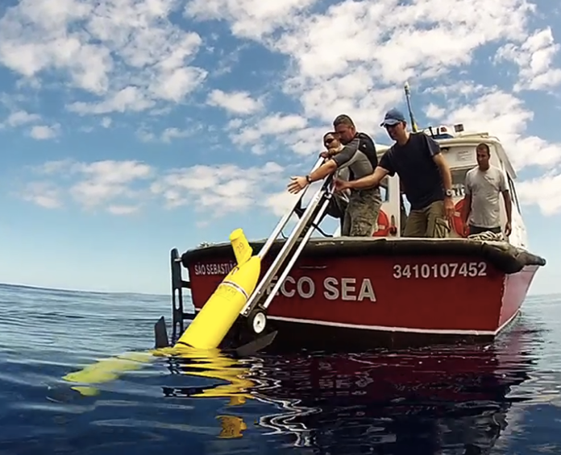
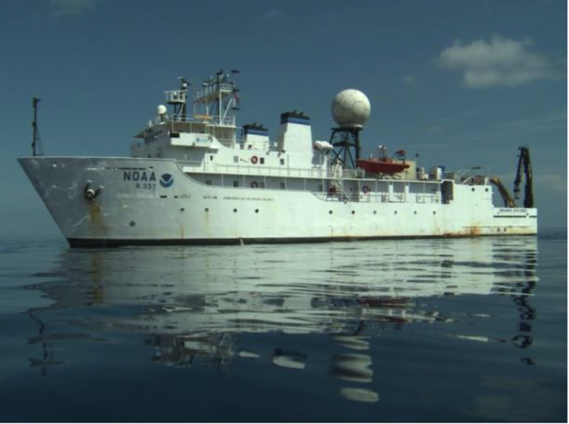
Mobile Subsurface Profile Observation Capabilities
Drifters
Gliders
Ships
Increasing Control, Capacity & Cost
Decreasing Endurance & Risk Tolerance

Slide 13
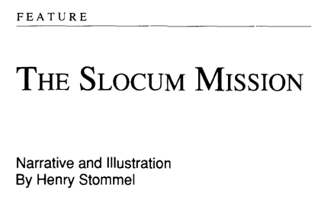
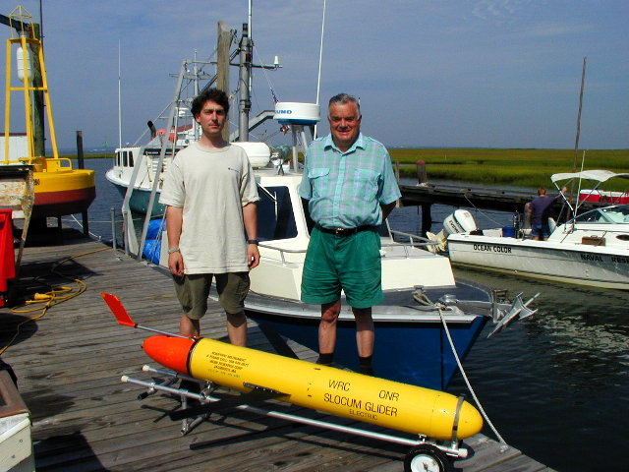
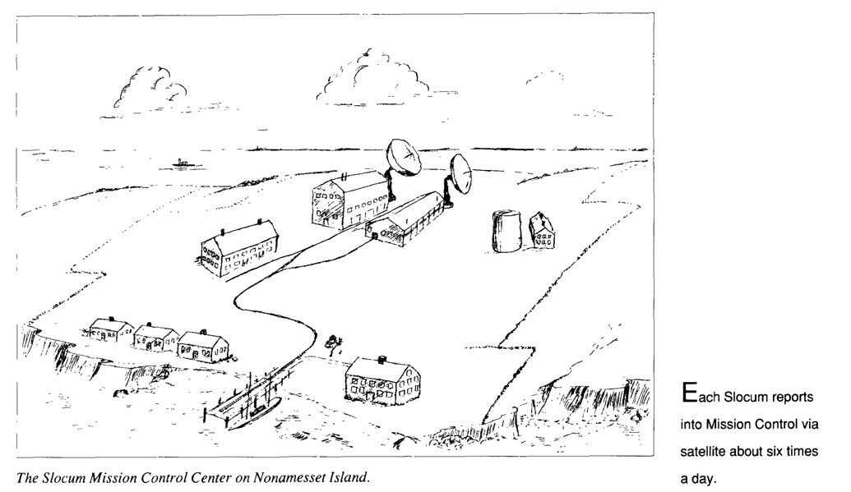
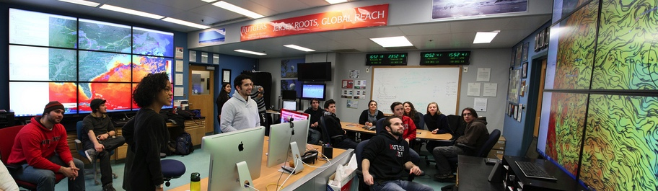
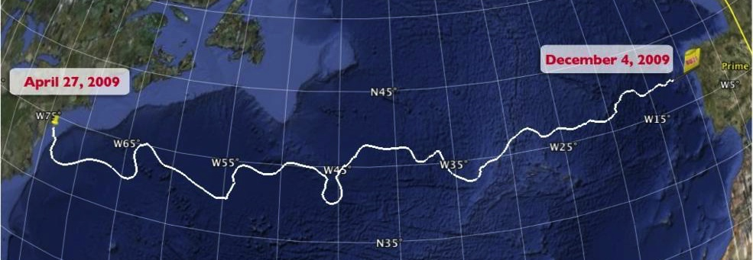
Underwater Gliders have Evolved Rapidly
1989 Science Fiction Article
1999
First Slocum deployed at Sea
2009
First Glider
crosses an Ocean Basin

Slide 14
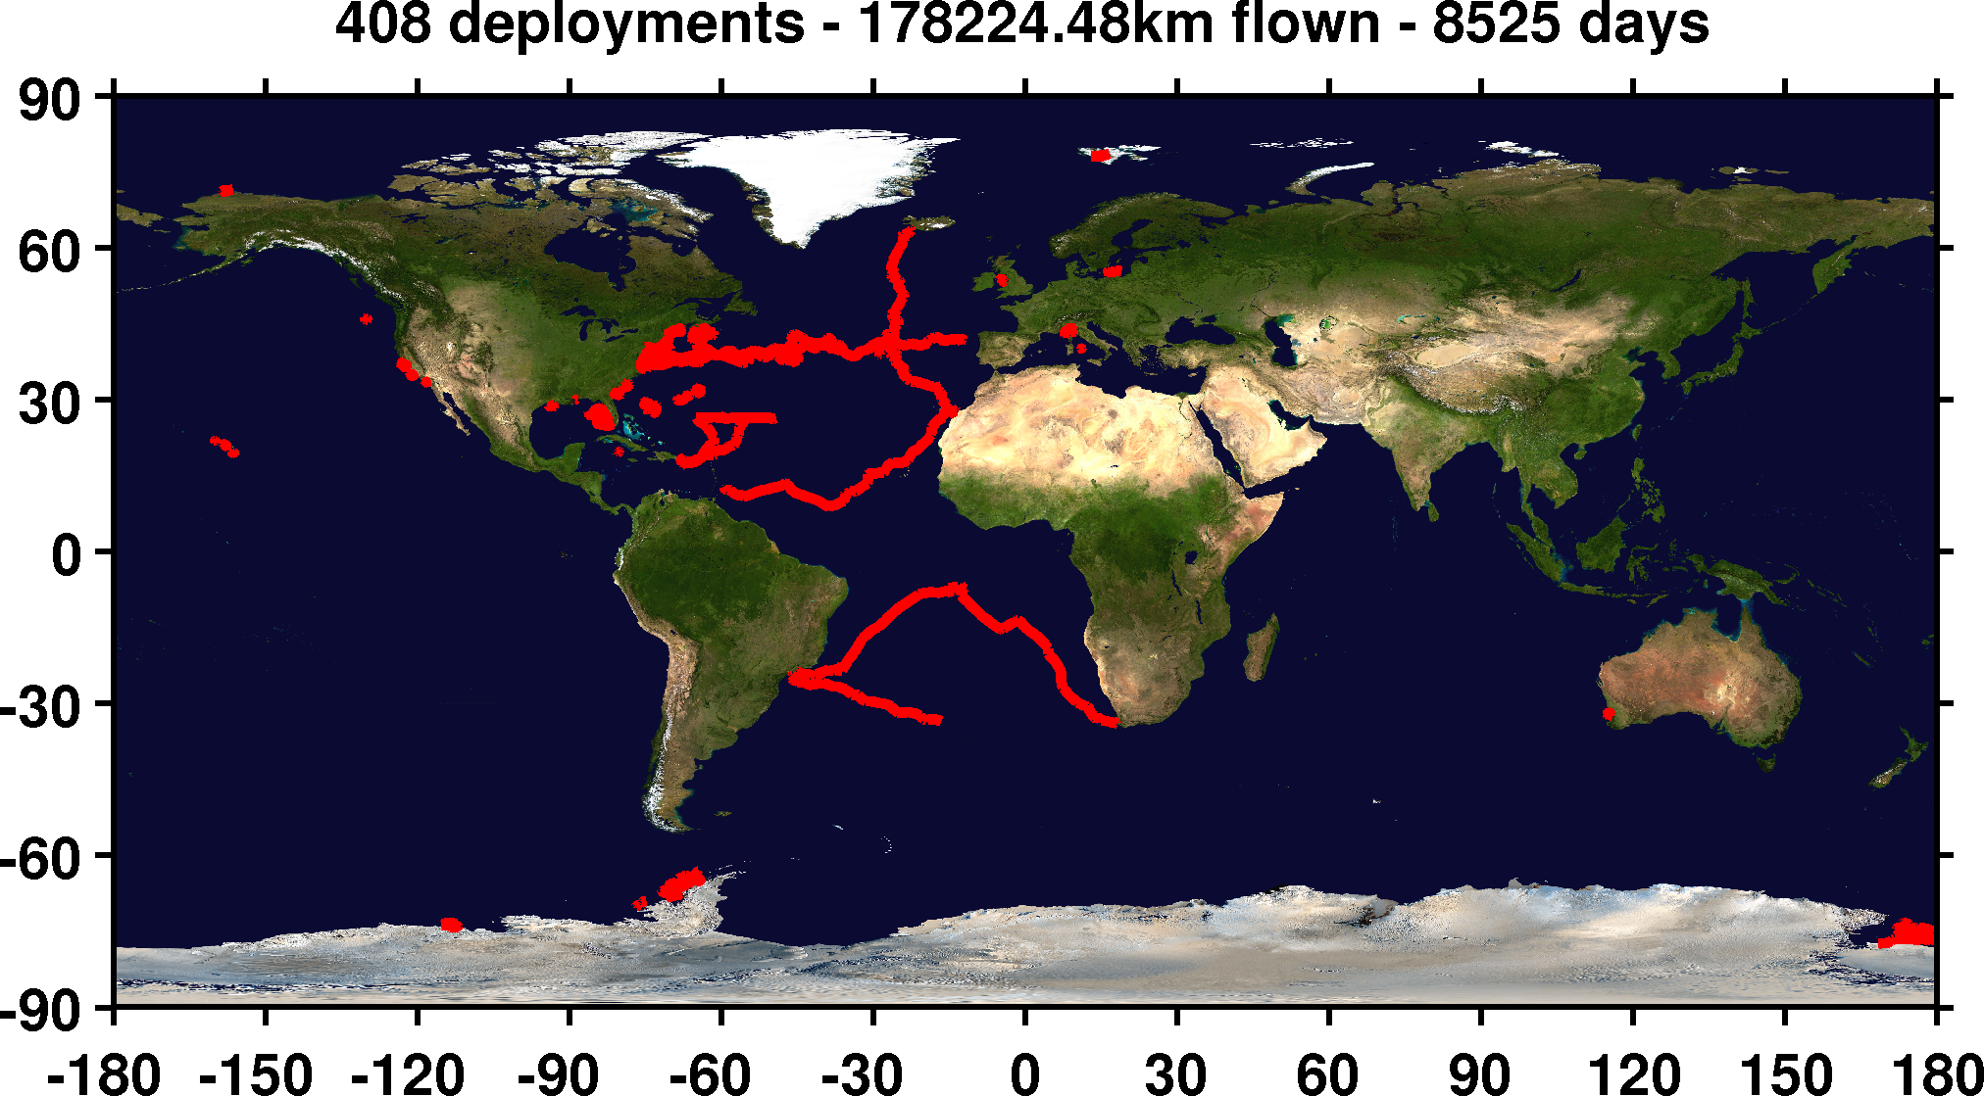
Sustained Subsurface Profile Observations
by Gliders - 1 Center

Slide 15

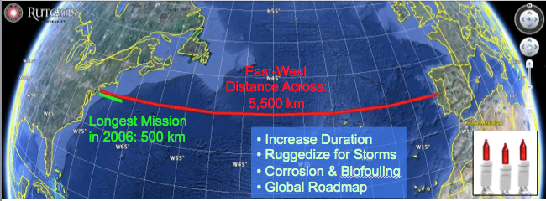
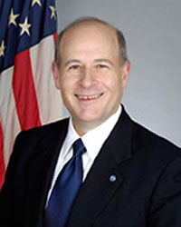
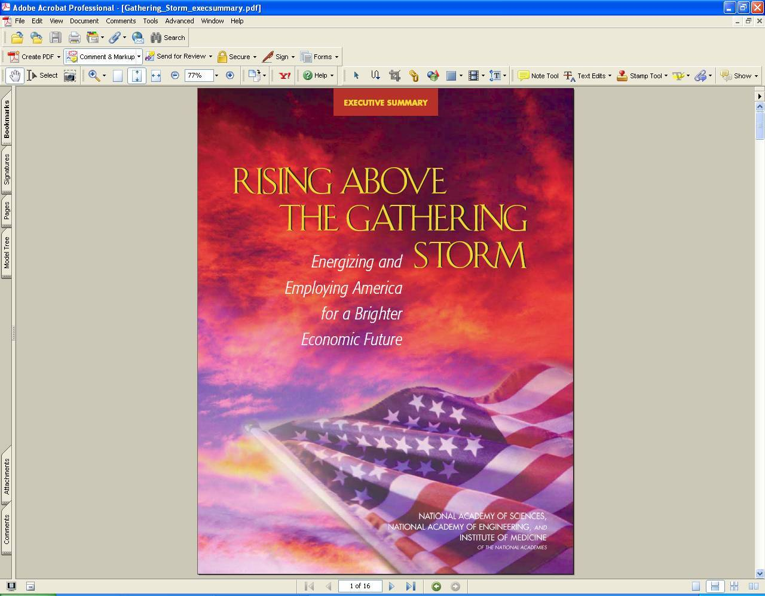
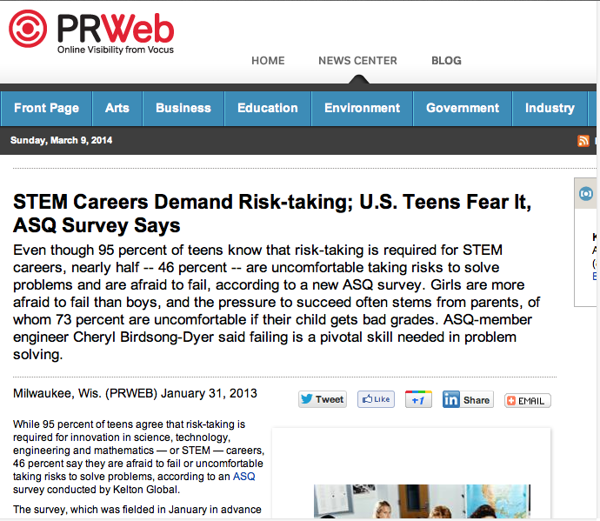
Trans-Atlantic Glider Challenge – May 24, 2006 –
UNESCO E.U./U.S. Baltic Sea Conference in Lithuania
Dr. Rick Spinrad
Assistant Administrator
NOAA
Office of Oceanic and Atmospheric Research
RU27: 7,400 km in 221 days
RU27: 7,400 km in 221 days
“I have something you need to do for the good of your country.”
“Take one of your gliders, modify it, and fly it across the Atlantic, inspiring students along the way.”
Positive risk-taking is required for innovation in STEM careers!
Notes:
Facing that slide before: “what keeps him up the most at night?” Answer: “Our education system, worried we’re not training our students to be technology innovators, which requires risk taking” To solve these problems it will require innovation
Wants us to take some of those risks, encourage students to take some of those risks to meet these challenges. Innovation requires positive risk taking.
We want to inspire those students to address those challenges, by encouraging them to take risks and be part of the process.

Slide 16
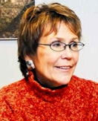
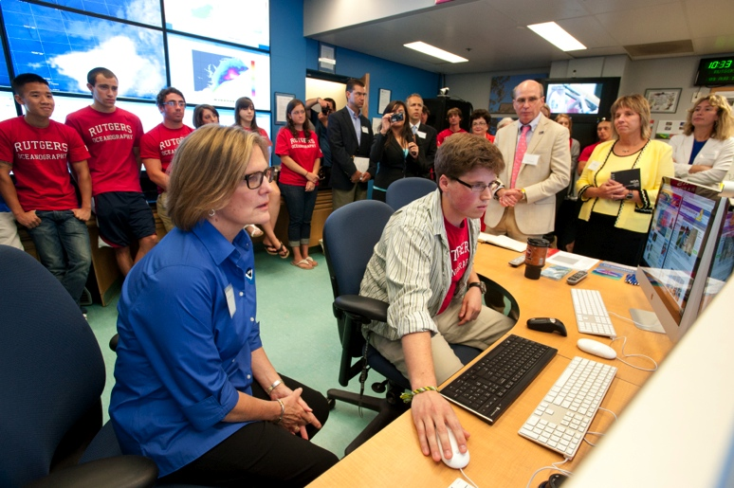
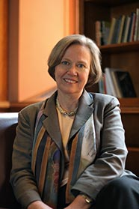
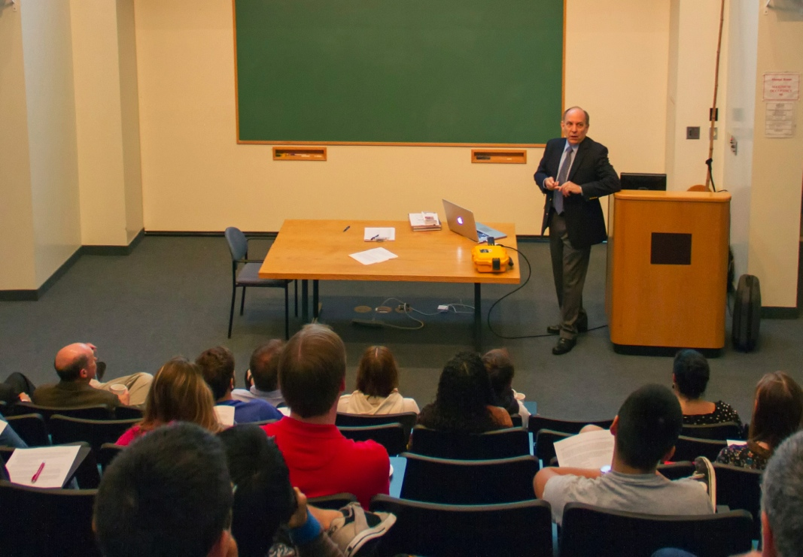
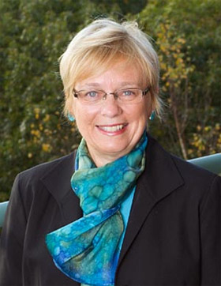
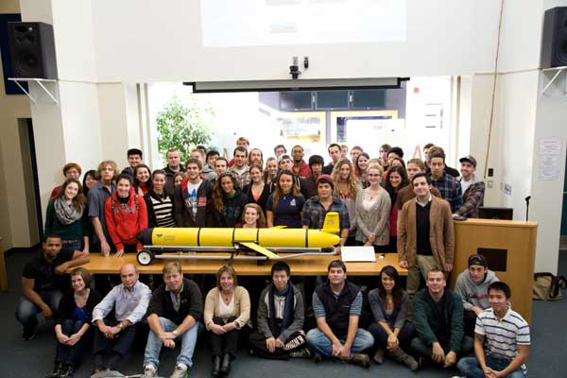
Advice from Some Friends
Margaret Leinen – Director, Scripps Institute of Oceanography
Mentorship – Mind the gender gap
Shirley Tilghman – Former President, Princeton University
Turn the pyramid upside down -
Start living the life of a scientist early
Susan Avery – Director, Woods Hole Oceanographic Institution
Present and publish scientific results
Kathy Sullivan – Administrator, NOAA
Encourage them to be explorers
Louis Uccellini – Director, National Weather Service
Explore our global models
Zdenka Willis – Director, U.S. IOOS
Communicate what you’ve learned
Notes:
Margaret Leinen – Mentorship is very important for our young people, incredibly important to students success: Including increasing mentorship of females and under represented groups
Turn the pyramid upside down: Start being a scientist as a Undergraduates, doing research right away ,better retention, better grades, better interactions. sent undergraduates to Antarctica, large research classes for 1st year students.
“We’re going to fly a glider across the Atlantic” Z: “Have you told anyone about this?”
Susan Avery – Get undergraduates presenting results and publishing scientific papers: we’ve had many undergraduate research presentations, culminates in publishing and often presenting at MTS conferences.

Slide 17
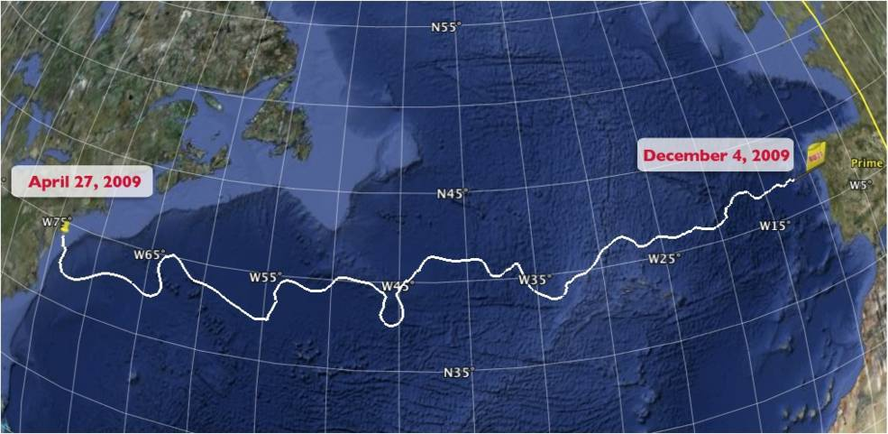
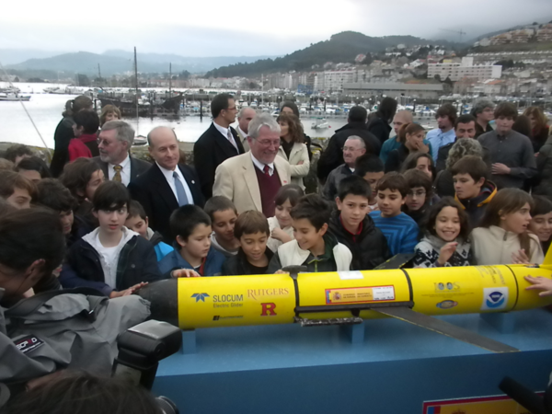
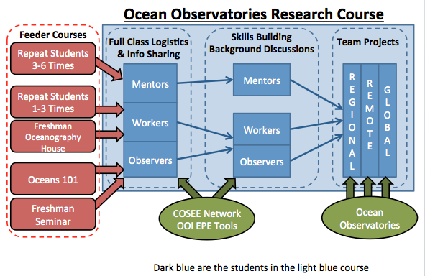
The Trans-Atlantic Glider Challenge
December 9, 2009 – Baiona, Spain
RU27: 7,400 km in 221 days
Trans-Atlantic Glider Challenge
Notes:
Letters from students to Spanish schools
Watch one, do one teach one. Borrowed best practices from COSEE, used data from ocean observatories. Increased students by over 400% with between 50 and 100 undergrads involved in the lab and research on a consistent basis. Reached carrying capacity.

Slide 18
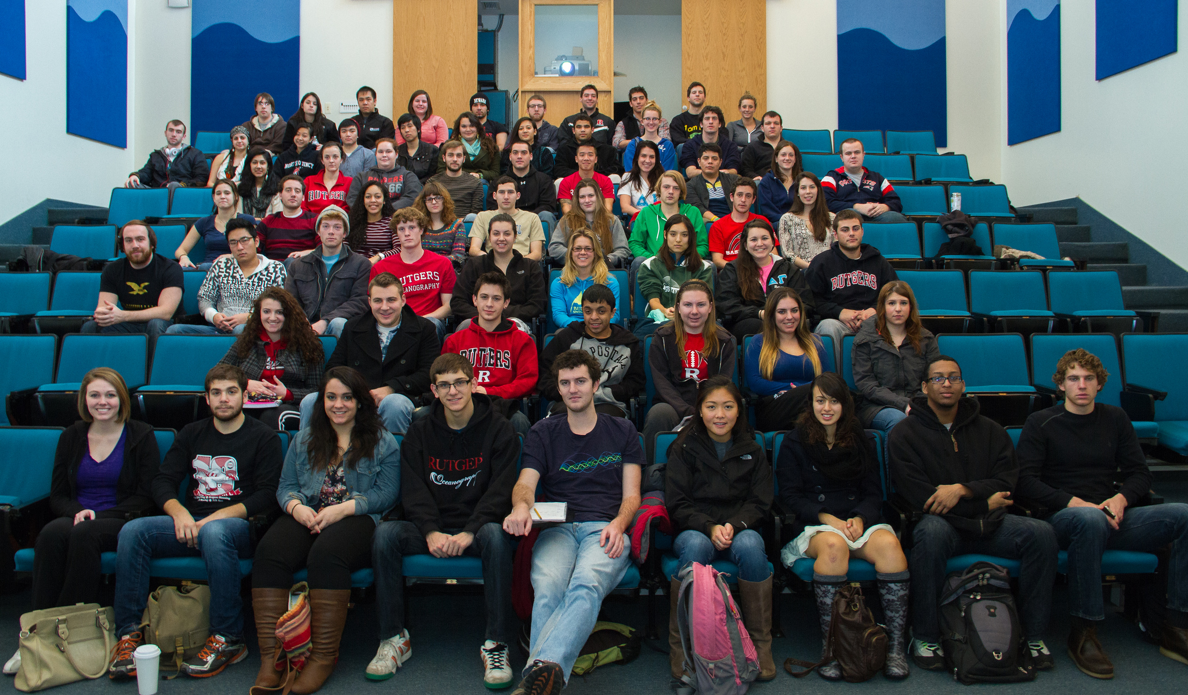
Marine Science Undergraduate Major
Common Core – Background Courses + Ocean Methods
Specialize in Physical, Biological, Chemical, Geology, Policy
Research Requirement – at least 6 research credits

Slide 19
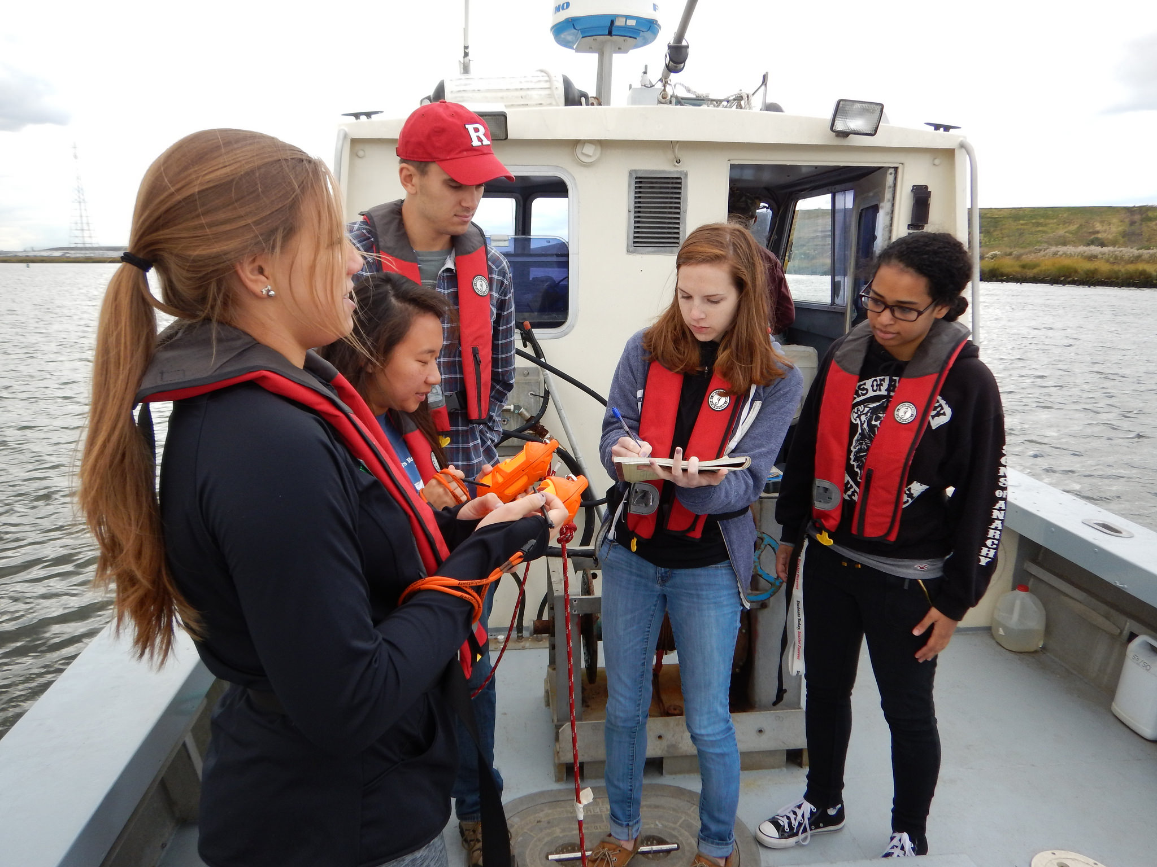
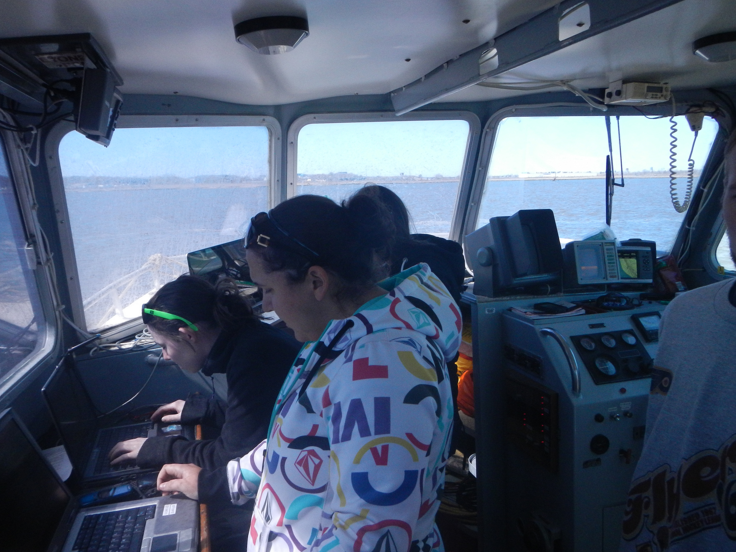
Ocean Methods – Hands-on Portion of Common Core
Use modern oceanographic sensors
Plan and conduct a research cruise on local estuary
Analyze data and present results

Slide 20
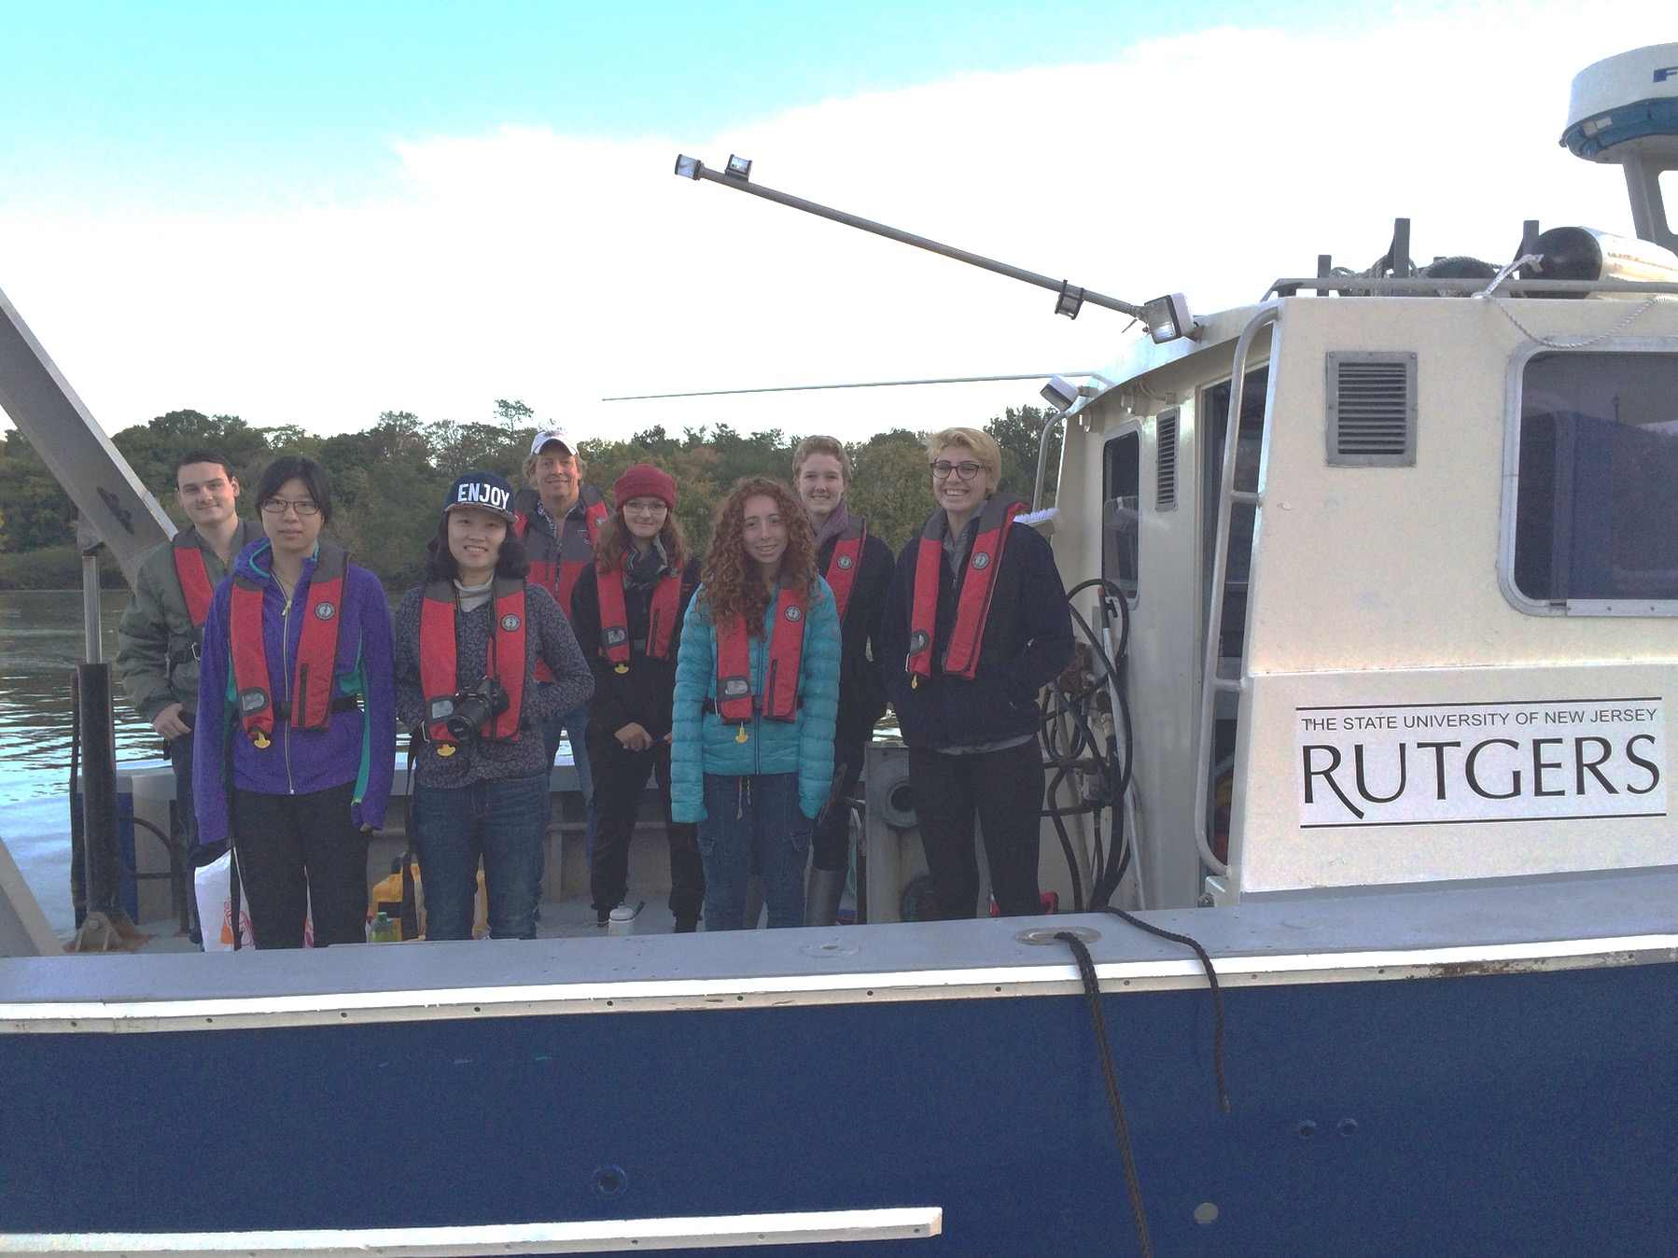
Oceanography House - Freshman Learning Community
Introduction to research opportunities and tools
Mentorship by upper level students
Intro research cruise on the Raritan Estuary

Slide 21
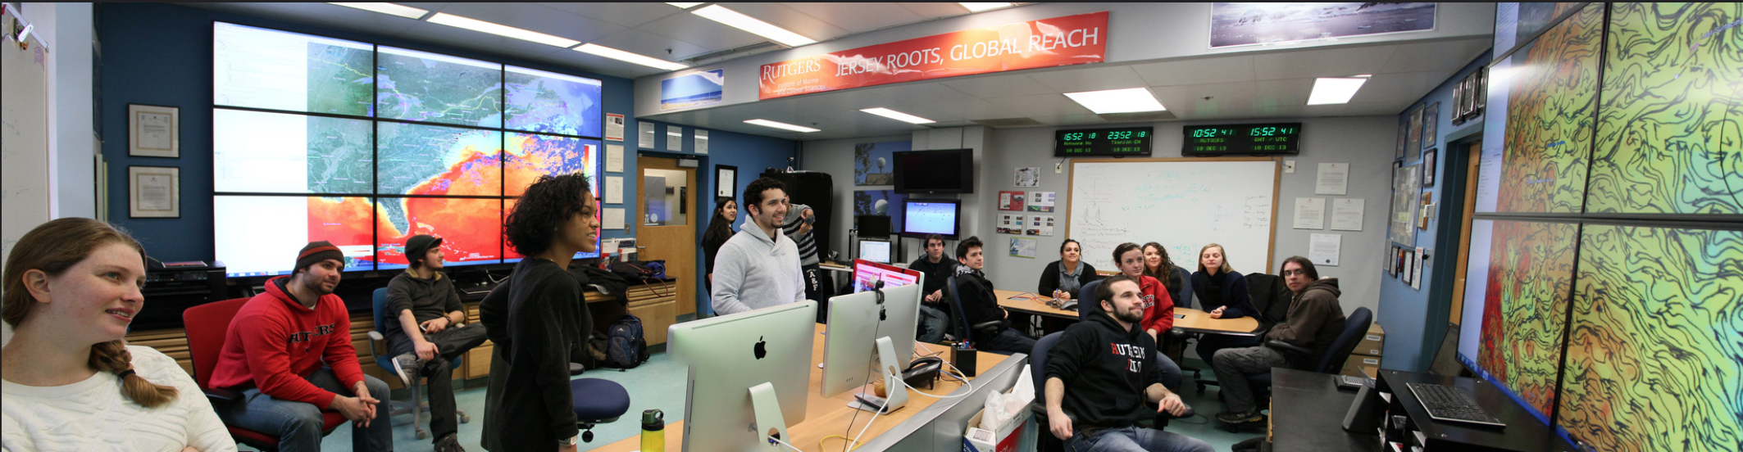
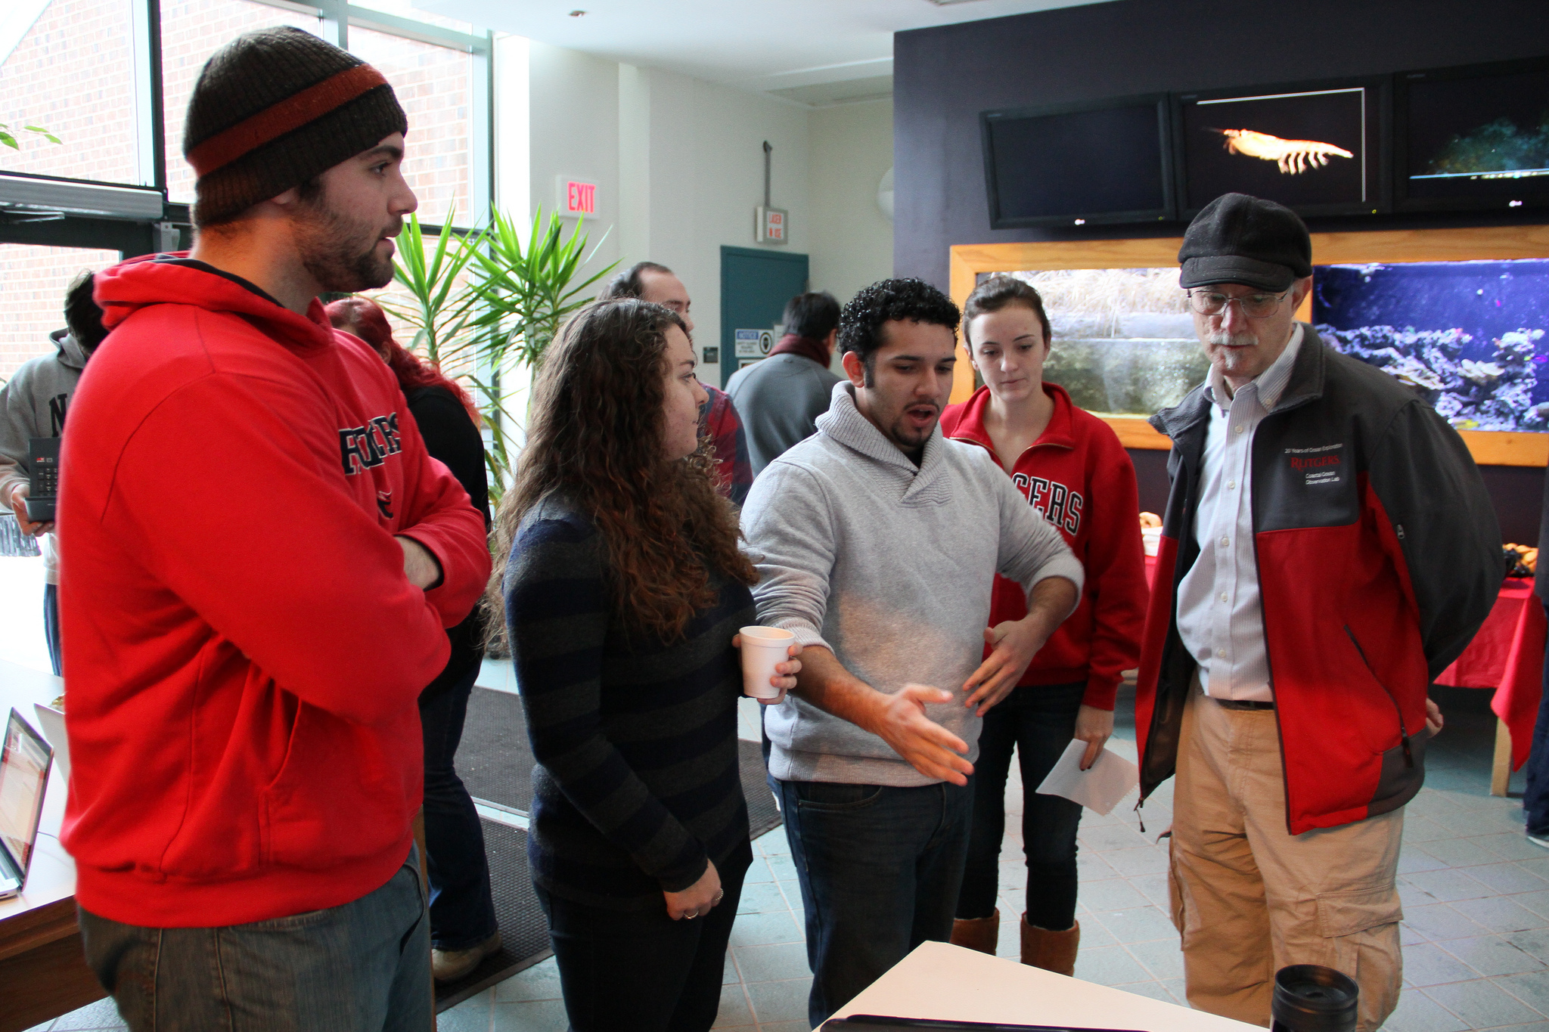
Research Course – 1.5 credits every semester
Can be taken multiple times
Cognitive Apprenticeship model – “watch on, do one, teach one”
Senior level students mentor younger students
Uses COSEE/OOI Concept Maps for organization
Research conference presentations at the end - overcome fear
Honor a high level guest speaker

Slide 22
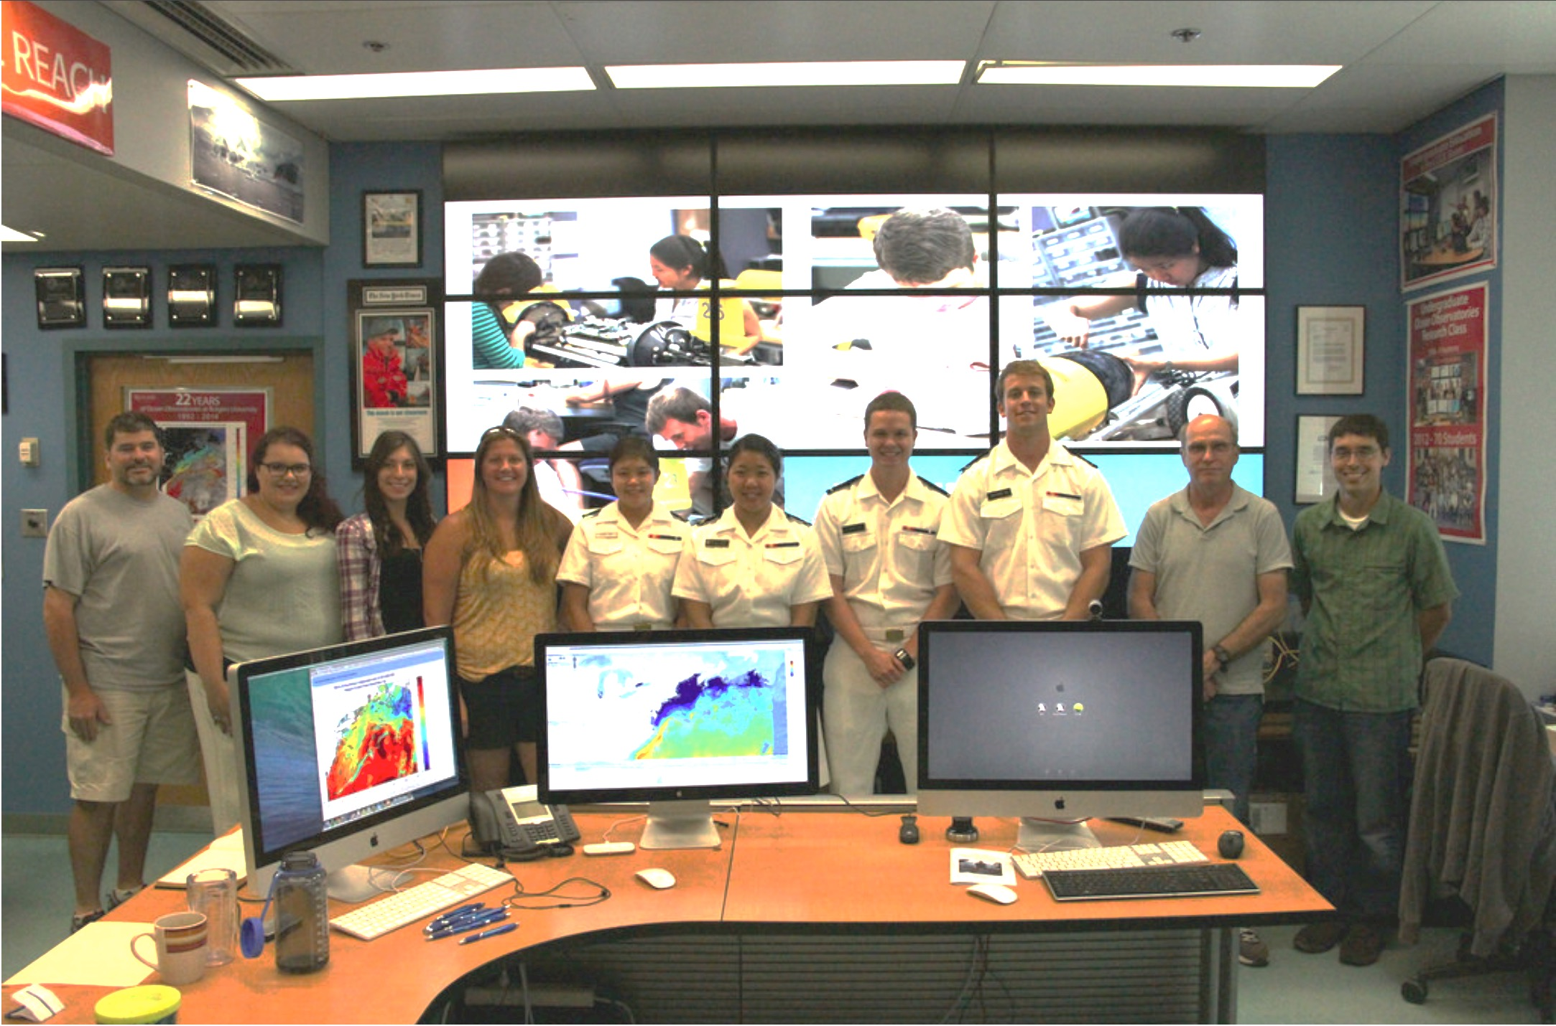
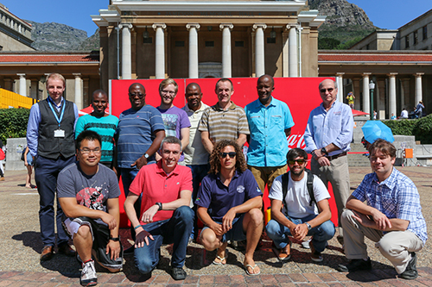
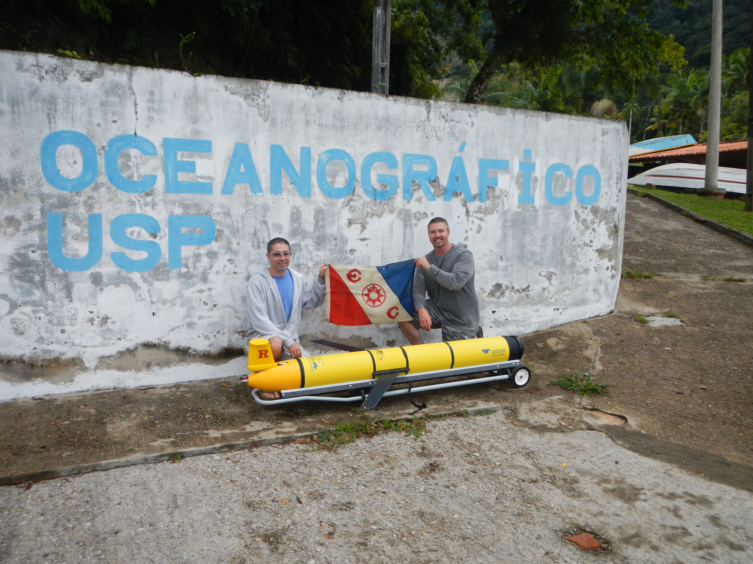
Endless Summer Research Institute
June-August at Rutgers
  NSF RIOS
  Industry-sponsored students –
  ( e.g. Teledyne)
  U.S. Naval Academy
January in Southern Hemisphere
  Antarctica - LTER
  South Africa – HF Radar Course
  Brazil – Glider Course

Slide 23

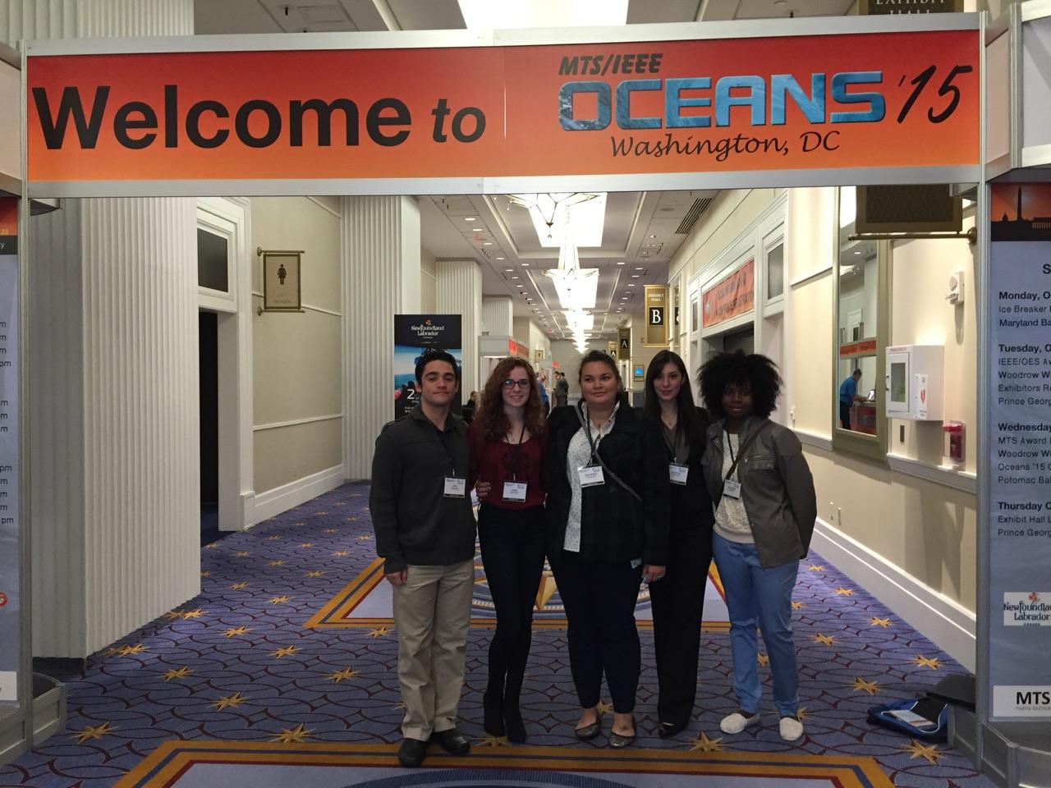
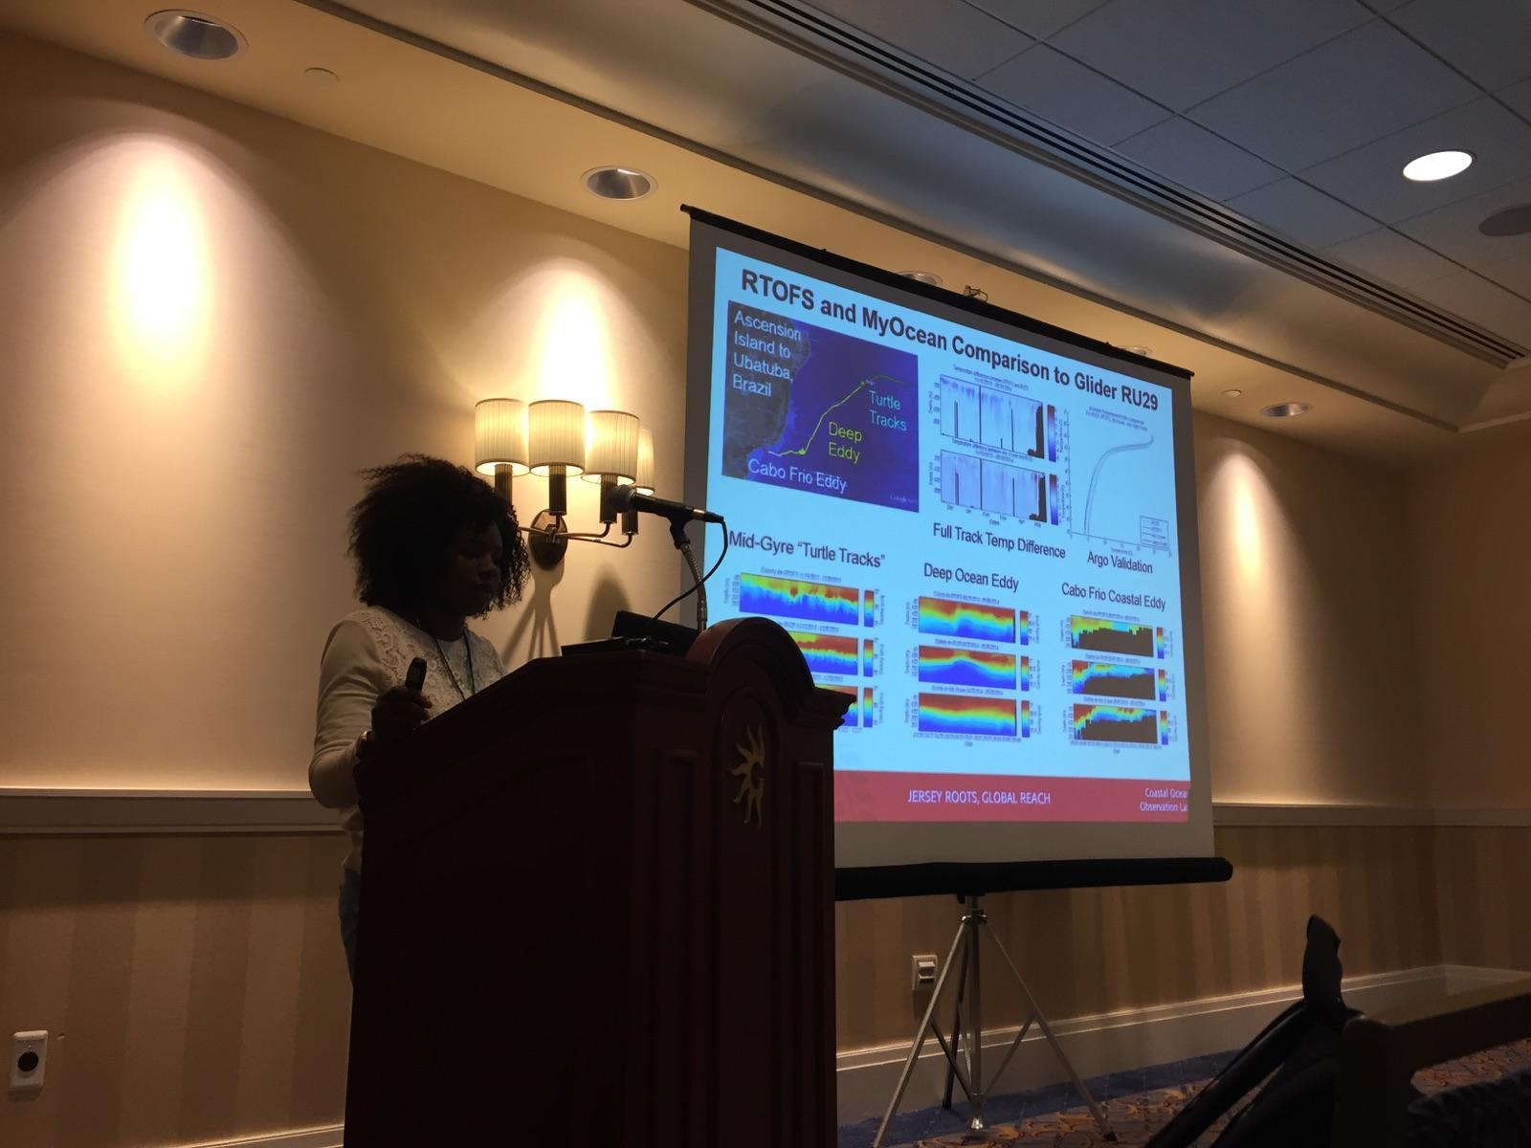
Critical role of MTS/IEEE Oceans Conferences
Student chapters
Students submit abstracts & papers that can be referenced
Students attend conference and give talks
Students visit vendors and return with job offers

Slide 24

NSF Ocean Observatories Initiative
A Sustained at Sea
Scientific Observing Presence
on a Global Scale
Five Integrated Components
High Latitude Global Arrays
Plate-scale Cabled Array
Coastal Dynamics Arrays
Cyber Data Access Network
Ocean Education Portal

Slide 25


OOI By the Numbers
As of February 2014

Slide 26



Educational Visualization Service
Building flexible and customizable visualization tools
Focused on time series and profiles
Goal is to balance capability and usefulness
Multiple entry points (teacher, student, developer)
26

Slide 27

Concept Mapper
Concept Map Builder (create & edit) and Viewer
Concept & linking phrase suggestions (ontologies)
Embedded content resources such as descriptions, data visualizations, photos & videos from OOI & outside resources
27

Slide 28







Data Investigation Builder
Community library of lessons
Online lesson template
Lesson Builder Wizard (step by step design process)
EPE resource integration

Slide 29


What did the students get out of this?
Experience Multimodal Multiplatform Science
Numerous speaking opportunities – Learn to Communicate.
Research on their Resume.
Leads to Summer Internships – National & International.
Leads to Graduate School Acceptances.
Leads to Job Offers from Glider Operations Centers.
Leads to higher rankings in the environmental job market.
Meet national and international leaders in oceanography.
Develop friendships that persist across space and time.
They return to tell others of the importance of this experience.

