Slide 1
Increasing the Coverage of an Island-based HF Radar Network
Ethan Handel, Hugh Roarty, Scott Glenn,
Carlos Garcia, Julio Morell, Miguel Canas

Slide 2
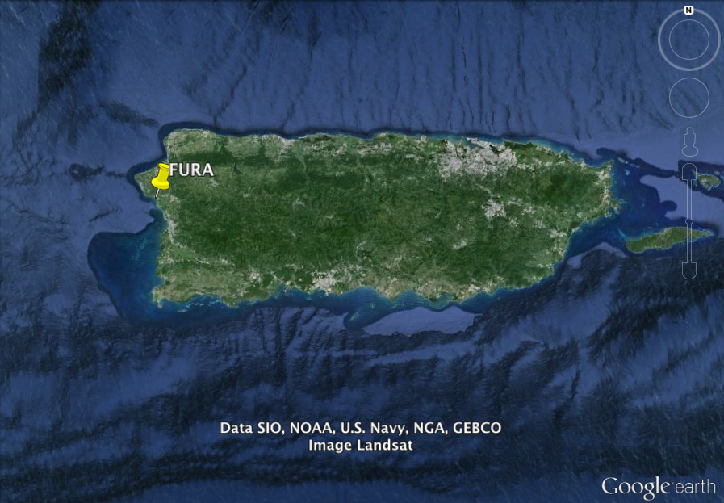
FURA- FURA Station, Anasco, PR
Installed 2009

Slide 3
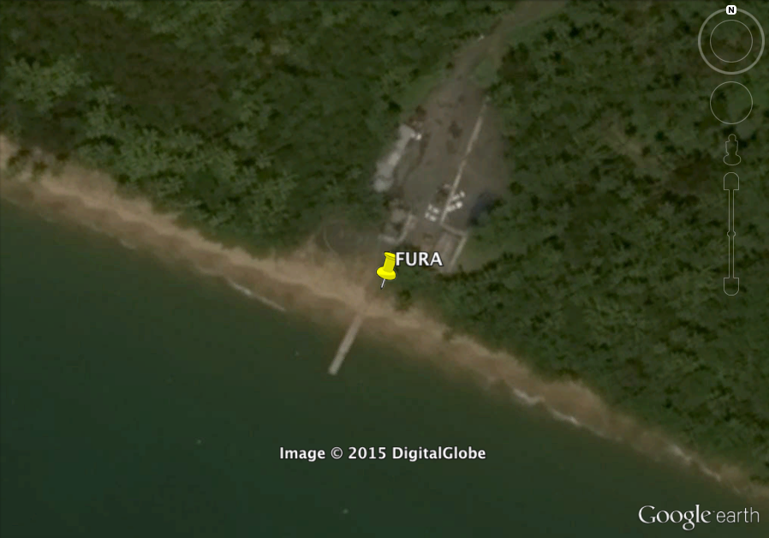
FURA- FURA Station, Anasco, PR

Slide 4
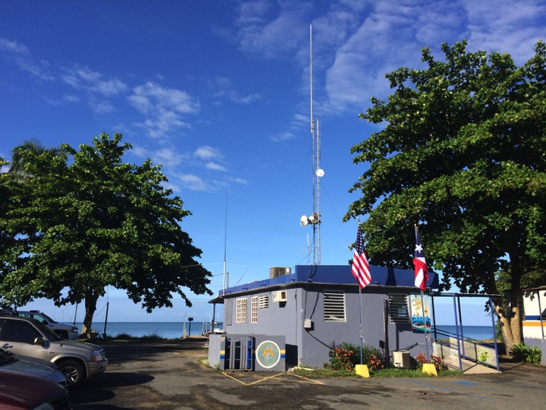
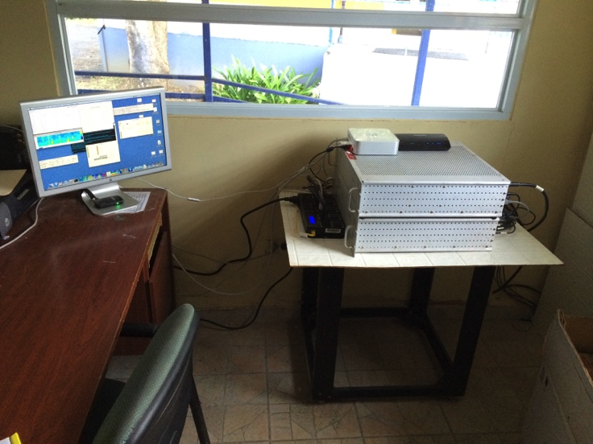
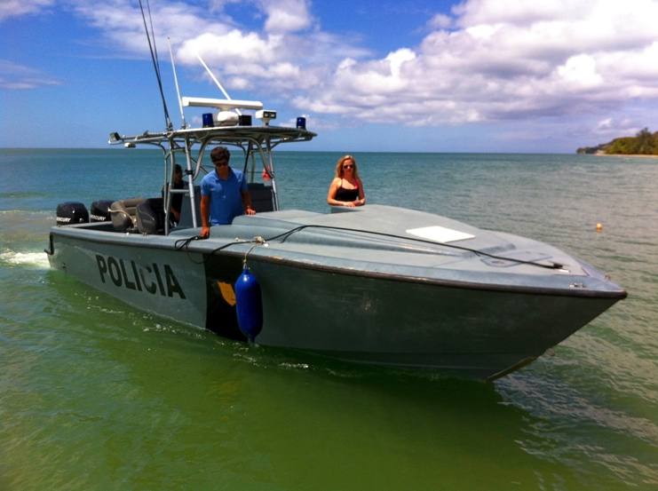
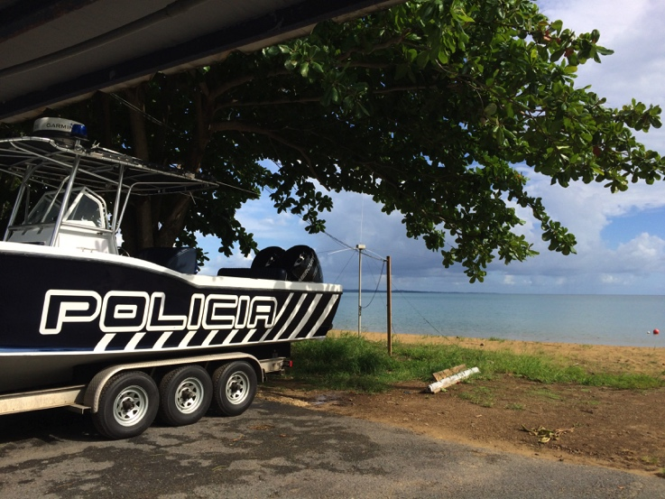
FURA- FURA Station, Anasco, PR

Slide 5
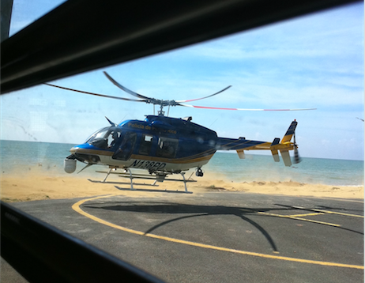
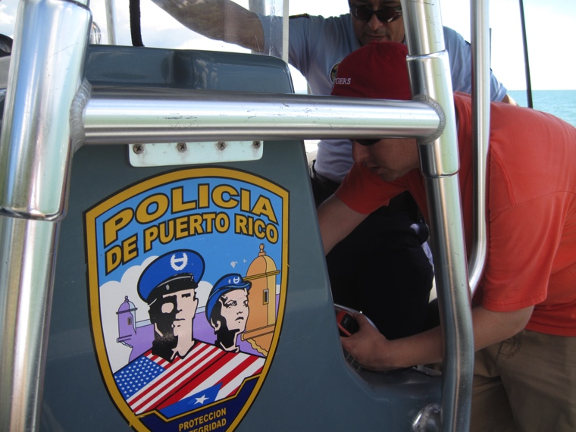
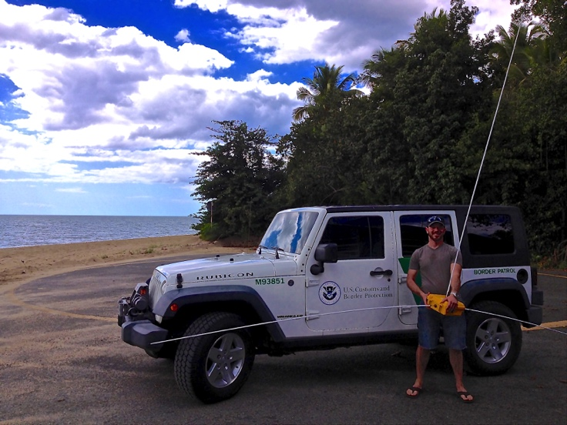
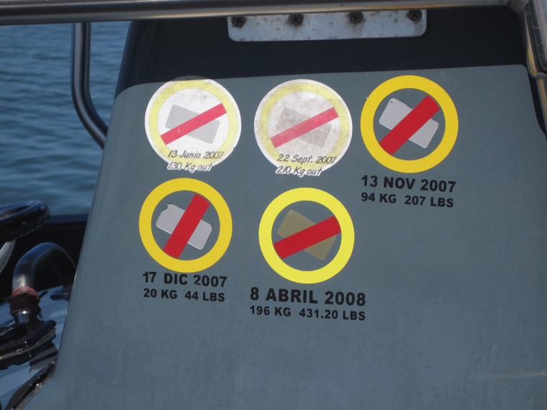
FURA- FURA Station, Anasco, PR

Slide 6
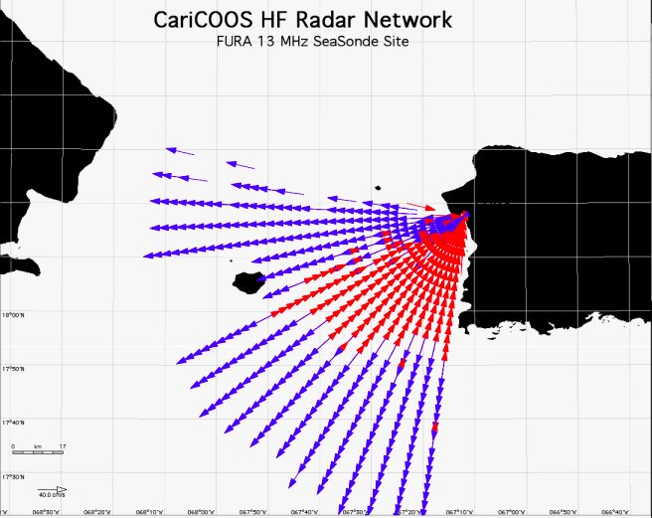
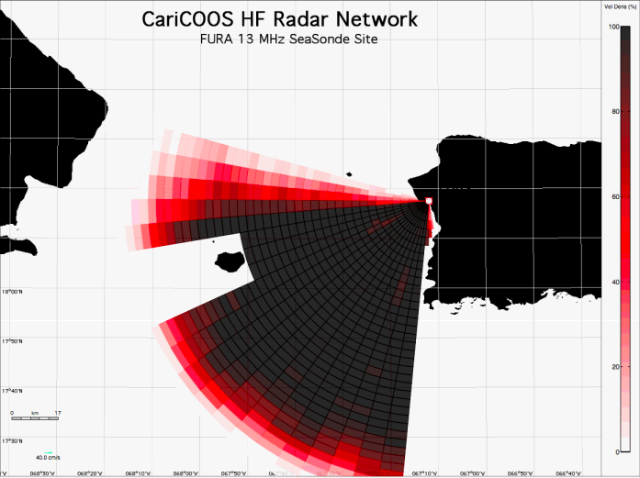
FURA- FURA Station, Anasco, PR
13 MHz CODAR, ~100km Range

Slide 7
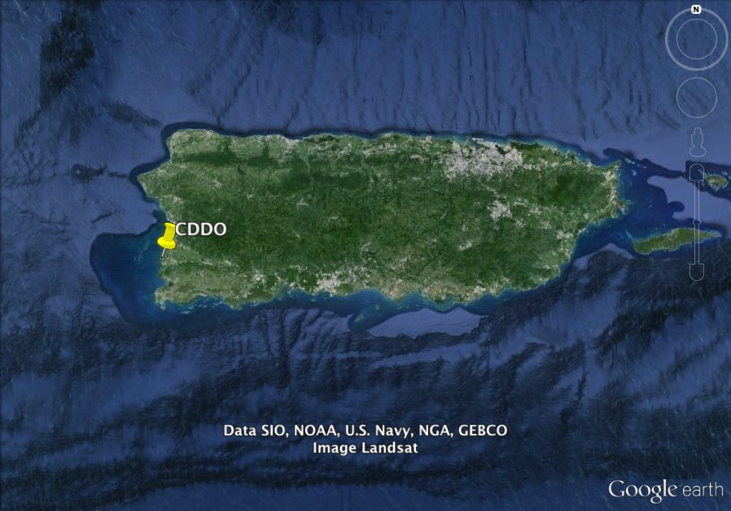
CDDO- Club Deportivo Del Oeste, Cabo Rojo
Installed 2009

Slide 8
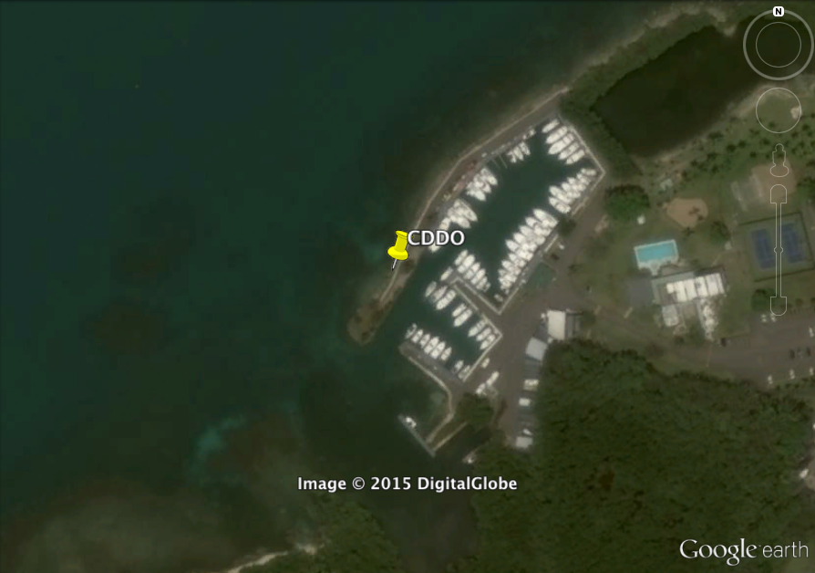
CDDO- Club Deportivo Del Oeste, Cabo Rojo

Slide 9
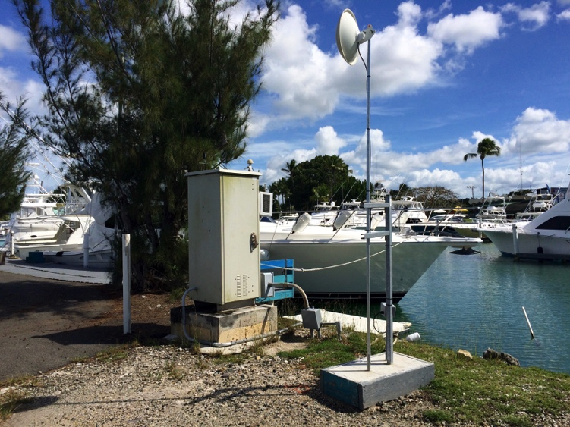
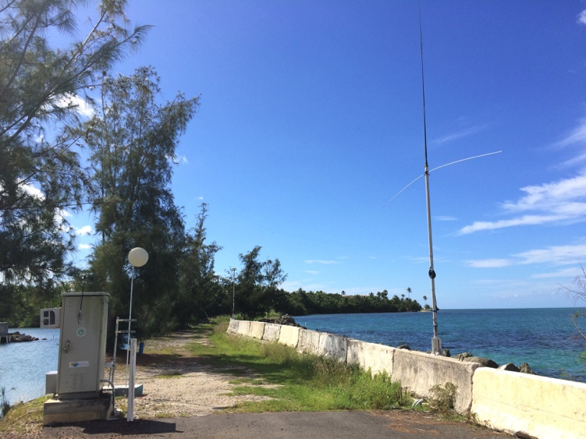
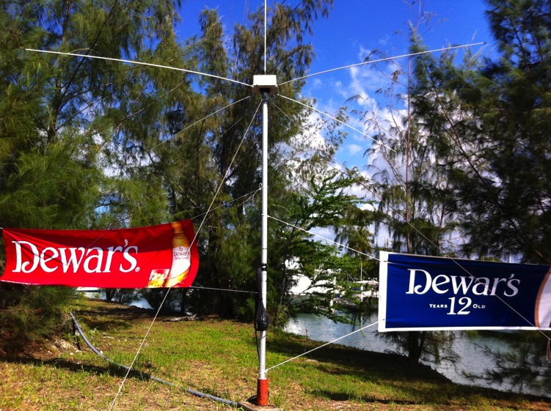
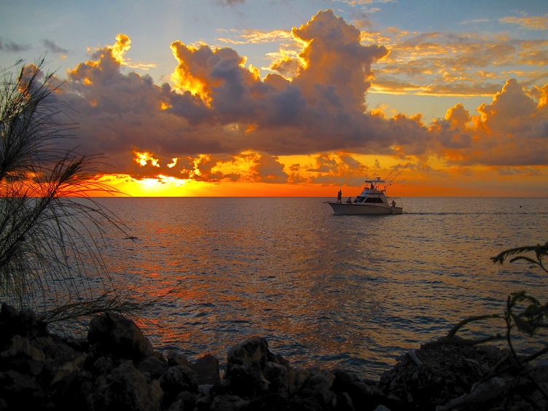
CDDO- Club Deportivo Del Oeste, Cabo Rojo

Slide 10
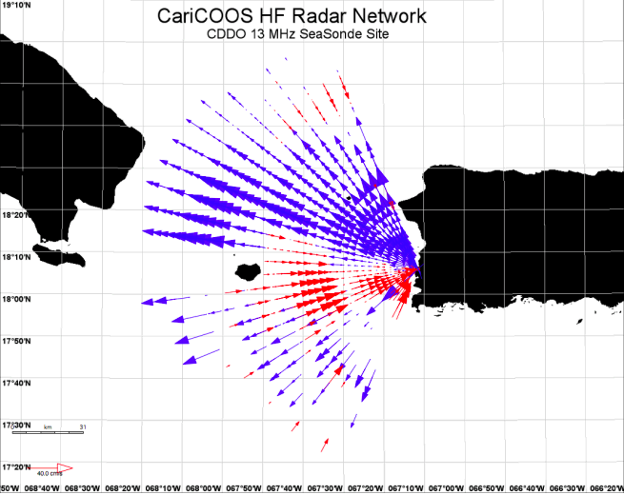
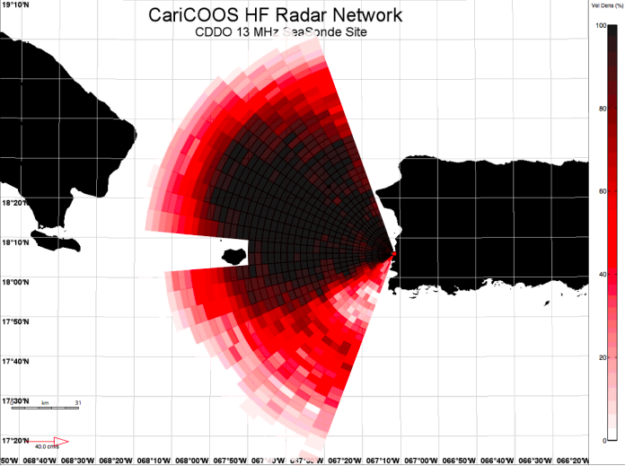
CDDO- Club Deportivo Del Oeste, Cabo Rojo
13 MHz CODAR, ~100km Range

Slide 11
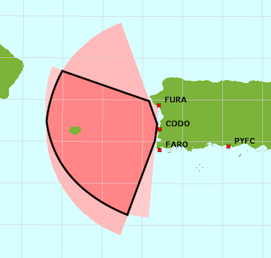
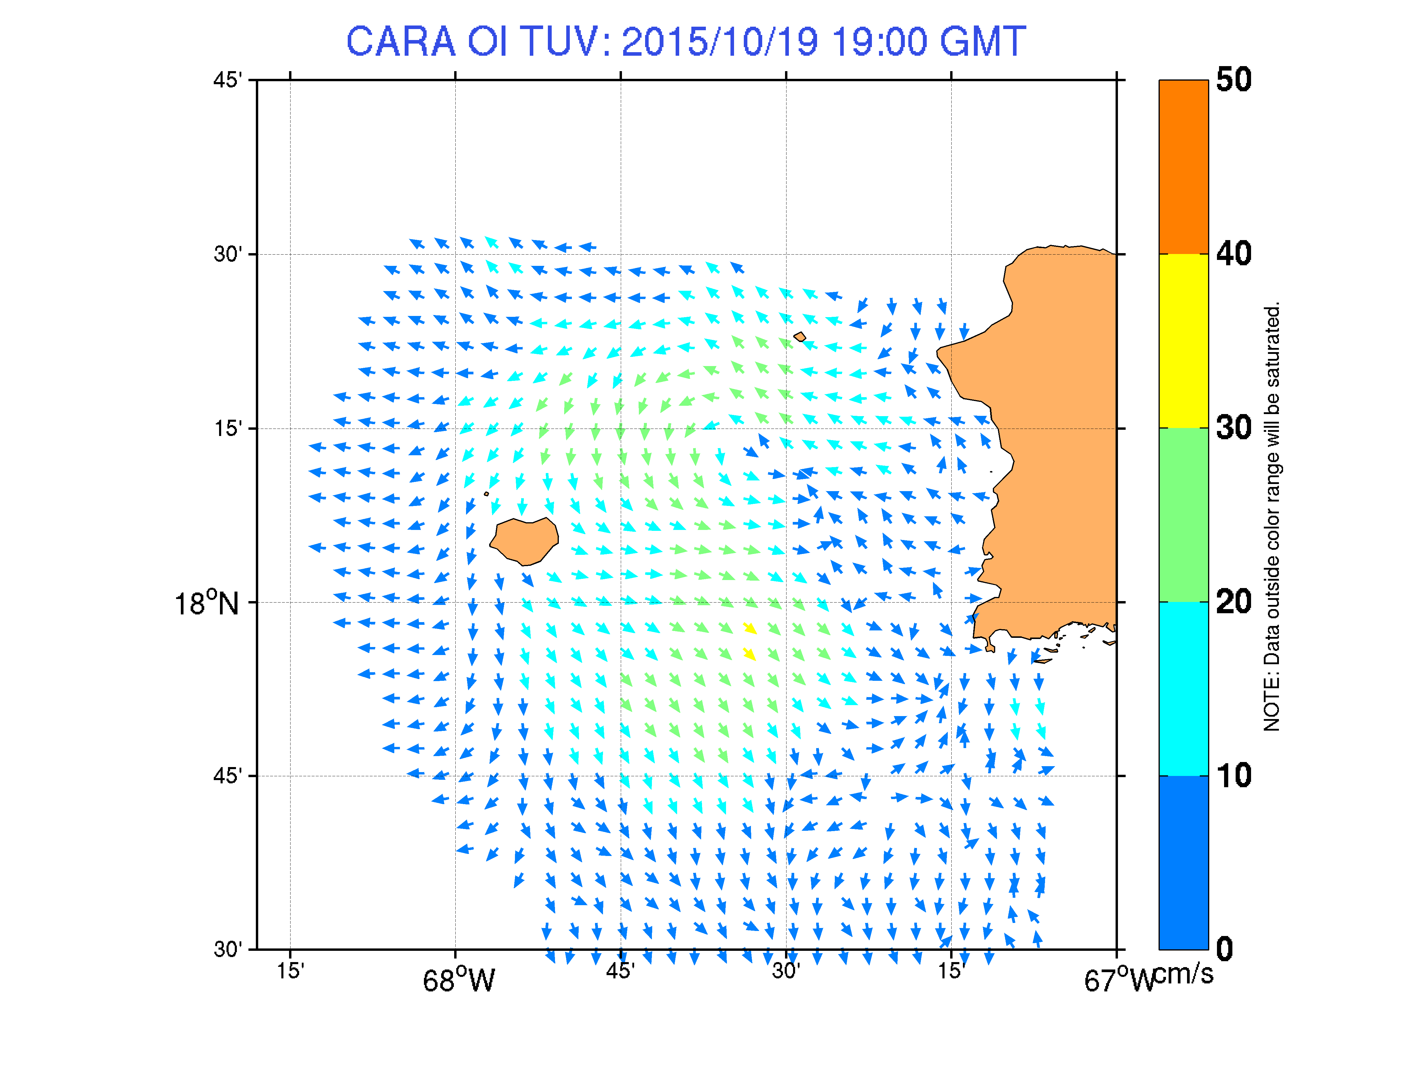
FURA & CDDO- Total Coverage

Slide 12
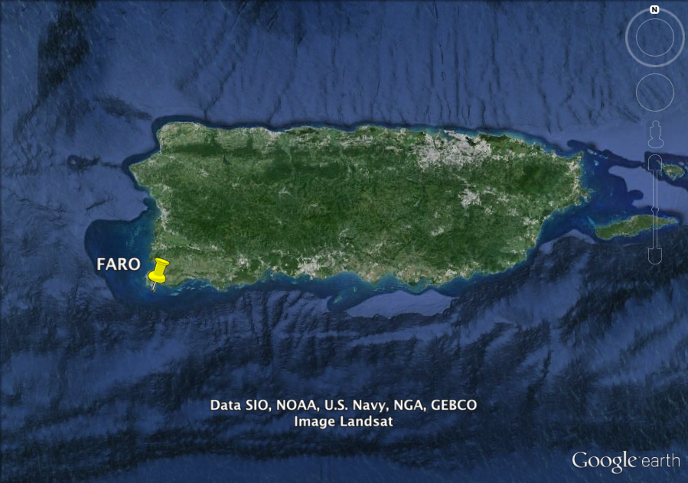
FARO- Los Morrillos Lighthouse, Cabo Rojo
Installed 2015

Slide 13
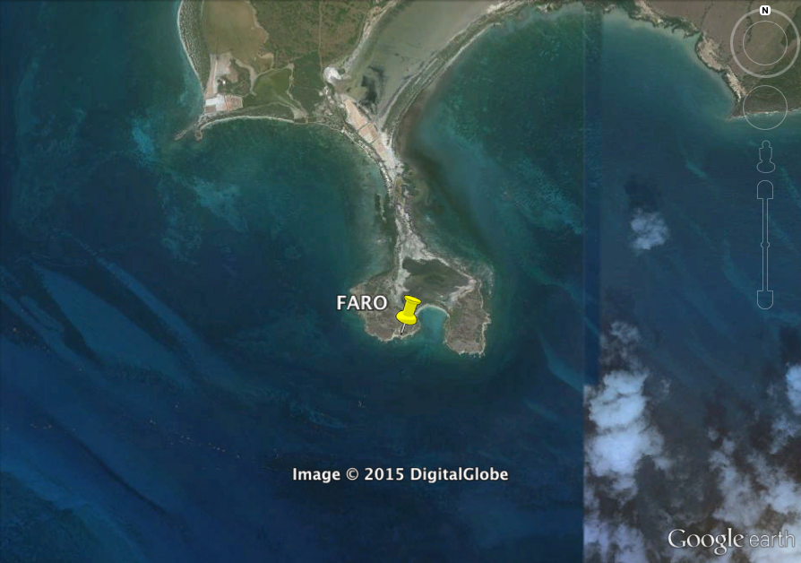
FARO- Los Morrillos Lighthouse, Cabo Rojo

Slide 14
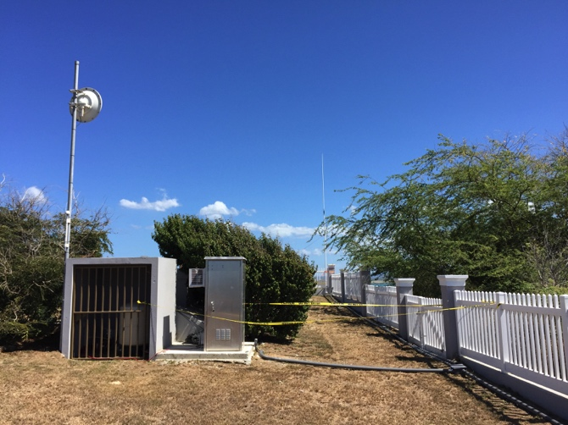
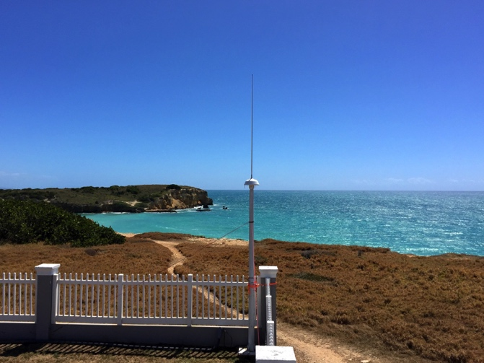
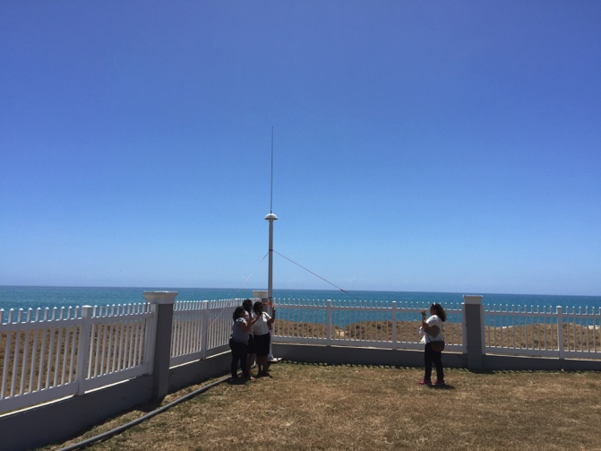
FARO- Los Morrillos Lighthouse, Cabo Rojo

Slide 15
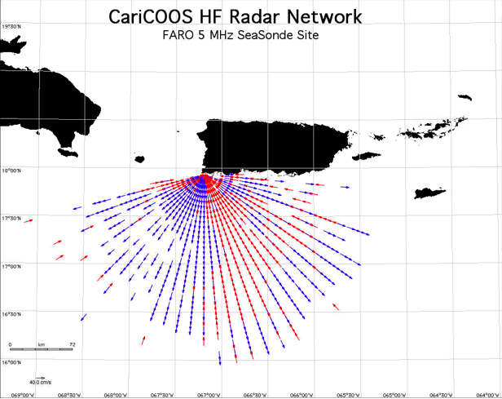
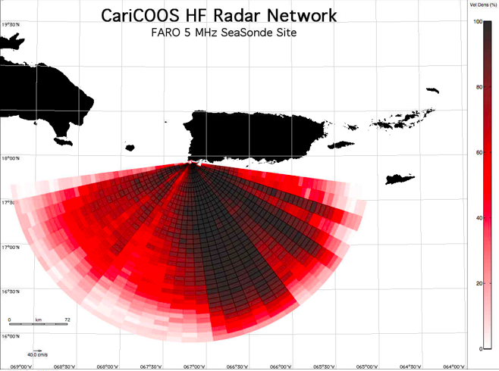
FARO- Los Morrillos Lighthouse, Cabo Rojo
5 MHz CODAR, ~200km Range

Slide 16
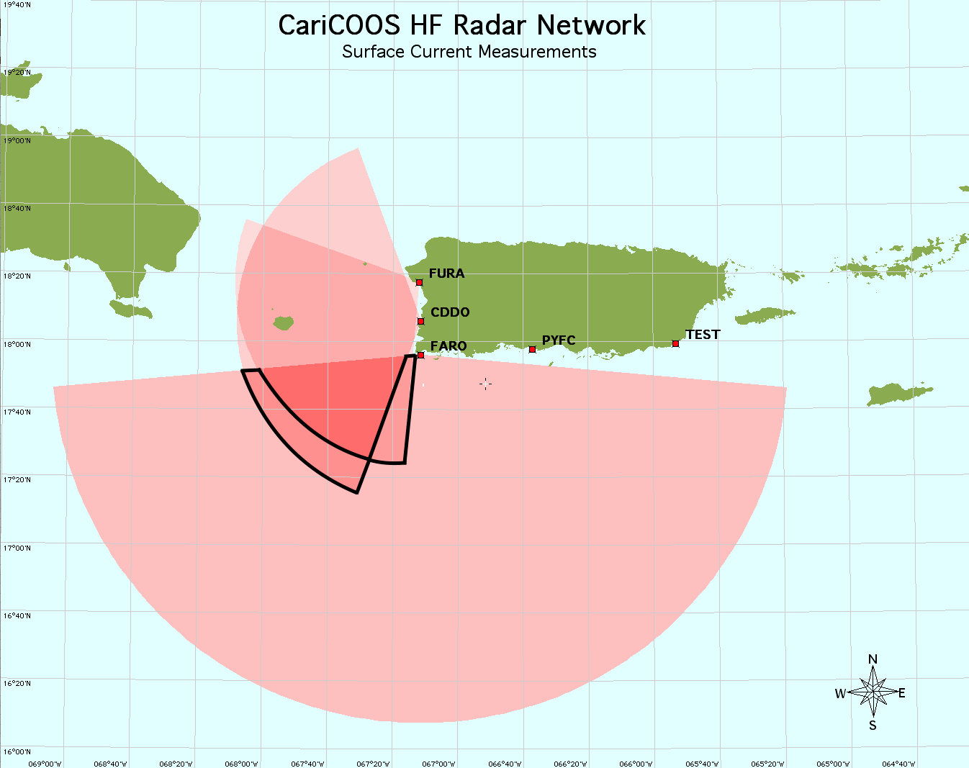
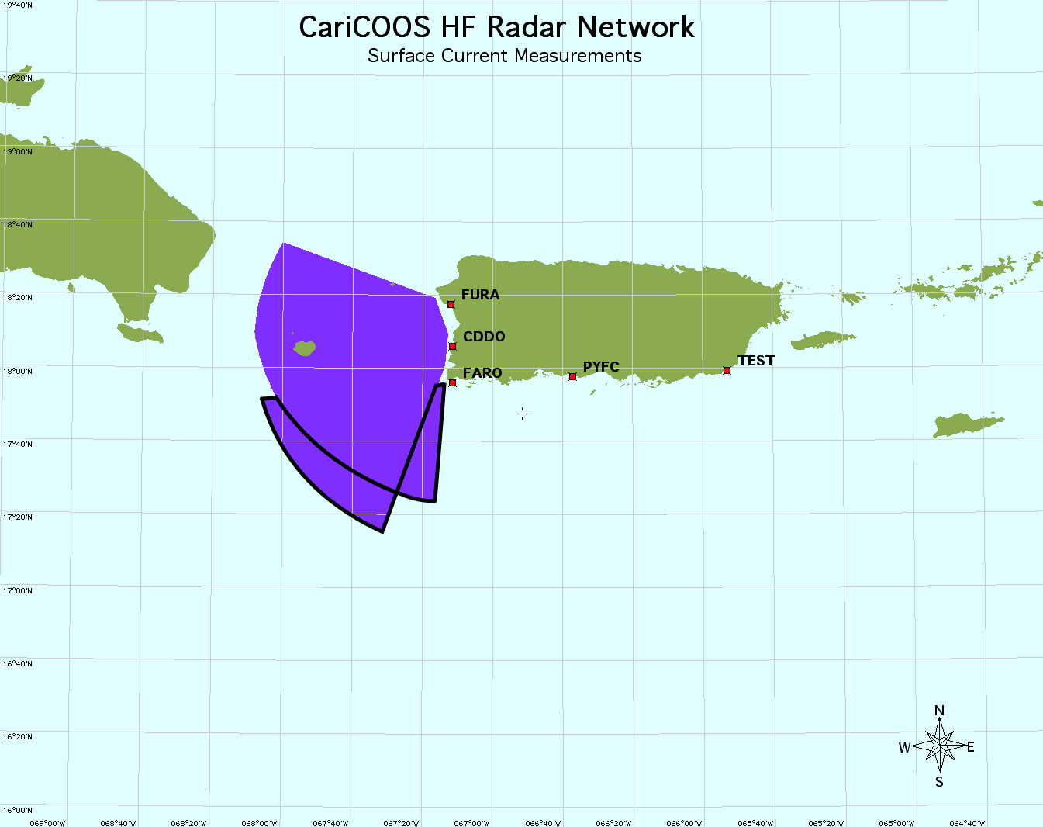
FURA, CDDO, & FARO Total Coverage

Slide 17
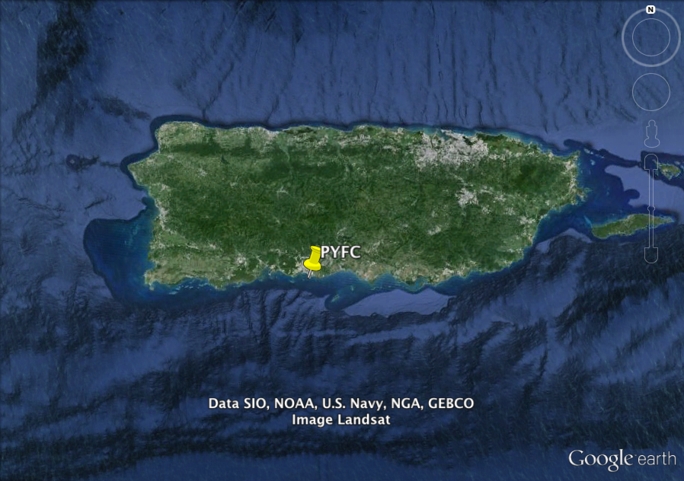
PYFC- Ponce Yacht & Fishing Club, Ponce
Installed 2015

Slide 18
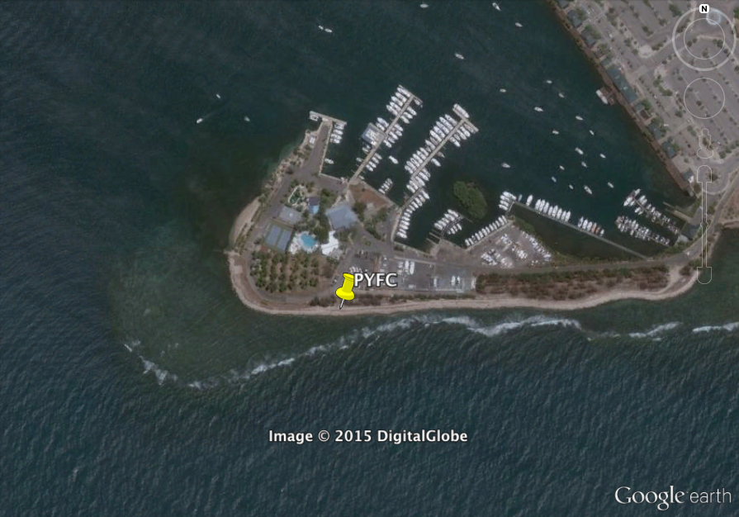
PYFC- Ponce Yacht & Fishing Club, Ponce

Slide 19
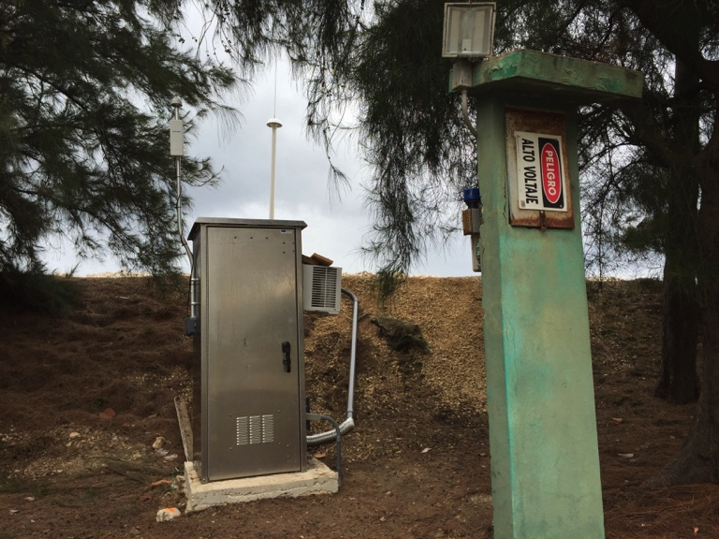
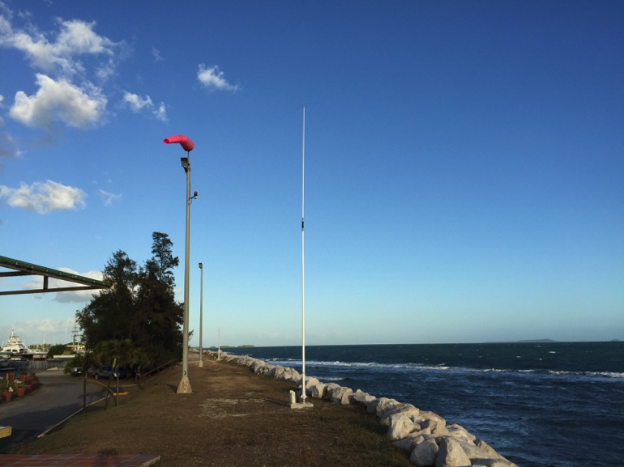
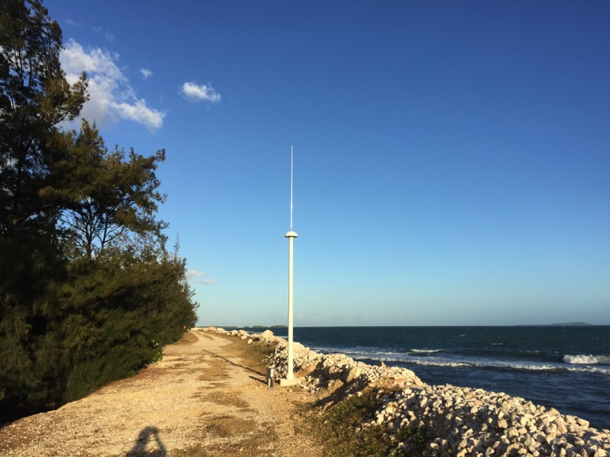
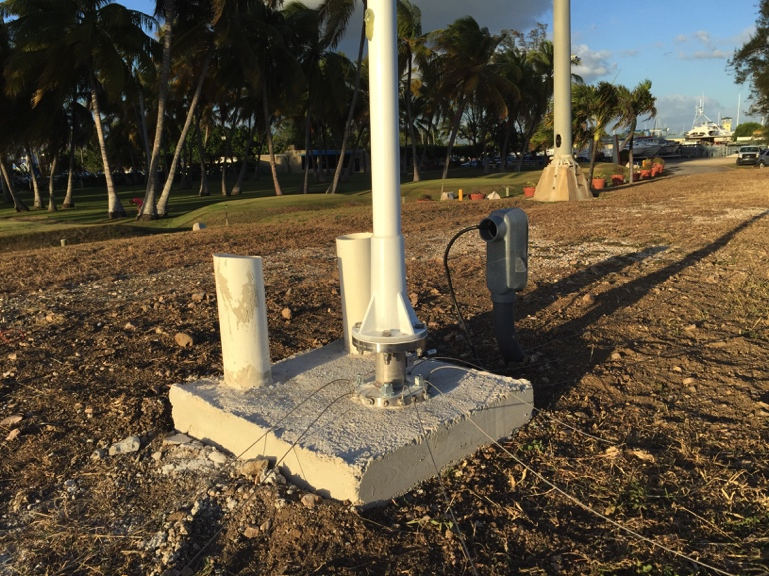
PYFC- Ponce Yacht & Fishing Club, Ponce

Slide 20
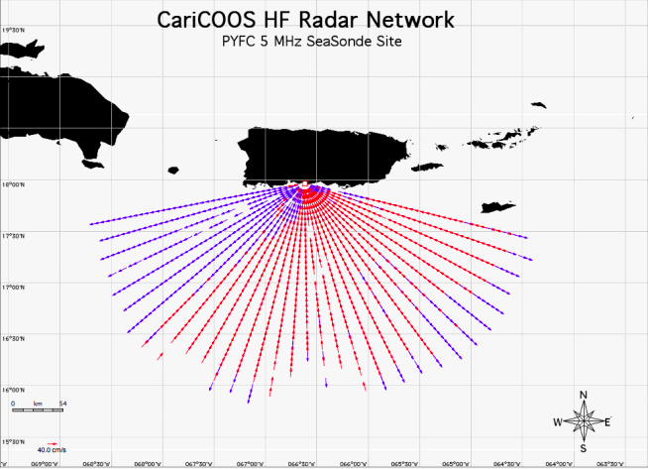
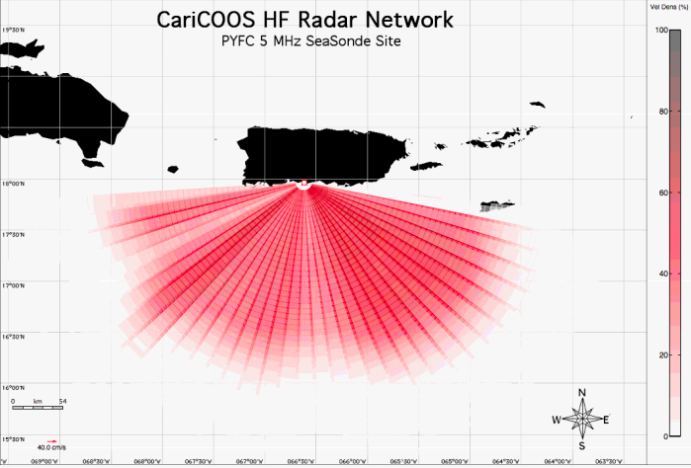
PYFC- Ponce Yacht & Fishing Club, Ponce
5 MHz CODAR, ~200km Range

Slide 21
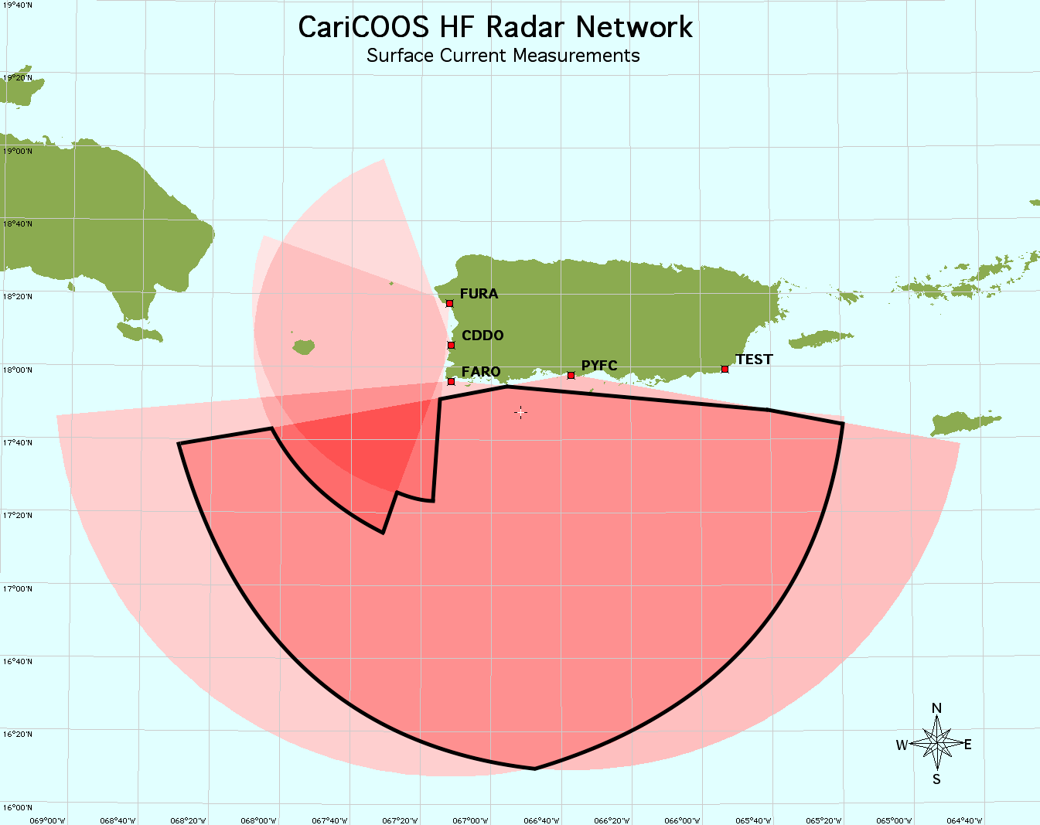
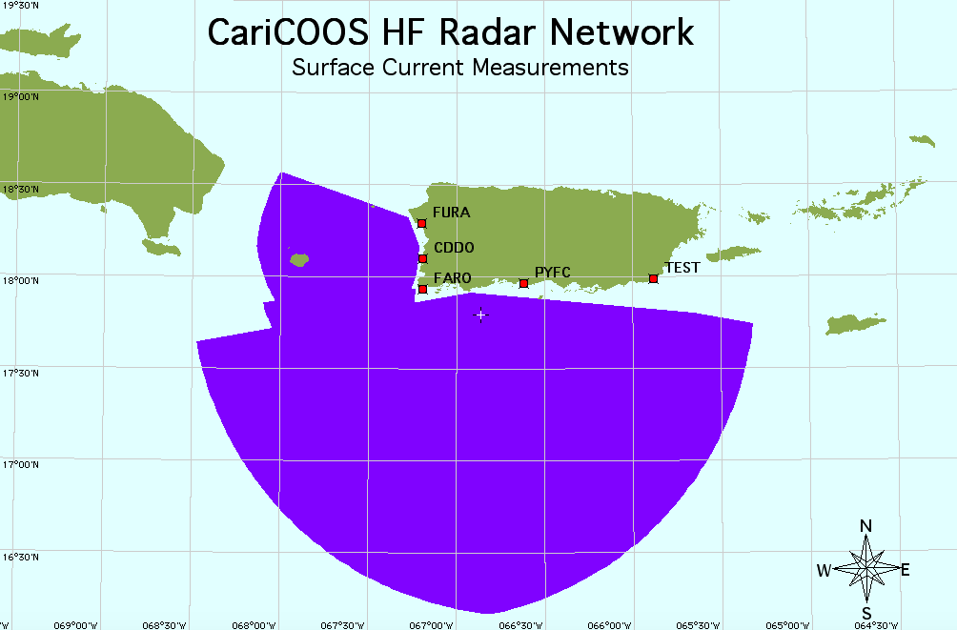
FURA, CDDO, FARO, & PYFC Totals

Slide 22
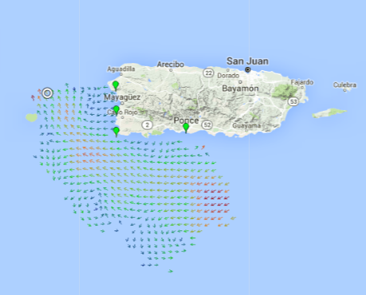
FURA, CDDO, FARO, & PYFC Totals

Slide 23
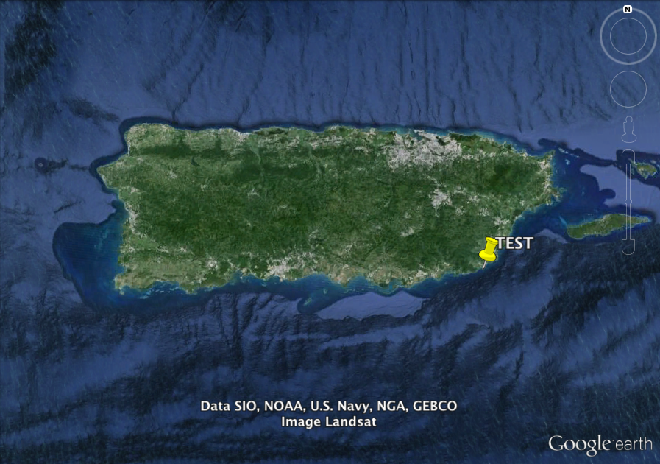
TEST- Faro de Punta Tuna, Emajagua
To be installed next month!

Slide 24
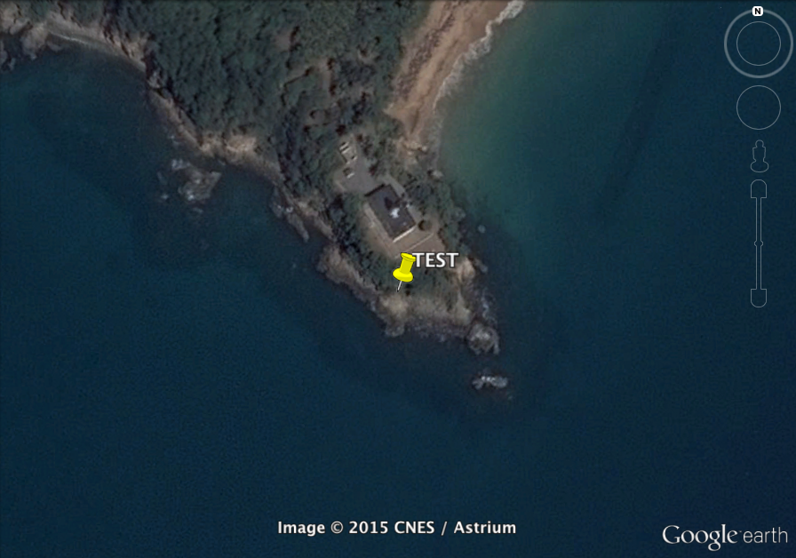
TEST- Faro de Punta Tuna, Emajagua

Slide 25
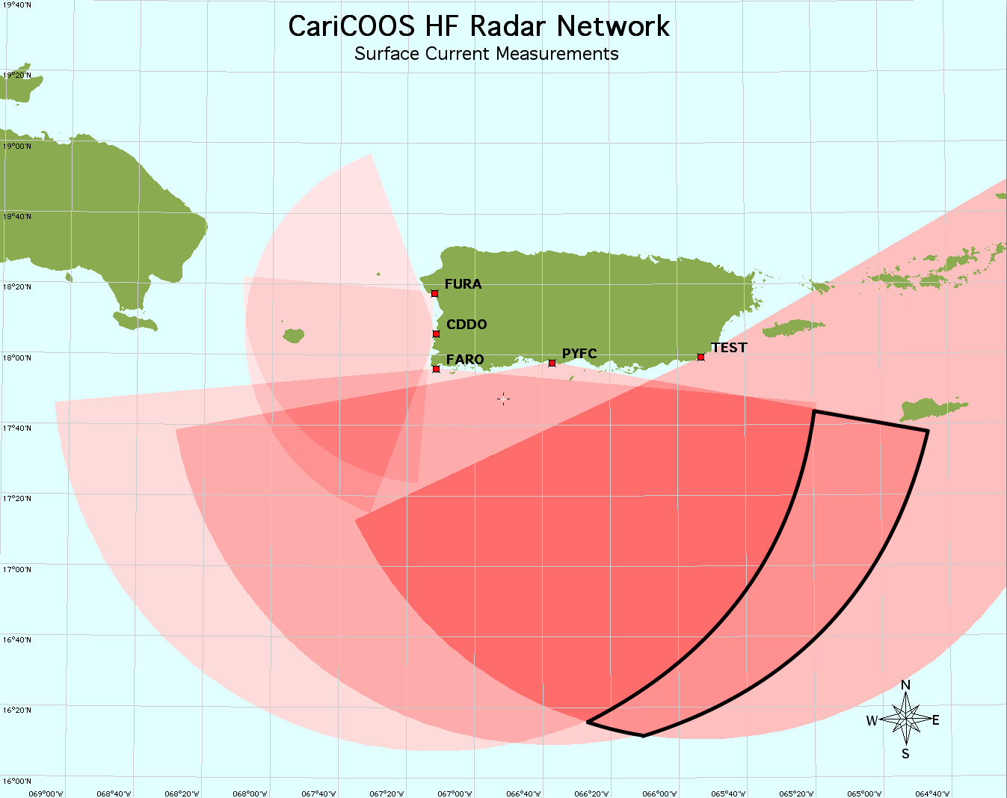
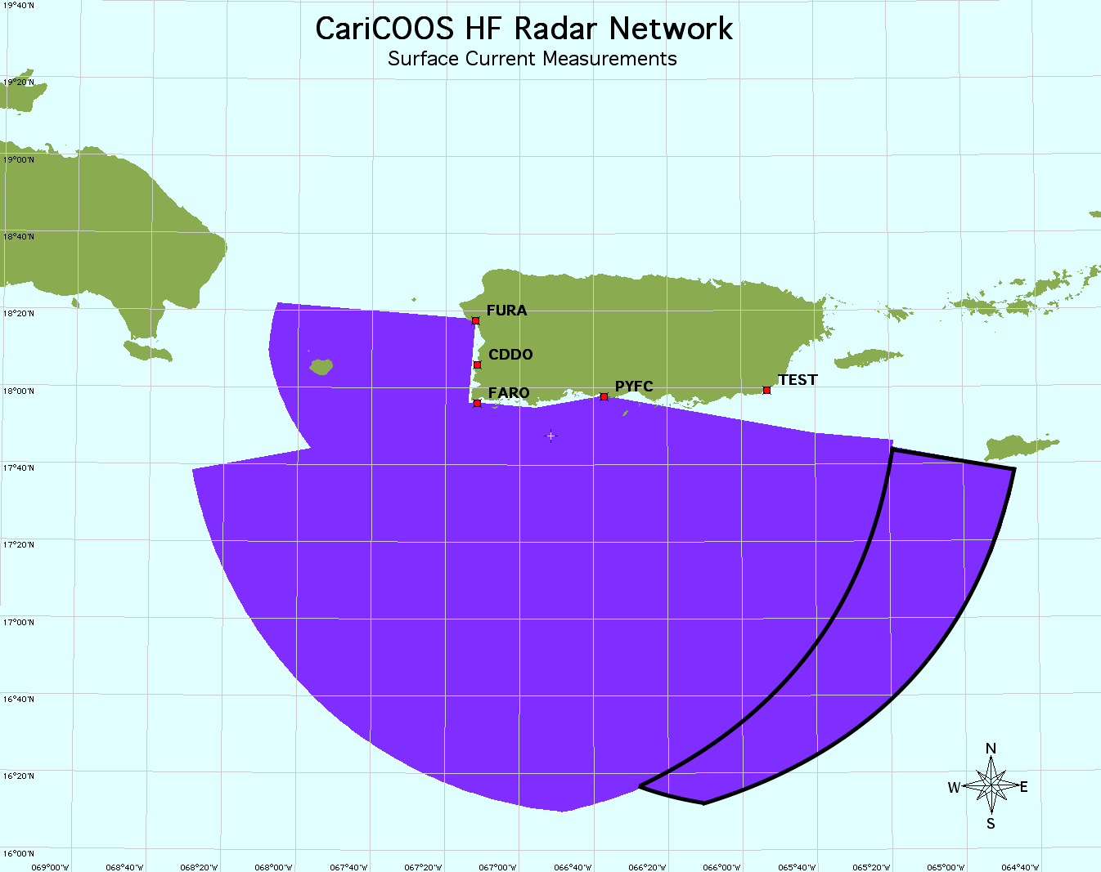
FURA, CDDO, FARO, PYFC, & TEST

Slide 26
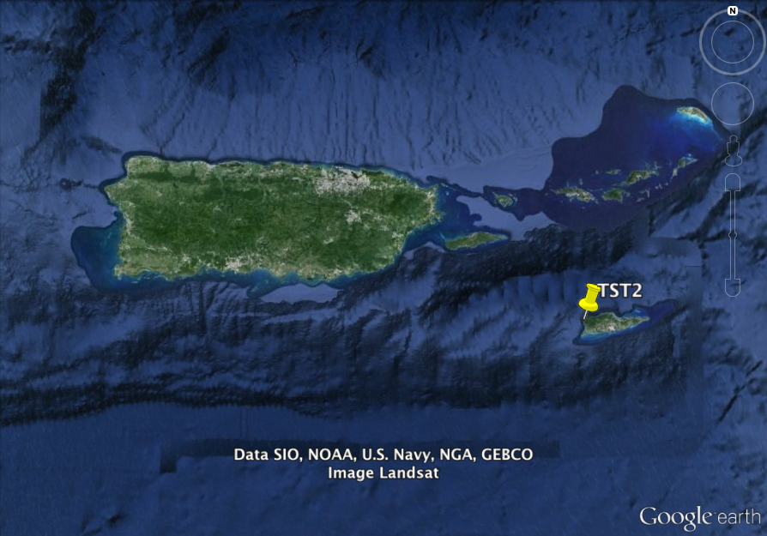
TST2- Potential Next Site

Slide 27
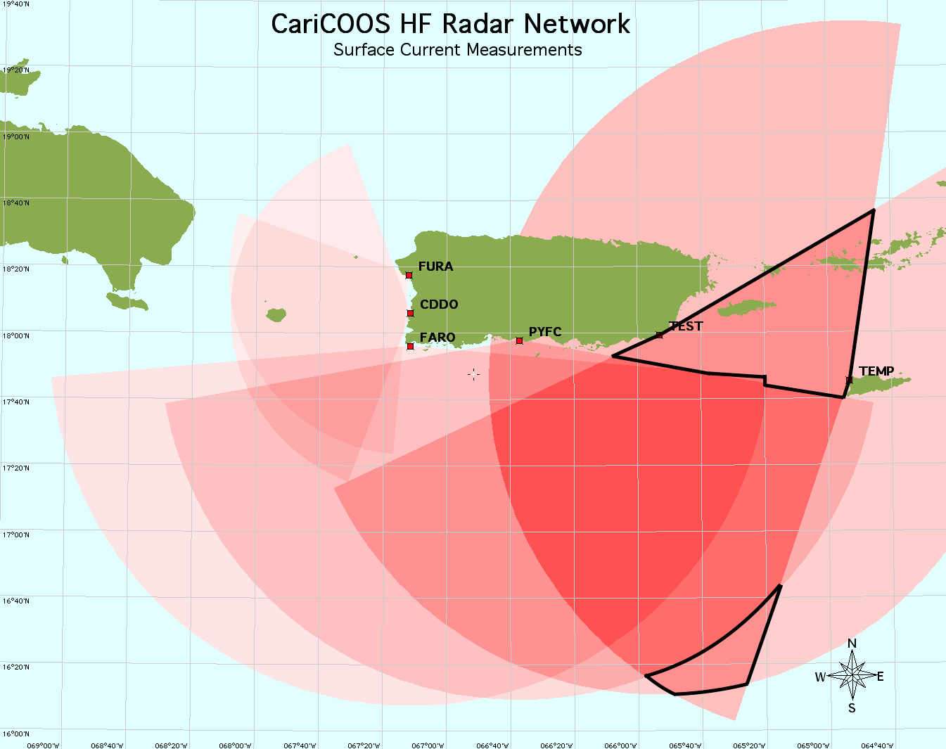
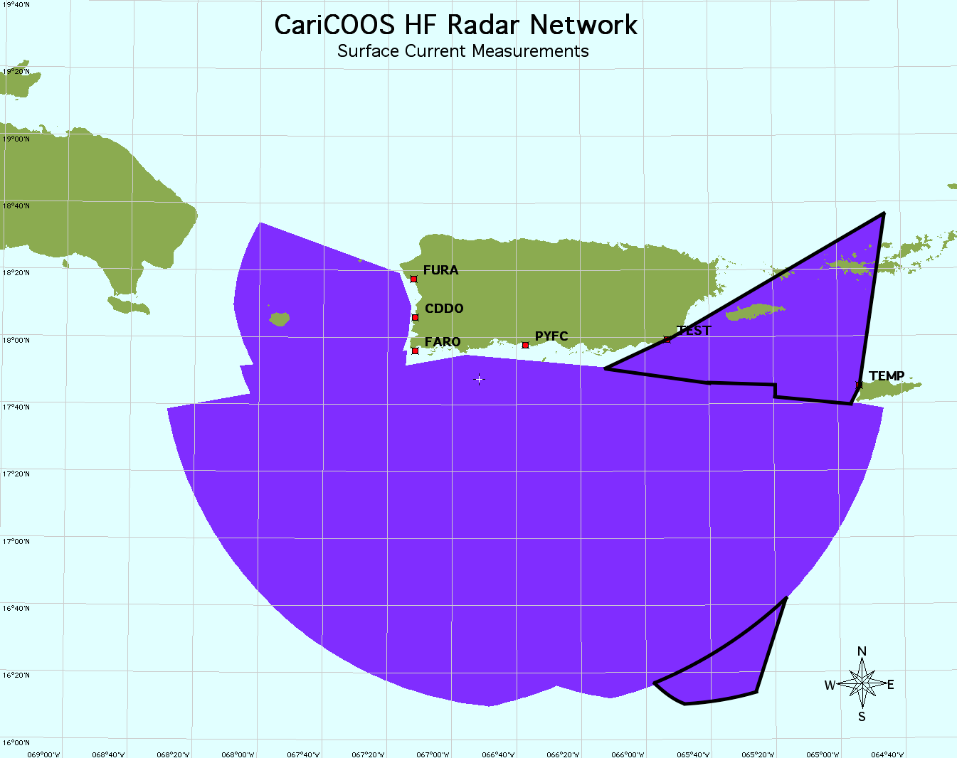
TST2- Potential Next Site

