Slide 1
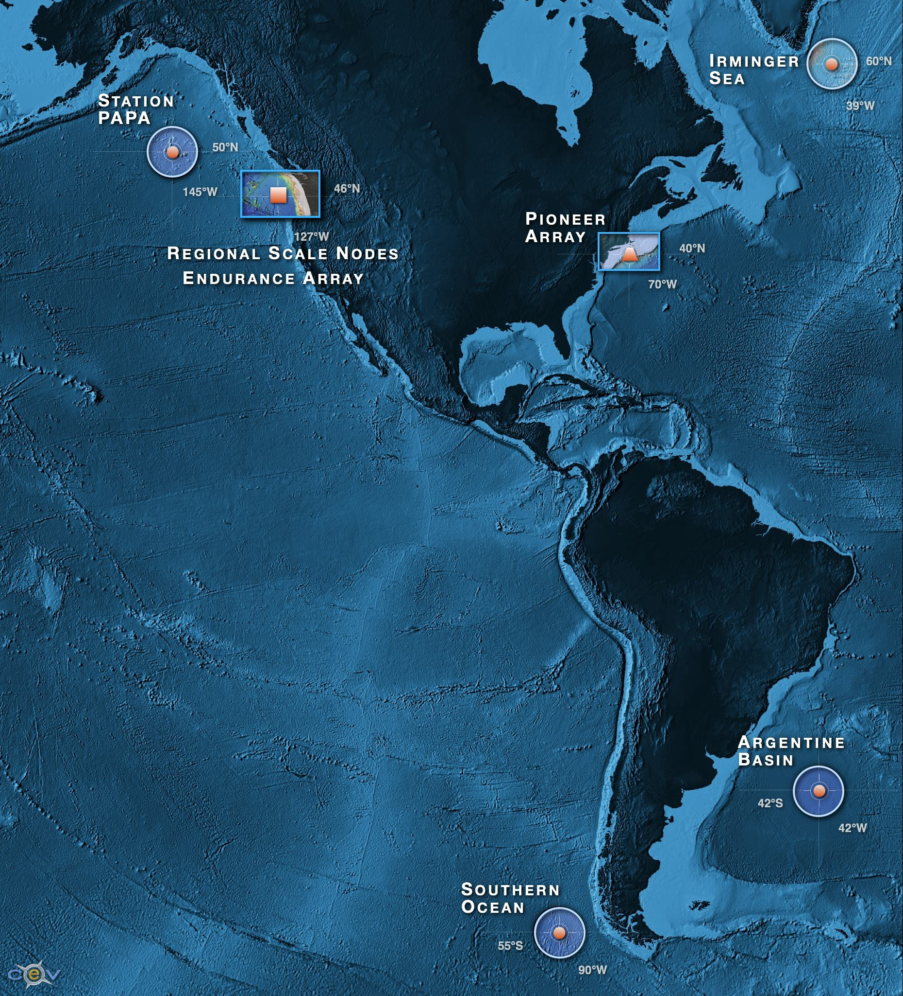
A distributed network of fully open access data for sustained periods open to anyone with open access to the web the democratization of oceanography
Ability to characterize the importance of episodic versus seasonal, annual variability over eddy, shelf and plate scales
>800 unique sensors deployed at any given time on the network
A network capable of absorbing new sensors as they are developed by the wider scientific community
A scalable cyber infrastructure providing a service orientated architecture
A system that provides web service data management with visualization
An integrated education and public engagement suite of tools that can be directly integrated into undergraduate education modules

Slide 3
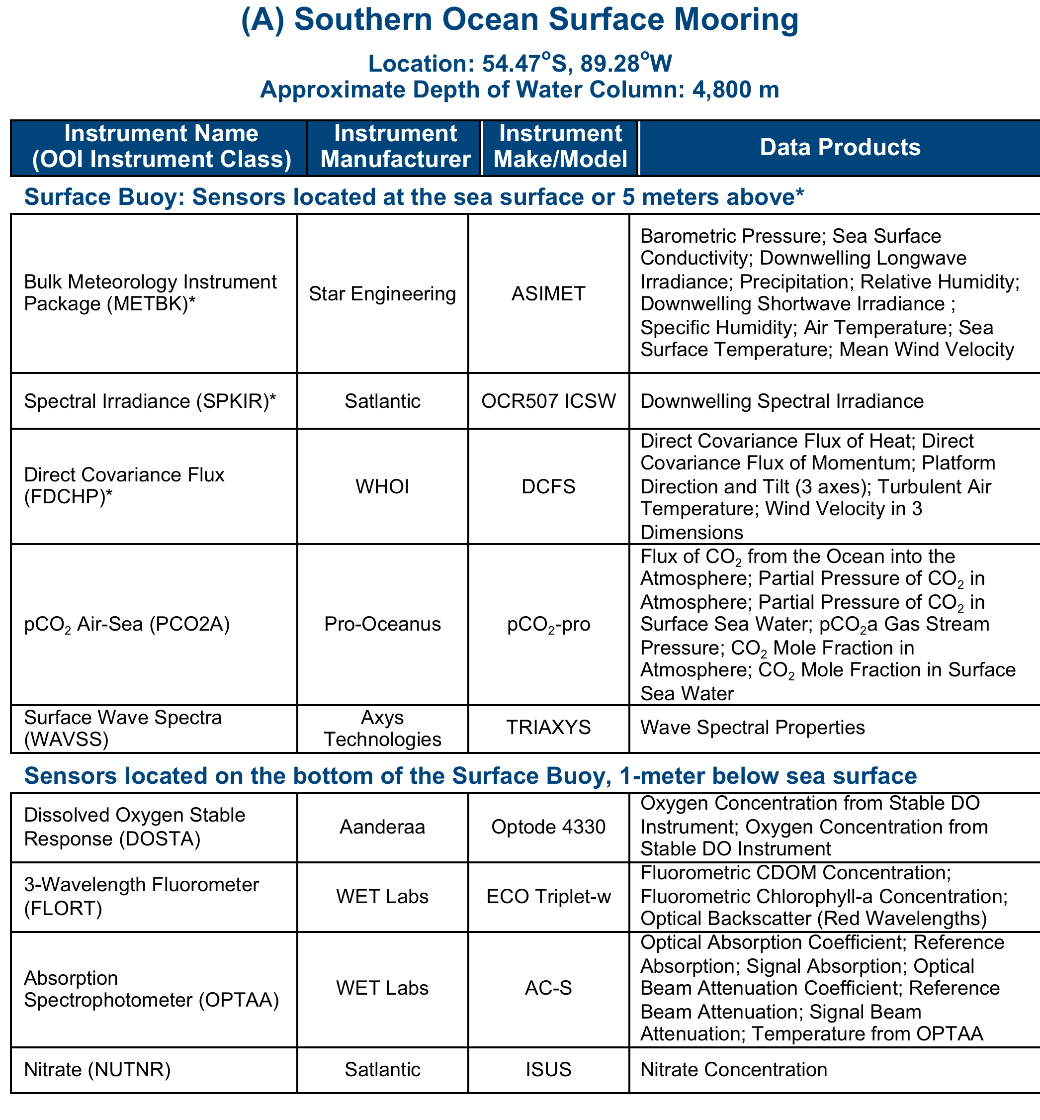

Slide 4
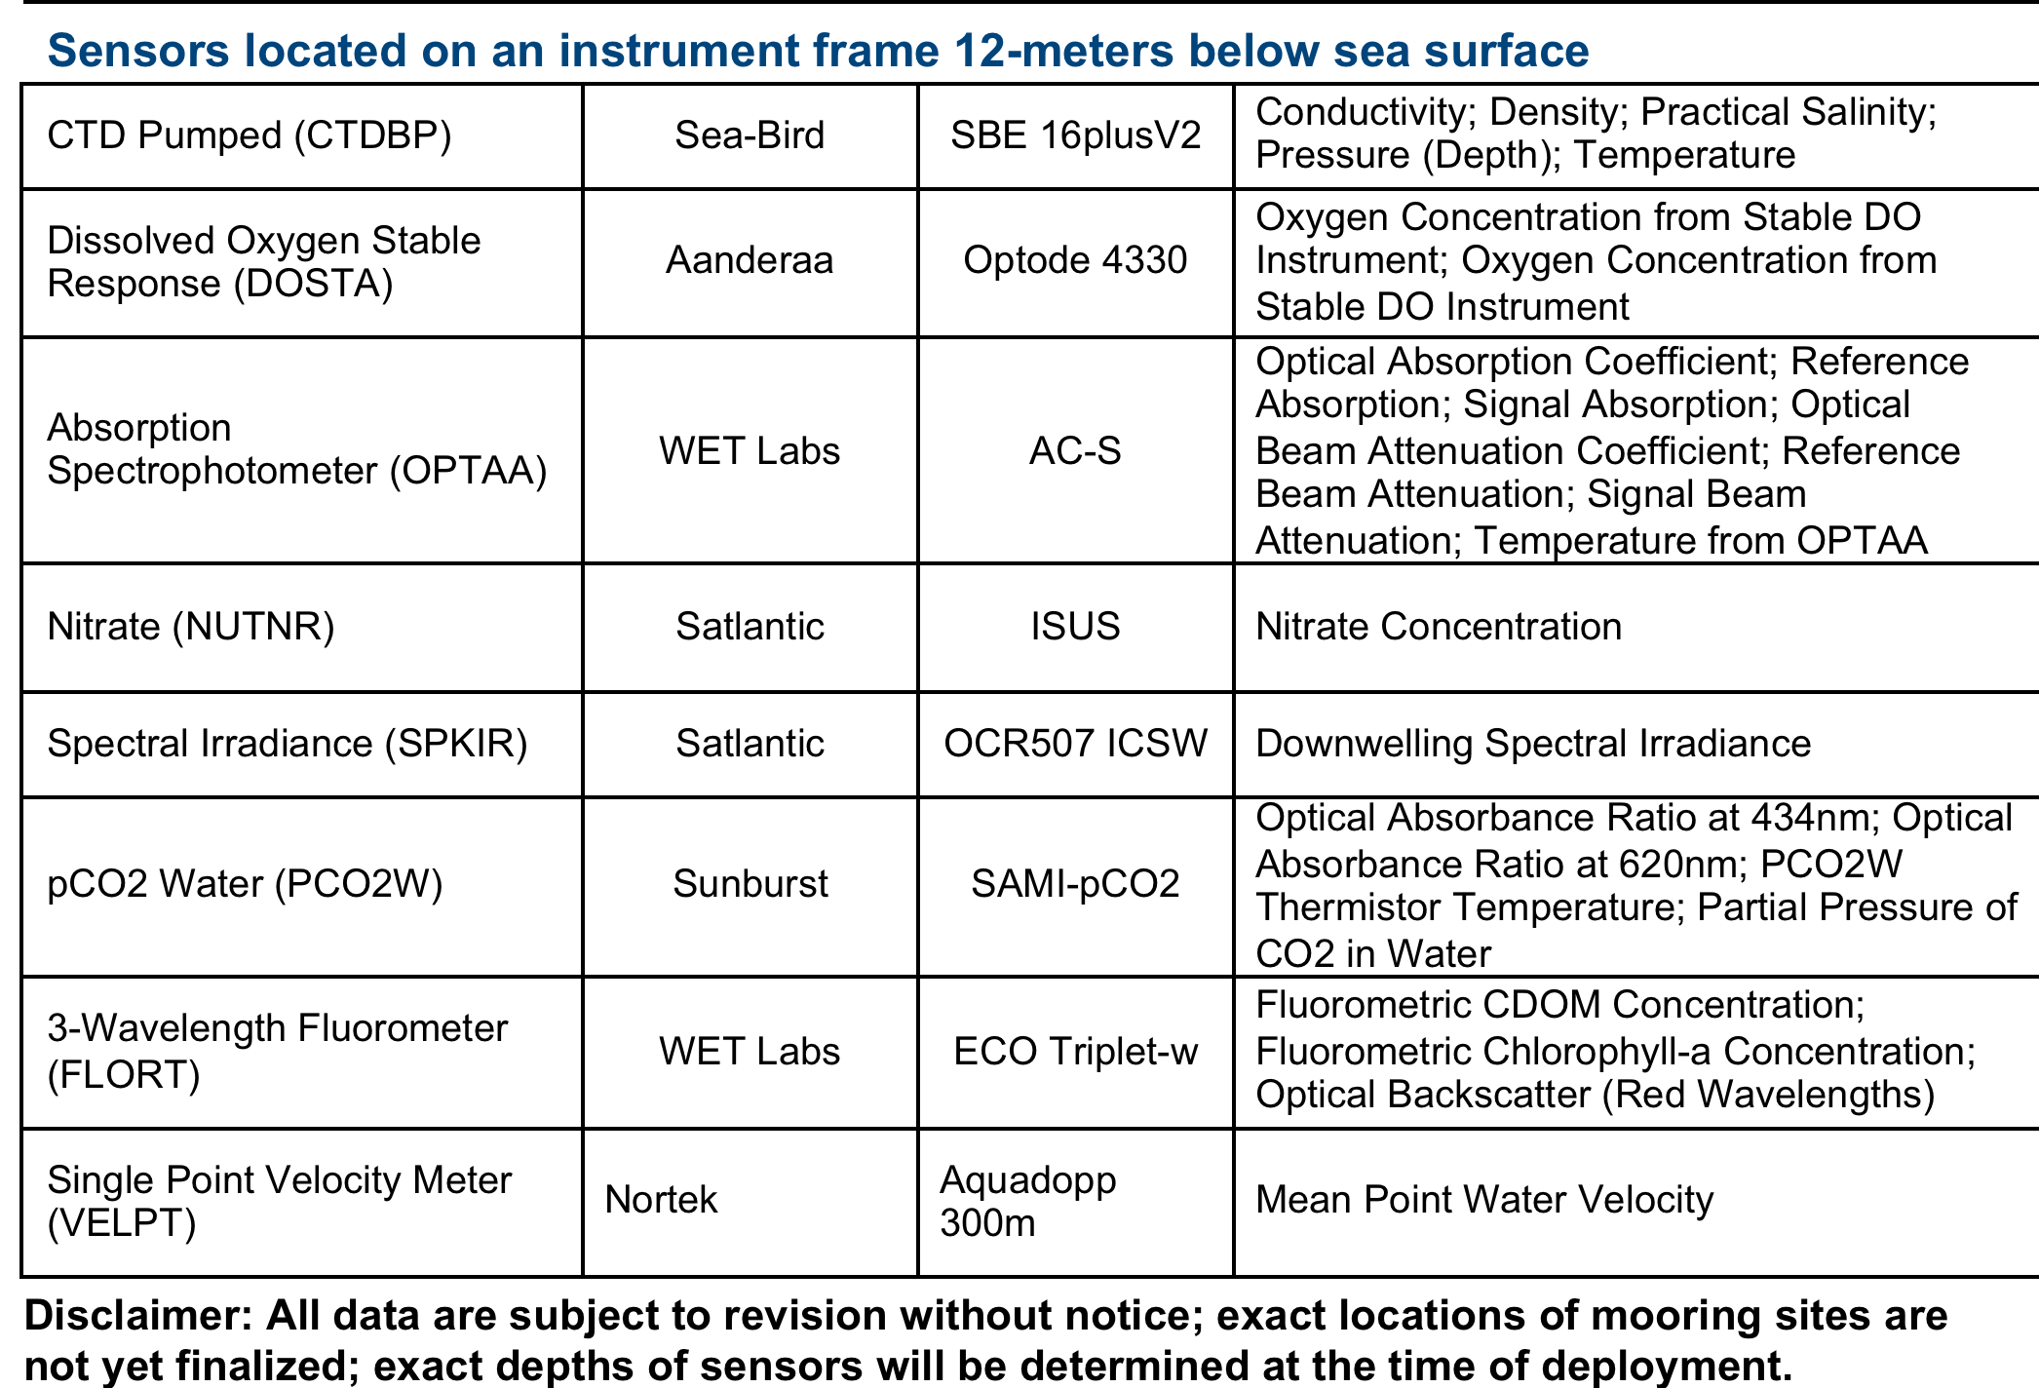

Slide 5
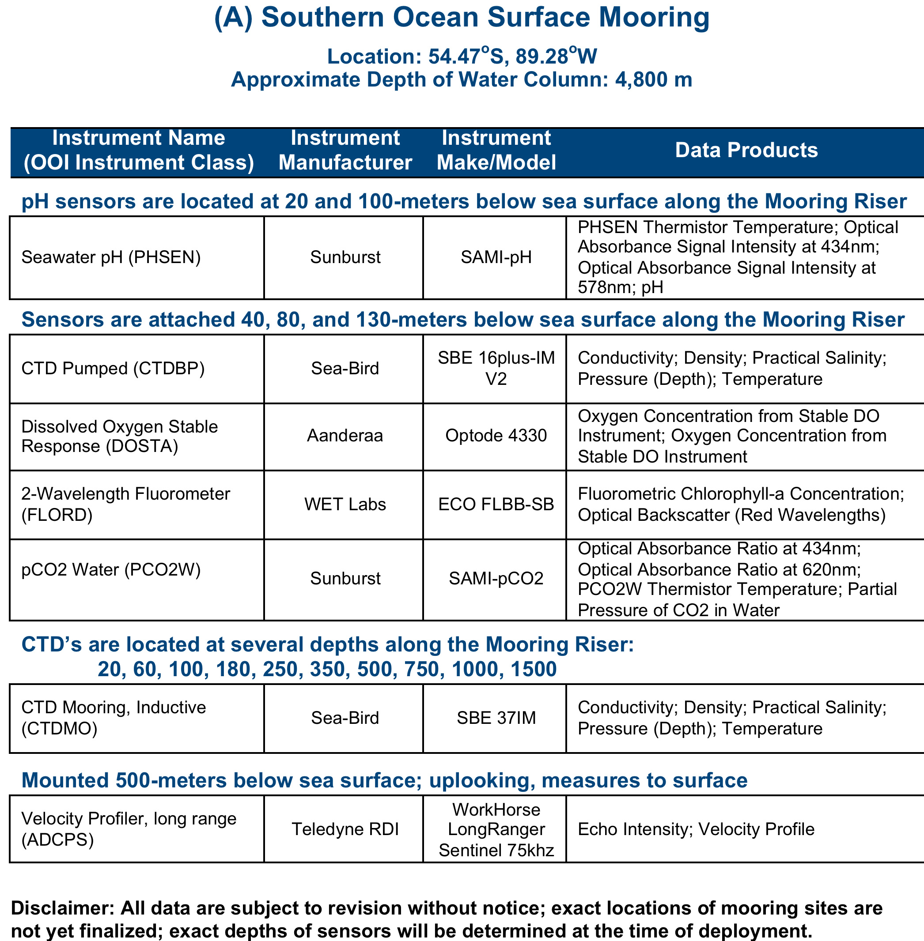

Slide 6
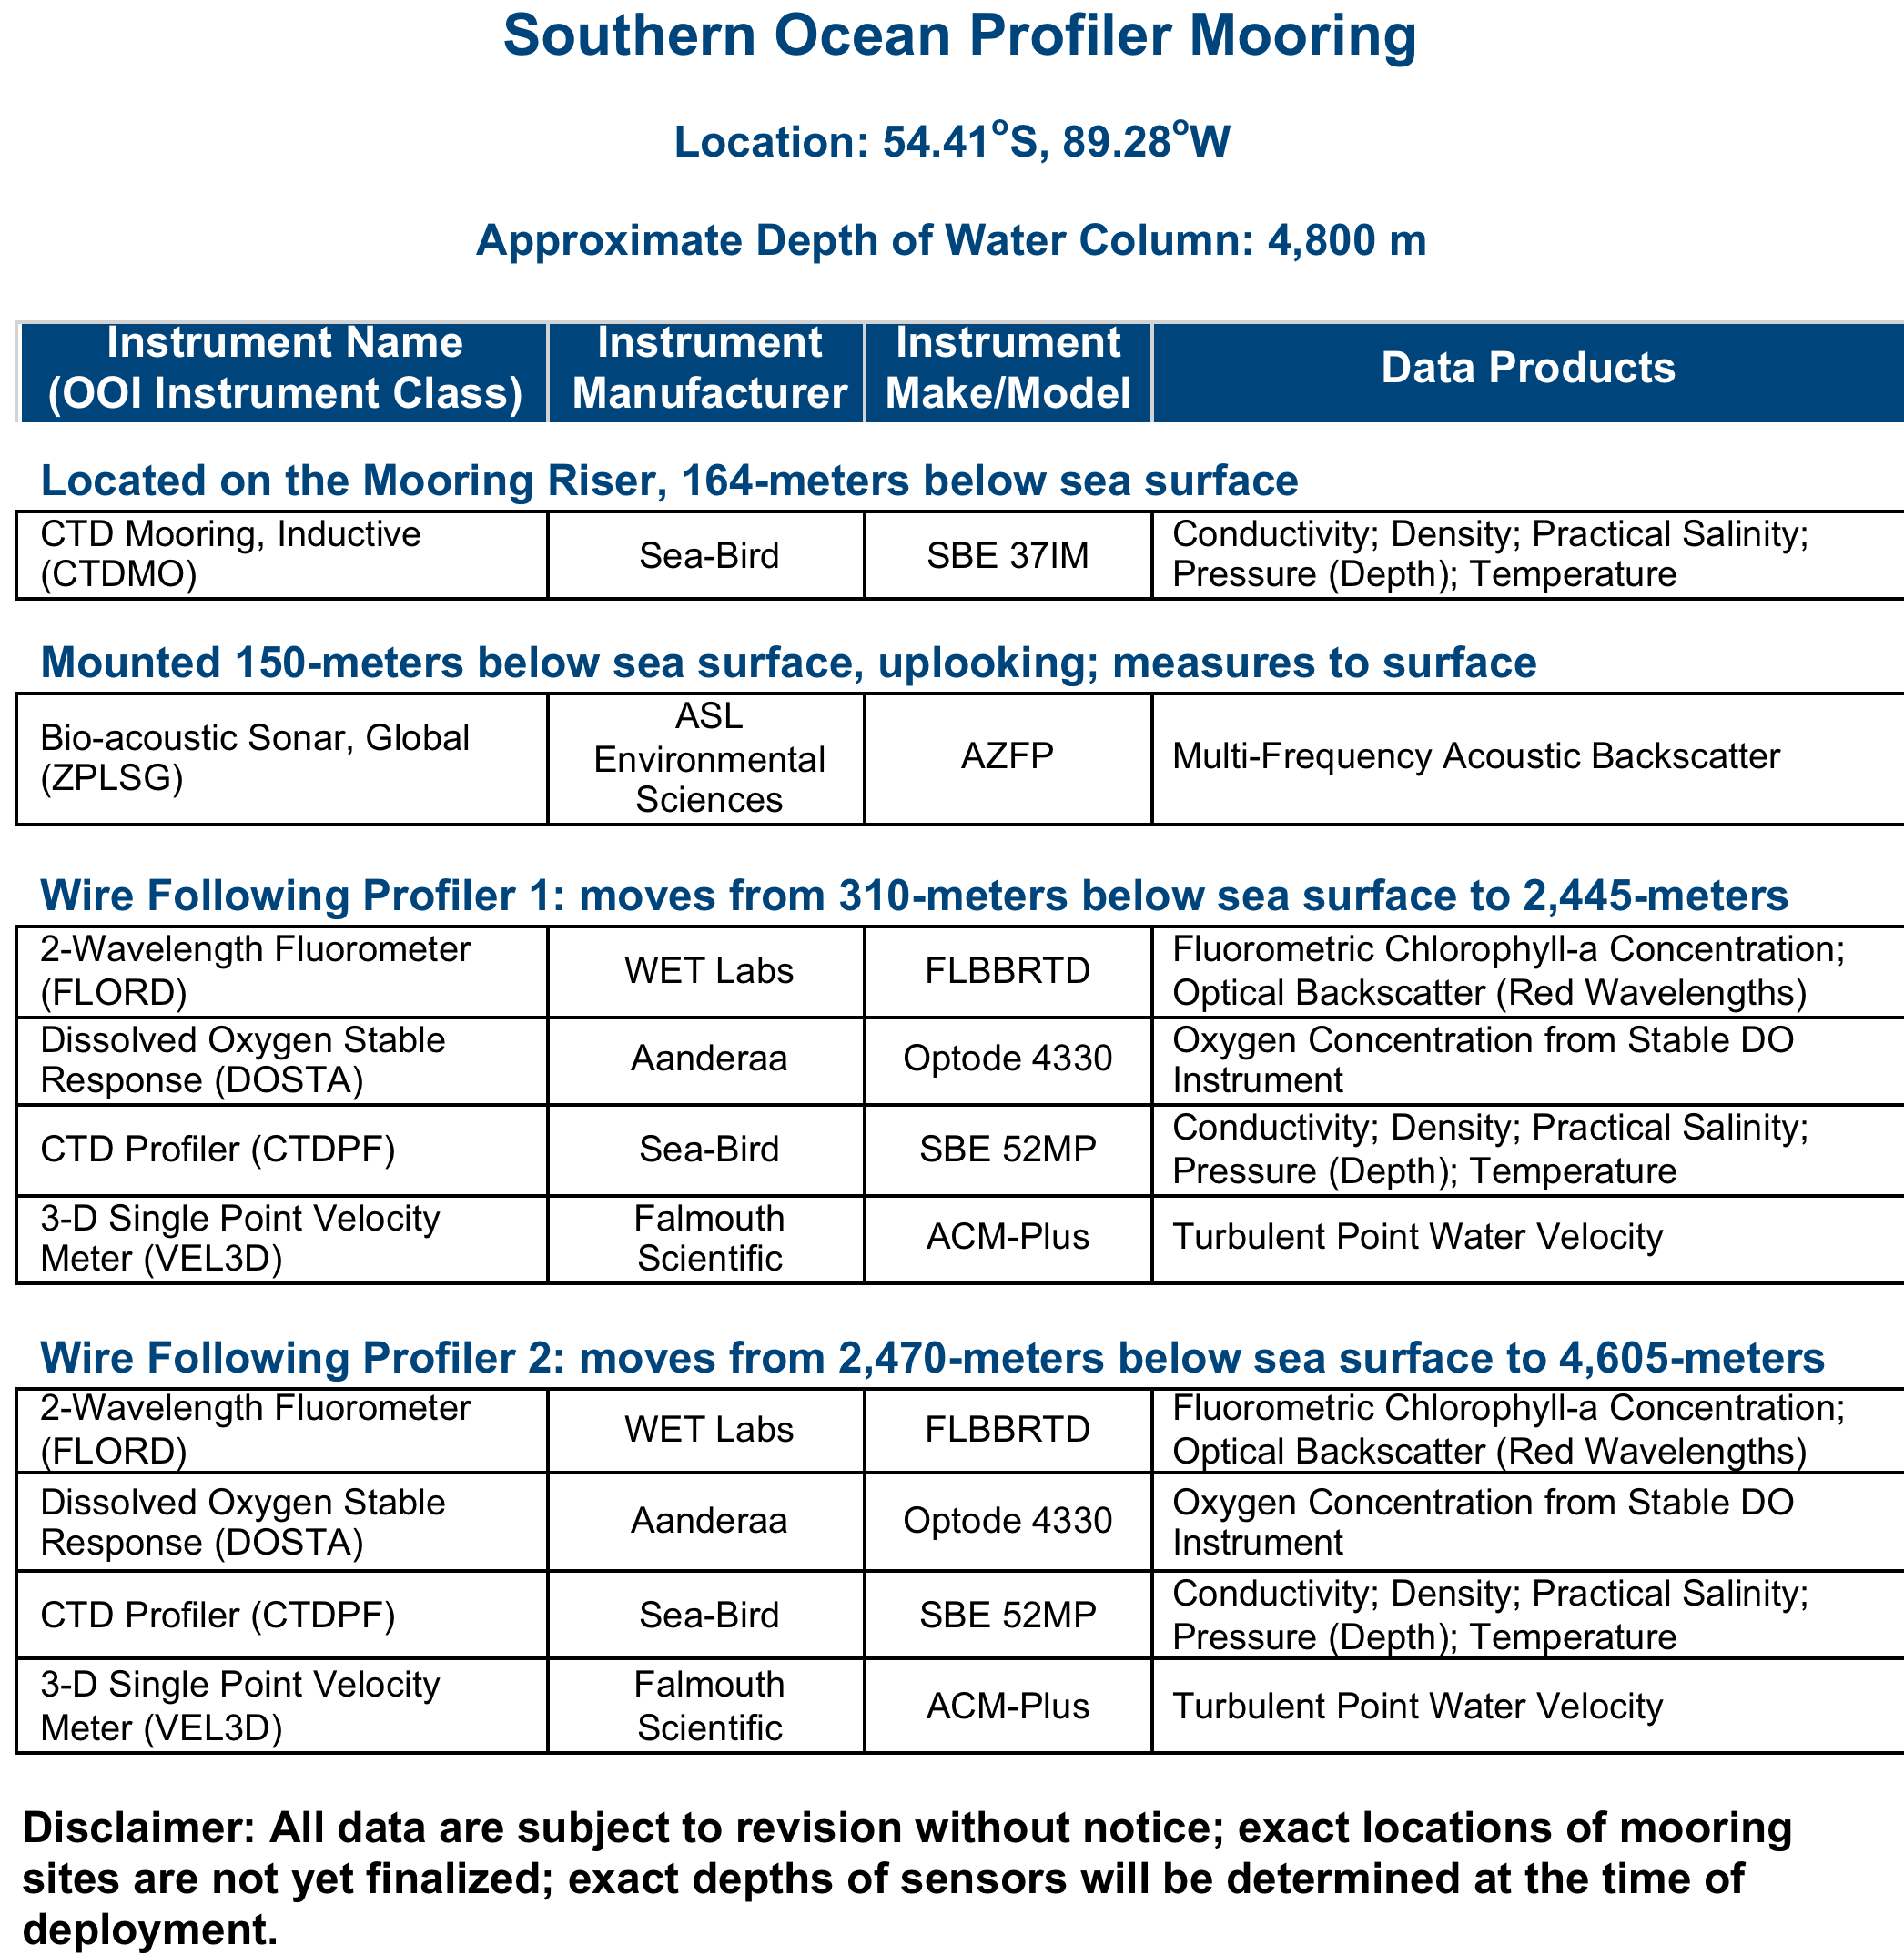

Slide 7
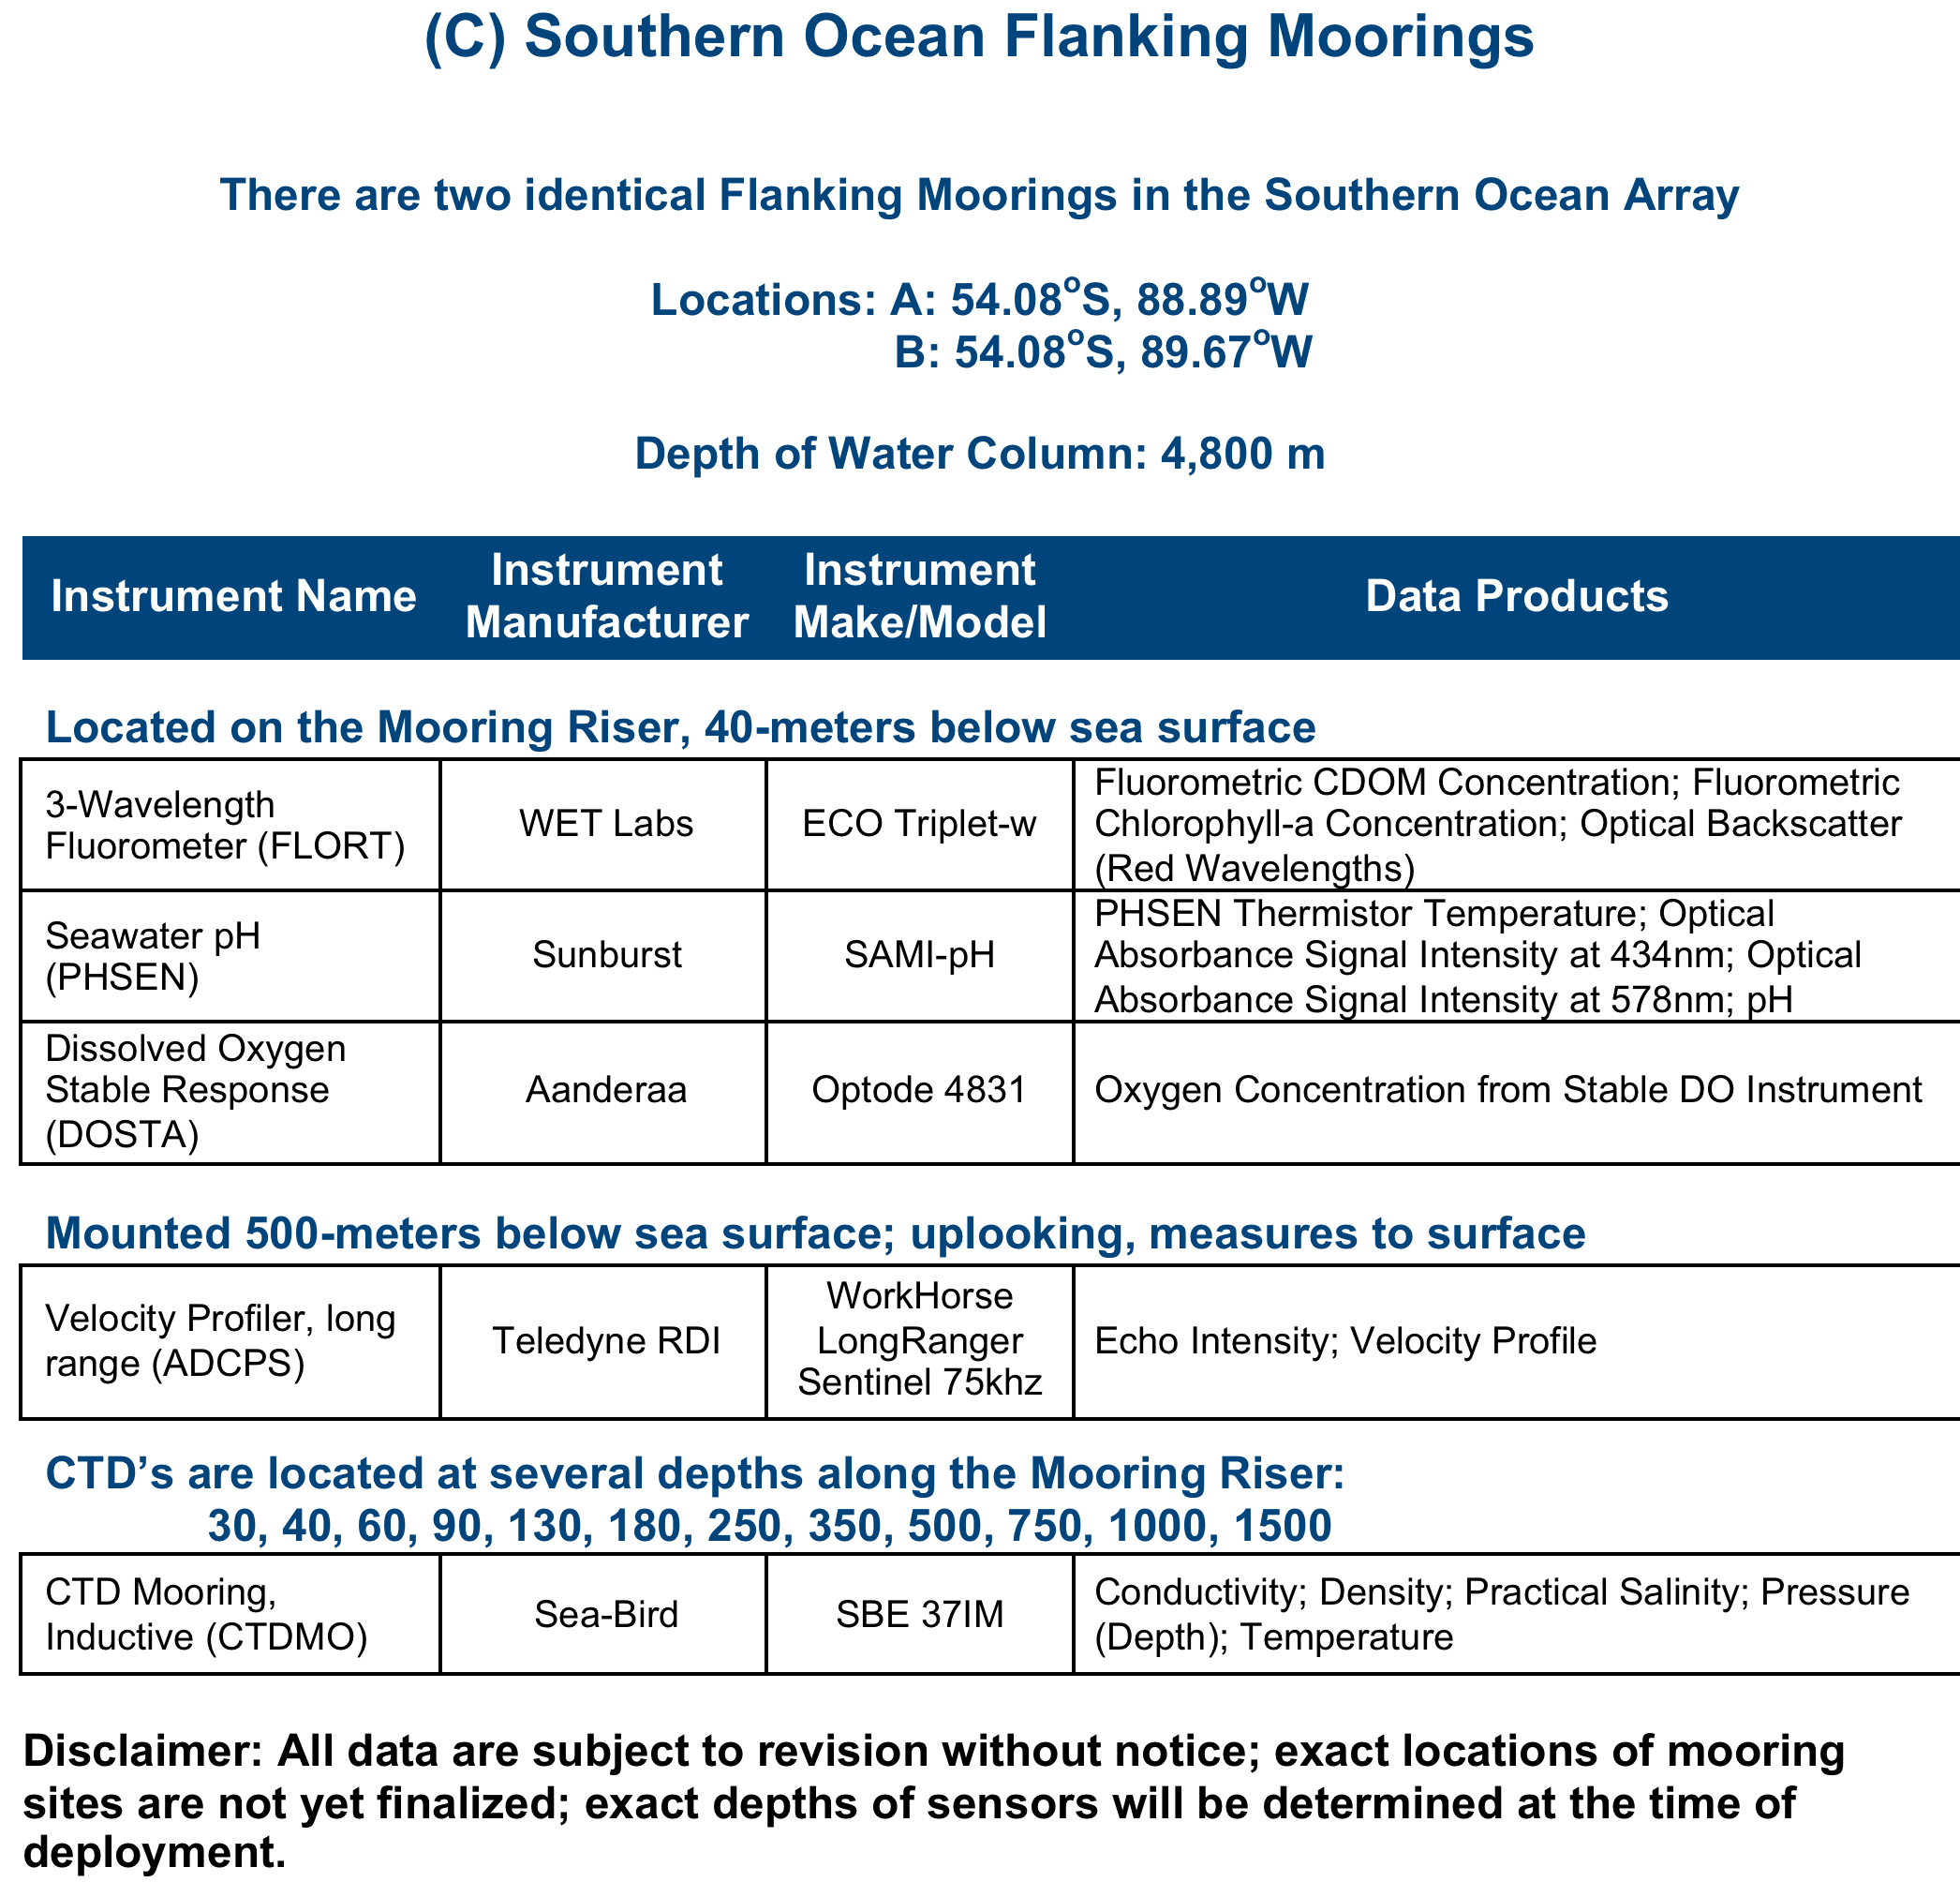

Slide 8
