Slide 1
Phytoplankton dynamics in submarine canyons in the West Antarctic Peninsula
Filipa Carvalho
Committee:
Josh Kohut (adviser)
Oscar Schofield (adviser)
Maxim Gorbunov
Matthew Oliver (U. Delaware)
Thesis Proposal Defense
Department of Marine and Coastal Sciences
December 5th, 2014

Slide 2
Mean Winter Temperature is Increasing in the West Antarctic Peninsula (WAP)
Introduction
86-day shorter
Ice season
Palmer
Station
Slope = 1.15°C/decade
-0.2
0.2
Temperature trends (°C/ year)
NASA/Goddard Space Flight Center Scientific Visualization Studio. Data provided by Larry Stock
Data Source: Palmer Station Weather

Slide 3
Ice Season Duration is Decreasing in the West Antarctic Peninsula (WAP)
Introduction
86-day shorter
Ice season
Palmer
Station
Slope = 1.15°C/decade
-0.2
0.2
Temperature trends (°C/ year)
Plus, 87% of the glaciers are in retreat
NASA/Goddard Space Flight Center Scientific Visualization Studio. Data provided by Larry Stock
Data Source: Palmer Station Weather

Slide 4
Introduction
ACC transports the water masses responsible for warming the WAP
Antarctic Circumpolar Current
Weddell gyre
Bellingshausen Sea
Amundsen
Sea
ASE
Ross gyre
WAP: West Antarctic Peninsula
ACC: Antarctic Circumpolar Current
ACC based on climatological dynamic topography of Orsi et al., DSR, 1995

Slide 5
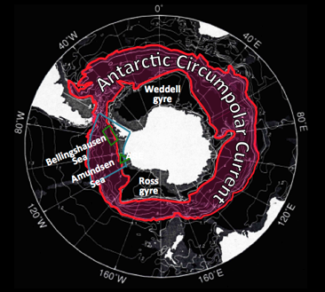
Introduction
Increase of Heat content on the shelf
due to Deep Water Intrusion

Slide 6
Introduction
WAP Canyons are “Biological Hotspots”
Penguin Colonies at costal termini of cross-shelf canyons/troughs
Predictable /elevated food availability;
Enhanced production in canyon heads;
Eveleth et al., In Prep.

Slide 7
Main Questions
Introduction
What physical mechanisms responsible phytoplankton spring bloom initiation in the WAP canyons?
Canyon dynamics affect phytoplankton dynamics?
Light or nutrient availability - Which one is the main control of bloom initiation?
Is Mixed Layer Depth (MLD) important?
Physiological responses to canyon dynamics?

Slide 8
Thesis Structure
Introduction
Physical Dynamics
(MLD)
Bloom Initiation
(Light vs. Nutrients)
Physiological Responses
(F_{v}/F_{m})
Phytoplankton Dynamics
in submarine canyons in the WAP
Notes:
Chapter 1: Physical Dynamics of Palmer Deep Canyon, WAP
Chapter 2: The role of light availability and nutrient delivery in controlling the spring phytoplankton bloom in canyons in the West Antarctic Peninsula
Chapter 3: Physiology and Primary Production at Palmer Deep Canyon, WAP

Slide 9
Thesis Structure
Introduction
Physical Dynamics
Physical Dynamics
(MLD)
Bloom Initiation
(Light vs. Nutrients)
Physiological Responses
(F_{v}/F_{m})
Phytoplankton Dynamics
in submarine canyons in the WAP
Notes:
Chapter 1: Physical Dynamics of Palmer Deep Canyon, WAP
Chapter 2: The role of light availability and nutrient delivery in controlling the spring phytoplankton bloom in canyons in the West Antarctic Peninsula
Chapter 3: Physiology and Primary Production at Palmer Deep Canyon, WAP

Slide 10
Introduction
Physical Dynamics
Increased Productivity
Correlated with UCDW Intrusion
Olbers & Visbeck, 2005
UCDW: Upper Circumpolar Deep Water – warmer (~ 1.8°C), low oxygen
AASW: Antarctic Surface Water – colder, lower salinity

Slide 11
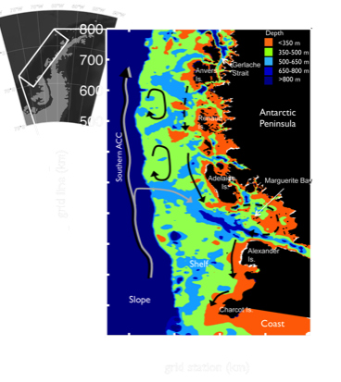
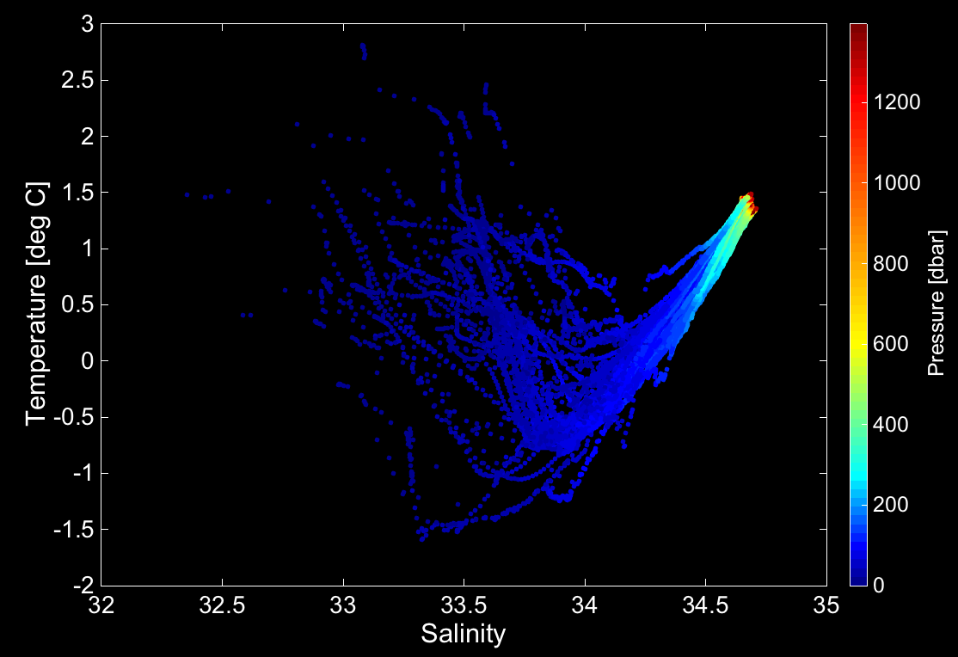
Water Masses at Palmer Deep Canyon
Introduction
Physical Dynamics
Pure UCDW
AASW
WW
UCDW: Upper Circumpolar Deep Water AASW: Antarctic Surface Water WW: Winter Water

Slide 12
Science Questions
Introduction
Physical Dynamics
Location of the bloom?
Do high productivity areas show similar physical properties of the water column as low productivity ones?
Key water column physical properties lead to blooms?
MLD and bathymetry relate to phytoplankton abundance?
Remote forcing relate to favorable water column characteristics associated with increased productivity?

Slide 13
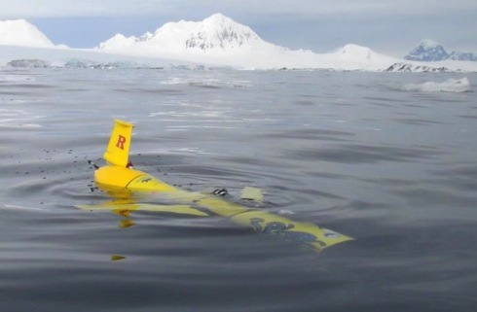
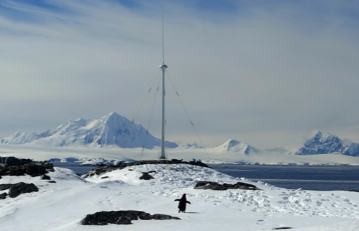
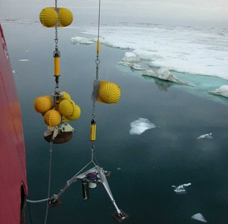
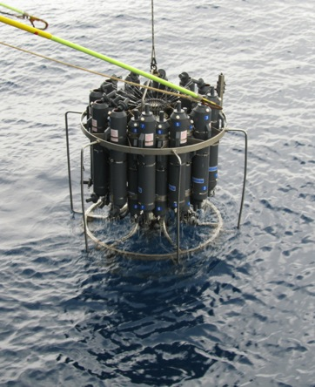
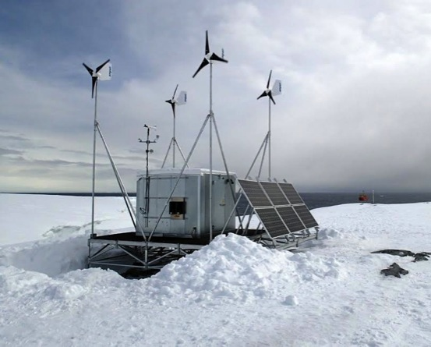
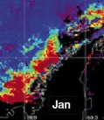
Datasets
Introduction
Physical Dynamics
Glider
CODAR
Mooring
Ship Data
Weather
Remote Sensing

Slide 14
Buoyancy Frequency (N²)
Introduction
Physical Dynamics
Mixed Layer Depth (MLD).

Slide 15
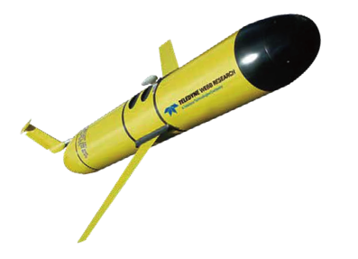
Water Column Properties vs. MLD
Introduction
Physical Dynamics

Slide 16
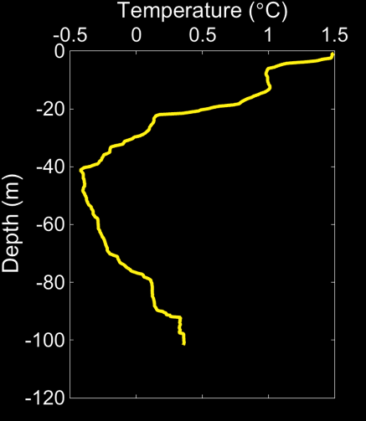
Other Important Variables
Introduction
Physical Dynamics
Tmin – Temperature minima in each profile
Depth Tmin – Depth of Tmin
Δσ_{t Tmin-0}
Martinson & Iannuzi, 1998; Saba et al, 2014
Stratification
Location of winter Water (or remnants)

Slide 17
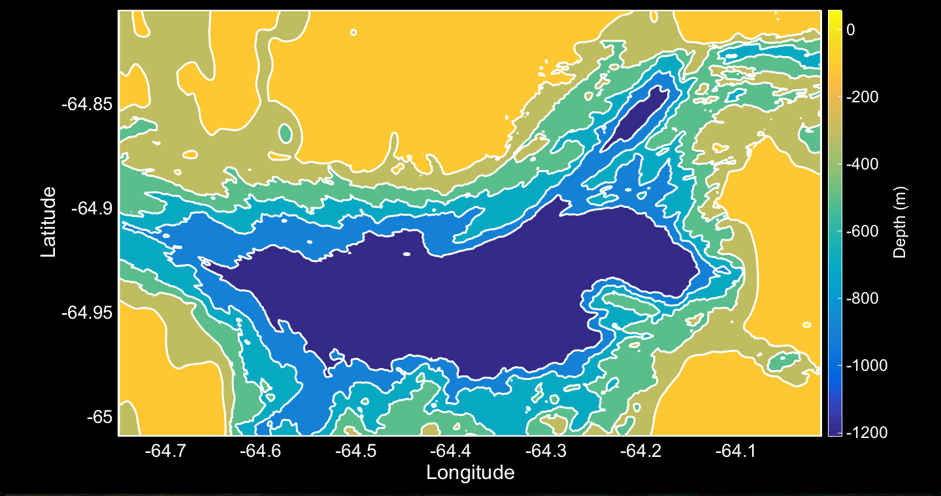
Palmer Deep Canyon
Introduction
Physical Dynamics
Palmer Station
22 Km
10 Km

Slide 18
Binning Data using Bathymetry & Distance to Shore
Introduction
Physical Dynamics
Distance to Shore
Bathymetry

Slide 19
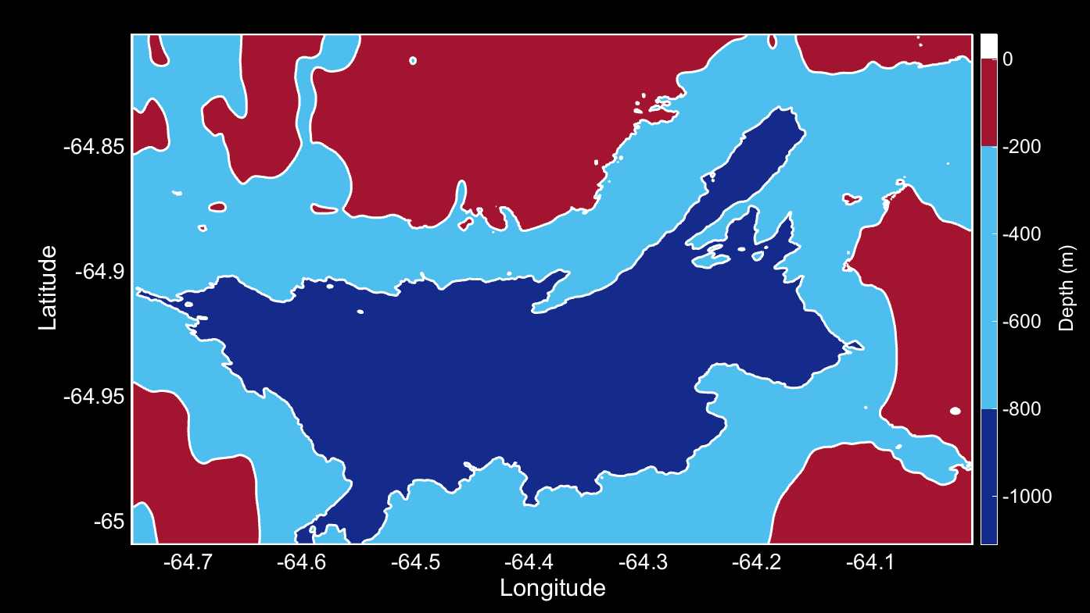
Binning Data using Bathymetry & Distance to Shore
Introduction
Physical Dynamics
Palmer Station
Shallow
Slope
Deep

Slide 20
Binning Data using Bathymetry & Distance to Shore
Introduction
Physical Dynamics
Offshore
Central
Nearshore
Palmer Station
Shallow
Slope
Deep

Slide 21
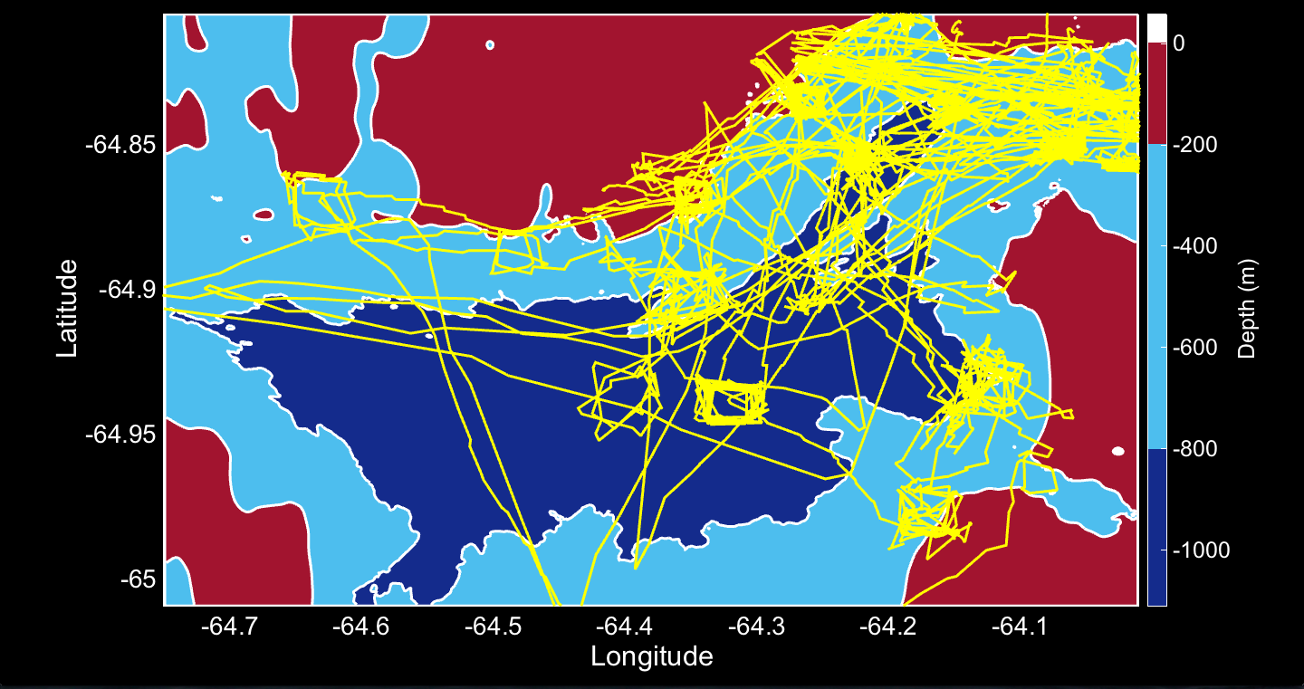
Introduction
Physical Dynamics
Good Coverage at Head of Canyon
Palmer Deep Gliders +
Offshore
Central
Nearshore
Palmer Station
Shallow
Slope
Deep

Slide 22
Introduction
Physical Dynamics
Good Coverage at Head of Canyon
Palmer Deep Gliders +
(NEARSHORE REGION)
Offshore
Central
Nearshore
Palmer Station
Shallow
Slope
Deep

Slide 23
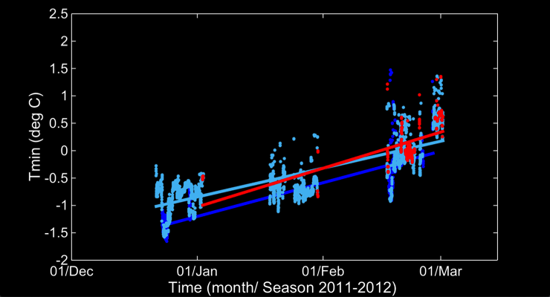
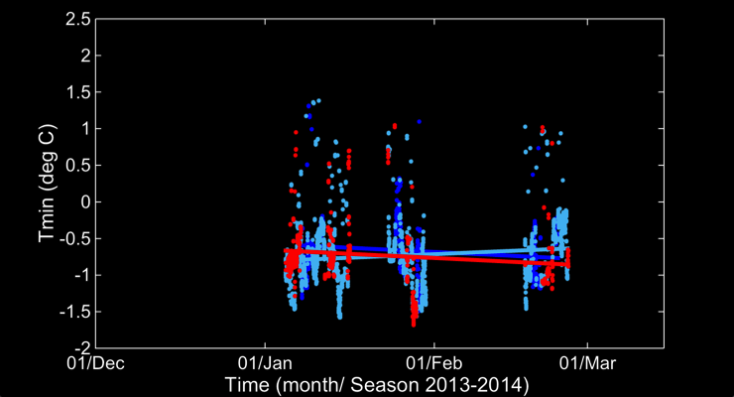
Annual & Seasonal Variability in Tmin
Introduction
Physical Dynamics
Tmin increases throughout Season
Season 2011-2012
Season 2013-2014
2013-2014 Season:
no change in Tmin – late ice retreat?

Slide 24
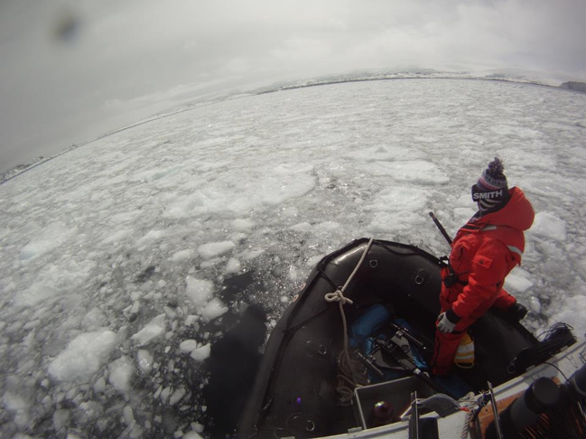
Introduction
Physical Dynamics
Tmin increases throughout Season
Season 2011-2012
Season 2013-2014
2013-2014 Season:
no change in Tmin – late ice retreat?

Slide 25
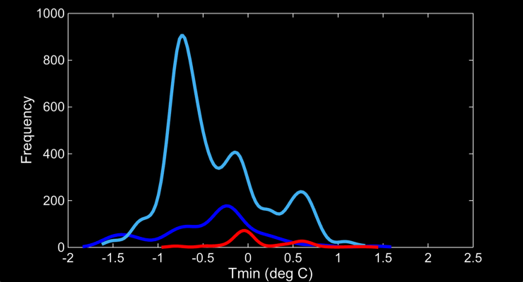
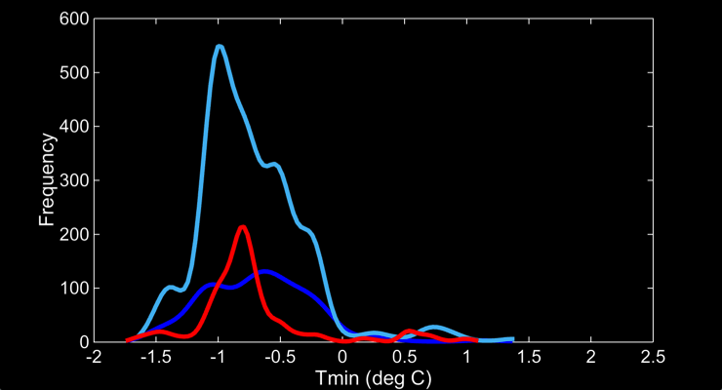
Introduction
Physical Dynamics
Tmin Colder on the Slope
2011-2012 Season
Tmin peaks colder on Slope < Deep < Shallow regions
2013-2014 Season:
colder in all regions
Winter water (T<-1°C) present on the slope
2013-2014 Season

Slide 26
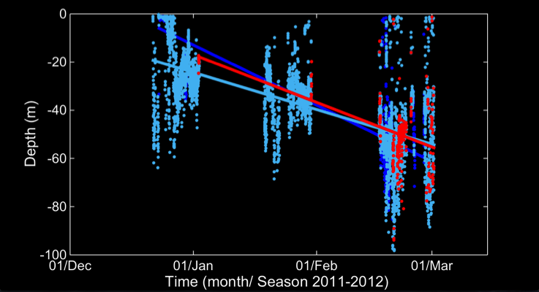
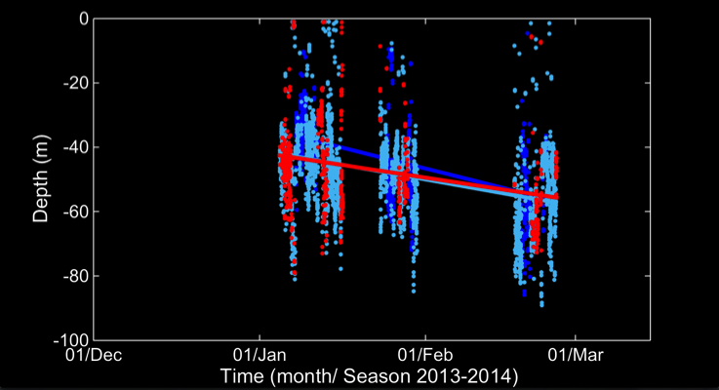
Introduction
Physical Dynamics
Depth Tmin decreases throughout Season
Season 2011-2012
Season 2013-2014
2013-2014 Season:
smaller decrease in depth in Tmin - late ice retreat?

Slide 27
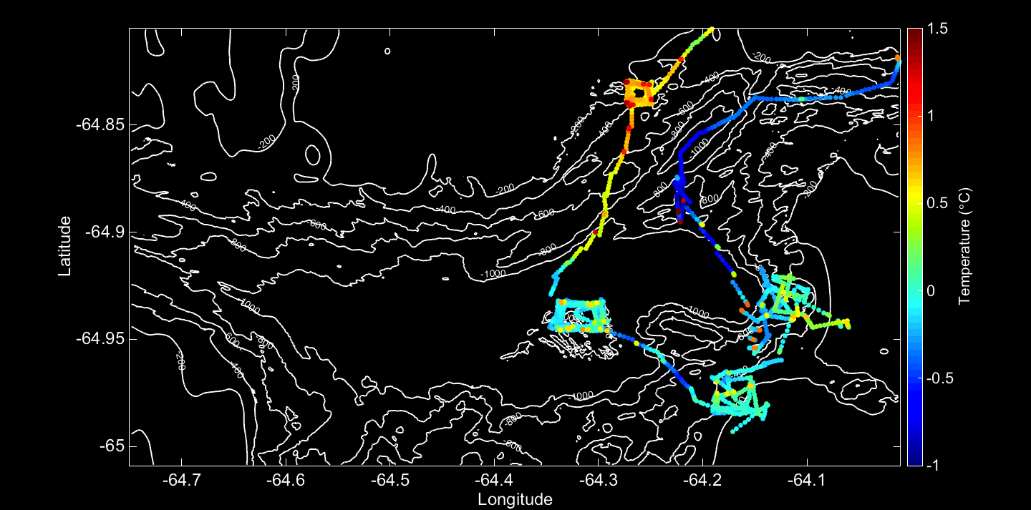
Different Water Masses In different parts of the Canyon
Introduction
Physical Dynamics
Palmer Station

Slide 28
Adjusting the Grid
Introduction
Physical Dynamics
Offshore
Central
Nearshore
Shallow
Slope
Deep

Slide 29
Adjusting the Grid
Introduction
Physical Dynamics
North
Offshore
Central
Nearshore
South
Shallow
Slope
Deep

Slide 30
Main Points for Physical Analysis
Introduction
Physical Dynamics
Bloom
Initiation
Good coverage of the Canyon
Can evaluate annual/seasonal trends
Analysis with classical + local specific MLD
Correlations between wind and ice retreat with MLD and Productivity

Slide 31
Thesis Structure
Introduction
Physical Dynamics
Bloom
Initiation
Physical Dynamics
(MLD)
Bloom Initiation
(Light vs. Nutrients)
Physiological Responses
(F_{v}/F_{m})
Phytoplankton Dynamics
in submarine canyons in the WAP
Notes:
Chapter 1: Physical Dynamics of Palmer Deep Canyon, WAP
Chapter 2: The role of light availability and nutrient delivery in controlling the spring phytoplankton bloom in canyons in the West Antarctic Peninsula
Chapter 3: Physiology and Primary Production at Palmer Deep Canyon, WAP

Slide 32
Bloom Initiation when MLD shallower that critical depth (Critical Depth Hypothesis)
Introduction
Physical Dynamics
Bloom
Initiation
Critical Depth when:
Integrated Biomass Gain (Production)
=
Integrated
Biomass Loss
Critical
Depth
Sverdrup, 1953

Slide 33
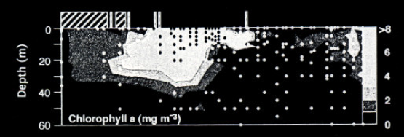
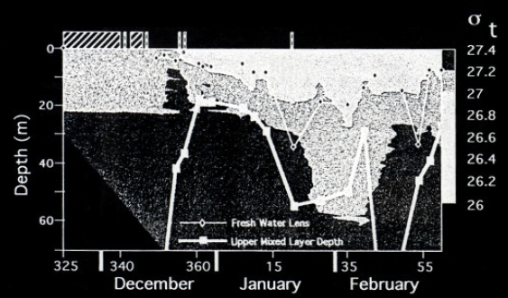
Primary Production explained by shoaling of MLD due to Fresh Water and Winds
Introduction
Physical Dynamics
Bloom
Initiation
Ice cover
Chlorophyll a
Mixed Layer Depth
Fresh Water Lens
Moline et al., 1996

Slide 34
Primary Production explained by shoaling of MLD due to Fresh Water and Winds
Introduction
Physical Dynamics
Bloom
Initiation
Ice cover
Fucoxanthin
(diatoms)
Mixed Layer Depth
Fresh Water Lens
Moline et al., 1996

Slide 35
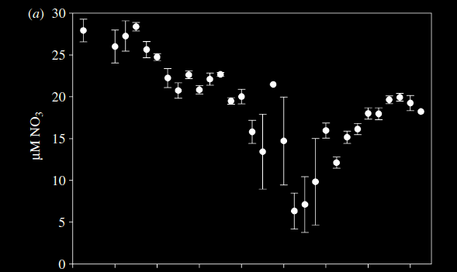
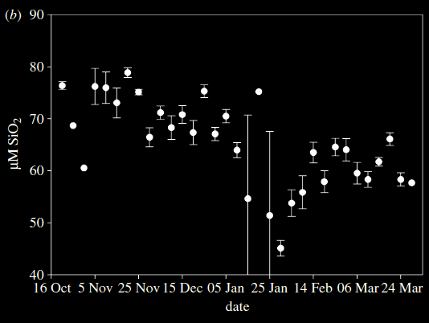
Macronutrients are abundant before bloom initiation & never completely drawdown
Introduction
Physical Dynamics
Bloom
Initiation
Nitrate
Silicate
Ducklow et al., 2007

Slide 36
Proposed Research
Introduction
Physical Dynamics
Bloom
Initiation
The main control of the bloom initiation is the:
H1: upwelling of nutrients from the Upper Circumpolar Deep Water (UCDW);
H2: shoaling of the mixed layer depth, increasing, this way, the light availability to the phytoplankton community.

Slide 37
Mesocosms Incubations
Introduction
Physical Dynamics
Bloom
Initiation
Stratification
(light)
Pure UCDW
AASW
VS.
Upwelling
(nutrients)
WW

Slide 38
Mesocosms Incubations
Introduction
Physical Dynamics
Bloom
Initiation
Stratification
(light)
Deep Water
mUCDW
VS.
Surface
Water
Upwelling
(nutrients)

Slide 39
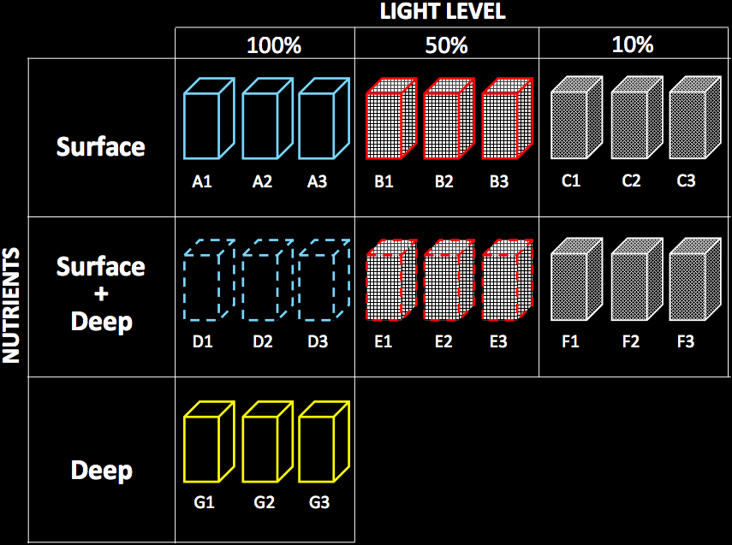
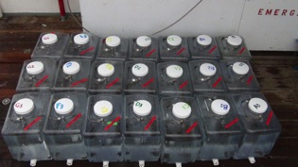
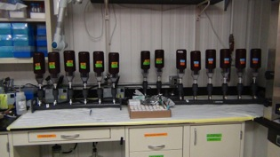
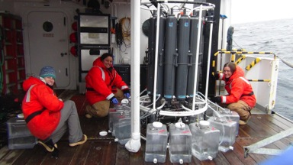
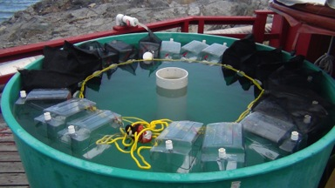
Setting up the Incubation Experiments
Introduction
Physical Dynamics
Bloom
Initiation

Slide 40
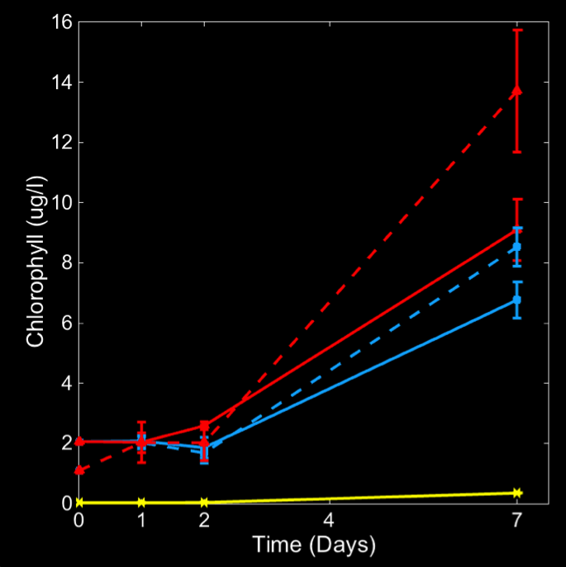
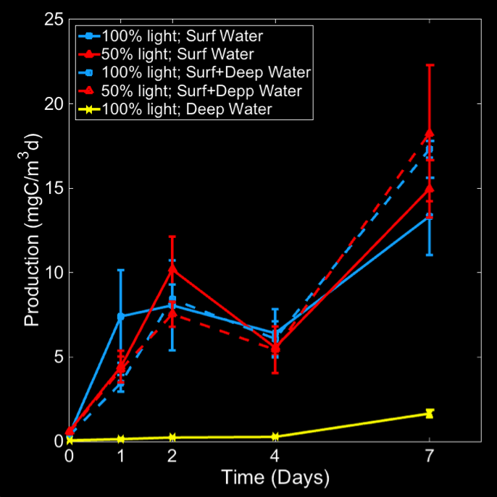
Chlorophyll Driven by Light (color)
Introduction
Physical Dynamics
Bloom
Initiation

Slide 41
Proposed analysis
Introduction
Physical Dynamics
Bloom
Initiation
Phytoplankton Biomass (Chlorophyll)
Primary Production (C¹⁴ method)
Pigments (HPLC)
Nutrients
Community Composition (HPLC, Flowcytometry)

Slide 42
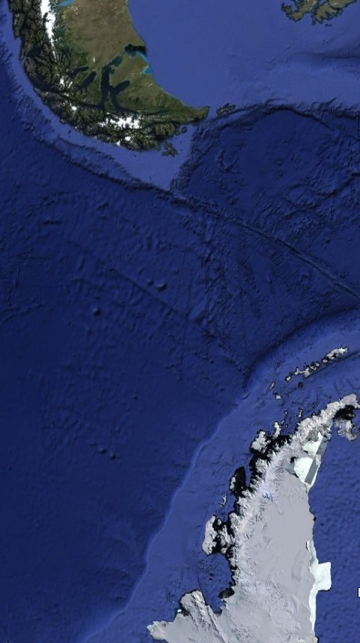
Iron Seems Abundant in Shelf Regions in the WAP
Introduction
Physical Dynamics
Bloom
Initiation
South America
Drake Passage
Gerlache Strait
Antarctica
Gerlache Strait Drake Passage
Martin et al., 1990

Slide 43
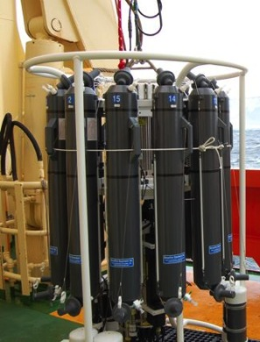
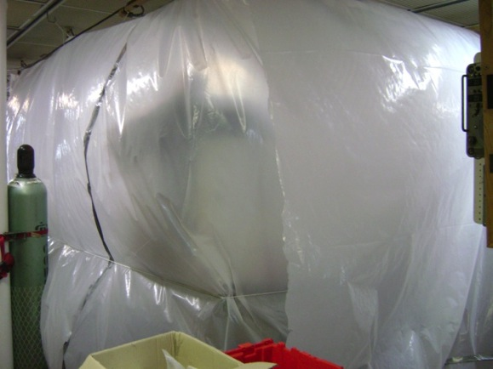
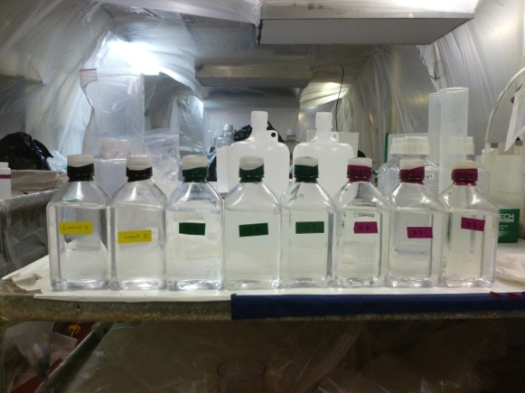
What about Iron?
Introduction
Physical Dynamics
Bloom
Initiation
Incubations in a trace metal clean environment
Iron enrichment experiments
Photos courtesy of : Jess Fitzsimmons

Slide 44
Thesis Structure
Introduction
Physical Dynamics
Bloom
Initiation
Physiological Responses
Physical Dynamics
(MLD)
Bloom Initiation
(Light vs. Nutrients)
Physiological Responses
(F_{v}/F_{m})
Phytoplankton Dynamics
in submarine canyons in the WAP
Notes:
Chapter 1: Physical Dynamics of Palmer Deep Canyon, WAP
Chapter 2: The role of light availability and nutrient delivery in controlling the spring phytoplankton bloom in canyons in the West Antarctic Peninsula
Chapter 3: Physiology and Primary Production at Palmer Deep Canyon, WAP

Slide 45
Photosynthesis
Introduction
Physical Dynamics
Bloom
Initiation
Physiological Responses
Fluorescence

Slide 46
Evaluating Environmental Stresses Using Quantum Yield of Photosynthesis
Introduction
Physical Dynamics
Bloom
Initiation
Physiological Responses
Iluz & Dubinsky, 2013

Slide 47
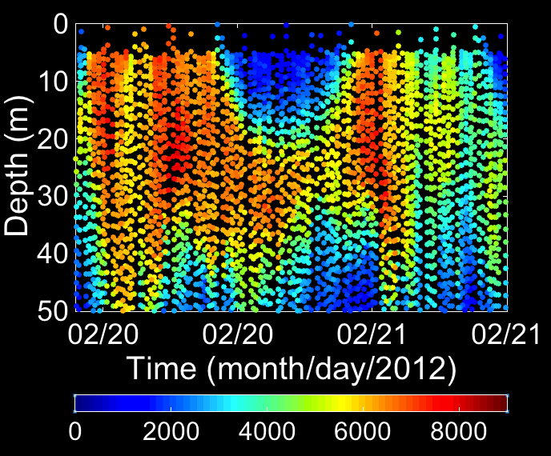
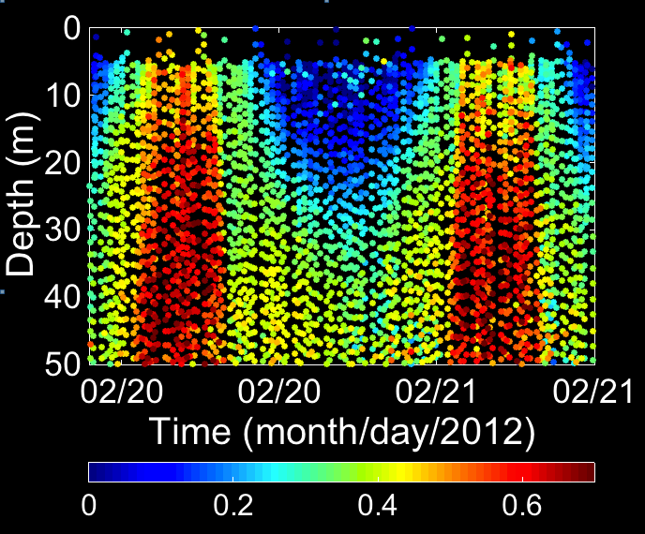
Daytime decreases Photosynthetic Efficiency (non-Photochemical quenching)
Introduction
Physical Dynamics
Bloom
Initiation
Physiological Responses
Night
Daytime
Night
Night
Daytime
Night
Biomass Proxy (F_{m})
Quantum Yield of Photosynthesis (F_{v}/F_{m})

Slide 48
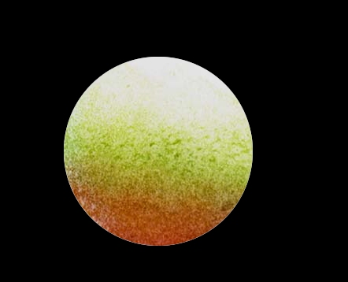
Photoacclimation observed in Pigments
Introduction
Physical Dynamics
Bloom
Initiation
Physiological Responses
Low
photosynthetic pigments)
Light Intensity
photoprotective
(non-photosynthetic) pigments
High
change in the chlorophyll/astaxanthin ratio
In diatoms , the ratio is diadinoxanthin/diatoxanthin
Dubinsky & Schofield, 2009

Slide 49
Science Questions
Introduction
Physical Dynamics
Bloom
Initiation
Physiological Responses
Nutrient/Light impact Physiology?
Key physiological characteristics and limiting factors?
Canyon dynamics drive physiological changes?
Variability of Nonphotochemical Quenching (NPQ) with MLD

Slide 50
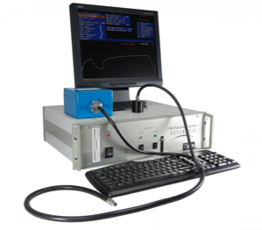
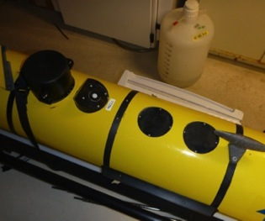
Fluorescence Induction and Relaxation Sensor (FIRe)
Introduction
Physical Dynamics
Bloom
Initiation
Physiological Responses
Iluz & Dubinsky, 2013

Slide 51
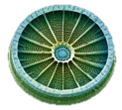
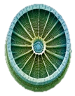
“Healthy” Phytoplankton have higher F_{v}/F_{m}
Introduction
Physical Dynamics
Bloom
Initiation
Physiological Responses
Increasing F_{v}/F_{m}

Slide 52
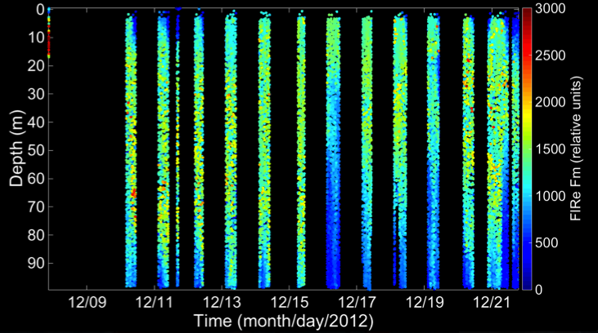
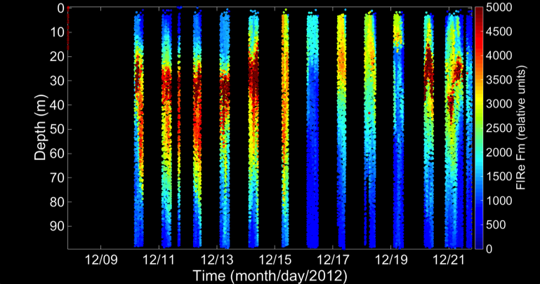
FIRe Glider Data Correction - Fm
Introduction
Physical Dynamics
Bloom
Initiation
Physiological Responses
Before correction
After correction
Fm - proxy for phytoplankton biomass (relative units)
Need in situ water collection and chl measurements through fluorometric method

Slide 53
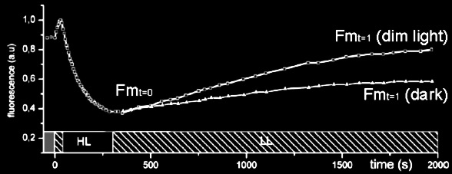
Evaluating Total Nonphotochemical Quenching (NPQ)
Introduction
Physical Dynamics
Bloom
Initiation
Physiological Responses

Slide 54
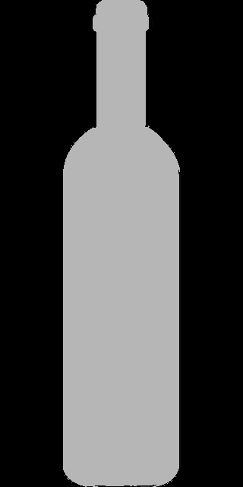
Looking at NPQ due to Photoinhibition
Introduction
Physical Dynamics
Bloom
Initiation
Physiological Responses
Initial
Sample
Dark
bottle
Dim light
bottle
~1h

Slide 55
Looking at NPQ due to Photoinhibition
Introduction
Physical Dynamics
Bloom
Initiation
Physiological Responses
Initial
Sample
Dark
bottle
Dim light
bottle
~1h

Slide 56
FIRe in an Upwelling Event: Light is the Main Driver of the Bloom
Introduction
Physical Dynamics
Bloom
Initiation
Physiological Responses
Upwelling
Photosynthetic Efficiency (Fv/Fm) fairly constant & high
Points=observations (no interpolations)

Slide 57
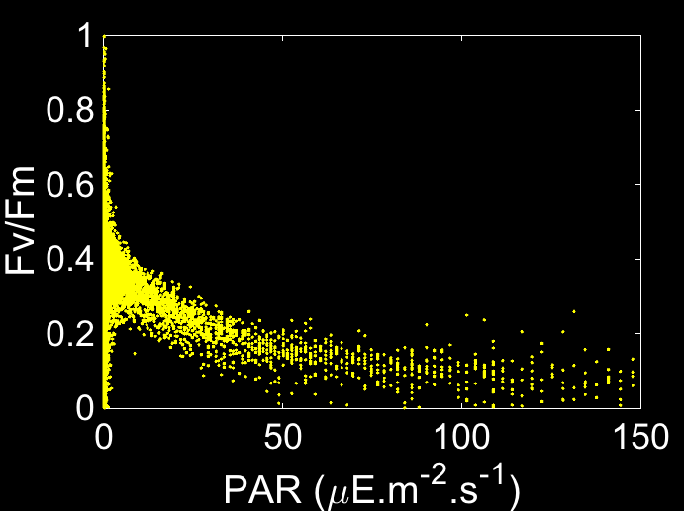
FIRe in an Upwelling Event: Light is the Main Driver of the Bloom
Introduction
Physical Dynamics
Bloom
Initiation
Physiological Responses
Fv/Fm inversely mirrors PAR data
Upwelling
Points=observations (no interpolations)

Slide 58
FIRe in an Upwelling Event: Light is the Main Driver of the Bloom
Introduction
Physical Dynamics
Bloom
Initiation
Physiological Responses
Upwelling
Fm decreases – Due to mixing? Deepening of the MLD?
Points=observations (no interpolations)

Slide 59
Fraction of Chronically damaged Reaction Centers
Introduction
Physical Dynamics
Bloom
Initiation
Physiological Responses
Able to recover overnight
Not able to
recover overnight
Gorbunov et at., 2001

Slide 60
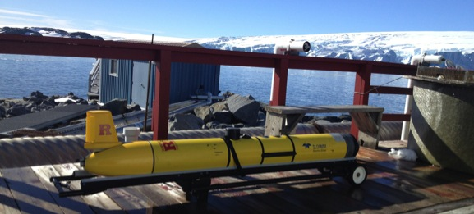
Evaluating NPQ using Diel Cycles
Introduction
Physical Dynamics
Bloom
Initiation
Physiological Responses
“dark adapted” and in relaxed state
Photoinhibited
Runcie & Riddle, 2011

Slide 61
Introduction
Physical Dynamics
Primary Production
Physiological Responses
Final Remarks
Primary Productivity in Submarine Canyons
Phytoplankton Dynamics
Physics
Physiology

