Slide 1
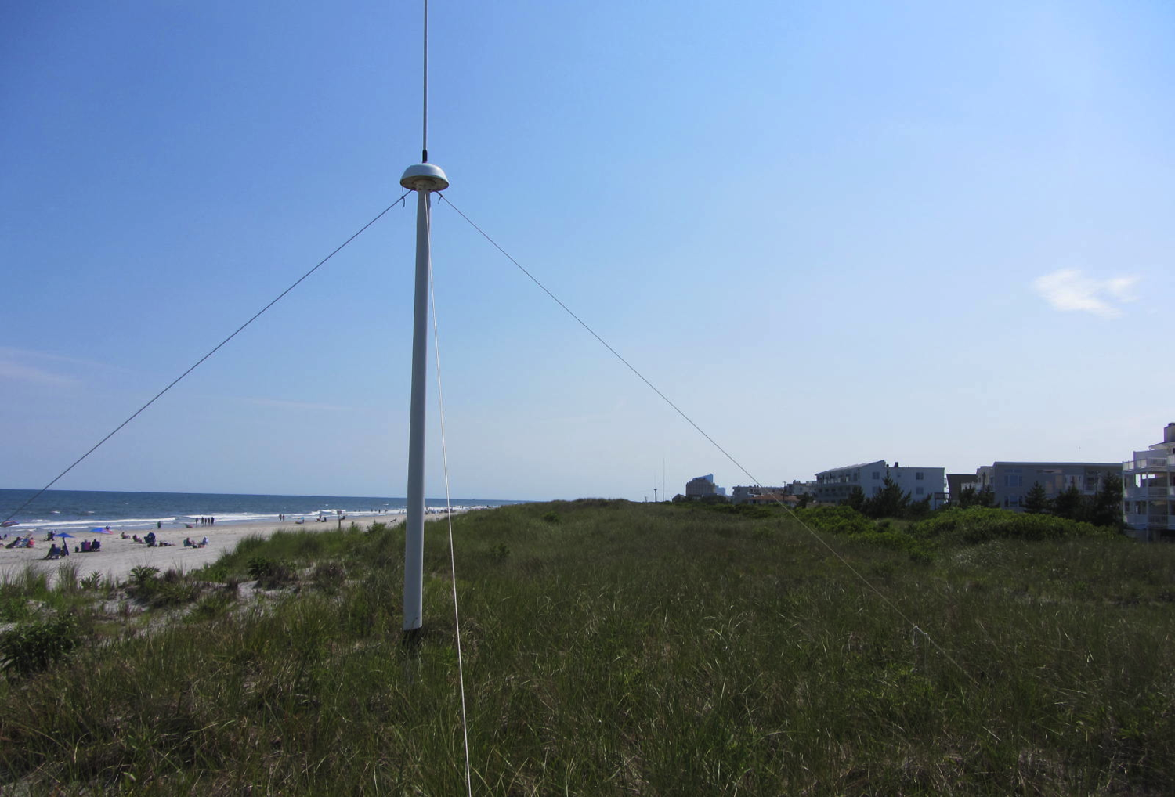



Reduced Averaging Times in the Long Range SeaSonde
Hugh Roarty, Chloe Baskin, Michael Smith, Scott Glenn

Slide 2
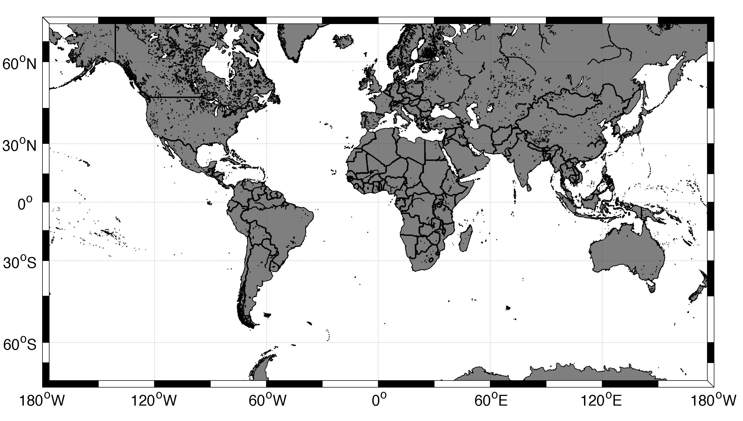
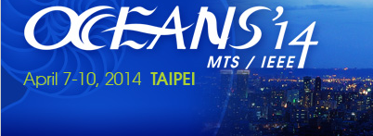

Slide 3
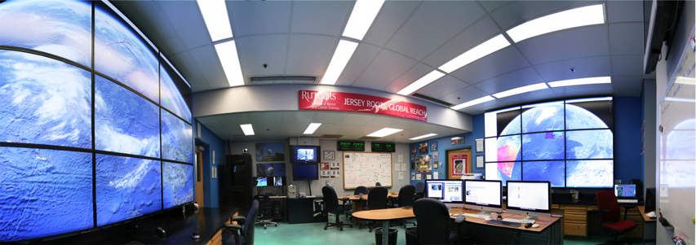

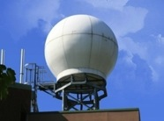
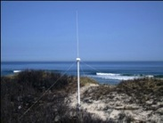
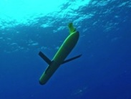
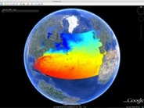
Rutgers University - Coastal Ocean Observation Lab
Operations, Research & Education Center
Vessels -
Satellite
Satellite
CODAR
Ships/ Vessels
Glider
REMUS
Data Vis.
Modeling
Security
Leadership
Education
Satellite Data Acquisition Stations
CODAR Network
Glider Fleet
3-D Forecasts

Slide 4
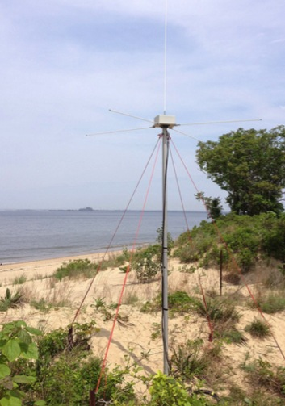
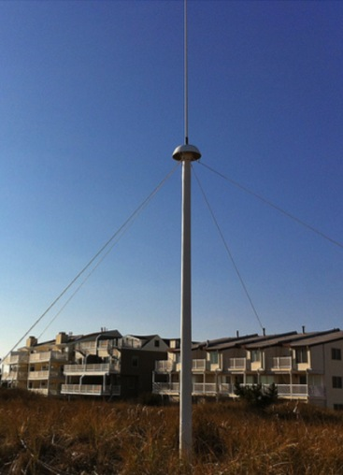
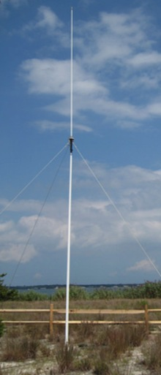
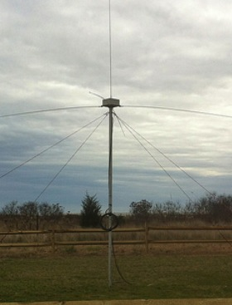
CODAR Compact HF Radar Antennas
25 MHz
13 MHz
5 MHz
Combined Transmitter & Receiver
Separate Transmitter & Receiver

Slide 5
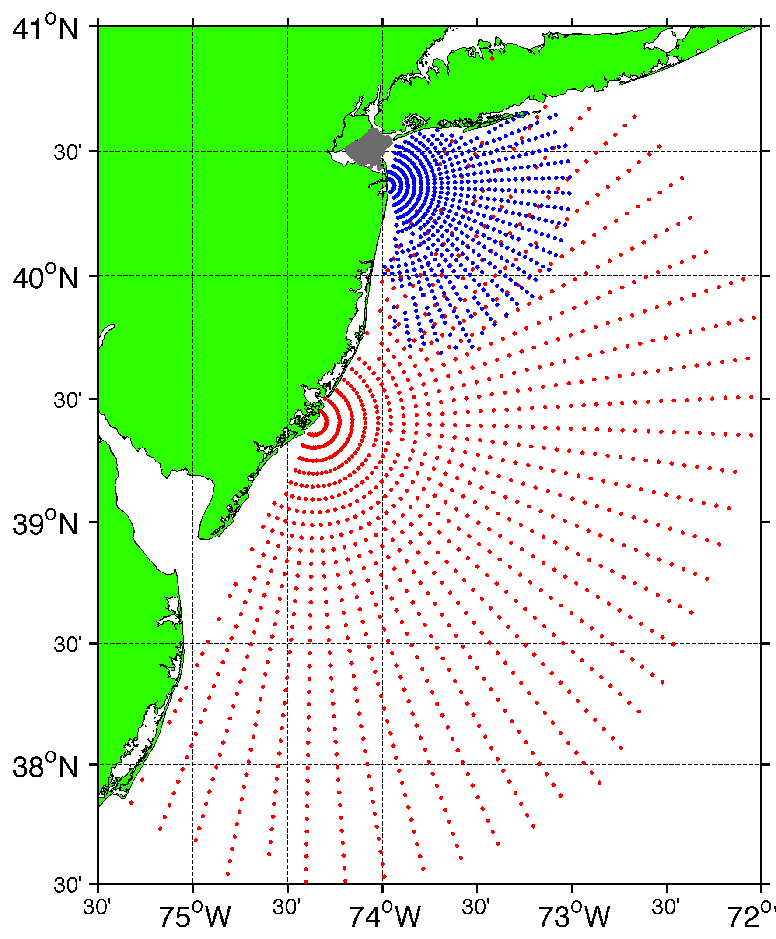
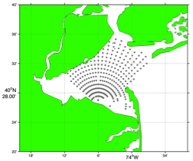
Surface Current Mapping Capability
25 MHz
Radar λ: 12 m Ocean λ: 6 m
Range: 30 km Resolution: 1 km
13 MHz
Radar λ: 23 m Ocean λ: 12 m
Range: 80 km Resolution: 3 km
05 MHz
Radar λ: 60m Ocean λ: 30 m
Range: 180 km Resolution: 6 km

Slide 6
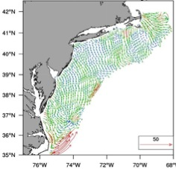
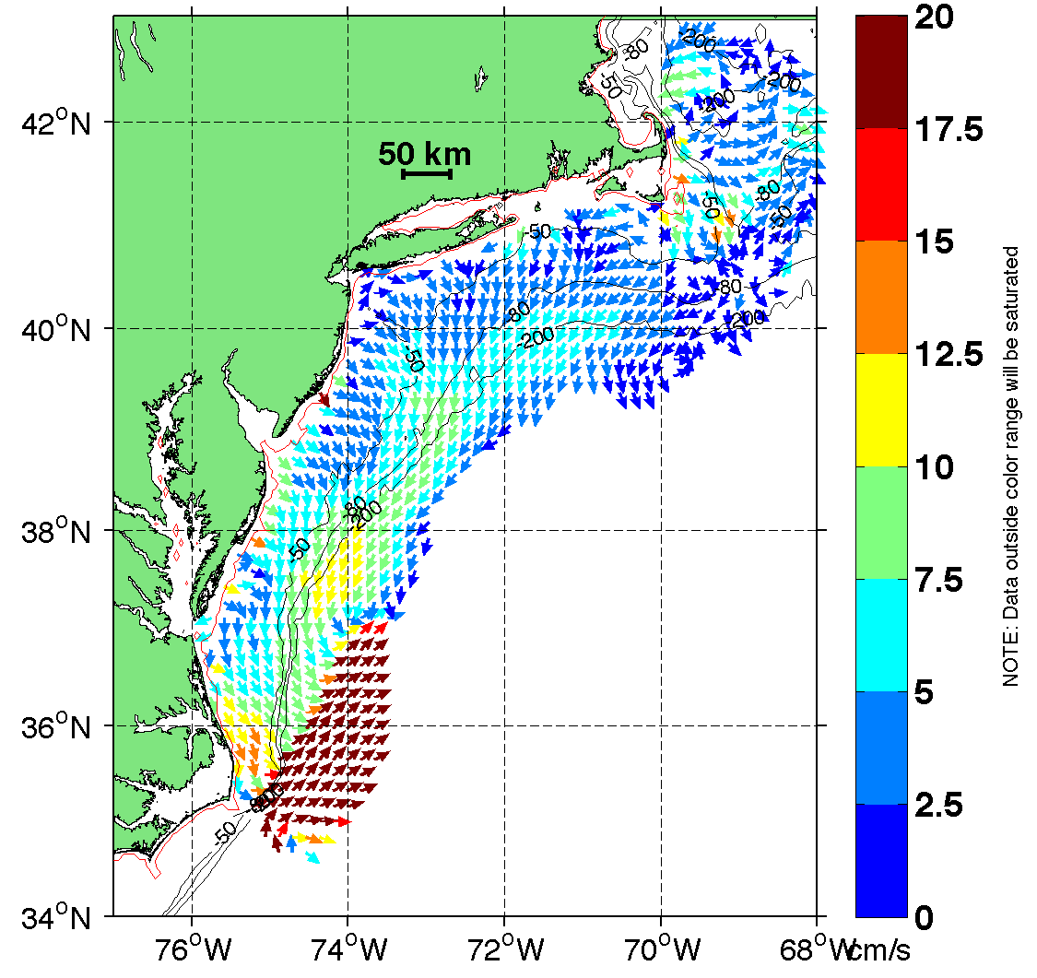
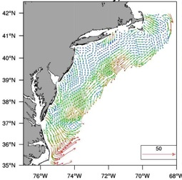
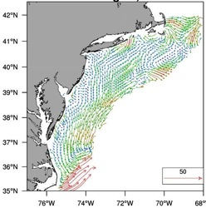
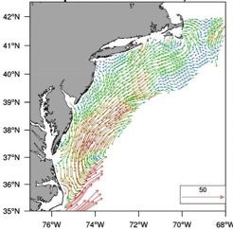
MARACOOS Annual Mean Surface Currents (2012)
Winter
Spring
Summer
Fall

Slide 7
SeaSonde processing

Slide 8
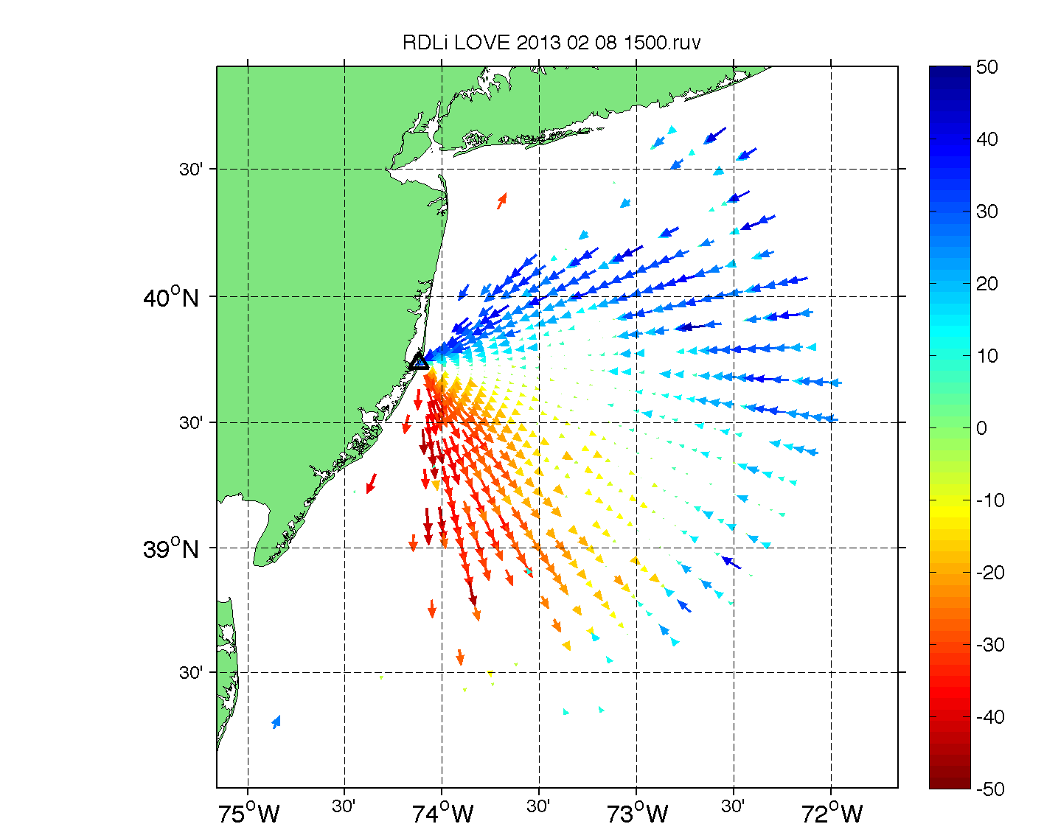

Slide 9
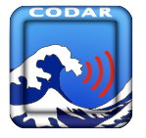

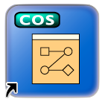
Existing SeaSonde Settings
SeaSonde Acquisition
CSPro
Analyze Spectra
Frequency (MHz) | Sweep Rate (Hz) | Doppler Bins | Time FFT | CSS Avg/Out | Radial Avg/Out | CSS per Radial File
5 | 1 | 1024 | 17m 04s | 60/30 | 180/60 | 5
13 | 2 | 512 | 04m 16s | 15/10 | 75/60 | 7
25 | 2 | 512 | 04m 16s | 15/10 | 75/30 | 7
CSQ
CSS
Radial

Slide 10
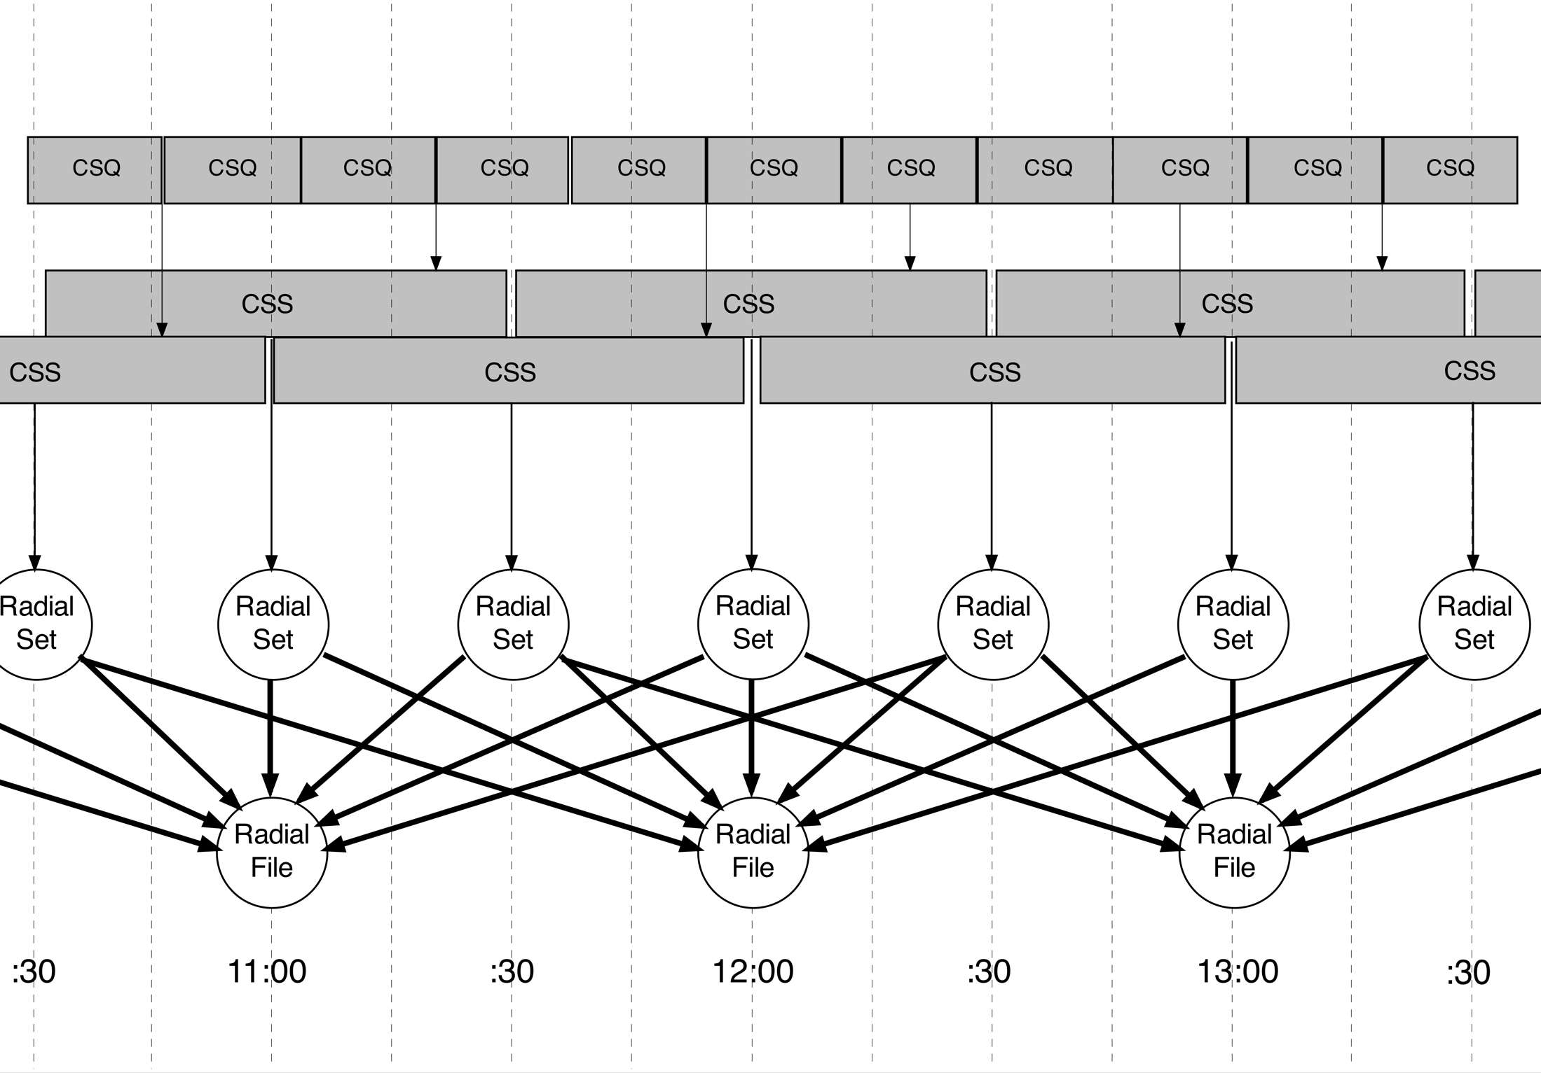

Slide 12
1 CSS ➔ 98%
3 CSS ➔ 96%
5 CSS ➔ 92%
7 CSS ➔ 86%

Slide 14
Drifter comparisons

Slide 15
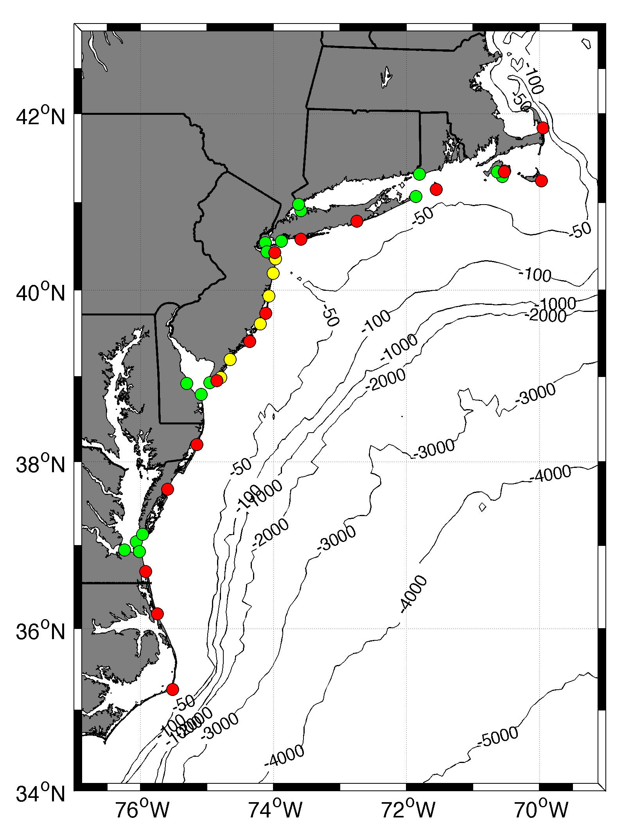

Slide 16
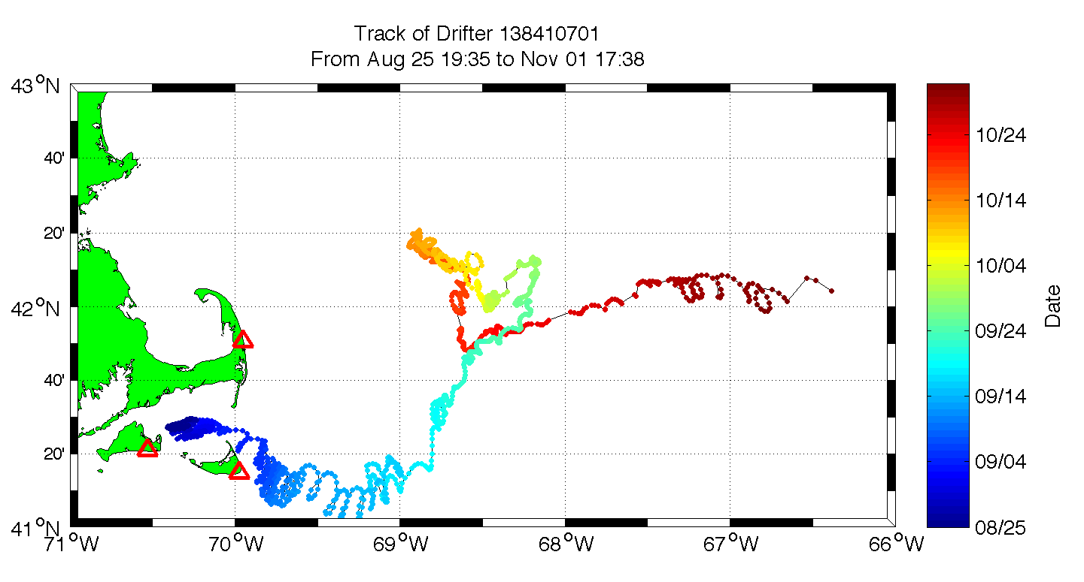
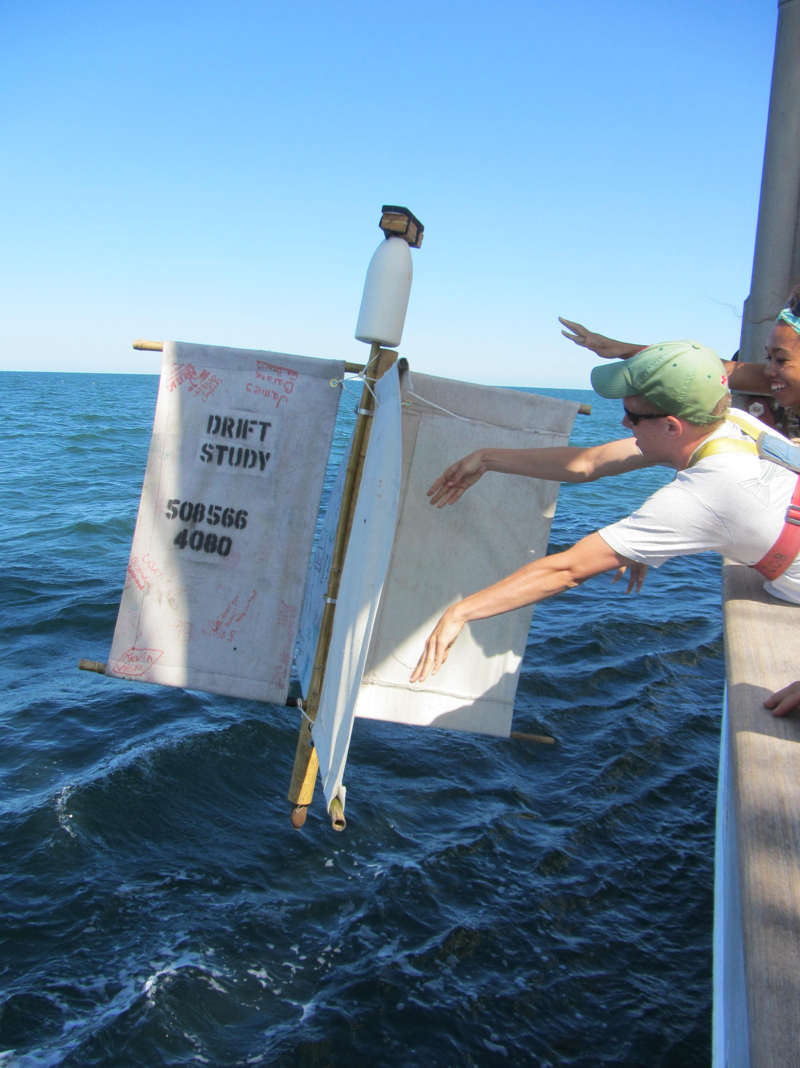

Slide 17
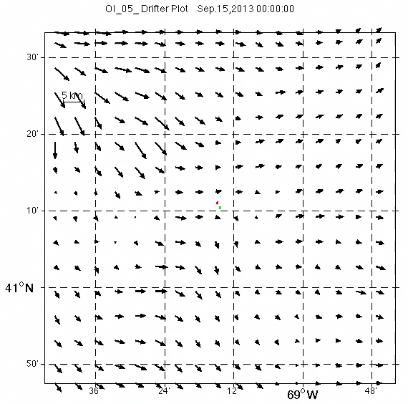
3 Hour Radial Averaging

Slide 18
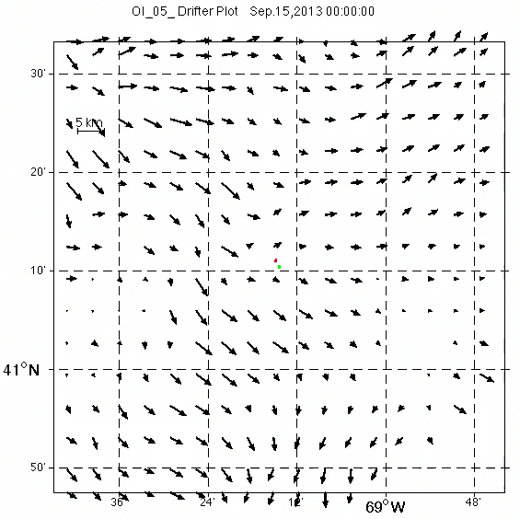
1 Hour Radial Averaging

Slide 19
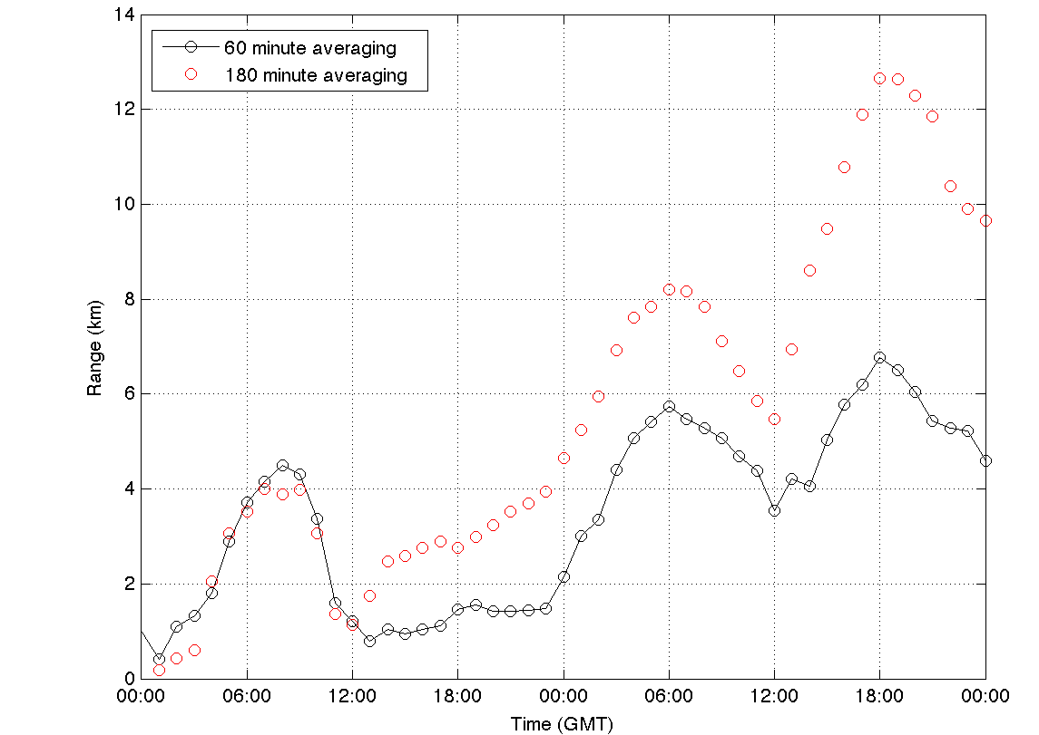
3 Hour
Separation (km)
1 Hour

Slide 20
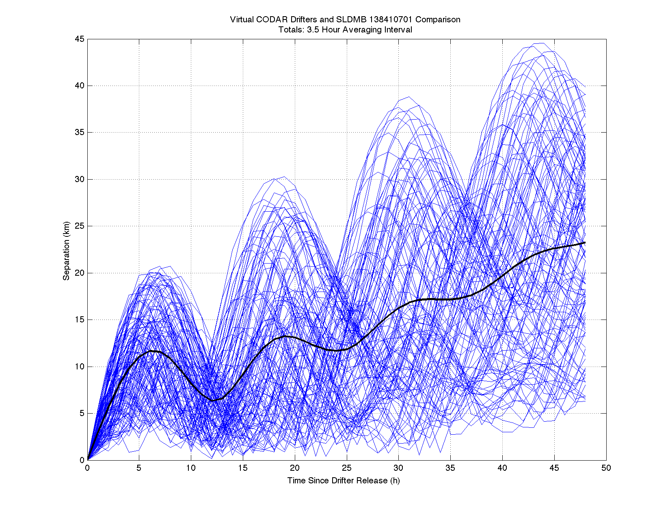
3 Hour Average
3.0
169 simulations

Slide 21
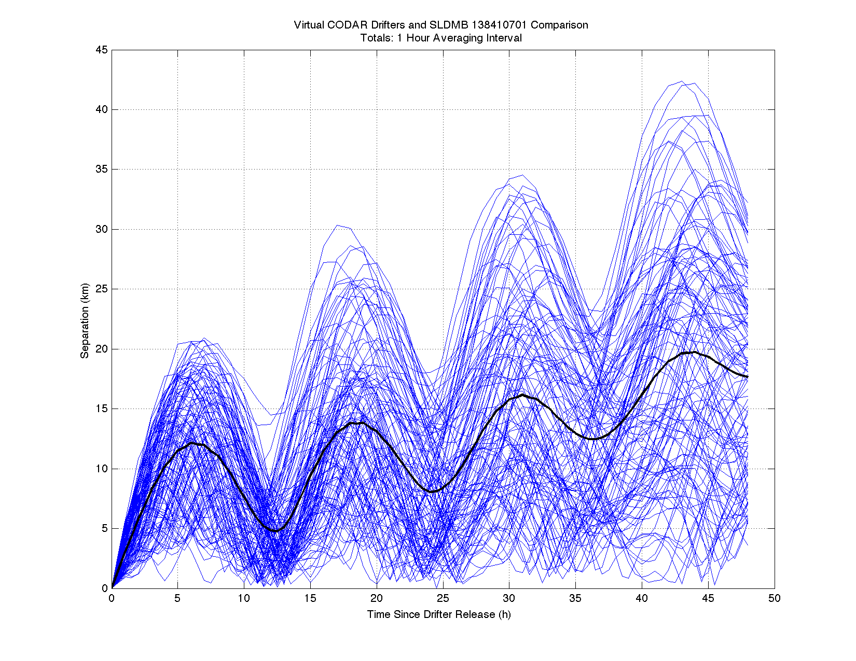
1 Hour Average
3 Hour – 23 km
1 Hour – 17 km
26% Drop
169 simulations

Slide 22
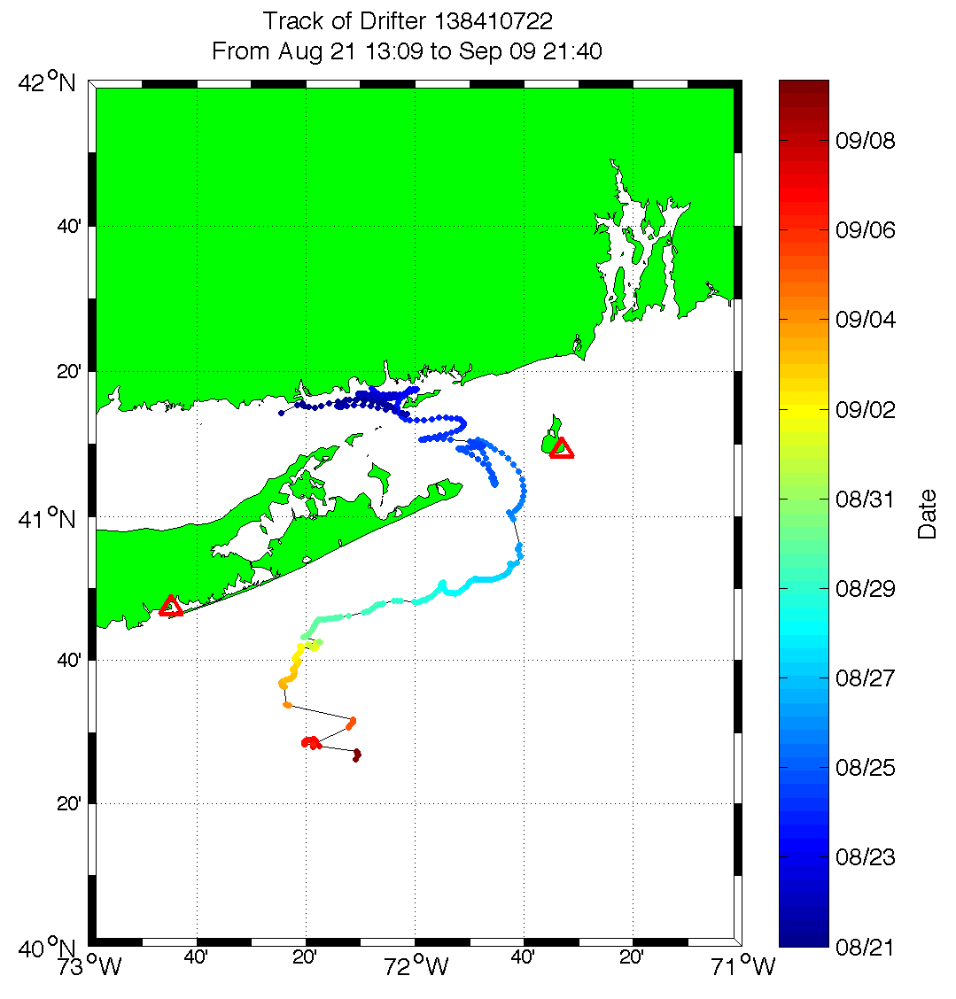

Slide 23
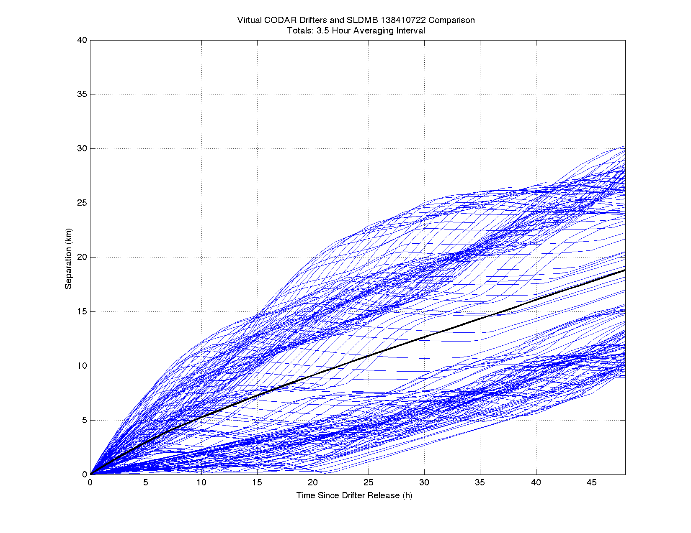
3 Hour Average
197 simulations

Slide 24
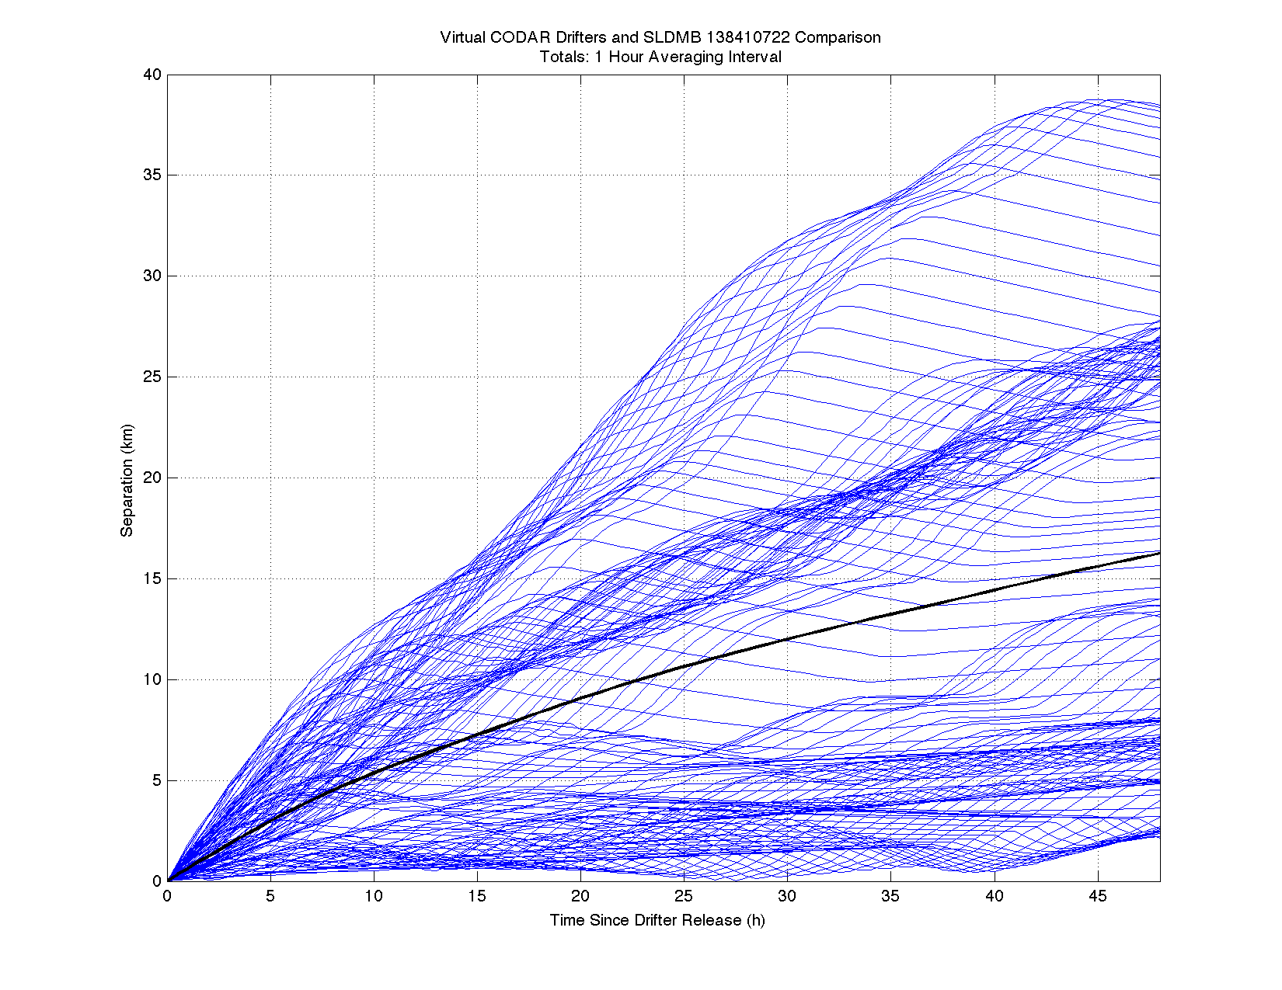
1 Hour Average
3 Hour – 19 km
1 Hour – 16 km
16% Drop
197 simulations

Slide 25
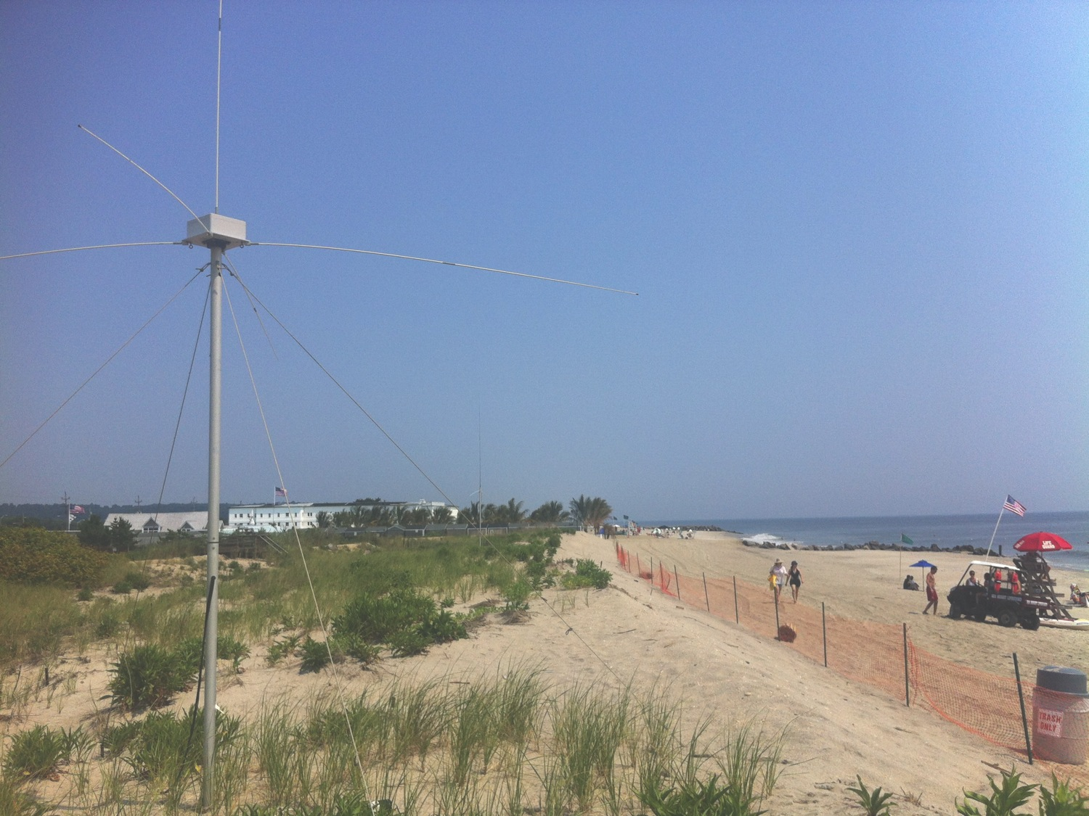
Conclusions
Shorter averaging intervals can increase tidal amplitude measurement
Shorter Averaging intervals led to reduced error in estimate of drifter position
Want to examine effect on uncertainty and coverage

