Slide 1
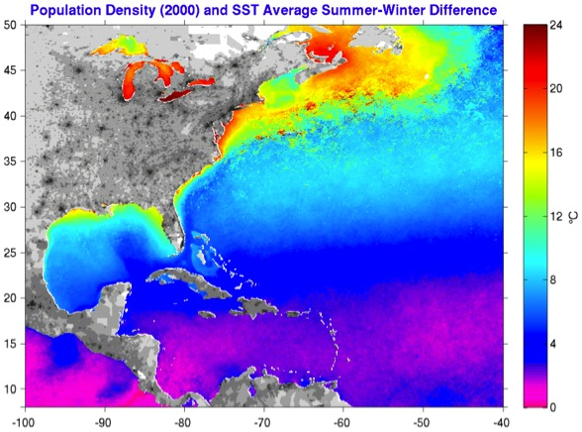
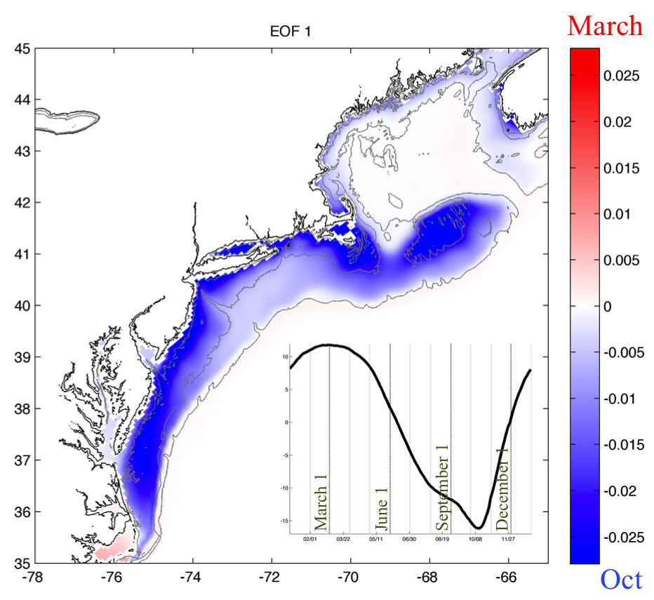
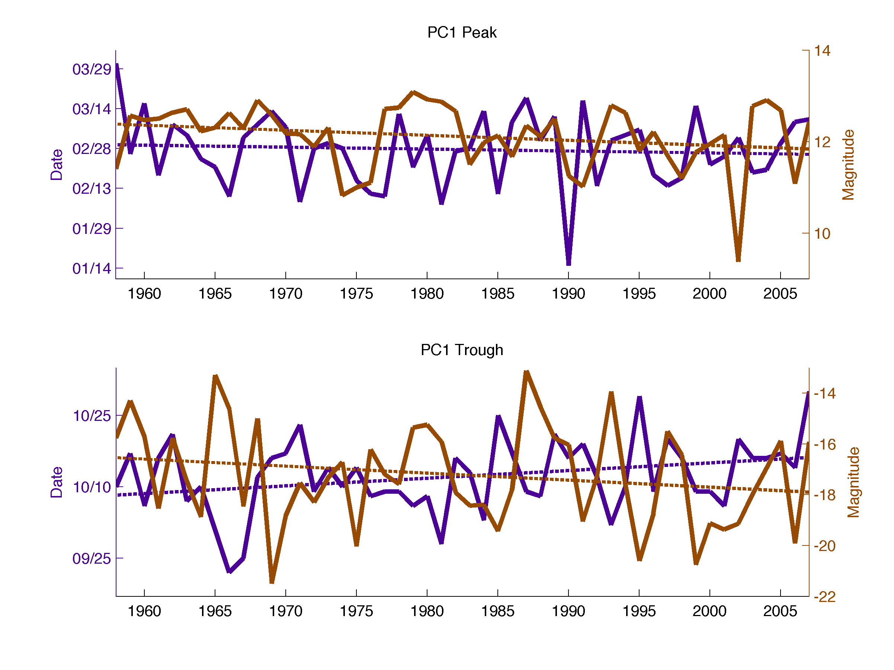
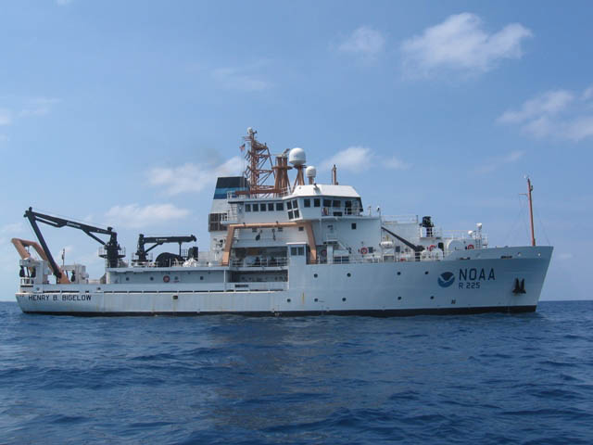
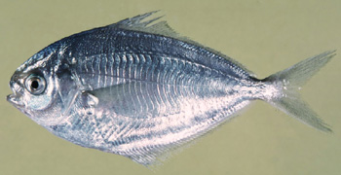
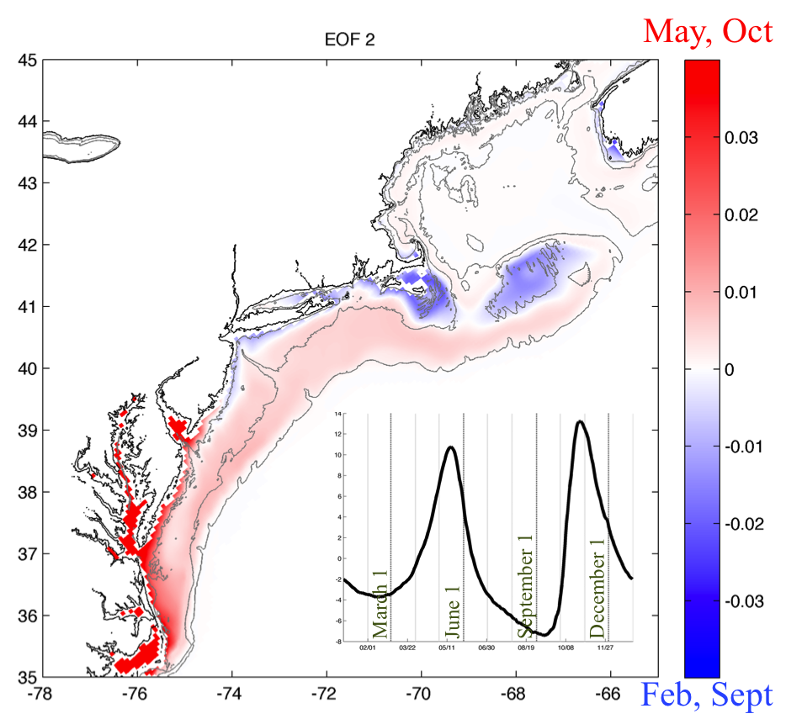
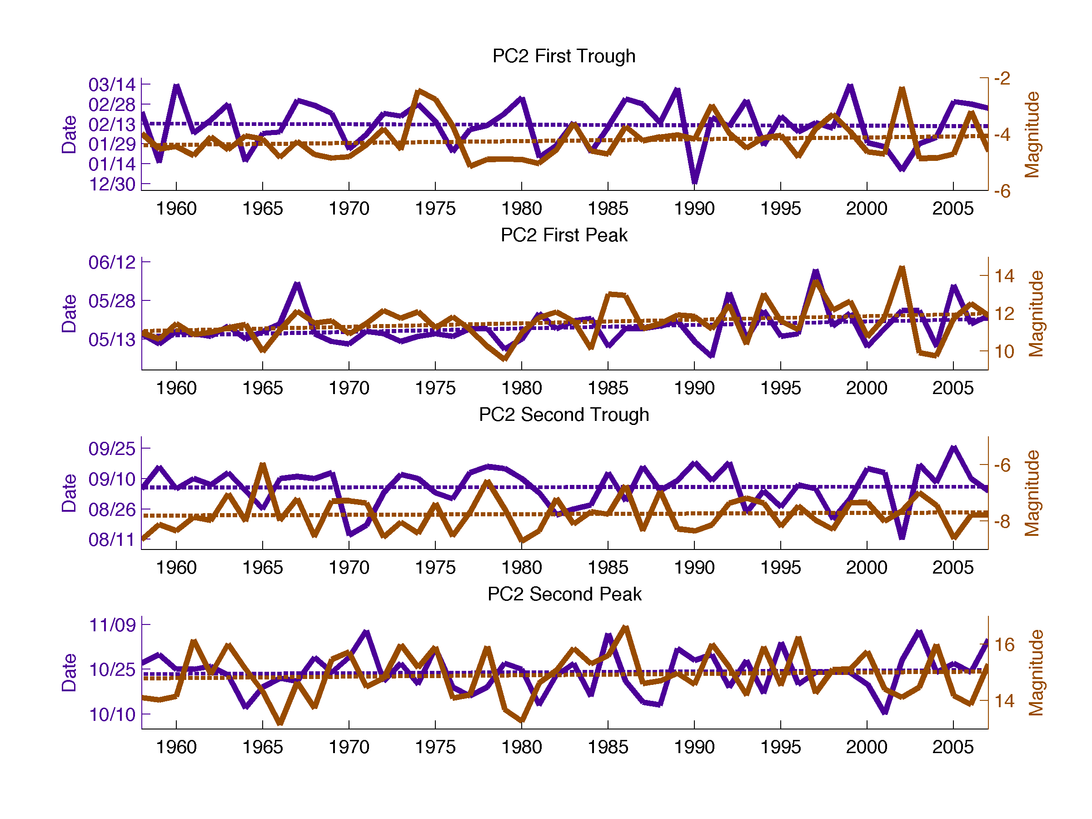
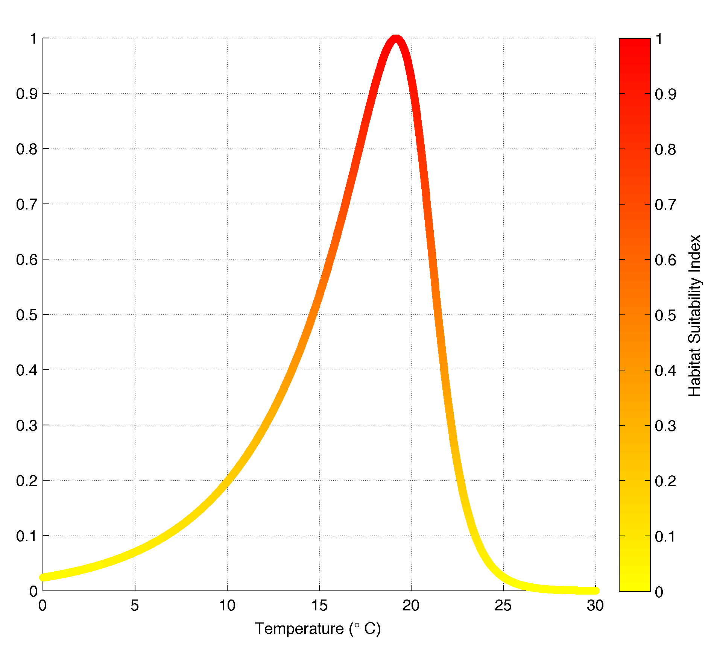
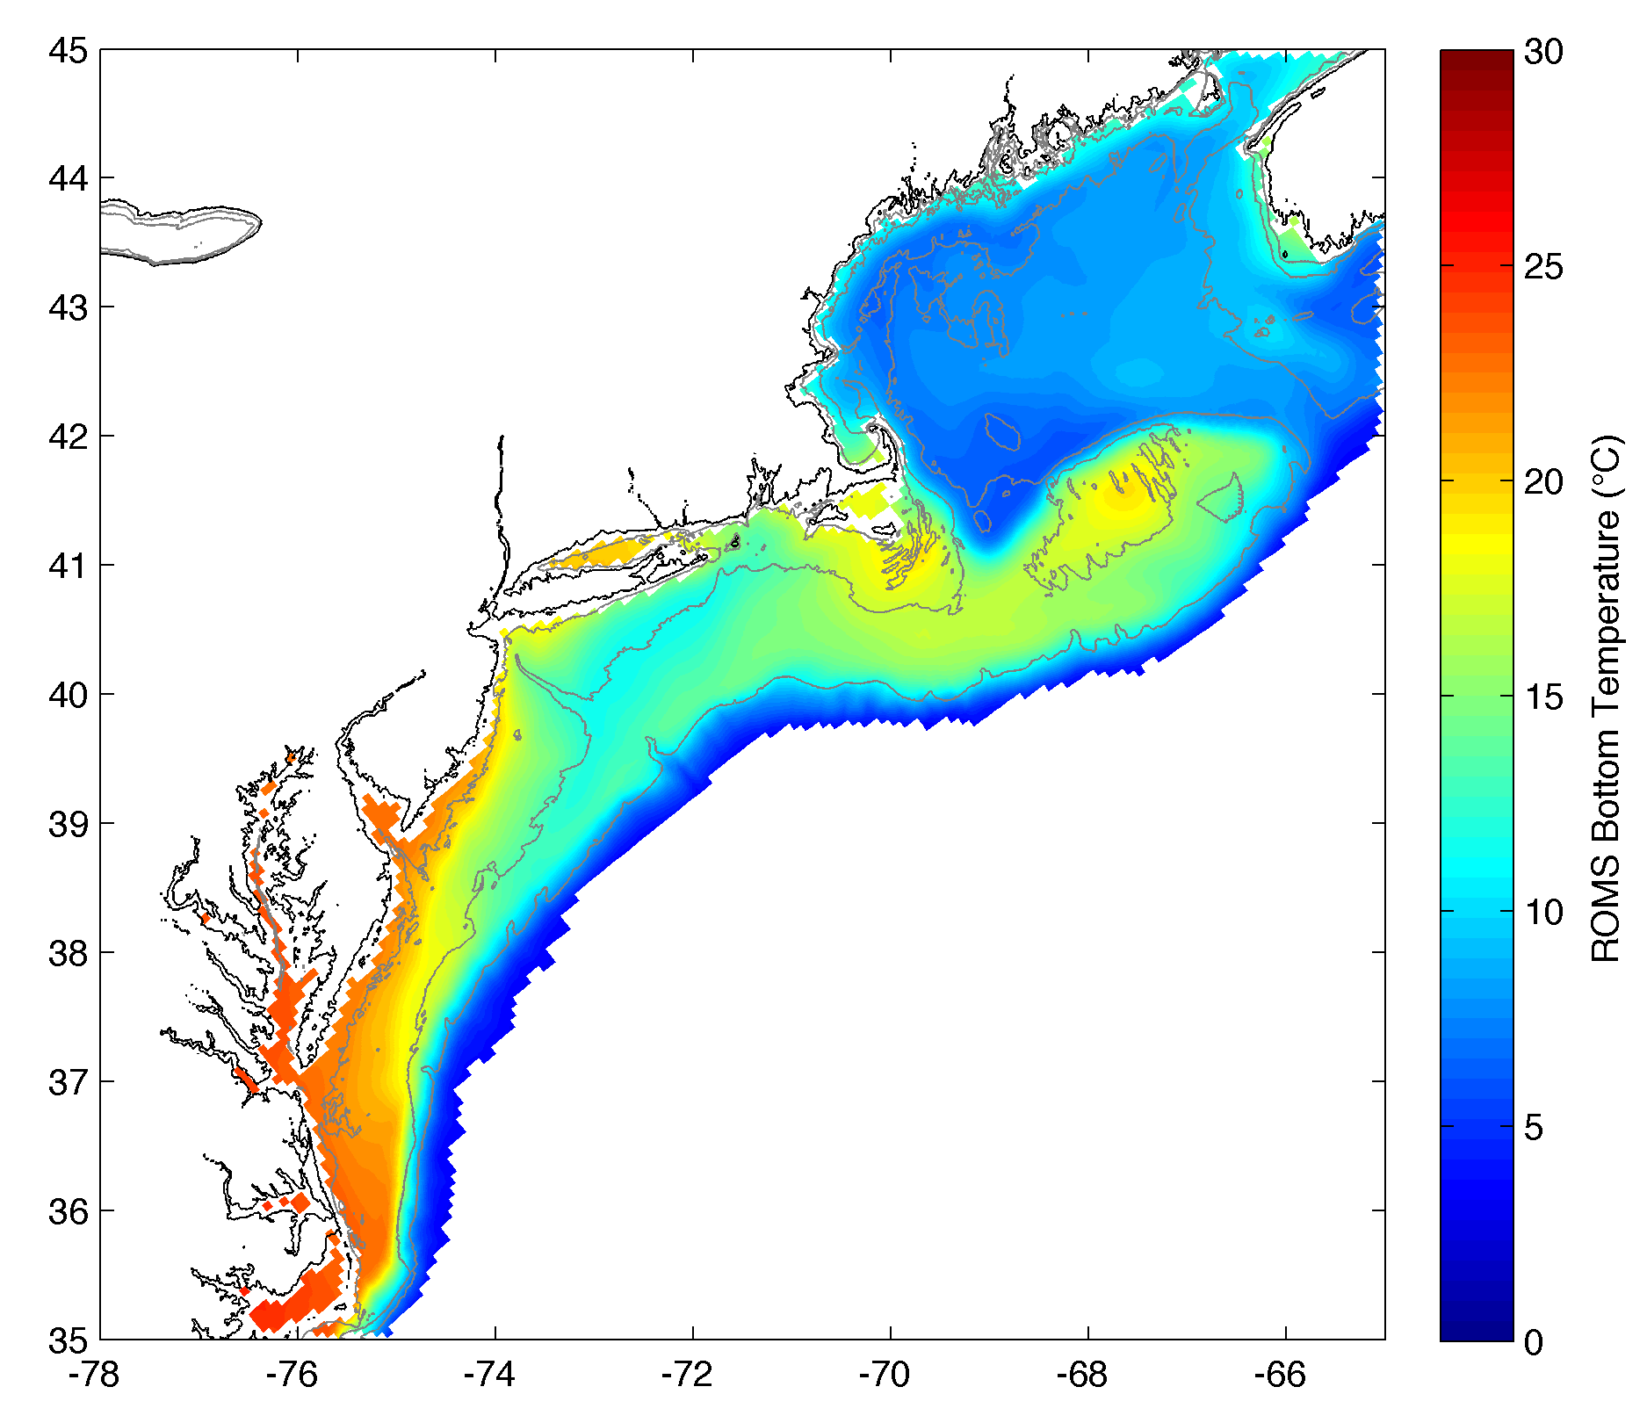
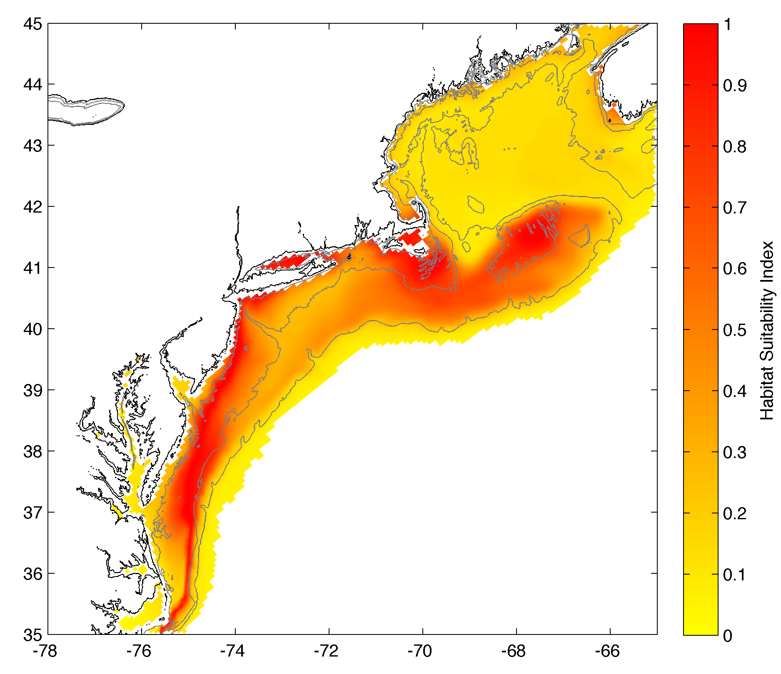
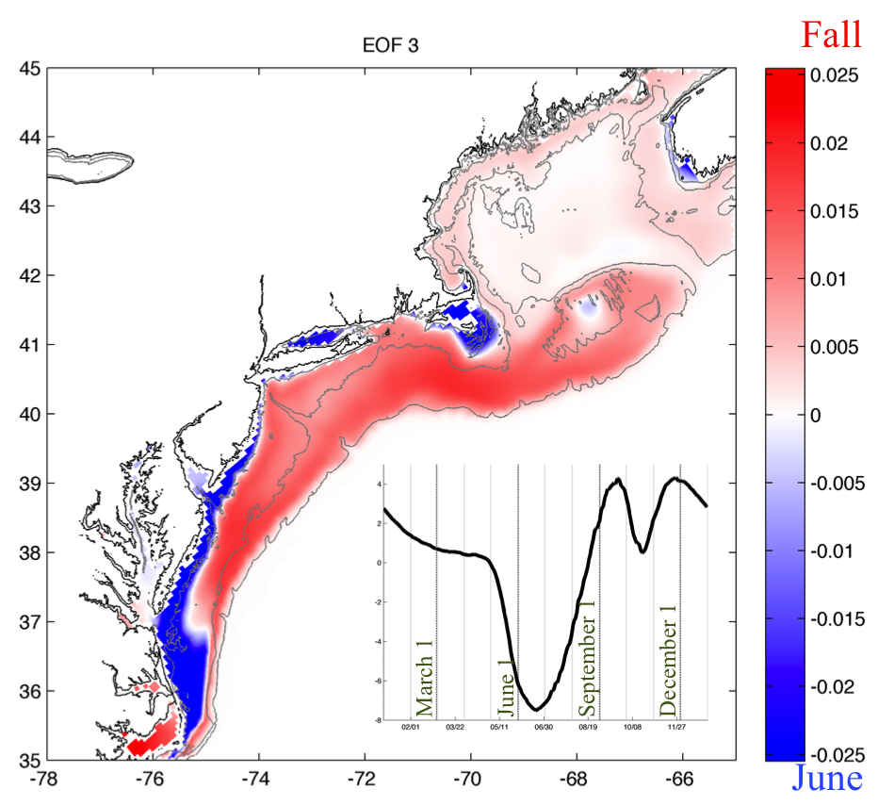
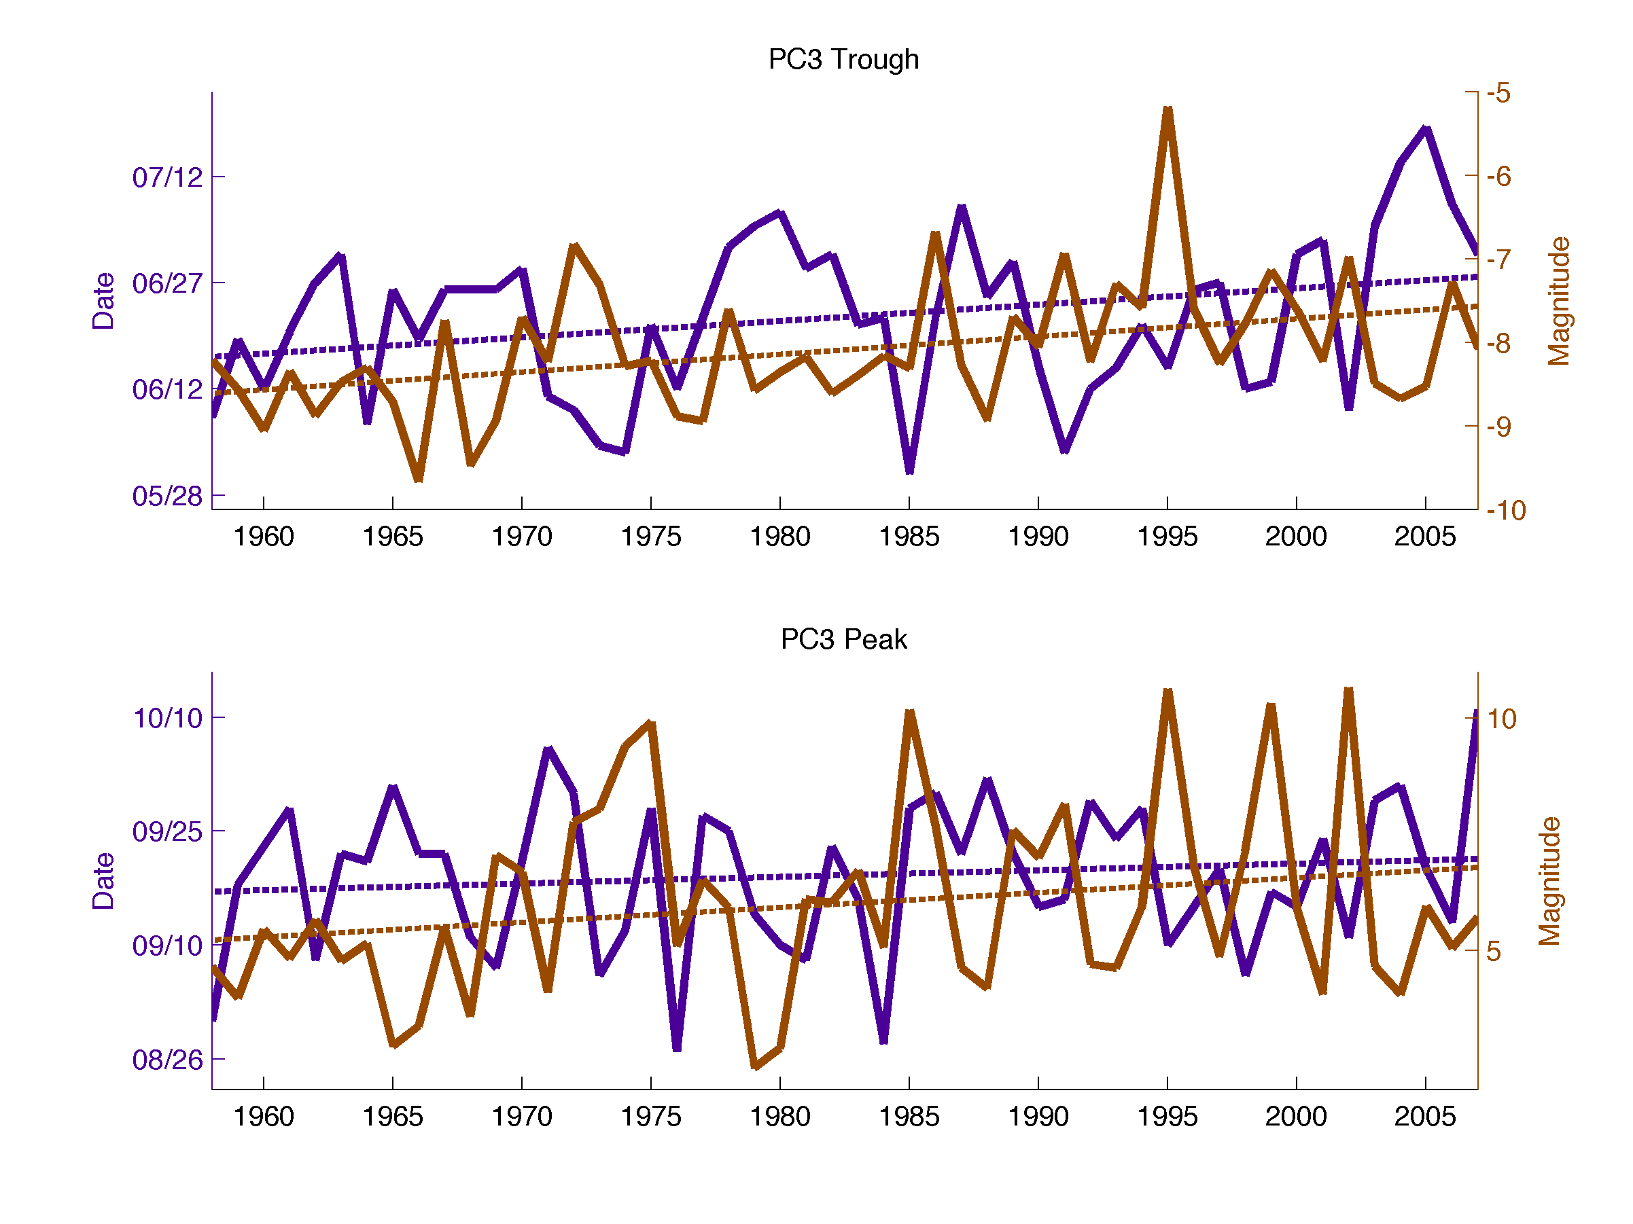
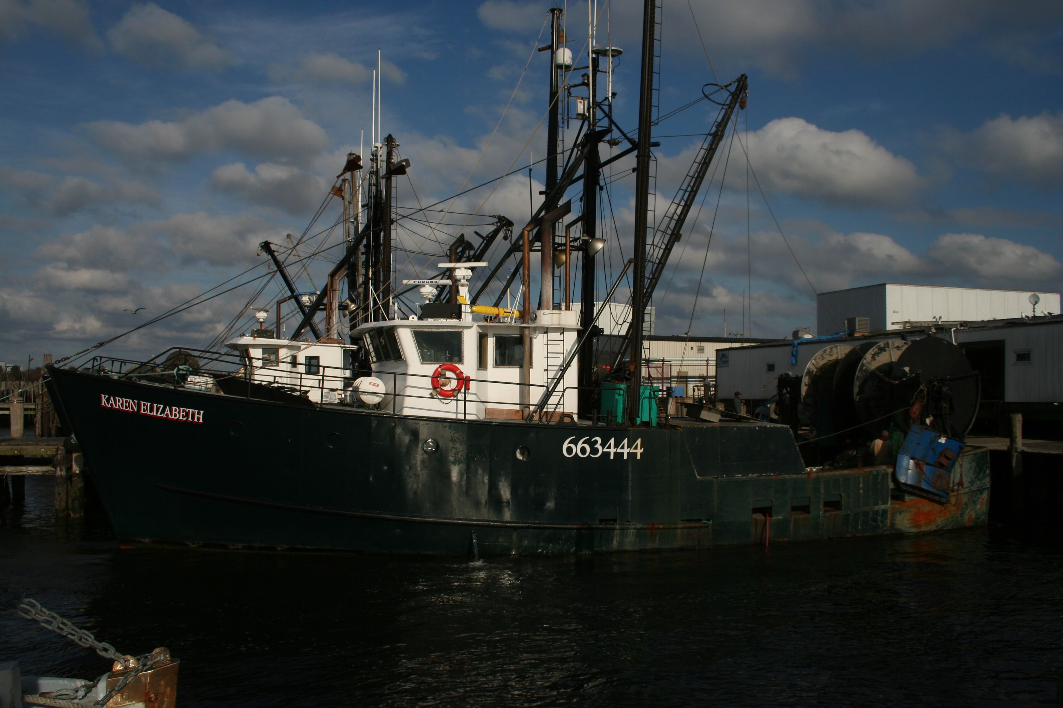
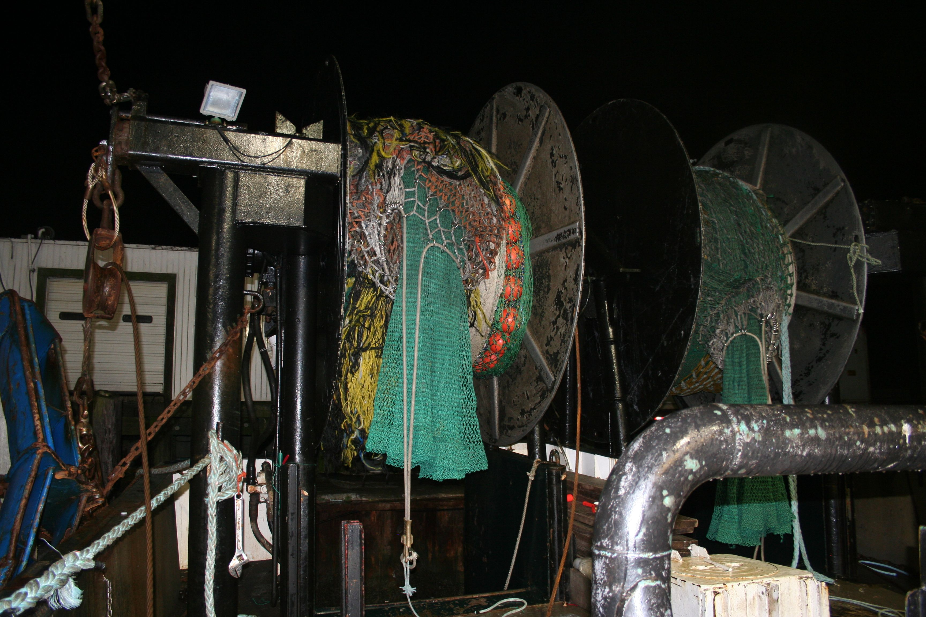
VARIABILITY IN THERMAL HABITAT DYNAMICS FOR A PELAGIC FORAGE FISH ESTIMATED BY COUPLING A THERMAL NICHE MODEL TO A HYDRODYNAMIC OCEAN MODEL
OpenOcean
Laura Palamara¹, John Manderson², Josh Kohut¹, Enrique Curchitser¹, Dujuan Kang¹, Howard Townsend²
¹Institute of Marine and Coastal Sciences, Rutgers University ²NOAA National Marine Fisheries Service
OVERVIEW
Ocean ecology is often treated similar to landscape ecology, where animals have physiologies that are fairly decoupled from the atmosphere. In contrast, the growth, survival, and reproduction of marine fish are highly dependent on the temperature of the surrounding fluid.
SPATIAL VARIABILITY
We used empirical orthogonal functions (EOFs) to determine major modes of spatial (EOF, figures below) and temporal (principal component/PC, figure insets) variability in MAB butterfish simulated bottom thermal habitat. The first three modes of variability explained 81.7% of the total variance in habitat.
TEMPORAL VARIABILITY
We analyzed interannual variability and climate trends in habitat suitability by looking at the timing and strength of the peaks and troughs in the annual cycles of the first three modes. Figures show timing and magnitude of peaks and troughs from 1958-2007 with dashed best-fit lines showing long-term trends, ‘+t’ and ‘-t’ indicating positive or negative trends, and ‘★’ indicating strong trends.
Changes in Butterfish Annual Cycle:
Interannual variability in the magnitude and timing of the key features of the annual cycle can be very high, and for some features increased over time.
Winter habitat suitability lows became less extreme over the 50-year simulation, and this seemed to lead to more extreme highs in late spring/early summer and later stratification over the shelf.
The overall habitat suitability high during the fall migration became more extreme over the 50-year simulation, but the timing of that suitability peak occurred later in the year over time.
In temperate regions such as the Mid-Atlantic Bight (MAB), USA, ocean temperature is extremely dynamic in both time and space.
some of the largest seasonal temperature changes in the world
strong interannual variability and long-term shifts due to climate change
many migratory species that move with water of optimal temperature
Mode 1: 53.2% (Annual Variability)
Mode 1: 53.2% (Annual Variability)
Consistent annual cycle over the shelf
Depth-dependent magnitude stronger inshore
Poorest habitat suitability in March, best in October
-t
IMPLICATIONS TO FISHERIES AND MANAGEMENT
+t★
Interannual Variability:
Butterfish are a short-lived species that rarely survive more than a couple of years, so large year-to-year changes in total habitat suitability and timing of key features can cause rapid and large changes in:
We used butterfish (Peprilus triacanthus), a mobile pelagic forage fish in the MAB, as a test species to study thermal habitat dynamics on the seafloor over a 50-year period.
economically and ecologically important
target for a directed fishery
by-catch in the longfin squid fishery
Mean PC 1
March habitat minimum (Mode 1 PC peak) decreased in magnitude through time
October habitat maximum (PC trough) became more variable in magnitude
October maximum shifted later in the year by about 1.6 days/decade
Mode 2: 20.0% (Seasonal Variability)
Mode 2: 20.0% (Seasonal Variability)
total abundance
growth rate
mortality
time of spawning
time of migration
NMFS bottom trawl survey ship Henry B. Bigelow
HABITAT MODEL
Differentiated the inshore South and MAB shelf [S/MAB] from the inshore North and Georges Bank [N/GB]
Two cycles per year: red (blue) areas high suitability mid-spring & fall (summer)
Thermal Niche Model
Bottom Temperature Model
These changes can affect abundance estimates used to inform management. Since the National Marine Fisheries Service (NMFS) bottom trawl survey occurs around the same time each year, these highly and increasingly variable changes can bias estimates of abundance.
Boltzmann-Arrhenius Function
ROMS Physical Model
+t★
+t★
+
Climate Trends:
More extreme and later habitat suitability highs in late spring could result in shifts in spawning time and recruitment success.
The overall habitat quality is increasing during the fall and spring surveys over the 50 year study period.
The timing of the peak of the fall migration relative to the fixed fall survey period is shifting later in the year over our 50 year study period.
These shifts can bias NMFS survey-estimated abundance. In addition, persistent trends in total abundance, the timing of key life history stages, and latitudinal and cross-shelf distribution could force fishermen to make changes that could result in expensive modifications to gear and fuel use, such as…
Traveling farther to reach good fishing grounds
Changing target species
Increasing avoidance effort
These potential effects are not unique to butterfish but conceivable for the many migratory, temperature-dependent fish in the region.
Daily averages 1958-2007
Mean PC 2
7km resolution
Kang & Curchitser 2013
gives us
May S/MAB suitability maximum and N/GB minimum (1st Mode 2 PC peak) became more extreme over the 50-year simulation
May PC peak shifted later in the year by about 1.4 days/decade
The timing of each extreme (except the September PC trough) became more variable over time
Estimated Bottom Habitat Suitability
Mode 3: 8.4% (Seasonal Migration)
Mode 3: 8.4% (Seasonal Migration)
Distinct separation at approximately 20 m isobath between the shelf and the shallow inshore region
Suitability inshore (on shelf) was highest in June (through Fall)
+t★
+t
We developed a thermal niche model using a nonlinear extension of the Boltzmann-Arrhenius model of temperature dependence.
Model parameters were estimated using National Marine Fisheries Service (NMFS) bottom trawl collections and temperatures and maximum likelihood estimation. Peak suitability was at 19.2°C.
We coupled the thermal niche model to simulated bottom temperatures from a Regional Ocean Modeling System (ROMS) model to get daily estimated bottom habitat suitability.
+t★
Fishing Vessel Karen Elizabeth and gear
Mean PC 3
June shelf suitability low/inshore high (Mode 3 PC trough) and fall shelf high/inshore low (PC peak) both became more variable
June PC trough occurred later in time by about 2.3 days/decade and became less extreme
Fall PC peak became more extreme and was overall more variable than the June trough

