Slide 1
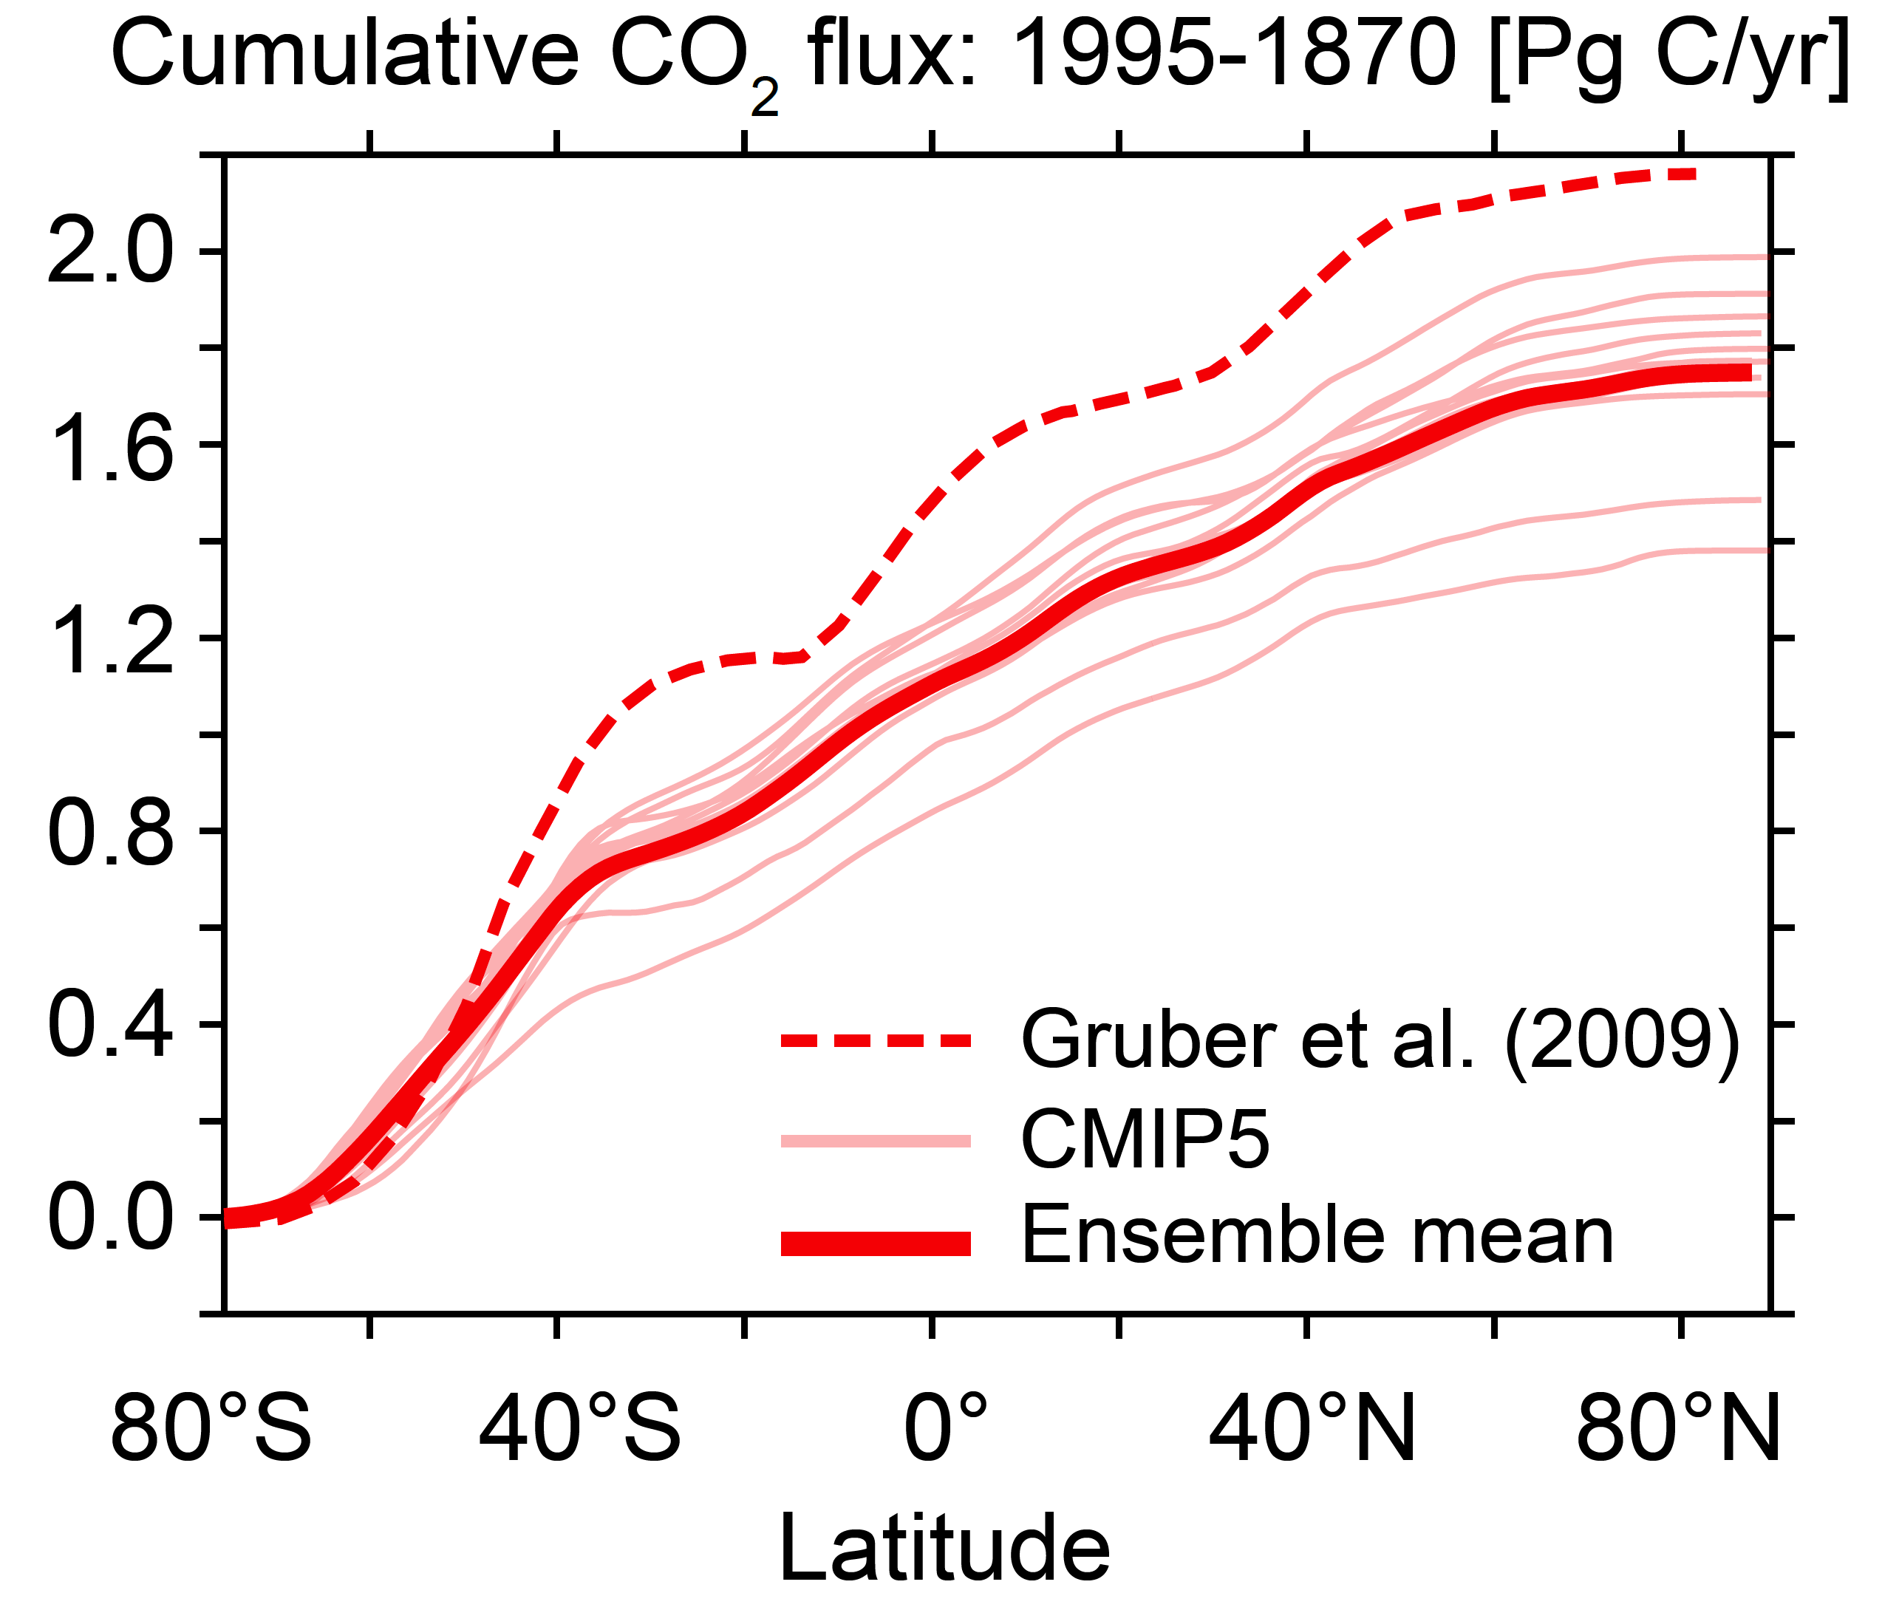
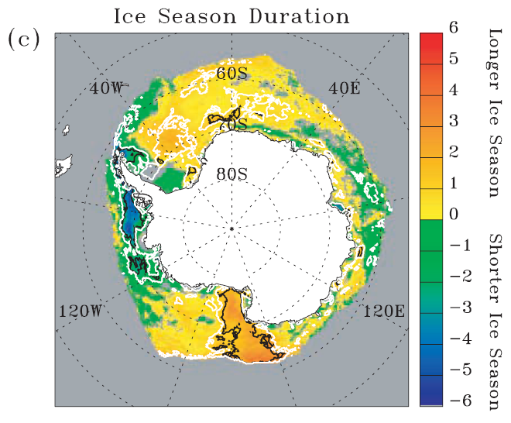
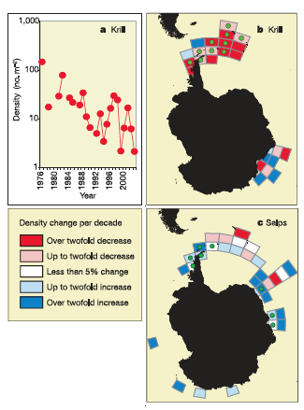
Science Requirements – status, issues, needs
Diverse data, many sources and many scales. Critical science needs to across many repositories
The Southern Ocean takes up 51% of global anthropogenic carbon
Temperature is changing
Altering ice dynamics
Altering phytoplankton dynamics
Altering zooplankton dynamics
Altering high trophic
level dynamics

Slide 2
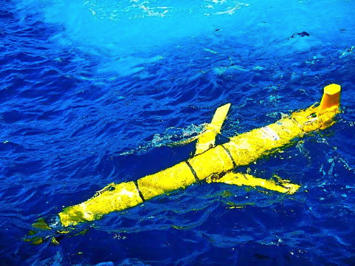
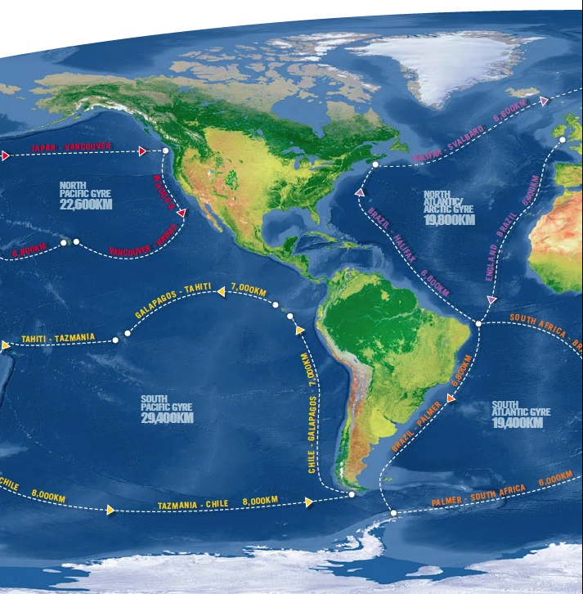
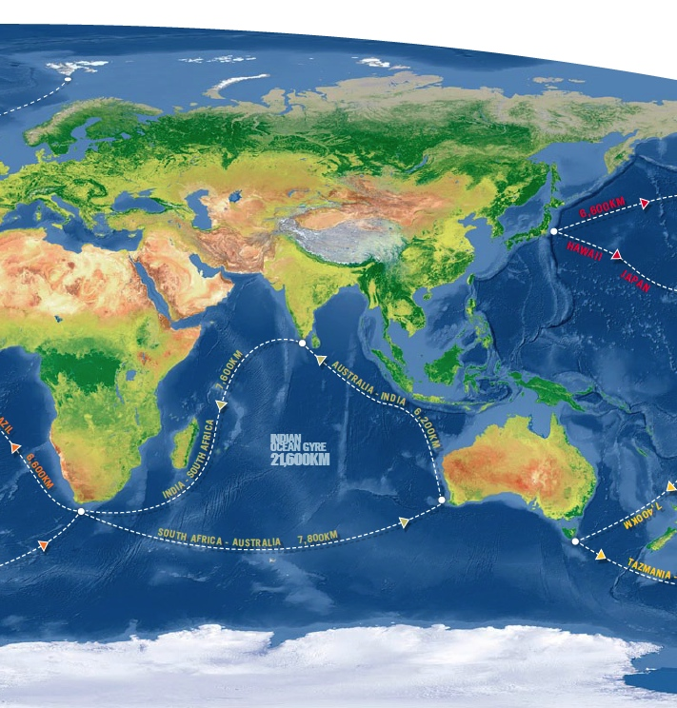
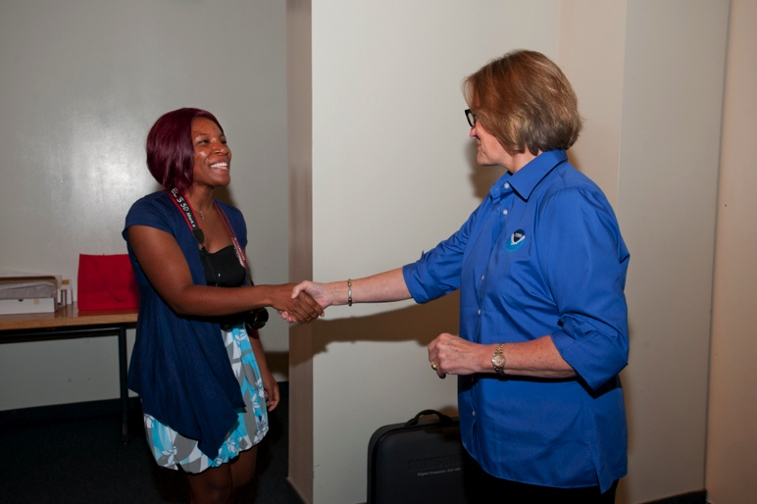

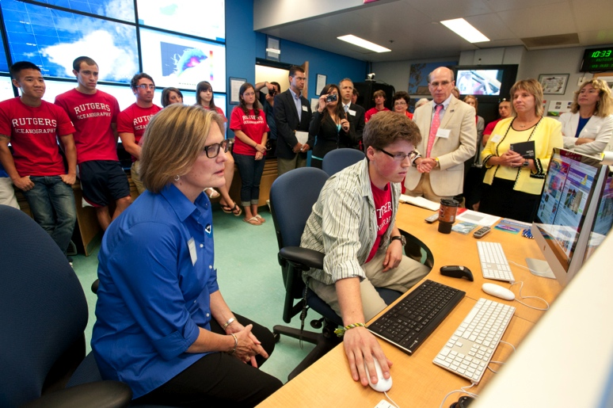
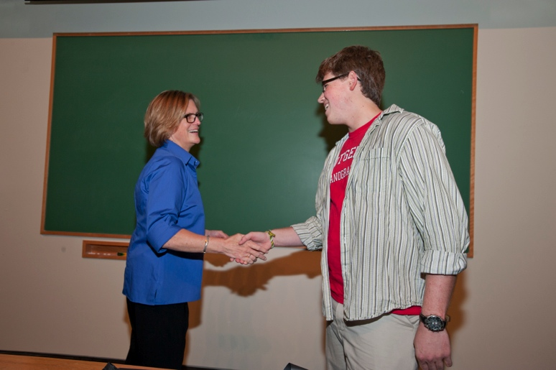
Using Existing Efforts as Test-Bed for the Broker Efforts: Global Challenger Glider Mission
16 Global-Class Gliders

Slide 3
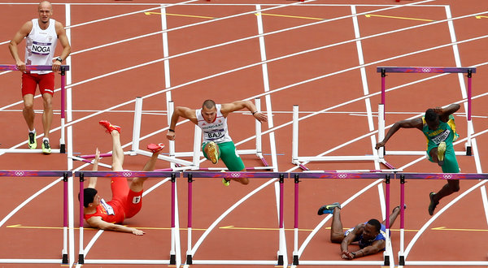
Hurdles?
Accessing complex data sets and linking to translation tools that lower the barrier for non-specialists to use

Slide 4
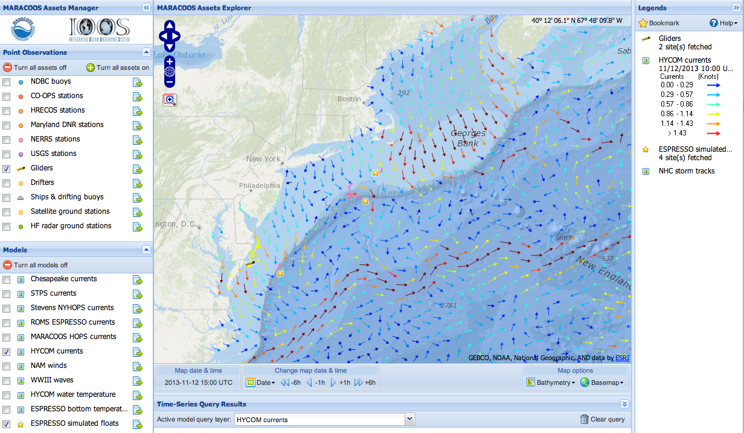
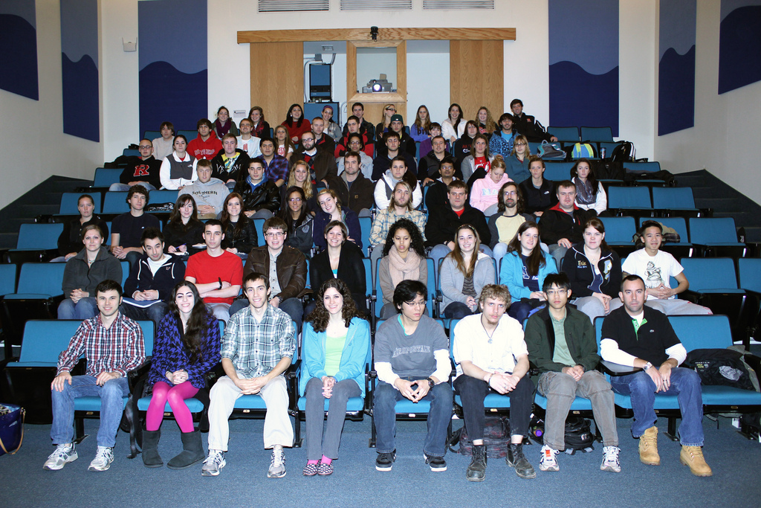
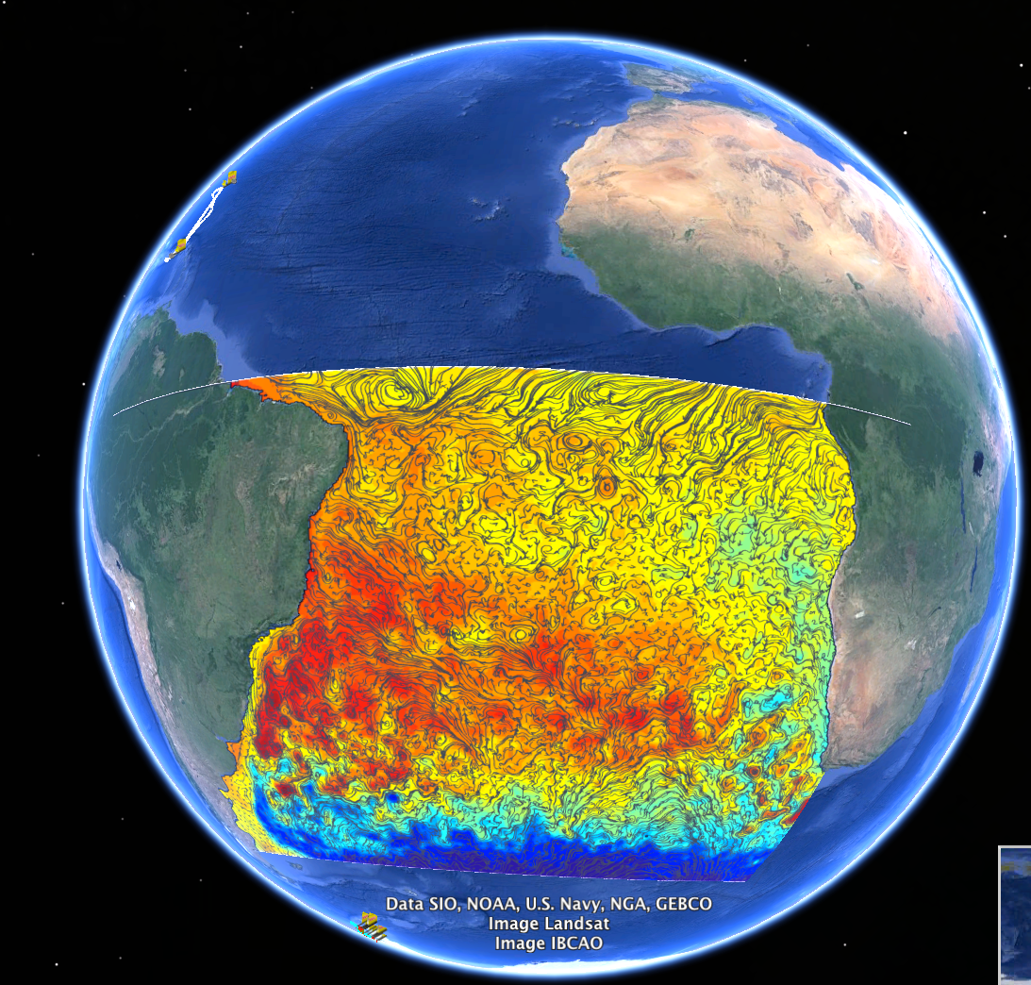
Ocean Use Case 1: Streaming data into the class room
(lowering the barrier for using streaming data)
NOAA
IOOS Streaming Operational
Datastreams
NSF OOI
Tools to enable the education
Broker
NWS Ocean Forecast model
Provide a means to link “data” (observations & models) to translation tools to allow inexperienced “users” to explore their world.

Slide 5
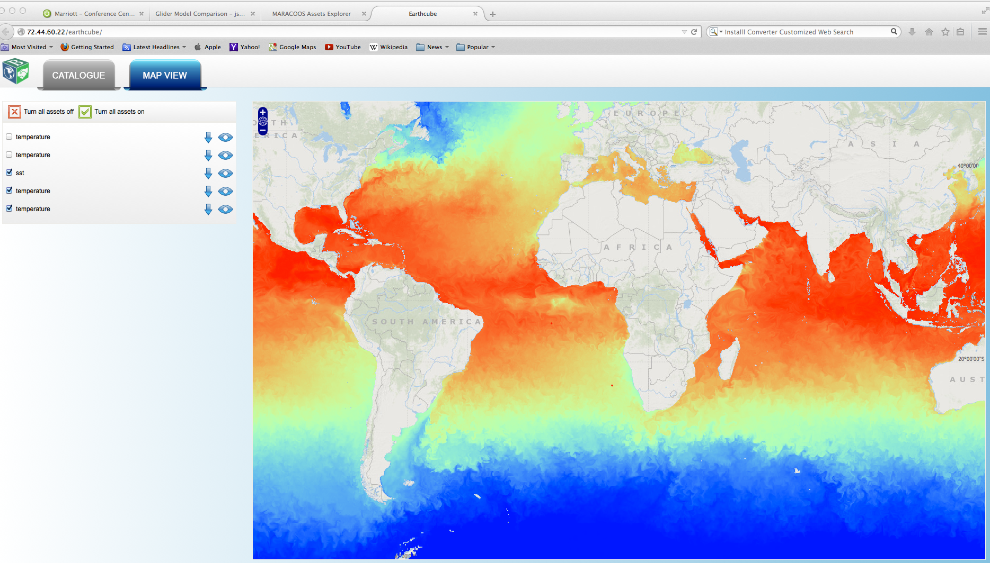
Broker portal

Slide 6


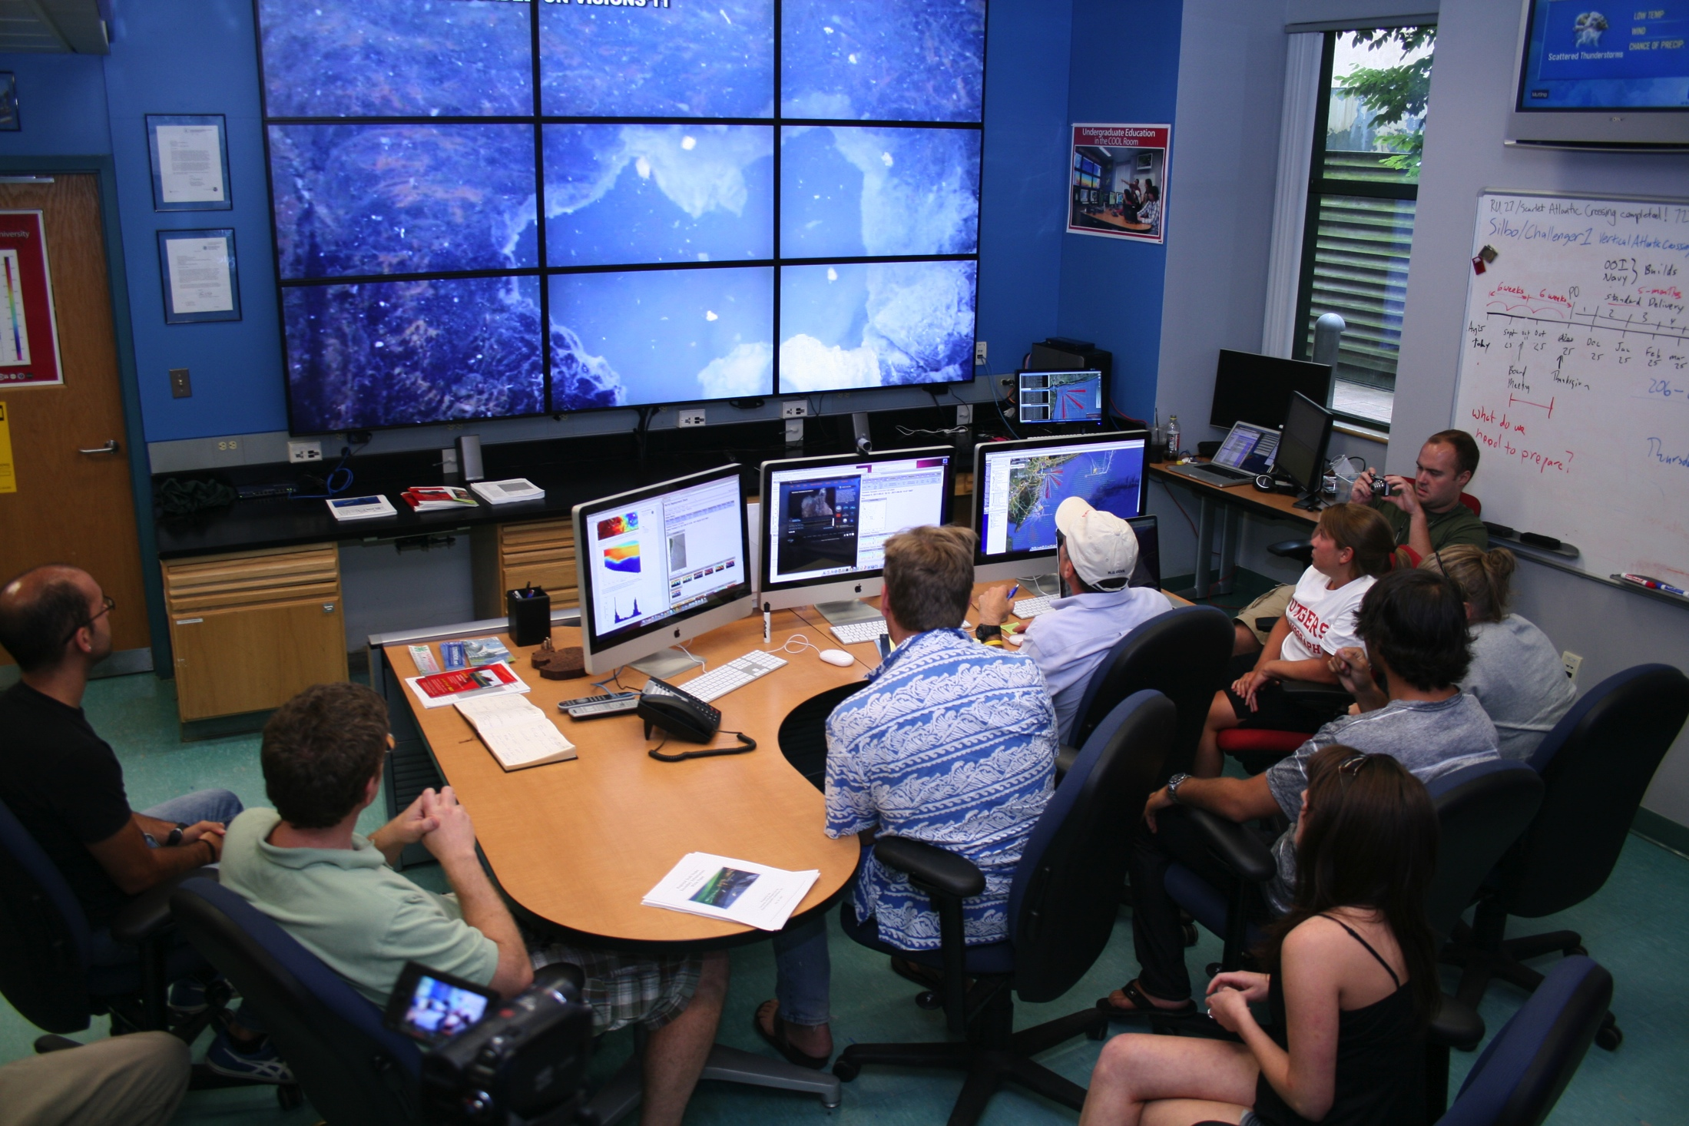
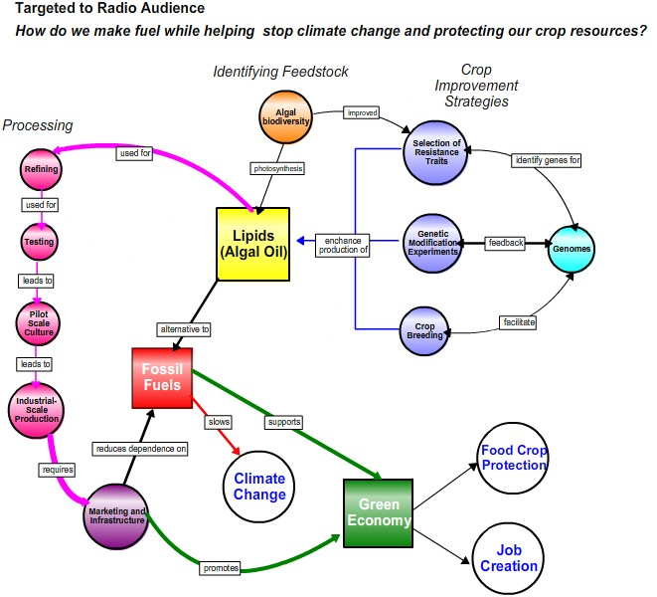
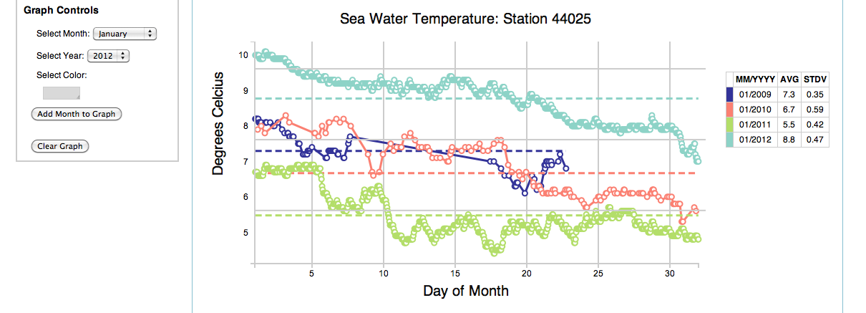
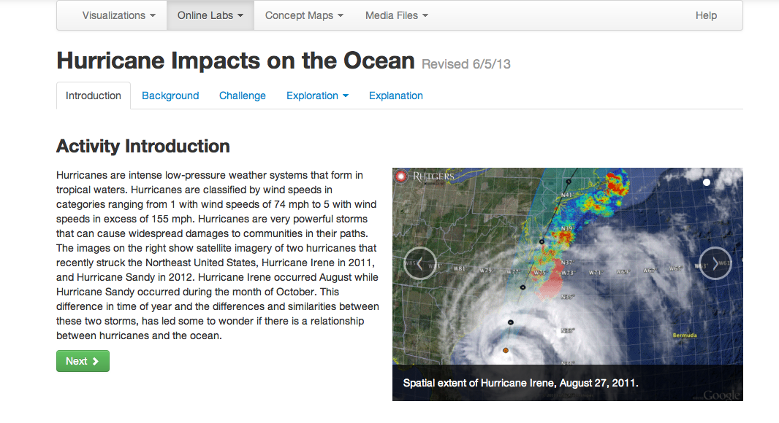
Expanding the model
Developing tools to increase the crowd sourcing & educational opportunities with OOI Education and Public Engagement team (EPE)
Concept Maps
Data Visualization Tools
Lab Lesson Builder

Slide 7
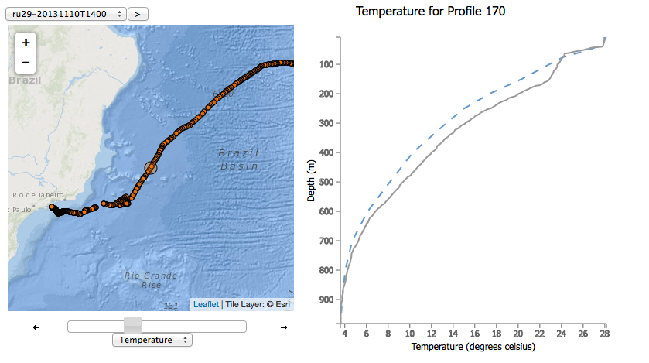

Slide 8
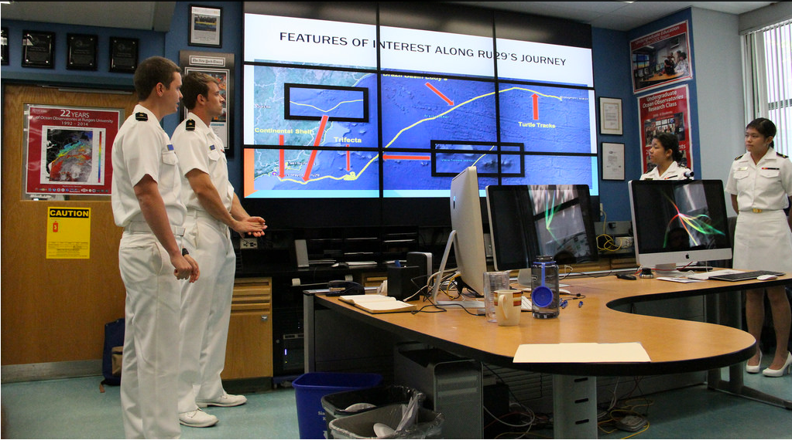
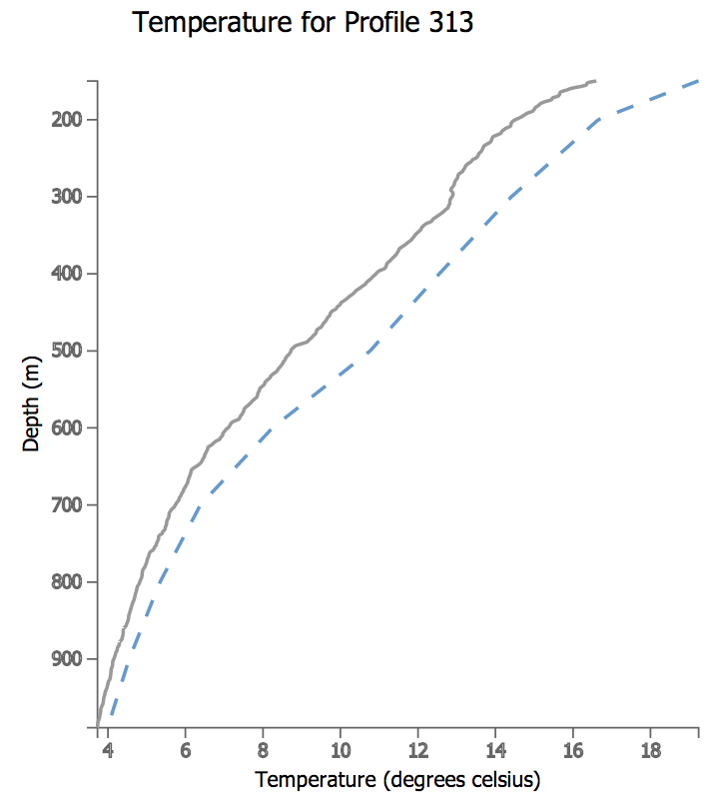
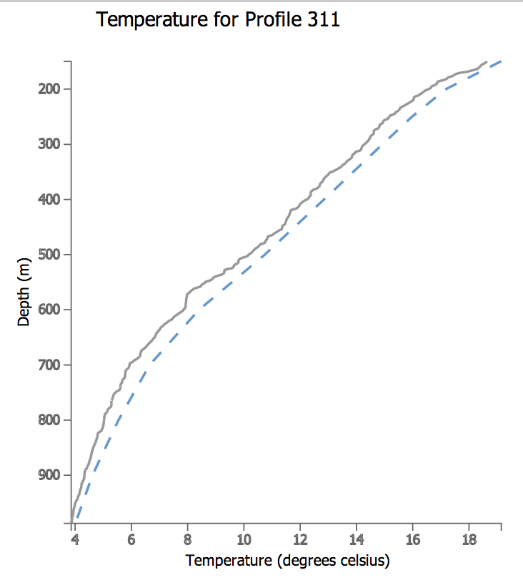
June 18 2014: Naval Academy Interns Assessing NOAA Global Skill Using an Ocean Robot
Data from the
Cabo Frio eddy off
Brazil

Slide 9
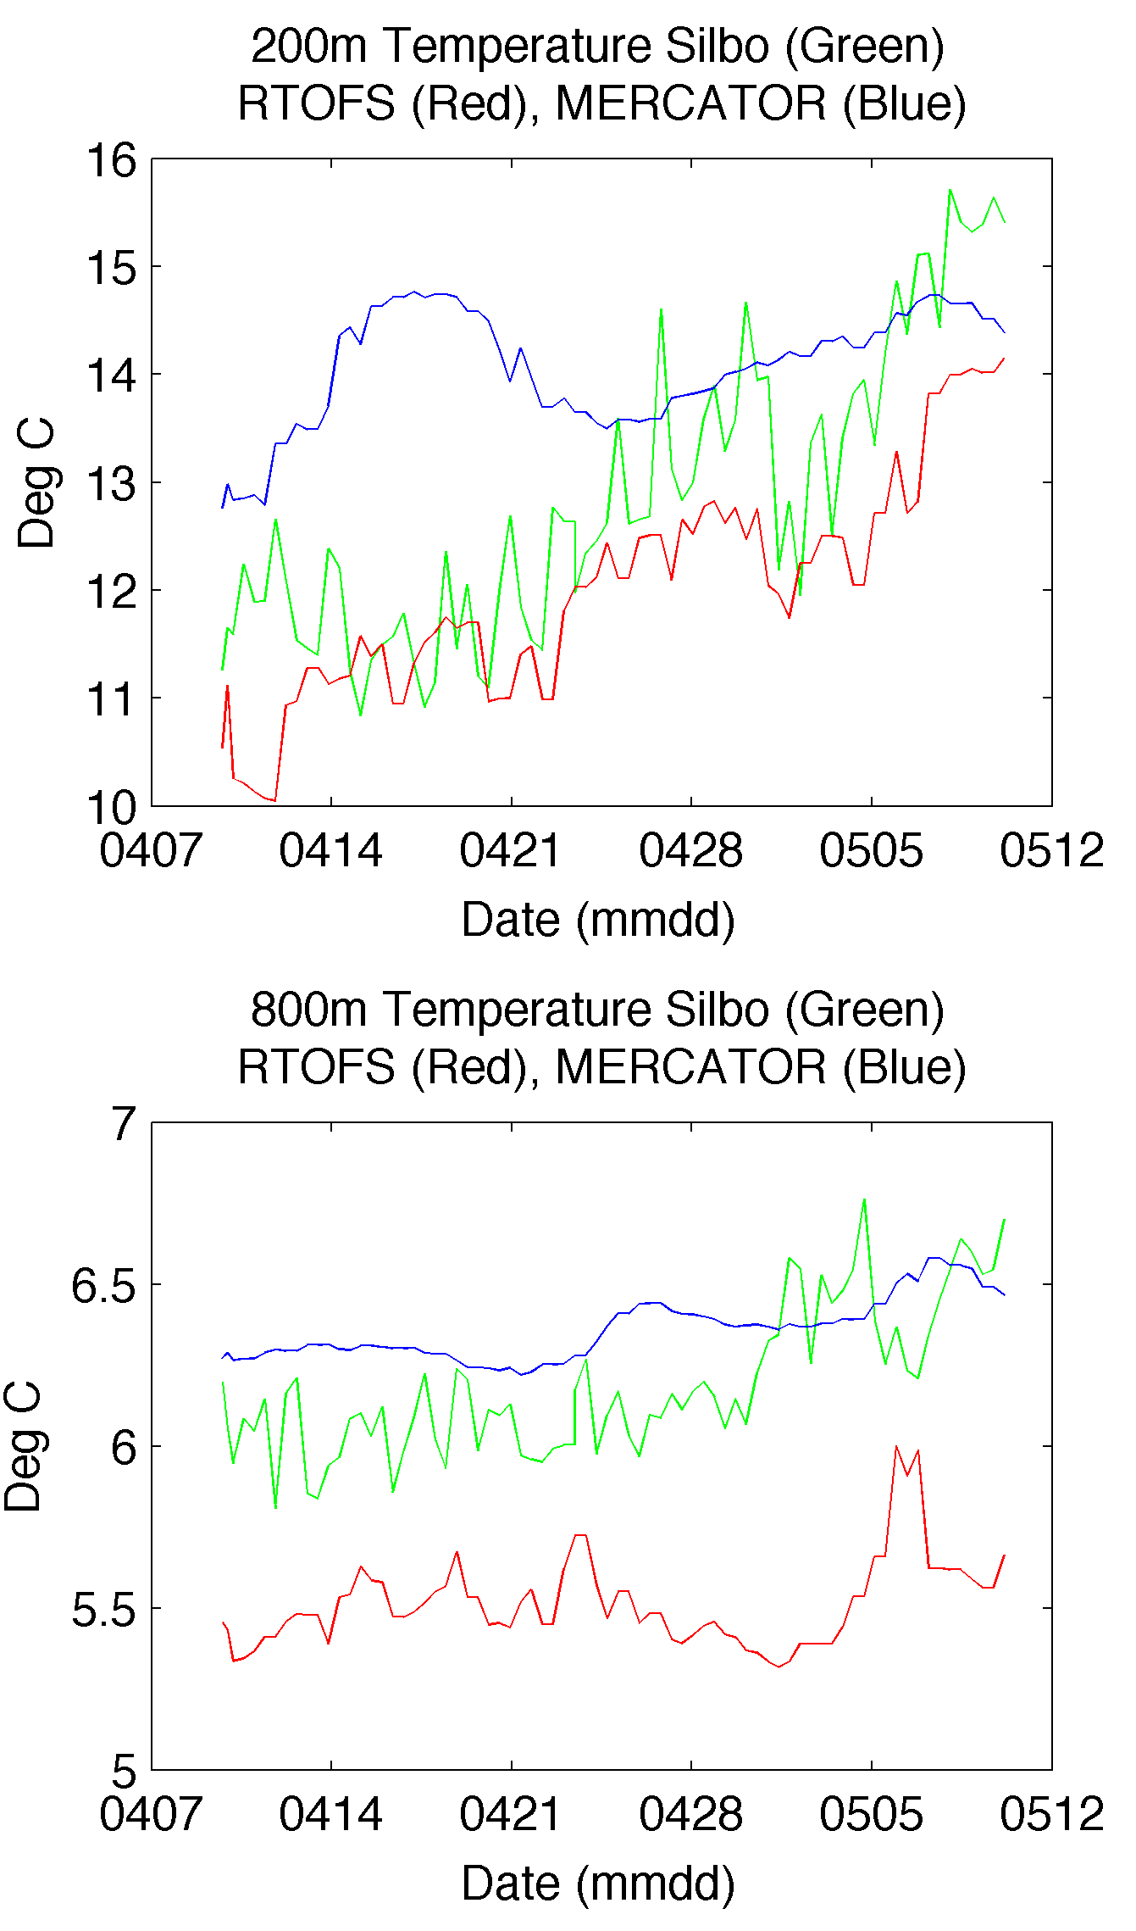
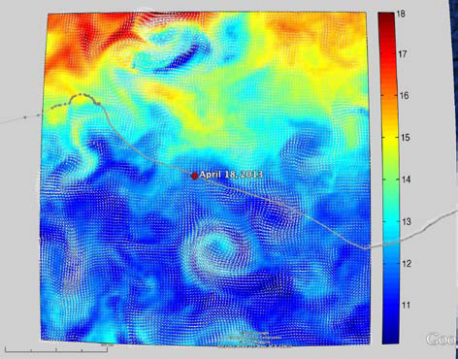
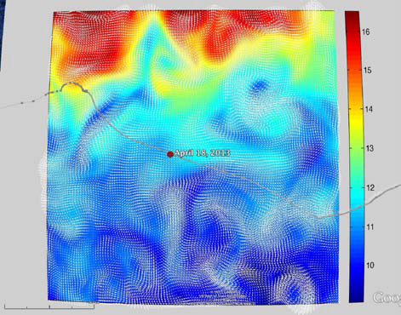
Next Steps: RTOFS and MERCATOR
Temperature and Current Maps at 200 m
200m temperature and currents on April 18th, 2013. The glider position is marked by the red dot.
RTOFS
200 m
800 m
MERCATOR
Student
Research
Published
Oceans ’13
Proceedings

Slide 10
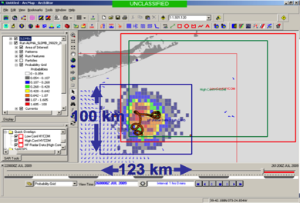
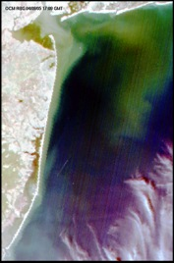
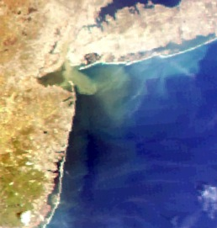
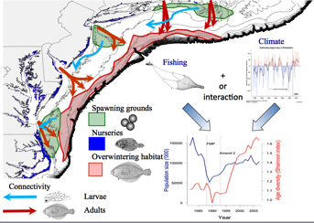
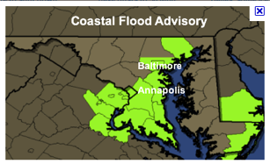
Ocean Use Case 2: Linking Discrete and Streaming Regional Data
1) Maritime Operations – Safety at Sea
3) Water Quality – a) Floatables, b) Hypoxia, c) Nutrients
2) Ecosystem Decision Support - Fisheries
5) Energy – Offshore Wind
4) Coastal Inundation - Flooding

Slide 12
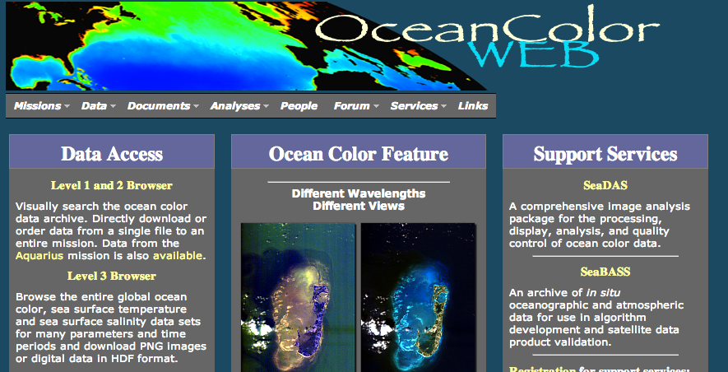
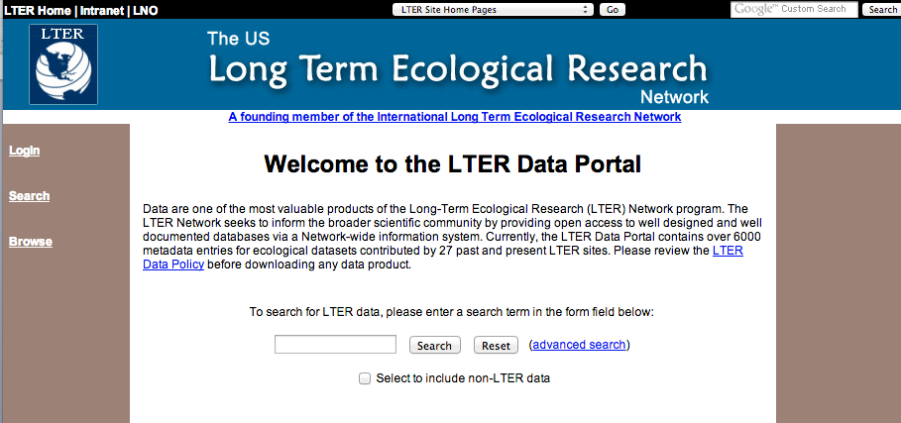
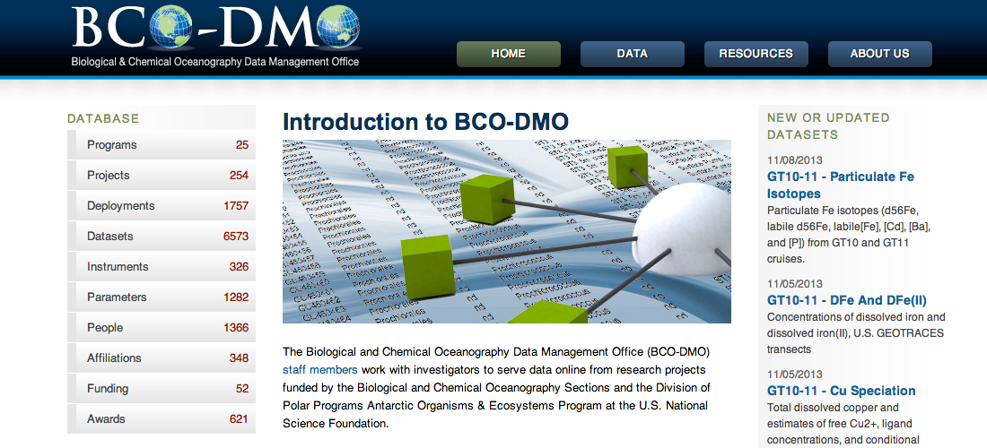
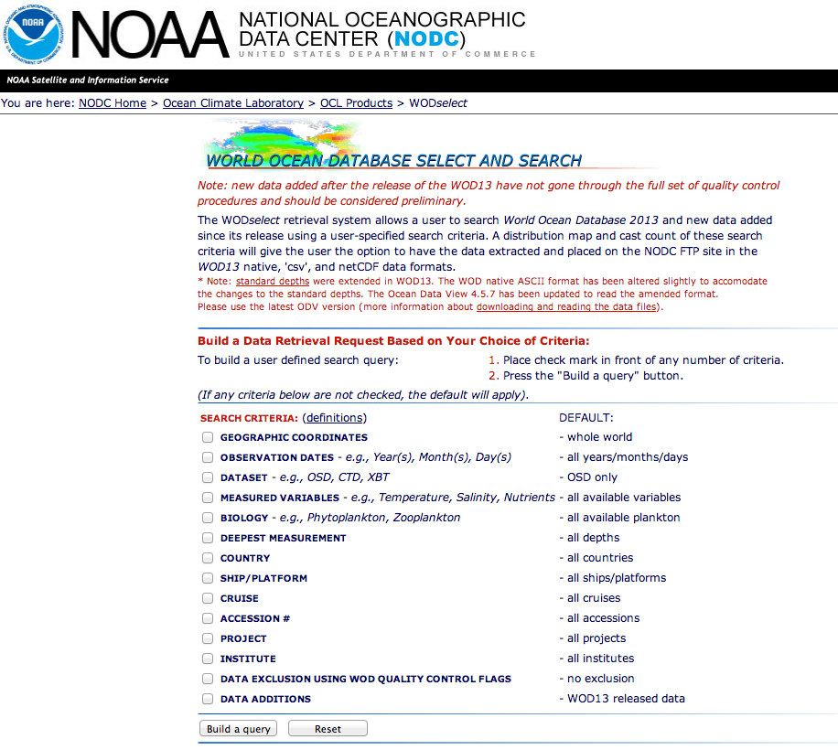
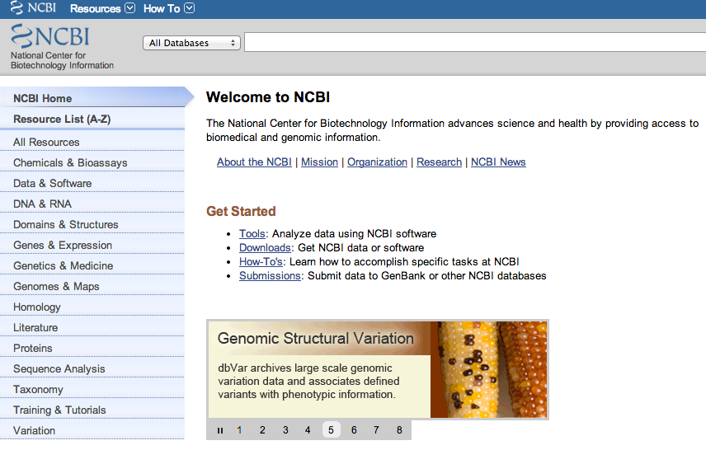
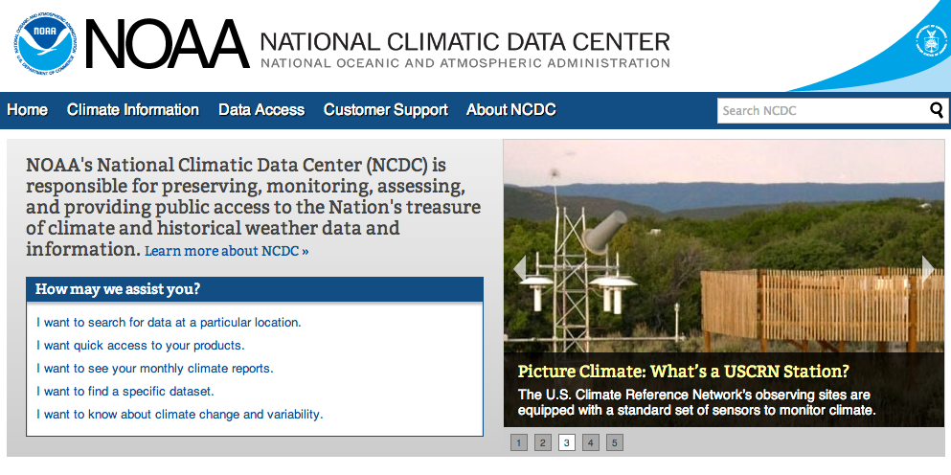
Distributed Databases
Stratified often by discipline
Too Many to keep up with

Slide 13
Integrating Marine Ecological Data & Model Output

Slide 14
Ocean Science Use Case 2: Is my data weird?
NOAA IOOS Streaming Data
NSF Expeditionary Discrete Data
Broker
I see some data from an ocean observing system. Is this data unique?
-Use the broker to access historical “discrete” data to put real-time data
in historical context

Slide 15
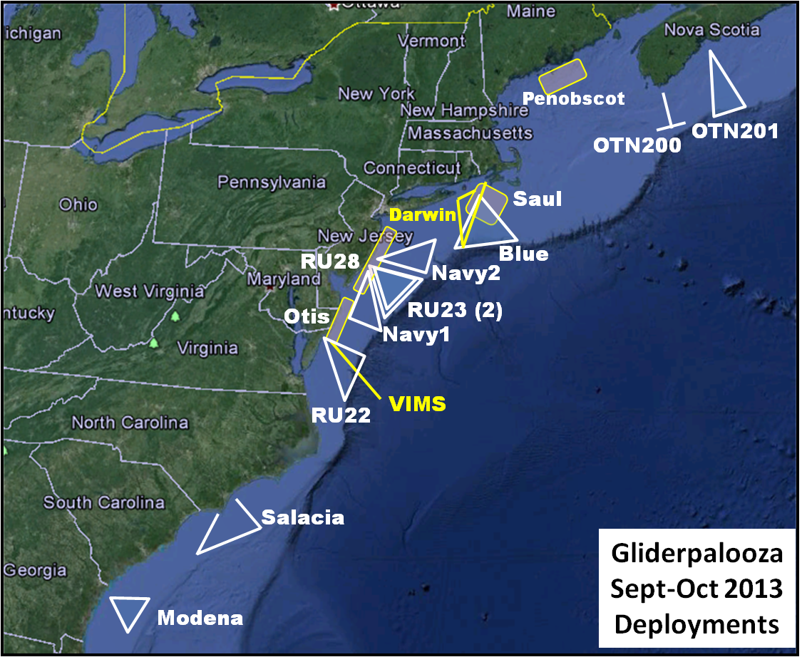

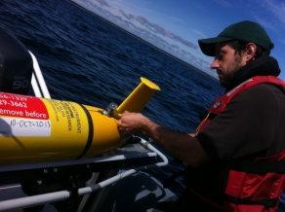
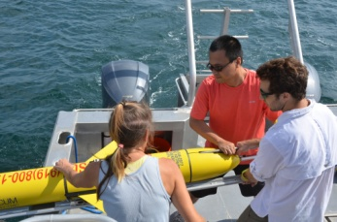
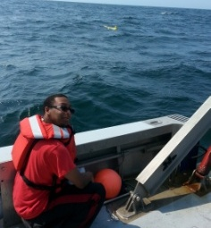
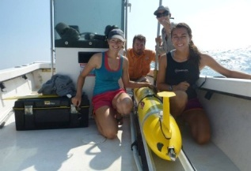
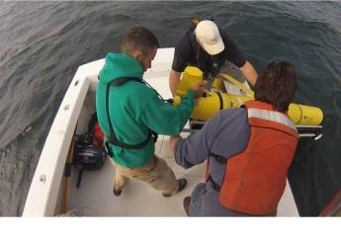
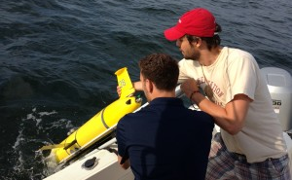
Gliderpalooza 2013 and we will conduct Modelpalooza 2014
 | Group | Glider | Deploy | Funding
1 | Dalhousie | OTN200 (2) | 10-Sep | OTN
2 |  | OTN201 | 16-Sep | OTN
3 | UMaine | Penobscot (2) | 10-Sep | Maine
4 | WHOI | Saul | 10-Sep | ONR
5 | UMass | Blue | 6-Sep | MARACOOS/IOOS
6 | Rutgers | RU28 | 12-Sep | NJDEP
7 | UMaryland | RU22 | 22-Sep | MARACOOS/IOOS
8 | Rutgers | RU23 (2) | 10-Sep | MARACOOS/IOOS
9 | UDelaware | Otis | 12-Sep | Private
10 | VIMS | Stewart | 10-Oct | VIMS
11 | NC State | Salacia | 17-Sep | NASA
12 | Skidaway | Modena | 10-Sep | Skidaway/SECOORA/IOOS
13 | T. Webb | Darwin | 11-Sep | Self
14 | Navy | Navy1 | 10-Oct | Navy
Oscar Schofield
Professor Bio-Optical Oceanography
Rutgers University

