Slide 1





Southern Ocean Observing System
Oscar Schofield (US), Anna Wåhlin (Sweden), Andrew Constable (Australia), Seb Swart (South Africa), and Louise Newman (Australia)

Slide 2
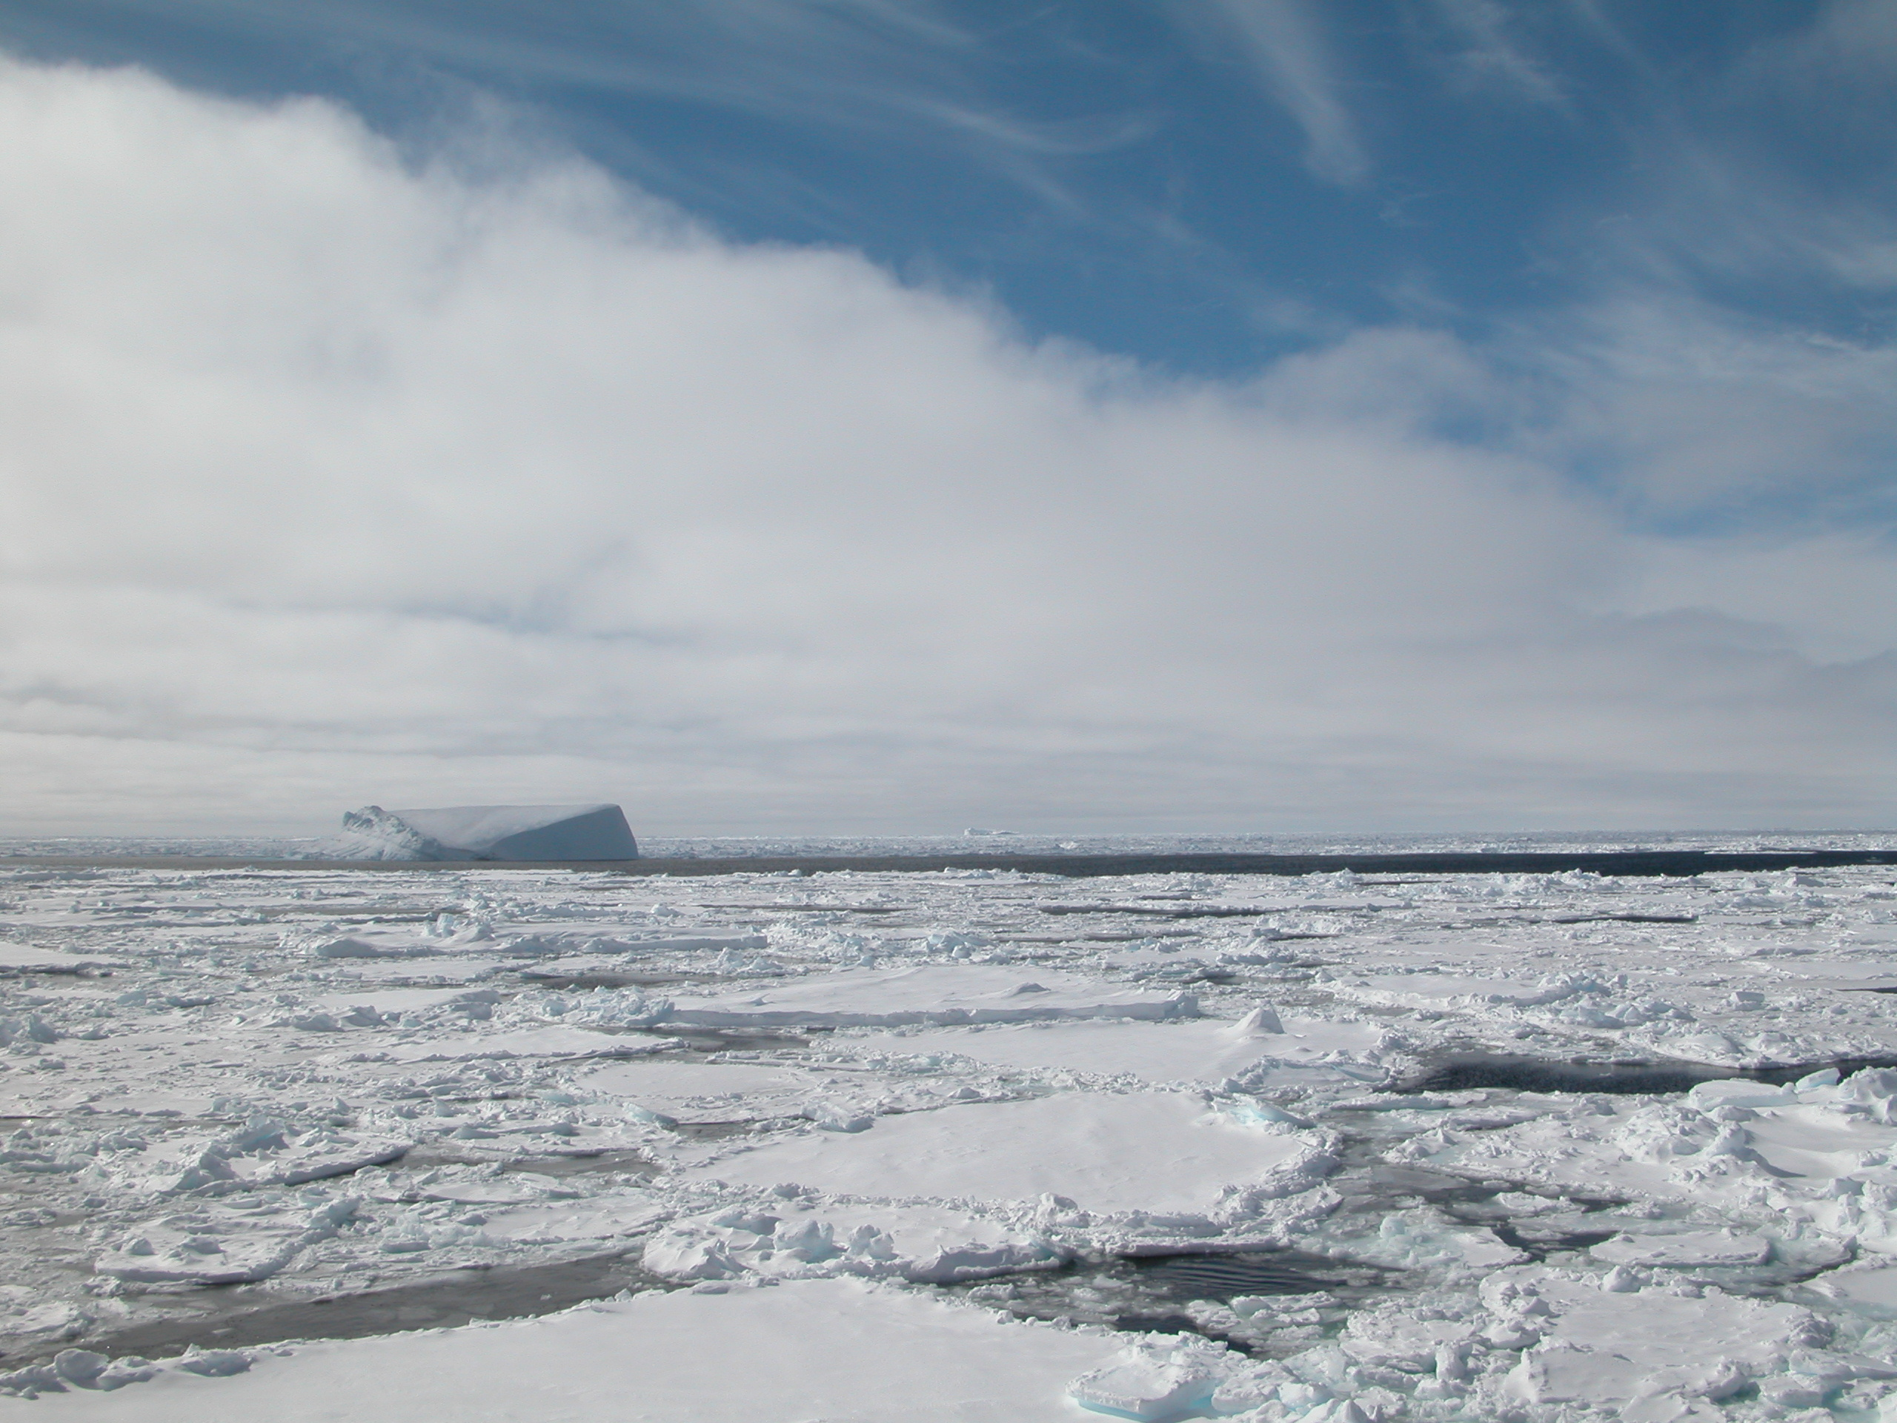
SOOS Motivation
- Many (mono-disciplinary) programmes in SO research, all with individual infrastructure, data routes etc. SOOS will connect across disciplines and programmes to ensure a coordinated approach to observing the SO.
- Sponsored by SCAR (Scientific Committee on Antarctic Research) and SCOR (Scientific Committee on Oceanic Research)
SOOS Initial Science and Implementation Strategy – developed by SCAR/SCOR Expert Group on Oceanography and the SCAR/CLIVAR/CliC Southern Ocean Panel.
International Project Office opened August 2011, hosted by the Institute for Marine and Antarctic Studies (University of Tasmania), with additional support from the Australian Antarctic Division.
Notes:
various (mostly mono-discipline) programmes have existed in the Southern Ocean for some time, each with their own infrastructures, data routes etc. Each are worthy, but the gains from genuinely cross-discipline working and shared data access have not been realised. SOOS aims to achieve these, and also chart the course for the future of sustained, strategic observations in the Southern Ocean. (Then the detail about SCAR, SCOR, IPO etc can come)

Slide 3
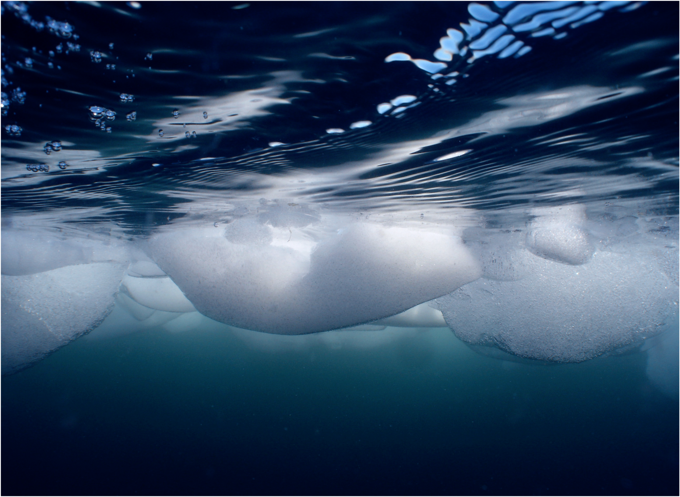
MISSION: To establish a multidisciplinary system to deliver the sustained observations of the Southern Ocean that are needed to address key challenges of scientific and societal relevance, including climate change, sea-level rise and the impacts of global change on marine ecosystems.
B. Wallis AAD

Slide 4
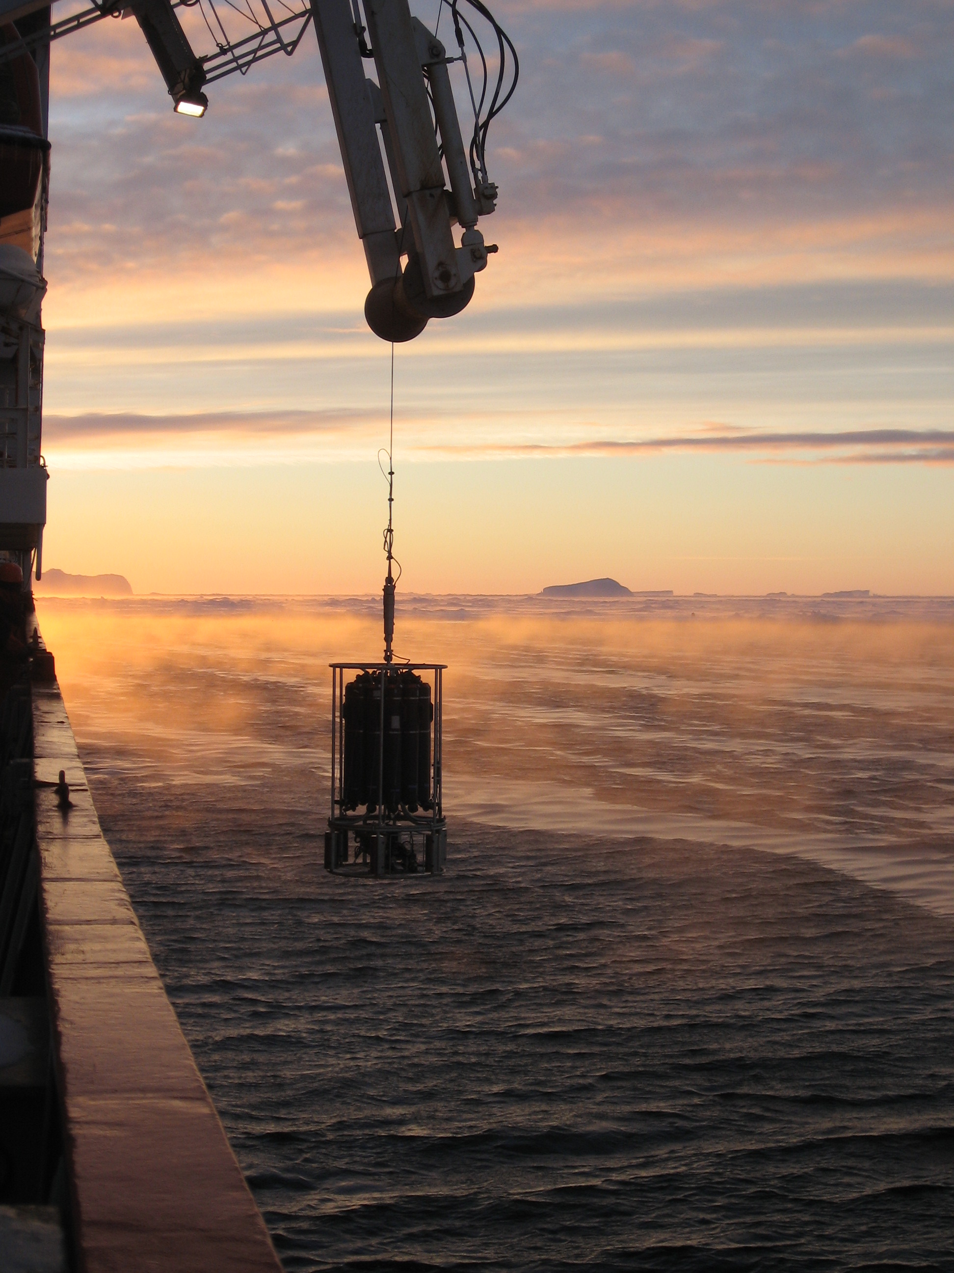
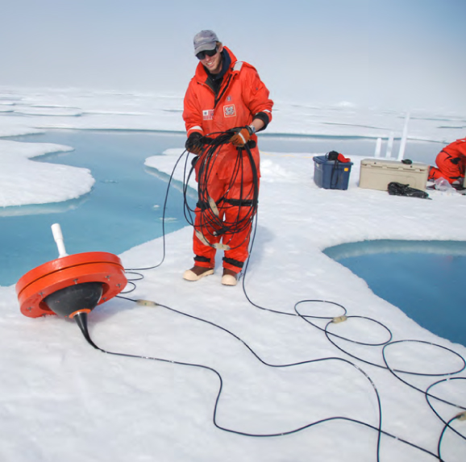
Science Themes
Key science challenges identified as most pressing issues, both scientifically and societally - to be addressed by the SOOS:
Role of Southern Ocean in global freshwater and heat balance
Stability of Southern Ocean overturning circulation
Stability of Antarctic ice sheet and future contribution to sea-level rise
Future of Southern Ocean carbon uptake
Future of Antarctic sea ice
Impacts of global change on Antarctic ecosystems
P. Holland
IPAB
Notes:
6 scientific challenges identified as being the key Southern Ocean issues that need addressing. SOOS will focus efforts along scientific themes
Outline in detail in strategy.
One important step is to articulate key questions within these themes.

Slide 5
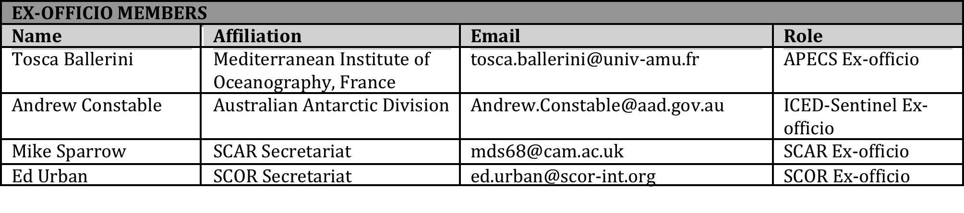
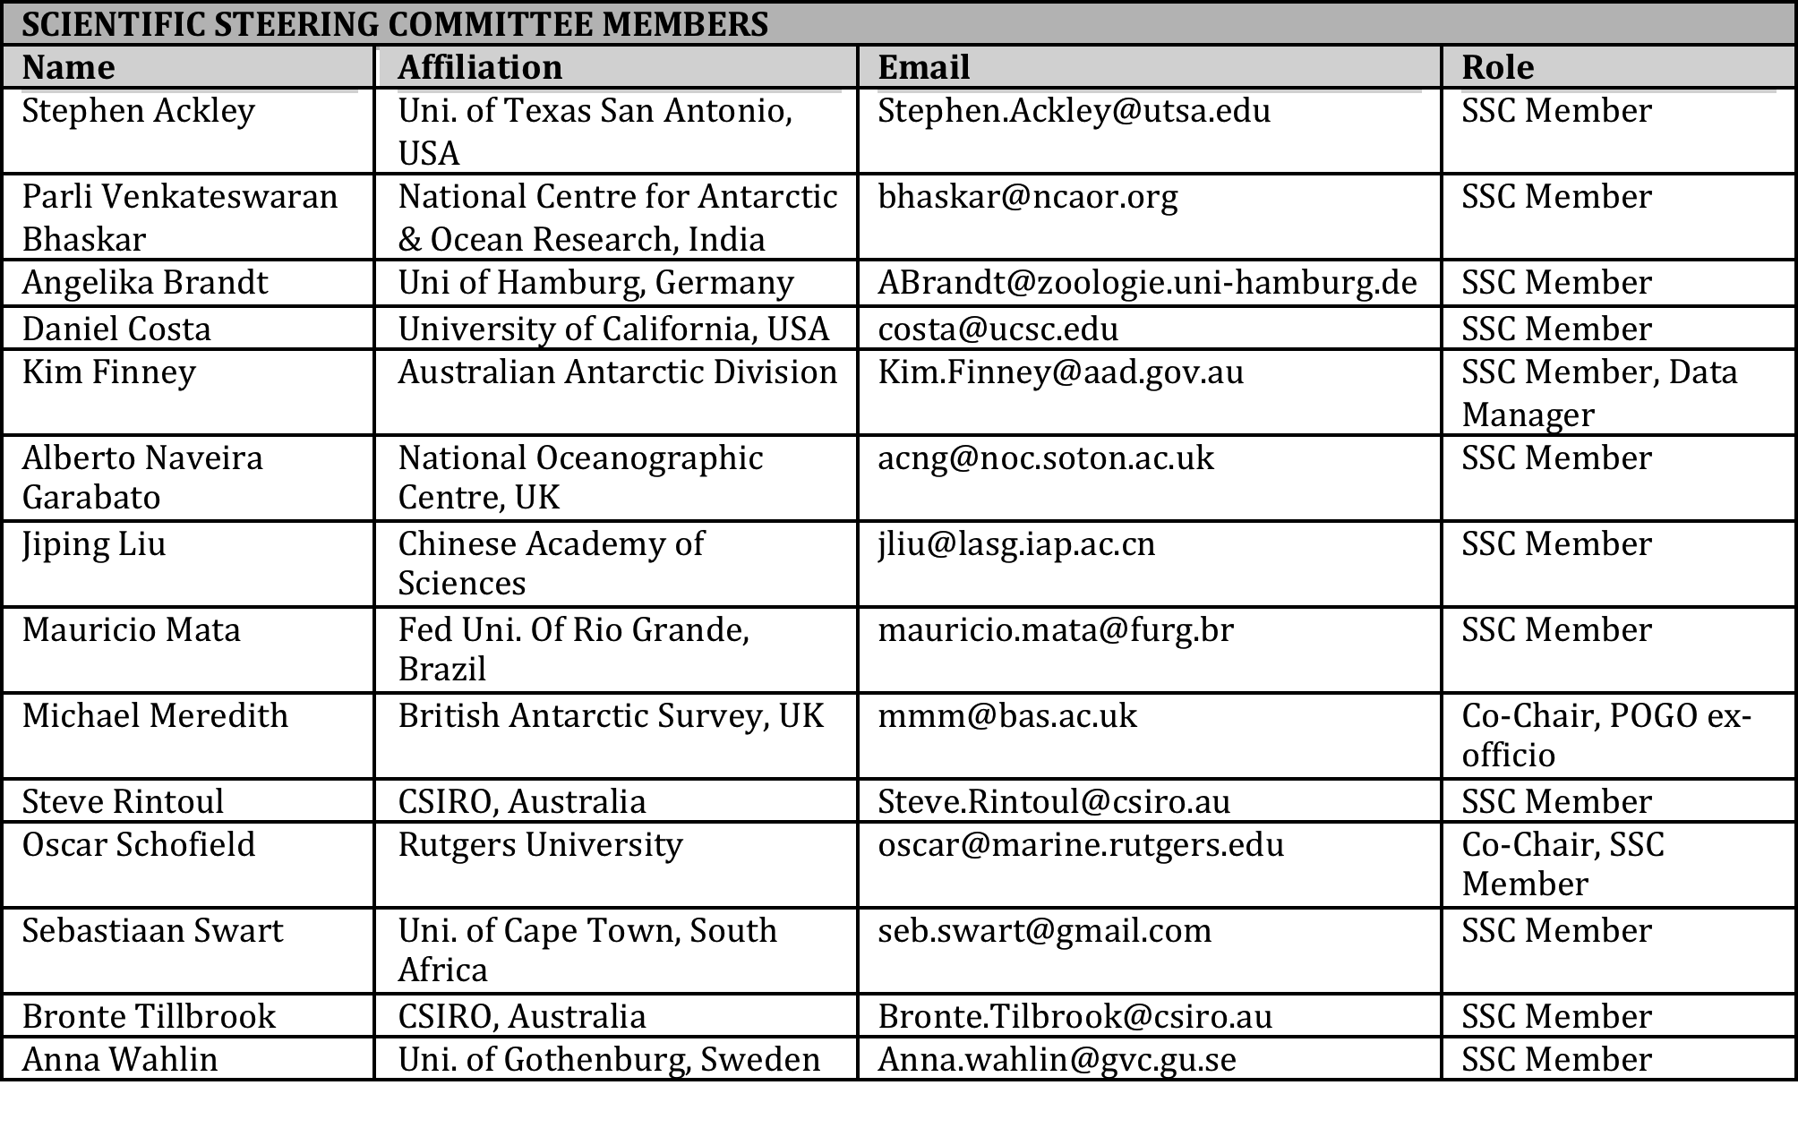
Scientific Steering Committee
Membership:
Expertise
Scientific standing
Programmatic connections
National representation

Slide 6
Achieving the mission…
Many international/national programmes involved in Southern Ocean observations. SOOS will work with these to:
- Design and implement SO observing system
Advocate and guide development of new technologies
Unify current observation efforts and leverage further resources
Integrate / communicate – between nations, international and national projects, and across traditional disciplinary boundaries
Facilitate and develop a data system with seamless access to essential data and data products
Notes:
focus in on 3 of these statements with specific activities

Slide 7
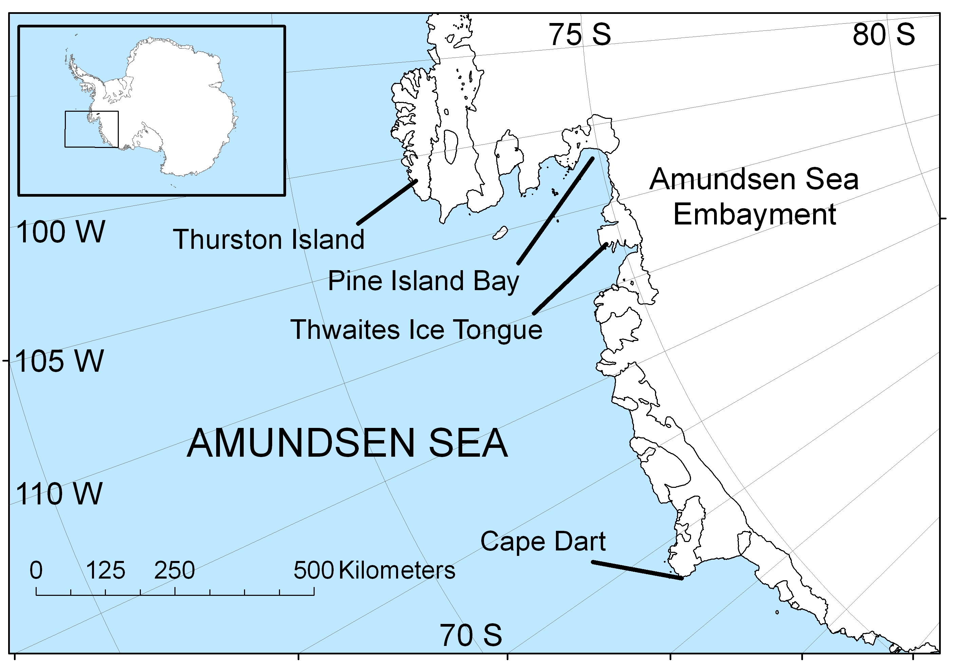
Flagship Projects: Focused on a chronically under-sampled region, little or no existing infrastructure, extensive international coordination of logistics required.
Benefits: As little is known about the region, any level of observation enhancement will significantly increase our understanding
Amundsen Sea
3rd largest ice drainage basin of WAIS
Area of high primary production in polynyas
Significant glacial retreat and melt input, and decrease in sea-ice extent.
Region may be a weak link in stability of WAIS.
No Antarctic bases nearby, no regular ship transects – therefore logistically demanding
Researchers from a number of nations now looking to enhance observations in this critical area – will need significant logistical and operational support

Slide 8
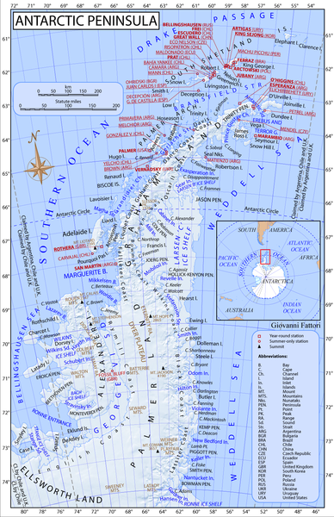
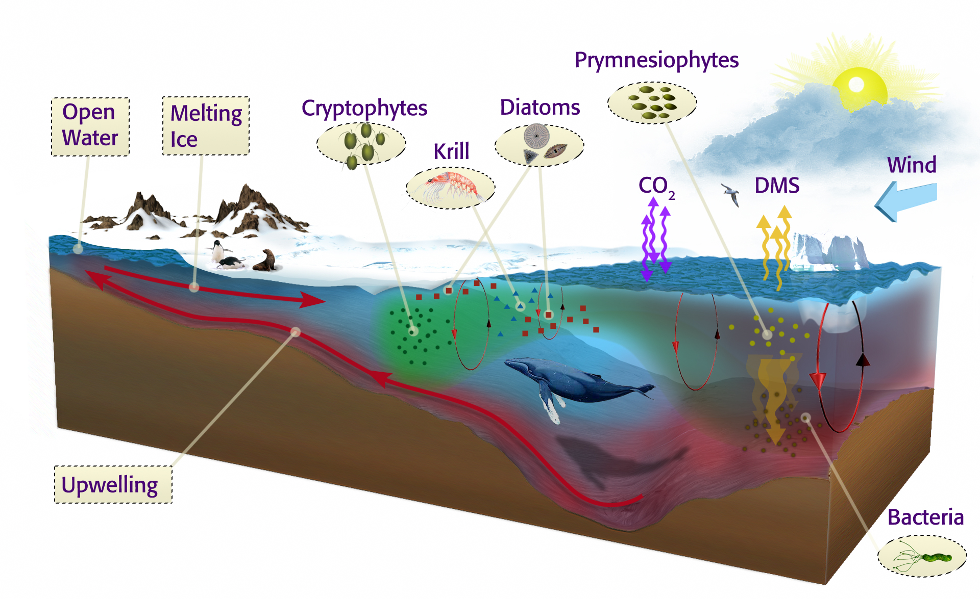
Enhanced Regional Study: Focused on a region with significant history of observations, has existing infrastructure and potential for many nations to be involved.
Benefits: Logistically “easy”, high potential to push the envelope with regard to the technology, will provide a “test-case” for SOOS vision
Antarctic Peninsula
Significant levels of infrastructure present
Many nations already work in region, therefore many international efforts that can be pulled together
Area of rapid change from physics to ecosystems driven by deep ocean.
Region of rapid climate change

Slide 9
Regionally Constrained Study: Region is constrained by unique physical feature, important biological/chemical/physical problems, variable logistical cooperation required.
Benefits: Logistical considerations are secondary, driven by a specific science question
Kerguelen Plateau – Ecosystem Study
Iron fertilisation from Plateau driving observed variability in productivity
Transects designed to sample upstream, on and downstream of the Kerguelen Plateau
Current project plans are ecosystem-based, but huge potential for international collaboration for a total-system study
Micronutrient control with potential geoengineering considerations
Mean Chlorophyll-a

Slide 10
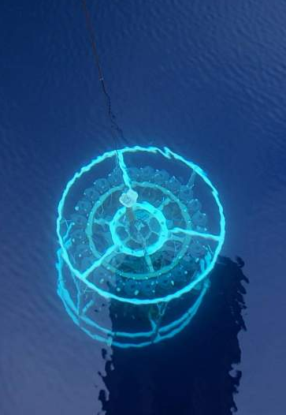
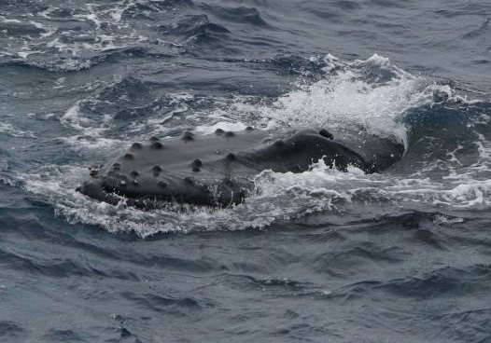
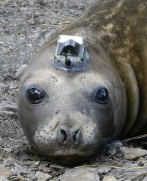
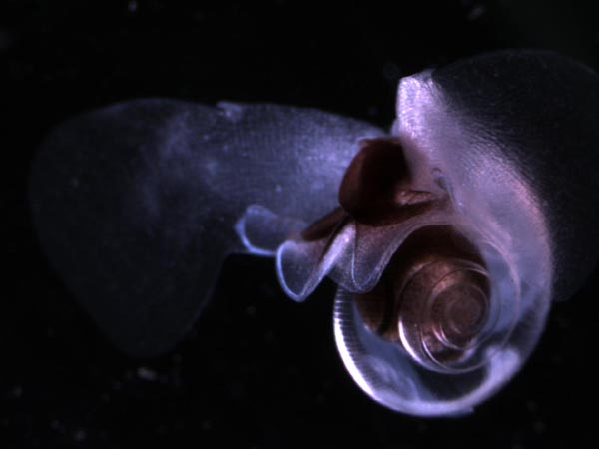
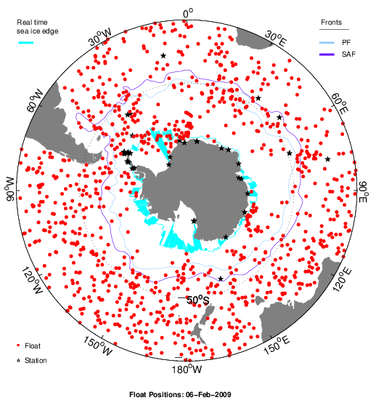
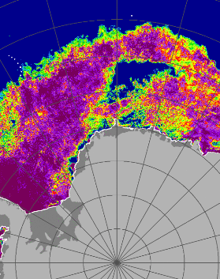
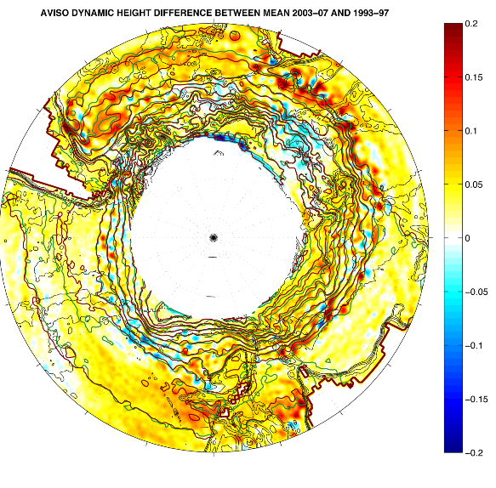
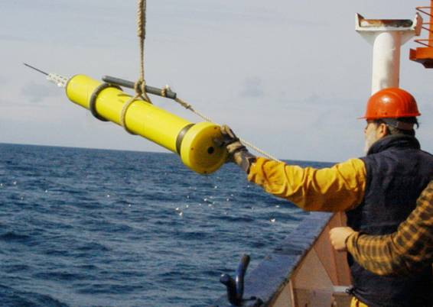
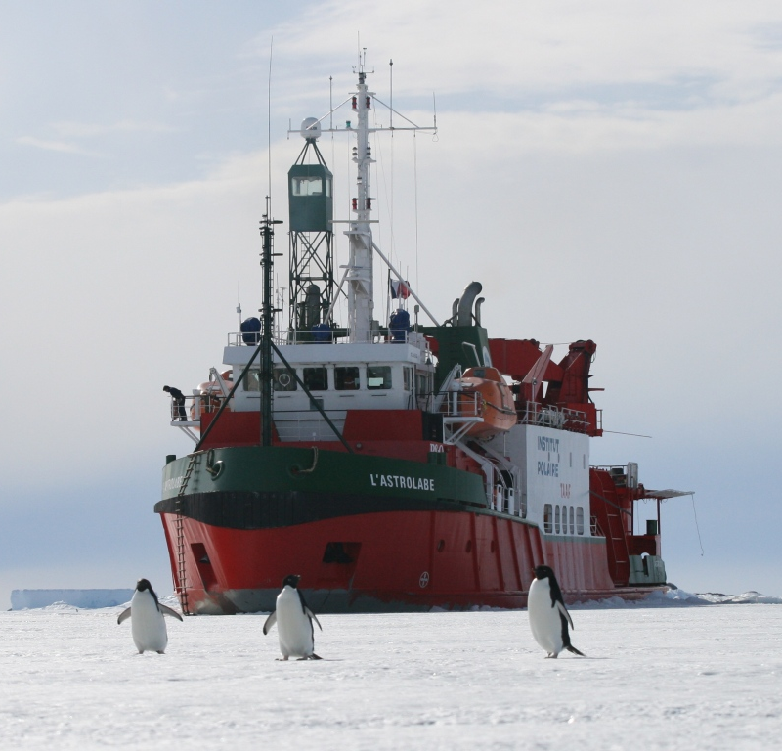
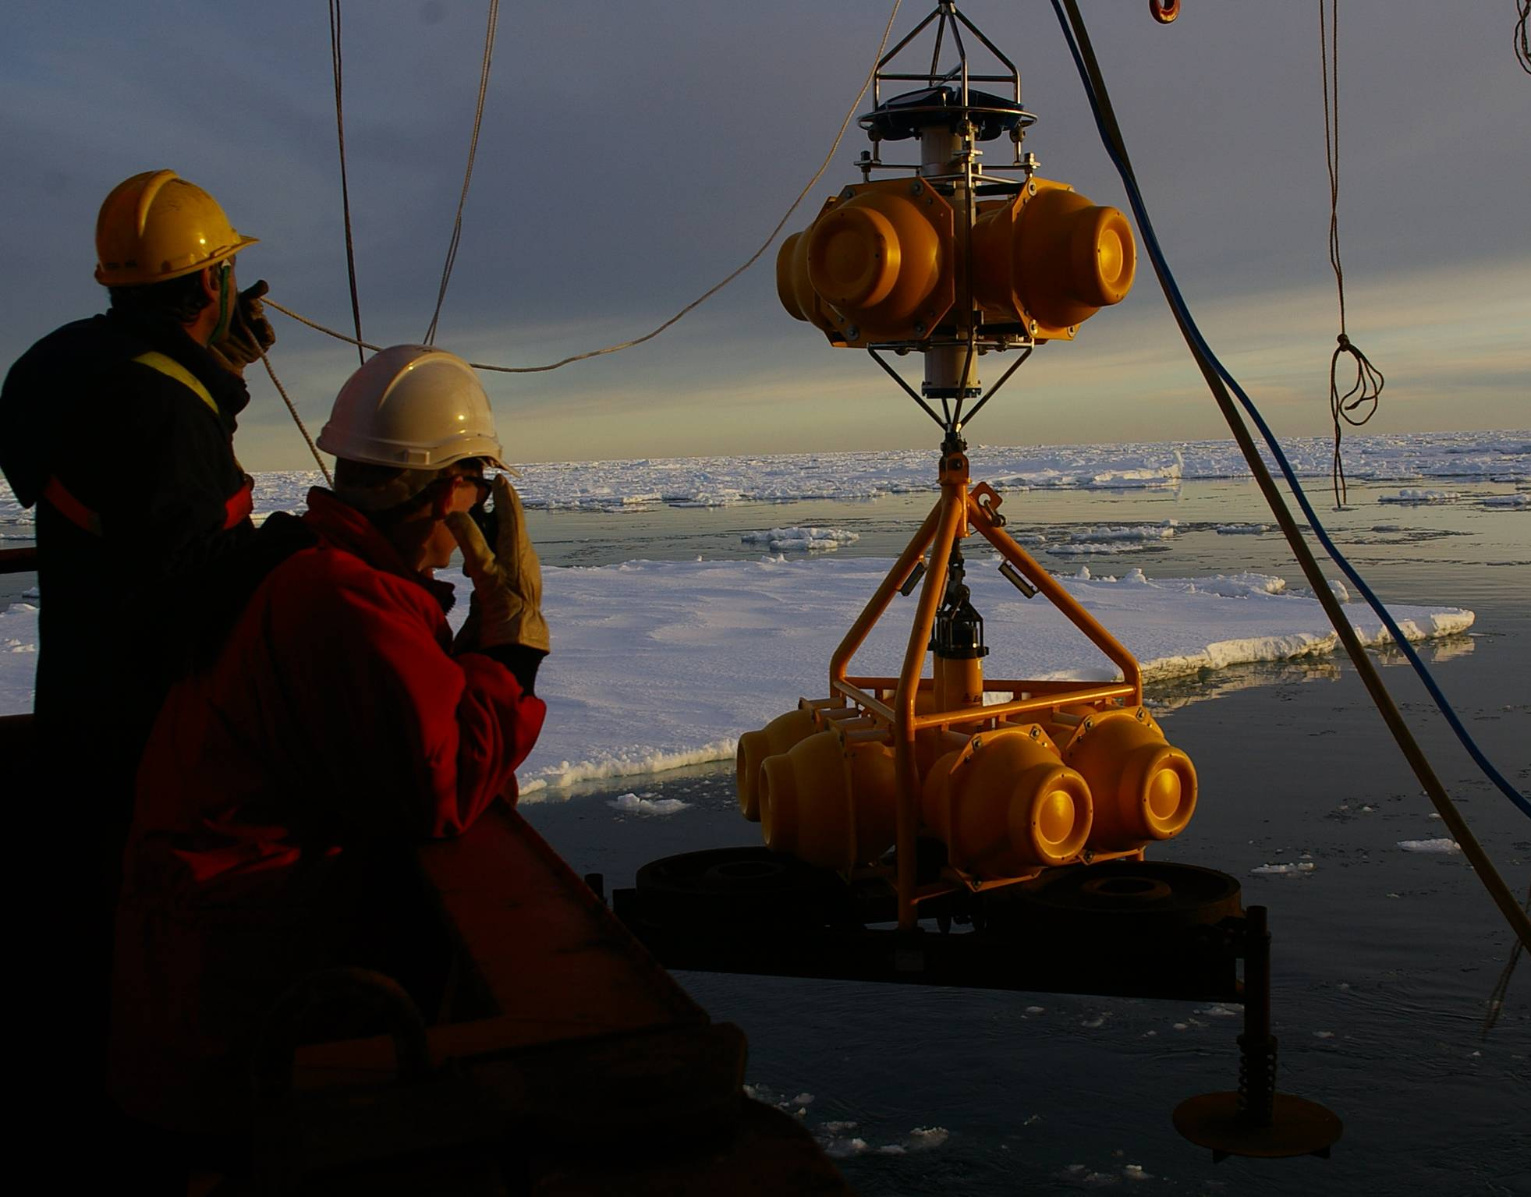

Slide 11
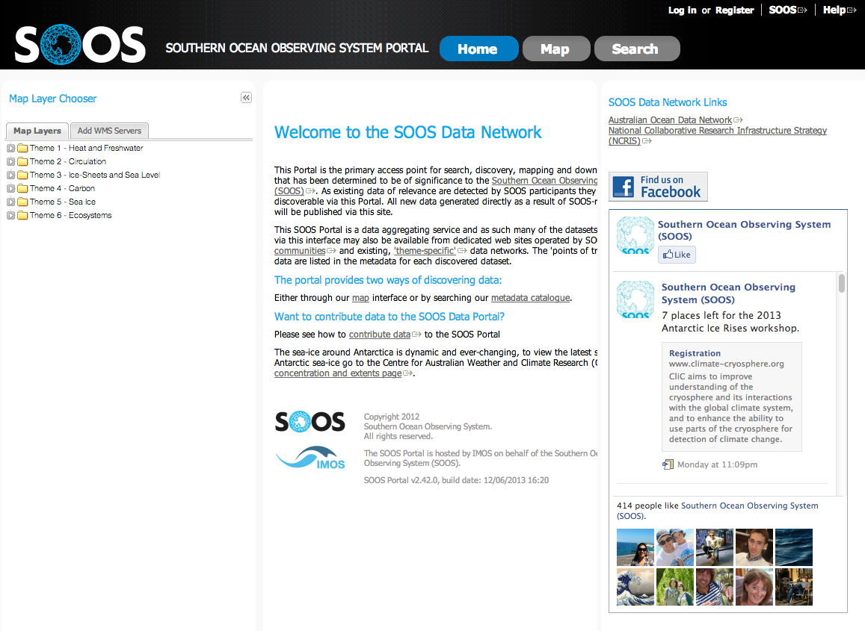
SOOS will require data systems and data portals

