Slide 1
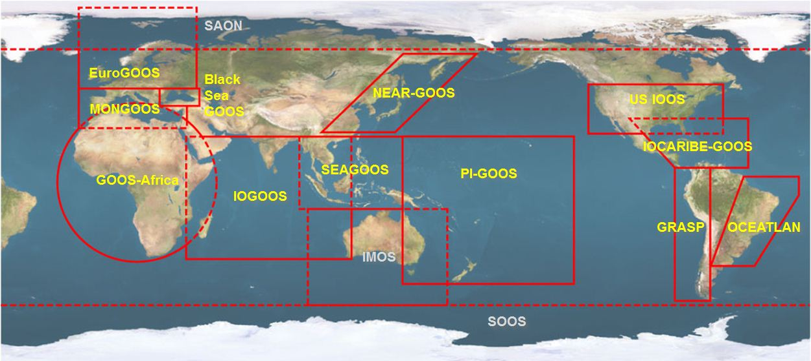





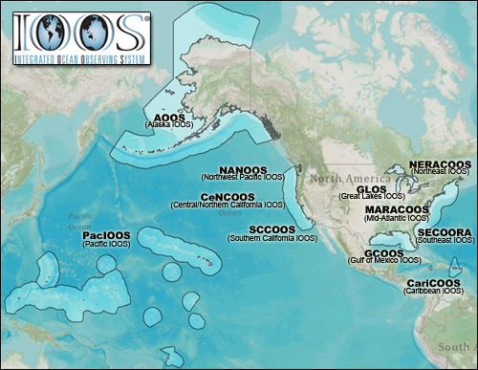


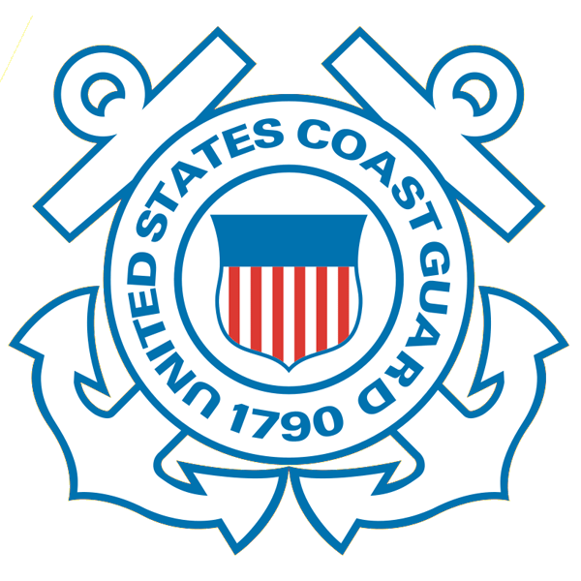









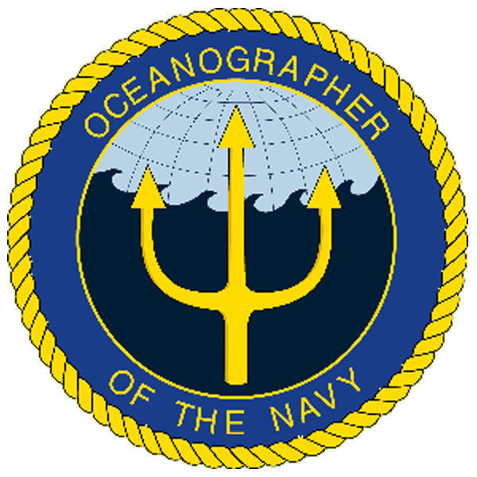
U.S. Integrated Ocean Observing System (IOOS)
Global Component
National Component
Regional Component
15 Regional Alliances in GOOS
Vessels -
Satellite
Satellite
CODAR
Ships/ Vessels
Glider
REMUS
Data Vis.
Modeling
Security
Leadership
Education
11 Regional Associations
17 U.S. Federal Agencies
http://ioos.gov

Slide 2
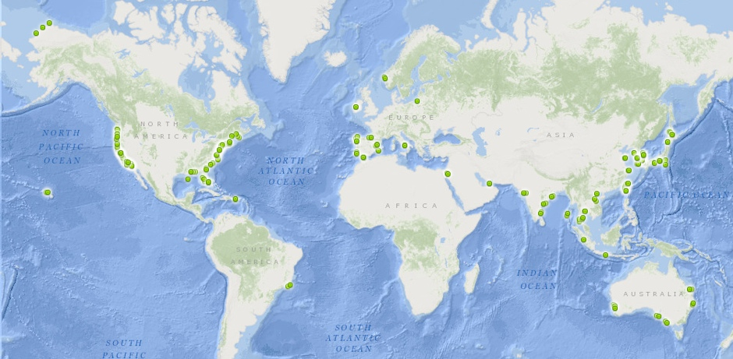
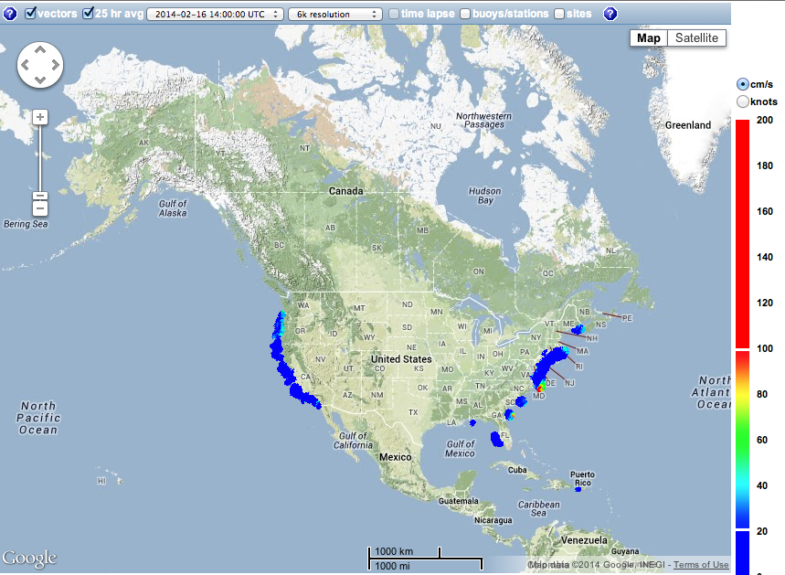
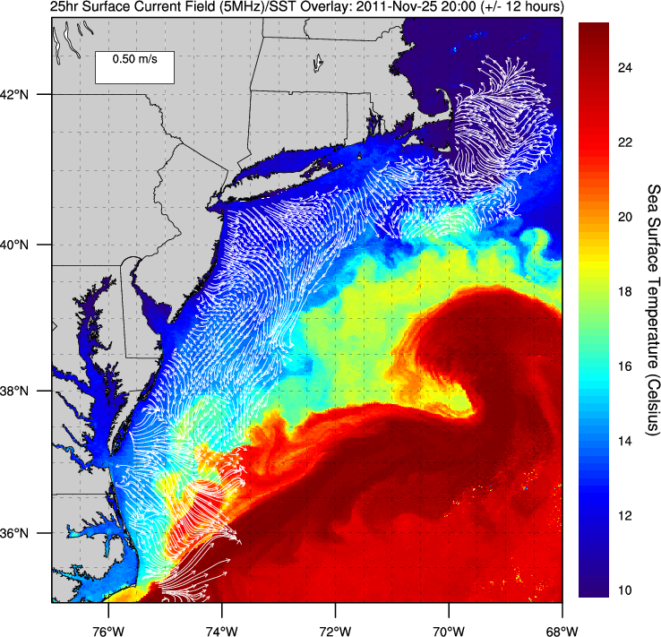
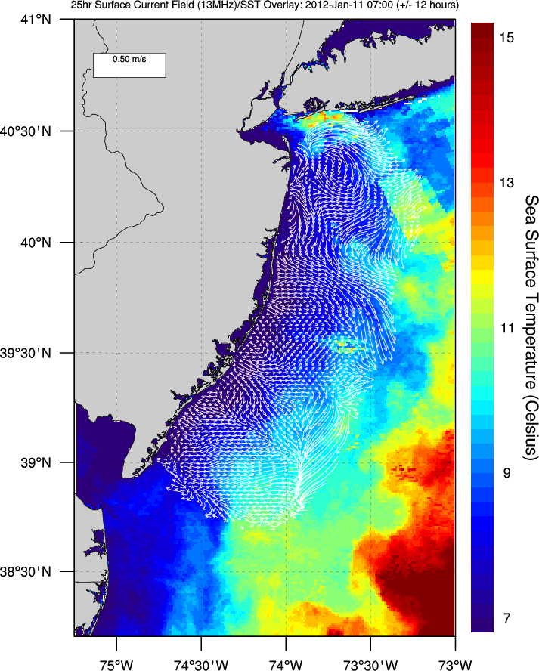
U.S. Integrated Ocean Observing System (IOOS)
Global Component
National Component
Regional Component
Positions
Global HF Radar Network
Vessels -
Satellite
Multistatic
Nested
Monostatic
Mid-Atlantic HF Radar Network
U.S. National HF Radar Network
http://ioos.gov

Slide 3
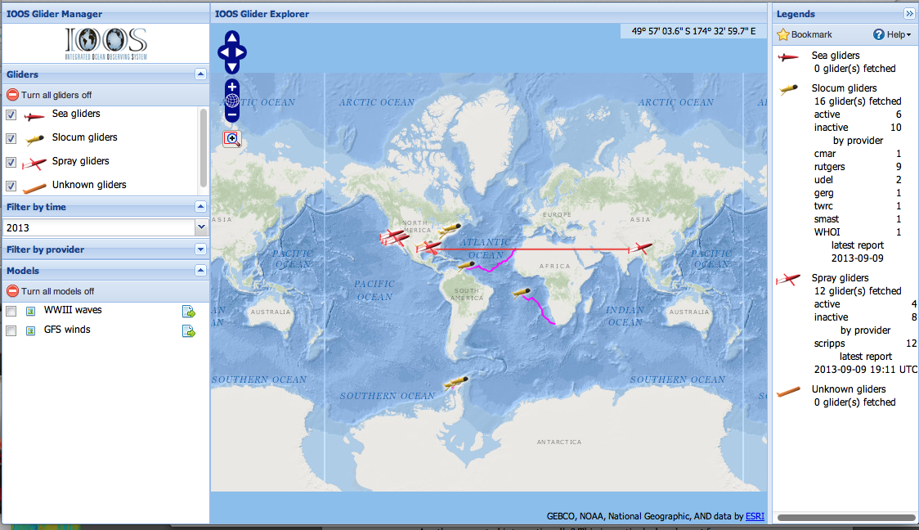
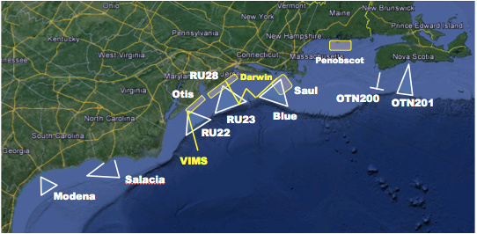
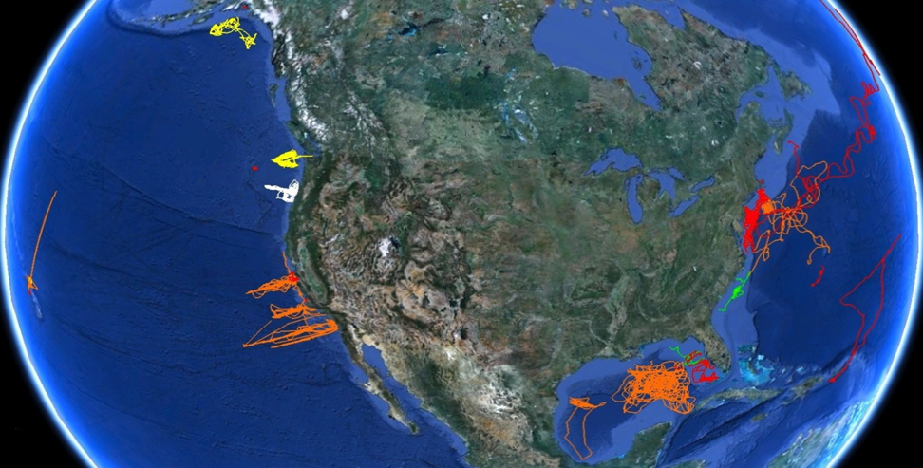
U.S. Integrated Ocean Observing System (IOOS)
Global Component
National Component
Regional Component
Vessels -
Satellite
Global Glider Networks
Multistatic
Nested
Mid-Atlantic Glider Network
U.S. National Glider Network
http://ioos.gov

Slide 4
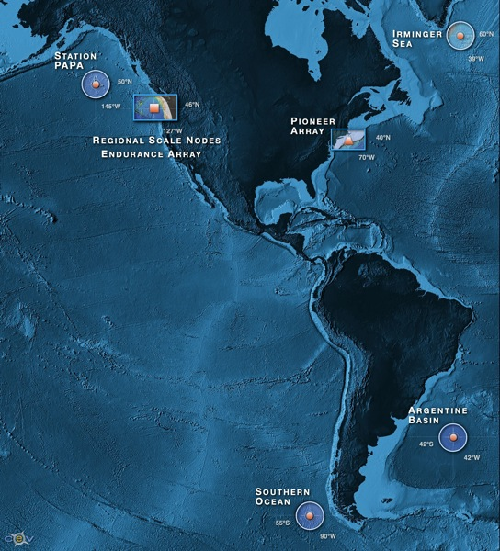


NSF Ocean Observing Initiative
Five Integrated Transformational Activities
High Latitude Global Sites
Regional Plate-scale Cable
Coastal Dynamics Arrays
Cyber-Science: Data Delivery & Sensor Interactivity
Cyber-Education: Undergrad & Public Engagement
4
Notes:
They are specific

Slide 5
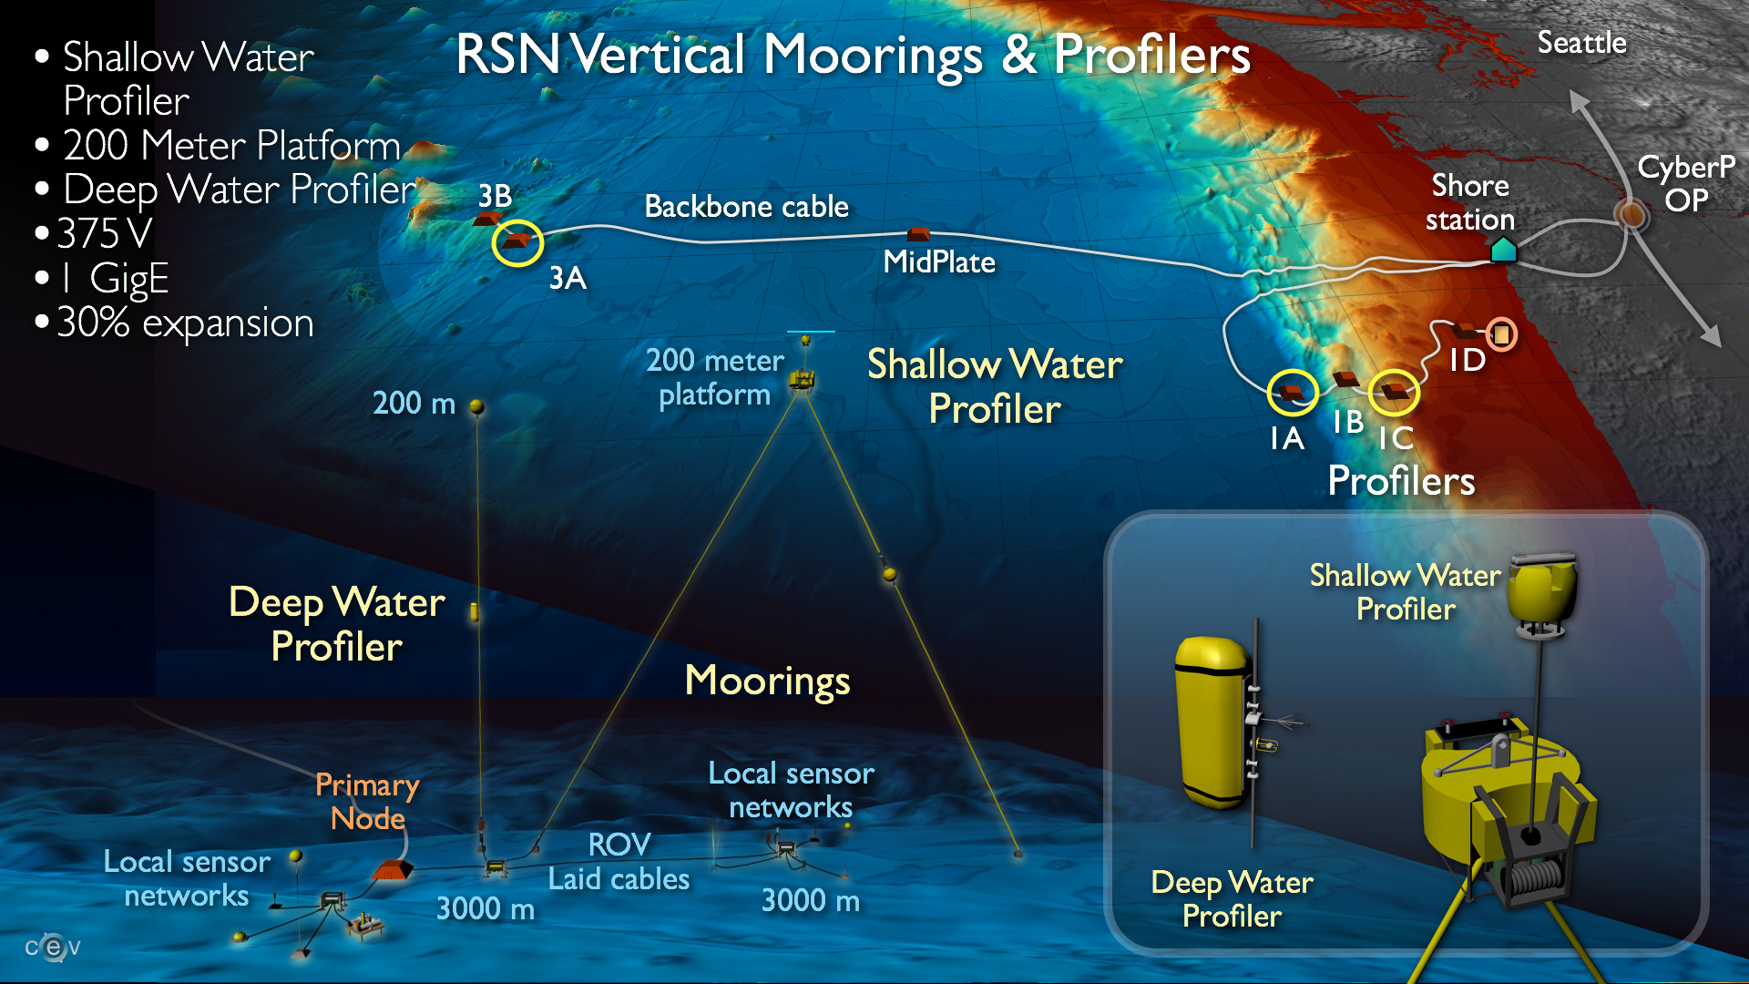
Regional Scale Node – Water Column Sensors
5
Notes:
They are specific

Slide 6
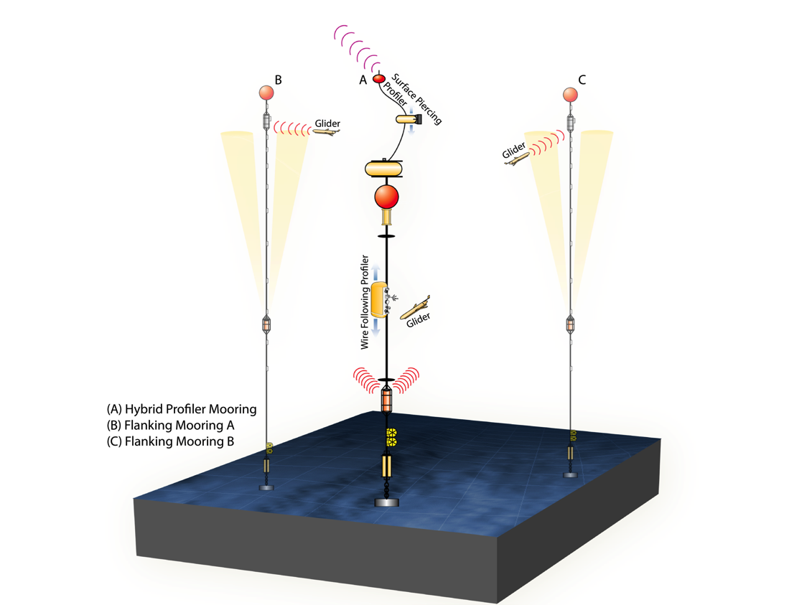
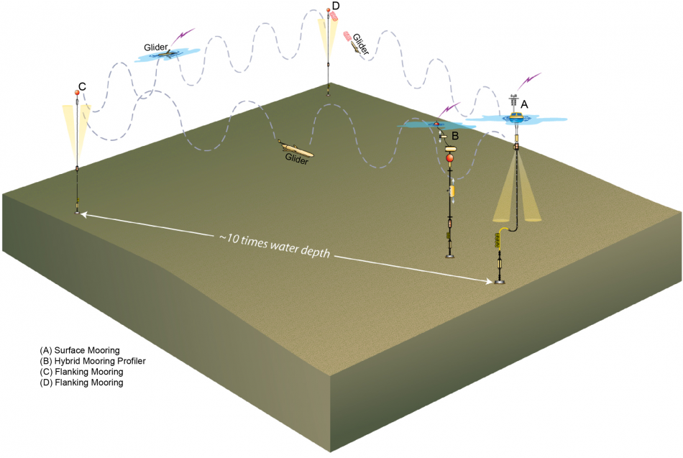
Global Scale Nodes
Station Papa
Irminger Sea, Southern Ocean, Argentine Basin
6
Notes:
They are specific

Slide 7
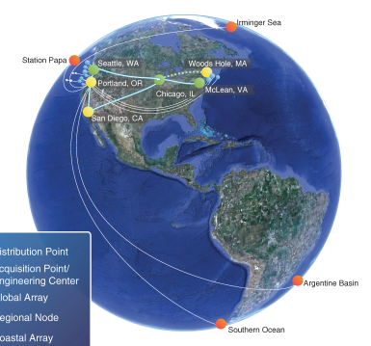
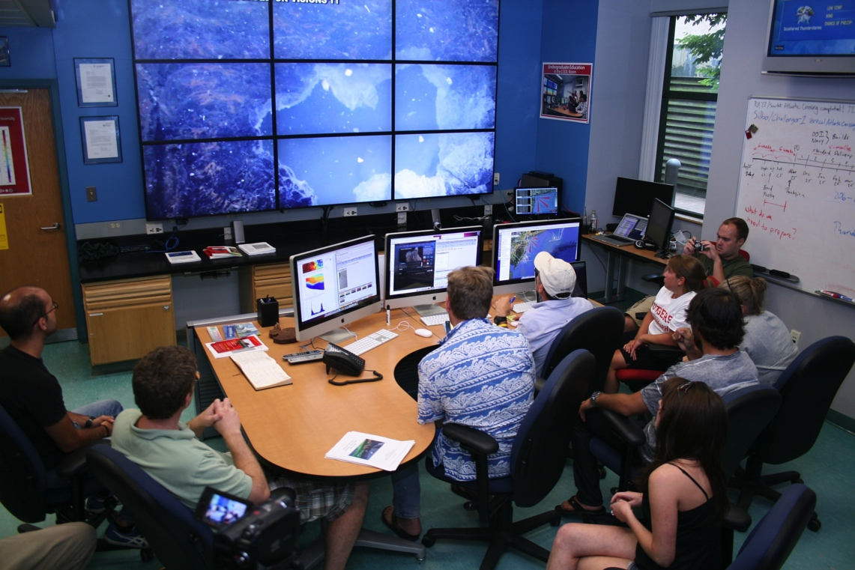
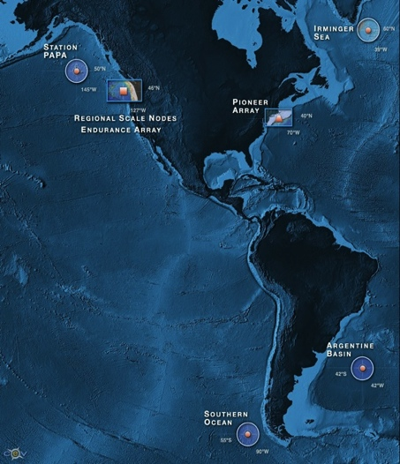


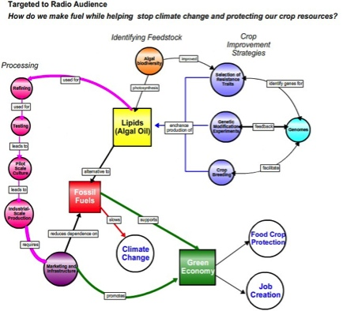
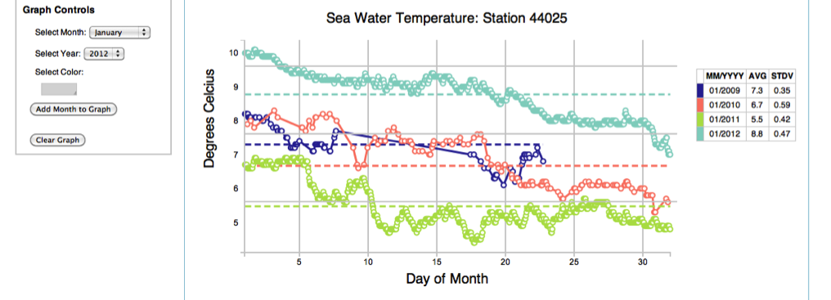
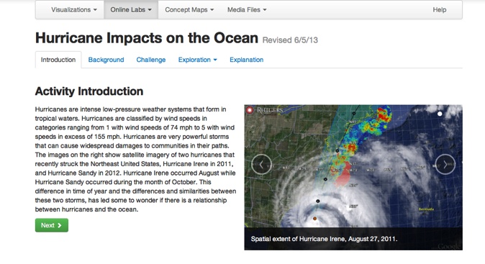
OOI – Enabling the Undergraduate Classroom
Cyber
Concept Maps
Data Visualization Tools
Investigation Builder

Slide 8
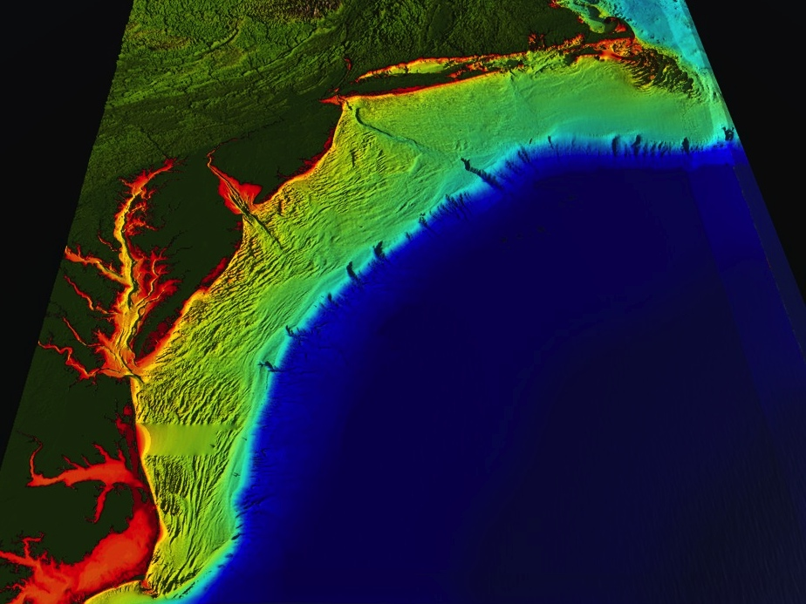
















RI
U..
Middle Atlantic
Regional Association
Coastal
Ocean Observing System
10 States - 76 Million People
1000 km Cape to Cape
CT
Cape
Cod
MA
NY
PA
NJ
MARACOOS:
A Sustained Real-Time Ocean Observation and Forecast Network
DE
MD
>40 PIs
>20 Institutions
>50 Members
>2000 Contacts
Scott Glenn + Many
VA
NC
Cape
Hatteras
Notes:
8

Slide 9
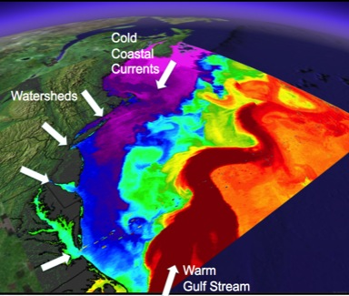
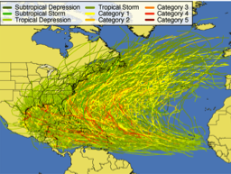
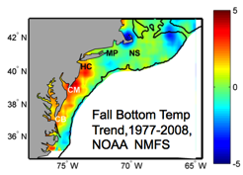
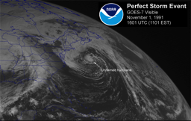
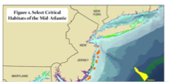
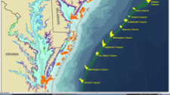
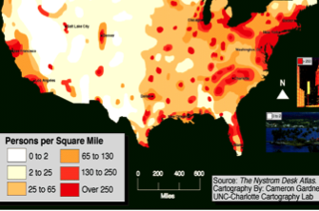
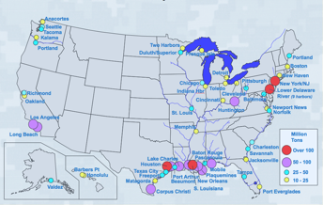
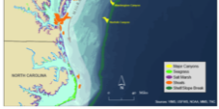
MID-ATLANTIC REGIONAL DRIVERS
Tropical Storms
Climate Change
Ocean Circulation
Critical Habitat
Northeasters
Population
Ports

Slide 10
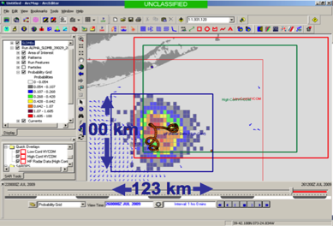
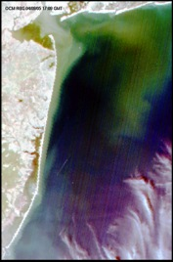
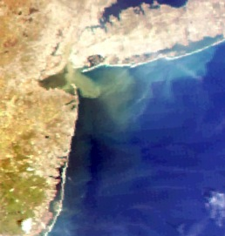
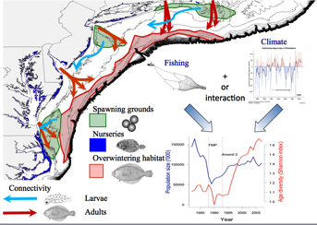
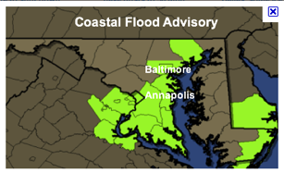
MARACOOS REGIONAL THEMES
1) Maritime Operations – Safety at Sea
3) Water Quality – a) Floatables, b) Hypoxia, c) Nutrients
2) Ecosystem Decision Support - Fisheries
5) Energy – Offshore Wind
4) Coastal Inundation - Flooding

Slide 11
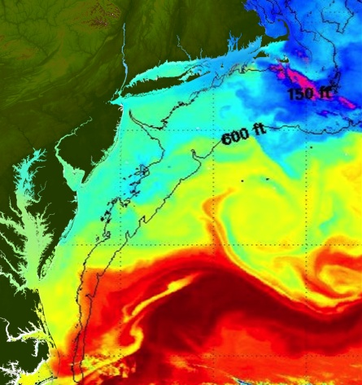
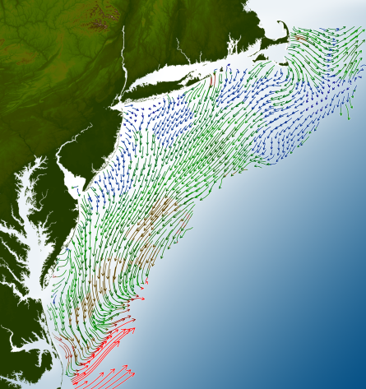
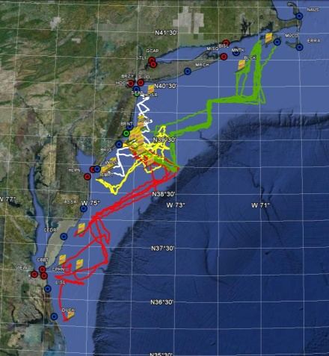
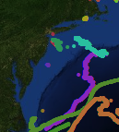
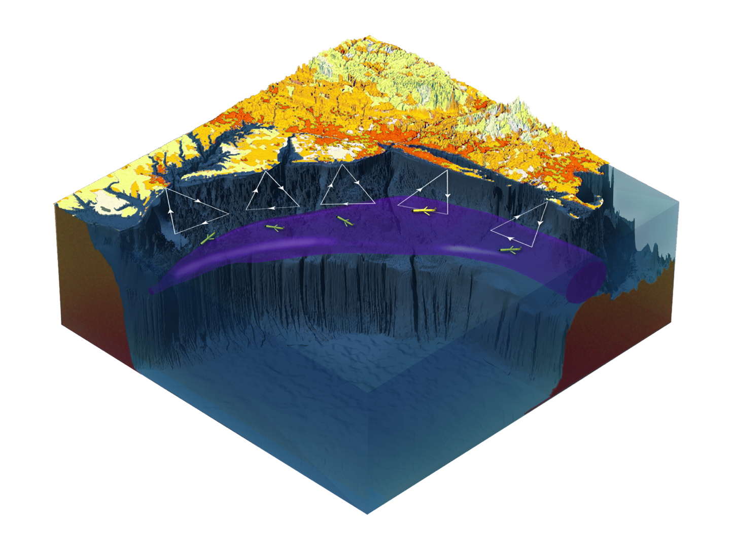

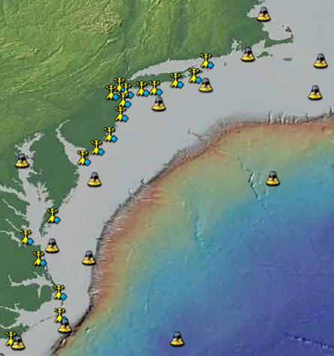
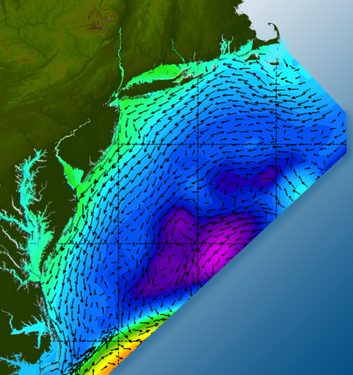

Satellites
HF-Radar
Gliders
Drifters
Population Density
To seek, discover & apply
new knowledge & understanding
of our coastal ocean
Weather Stations
Ocean Forecast Ensemble
Notes:
Need to cut off cold pool in south and bend offshore
Need to experiment with dulling down the colors in the pop density. Maybe orange/tan to white like the box I put in?
Put gliders just below the lines in 3 of them, and increase their angles facing up and down randomly. I stuck in cheesy examples
I already put the shadow and 80% clear line around the two new maps in the upper right, so we are good there.

Slide 12
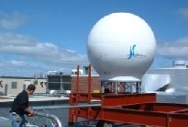
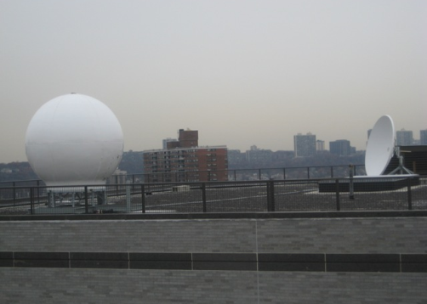
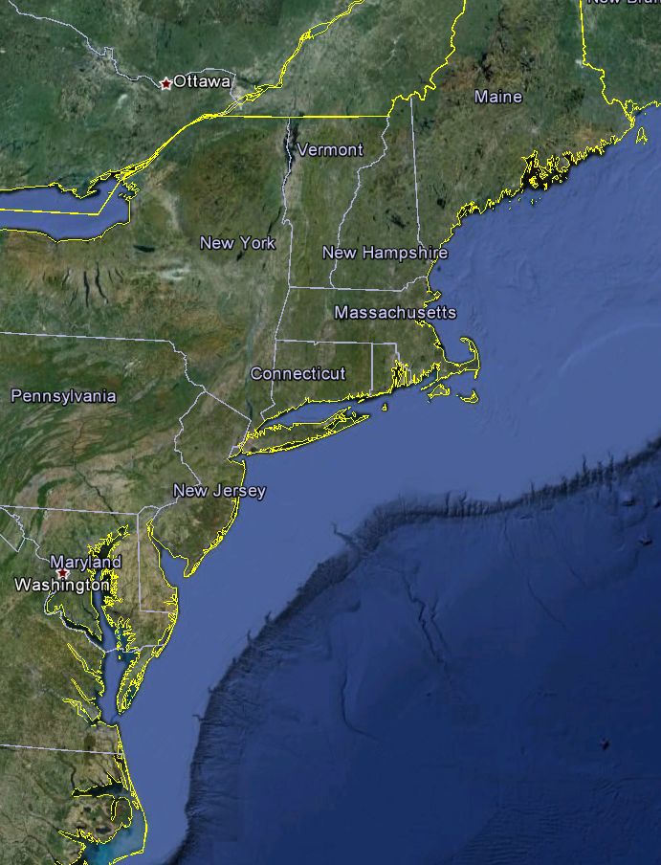
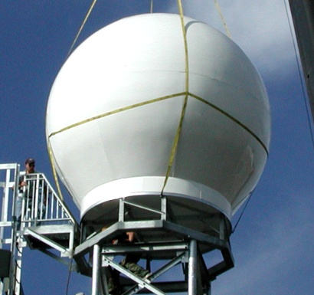
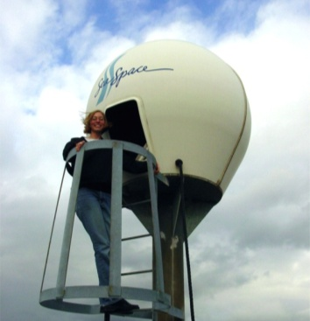
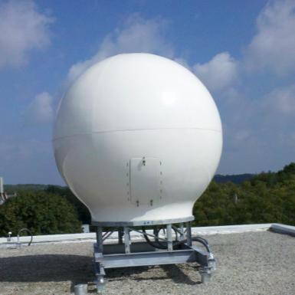
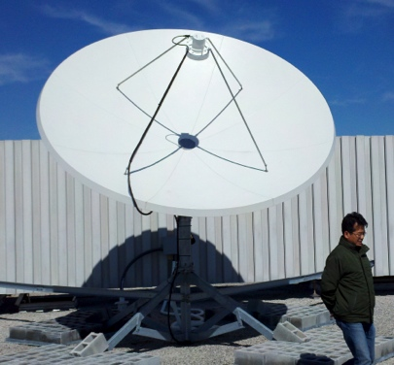

Real-Time Satellite Ground Stations in the Northeast U.S.
Satellites: NPP, Terra, Aqua, NOAA Polar Orbiters, Metop & GOES
U. Maine
City College of N.Y.
Rutgers
U. Delaware
Johns Hopkins

Slide 13










Mid-Atlantic Bight HF Radar Network
1000 km
Cape to Cape
Mid-Atlantic HF Radar Network
16 Long-Range CODARs
8 Medium-Range CODARs
17 Short-Range CODARs
41 Total
Triple Nested, Multi-static, Multi-use
Industry Partner: CODAR Ocean Sensors

Slide 14






Mid-Atlantic Bight Glider Network
RU01
RU15
RU29
G1
G1-Ruggedized
G2
Satellite Ocean Color
Satellite SST
Subsurface
Glider
Data
Industry Partner: Teledyne Webb Research

Slide 15













Glider Sensors
Inside Payload Bay or External

Slide 16




Glider Fleets
Rutgers Glider Fleet RU01-RU30
U.S. Navy Glider Fleet – 150 Gliders
NSF OOI Glider Fleet – 48 Gliders
NOAA Hurricane/Typhoon Glider Fleet – ?? Gliders

Slide 17




MARACOOS Weather Network
NDBC
Backbone
> 50 sites
Regional Industry
Enhancement
> 100 sites

Slide 18

MARACOOS Weather Network
NDBC
Backbone
> 50 sites
MARACOOS
Weather Ensemble
3-7 Members
Verified with Coastal Observations

Slide 19

Advanced Research Version of WRF
Weather Research and Forecasting (WRF) model, Advanced Research core (ARW), Version 3.4.1 (Michalakes et al., 2001)
Horizontal Resolution: 6km
Vertical Resolution: 35 levels, focused near surface
Lateral B.C.: Global Forecast System (GFS) 0.5 degree
Microphysics: WRF Double-Moment 6-class scheme
Planetary Boundary Layer (PBL) scheme: Yonsei University scheme
Longwave radiation: Rapid Radiative Transfer Model (RRTMG)
Shortwave radiation: Dudhia
Bottom B.C. (Sea Surface Temperature, SST): Variant

Slide 20




Improved Predictive Modeling and Data Assimilation
1) STPS
U. Connecticut
2) NYHOPS
Stevens Institute of Technology
3) ROMS
Rutgers University
4) HOPS
U. Massachusetts, Dartmouth

Slide 21

Rutgers ROMS 4DVAR uses all available data
from a modern coastal ocean observing system
  more and diverse data is better (T, S, u, sea level)
  bias correction to OBC and MDT is essential
Useful subsurface skill for real-time applications:
  4 days for temperature and salinity;
  1-2 days for velocity
Future directions: variational methods for
observing system design; coupling; ecosystems
correlation
Forward model
Forward model
after bias removal
Data assimilation
analysis/hindcast
depth
2-day forecast
4-day forecast
Bottom temperature
Data used by Operational Forecast [… real-time SOURCE]
*THREDDS Data Server
72-hour forecast NAM 0Z cycle at 2 am EST [NCEP NOMADS]
RU regional CODAR hourly: 4-hour latency delay [RU TDS*]
RU glider T,S when available (~ 1 hour delay) [RU TDS]
USGS daily average flow available 11:00 EST [USGS waterdata]
AVHRR IR passes 6-8 per day (~ 2 hour delay) [MARACOOS TDS]
REMSS MW-IR blended SST daily average [NASA PO-DAAC]
HYCOM NCODA 7-day forecast updated daily [NRL]
Jason-2, CryoSat, AltiKa along-track altimeter OGDR [RADS.nl]
SOOP XBT/CTD, Argo floats, on GTS [NOAA OSMC ERDDAP]

Slide 22


Global Models & the Mid- Atlantic Shelf
Glider Data compared to Global Model Forecasts
Summer 2013: Current
Mid-Atlantic
Temperature

Slide 23






MARACOOS Operations Center
Rutgers University - Coastal Ocean Observation Lab
Satellite Data Acquisition Stations
CODAR Network
Glider Fleet
3-D Forecasts

Slide 24












ONR Shallow Water 2006 Joint Experiment
HiSeasNet
>12 Satellites
48 Senior
PI’s & PM’s
Communication
7 Ships
3 Groundstations
10 Gliders
1 Aircraft
62 Moorings

Slide 25



The Trans-Atlantic Glider Challenge
“The Ocean is Our Classroom”
RU27: 7,400 km in 221 days
Trans-Atlantic Glider Challenge

Slide 26




The 2050 Grand Challenge for our Students
During the Professional Lifetimes of Today’s Undergraduates,
The Earth at Night
Global Population
Transform This
Into This
Projected Population Growth
Projected Water Scarcity
When the Human Population is Growing
And the Earth is Changing

Slide 27

Regional Seas around South Korea
1000 km Alongshore Length Scale

Slide 28


U.S. & Korea
National HF Radar Networks –
World’s largest networks
MAB & Korea similar in scale
U.S. - Korea
Collaborations in:
Network Operations
Data Quality Control
Product Development
Science
1000 km

Slide 29

Korea-U.S. Collaborations in Ocean Observing to Improve Environmental Forecasting
San Hoon Lee, Ho Kyung Ha, Tae Wan Kim, Doshik Hahm, Jisoo Park, KOPRI
Hak Soo Lim, KIOST
Sang-Ho Lee, KNU
Byoung-Jui Choi, KNU
Jung Sik Han, KHOA
Kwang Nam Han, KHOA
Sik Huh, KIOST
Scott Glenn,
Oscar Schofield,
Josh Kohut &
Hugh Roarty
Rutgers University

Slide 30





Arctic Ocean
Potential Korean Glider Paths
KNRV5000 Circumnavigation + 2015-2016 Glider Deployments
(Proposed by Rutgers students in response to Dr. Sik Huh)
NOAA/PMEL
Chuuk, Micronesia
Lima, Peru
Antarctica

Slide 31

South African Coast with Bathymetry
South African Coast
2400 km

Slide 32

South African Coast with Global Ocean Model
South African Coast
2400 km

Slide 33





South Africa – Workforce Development for HF Radar
South African Coast
2400 km
Full Semester Research Course
Intense 1-2 week teacher in residence
Skype sessions with research teams
Jobs in the SA Weather Service

Slide 34

Brazil: South Atlantic Currents

Slide 35

Brazil: South Atlantic Currents

Slide 36




Global Drivers
Coastal Population Centers
International Commerce
Ocean Seasonality
Tropical Cyclones

Slide 37




Prediction and Research Moored Array in the Atlantic (PIRATA)

Slide 38




NSF OOI Global Node in Argentine Basin

Slide 39

Surface Salinity from Aquarius Satellite

Slide 40



Challenger Glider Mission
16 Global-Class Gliders
Active Participants Today:
Challenger Society
POGO
U.S. IOOS
NOAA
ONR
NSF
Teledyne
Rutgers
Vetlesen
PLOCAN
ANFOG
KIOST
U. Las Palmas
U. Cape Town
U. Sao Paulo
USNA
CLS
Iridium

Slide 41





Glider RU29: Launched from Cape Town 11 Jan 2013, flown >8,700 km
RU29
South African Coast
2400 km

Slide 42



Phytoplankton Bloom,
Campos Basin, BRAZIL
19 January 2014
RU29: 12 March 2014
40 days to Sao Paulo

Slide 43





Scarlet Knight’s Landfall in Baiona, Spain
Same Port where Columbus’ Pinta made landfall in 1493
Baiona’s Mayor unveils Scarlet Knight’s Plaque
Scarlet Knight’s victory lap around the Pinta
U.S. & Spanish Secretaries of Commerce
Scarlet Knight swarmed by Baiona’s school children

Slide 44

Thank you!

