Slide 1

















RI
U..
Middle Atlantic
Regional Association
Coastal
Ocean Observing System
10 States - 76 Million People
1000 km Cape to Cape
CT
Cape
Cod
MA
NY
PA
NJ
U.S. IOOS
Responds to
Hurricanes Irene
and Sandy
DE
MD
Sandy
>40 PIs
>20 Institutions
>50 Members
>2000 Contacts
Irene
Scott Glenn + Many
VA
NC
Cape
Hatteras
Notes:
1

Slide 2
RI
U..
Middle Atlantic
Regional Association
Coastal
Ocean Observing System
10 States - 76 Million People
1000 km Cape to Cape
CT
Cape
Cod
MA
NY
PA
NJ
U.S. IOOS
Responds to
Hurricanes Irene
and Sandy
DE
MD
Sandy
>40 PIs
>20 Institutions
>50 Members
>2000 Contacts
Irene
Scott Glenn + Many
Hurricane Tuesday Group:
Greg Seroka, Travis Miles,
Yi Xu, Hugh Roarty,
Josh Kohut, Oscar Schofield
VA
NC
Cape
Hatteras
Notes:
2

Slide 3
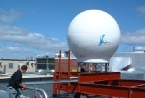
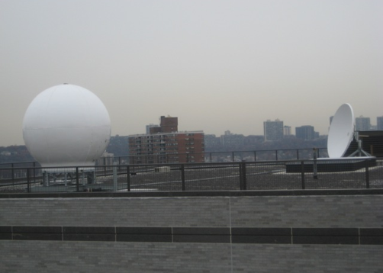
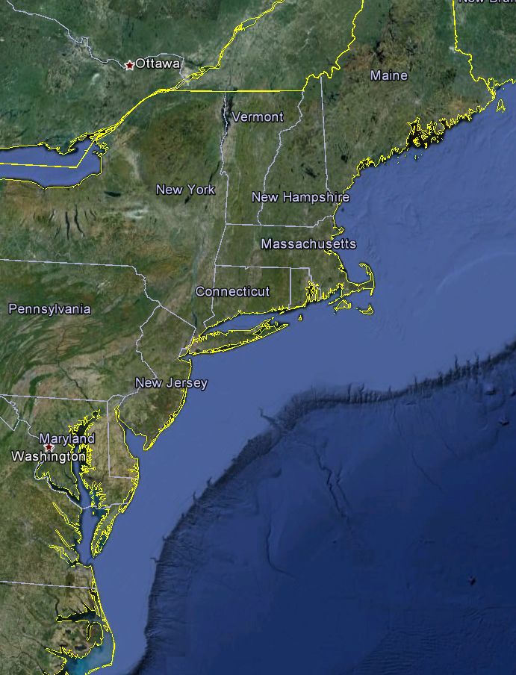
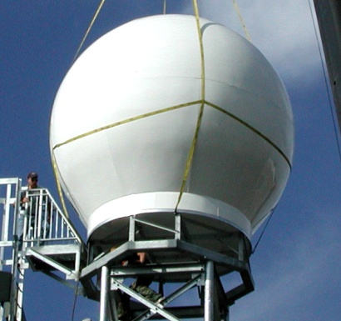
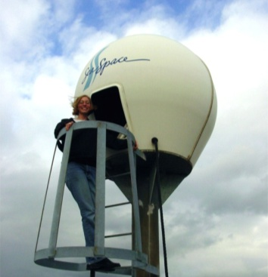
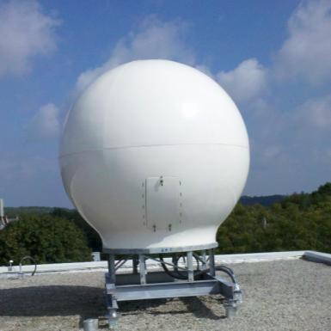
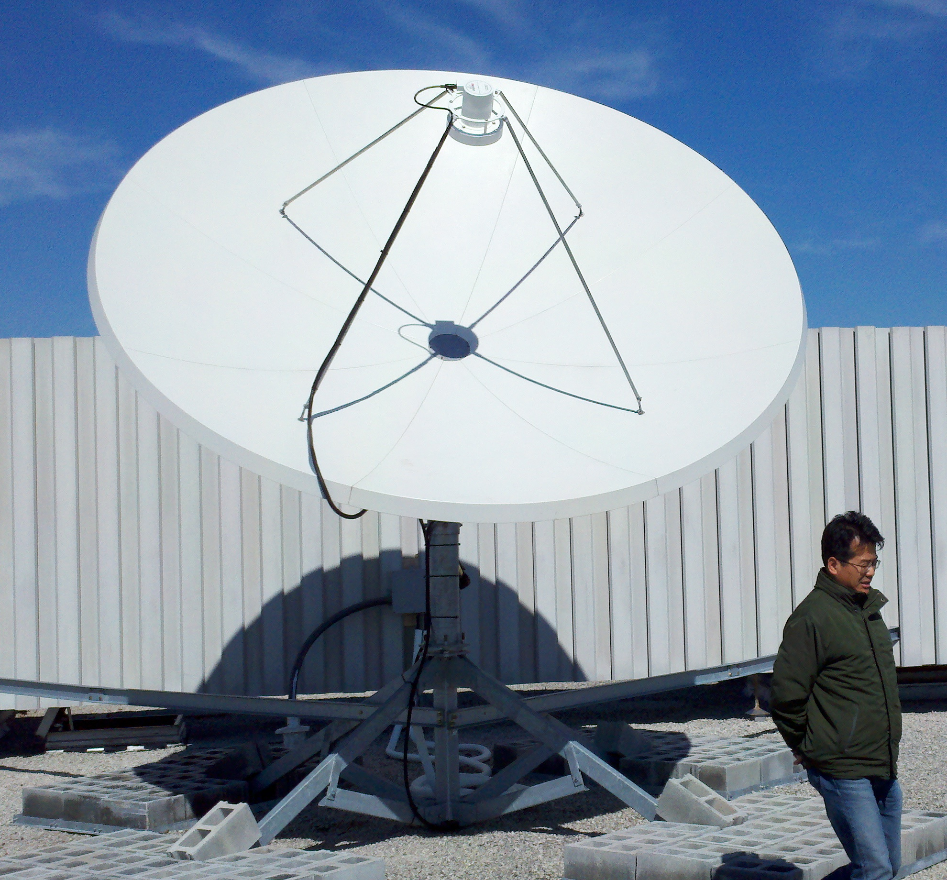
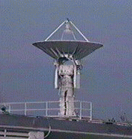
Real-Time Satellite Ground Stations in the Northeast U.S.
Satellites: NPP, Terra, Aqua, NOAA Polar Orbiters, Metop & GOES
U. Maine
City College of N.Y.
Rutgers
U. Delaware
Johns Hopkins

Slide 4
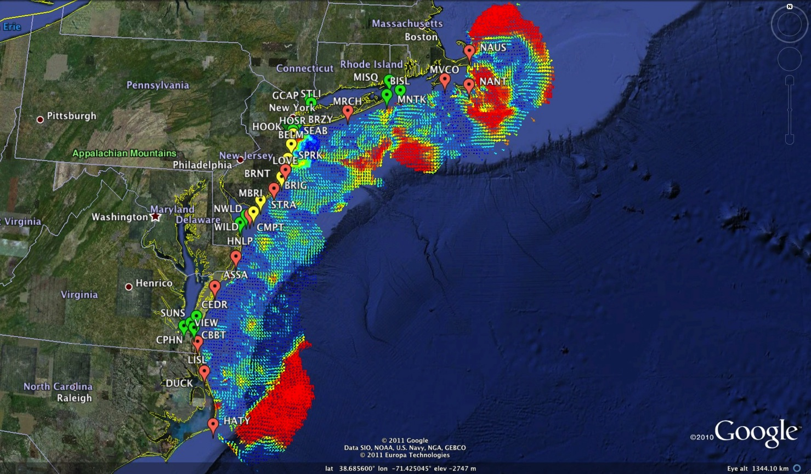
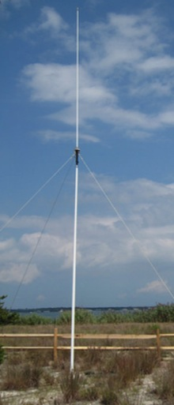
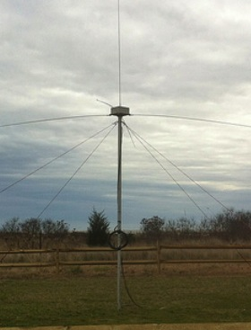
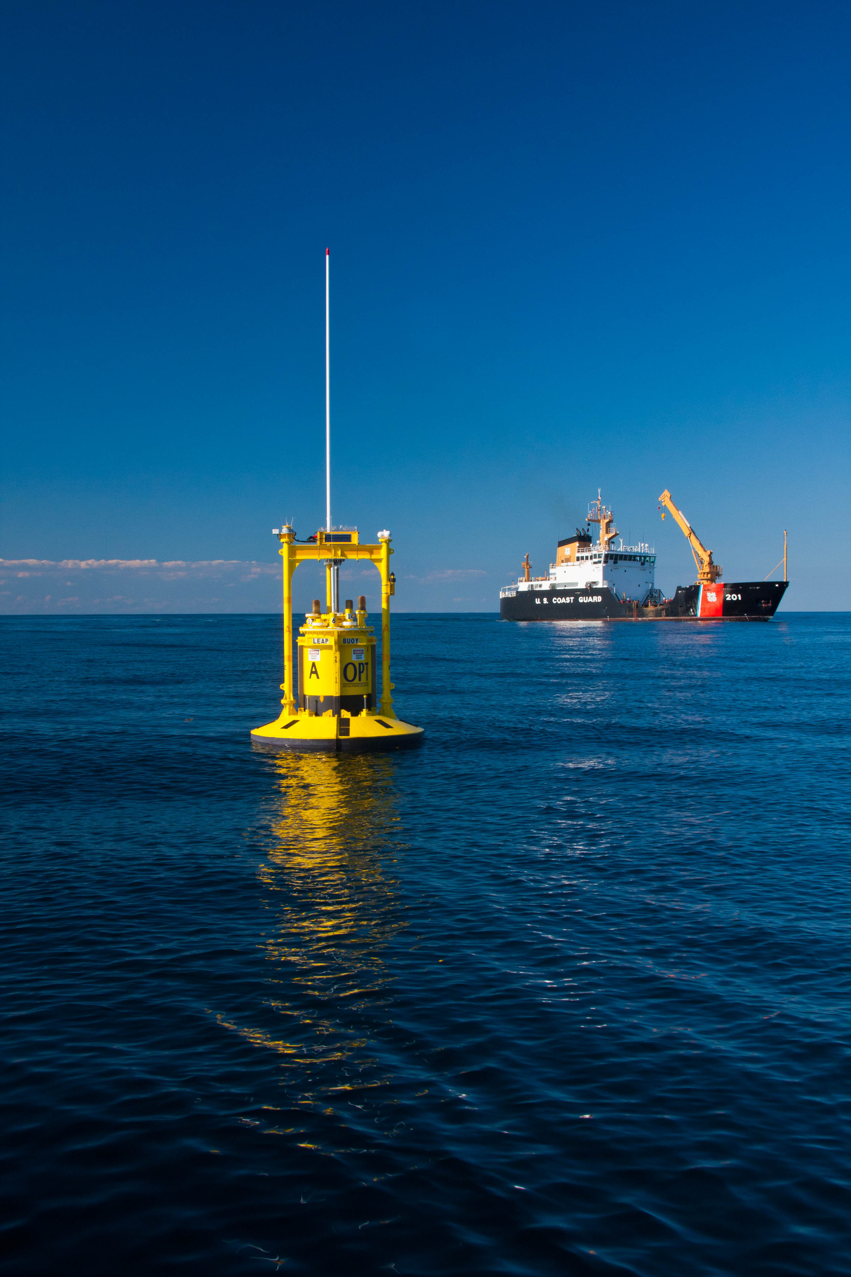
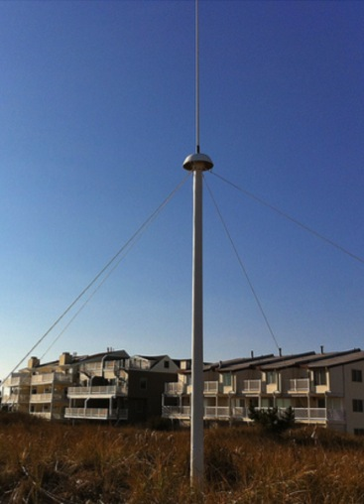

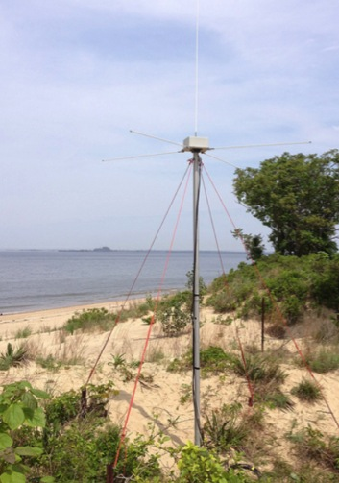

Mid-Atlantic Bight HF Radar Network
1000 km
Cape to Cape
Mid-Atlantic HF Radar Network
16 Long-Range CODARs
8 Medium-Range CODARs
17 Short-Range CODARs
41 Total
Triple Nested, Multi-static, Multi-use
Industry Partner: CODAR Ocean Sensors

Slide 5
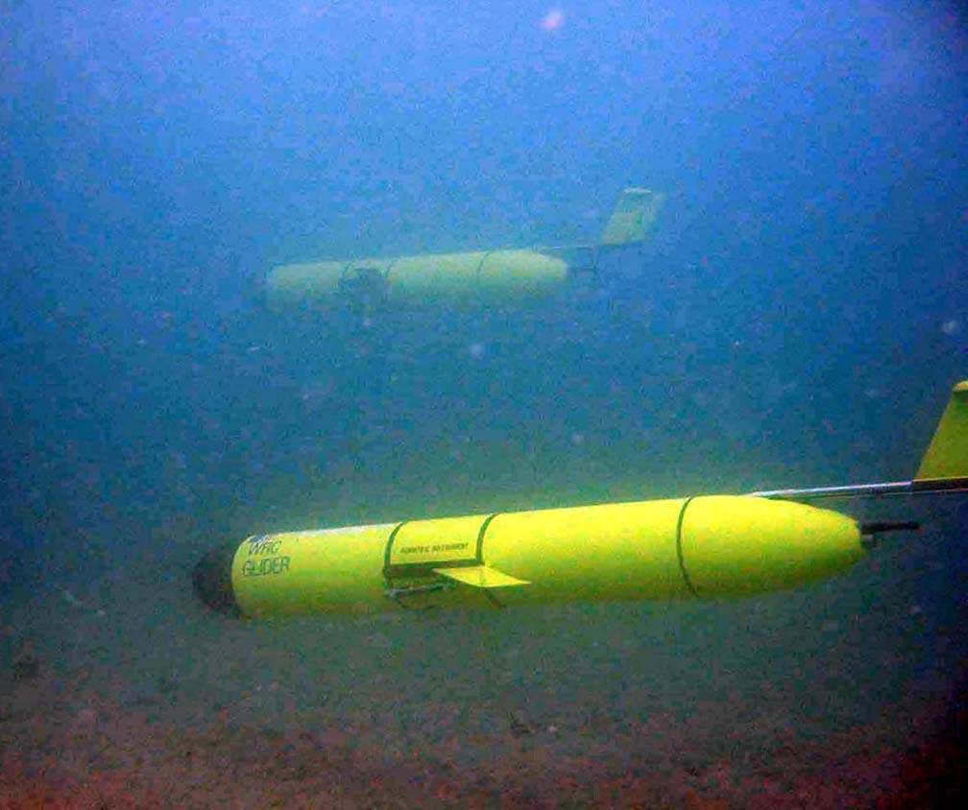

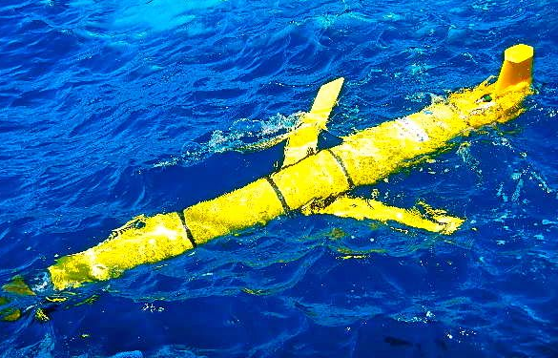
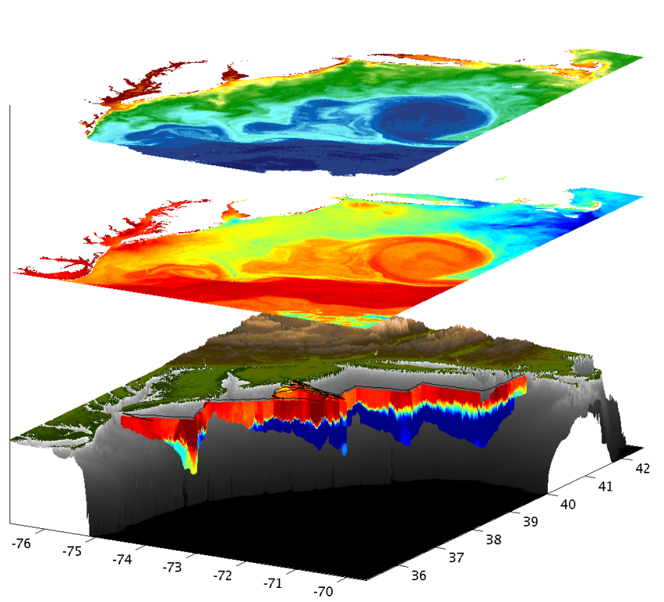
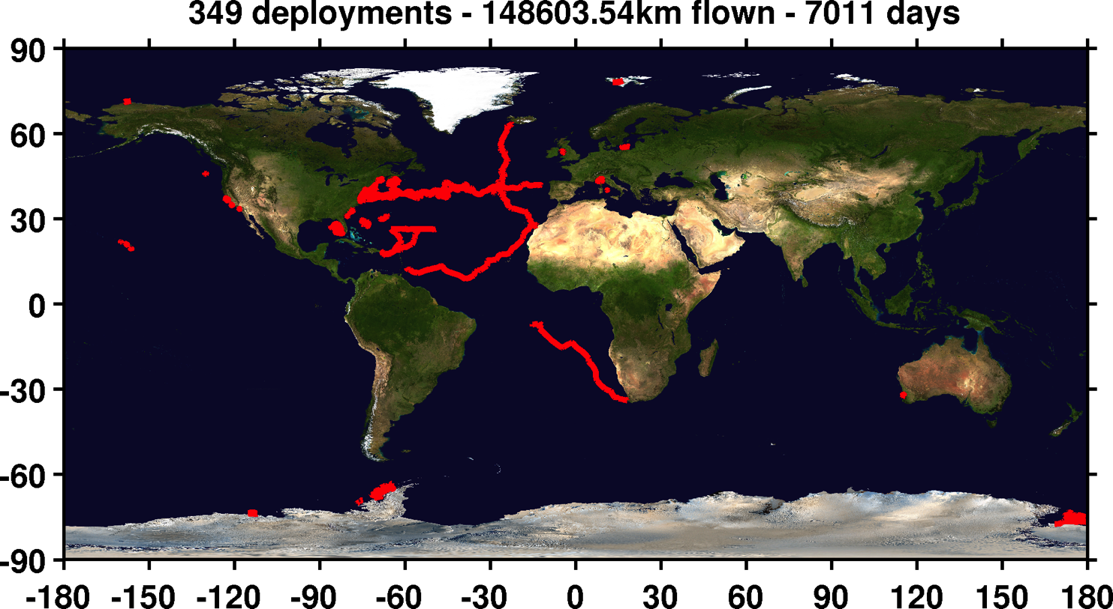
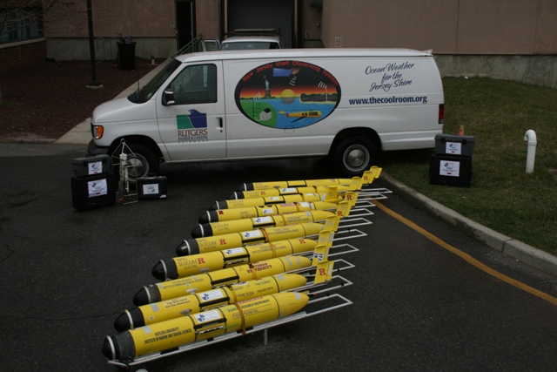

Mid-Atlantic Bight Glider Network
RU01
RU15
RU29
G1
G1-Ruggedized
G2
Satellite Ocean Color
Satellite SST
Subsurface
Glider
Data
Industry Partner: Teledyne Webb Research

Slide 6
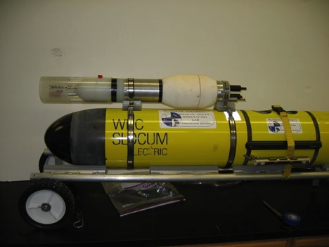
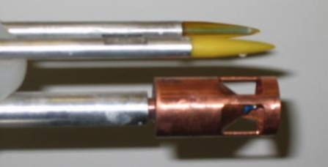
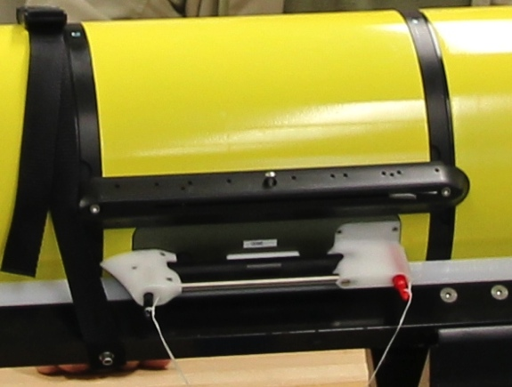
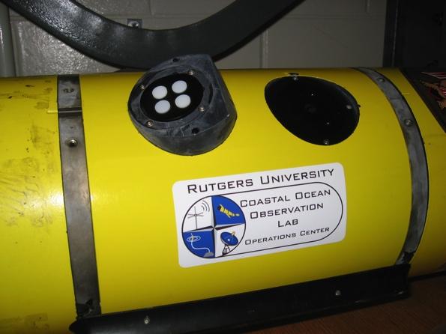
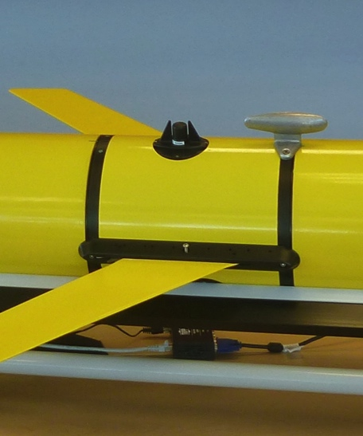
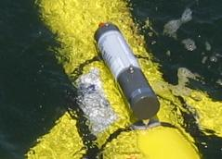
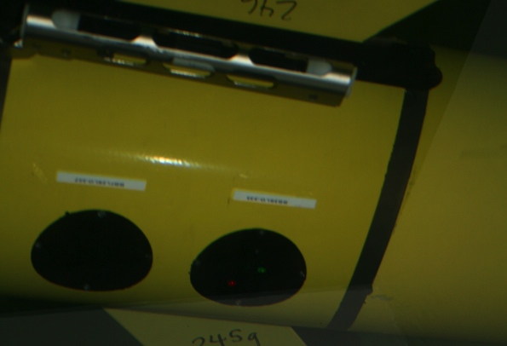
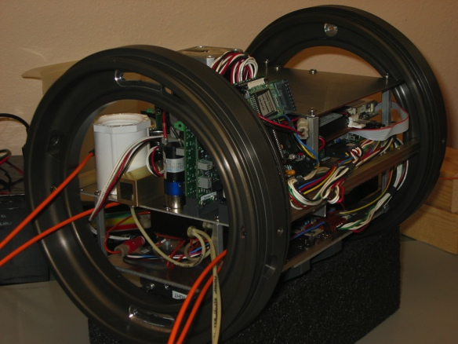
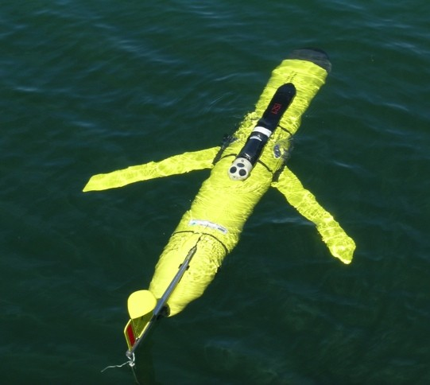
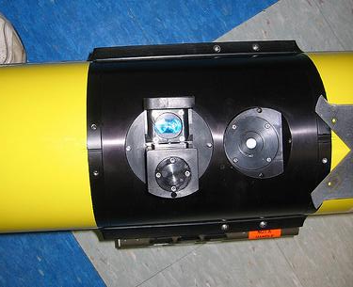
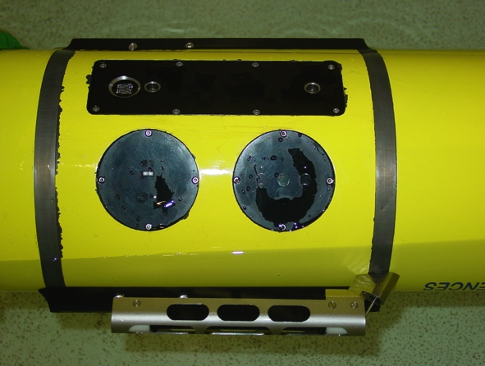

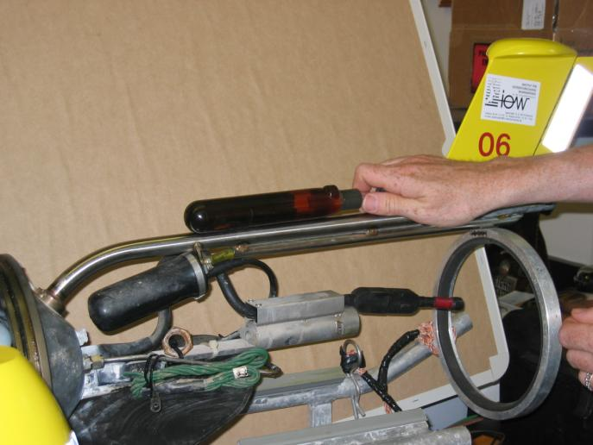
Glider Sensors
Inside Payload Bay or External

Slide 7
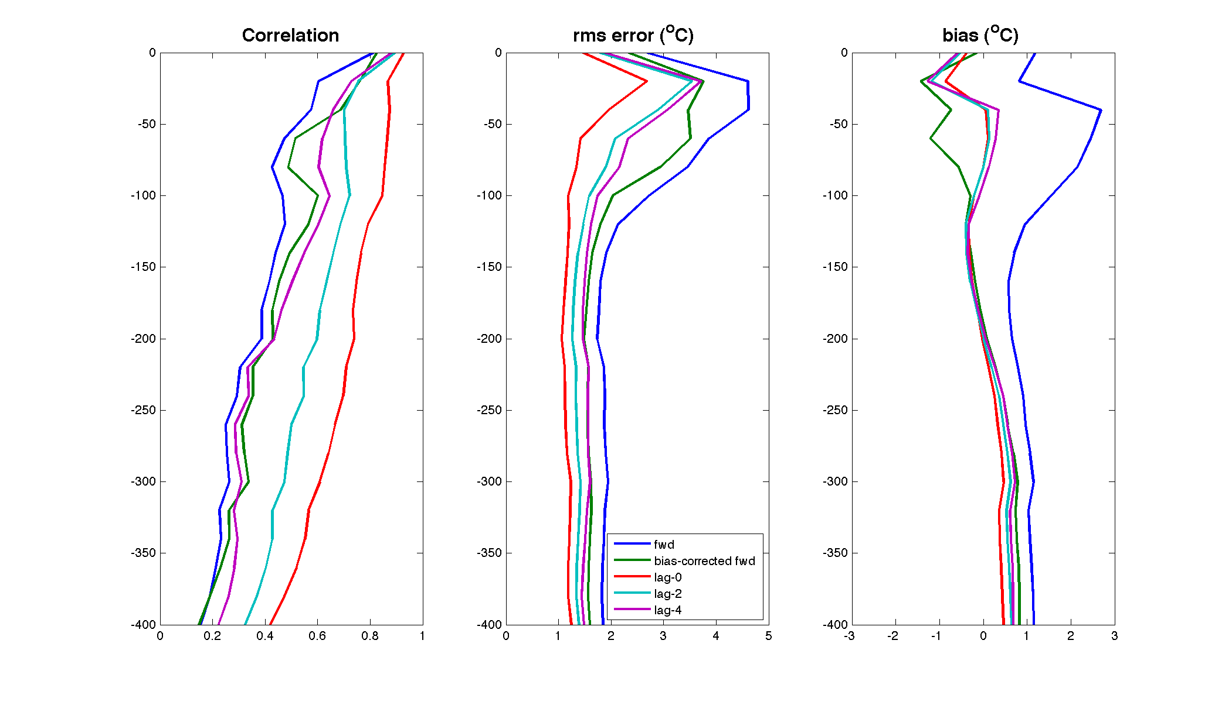
Rutgers ROMS 4DVAR uses all available data
from a modern coastal ocean observing system
  more and diverse data is better (T, S, u, sea level)
  bias correction to OBC and MDT is essential
Useful subsurface skill for real-time applications:
  4 days for temperature and salinity;
  1-2 days for velocity
Future directions: variational methods for
observing system design; coupling; ecosystems
correlation
Forward model
Forward model
after bias removal
Data assimilation
analysis/hindcast
depth
2-day forecast
4-day forecast
Bottom temperature
Data used [… real-time SOURCE]
*THREDDS Data Server
72-hour forecast NAM 0Z cycle at 2 am EST [NCEP NOMADS]
RU regional CODAR hourly: 4-hour latency delay [RU TDS*]
RU glider T,S when available (~ 1 hour delay) [RU TDS]
USGS daily average flow available 11:00 EST [USGS waterdata]
AVHRR IR passes 6-8 per day (~ 2 hour delay) [MARACOOS TDS]
REMSS MW-IR blended SST daily average [NASA PO-DAAC]
HYCOM NCODA 7-day forecast updated daily [NRL]
Jason-2, CryoSat, AltiKa along-track altimeter OGDR [RADS.nl]
SOOP XBT/CTD, Argo floats, on GTS [NOAA OSMC ERDDAP]

Slide 8
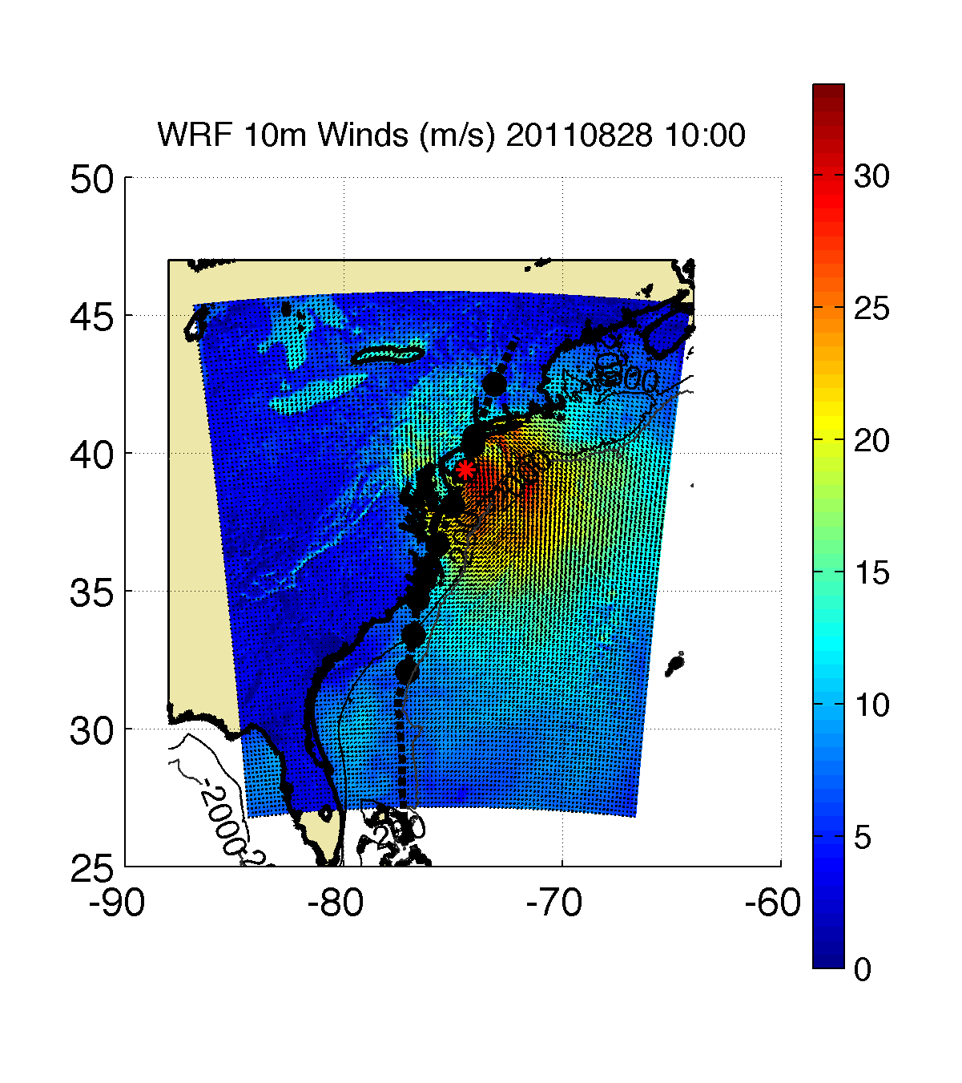
Advanced Research Version of WRF
Weather Research and Forecasting (WRF) model, Advanced Research core (ARW), Version 3.4.1 (Michalakes et al., 2001)
Horizontal Resolution: 6km
Vertical Resolution: 35 levels, focused near surface
Lateral B.C.: Global Forecast System (GFS) 0.5 degree
Microphysics: WRF Double-Moment 6-class scheme
Planetary Boundary Layer (PBL) scheme: Yonsei University scheme
Longwave radiation: Rapid Radiative Transfer Model (RRTMG)
Shortwave radiation: Dudhia
Bottom B.C. (Sea Surface Temperature, SST): Variant

Slide 9
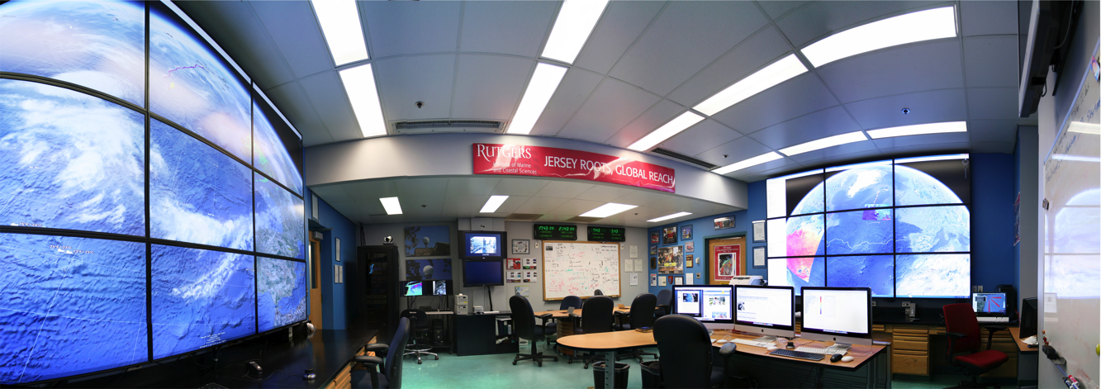
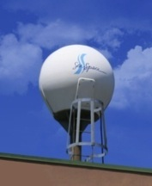
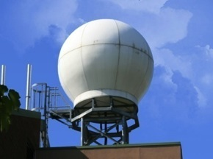
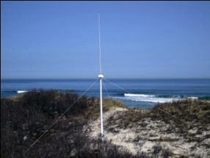
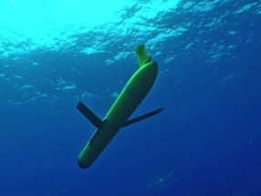
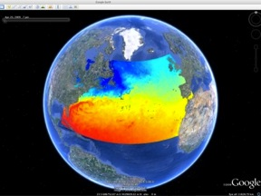
MARACOOS Operations Center
Rutgers University - Coastal Ocean Observation Lab
Satellite Data Acquisition Stations
CODAR Network
Glider Fleet
3-D Forecasts

Slide 10
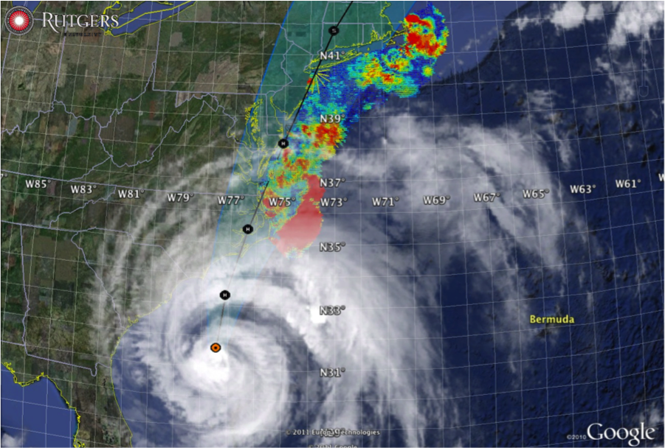

Hurricane Irene
August 26, 2011
NOAA/NHC Damage:
#8 with >$15 Billion.
Track Accurate;
Intensity Over-predicted.
Hurricane Sandy
October 29, 2012
NOAA/NHC Damage:
#2 with >$60 Billion.
Track Accurate;
Intensity Under-predicted.

Slide 11
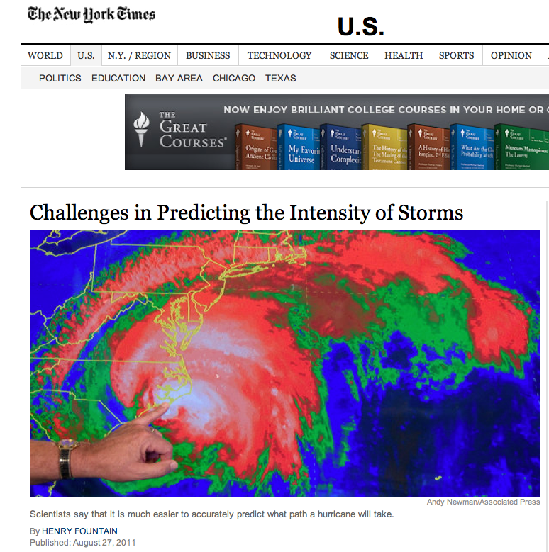
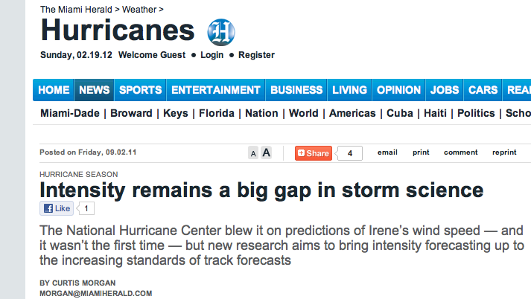
Hurricane Irene in the News:
Track accurately forecast days in advance.
Intensity was over-predicted.
Led to public skepticism.

Slide 12
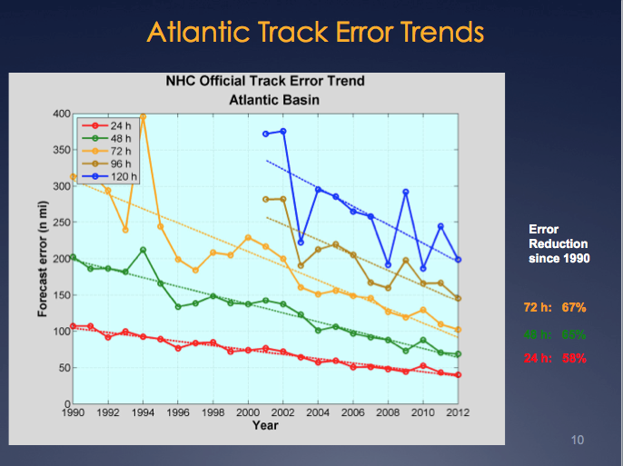
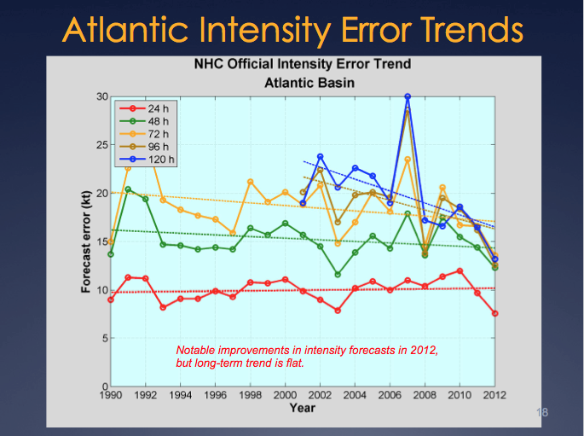
National Hurricane Center: Track & Intensity Error Trends
20-Year Track Error Decreasing Long-term Intensity Error is Flat
Track: Improvements attributed to Global Forecast Models & the Super-Ensemble.
Intensity: “…upper-ocean thermal structure can affect the evolution of storm intensity, …Unfortunately, the paucity of subsurface measurements limits our ability to assess the effect of upper-ocean variability on tropical cyclone intensity evolution.”
– Emanuel et al., (2004)
Production Suite Review: December 4, 2012

Slide 13

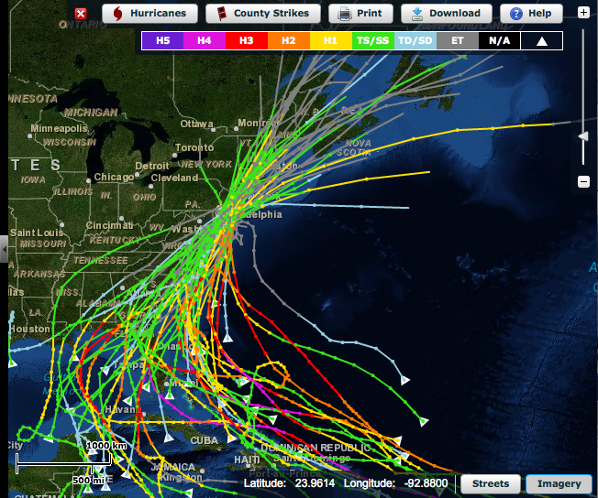
Hurricane Irene: Track (August 2011)
Historical Hurricane Tracks
within 120 km of Atlantic City, NJ

Slide 14
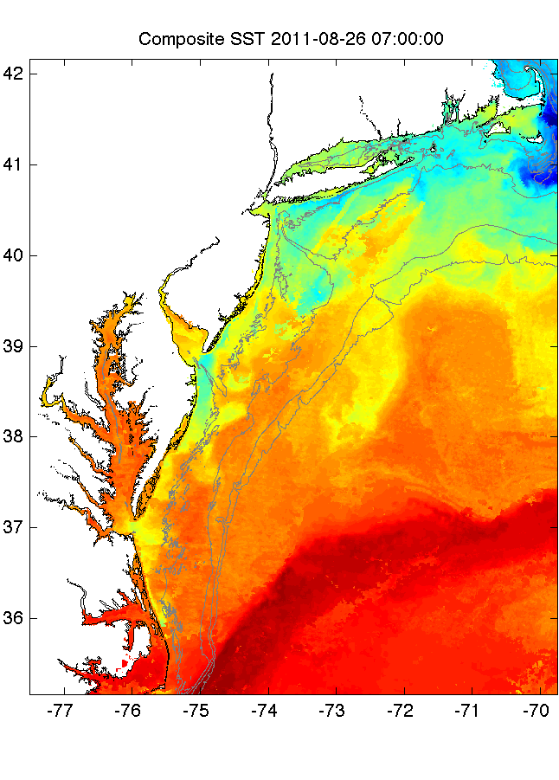
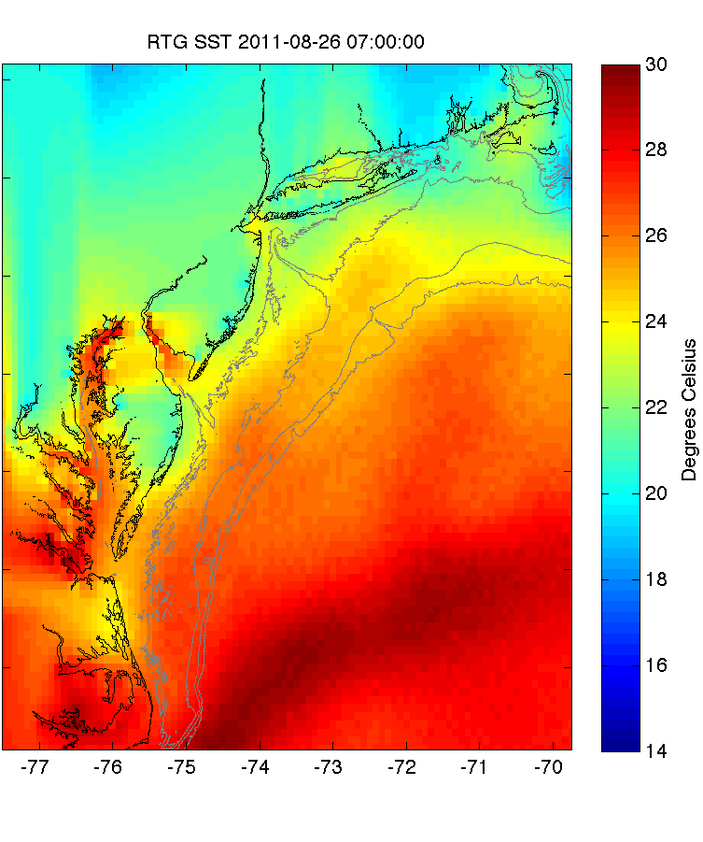
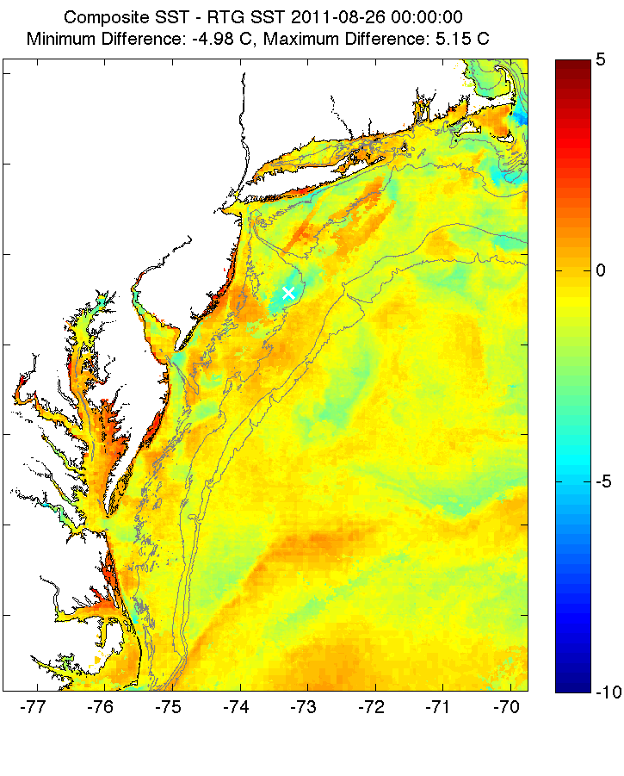
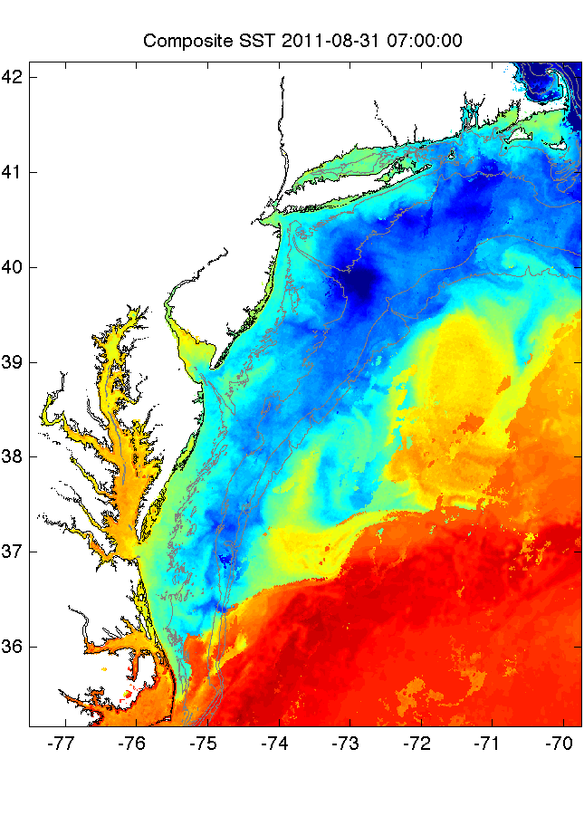
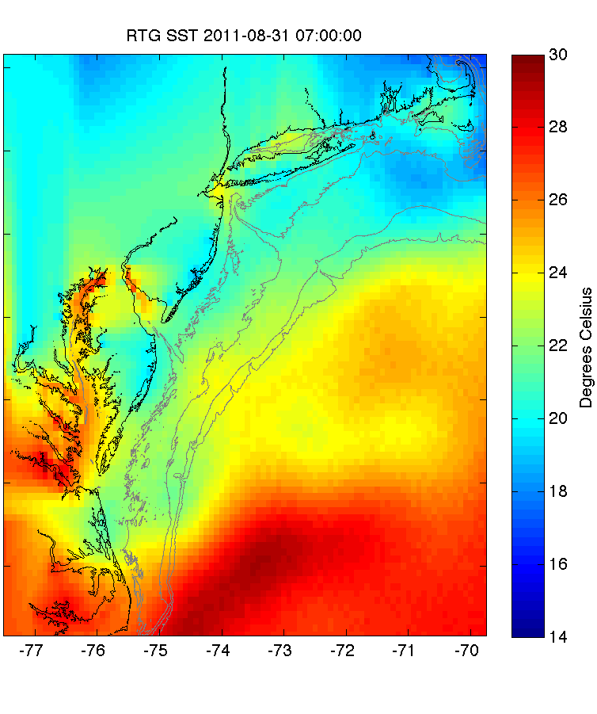

Sept 26
Coldest
Dark
Pixel
Sept 26
Real Time
Global
Sept 26
SST
Difference
SST
Before Irene
Sept 31
Coldest
Dark
Pixel
Sept 31
Real Time
Global
Sept 31
SST
Difference
SST
After Irene

Slide 15

Hurricane Irene Glider Sampling
RU23
Deployed for MARACOOS.
Map subsurface T/S structure for fisheries.
Damaged early - drifter
Recovered by fisherman
Provided data on inertial currents during storm.
RU16
Deployed for EPA.
Map bottom dissolved oxygen.
Provided data on mixing during storm.

Slide 16



Hurricane Irene Glider Sampling
Hurricane Irene
0
26
depth
Temperature
55
14
0
33
depth
RU23
Deployed for MARACOOS.
Map subsurface T/S structure for fisheries.
Damaged early - drifter
Recovered by fisherman
Provided data on inertial currents during storm.
Salinity
55
29
RU16
Deployed for EPA.
Map bottom dissolved oxygen.
Provided data on mixing during storm.
0
105
depth
% Saturation
(DO)
55
60
Aug 12
Sep 07

Slide 17




Hurricane Irene: Glider Sampling Through the Storm

Slide 18




Before
After
Onshore
Offshore

Slide 19













Hurricane Irene:
Regional Ocean
Modeling System
ROMS
Wind Stress =
Pressure Grad.
--------------------
Pressure Grad.
= Coriolis Force
Onshore
Offshore
Vertical Diffusion
> Vertical Advection > Other Terms

Slide 20


Sea Surface Temperature Difference
(After – Before Irene)
Real-Time MARACOOS Real-Time Global

Slide 21




Hurricane Irene: Spatial Distribution & Timing of Mixing & Cooling

Slide 22


Hurricane Irene: AWRF Atmospheric Forecast Sensitivity Study
Warm SST
Cold SST
Hindcast Sensitivity Matrix

Slide 23

WRF Model Sensitivity Matrix
86 Model Runs to Date
Initial Match-ups
Largest Sensitivities to SST and Flux Coefficients.

Slide 24


Maximum Wind Speed
Eye over Mid-Atlantic
Wind Speed Difference
Top Sensitivities:
SST
Flux Coefficients Warm
Flux Coefficients Cold

Slide 25

Max Wind Speed: Hindcast Sensitivities vs. NHC Best Track
Operational
Forecast
GFS
Model
Guidance
WRF with Ocean Mixed Layer

Slide 26
Hurricane Irene
August 26, 2011
Strong Stratification
Limited storm surge
Mixing cooled surface
Limited intensity
Hurricane Sandy
October 29, 2012
NOAA/NHC Damage:
#2 with >$60 Billion.
Track Accurate;
Intensity Under-predicted.

Slide 27
Hurricane Irene
August 26, 2011
Strong Stratification
Limited storm surge
Mixing cooled surface
Limited intensity
Hurricane Sandy
October 29, 2012
After fall transition
Single layer ocean
No mixing/cooling
No escape for surge

Slide 28




Next Steps:
2013 Cold Pool Fall Transition 2014-2015 Hurricanes & Winter Storms
Provide a unique data set to modelers
Provide standardized dataset a over ecological scales and information on fish/mammal migrations
Provide a 3-D snapshot of the MAB cold pool
Provide an extensive distributed network through the peak period of fall storms, demonstrating "surge" capacity
Demonstration of a national glider network
Proof of data flow through IOOS to NDBC via DMAC
Engage undergraduates in ocean observing efforts.

