Slide 1
Where are we? What will be there for you? What are the opportunities?
Oscar Schofield on behalf of many
oscar@marine.rutgers.edu

Slide 2
Themes to be covered
History and status
Basic system
OCB Science Potential
Procedures For Data Quality

Slide 3
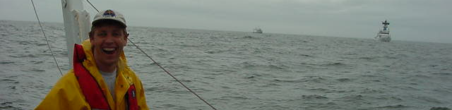
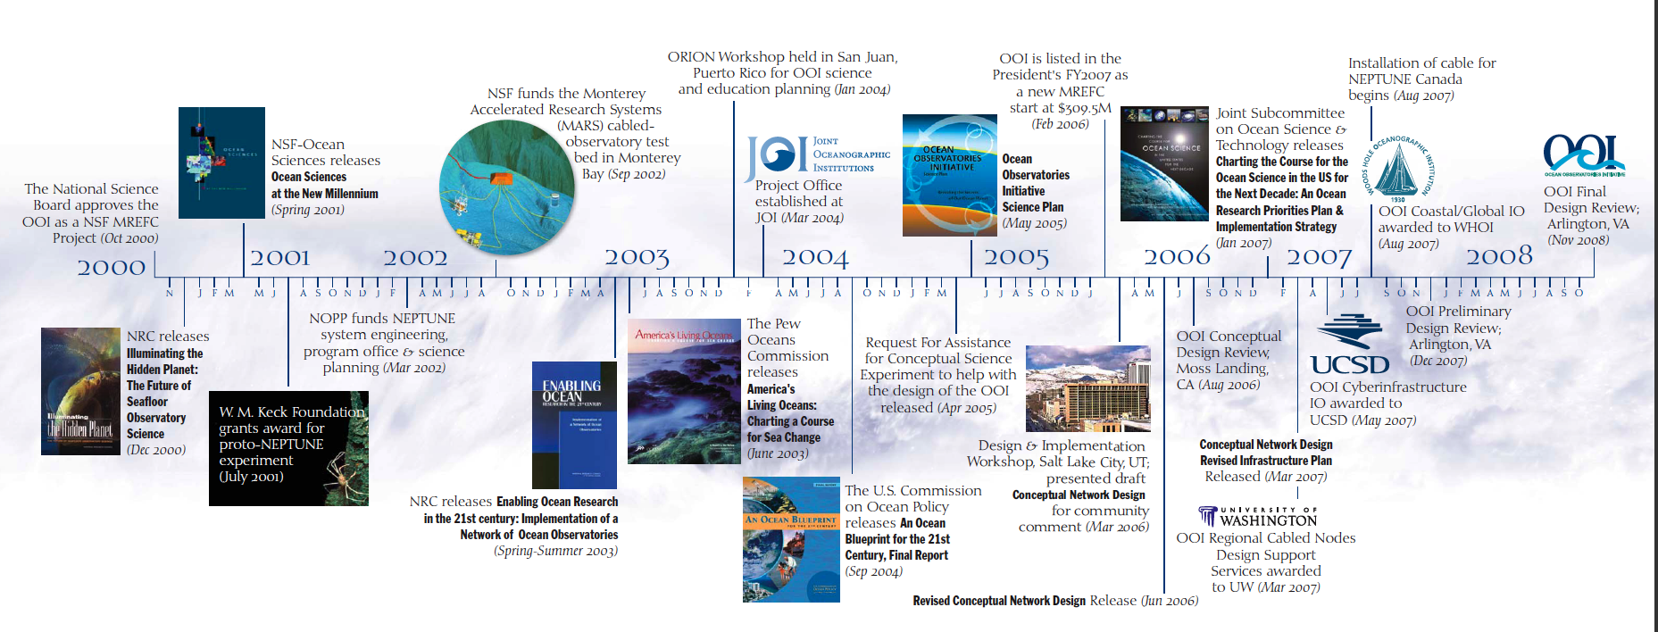
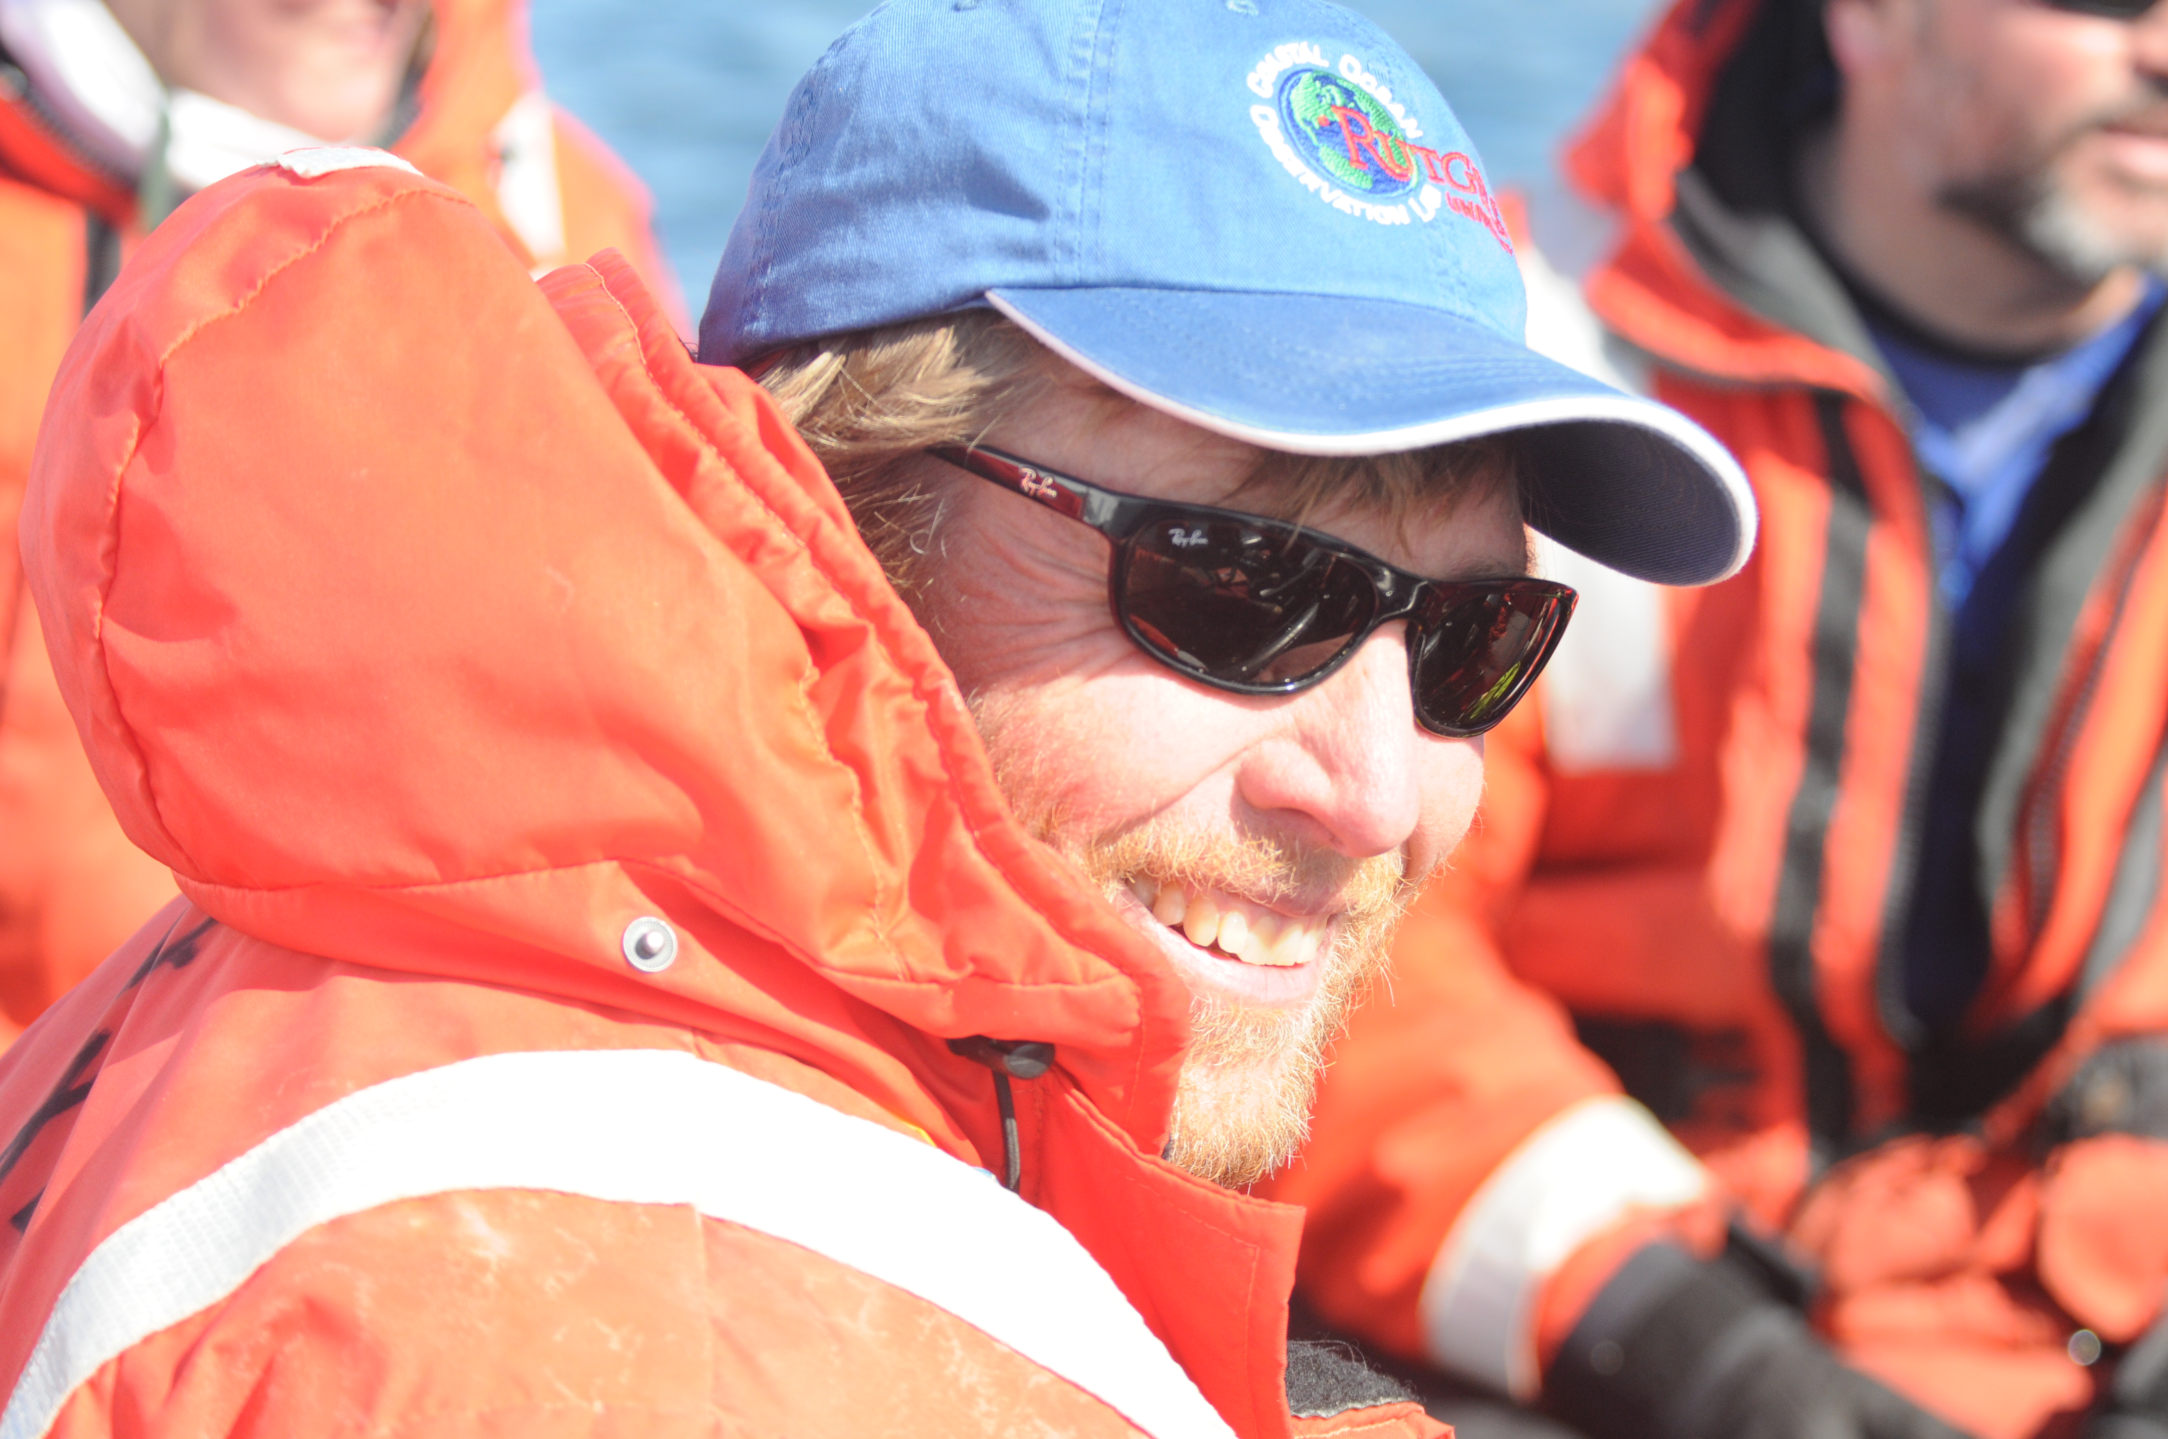
OOI Science Requirements Community Defined Over a Two Decades
Untenured, ONR HyCode experiments during formation of COOL, care free, cholesterol low, kids in kindergarten and early elementary.
2014
During OOI
construction
Tenured, Department of Oceanography Chair, OOI construction and LTER program, care free, cholesterol high, grey hair, 2 kids finished with college
Overarching Science Themes
Forcing and exchanges at the boundaries
    Ocean-atmosphere exchange
    Fluid-rock interactions
Dynamics of the boundary regimes
    Coastal ocean dynamics and ecosystems
    The subseafloor biosphere
    Plate-scale, ocean geodynamics
Dynamics and variability of the ocean volume
    Climate variability
    Ocean circulation
    Turbulent mixing and biophysical interactions
    Ecosystems
Across the boundaries and in the interior
    Carbon cycling, ocean acidification, ecosystem health

Slide 4
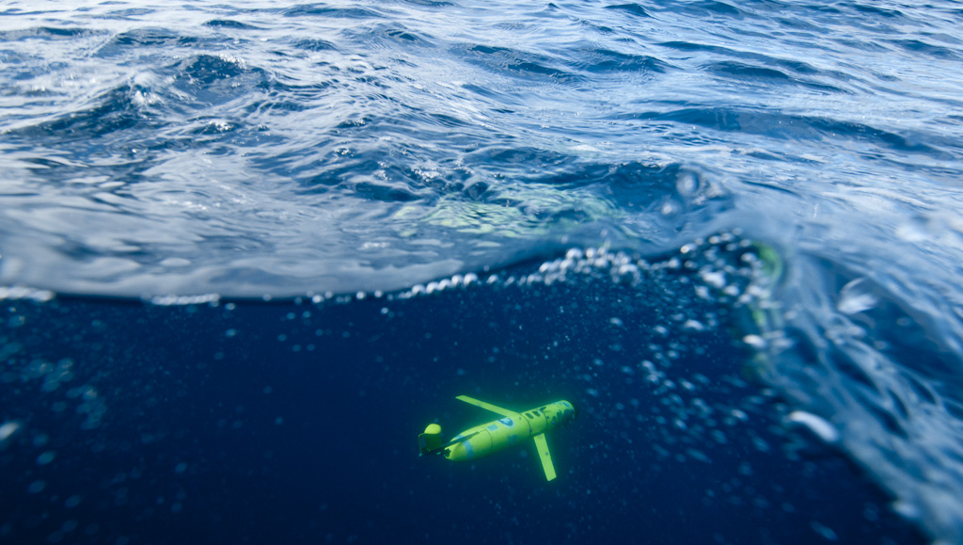
Over the long term the technologies have been evolving as the OOI process has evolved.
When I became initially involved in the plans for a future OOI autonomous systems where not considered acceptable as they were “too unproven and just a concept”.

Slide 5
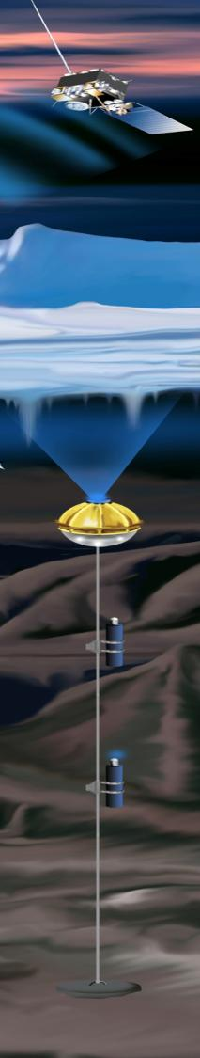
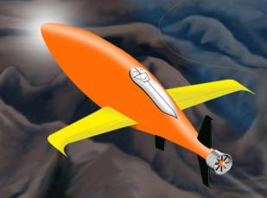
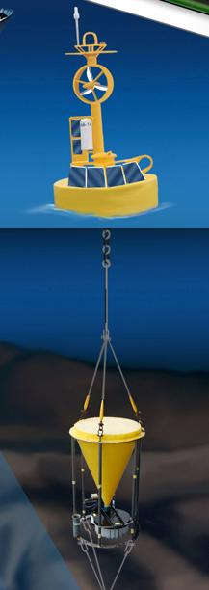
Development of new infrastructure critical component to winning MRE-FC funds
Barron, E. J., et al.. 2011. Critical infrastructure for ocean research and societal needs in 2030. Ocean Studies Board, National Research Council.
Recommendations
  Expand abilities for autonomous monitoring at
  a wide range of spatial and temporal scales with greater sensor and platform capabilities
Facilitate broad community access to infrastructure assets, including mobile and fixed platforms and costly analytical equipment

Slide 6
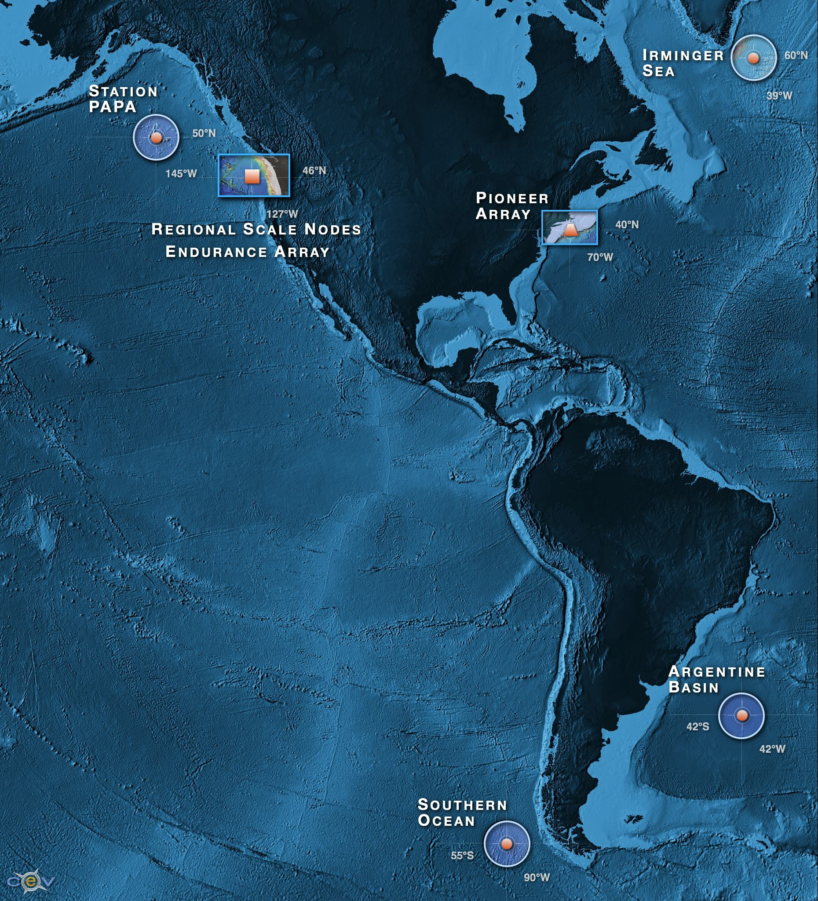
What is being built?
A distributed network of fully open access data for sustained periods open to anyone with open access to the web the democratization of oceanography
Ability to characterize the importance of episodic versus seasonal, annual variability over eddy, shelf and plate scales
>800 unique sensors deployed at any given time on the network
A network capable of absorbing new sensors as they are developed by the wider scientific community
A scalable cyber infrastructure providing a service orientated architecture
A system that provides web service data management with visualization
An integrated education and public engagement suite of tools that can be directly integrated into undergraduate education modules
After an RFA that gave input from 48 white papers from 130 academic institutions (representing 550 investigators) followed by community meetings across all ocean disciplines (lithosphere to atmosphere) identified: 1) high latitude sites that could be afforded (2 in north and south Pacific and Atlantic), 2) coastal regimes (eastern boundary short continental and western boundary broad continental shelves), and 3) a plate scale lithospheric plate encompassing gas hydrate-vent field-repository from the upper ocean.

Slide 7
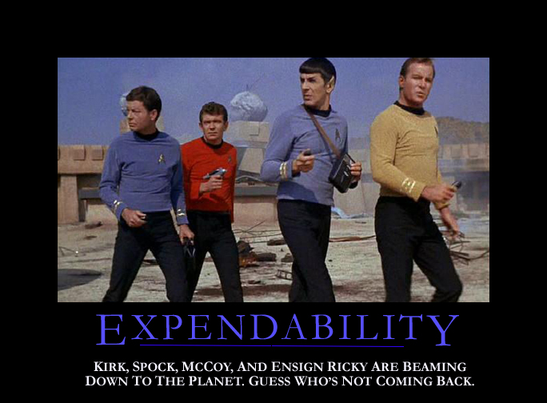
So what is living the dream?
Oscar

Slide 8
Where are we in the deployment of the OOI?

Slide 9
Deployed Scope of OOI (over 800 instruments distributed over all moorings, benthic packages, seafloor nodes, gliders and AUVs)
Global Arrays
Coastal Arrays
Cabled Arrays
Cyberinfrastructure
Computing platforms, software applications, storage, and high speed network equipment
Cyber Points of Presence (CyberPoPs)
  Acquisition Points
  Distribution Points
Integrated Observatory Network – OOI Net
  Hardware / Software
Redundant computing environment
Connected by 880km of seafloor cable, with 10KW power, internet connectivity between 7 primary nodes, multiple secondary nodes, and all distributed instrumentation
Extensive details about each component can be found on the OOI website (http://oceanobservatories.org)

Slide 10
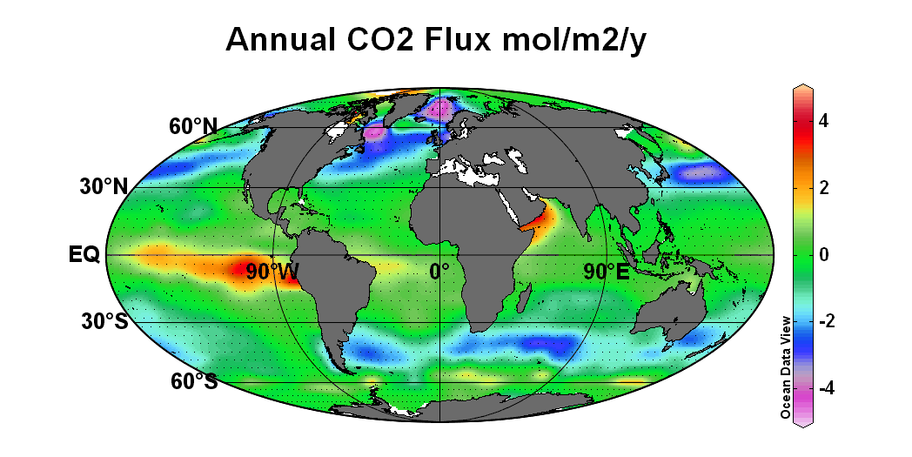
Science opportunities?
Annual air-sea carbon dioxide flux (positive out) using gridded data from Takahashi et al. (2009).

Slide 11
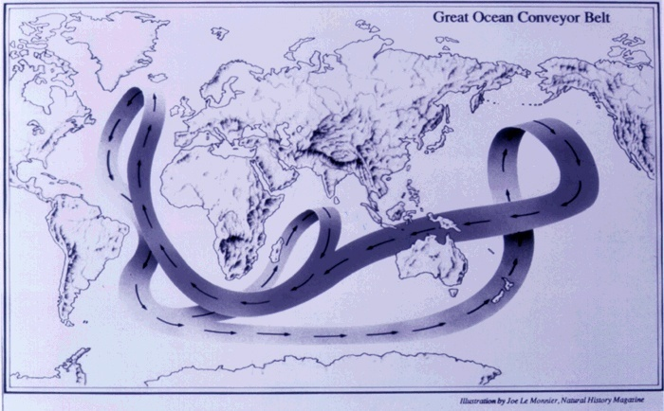
OOI will support ongoing and new science programs
Water mass formation and overturning

Slide 12
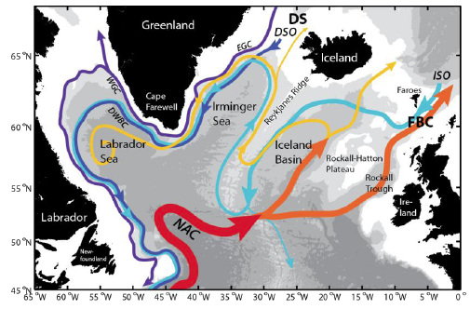
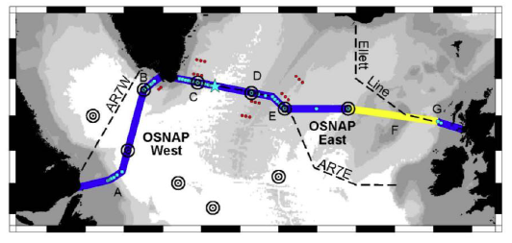

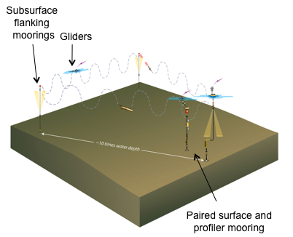
OOI part of overturning circulation experiments
OSNAP is configured as a trans-basin observing system, across which AMOC metrics will be measured using a combination of fixed current meter arrays, repeat hydrographic occupations and gliders.
1) Quantify the subpolar Atlantic Meridional Overturning Circulation (AMOC) and its intra-seasonal to interannual variability (including associated fluxes of heat and freshwater).
2) Determine the pathways of overflow waters in the North Atlantic subpolar gyre to investigate the connectivity of the deep boundary current system.
3) Relate AMOC variability to deep water mass variability and basin-scale wind forcing.
4) Determine the nature and degree of the subpolar-subtropical AMOC connectivity.
OOI array in Irminger Sea

Slide 13

OOI will facilitate comparison open ocean high lattitude systems
Compare magnitudes and rates of change across the NE Pacific and NW Atlantic and examining how those changes will impact ocean circulation, weather, and marine ecosystems.

Slide 14
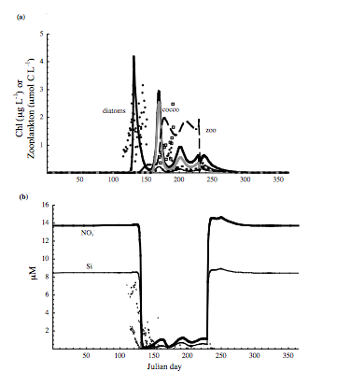
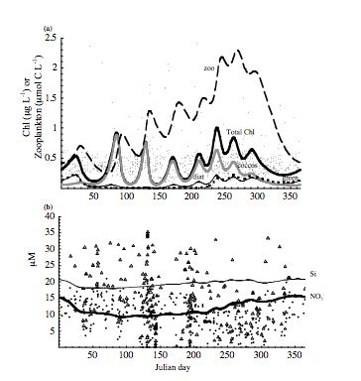
Differences in microbial systems between North Atlantic and Ocean Station Papa
Phytoplankton functional type model showing distinct microbial responses to seasonal forcing, projected changes in the timing and stratification of these regions will alter these community dynamics
North Atlantic
Ocean Station Papa
-Spring diatom bloom
-Succession from the diatom to coccolithophore to prasinophytes
-Low phytoplankton biomass
-Dominated by coccolithophore and prasinophytes
Litchman et al 2006 Biogeosciences

Slide 15
Time series that could enable these comparative ecosystem studies
Platform and measurements
Gliders: Fluorometric chlorophyll a, optical backscatter, oxygen concentration, Conductivity, Pressure, Temperature, Depth averaged currents
Flanking Mooring: On Mooring Riser (40meter below the surface) Fluorometric chlorophyll a and colored dissolved organic matter, optical backscatter, oxygen concentration, Conductivity, Pressure, Temperature, optical absorbance at 434 and 578 nm, pH (500 meters below surface looking up) echo intensity, velocity profile (CTDs at 30, 40, 60, 90, 130, 180, 250, 350, 500, 750, 1000, 1500)
Profiling Mooring: (Surface to 150 meters) Fluorometric chlorophyll, optical backscatter, pCo2, oxygen, spectral absorption, nitrate, spectral irradiance, conductivity, temperature (150 meter) upward looking acoustic backscatter (below 240 meters to 2400 meters) fluorometric chlorophyll a, optical backscatter, oxygen, conductivity, temperature, turbulence

Slide 16
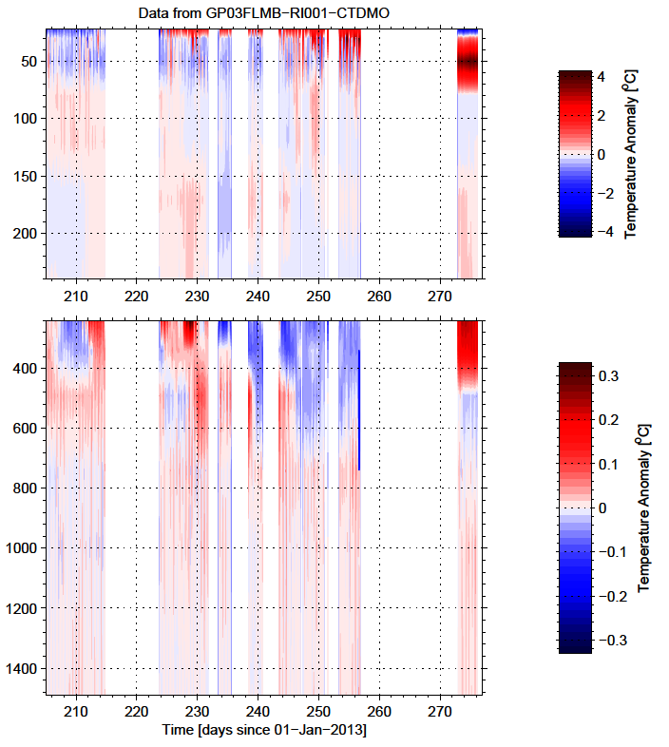
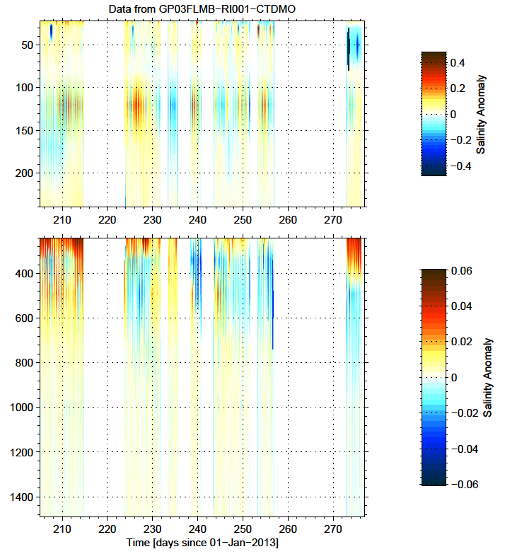
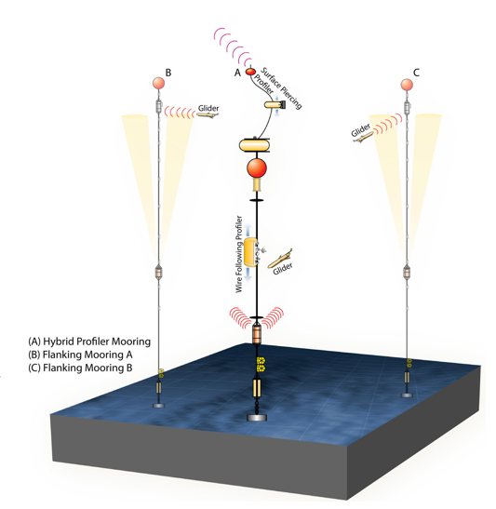
Station Papa – Flanking Mooring-B

Slide 17
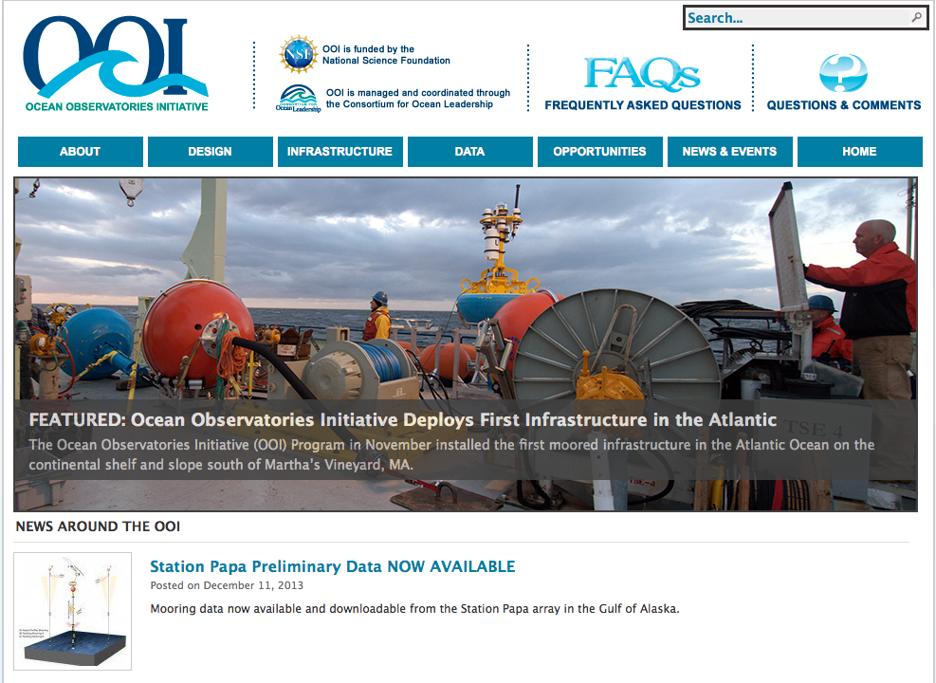
Access to Pre-commissioned Data

Slide 18
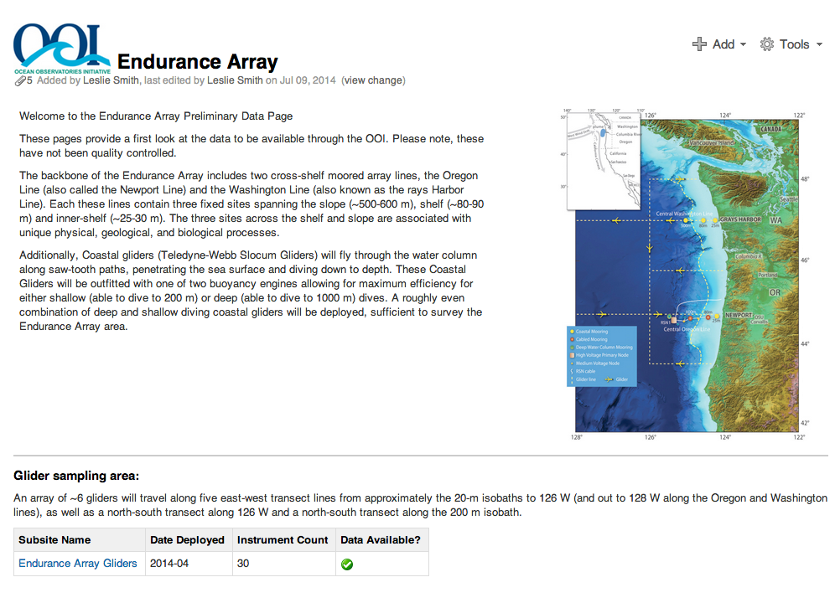
Access to Pre-commissioned Data

Slide 19
OOI will sample the high latitudes- strongly forced, poorly observed

Slide 20
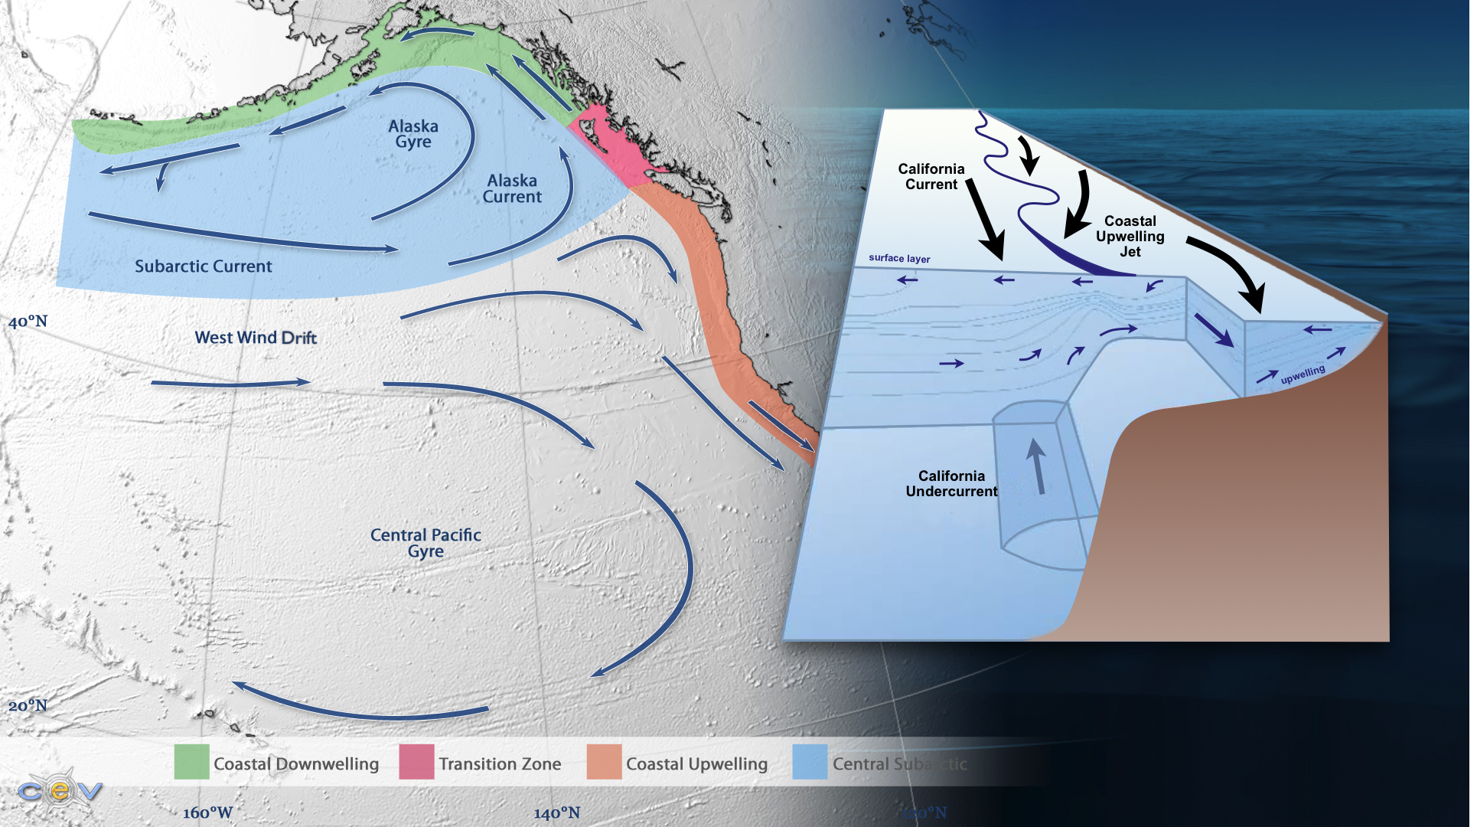
What is the coupling of the exchanges between open ocean and coastal systems?

Slide 21
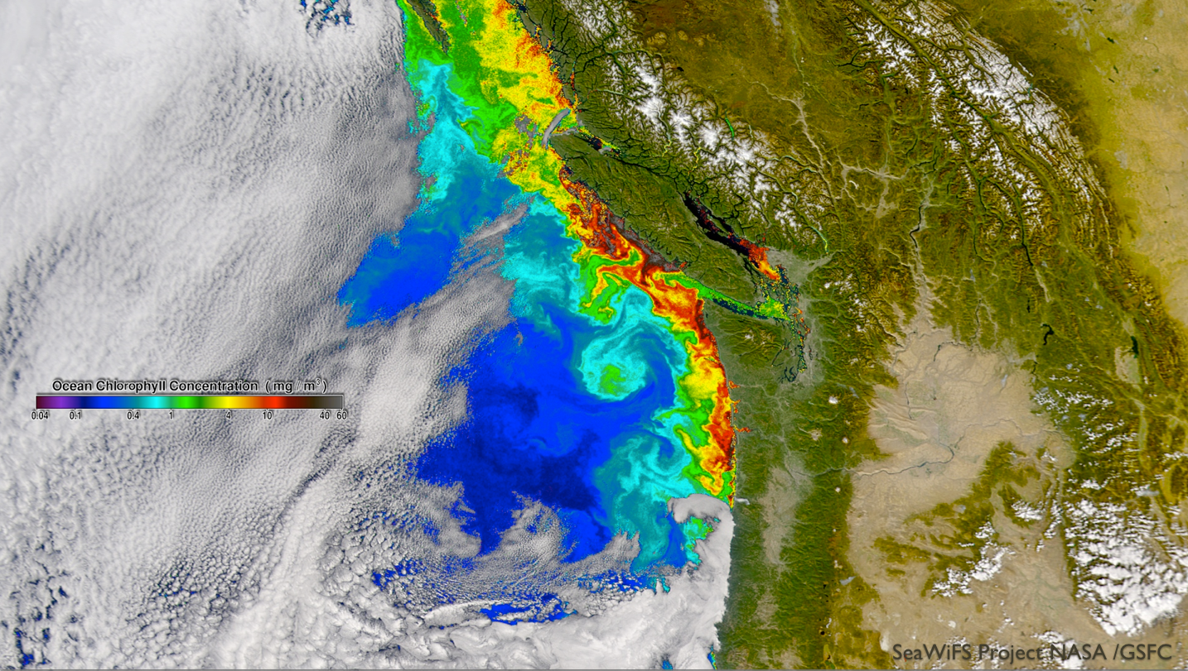
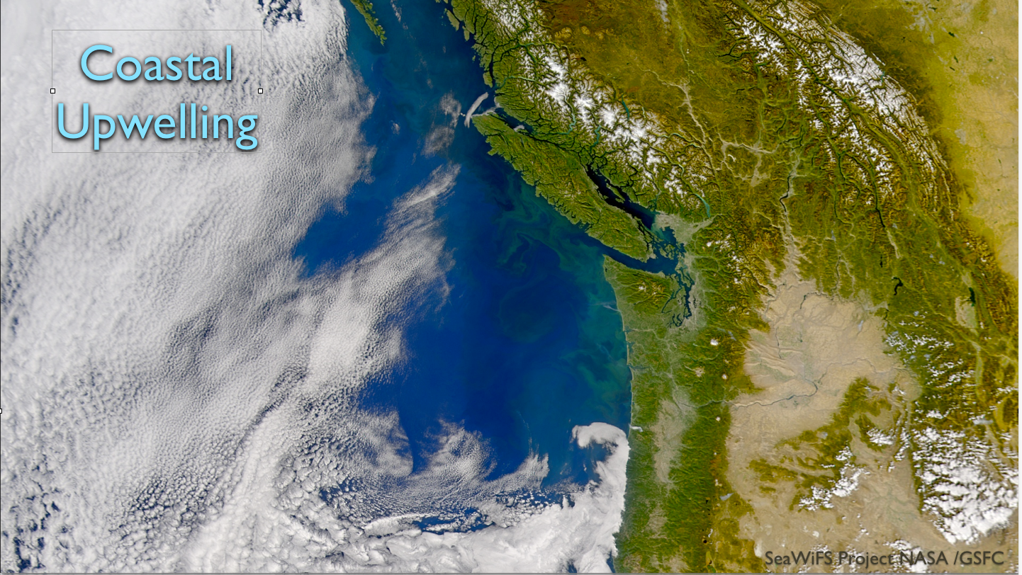
How do these deep and coastal ocean systems drive local biological activity?

Slide 22
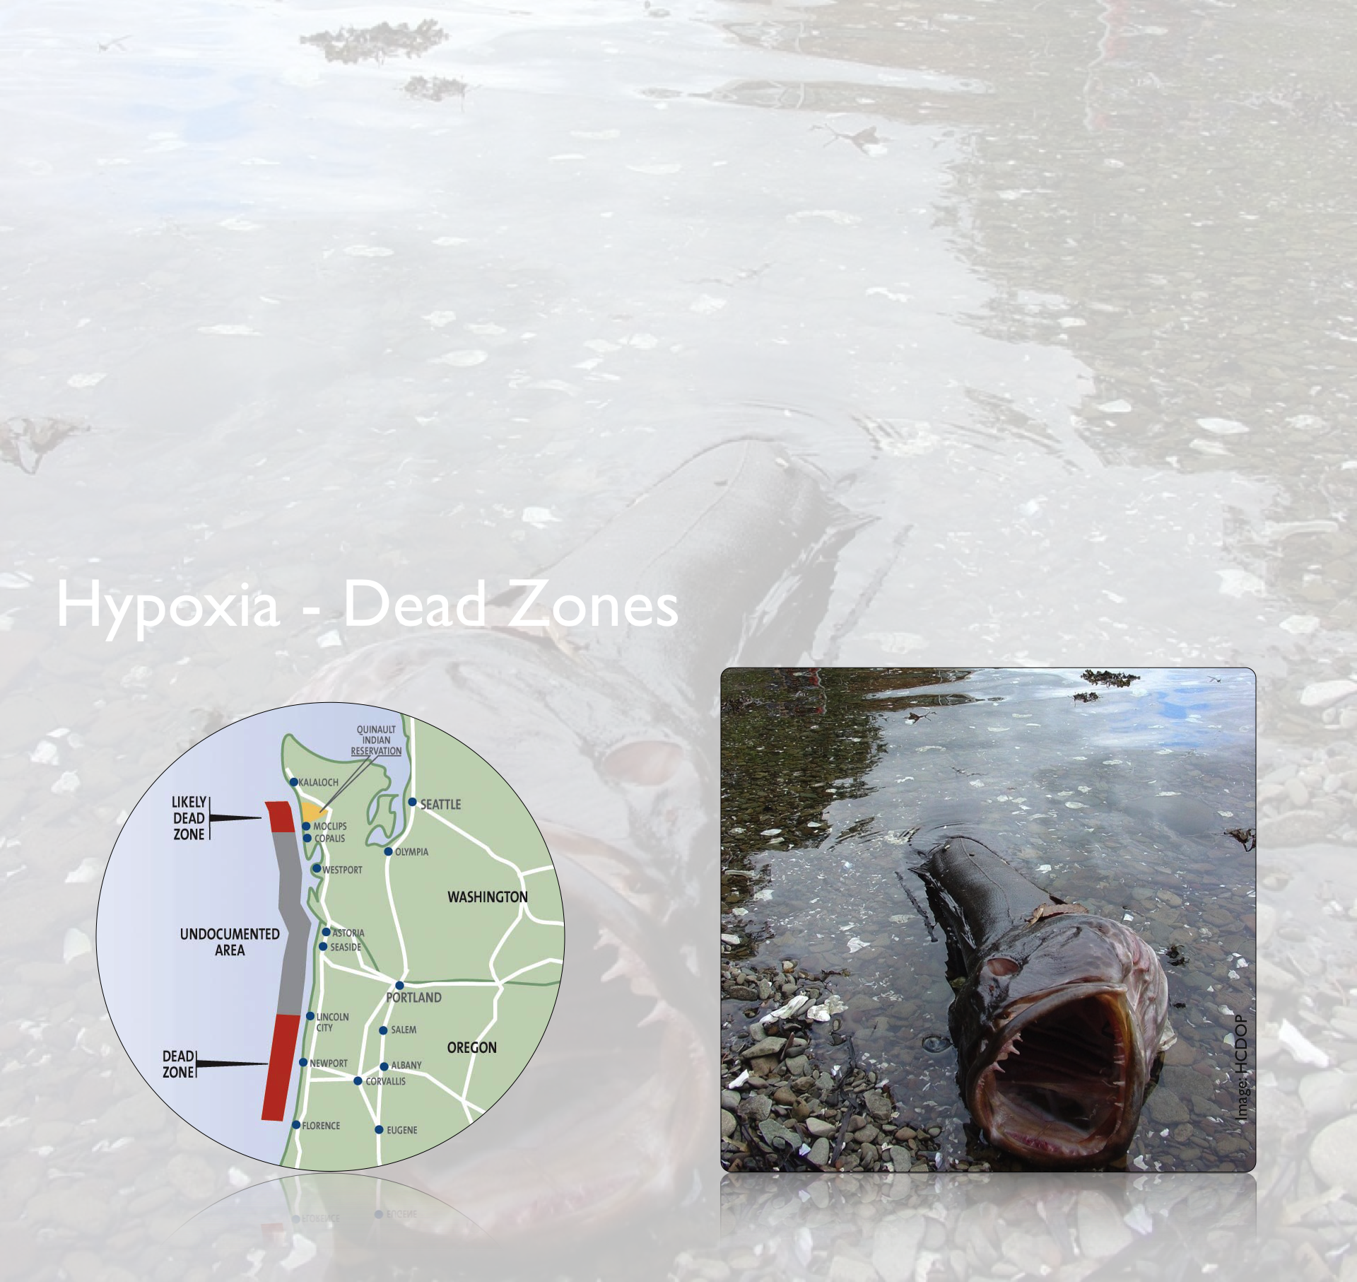
How systems being modified by shifting redox state?

Slide 23
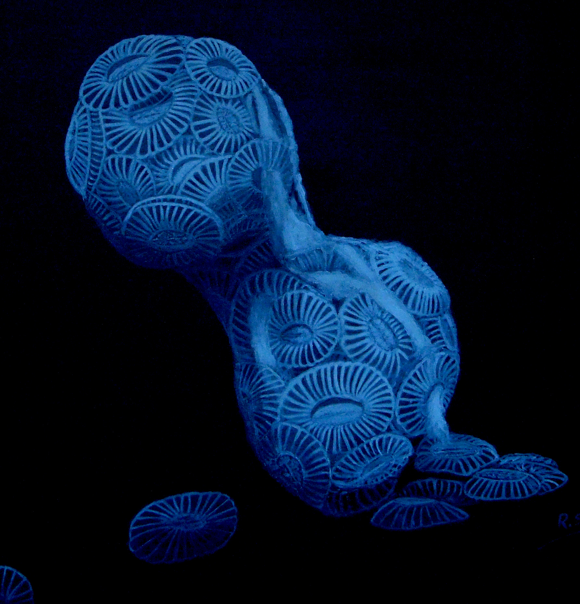
How systems being modified by shifting pH?
How will the world react
to an acidified ocean?
Melting coccolithophorrids
Artwork by Rosa Seoane

Slide 24
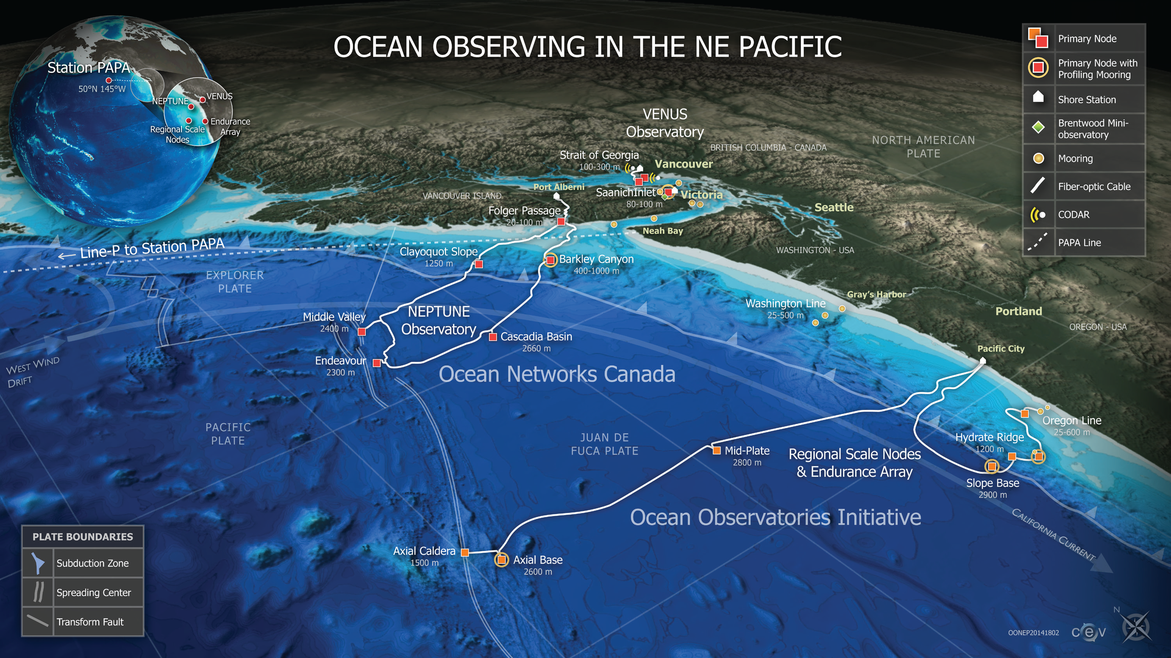
NE Pacific Observatory Assets

Slide 25
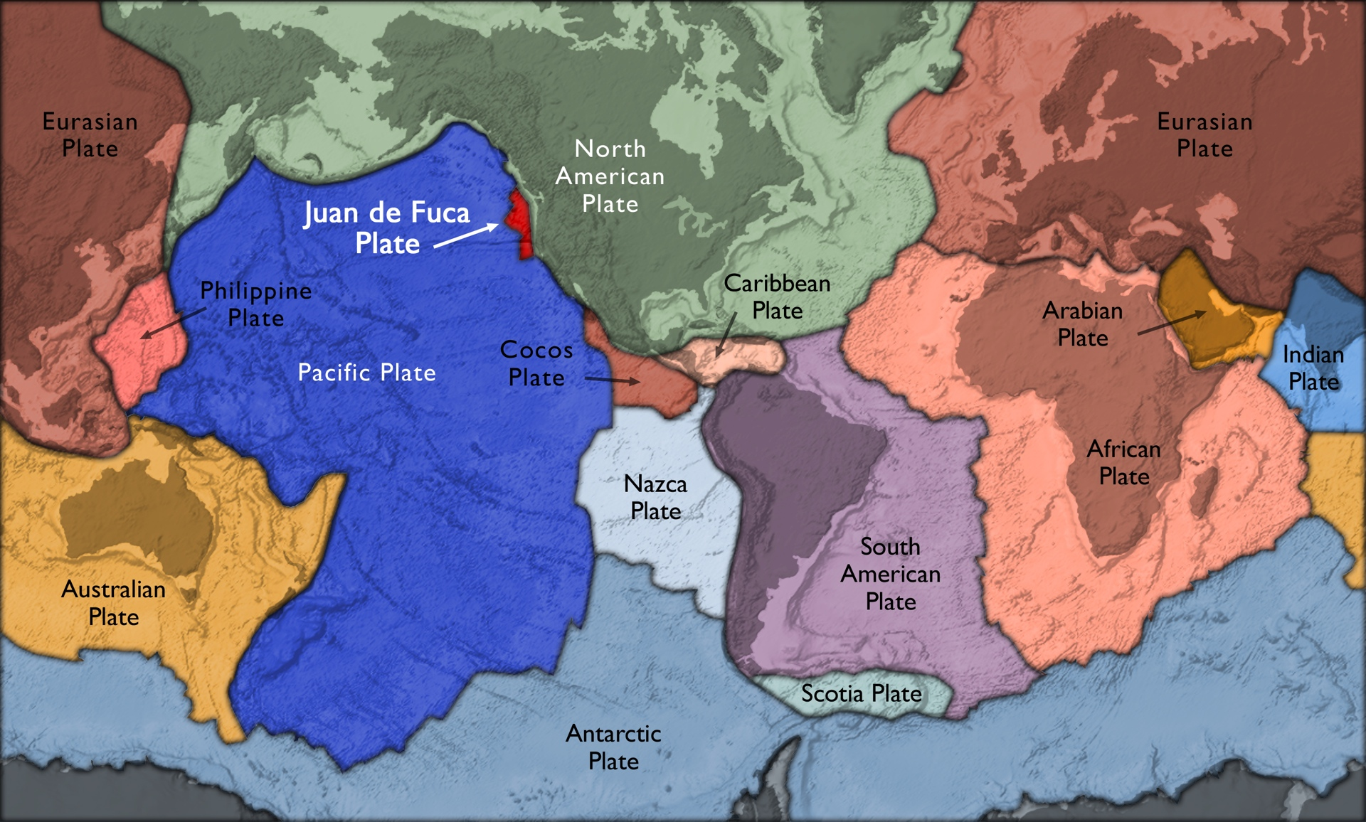
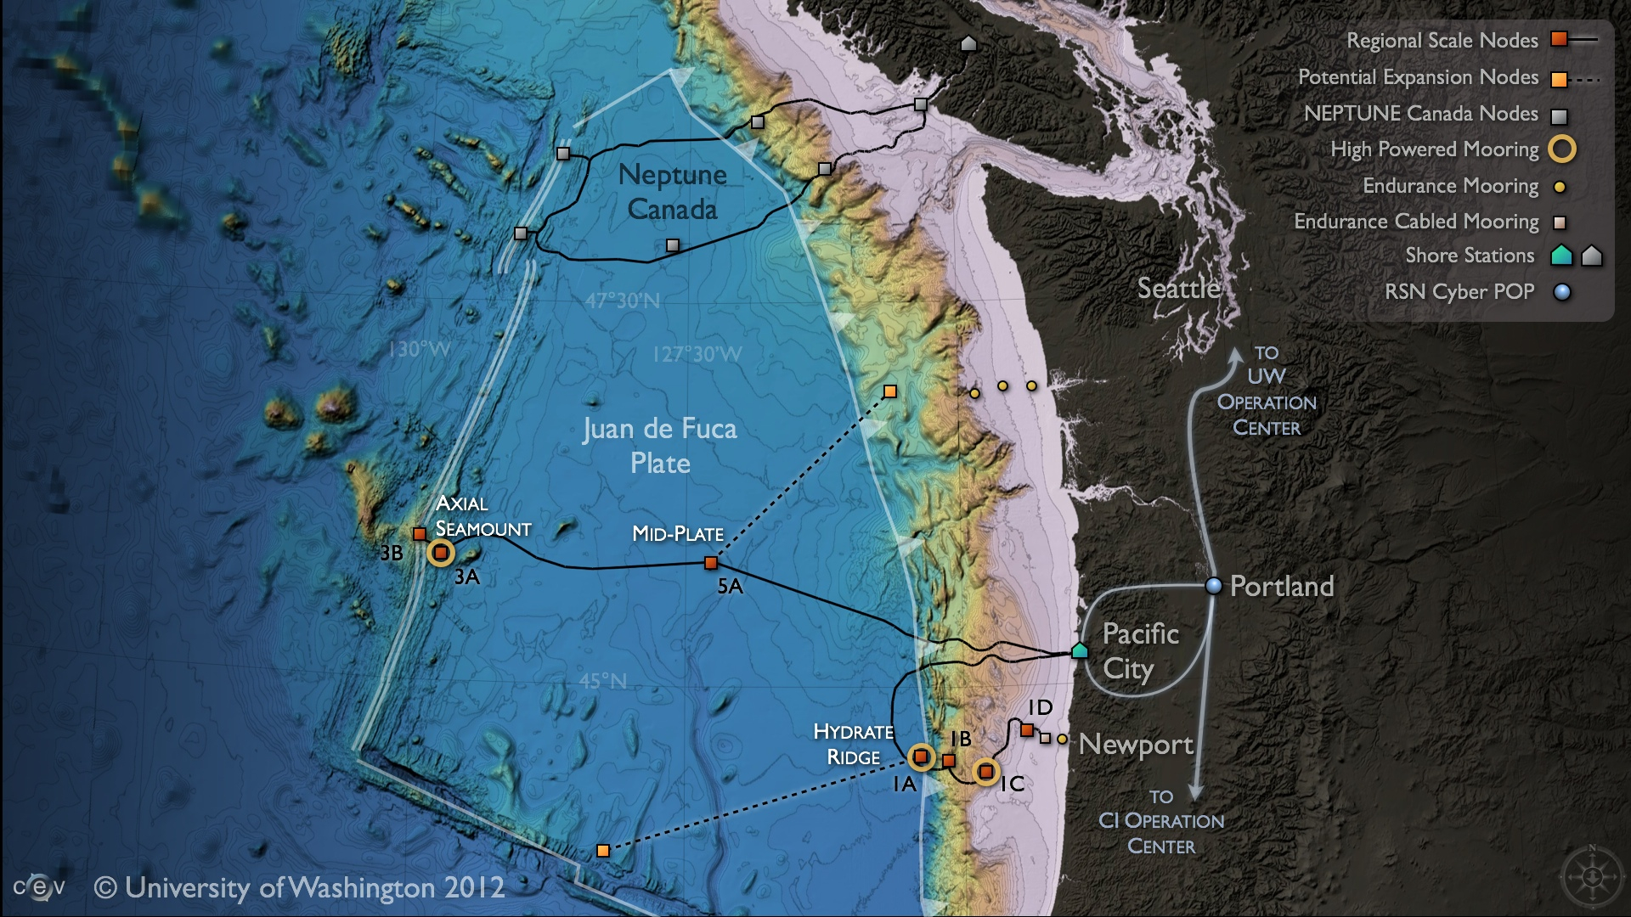
Spanning the Juan de Fuca Plate

Slide 26
Data Products from NE Pacific observatories

Slide 27
Data Products from NE Pacific observatories

Slide 28
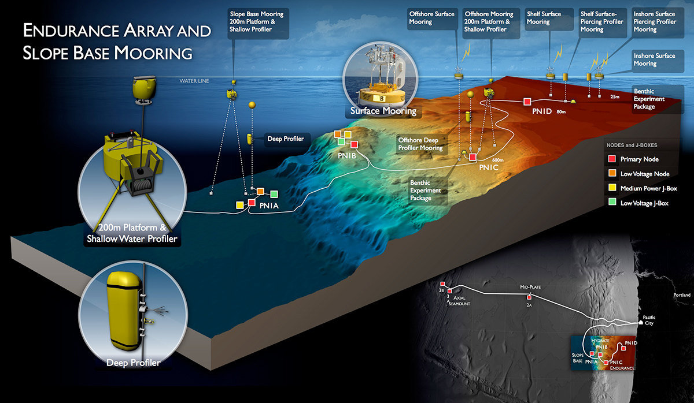
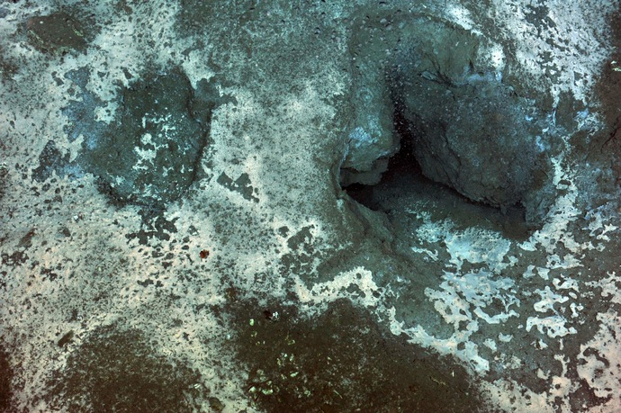
Shelf/Slope Mixing and Biophysical Interactions
Understanding processes along the shelf/slope gradient, quantifying exchanges, observing shallow methane hydrates.
Active Methane Hydrate Seep
Sampled with mass spectrometer, osmosis based water sampler, benthic fluid flow sensors, etc.

Slide 29
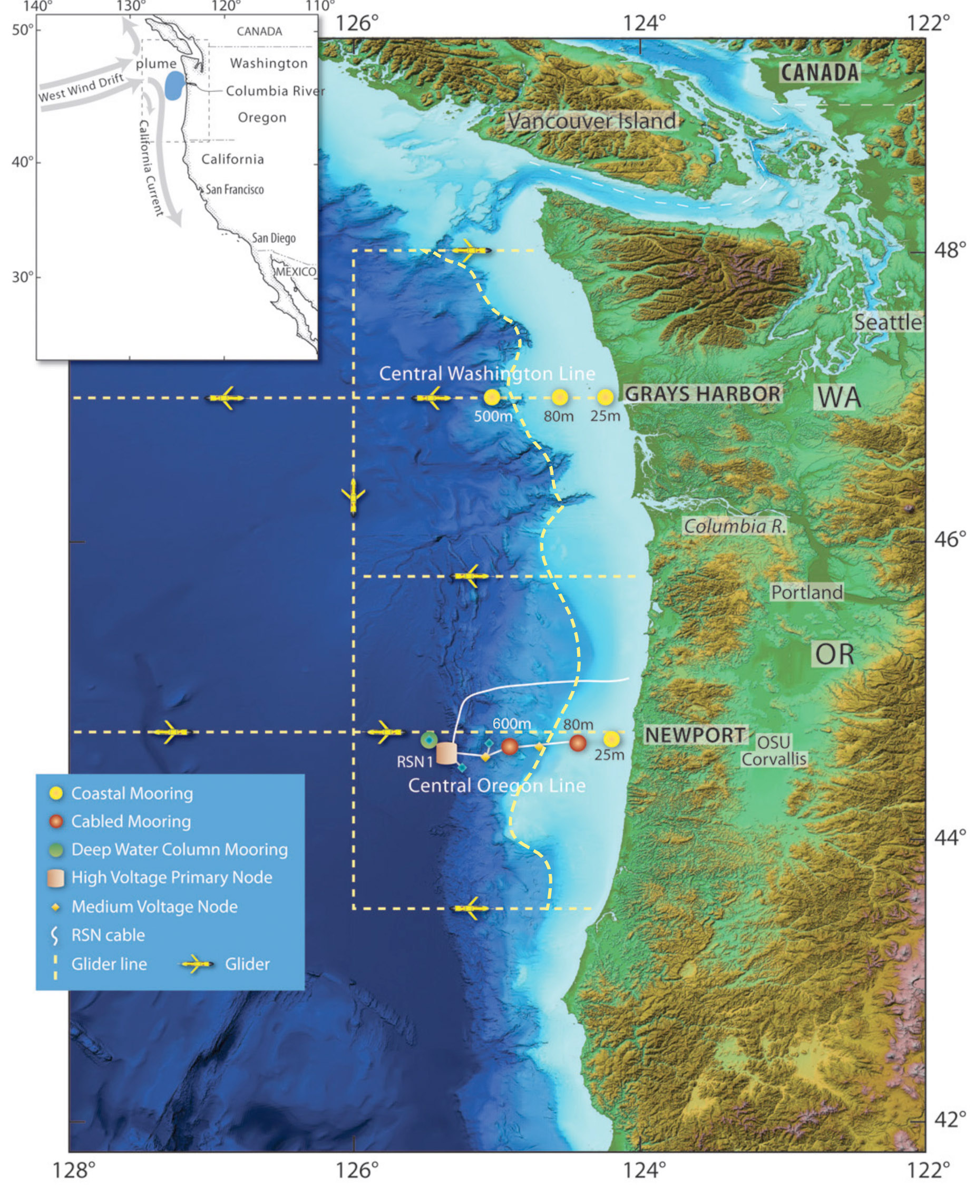
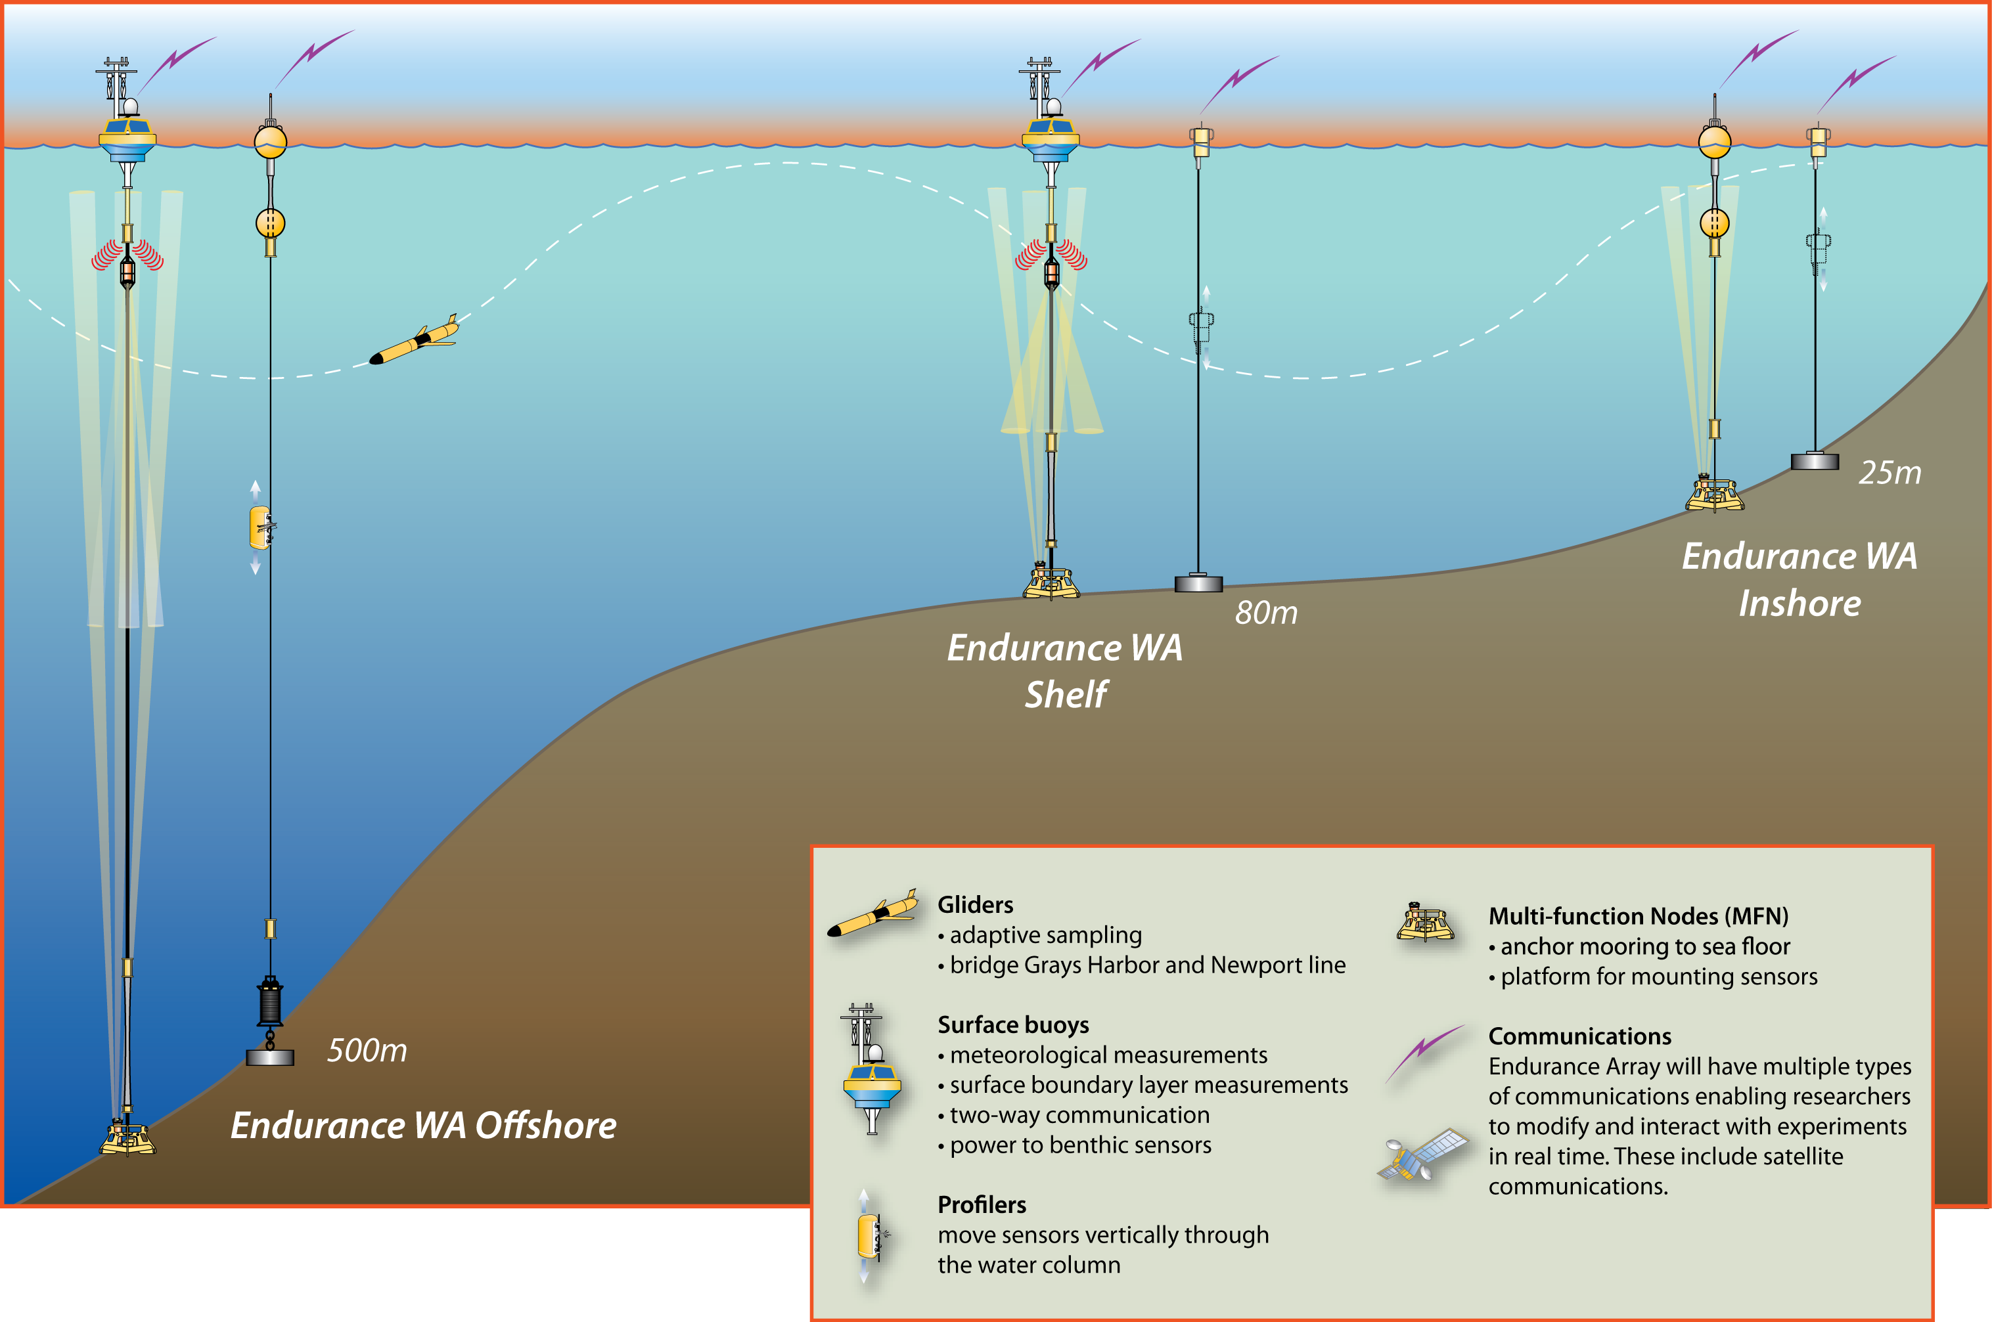
Coastal Ocean Dynamics and Ecosystems
Understanding spatial and temporal complexity of the coastal ocean (upwelling, circulation, mixing) and quantifying interactions between atmospheric and terrestrial forcing.
Mooring lines straddle Columbia River discharge
Meteorological Observations
Data transmitted to shore in near-real time
Fixed instruments:
high resolution time-series data
Profilers: high resolution water column data
Gliders map shelf/slope to the abyssal plane; 1,000m depths

Slide 30
Can we sample a water column?
-technologies available to sample the upper, mesopelagic, deep and sea floor represents diverse communities who unfortunately do not interact
-technologies for the different parts of the water column are distinct
-many of the technologies we need to “constrain” the arrows of the flow do not yet exist
-many of the processes that drive the size of the arrows we do not know
The Chisholm figure that launched 1000s of proposals

Slide 31
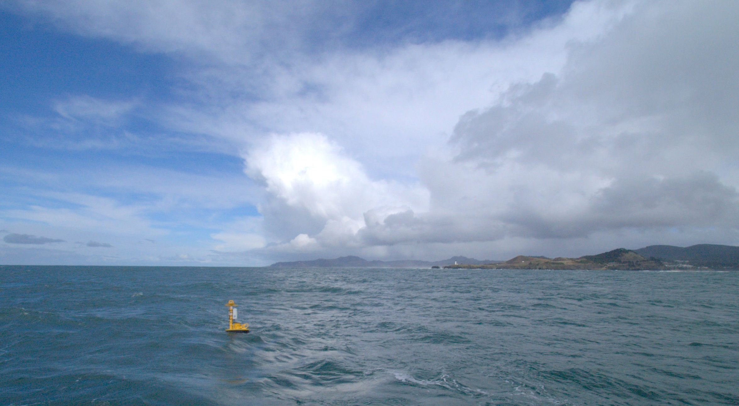
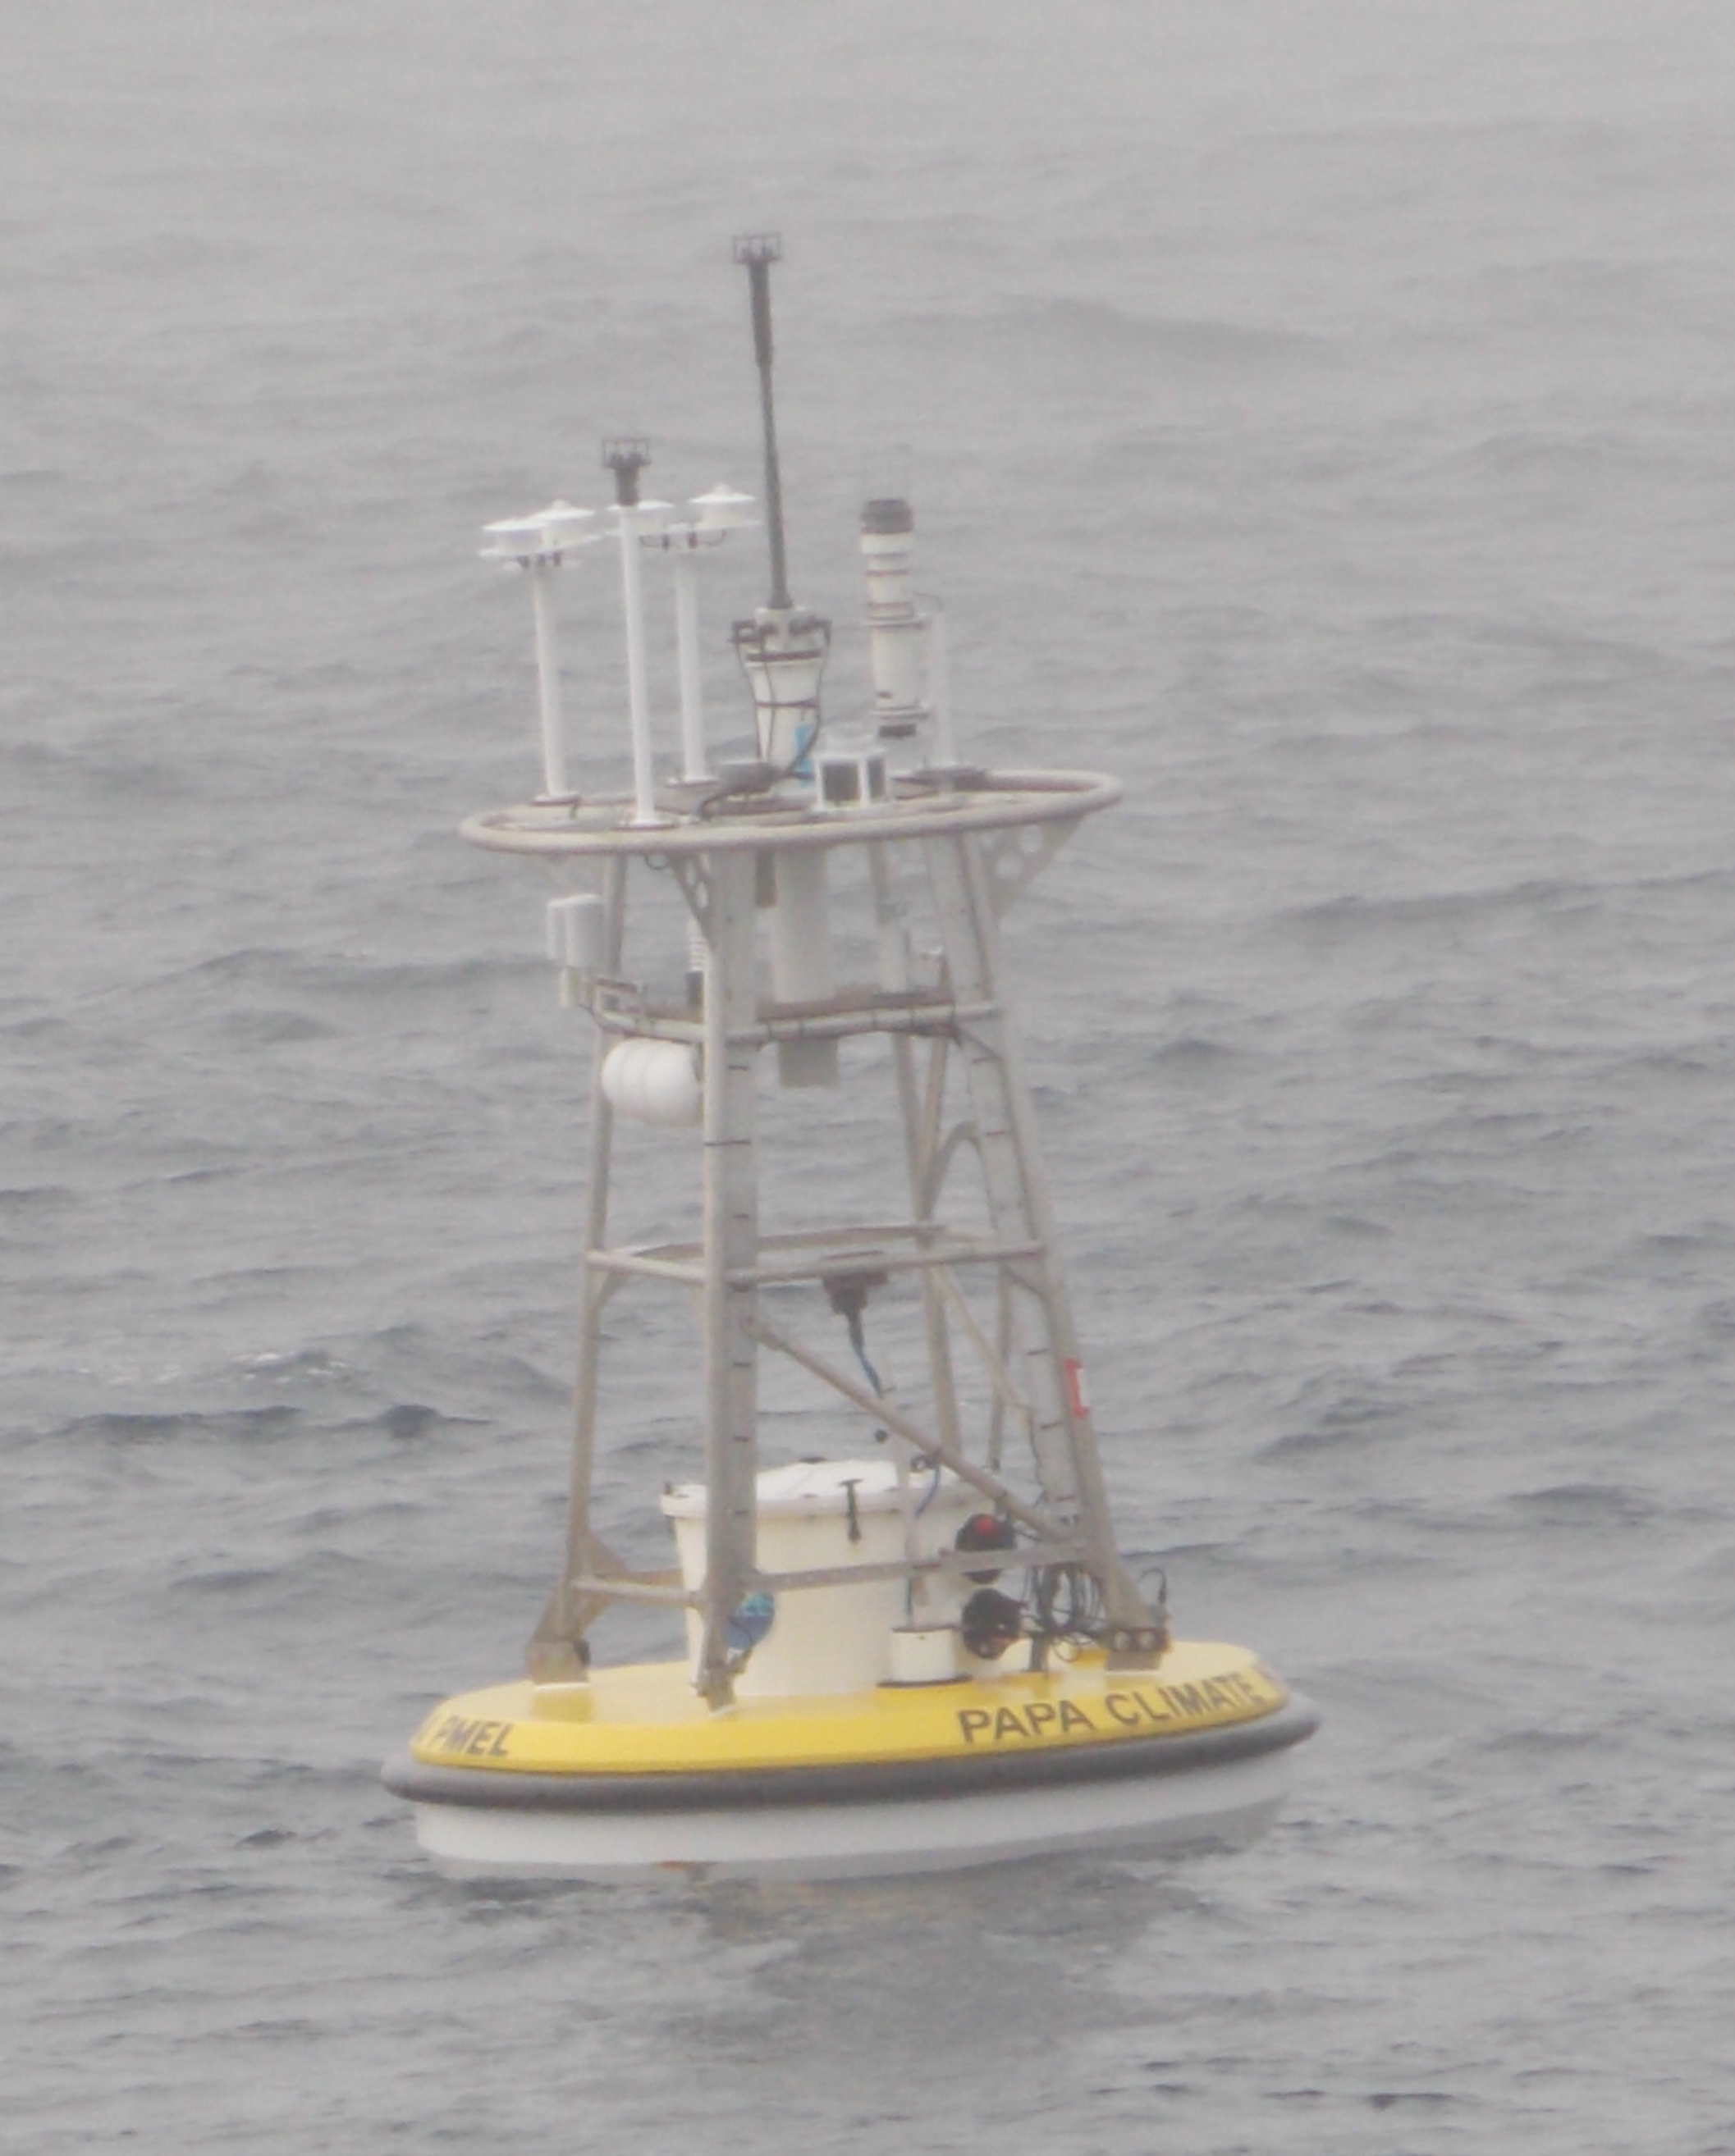
Ocean-Atmosphere Exchange
Examining the exchange of gas and energy between ocean and atmosphere:
carbon dioxide, heat, methane, water vapor

Slide 32
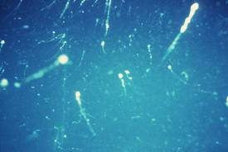
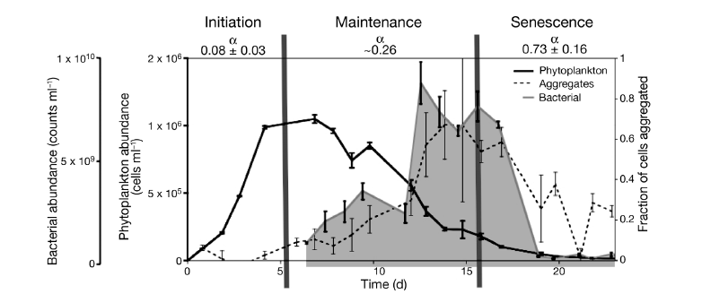
What might someone focus on with the existing infrastructure?
Timing of Marine Snow Formation, bloom dynamics defined by detailed OOI moored time series,
Spatial glider surveys, combined with satellite imagery, and models
Kahl et a. 2008

Slide 33
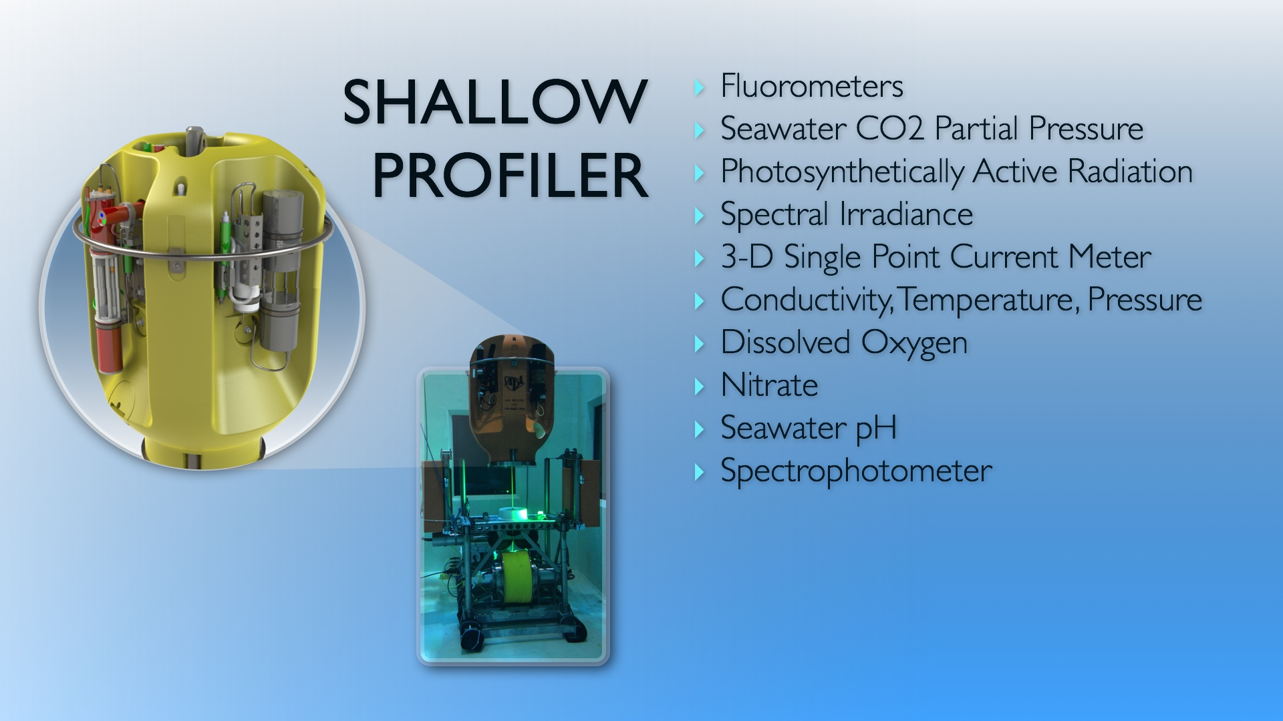
Assets to the NE Pacific system have OCB relevant features

Slide 34
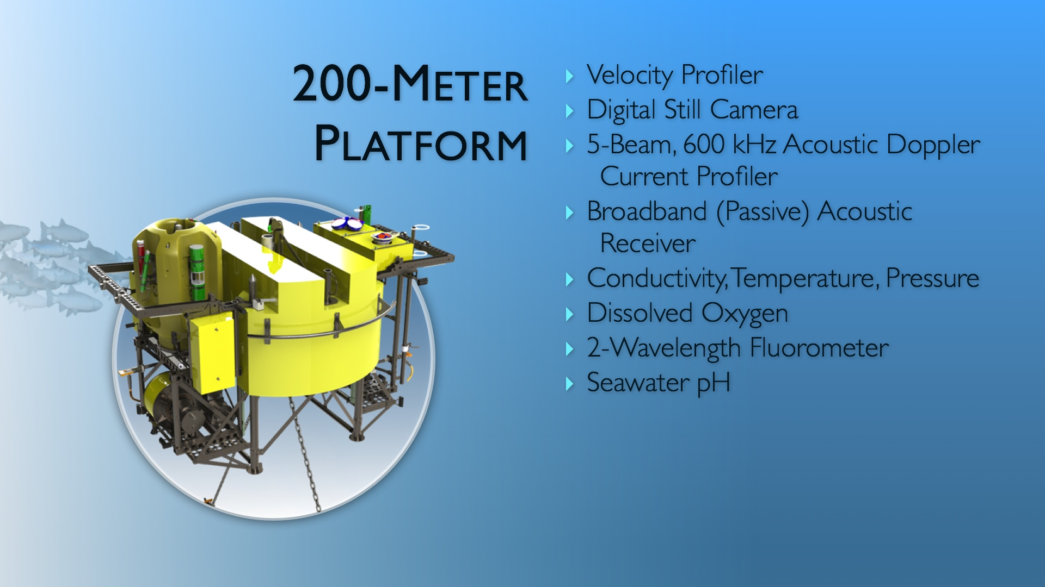
Assets to the NE Pacific system have OCB relevant features

Slide 35
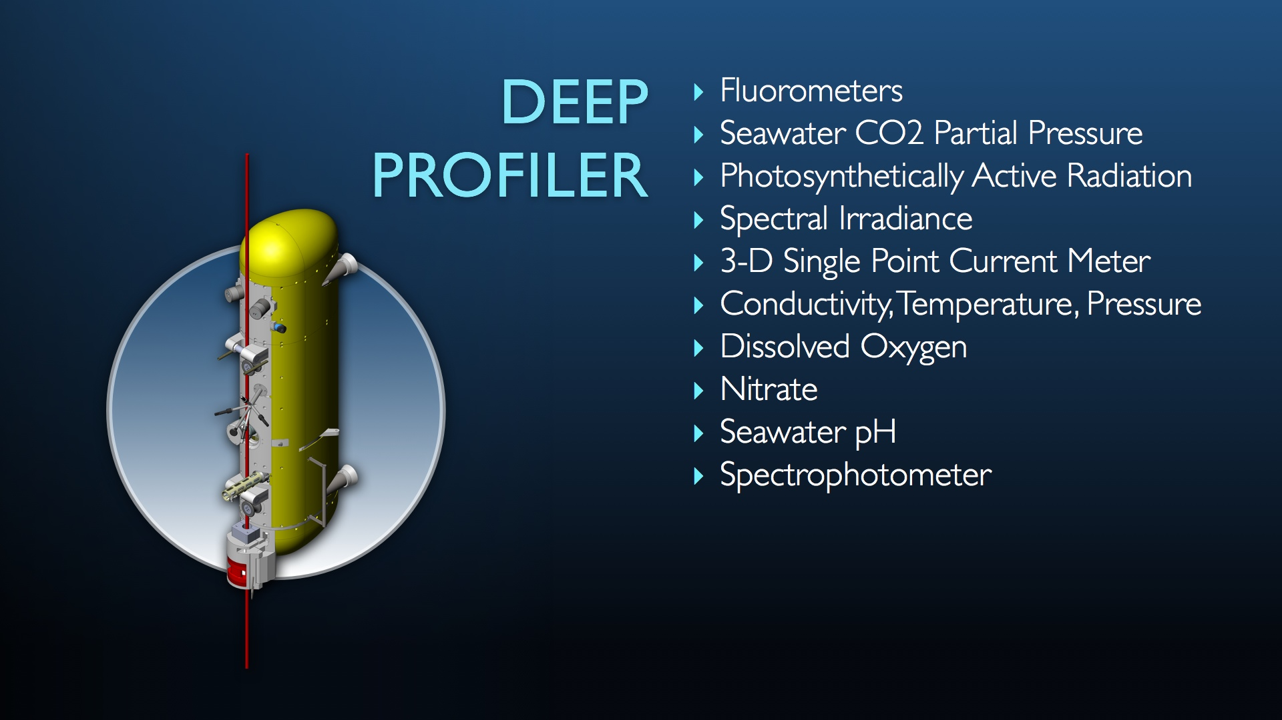
Assets to the NE Pacific system have OCB relevant features
-CTD
-oxygen
-velocity
-optical attenuation
-chlorophyll fluorescence
-optical backscatter

Slide 36
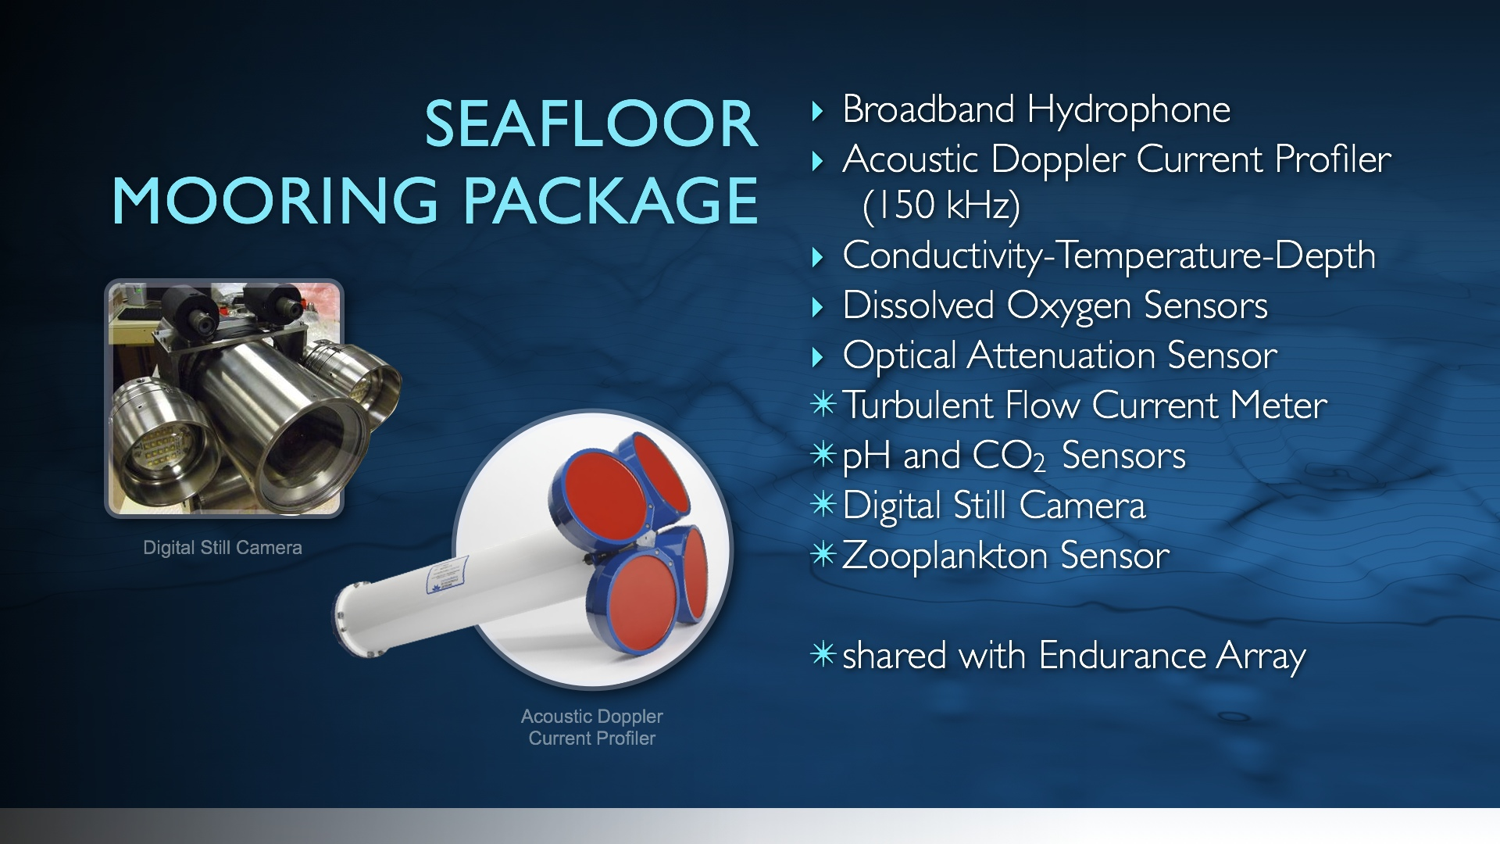
Assets to the NE Pacific system have OCB relevant features

Slide 37
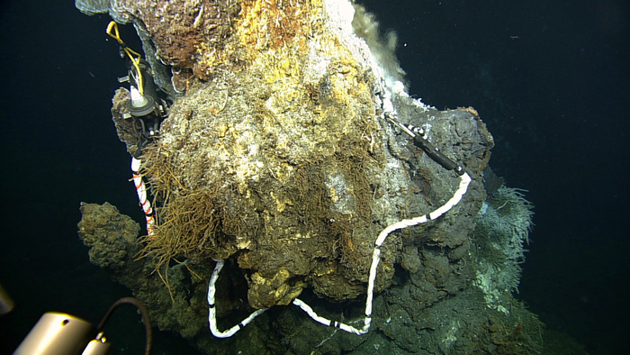
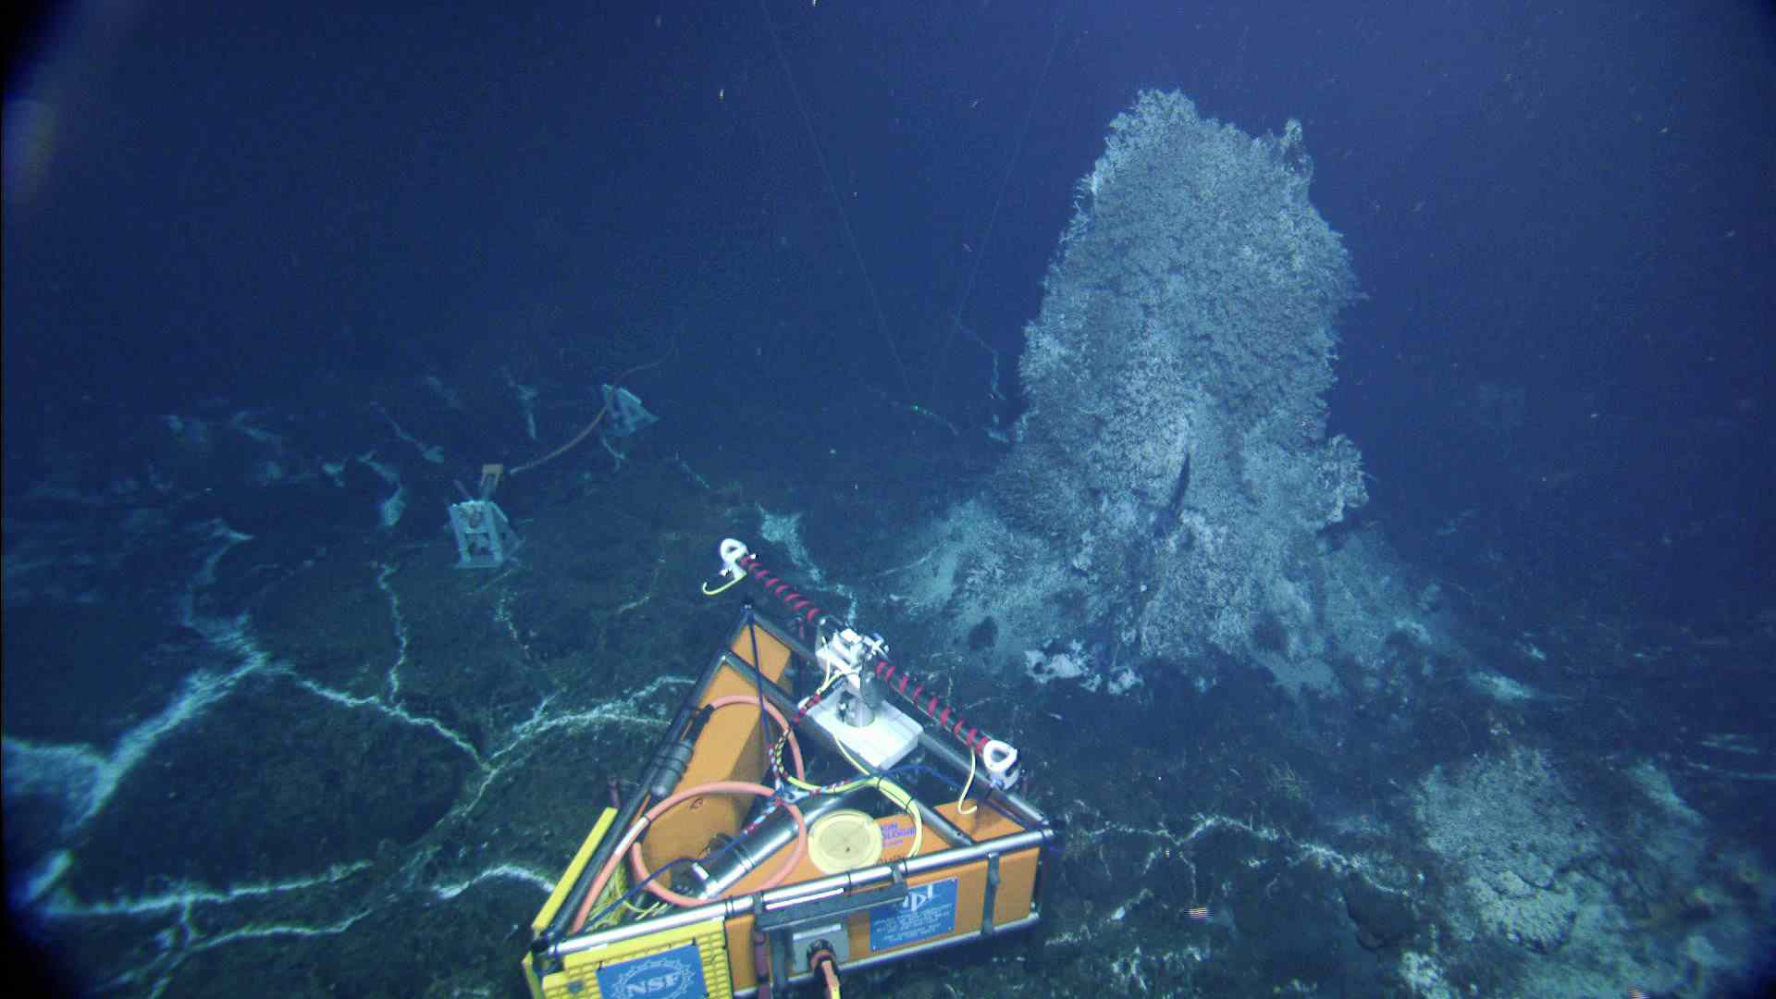
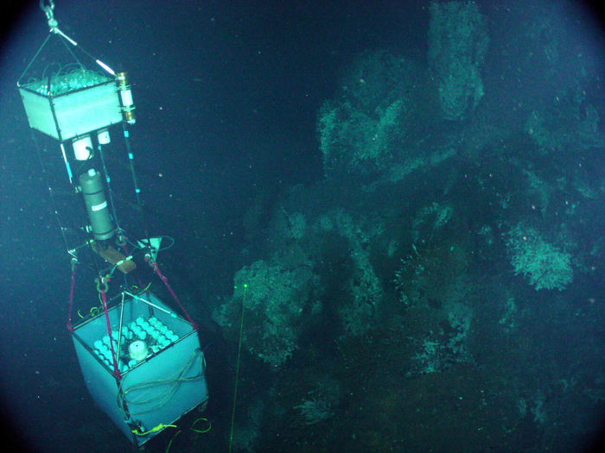
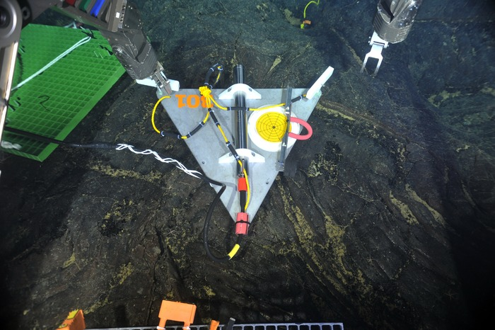
Mid-Ocean Ridge
Examining heat and chemical exchanges between the oceanic crust and seawater.
Vent Fluid Resistivity
HD Video Camera
Seismometer
Remote Access Fluid and DNA Sampler
Images from: www.interactiveoceans.washington.edu/
Notes:
Vent communities
Hydrothermal fluids
Regional circulation
Buoyant plume

Slide 38
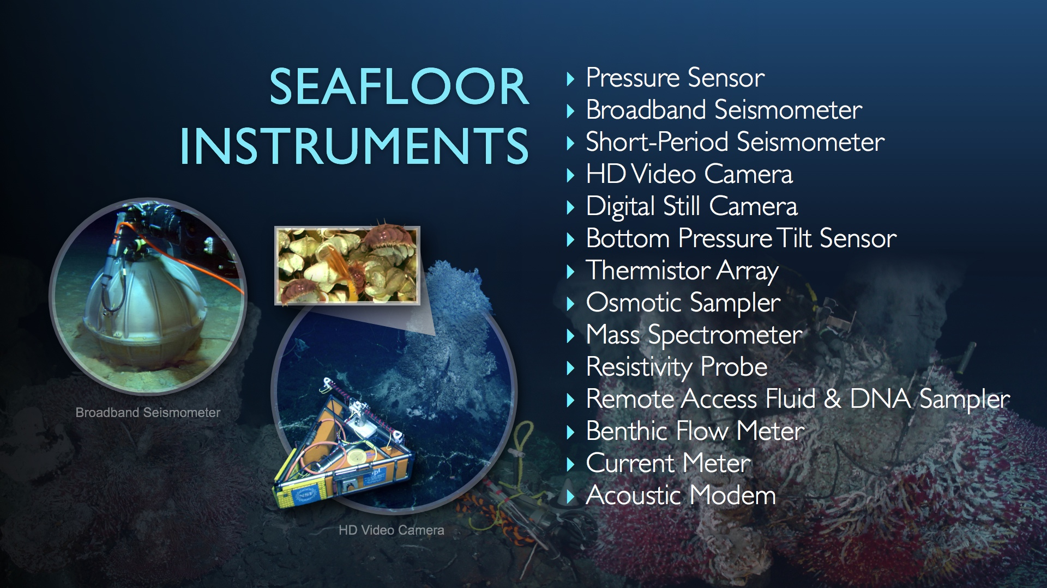
Assets to the NE Pacific system have OCB relevant features

Slide 39
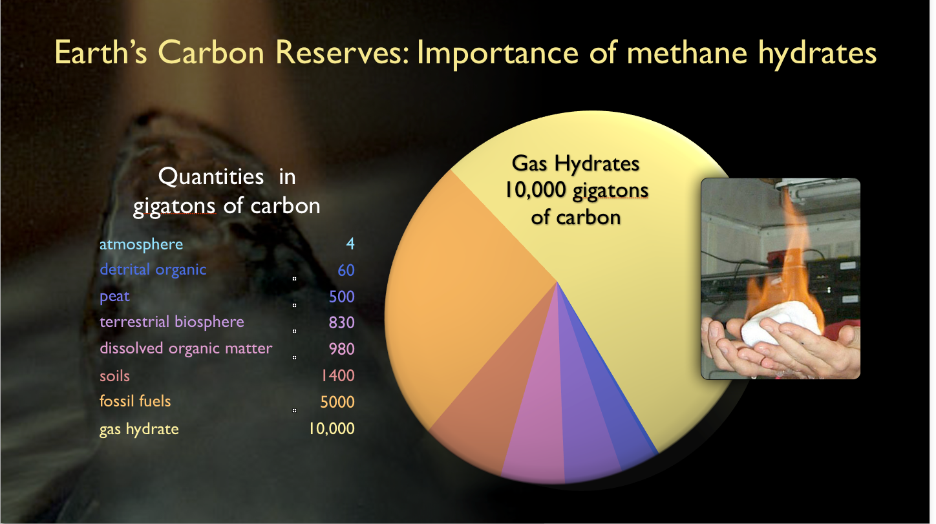
How does shifting system impact carbon storage in sea-floor?

Slide 40
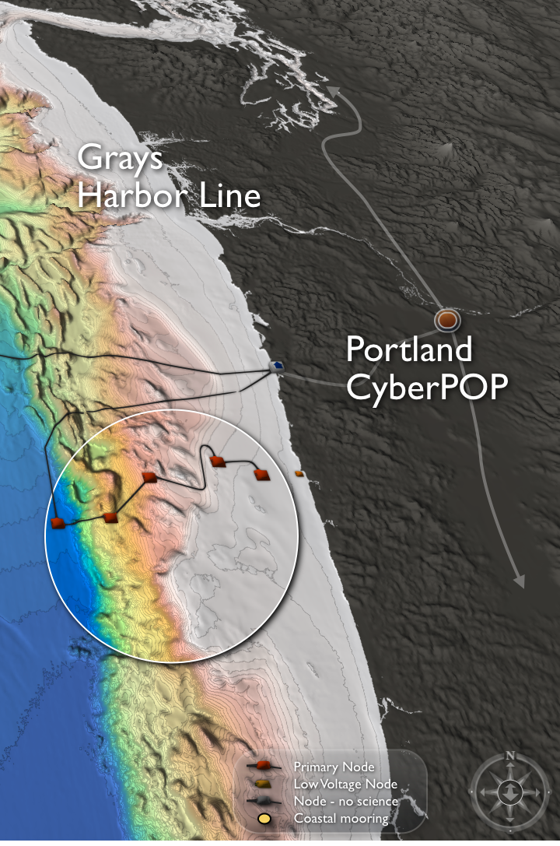
Regional Cabled Network
An engineering driver is to sample the lithosphere, methane hydrate, and overlying water column
Observing Requirements: High frequency physical, chemical, and biological data below, within the methane hydrate, and the overlying water column.
• Engineering Drivers: High
H power and bandwidth required to support seismic, chemical, and geophysical and water column measurements. Sensors require high frequency information to resolve rapid responses
Seafloor Photomosaic of an
Experimental Site – in
Hydrate Ridge Area

Slide 41
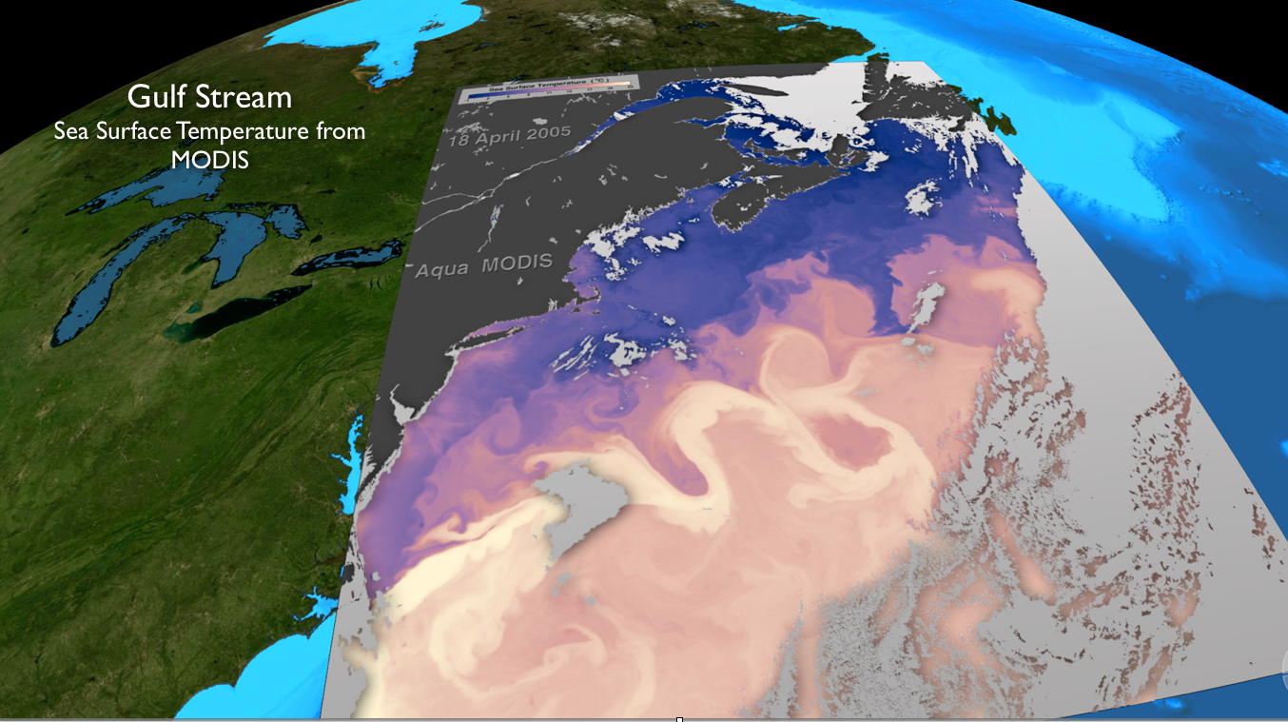
Are the compact continental shelves of the west US coast biogeochemically similar to the more reubinstic shallow continental shelves of the east coast?

Slide 42
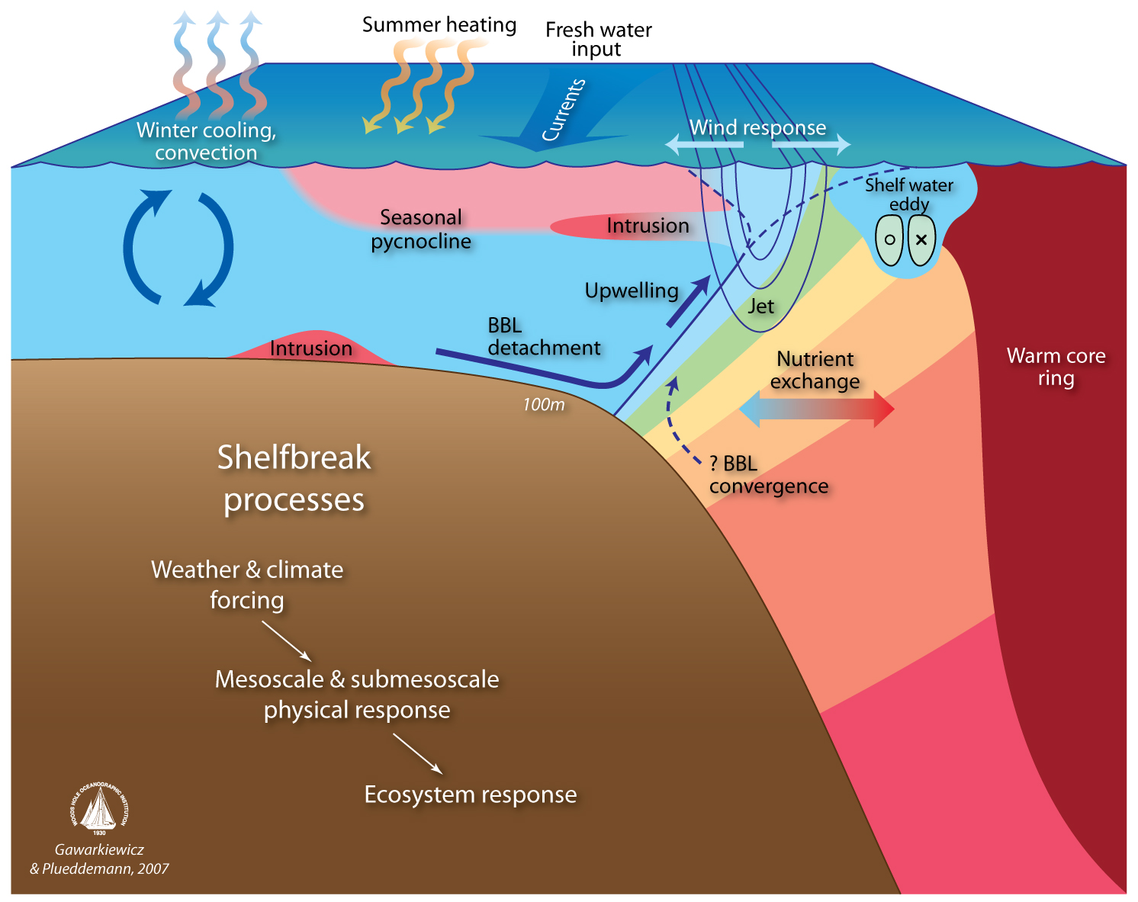
Coastal Node: Pioneer Array
How exchanges between a broad shelf with the a deep ocean that is bounded by an energetic western boundary system structure physics, chemistry, and biology of continental shelves
Observing Requirements: Nested simultaneous observations resolving short time scales and multiple spatial scales, data from air-sea interface to sea floor, multidisciplinary sensor suites, real-time data, high resolution adaptive sampling
Engineering Drivers:
High turbulence resulting in high frequency heterogeneity in space/time, high rates of bio-fouling, human presence, rapid response cabailities

Slide 43


Coastal Node: Pioneer Array
Engineering Design: Multi-element, multi-scale, fixed and mobile assets, relocatable, reconfigurable to resolve processes Network consists of surface profiling floats, subsurface floats, coastal gliders, and docking AUVs

Slide 44

Like Ocean Station Papa, pioneer array preliminary data is now beginning to flow
Warm core rings on the
shelf-slope edge

Slide 45

OOI embedded within national investments such as NOAA’s IOOS

Slide 46






Embedded and increasing central national/international efforts
 | Group | Glider | Deploy
1 | Dalhousie | OTN200 (2) | 10-Sep
2 |  | OTN201 | 16-Sep
3 | U. Maine | Penobscot (2) | 10-Sep
4 | WHOI | Saul | 10-Sep
5 | U. Mass | Blue | 6-Sep
6 | Rutgers | RU28 | 12-Sep
7 | U. Maryland | RU22 | 22-Sep
8 | Rutgers | RU23 (2) | 10-Sep
9 | U. Delaware | Otis | 12-Sep
10 | VIMS | Stewart | 10-Oct
11 | NC State | Salacia | 17-Sep
12 | Skidaway | Modena | 10-Sep
13 | T. Webb | Darwin | 11-Sep
14 | U.S. Navy | Navy1 | 10-Oct
 | Group | Glider | Deploy
1 | Dalhousie | OTN200 (2) | 10-Sep
2 |  | OTN201 | 16-Sep
3 | U. Maine | Penobscot (2) | 10-Sep
4 | WHOI | Saul | 10-Sep
5 | U. Mass | Blue | 6-Sep
6 | Rutgers | RU28 | 12-Sep
7 | U. Maryland | RU22 | 22-Sep
8 | Rutgers | RU23 (2) | 10-Sep
9 | U. Delaware | Otis | 12-Sep
10 | VIMS | Stewart | 10-Oct
11 | NC State | Salacia | 17-Sep
12 | Skidaway | Modena | 10-Sep
13 | T. Webb | Darwin | 11-Sep
14 | U.S. Navy | Navy1 | 10-Oct

Slide 47

Web based services
Technical Approach Uses Proven SOA Infrastructure to Integrate OOI Data

Slide 48

Ship and Shore-based sensor verification

Slide 49
At-sea protocols
Deployment and post-deployment procedures
Deployment documentation
Pre-deployment checklists [CP02PMUI-00001_checklist.pdf]
Mooring deployment logs [CP02PMUI-00001_deployment-log.pdf]
Post-deployment data assessment
Adjacent CTD cast(s) (temp,sal,oxy,chl,turb) [see quick look report]
Shipboard systems (met, surface t-sal, ADCP) [SCS_WSPD.gif, SCS_WDIR.gif]
Water samples and lab analysis (sal,oxy,chl,etc) [Pioneer1_salinity_oxygen.xlsx]

Slide 50
At-sea procedures
Post-deployment procedures
Deployment documentation
Pre-deployment checklists [CP02PMUI-00001_checklist.pdf]
Mooring deployment logs [CP02PMUI-00001_deployment-log.pdf]
Post-deployment assessments
Adjacent CTD cast(s) (temp,sal,oxy,chl,turb) [see quick look report]
Shipboard systems (met, surface t-sal, ADCP) [SCS_WSPD.gif, SCS_WDIR.gif]
Water samples and lab analysis (sal,oxy,chl,etc) [Pioneer1_salinity_oxygen.xlsx]
Quick-look report [3204-00023_Poineer_1_Quick_Look_Cruise_Report.pdf]
Lessons learned [internal working documents]

Slide 51

OOI Developing the infrastructure to enable education and public engagement (EPE)
OOI is constructing a series of software tools and a web-based social network to engage a wide range of education users spanning from faculty, graduate and undergraduate students, informal science educators and the general public.
The software will be designed to provide
scientists and educators a suite of tools
that will enable them to enhance their
undergraduate education and engage
the general public using real-time and
streaming data provided by the OOI.

Slide 52




Expanding the model
Developing tools to increase the crowd sourcing & educational opportunities with OOI Education and Public Engagement team (EPE)
Concept Maps
Data Visualization Tools
Lab Lesson Builder

Slide 53



June 18 2014: Naval Academy Interns Assessing NOAA Global Skill Using an Ocean Robot
Data from the
Cabo Frio eddy off
Brazil

Slide 54



Web access to allow all to explore the ocean
MTS manuscript submitted July 14th 2014
Student project using OOI EPE tools to show the MyOcean global model is biased high relative to the NOAA RTOFS and real ocean using ocean glider and argo.
 | Group | Glider | Deploy
1 | Dalhousie | OTN200 (2) | 10-Sep
2 |  | OTN201 | 16-Sep
3 | U. Maine | Penobscot (2) | 10-Sep
4 | WHOI | Saul | 10-Sep
5 | U. Mass | Blue | 6-Sep
6 | Rutgers | RU28 | 12-Sep
7 | U. Maryland | RU22 | 22-Sep
8 | Rutgers | RU23 (2) | 10-Sep
9 | U. Delaware | Otis | 12-Sep
10 | VIMS | Stewart | 10-Oct
11 | NC State | Salacia | 17-Sep
12 | Skidaway | Modena | 10-Sep
13 | T. Webb | Darwin | 11-Sep
14 | U.S. Navy | Navy1 | 10-Oct

Slide 55
Conclusions
Open access high frequency diverse data for sustained periods of time
Ability to enable science as is, provide a infrastructure to expanded by investigators, and can provide leverage to other programs
Coupled to tools to enable teaching and shared community education resources

Slide 58
Operating and Maintaining the OOI
The OOI team will execute processes, procedures, work instructions to meet operational requirements and deliver data products. Activities include:
Marine hardware and instrumentation
  System status monitoring, reporting and corrective actions
Pre-deploy (test, integration, calibrate), Deploy (platform ops, command/control)
Vehicle ops, alarms/alerts, sampling strategies, data QC
Recovery, post-recovery (refurb, calibrate), data recovery
  Performance monitoring and reporting, Asset management, Incident Reporting
  Data delivery (system services and products)
  Cybersecurity, System monitoring, status display, software maintenance
  Performance measurement, network and application enhancement
  Hardware/Software – Development, Maintenance, Quality assessment
  Maintenance and improvement of data products, algorithms, metadata
  Data QA/QC enhancements, user request and support

