Slide 1
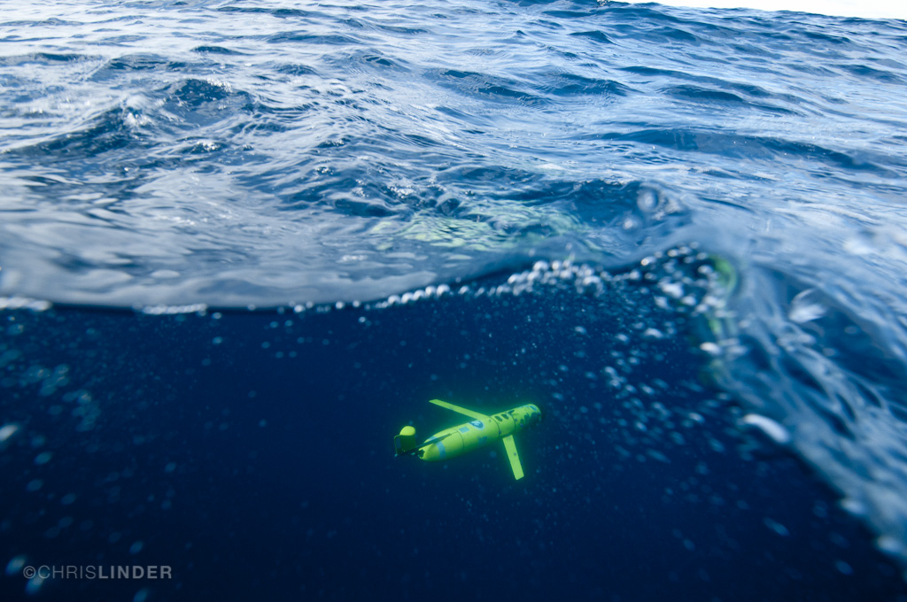
Rutgers glider ops
What we have
What we are doing
What would like to do and build

Slide 2
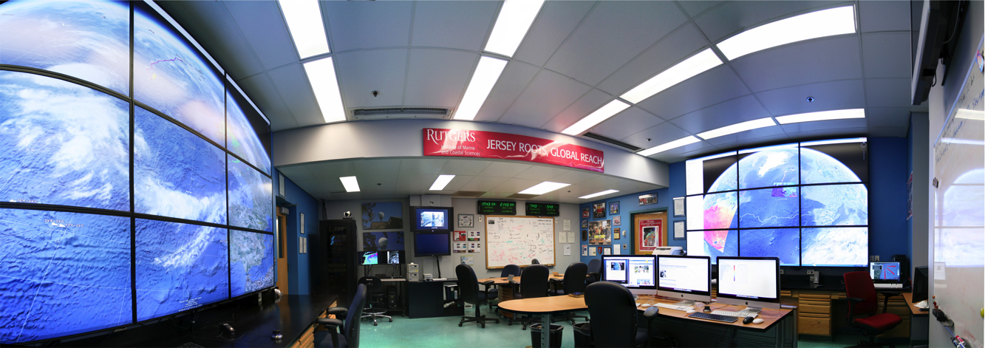
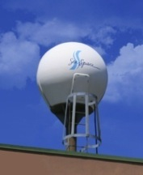
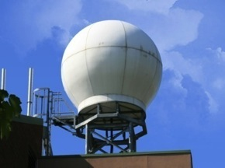
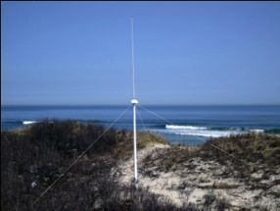
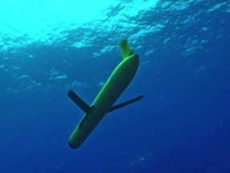
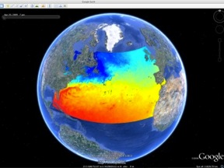
Rutgers University - Coastal Ocean Observation Lab
Satellite Data Acquisition Stations
CODAR Network
Glider Fleet
3-D Forecasts

Slide 3
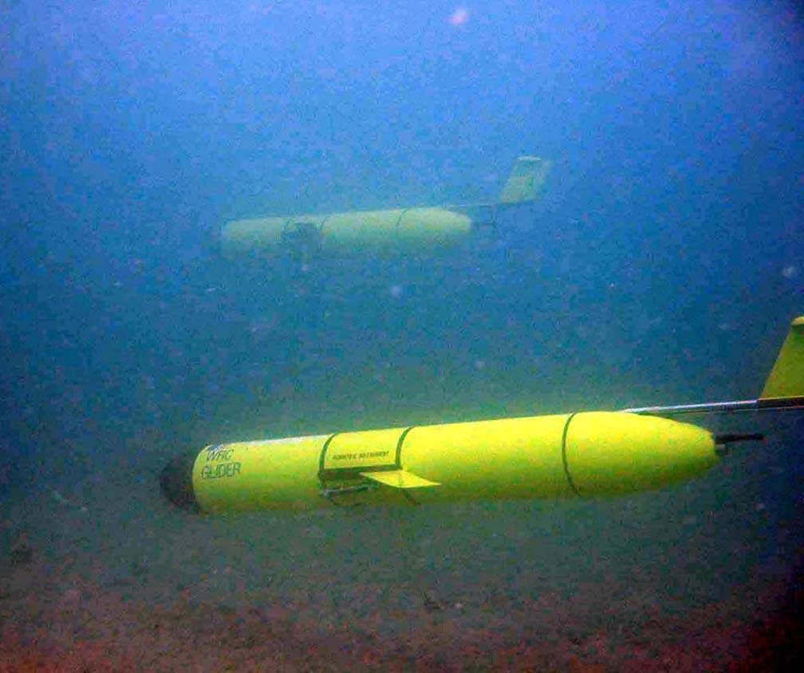

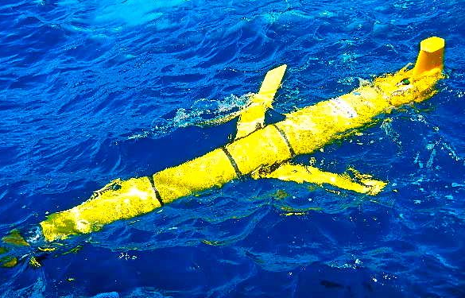
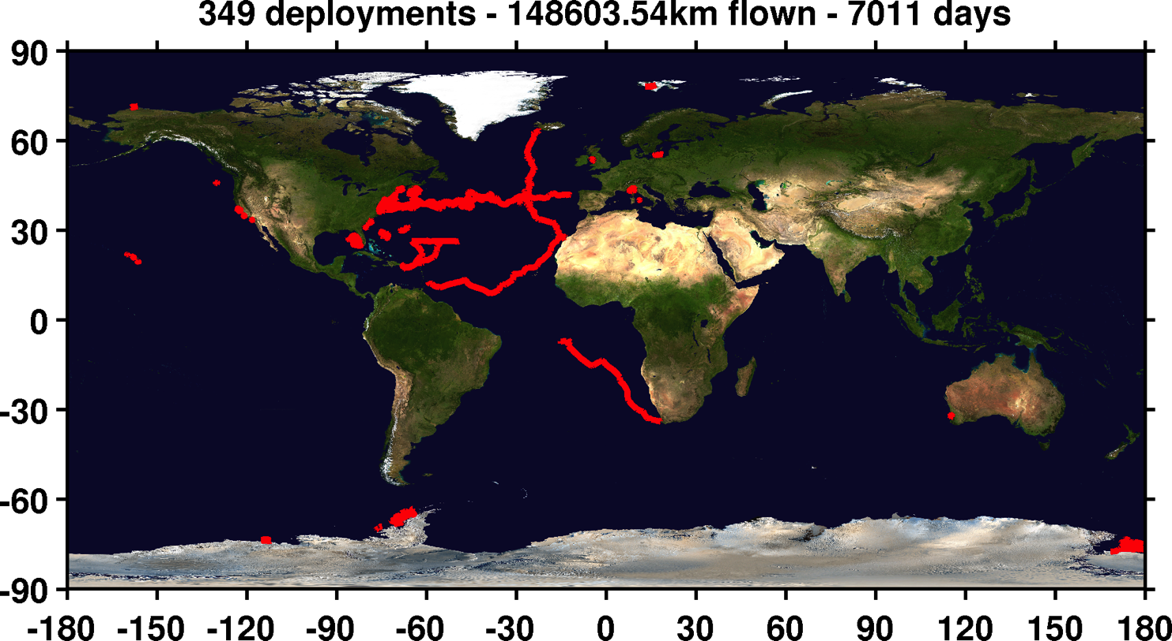
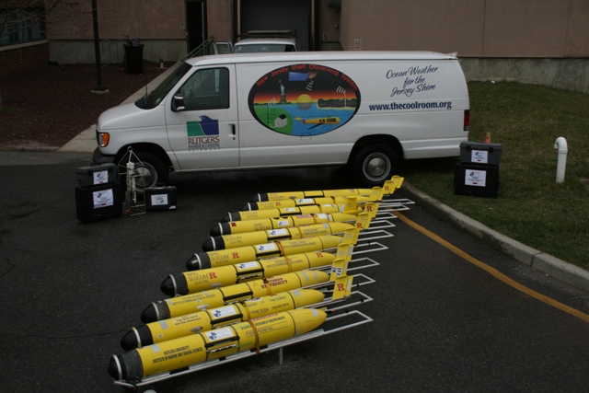

Subsurface glider network (currently 22 gliders in fleet)
RU01
RU15
RU29
G1-Ruggedized
G2
Days @ Sea (/100)
# of Missions
Km traveled @ sea
Year

Slide 4
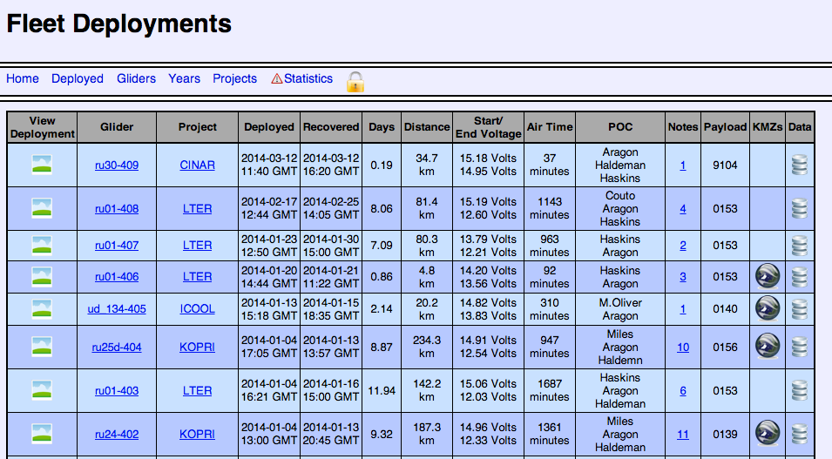
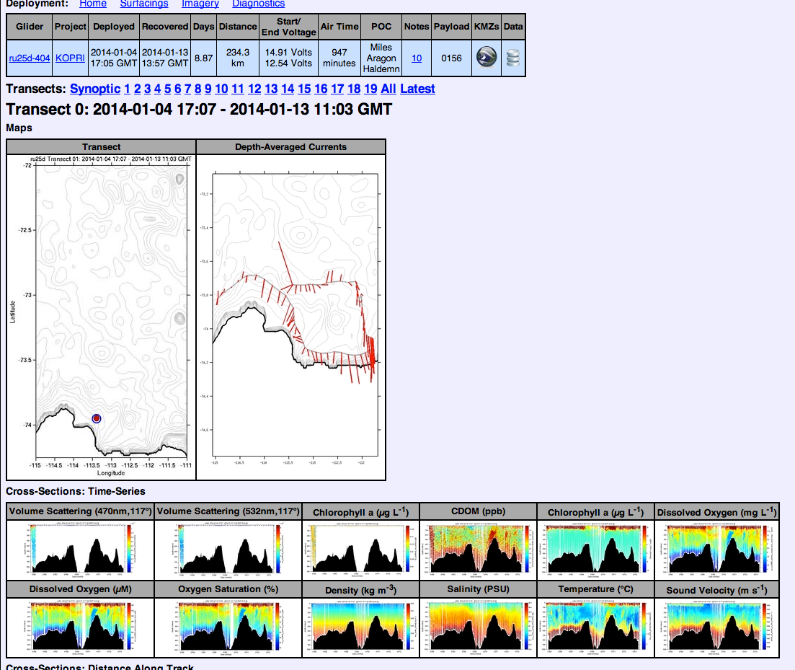
http://marine.rutgers.edu/cool/auvs/?page=deployments
Mid-Atlantic Missions
CBLAST (7), CINAR (1), eline (56), EPA (9), ESPreSSO (5), GP2013 (14), IOOS (18), LaTTE (7) LaTTE-eline (1), LBCO (1), MARACOOS (9) MARCOOS (12), midshelf (1), MURI (19), NJDEP (9) OOI (1), OSSE (4), SHAREM151 (2), SW06 (19)
Antarctica
ASPIRE (3), KOPRI (2), LTER (41), ross (3)
Europe
BALTOPS (1), ICOOL (4) ICOOL-Atlantic (6), NORUS (3), RU-COOL-PLOCAN-NOCS ULPGC (5),
Pacific
AOPEX (5), CalVal (4), SBC (9), RIMPAC (7), perth (1), MBARI-TWRC (1)
Other
AOPEX (5), CaRA (6), Challenger (1), CWBCS (2), EcoHAB (7), EDDIES (2), GLOBEC (1), hb (2), MTR (2), PWSP (1)
TWRC-RU (7)

Slide 5
RUCOOL Research Team
FACULTY Scott Glenn Oscar Schofield Josh Kohut Janice McDonnell
Grace Saba
SR. MANAGEMENT
Michael Crowley (PM)
Steve Levenson (Finance)
Patty Gillen (Admin)
POST DOCS & GRAD STUDENTS
Ana Filipa Carvalho
Nicole Courto
Christien Laber
Travis Miles
Greg Seroka
HARDWARE & FIELD WORK
Hugh Roarty
Chip Haldeman
David Aragon
Tina Haskins
Ethan Handel
Colin Evans
SOFTWARE & SYNTHESIS
John Kerfoot
Michael Mills
Michael Smith
Laura Palamara
Nilsen Strandskov
Xu Yi
FUTURE: Corporations, State, International Partnerships
EDUCATION/OUTREACH
Carrie Ferraro
Sage Lichtenwalner
Kristen Hunter-Thompson
1990 1998 2006 2014
Hard Money
Soft Money
Undefined

Slide 6
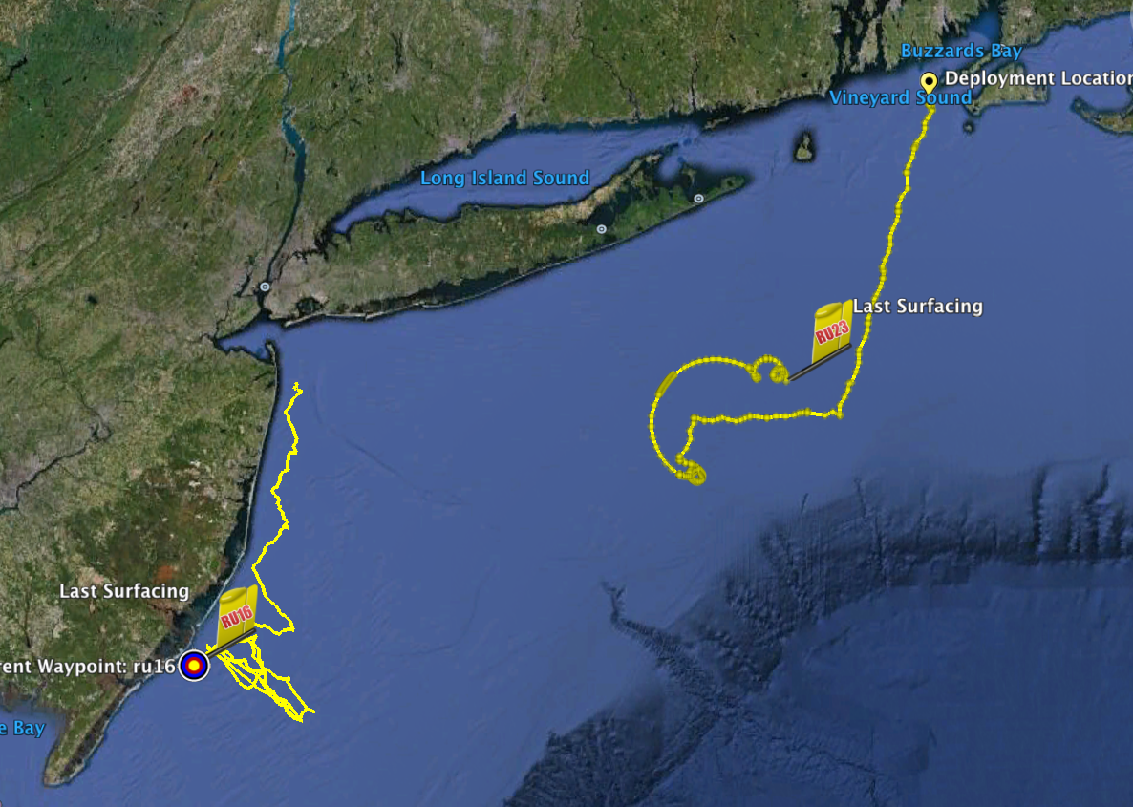
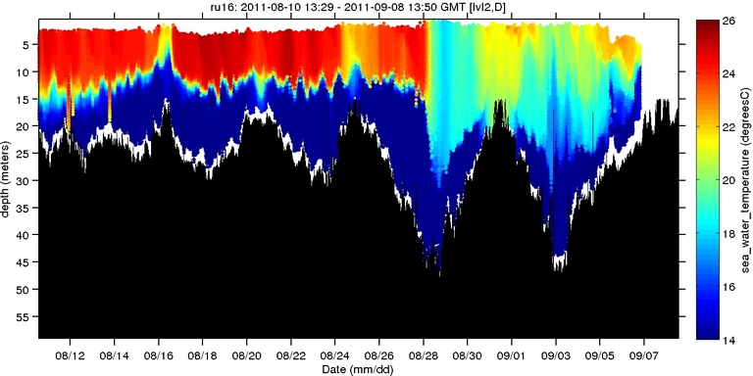
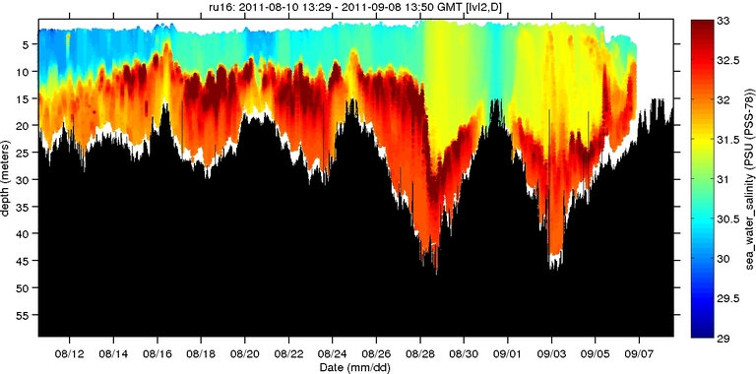
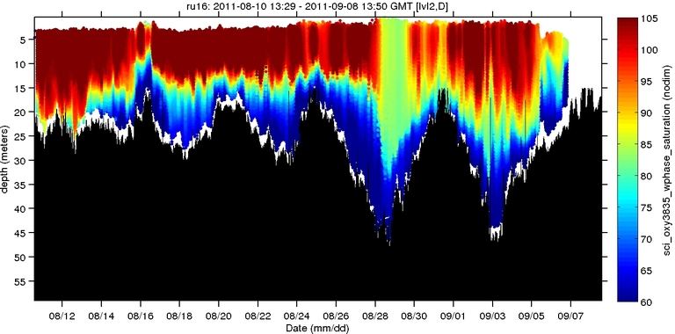
Hurricane Irene Glider Sampling
Hurricane Irene
0
26
depth
Temperature
55
14
0
33
depth
RU23
Deployed for MARACOOS.
Map subsurface T/S structure for fisheries.
Damaged early - drifter
Recovered by fisherman
Provided data on inertial currents during storm.
Salinity
55
29
RU16
Deployed for EPA.
Map bottom dissolved oxygen.
Provided data on mixing during storm.
0
105
depth
% Saturation
(DO)
55
60
Aug 12
Sep 07

Slide 7
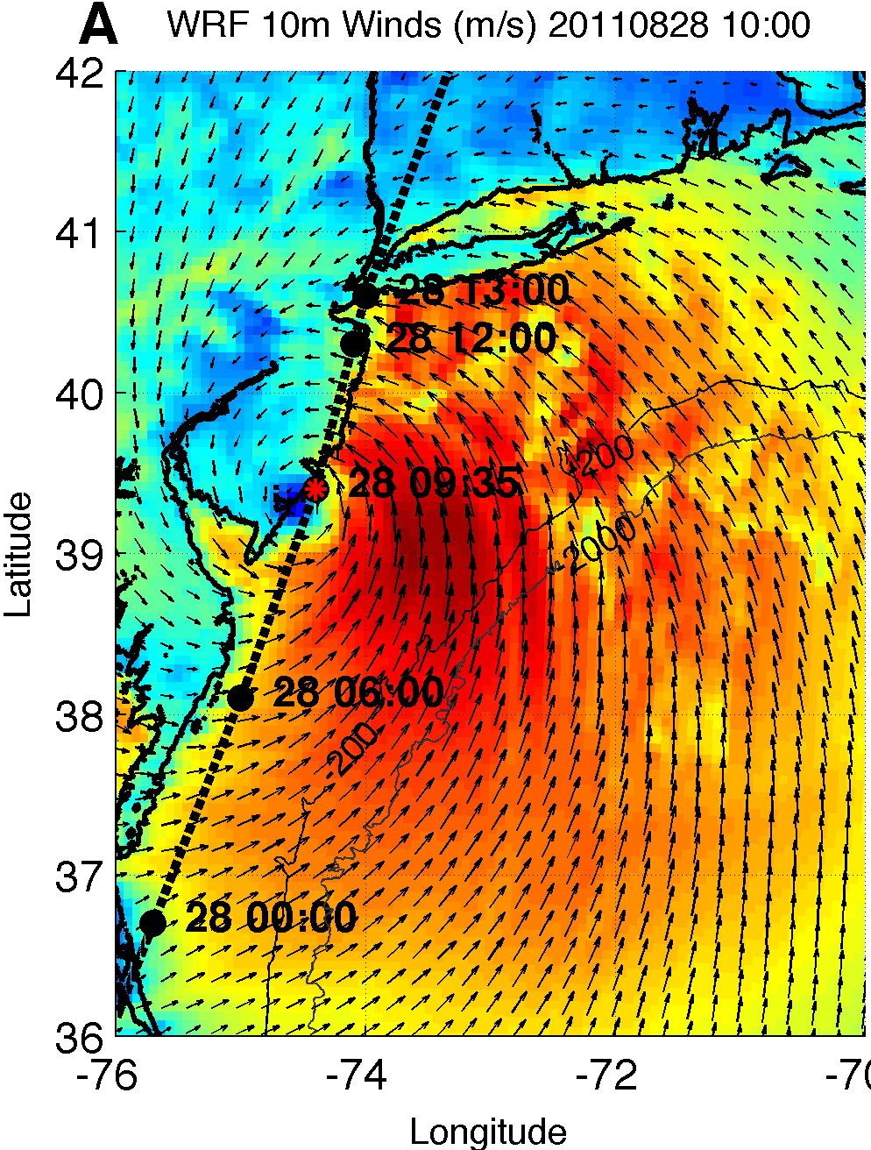
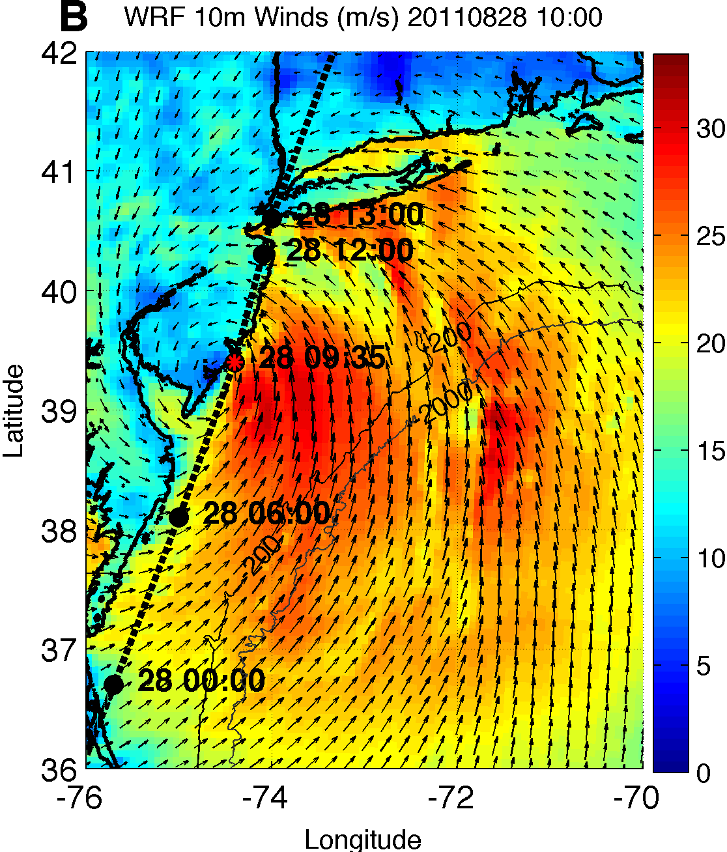
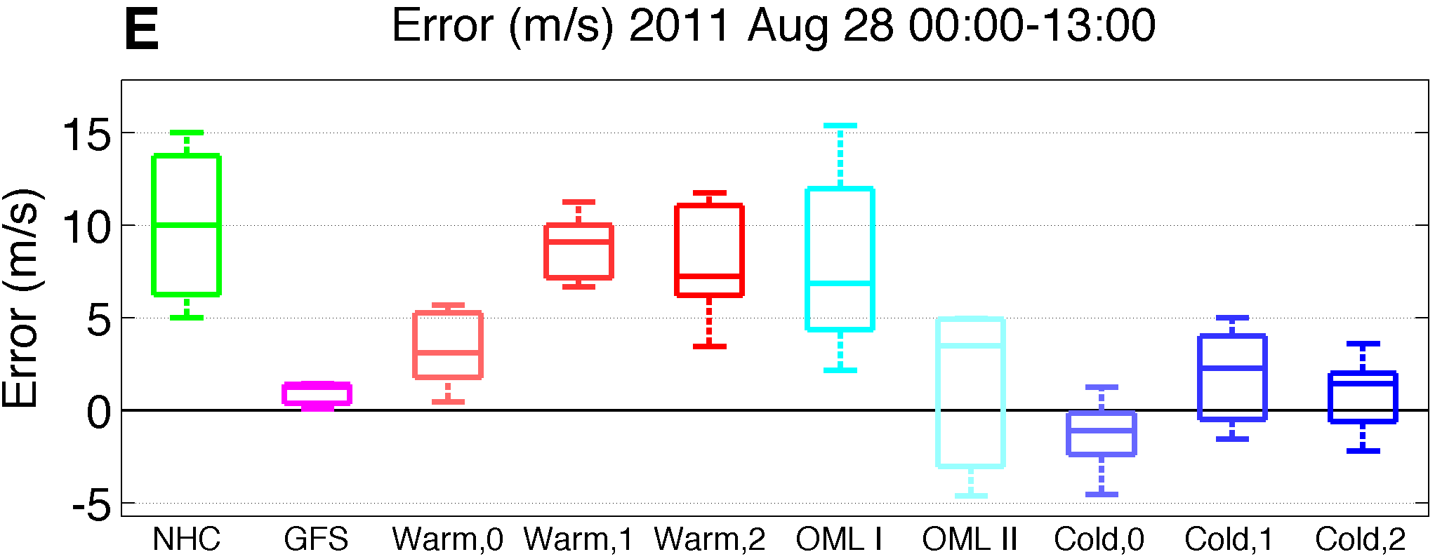
Max Wind Speed: Hindcast Sensitivities vs. NHC Best Track
Operational
Forecast
GFS
Model
Guidance
WRF with Ocean Mixed Layer

Slide 8
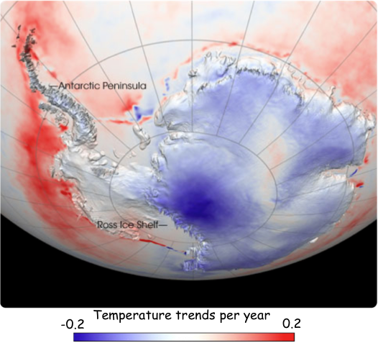
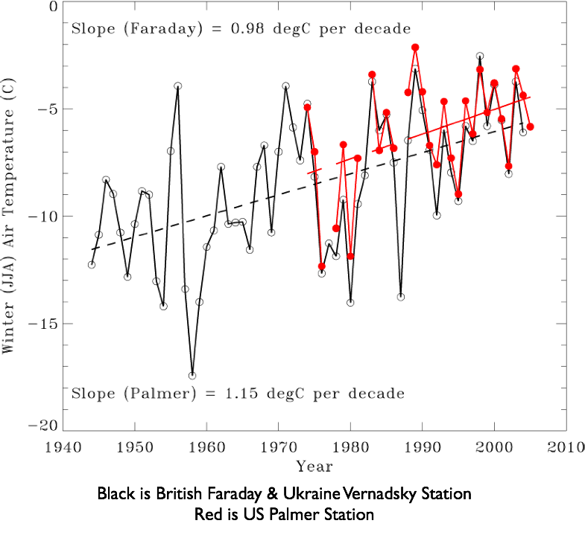
We are using the WAP as zone to study how rapid warming can shift the food web
Fastest winter warming location on Earth
Northern WAP perennial ice is gone
87% glaciers in retreat
Sea ice duration decreased by ~60 days
Increase in ocean heat content
Increase in wind and clouds

Slide 9
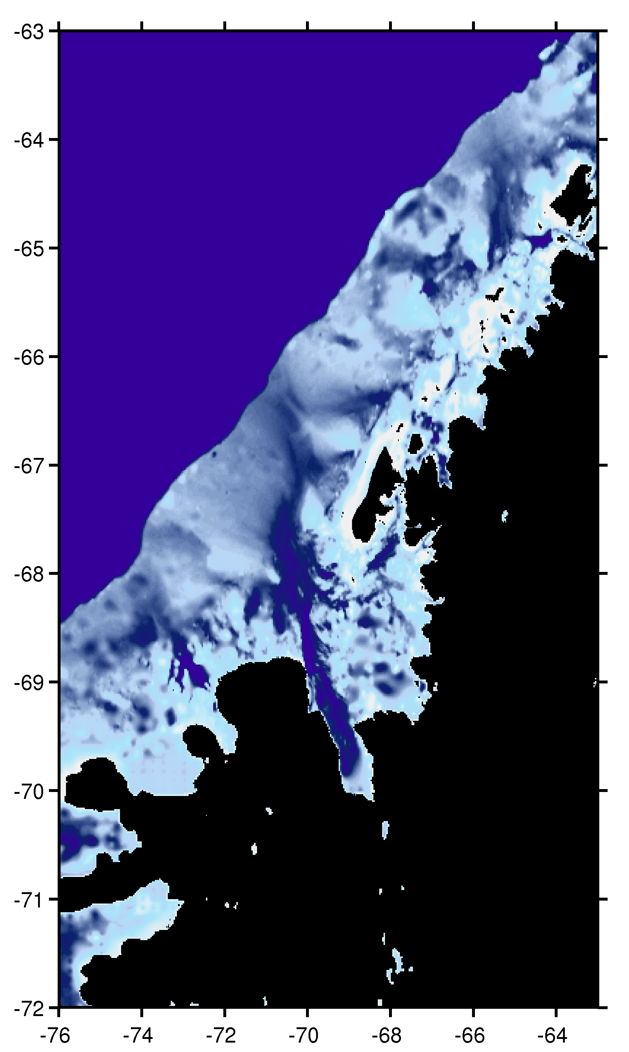
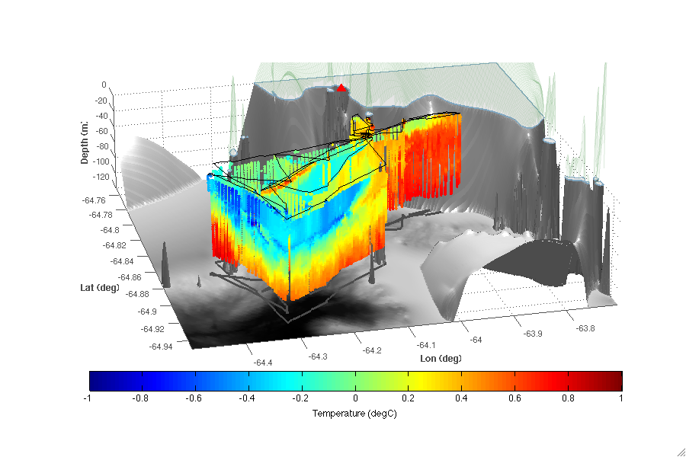
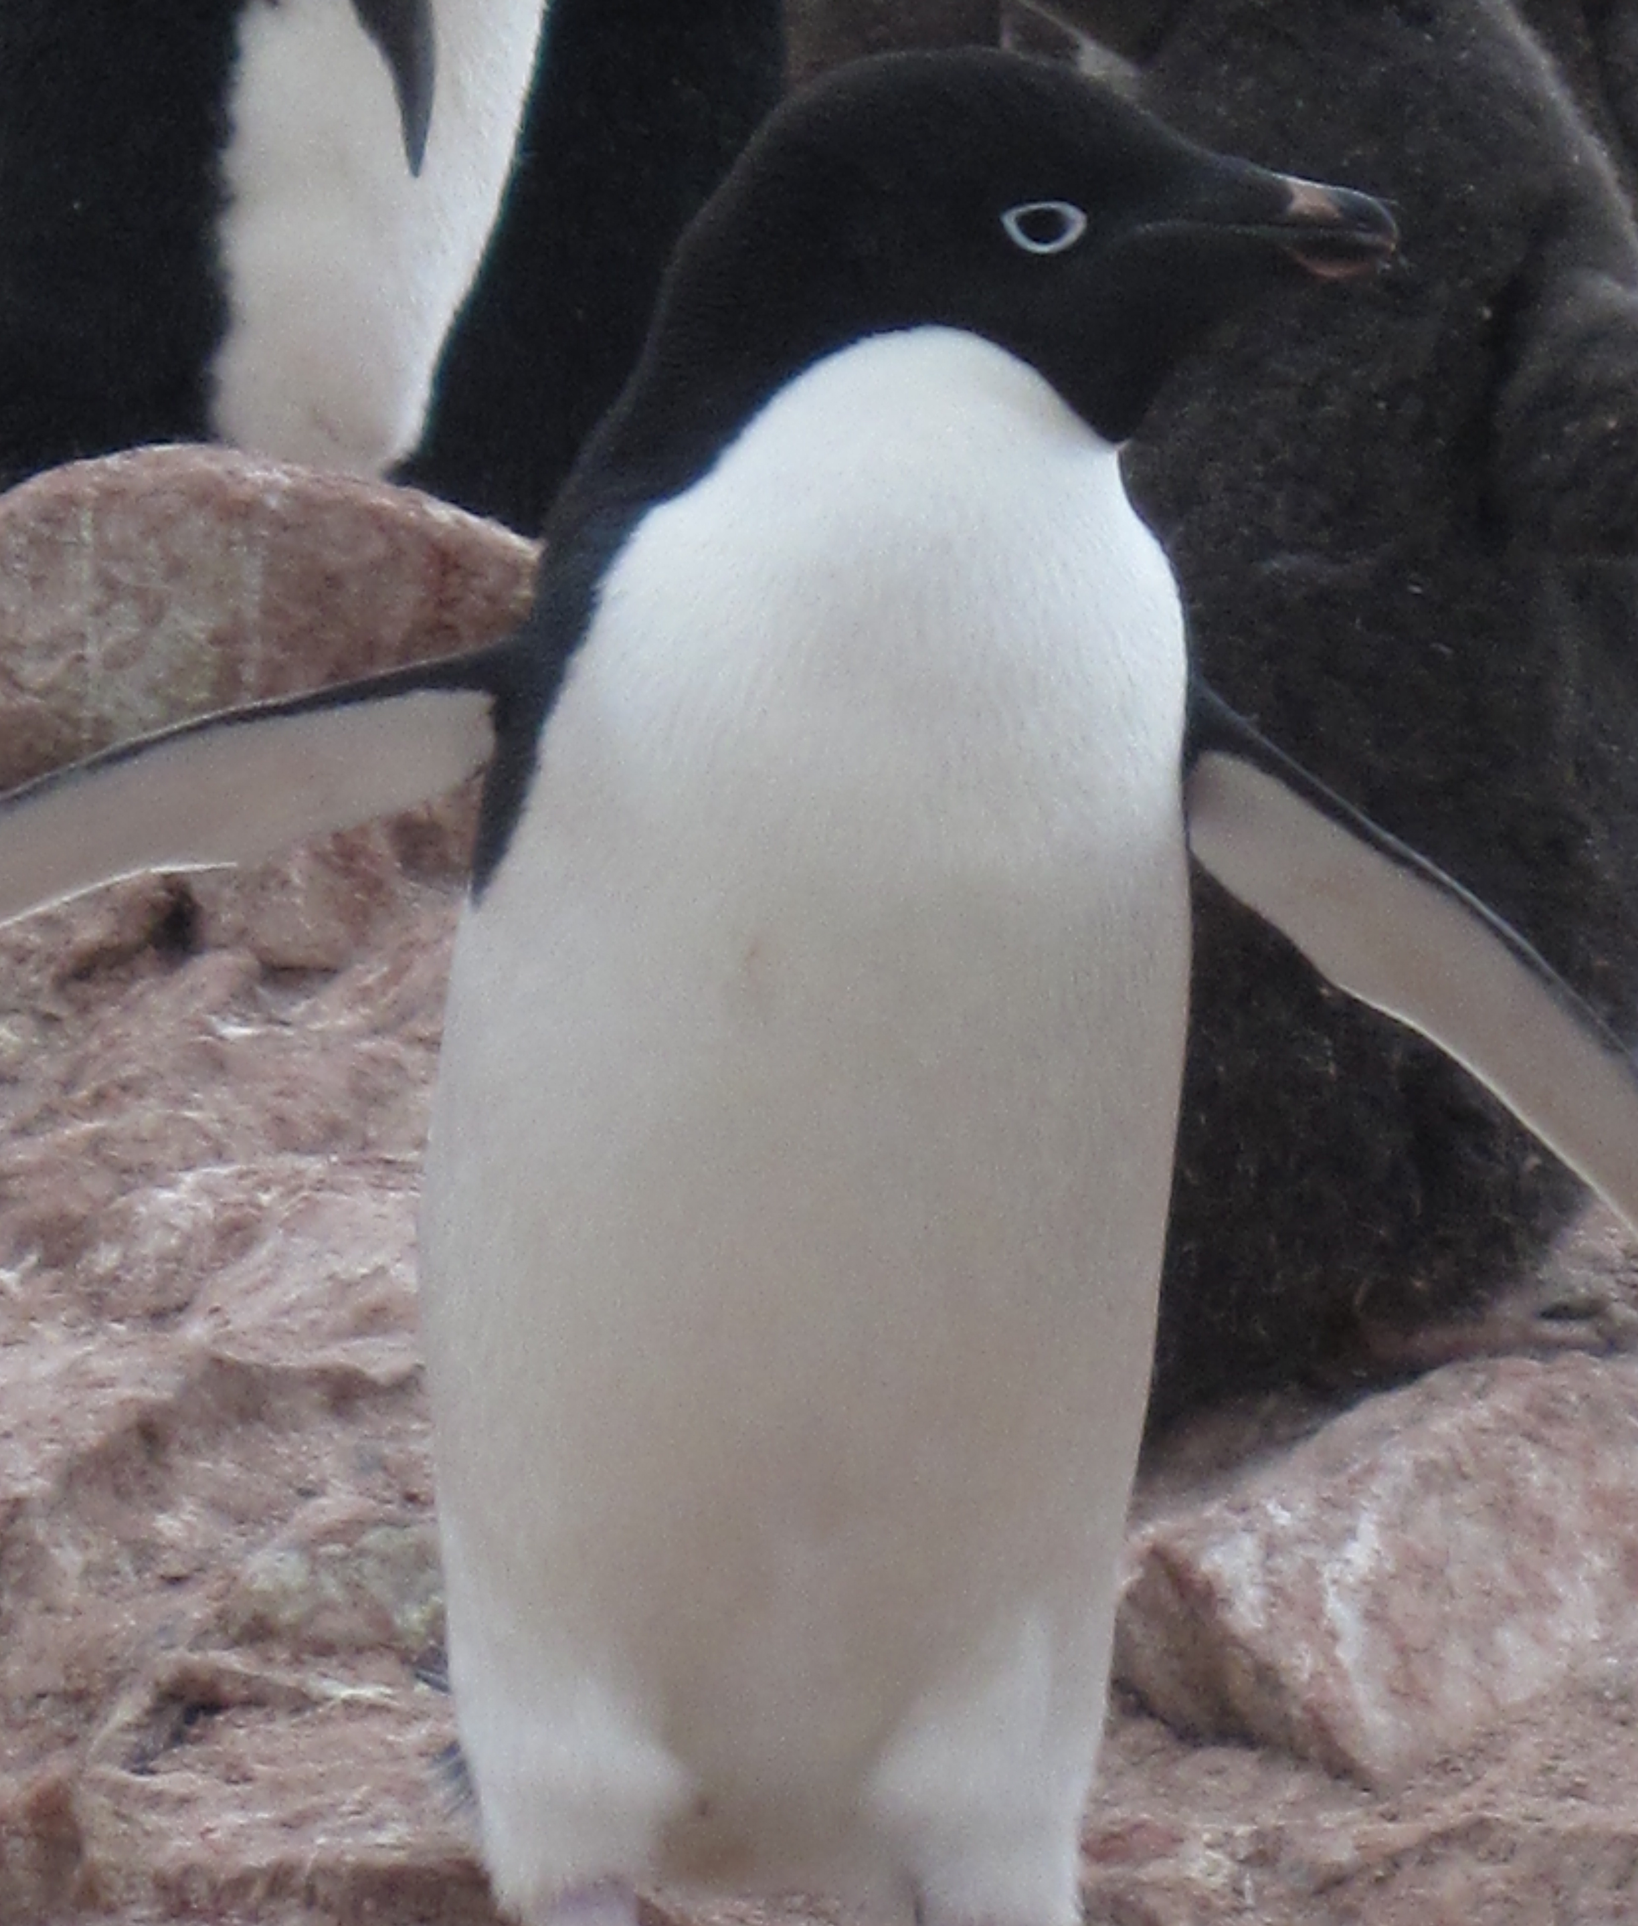

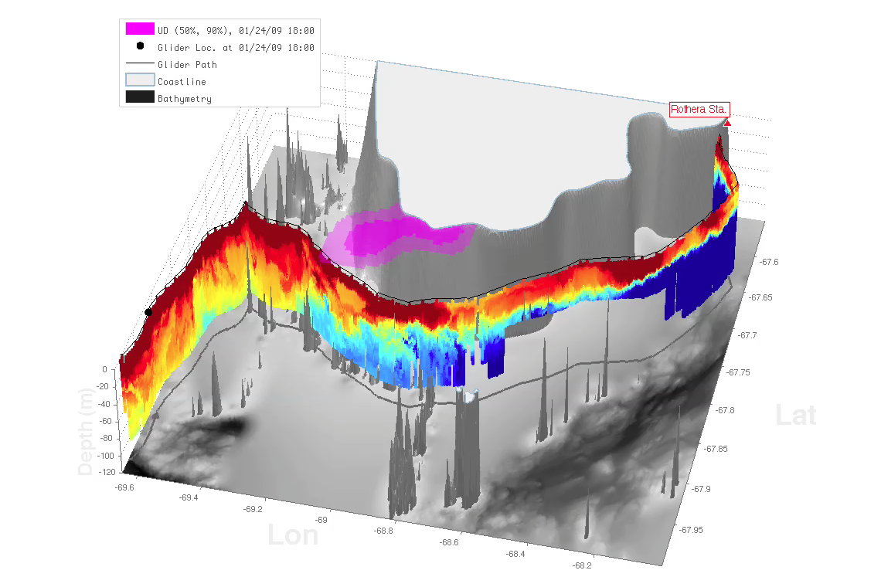
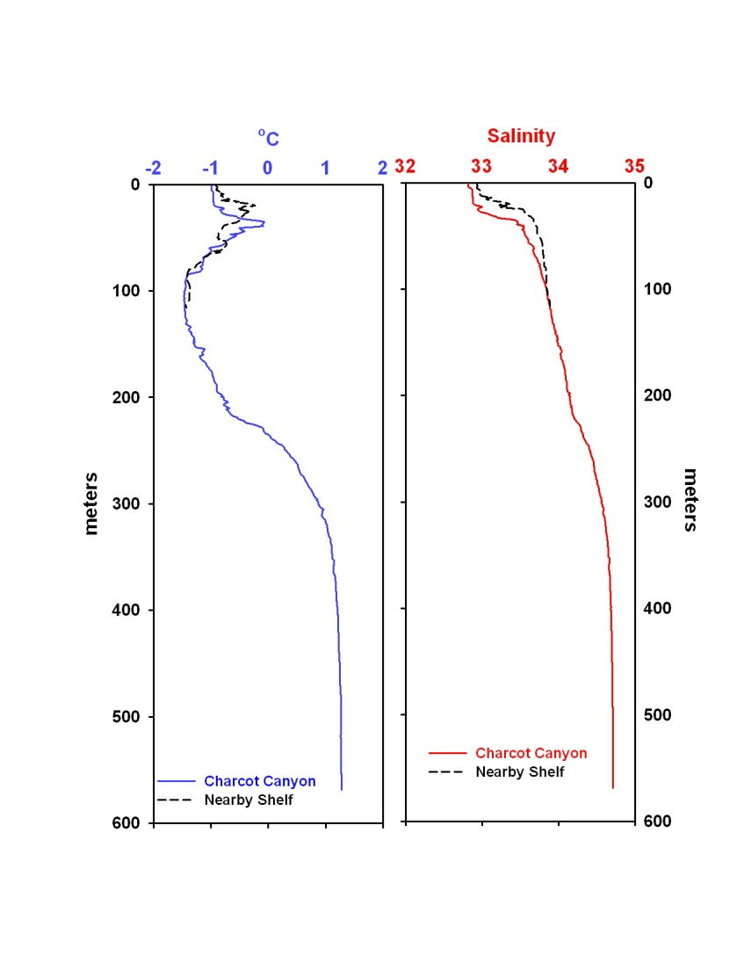
B)
A)
0
Depth (m)
120
-64.8
?
Latitude
Antarctic Circumpolar Current
-64.9
-64.3
Longitude
-63.9
<-1
0
>1
Temperature (C)
C)
?
Rothera
?
D)
-2
°C
2
0
0
-67.7
Depth (m)
Latitude
120
Depth (m)
-69.4
-67.9
Longitude
-68.4
<-1
0
>1
Temperature (C)
600

Slide 10
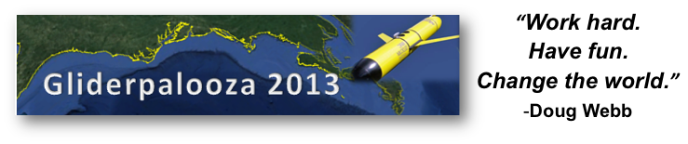
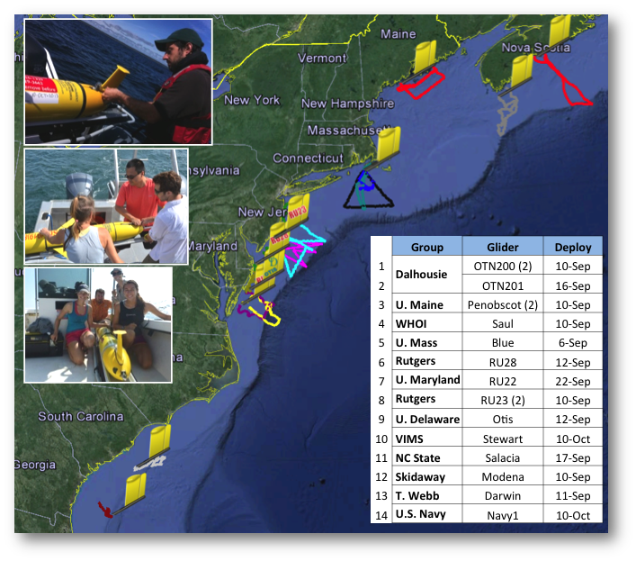
Future Interests: Glider Community, Coordinated,
Standardized, Leveraged Effort

Slide 11
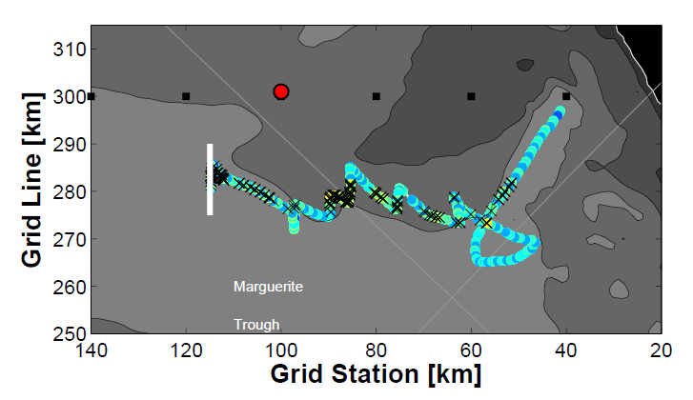
Future Interests
Adaptive Sampling

Slide 12
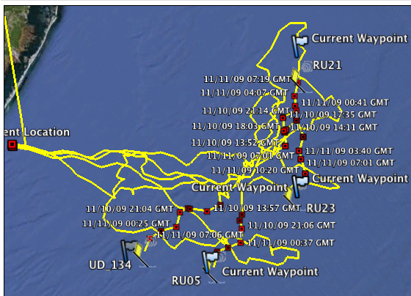
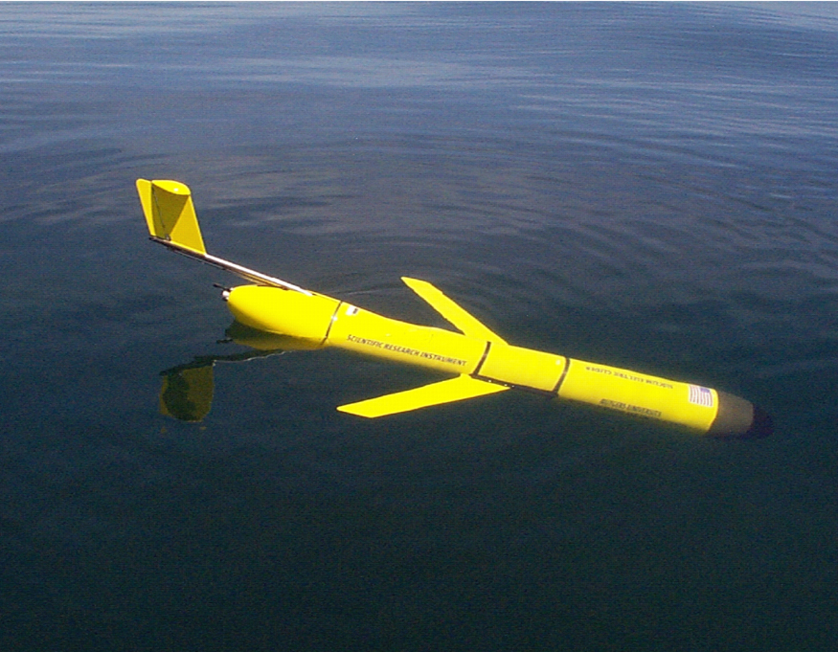
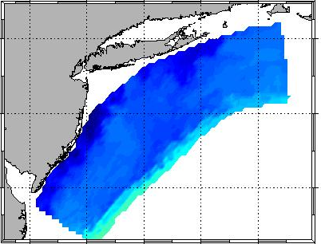
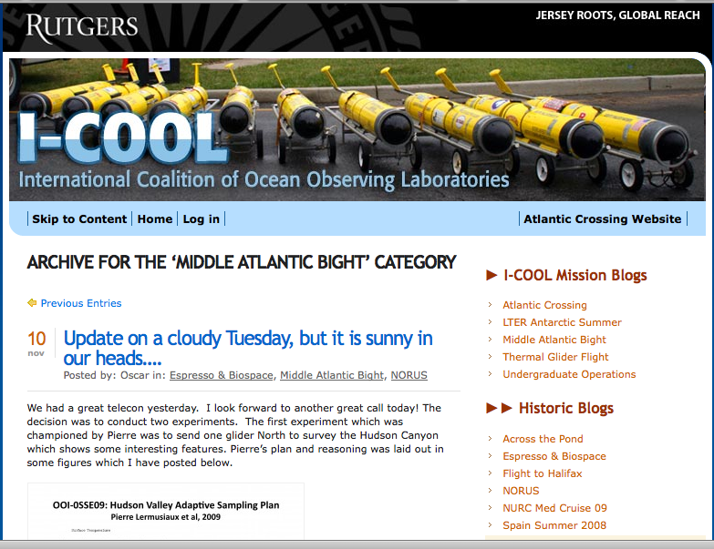
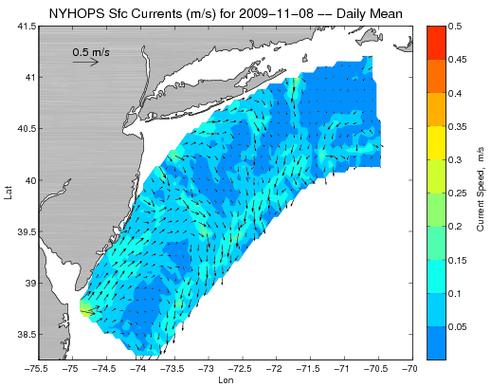
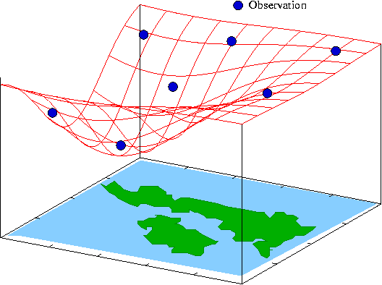
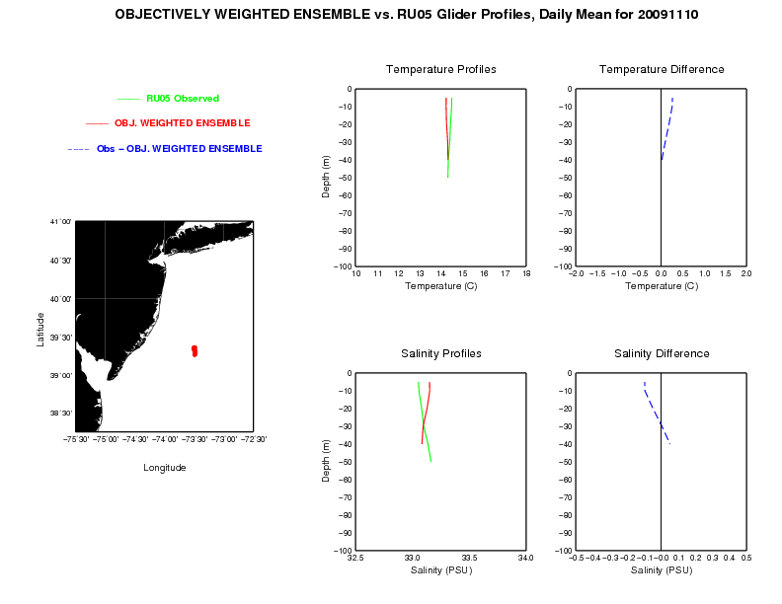
Future Interests: Integrated networks
Design, Testing and Deploy
Observatory (simulated) data
Models
Sensor &
Platform
~3 km
~100 m
Virtual Ocean
Data Assimilation
Data
Analysis
Science Questions & Drivers
Data Synthesis: Nowcast & Data Impact

Slide 13
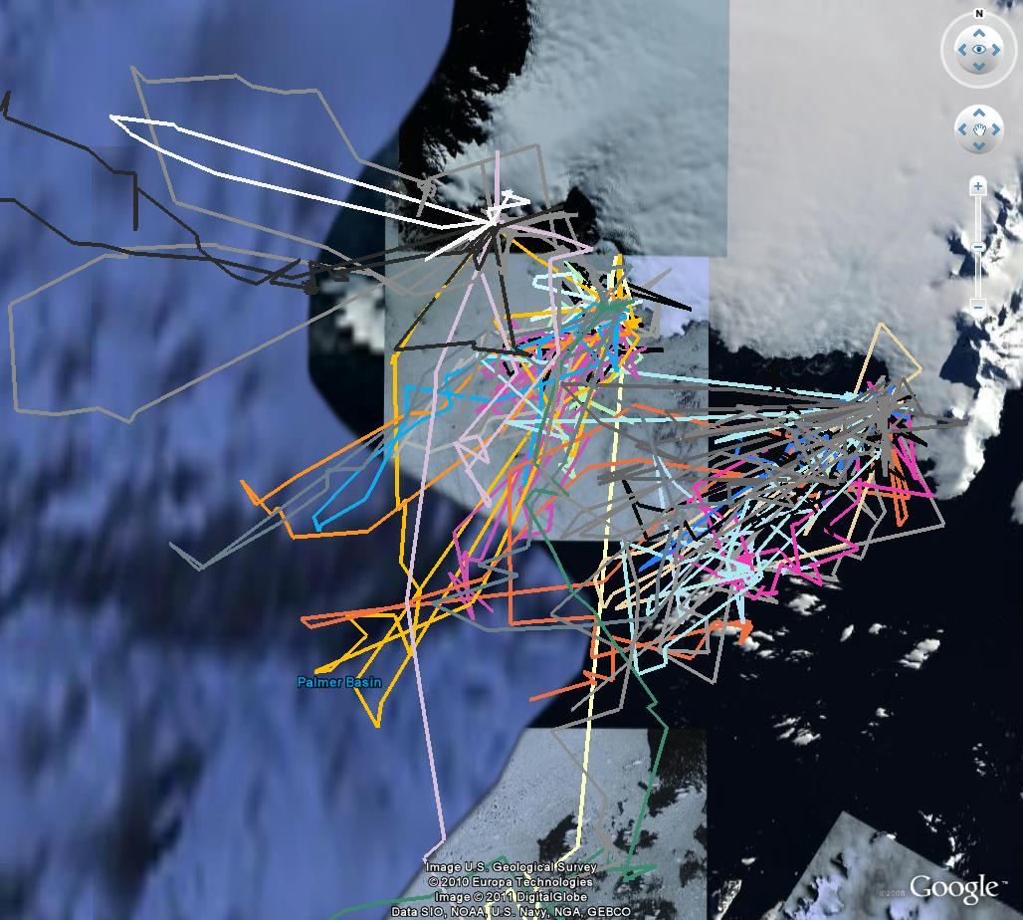

Slide 14
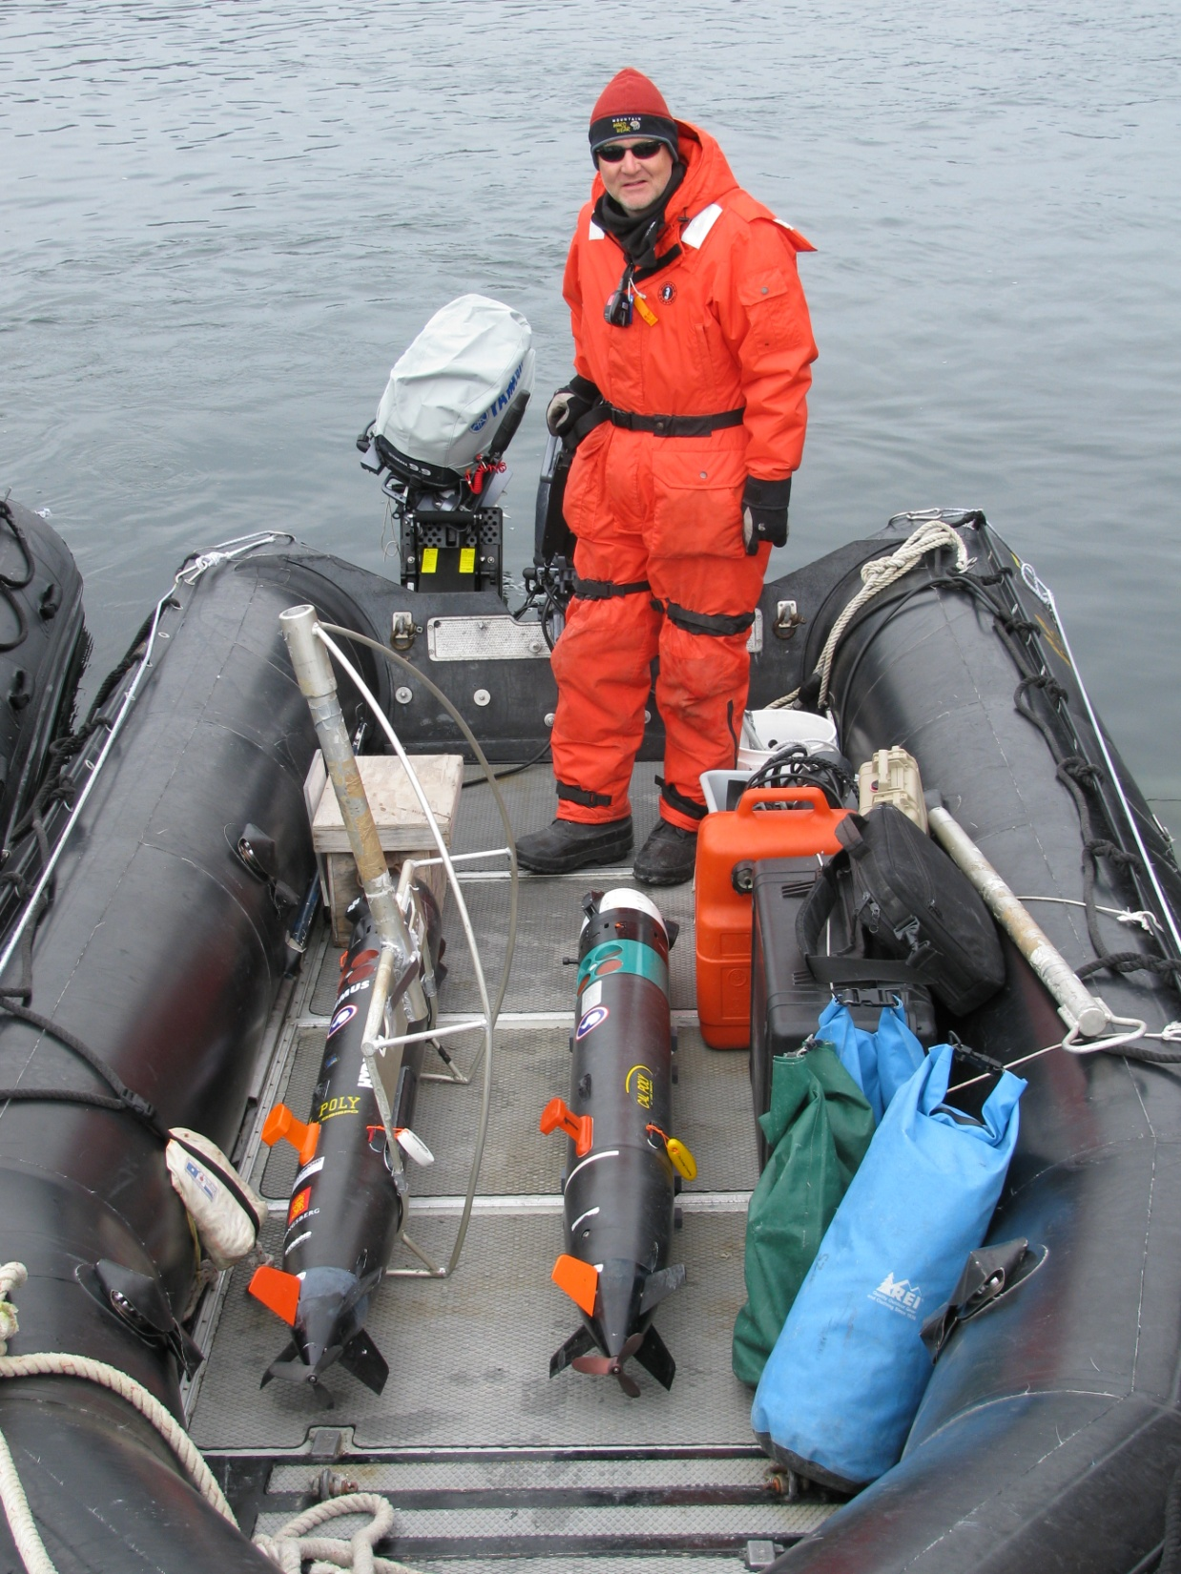

Slide 15
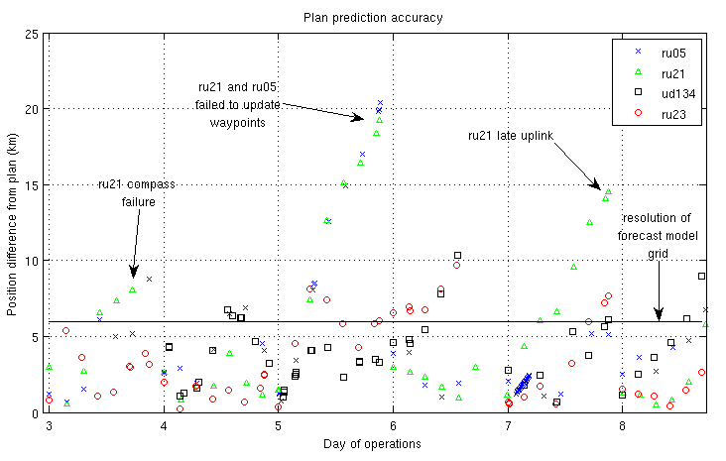
Increase model resolution
Reduce forecast error

Slide 16
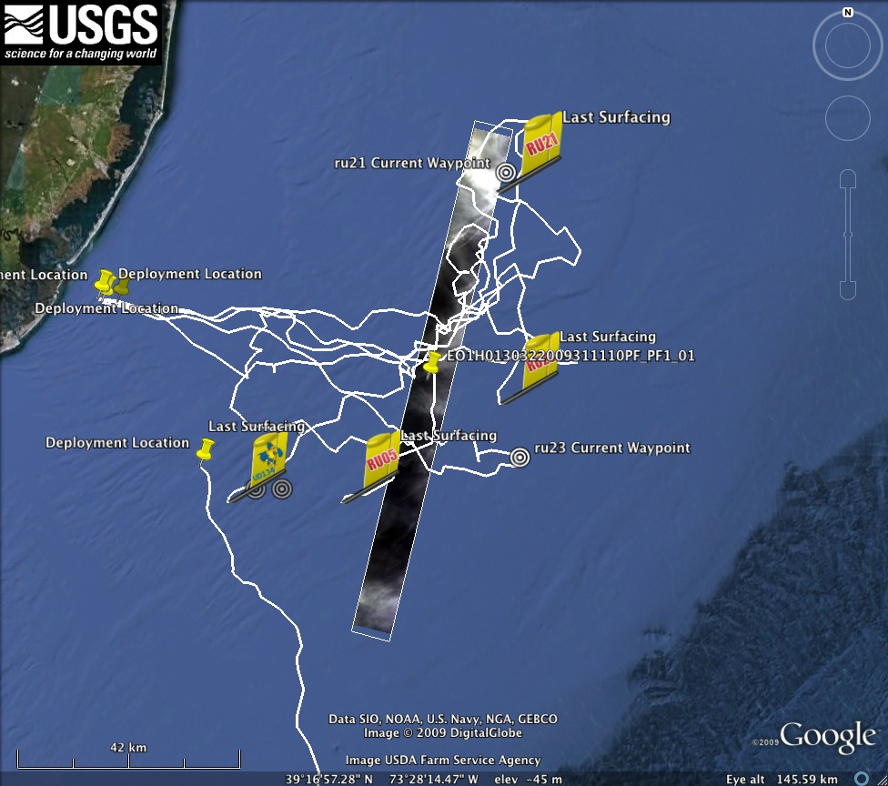

Slide 17
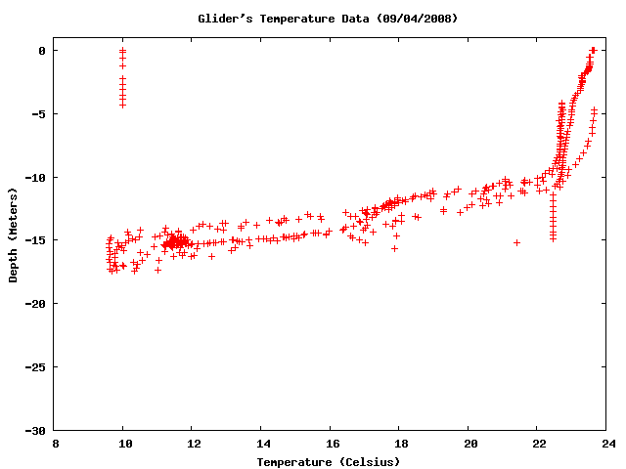
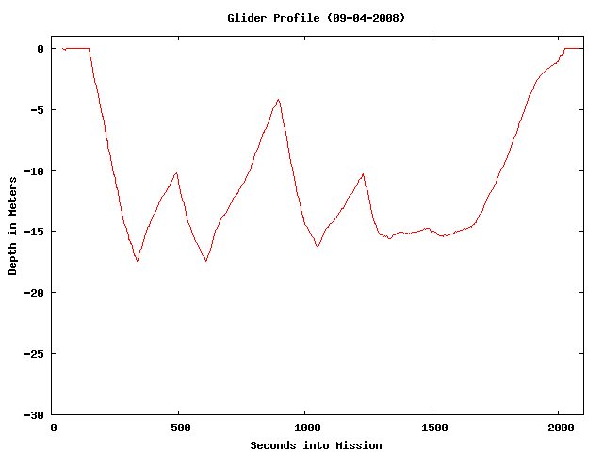
Future Interests: Onboard thinking

Slide 18
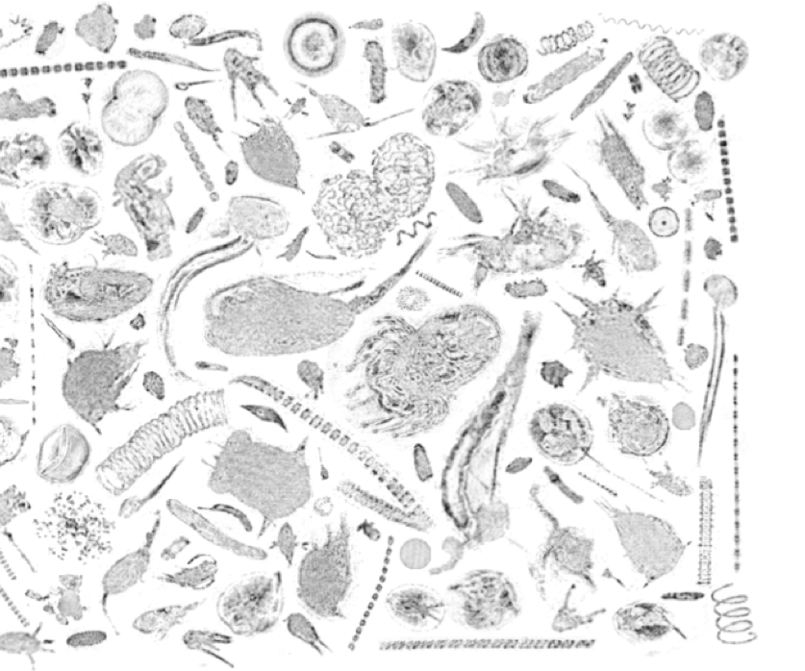
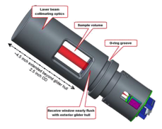
Future Interests: Sensors
LISST -HOLO

Slide 19
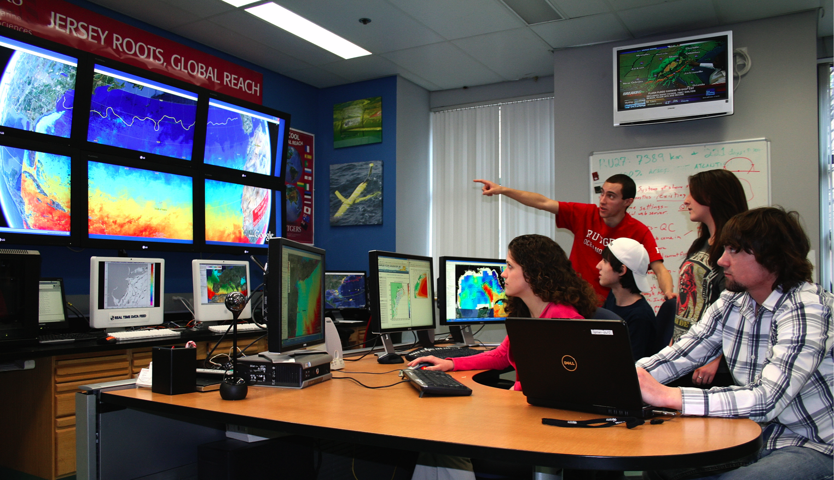
STEM education: Undergraduates are active pilots of the observatory

