Slide 1
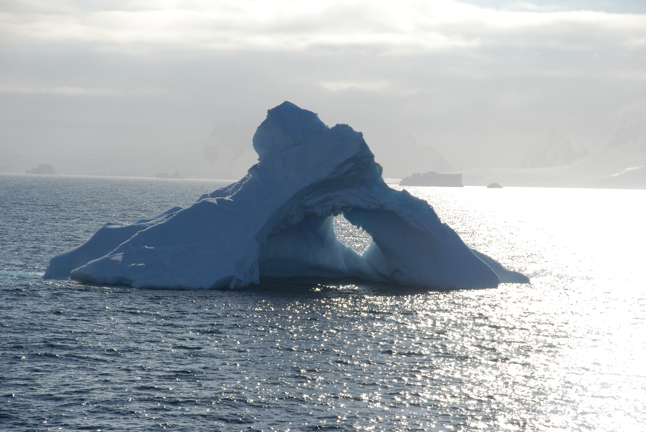

Shelf-coastal LTER perspectives on
Export and NCP
NCP and Th-234 export at Palmer Station (nearshore, shallow water), weekly time series 2012-13, local scale
Th-234 export on LTER Grid, January 2012, 2013, regional scale
Inverse Foodweb model estimates of NCP
Hugh Ducklow
Oscar Schofield
Mike Stukel
Philippe Tortell
Scott Doney
Sevrine Sailley

Slide 2


Palmer LTER Program
Acknowledgements to past LTER PIs: Ray Smith, Barbara Prezelin, Robin Ross, Langdon Quetin, Dave Karl, Maria Vernet, Eileen Hoffman, John Klinck, Dave Karl

Slide 3
Some of our Long Standing Questions:
What is are the relationships among New and Net Community Production and Export? Are they equivalent? Are imbalances method artifacts or scale mismatches, or real differences?
How does ecological community structure influence NCP and Export? Are there high- and low NCP (Export) regimes?

Slide 4
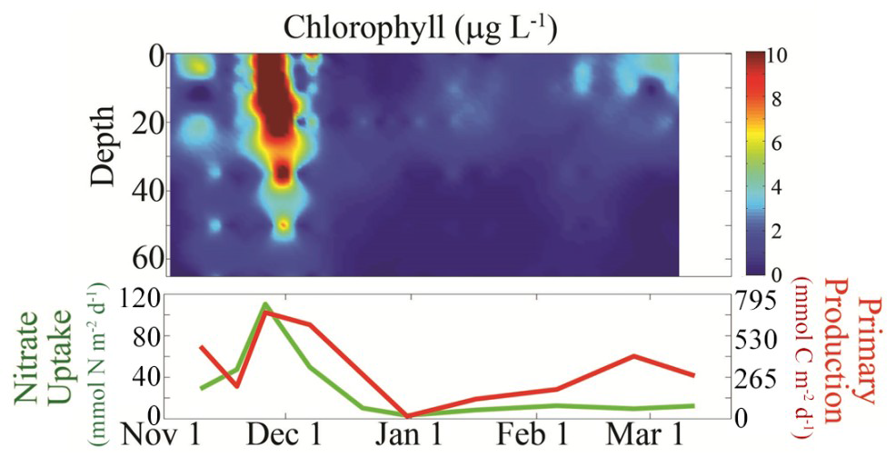
Local Scale: O2/Ar-NCP and Th-234 export at Palmer Station (nearshore, shallow water), weekly time series 2012-13: imbalance between New & NCP and Export over spring-summer growth season
Notes:
2012-2013 field season
The season was dominated by a large diatom bloom in late November-early December.
The figure below shows the bloom and associated primary and new production (NO3 uptake) estimates.

Slide 5
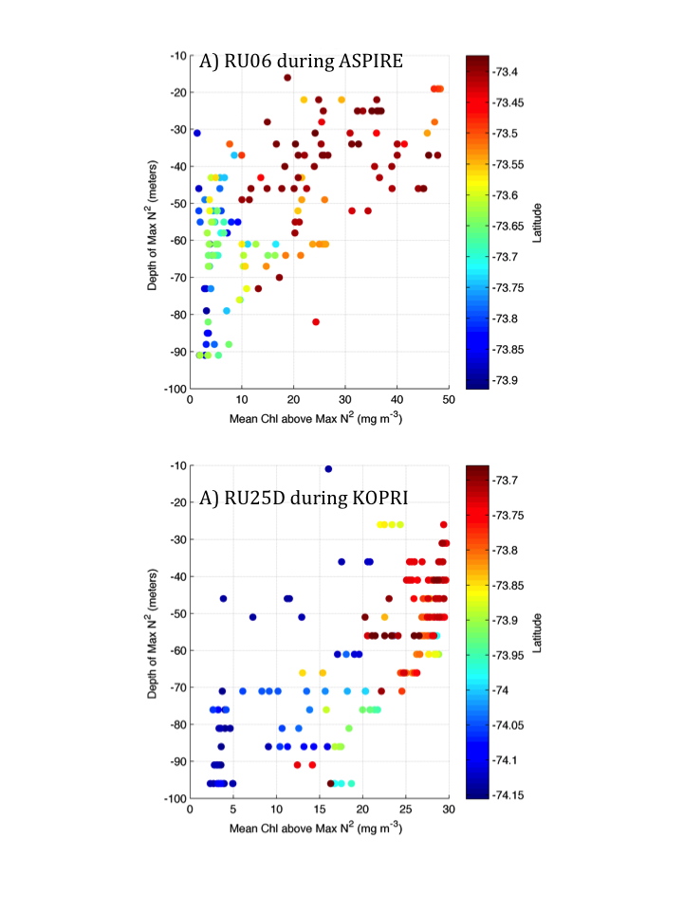
Presence or absence of bloom strongly associated with upper mixed layer depth
General finding consistent with other regions (Amundsen)
>10
1991-1992 field season

Slide 6
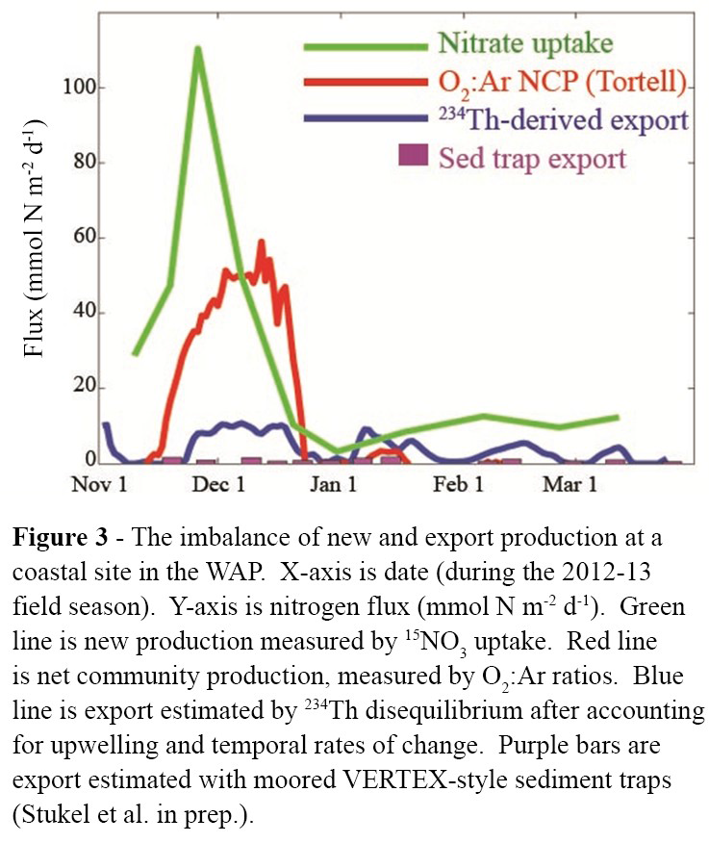
O₂:Ar – surface via 10-m seawater intake (MIMS)
¹⁵N, ²³⁴Th, traps – upper 50 meters
Notes:
The cumulative seasonal NCP exceeds the export by a factor of 2-3.
Also that after an episode of very high NCP during the diatom bloom, the system was poised near zero NCP (production = respiration) for the remainder of the season (3 months),
Export continued at a low level.
The integration of the NCP and export over the full, illuminated production season suggests that a temporal offset or lag between NCP and export was not the cause of the discrepancy or uncoupling between production and export

Slide 7
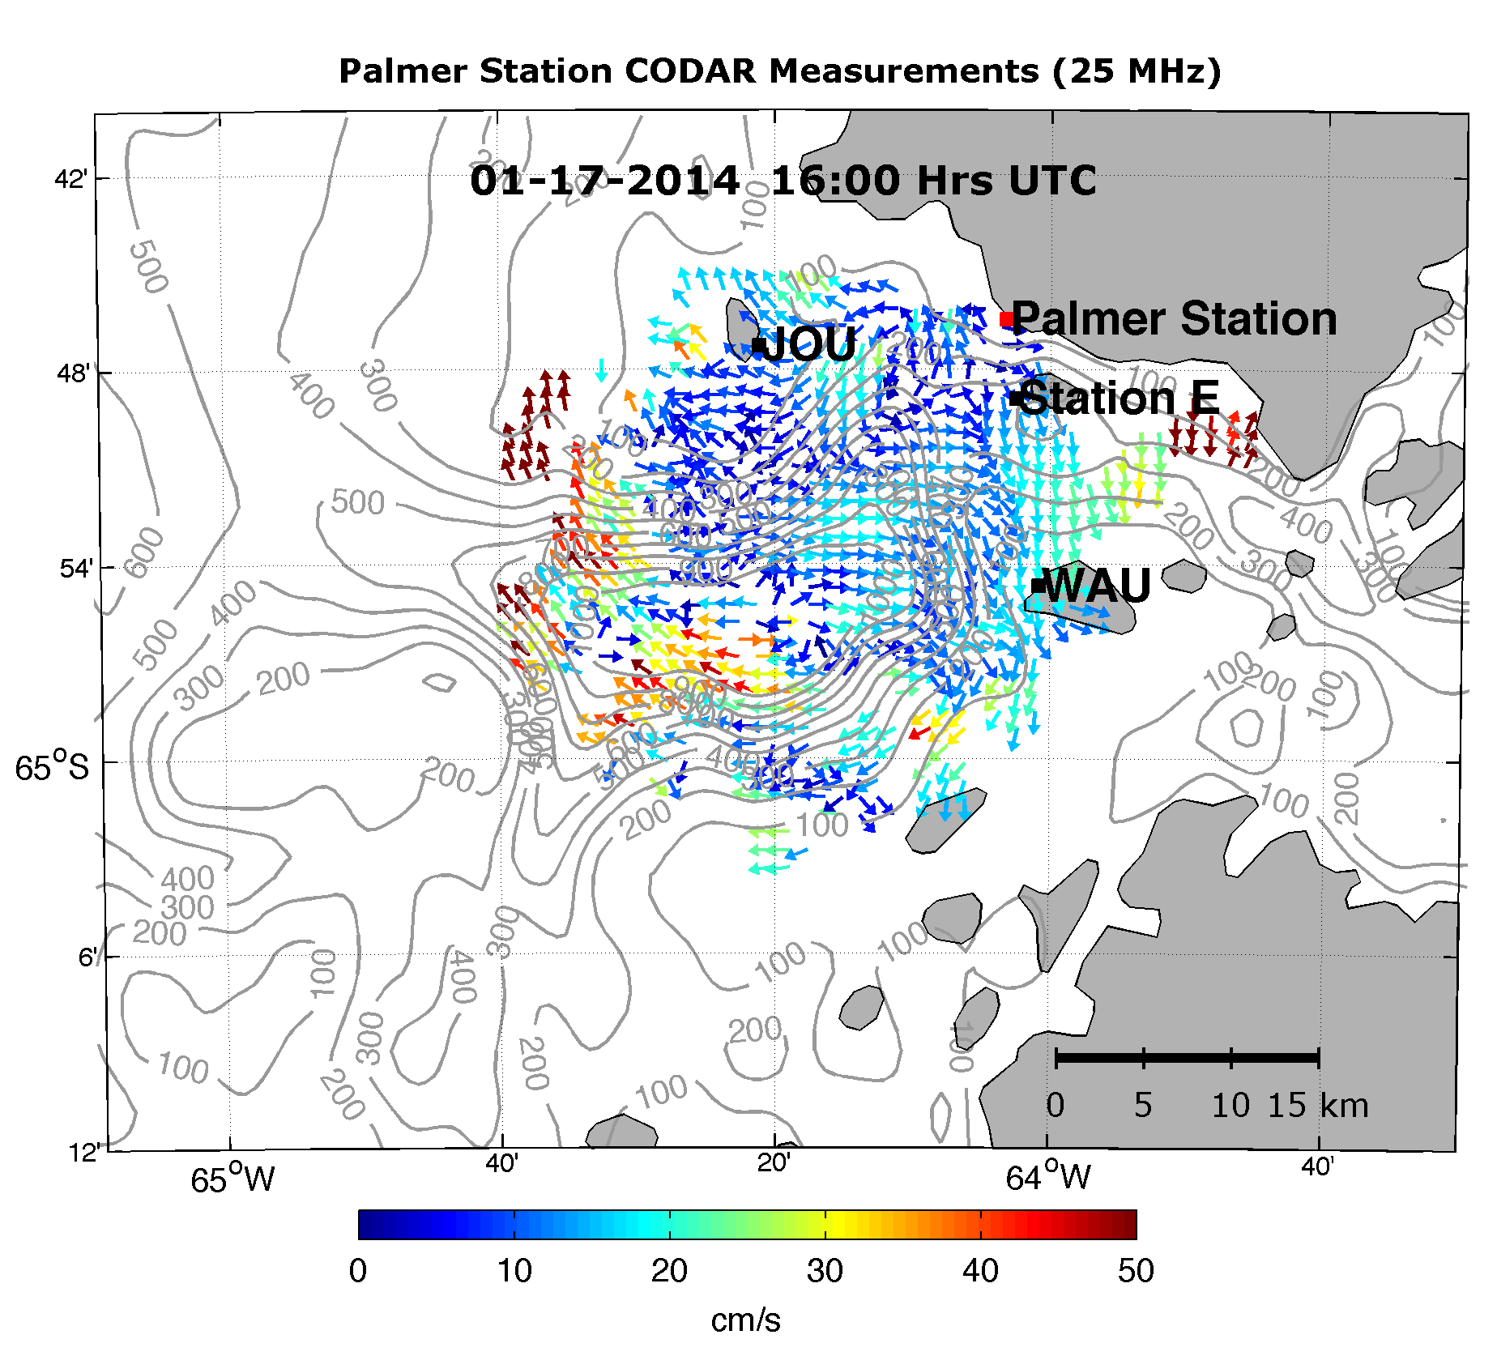
Advection biases, still not constrained but new CODAR and mooring
deployments will assist in the future analysis
Thanks to Josh Kohut, Peter Winsor, and Hank Statceswich

Slide 8
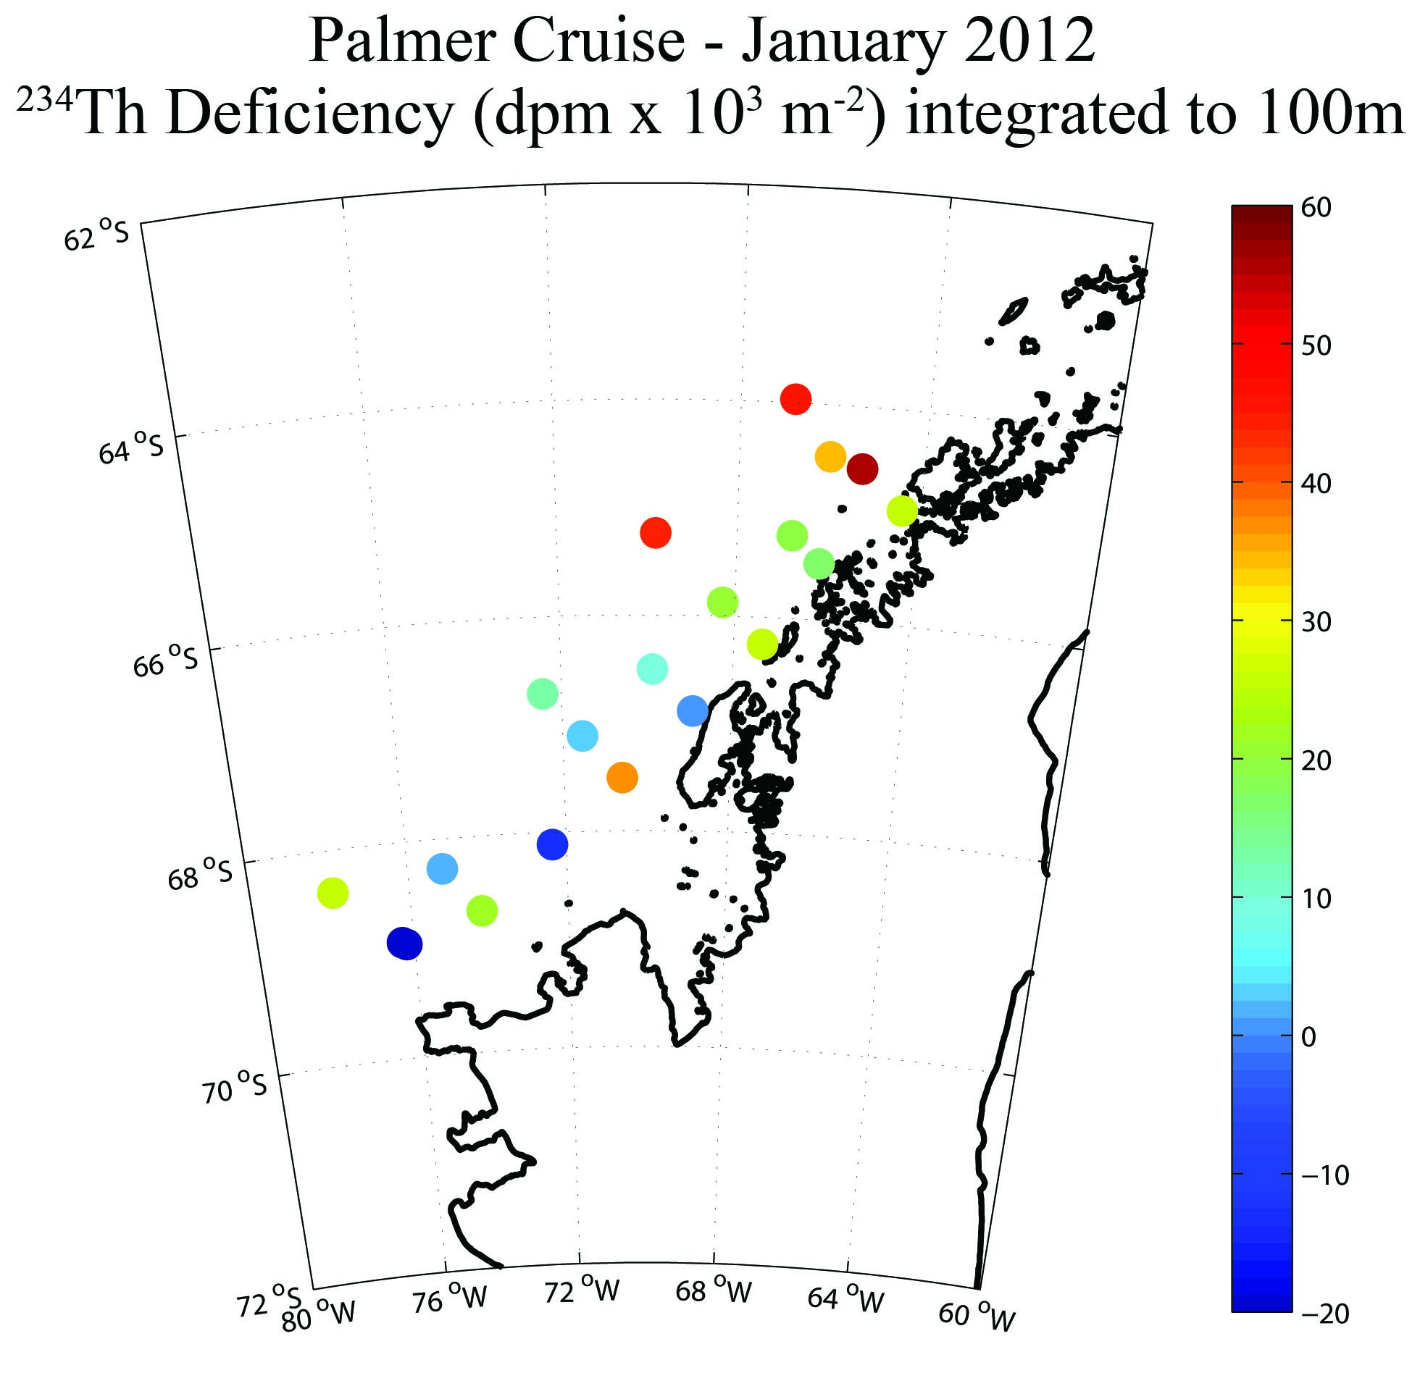
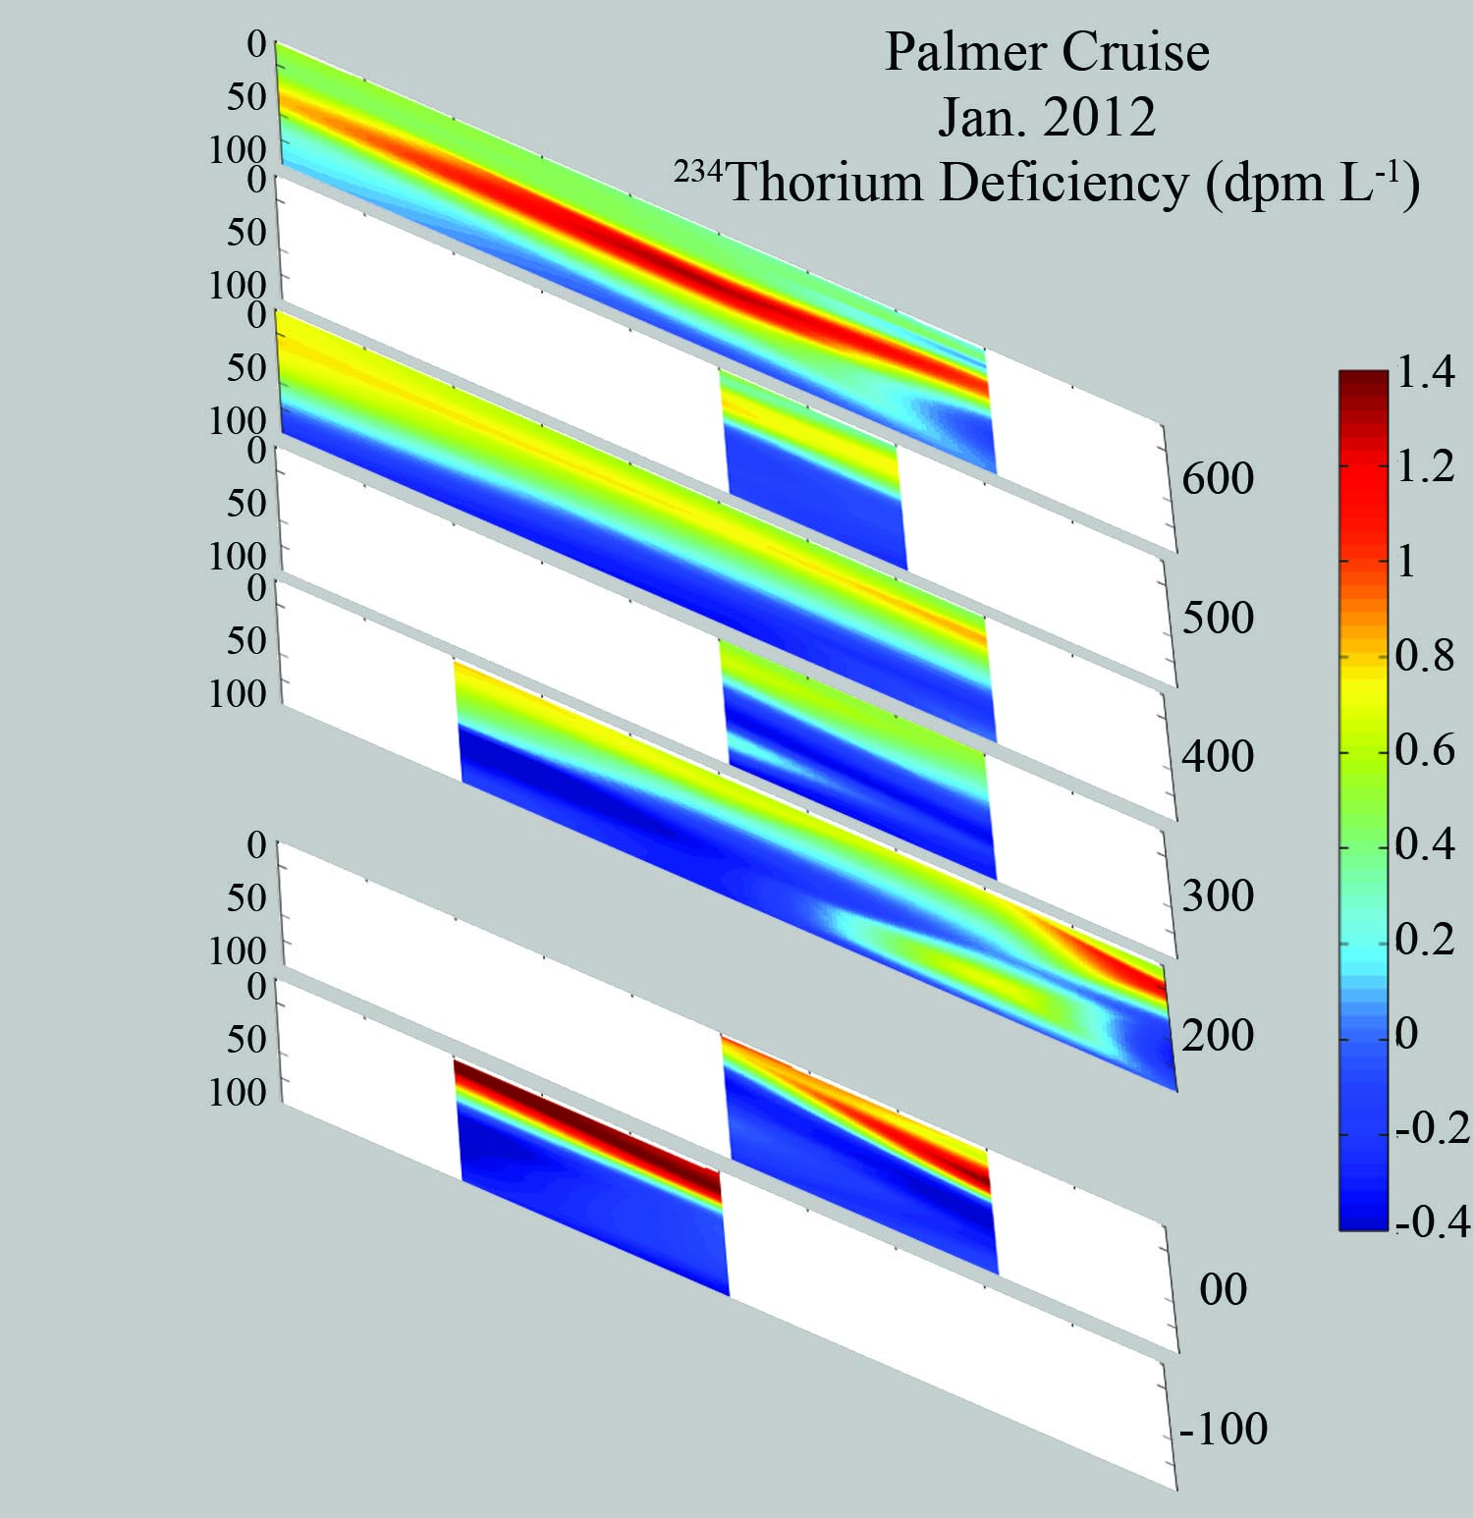
Thorium-234: Uranium-238 disequilibrium, 0-100 meters: 2012
-20 to +60 x 10³ dpm m⁻²
+ disequilibria in upper ~ 50 meters: net Thorium export (on particles)
- disequilibria in ~50-100 meters: net Thorium regeneration
(particle dissolution)
Notes:
In general there was net (positive) export in the upper 50 meters, and net thorium regeneration from particle dissolution/decomposition below, leading to apparent negative water column export over 0-100 meters at some stations.
higher export in the north, and lower, or zero export in the south
Some of the north-south contrast may be time-dependent, in that the bloom was underway, or recently completed in the north, but had not yet started farther south.
They demonstrate the sampling resolution achievable for full water column profiles.

Slide 9
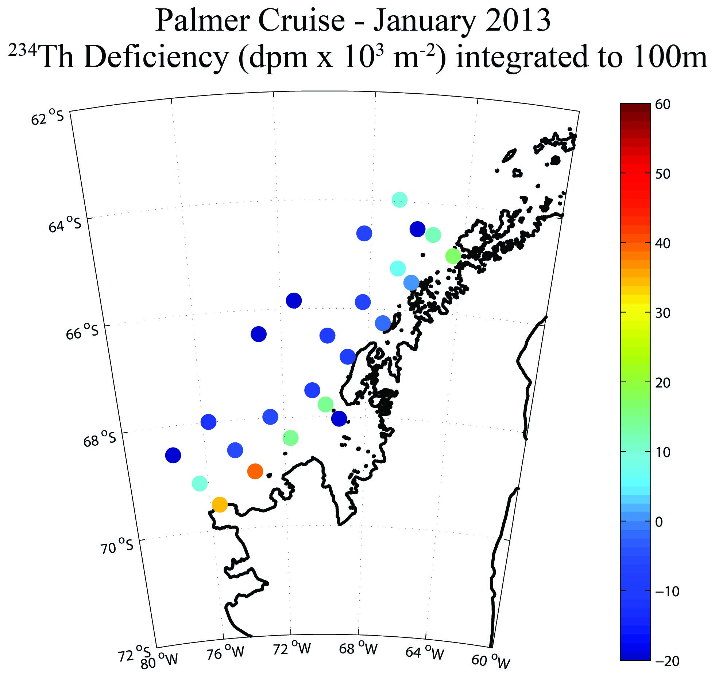
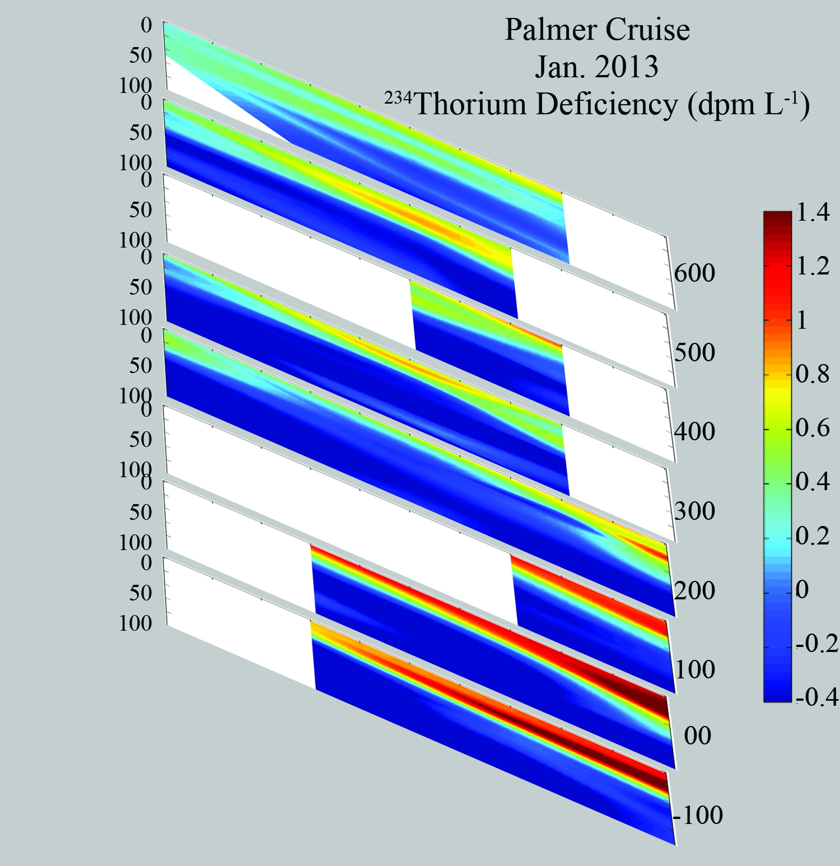
Thorium-234: Uranium-238 disequilibrium, 0-100 meters: 2013
-20 to +40 x 10³ dpm m⁻²
mostly - disequilibria in upper 100 meters: Thorium regeneration
in 50-100 m outweighs export in 0-50 m
Notes:
Sea ice retreated historically late in 2012-13 (Dec 31, latest since 1986). The 234Th deficiencies observed over the region may reflect the late ice retreat: apparent export was very low across the entire region, except in the farthest south. We did observe very high chlorophyll and primary production levels across the entire inner to midshelf region.
Overall these observations suggest substantial year to year variability. An important caveat is that the fixed observation window complicates consideration of the seasonal variability in ice retreat and bloom initiation.

Slide 10
Process | Mean | Min | Max
all data 2008-12, grid-avg | --------- mmol C m⁻² d⁻¹ ----------
GPP: | 80 | 13 | 263
NPP (C14) | 39 | 5 | 198
NCP (discrete O2:Ar) (mixed layer) | 31 | -5 | 213
Sinking Particle Export (²³⁴Th) 100 m | ~10
Sinking Particle Export (Traps) 170 m | 1 | 0.1 | 2.5
Other processes:
DOC export (horiz & vert) | ?
POC advection & mixing | ?
Notes:
Within the wide range of observed values there is an apparent 3-fold discrepancy between NCP and export. The nature of this uncoupling is not clear.
Especially given the DOC production measurements suggest these measurements are low.

Slide 11
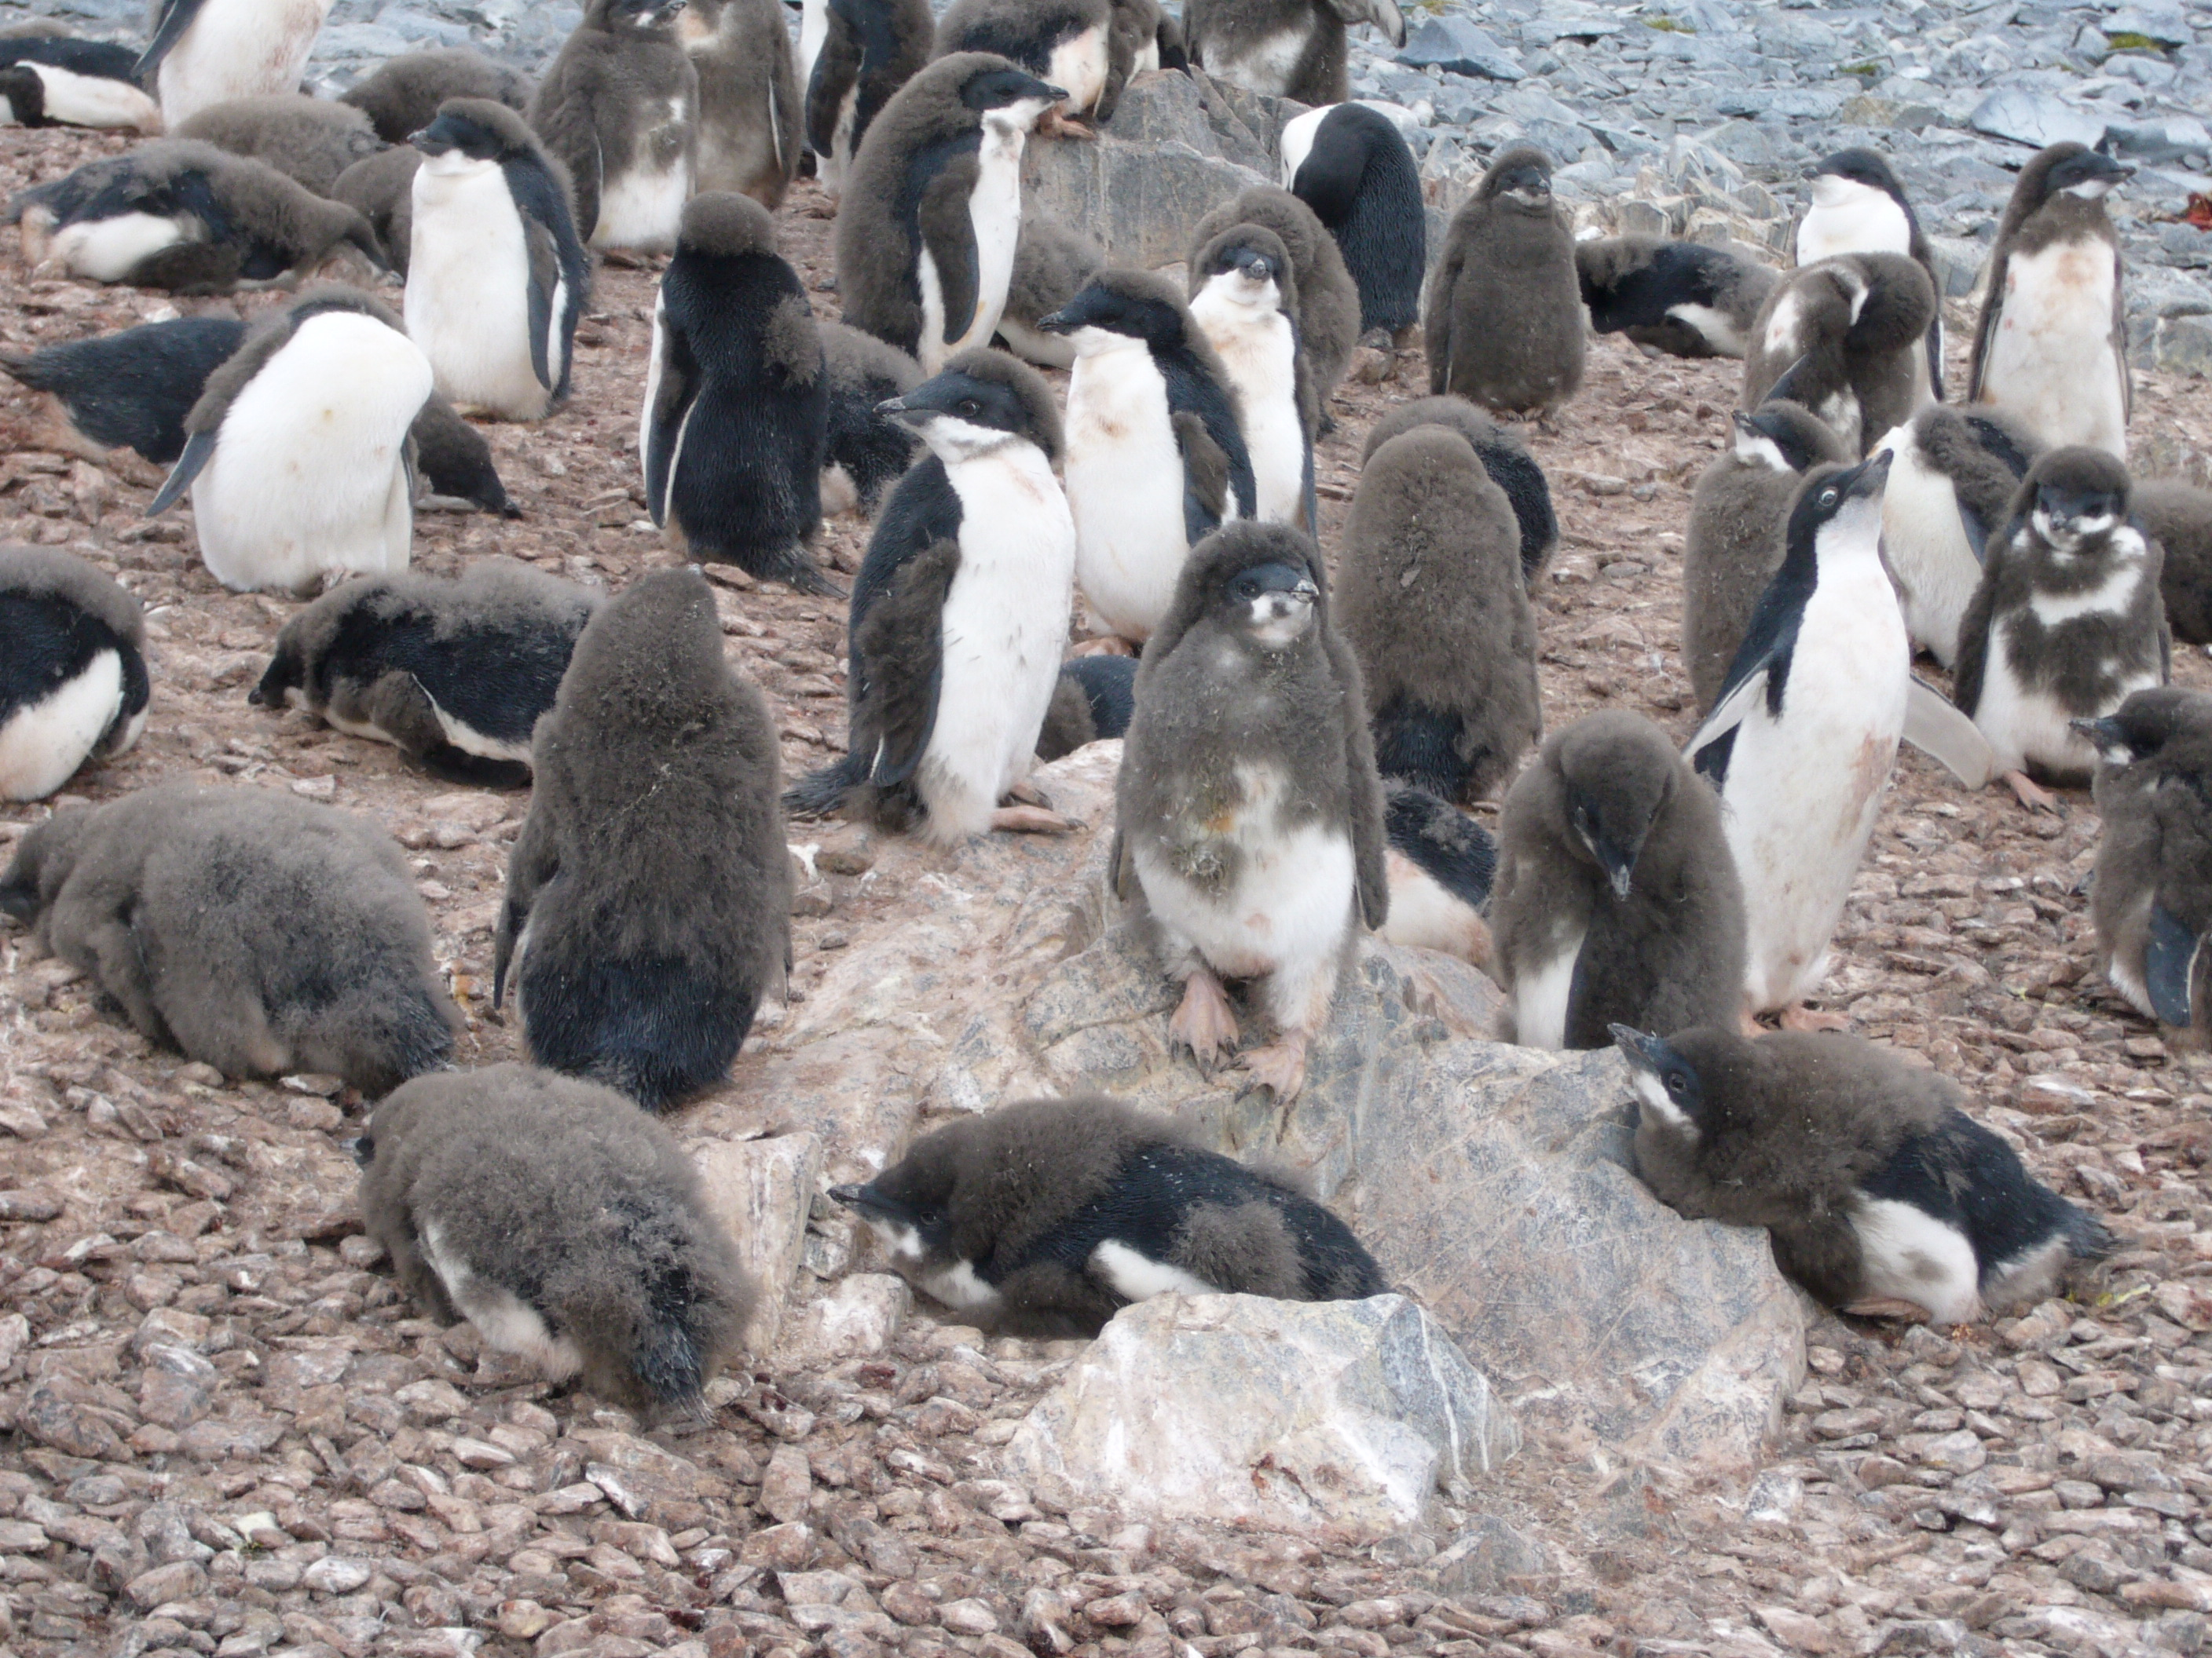
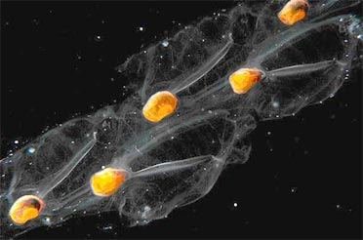
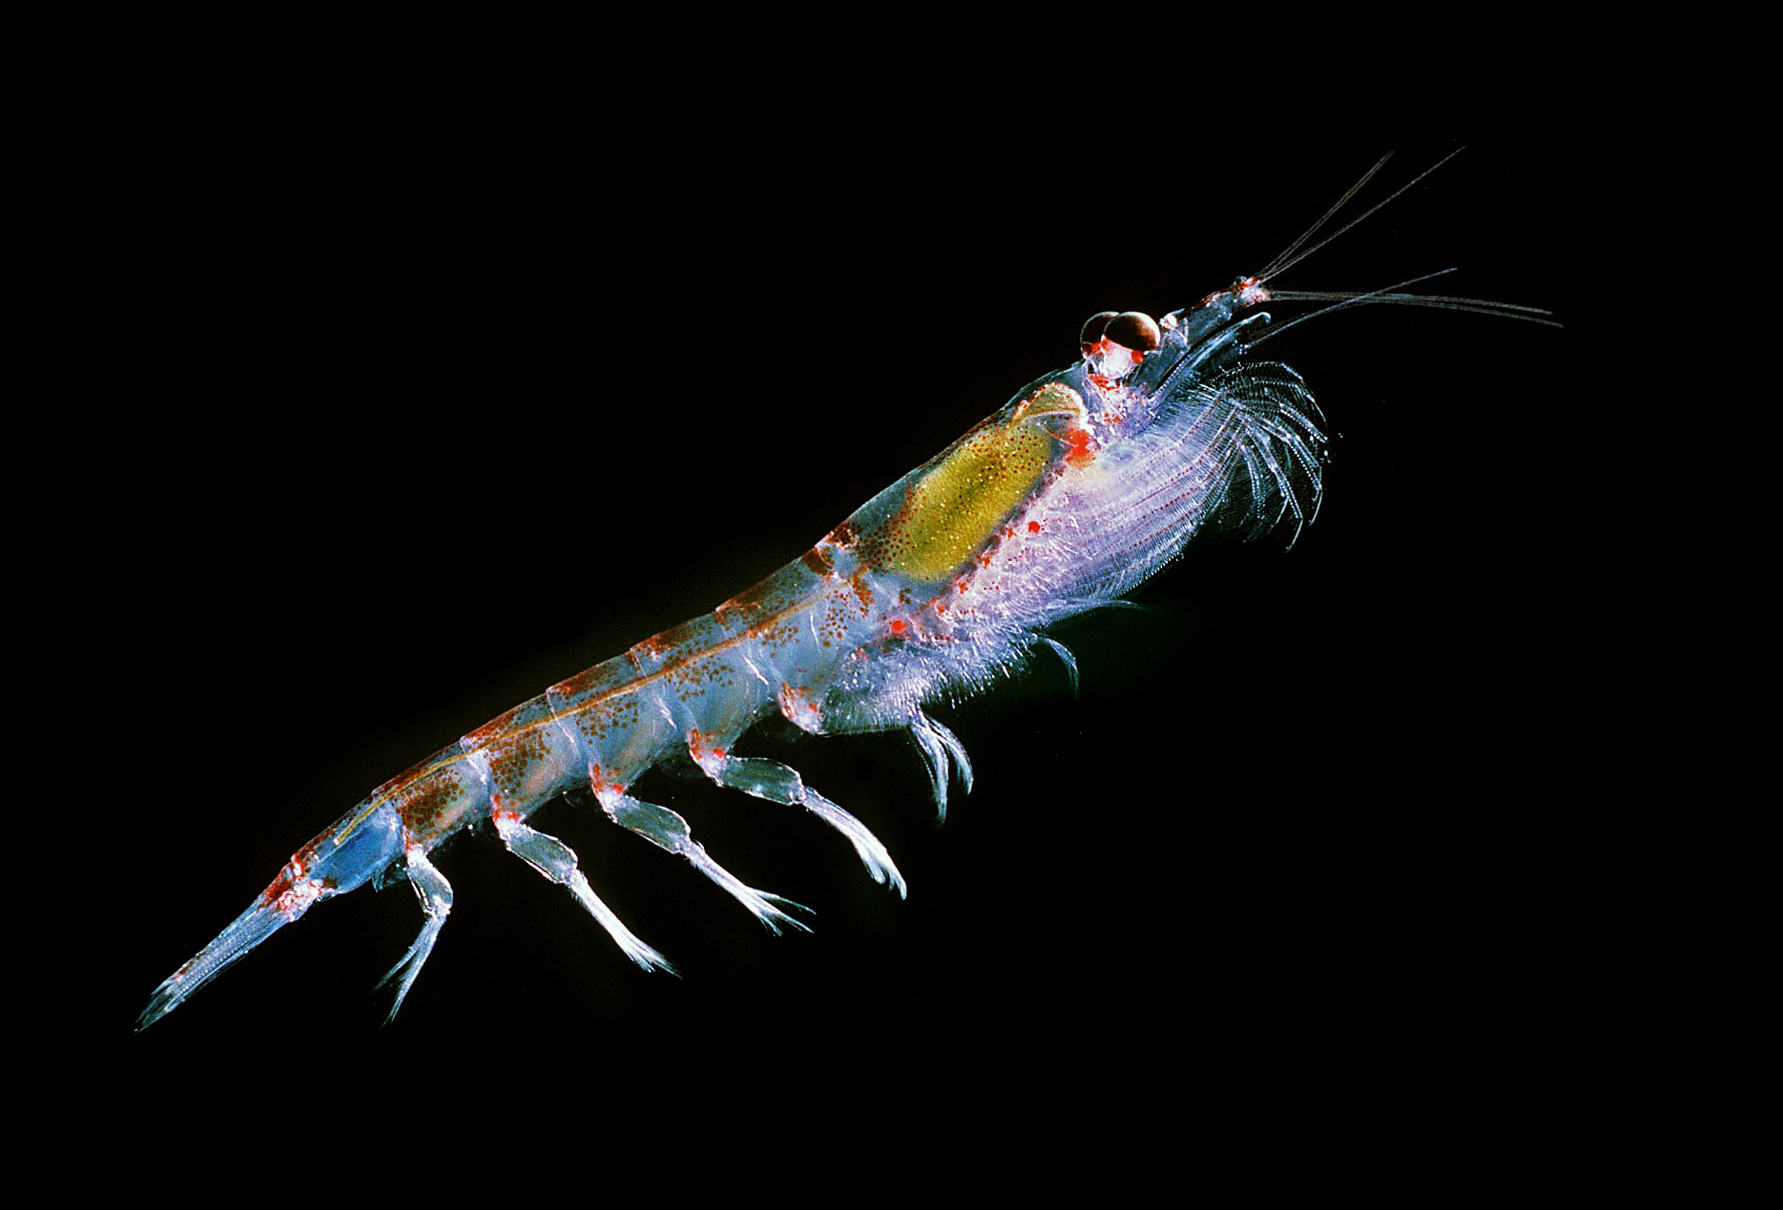
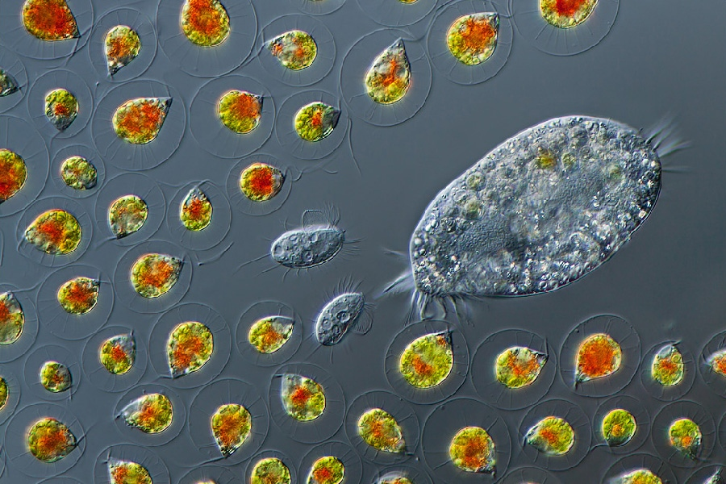
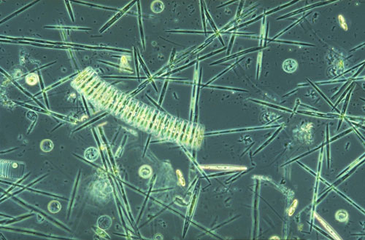
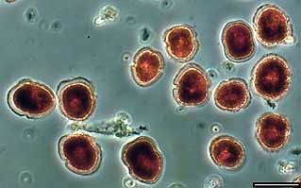
Antarctic foodchains
LARGE
SMALL
Penguins
Seals
Whales
Salps
Krill
Pteropods
Copepods
Protozoans
Micro-
Zooplankton
Diatoms
Cryptophytes

Slide 12
Generally you find phytoplankton populations dominated by either large diatoms or small cryptophytes, these two phytoplankton taxa explain ~80% of the variability in the chlorophyll

Slide 14
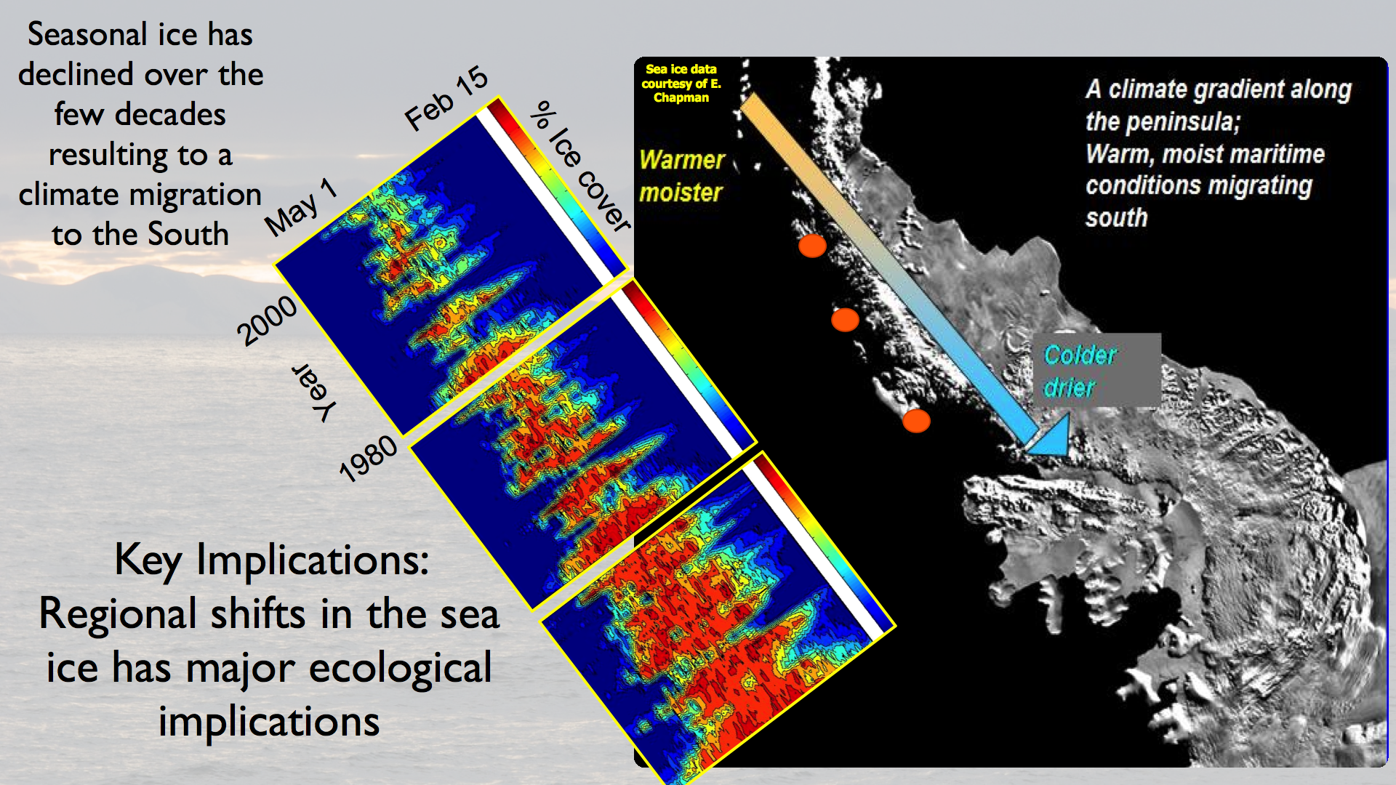

Slide 15
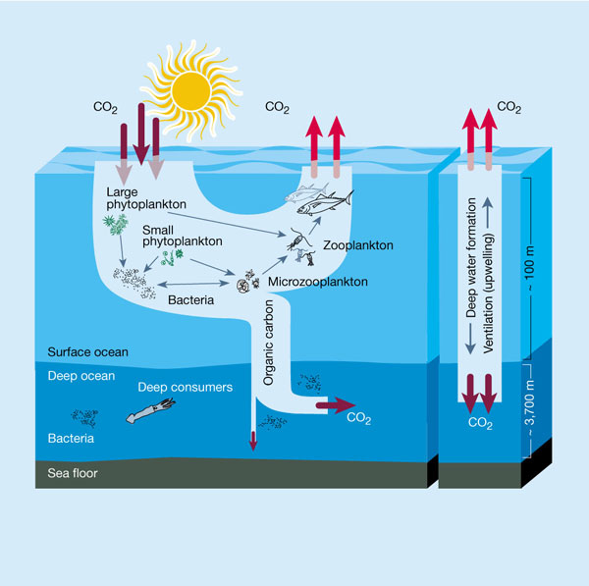
HYPOTHESIS: Large phytoplankton-initiated food chains enhance NCP and export (transport); small foodchains favor recycling and respiration (dissipation)
SMALL
RESPIRATION
LARGE
NCP & EXPORT

Slide 16
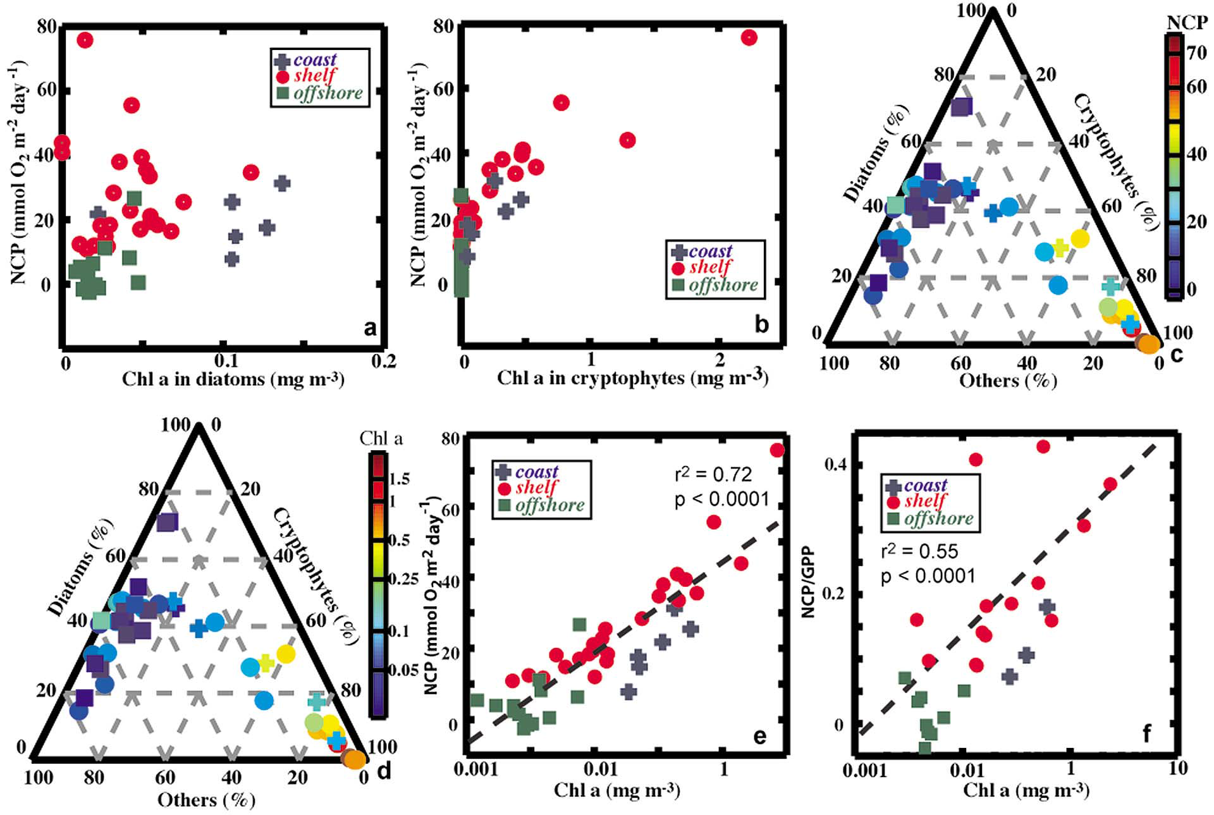
But Huang et al found high NCP in Cryptophyte-dominated assemblages
Huang et al 2012
Notes:
Surprisingly, Huang et al (2012) observed just the opposite during the January, 2008 LTER cruise: NCP was relatively insensitive to the overall Chl level in diatoms (panel a below),
and responded most to the amount or proportion of cryptophytes present in the water (panels b, c).
This suggested that small foodwebs have mechanisms to generate larger export than proposed by the simple hypothesis.
To investigate thus further we looked at greater detail at foodweb structure in the north and south of our study area, in systems dominated by large and small phytoplankton. (K. Huang et al. GBC 26)

Slide 17
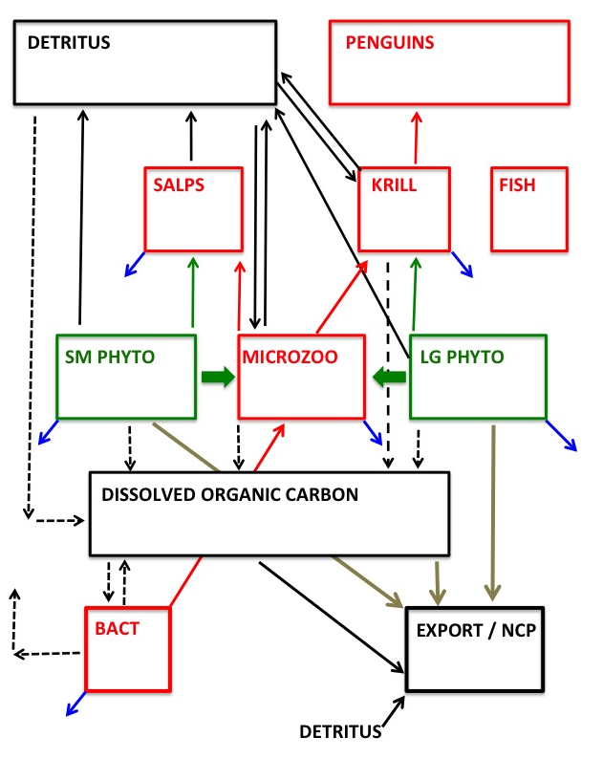
Inverse foodweb model-based estimates of NCP:
Yields estimates of trophic exchange rates for a specific foodweb structure, consistent with observations, constraints and other assumptions.
Complete solutions for North & South regions, 1995-2006.
NCP = GPP- CR =
Sum of unconsumed production = “Export”
Sevrine et al 2013
Notes:
The inverse model yields estimates of the trophic exchanges (rate processes, mmol C m⁻² day⁻¹) for a specified foodweb structure, consistent with observations and assumptions about ecological and physiological parameters.
total GPP is the sum of that by the large and small phytoplankton and the community respiration (CR) is the sum of the R in the individual compartments. Note that the NCP is equal to the total of all unconsumed flows in the system (arrows to NCP box).

Slide 18
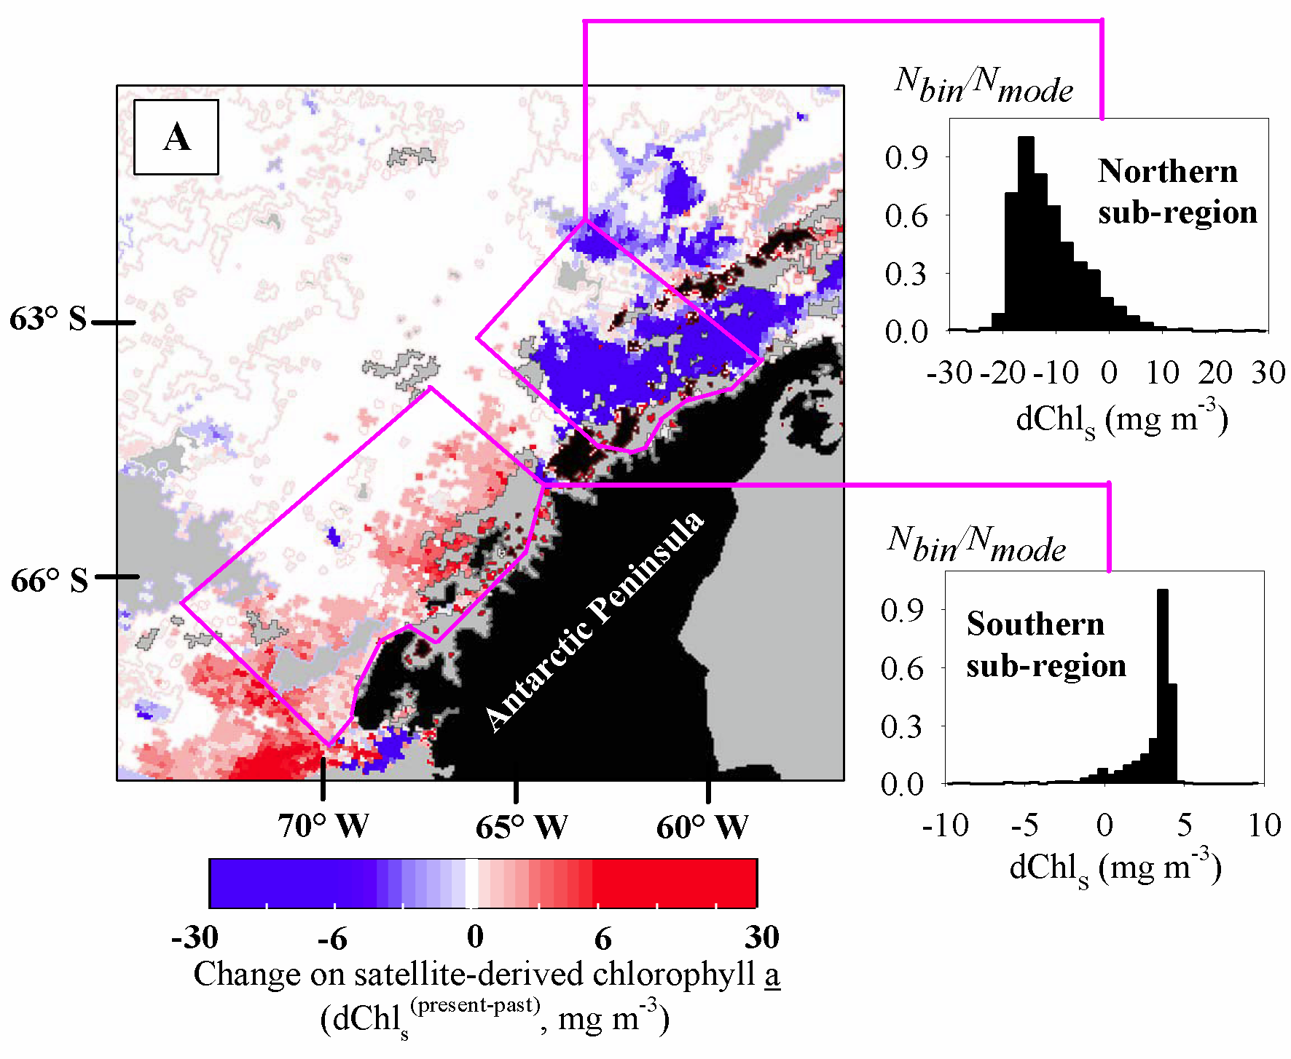
Changes in phytoplankton (1978-86 to 1998-2006) in response to sea ice loss: decreasing in North dominated by small cells, increasing in South, dominated by large diatoms: Two regimes: High Chl/Large cells – Low Chl/small cells
-90%
+67%
Montes-Hugo et al Science 2009
Notes:
Earlier observations had already established that surface Chl was declining in the northern region of the Peninsula, and increasing in the south, both in response to decreasing sea ice cover.
Backscatter-based estimates of particle size distributions also showed that the higher-Chl, southern region was dominated by diatoms, whereas the lower-Chl, northern region had higher proportions of smaller cells.

Slide 19
Annual anomalies: Ice duration & Chlorophyll
High & Low Chl Regimes (anomaly >0.5)
North
Model solutions
obtained for 4 regimes (1995-2006):
Means of flows (arrows) for:
North High Chl
(95, 96, 06)
North Low Chl
(97, 98, 04)
South High Chl
(02, 06)
South Low Chl
(97, 98, 03, 04)
South
Ice
Chl
Notes:
Long-term observations show distinctive patterns for sea ice duration and Chl. In particular, Chl in the north and south has 3-5 years of negative (low) anomalies, punctuated by one or two years of positive (high) anomalies
Values of foodweb exchanges (flows) from inverse model solutions were averaged for these years to define foodweb structure in the two Chl regimes.

Slide 20
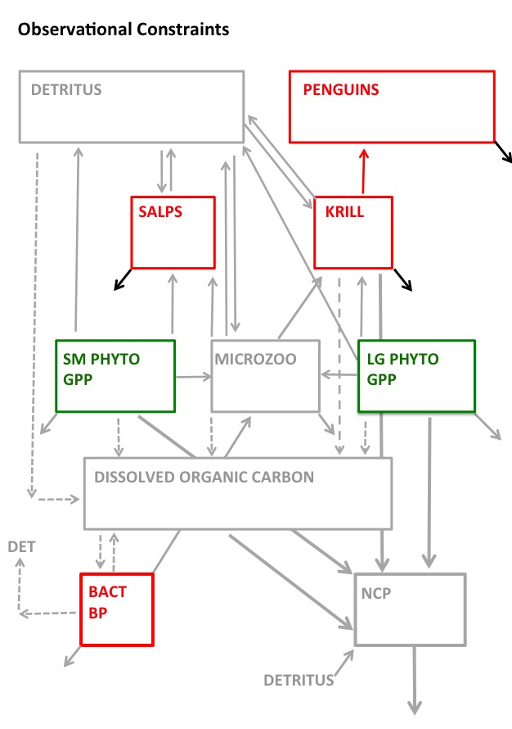
Inverse foodweb model-based estimates of NCP:
Observational constraints:
Stocks: Chl, krill, salps, penguins, bacteria
Rates: primary, bacterial production
Size structure: Chl & PP allocated between Large and Small fractions based on size-frac Chl and/or HPLC
See Tables for other constraints
Notes:
compartments and flows constrained (“known”) from observations are shown in color, the others are in gray.
The foodweb is underconstrained, and there is virtually an infinite number of solutions satisfying the constraints.
The solution space of all solutions obeying the constraints was explored using a Monte Carlo approach, successively maximizing and minimizing each parameter in combination with the others, and selecting the mean value for each solved flow.
Here we used observations of the standing stocks, primary and bacterial production to constrain the solutions. Standing stocks yield estimates of maintenance respiration by well-known allometric relationships.

Slide 21
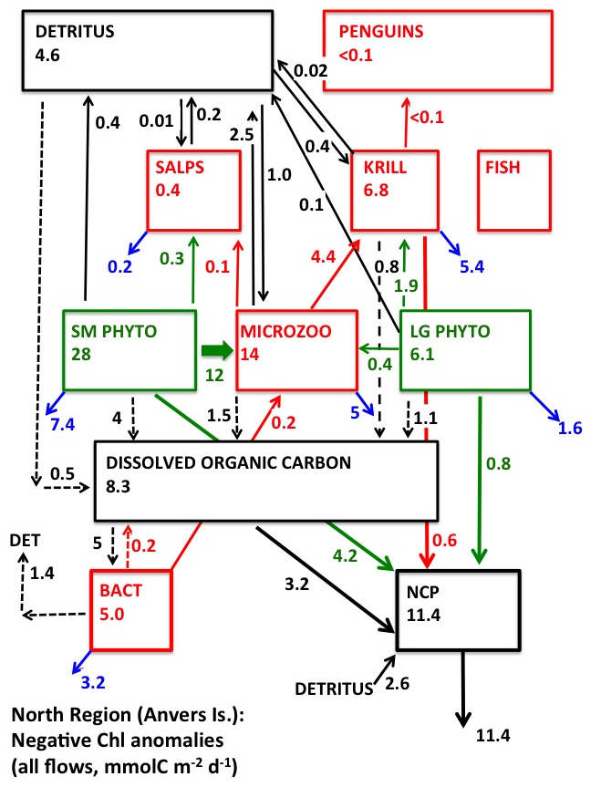
Numbers inside compartments are total throughputs (inputs = outputs).
Small to Large Phytoplankton Ratio: 80:20.
Flows dominated by Small Phytoplankton, microzooplankton and NCP
Microzooplankton make up majority of krill diet (not Large Phytoplankton – Diatoms)
NCP is 33% of GPP
CR is 67% of GPP
NCP is mostly unconsumed small phytoplankton & DOC
Notes:
This is one example of a solved foodweb, showing all flows (mmol C m⁻² d⁻¹) for the averaged flows of the low-Chl years in the northern region (the low-Chl regime in the North).

Slide 22
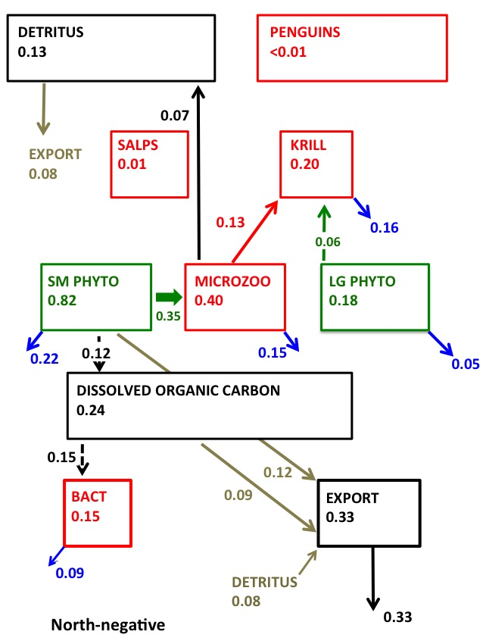
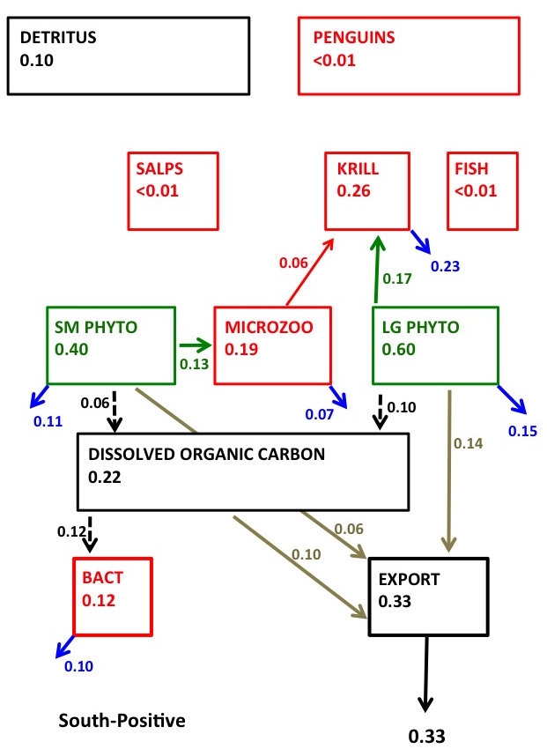
North-Low Chl vs South High Chl: Polar Opposite Regimes
Flows normalized to GPP; only flows < 5% GPP shown
Notes:
Inverse model solutions show two contrasting regimes. Note the Krill diet: In North, Low-Chl, microzooplankton are a more important food source. In South, large phytoplankton are more important.
In
. Note the relative proportions of microzooplankton and diatoms in the krill diets. In both regimes the NCP is 33% of the GPP and 45% of the NCP.

Slide 23
Food web is tightly coupled to the high chlorophyll anomaly years
Saba et al. Nature Comm (2014)

Slide 24
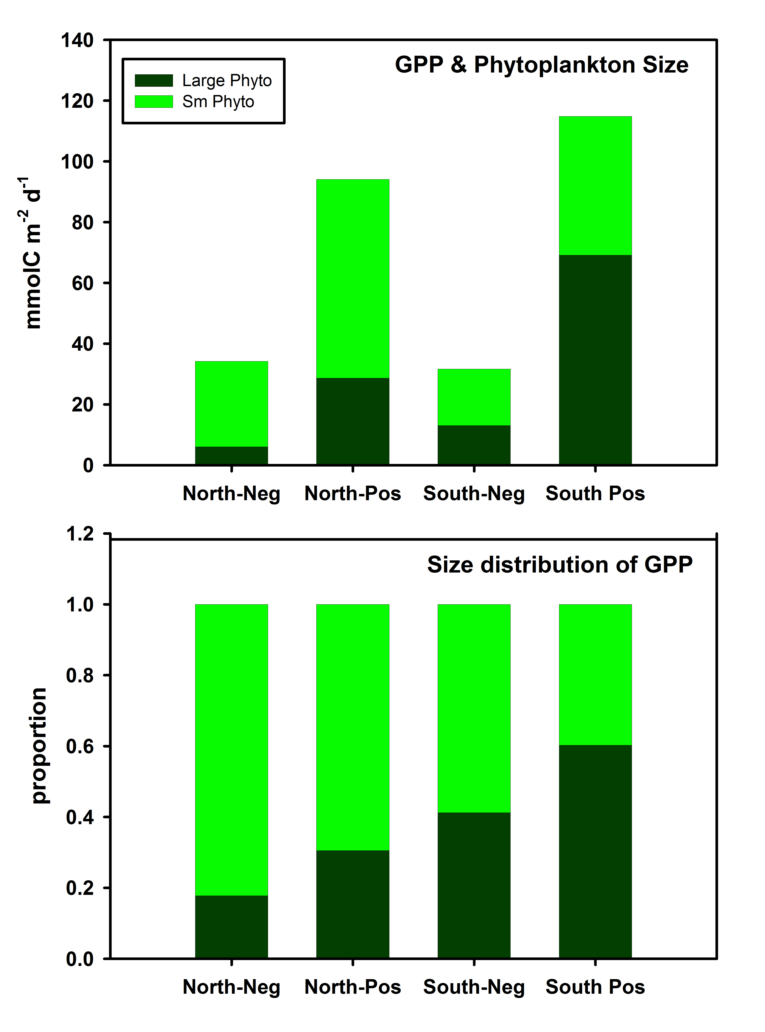
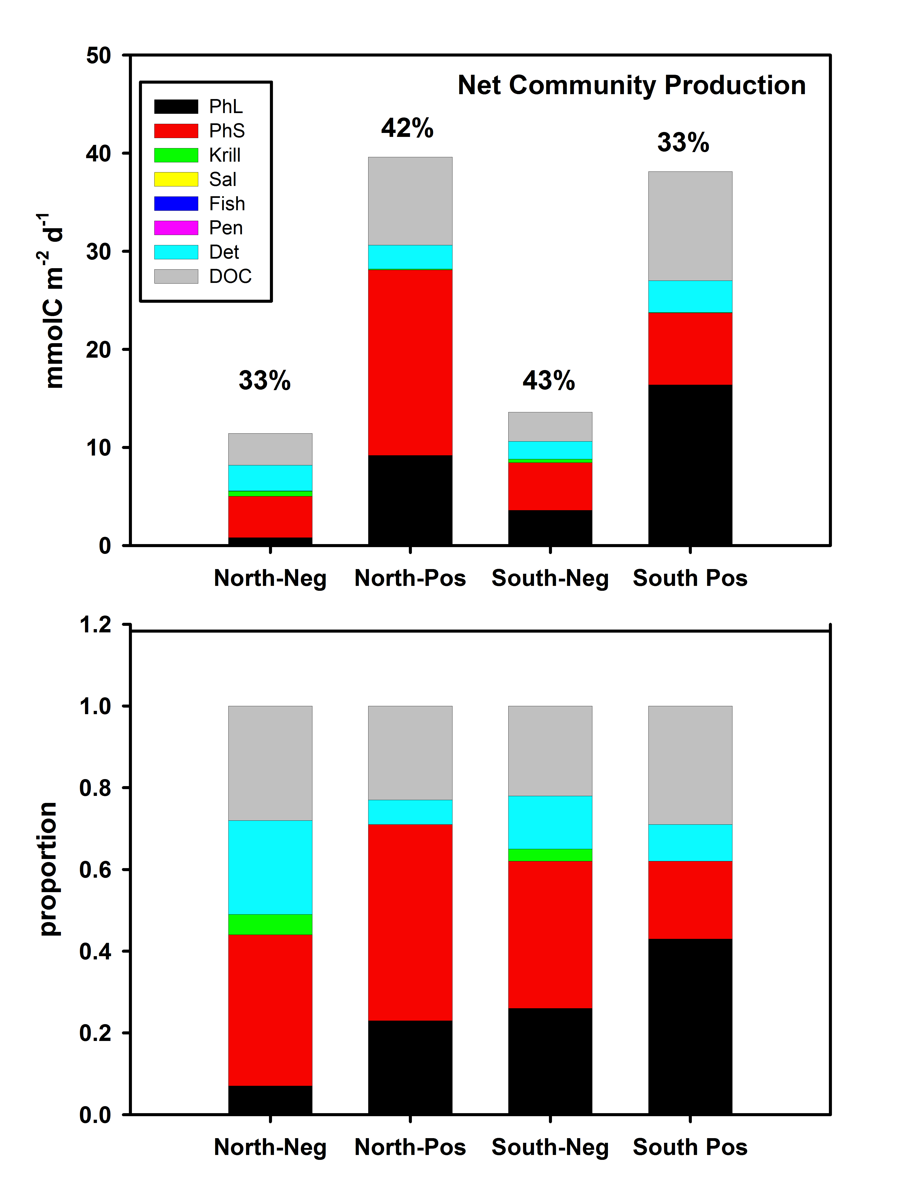
North-Low Chl vs South High Chl: Polar Opposite Regimes
Note progression of Large Phytoplankton importance, N to S, low to high Chl; and variable importance of small phytoplankton to NCP

Slide 25
Observational data suggests that small phytoplankton
associated with melt-water. This could be significant the observed warming large trends in this region.

Slide 26
All cryptophytes are not the same

Slide 27
Conclusions:
PAL-LTER afforded opportunity to compare various estimates of NPP, NCP, new production, export over daily-weekly and local-regional scales and multiple years (ongoing).
Imbalance between NCP/New P and Export. High resolution temporal sampling argues against temporal uncoupling.
Large interannual & spatial variability in NCP and 234Th-export
High NCP can be associated with small phytoplankton (observations & models)
Two contrasting regimes: a low-Chl regime in the north associated with small phytoplankton, and a high-Chl regime in the south associated with large phytoplankton
The two regimes have similar NCP/GPP ratios, but magnitude of GPP and NCP differs. Foodweb structure reflects the phytoplankton size classes.

