Slide 1
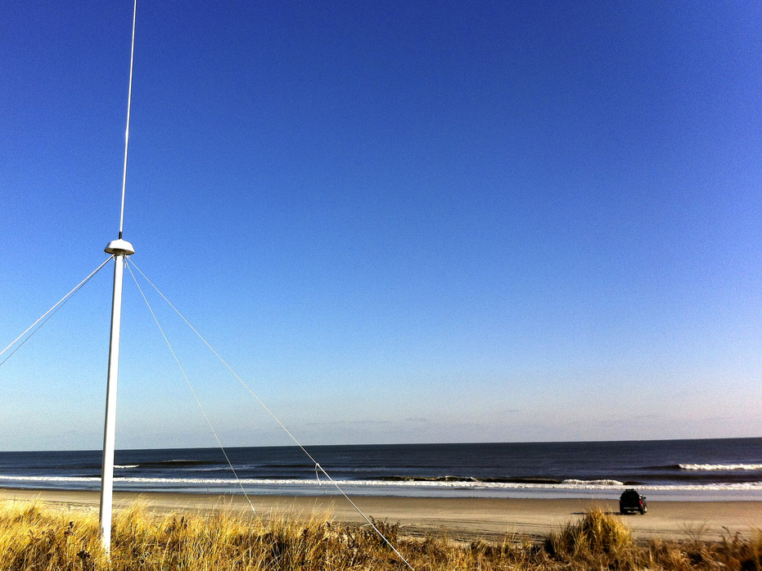
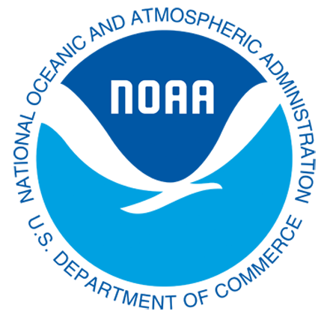
Implementation of a National Dual-Use High Frequency Radar Network
Dr. Hugh Roarty
Dr. Scott Glenn
Dr. Josh Kohut
Mr. Michael Smith
Mr. Ethan Handel
Mr. Colin Evans
Maritime Security Workshop
Oceanology International 2014
12 March 2014
ExCeL

Slide 2
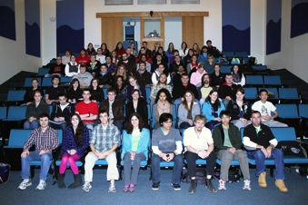
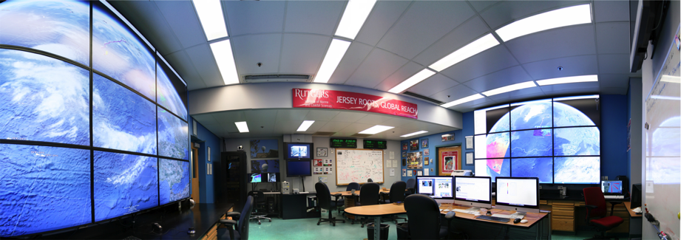
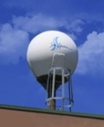
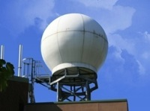
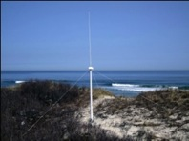
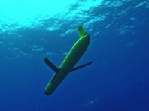
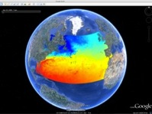
Rutgers University
Coastal Ocean Observation Lab
>20 Researchers, > 100 Undergrads, >$100 M Funding
Satellite Data Acquisition Stations
CODAR Network
Glider Fleet
3-D Forecasts

Slide 3
Introduction to high frequency radar

Slide 5
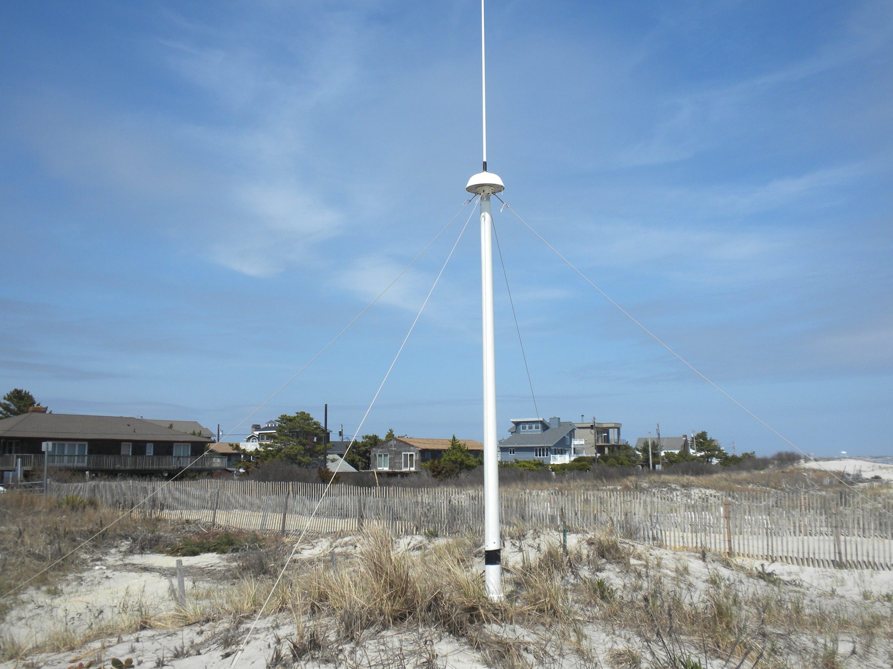
13 MHz Transmit and Receive Antenna
4 meters

Slide 6
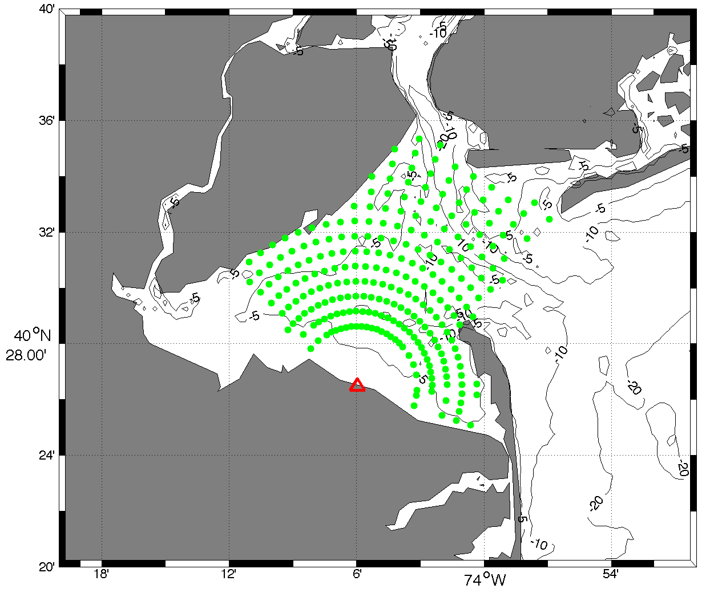
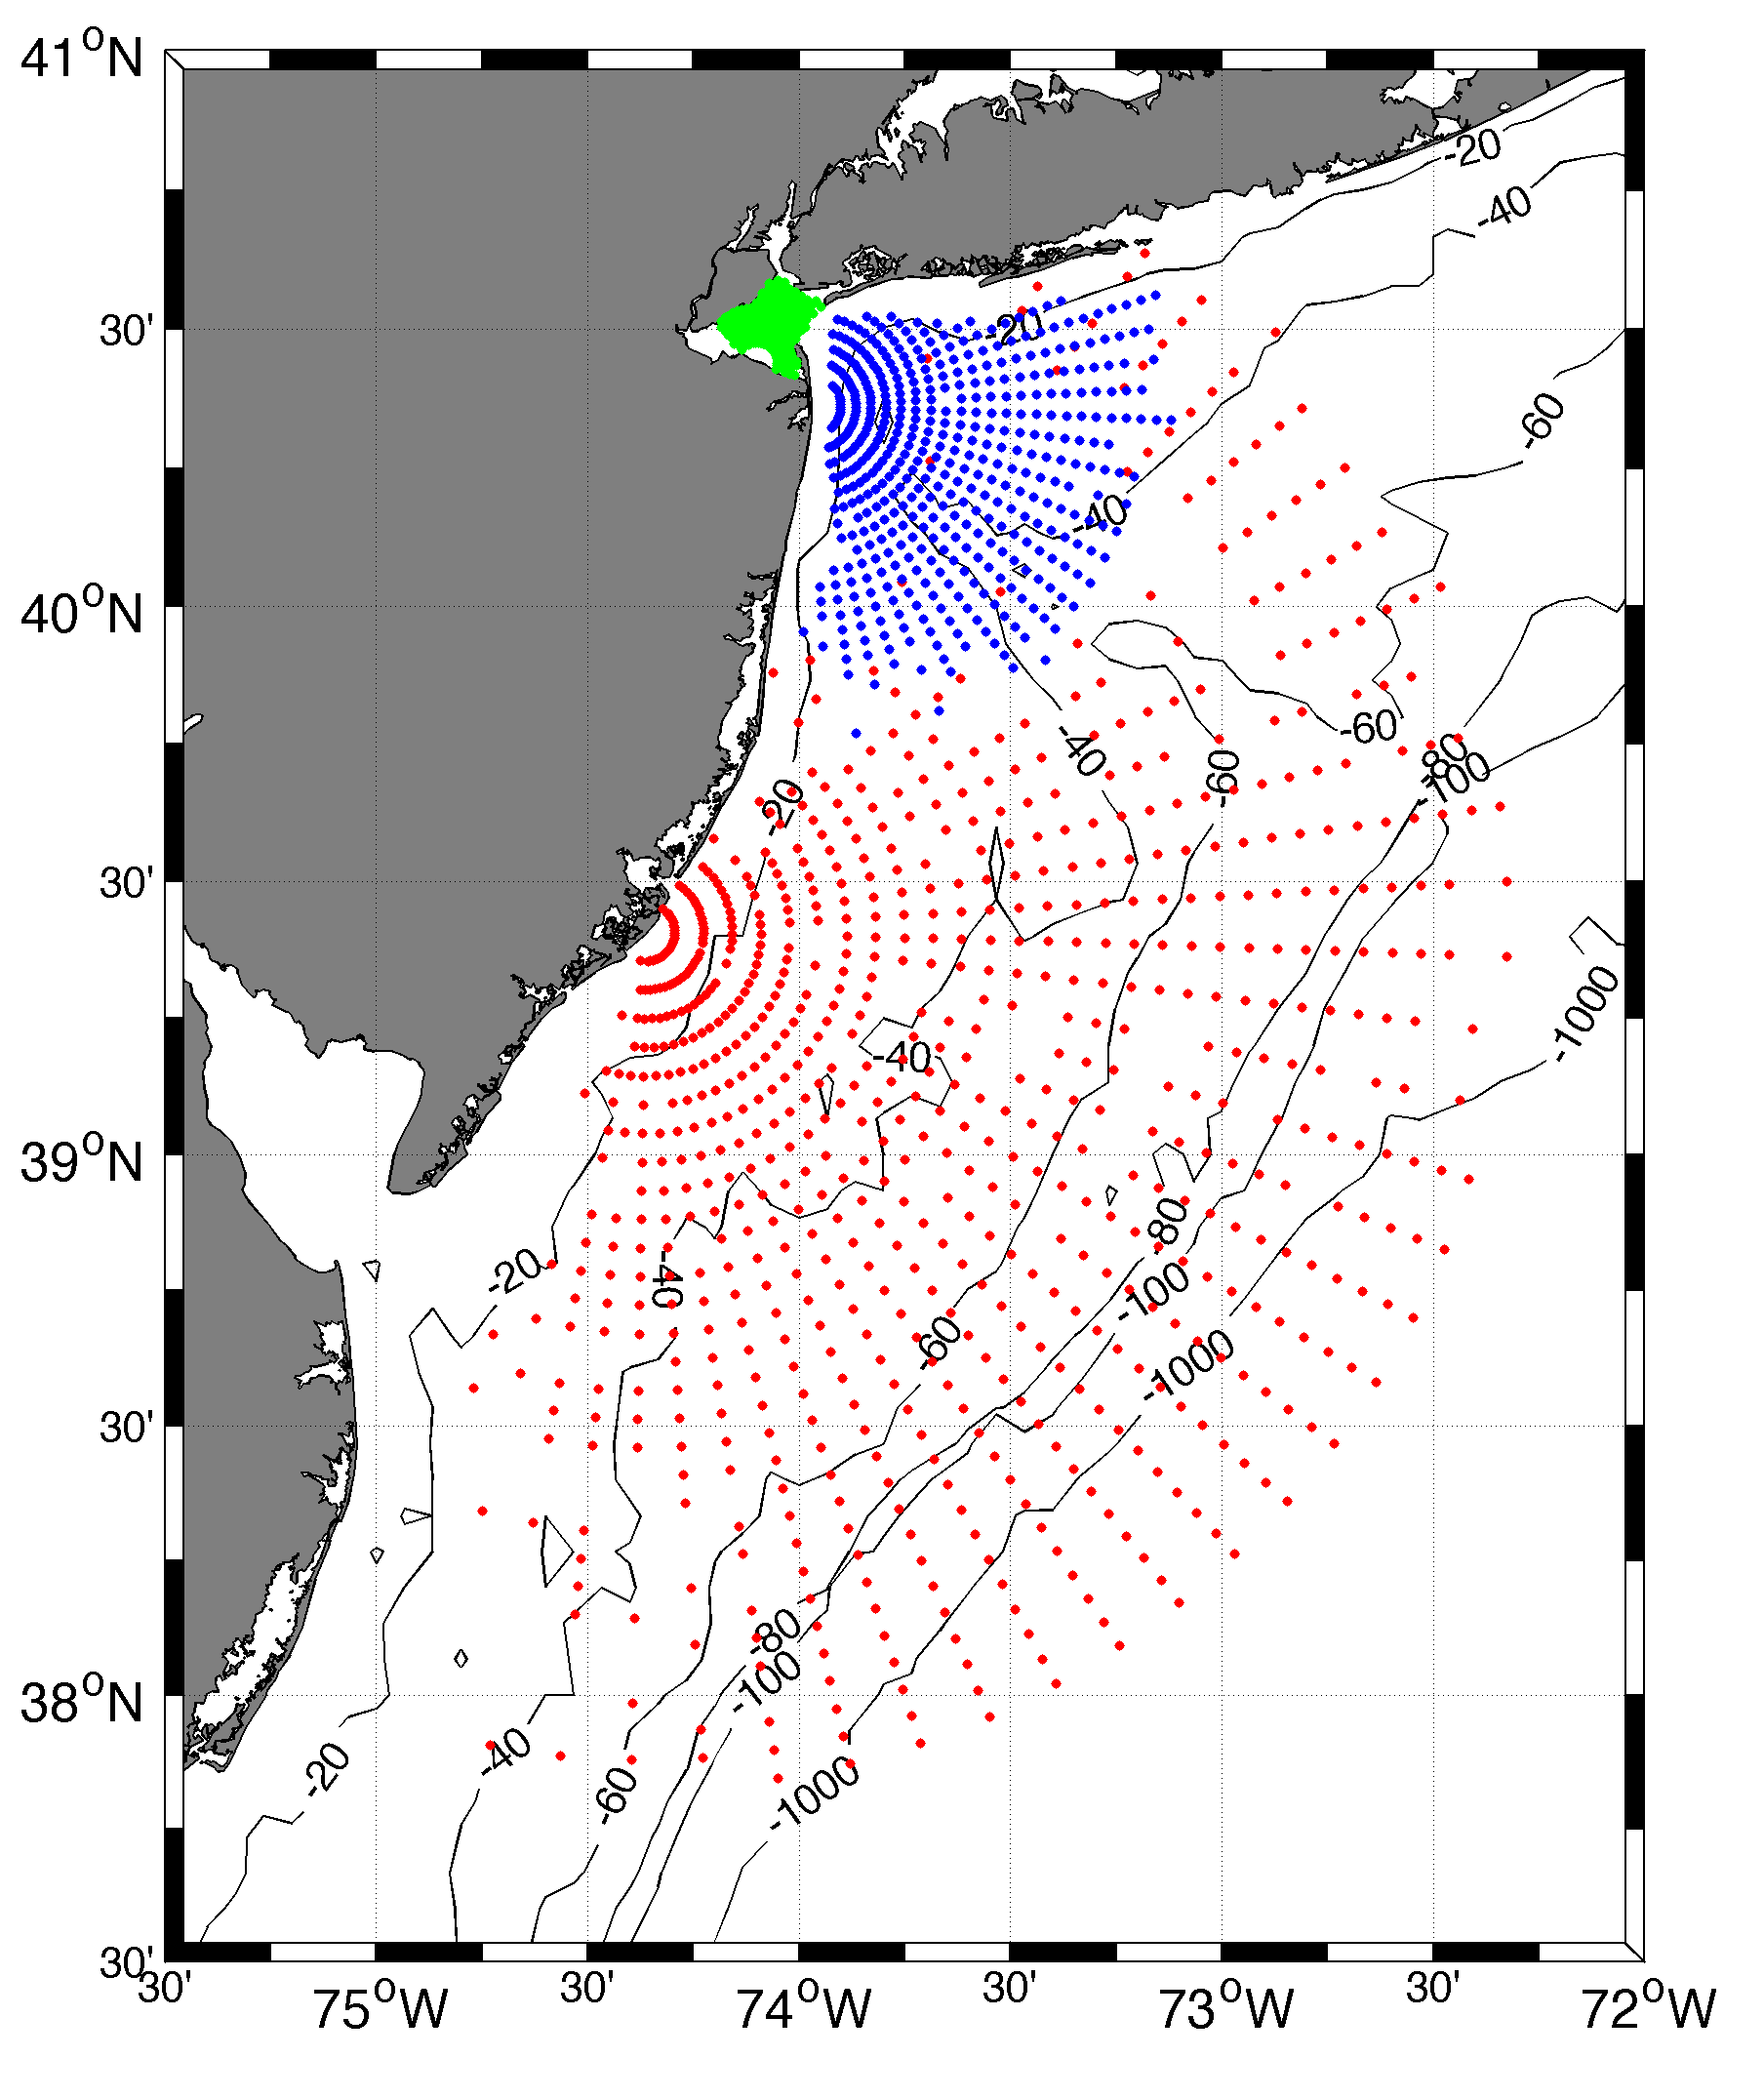
Surface Current Mapping Capability
25 MHz
Radar λ: 12 m Ocean λ: 6 m
Range: 30 km Resolution: 1 km
13 MHz
Radar λ: 23 m Ocean λ: 12 m
Range: 80 km Resolution: 3 km
05 MHz
Radar λ: 60m Ocean λ: 30 m
Range: 180 km Resolution: 6 km

Slide 7
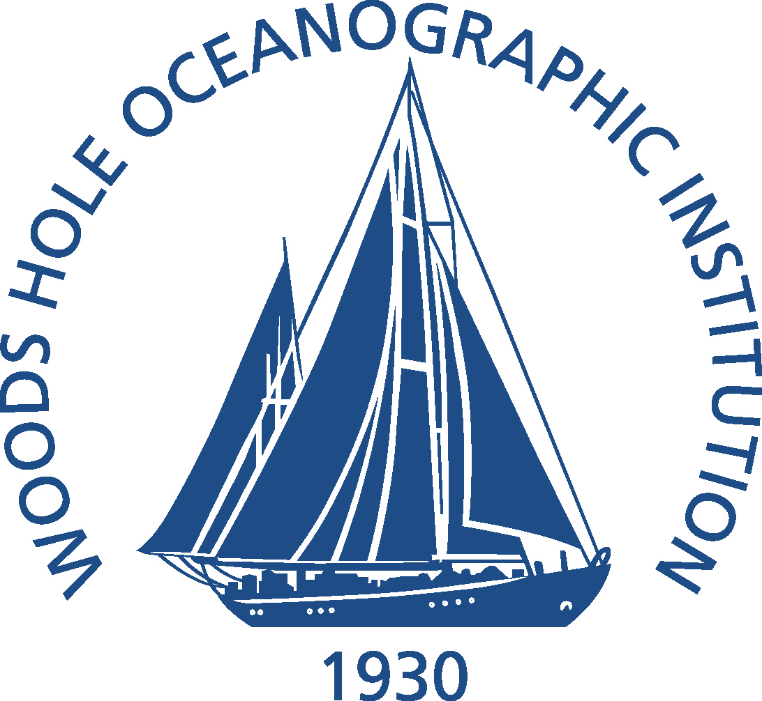
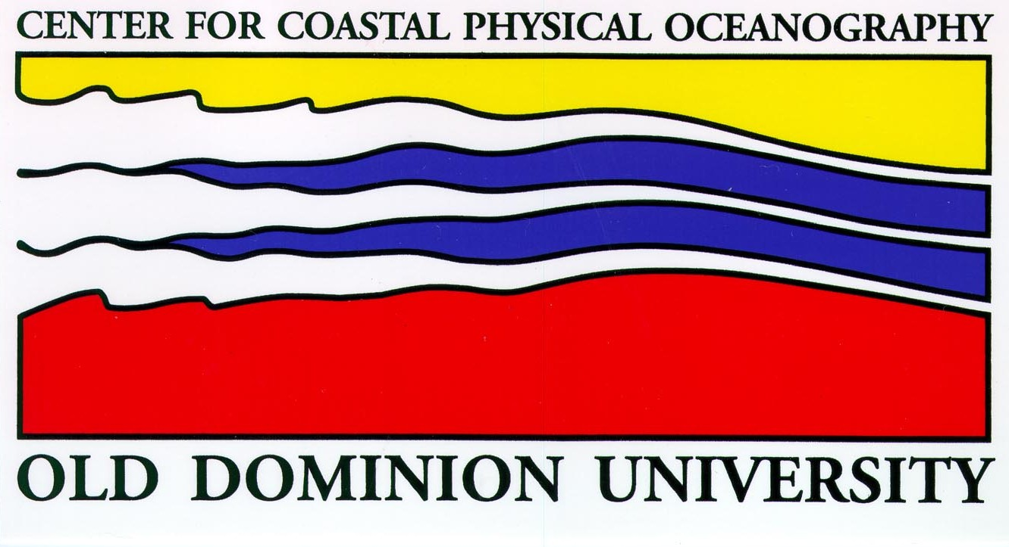
MARACOOS HF RADAR NETWORK
 | 5 MHz | 13 MHz | 25 MHz
U Mass
WHOI
U Conn
URI
Stevens
Rutgers
Delaware
ODU/CIT
UNC
9 | 17 | 8 | 17
41 Stations in Total

Slide 8
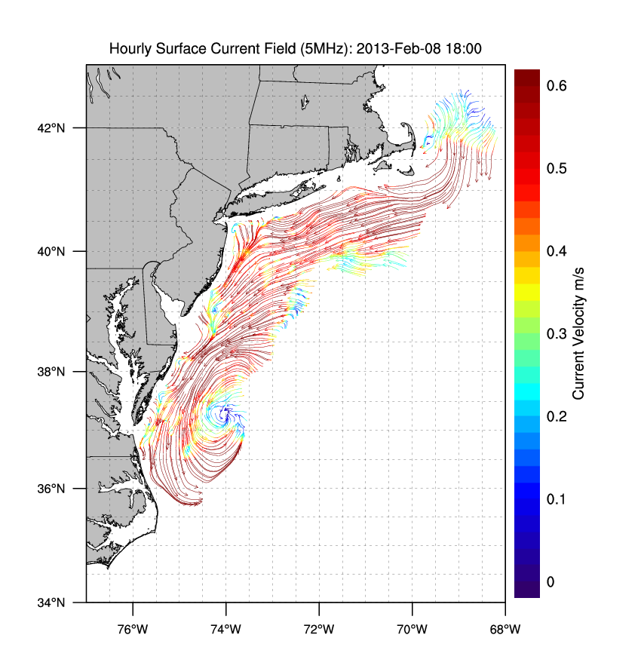
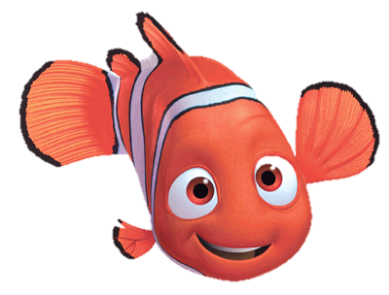
Winter Storm Nemo
February 9, 2013

Slide 9
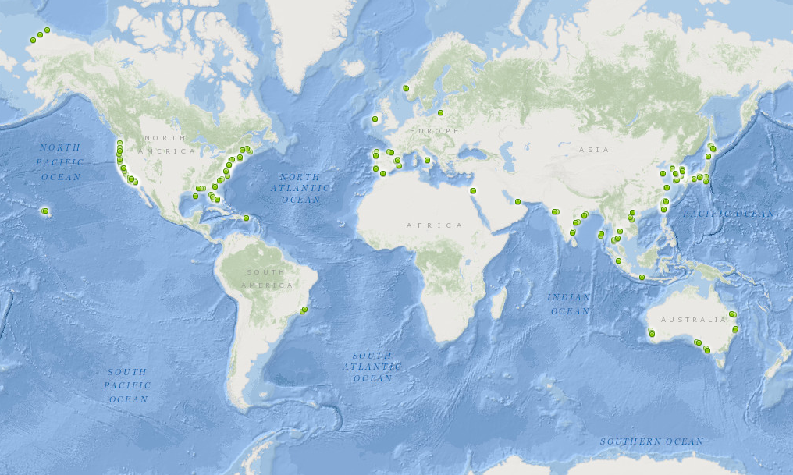
350 Radars World Wide
Region | Number | Percentage
Americas | 162 | 47%
Europe | 54 | 16%
Middle East | 7 | 2%
Asia | 122 | 35%

Slide 11
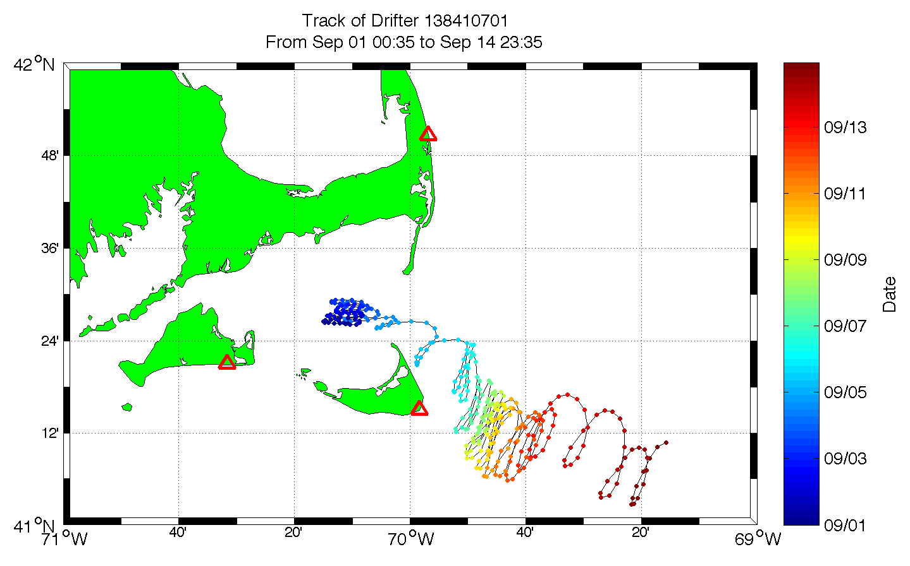

Slide 12
Application: Search and Rescue

Slide 13
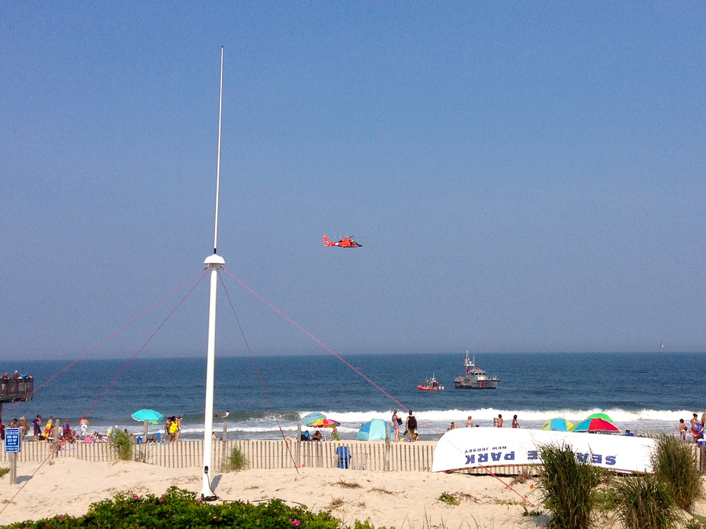
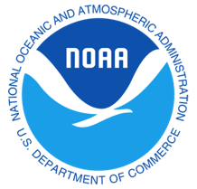
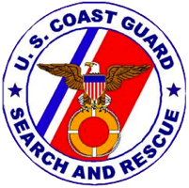
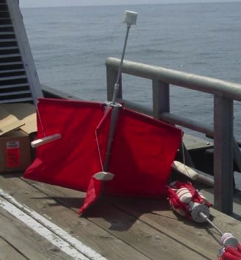
Success Stories – Making a Difference
Optimizing HF Radar for SAR using USCG Surface Drifters

Slide 14
Search and Rescue - 2004

Slide 15
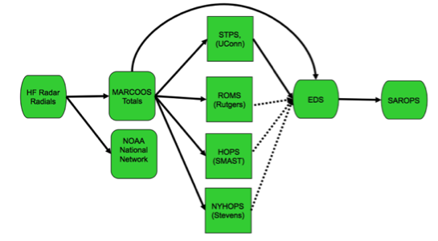
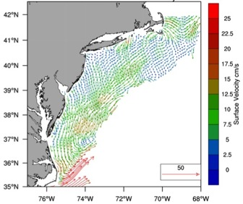
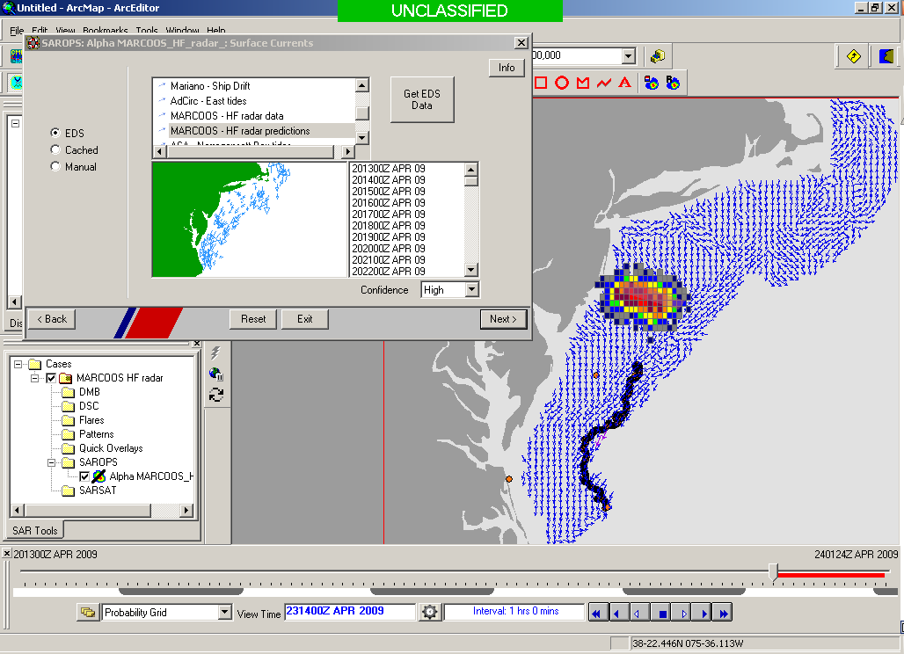
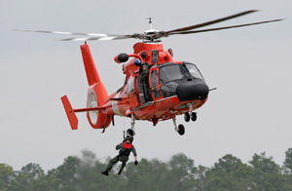
Transition Objective –
Operational Use of HF Radar Surface Currents for Search And Rescue
Surface Currents
Data Acquisition
(MARACOOS)
Data Product Generation & Management
(U.S. IOOS)
Environmental Data Server (EDS)
Search And Rescue Optimal Planning System (SAROPS)

Slide 16
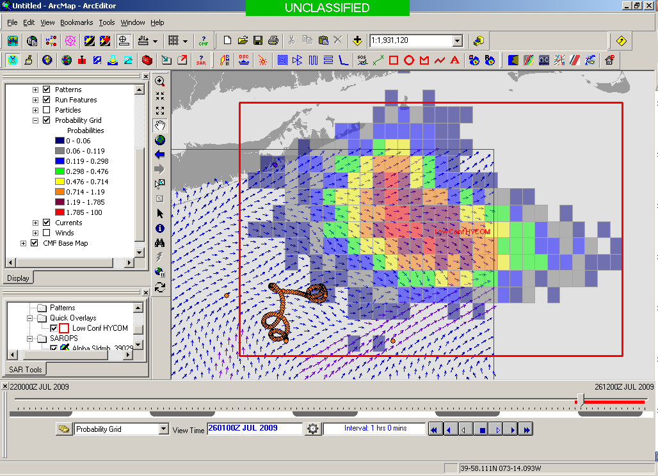
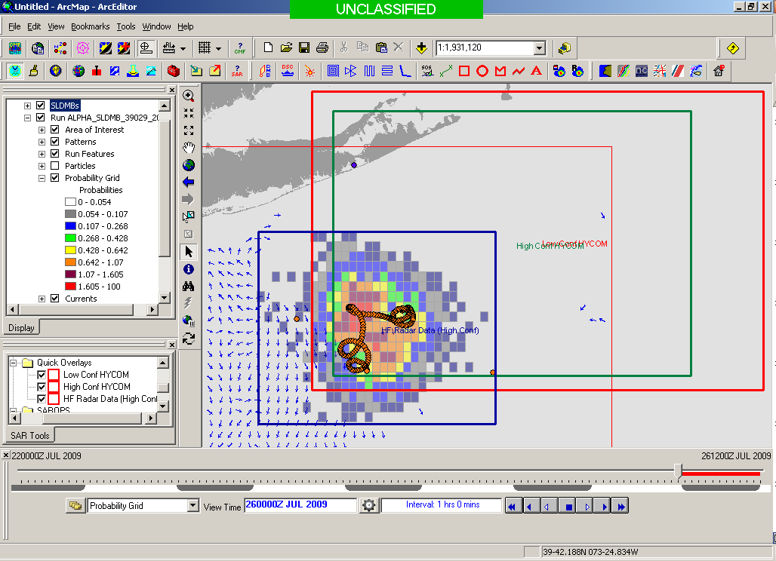
SAROPS Test Case 5000 Virtual Drifters + 1 Real Drifter (Black Line): Search Area After 96 Hours
154 km
100 km
232 km
123 km
HyCOM
36,000 km²
HF Radar
12,000 km²
Notes:
HYCOM (Low Conf) 48 hours

Slide 17
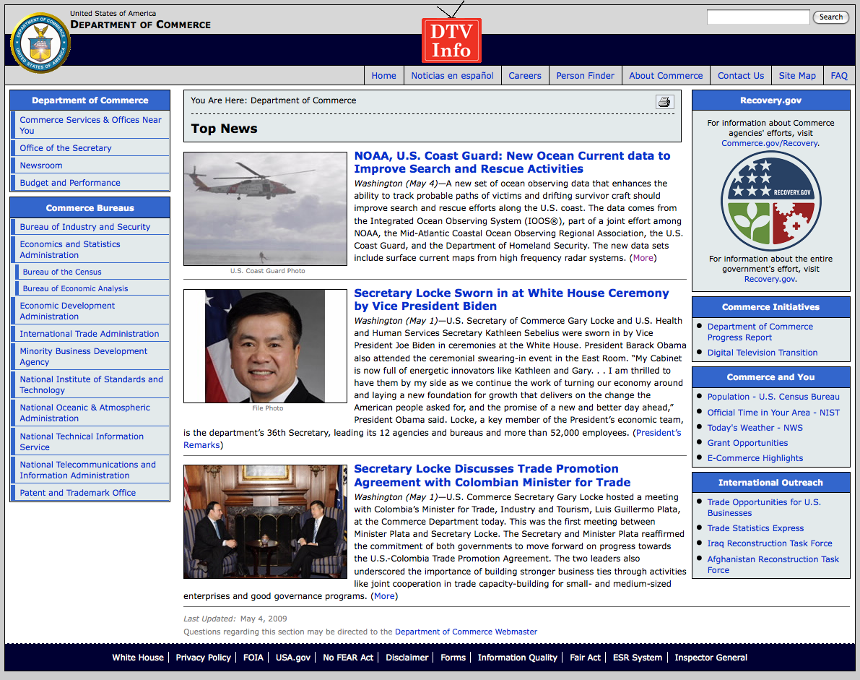
May 4, 2009: After a year of testing, NOAA Announces on
U.S. Department of Commerce Website that
MARACOOS CODAR is Operational in SAROPS
Present Activity:
Bring all
sustained regional-scale HFR networks up to operational status in USCG SAROPS
3 West Coast Regions for
California & Oregon are ready.

Slide 18
Application: Oil spill modeling

Slide 19
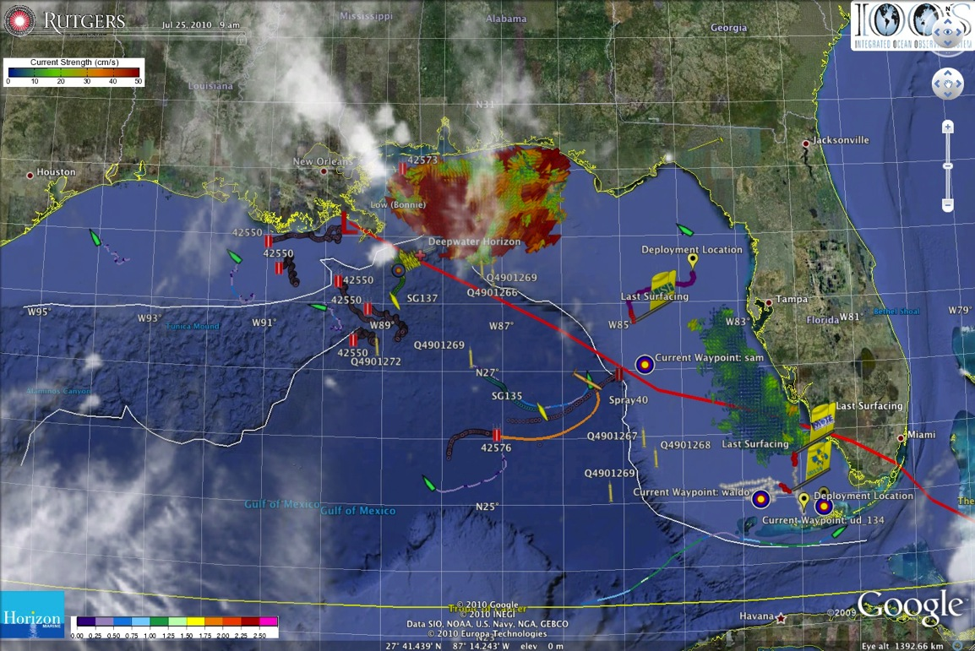
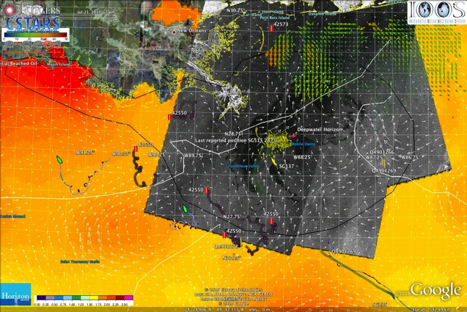
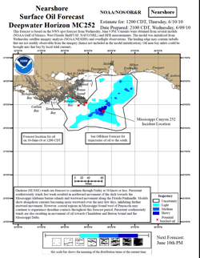
Deepwater Horizon Oil Spill: Coordinated Rapid Response
Contributed Assets:
HF Radar Networks
USF, USM
Gliders
iRobot, Mote, Rutgers,
SIO, UDel, USF, Navy
Drifters & Profilers
Horizon Marine, Navy
Satellite Imagery
CSTARS, UDel, Rutgers
Ocean Forecasts
Navy, NCSU
Data/Web Services
ASA, Rutgers, SIO
Tropical Storm Bonnie crosses the Gulf of Mexico
USM HFR
TS Bonnie
USF HFR
USM HFR validation of SABGOM Forecast
in region with satellite detected oil slicks
HFR used for Oil Slick Forecasts by NOAA/NOS/OR&R

Slide 20
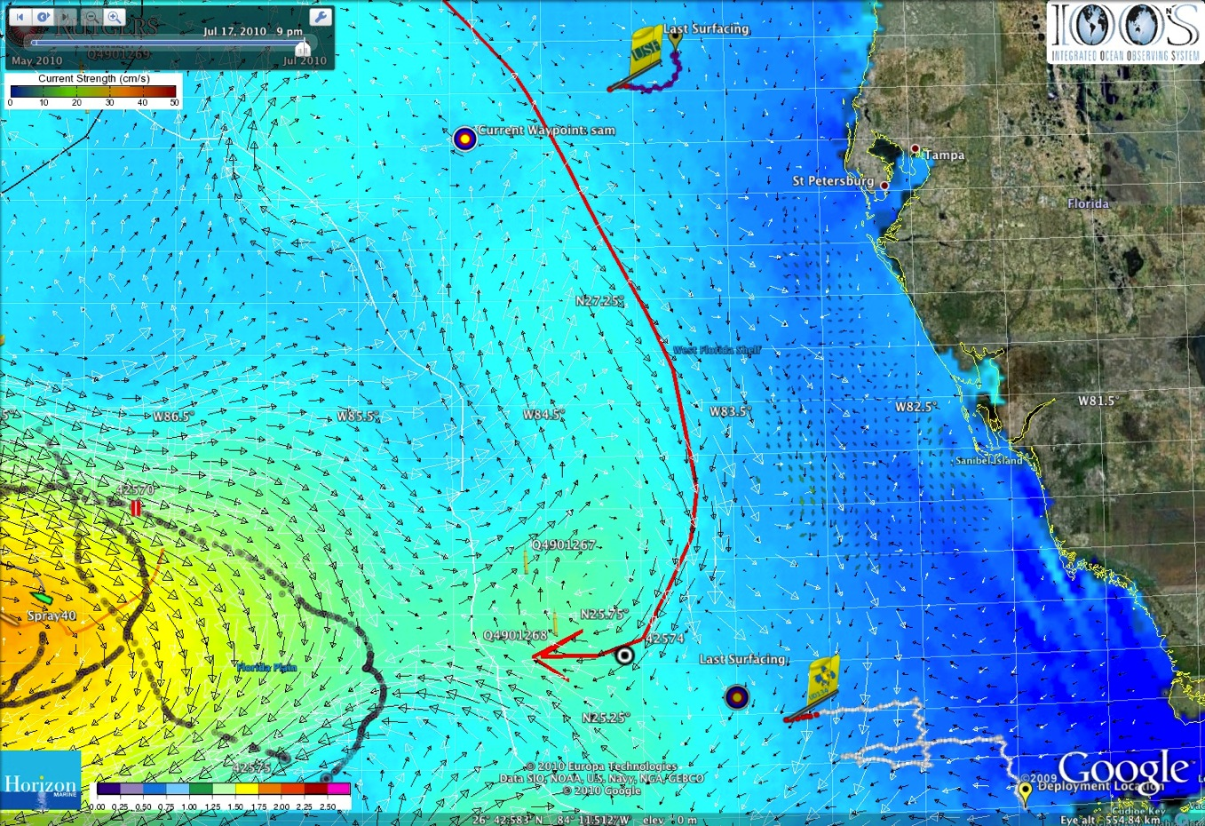
18 July 2010 Blog Entry - 2010-2020: The Ocean Forecasting Decade
White Arrows – HyCOM
Black Arrows - SABGOM

Slide 21
18 July 2010 Blog Entry - 2010-2020: The Ocean Forecasting Decade
White Arrows – HyCOM
Black Arrows - SABGOM

Slide 22
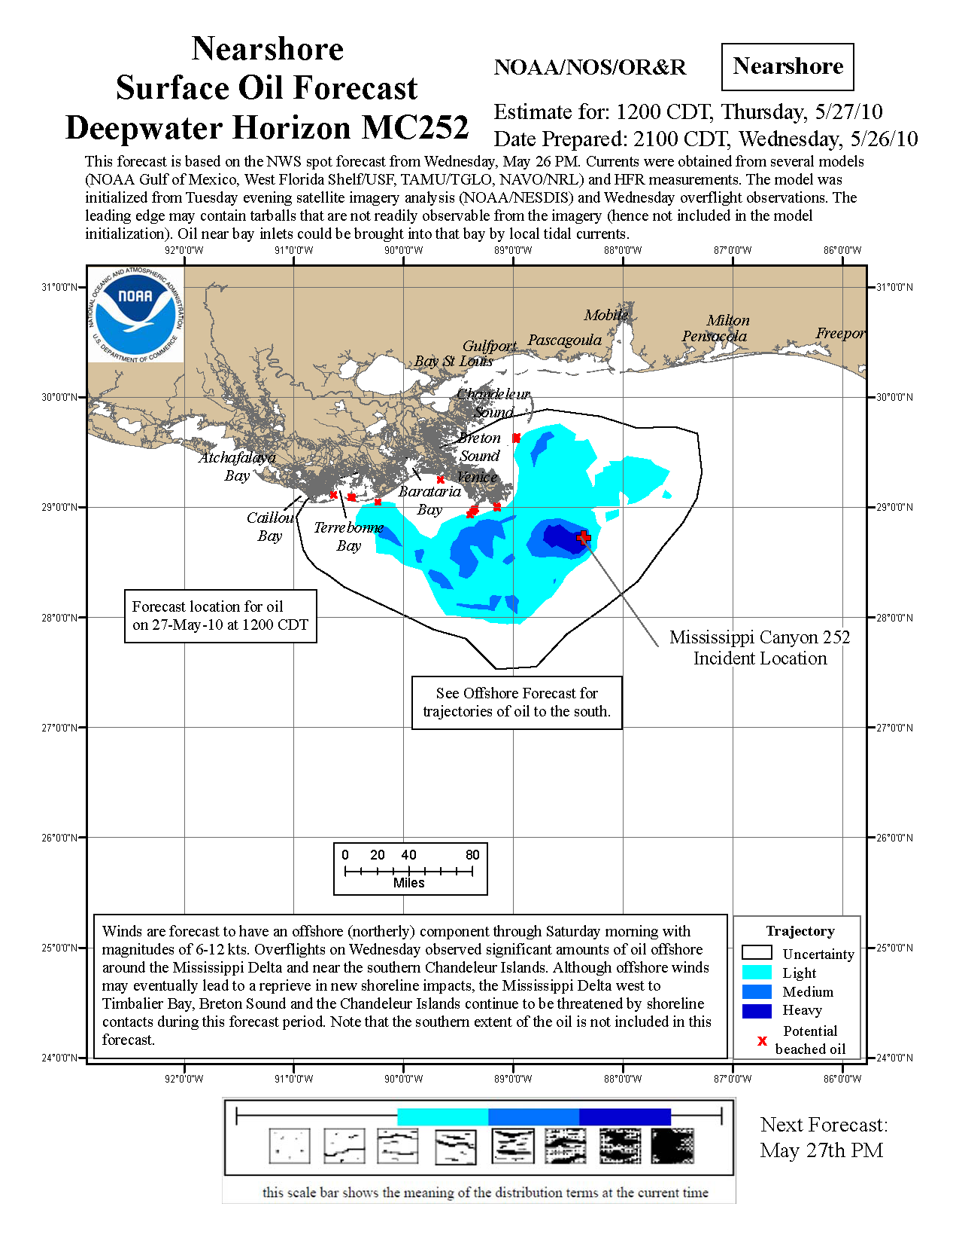
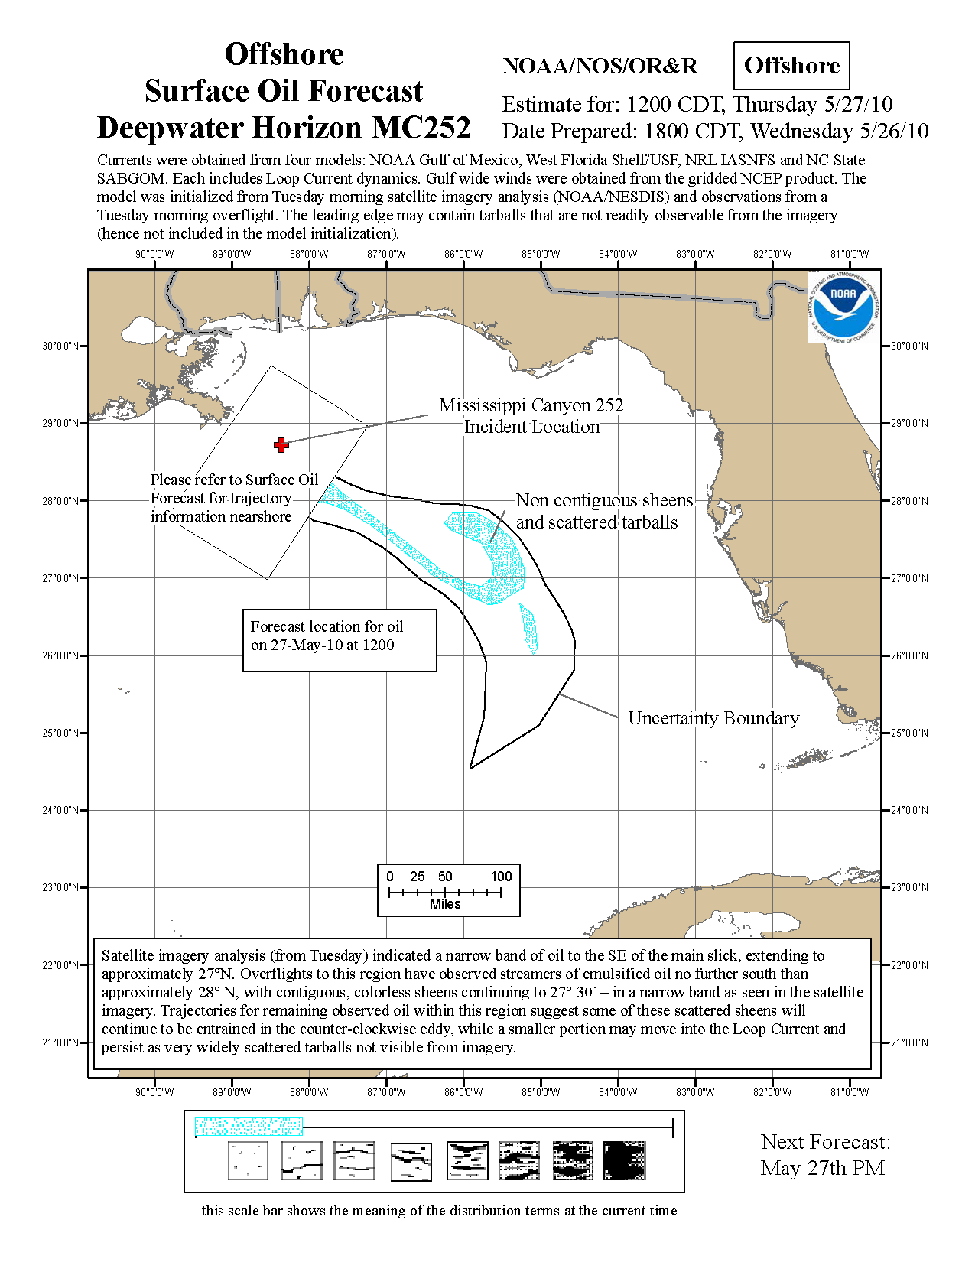
Oil Spill Status : NOAA Guidance

Slide 23
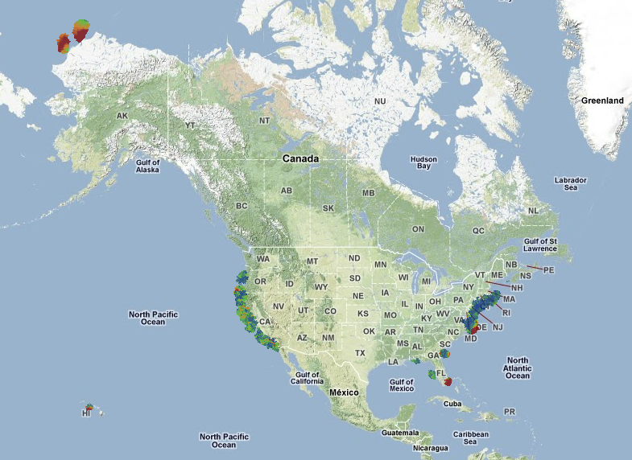
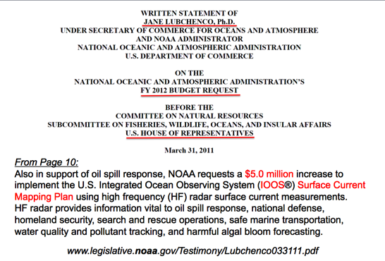
U.S. National HF Radar Network
$5 M First Year Investment
$20 M/Year for 5 Years for Full Buildout
Summer
2011 Coverage
131 Radars

Slide 24
Application: vessel detection

Slide 25
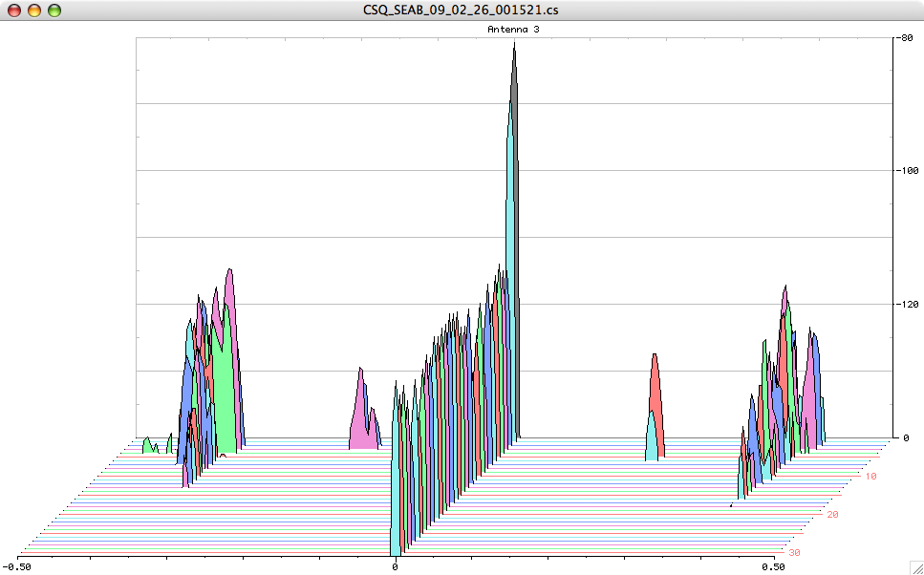
Doppler Spectra from all Range Cells
with Detection Threshold above Background Applied
Fixed Objects & Direct Signals
Bragg Waves
Bragg Waves
Vessel
Vessel
Range
Doppler Frequency
(Target Speed)

Slide 26
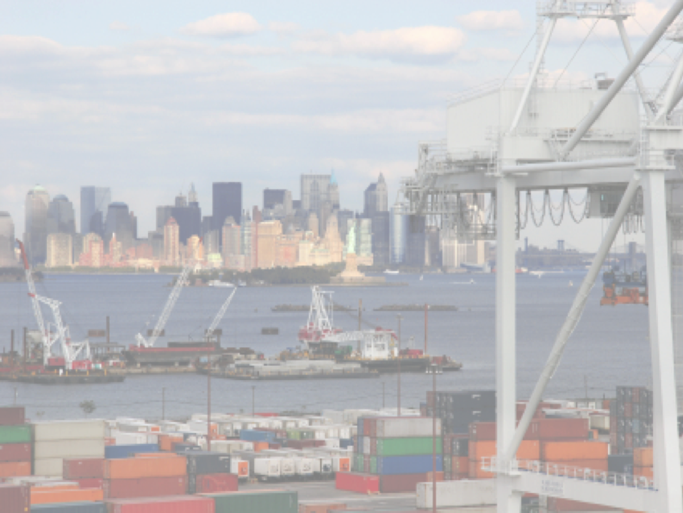
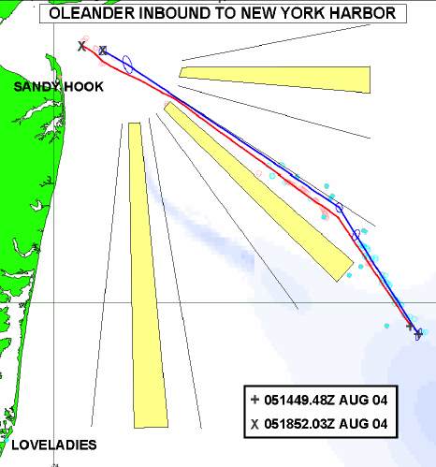
The Center for Secure and Resilient Maritime Commerce (CSR)
HF Radar Team
Rutgers University -
Scott Glenn, Josh Kohut, Hugh Roarty,
Mike Crowley, John Kerfoot, Ethan
Handel, Mike Smith, Colin Evans
CODAR Ocean Sensors -
Don Barrick, Pete Lilleboe, Chad Whelan
Belinda Lipa, Bill Rector, Jimmy Isaacson
University or Puerto Rico – Mayaguez
Jorge Corredor, Julio Morell, Miguel Canals
Applied Mathematics, Inc -
Bill Browning
University of Alaska – Fairbanks
Tom Weingarter, Hank Statscewich
Ocean Power Technologies –
Debbie Montagna, Bruce Downie
Naval Research Laboratory
Michael Lovellette, Dan Newton
Norwegian Defence Research Establishment (FFI)
Terje Johnsen, Walther Asen
CODARNor
Anton Kjelaas
Rutgers University – CODAR Ocean Sensors
Academic – Industry Partnership since 1998
ONR - 2004
27 Researchers @ 9 Institutions

Slide 27
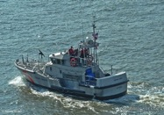
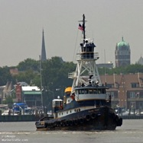
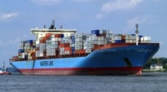
Vessel Detection Capability
25 MHz
Range: 11 nmi
Height >10 ft
13 MHz
Range: 43 nmi
Size: >19 ft
05 MHz
Range: 65 nmi
Size: >49 ft

Slide 28
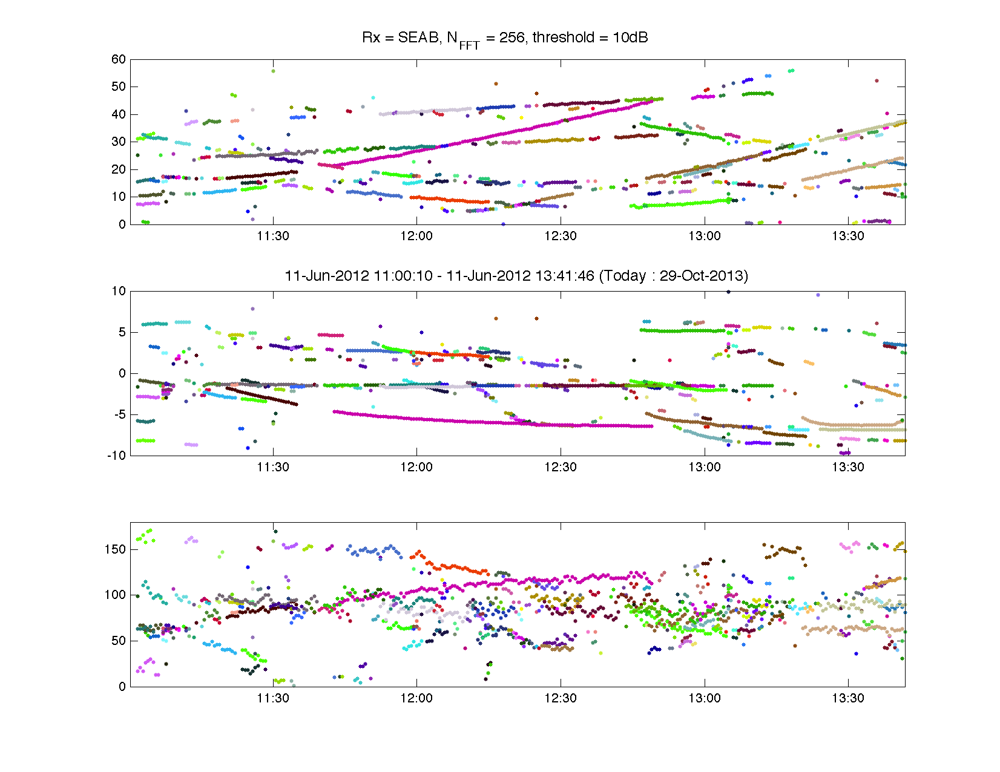
Step 1 Detection:
Range (km)
Radial Velocity (m/s)
Bearing (°CWN)

Slide 29
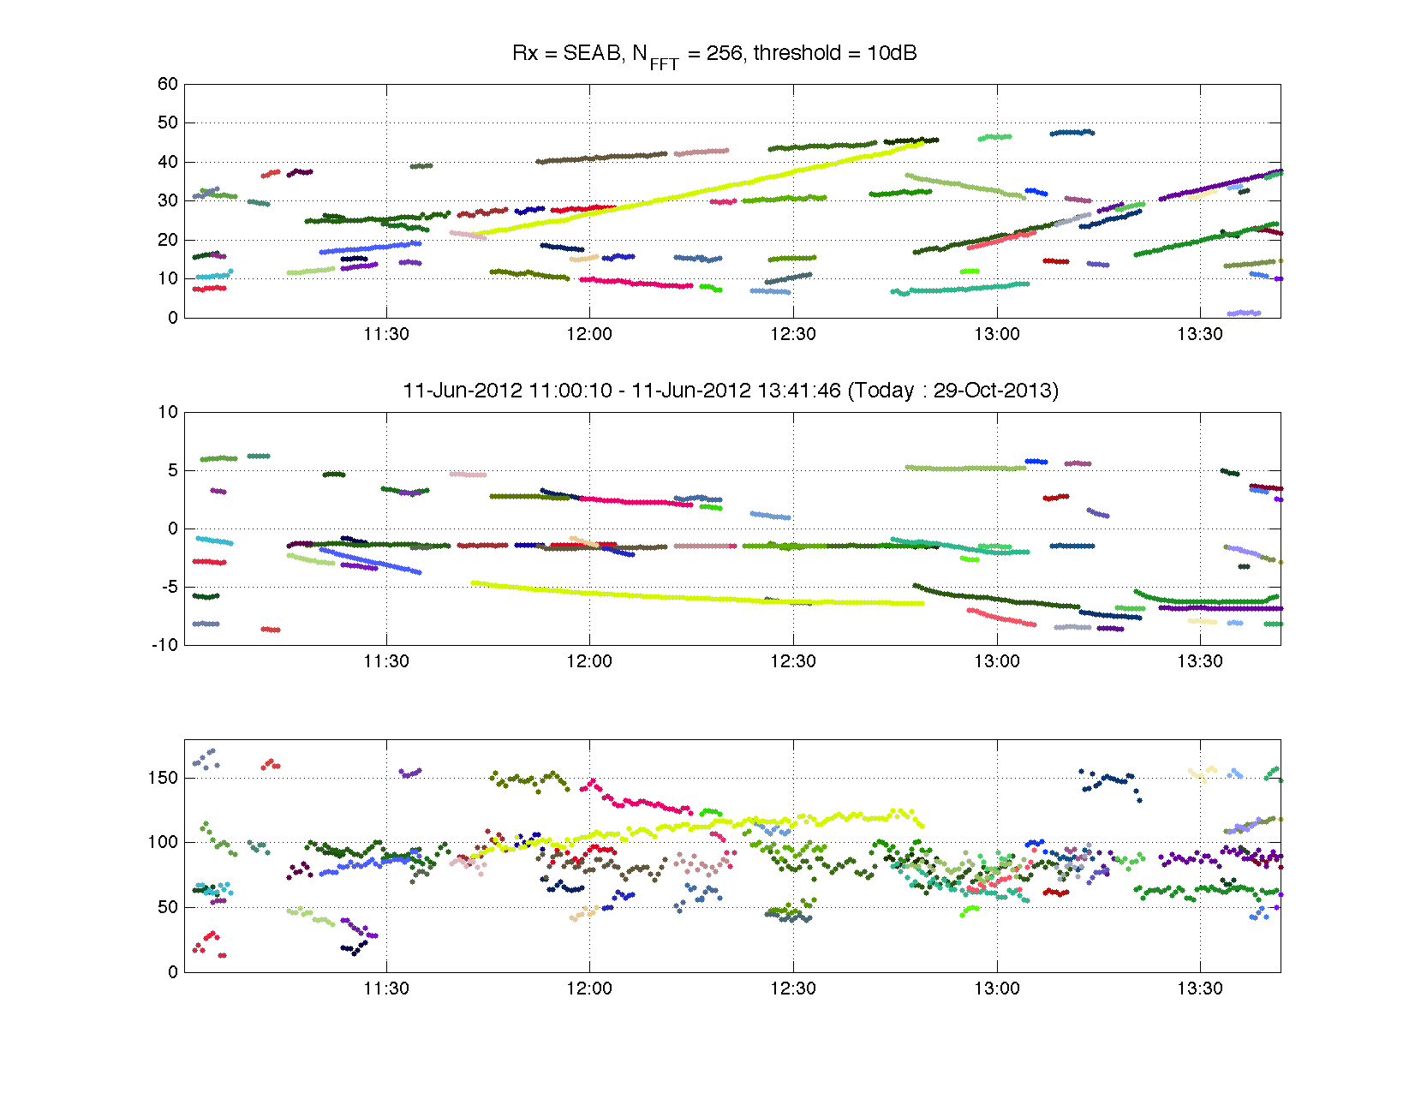
Step 1 Detection:
Range (km)
Radial Velocity (m/s)
Bearing (°CWN)

Slide 30
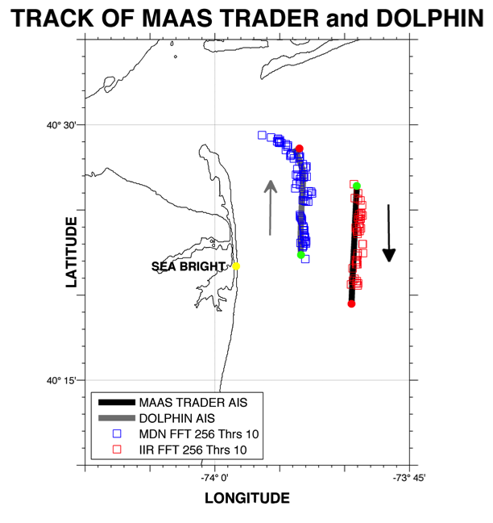
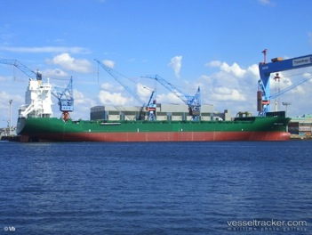
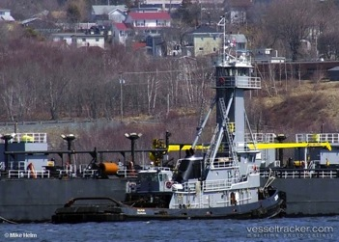
Step 2 Association:
MAAS TRADER
DOLPHIN

Slide 31
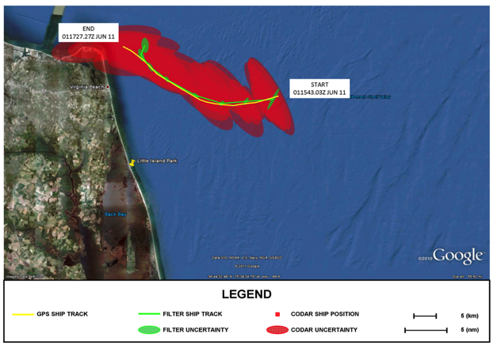
Step 3 Track Fitting: M/V Victorius
M/V VICTORIOUS: GPS Track, CODAR Data, and Ship Tracker Solution with Uncertainty Ellipses

Slide 32
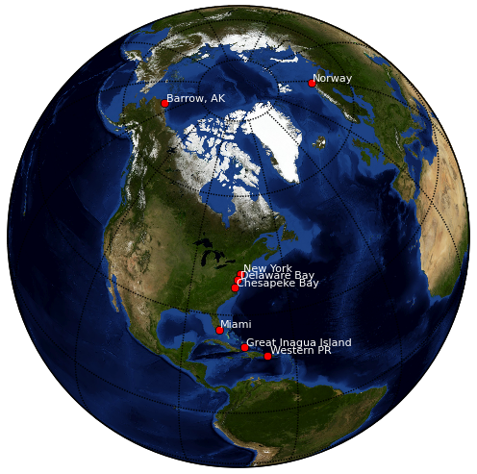
Vessel Tracking
Research Areas
Current Testbeds
New York Harbor
Delaware Bay
Chesapeake Bay
Port of Miami
Western Puerto Rico
Barrow Alaska
Proposed Testbeds
Great Inagua
Norway
San Diego

Slide 33
HF Radar Alaska
Alaska

Slide 35
Bistatics for Vessel Detection

Slide 36
HF Radar Bistatic Transmitters – Extending Range & Number of Look Angles
On Buoys On Ships On Shore

Slide 37
Monostatic Detections

Slide 38
Bistatic Detections

Slide 39
SEAB – Monostatic
SEBE – Bistatic
Rx SEAB
Tx BELM
SPRK – Monostatic

Slide 40
Detections by a Network of Radars
Tokyo Express
November 23, 2013
15:30 – 18:30
Red – AIS
Blue – Radar

Slide 41
Implementation of a National Dual-Use High Frequency Radar Network

