Slide 1
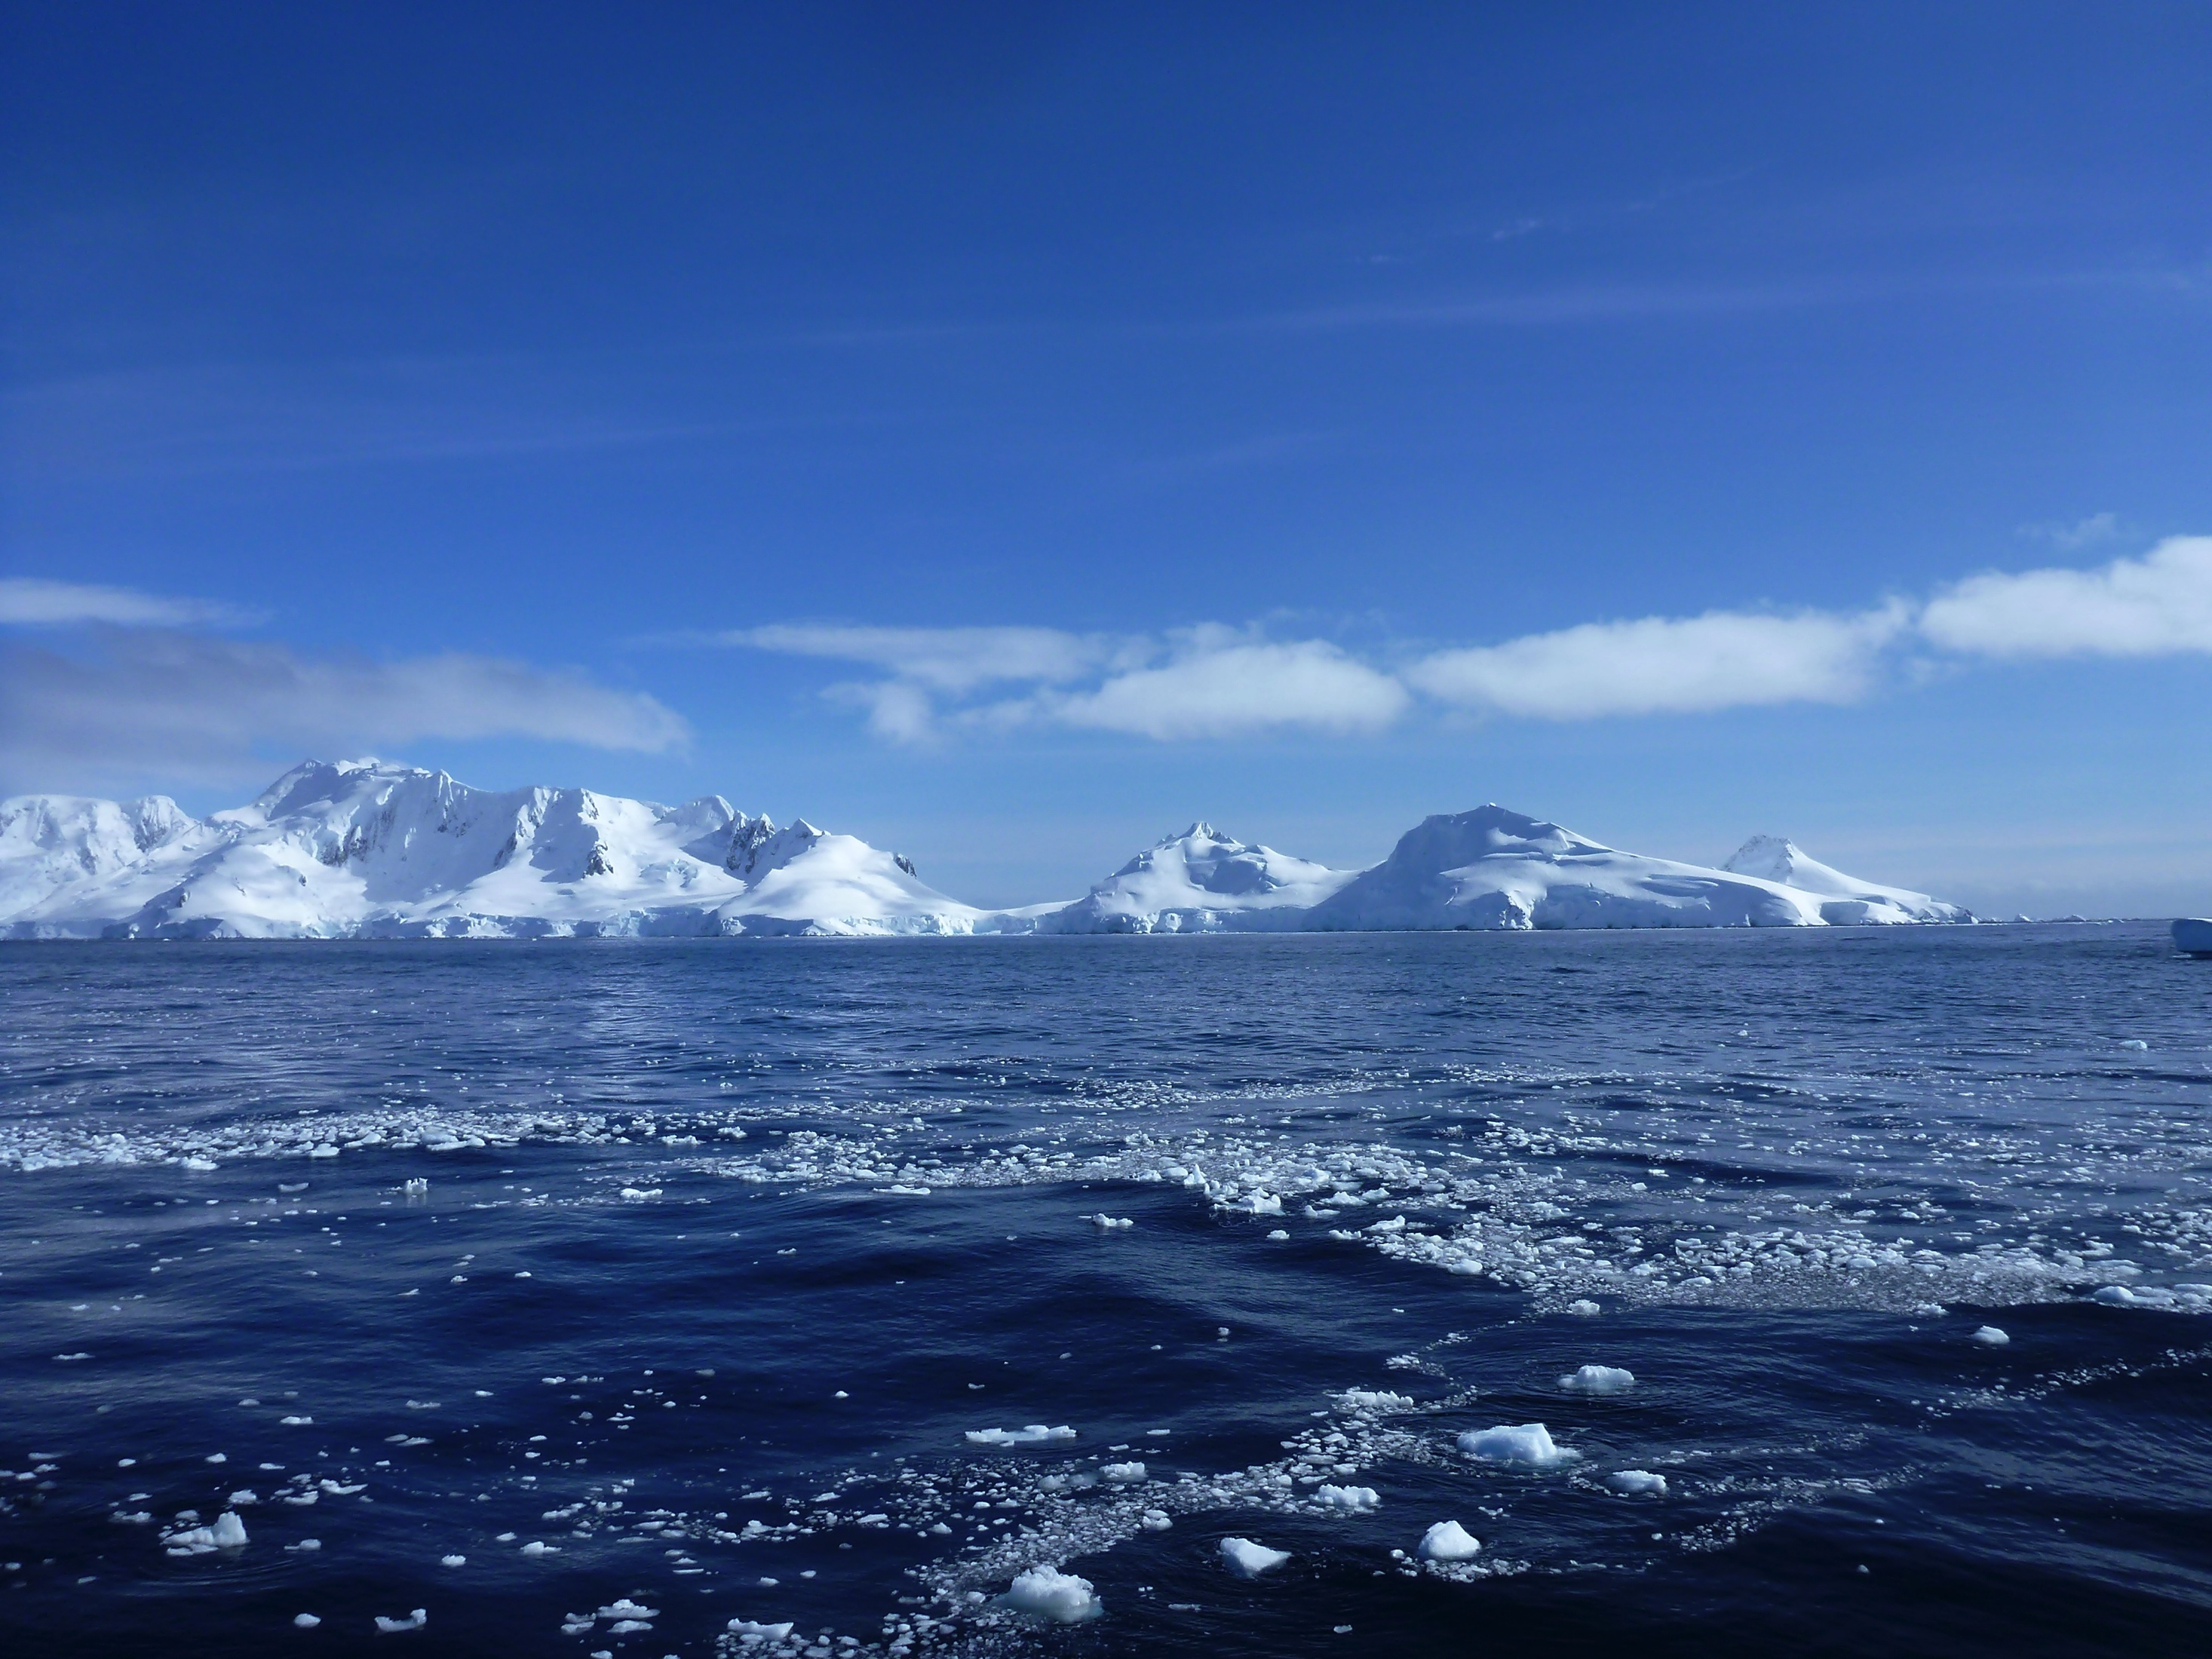
Warm water intrusions onto the continental shelf of the West Antarctic Peninsula
Nicole Couto
PhD Thesis Proposal
12 December 2014
Department of Marine and
Coastal Sciences
Rutgers University
Thesis committee:
Oscar Schofield
Josh Kohut
Bob Chant
Doug Martinson (LDEO)

Slide 2
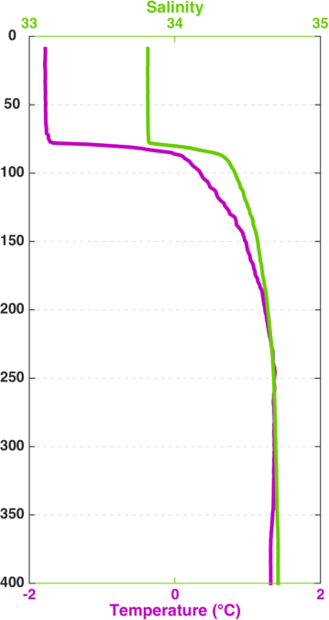
Seasonal changes in water column structure
Winter
(June 1999)

Slide 3
Seasonal changes in water column structure
Surface water cools and gets salty
Winter
(June 1999)

Slide 4
Seasonal changes in water column structure
Surface water cools and gets salty
Water is warmer and saltier at depth
Winter
(June 1999)

Slide 5
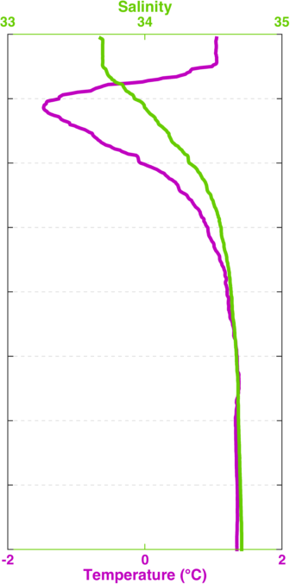
Seasonal changes in water column structure
Surface water warms and freshens
Surface water cools and gets salty
Water is warmer and saltier at depth
Winter
(June 1999)
Summer
(January 2000)

Slide 6
Seasonal changes in water column structure
Surface water warms and freshens
Surface water cools and gets salty
Cold winter water lingers at mid depths
Water is warmer and saltier at depth
Winter
(June 1999)
Summer
(January 2000)

Slide 7
Seasonal changes in water column structure
Surface water warms and freshens
Surface water cools and gets salty
Cold winter water lingers at mid depths
Water is warmer and saltier at depth
Water is warmer and saltier at depth
Winter
(June 1999)
Summer
(January 2000)

Slide 8
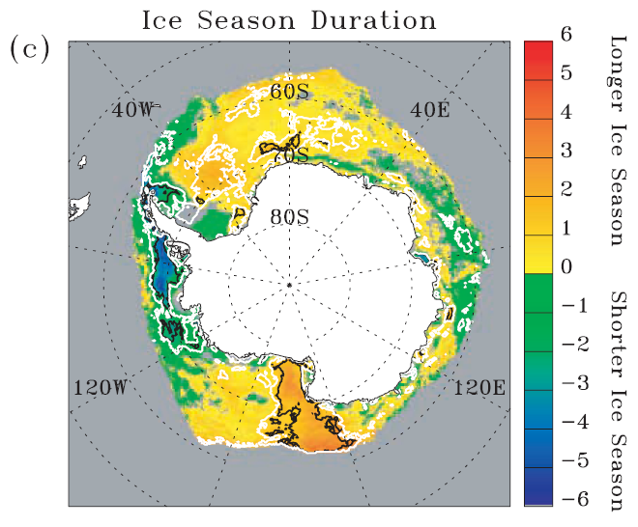
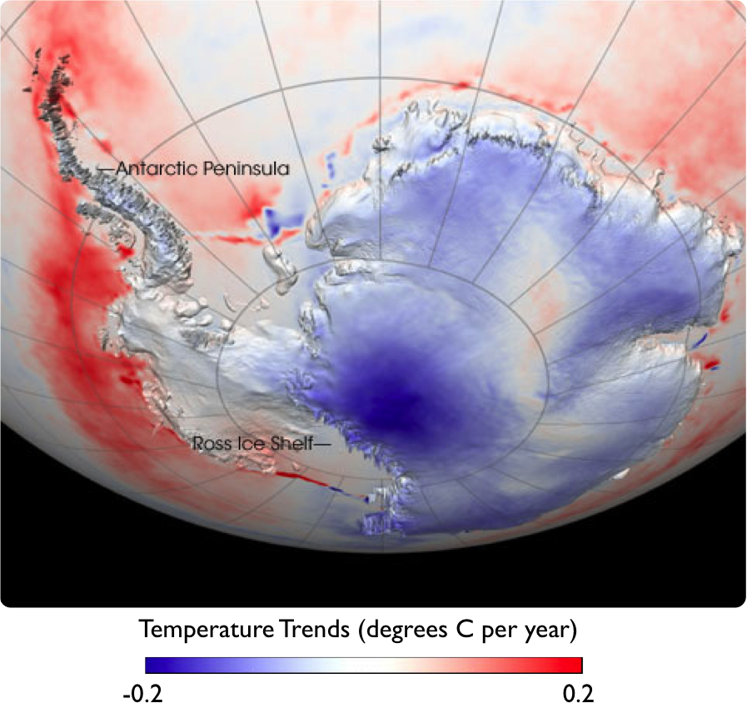
West Antarctic Peninsula is warming and losing ice
60-106 days
shorter
(1979 – 2006)
Ray Smith, Stammerjohn 2008

Slide 9
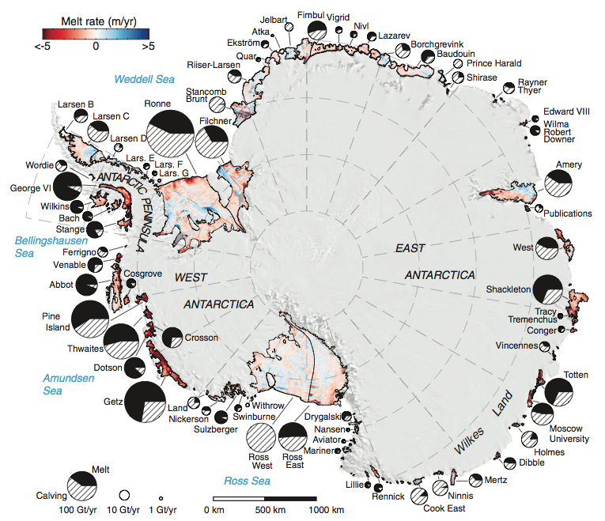
West Antarctic Peninsula is warming and losing ice
Ray Smith, Rignot 2013

Slide 10
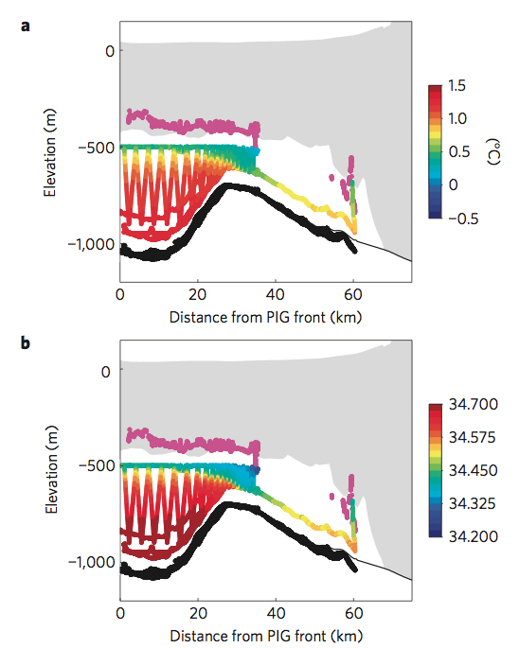
West Antarctic Peninsula is warming and losing ice
Jenkins 2010, Rignot 2013

Slide 11
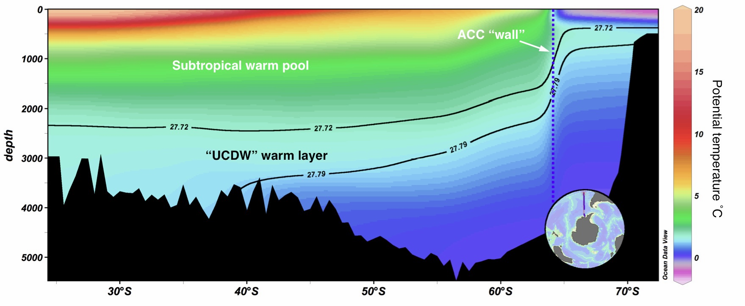
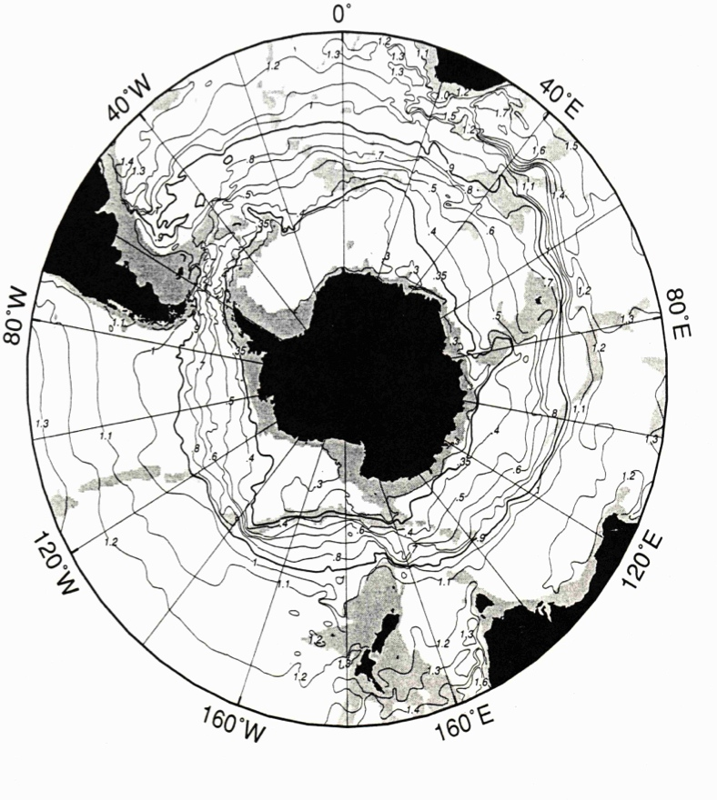
Water masses in the ACC contain more heat
than those on the WAP
Circumpolar Deep Water
Pacific Deep Water

Slide 12
The westerlies drive a northward Ekman transport
Circumpolar Deep Water
Pacific Deep Water

Slide 13
Isopycnals are lifted in response to surface transport
Circumpolar Deep Water
Pacific Deep Water

Slide 14
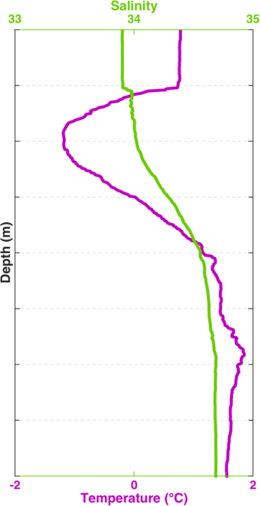
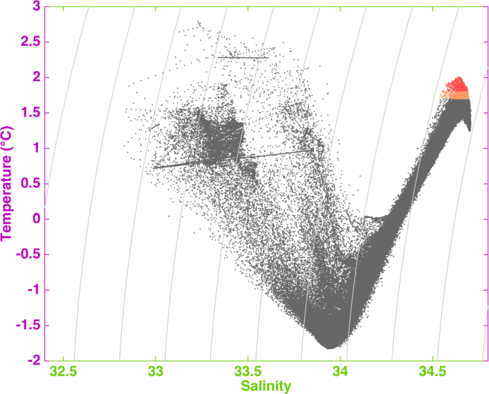
How do we identify Upper Circumpolar Deep Water?
AASW
WW
UCDW
AASW
UCDW
WW

Slide 15
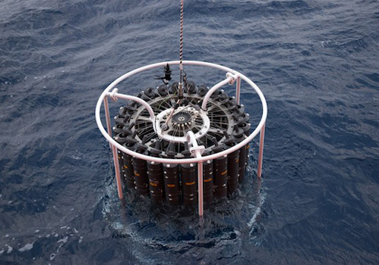
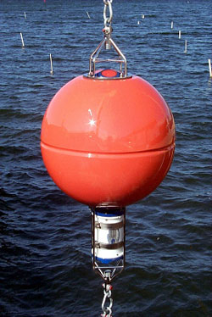
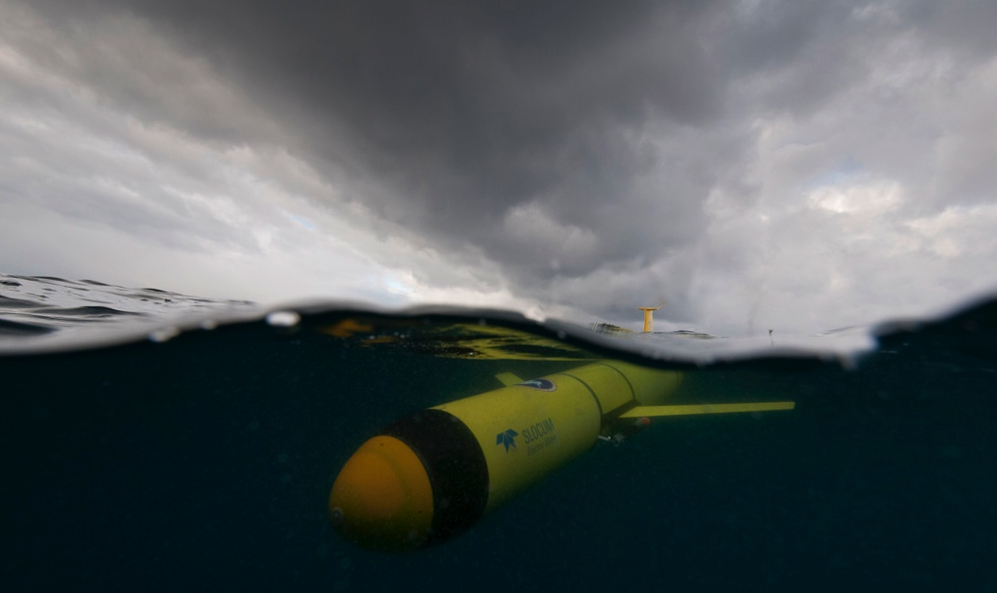
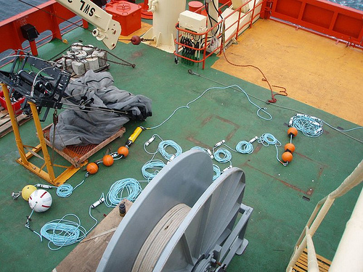
How do we identify Upper Circumpolar Deep Water?

Slide 16
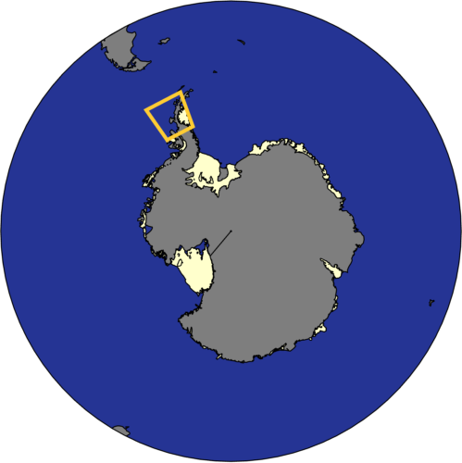
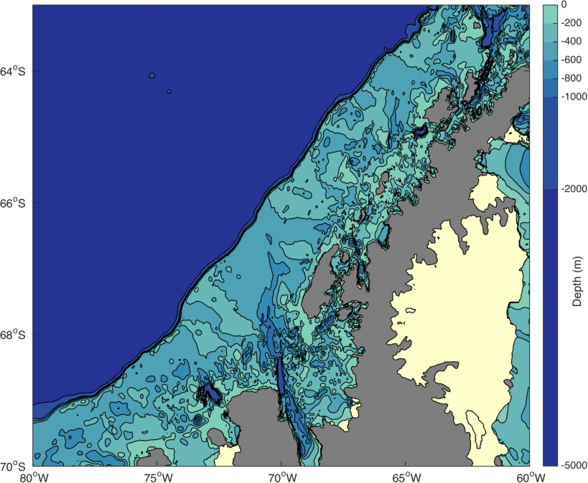
The West Antarctic Peninsula (WAP)
Palmer Deep
Palmer Station
(Anvers Island)
Marguerite Bay
Antarctic Peninsula
Ice Shelf
Rothera
(Adelaide Island)

Slide 17
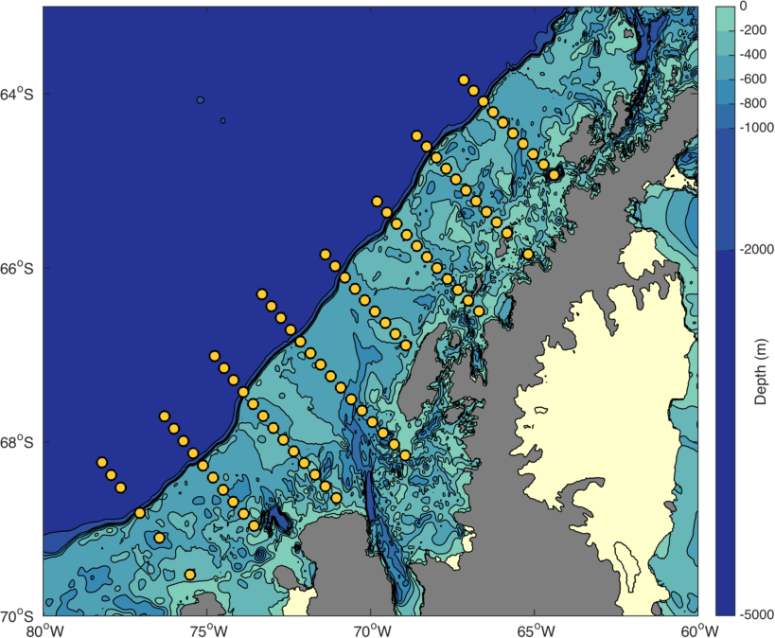
The West Antarctic Peninsula (WAP)
600
500
400
300
200
Antarctic Peninsula
100
0
Ice Shelf
-100

Slide 18
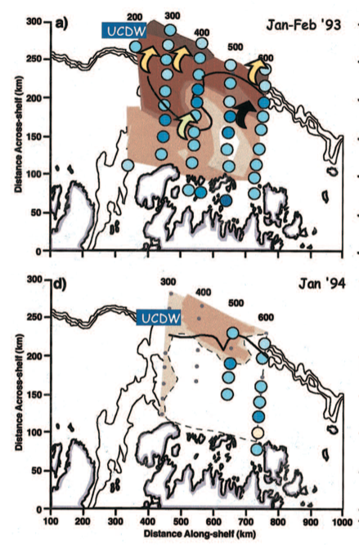
High productivity is associated with UCDW intrusions
600
500
400
300
200
Prezelin 2004

Slide 19
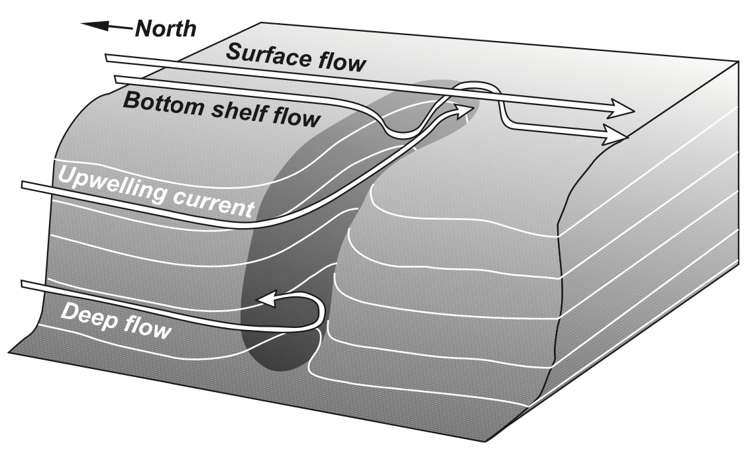
Canyon flow during upwelling events
Allen 2001

Slide 20
Canyon flow during upwelling events
Allen 2001

Slide 21
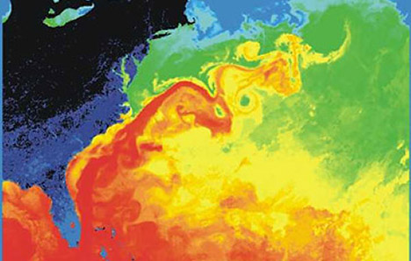
Sub-surface eddies may
contribute significantly to heat flux

Slide 22
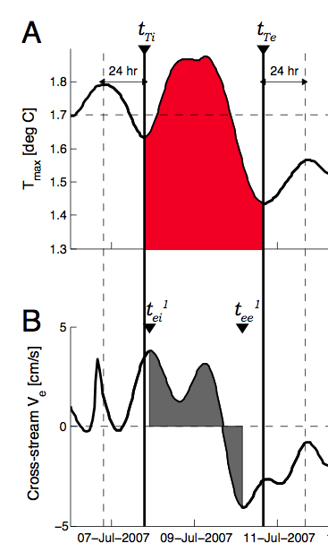
Sub-surface eddies may
contribute significantly to heat flux

Slide 23
Sub-surface eddies may
contribute significantly to heat flux
Martinson and McKee 2012

Slide 24
Sub-surface eddies may
contribute significantly to heat flux
Martinson and McKee 2012

Slide 25
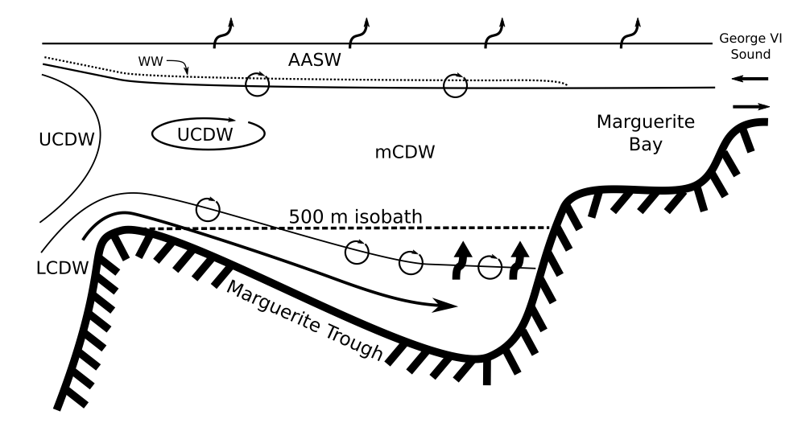
Sub-surface eddies may
contribute significantly to heat flux
Moffat 2009

Slide 26
Driving questions:
Where does heat intrude onto the continental shelf of the west Antarctic Peninsula?
What is the flux of heat onto the continental shelf of the west Antarctic Peninsula?
How much heat is mixed/diffused into the surface water?
What effect do canyons have on the delivery of UCDW to the surface?

Slide 27
Chapter 1
Distribution of UCDW on the shelf

Slide 28
Chapter 1
What is the likelihood of finding UCDW in different parts of the shelf?
What are the spatial scales of UCDW intrusions?
How much heat is carried in pure UCDW intrusions?

Slide 29
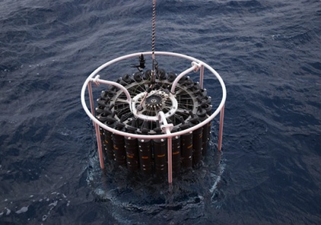
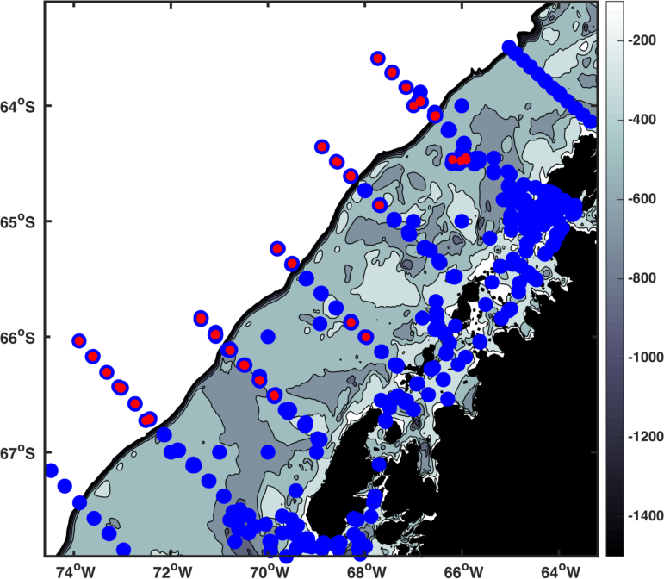
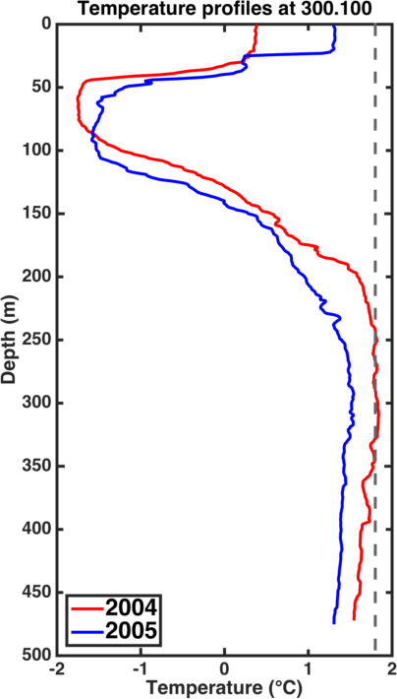
20 years of CTD data

Slide 30
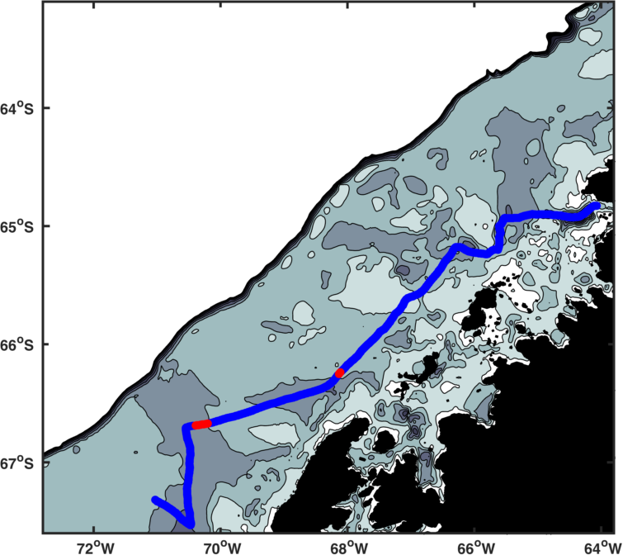
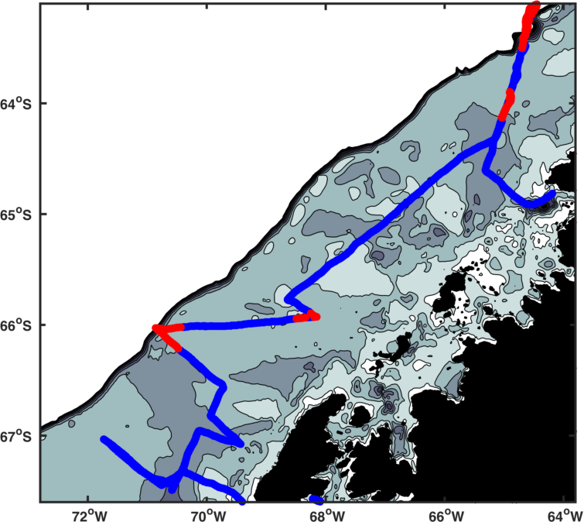
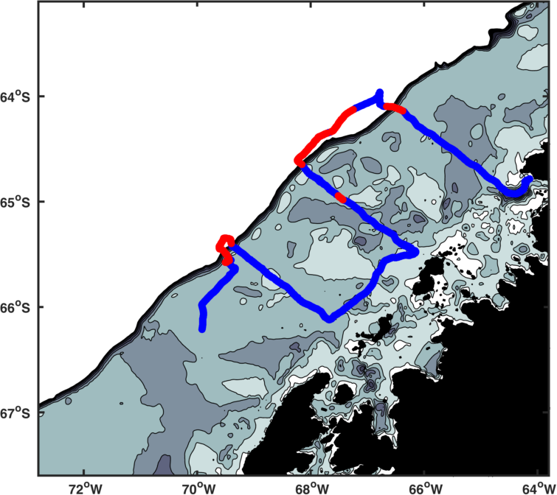
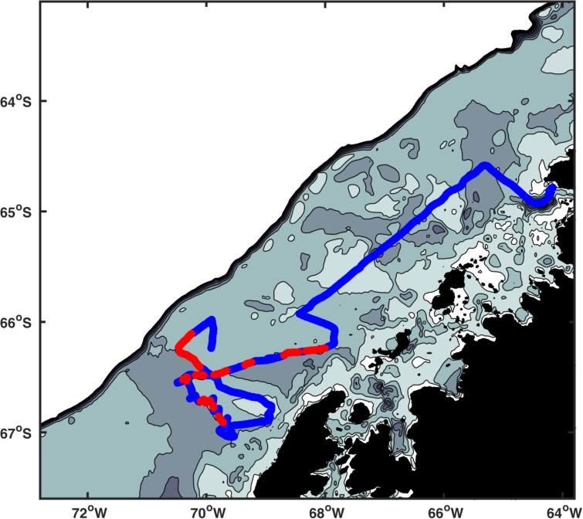
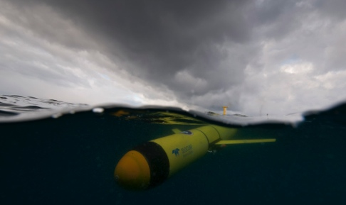
4 glider deployments
2010/11
2011/12
2012/13
2012/13

Slide 31
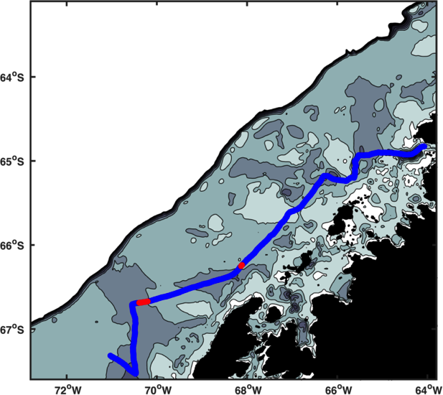
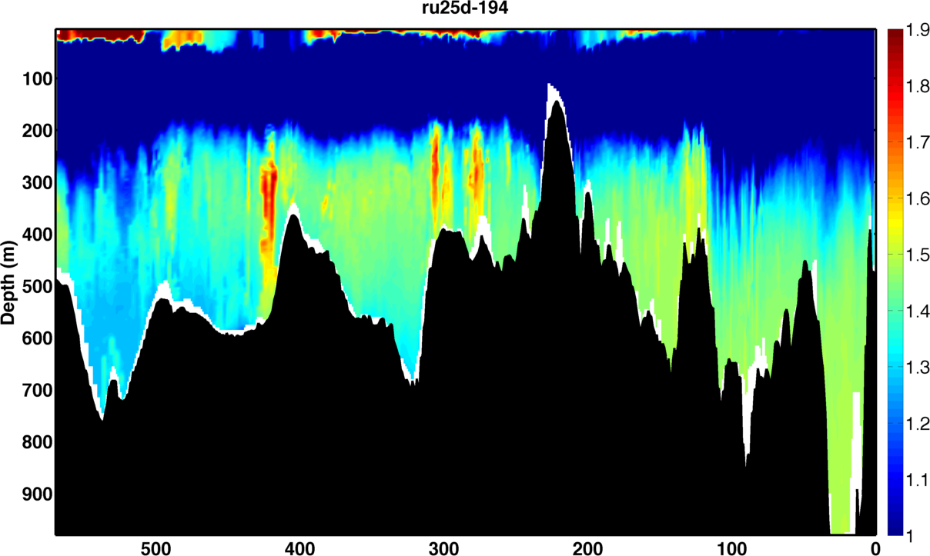
Packets of pure UCDW are on the shelf
Temperature
The Pioneer
Distance (km)

Slide 32
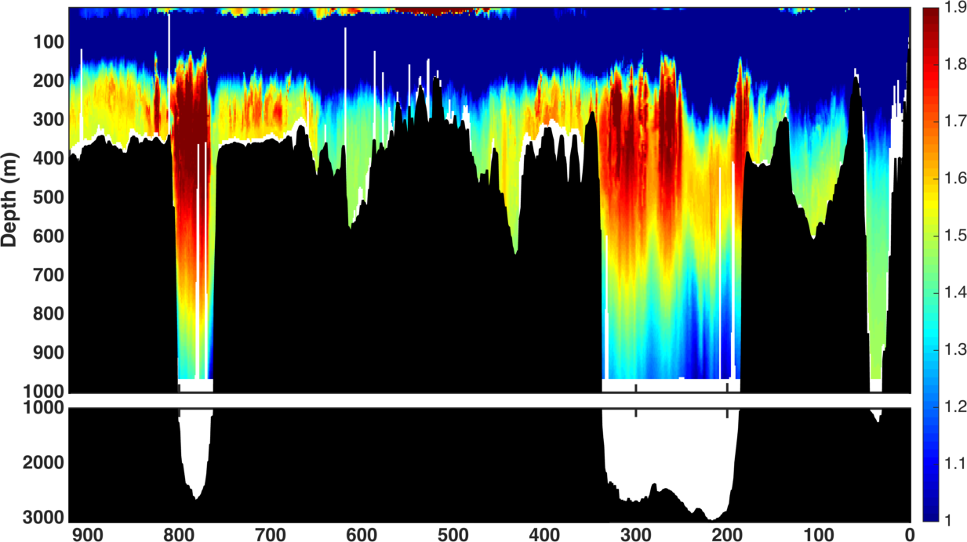
Packets of pure UCDW on the shelf … and off
Temperature
2 panels
Track Distance (km)
Distance (km)

Slide 33
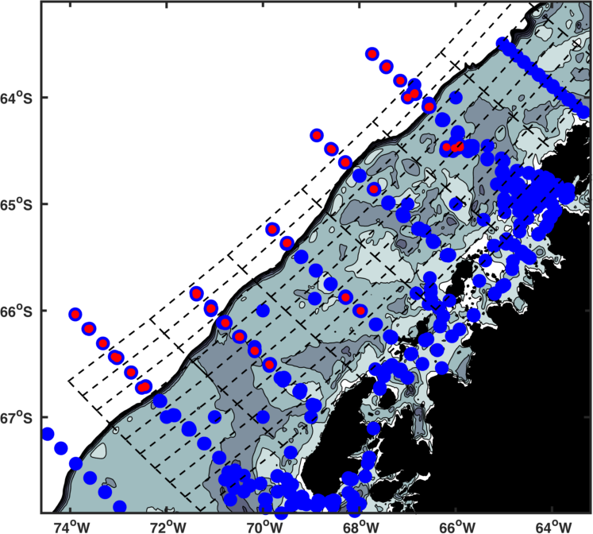
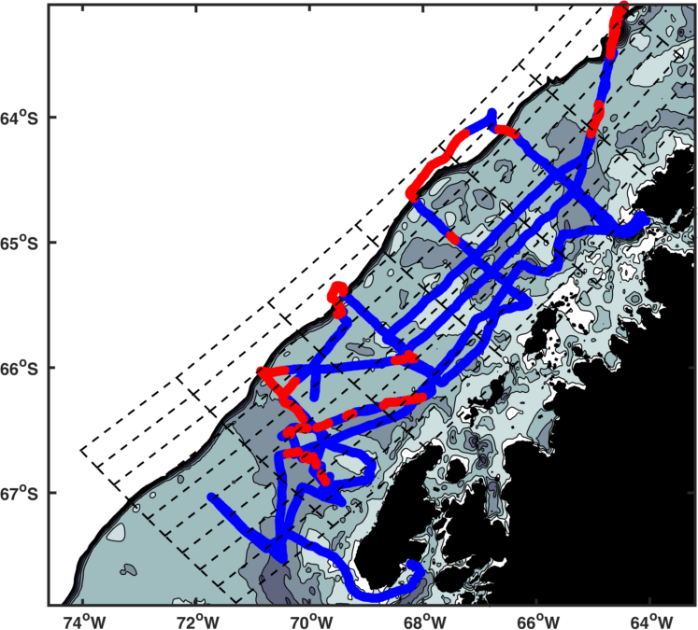
What are the spatial trends in UCDW on the shelf?
20 years of CTD sampling
4 glider deployments

Slide 34
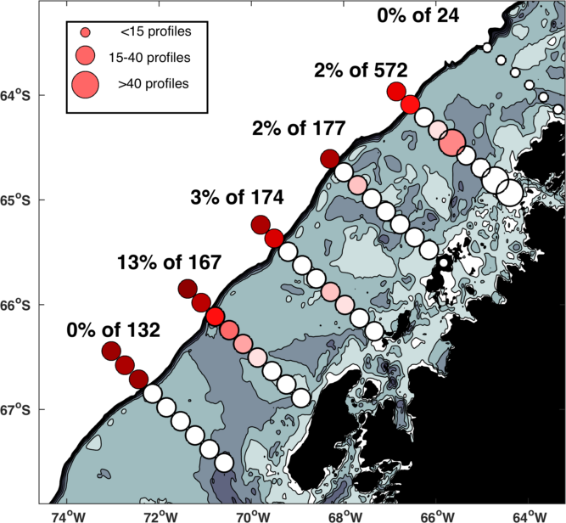
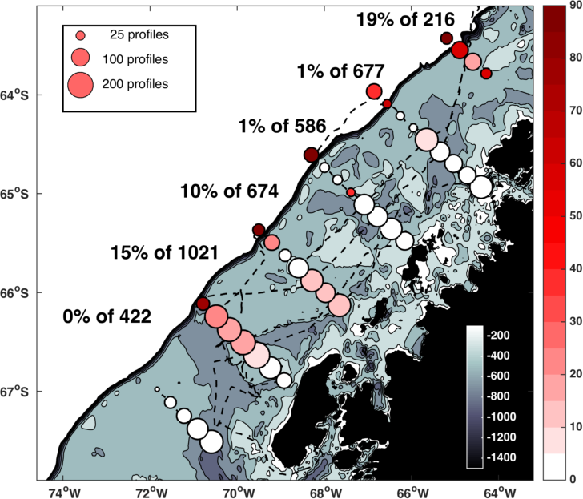
Spatial patterns are similar in CTD and glider datasets
20 years of CTD sampling
4 glider deployments

Slide 35
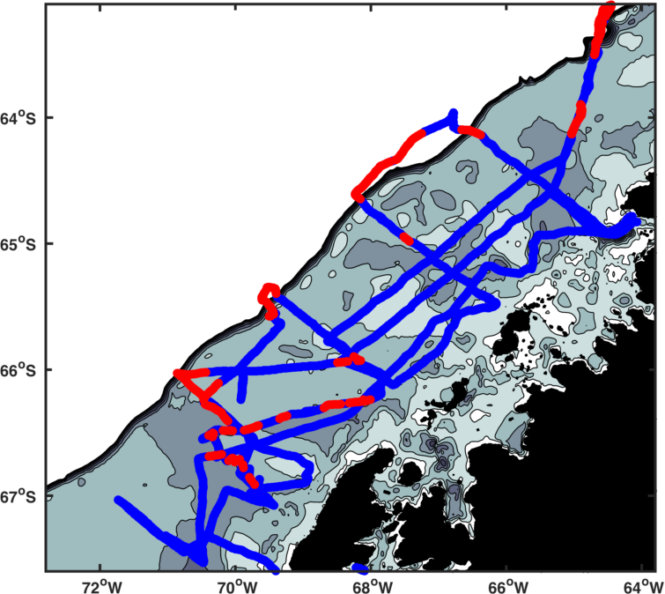
How do UCDW features change
across the shelf?
How does the width change?
How does the height change?
?
How does the heat content change?
?

Slide 36
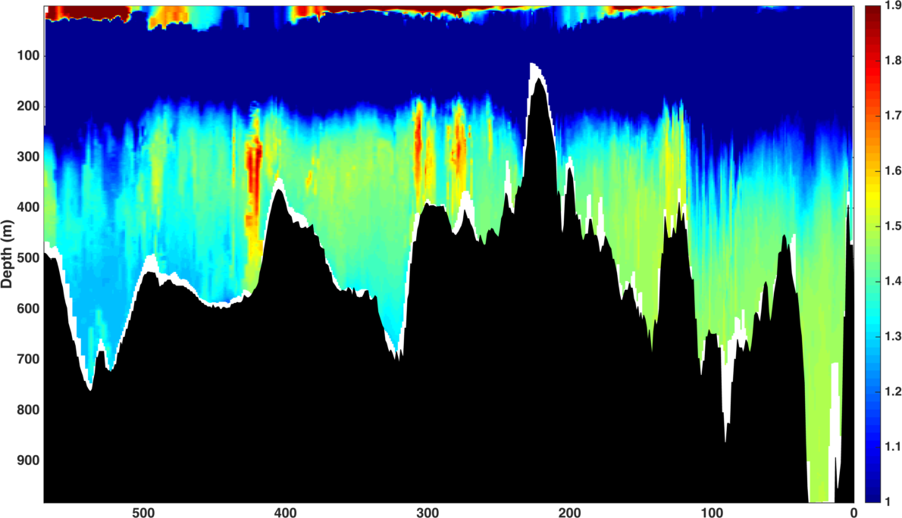
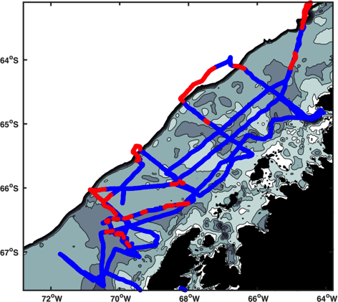
Measuring width
Temperature (°C)
Distance (km)

Slide 37
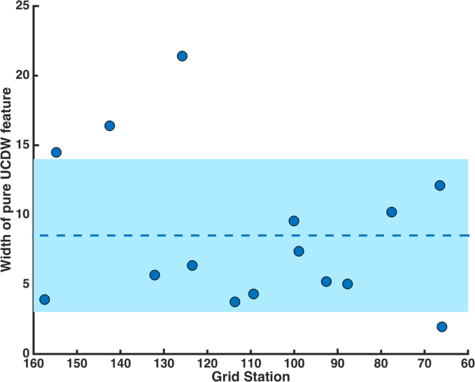
How does the width change?
Shelf break
Coast

Slide 38
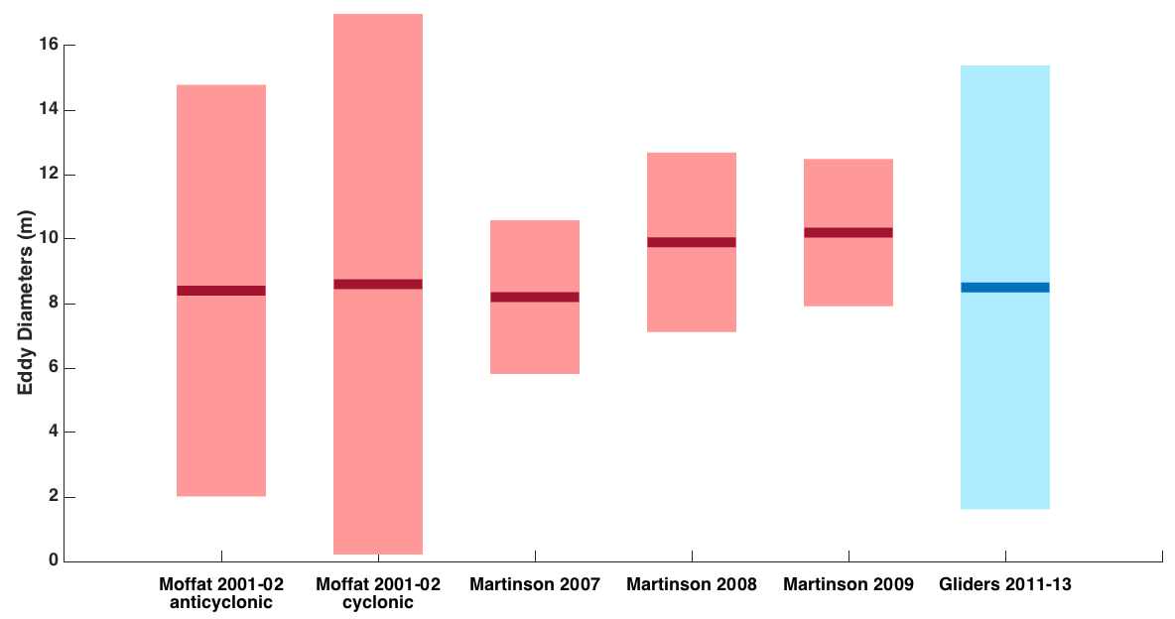
The width of the packets is consistent
with the diameter of eddies
Moffat 2009, Martinson 2012

Slide 39
Measuring height
Temperature (°C)
Distance (km)

Slide 40
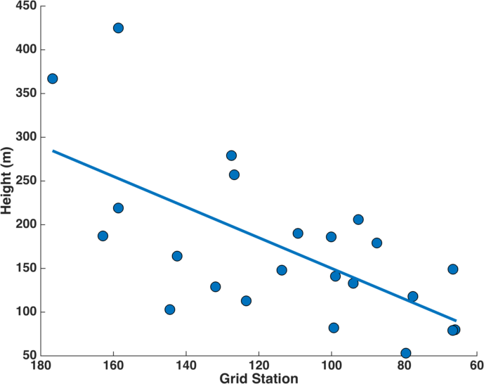
How does the height change?
Shelf break
Coast

Slide 41
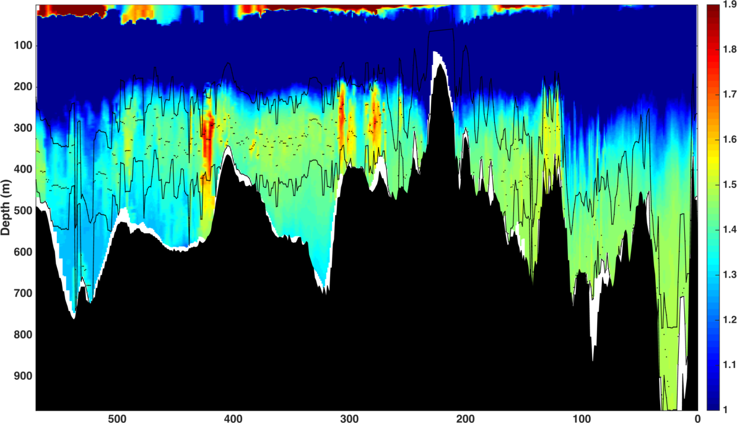
How does heat change?
Temperature (°C)
Distance (km)

Slide 42
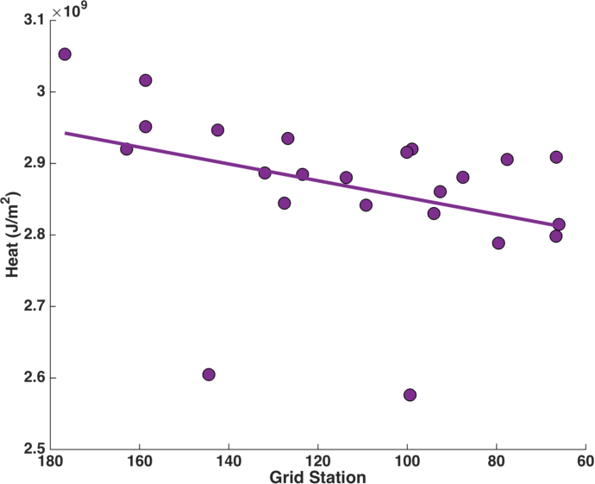
How does heat change?

Slide 43
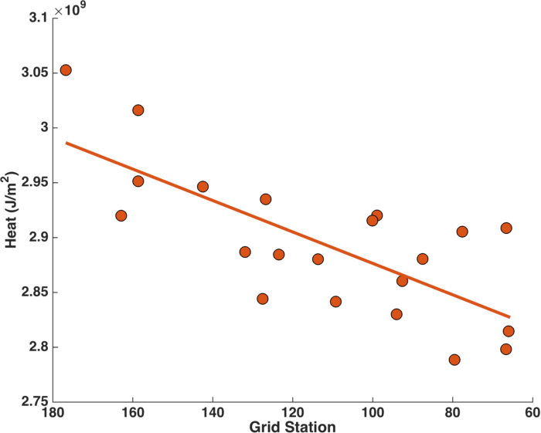
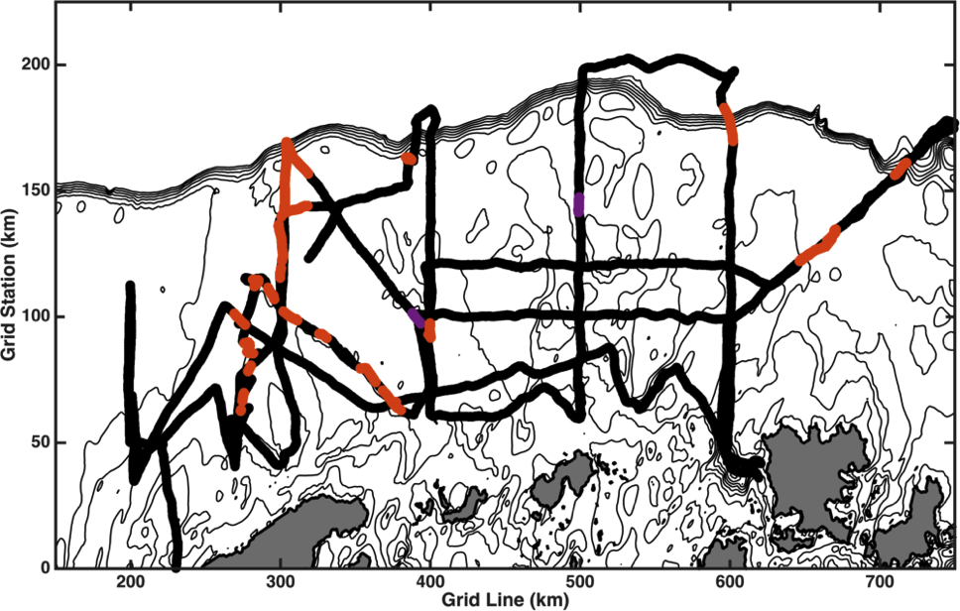
How does heat change?

Slide 44
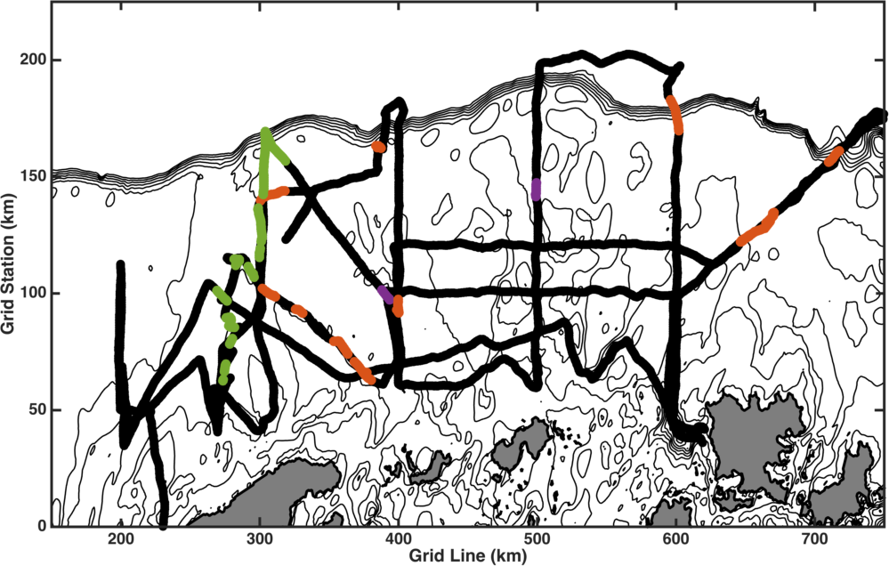
Track the heat along Marguerite Trough

Slide 45
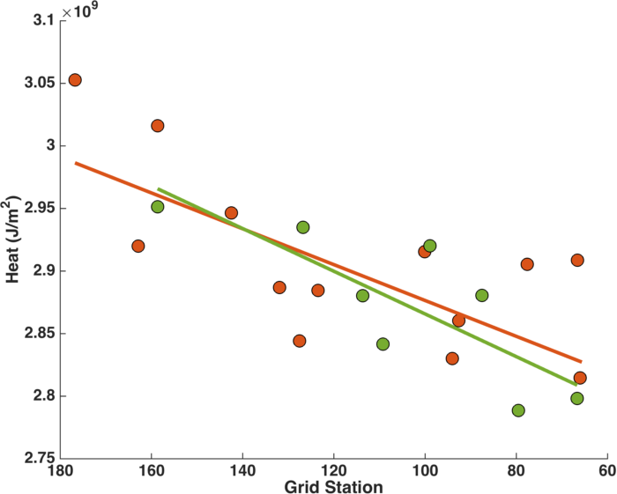
Heat appears to decrease at a consistent
rate across the shelf

Slide 46
Heat decreases as height decreases

Slide 47
What are the spatial trends in UCDW on the shelf?
Width doesn’t change much
Height decreases
?
Heat decreases
?

Slide 48
Chapter 2
Shelf circulation and heat transport

Slide 49
Chapter 2
What effect does the shelf circulation have on heat transport?
What is the heat flux carried by pure UCDW features?

Slide 50
Heat flux from shipboard data
Savidge 2009
Notes:
Fig. 2. Data coverage for the study period. Panel a: cruise tracks from the R/V Gould in green/gray and from the R/V Palmer in blue/black, in color/grayscale figures. Panel b: locations of available CTD casts from early PAL LTER (upward triangles), SO GLOBEC (x), and 2003–2005 PAL LTER (downward triangles) studies. Red/gray bars indicate the approximate locations of the southern parts of the three cross-Drake Passage XBT lines discussed by Sprintall (2003), for reference.

Slide 51
Heat flux from shipboard data
Savidge 2009
Notes:
Fig. 6. Record long means (red) and standard errors (blue) from detided, binned shipboard ADCP velocities between 40 and 200 m depth. Note the blue arrows are all oriented to the northeast, as the standard errors in the north and east directions are expressed as positive values. Panel a: region near SSI; panel b: region south of SSI. Long gray bars indicate lines shown in Fig. 5.

Slide 52
Heat flux from shipboard data
Velocity (cm/s)
Kessler 2006

Slide 53
Heat flux from glider data

Slide 54
Heat flux from glider data
High
Pressure
Current
Low
z
y
Coriolis
Pressure
x
Pressure

Slide 55
Heat flux from glider data
Density (kg/m³)

Slide 56
Heat flux from glider data
Density (kg/m³)

Slide 57
Heat flux from glider data
Velocity (m/s)

Slide 58
Chapter 3
Circulation and heat transport affecting Palmer Deep

Slide 59
The West Antarctic Peninsula (WAP)
Palmer Deep
Palmer Station
(Anvers Island)
Marguerite Bay
Antarctic Peninsula
Ice Shelf
Rothera
(Adelaide Island)

Slide 60
Biological hotspots along the WAP
are associated with canyons
Schofield 2013, Prezelin 2004

Slide 61
UCDW has been modified
by the time it gets to Palmer Deep
20 years of CTD sampling
4 glider deployments

Slide 62
UCDW has been modified
by the time it gets to Palmer Deep
Prezelin 2004

Slide 63
Chapter 3
What are the paths of intrusion to Palmer Deep?
How much heat does UCDW contains when it reaches Palmer Deep?
How much heat is mixed and diffused into the surface water?

Slide 64
A new deployment begins next week!

Slide 65
Modeling studies to investigate how UCDW
is modified on its path to Palmer Deep
Dinniman 2011

Slide 66
Modeling studies to investigate how UCDW
is modified on its path to Palmer Deep
Dinniman 2011

Slide 67
Modeling studies to investigate how UCDW
is modified on its path to Palmer Deep
Dinniman 2011

Slide 68
Modeling studies to investigate how UCDW
is modified on its path to Palmer Deep
Dinniman 2011

Slide 69
Modeling studies to investigate how UCDW
is modified on its path to Palmer Deep
Dinniman 2011

Slide 70
Summary
Where is warm water intruding onto the shelf?
?
?
?
?

Slide 71
Summary
Where is warm water intruding onto the shelf?
What is the heat flux and how is it modified?
?
?
?
?

Slide 72
Summary
Where is warm water intruding onto the shelf?
What is the heat flux and how is it modified?
?
How do canyons affect transport to the coast and mixing to the surface?
?
?
?

Slide 73
Thank you!
My committee:
Oscar Schofield
Josh Kohut
Bob Chant
Doug Martinson (LDEO)
Filipa Carvalho
Travis Miles
Darren McKee
Rich Iannuzzi
Tina Haskins
Dave Aragon
Chip Haldeman

