Slide 1
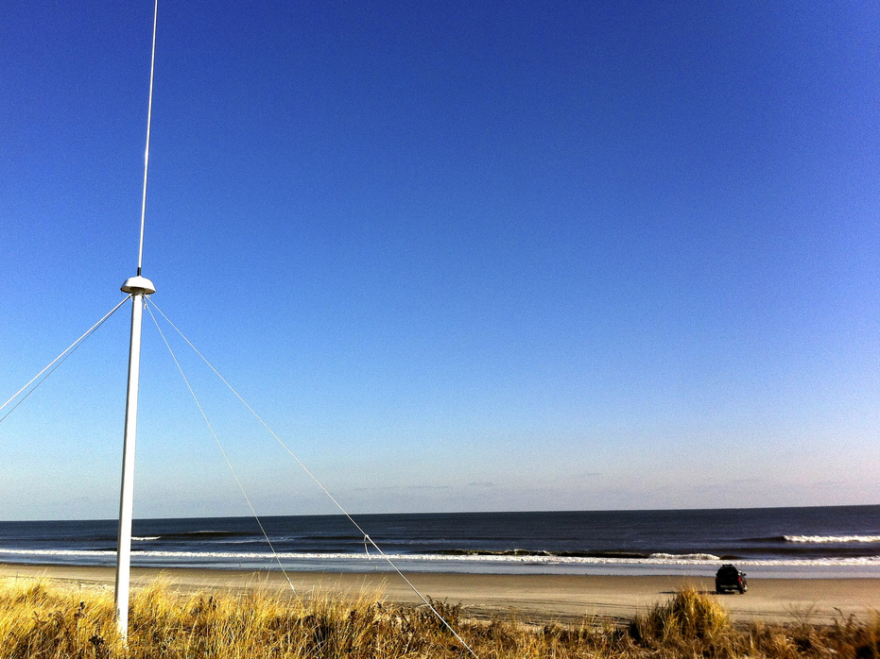
The Global High Frequency Radar Network
Dr. Hugh Roarty
Dr. Scott Glenn
Dr. Josh Kohut
Mr. Michael Smith
Mr. Ethan Handel
Mr. Colin Evans
OGP Workshop on New Technologies in Offshore Monitoring
Oceanology International 2014
10 March 2014
ExCeL

Slide 2
High Frequency Radar
What Does It Measure
Where Is It Applied
What Are The Applications

Slide 3
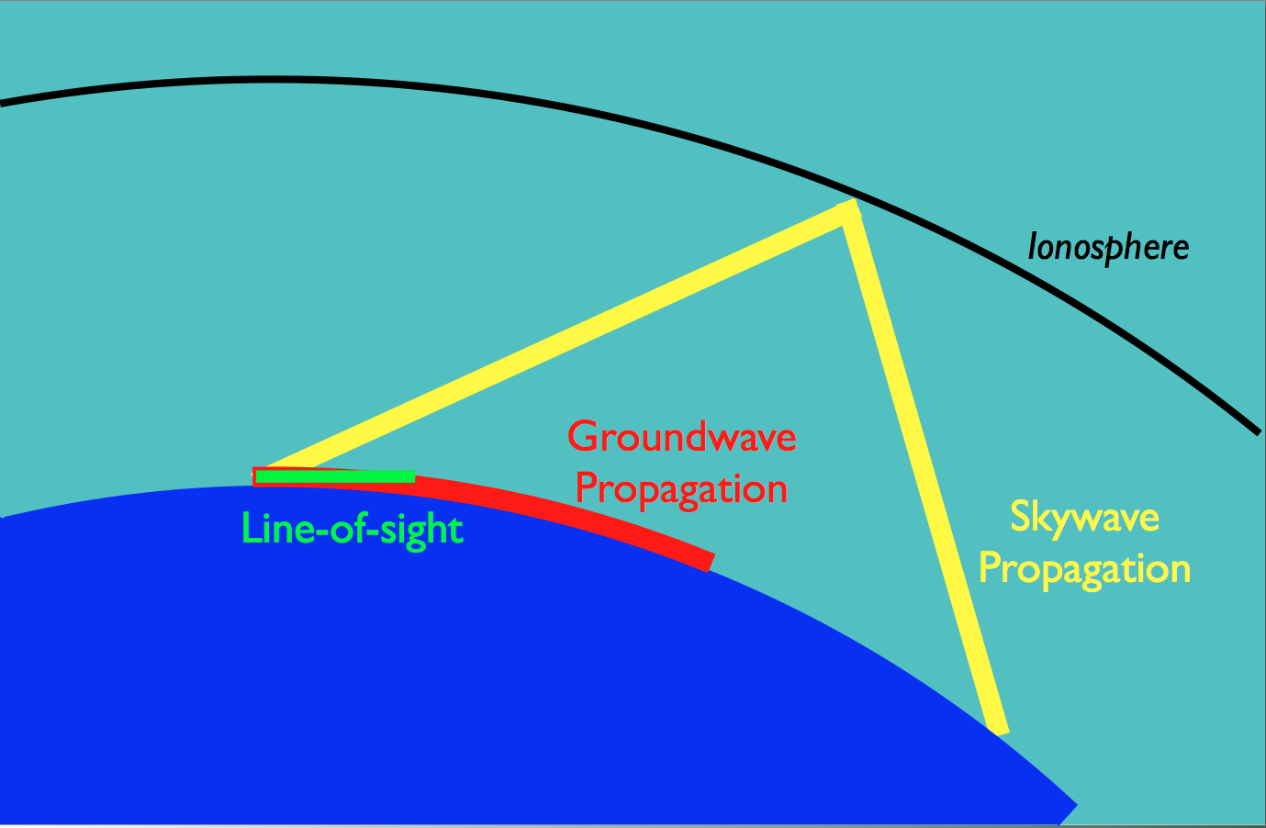
“The benefits of
HF radar are over the horizon measurements and
persistent surveillance”
Radar measures roughness and motion

Slide 4
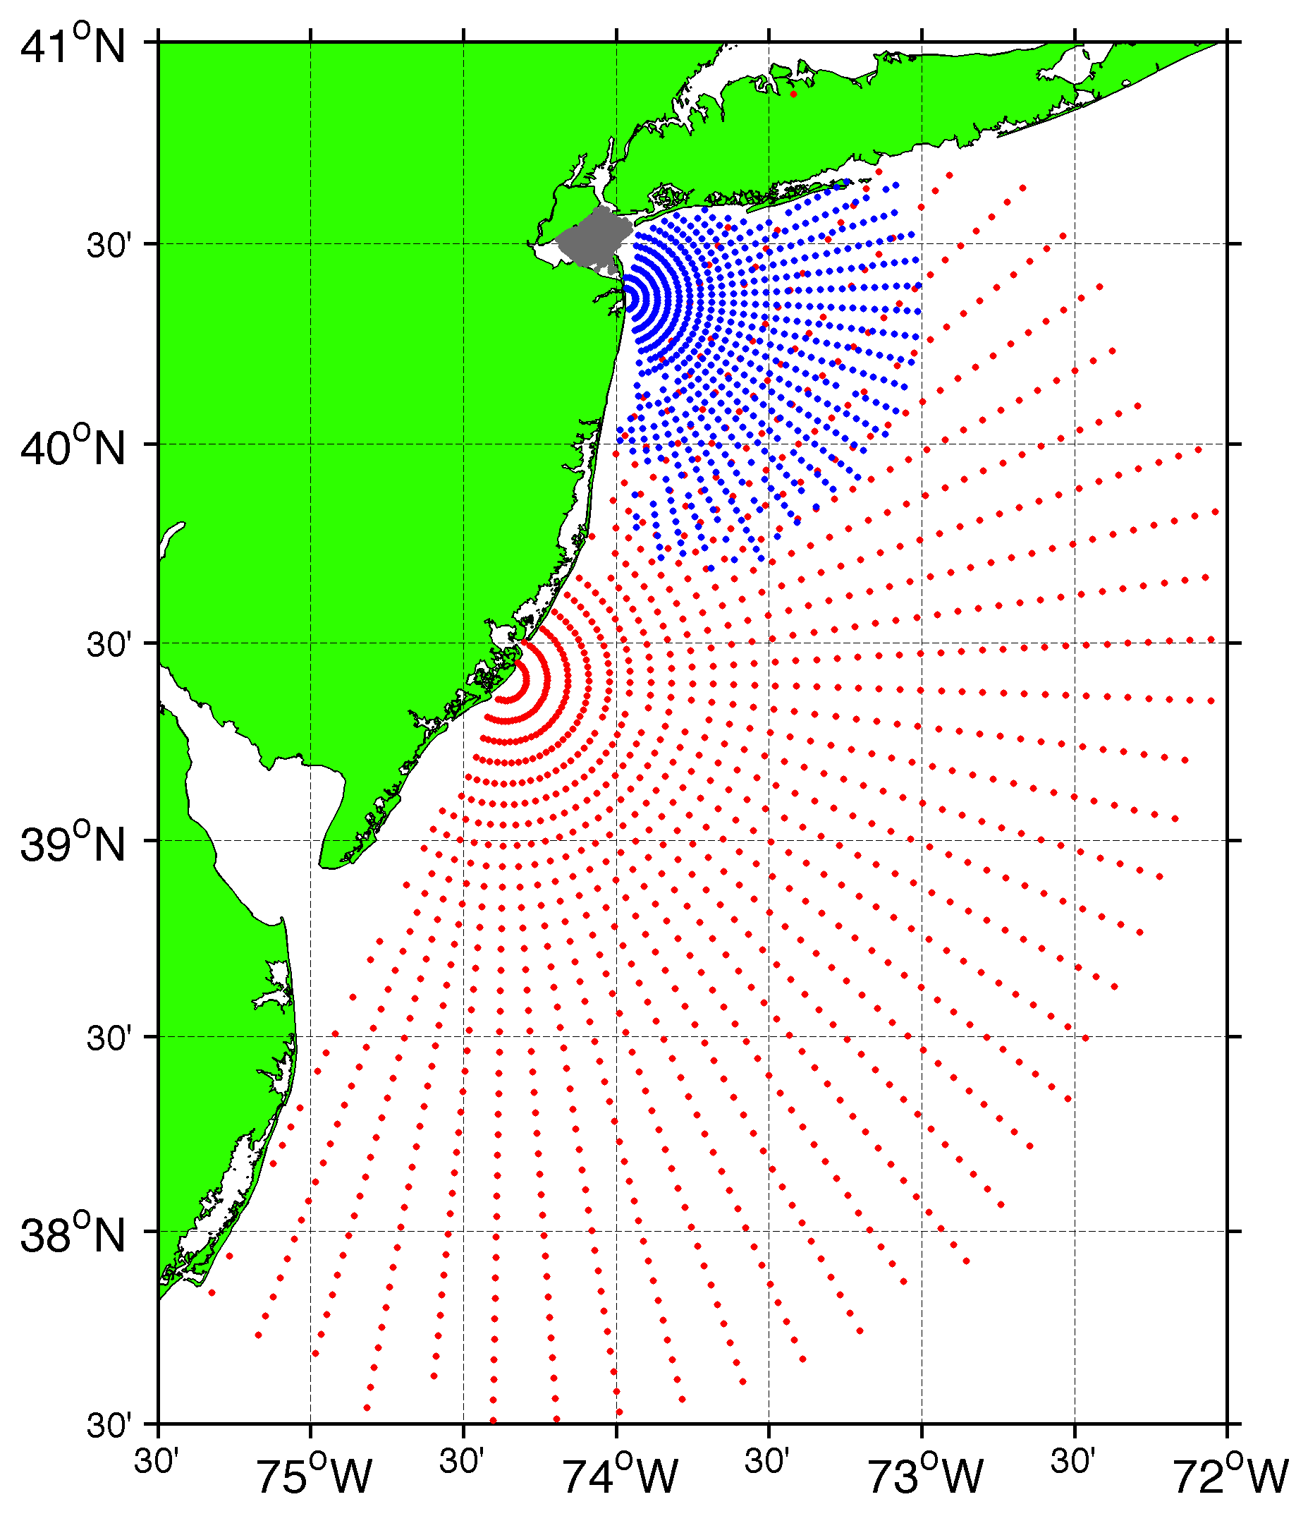
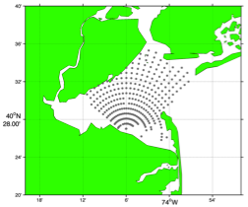
Surface Current Mapping Capability
25 MHz
Radar λ: 12 m Ocean λ: 6 m
Range: 30 km Resolution: 1 km
13 MHz
Radar λ: 23 m Ocean λ: 12 m
Range: 80 km Resolution: 3 km
05 MHz
Radar λ: 60m Ocean λ: 30 m
Range: 180 km Resolution: 6 km

Slide 5
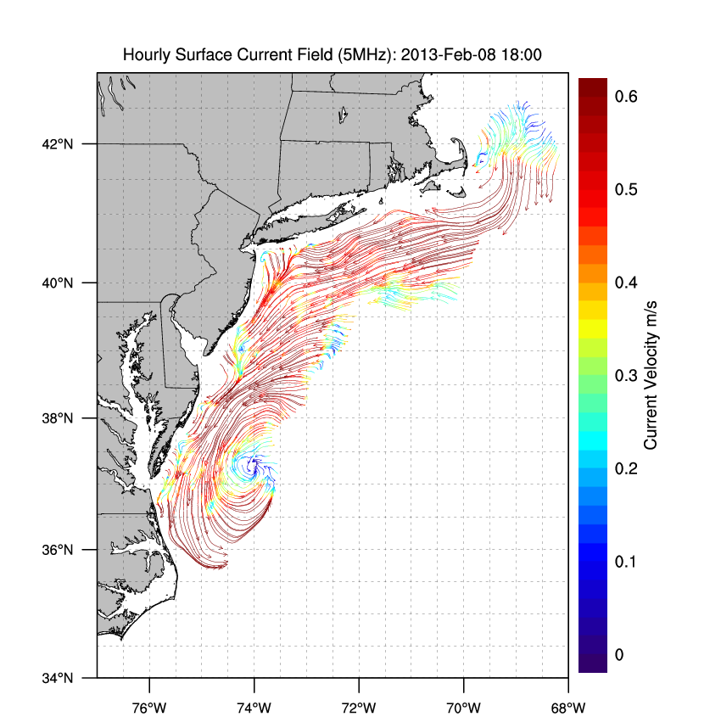
Winter Storm Nemo
February 9, 2013

Slide 6
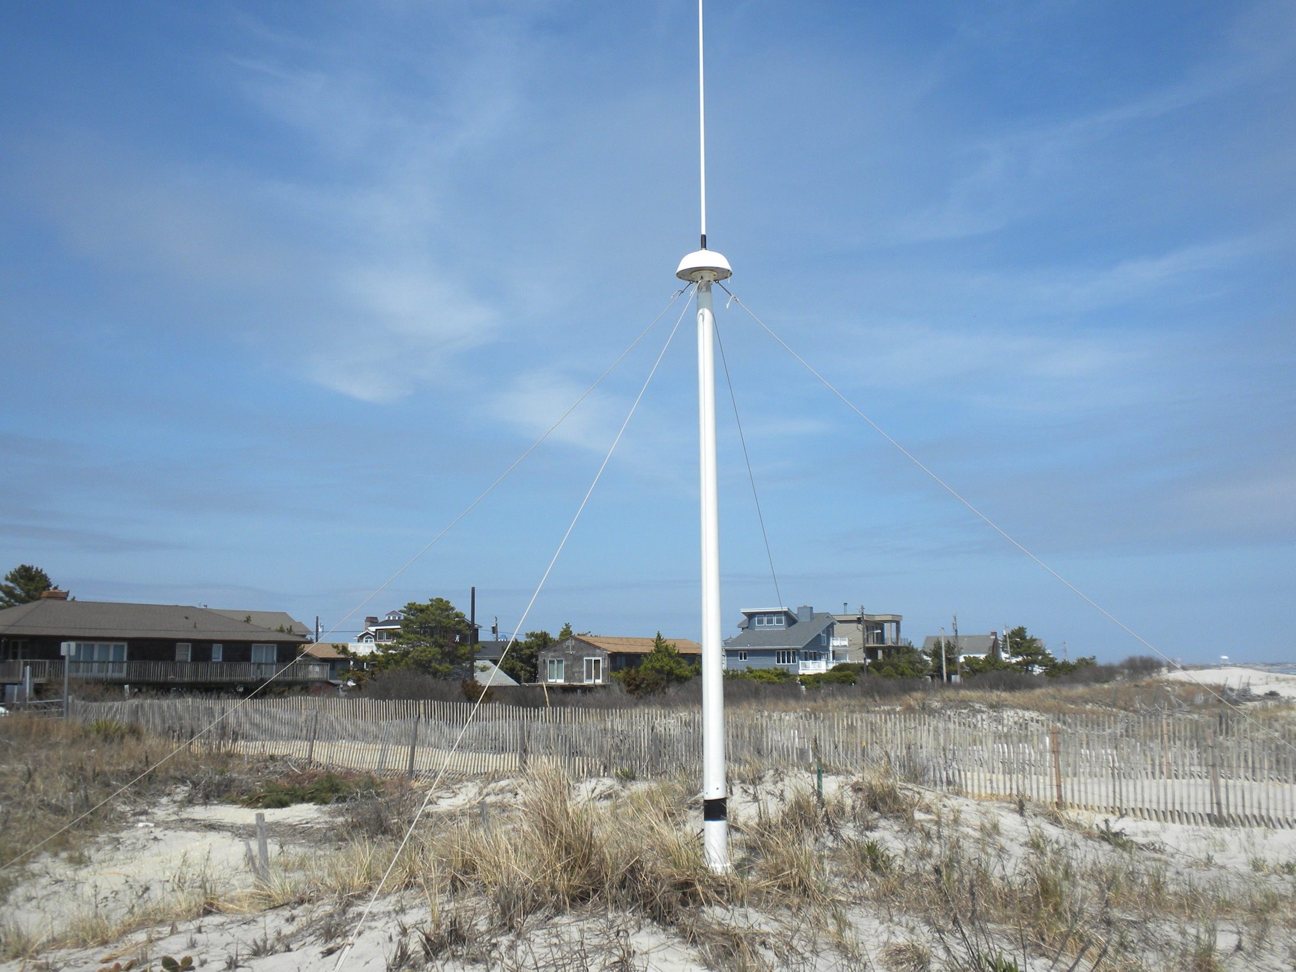
13 MHz Transmit and Receive Antenna
4 meters

Slide 7
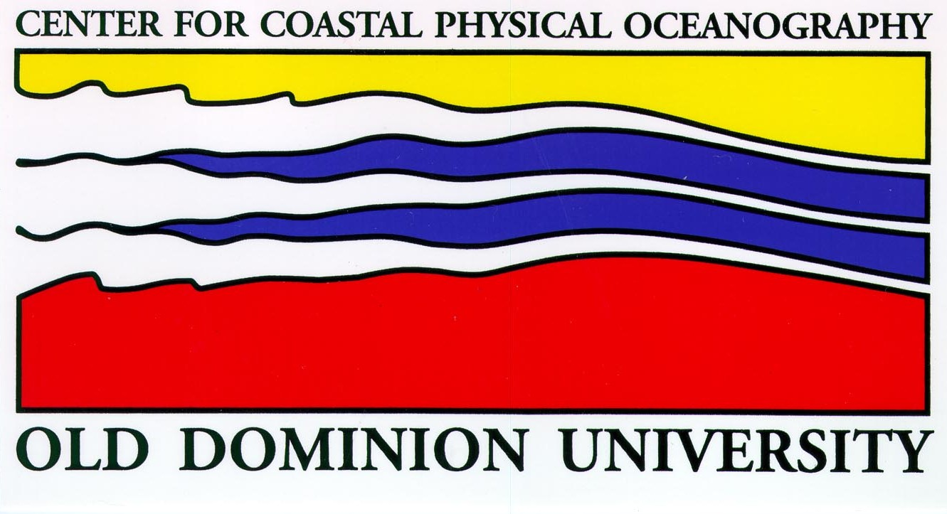
MIDATLANTIC HF RADAR NETWORK
 | 5 MHz | 13 MHz | 25 MHz
U Mass
WHOI
U Conn
URI
Stevens
Rutgers
Delaware
ODU/CIT
UNC
9 | 17 | 8 | 17
41 Stations in Total

Slide 8
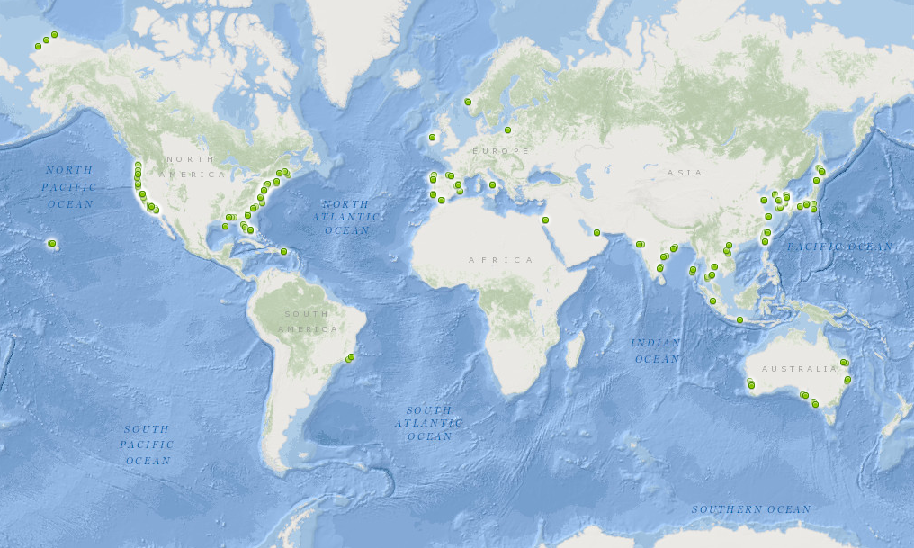
350 Radars World Wide
Region | Number | Percentage
Americas | 162 | 47%
Europe | 54 | 16%
Middle East | 7 | 2%
Asia | 122 | 35%

Slide 9
Application: Search and Rescue

Slide 10
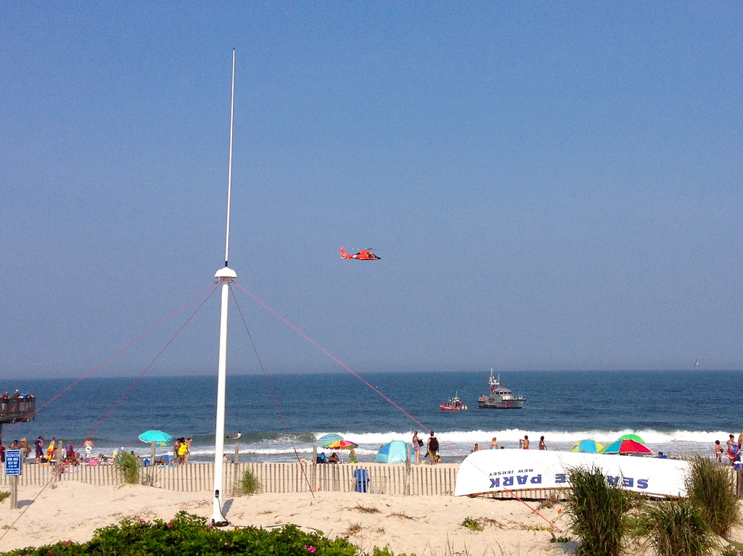
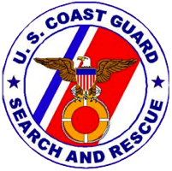
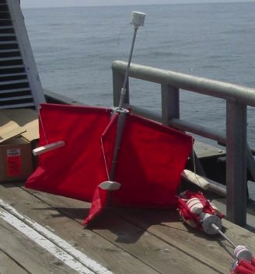
Success Stories – Making a Difference
Optimizing HF Radar for SAR using USCG Surface Drifters

Slide 11
Search and Rescue - 2004

Slide 12
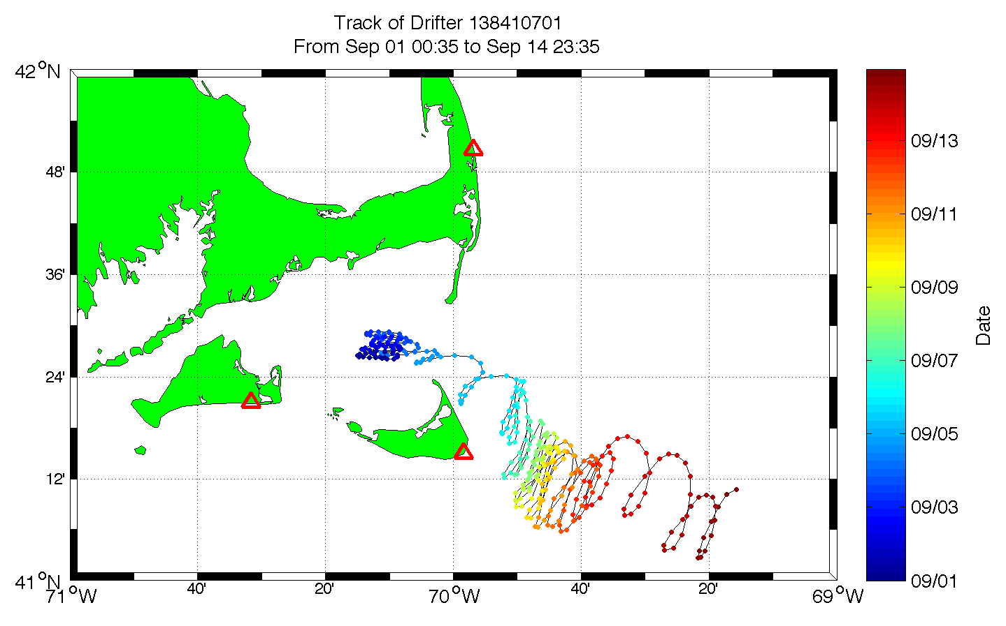

Slide 13
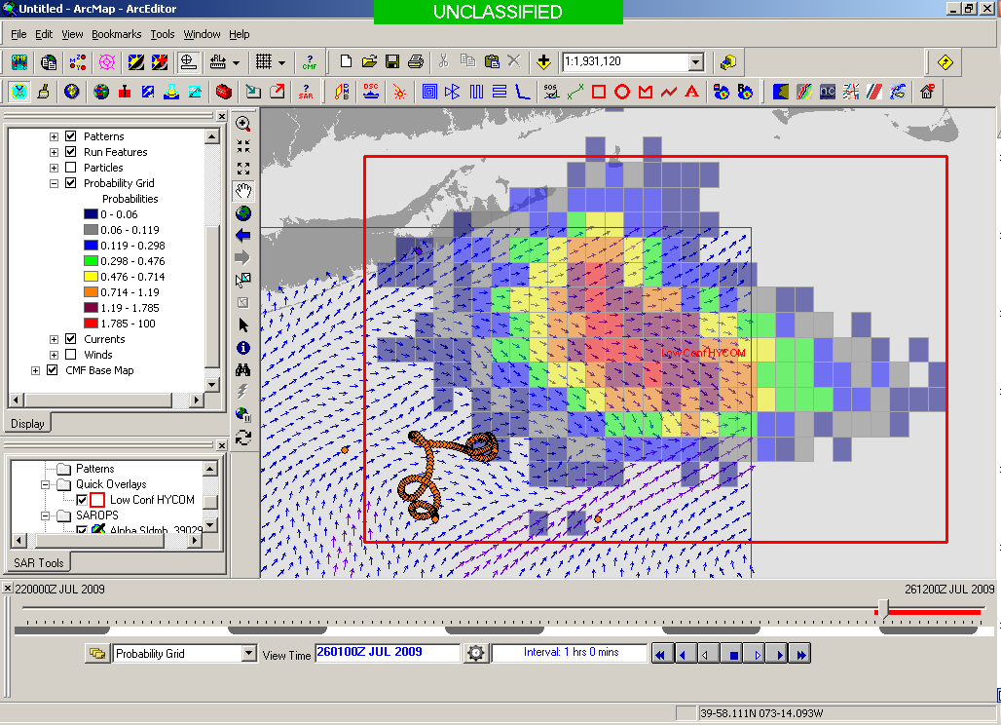
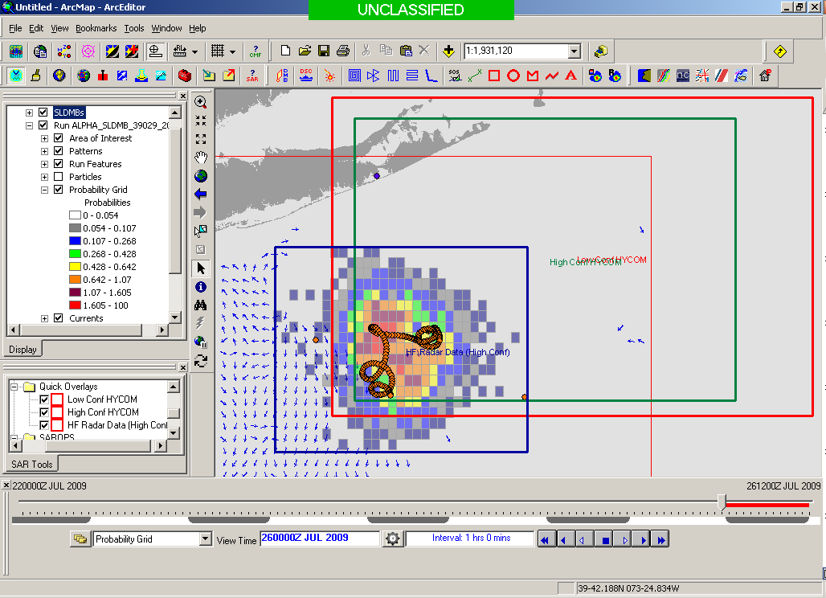
Search Area After 96 Hours
154 km
100 km
232 km
123 km
HYCOM
36,000 km²
CODAR
12,000 km²
Notes:
HYCOM (Low Conf) 48 hours

Slide 14
CONCLUSIONS
Other Applications Include
Oil Spill Modeling
Wind and Wave Measurements
Vessel Detection and Tracking

