Slide 1
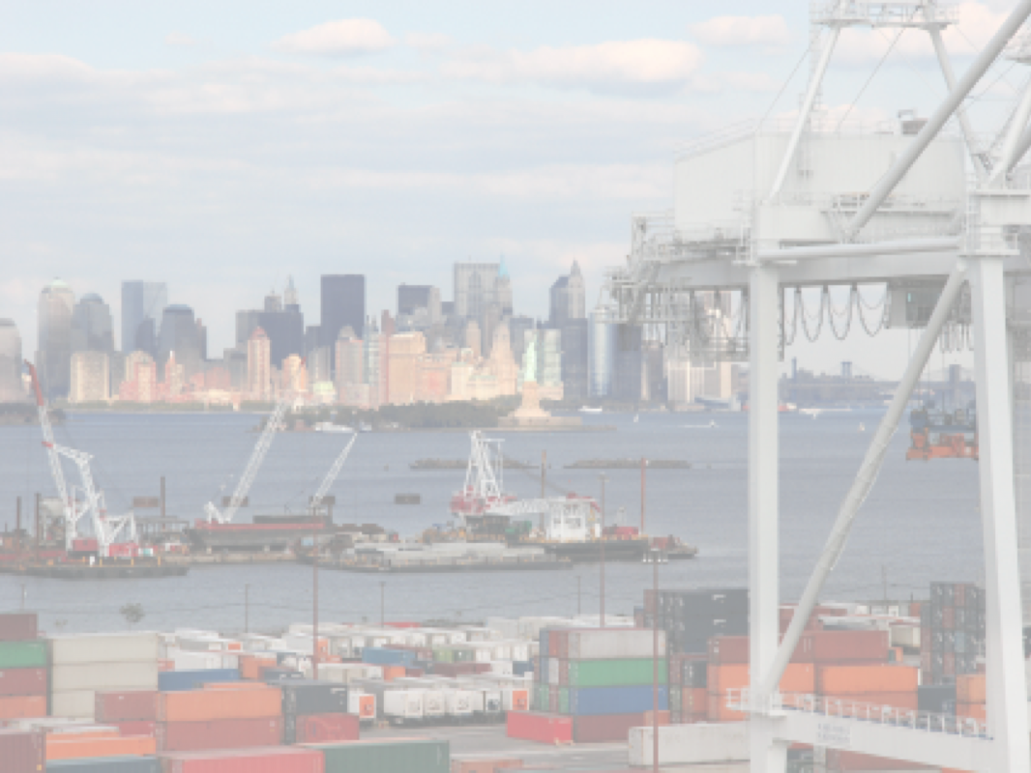






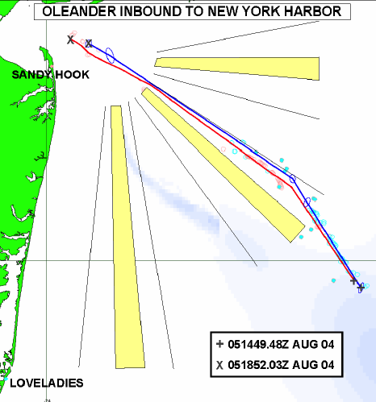





The Center for Secure and Resilient Maritime Commerce (CSR)
HF Radar Team
Rutgers University -
Scott Glenn, Josh Kohut, Hugh Roarty,
Mike Crowley, John Kerfoot, Ethan
Handel, Mike Smith, Colin Evans
CODAR Ocean Sensors -
Don Barrick, Pete Lilleboe, Chad Whelan
Belinda Lipa, Bill Rector, Jimmy Isaacson
University or Puerto Rico – Mayaguez
Jorge Corredor, Julio Morell, Miguel Canals
Applied Mathematics, Inc -
Bill Browning
University of Alaska –
Tom Weingarter, Hank Statscewich
Ocean Power Technologies –
Debbie Montagna, Bruce Downie
Naval Research Laboratory
Michael Lovellette, Dan Newton
Norwegian Defence Research Establishment (FFI)
Terje Johnsen, Walther Asen
CODARNor
Anton Kjelaas
Rutgers University – CODAR Ocean Sensors
Academic – Industry Partnership since 1998
ONR - 2004

Slide 2
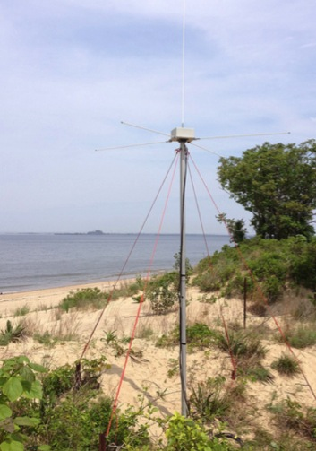
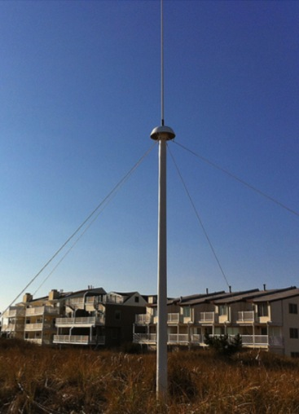
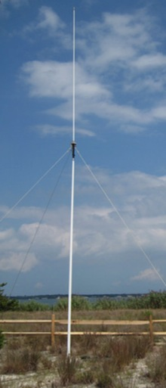
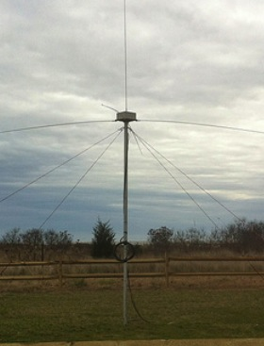
CODAR Compact HF Radar Antennas
25 MHz
13 MHz
5 MHz
Combined Transmitter & Receiver
Separate Transmitter & Receiver

Slide 3
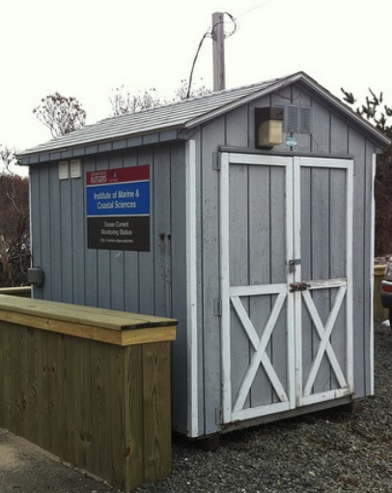
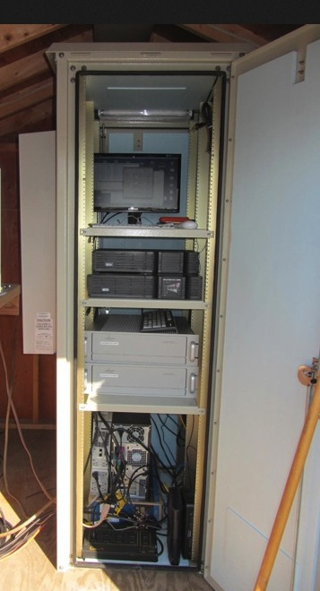
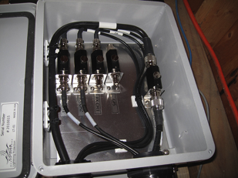
Standard CODAR Shore Site:
Shed, Enclosure, Tx/Rx, Comms, Power, GPS, AIS
monitor
computer & external hard drive
A.C. unit
UPS system
transmitter
receiver
Two lines of Communication
Shed
Enclosure
Lightning Protection

Slide 4
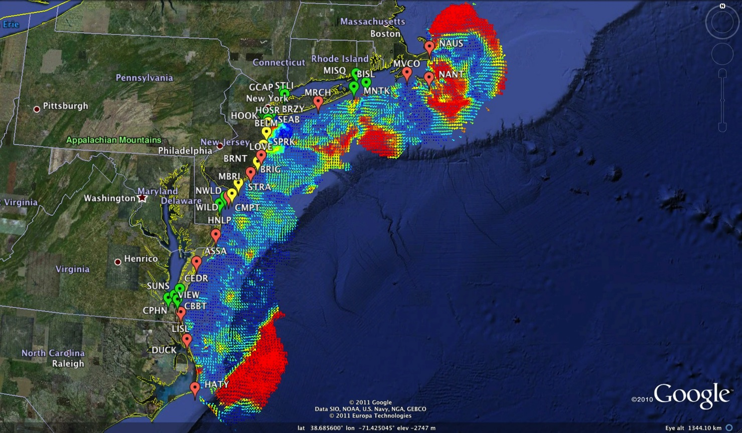
Mid-Atlantic Bight HF Radar Network
1000 km Alongshore Length Scale
Mid-Atlantic HF Radar Network
16 Long-Range CODARs
8 Medium-Range CODARs
17 Short-Range CODARs
41 Total
Triple Nested & Multistatic

Slide 5
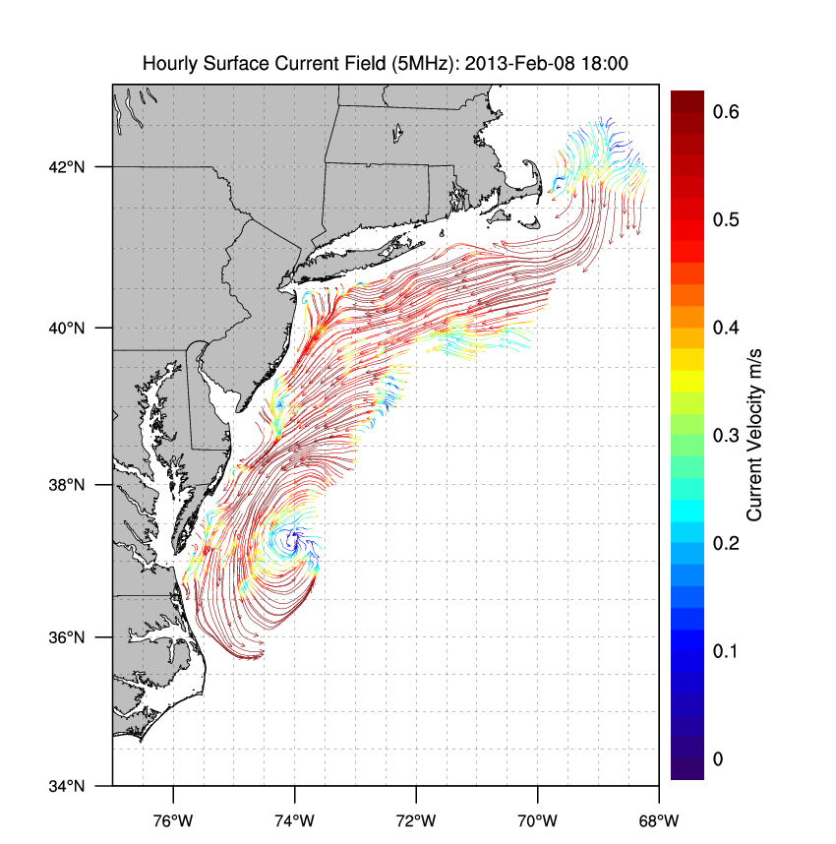
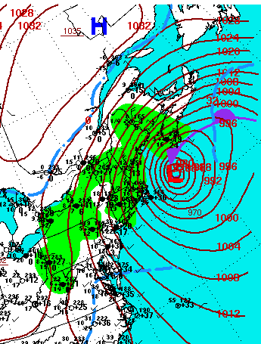

Winter Storm Nemo
February 9, 2013

Slide 6
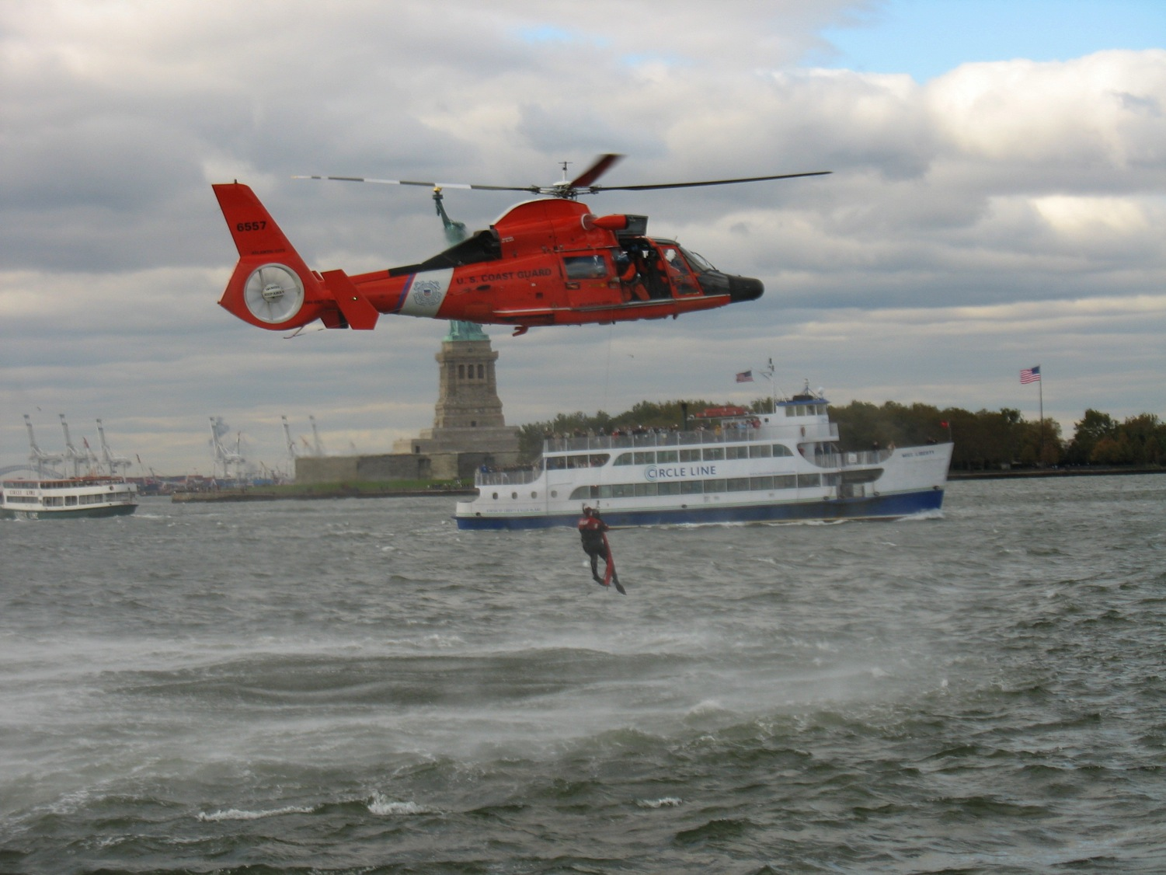
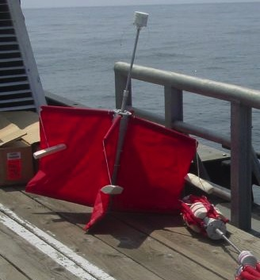
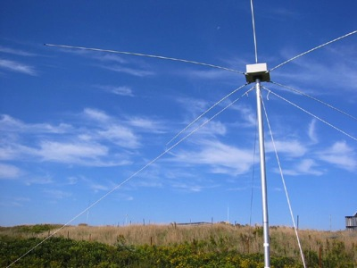
Transition Success Stories – Making a Difference
Optimizing HF Radar for SAR using USCG Surface Drifters
Art Allen
U.S. Coast Guard
Scott Glenn
Rutgers University
Mid-Atlantic Regional Association
Coastal Ocean Observing System

Slide 7

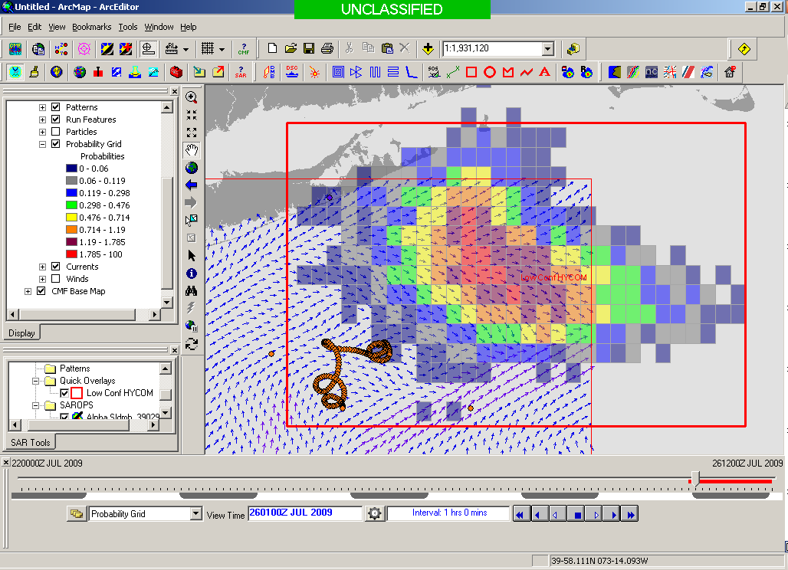
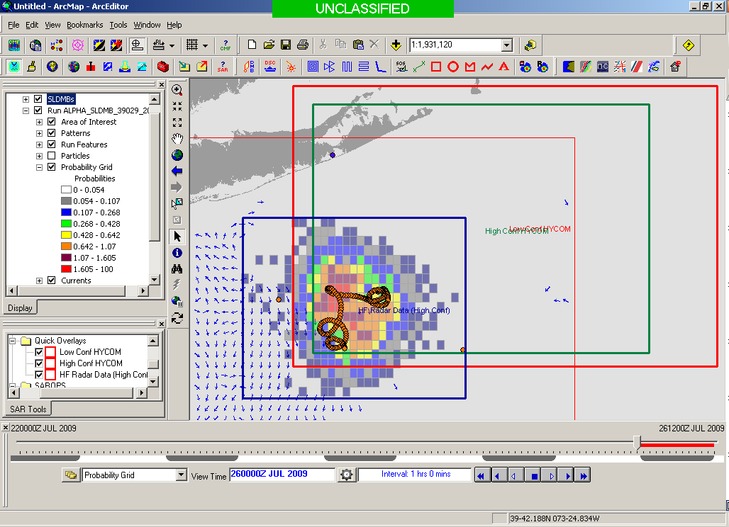
SAROPS Test Case
5000 Virtual Drifters +
1 Real Drifter (Black Line):
Search Area After 96 Hours
154 km
100 km
232 km
123 km
HYCOM
36,000 km²
CODAR
12,000 km²
Notes:
HYCOM (Low Conf) 48 hours

Slide 8
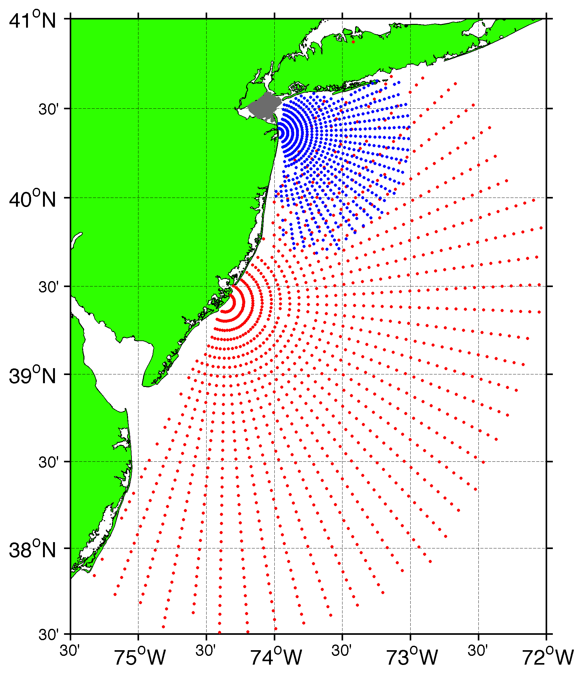
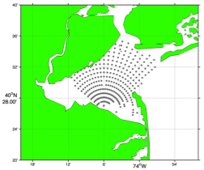
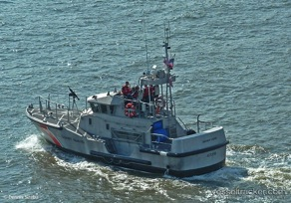
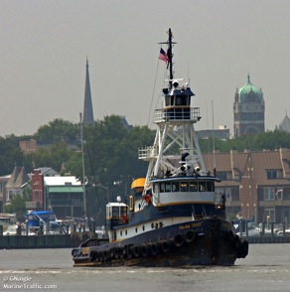
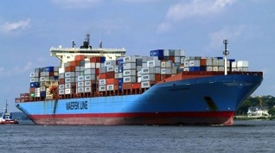
Vessel Detection Capability
25 MHz
Range: 11 nmi
Height >10 ft
13 MHz
Range: 43 nmi
Size: >19 ft
05 MHz
Range: 65 nmi
Size: >49 ft

Slide 9
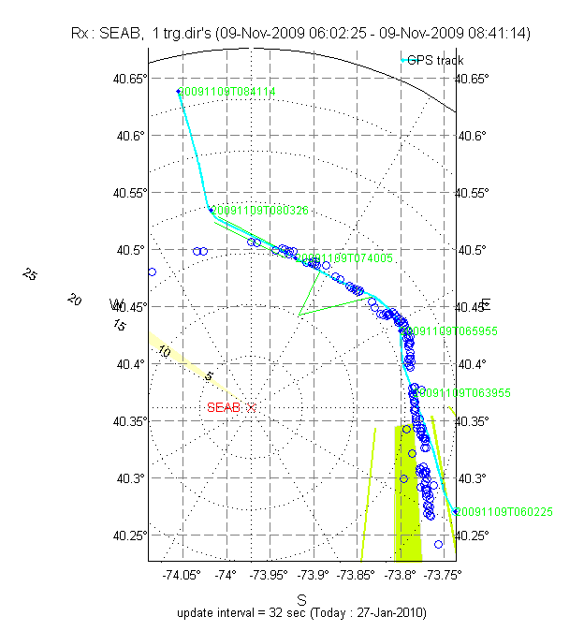
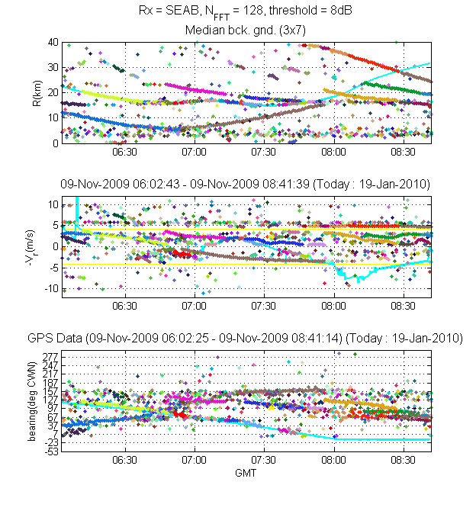
Pepper Plot
Detections on a Map
Notes:
9

Slide 10
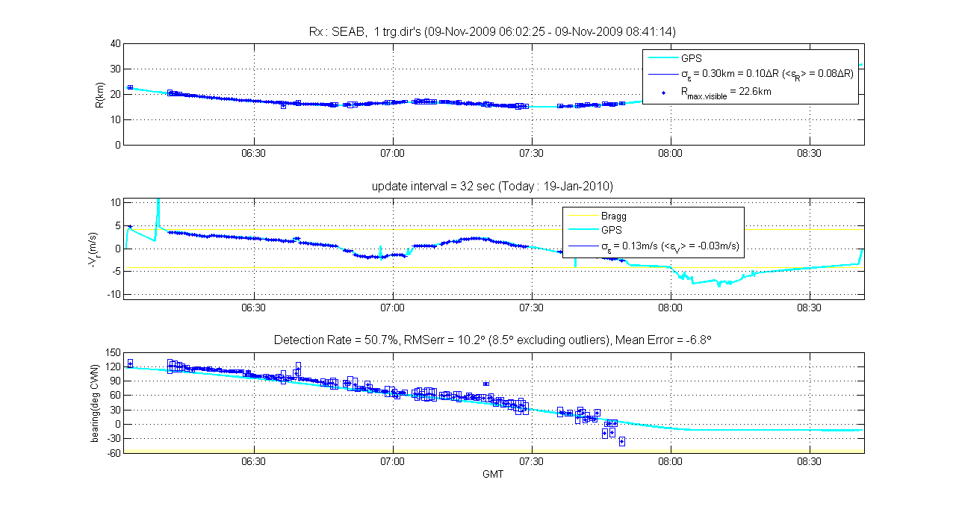
Association of GPS with Detections
Notes:
10

Slide 11
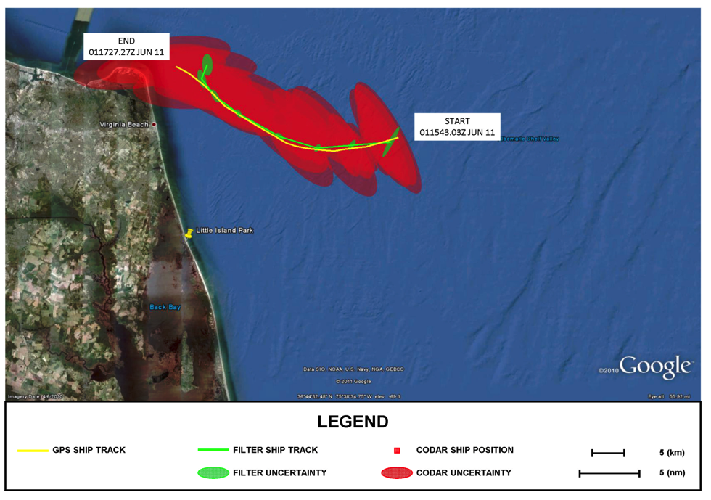
Step 3 Track Fitting: M/V Victorius
M/V VICTORIOUS: GPS Track, CODAR Data, and Ship Tracker Solution with Uncertainty Ellipses

Slide 12
Synergy Experiment
Saturday November 23, 2013

Slide 13
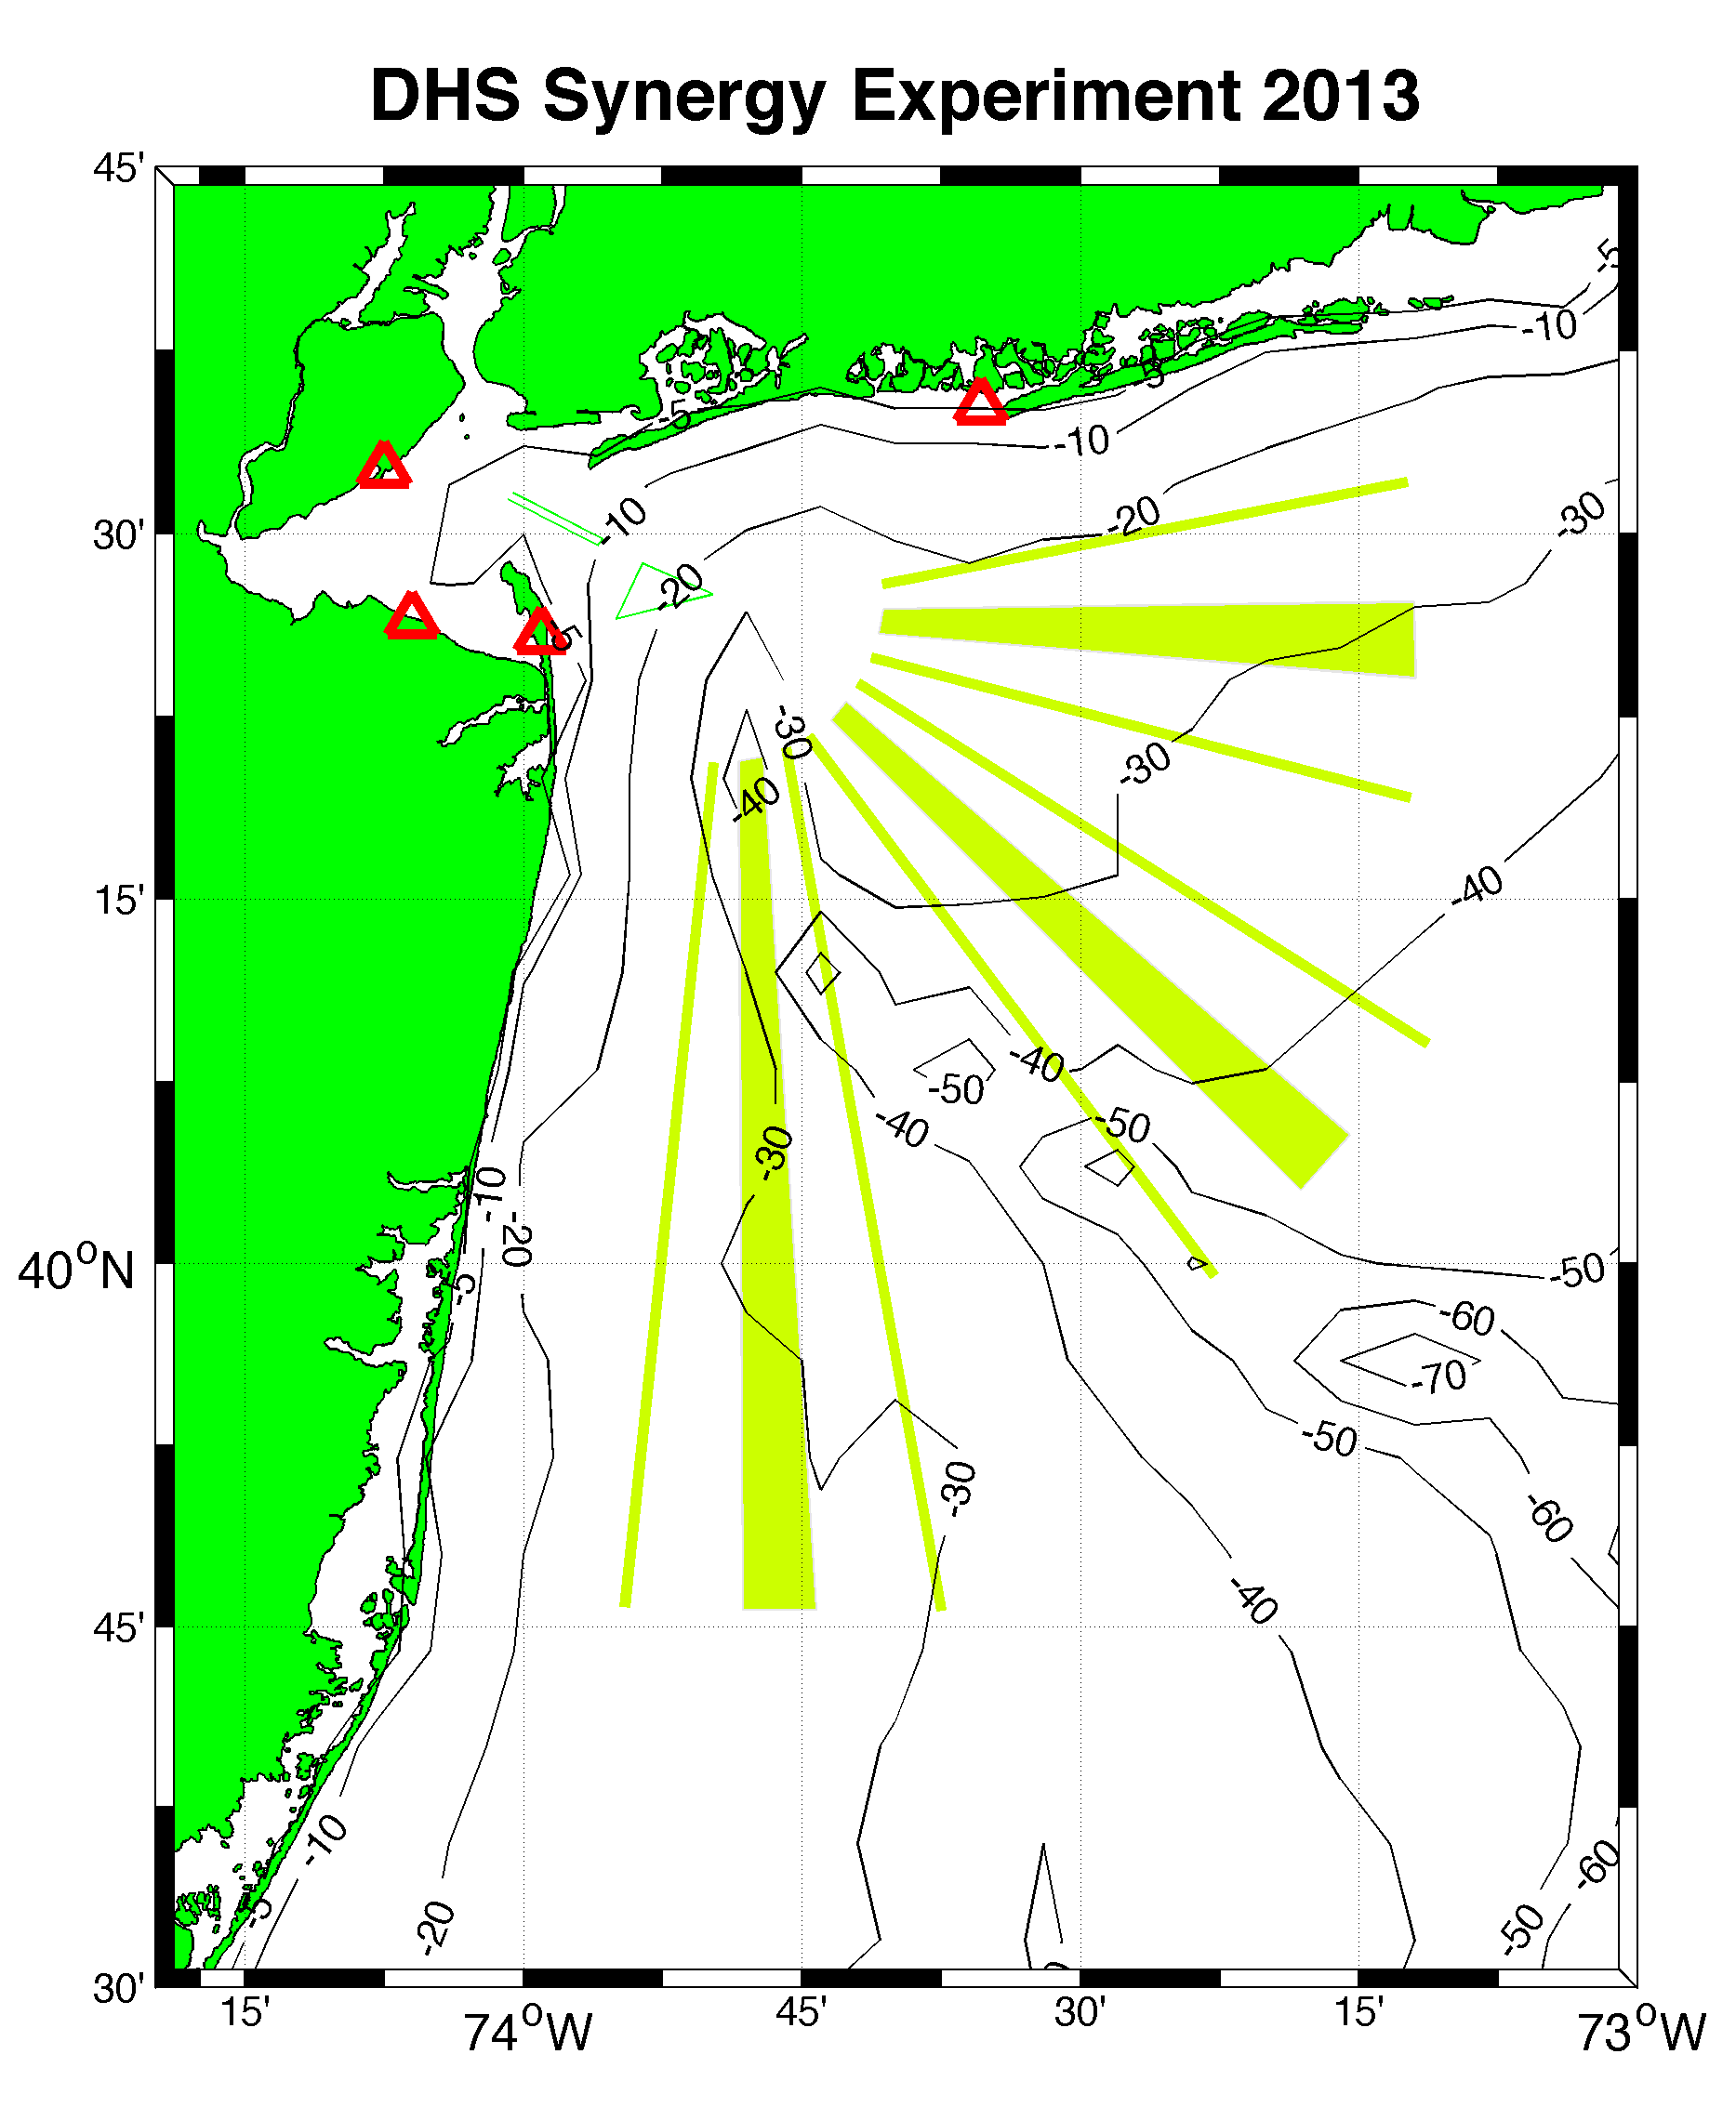
HEMP 5 MHz
HEMP
SILD
TEST 13 MHz
SILD 25 MHz
PORT
TEST
PORT 25 MHz

Slide 14
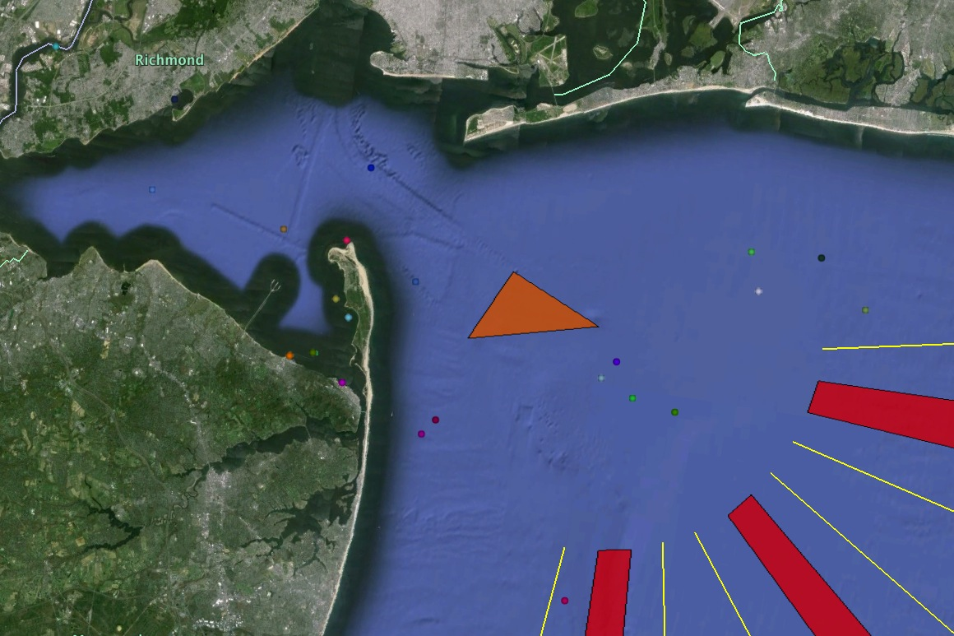
Vessels Detected by HF Radar
Stationary Vessels
AIS at 16:49 GMT
November 23, 2013
2
1
3
13
4
15
5
1 Liberty Service
2 Sarah Dann
3 Lady B
4 Shelby
5 Elizabeth
6 Glenn Edwards
7 Stuyvesant
8 Maersk Chicago
9 Tokyo Express
10 Pilot No. 1
11 NYK Rumina
12 Hyundai Supreme
13 Handy Tanker Spirit
14 Kastos
15 Chemtrans Star
16 Prisco Elena
16
10
14
7
8
9
6
11
12

Slide 15
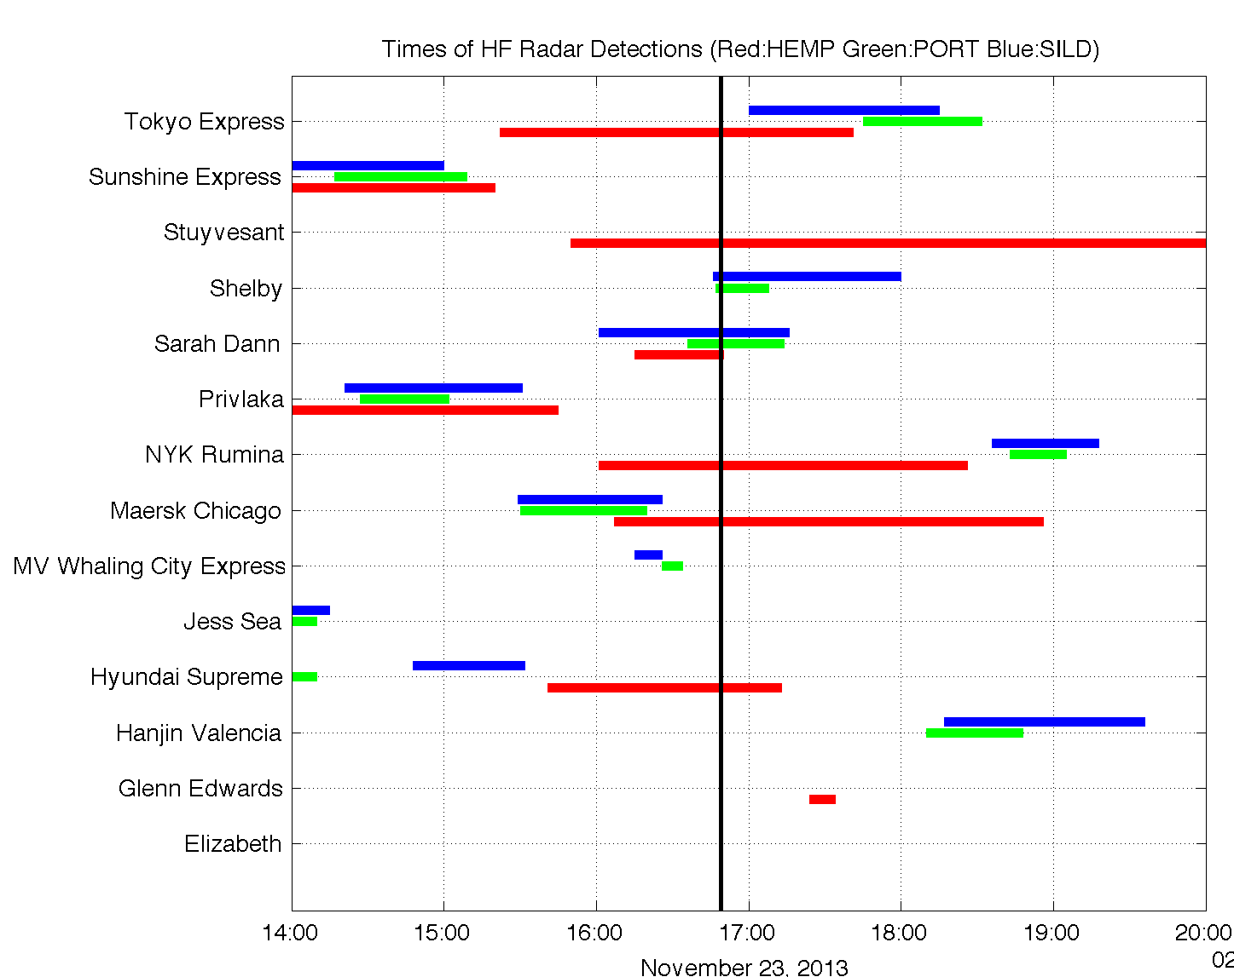
Station | Detection Time (Minutes) | Samples
HEMP (5 MHz) | 139 | 8
PORT (25 MHz) | 33 | 11
SILD (25 MHz) | 58 | 11
Optical Satellite Pass at 16:49 GMT

Slide 16
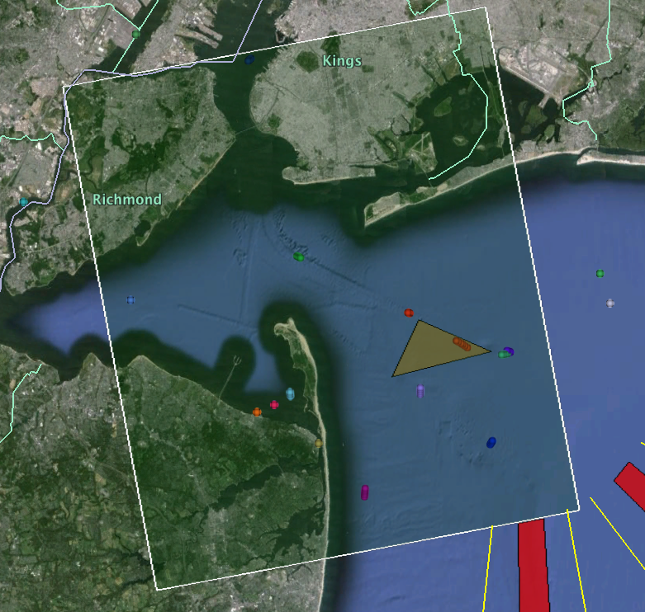
Vessels Detected by HF Radar
AIS at 22:43 GMT
November 23, 2013
2
Stationary Vessels
3
15
1 Liberty Service
2 NYK Rumina
3 Bering Dawn
4 R/V Nauvoo
5 Shelby
6 Sea Bear
7 Sand Master
8 Jane A Bouchard
9 Explorer of the Seas
10 PB Wanderer
11 Pilot No. 1
12 Glenn Edwards
13 Sarah Dann
14 Kastos
15 Handy Tanker Spirit
1
7
11
14
9
10
8
6
5
4
13
12

Slide 17
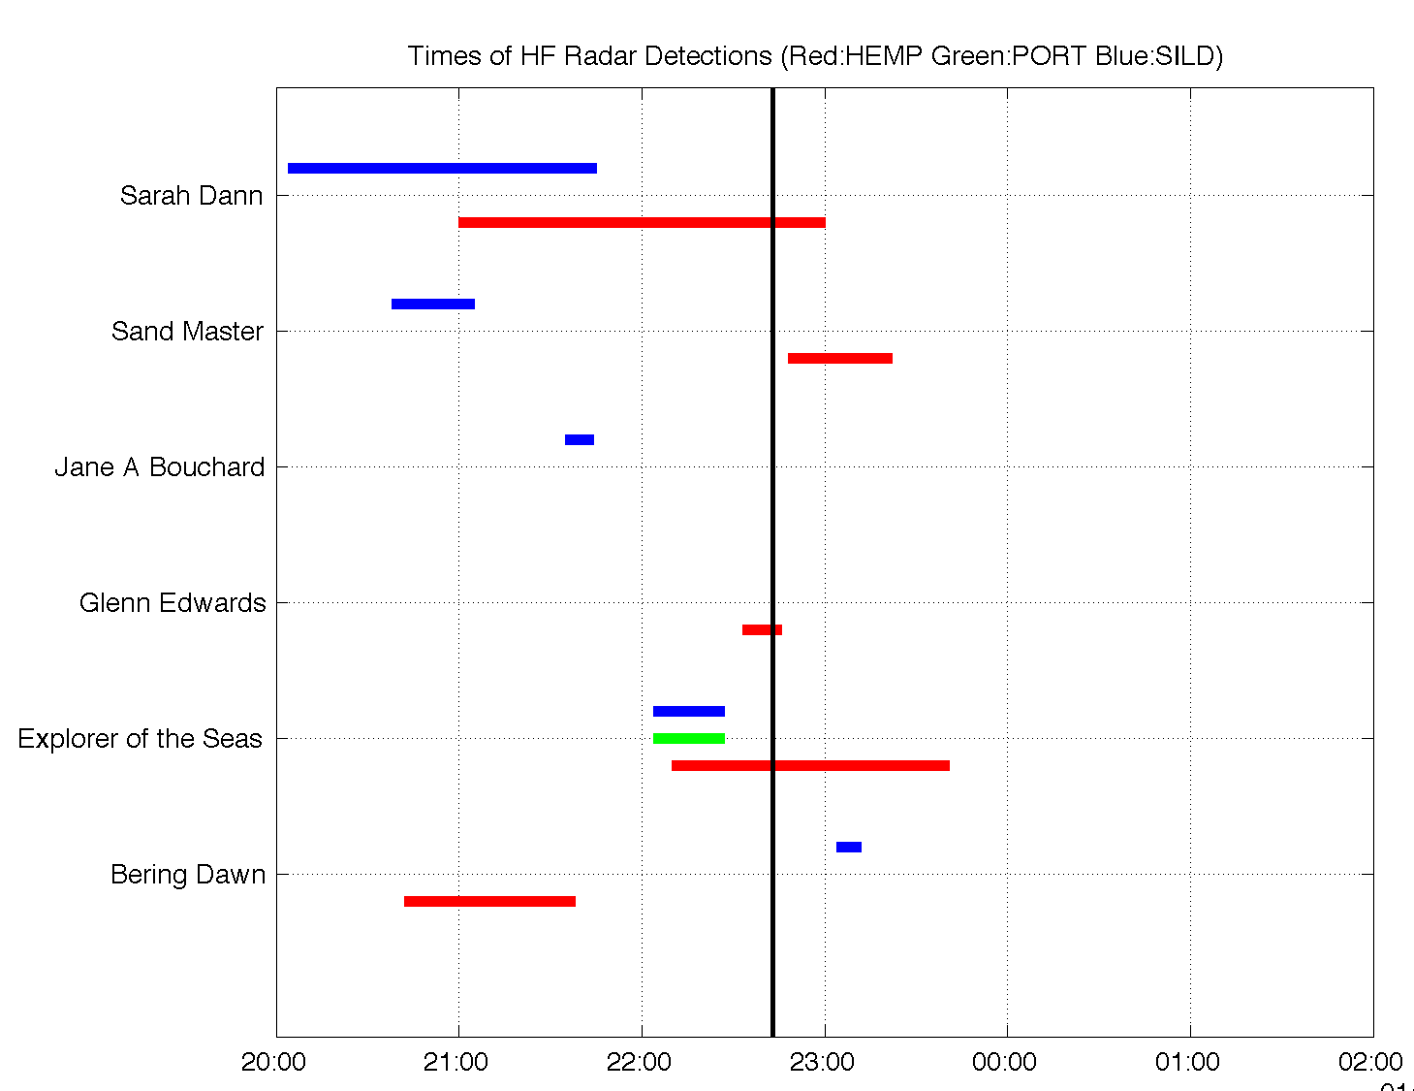
Station | Detection Time (Minutes) | Samples
HEMP (5 MHz) | 63 | 5
PORT (25 MHz) | 31 | 2
SILD (25 MHz) | 34 | 5
SAR Satellite Pass at 22:43 GMT

Slide 18
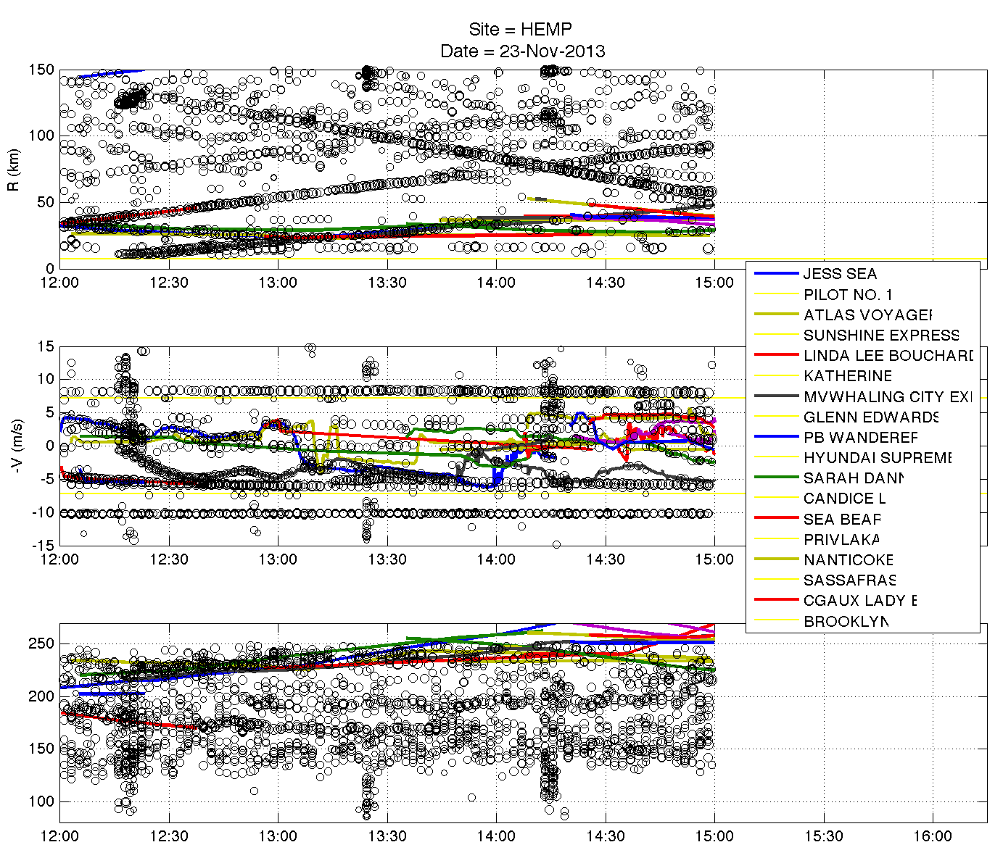

Slide 19
A Network of Radars
Combining detections from multiple radars we can track vessels on average of 168 minutes from first detection to last.
Eight examples of this

Slide 20
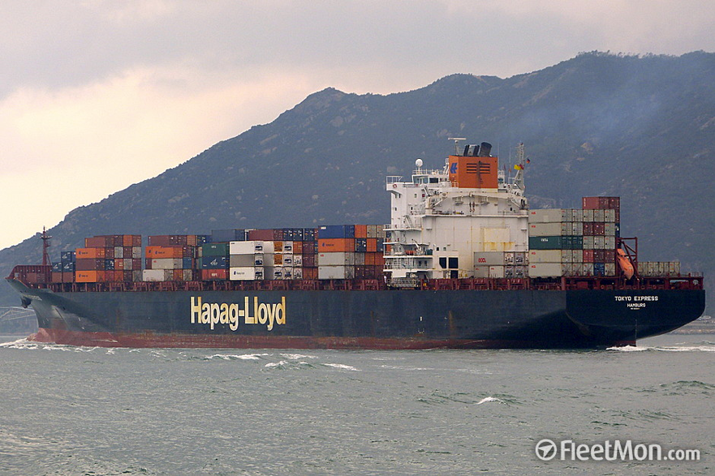
Tokyo Express Detections

Slide 21
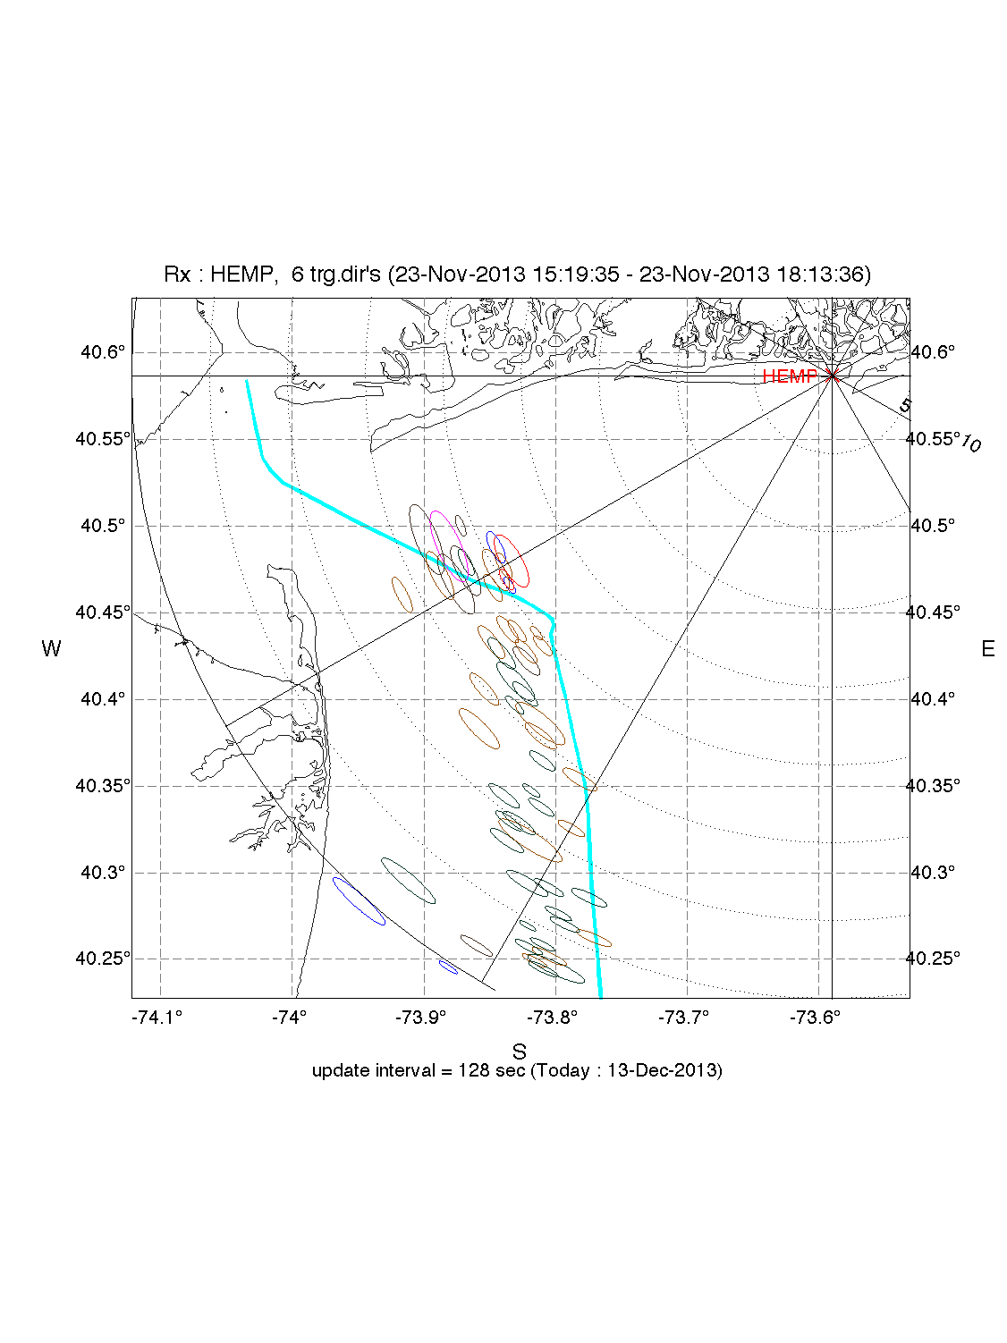
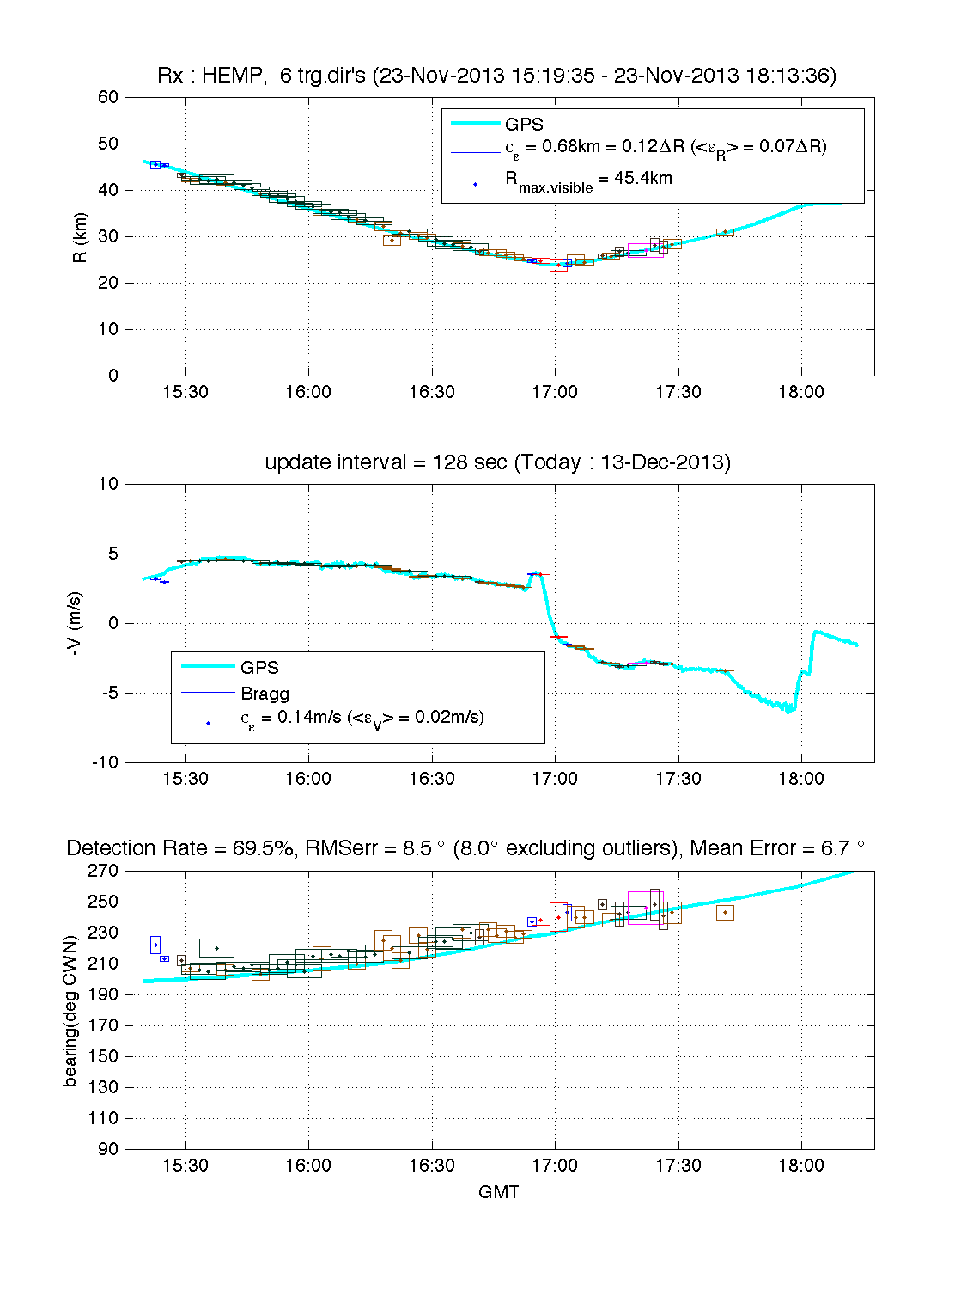
Hempstead 5 MHz

Slide 22
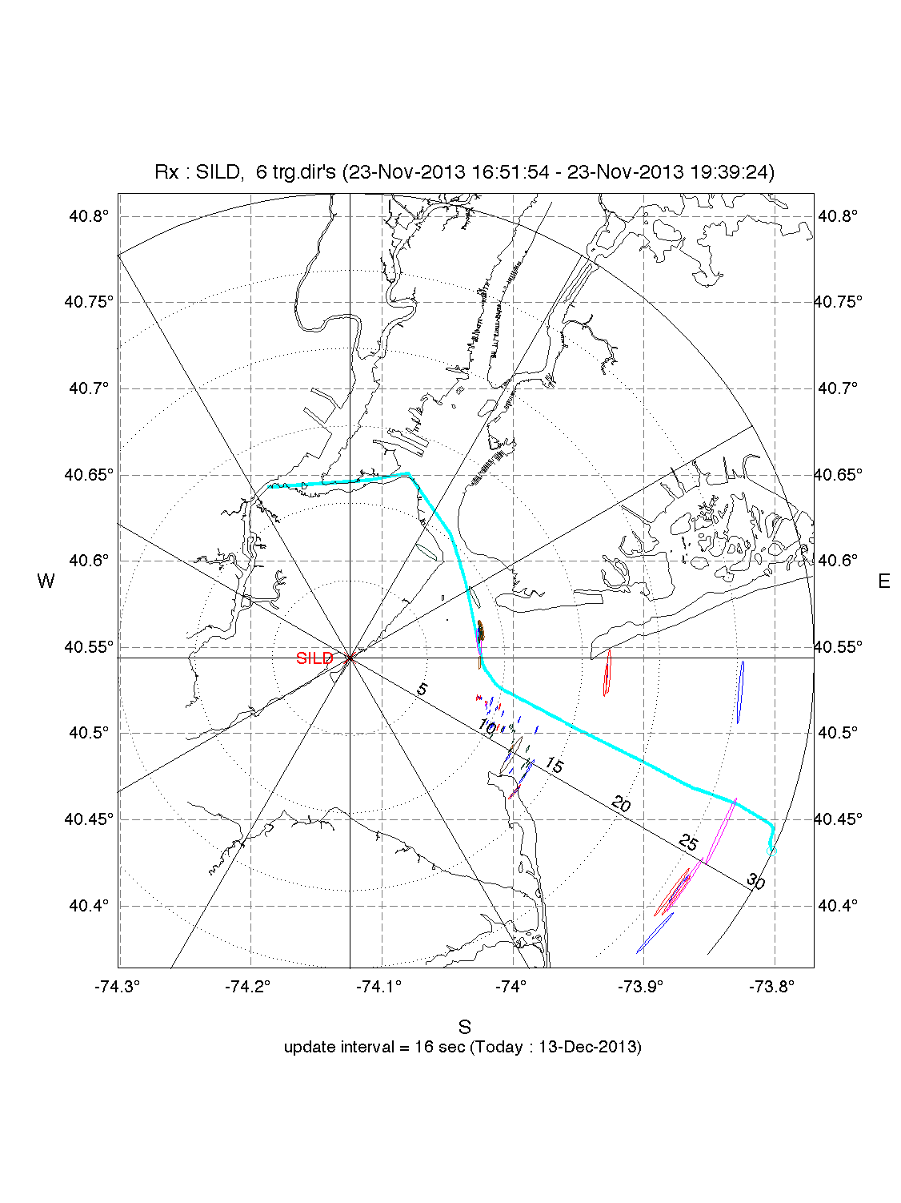
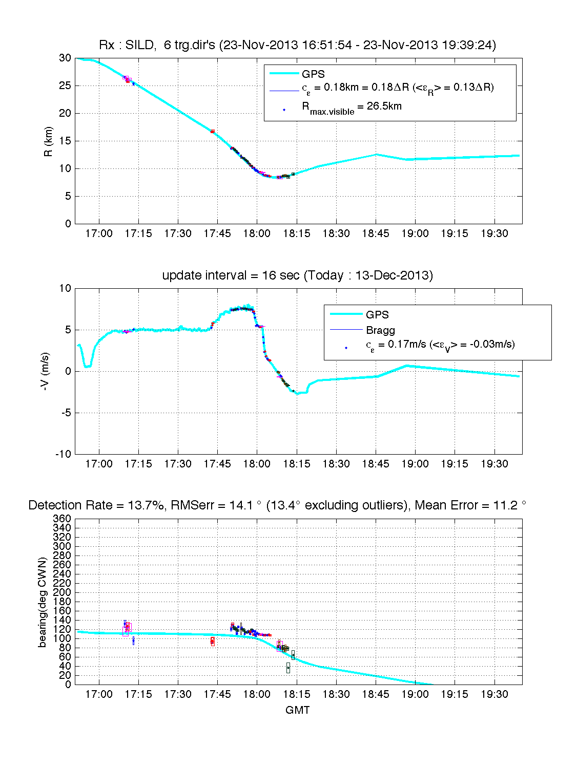
Staten Island 25 MHz

Slide 23
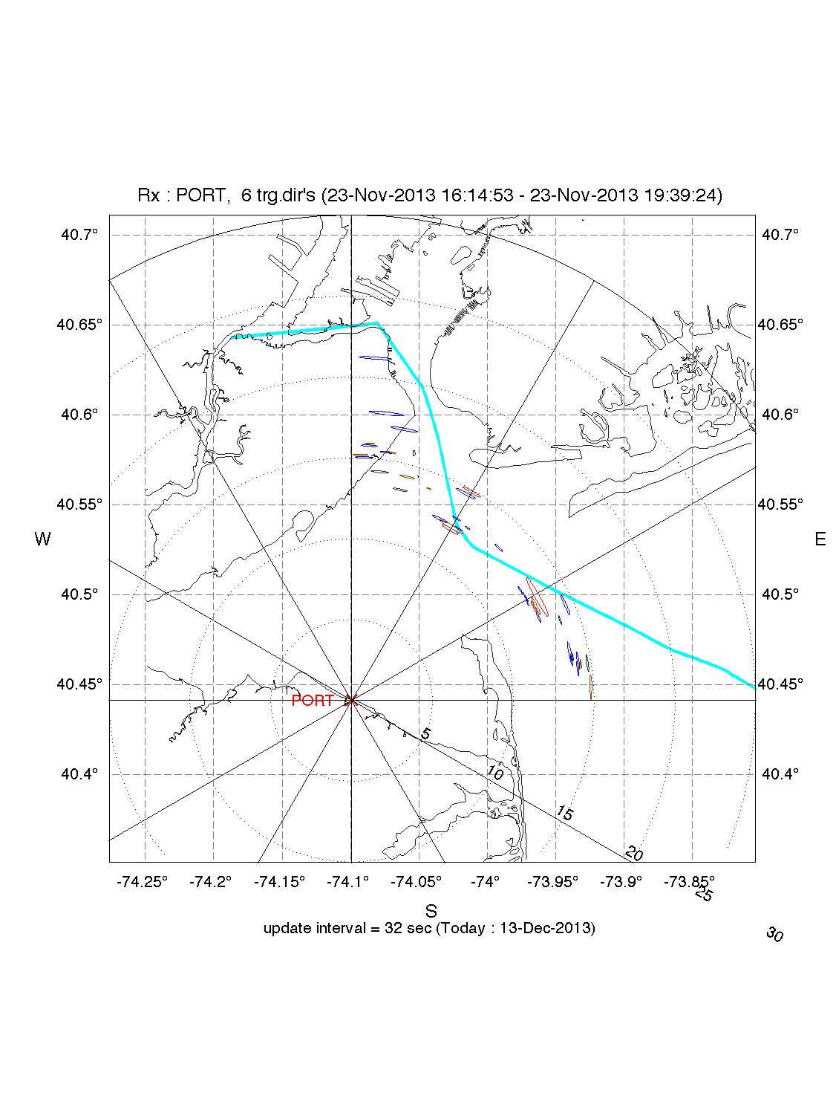
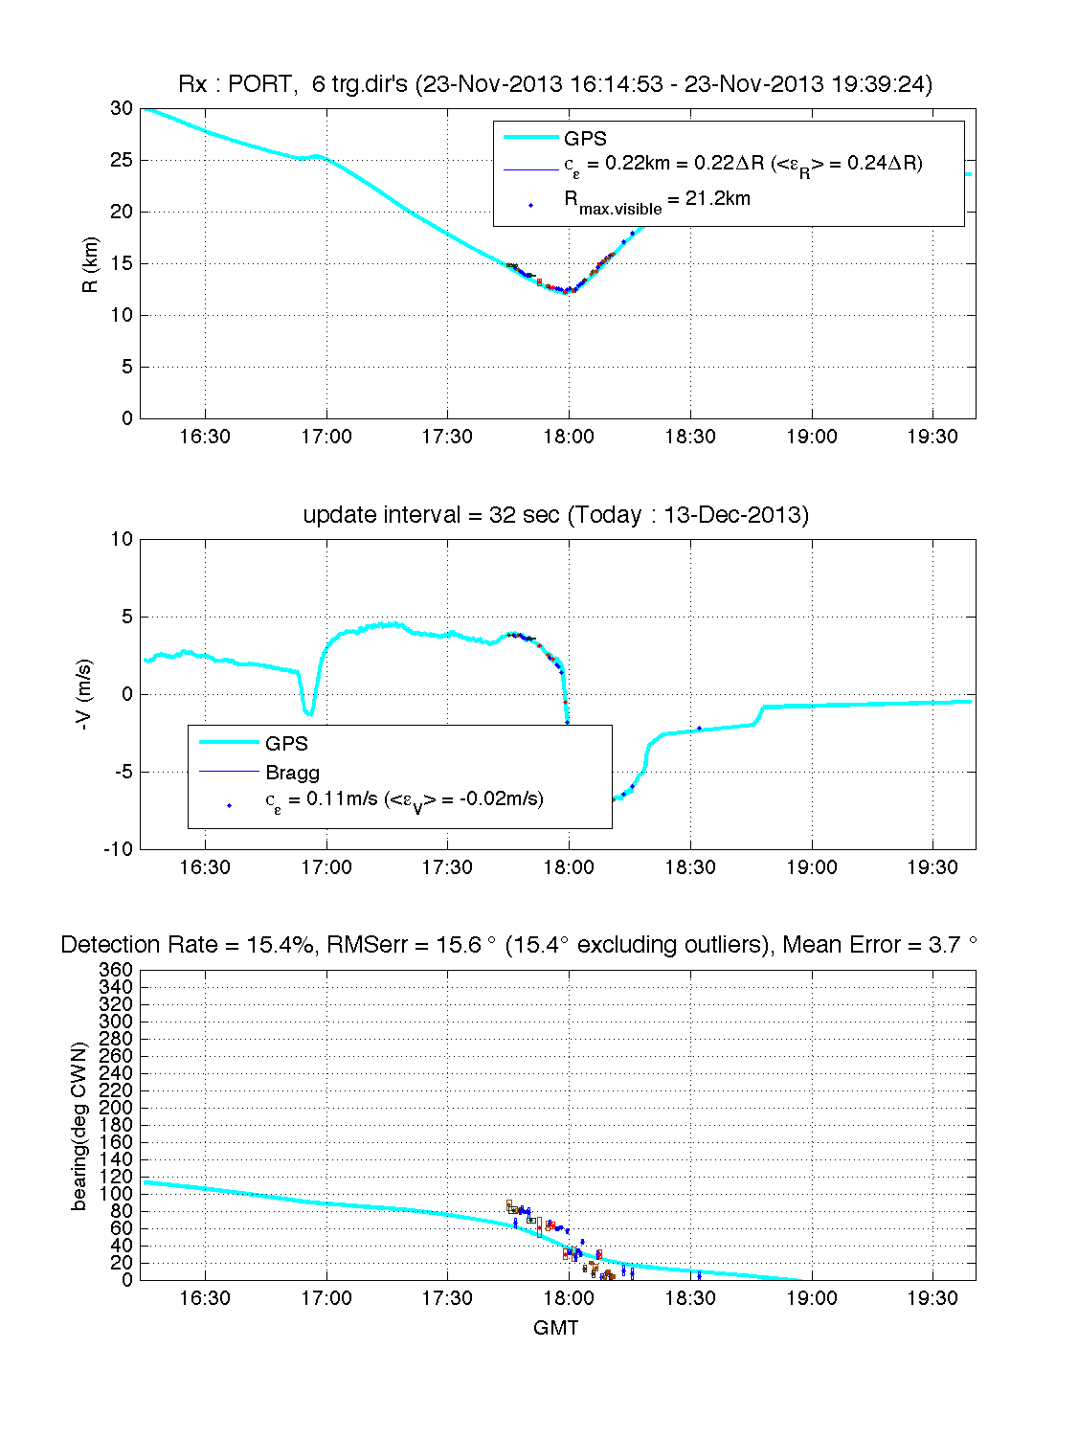
Port Monmouth 25 MHz

Slide 24
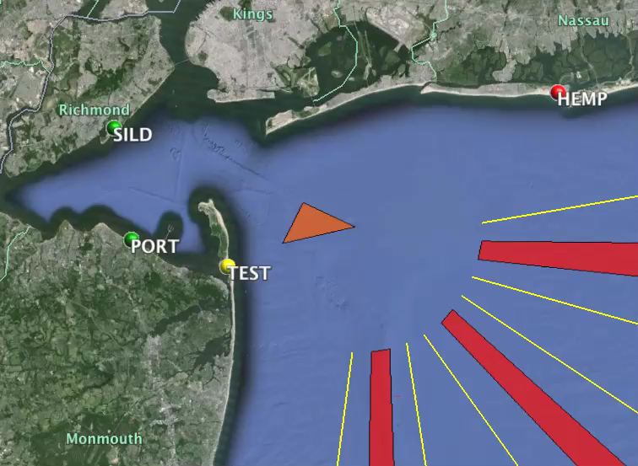

Slide 25
Environmental Conditions Analysis

Slide 26
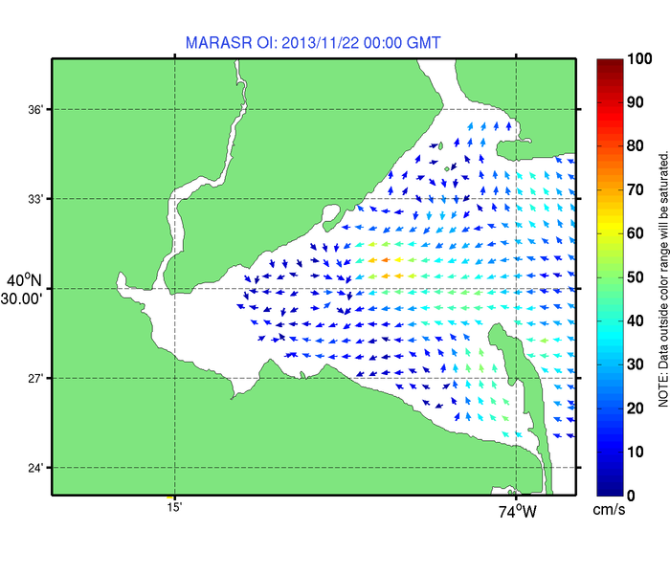

Slide 27
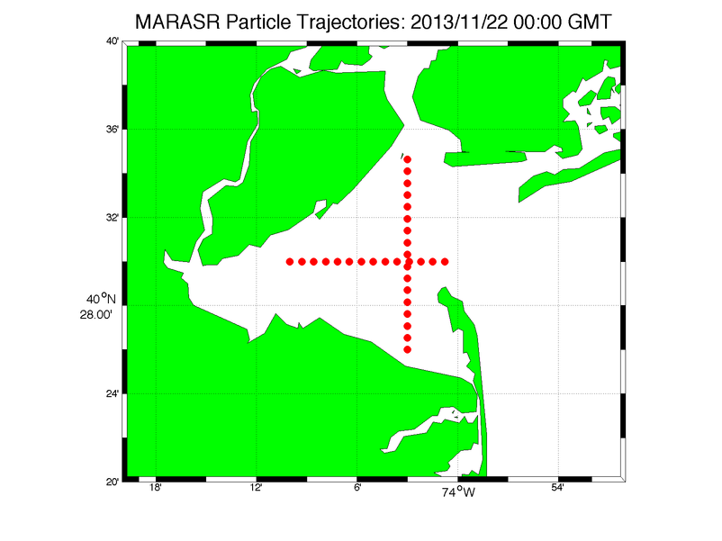

Slide 28
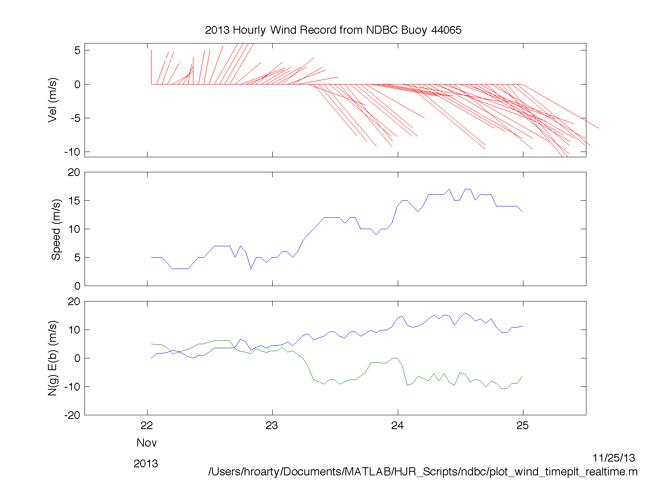

Slide 29
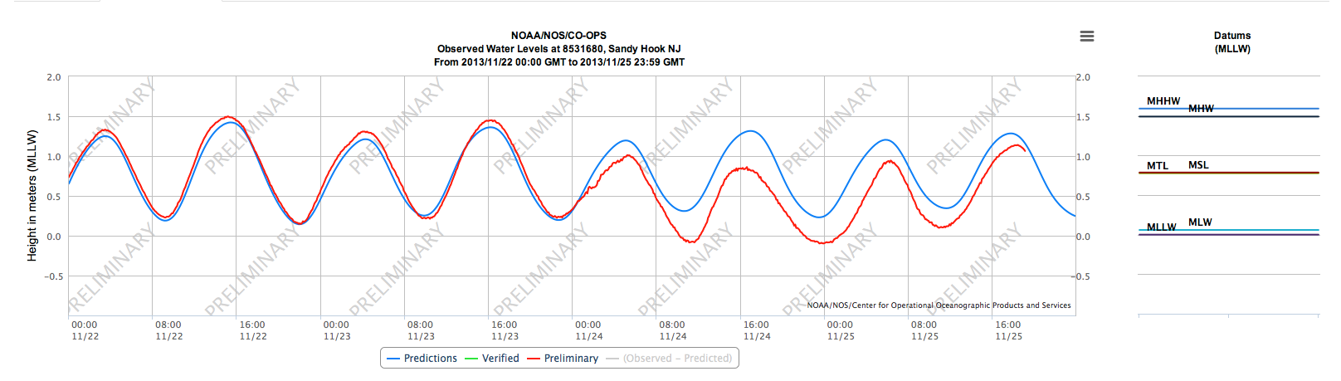

Slide 30
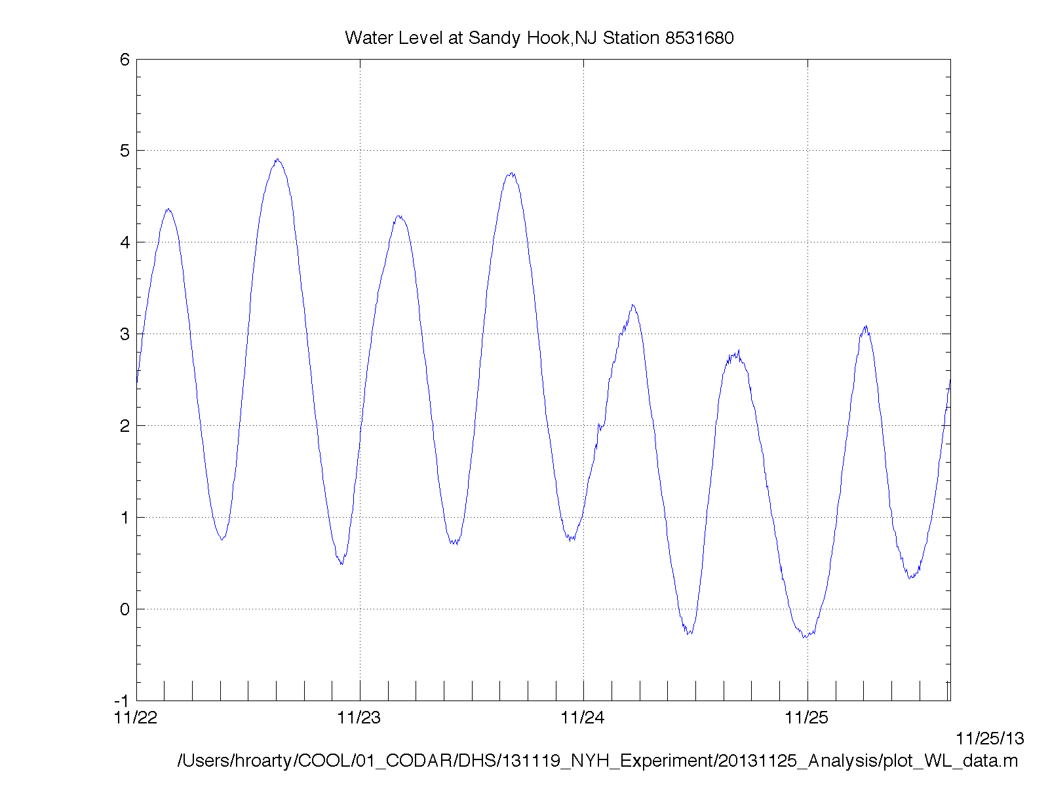

Slide 31
