Slide 1
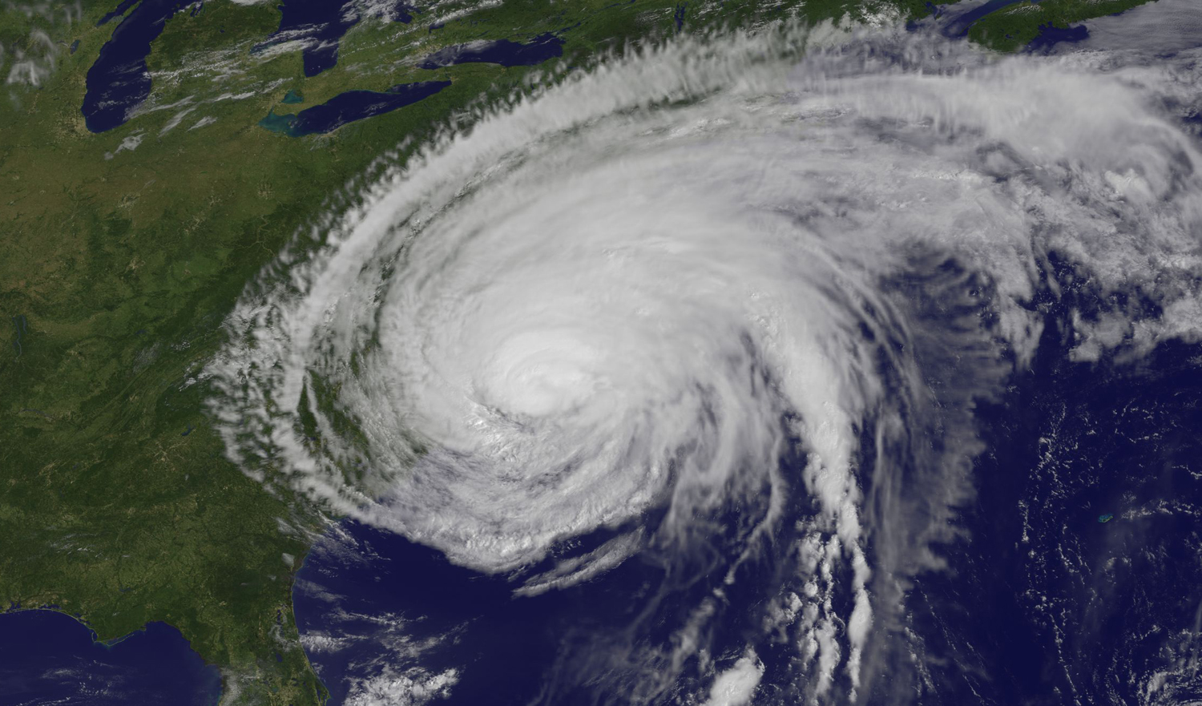
Impact of simple parameterizations of upper ocean heat content on modeled Hurricane Irene (2011) intensity
Greg Seroka, Travis Miles, Yi Xu, Scott Glenn, Oscar Schofield
Rutgers University Coastal Ocean Observation Lab
April 2, 2014
31st AMS Tropical Conference
Image Credit: NASA/NOAA GOES Project

Slide 2
Motivation
In August 2011, Hurricane Irene’s intensity was over-predicted by several hurricane models and over-forecast by the National Hurricane Center (NHC)
NHC final report on Irene:
Consistent high bias in official intensity forecasts
Incomplete eyewall replacement cycle in light wind shear and over warm South Atlantic Bight waters
High bias in operational analysis of intensity
Deep central pressure, strong flight-level winds but low surface winds
Notes:
Case study (Irene)

Slide 3
Governing factors of hurricane intensity
dry air intrusion
Question:
Did the upper ocean thermal structure and evolution (i.e. evolution of sea surface temperature, SST) contribute to Irene’s intensity over-prediction?
vertical wind shear
upper ocean thermal structure and evolution
hurricane track
After Emanuel et al. (2004)

Slide 4
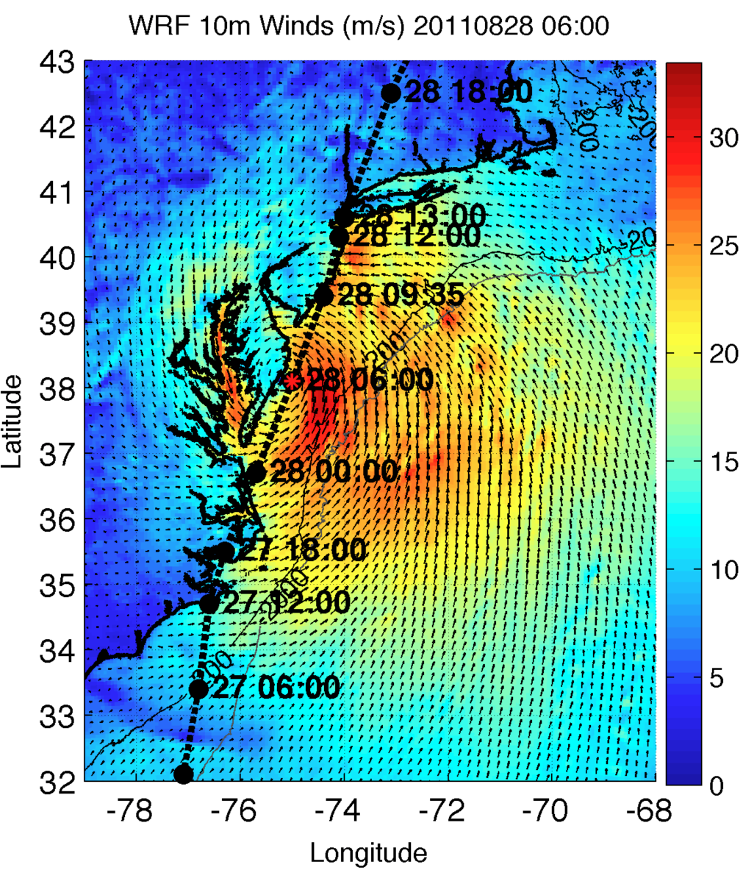
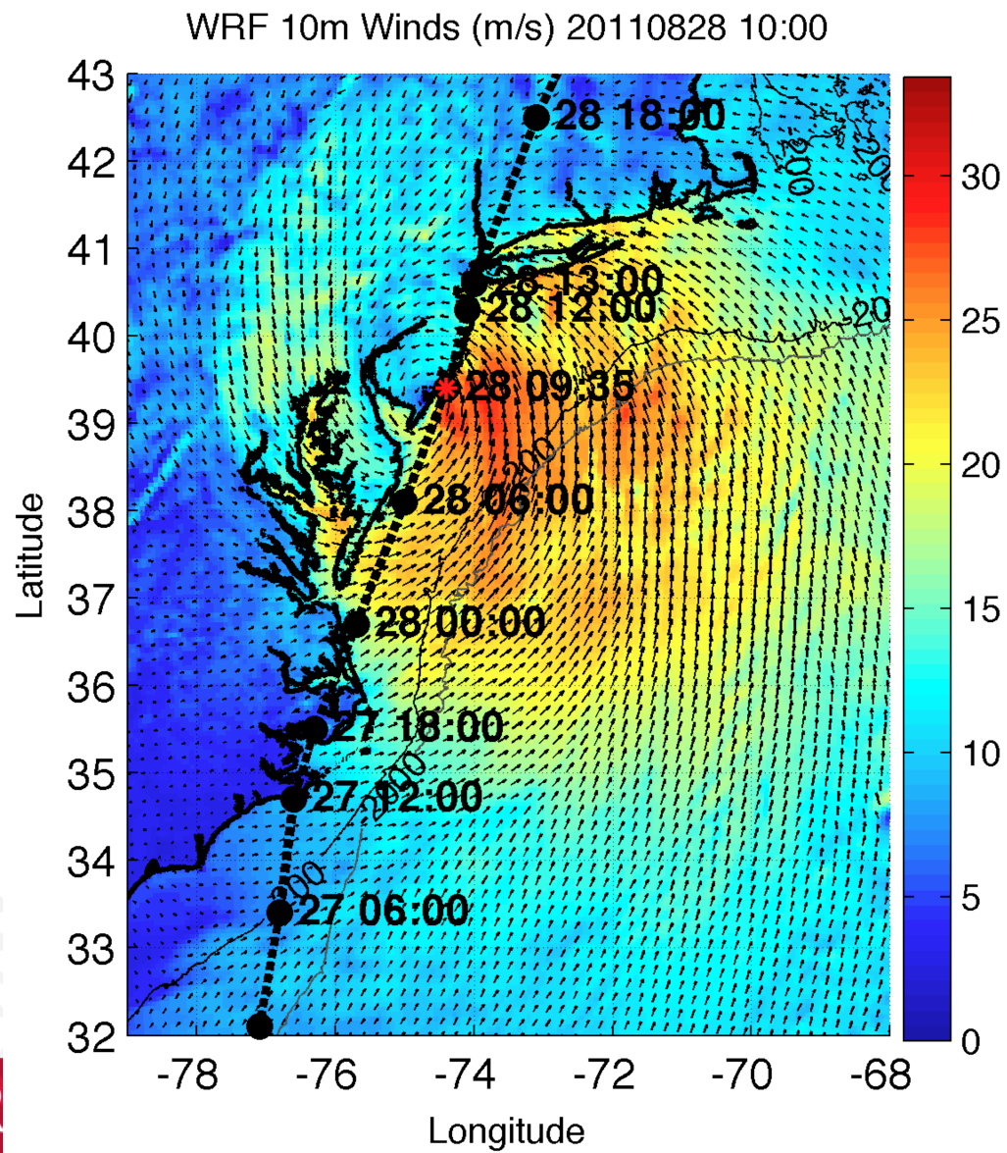
Hypothesis
We hypothesize that the models handled well:
hurricane track (use best boundary conditions);
06Z
10Z

Slide 5
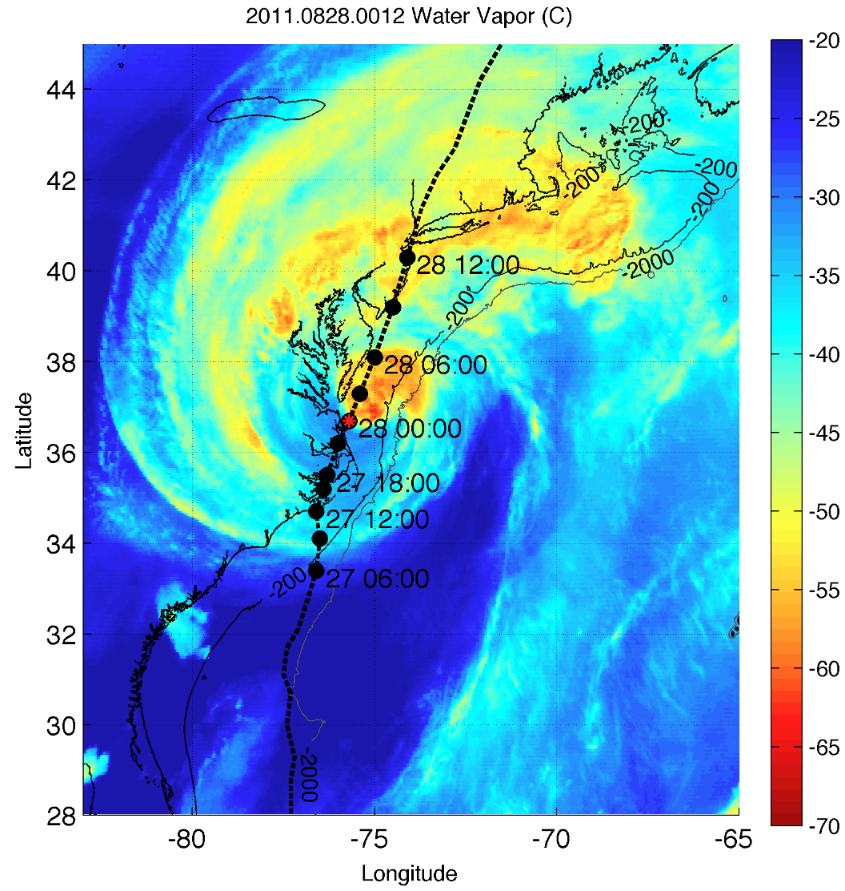
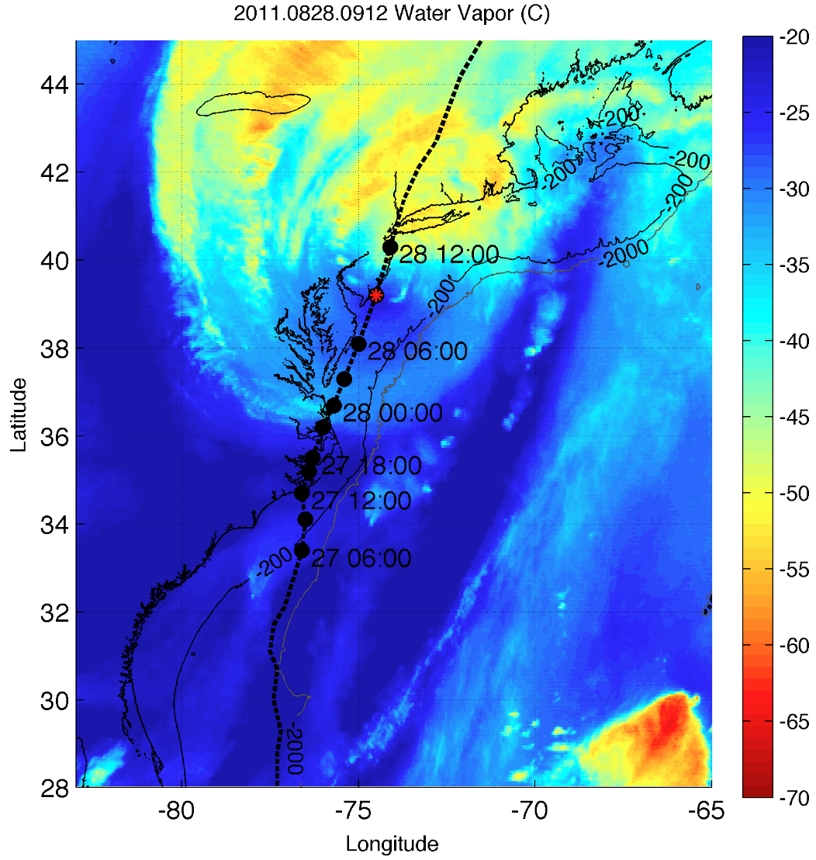
Hypothesis
5
We hypothesize that the models handled well:
hurricane track (use best boundary conditions);
vertical wind shear (TBD);
dry air intrusion (TBD);
GOES 13 Channel 3
00Z
09Z

Slide 6
Hypothesis
6
We hypothesize that the models handled well:
hurricane track (use best boundary conditions);
vertical wind shear (TBD);
dry air intrusion (TBD);
Some possible reasons:
Models have improved considerably on predicting tracks
Atmosphere tends to receive more attention in modeling
Models resolve large-scale processes fairly well
But models handled poorly:
upper ocean thermal structure and evolution
This talk aims to show the relative importance of ocean prediction for intensity forecasting of Hurricane Irene

Slide 7
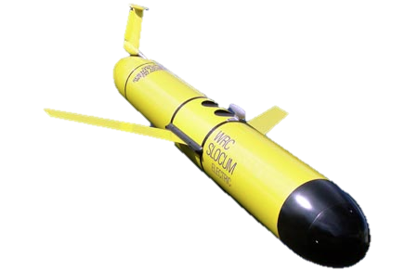
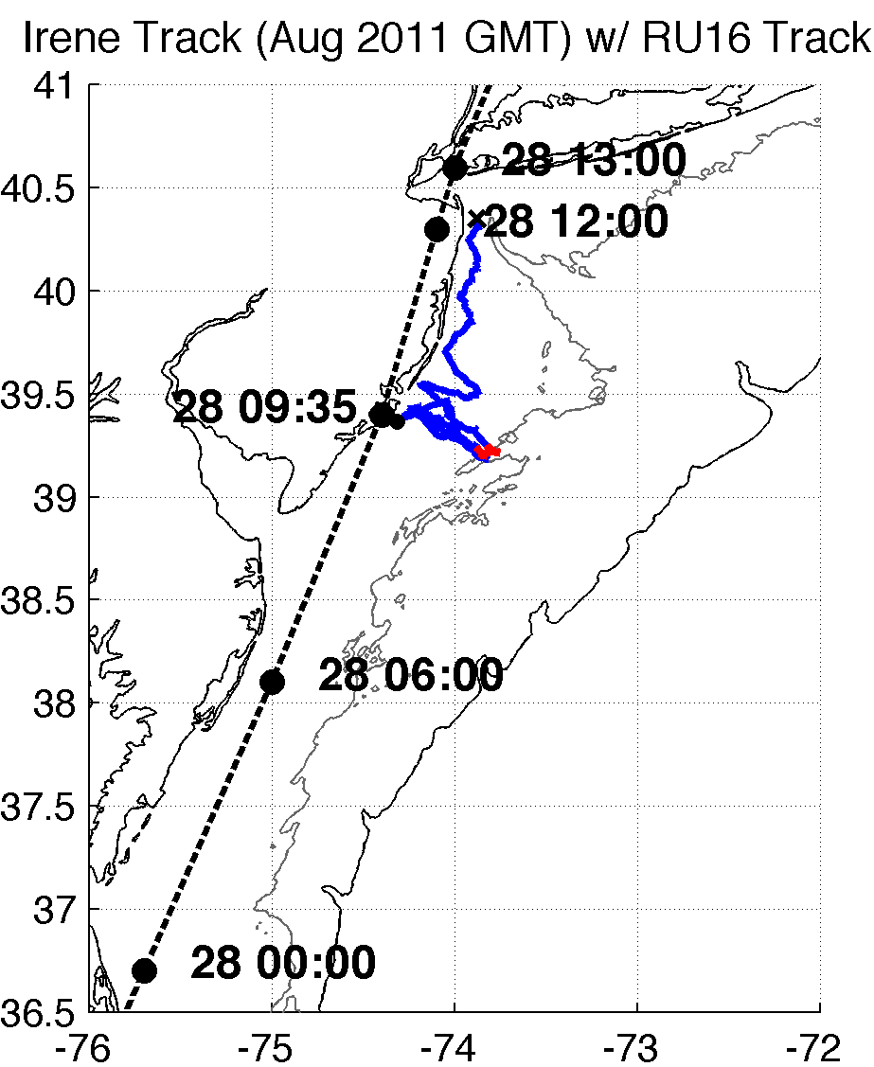
Methods – Observations and Model
7
RU16 Glider: at 40m isobath, right of eye track
Satellite (“Rutgers SST”): ~1km AVHRR 3-day coldest dark pixel SST composite (preserve cold wake); NASA SPoRT 2km SST for cloudy gaps
Model: 6km WRF-ARW, boundary conditions to get track correct (important because close to coast); no data assimilation
Full RU16 Glider Track
Irene RU16 Glider Track
40m isobath
200m isobath (shelf break)
Notes:
SST product is IR/near IR (AVHRR); SPoRT is IR/near IR as well
GFS 0.5 degree 08/27/11 06Z for boundary conditions
Modeling is semi-realistic/semi-idealized

Slide 8
Results
Glider (and buoy) data revealed that ocean mixing and resulting surface cooling preceded the passage of the eye
Improved satellite SST product revealed that this surface ocean cooling was not captured by:
Basic satellite products
Ocean models used for forecasting hurricane intensity
Over 100 sensitivity tests showed that Hurricane Irene intensity is very sensitive to this “ahead-of-eye” SST cooling

Slide 9
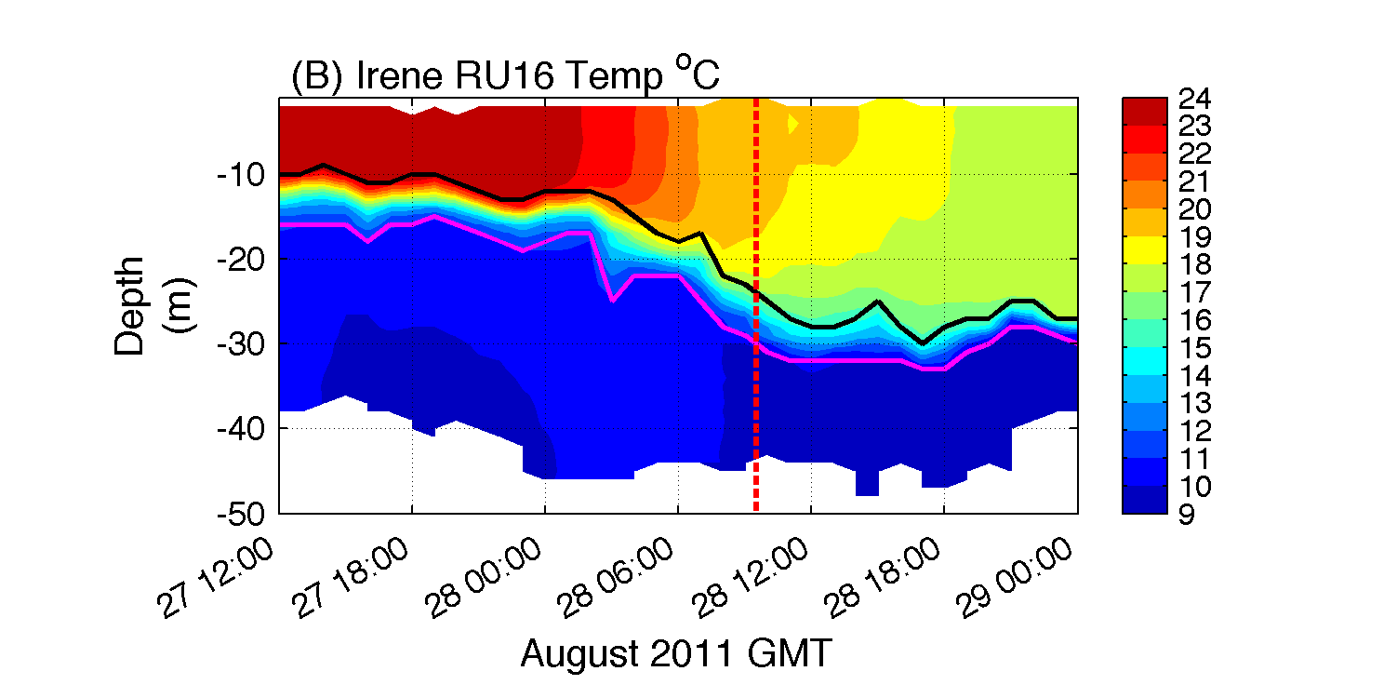
1. Glider revealed “ahead-of-eye” cooling
warm SSTs before storm
passage of eye
T (°C)
thermocline top
Ocean column mixing from leading storm winds cools surface
onshore surface currents
thermocline bottom
offshore bottom currents
Notes:
**HF radar for surface currents onshore, glider depth-averaged currents near zero, infer offshore bottom currents
BUOYS CORROBORATED AHEAD OF EYE COOLING
Coastal downwelling circulation, which resulted in shear across thermocline, turbulence/entrainment, and finally surface cooling
Fire escape at bottom for less storm surge, fire extinguisher at top for weakening storm
Inertial response likely cooled remaining waters post-storm

Slide 10
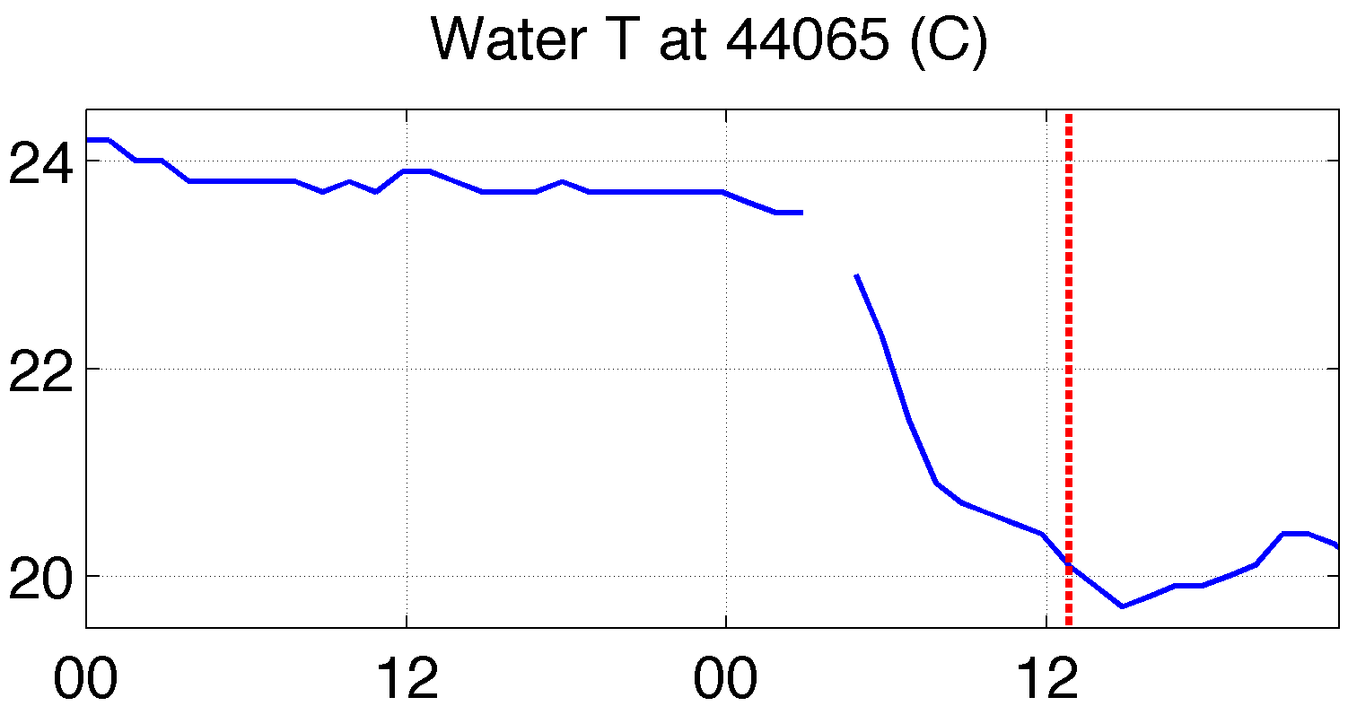
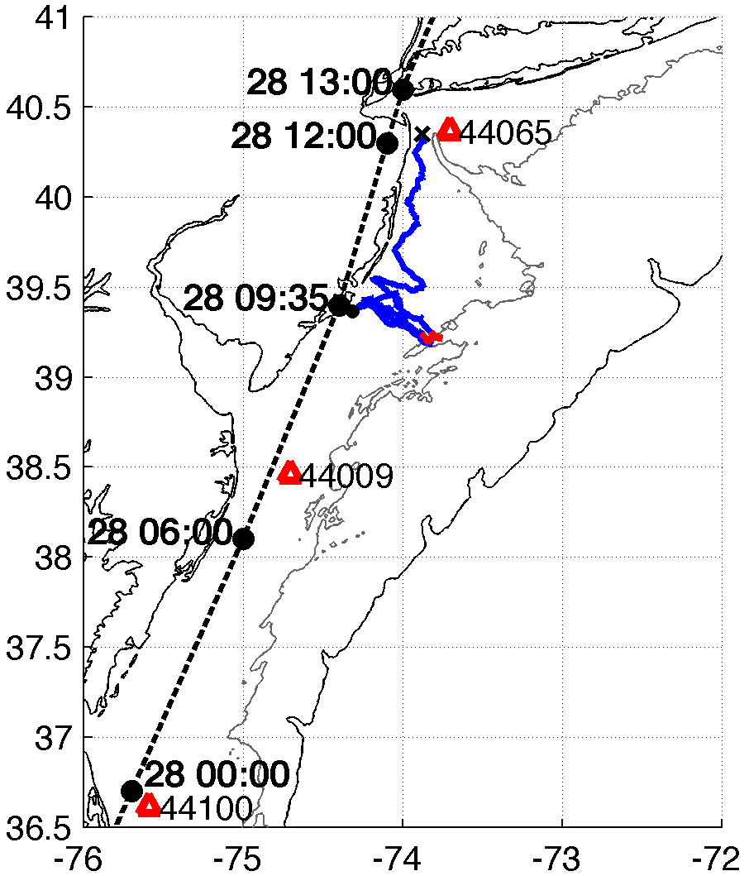
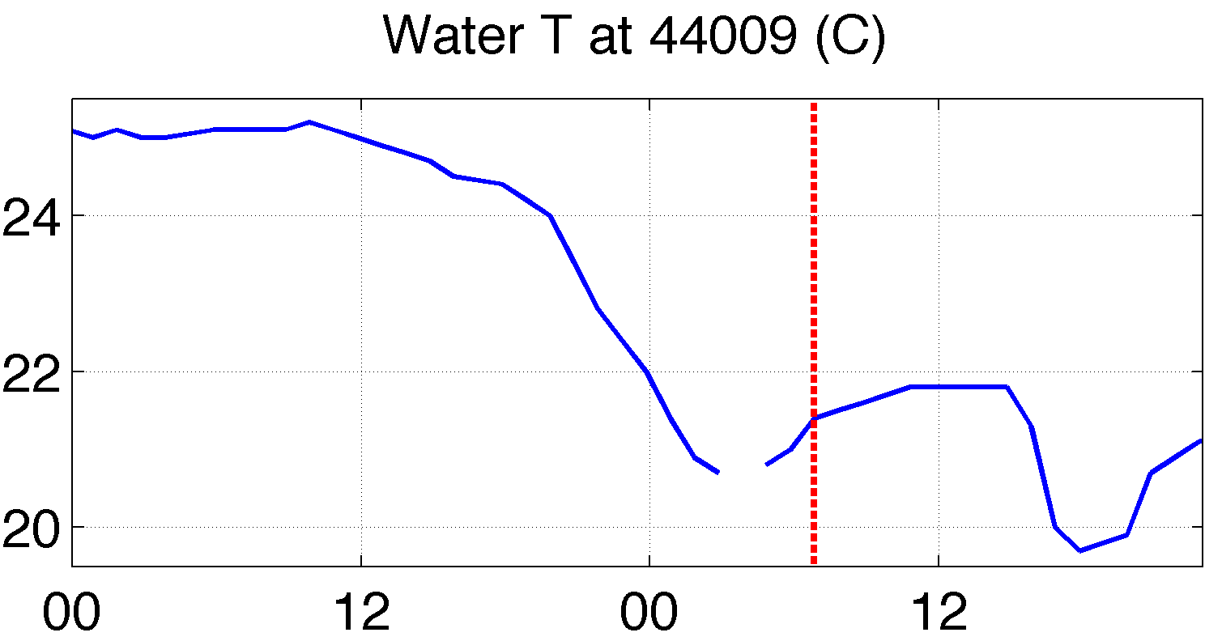
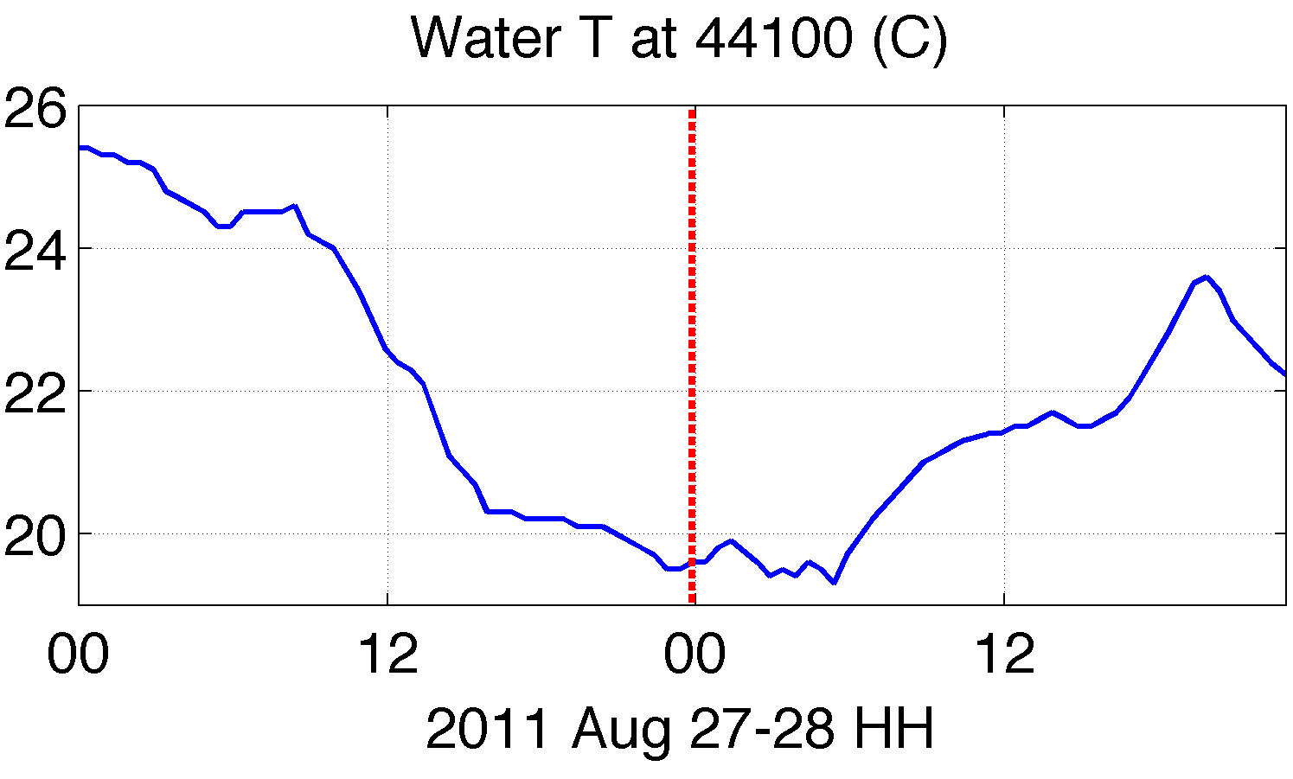
1. Buoys corroborated “ahead-of-eye” cooling along entire MAB track
passage of eye
4
3
4
3
2
2
1
1

Slide 11
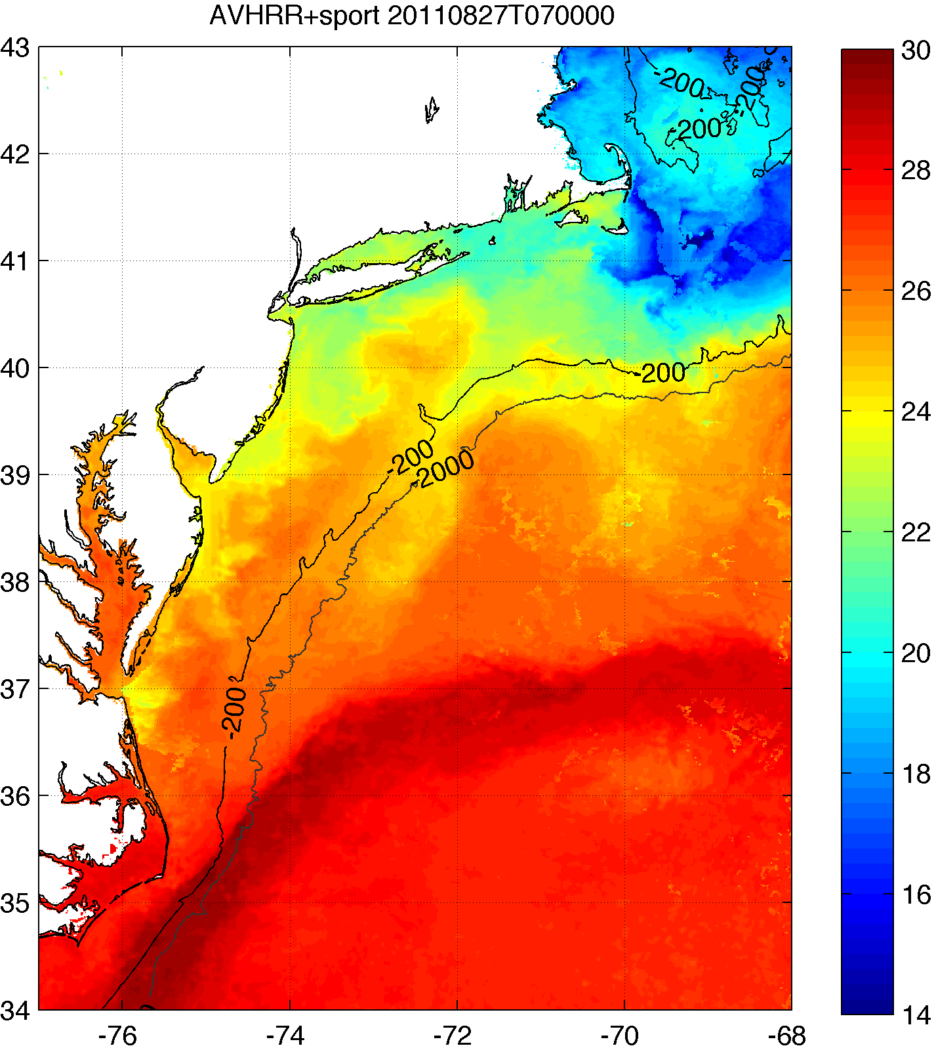
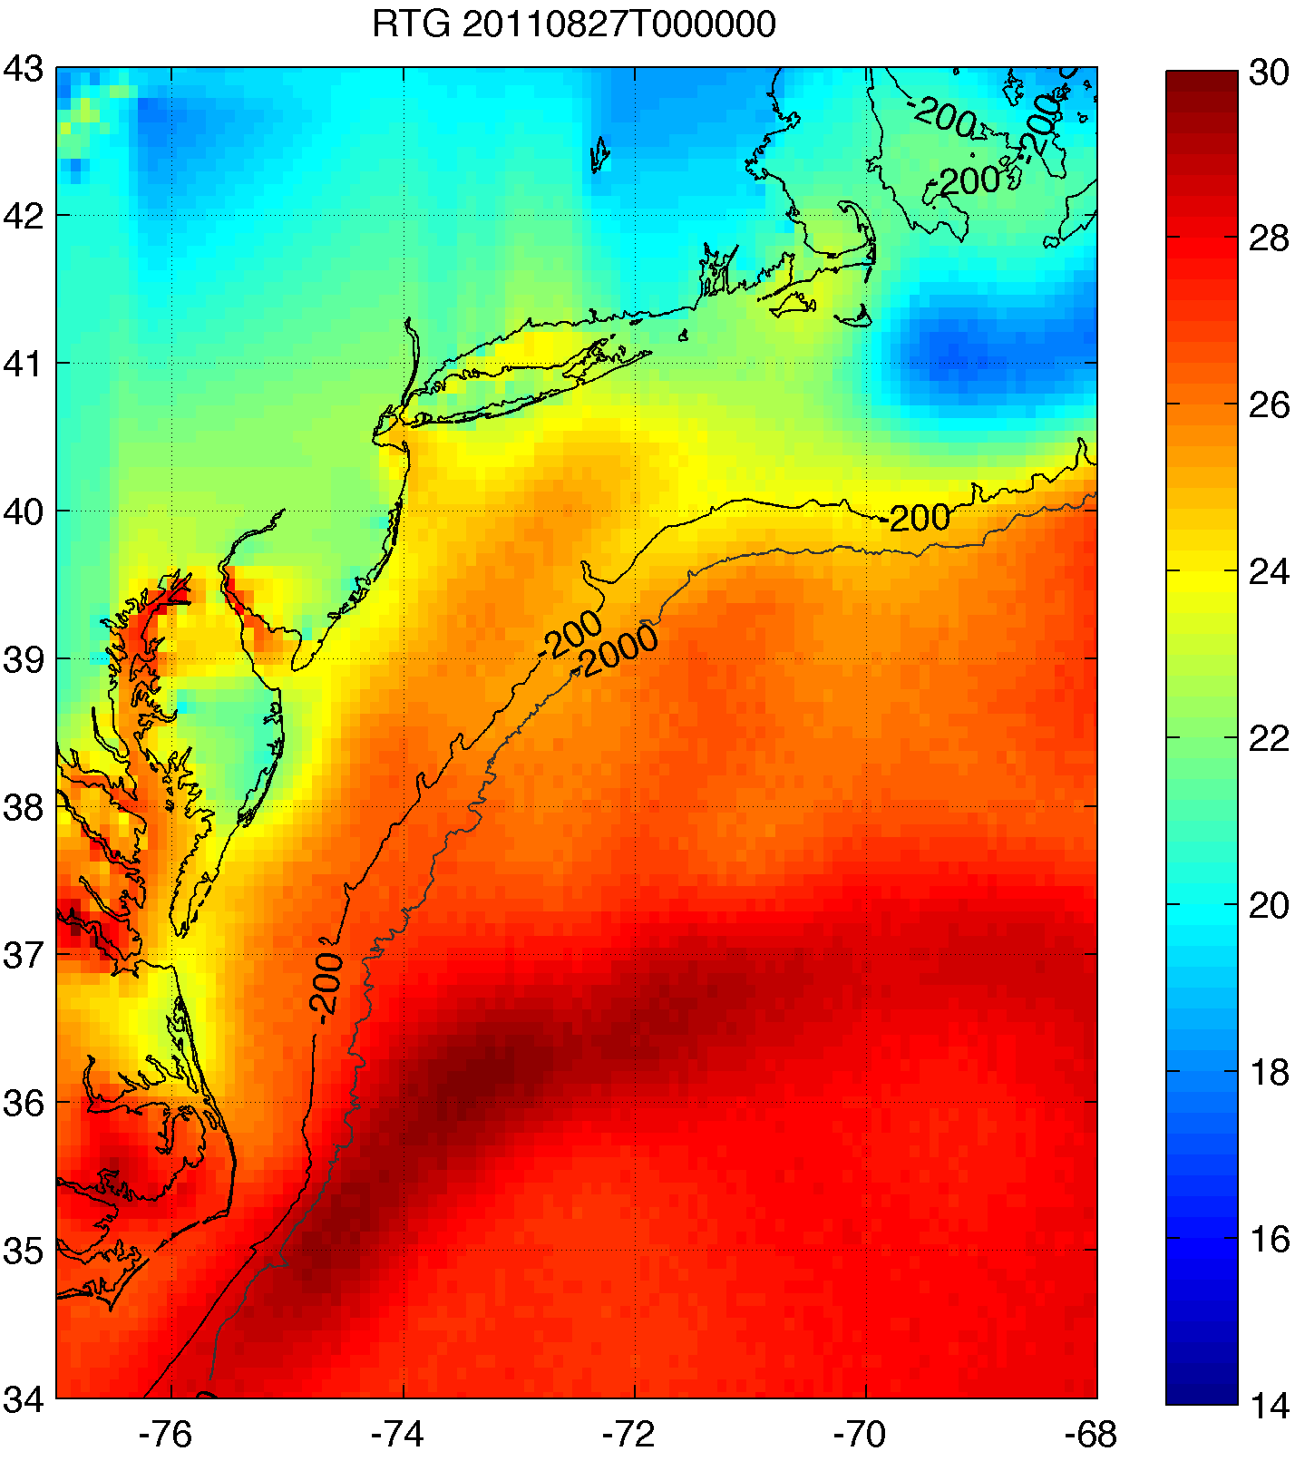
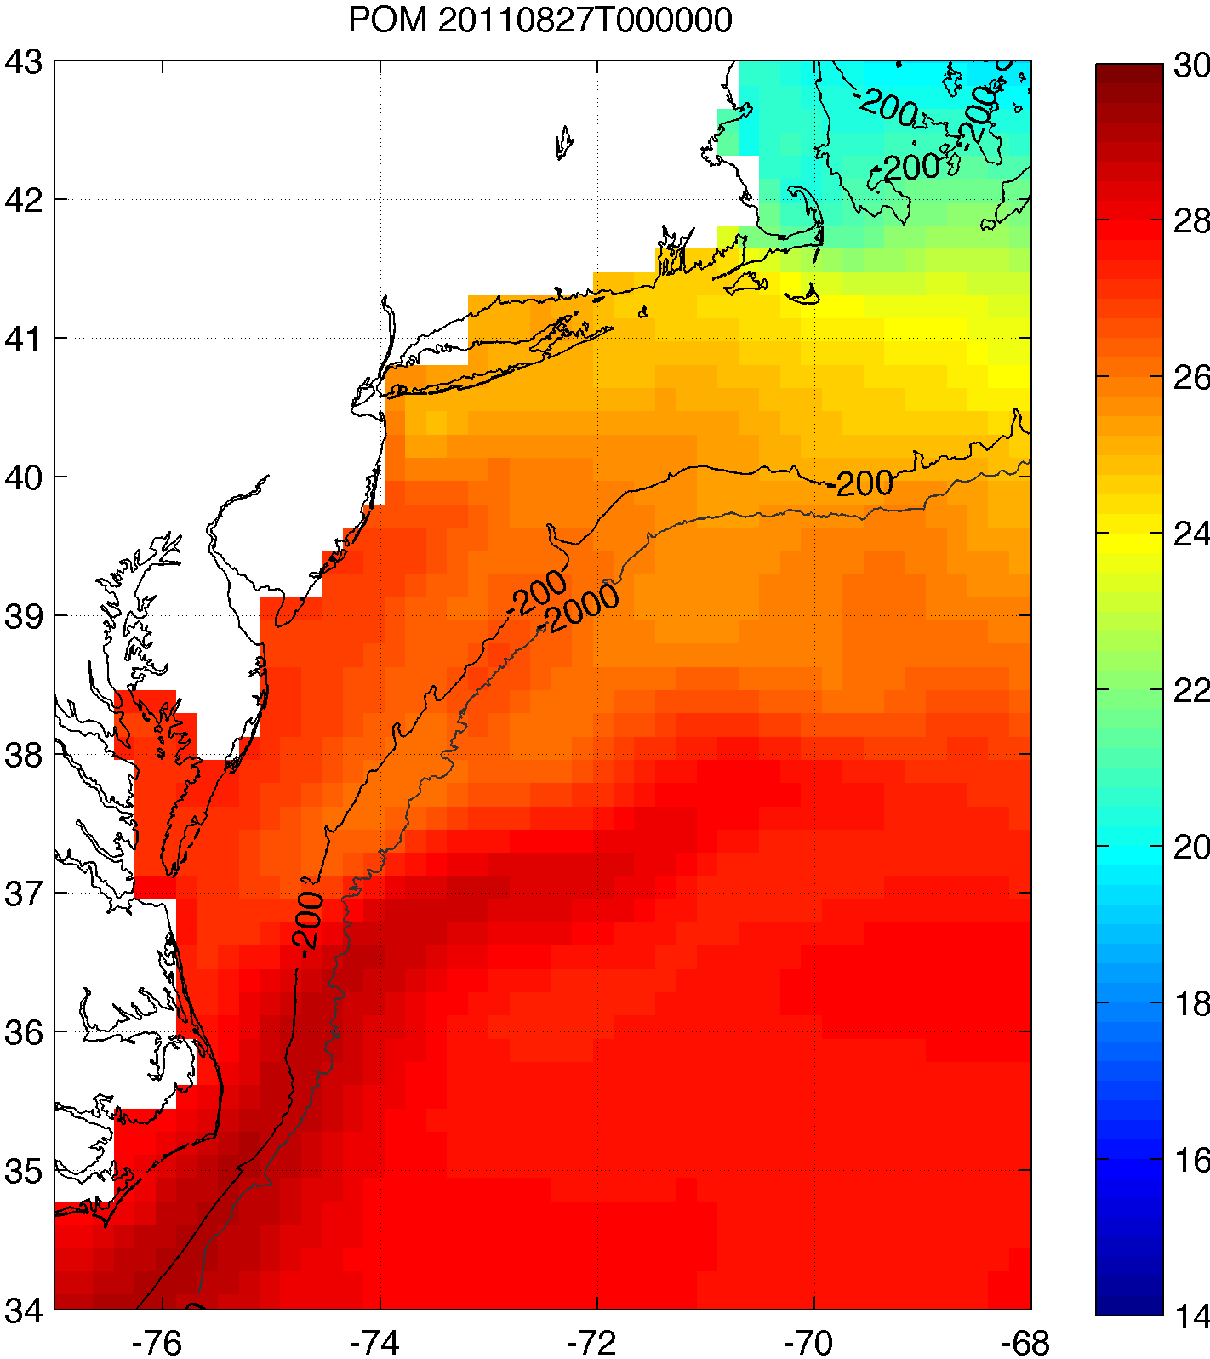
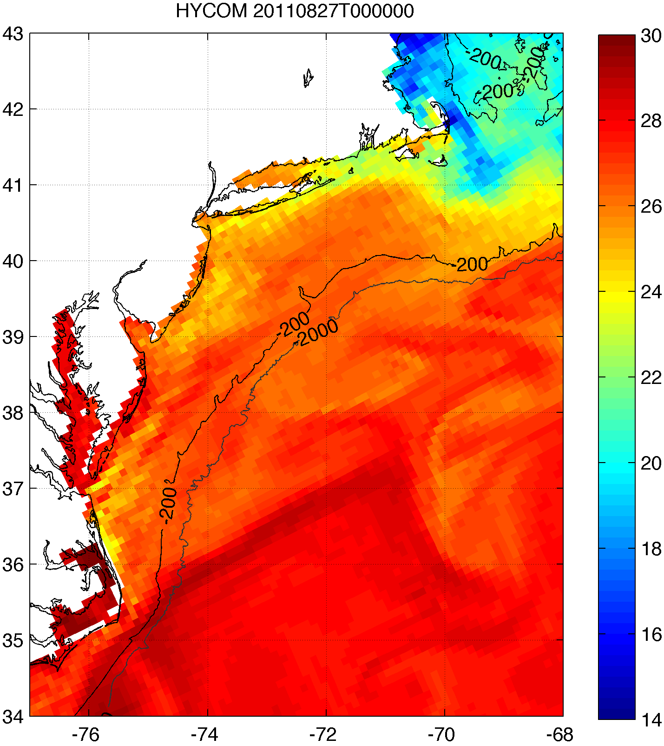
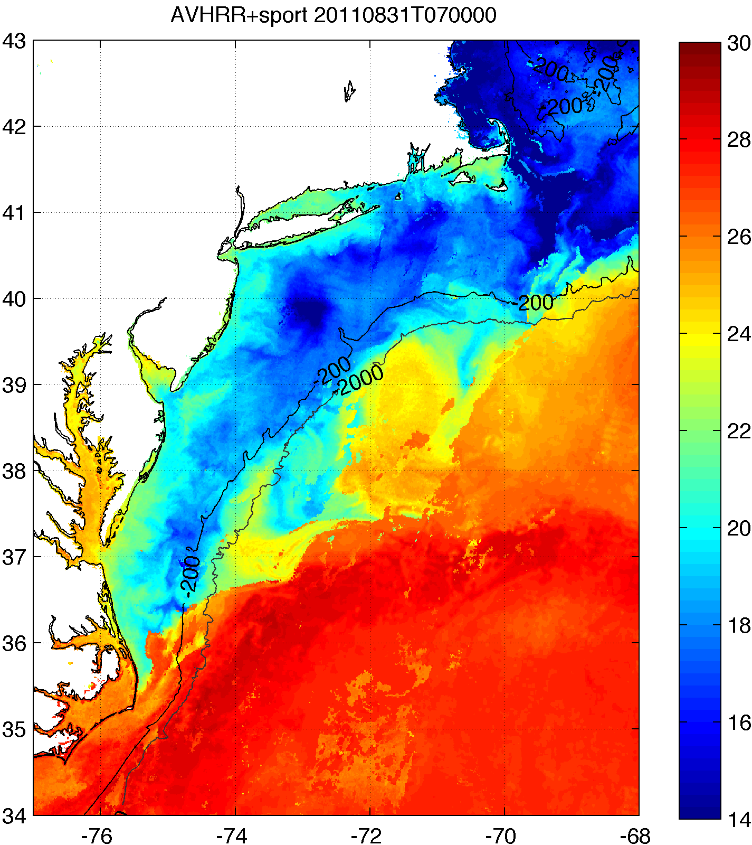
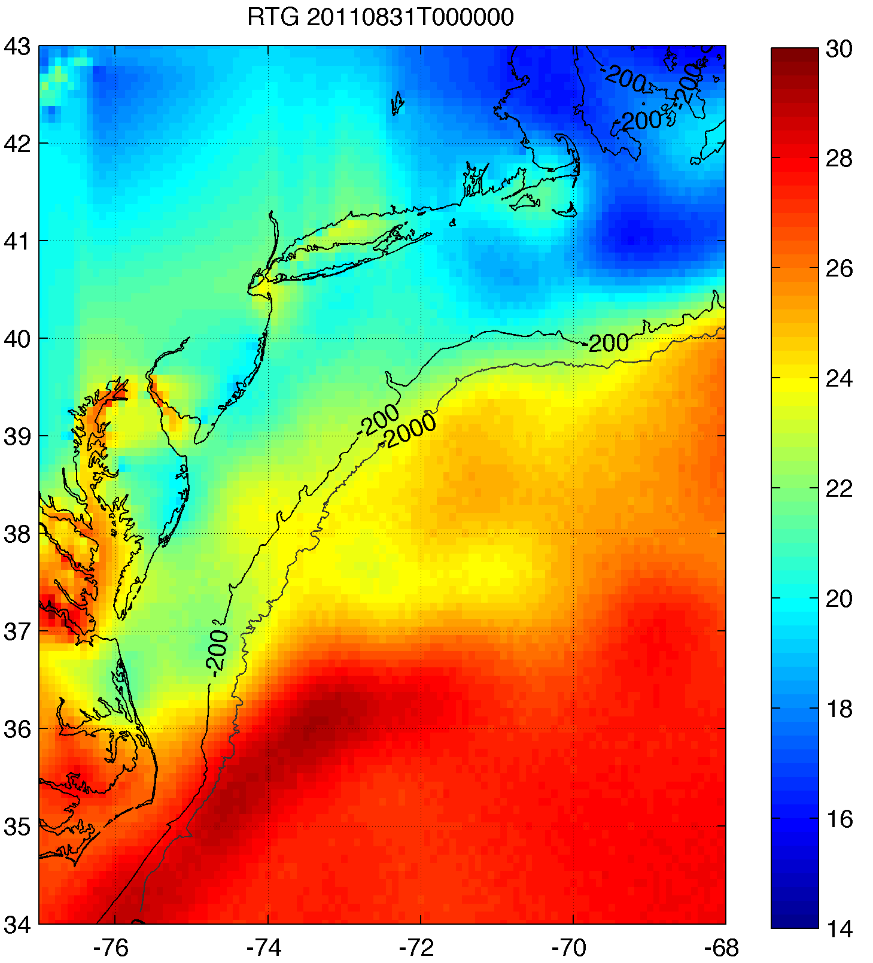
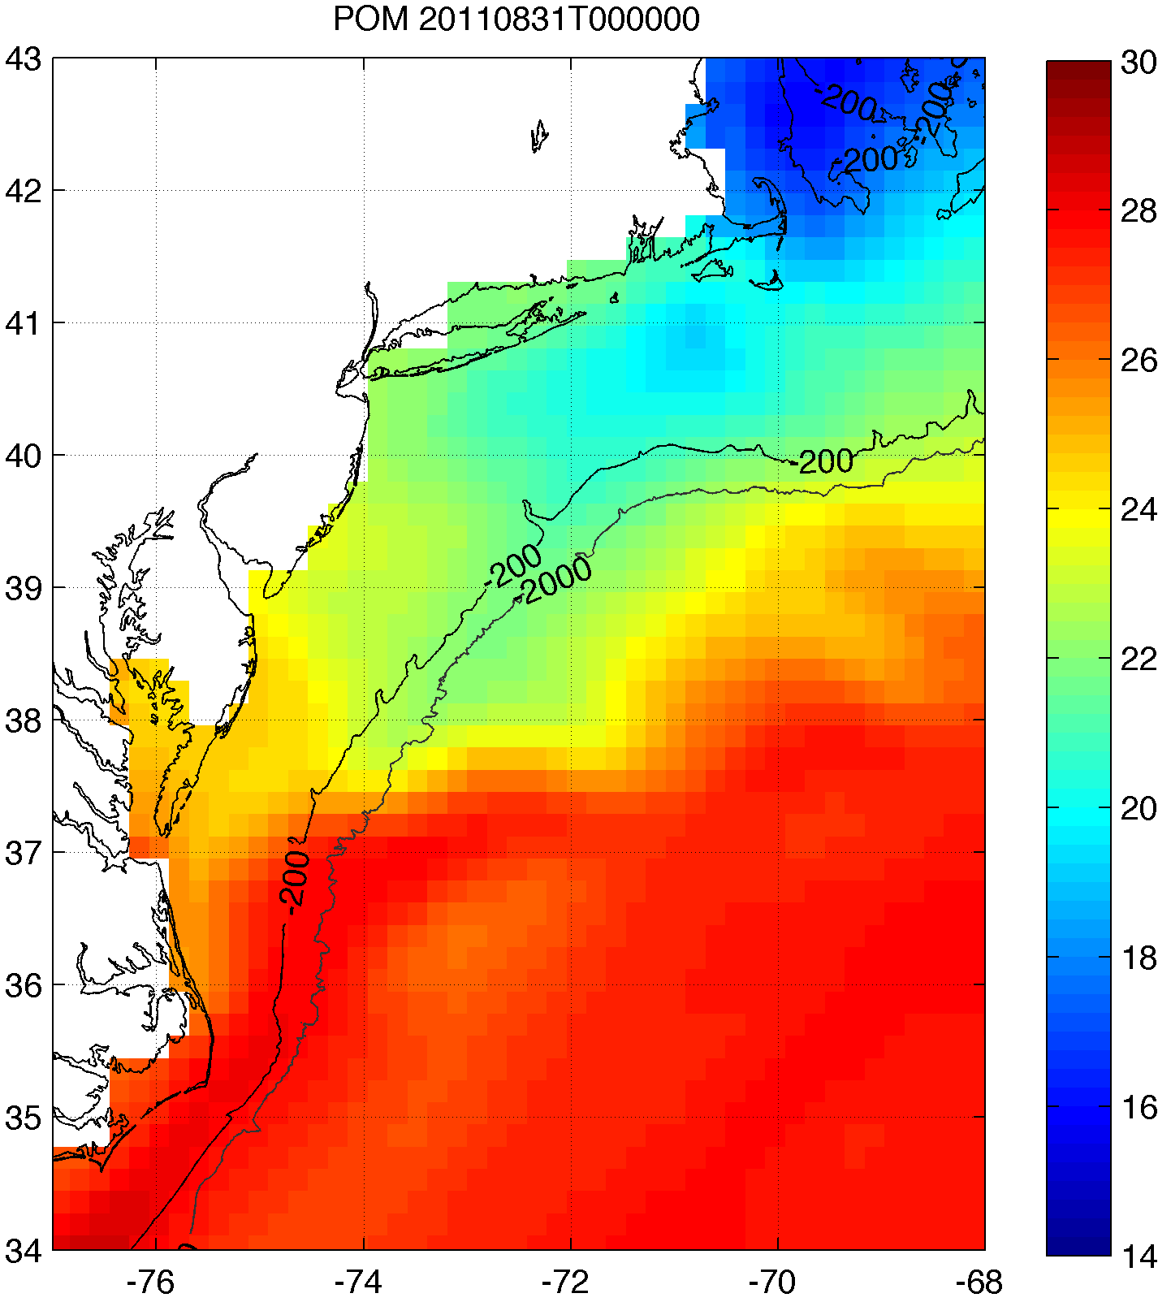
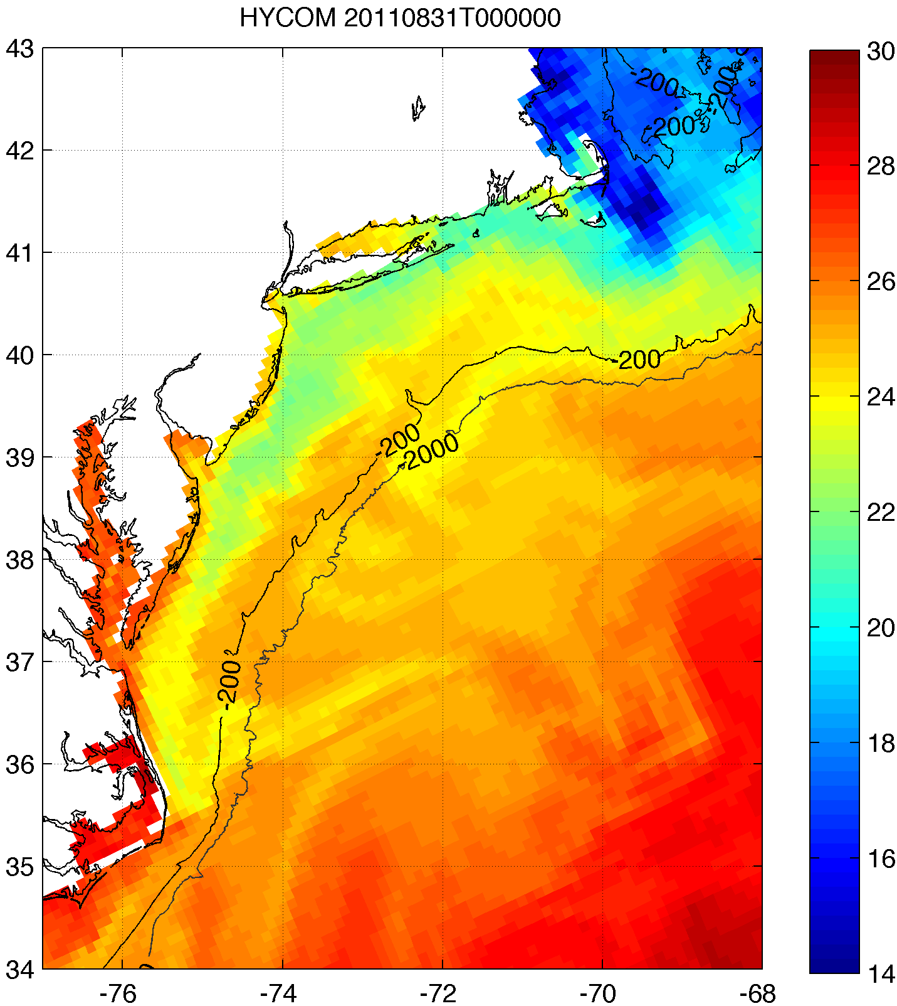
2. Improved satellite SST product revealed that this cooling was not captured by:
basic satellite product
ocean models used for forecasting hurricane intensity
Rutgers SST
RTG HR SST
NAM model
HWRF-POM
low res
HWRF-HYCOM
medium res
BEFORE IRENE
AFTER IRENE
Notes:
Caveats: different atmospheric forcing, etc.
Rutgers SST: 2km, RTG: 1/12 deg, ~9 km, HWRF-POM: 18km, HWRF-HYCOM: 1/12 deg, ~9km

Slide 12
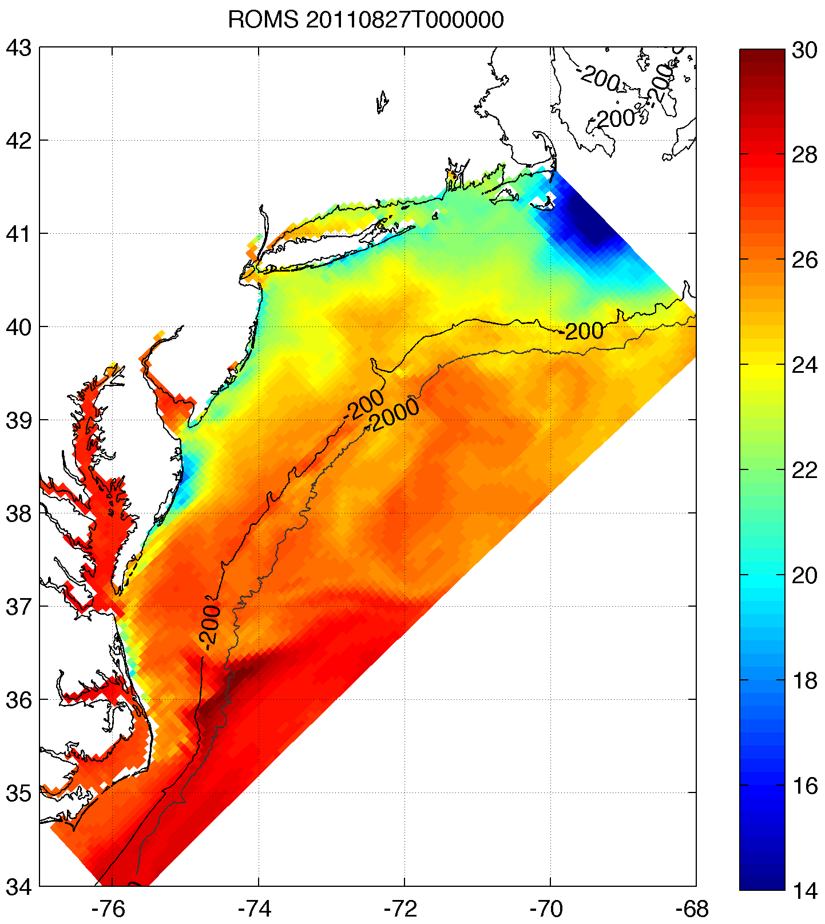
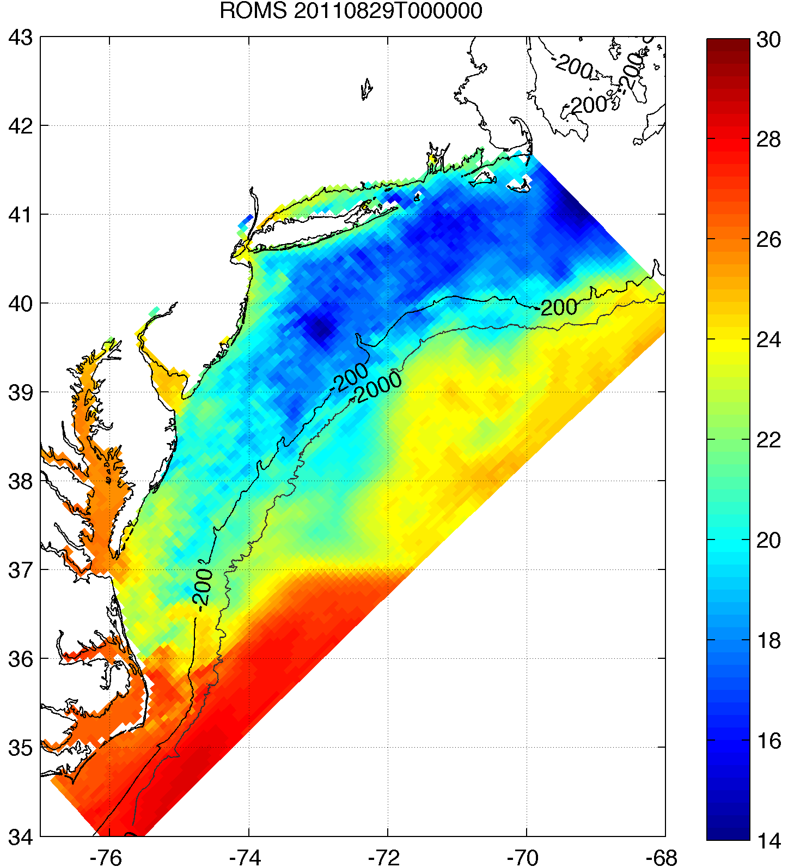
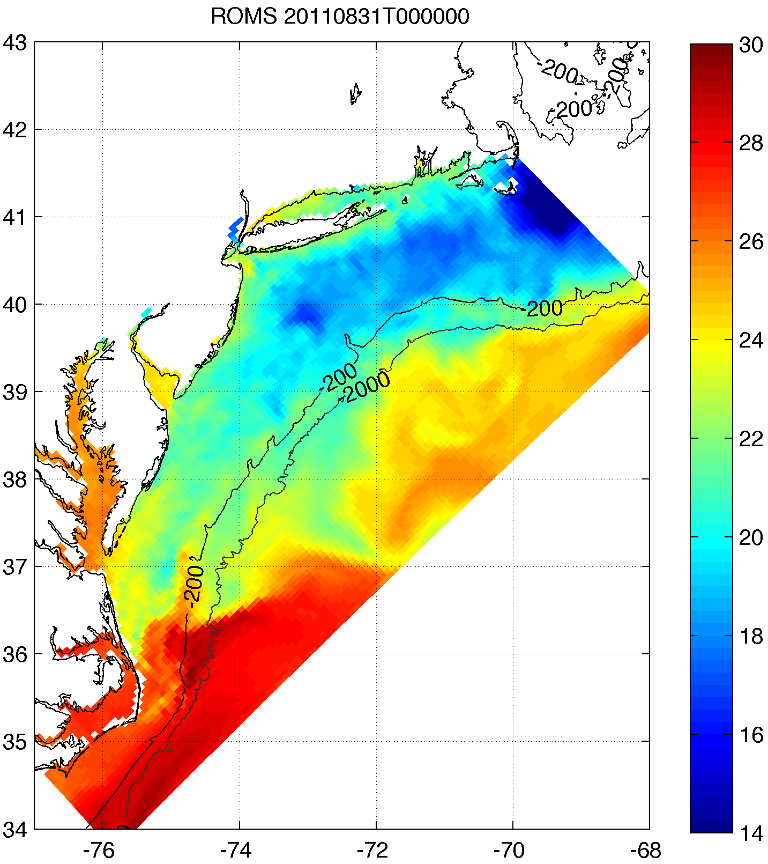
2. However, cooling was captured by high res ocean models
Rutgers composite showed that cooler SSTs are captured relatively well by high res coastal ocean models not specifically used for forecasting hurricanes
Rutgers SST
ROMS ESPreSSO
BEFORE
RIGHT AFTER
AFTER
Notes:
Caveats: -ROMS ESPreSSO run shown initialized 8/27/11 00Z, while HWRF-POM and HWRF-HYCOM initialized 8/26/11 00Z, 24 hrs earlier
-Satellite SST product is 3-day composite, so possible that post-storm cooling did not persist as long as satellite shows
ROMS resolution: 5 km

Slide 13
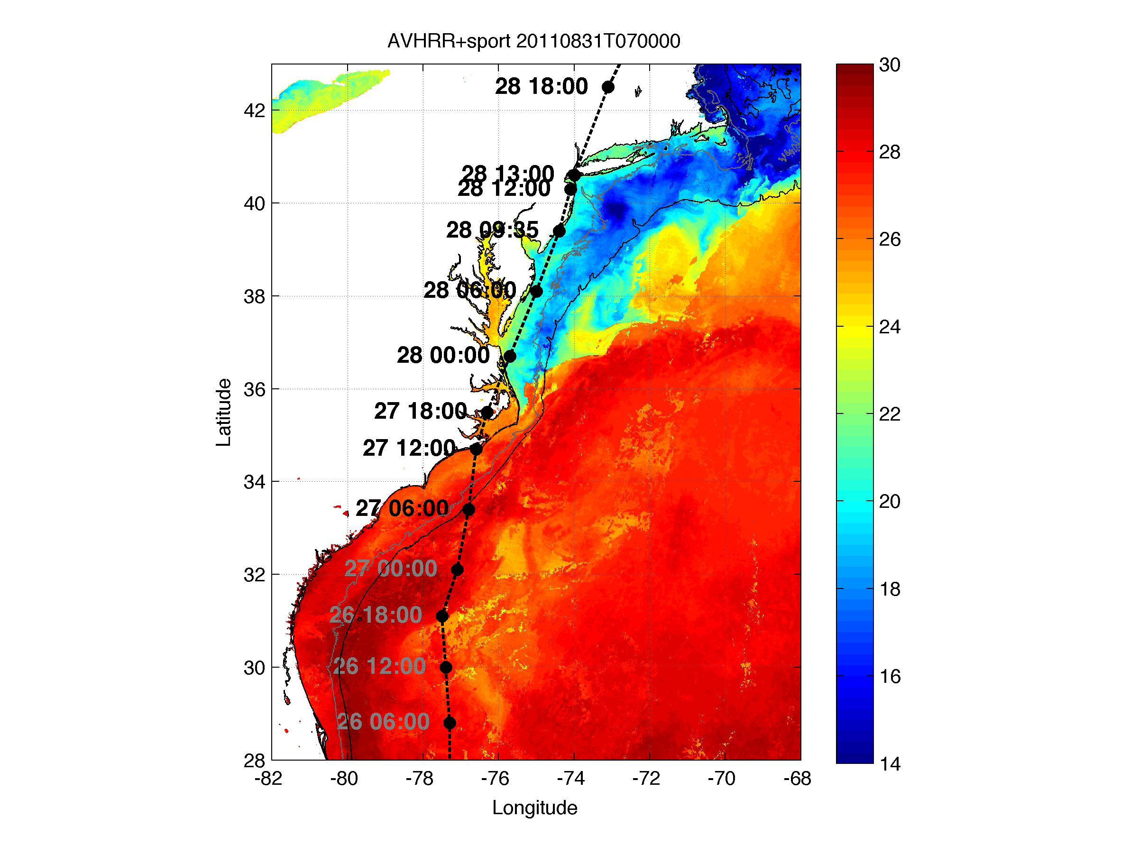
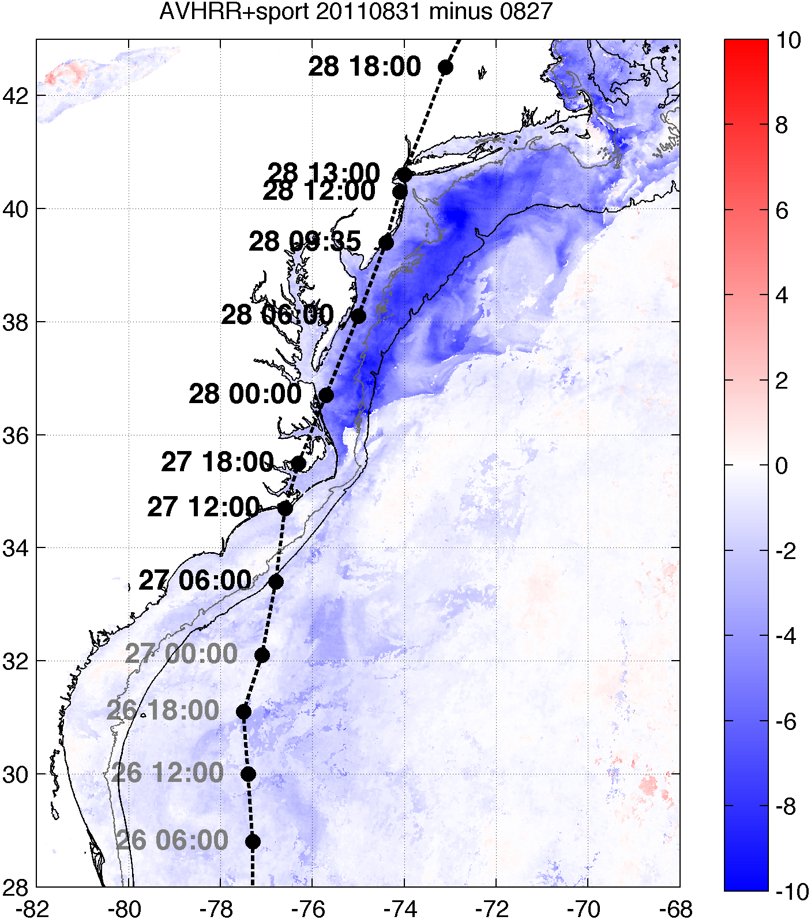
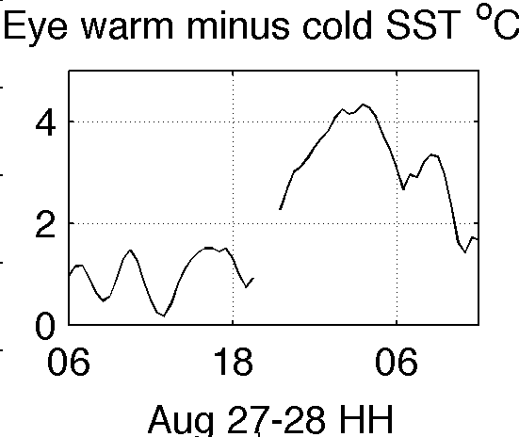
Another look at the cooling to explain SST sensitivity set-up…
T (°C)
T (°C)
model time
obs show MAB cooling is ahead of eye
less SAB cooling
BEFORE
AFTER
COOLING
Momentum flux: τ = -ρC_{D}U² Sensible heat flux: H = -(ρc_{p})C_{H}U(θ_{2m} – θ_{sfc})
Latent heat flux: E = -(ρL_{ν})C_{Q}U(q_{2m} – q_{sfc})
SAB
MAB
Notes:
-model initialized 27/0600 (first 6 hours over SAB)
-cooling over SAB much less than over MAB
-with buoys and glider showing majority of cooling ahead of eye, use post-storm SST (Rutgers) compared to pre-storm SST (RTG)

Slide 14
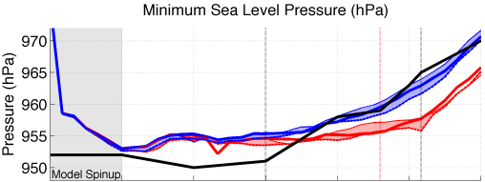
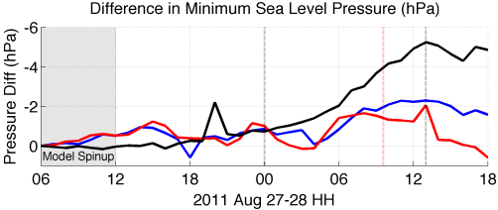
3. >100 sensitivity tests showed Irene intensity very sensitive to this “ahead-of-eye” SST cooling
Over Mid-Atlantic Bight & NY Harbor
NJ landfall
NHC Best Track
Warm pre-storm SST, WRF isftcflx=2
Warm pre-storm SST, isftcflx=1
Warm pre-storm SST, isftcflx=0
Cold post-storm SST, isftcflx=2
Cold post-storm SST, isftcflx=1
Cold post-storm SST, isftcflx=0
Sensitivity to SST (warm minus cold), isftcflx=2
Sensitivity to air-sea flux parameterization (isftcflx=1 minus isftcflx=0), warm SST
Sensitivity to air-sea flux parameterization (isftcflx=1 minus isftcflx=0), cold SST
Notes:
See extra slides for air-sea flux parameterization explanation (and what we are changing in the equations when we change SST)
See extra slide for time series of wind time series (and NHC over-prediction), 1D ocean mixed layer model results (and issues)

Slide 15
Conclusions
Large majority of SST cooling occurred ahead of Irene’s eye
Glider observed coastal downwelling, which resulted in shear across thermocline, turbulence/entrainment, and finally surface cooling
We determined max impact of this cooling on storm intensity (fixed cold vs. fixed warm SST)
One of the largest among tested model parameters
Some surface cooling occurred during/after eye passage
Actual impact of SST cooling on storm intensity may be slightly lower
A 1D ocean model cannot capture 3D coastal ocean processes resulting in important “ahead-of-eye” SST cooling
A 3D high res ocean model (e.g. ROMS) nested in a synoptic ocean model could add significant value to tropical cyclone (TC) prediction in the coastal ocean—the last hours before landfall
Notes:
This one case study can be the beginning of a whole series of case studies to quantify the value of 3D ocean modeling to TC intensity forecasting

Slide 16
Future work
Improve model spin-up issues
Validate wind shear and dry air intrusion
Evaluate storm size and structure
Compare modeled to observed heat fluxes
Move towards accurate fully coupled WRF-ROMS system
WRF w/ hourly ROMS SST
WRF coupled w/ 3D Price-Weller-Pinkel ocean model
WRF-ROMS
More case studies to quantify value of 3D ocean prediction to TC intensity forecasting, eventually across season(s)
Notes:
Observed sensible heat flux from buoys, latent from satellites?
Last bullet point is a collective future work direction

Slide 17
Thank You

Slide 18
Extra Slides

Slide 19
“Rutgers SST” Satellite Composite
Clean up AVHRR scans
Remove sun glint, data close to edge
Decloud (specific to MAB)
AVHRR Channel 2 (0.725-1 μm) tests:
Remove if near IR albedo > 2.3%
Remove if Δnear IR albedo > 0.15% within 3km x 3km box
AVHRR Channel 4 (10.3-11.3 μm) tests:
Remove if T < 5°C (summer), 3.5°C (winter)
Remove if ΔT > 1°C within ~3km x 3km box
3-day coldest pixel composite with NASA SPoRT 2km SST
Keep only coldest pixel between SPoRT SST and 12-17 UTC AVHRR scans
AVHRR Channel 2 needs daytime
Hurricane cooling
Coastal upwelling

Slide 20
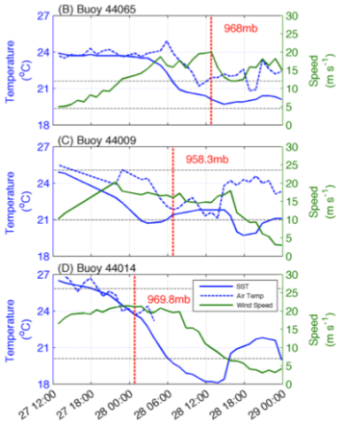
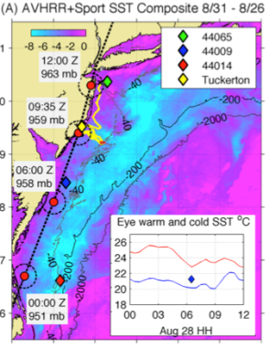
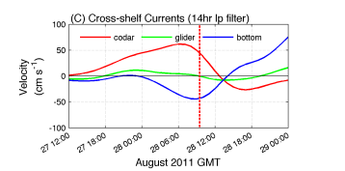
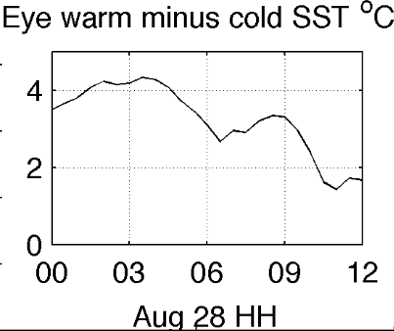
Glider, buoy, and HF radar obs.
At surface
Below surface

Slide 21
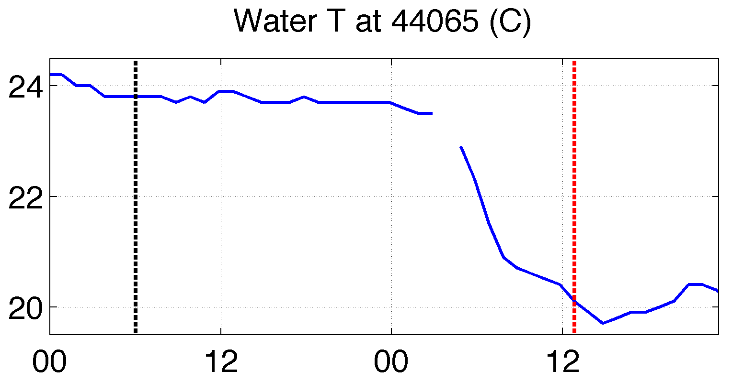
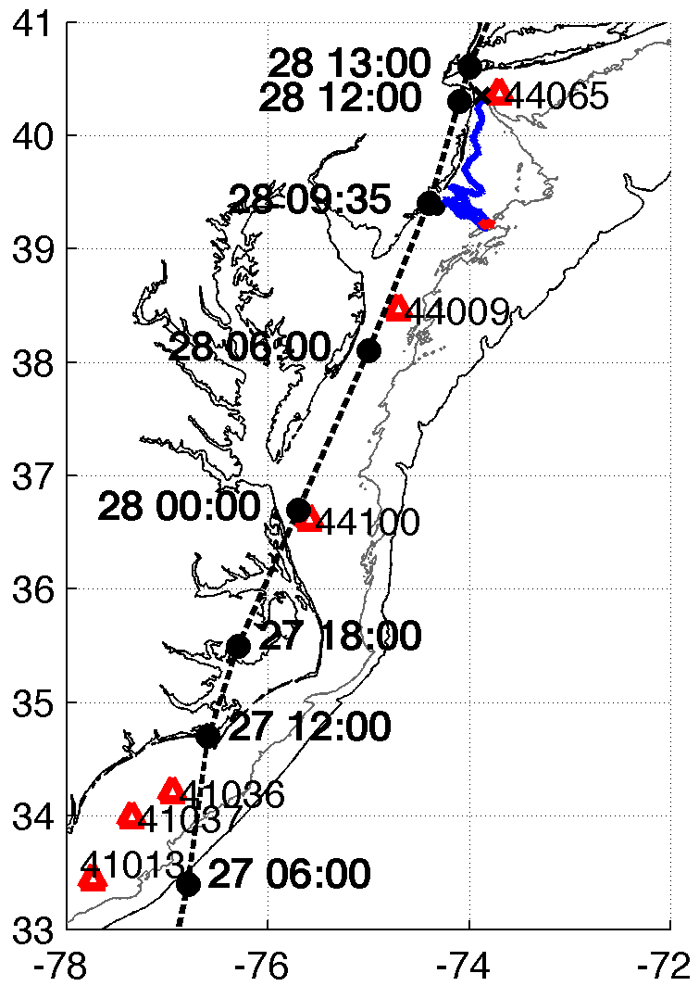
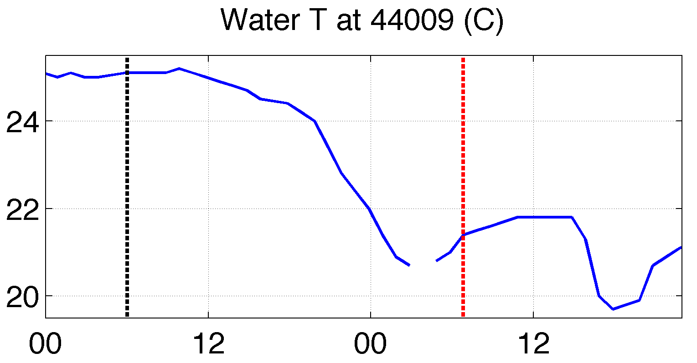
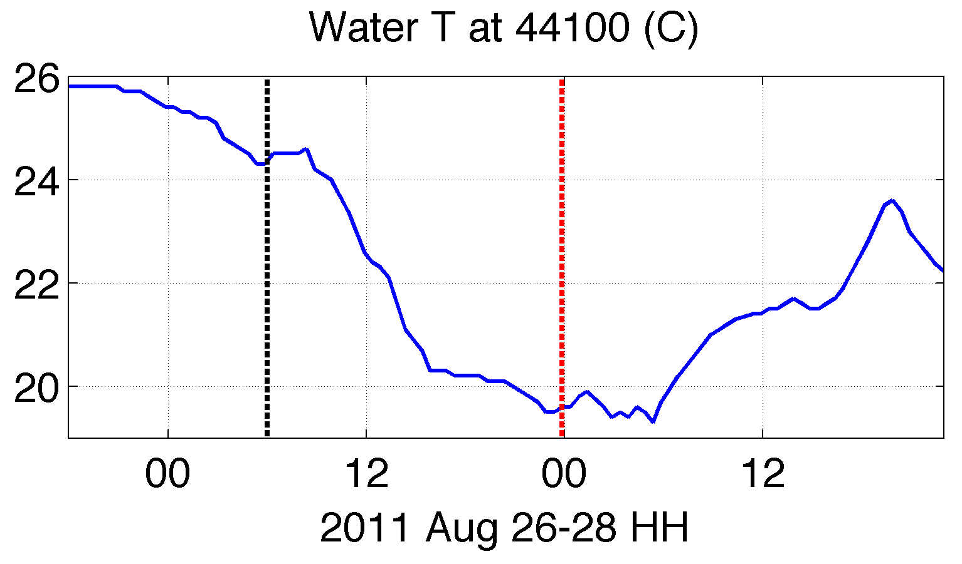
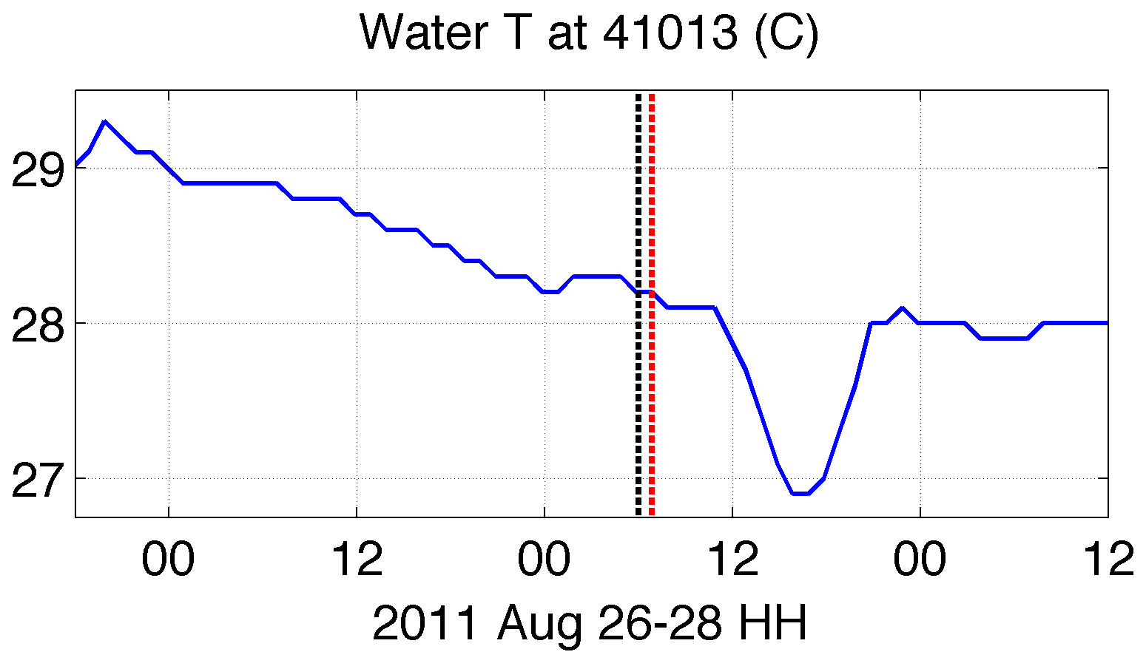
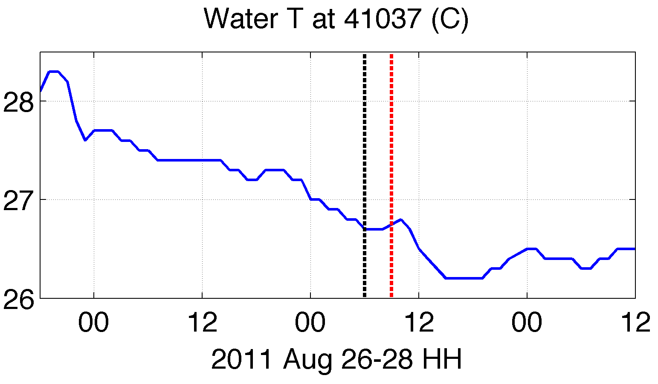
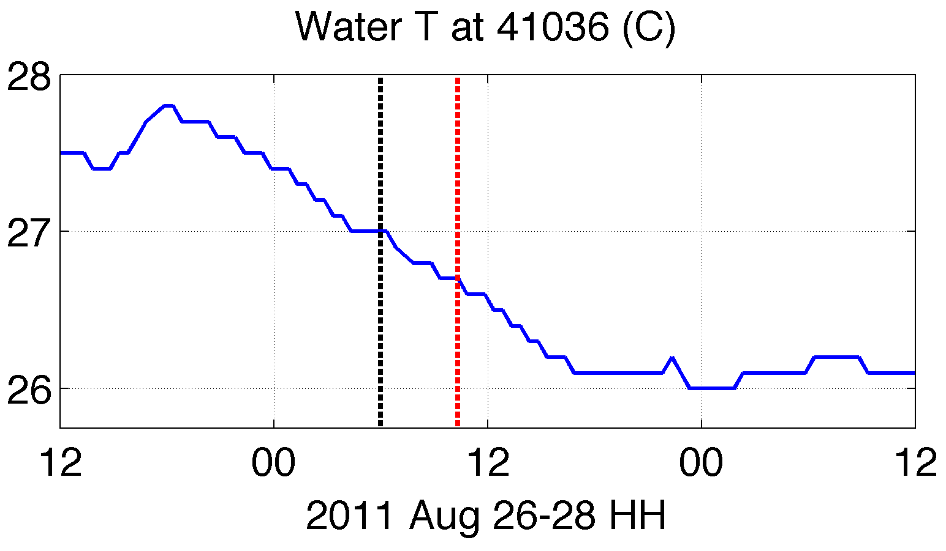
SAB and MAB buoy water temperature
MAB
model start
passage of eye
MAB
SAB
SAB
Notes:
SAB buoys showed ahead-of-eye cooling, but not as much and model run time over SAB not long to capture impact of SAB ahead-of-eye-cooling

Slide 22
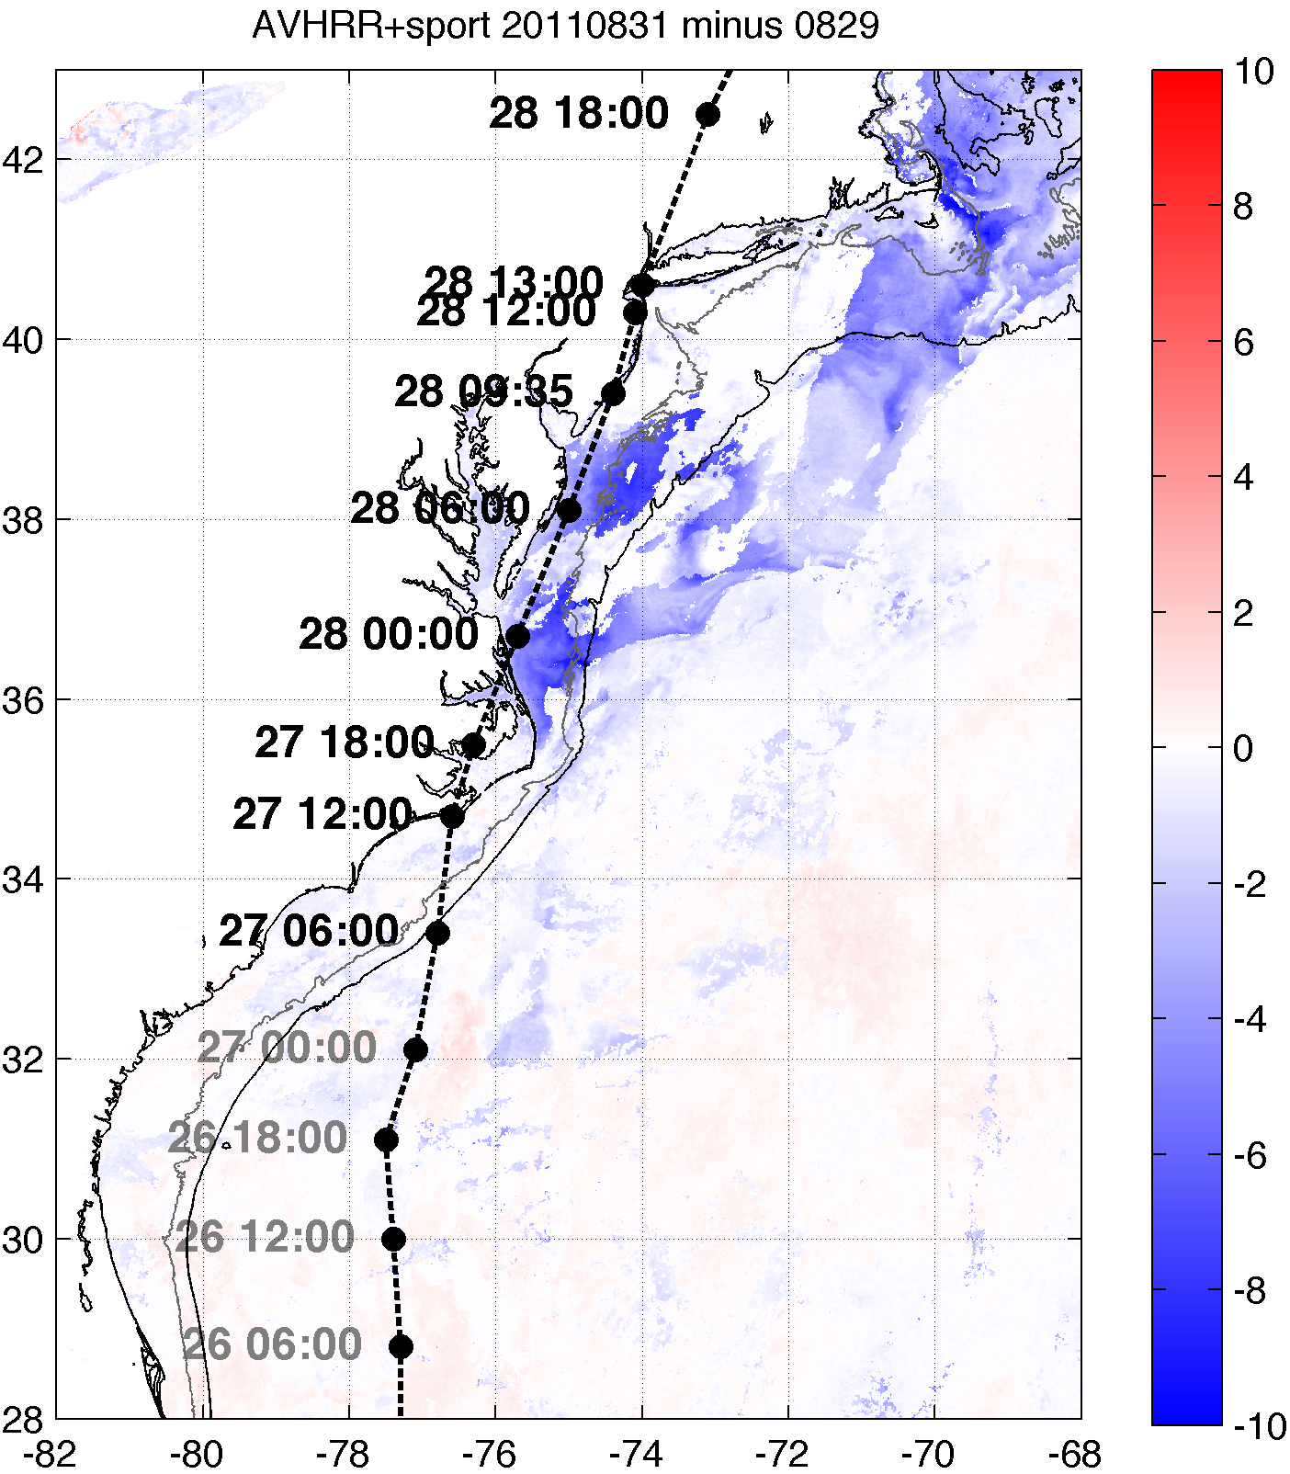
Post-storm SST
AUG 28
AUG 29
AUG 30
AUG 31
AUG 31-29
Under clear skis, no additional cooling after AUG 29
Clouds
Notes:
-no additional cooling after Aug 29 captured by satellites, outside of cloudy conditions

Slide 23
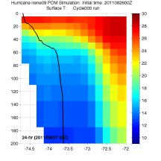
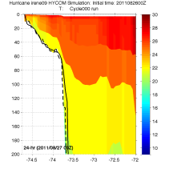
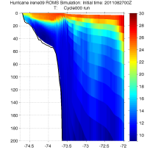
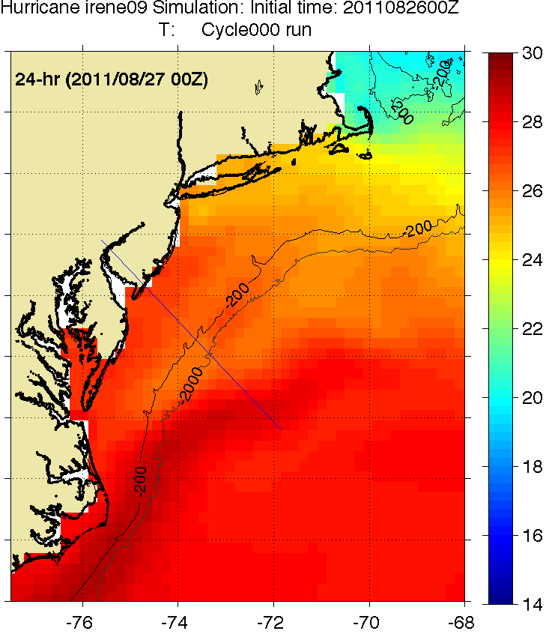
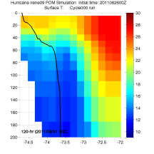
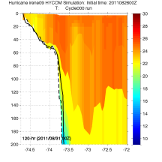
Cross-shelf Transects
HWRF-POM
Before
HWRF-HYCOM
Before
ROMS ESPreSSO
Before
HWRF-POM
After
HWRF-HYCOM
After
Observed bathymetry from NOAA National Geophysical Data Center, U.S. Coastal Relief Model, Retrieved date goes here, http://www.ngdc.noaa.gov/mgg/coastal/crm.html
Notes:
Note that the glider colorbar range is 9 to 24

Slide 24
Explanation of Air-Sea Flux Changes in WRF
τ = -ρu*² = -ρC_{D}U² momentum flux (τ)
H = -ρc_{p}u*θ* = -(ρc_{p})C_{H}UΔθ sensible heat flux (H)
E = -ρL_{ν}u*q* = -(ρL_{ν})C_{Q}UΔq latent heat flux (E)
ρ: density of air
(u*,θ*,q*): friction velocity, surface layer temperature and moisture scales
U: 10m wind speed
c_{p}: specific heat capacity of air, L_{ν}: enthalpy of vaporization
Δ(θ,q): temperature, water vapor difference between z_{ref}=10m and z=sfc In neutrally stable surface layer within TC eyewall (e.g. Powell et al. 2003):
C_{D} = k²/[ln(z_{ref} ⁄ z₀)]² drag coefficient
C_{H} = (C_{D}^{½} ) X [k/ln(z_{ref} ⁄ z_{T})] sensible heat coefficient
C_{Q} = (C_{D}^{½} ) X [k/ln(z_{ref} ⁄ z_{Q})] latent heat coefficient
C_{k} = C_{H} + C_{Q} moist enthalpy coefficient
k: von Kármán constant
z_{ref}: (usually 10m) reference height
Our Changes in SST:
Δθ = θ_{(2 or 10m)} – θ_{sfc} (θ∝T)
Δq = q_{(2 or 10m)} – q_{sfc}
∴Δ(SST)→Δθ_{sfc}→ΔΔθ→ΔH (sensible heat flux)
Δ(SST)→(indirectly)Δq_{sfc}→ΔΔq→ΔE (latent heat flux)
WRF isftcflx | z₀: momentum roughness length | z_{T}: sensible heat roughness length | z_{Q}: latent heat roughness length | Dissipative heating?
0 | z₀ = 0.0185u*²⁄g + 1.59E-5 Charnock (1955) | z₀ | z_{Q} = (z₀⁻¹ + ku*K_{a}⁻¹)⁻¹ Carlson & Boland (1978) | No
1 | See Green & Zhang (2013) for eq. Powell (2003), Donelan (2004) | 10⁻⁴ m | 10⁻⁴ m Large & Pond (1982) | Yes
2 | Same as z₀ for Option 1 Powell (2003), Donelan (2004) | z_{T} = z₀exp[k(7.3Re*^{¼}Pr^{½}-5)] Brutsaert (1975) | z_{Q} = z₀exp[-k(7.3Re*^{¼}Sc^{½}-5)] Brutsaert (1975) | Yes
K_{a}= 2.4E-5 m²s⁻¹ (background molecular viscosity)
Re* = u*Z₀ ⁄ν (Roughness Reynolds number), Pr = 0.71 (Prandtl number), Sc = 0.6 (Schmidt number)
After Green & Zhang (2013)

Slide 25
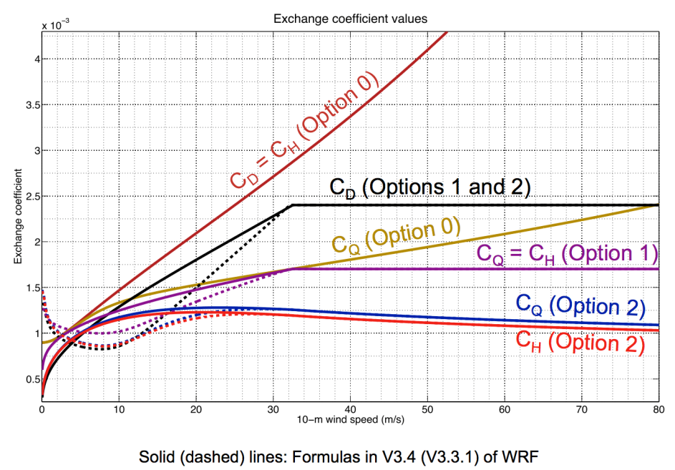
Plot of Resulting Exchange Coefficients
After Zhang et al. (2012) Presentation for HFIP
Notes:
Some of these studies (3, 19) imply that the decreasing drag at high winds seems to be related to the spray, foam, and bubbles from breaking waves that reduce the drag and allow the hurricane to slip over the sea.

Slide 26
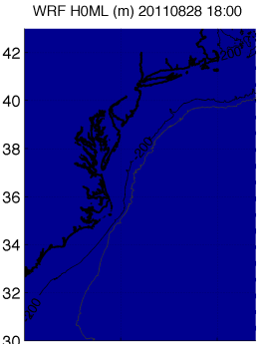
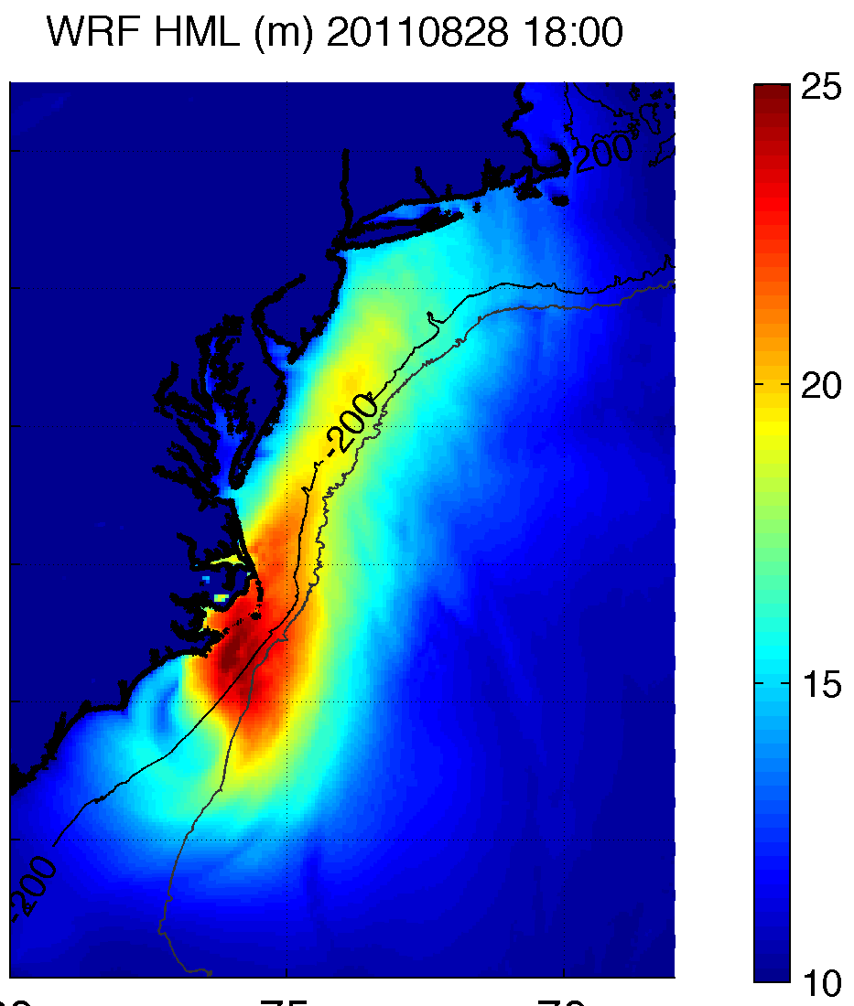
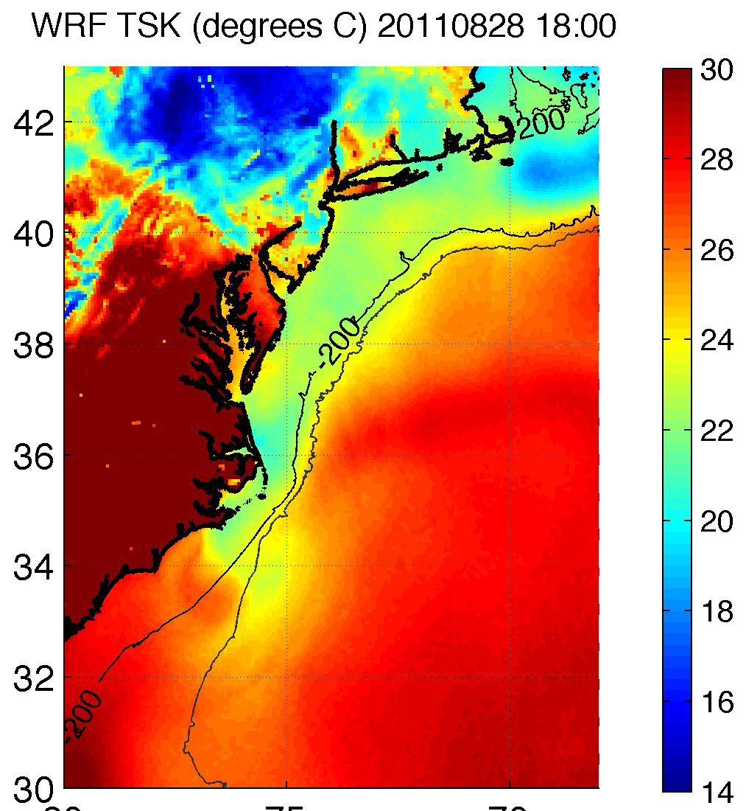
1D ocean model
H0ML = 10m
Gamma = 1.6C/m
1D ocean model
H0ML from HYCOM
Gamma = 1.6C/m

Slide 27
Results:
F
G
H
I
J
Notes:
Can provide model setup parameters for WRF runs (namelist) if requested

Slide 28
Sensitivity tables:
110 runs
Bad B.C.
Bad forecast of wind
Max wind largest sensitivity to SST
Parameterized Upper Ocean Heat Content
Diff. init. time
Bad B.C.
Bad forecast of pressure
Min SLP large sensitivity to SST

Slide 29
ROMS simulation results

Slide 30
Model Validation
Ray et al. (2006)
Height 9.08m (obs) vs. 10m (WRF) [log law]
Averaging time 2-min (land stations)*, 8-min (buoys) vs. instantaneous (WRF) [obs gusts]
Validate at 44014, 44009, 44065, and tall met towers (for boundary layer shear profile- NHC indicated it as large during Irene)
*OYC: 15-min, Stafford Park: 10- and 60-min

Slide 31
Model Validation

