Slide 1
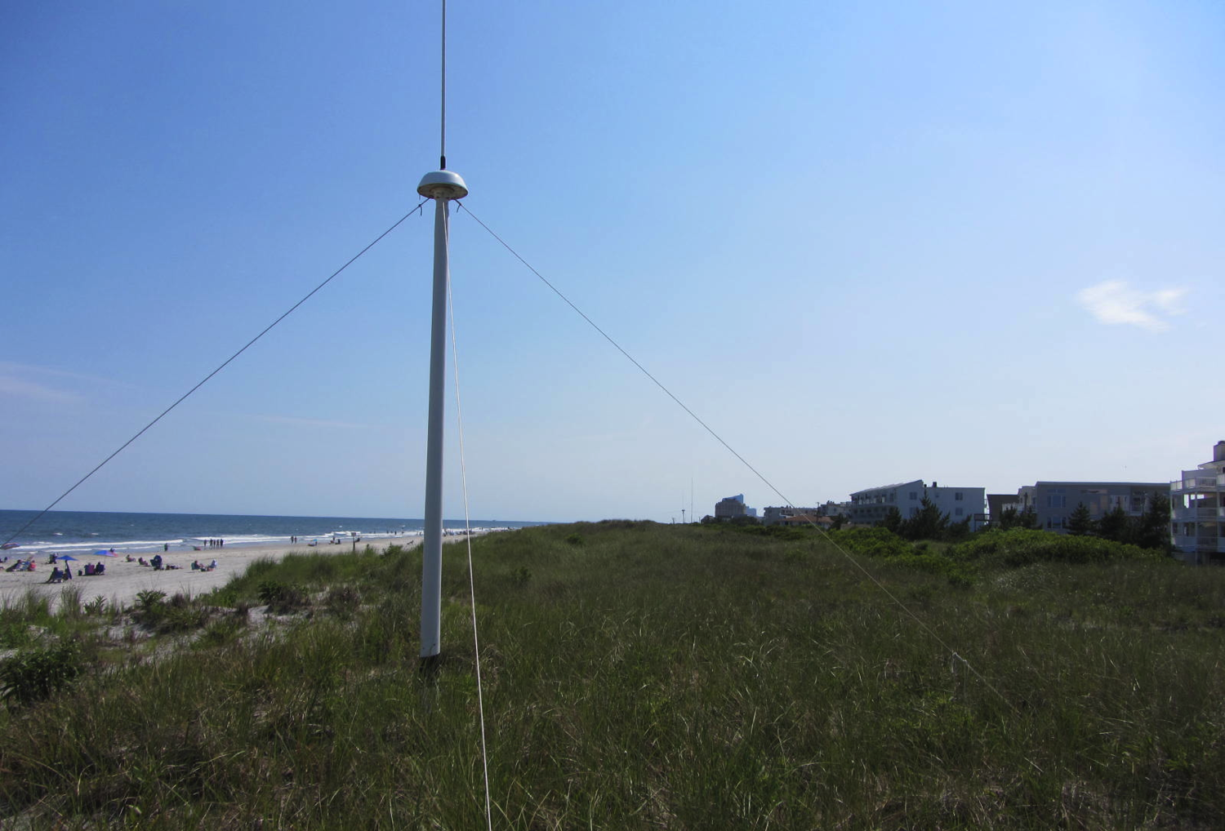
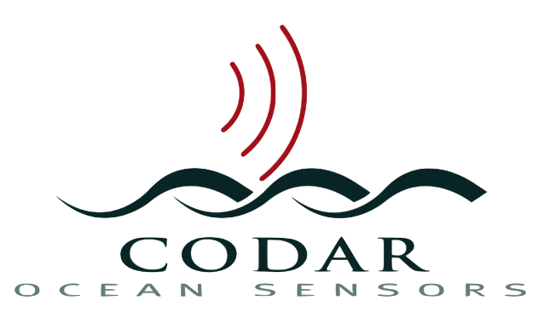
Monostatic Vessel Detection from the CODAR SeaSonde
Collin Dobson, Kristen Holenstein, Michael Smith, Hugh Roarty, Scott Glenn
Chad Whelan, Donald E. Barrick, James Issacson

Slide 2
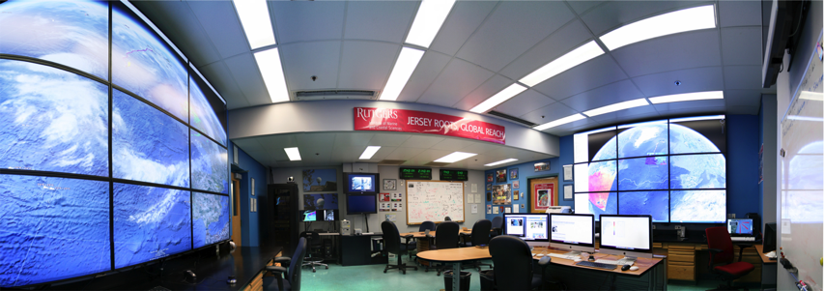
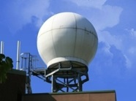
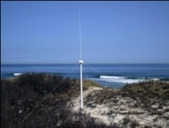
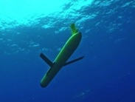
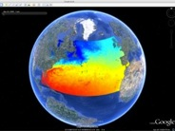
Rutgers University - Coastal Ocean Observation Lab
Operations, Research & Education Center
Vessels -
Satellite
Satellite
CODAR
Ships/ Vessels
Glider
REMUS
Data Vis.
Modeling
Security
Leadership
Education
Satellite Data Acquisition Stations
CODAR Network
Glider Fleet
3-D Forecasts

Slide 3
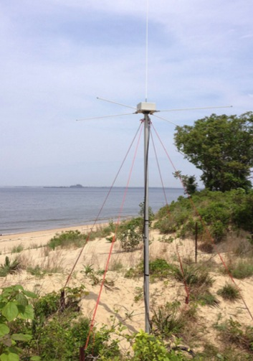
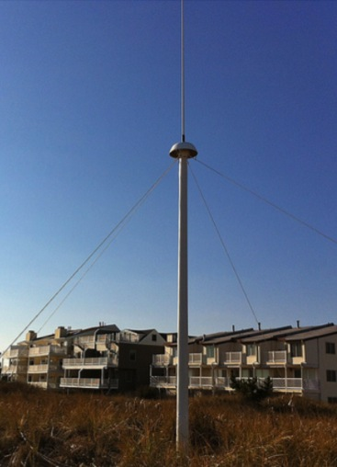
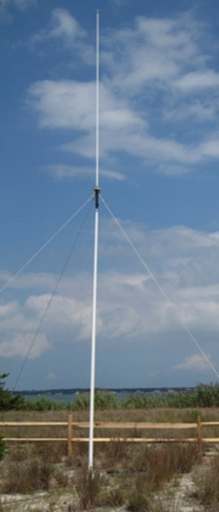
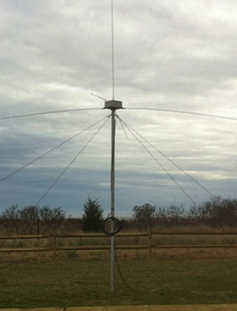
CODAR Compact HF Radar Antennas
25 MHz
13 MHz
5 MHz
Combined Transmitter & Receiver
Separate Transmitter & Receiver

Slide 4
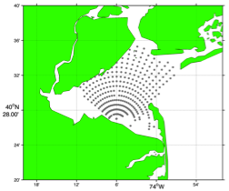
Surface Current Mapping Capability
25 MHz
Radar λ: 12 m Ocean λ: 6 m
Range: 30 km Resolution: 1 km
13 MHz
Radar λ: 23 m Ocean λ: 12 m
Range: 80 km Resolution: 3 km
05 MHz
Radar λ: 60m Ocean λ: 30 m
Range: 180 km Resolution: 6 km

Slide 5
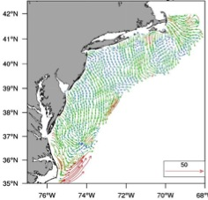
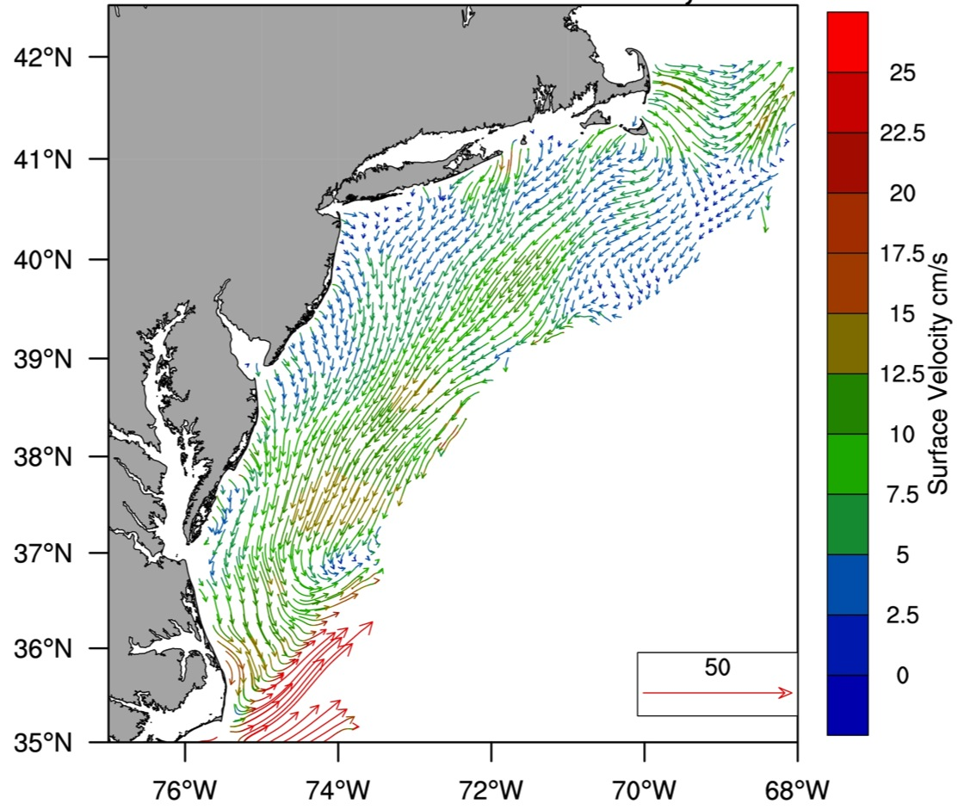
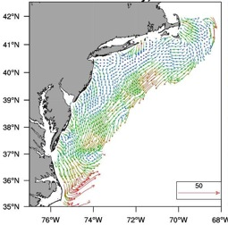
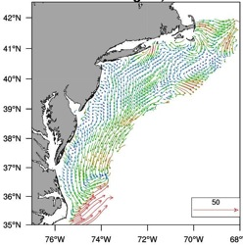
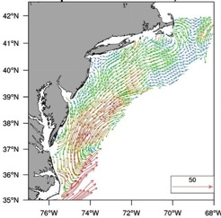
MARACOOS Annual Mean Surface Currents (2009)
Winter
Spring
Summer
Fall

Slide 6
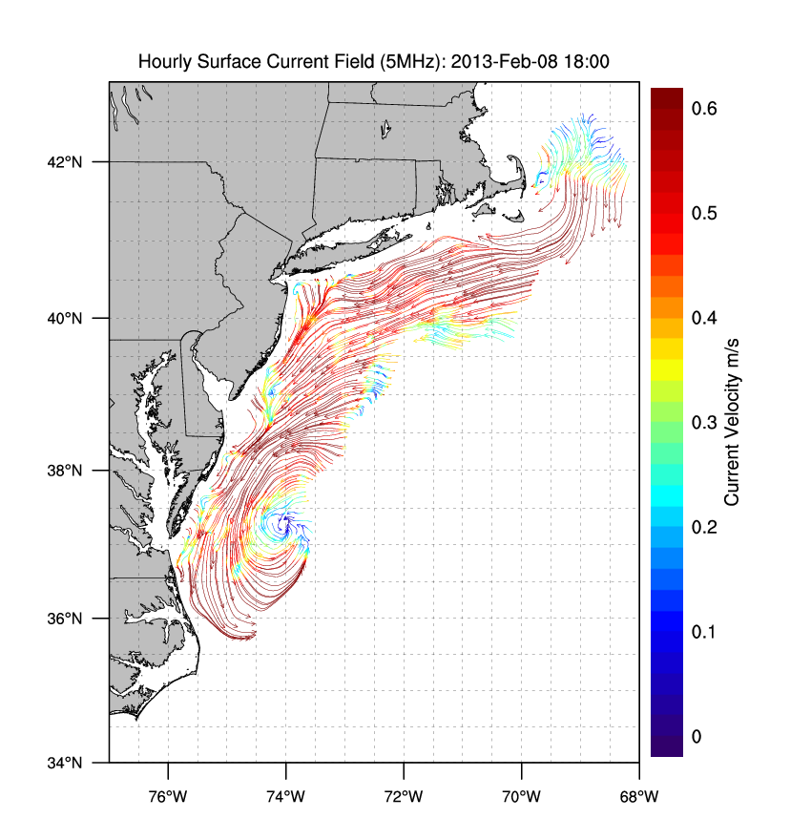
Winter Storm Nemo February 8, 2013
February 9, 2013

Slide 7
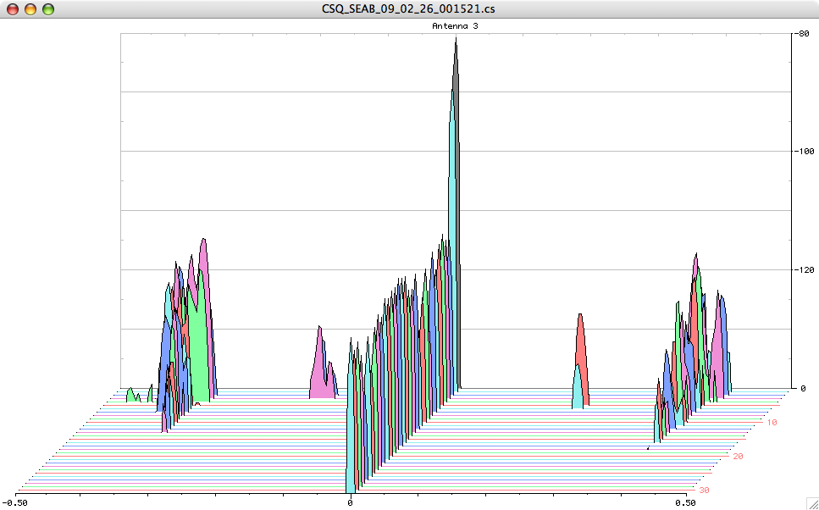
Doppler Spectra from all Range Cells
with Detection Threshold Applied
Fixed Objects & Direct Signals
Bragg Waves
Bragg Waves
Vessel
Vessel
Range
Doppler Frequency

Slide 8
Ships Crossing in the Night

Slide 23
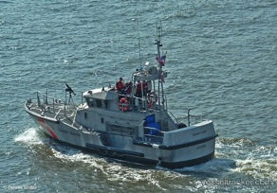
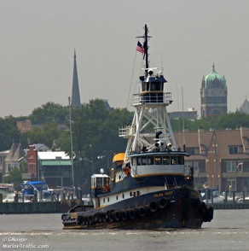
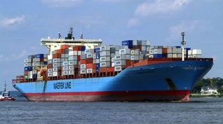
Vessel Detection Capability Vessel Height Determines Detection
25 MHz
Range: 20 km
Height >10 ft
13 MHz
Range: 60 km
Height: >19 ft
05 MHz
Range: 130 km
Height: >49 ft

Slide 24
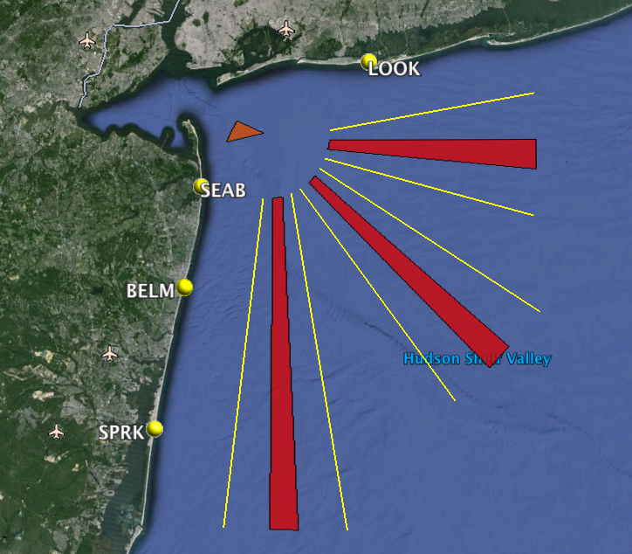
Monostatic Detections

Slide 25
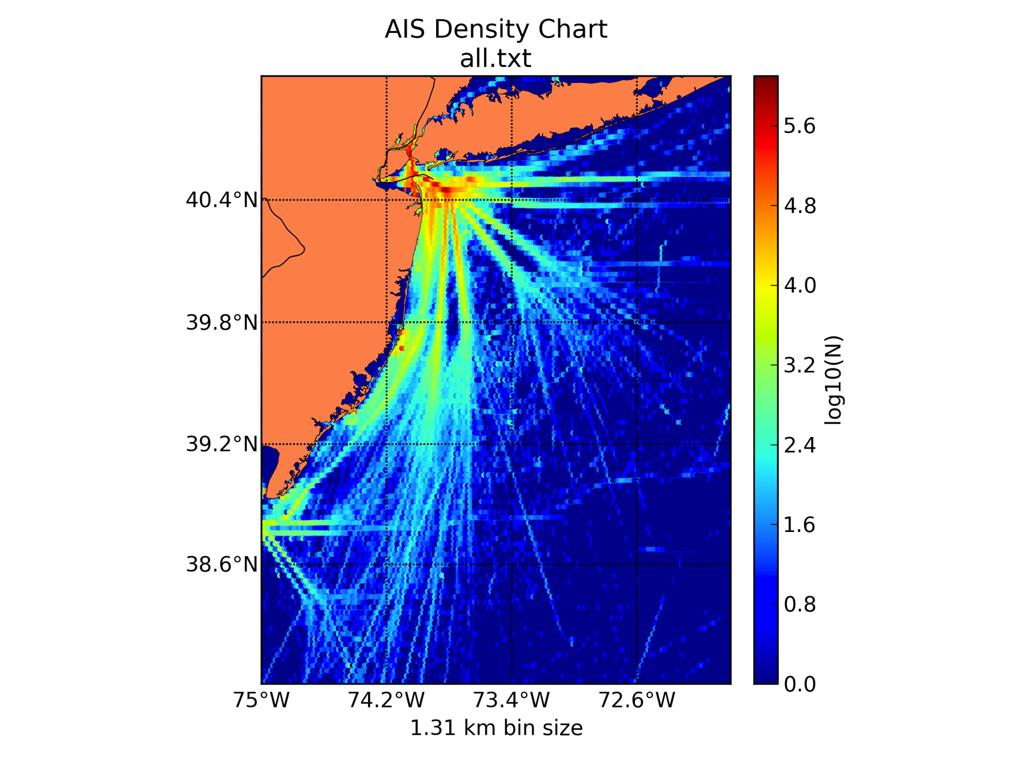
July 2011 to June 2012
Automatic Identification System (AIS) Heat Map
100,000
10,000
1,000
100
10

Slide 26
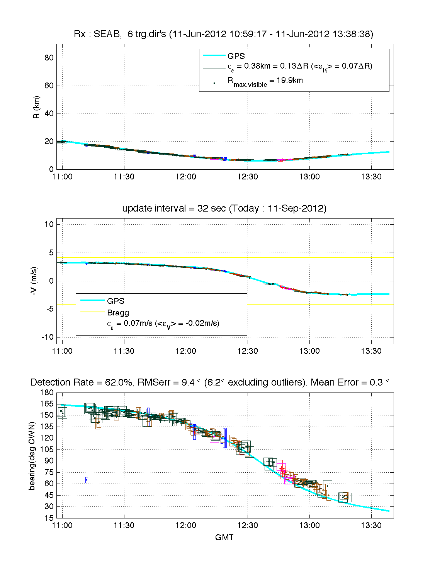
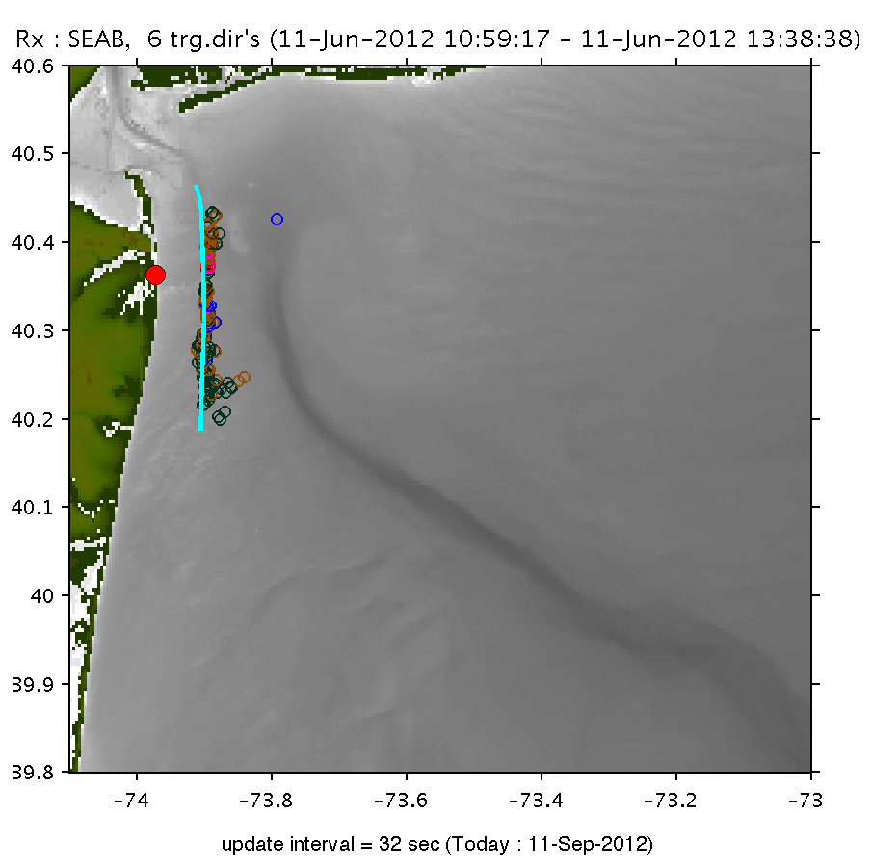
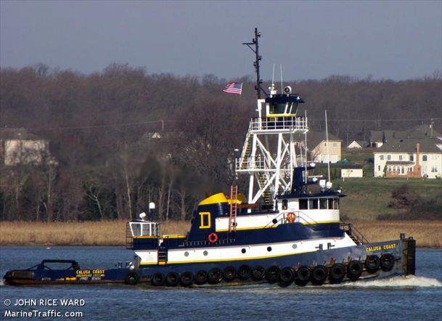
Calusa Coast

Slide 27
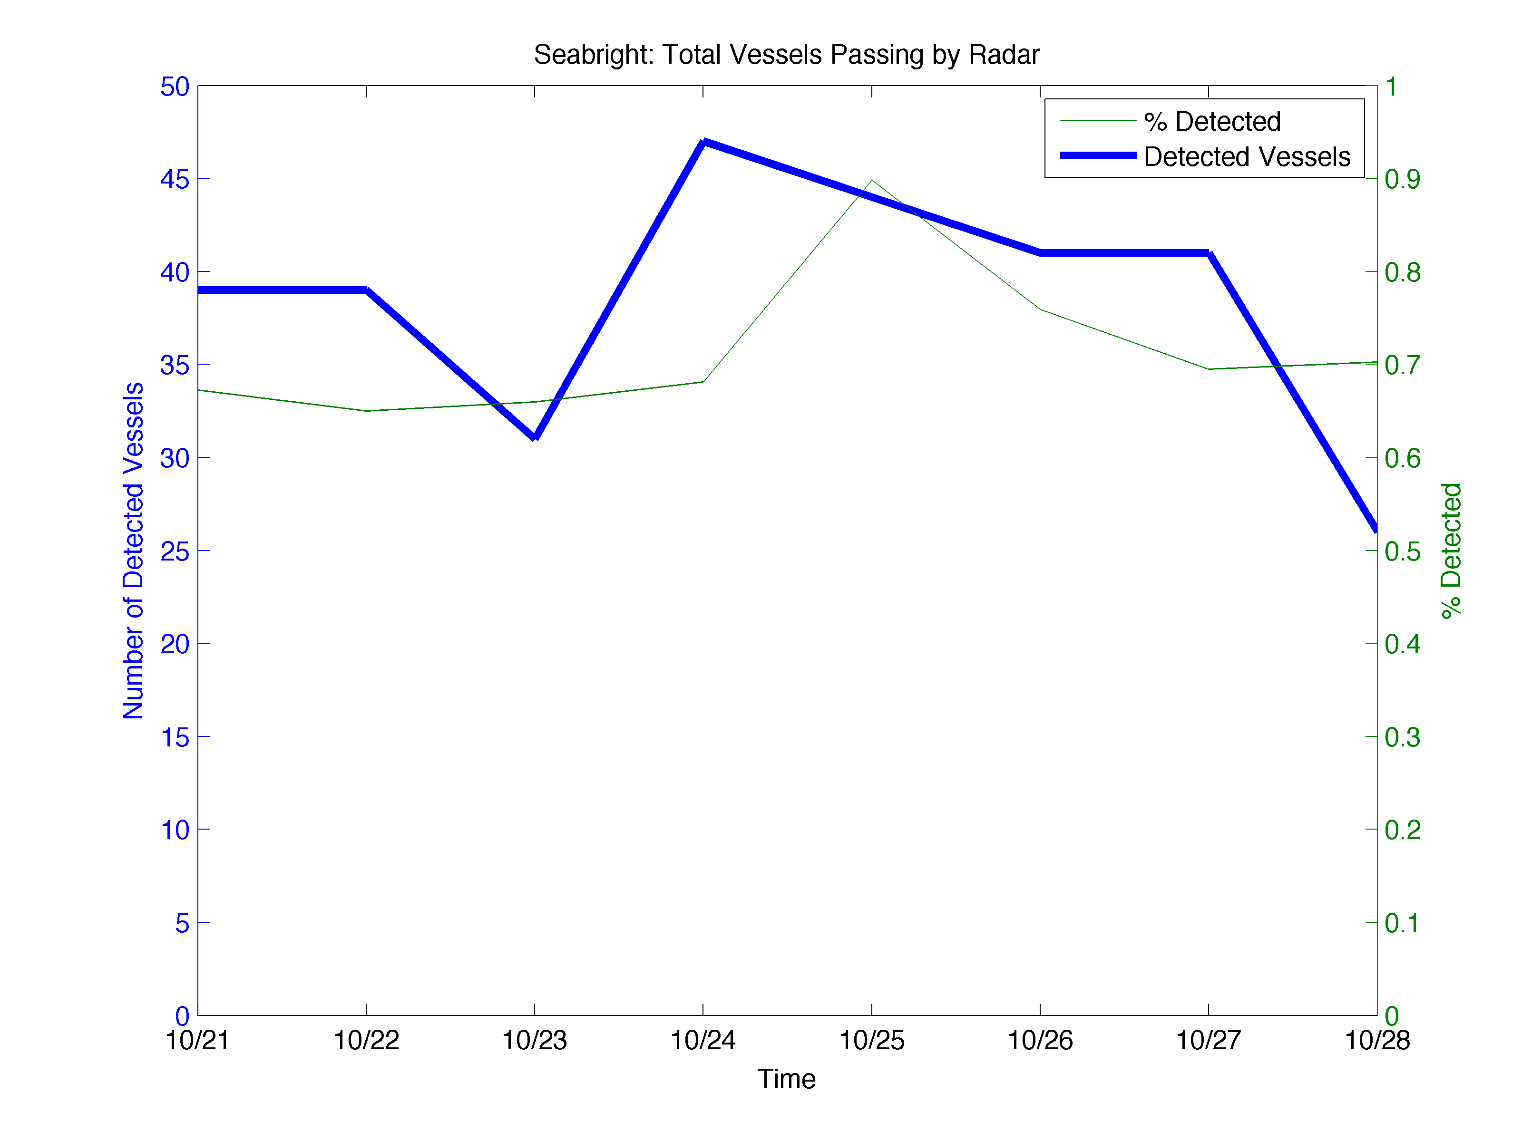
Sea Bright – 308 Vessels Detected

Slide 28
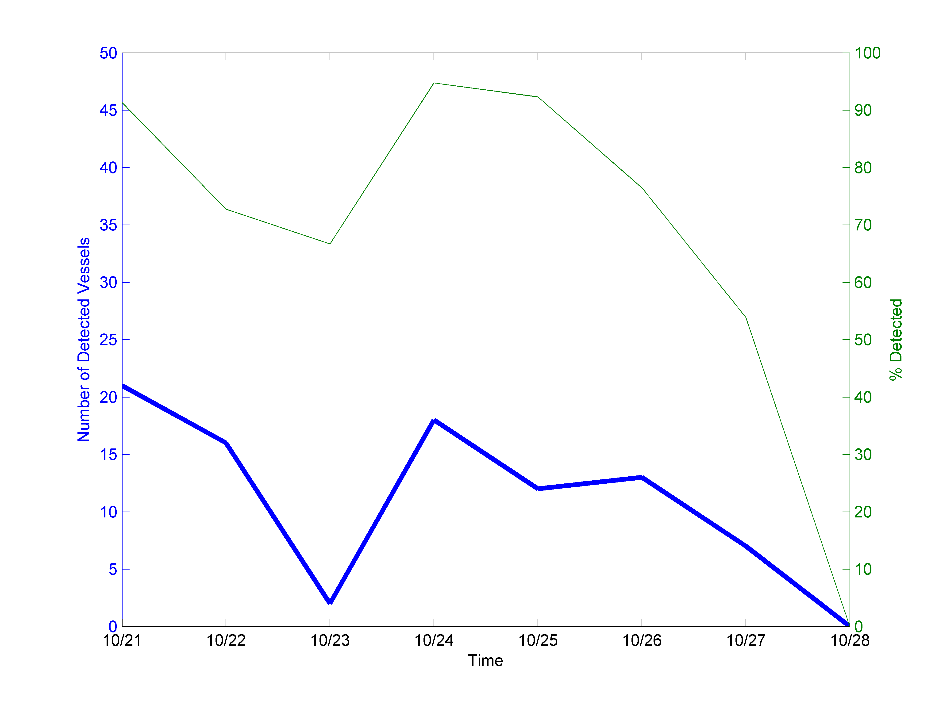
Seaside Park – 89 Vessels Detected

Slide 29
Hurricane Sandy Approaching

Slide 30
Vessels Detected by Radar with No Corresponding AIS
Date | Sea Bright | Seaside Park
10/21/12 | 6 | 1
10/22/12 | 10 | 10
10/23/12 | 6 | 6
10/24/12 | 9 | 3
10/25/12 | 5 | 7
10/26/12 | 8 | 8
10/27/12 | 4 | 11
10/28/12 | 3 | 0
Average | 6.4 | 5.8

Slide 31
Conclusions
Compact SeaSonde radars are consistently detecting vessels outside New York Harbor
20% of vessels detected not transmitting AIS

