Slide 1
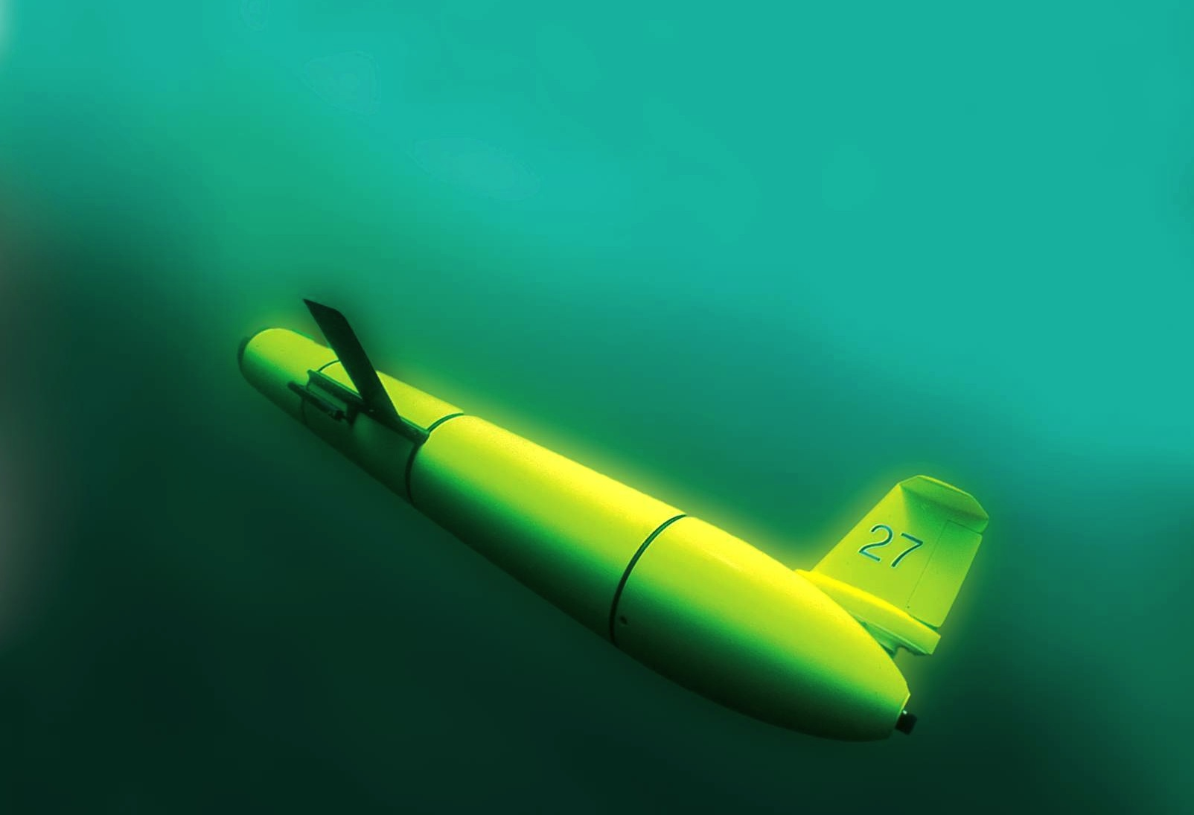
The Challenger Glider Mission:
A Collaborative Global Network for Ocean Science and Education
Scott Glenn,
Oscar Schofield,
Josh Kobut &
Janice McDonnell
Rutgers University
Coastal Ocean Observation Lab
http://rucool.marine.rutgers.edu/

Slide 2
4
The Challenger Glider Mission:
A Collaborative Global Network for Ocean Science and Education
Scott Glenn,
Oscar Schofield,
Josh Kobut &
Janice McDonnell
Rutgers University
Coastal Ocean Observation Lab
http://rucool.marine.rutgers.edu/
1
3
2

Slide 3
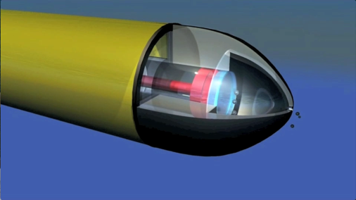
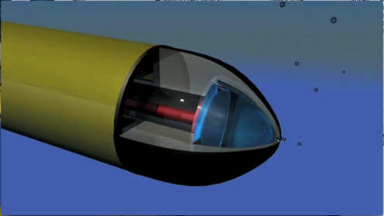
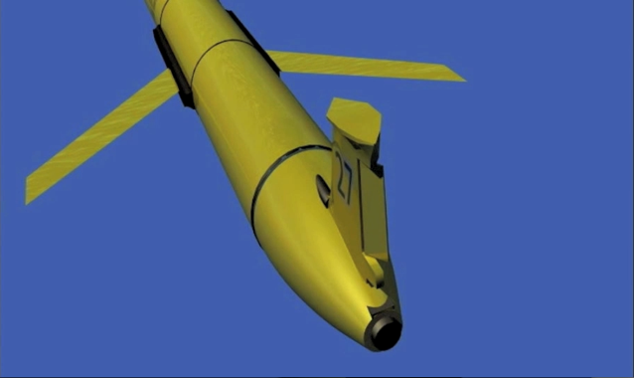
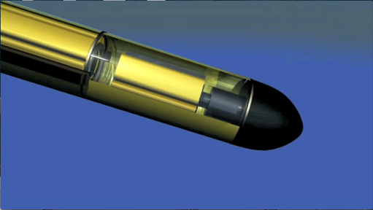
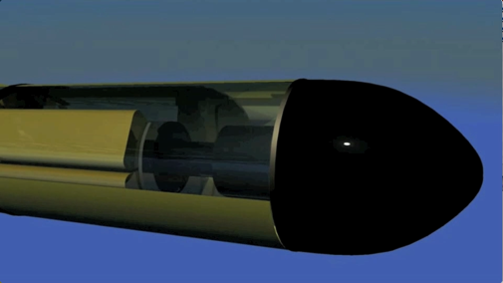
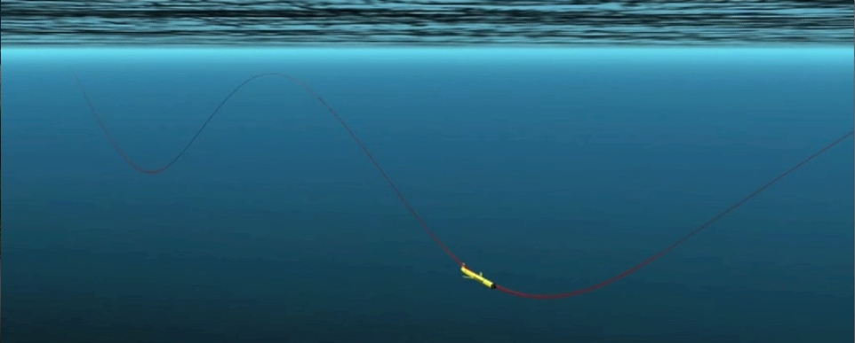
Dive: Pump In,
Batteries Forward
Glider Flight
Climb: Pump Out, Batteries Back
Rudder for Steering

Slide 4
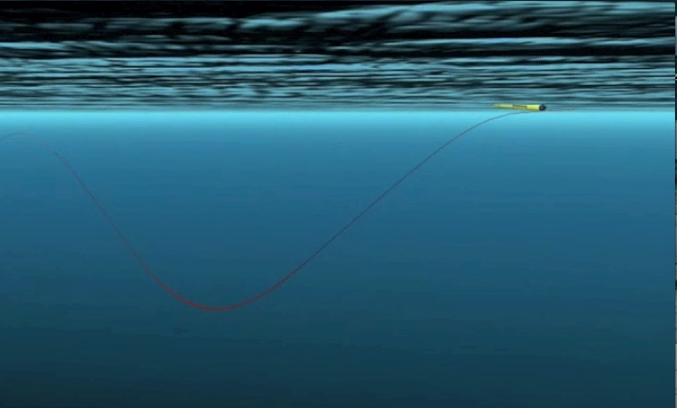
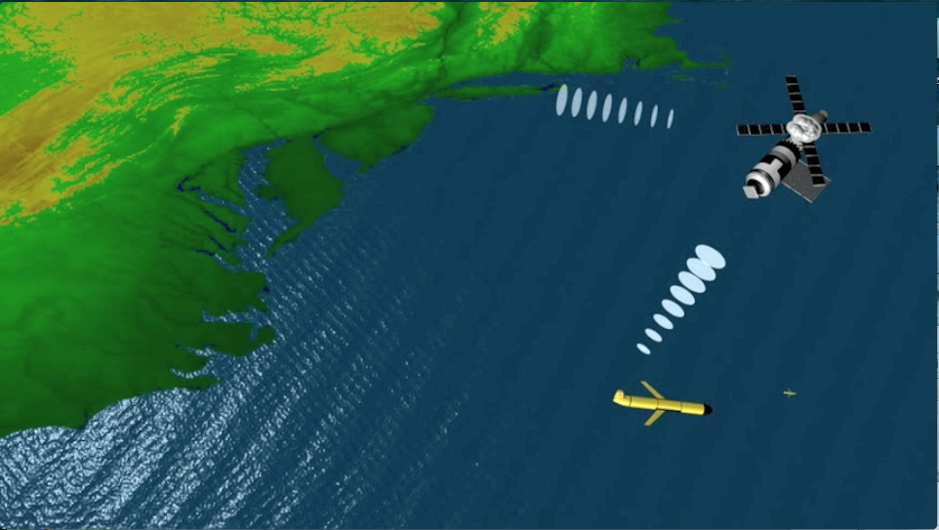
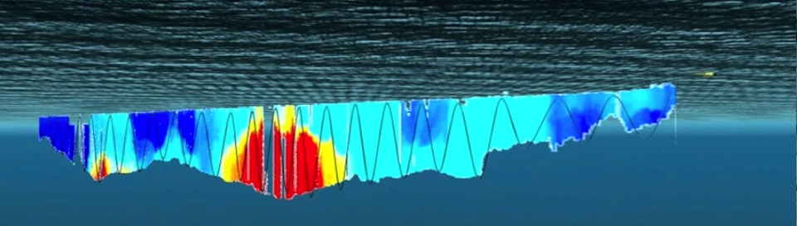
Glider Communications
GPS for Position, Iridium for 2-Way, ARGOS for Emergencies
Glider Surfaces
2-Way Satellite Communications in Tail
Data Ribbon Transmitted to Shore

Slide 5
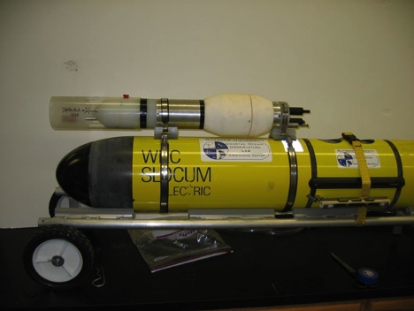
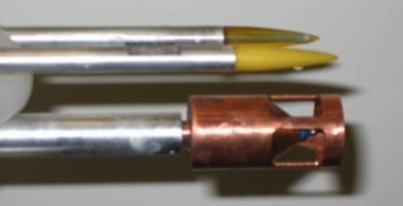
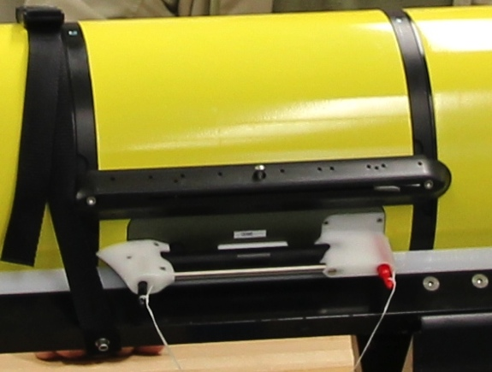
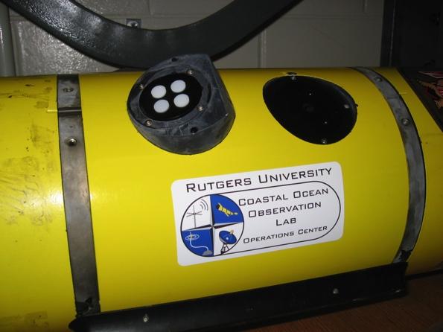
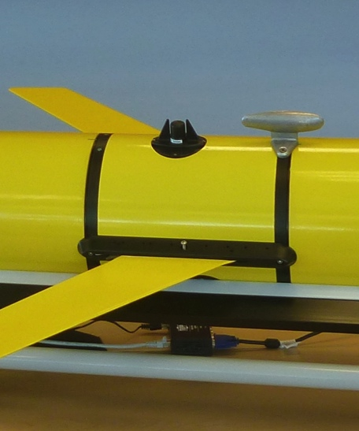
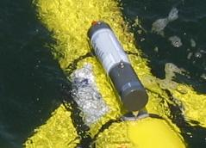
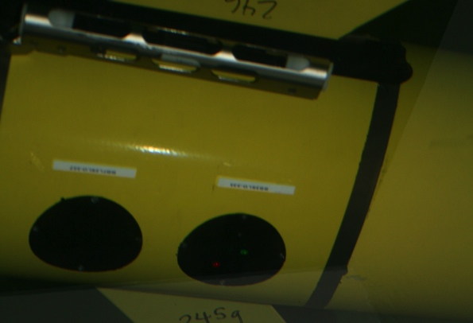
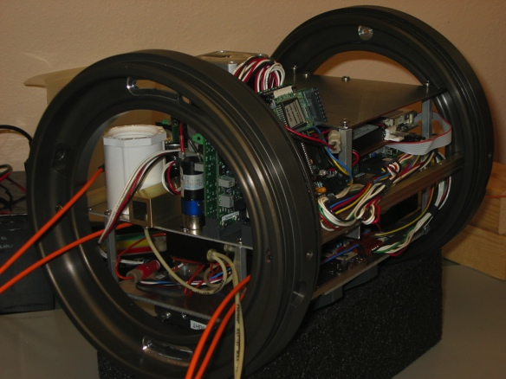
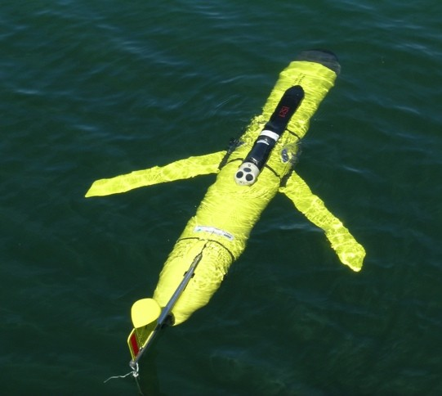
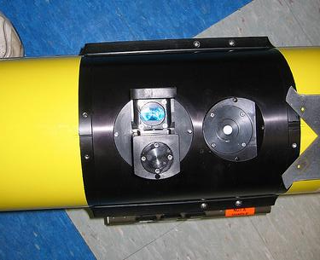
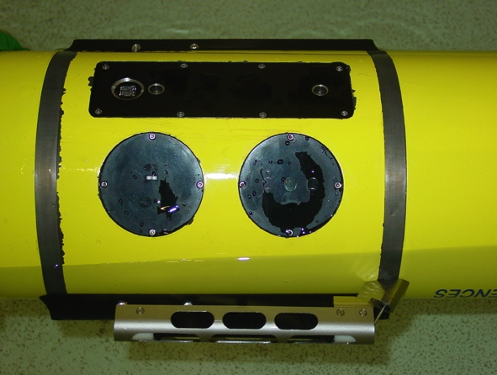

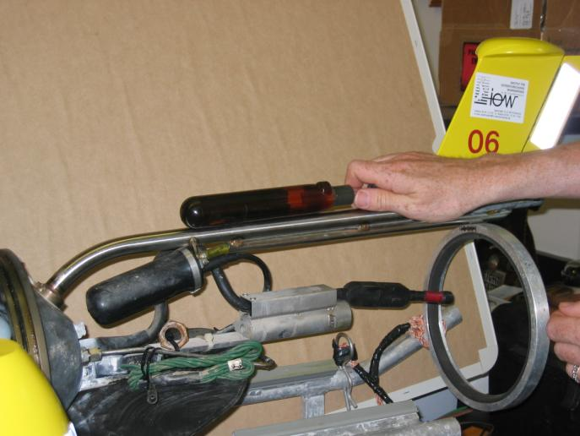
Glider Sensors
Inside Payload Bay or External

Slide 6
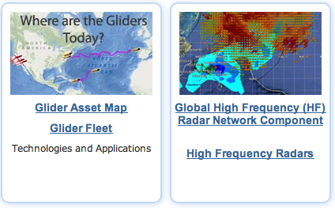

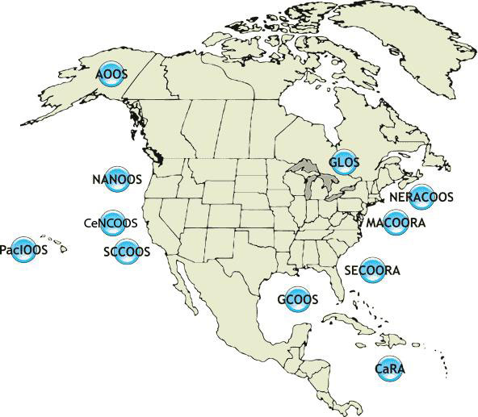






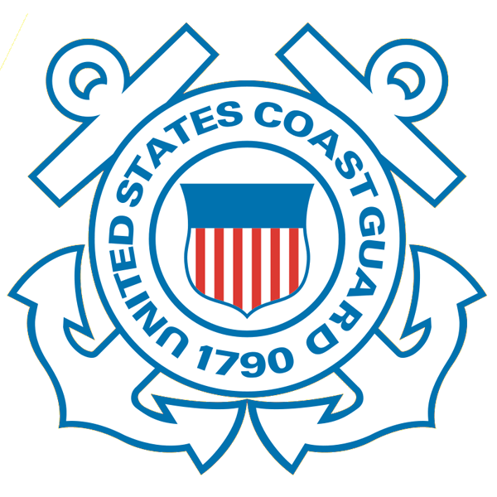









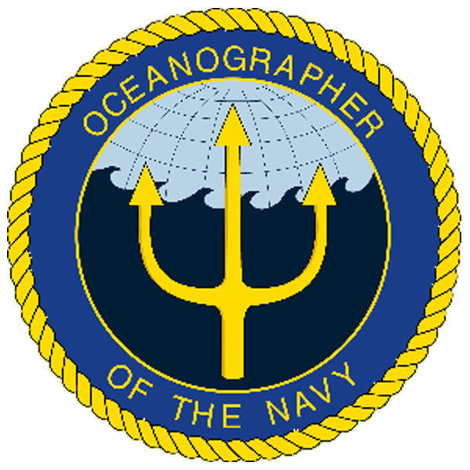
U.S. Integrated Ocean Observing System
IOOS Relationships
Global Component
National Component
Regional Component
Globally Coordinated Initiatives
Vessels -
Satellite
Satellite
CODAR
Ships/ Vessels
Glider
REMUS
Data Vis.
MARACOOS
Modeling
Security
Leadership
Education
11 Regional Associations
17 U.S. Federal Agencies
http://ioos.gov

Slide 7
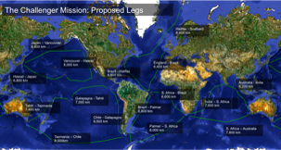
U.S. Integrated Ocean Observing System
IOOS Relationships
Global Component
Challenger Glider Mission
National Component
Regional Component
Technology
Technology
Education
Globally Coordinated Initiatives
Vessels -
Satellite
Satellite
CODAR
Ships/ Vessels
Glider
REMUS
Data Vis.
Modeling
Security
Leadership
Education
11 Regional Associations
17 U.S. Federal Agencies
http://ioos.gov

Slide 8
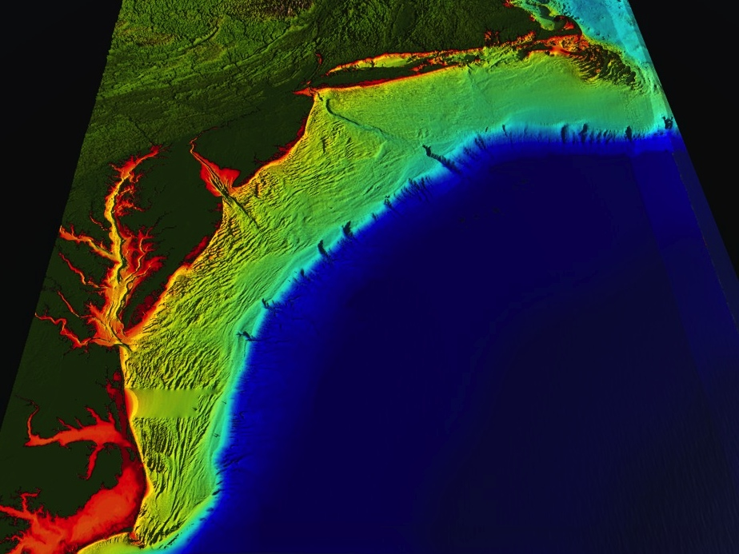
















U..
Middle Atlantic
Regional Association
Coastal
Ocean Observing System
1000 km
Cape to Cape
CT
RI
Cape
Cod
MA
NY
10 States
PA
NJ
MARACOOS:
Sustained Real-Time
Regional-Scale Observation and Forecast System
MD
DE
>40 PIs
>20 Institutions
>50 Members
Scott Glenn + Many
VA
NC
Cape
Hatteras
Notes:
8

Slide 9
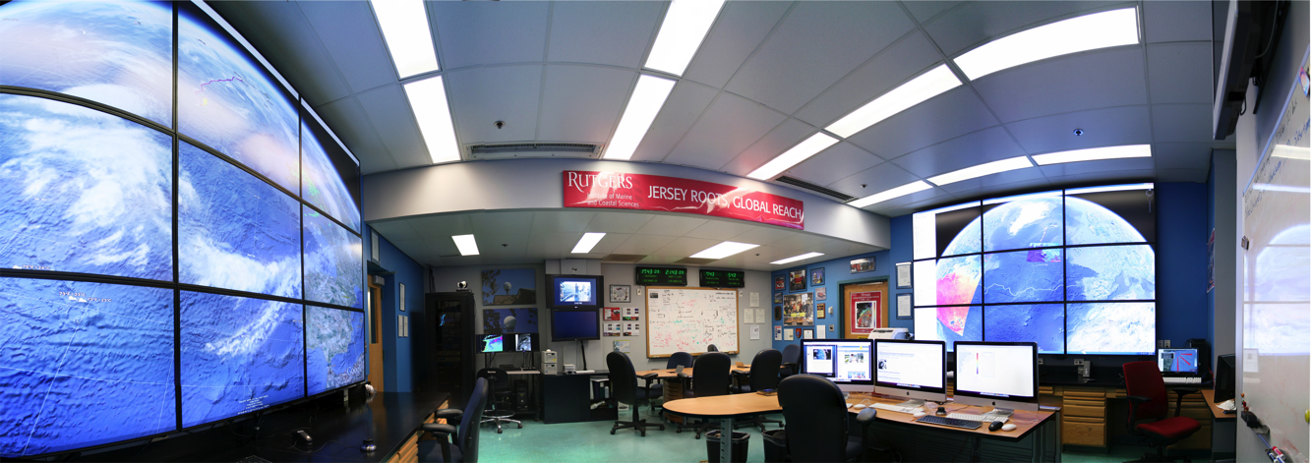
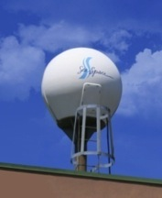
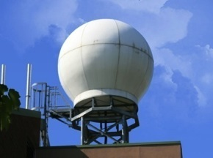
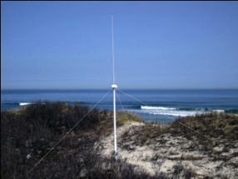
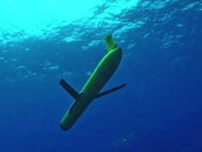
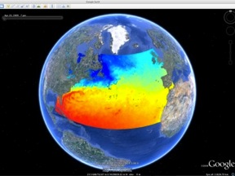
MARACOOS Operations Center
Rutgers University - Coastal Ocean Observation Lab
Satellite Data Acquisition Stations
CODAR Network
Glider Fleet
3-D Forecasts

Slide 10
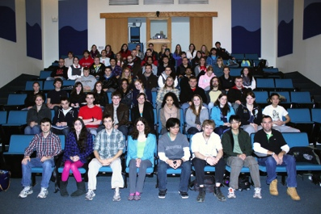
MARACOOS Operations Center
Rutgers University - Coastal Ocean Observation Lab
Challenger Glider Mission
Satellite Data Acquisition Stations
CODAR Network
Glider Fleet
3-D Forecasts

Slide 11
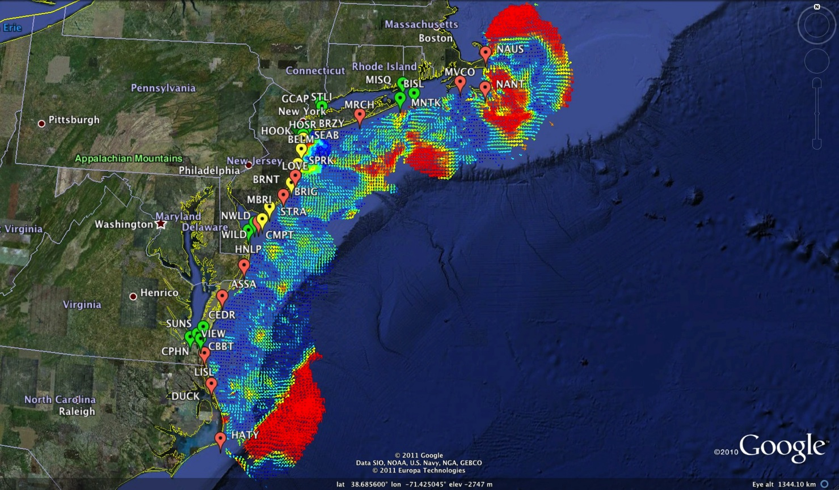
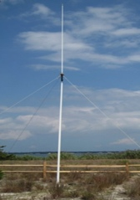
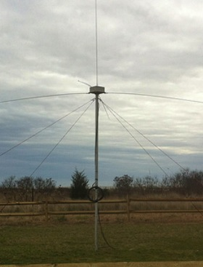
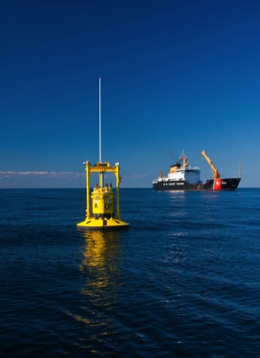
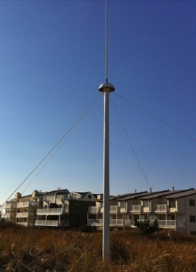
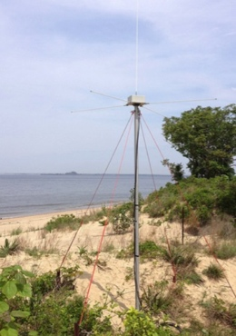


Mid-Atlantic Bight HF Radar Network
1000 km
Cape to Cape
Mid-Atlantic HF Radar Network
16 Long-Range CODARs
8 Medium-Range CODARs
17 Short-Range CODARs
41 Total
Triple Nested, Multi-static, Multi-use
Industry Partner: CODAR Ocean Sensors

Slide 12
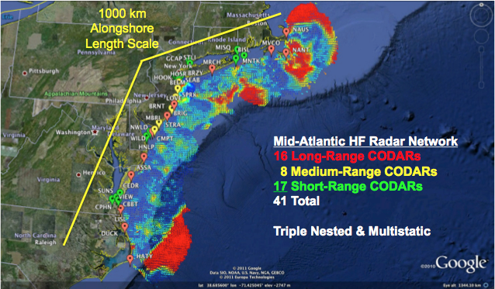
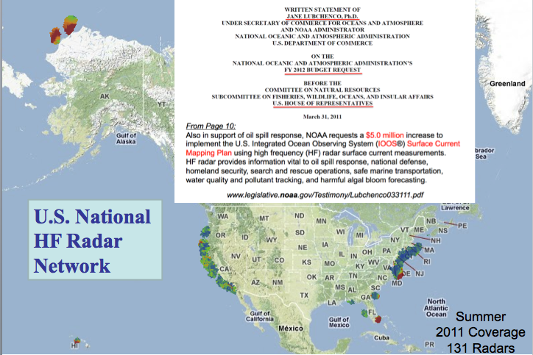
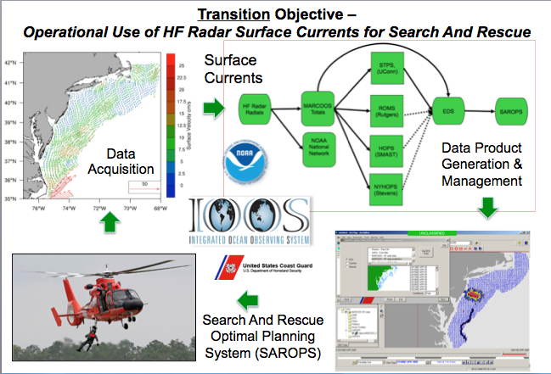
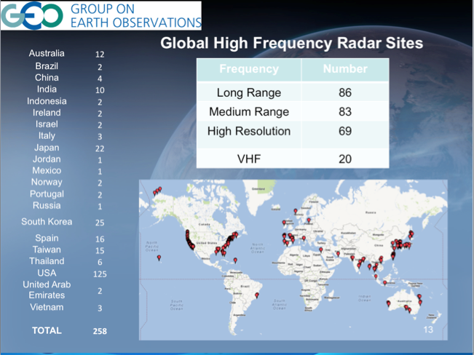
Regional to Global Scale – High Frequency Radar
Mid-Atlantic Regional Scale HFR Network
U.S. National HFR Network
Search And Rescue Operational 2009
Global HFR Network

Slide 13


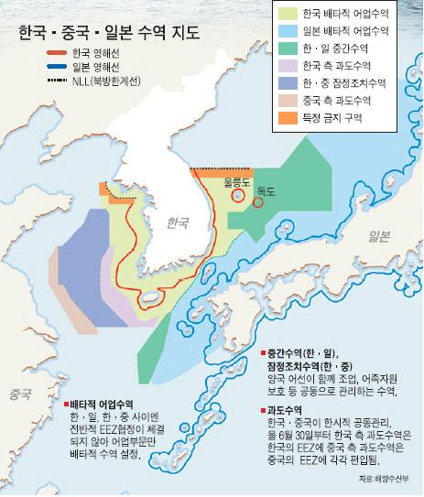

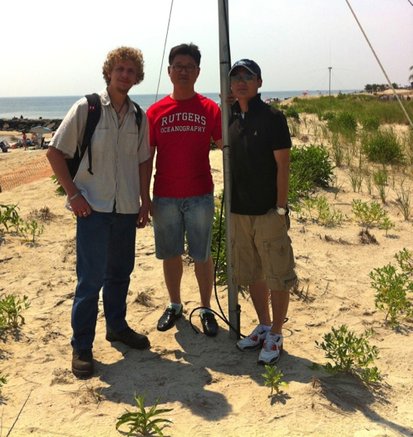



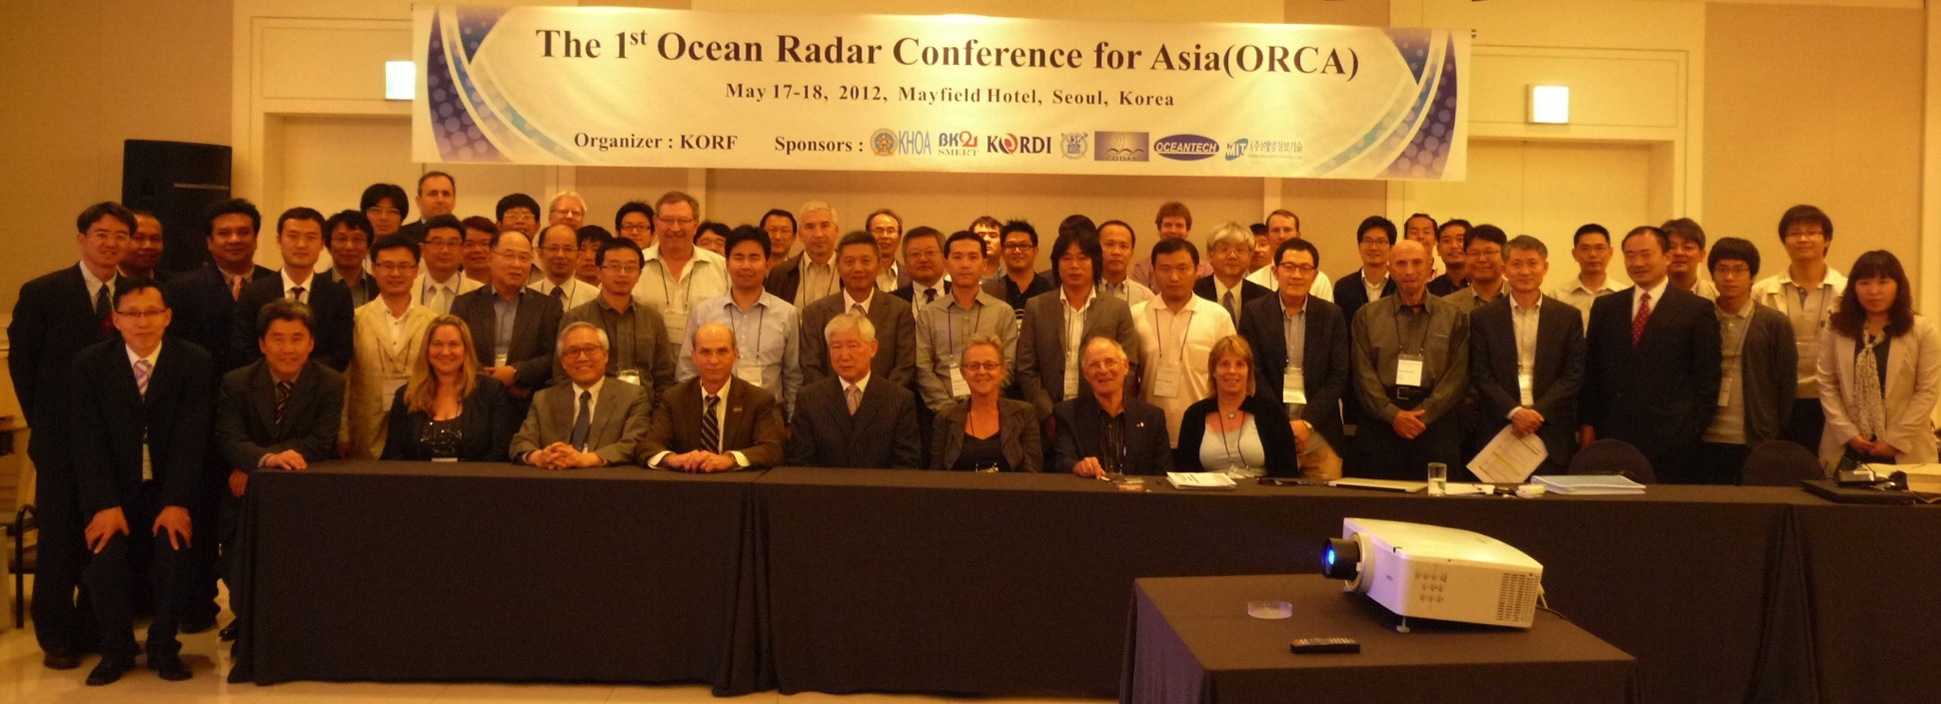
Korea & United States
HF Radar Collaboration

Slide 14
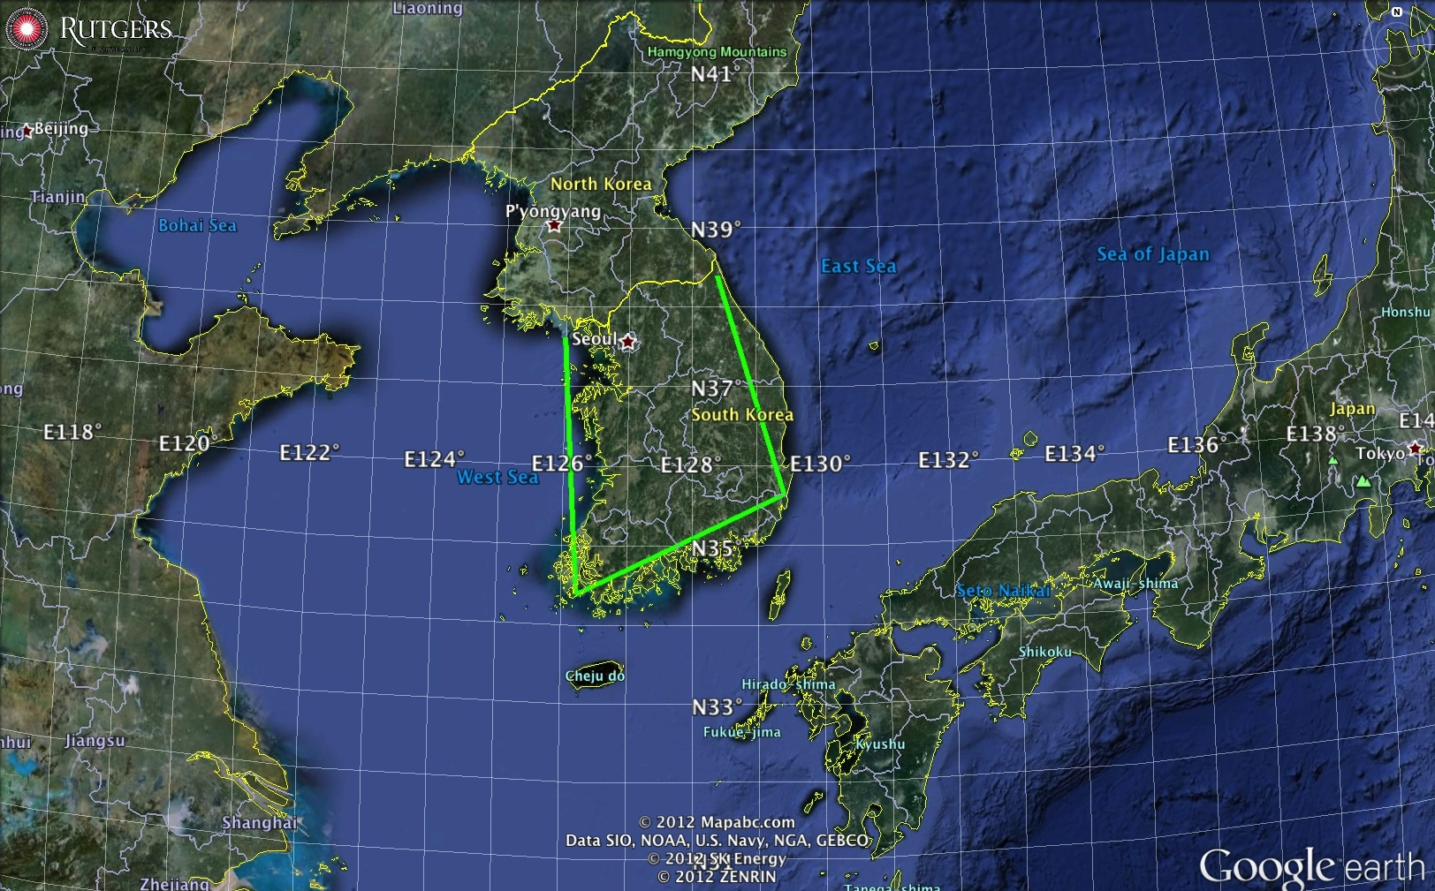
Ongoing HF Radar Collaboration with South Korea
1000 km Alongshore Length Scale
Rutgers July 2013 Visit
KIOST, KHOA, KNU, KAIST

Slide 15
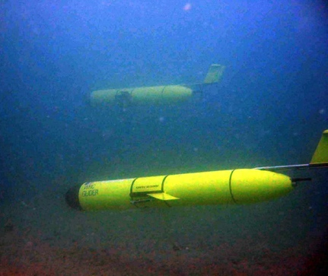






MARACOOS Glider Network
RU01
RU15
RU29
Satellite Ocean Color
MARACOOS
MURI
Intl. Missions
EPA & NJDEP
Cblast
Endurance
OSSE
SW06
Satellite SST
Subsurface
Glider
Data
Many Missions,
Many Agencies
Industry Partner: Teledyne Webb Research

Slide 16





Rutgers Glider Deployments
U.S. IOOS Glider Asset Map
U.S. Navy Operational Fleet - 2011
Emerging Global Glider Network

Slide 17








Korea & United States
Antarctic Glider Collaboration
RU Glider w/FIRe
RU Glider w/ ADP

Slide 18
Current Collaborations Between Korea & Rutgers with Gliders
Aaron Expedition in 2014 in the Amudsen Sea
Professor Lee Sanghoon will be leading the Araon Expedition in 2014 with a focus on the biological dynamics at the marginal ice zone.
As part of that effort, Rutgers is
Hosting Glider school for Korean scientists June 10-15, 2013.

Slide 19



Trans-Atlantic Glider Challenge – May 24, 2006 –
UNESCO E.U./U.S. Baltic Sea Conference in Lithuania
Dr. Rick Spinrad
Assistant Administrator
NOAA
Office of Oceanic and Atmospheric Research
“I have something you need to do for the good of your country.”
“Take one of your gliders, modify it, and fly it across the Atlantic, inspiring students along the way.”

Slide 20


Technology Challenges for a Trans-Atlantic Glider Mission
East-West
Distance Across:
5,500 km
Longest Mission
in 2006: 500 km
Increase Duration
Ruggedize for Storms
Corrosion & Biofouling
Global Roadmap

Slide 21


Technology Challenges for a Trans-Atlantic Glider Mission
East-West
Distance Across:
5,500 km
Longest Mission
in 2006: 500 km
Increase Duration
Ruggedize for Storms
Corrosion & Biofouling
Global Roadmap
Federal Research Agency Response:
Too Risky
for Research
Rutgers
Alumni
Support
RU15 – NJ to Halifax - 2008
RU17 – NJ to Azores - 2008
RU27 – NJ to Spain - 2009
RU15
RU17
RU27

Slide 22




RU27 Trans-Atlantic Mission: Ocean Model Assessment
Eddy
Glider
Azores
Sea Surface Temperature
HyCOM Forecast
Surface Drifter
No Argo Profilers No Altimetry

Slide 23



Scarlet Knight’s Trans-Atlantic Mission Summary
Baiona, Spain
Tuckerton, New Jersey
Time at Sea: 221 days
Track Length: 7,400 kilometers
Undulations: >11,000
Students Directly Involved: >40

Slide 24





Scarlet Knight’s Landfall in Baiona, Spain
Same Port where Columbus’ Pinta made landfall in 1493
Baiona’s Mayor unveils Scarlet Knight’s Plaque
Scarlet Knight’s victory lap around the Pinta
U.S. & Spanish Secretaries of Commerce
Scarlet Knight swarmed by Baiona’s school children

Slide 25



Atlantic Crossing: A Robot’s Daring Mission
An Award-Winning Feature-Length Documentary by Rutgers Filmmaker Dena Seidel
Dena filming the recovery of RU27
offshore Baiona, Spain
TV version broadcast over 350 times nationwide
on PBS Stations starting April 29, 2011
Rutgers Students, Fabien Cousteau & Dena
at the Blue Ocean Film Festival

Slide 26



The Scarlet Knight’s Ribbon Cutting Ceremony
at the Smithsonian: Dec. 9th, 2010
Rutgers Students are welcomed by White House Science & Technology Advisor Shere Abbott
Rutgers Students share Ocean Exploration stories with Fabien Cousteau
The Scarlet Knight in her display case at the Smithsonian’s
National Museum of Natural History, Ocean Hall, Washington, DC

Slide 27




Advice From Some Friends:
Margaret Leinen – Geological Oceanography – Assoc. Provost, Florida Atlantic U.
Good news – Geoscience Majors are more likely to remain in their field.
Key to success – Mentorship – But there remains a mentorship gender gap.
Shirley Tilghman – Molecular Biology - President, Princeton U.
Good news – We know what works.
Keys to success – Turn the pyramid upside down.
Start living the life of a scientist early.
Distribution classes taught within discipline.
Catherine Halversen – Lawrence Hall of Science – NSF COSEE has resources.
Chris Parsons – Word Craft – Don’t forget to layer-on the assessment cycle.

Slide 28








Needs Assessment
- Example: How should universities educate the future ocean workforce?
Graduate Programs: need strong science/math backgrounds, and increasingly look for research experience.
Federal Agencies: Also needs Bachelors & Masters graduates. Not just Ph.D. Researchers.
Companies: seeking people with a range of technical
abilities and Team Working Skills. Not just Ph.D. Researchers.
MATES & NPS Assessment of Marine related Jobs
Nationally in 2007, only 4000 (0.3% of the 1,542,000) Bachelors Degrees were in Earth/Ocean/Atmospheric Sciences.
Need to increase STEM interest within a diverse K-12 pipeline.
Provide Undergrads real-world working-team experience.
Cognitive Apprenticeship.
Strong written and verbal communication skills emphasized by employers
Cross-disciplinary training highly desired (Oceanography combined with other disciplines Atmospheric Science, Computer Science, Engineering, Economics, Communication, Foreign Language)
Workforce of future industries

Slide 29

Cognitive Apprenticeship Model:
Watch One > Do One > Teach One

Slide 30


Summative Assessment – Did we have an impact?
Increase in Number & Scope of Research Internships
Locations: Australia, Antarctica, Svalbard, Spain, Canaries, Azores, California, Florida, New Jersey
Sponsors: NSF, DHS, Alumni
Trans-Atlantic Glider Challenge
Spring 2012 Course: >70 Students
Number of Marine Science Majors

Slide 31
Trans-Atlantic Glider Challenge – May 24, 2006 –
UNESCO E.U./U.S. Baltic Sea Conference in Lithuania
Dr. Rick Spinrad
Assistant Administrator
NOAA
Office of Oceanic and Atmospheric Research
RU27: 7,400 km in 221 days
“I have something you need to do for the good of your country.”
“Take one of your gliders, modify it, and fly it across the Atlantic, inspiring students along the way.”
Trans-Atlantic Glider Challenge

Slide 32





A Global Challenge – The Challenger Glider Mission
December 9, 2009 – Baiona, Spain
Ralph Rayner & Rick Spinrad’s Global Challenge:
Build a Global Glider Fleet
and Coordinate the First
Robotic Circumnavigation.
Revisit the Historic Track of the
HMS Challenger –
And inspire a global network
of students along the way.
HMS Challenger Voyage
First Scientific
Circumnavigation
1872-1876
128,000 km =
= 16 gliders
x 8,000 km/glider

Slide 33





























Partners:

Slide 34

Operational Models for Global Circulation and Heat Transport
Science &
Education
Drivers
How accurate are these global models?
Do I need to embed a regional model?
How much data do I need to assimilate?
Broaden the workforce
Improve ocean literacy
Develop a global perspective
http://polar.ncep.noaa.gov
/global/nctest/viewer.shtml

Slide 35



Global Challenger Glider Mission
16 Global-Class Gliders
5 Ocean Gyres: 16 gliders x 8,000 km/glider = 128,000 km

Slide 36

Ocean Observatories Research Course:
Spring 2013 Project Titles
1. Exploring the South Atlantic
2. Challenger Mission Hazards
3. Antarctic Circumpolar Currents
4. Challenger Mission: The Pacific Leg
5. MAB Spring Bloom: A Game of Oxygen
6. Challenger Path Planning with Migratory Patterns
7. Antarctic Sea Ice: A Comprehensive Look at the Impact of Sea Ice
8. Changes in the Trophic Structure, Species Richness & Biodiversity in Antarctica
9. Comparing the RTOFS (U.S.) & MyOcean (Euro) models with Global Gliders Missions

Slide 37








Ocean Observing Initiative (OOI) Education and Public Engagement (EPE)
Concept Maps generated for each team project.
Reviewed with Students
by Fabian Cousteau.

Slide 38





Dr. Louis Uccellini, Director
National Weather Service
Crowd-sourced comparisons between
U.S. & European Models & Gliders
SALINITY 8 APR 2013
Visualization by
Universidad de Las Palma de Gran Canaria
Model-Glider comparisons of the Amazon outflow fresh water distribution
with NSF OOI EPE Visualization Tools.

Slide 39




Companion Course at
Plataforma Oceanica de Canarias
Shared Glider Missions – Iceland to Azores; Azores to Canaries; Canaries to Brazil?
Skype Sessions between classes
Two-way International Exchange programs
Students Learn Science from their teachers
Students Learn Culture from their peers

Slide 40







Temperature
North Atlantic Gyre: Silbo
Deployments: 3
Initial Deployment: June 23, 2011
Days at Sea: 164 + 76 + 294 = 534
Kilometers Flown: 10,404
Speed: 20 km/day
1
2
3
Salinity
1
2
3

Slide 41





Challenger Glider Mission: South African Launch of RU29
University of Cape Town, Nansen-Tutu Centre
Students Sinekhaya, Ashley, JP Launch Challenger
Challenger rides an eddy
Glider Challenger (RU29): >192 km since January 11, 2013

Slide 42



South Atlantic Gyre: Challenger
Initial Deployment: Jan. 11, 2013
Days at Sea: 124
Kilometers Flown: 3,033
Speed: 24 km/day
Salinity
Temperature

Slide 43





Korean & United States
Potential Collaborations

Slide 44

Conclusions:
MARACOOS / IOOS has developed and sustained a
Regional Scale Observation & Forecasting System.
Demonstrated value for Science & Education.
Global HF Radar & Glider Networks are emerging.
Challenger Glider Mission:
2 Gliders deployed
Leverage existing programs
Build a global community
http://challenger.marine.rutgers.edu

