Slide 1
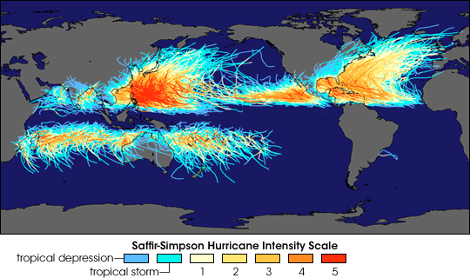
Global Tropical Cyclones – Hurricanes & Typhoons

Slide 2
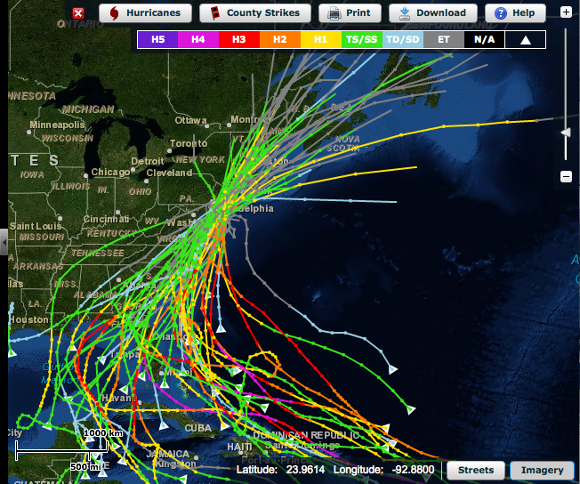
Historical Hurricane Tracks within 65 nm of Atlantic City, NJ
Primary
Approach:
Alongshore
from
Southeast

Slide 3
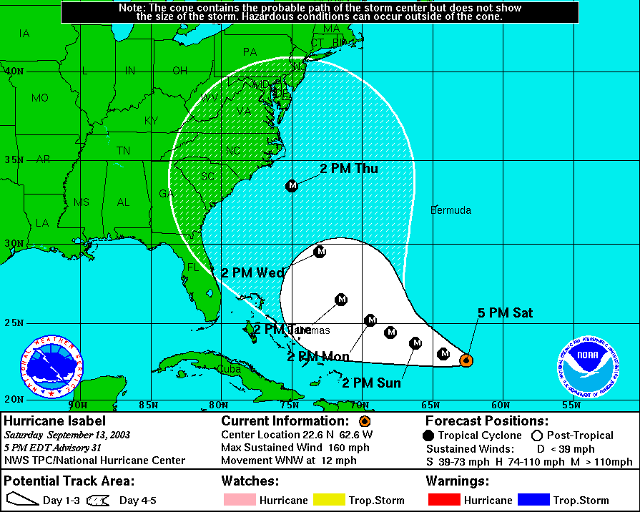
White cone – 2003
Brown cone - 2010
3:17 PM
Notes:
3

Slide 4
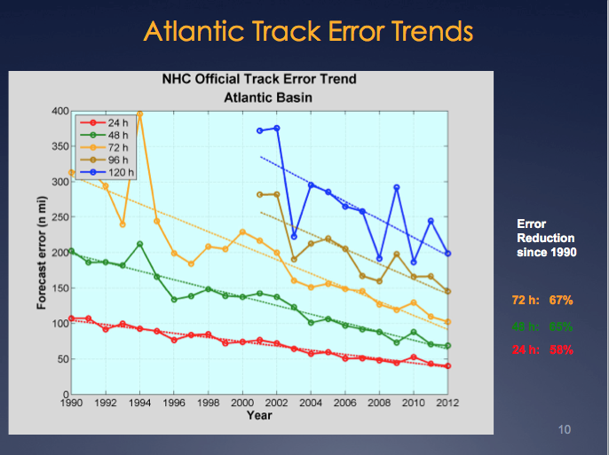
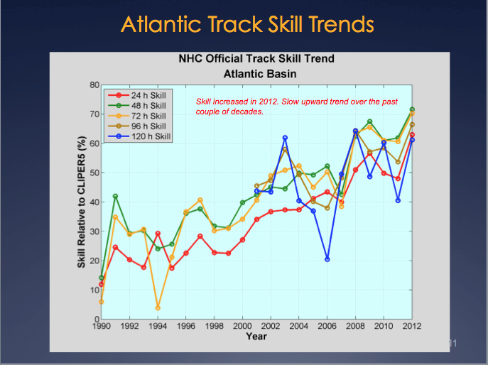
Report from National Hurricane Center: Track Error & Skill
Reduction in forecast track error & Increase in forecast track skill
over the last 2 decades.
Significant Drivers – Improvement in Global Forecast Models
- Super-Ensemble
Production Suite Review: December 4, 2012

Slide 5
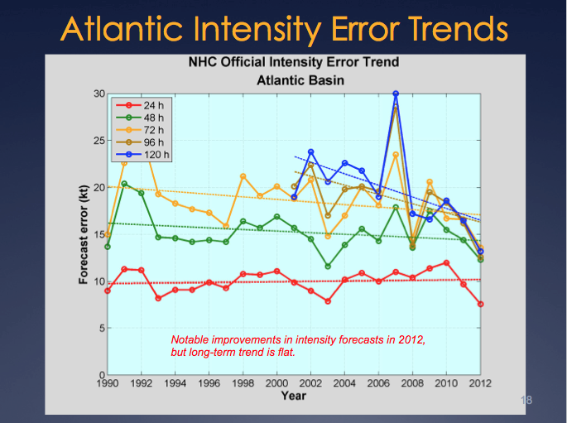
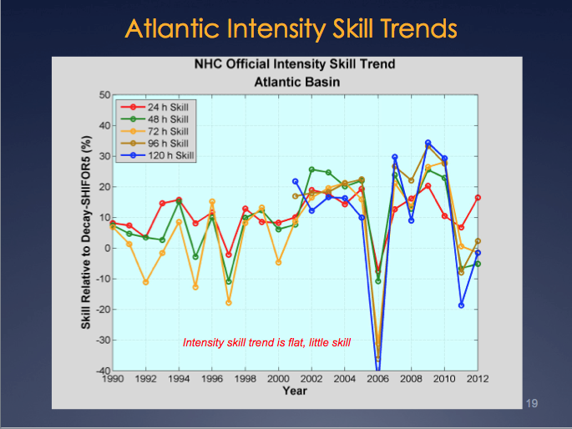
Report from National Hurricane Center: Intensity Error & Skill
“Long-term trend is flat.” “Skill trend is flat, little skill.”
Production Suite Review: December 4, 2012

Slide 6
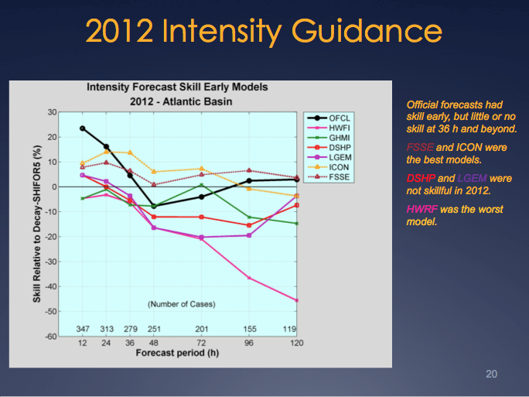
Report from National Hurricane Center: Intensity Skill in 2012
Adding the ocean model reduced skill!
Production Suite Review: December 4, 2012

Slide 7
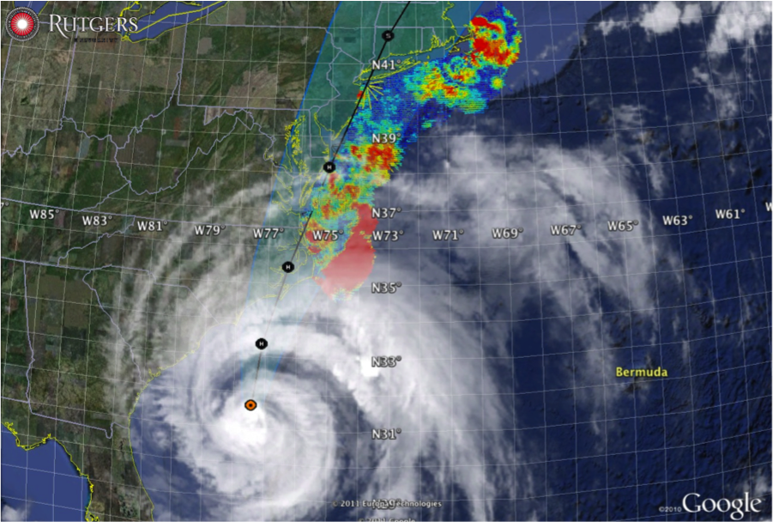

Hurricane Irene
August 26, 2011
NOAA/NHC Damage:
#8 with >$15 Billion.
Track Accurate;
Intensity Over-predicted.
Hurricane Sandy
October 29, 2012
NOAA/NHC Damage:
#2 with >$60 Billion.
Track Accurate;
Intensity Under-predicted.

Slide 8
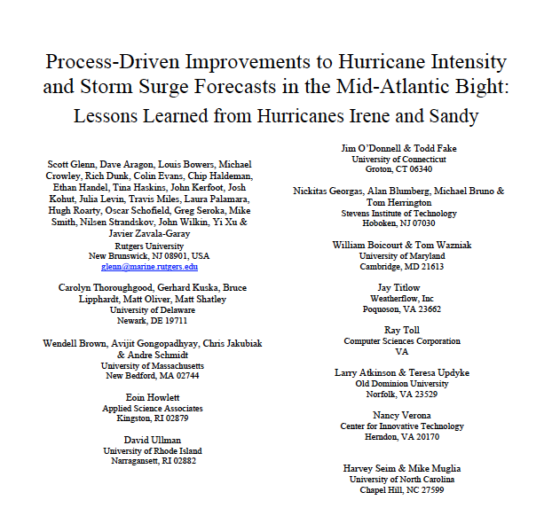
Can Rutgers Oceanography Improve Hurricane Intensity Forecasts for the United States of America?
Sandy
2012
Irene
2011
Submitted April 12 to MTS:

Slide 9

IMPACT OF
OCEAN OBSERVATIONS
ON HURRICANE IRENE
INTENSITY FORECASTS
2011

Slide 10
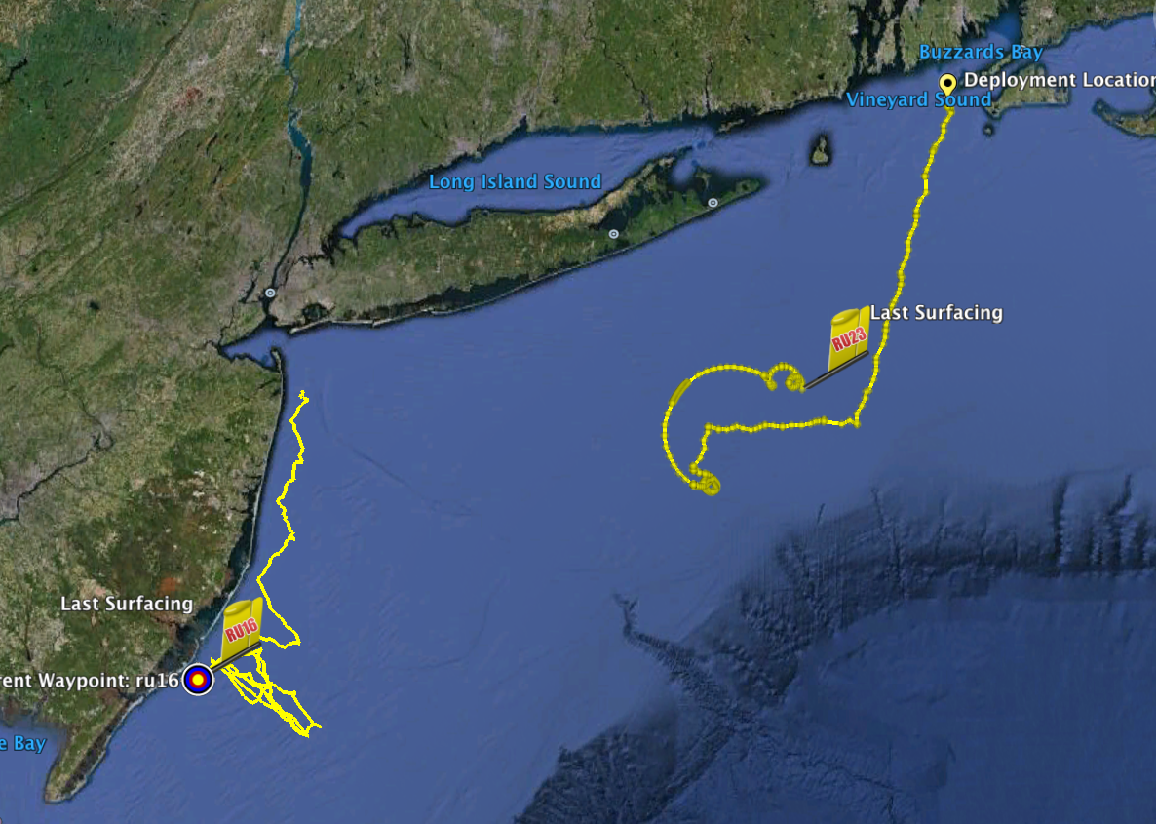
Two Gliders
Operated by Rutgers
in Hurricane Irene
RU23
Deployed for MARACOOS.
Map subsurface T/S structure for fisheries.
Damaged early - drifter
Recovered by fisherman
Provided data on inertial currents during storm.
RU16
Deployed for EPA.
Map bottom dissolved oxygen.
Provided data on mixing during storm.

Slide 11
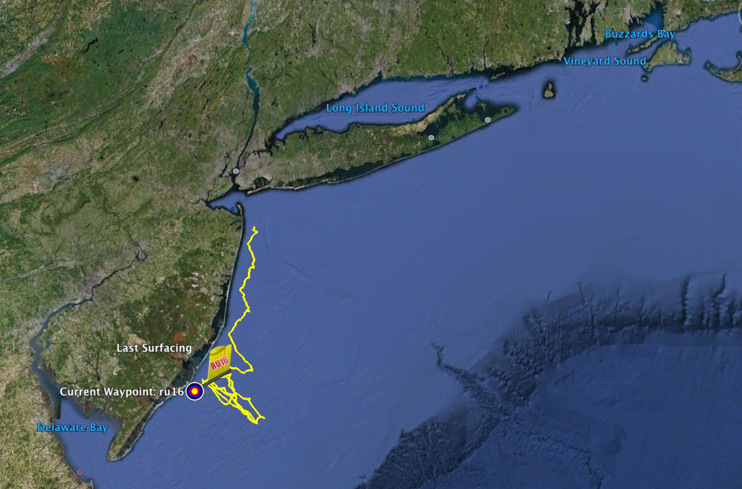
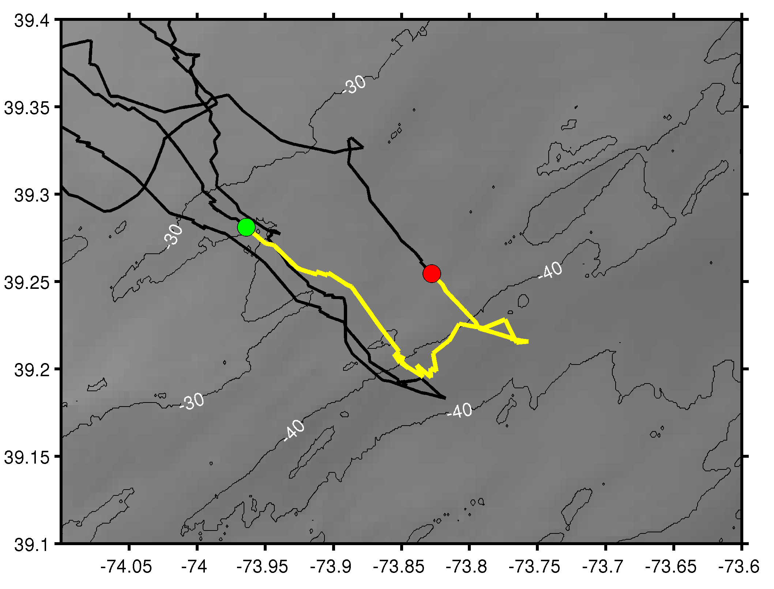
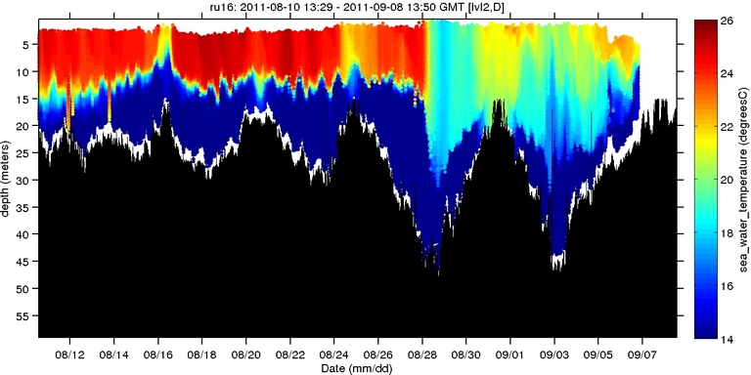
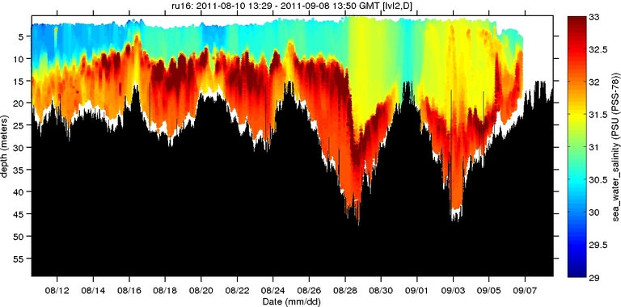
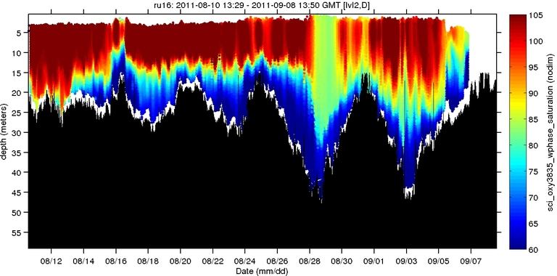
Hurricane Irene
Hurricane Irene
0
26
depth
temperature
55
14
0
33
depth
salinity
55
29
0
105
depth
% oxygen
55
60
8/12
date
9/07

Slide 12
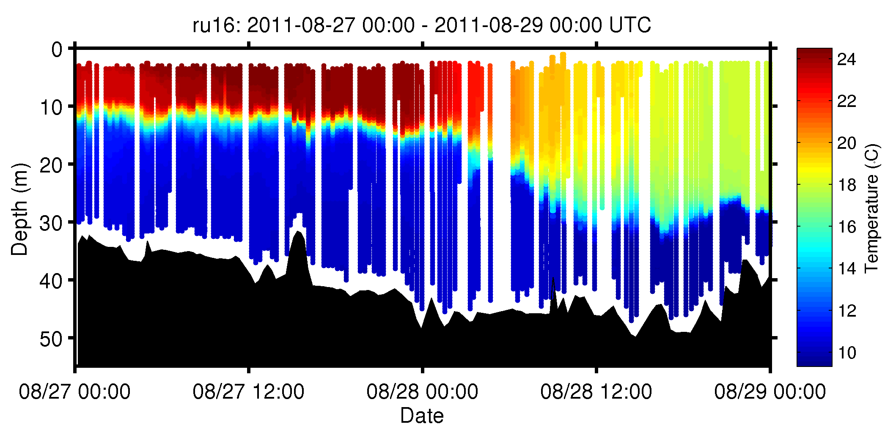
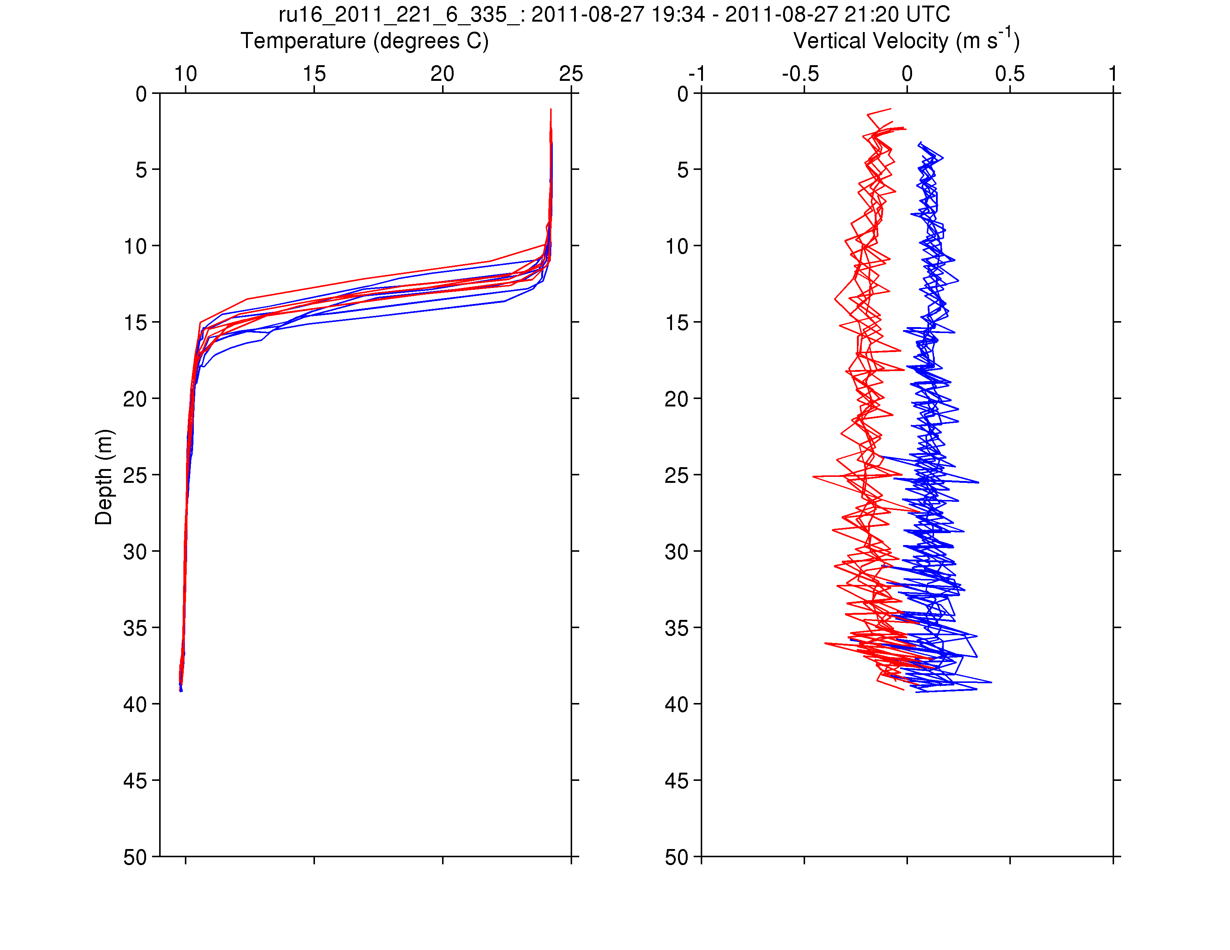
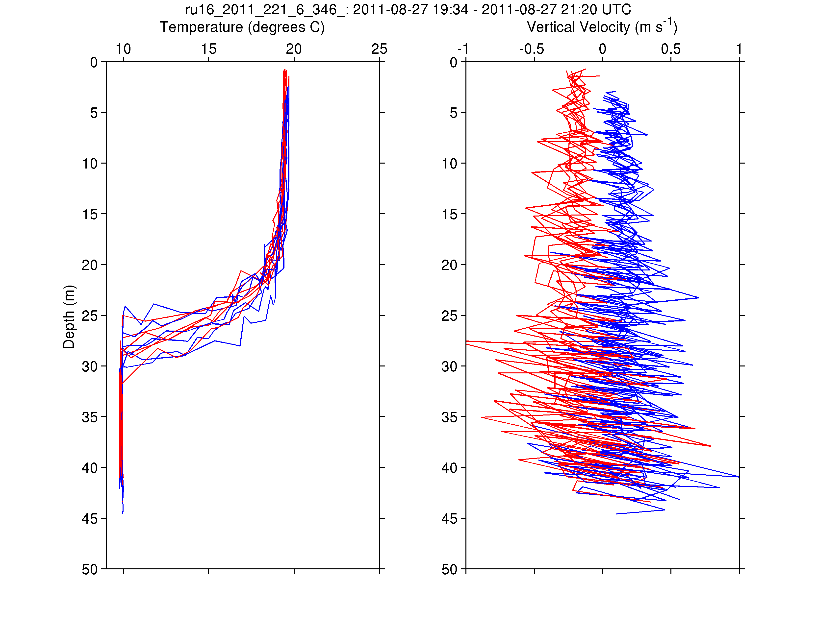
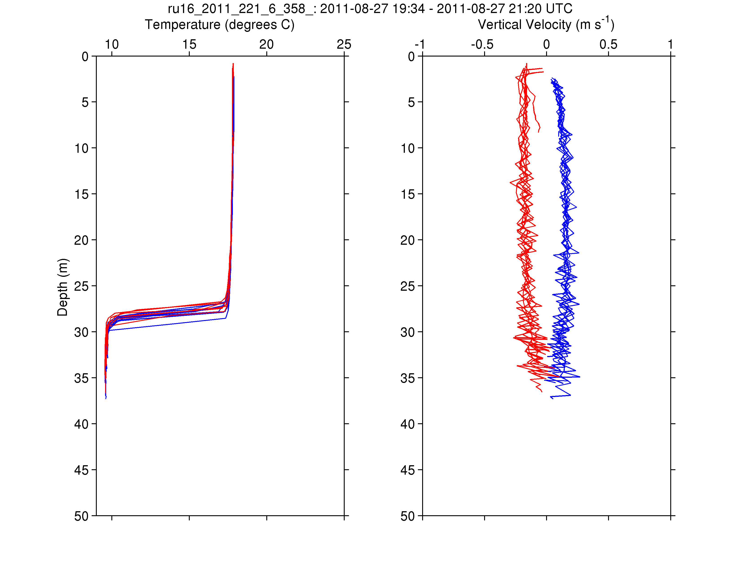
RU16
Temp.
Section
Upcast
Downcast
Temp. Vert. Vel.
Temp. Vert. Vel.
Temp. Vert. Vel.

Slide 13
Post-Hurricane Irene Sea Surface Temperatures
Global
SST
Regional
SST
SST Difference
How does the 6C - 8C Cooling impact the hurricane?

Slide 14
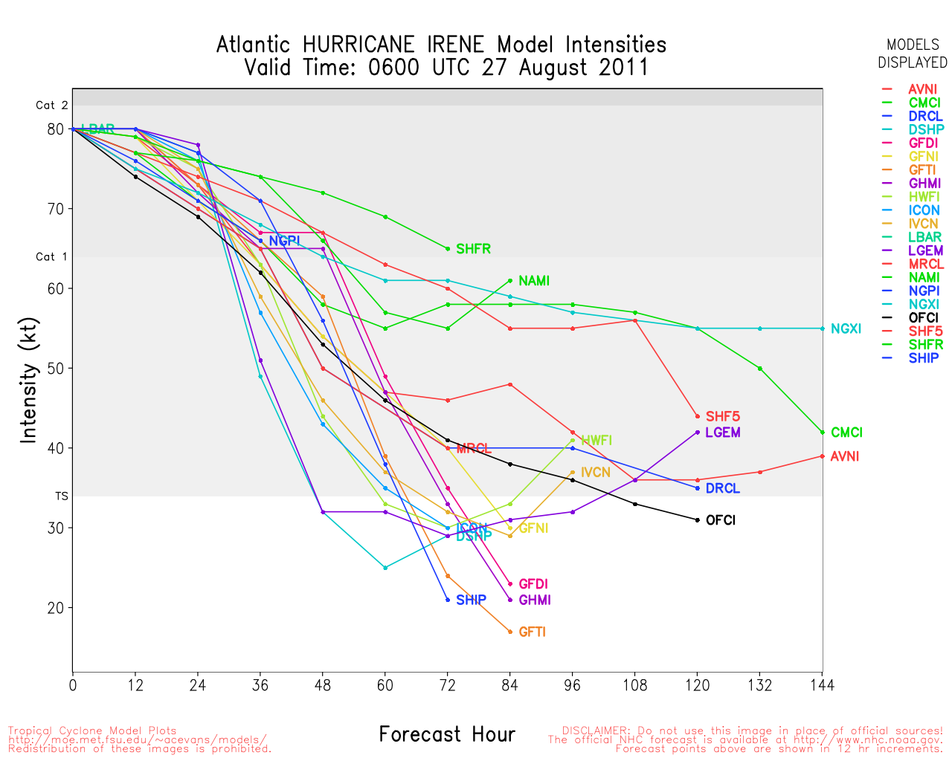
Even coupled models (e.g. HWRF) overpredicted Irene
NHC Best Track
Notes:
-HWRF is labeled as “HWFI”

Slide 15
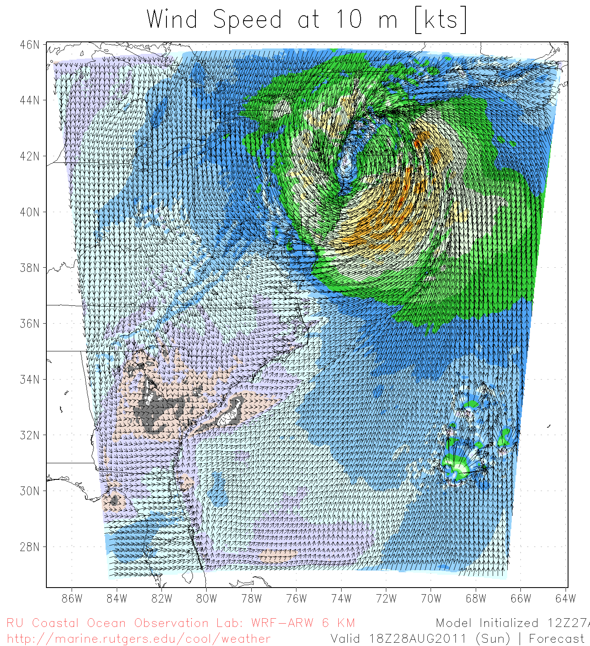
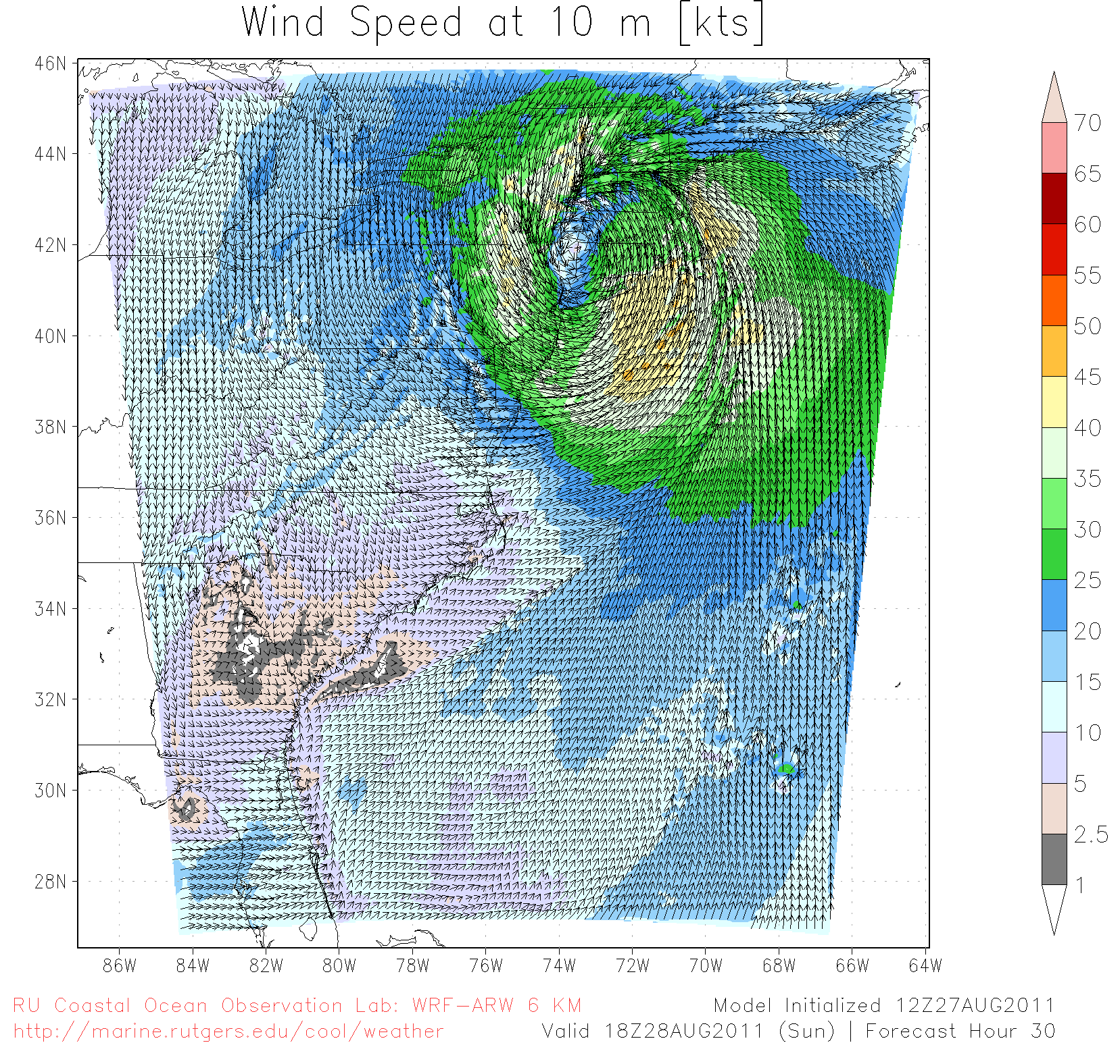
Hurricane Irene SST Sensitivity Hindcast
Global Warm SST
Regional Cold SST
Maximum Wind Speed Skill Score | Official Forecast | Warm SST Hindcast | Warm SST + OML Model Hindcast | Cold SST Hindcast
RMS Error (knots) | 9.43 | 7.13 | 7.09 | 3.61

Slide 16
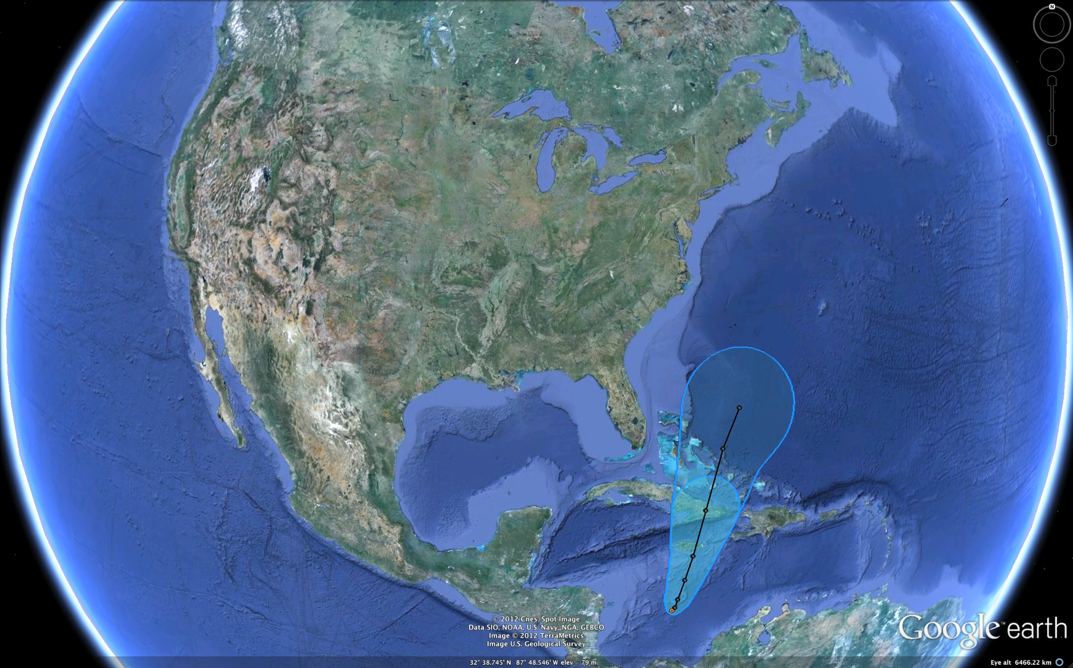
Hurricane Sandy: 5 Day Track Uncertainty Cone

Slide 17
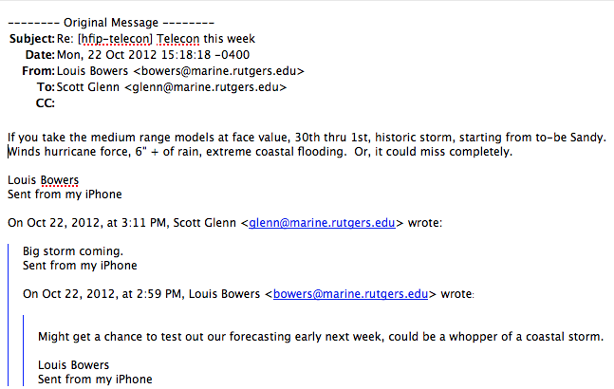
First Warning - Monday, Oct 22, 1-week prior to landfall

Slide 18
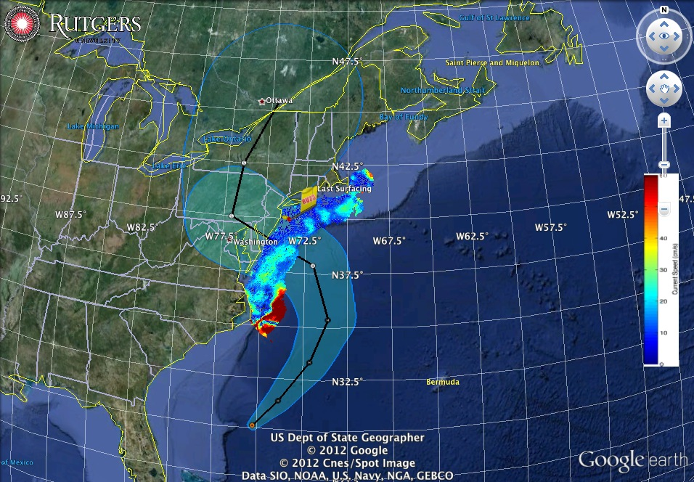
Sandy:
2 days before
landfall

Slide 19
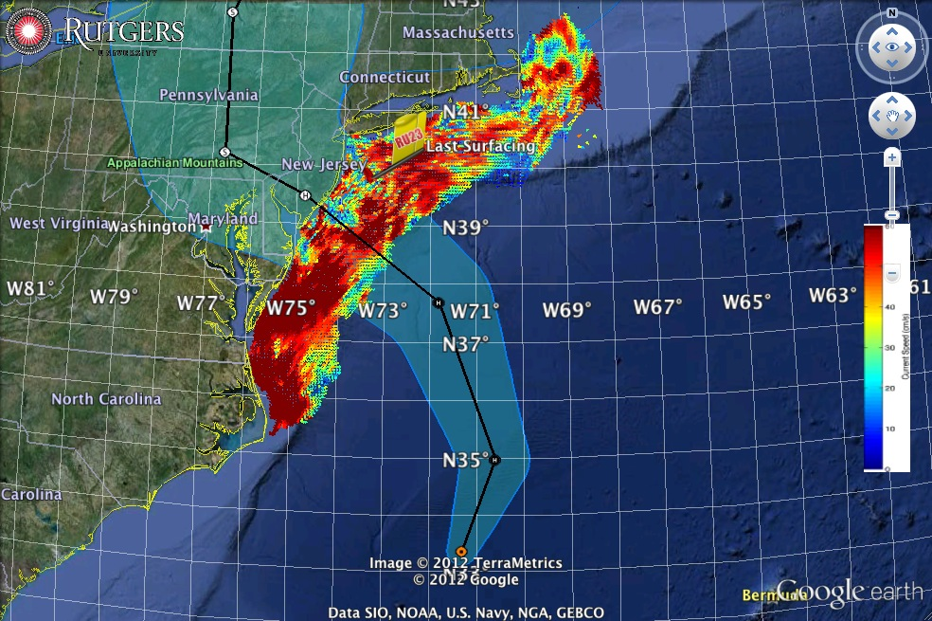
Sandy:
1 day before
landfall

Slide 20
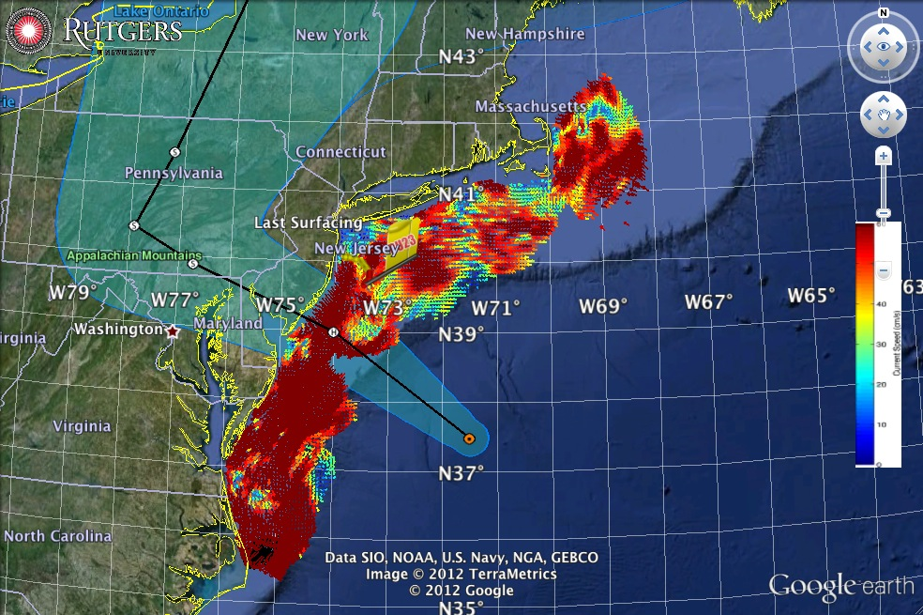
Sandy:
morning before
landfall

Slide 21
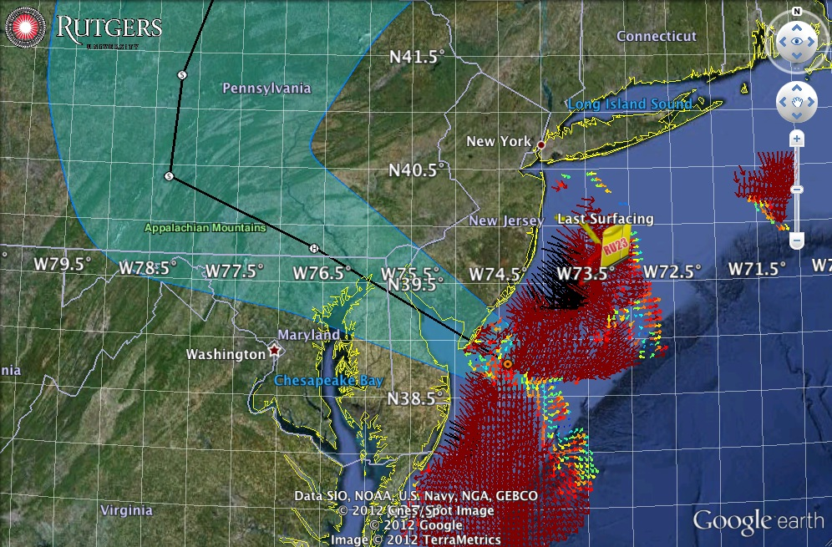
Sandy:
landfall

Slide 22
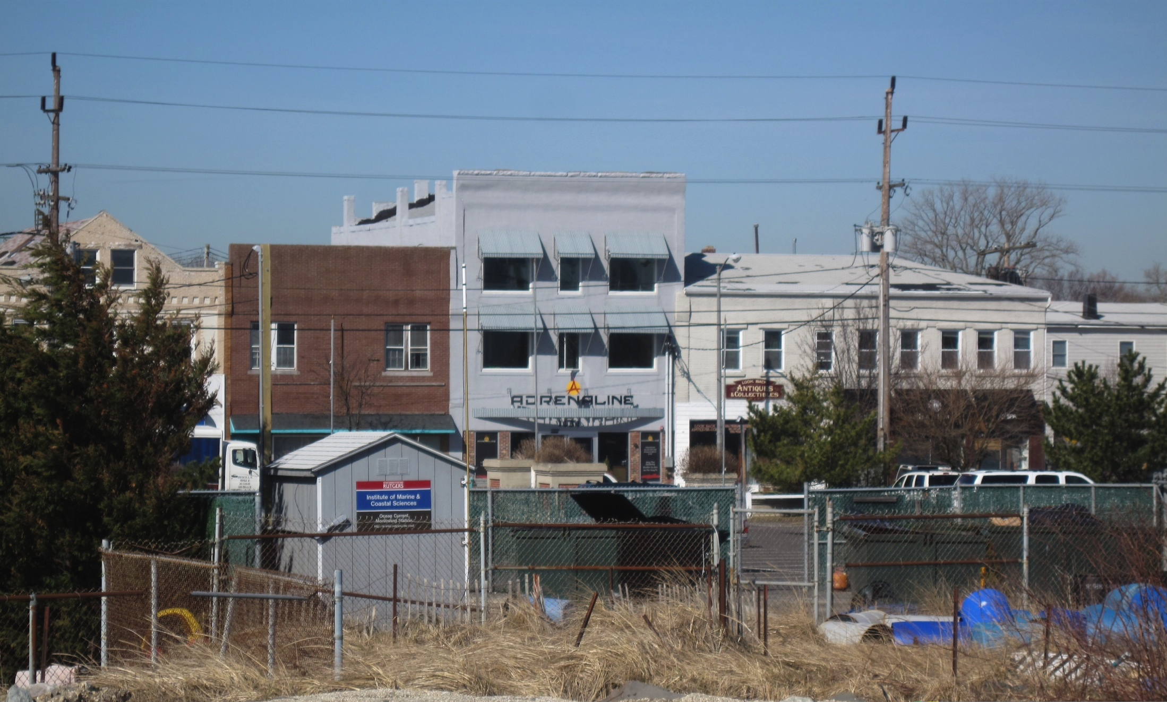
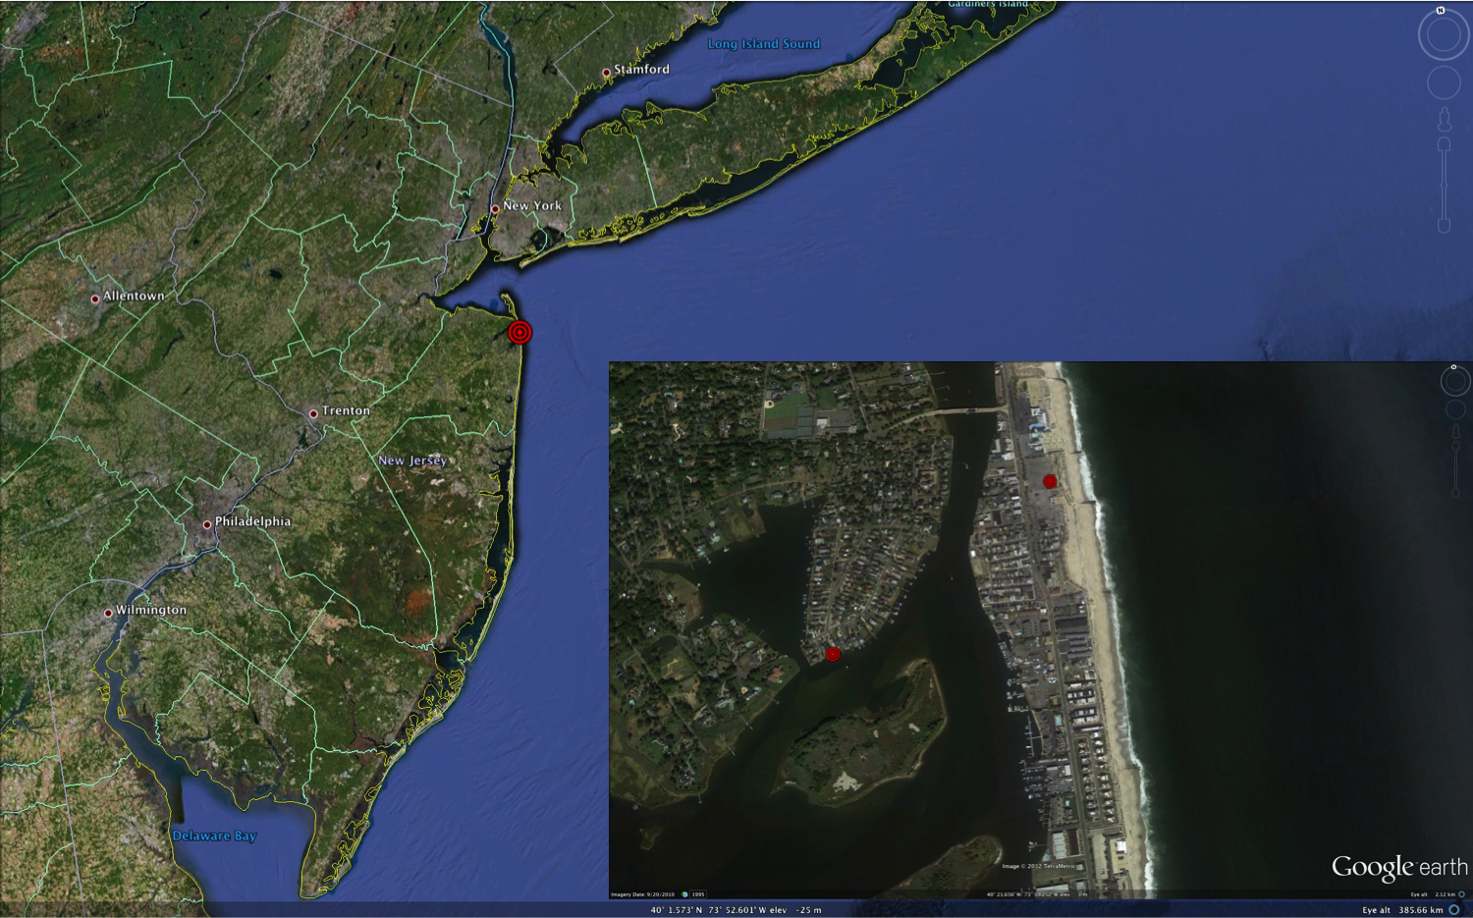
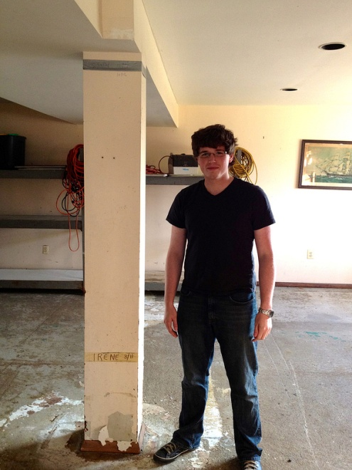
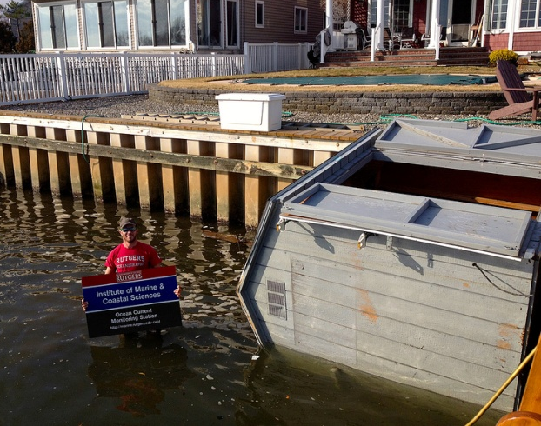
HF Radar Storm Damage
Keyport
S
HF Radar Shed floats 0.85 km across barrier island & river
I

Slide 23
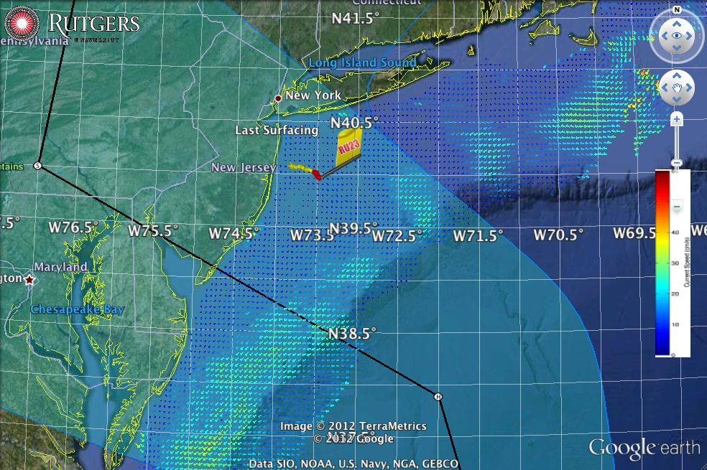
RU23 Glider Deployment

Slide 24
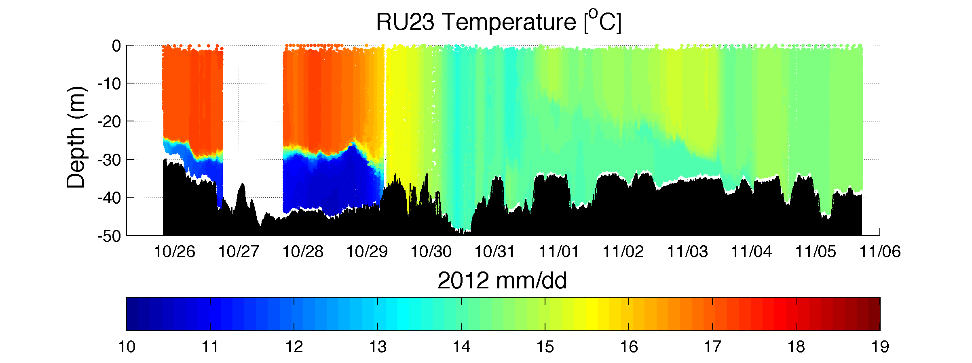
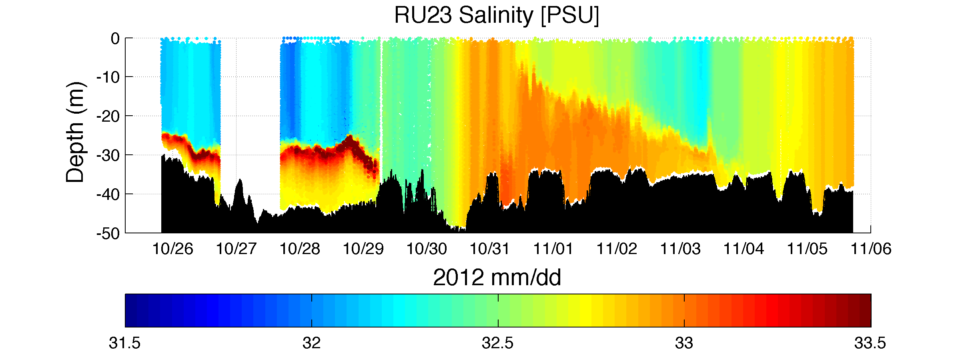
Glider RU23 Temperature and Salinity Section

Slide 25
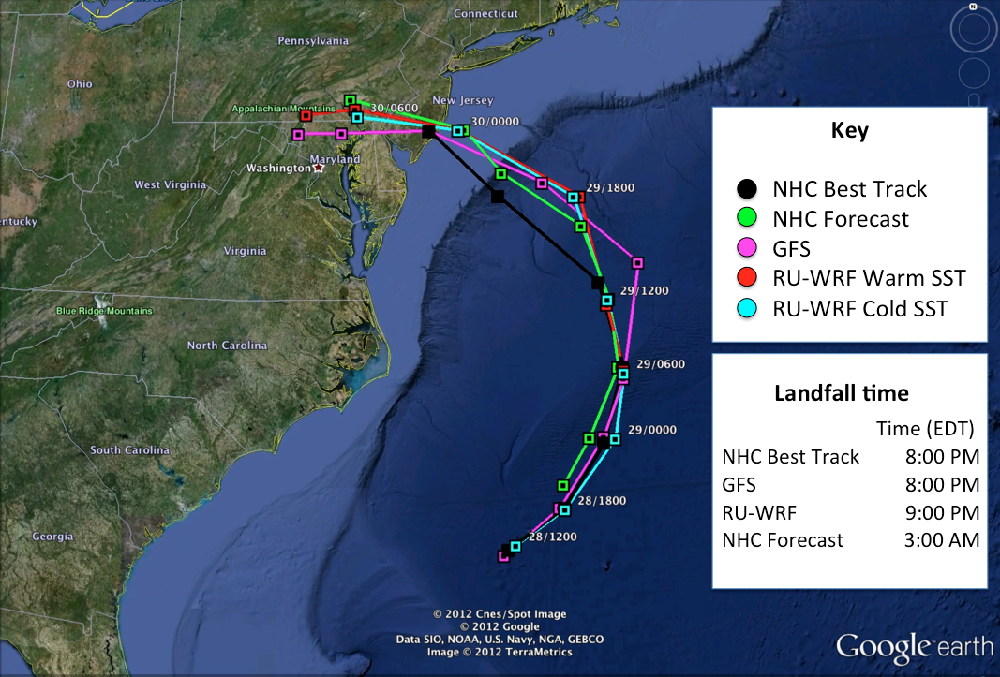
Hurricane Sandy Track Forecasts & Hindcasts

Slide 26
Hurricane Sandy Hindcast: Intensity

Slide 27
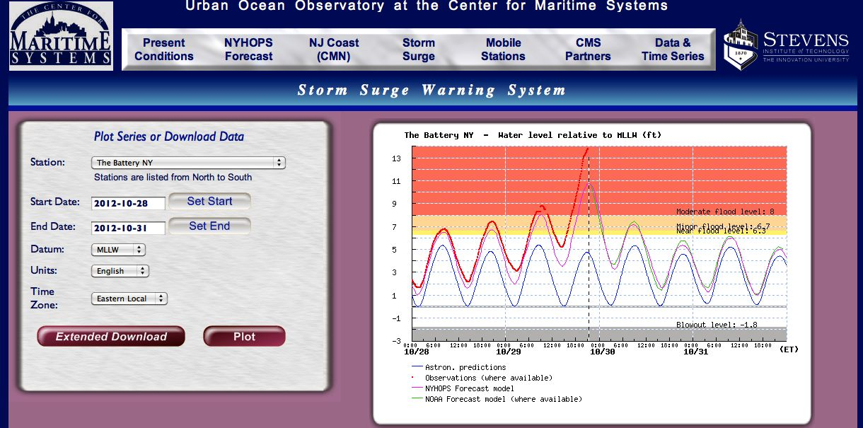
Storm Surge Forecast at Peak

Slide 28
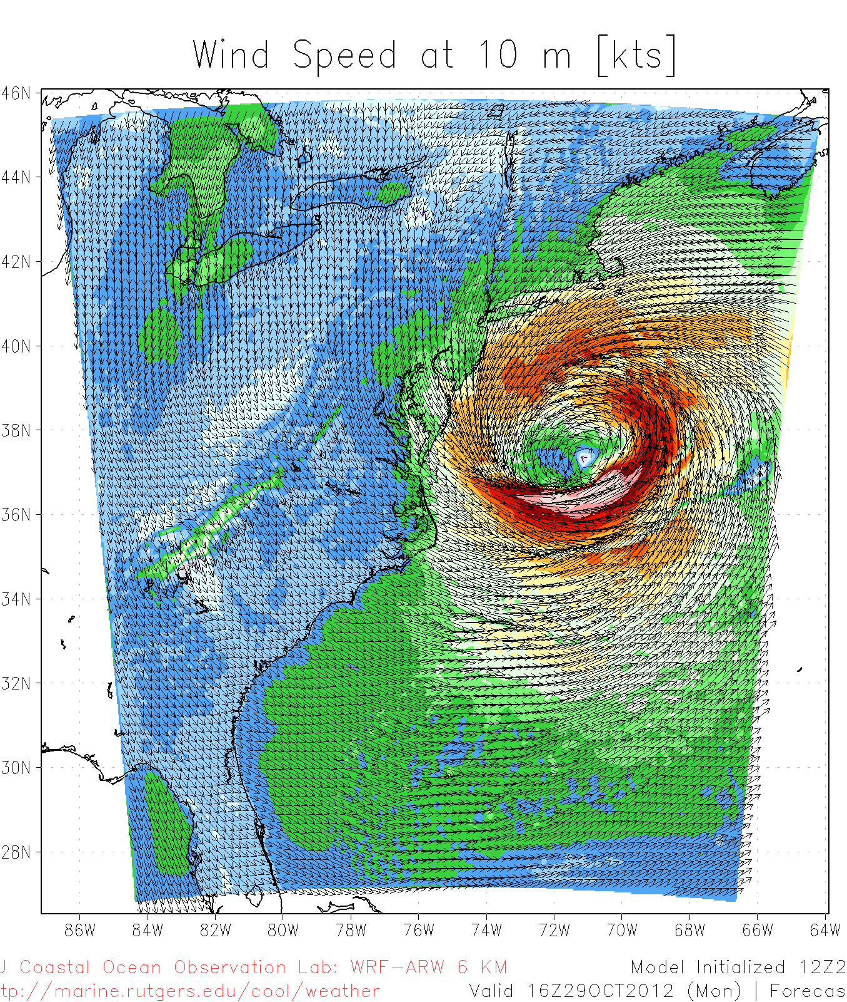
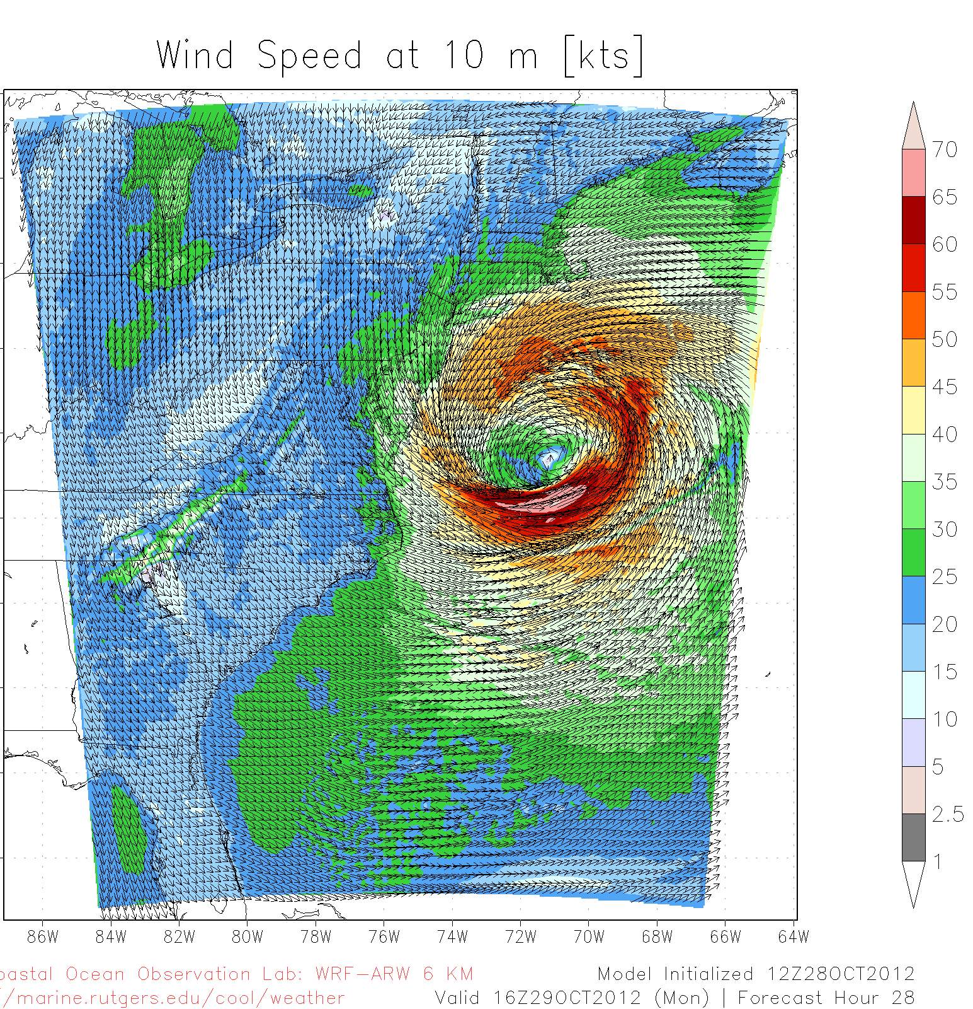
Hurricane Sandy Hindcast: SST Sensitivity
Warm SST
Cold SST Switch

Slide 29
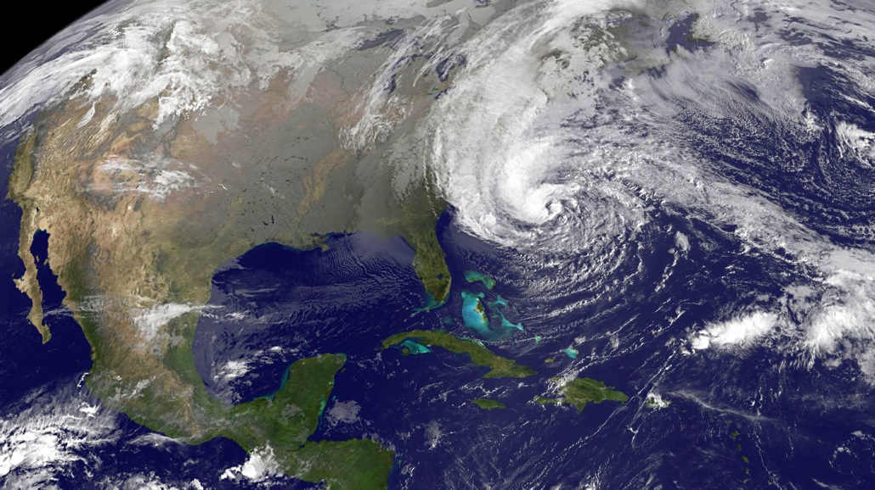
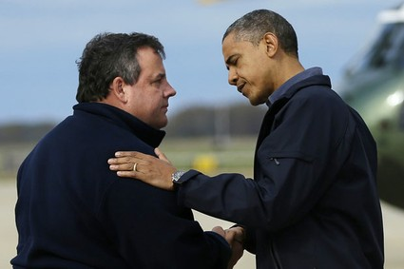
Response Summary:
Sandy was a disruptive event.
Rutgers was there before, during and after.
Rutgers made a difference.

Slide 30
Sandy Supplemental Congressional Budget Request
$2.5 M for repair of the
HF Radar network.
$4.5 M for storm research
$22.5 M to improve hurricane intensity forecasts

Slide 31
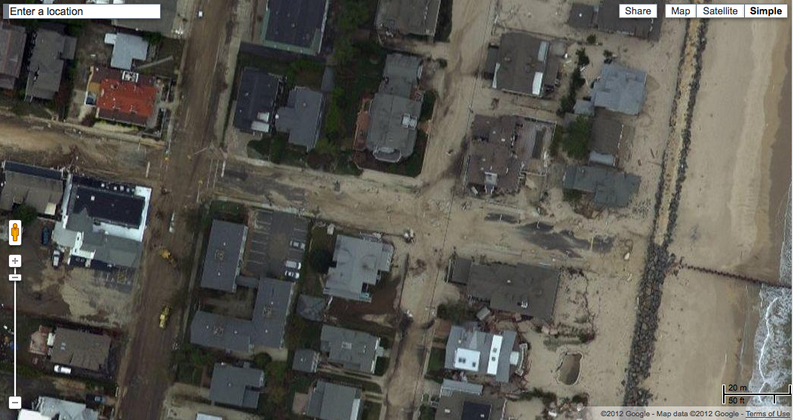
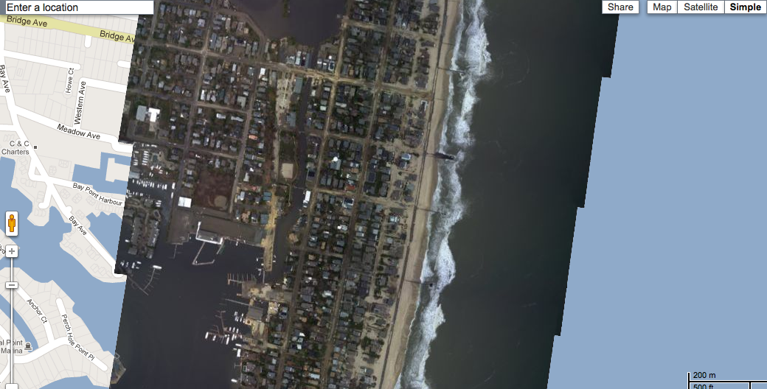
Mount Street
Bay Head, New Jersey

Slide 32
IMCS priorities that will move it to becoming the number one Oceanography program in the world
Goals are prioritized for the next year to enable the collection of matching funds from the University’s current Capital Campaign and Donors offering potentially 50% match. Goals are the same as a year ago.
We will attract/retain the world’s greatest faculty
We will develop interdisciplinary research space that will enable the new clusters of strength we are building to serve the state, the nation and the world.
We will be the first to develop global omnipresence
The priorities therefore are:
Acquisition of the endowed Chairs for faculty
Development of Coastal Resource Center
Development of the global glider fleet through the Challenger Initiative

Slide 33
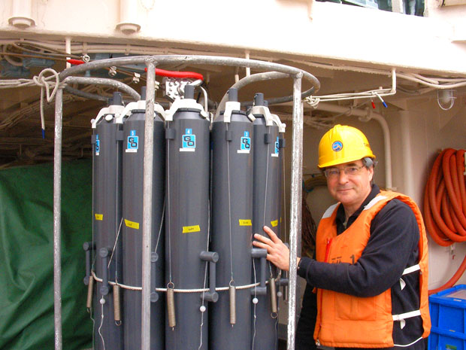
Attracting/retaining the world’s greatest faculty
Situational analysis: IMCS will maintain its reputation as research friendly and creative environments to attract world-leading faculty. Additionally many of the leading IMCS faculty are routinely approached as targets of opportunity so focus will be retaining our strengths. Endowed Chairs provide a unique tool to honor faculty that can be used to attract leading faculty and retain current faculty being pursued by other Universities. IMCS has one endowed Chair (Paul Falkowski, Bennett Smith in Business and Natural Resources).
Our peer institutions:
University of Washington 1
Oregon State University 7
Scripps Institute 6
WHOI 5

Slide 34
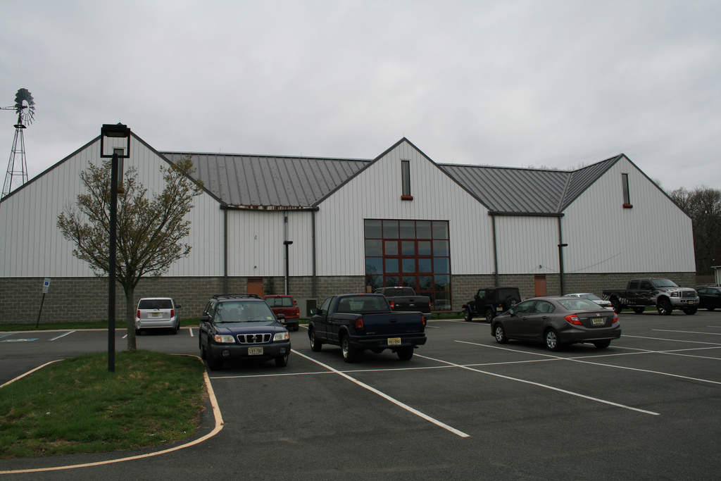
Developing the Coastal Resource Center (CRC)
The CRC will be the world’s first focused on the resilience of ecosystems impacted by coastal megacities and urbanization. The proposed CRC will leverage Rutgers diverse strengths to develop and deploy novel science/technology that will support economic development, education, management and outreach.
Situational analysis: The building renovations and its functionalities have been
the focus of the last year. To date:
-RSC Architects was retained by Rutgers University to conduct a physical needs assessment and space planning study for the potential renovation of the existing New Jersey Agricultural Museum Building. This feasibility study was conducted with the many of the research groups that would use the newly renovate facility. The study has been completed for the 30,000 square foot building.
-Core faculty teams that will use the CRC have worked to optimize the renovated space.

Slide 35
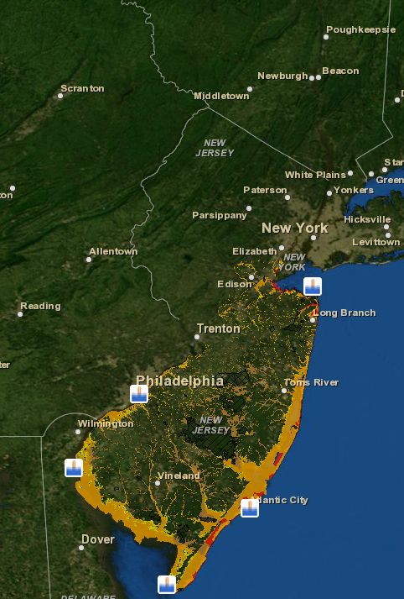
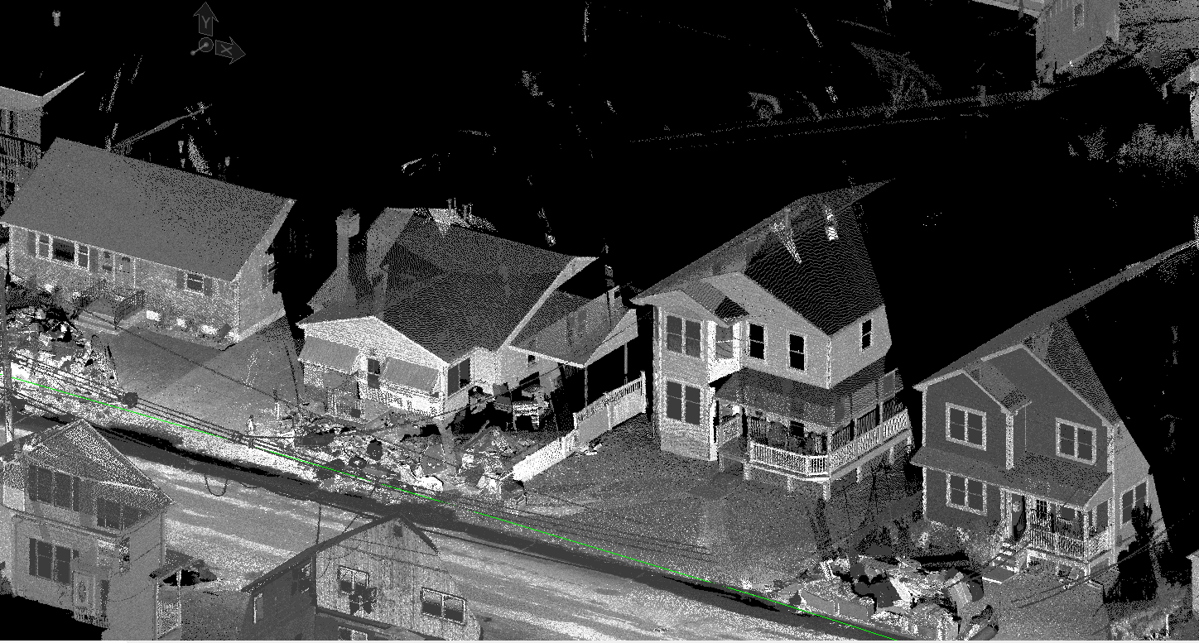
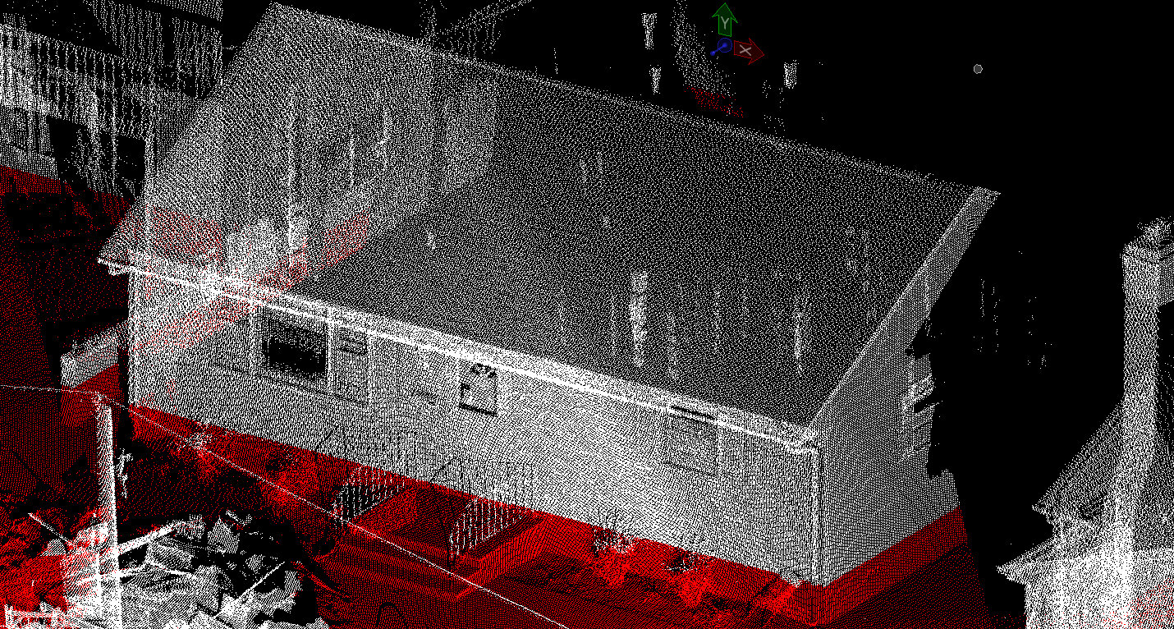
Developing the Coastal Resource Center (CRC)
The CRC will support improving New Jersey and Nations resiliency and sustainability
Environmental obs and prediction
Observations to
expand
environmental
GIS library
Realistic environmental
observations/models to
allow realistic infrastructure
simulations
Identify where
observations
are needed
Identify what
models
are needed
Flood vulnerability maps
Ortley Beach Flood Simulations
Rutgers COOL
Ocean Observatories
High resolution observations
and models to increase
GIS library products
Identify where
observations
are needed
Rutgers CRSSA
GIS Mapping layers
Rutgers CAIT
LIDAR based simulations

Slide 36
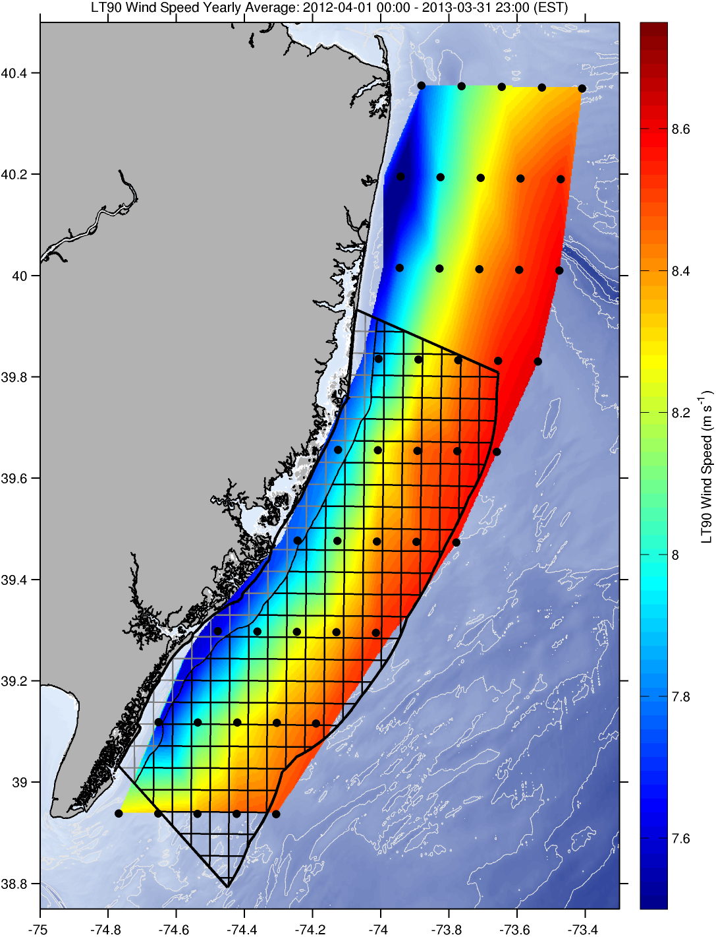

Developing the Coastal Resource Center (CRC)
The CRC will support improving New Jersey economy, Offshore wind example

Slide 37



Developing the Coastal Resource Center (CRC)
The CRC will allow the new fisheries cluster to support Mid-Atlantic fisheries
NOAA US Fishery Data
Spatial grain = 11km
Ocean
observations
+
Regional
Seabed data
Regional
Habitat
Projection

Slide 38






Developing the Coastal Resource Center (CRC)
The CRC will support K-12, undergraduate, and graduate education
Majors
Demographics: Status
Demographics: Gender
Seniors
Freshmen
SEBS
Marine
Science
Others
Female
Undeclared
Male
SAS Marine Science
Juniors
Sophomores

Slide 39

First Floor
Ocean infrastructure fabrication facility
Technology Innovation wing, from molecules to robots
K-12, undergraduate, and graduate teaching

Slide 40

Second Floor
Fisheries cluster spanning research,
management, and simulation
Environmental/infrastructure observation/modeling
data fusion Center

Slide 41

CRC Situational Analysis
HARD COSTS
SOFT COSTS
-computing interface
-internet access
-hardening of utilities
Raises bottom line to $14 million. With Capital Campaign match of 50%, the external costs are 7 million.

Slide 42
Building IMCS’s the global presence highlighting
impact of CRC
The Challenger Initiative will be the means for Rutgers to establish a global presence by leap frogging competitors.
Situational analysis:
-SEBS provided match funds to purchase the global test glider for the Challenger mission. This allowed key technology tests to begin, came at the cost of the New Jersey glider fleet.
-We have garnered support from the Navy for two gliders, and England is onboard wanting to own a Challenger line
Challenge:
-Spring 2014 the projected start date, by which we need to start taking delivery
-Match from capital campaign requires funds in hand by the next 18 months

Slide 43




















Robert Gordon Sproul
Revelle
Melville
New Horizon
Unnamed
Atlantis
Knorr
Tioga
Neil Armstrong
Oceanus
Wecoma
Historically, metric of global leadership was the ownerships of ships that can remain out at sea for longer the 24 hours
Clifford A. Barnes
Thomas G. Thompson
Ronald H. Brown
Okeanos Explorer

Slide 44




















Marcus Langseth
Kilo Moana
Hugh R. Sharp
Atlantic Explorer
F.G. Walton Smith
Endeavor
Blue Heron
Pelican
Connecticut
Savannah

Slide 45

2010 ONR Selected WHOI & SCRIPPS for two new R/V
  WHOI- R/V Neil Armstrong. WHOI Contributes $350,000/year in exchange for 10 days of preferential access to the ship schedule
  SCRIPPS- unnamed. “The US Navy is providing more than $88 million to fund the design and construction of the vessel, and, through the Naval Sea Systems Command, will provide program management throughout the design and construction process.” “The economic impact of the new vessel is anticipated to be $10 million annually.”
Okeanos Explorer: “The Panel received estimates that the full annual operating costs of the Okeanos Explorer for FY12 ranged from $6.1 million to over $8 million”

Slide 46

As of 4/24/2013

Slide 47


A Modern Challenger Mission lead to the acquisition of a global glider fleet: Now - 2016

Slide 48
IMCS priorities that will move it to becoming the number one Oceanography program in the world
The priorities therefore are:
Acquisition of the endowed Chairs for faculty
Development of Coastal Resource Center
Development of the global glider fleet through the Challenger Initiative
Hurdles and timeline
Endowed chairs: Anonymous donor, 18 endowed lines at ½ price, first come first serve, 7 of these lines remain.
CRC: Capital Campaign has 18 months to completion, represents a 50% match. The CRC would then require $7 million external funds to be raised.
Challenger: While the full global mission is $20 million, what we require is the global fleet. 16 global class gliders with batteries is $2.7 million. Capital campaign timeline combined with the timeline of the public announcement at Oceanology 2014.

Slide 49
To help facilitate:
-More frequent communication to the board via the monthly newsletter that gives fund-raising updates
-Deployment of faculty to reach out to constituents identified by the Board
There have been discussions of developing a few community meetings or forums (Fisheries, Barnegat Bay, etc.)
-Involvement of Rutgers Foundation in developing promotional resources working closely with faculty pool. Challenger brochure is completed. CRC brochure is being developed.
-We really need help to increase visibility among the state and federal legislators

Slide 50





Leap frog competitors with new technology
Telepresence? Expensive, decadal investment for science finished

