Slide 1
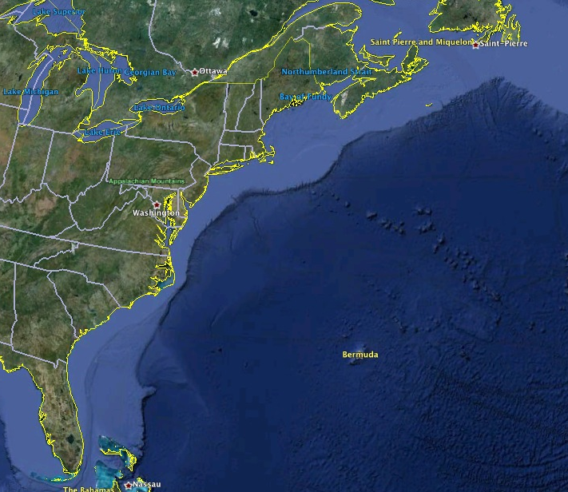
















RI
U..
Middle Atlantic
Regional Association
Coastal
Ocean Observing System
10 States
76 Million People
CT
Cape
Cod
MA
NY
PA
NJ
U.S. IOOS
Responds to
Hurricanes Irene
and Sandy
MD
DE
Sandy
>40 PIs
>20 Institutions
>50 Members
>2000 Contacts
Irene
VA
NC
Cape
Hatteras
Notes:
1

Slide 2
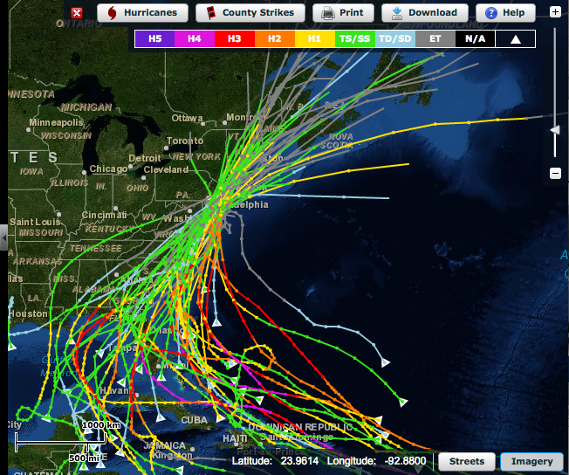
Historical Hurricane Tracks within 65 nm of Atlantic City, NJ
Primary
Approach:
Alongshore
from
Southeast

Slide 3
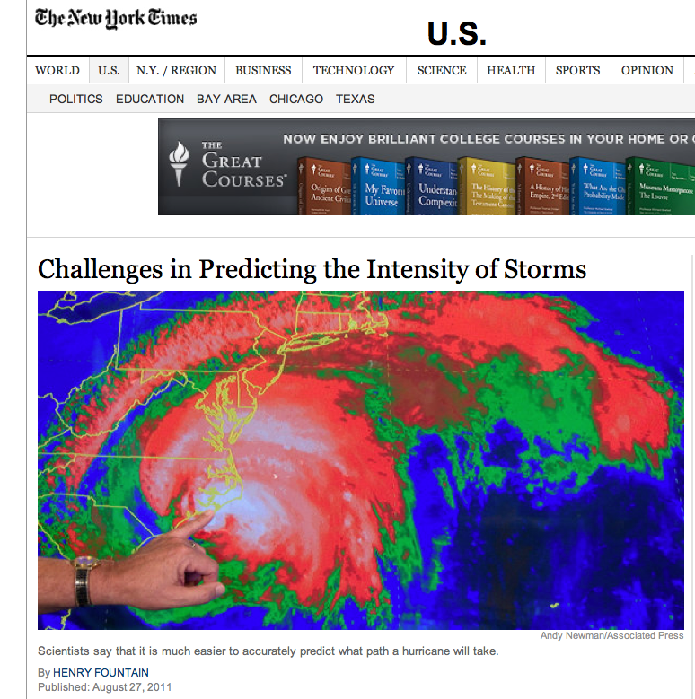
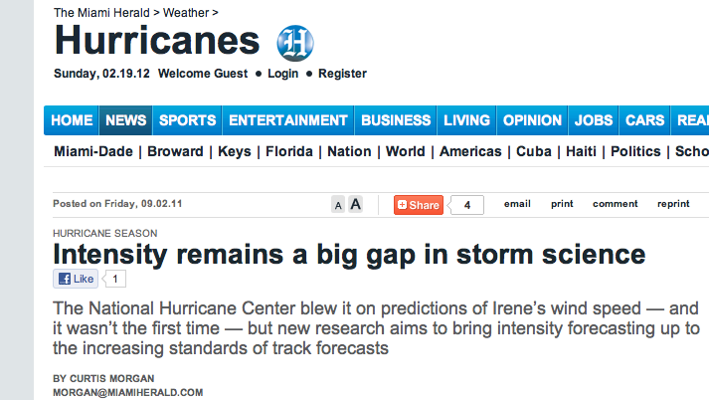
Hurricane Irene in the News:
Track accurately forecast days in advance.
Intensity was over-predicted.

Slide 4
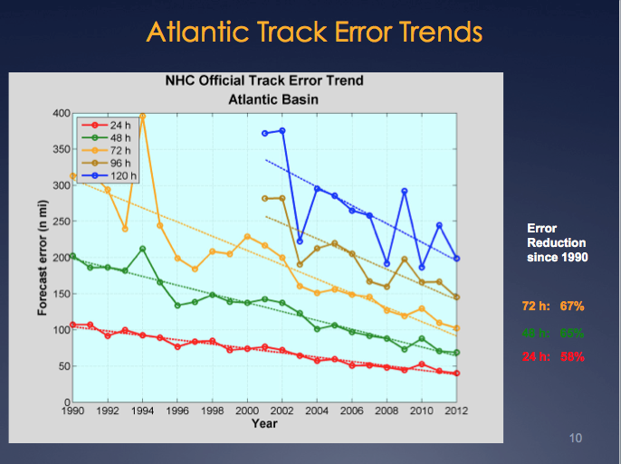
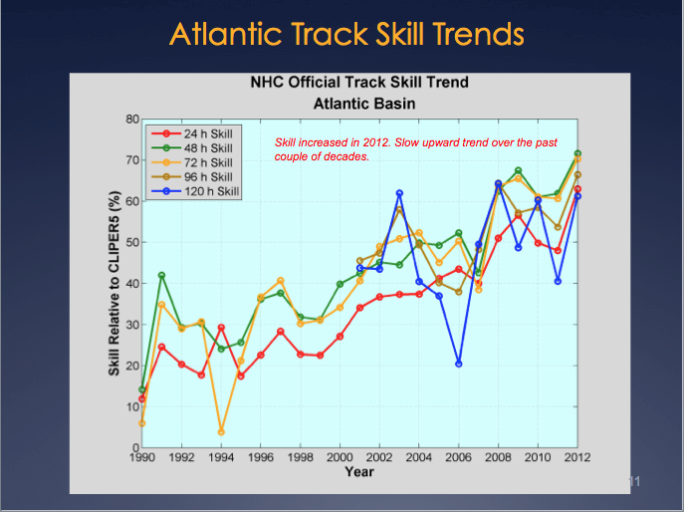
Report from National Hurricane Center: Track Error & Skill
Reduction in forecast track error & Increase in forecast track skill
over the last 2 decades.
Significant Drivers: 1) Improvement in Global Forecast Models
2) Super-Ensemble
Production Suite Review: December 4, 2012

Slide 5
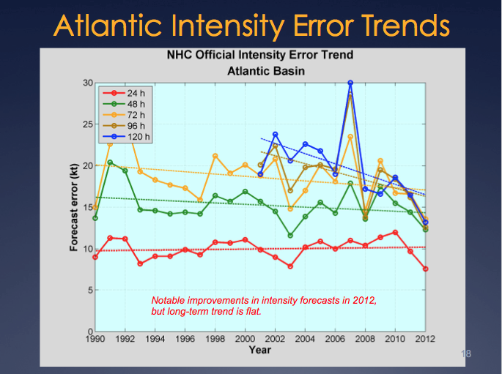
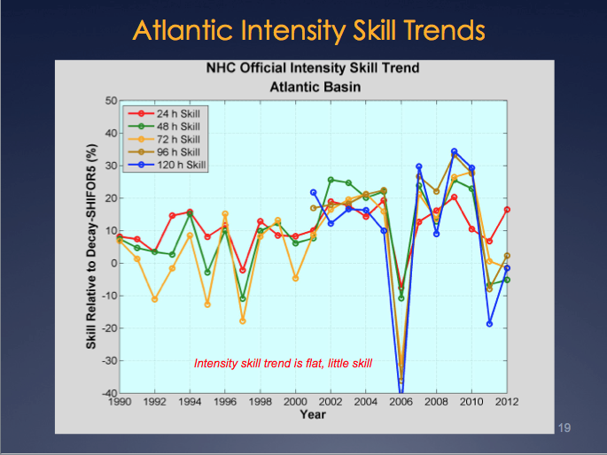
Report from National Hurricane Center: Intensity Error & Skill
“Long-term trend is flat.” “Skill trend is flat, little skill.”
Production Suite Review: December 4, 2012

Slide 6
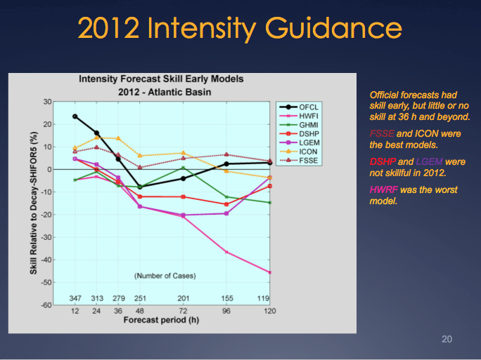
Report from National Hurricane Center: Intensity Skill in 2012
Adding the ocean model reduced skill!
Production Suite Review: December 4, 2012

Slide 7
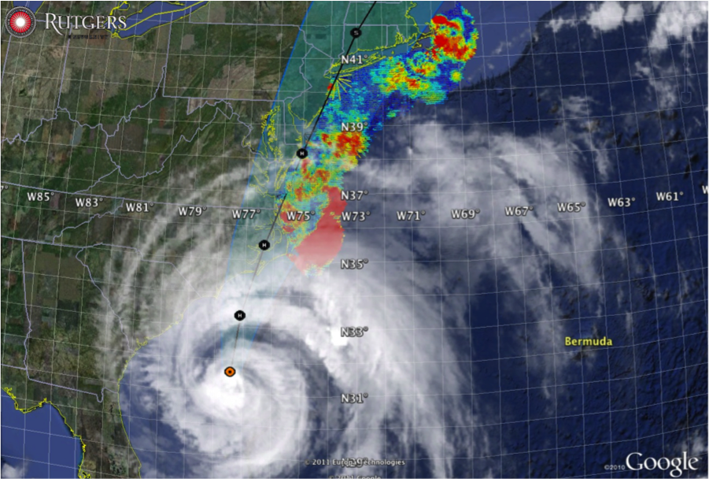

Hurricane Irene
August 26, 2011
NOAA/NHC Damage:
#8 with >$15 Billion.
Track Accurate;
Intensity Over-predicted.
Hurricane Sandy
October 29, 2012
NOAA/NHC Damage:
#2 with >$60 Billion.
Track Accurate;
Intensity Under-predicted.

Slide 8
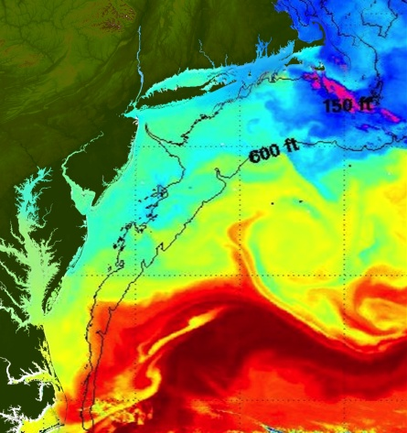
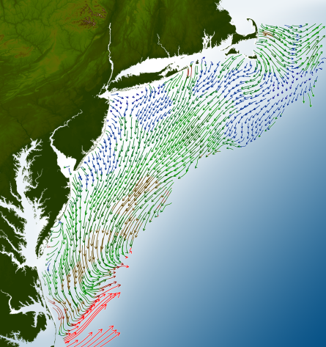
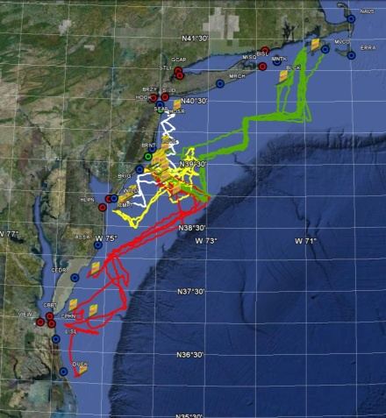
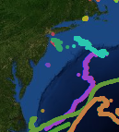
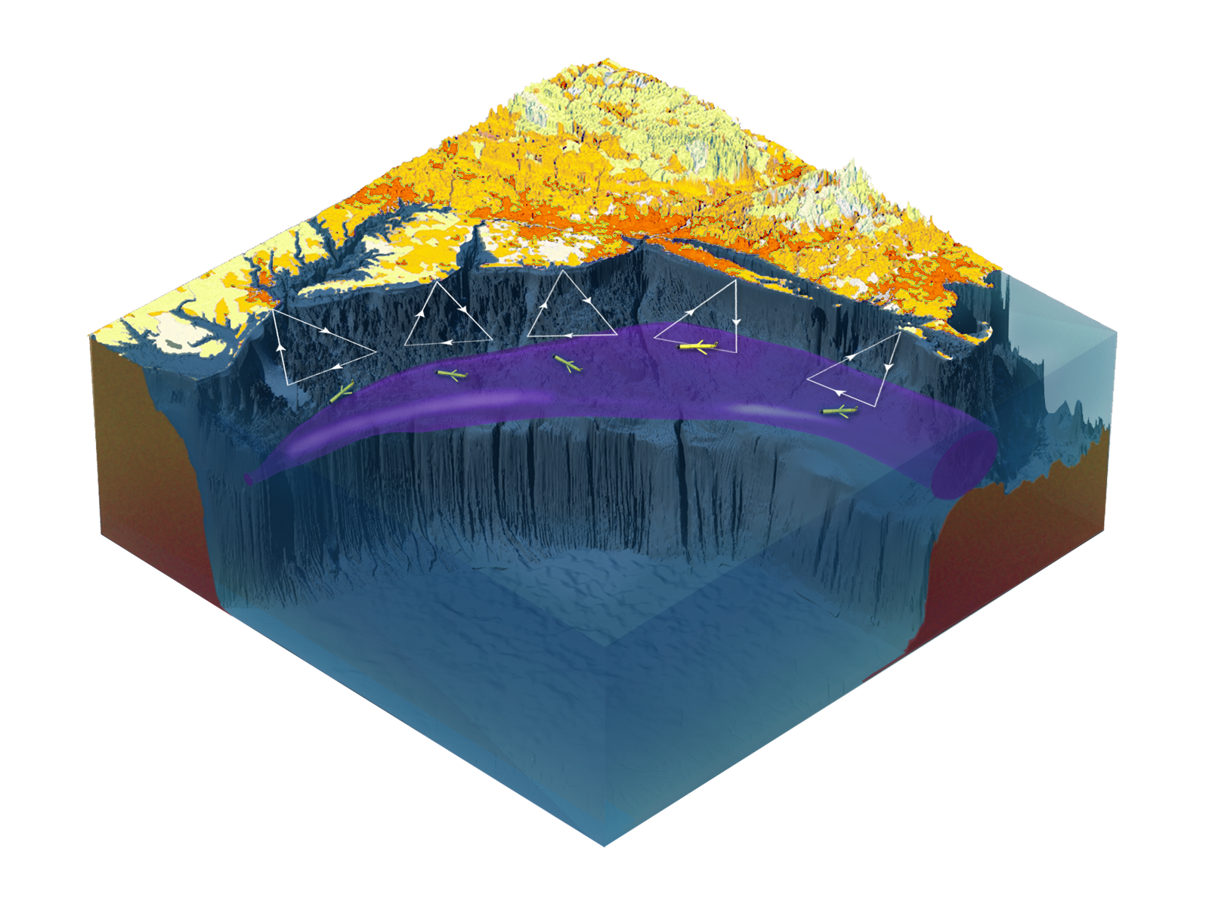

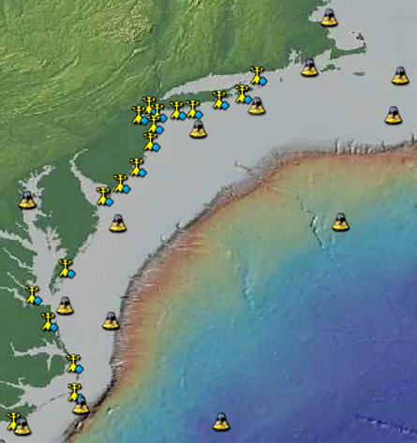
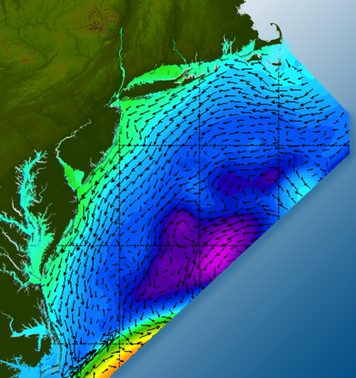

Satellites
HF-Radar
Gliders
Drifters
Population Density
To seek, discover & apply
new knowledge & understanding
of our coastal ocean
Weather Stations
Ocean Forecast Ensemble
Notes:
Need to cut off cold pool in south and bend offshore
Need to experiment with dulling down the colors in the pop density. Maybe orange/tan to white like the box I put in?
Put gliders just below the lines in 3 of them, and increase their angles facing up and down randomly. I stuck in cheesy examples
I already put the shadow and 80% clear line around the two new maps in the upper right, so we are good there.

Slide 9

Hurricane Irene: Track (August 2011)

Slide 10
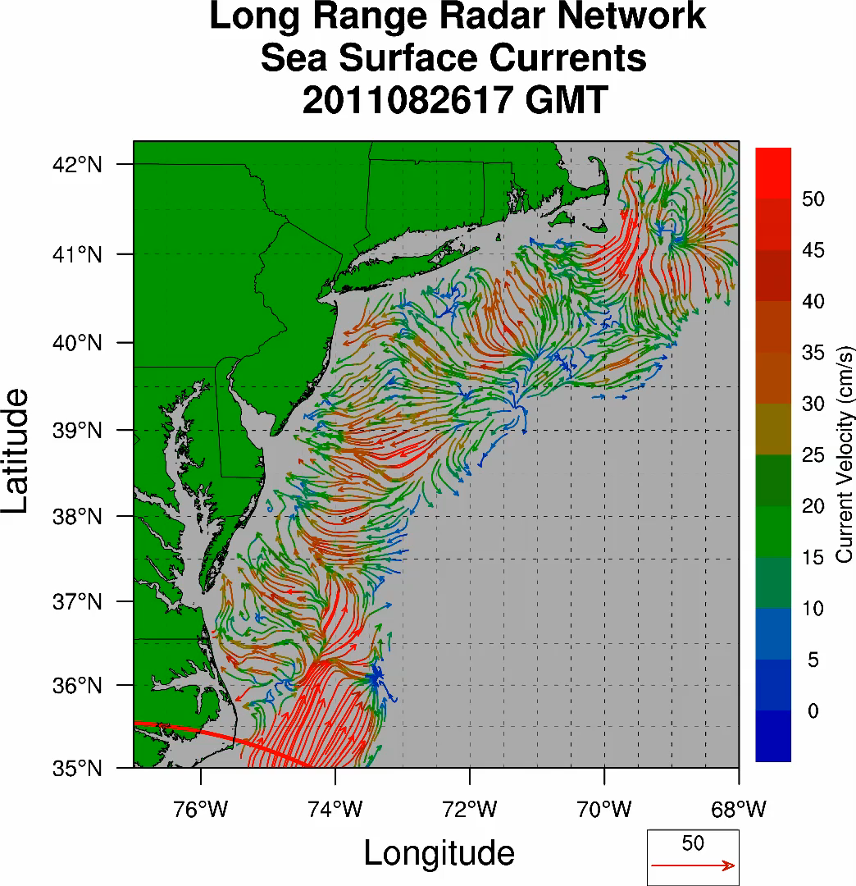
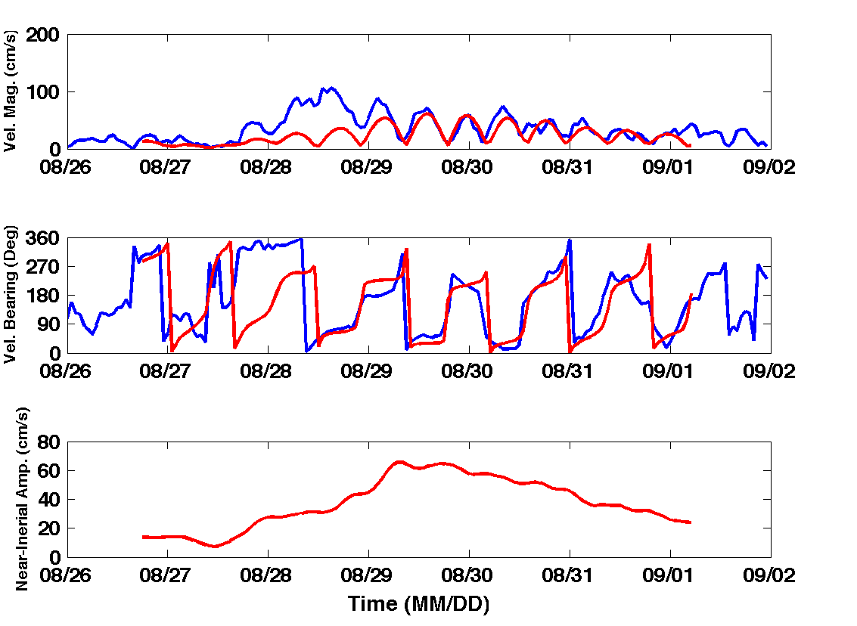
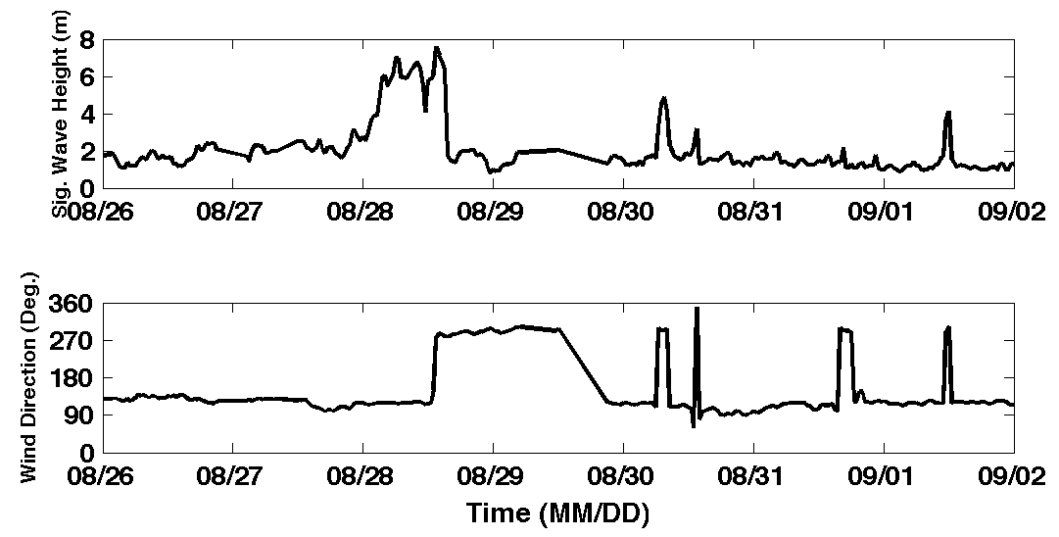
Hurricane Irene
39.5N 73W Surface Current Time Series
Total Current Near-Inertial Current
Wave & Wind Direction Time Series
Eye crosses NJ mid-day on Aug 28

Slide 11
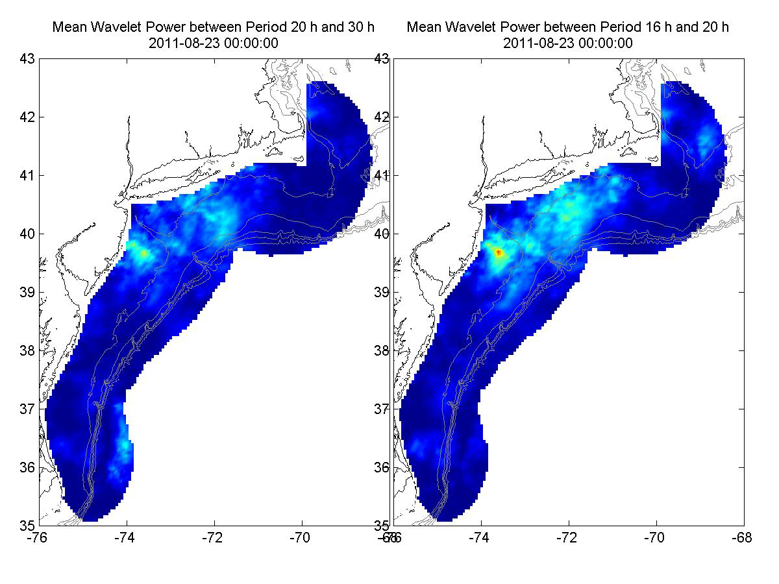
Hurricane Irene Surface Current Wavelet Analysis
Direct Wind Forcing
Inertial Response
Aug 27 Aug 28 Aug 29 Aug 30 Aug 31 Sep 01
Frontside Eye Backside Inertial Inertial Inertial

Slide 12
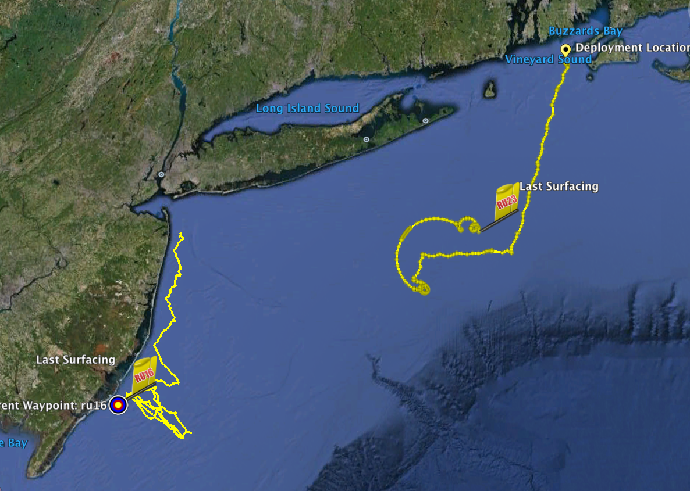
Two Gliders
Deployed by MARACOOS
in Hurricane Irene
RU23
Deployed for MARACOOS.
Map subsurface T/S structure for fisheries.
Damaged early - drifter
Recovered by fisherman
Provided data on inertial currents during storm.
RU16
Deployed for EPA.
Map bottom dissolved oxygen.
Provided data on mixing during storm.

Slide 13
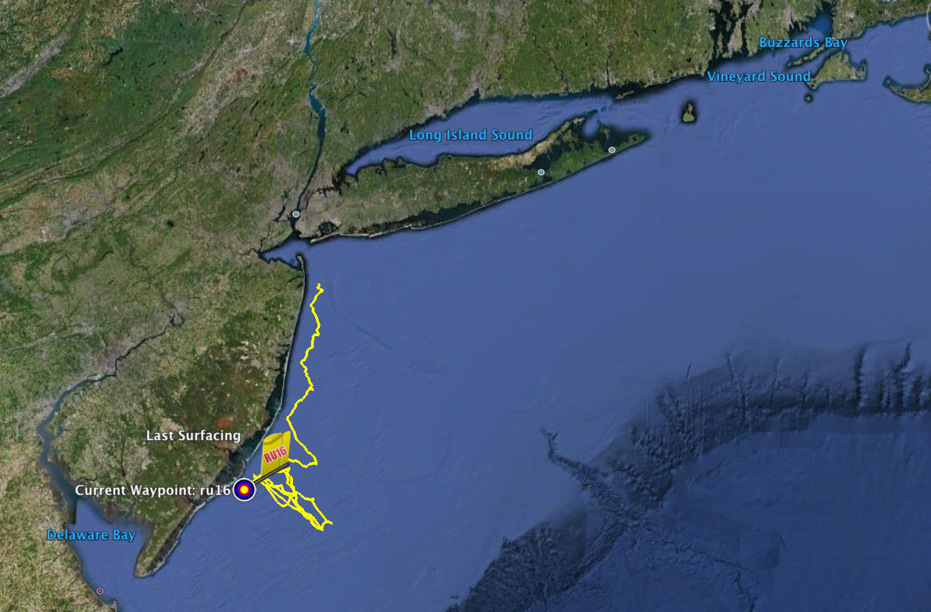
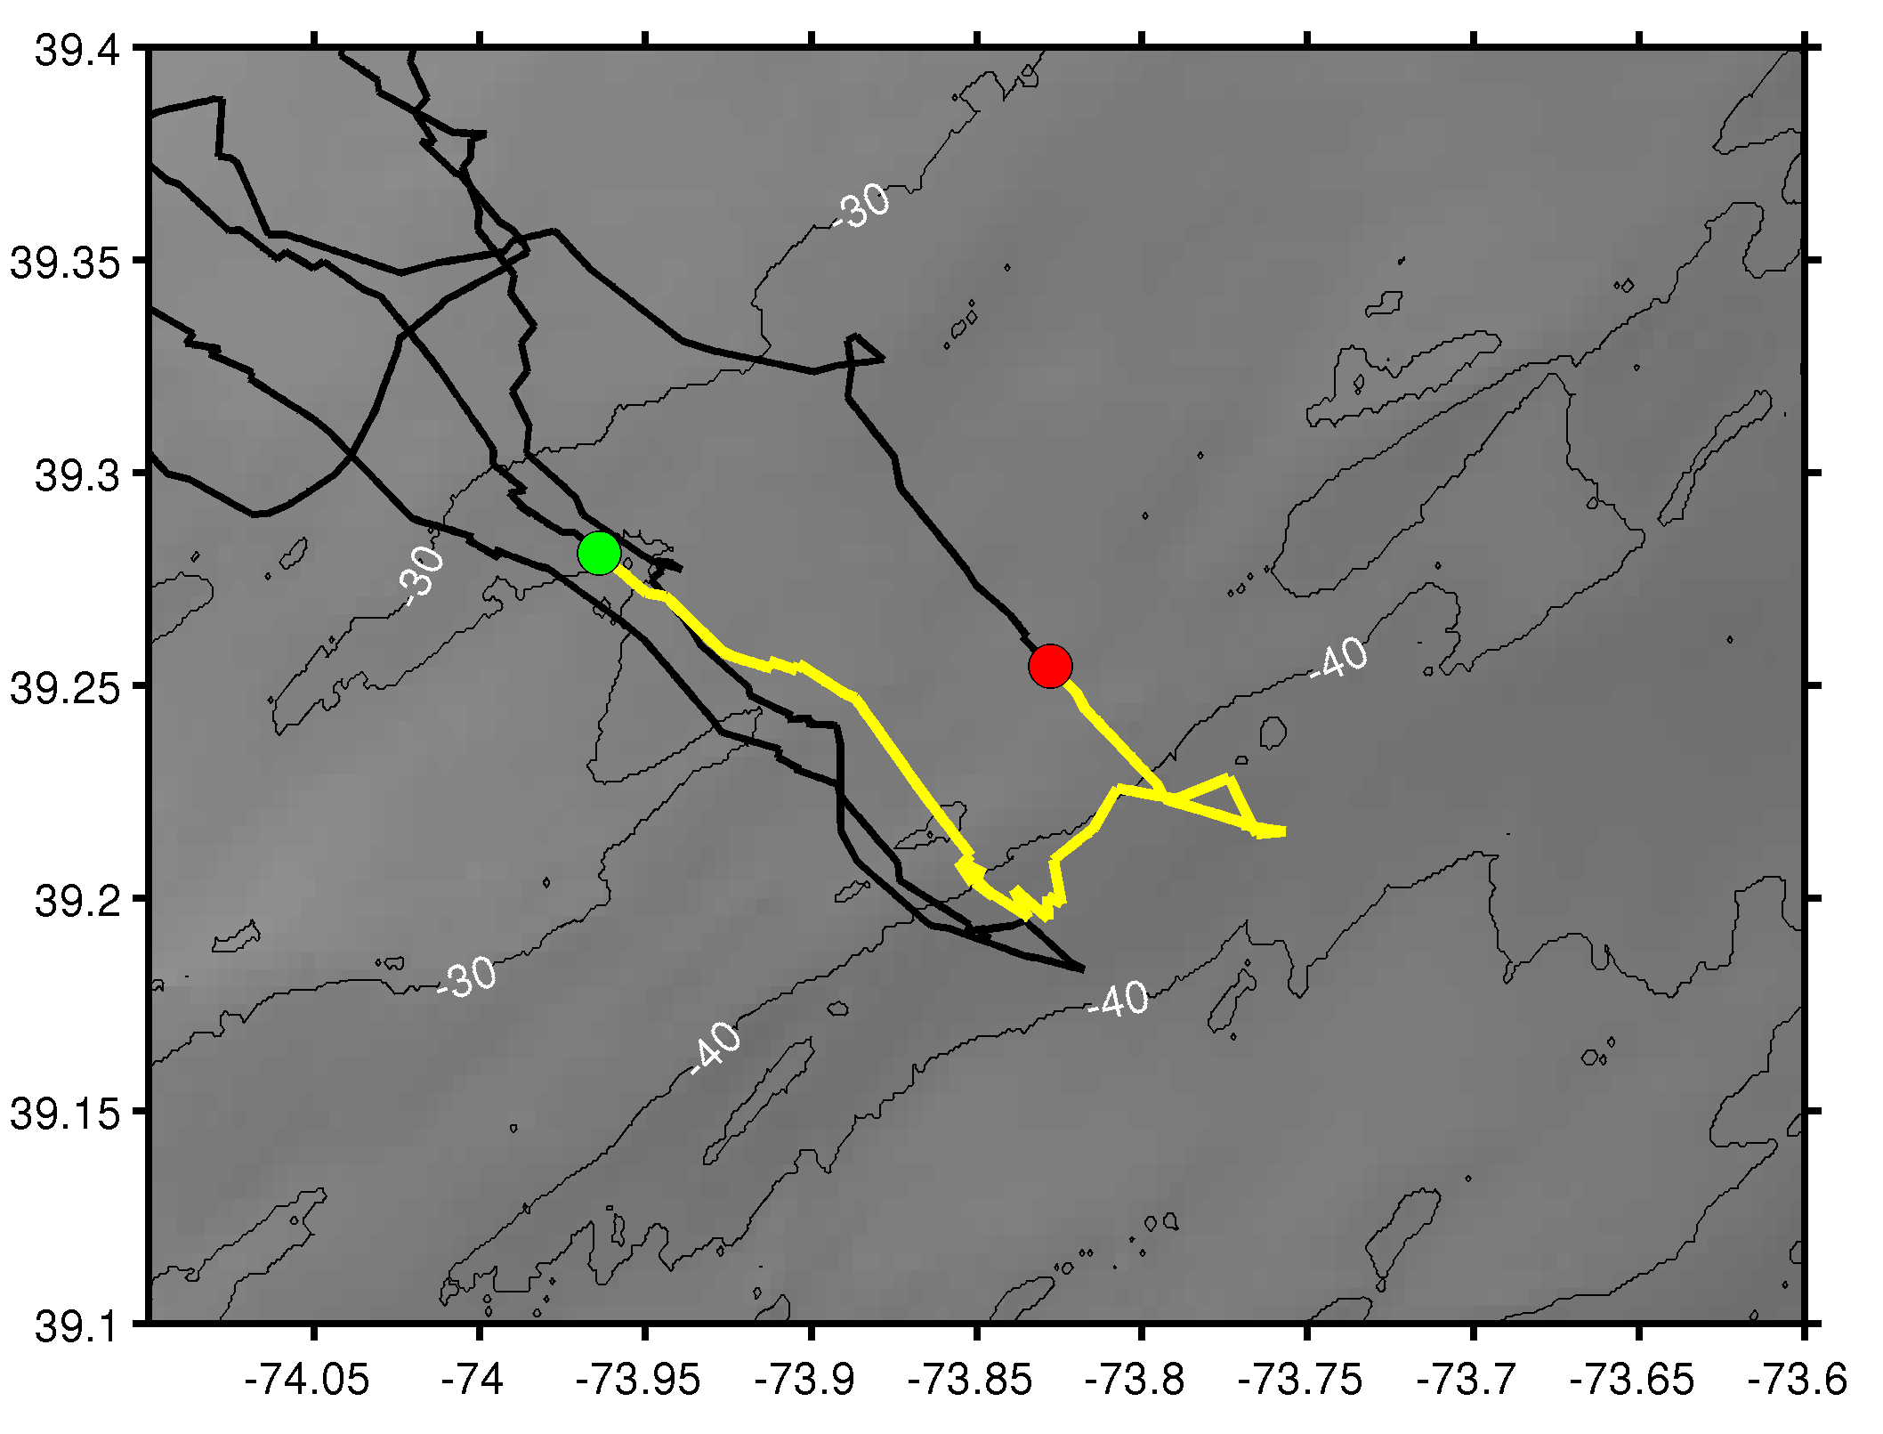
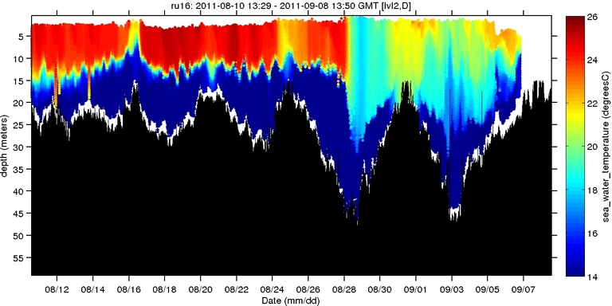
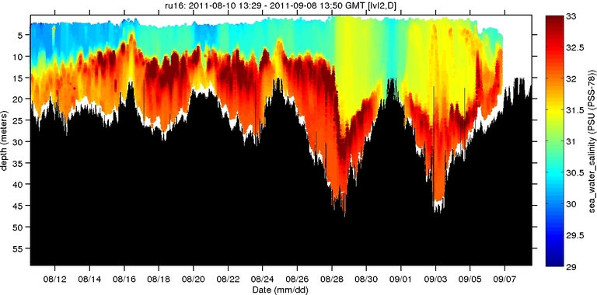
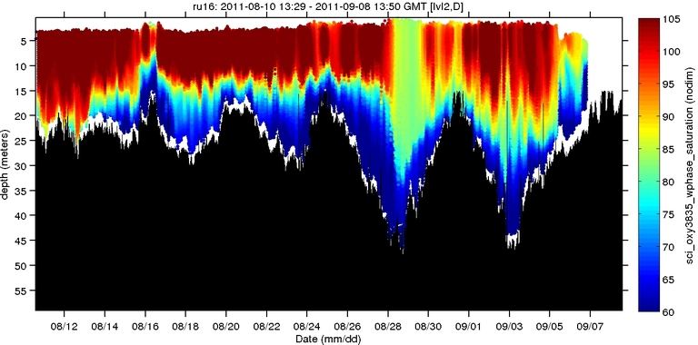

Hurricane Irene: Glider Sampling Through the Storm
Hurricane Irene
0
26
depth
Temperature
RU16
Deployed for EPA.
Map bottom dissolved oxygen.
Provided data on mixing during storm.
55
14
0
33
depth
Salinity
55
29
0
105
depth
% Saturation
(DO)
55
60
Aug 12
date
Sep 07

Slide 14
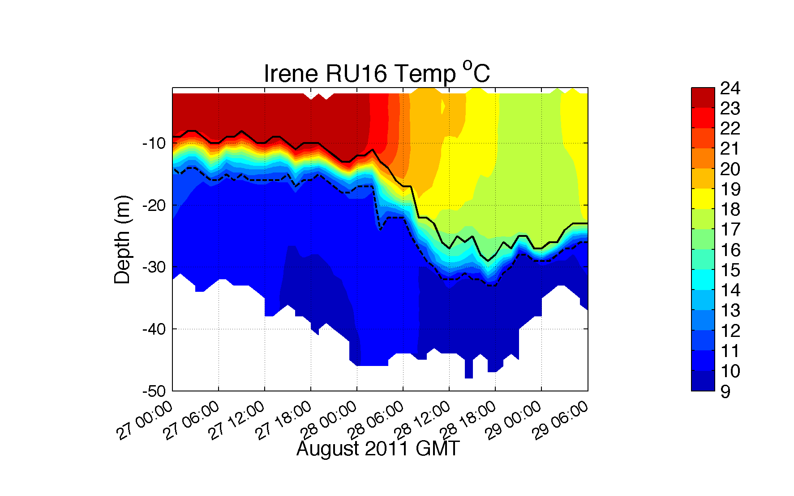
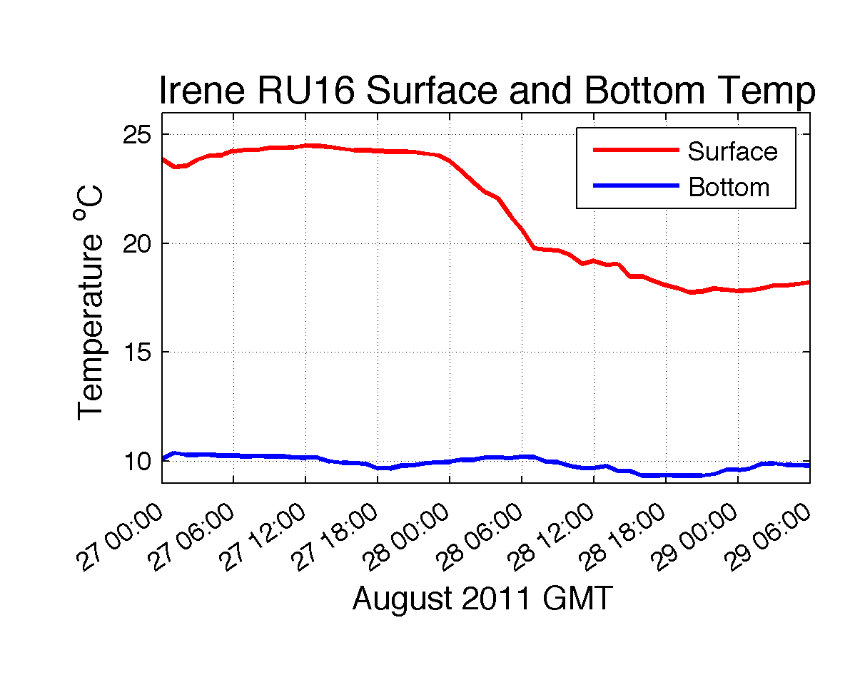
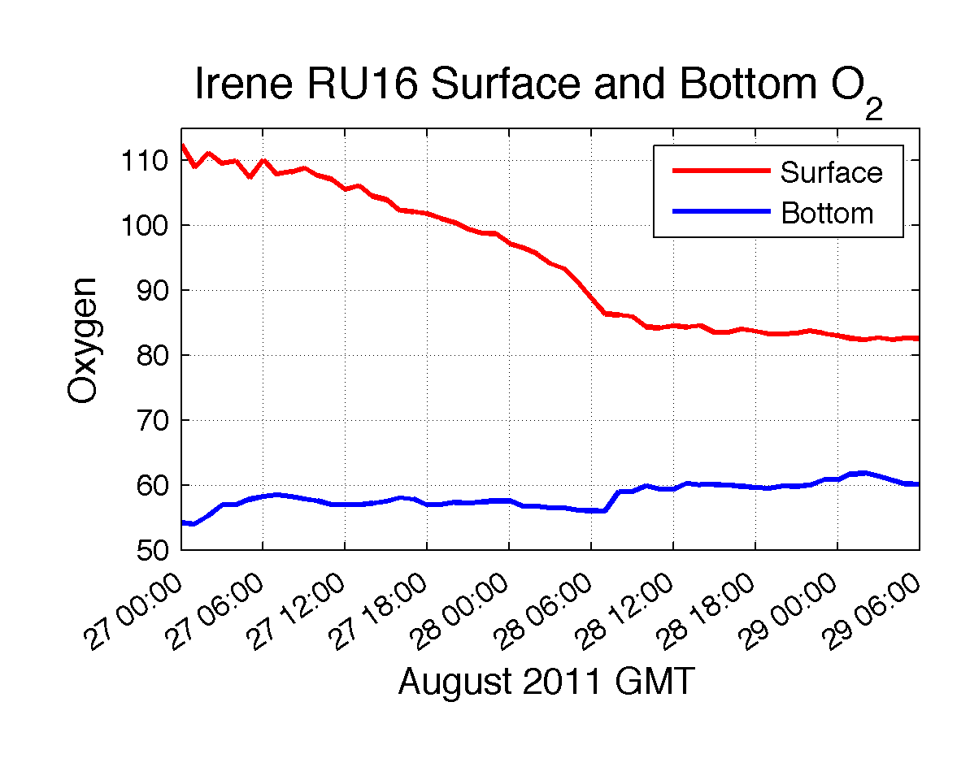
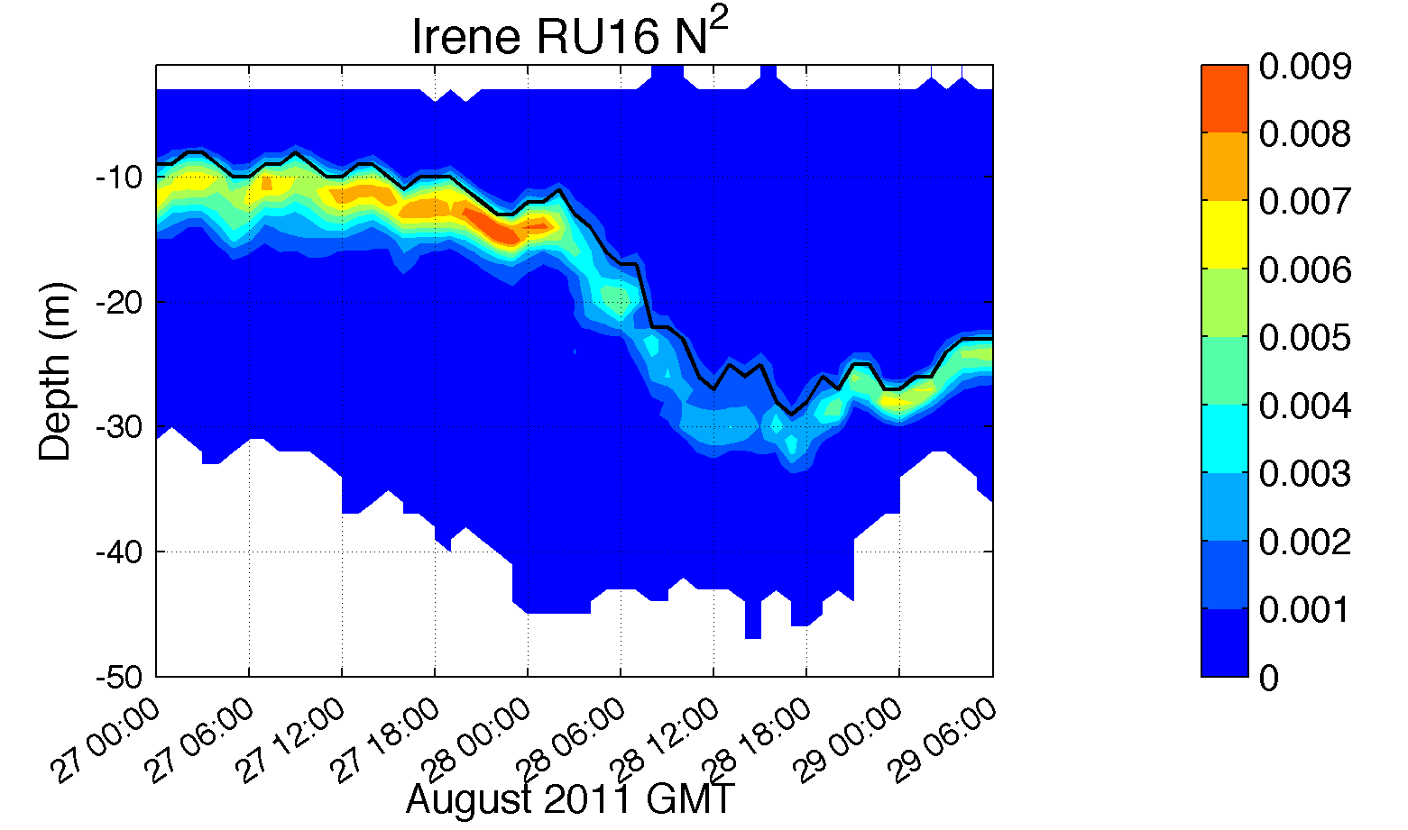
Hurricane Irene: Glider Sampling Through the Storm

Slide 15
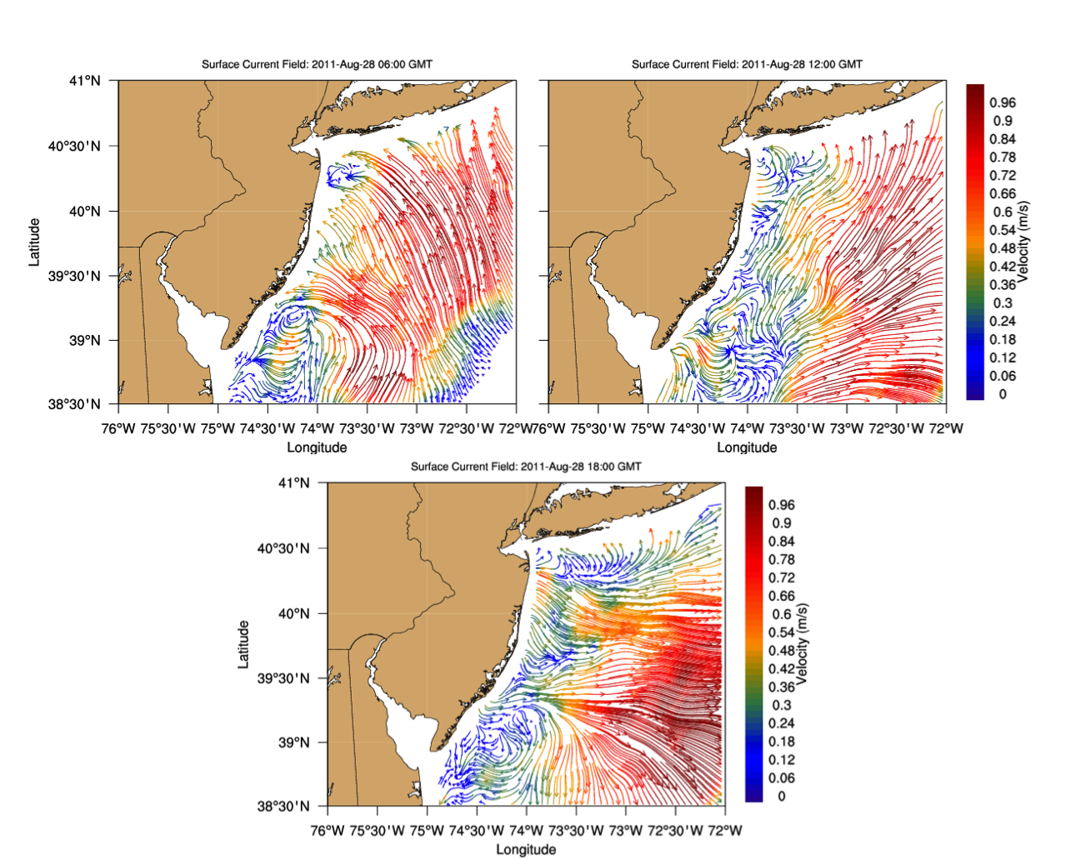
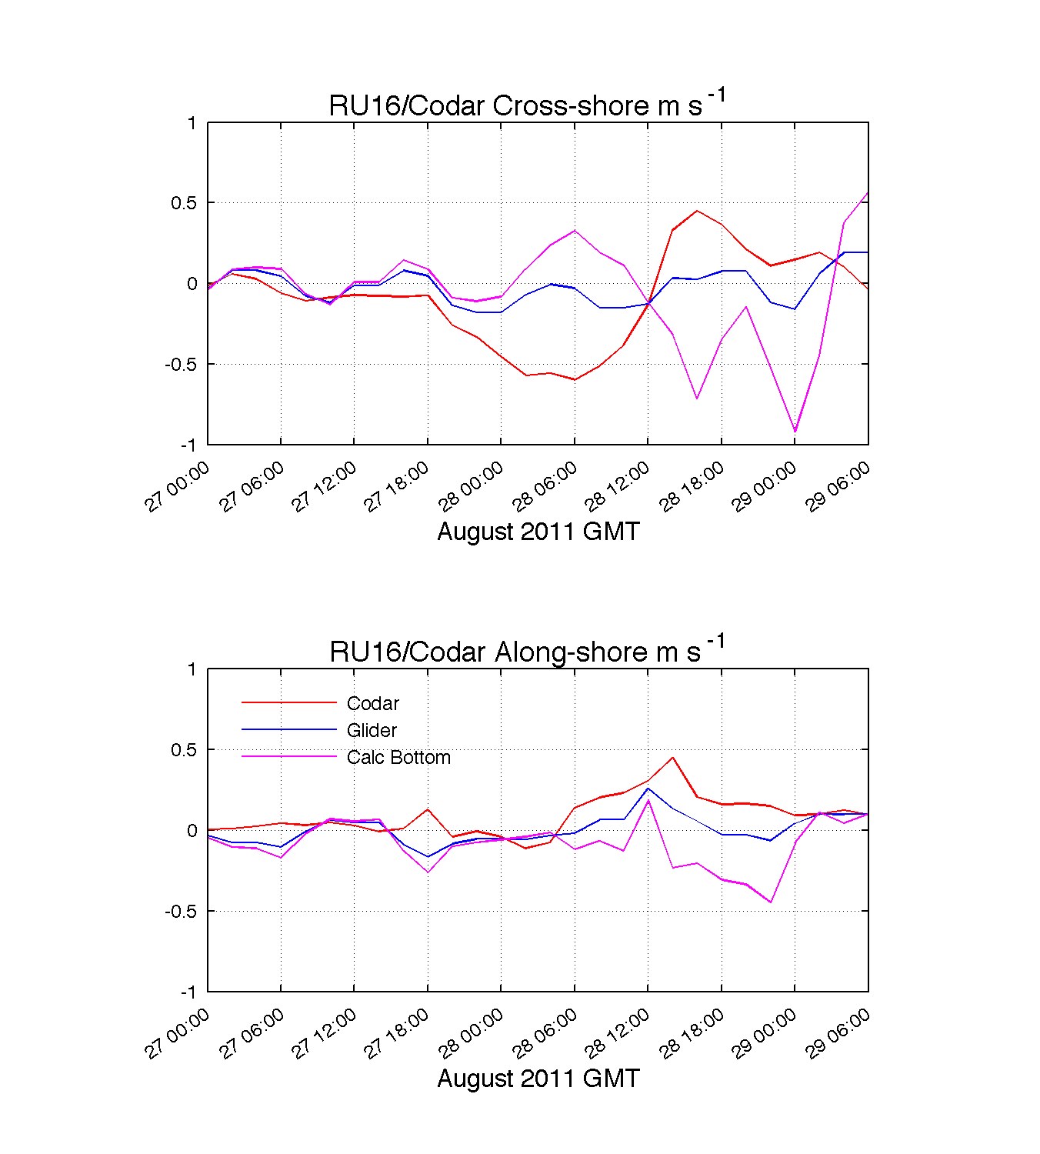
Before
After
Offshore
Onshore
Surface (CODAR) Depth Avg (Glider) Bottom (Difference)

Slide 16
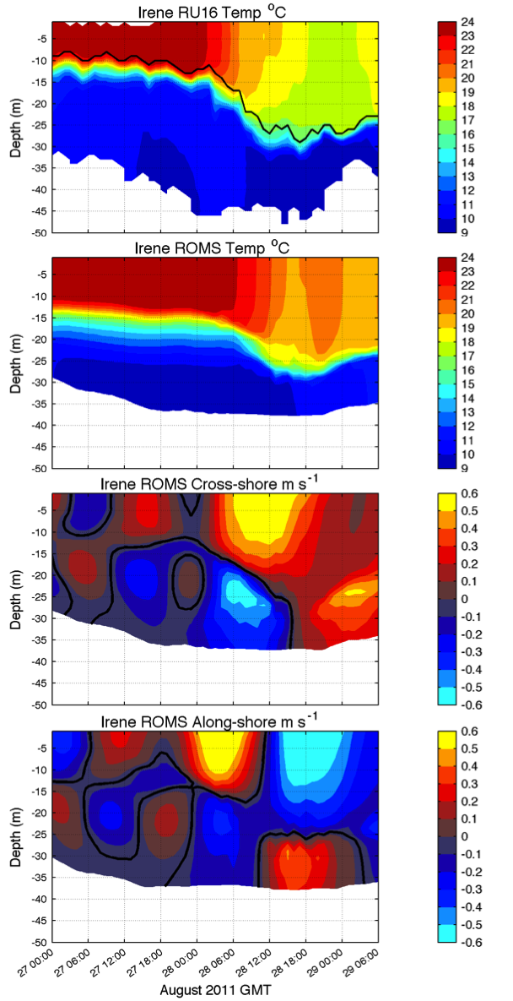
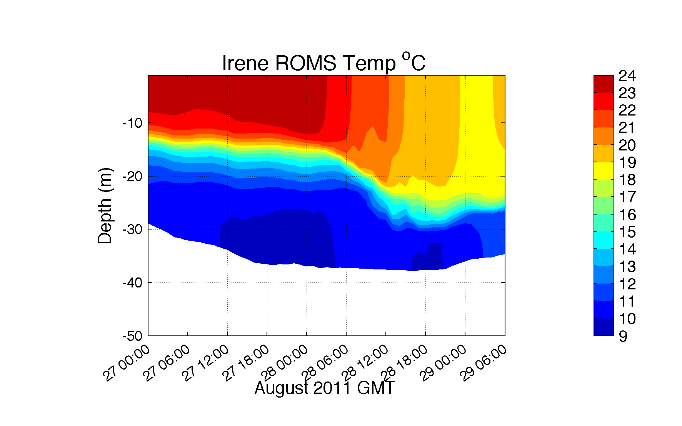
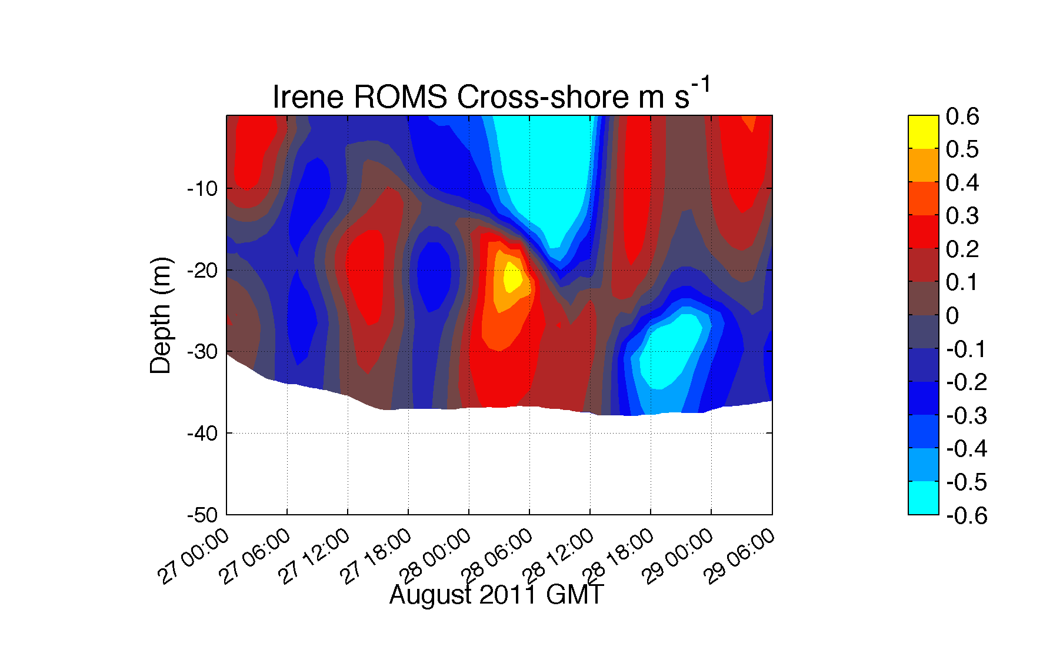
Hurricane Irene: Our Modeled Ocean (ROMS)
Offshore
Onshore
Glider Temperature
ROMS Temperature
ROMS Cross-Shore

Slide 17
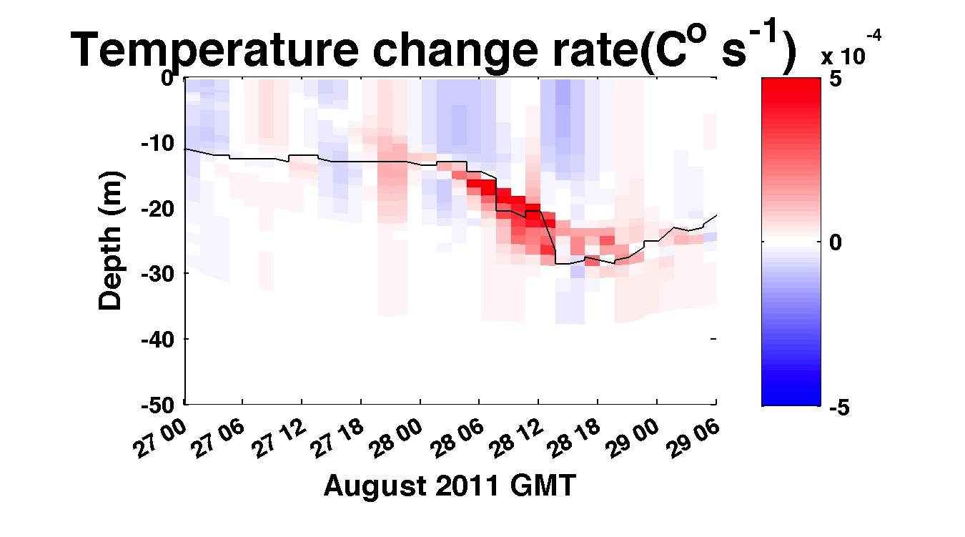
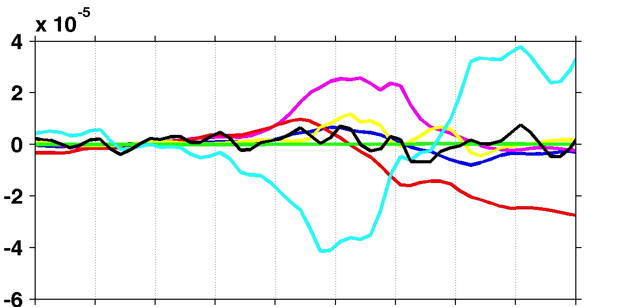
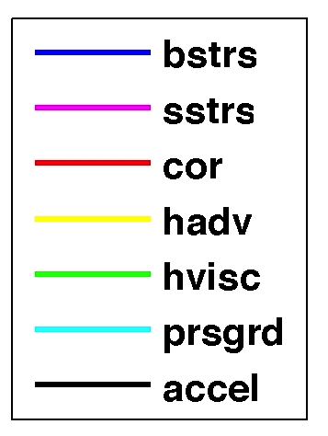
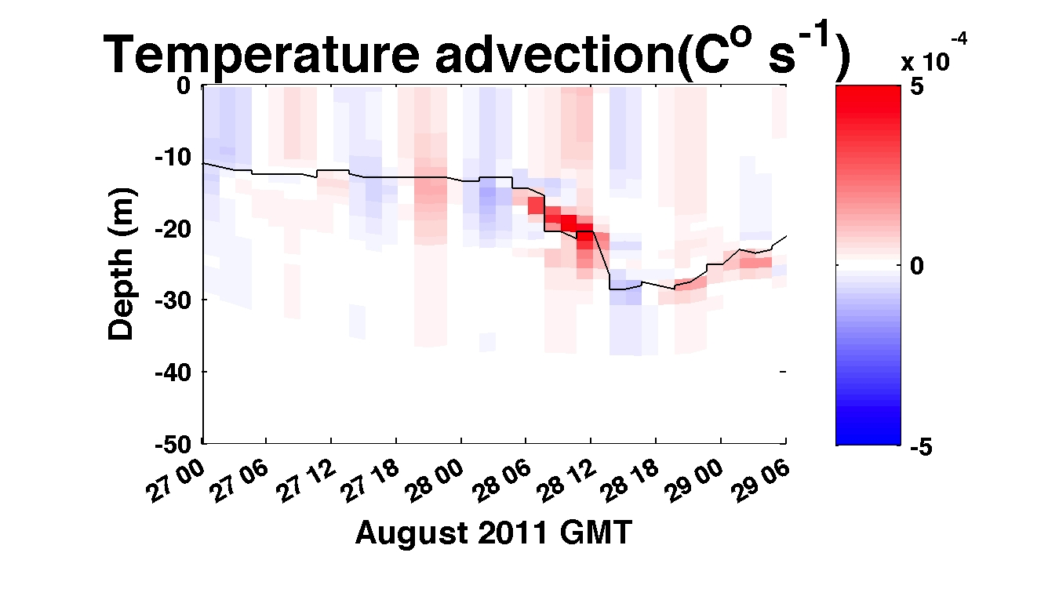
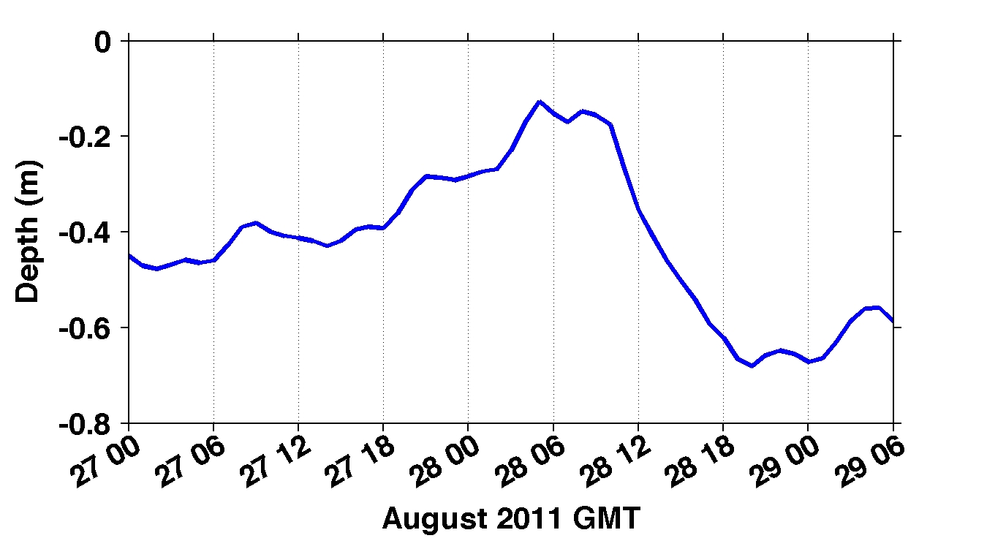
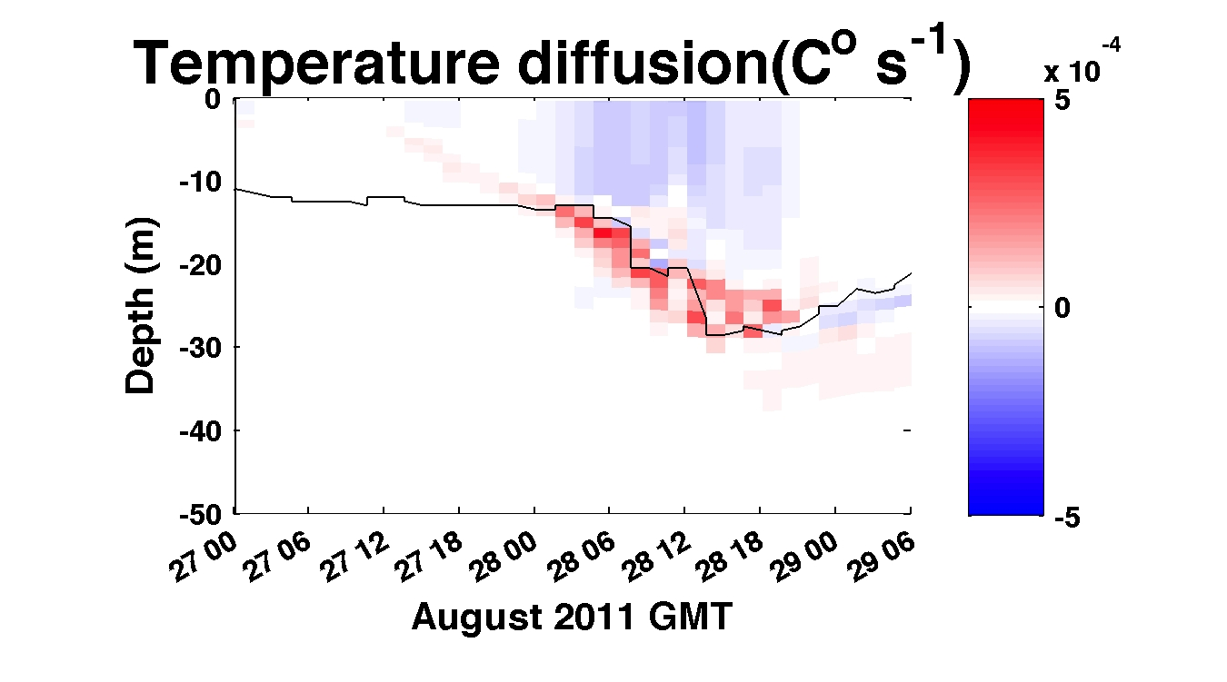
Depth-averaged across-shelf
momentum balance terms
Depth-averaged across-shelf momentum terms(m s⁻²)
Onshore
Offshore
De-tided free surface height (m)

Slide 18
Pre- and Post-Hurricane Irene
Sea Surface Temperatures
Before
After
Difference
The 6C -10C Cooling occurred:
With the outer wind bands
Before the eye passed over

Slide 19
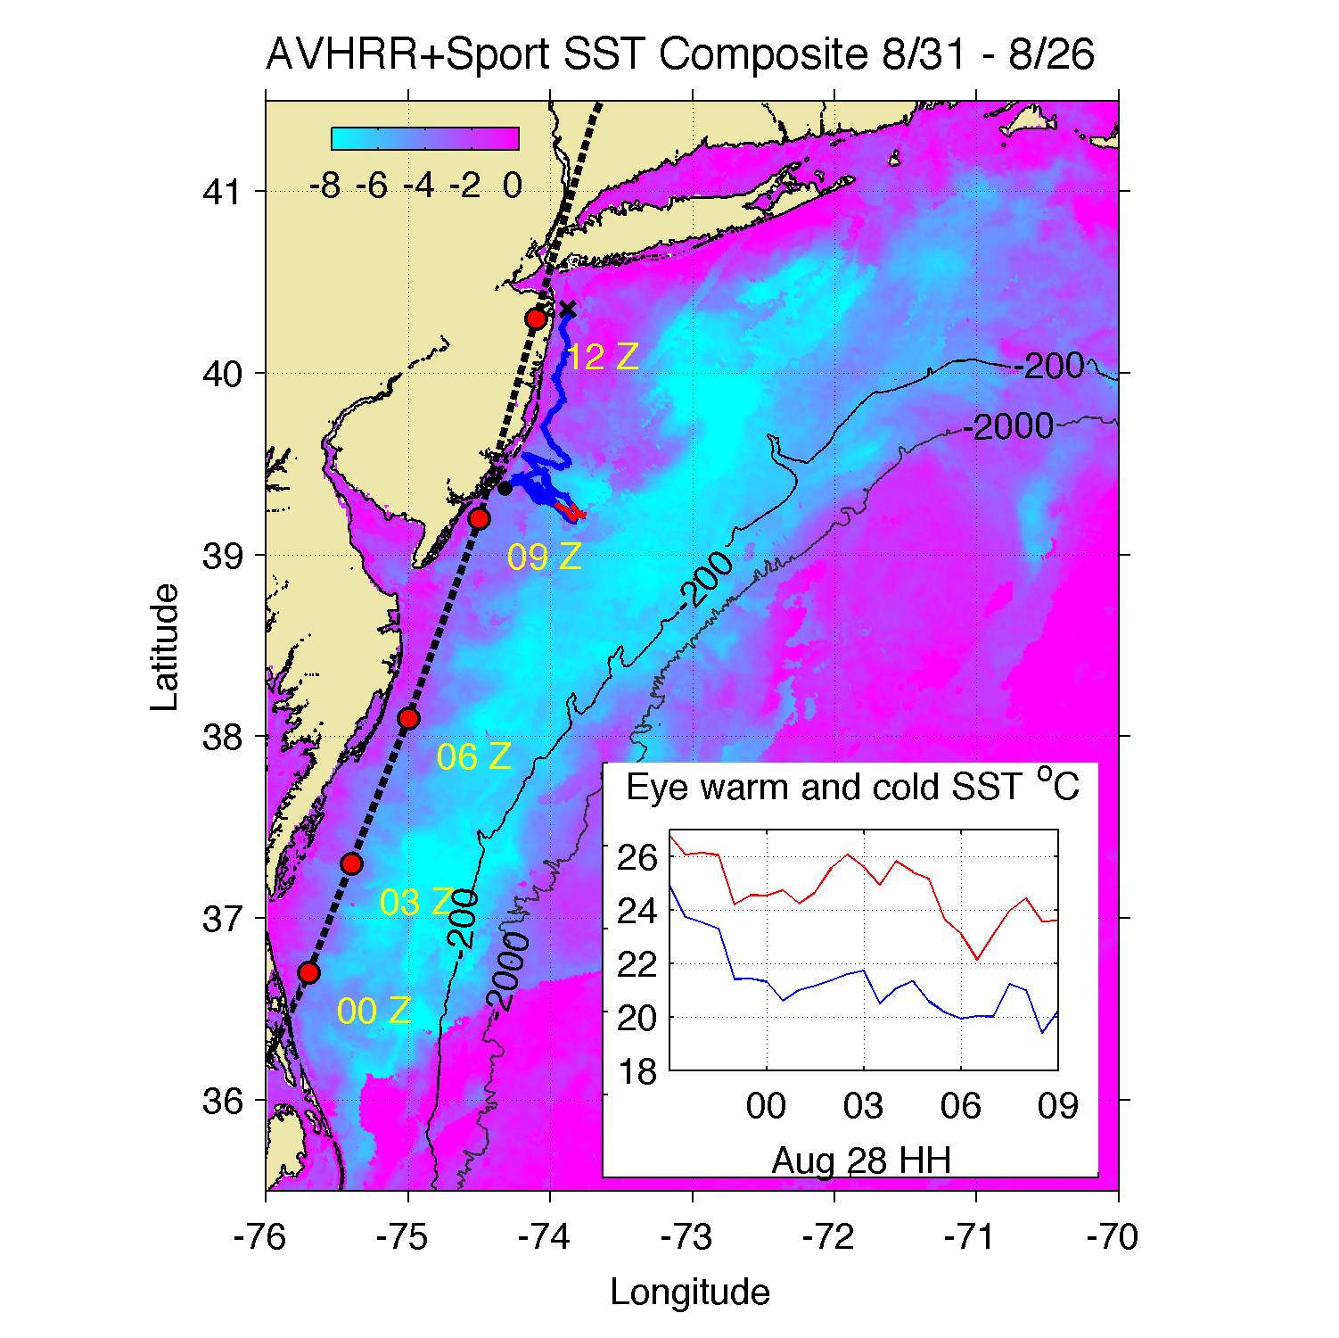
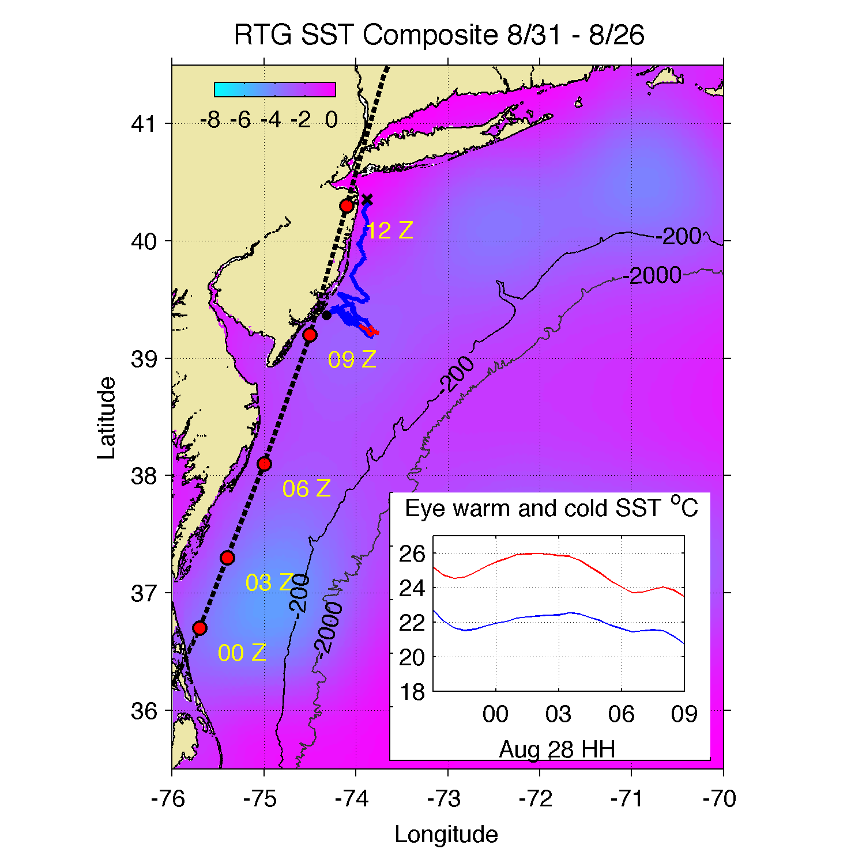
Sea Surface Temperature Difference
(After – Before Irene)
Real-Time MARACOOS Real-Time Global

Slide 20
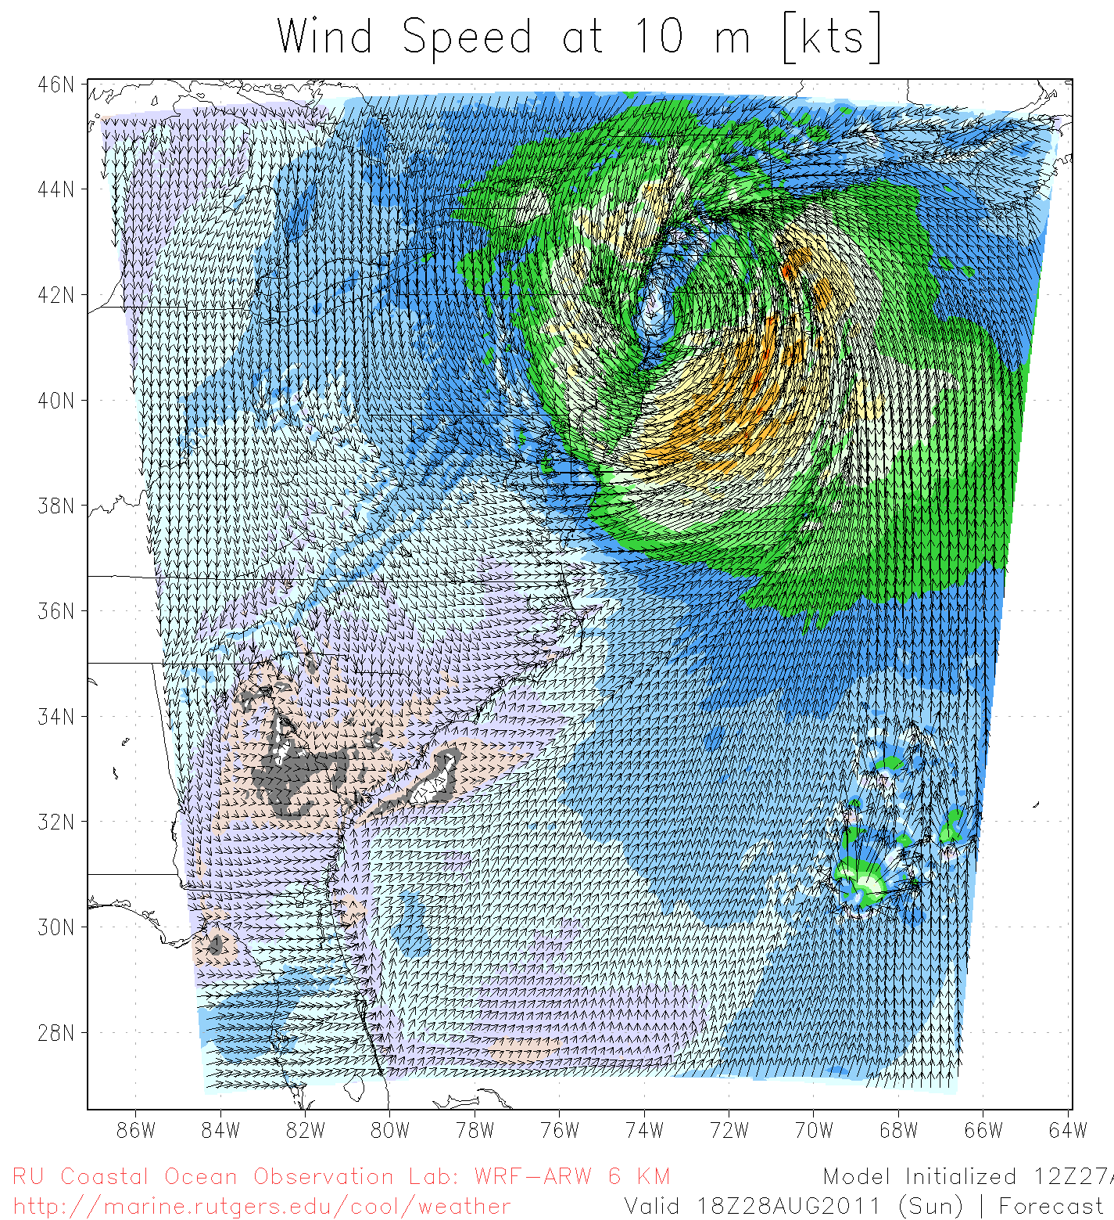
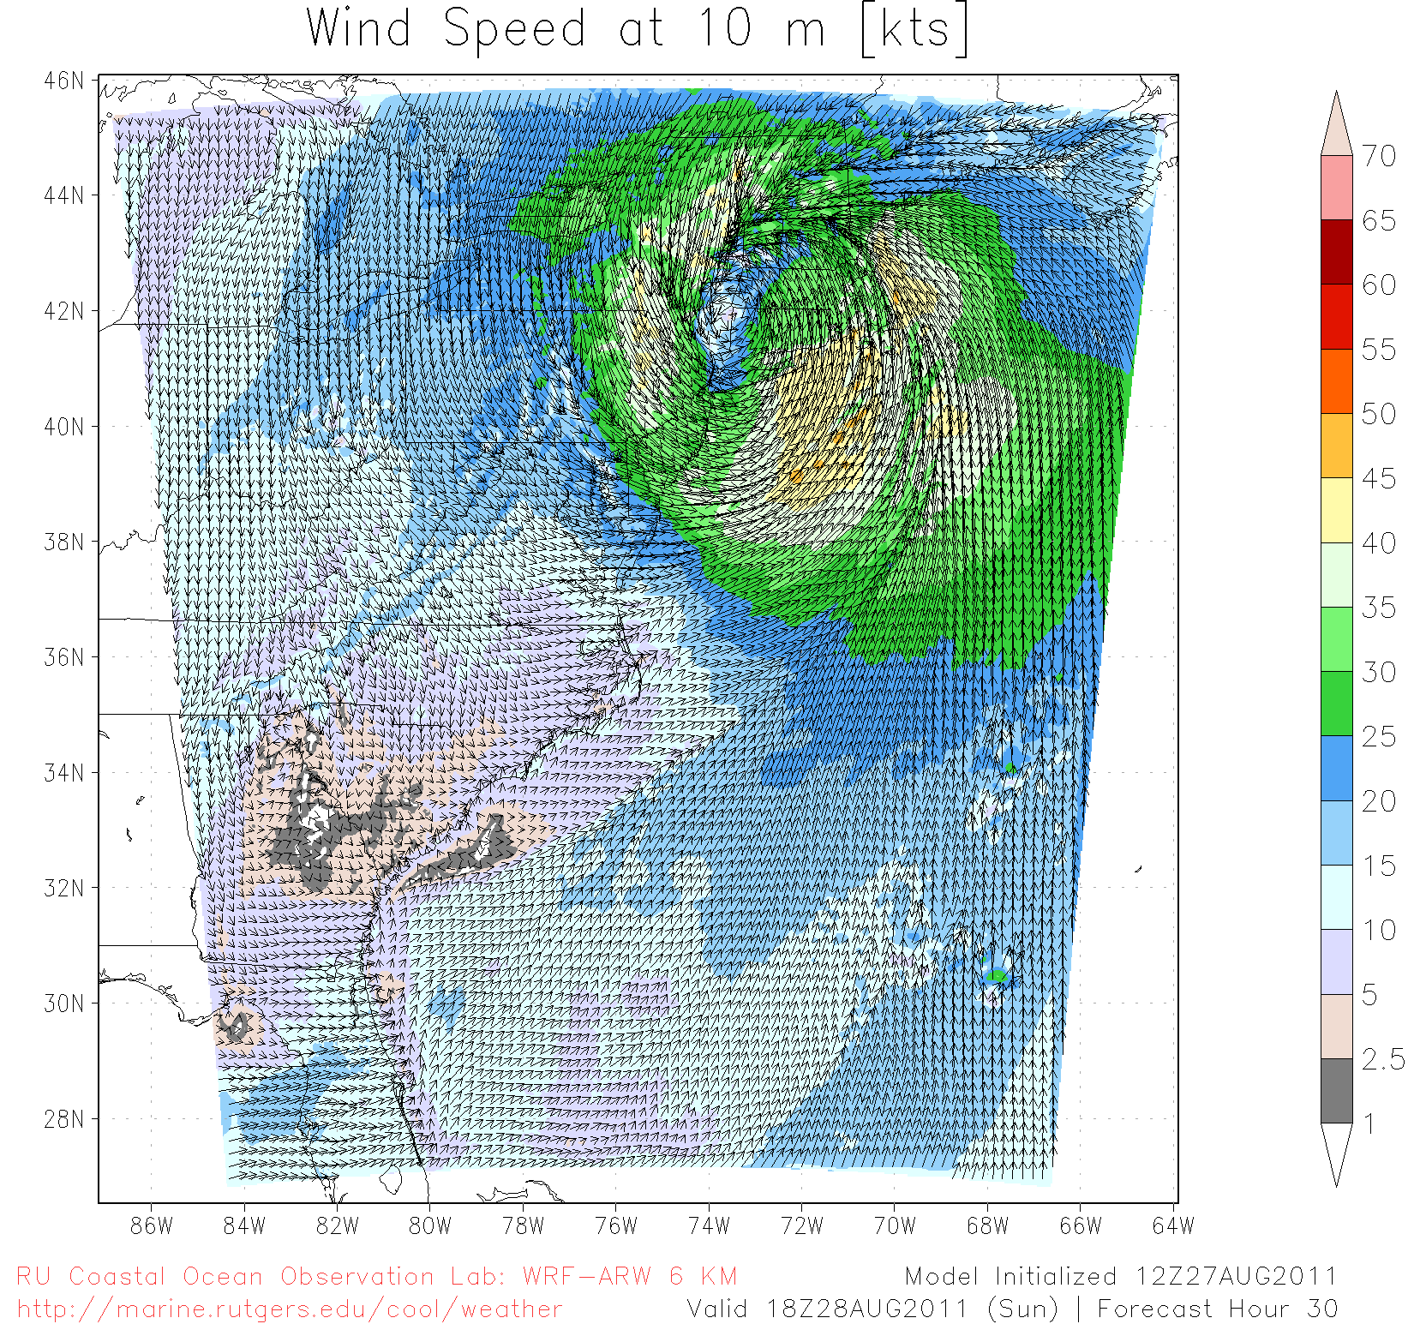
Hurricane Irene SST Sensitivity Hindcast
Global Warm SST
Regional Cold SST
Maximum Wind Speed Skill Score | Official Forecast | Warm SST Hindcast | Warm SST + OML Model Hindcast | Cold SST Hindcast
RMS Error (knots) | 9.43 | 7.13 | 7.09 | 3.61

Slide 21
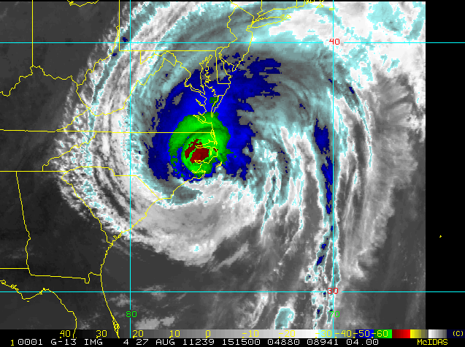
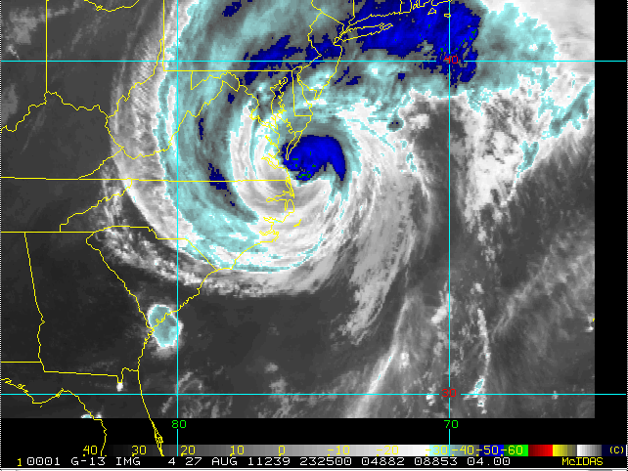
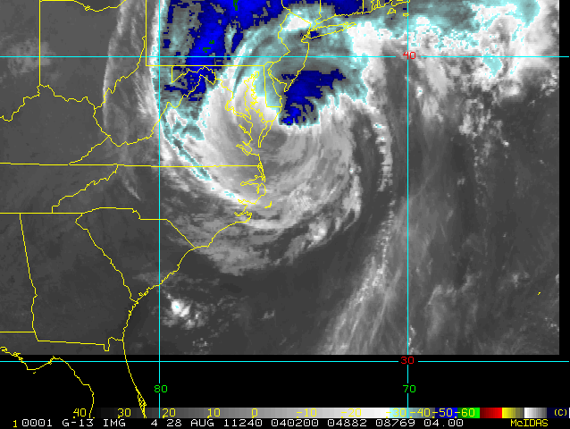
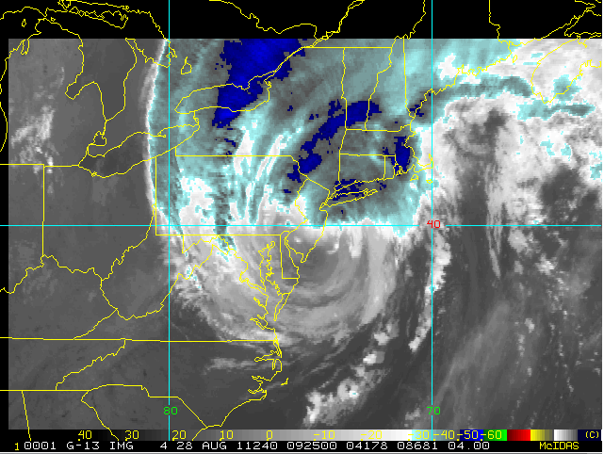

Slide 22
Hurricane Irene
August 26, 2011
Strong Stratification
Limited storm surge
Mixing cooled surface
Limited intensity
Hurricane Sandy
October 29, 2012
NOAA/NHC Damage:
#2 with >$60 Billion.
Track Accurate;
Intensity Under-predicted.

Slide 23





Superstorm Sandy: Before and After
Over 10,000 Homes
Destroyed in New Jersey

Slide 24





Slide 25




HF Radar Storm Damage
Keyport
S
HF Radar Shed floats 0.85 km across barrier island & river
I

Slide 26

First Warning for Hurricane Sandy:
Monday, Oct 22, 1-week prior to landfall
IOOS Response: Prepare the Network

Slide 27

First Warning for Hurricane Sandy:
Monday, Oct 22, 1-week prior to landfall
IOOS Response: Prepare the Network

Slide 28

Hurricane Sandy: 5 Day Track Uncertainty Cone

Slide 29


Superstorm Sandy: 2 Days Before Landfall

Slide 30

Superstorm Sandy: 1 Day Before Landfall

Slide 31

Superstorm Sandy: Morning Before Landfall

Slide 32

Superstorm Sandy: Landfall (20:00 Local)

Slide 33




Slide 34







Slide 35




Slide 36





Slide 37





Offshore
Onshore
Upshelf
Downshelf

Slide 38



Hurricane Sandy Hindcast: SST Sensitivity
Warm SST
Cold SST Switch
2-3 °C Cooling
Over 12 days

Slide 39

Hurricane Sandy Track Forecasts & Hindcasts

Slide 40
Hurricane Sandy Hindcast: Intensity

Slide 41



Storm Surge Forecast at Peak:
Lower Manhattan, New York
4
3
2
1
0
(m)
Observed
?
See Alan’s Talk
Forecasted

Slide 42
Hurricane Irene
August 26, 2011
Strong Stratification
Limited storm surge
Mixing cooled surface
Limited intensity
Hurricane Sandy
October 29, 2012
After fall transition
Single layer ocean
No mixing/cooling
No escape for surge

Slide 43


Response Summary:
Irene and Sandy were
disruptive events.
IOOS was there before, during and after.
IOOS made a difference.

