Slide 1
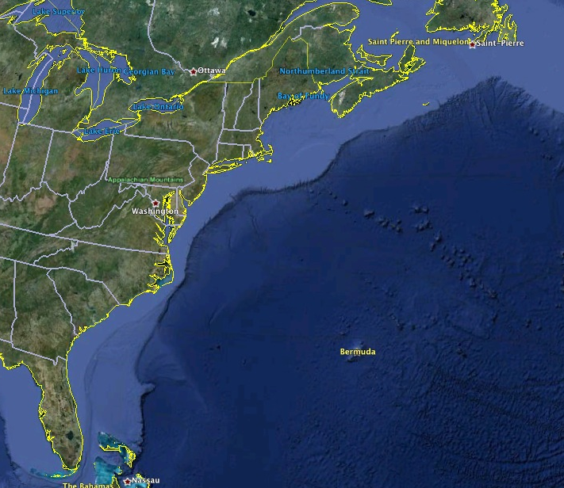
















RI
U..
Middle Atlantic
Regional Association
Coastal
Ocean Observing System
10 States
76 Million People
CT
Cape
Cod
MA
NY
PA
NJ
U.S. IOOS
Responds to
Hurricanes Irene
and Sandy
MD
DE
Sandy
>40 PIs
>20 Institutions
>50 Members
>2000 Contacts
Irene
VA
NC
Cape
Hatteras
Notes:
1

Slide 2
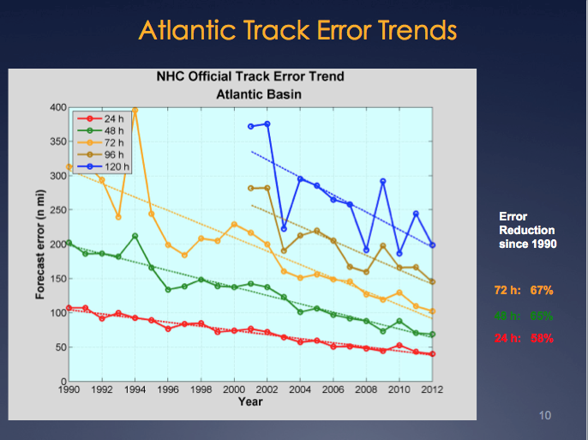
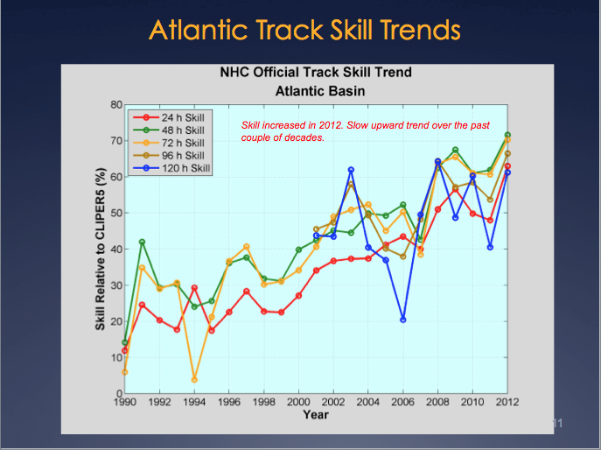
Report from National Hurricane Center: Track Error & Skill
Reduction in forecast track error & Increase in forecast track skill
over the last 2 decades.
Significant Drivers: 1) Improvement in Global Forecast Models
2) Super-Ensemble
Production Suite Review: December 4, 2012

Slide 3
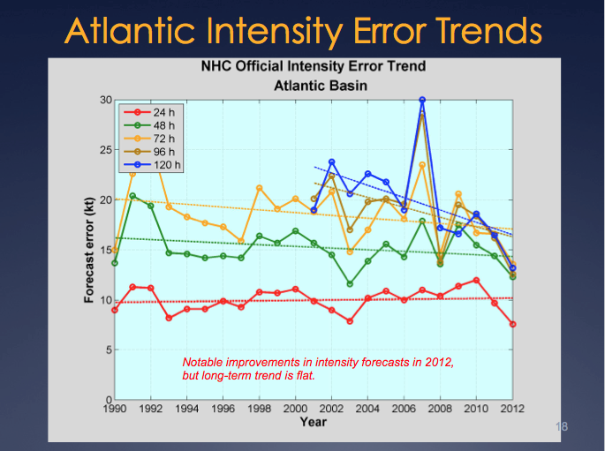
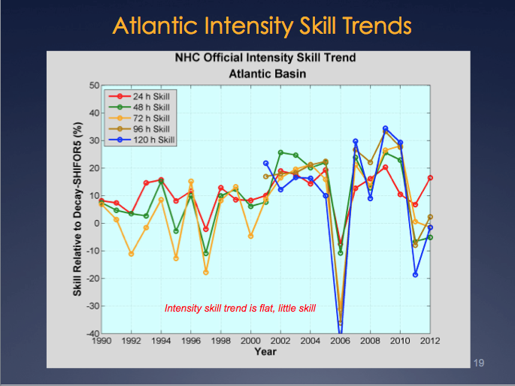
Report from National Hurricane Center: Intensity Error & Skill
“Long-term trend is flat.” “Skill trend is flat, little skill.”
Production Suite Review: December 4, 2012

Slide 4
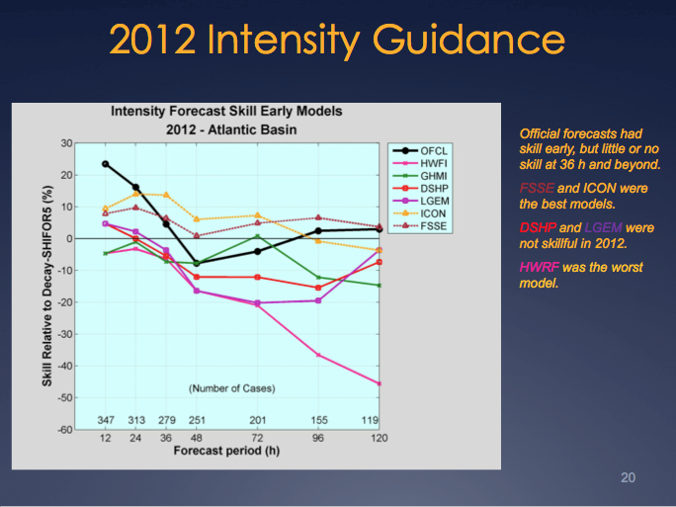
Report from National Hurricane Center: Intensity Skill in 2012
Adding the ocean model reduced skill!
Production Suite Review: December 4, 2012

Slide 5
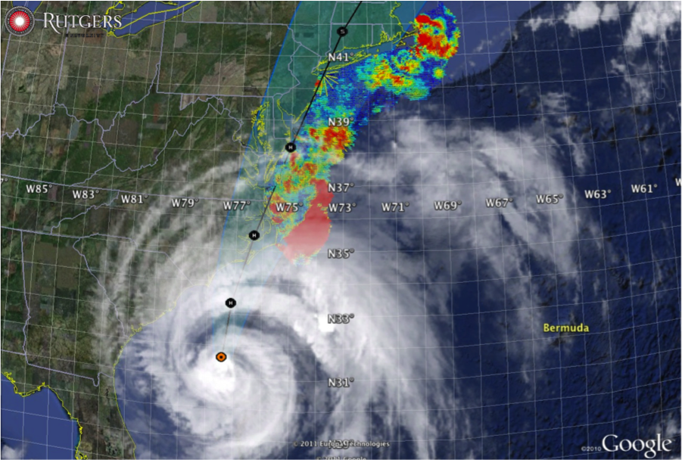

Hurricane Irene
August 26, 2011
NOAA/NHC Damage:
#8 with >$15 Billion.
Track Accurate;
Intensity Over-predicted.
Hurricane Sandy
October 29, 2012
NOAA/NHC Damage:
#2 with >$60 Billion.
Track Accurate;
Intensity Under-predicted.

Slide 6
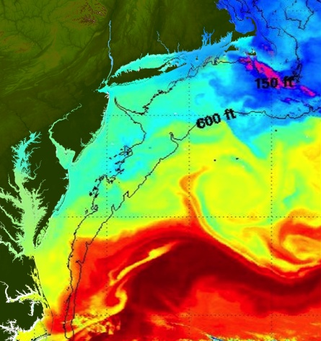
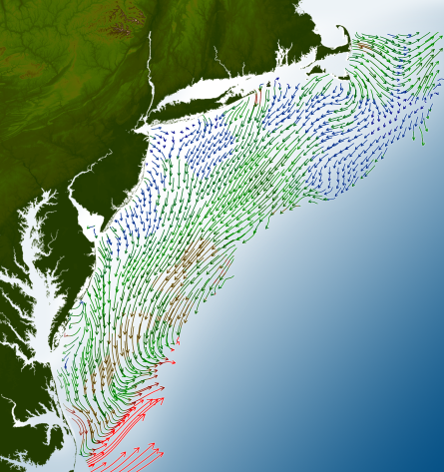
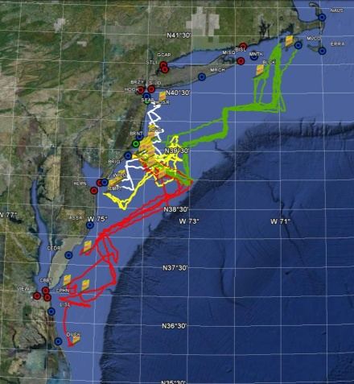
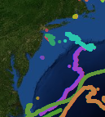
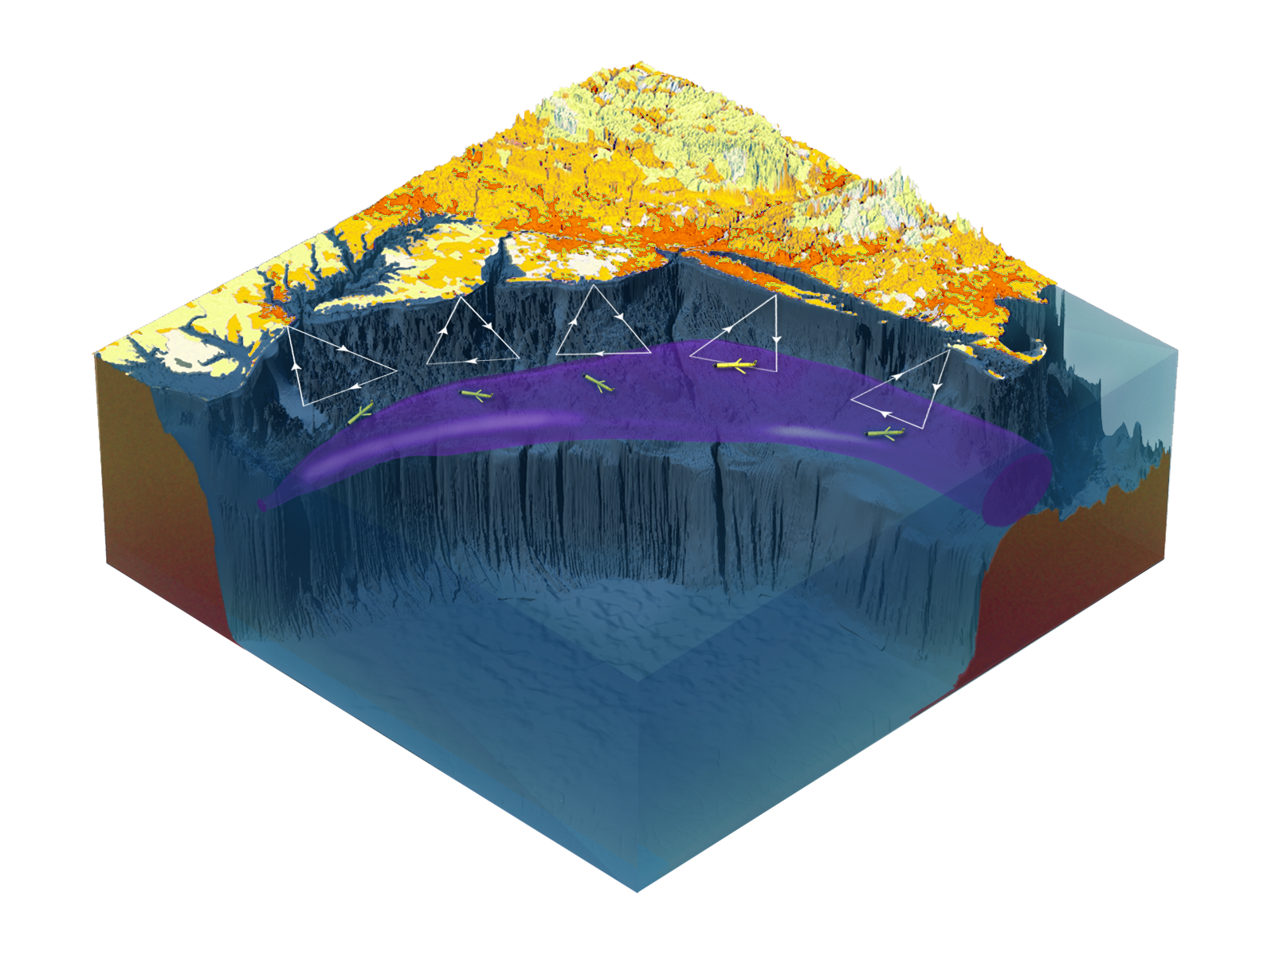

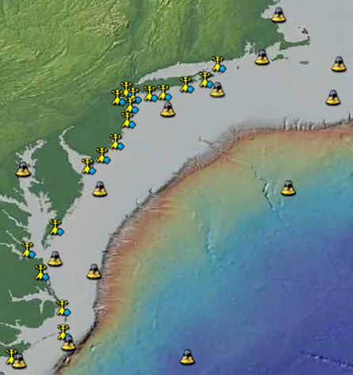
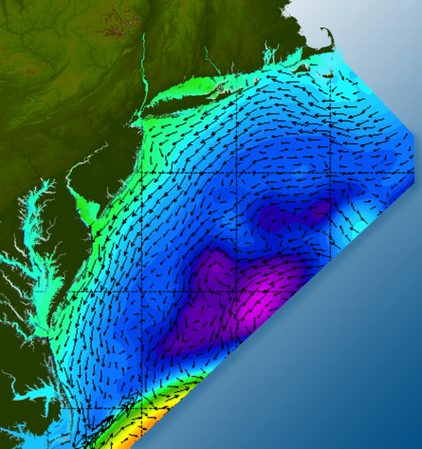

Satellites
HF-Radar
Gliders
Drifters
Population Density
To seek, discover & apply
new knowledge & understanding
of our coastal ocean
Weather Stations
Ocean Forecast Ensemble
Notes:
Need to cut off cold pool in south and bend offshore
Need to experiment with dulling down the colors in the pop density. Maybe orange/tan to white like the box I put in?
Put gliders just below the lines in 3 of them, and increase their angles facing up and down randomly. I stuck in cheesy examples
I already put the shadow and 80% clear line around the two new maps in the upper right, so we are good there.

Slide 7
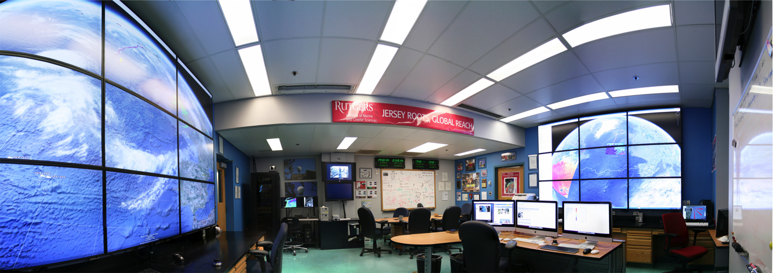
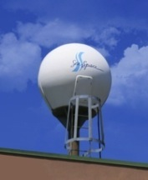
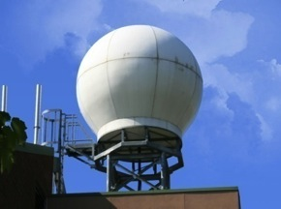
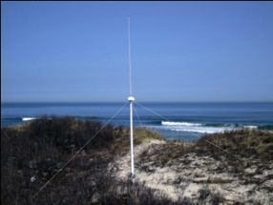
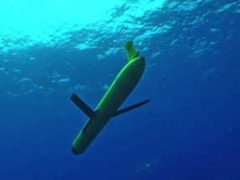
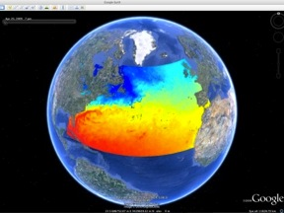
MARACOOS Operations Center
Rutgers University - Coastal Ocean Observation Lab
Satellite Data Acquisition Stations
CODAR Network
Glider Fleet
3-D Forecasts

Slide 8

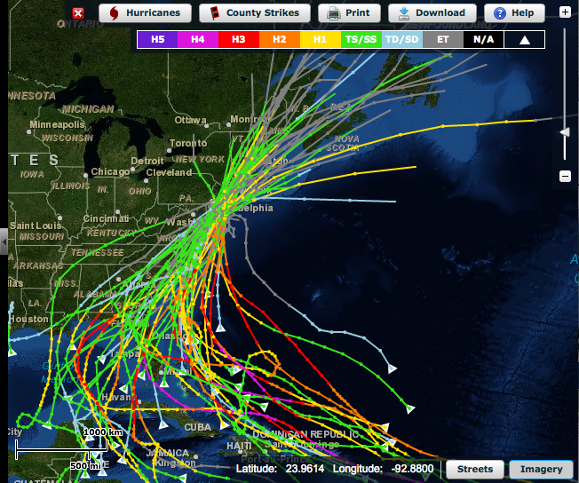
Hurricane Irene: Track (August 2011)
Historical Hurricane Tracks
within 120 km of Atlantic City, NJ

Slide 9
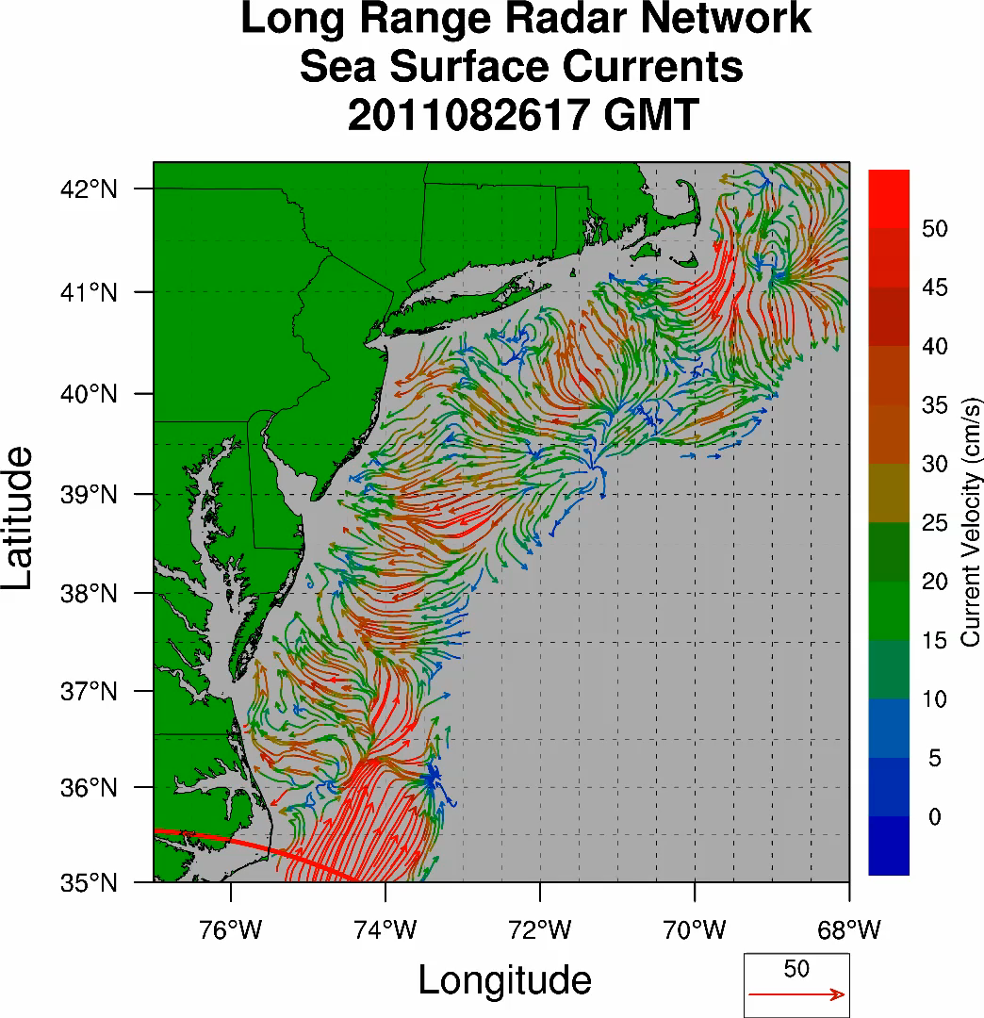
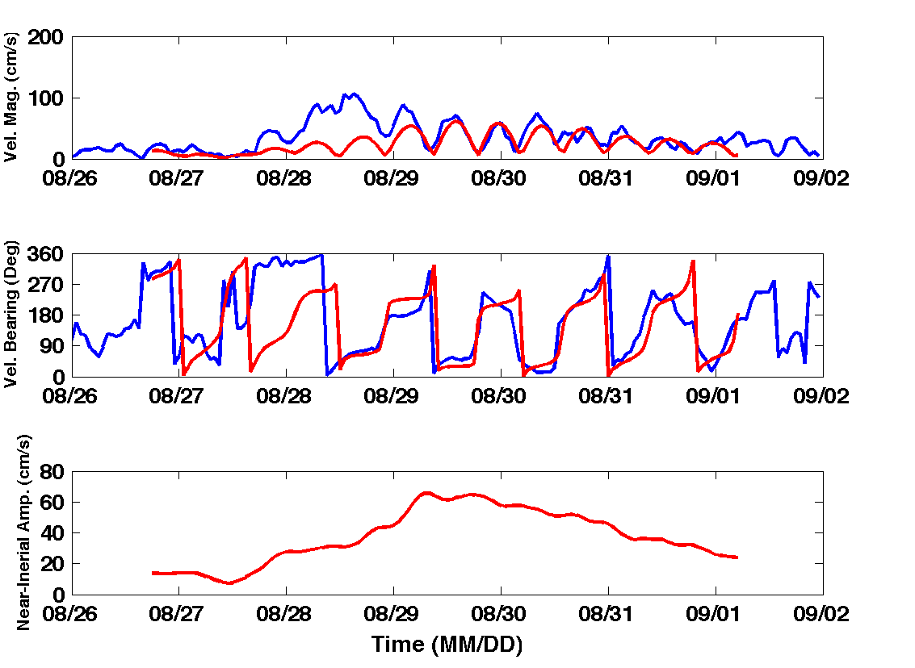
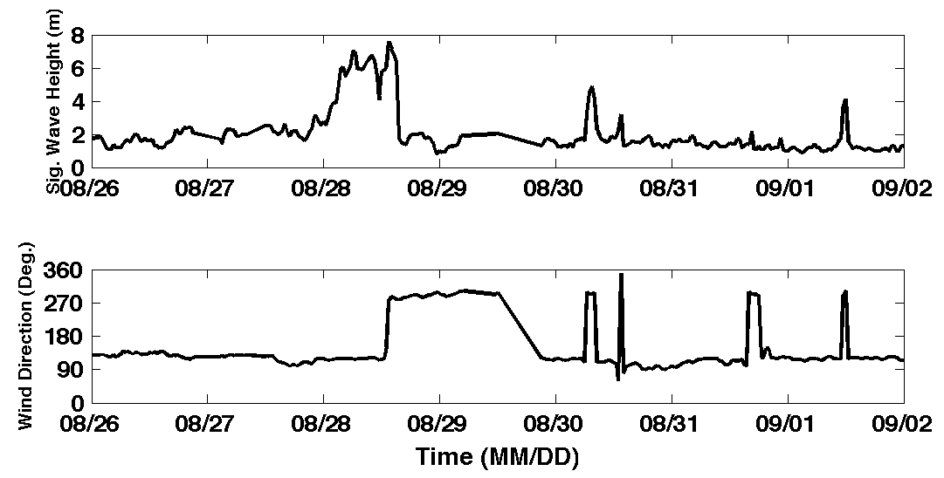
Hurricane Irene
39.5N 73W Surface Current Time Series
Total Current Near-Inertial Current
Wave & Wind Direction Time Series
Eye crosses NJ mid-day on Aug 28

Slide 10
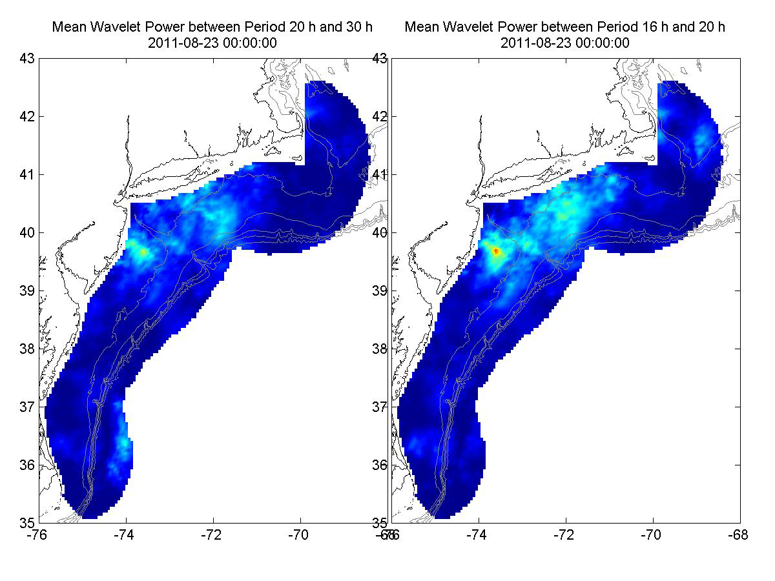
Hurricane Irene Surface Current Wavelet Analysis
Direct Wind Forcing
Inertial Response
Aug 27 Aug 28 Aug 29 Aug 30 Aug 31 Sep 01
Frontside Eye Backside Inertial Inertial Inertial

Slide 11
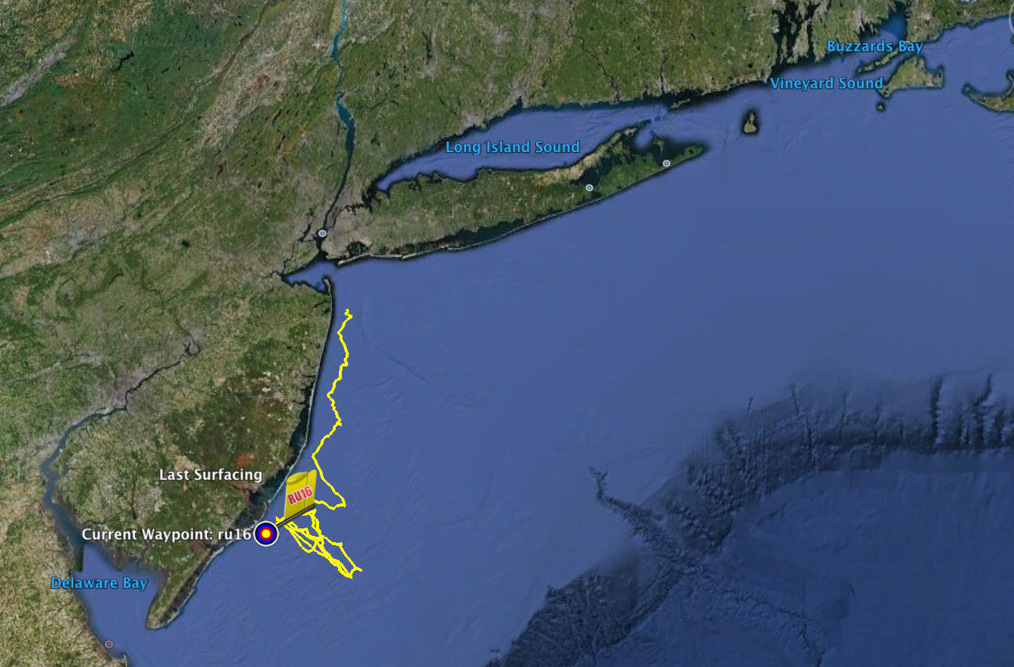
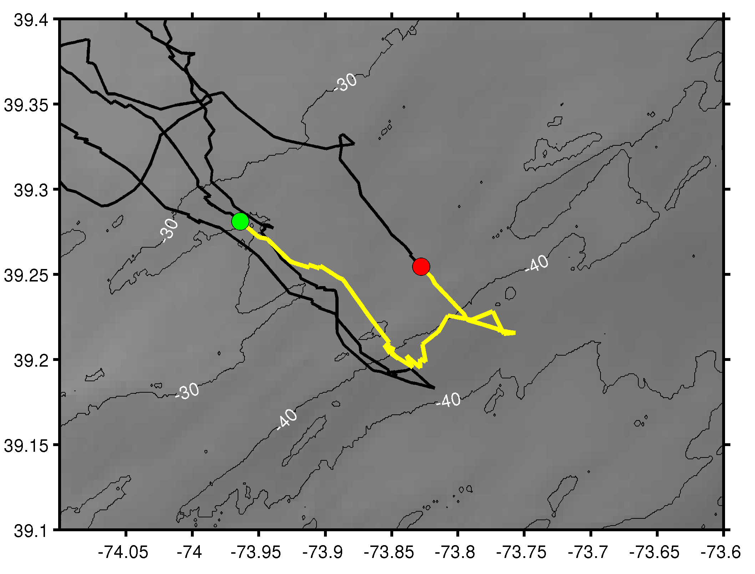
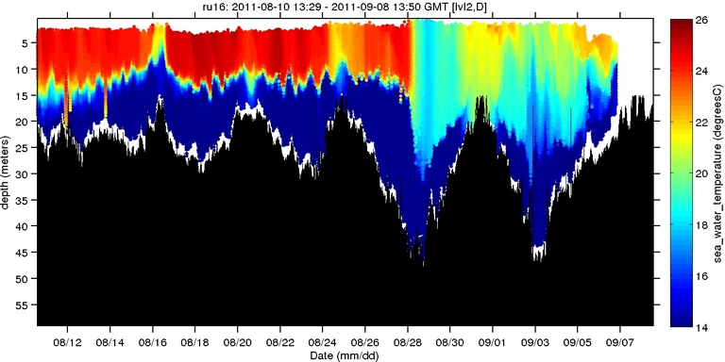
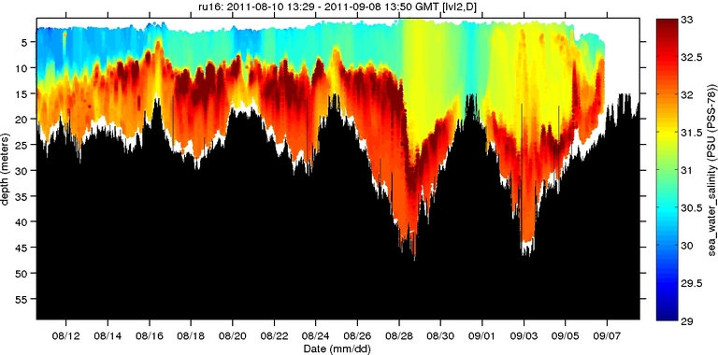
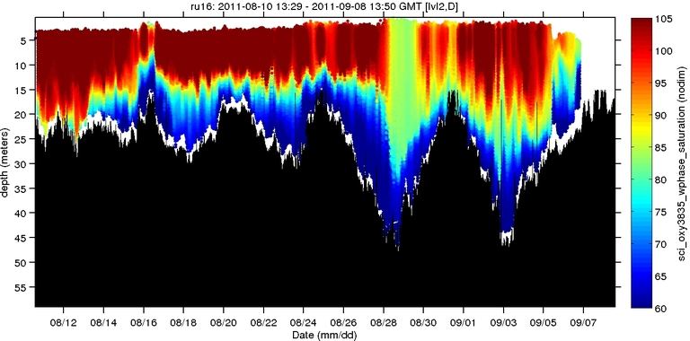

Hurricane Irene: Glider Sampling Through the Storm
Hurricane Irene
0
26
depth
Temperature
RU16
Deployed for EPA.
Map bottom dissolved oxygen.
Provided data on mixing during storm.
55
14
0
33
depth
Salinity
55
29
0
105
depth
% Saturation
(DO)
55
60
Aug 12
date
Sep 07

Slide 12
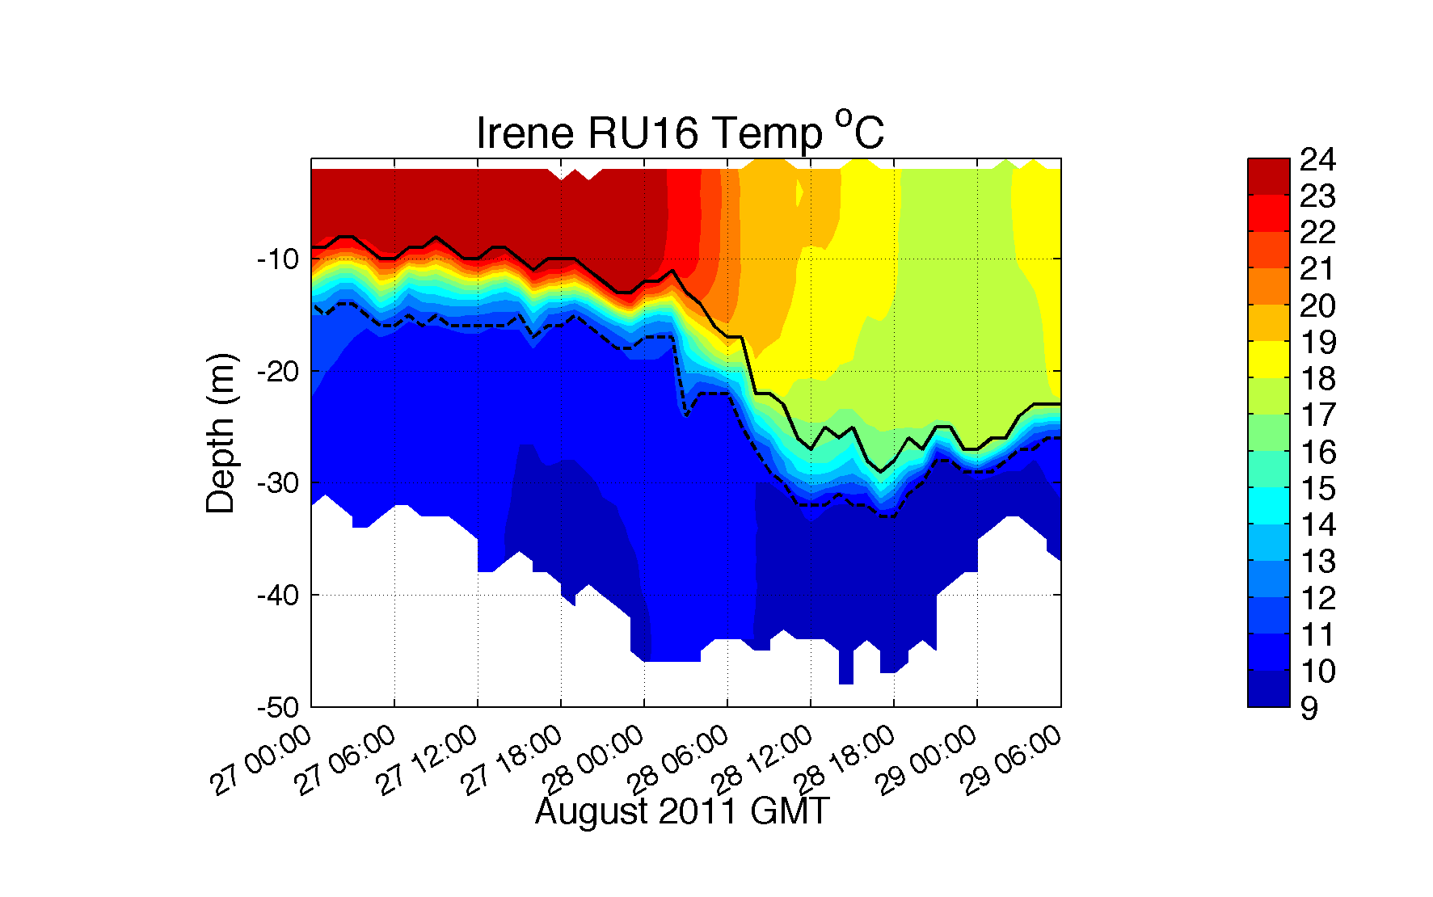
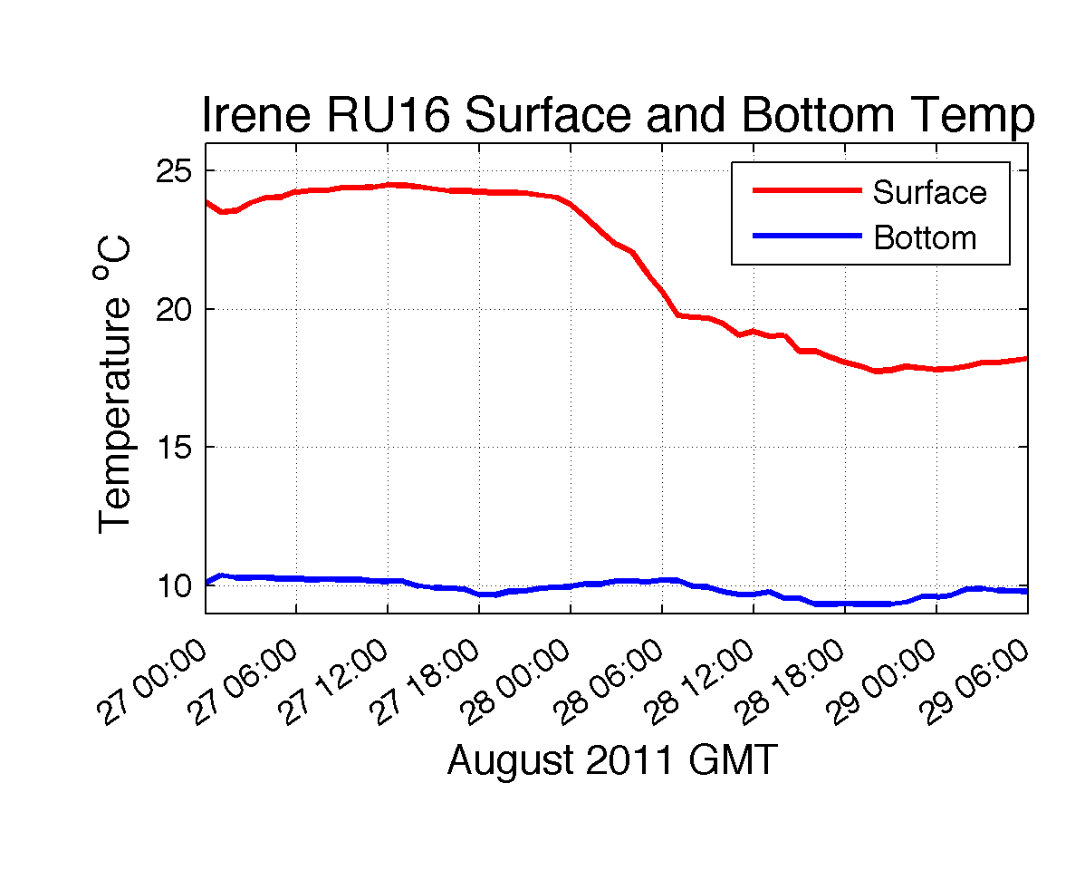
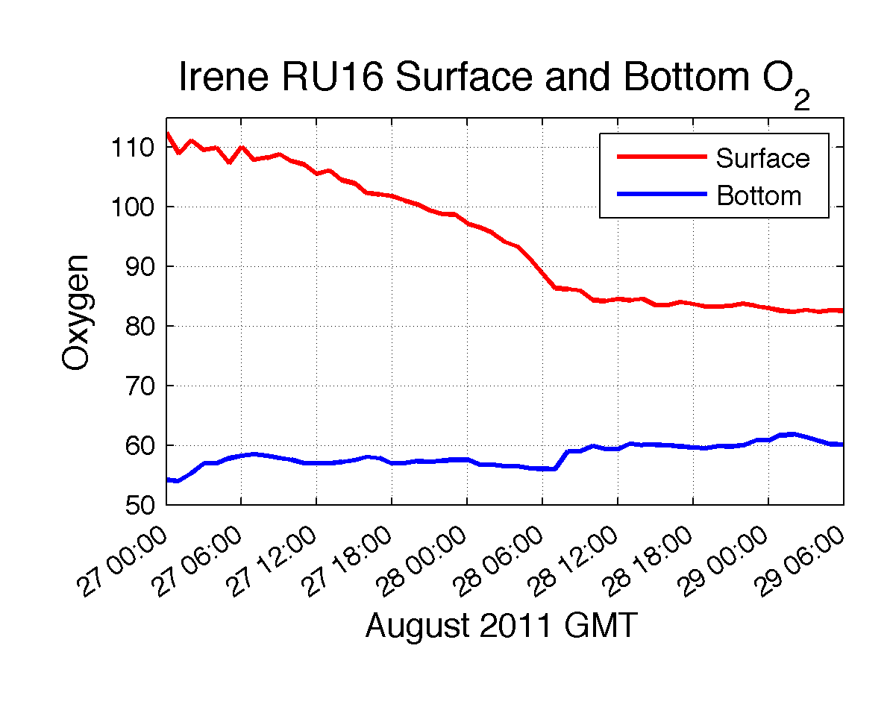
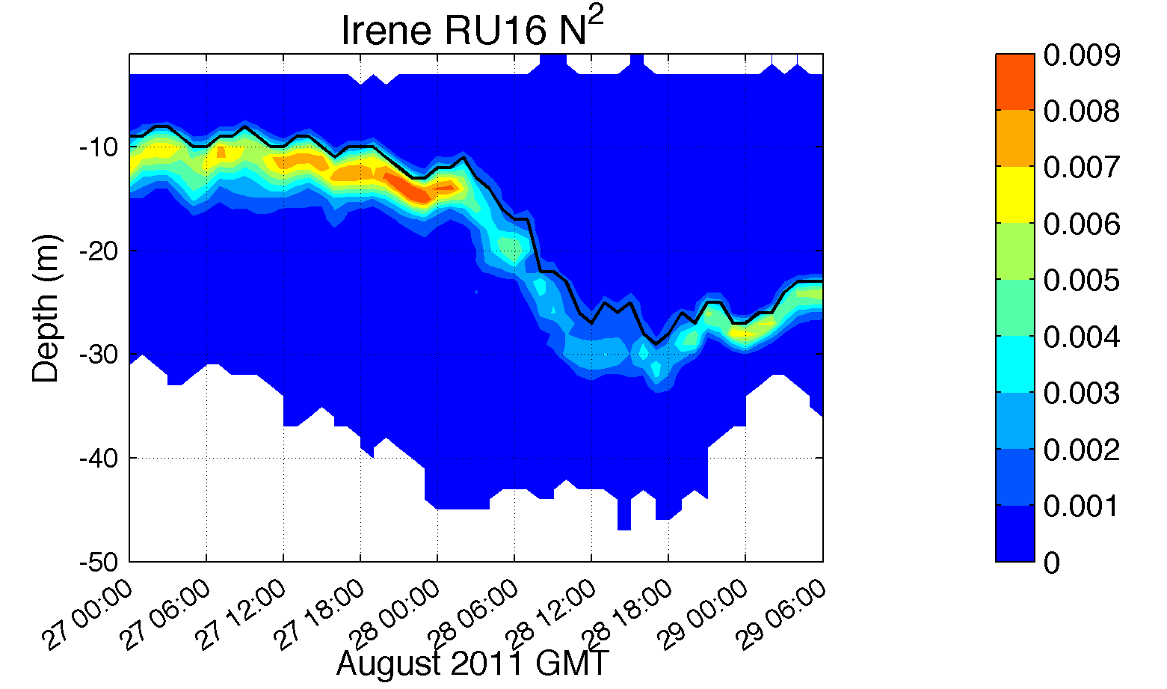
Hurricane Irene: Glider Sampling Through the Storm

Slide 13
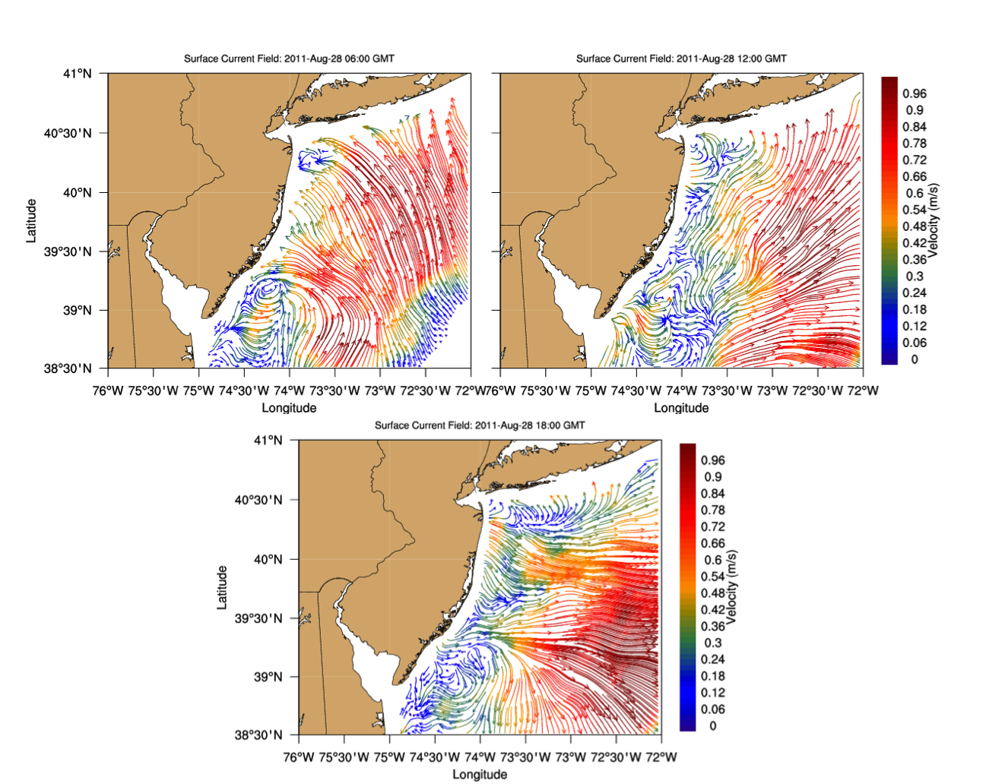
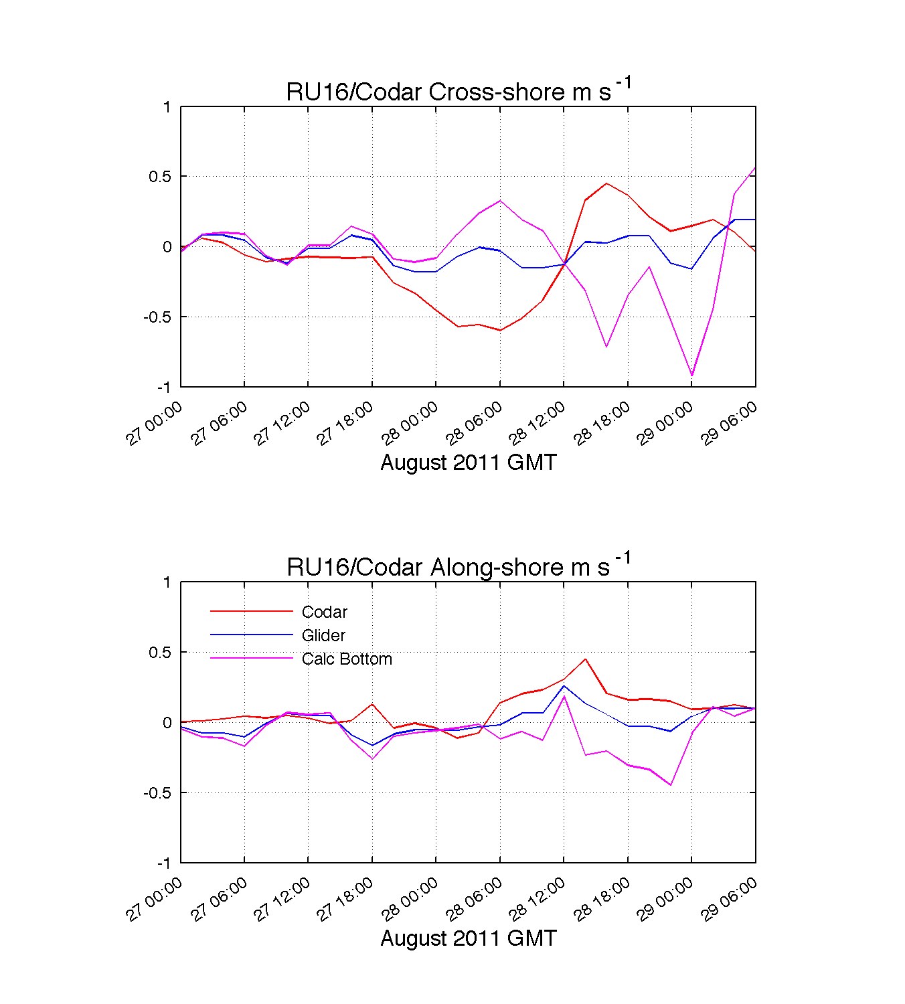
Before
After
Offshore
Onshore
Surface (CODAR) Depth Avg (Glider) Bottom (Difference)

Slide 14
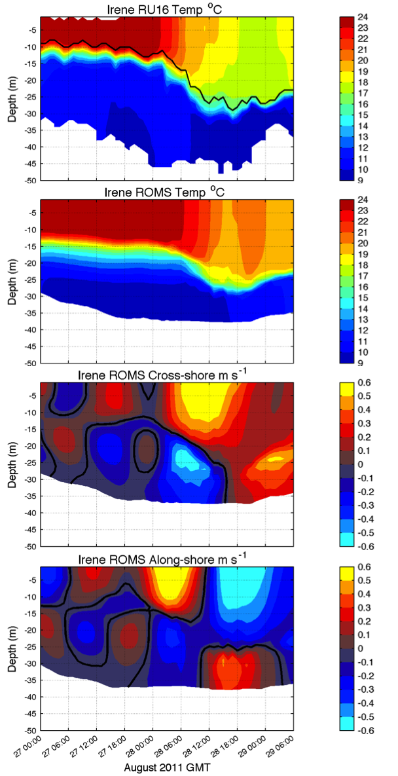
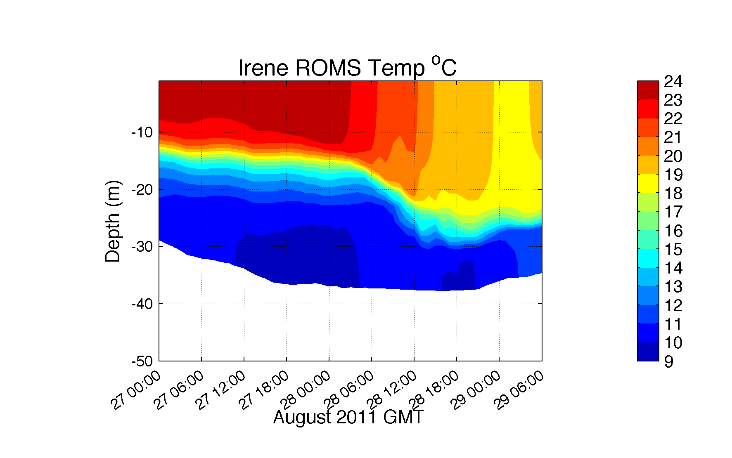
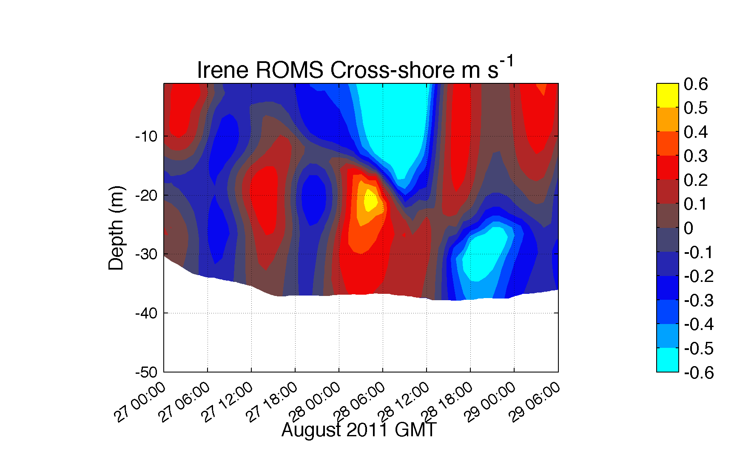
Hurricane Irene: Our Modeled Ocean (ROMS)
Offshore
Onshore
Glider Temperature
ROMS Temperature
ROMS Cross-Shore

Slide 15
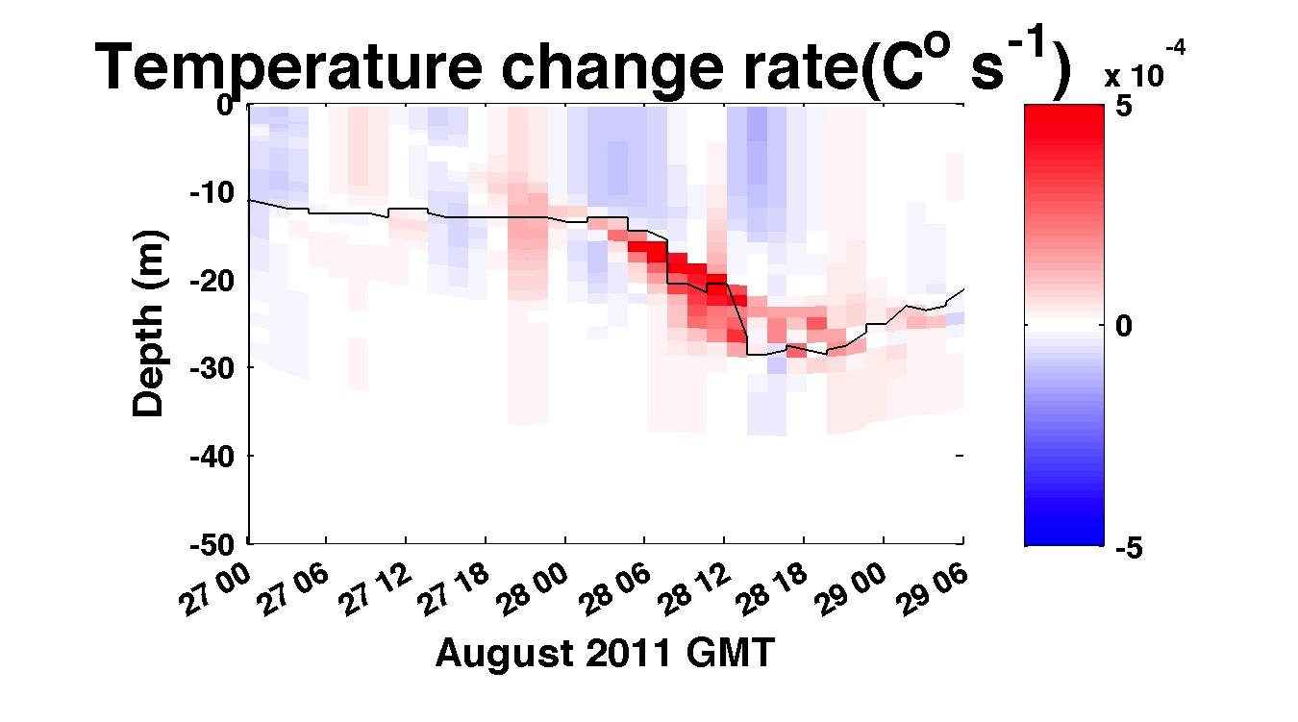
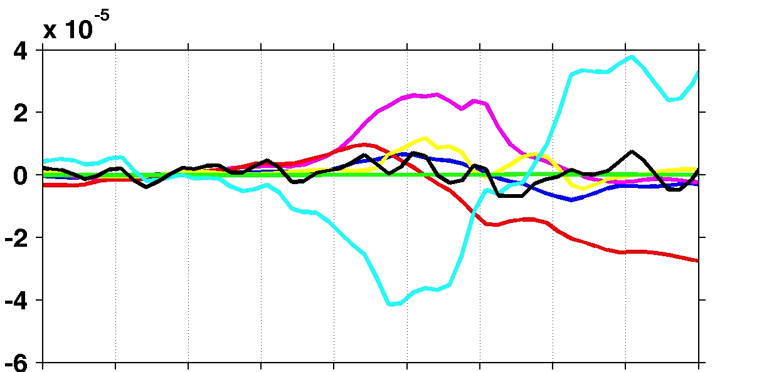
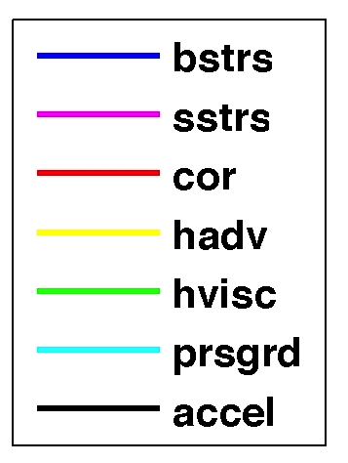
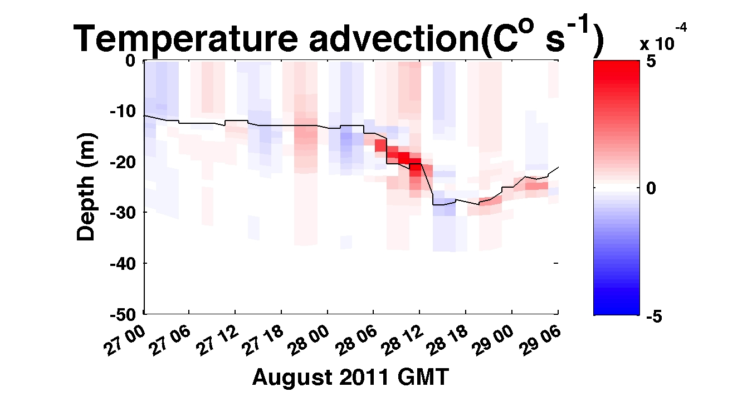
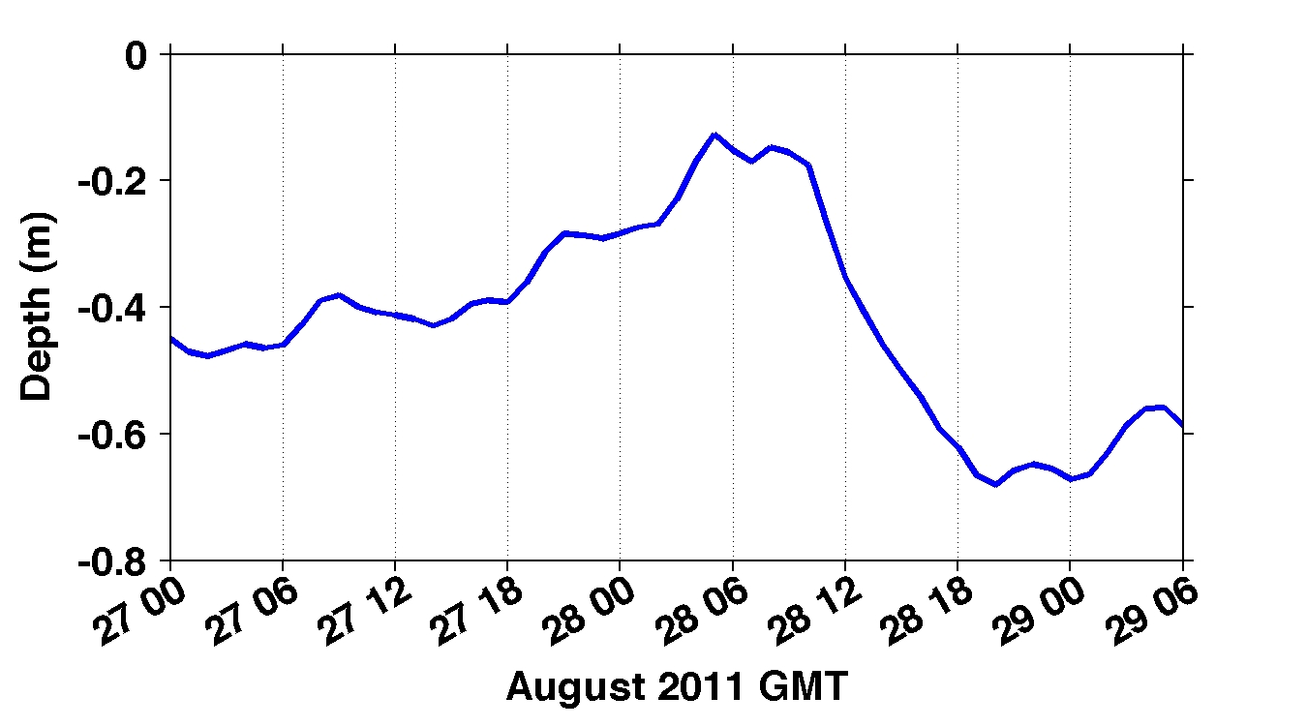
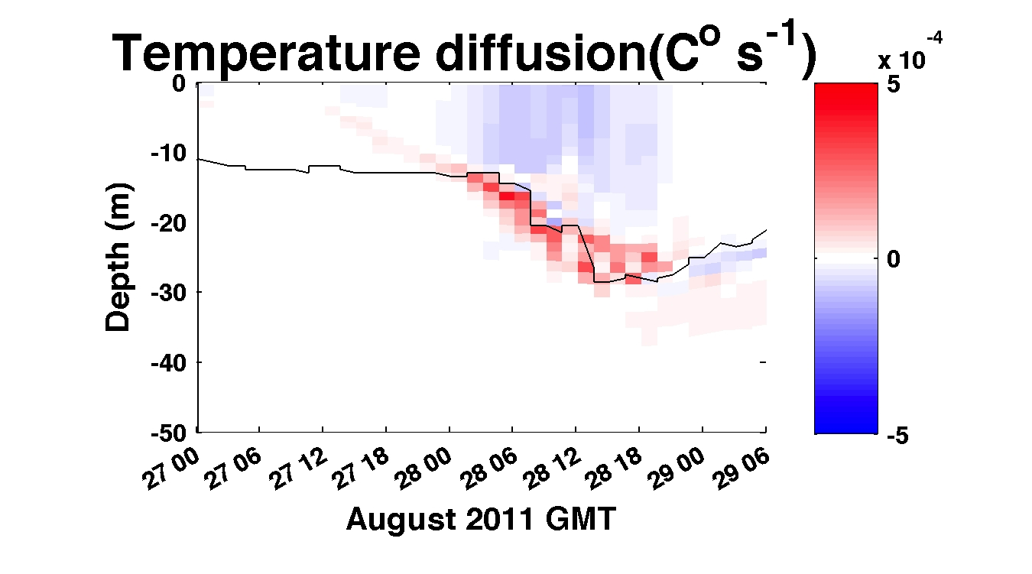
Depth-averaged across-shelf
momentum balance terms
Depth-averaged across-shelf momentum terms(m s⁻²)
De-tided free surface height (m)

Slide 16
Pre- and Post-Hurricane Irene
Sea Surface Temperatures
Before
After
Difference
The 6C -10C Cooling occurred:
With the outer wind bands
Before the eye passed over

Slide 17
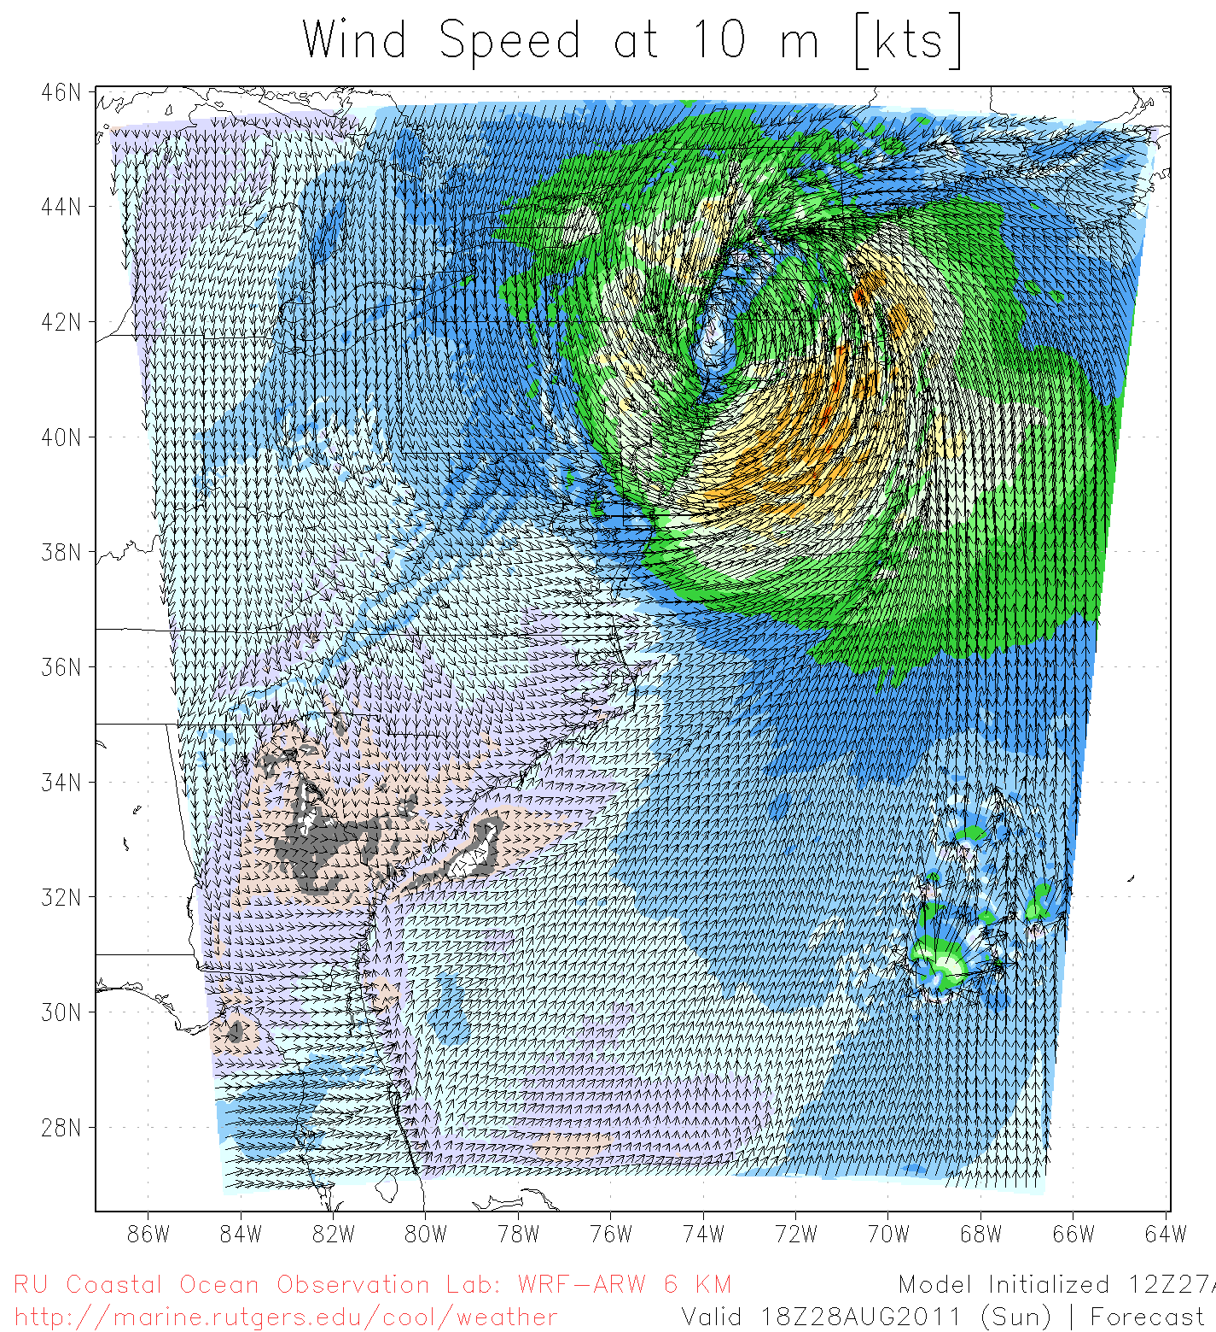
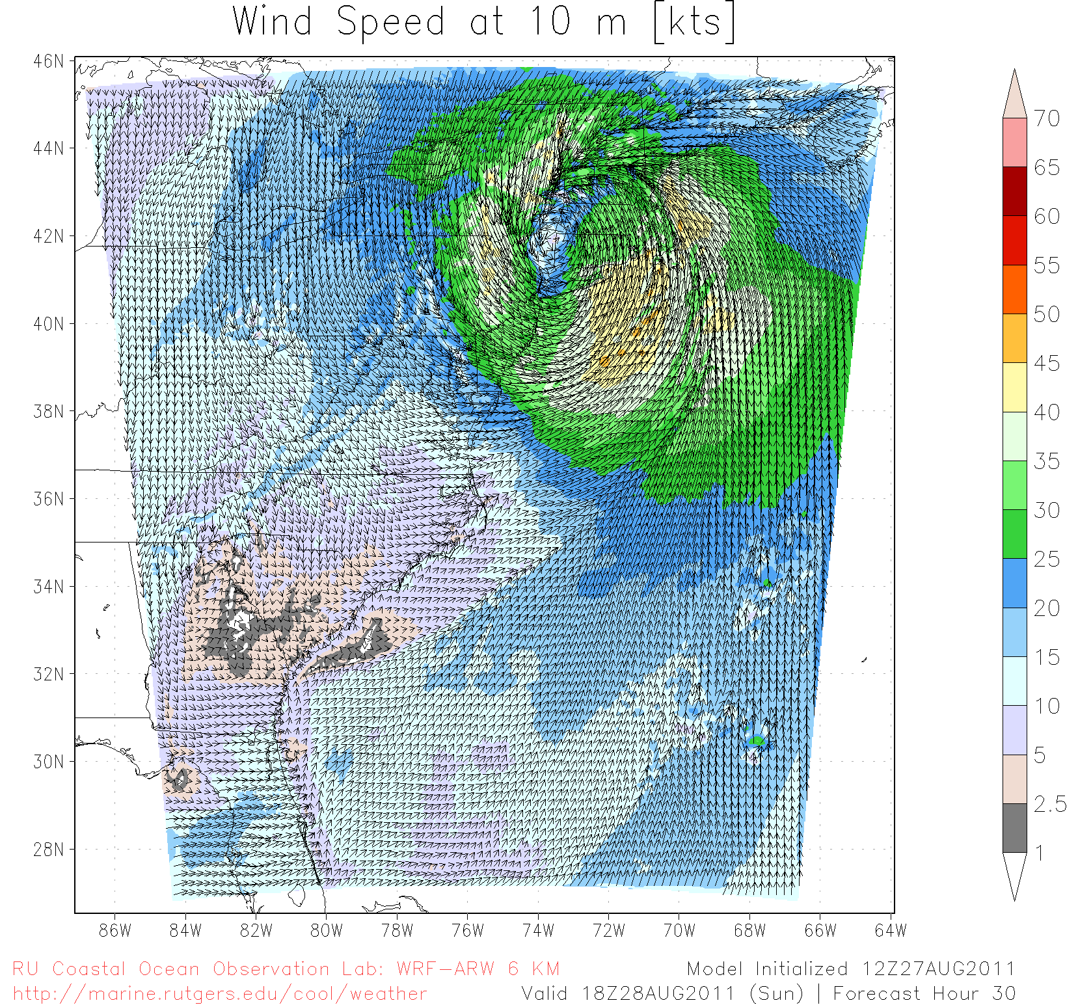
Hurricane Irene SST Sensitivity Hindcast
Global Warm SST
Regional Cold SST
Maximum Wind Speed Skill Score | Official Forecast | Warm SST Hindcast | Warm SST + OML Model Hindcast | Cold SST Hindcast
RMS Error (knots) | 9.43 | 7.13 | 7.09 | 3.61

Slide 18
Hurricane Irene
August 26, 2011
Strong Stratification
Limited storm surge
Mixing cooled surface
Limited intensity
Hurricane Sandy
October 29, 2012
NOAA/NHC Damage:
#2 with >$60 Billion.
Track Accurate;
Intensity Under-predicted.

Slide 19
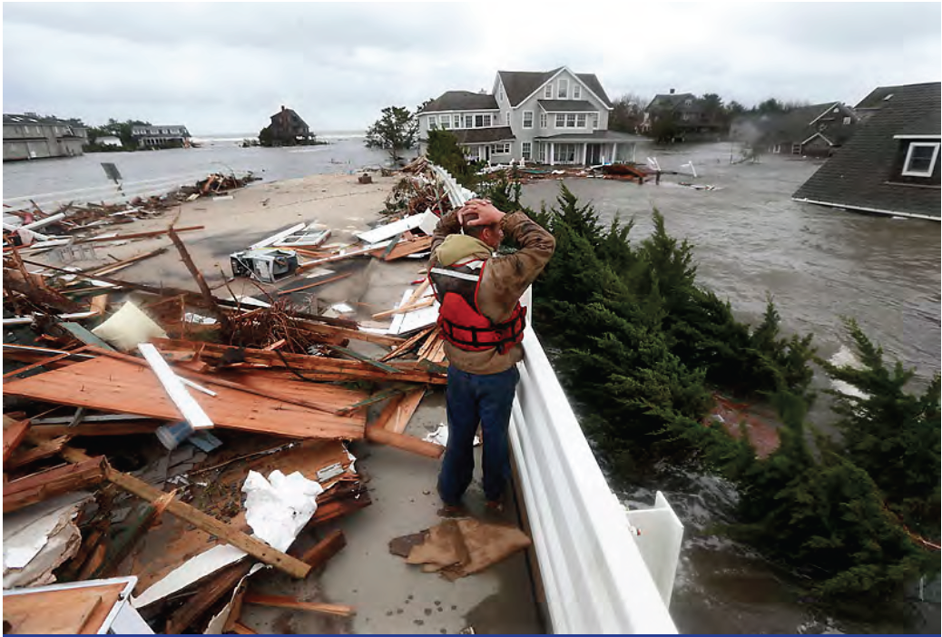
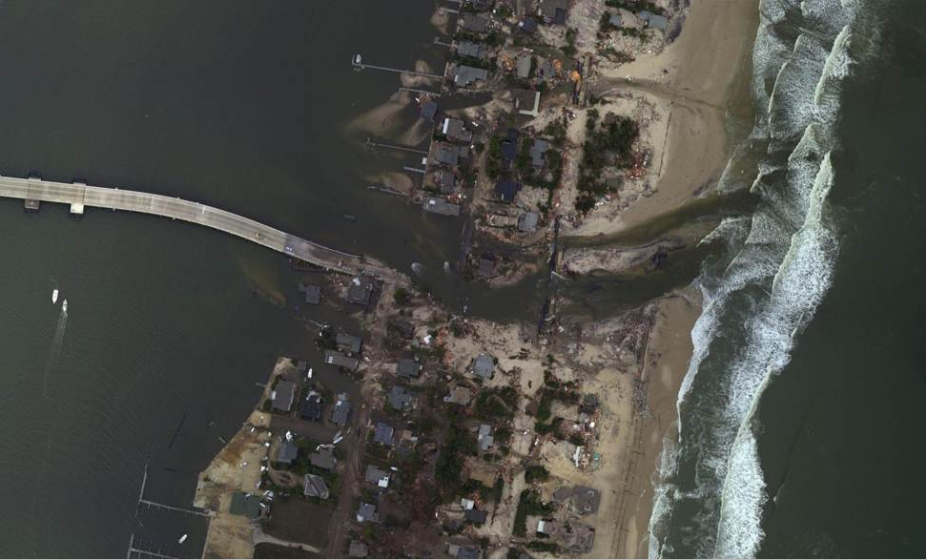
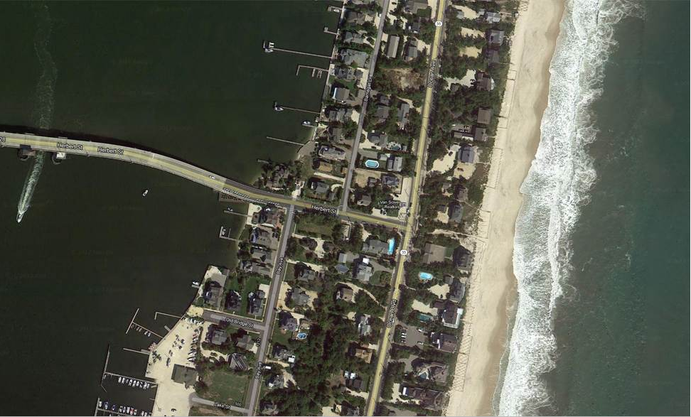


Superstorm Sandy: Before and After
Over 10,000 Homes
Destroyed in New Jersey

Slide 20





Slide 21




HF Radar Storm Damage
Keyport
S
HF Radar Shed floats 0.85 km across barrier island & river
I

Slide 22

Hurricane Sandy: 5 Day Track Uncertainty Cone

Slide 23


Superstorm Sandy: 2 Days Before Landfall

Slide 24

Superstorm Sandy: 1 Day Before Landfall

Slide 25

Superstorm Sandy: Morning Before Landfall

Slide 26

Superstorm Sandy: Landfall (20:00 Local)

Slide 27



Hurricane Sandy Hindcast: SST Sensitivity
Warm SST
Cold SST Switch
2-3 °C Cooling
Over 12 days

Slide 28

Hurricane Sandy Track Forecasts & Hindcasts

Slide 29



Storm Surge Forecast at Peak:
Lower Manhattan, New York
4
3
2
1
0
(m)
Observed
Forecasted

Slide 30
Hurricane Irene
August 26, 2011
Strong Stratification
Limited storm surge
Mixing cooled surface
Limited intensity
Hurricane Sandy
October 29, 2012
After fall transition
Single layer ocean
No mixing/cooling
No escape for surge

Slide 31


Response Summary:
Irene and Sandy were
disruptive event2.
IOOS was there before, during and after.
IOOS made a difference.

Slide 33

Hurricane Irene
39.5N 73W Surface Current Time Series
Total Current Near-Inertial Current
Wave & Wind Direction Time Series
Eye crosses NJ mid-day on Aug 28

Slide 34








Real-Time Satellite Ground Stations in the Northeast U.S.
Satellites: NPP, Terra, Aqua, NOAA Polar Orbiters, Metop & GOES
U. Maine
City College of N.Y.
Rutgers
U. Delaware
Johns Hopkins

Slide 35







Mid-Atlantic Bight HF Radar Network
1000 km
Cape to Cape
Mid-Atlantic HF Radar Network
16 Long-Range CODARs
8 Medium-Range CODARs
17 Short-Range CODARs
41 Total
Triple Nested, Multi-static, Multi-use
Industry Partner: CODAR Ocean Sensors

Slide 36




Mid-Atlantic Glider Network
RU01
RU15
RU29
Satellite Ocean Color
MARACOOS
MURI
Intl. Missions
EPA & NJDEP
Cblast
Endurance
OSSE
SW06
Satellite SST
Subsurface
Glider
Data
Many Missions,
Many Agencies
Industry Partner: Teledyne Webb Research

Slide 37
Hurricane Sandy Hindcast: Intensity

