Slide 1



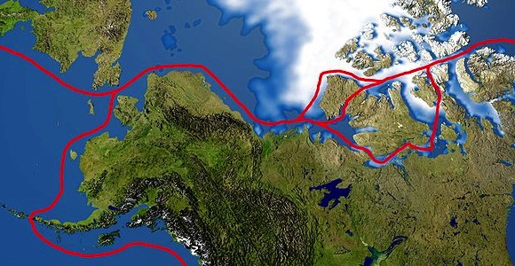
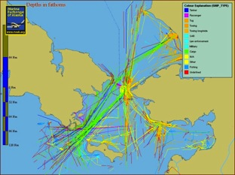
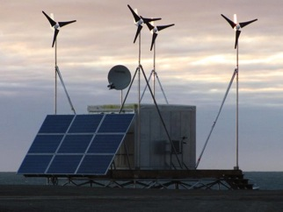
CSR High Latitude HF Radar Testbed
Objective:
Test the capability of the SeaSonde HF Radar as a detection and surveillance sensor at high latitudes in anticipation of the polar ice cap melting and the increased usage of the Northwest Passage.
Sponsor:
Participants:
Remote Power Module
AIS traffic near Barrow, AK
Northwest passage routes

Slide 2
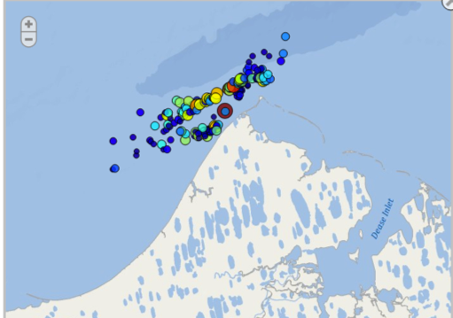

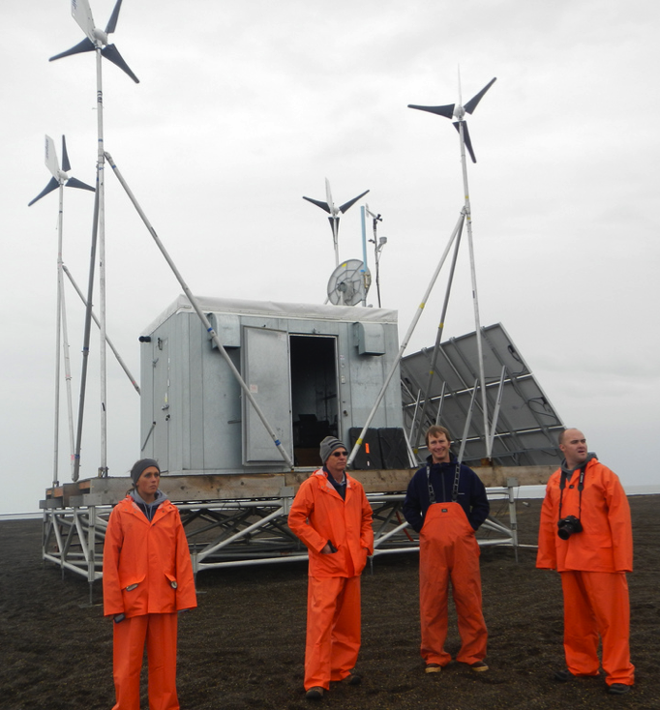
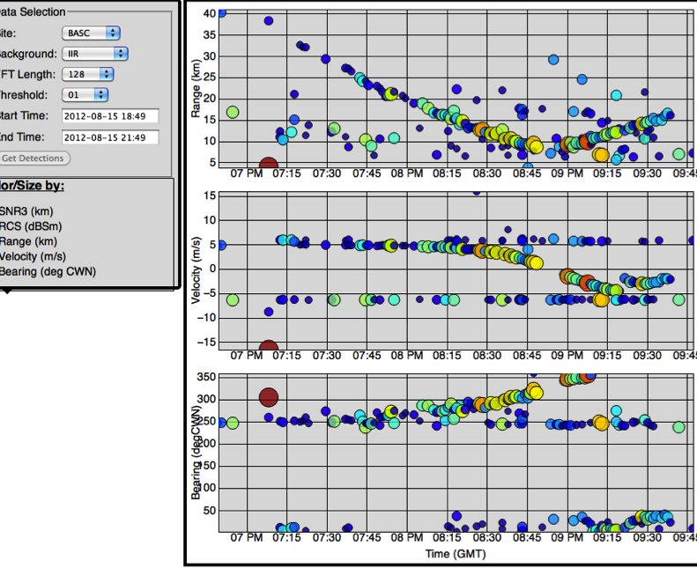
Point Barrow Detections
All AIS vessels detected. Range to
70 km.

Slide 3
Alaska Experiment
Installed radars in June 2012
Collected vessel real time vessel detection data starting on July 9
Data transferred back to Rutgers in real time
Focused analysis on September 9 and 10

Slide 4
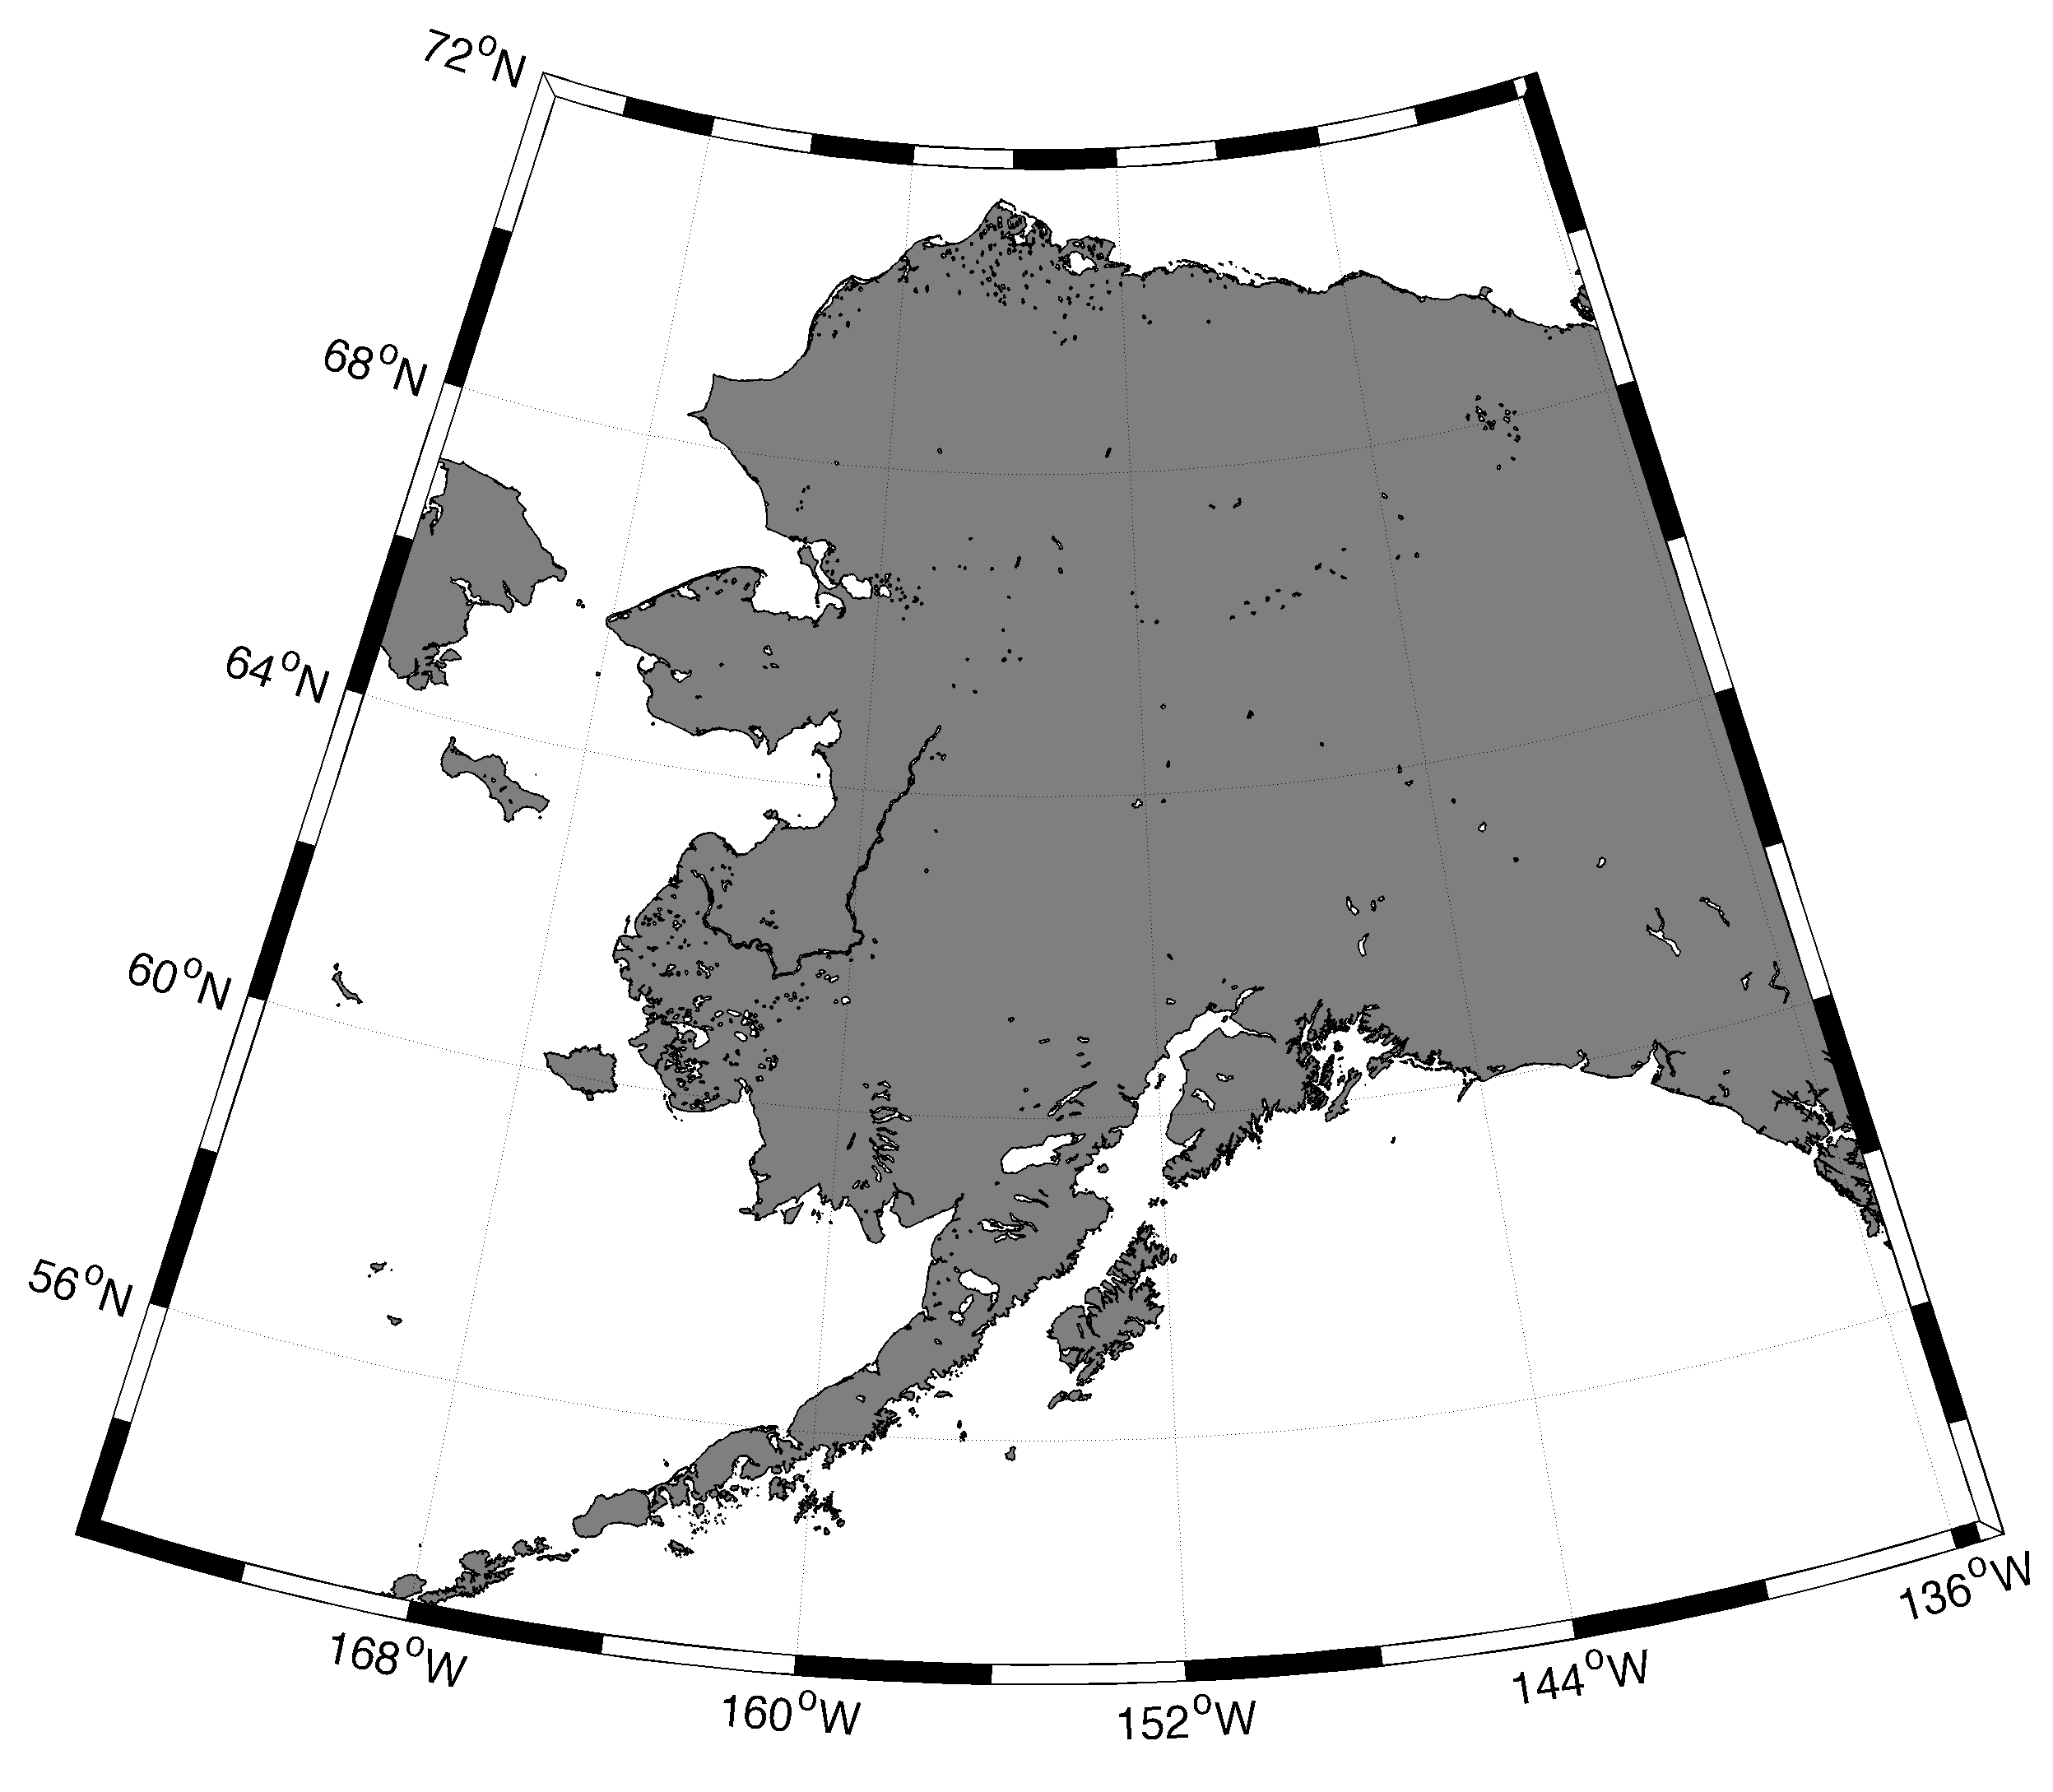
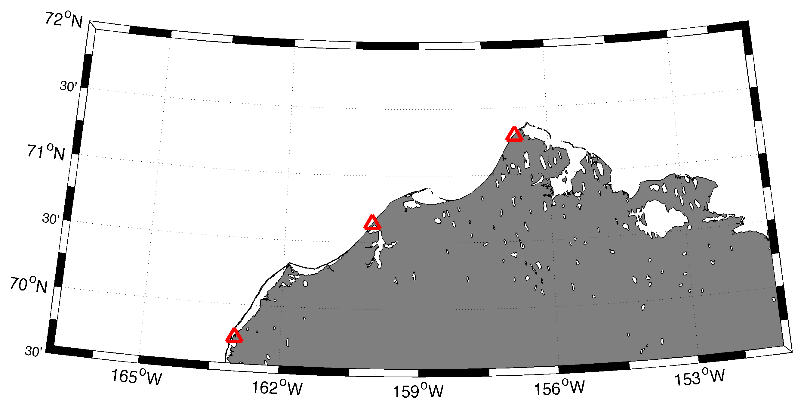
Alaska

Slide 5
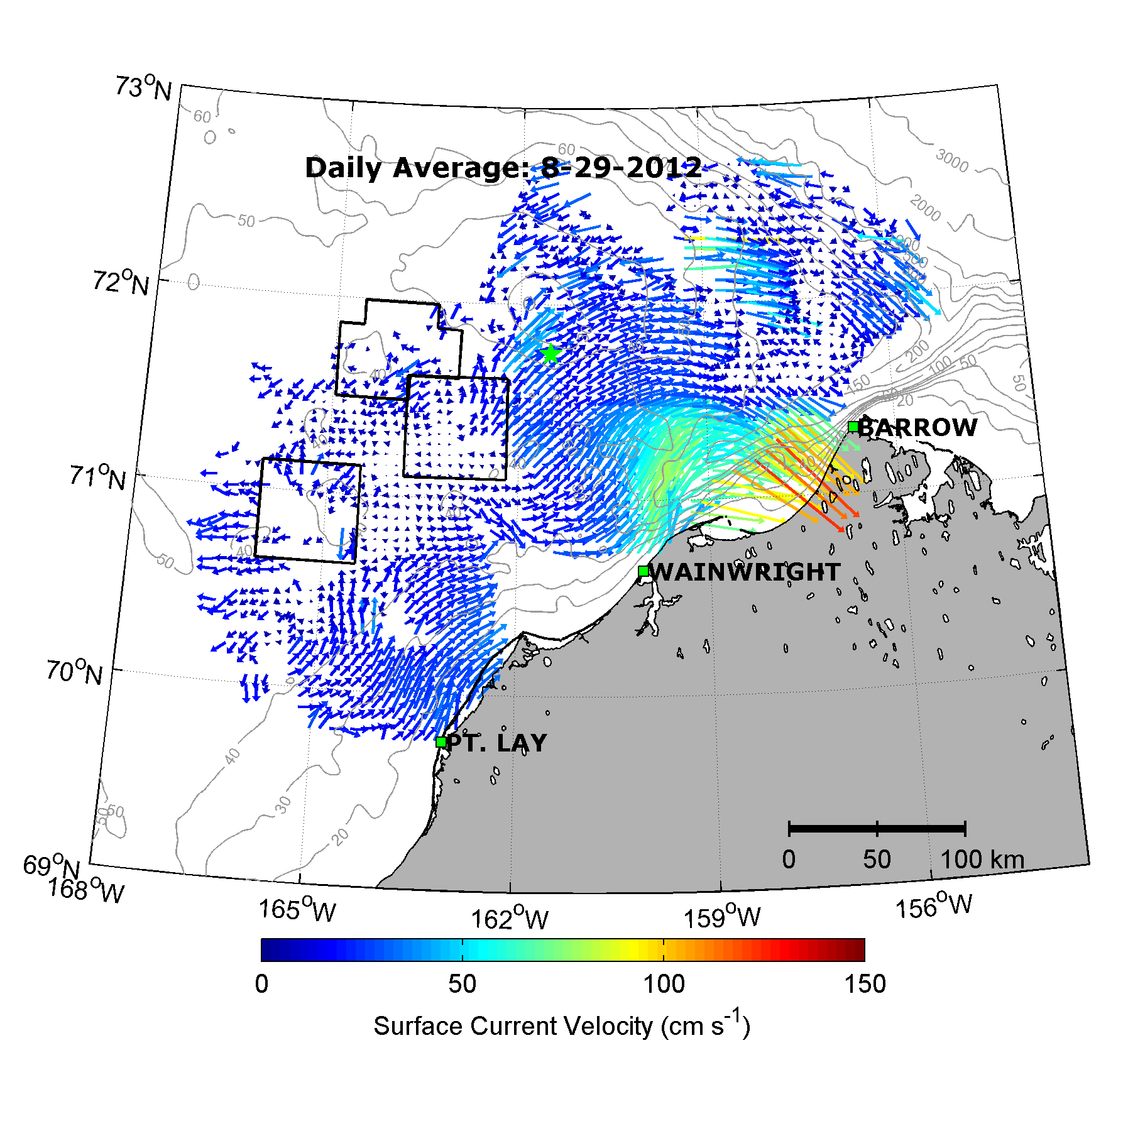
Daily Average Aug 29, 2012
5 MHz Long Range Network

Slide 6
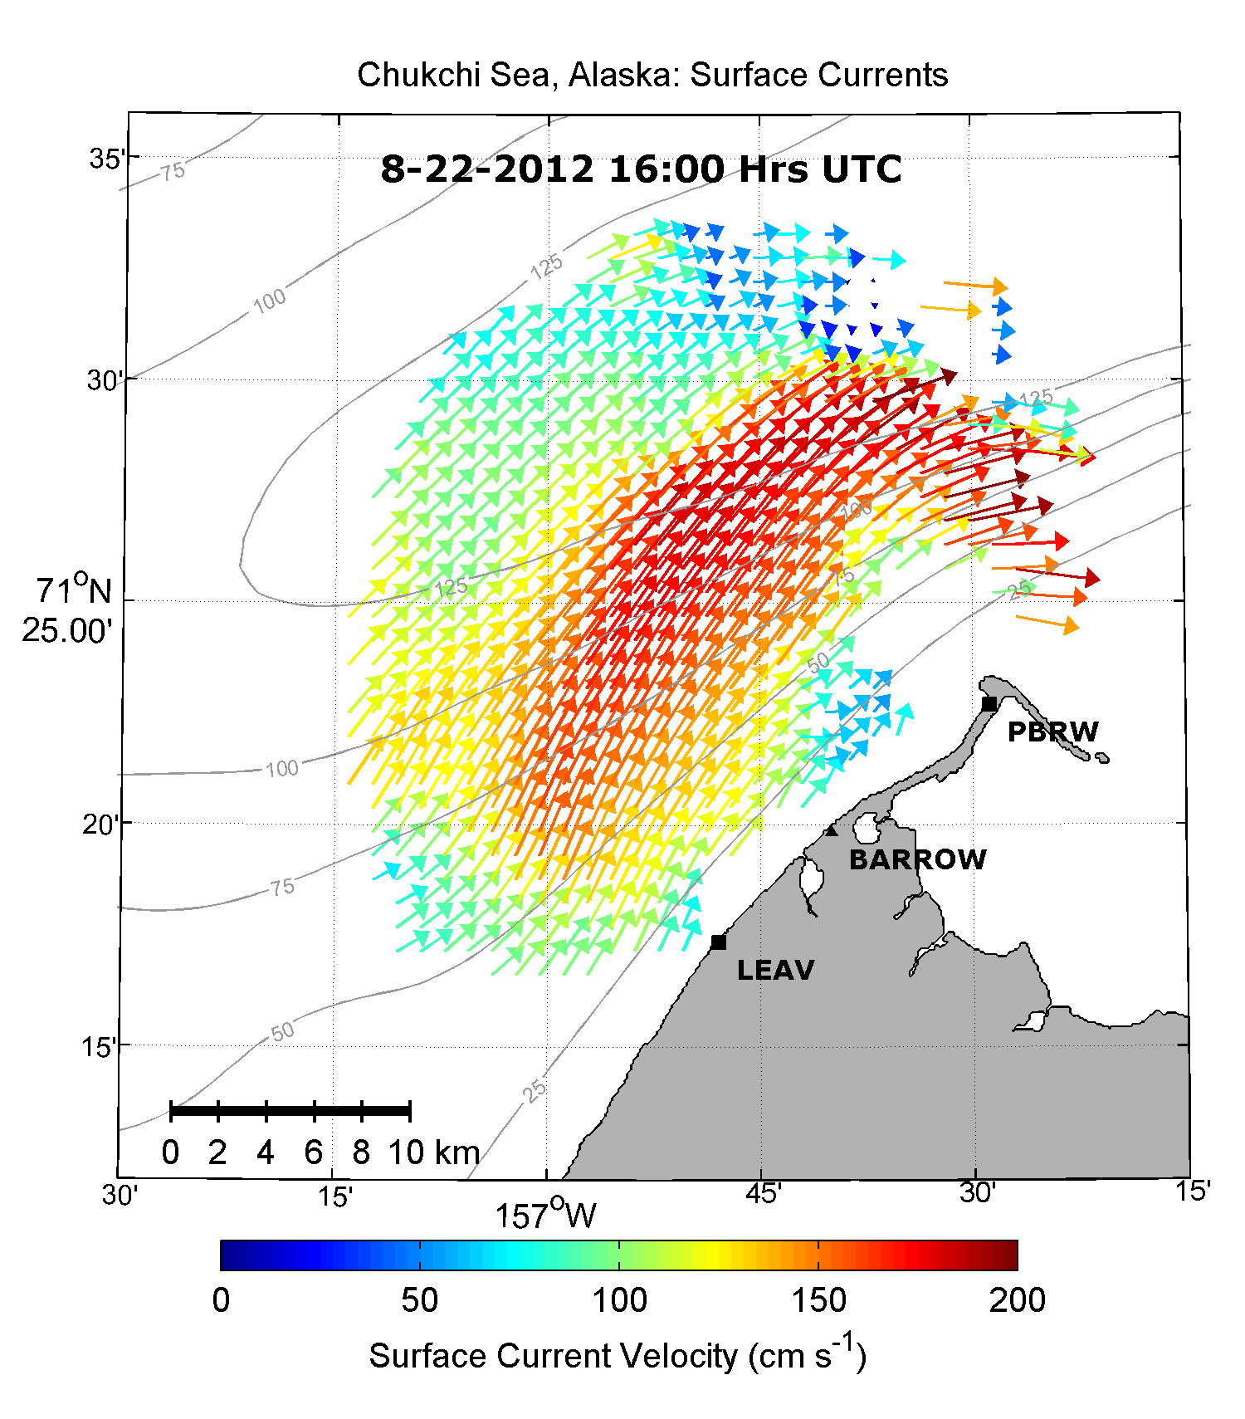
Aug 22, 2012
16:00 UTC
25 MHz High Resolution Network

Slide 7
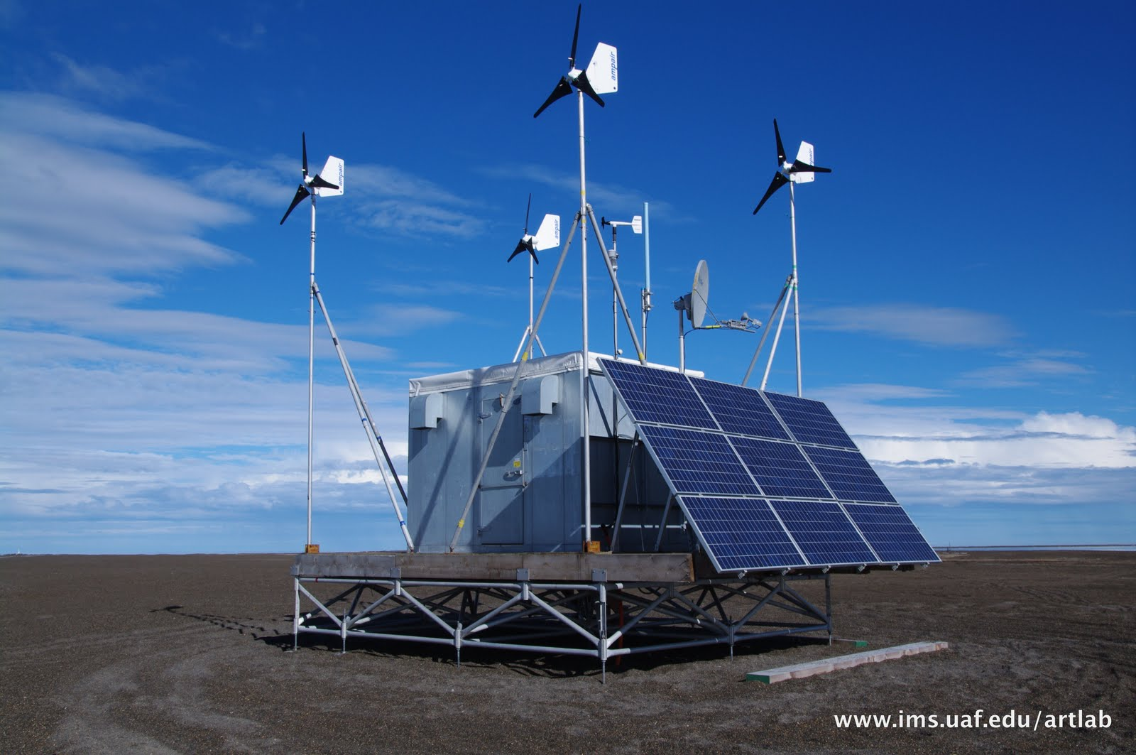
Remote Power Module

Slide 8
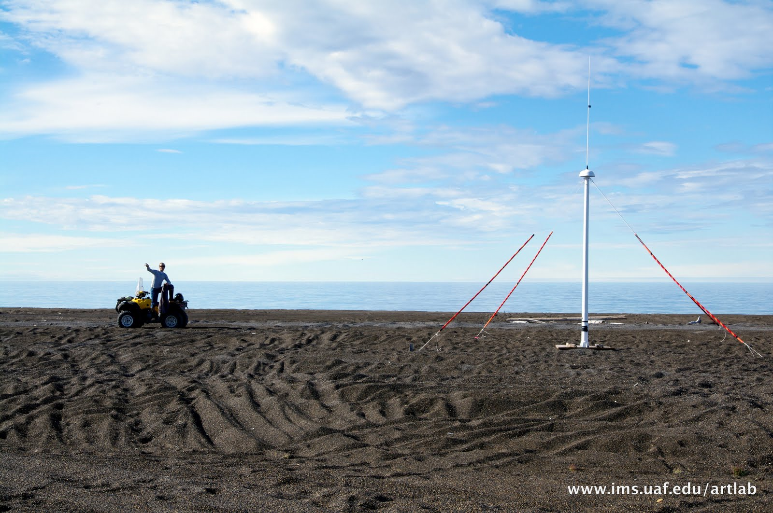
Receive Antenna

Slide 9
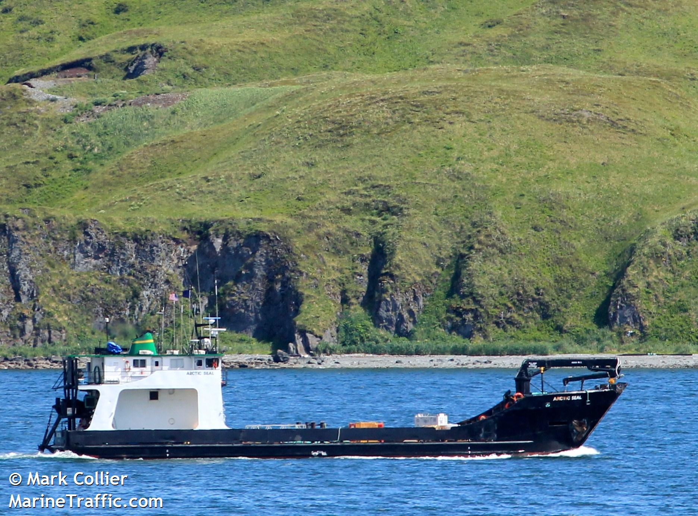
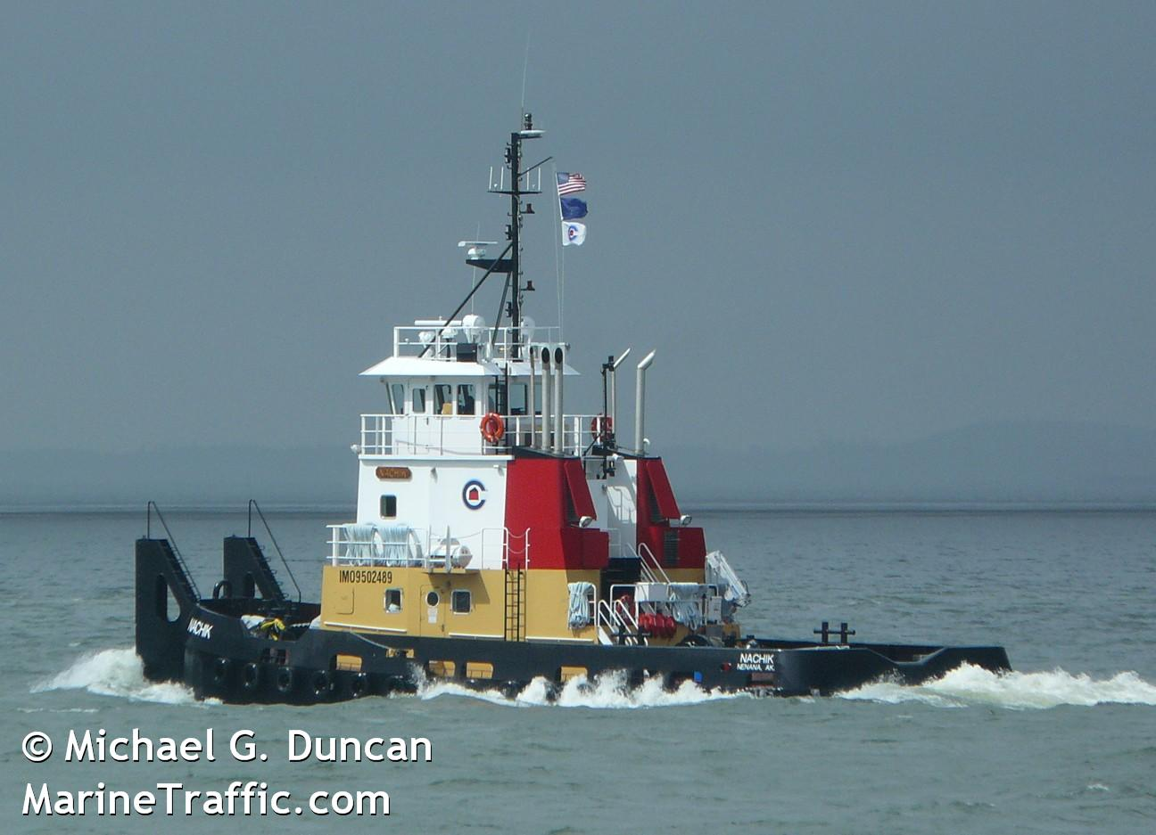
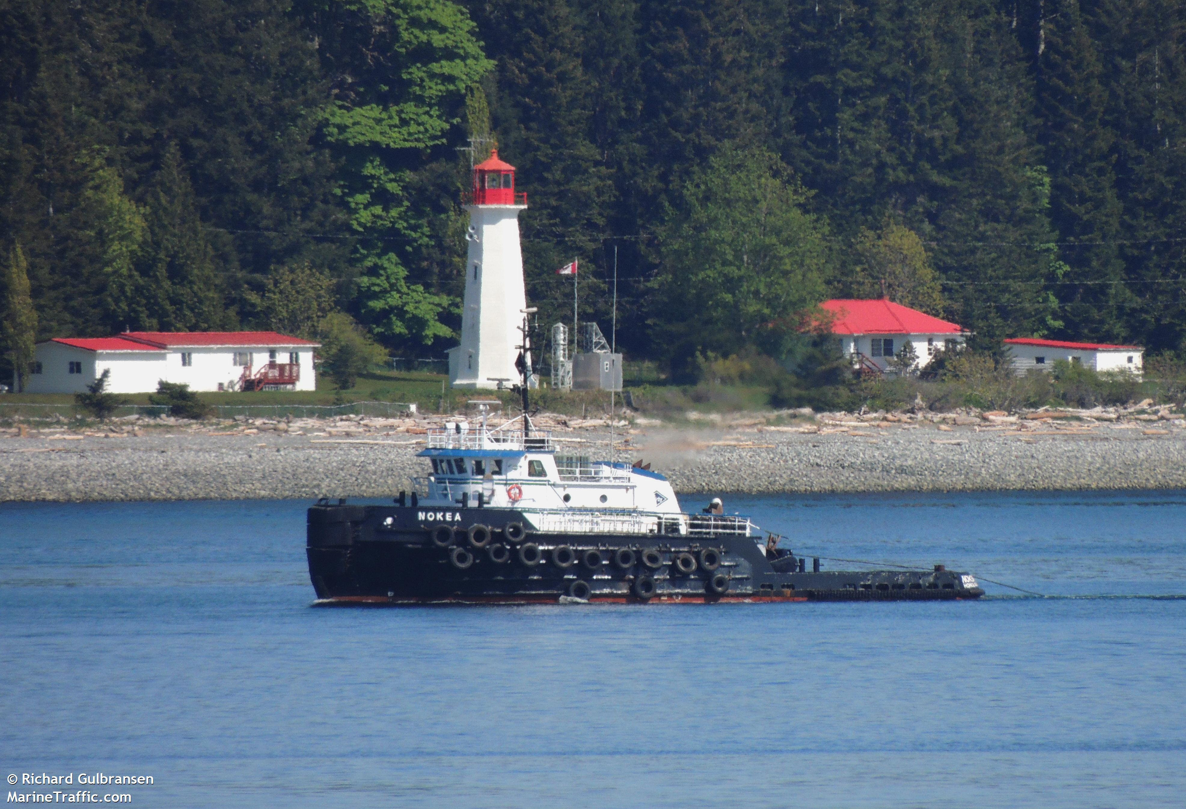
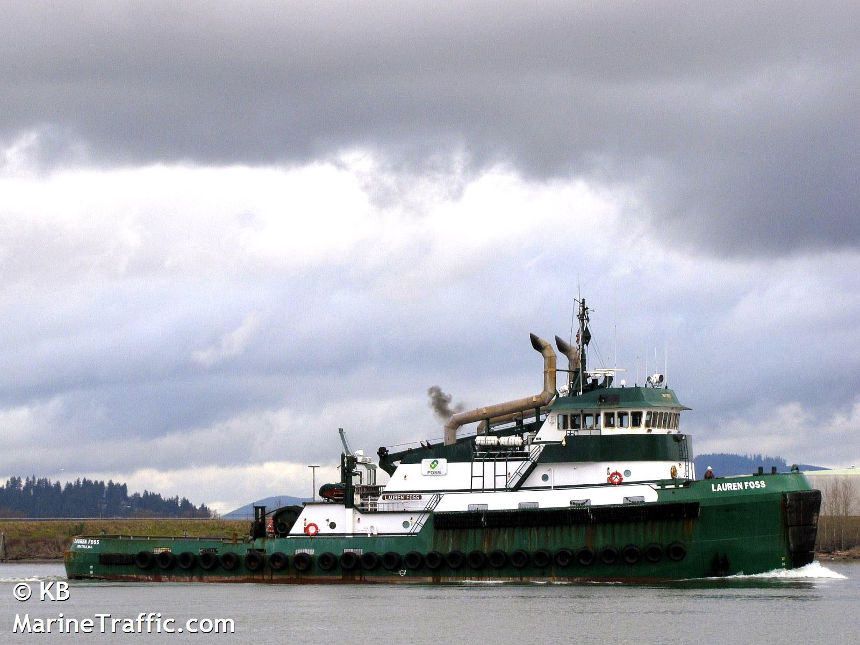
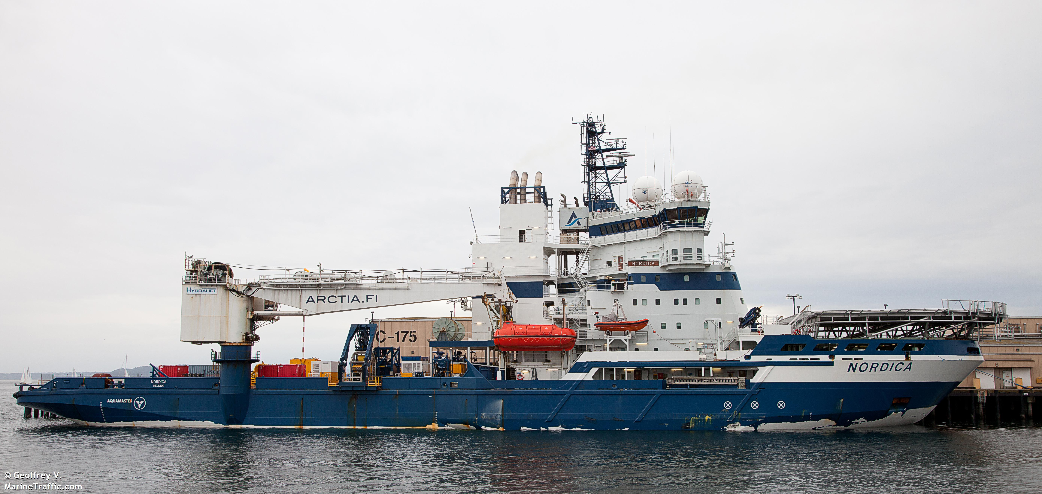
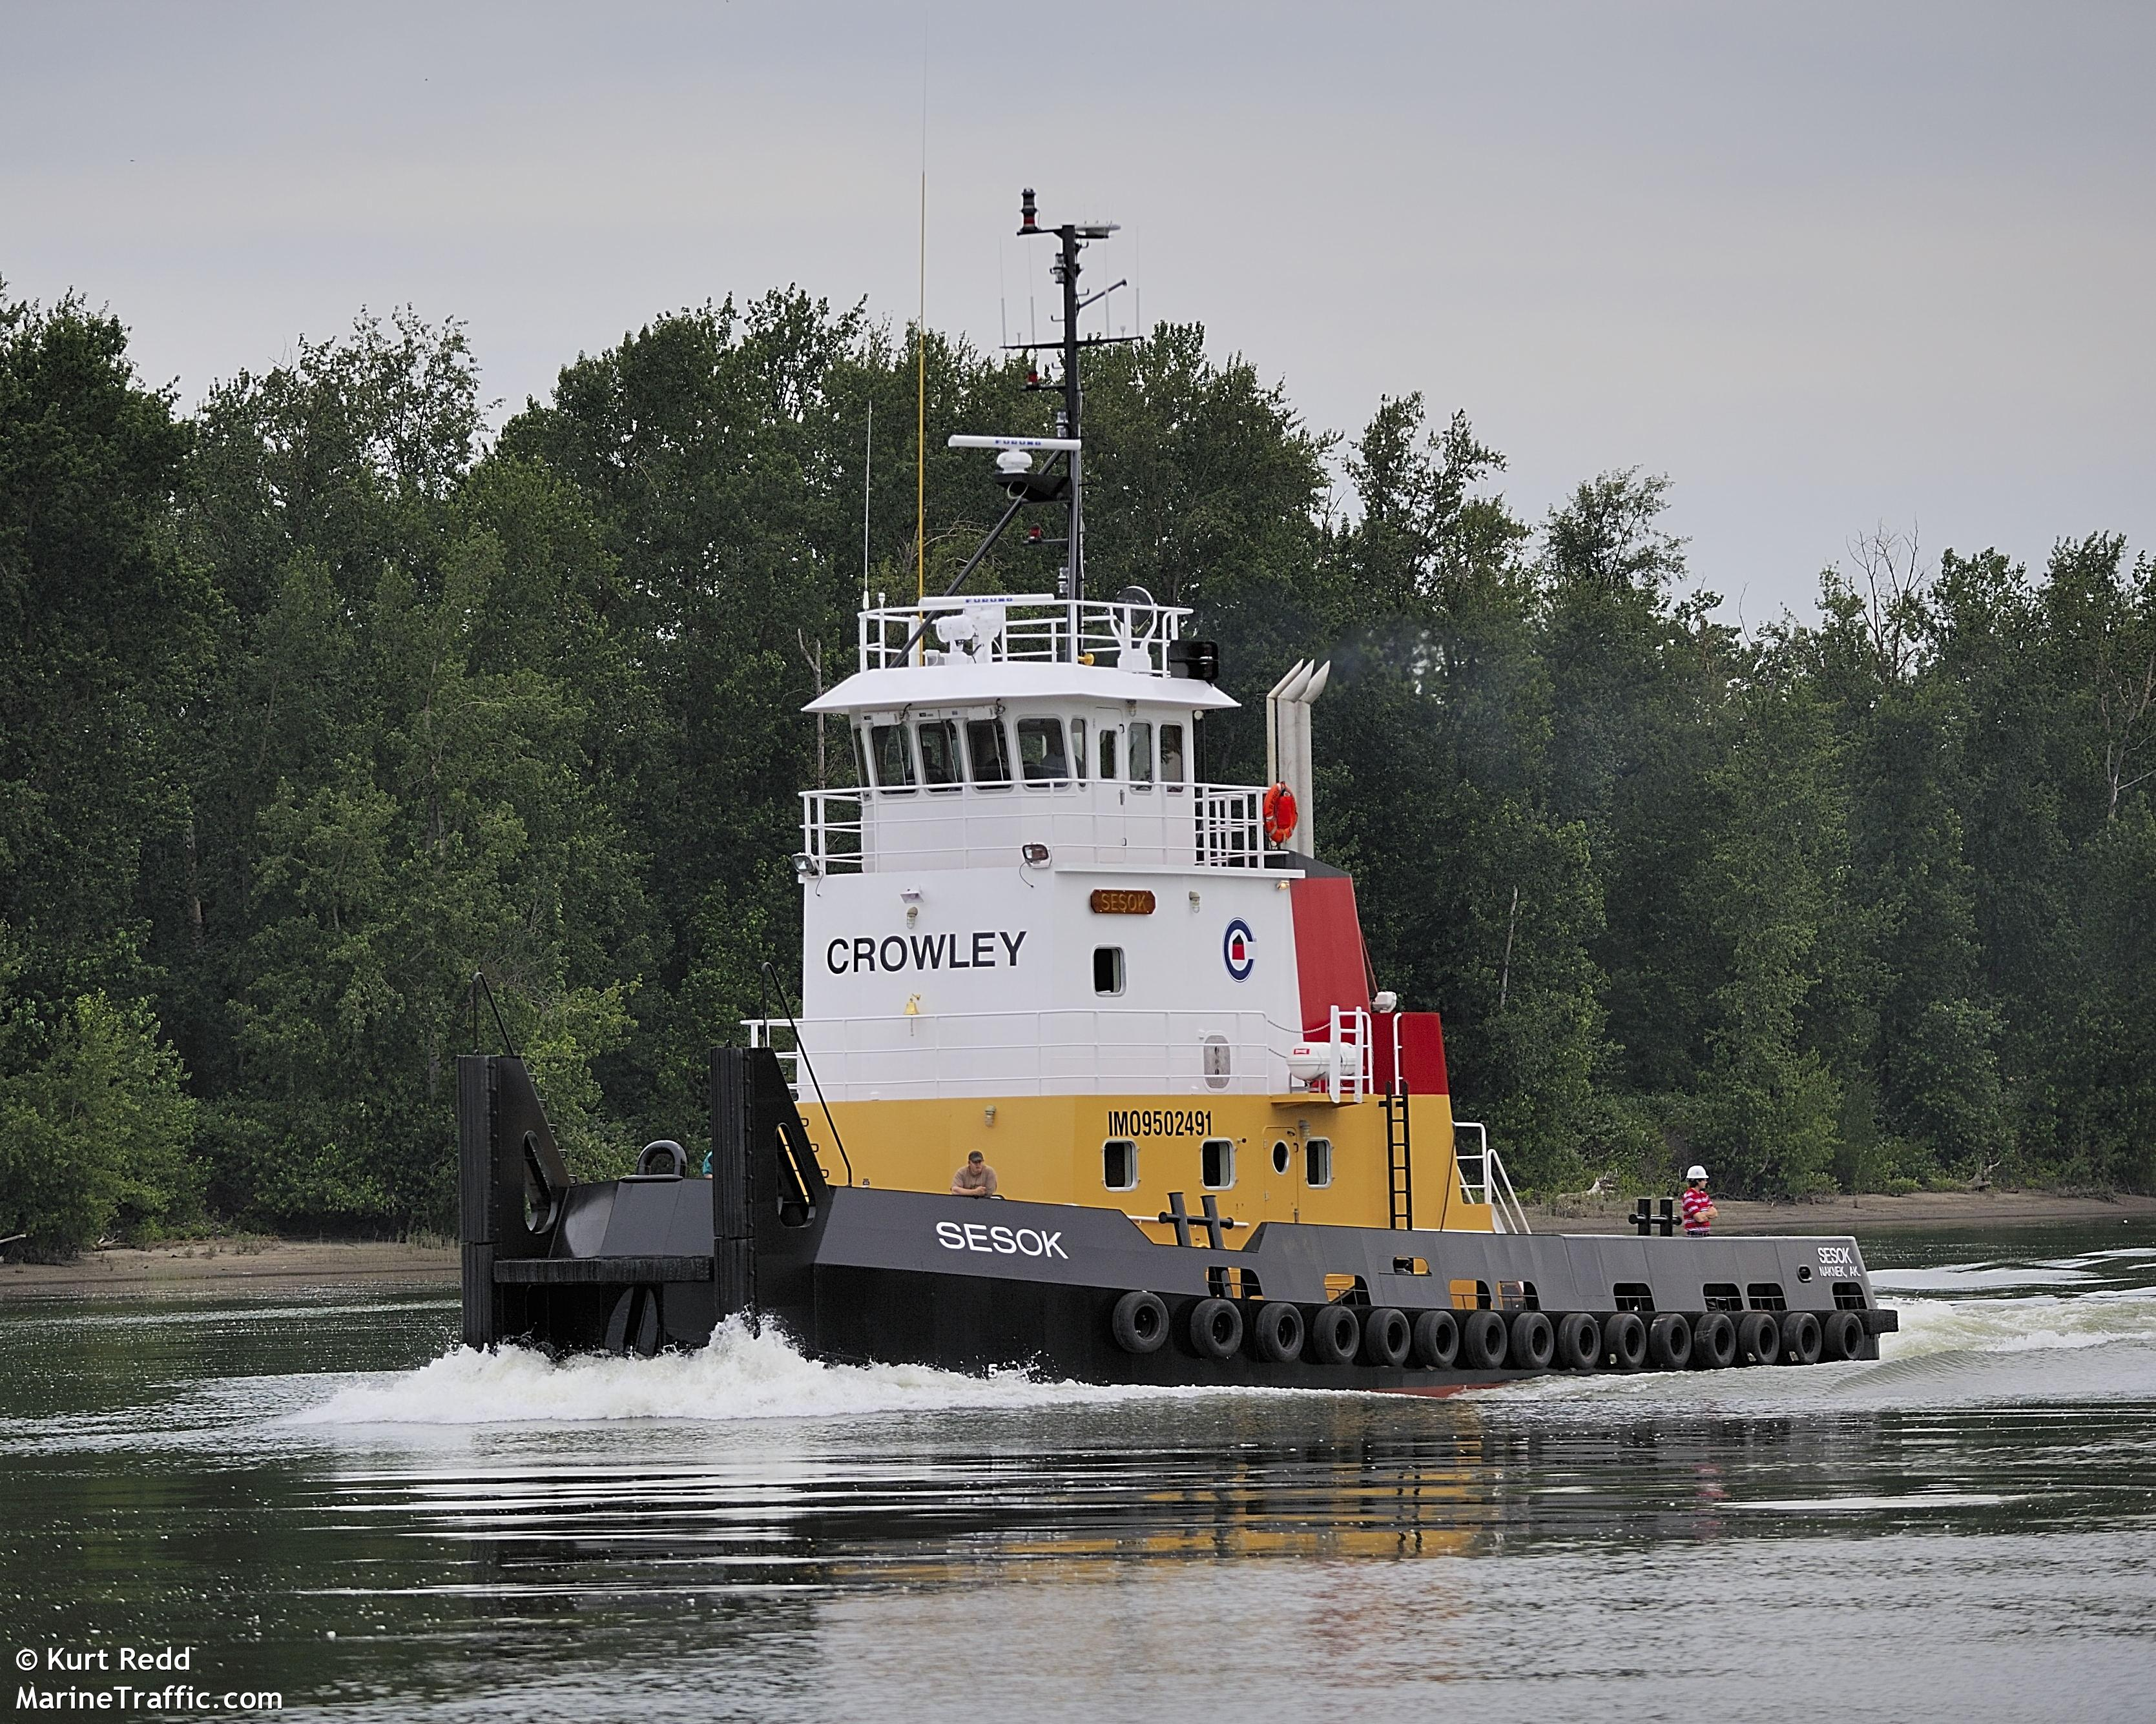
Vessels Detected During Sept 9/10

Slide 10
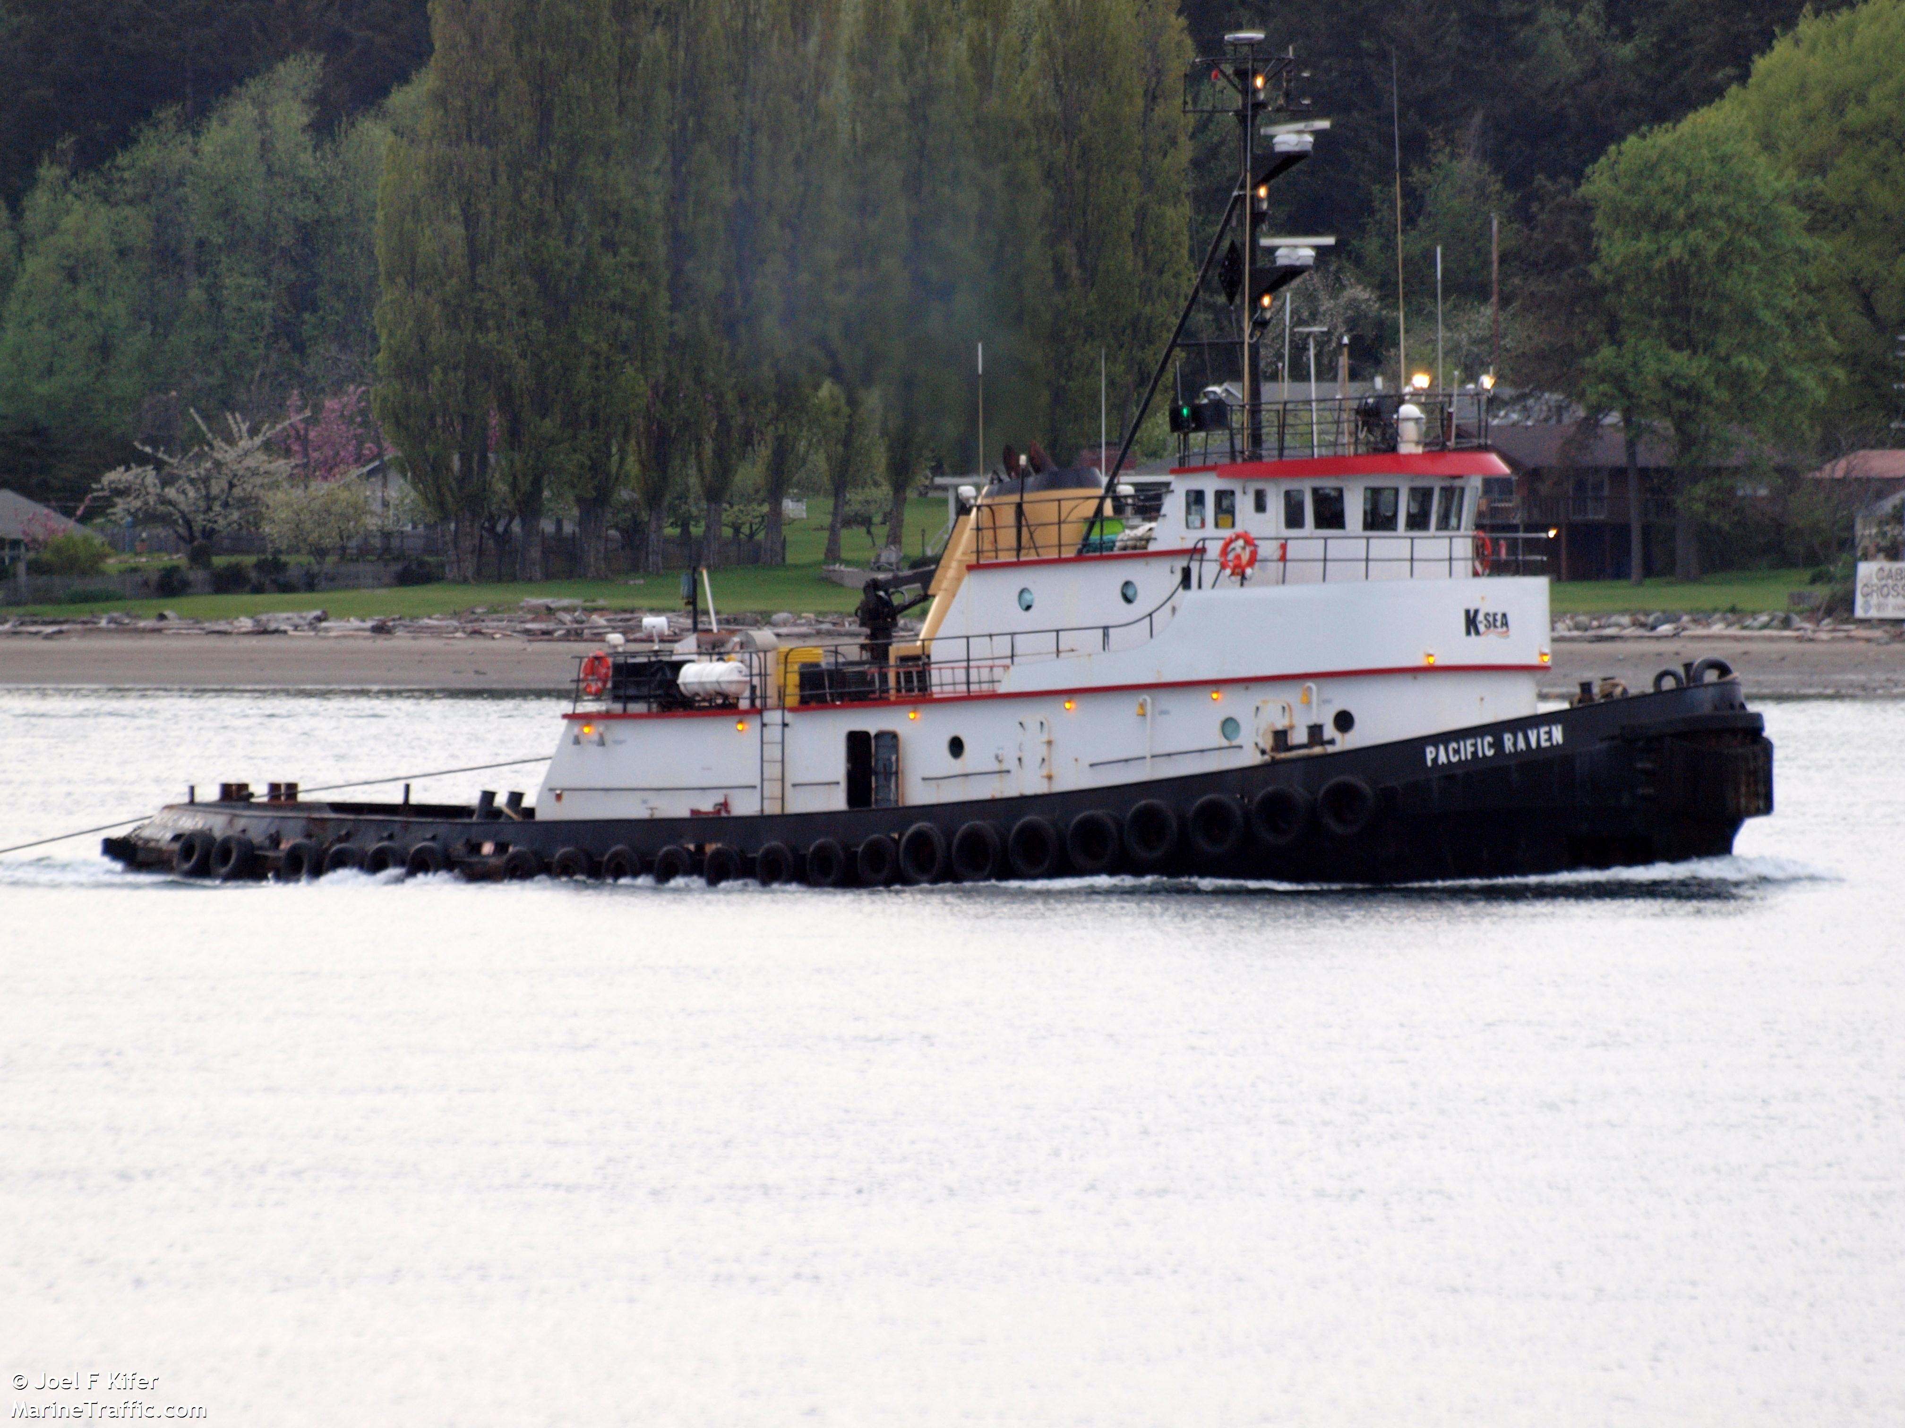
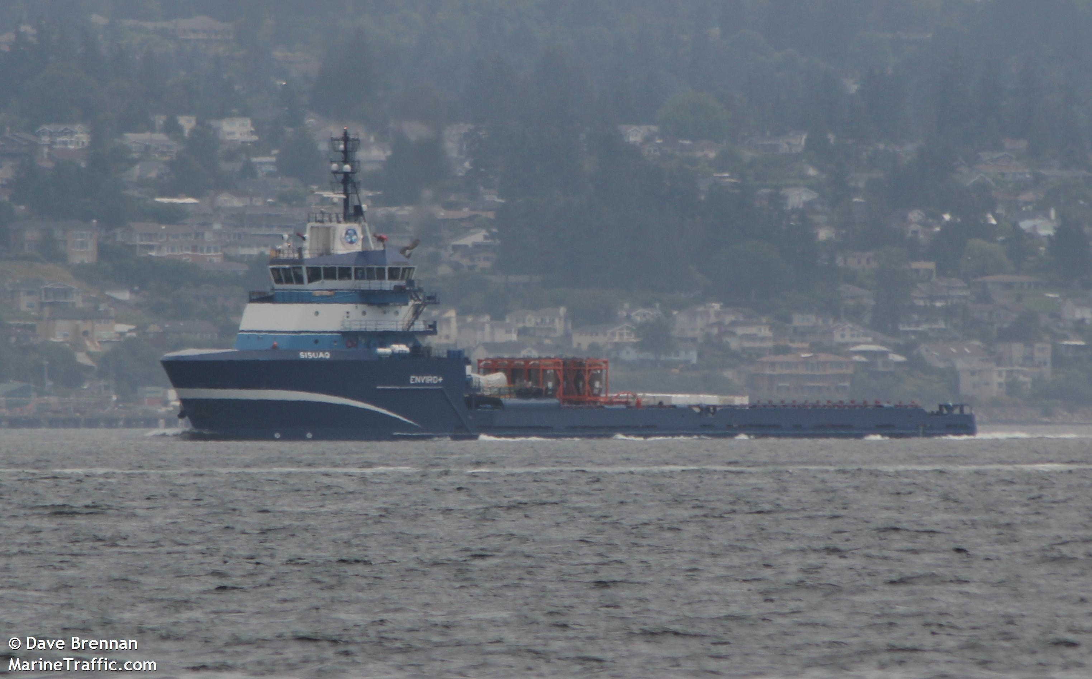
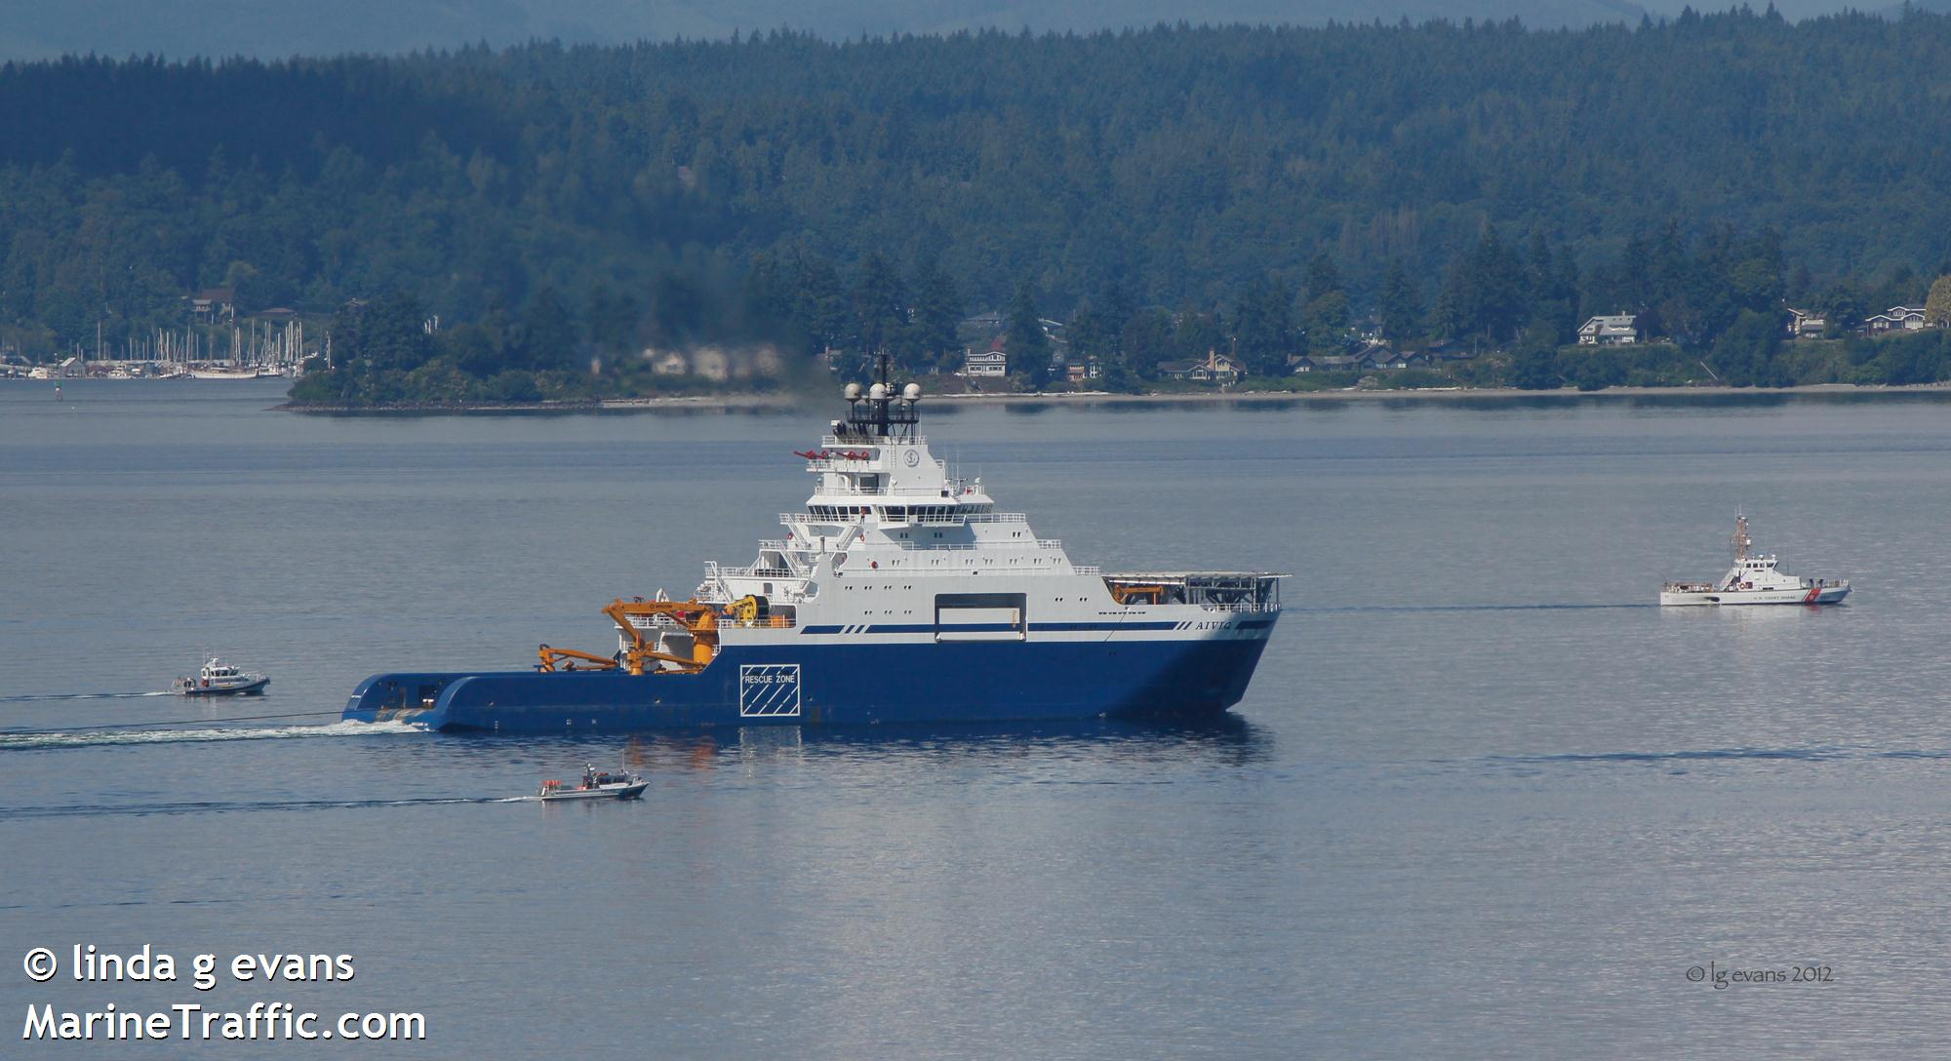
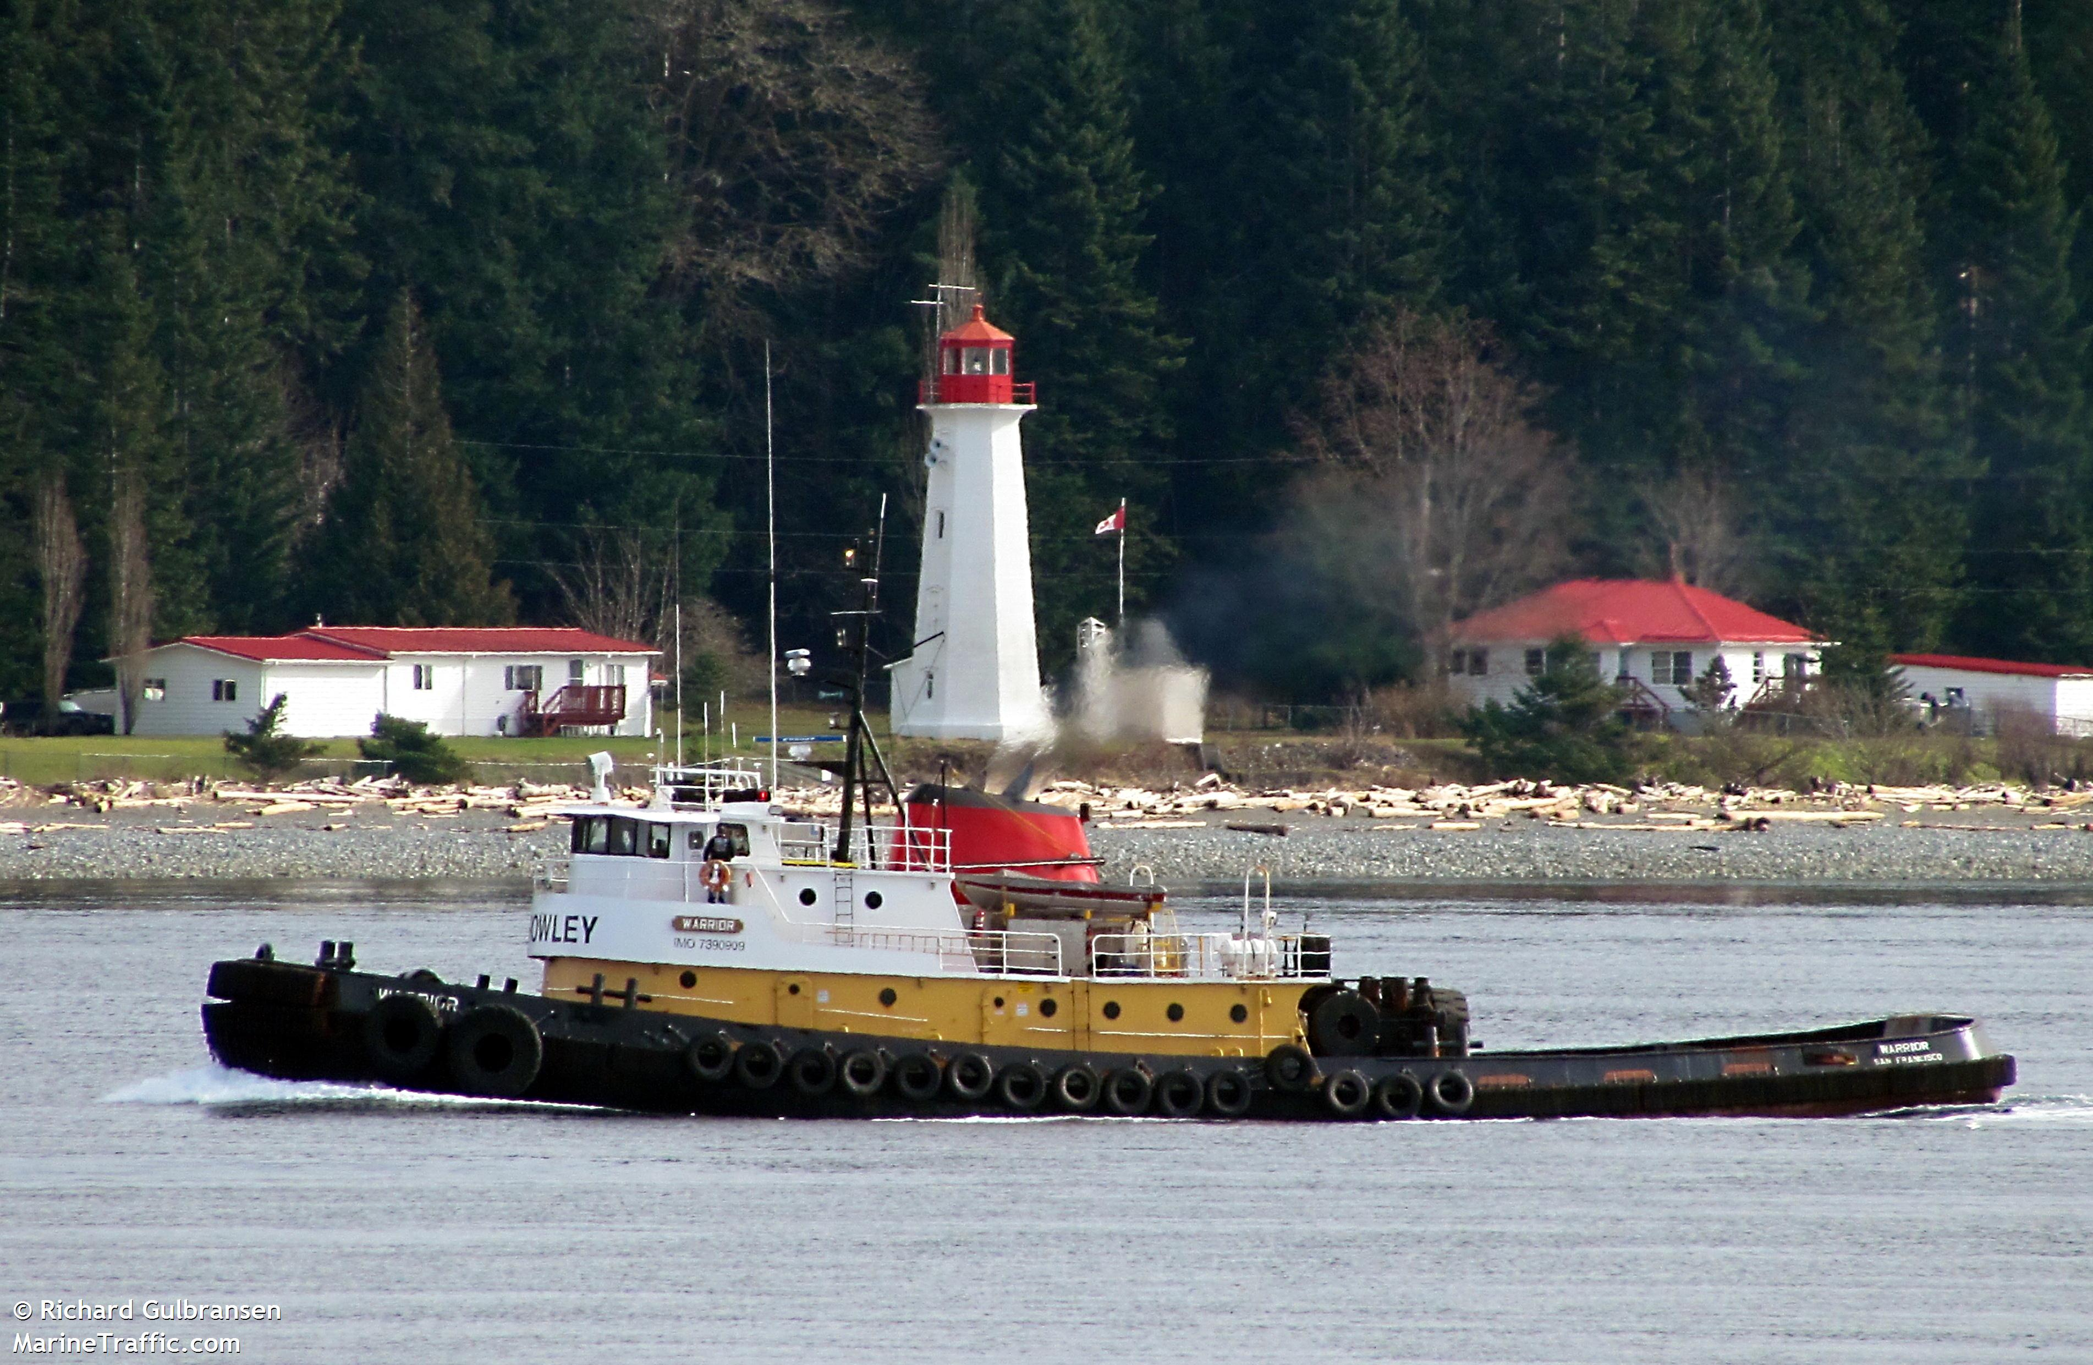
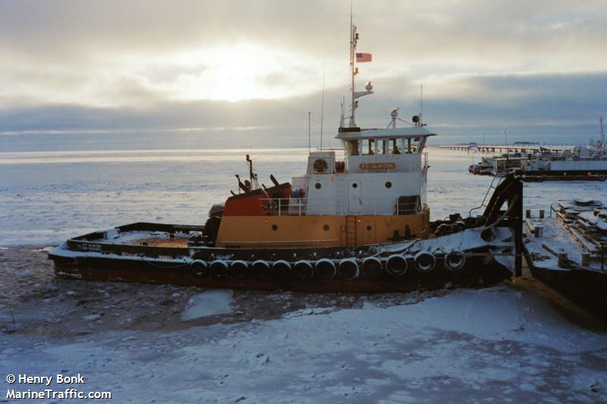

Slide 11
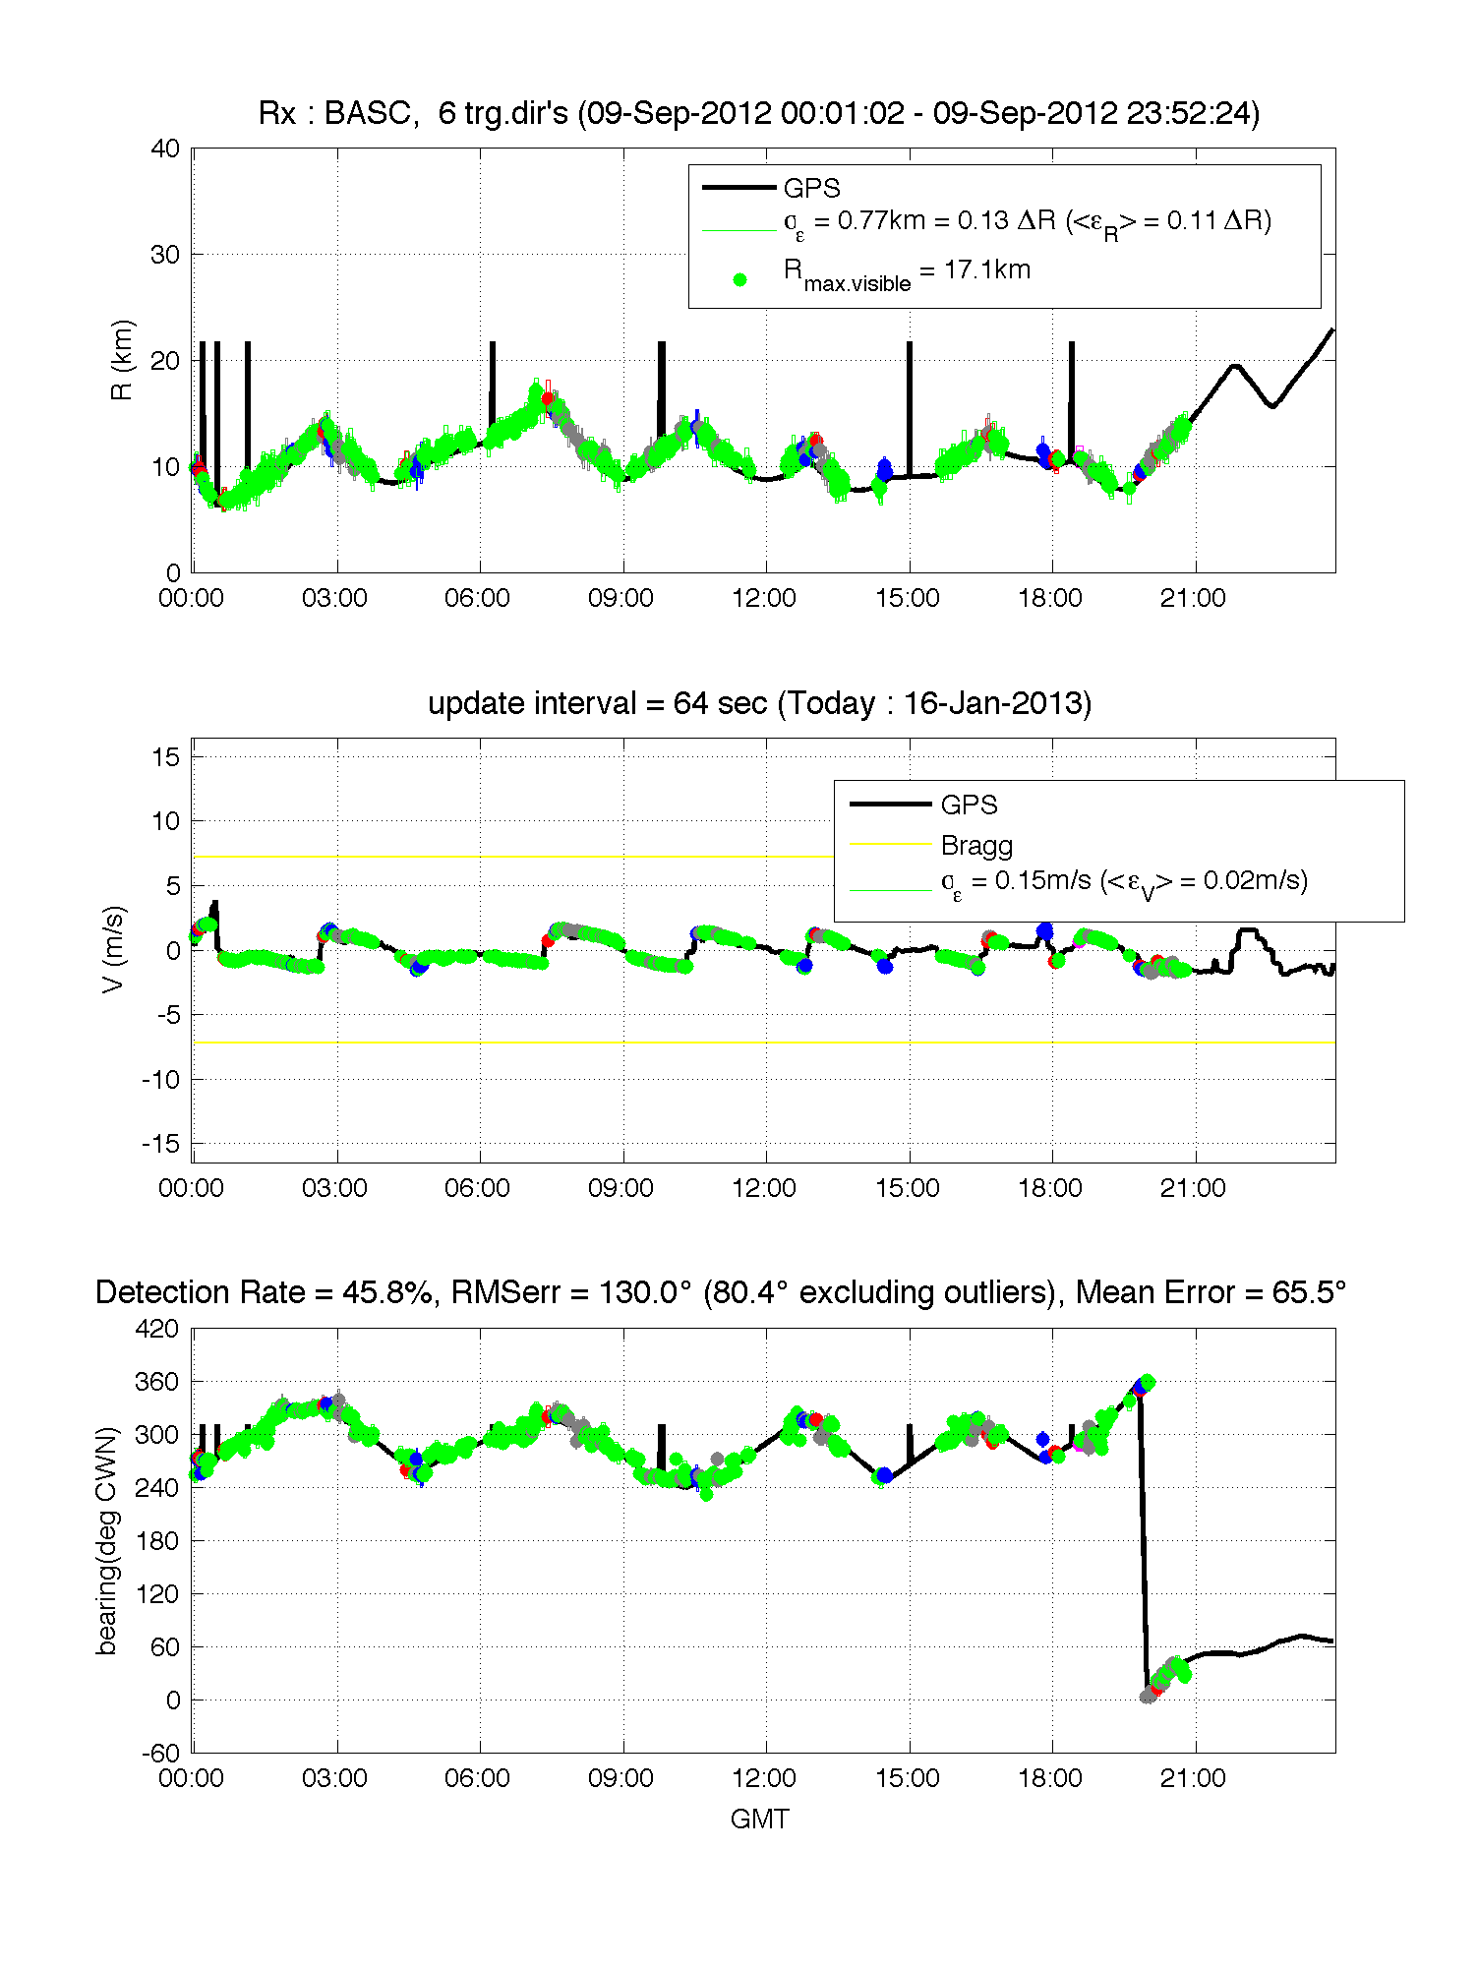
21 hours of Detection for Tug Boat Nokea

Slide 12
