Slide 1

















Update from the
Mid Atlantic HF Radar Network:
Multi Use Current Mapping and Vessel Tracking Applications
Scott Glenn,
Josh Kohut,
Hugh Roarty.
John Kerfoot,
Ethan Handel,
Mike Smith, &
Colin Evans

Slide 2
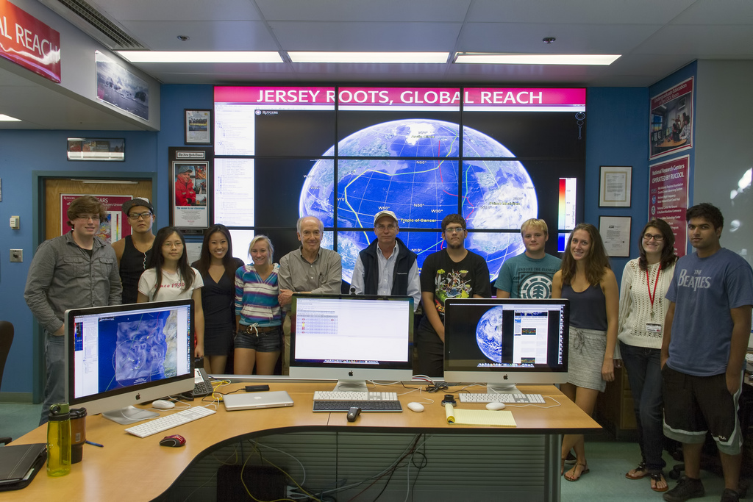
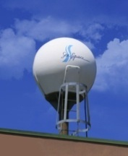
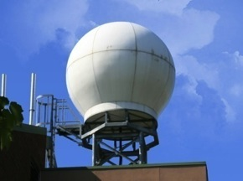
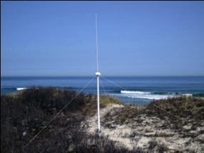
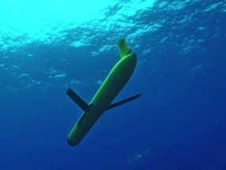
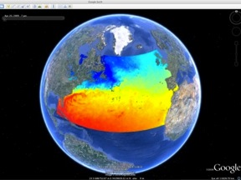
Rutgers University
Coastal Ocean Observation Lab
Satellite Data Acquisition Stations
CODAR Network
Glider Fleet
3-D Forecasts

Slide 3
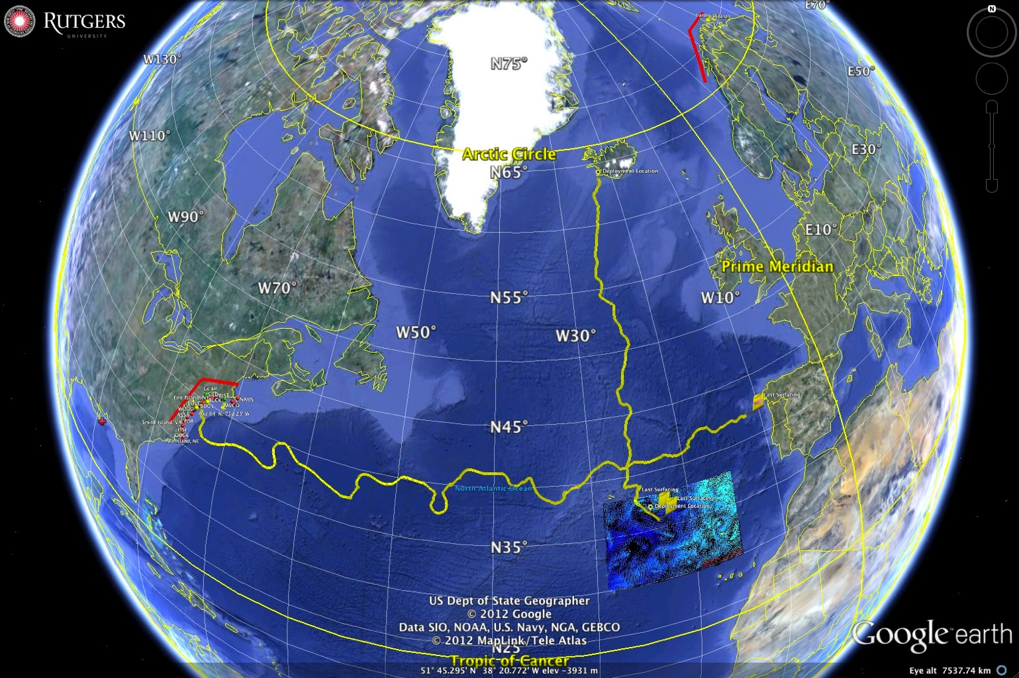
Norway:
Convex Coastline
Mid-Atlantic Bight:
Concave Coastline

Slide 4
Mid Atlantic
HF Radar Network

Slide 5
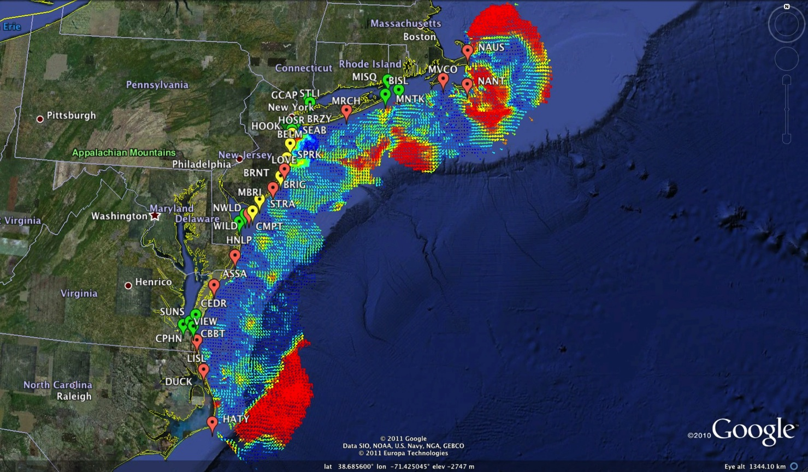
Mid-Atlantic Bight HF Radar Network
1000 km Alongshore Length Scale
Mid-Atlantic HF Radar Network
16 Long-Range CODARs
8 Medium-Range CODARs
17 Short-Range CODARs
41 Total
Triple Nested & Multistatic

Slide 6
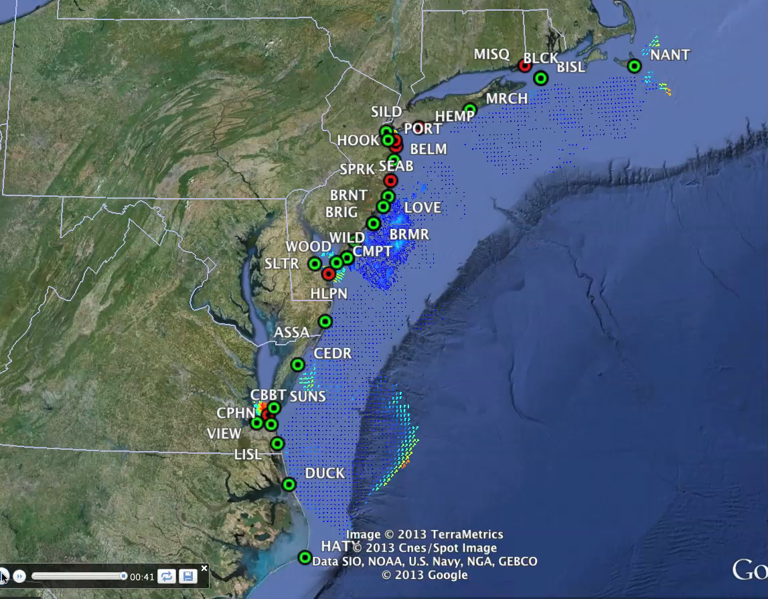
Mid Atlantic Bight
HF Radar Network

Slide 7
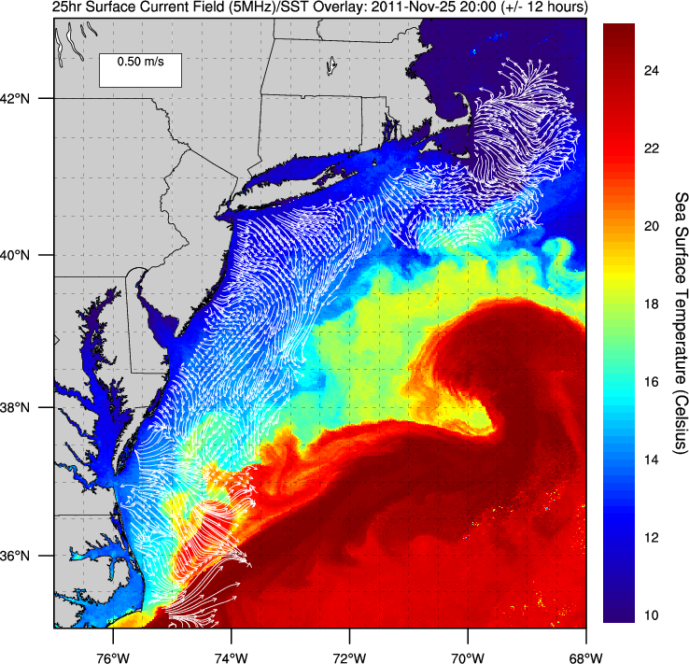
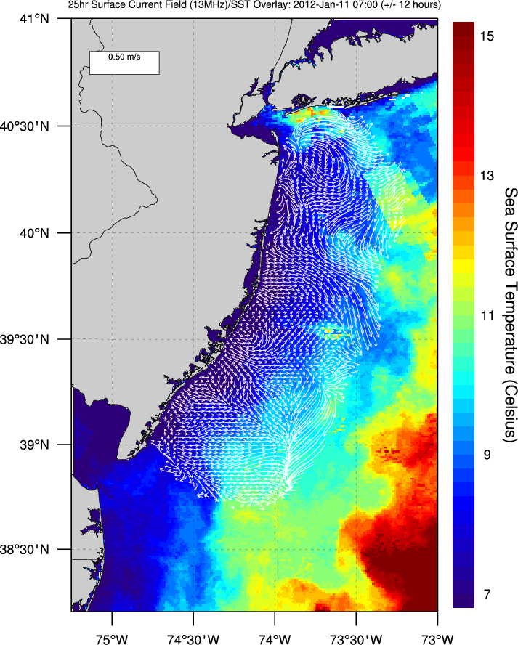
Mid-Atlantic Bight Testbeds – Long Range and Medium Range
5 MHz Testbed for Current Mapping
Both are Dual Use
Both are Multistatic
13 MHz Testbed for Vessel Tracking

Slide 8
Application:
Search and Rescue

Slide 9
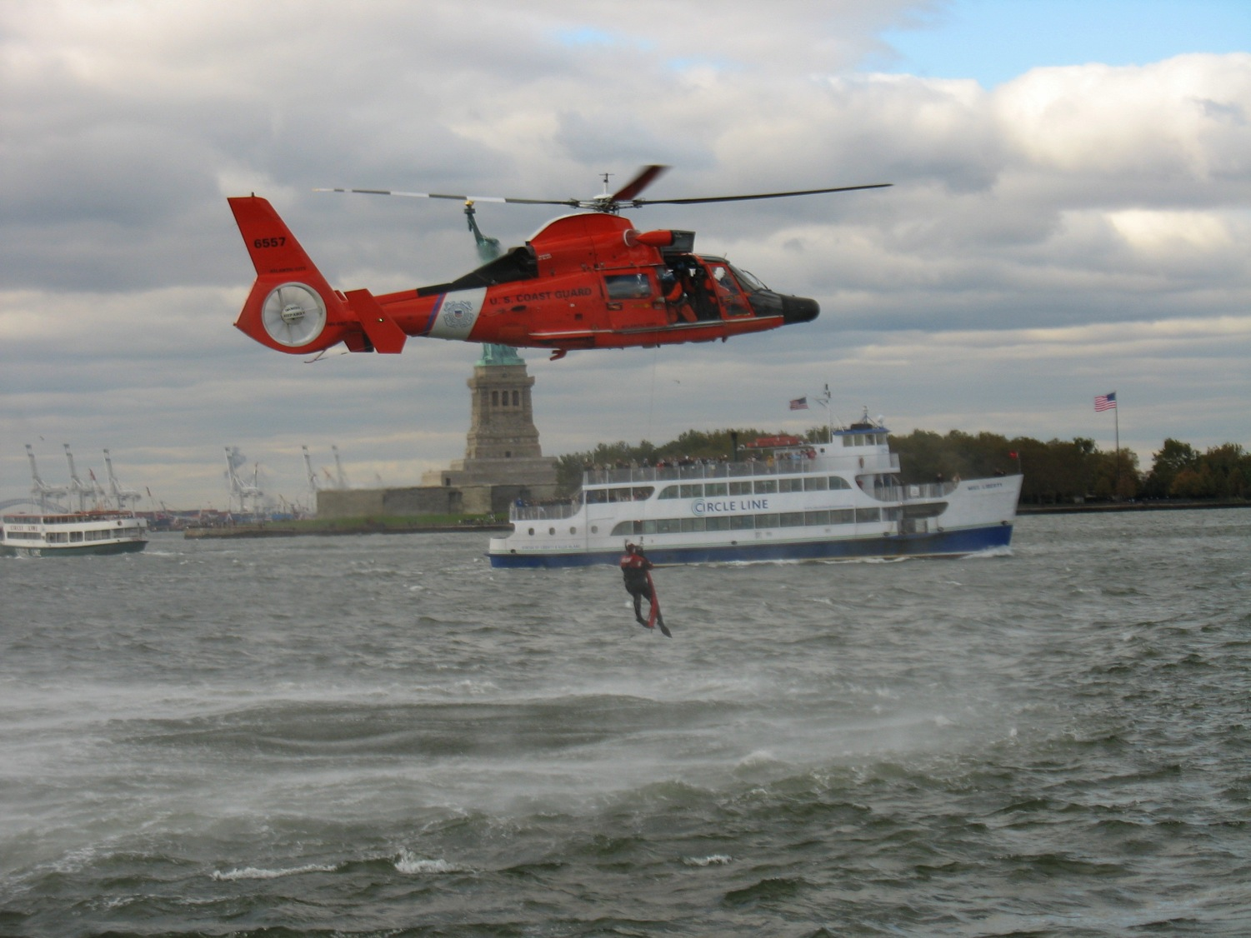


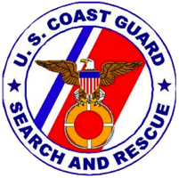
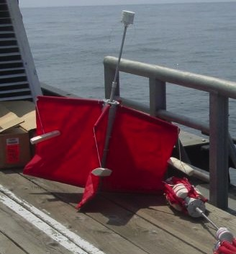
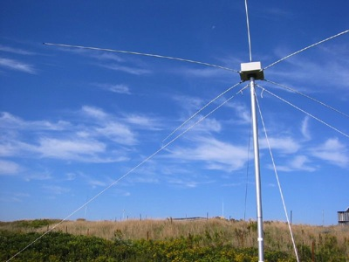
Success Stories – Making a Difference
Optimizing HF Radar for SAR using USCG Surface Drifters
Art Allen
U.S. Coast Guard
Scott Glenn
Rutgers University
and the Mid-Atlantic Regional
Coastal Ocean Observing System

Slide 10
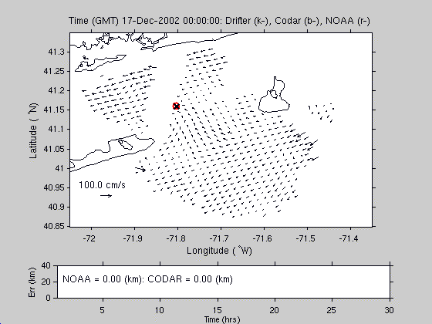

Slide 11
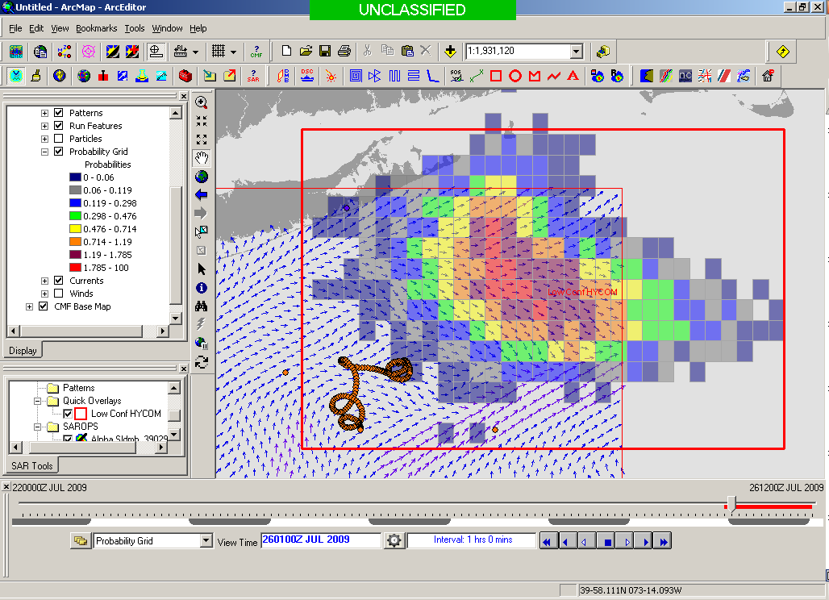
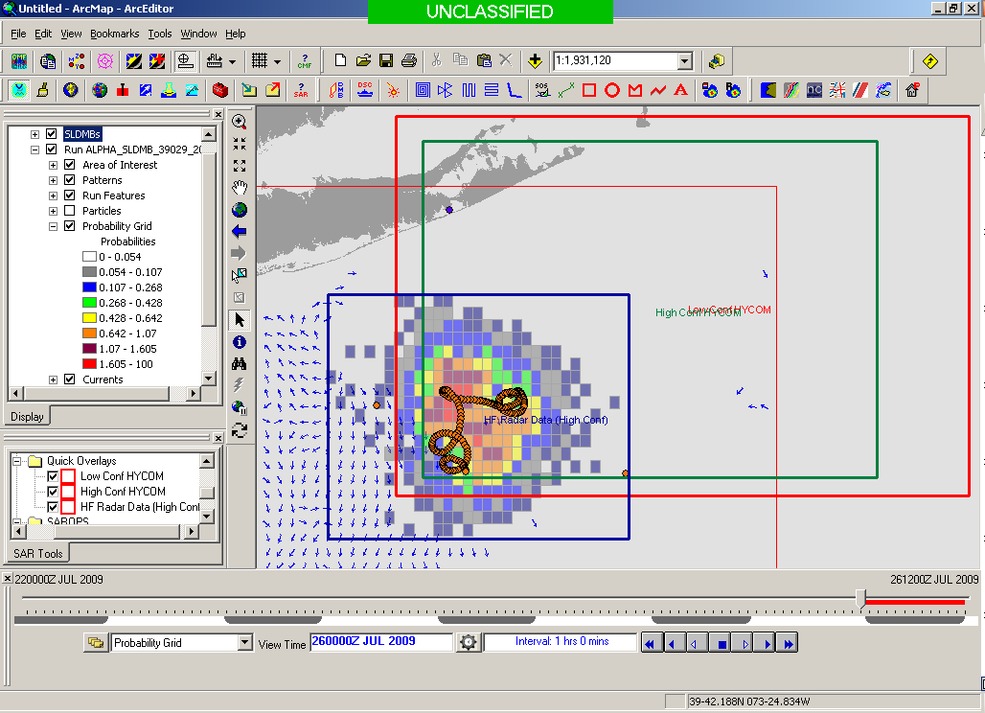
Search Area After 96 Hours
154 km
100 km
232 km
123 km
HYCOM
36,000 km²
CODAR
12,000 km²
Notes:
HYCOM (Low Conf) 48 hours

Slide 12
Bistatics for surface currents

Slide 13
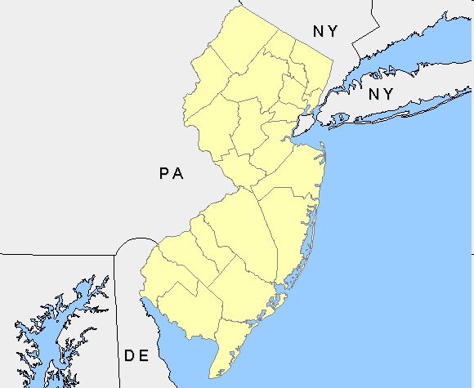

Enhancing the Network with Bistatics
3 radars can provide
6 measurements

Slide 14
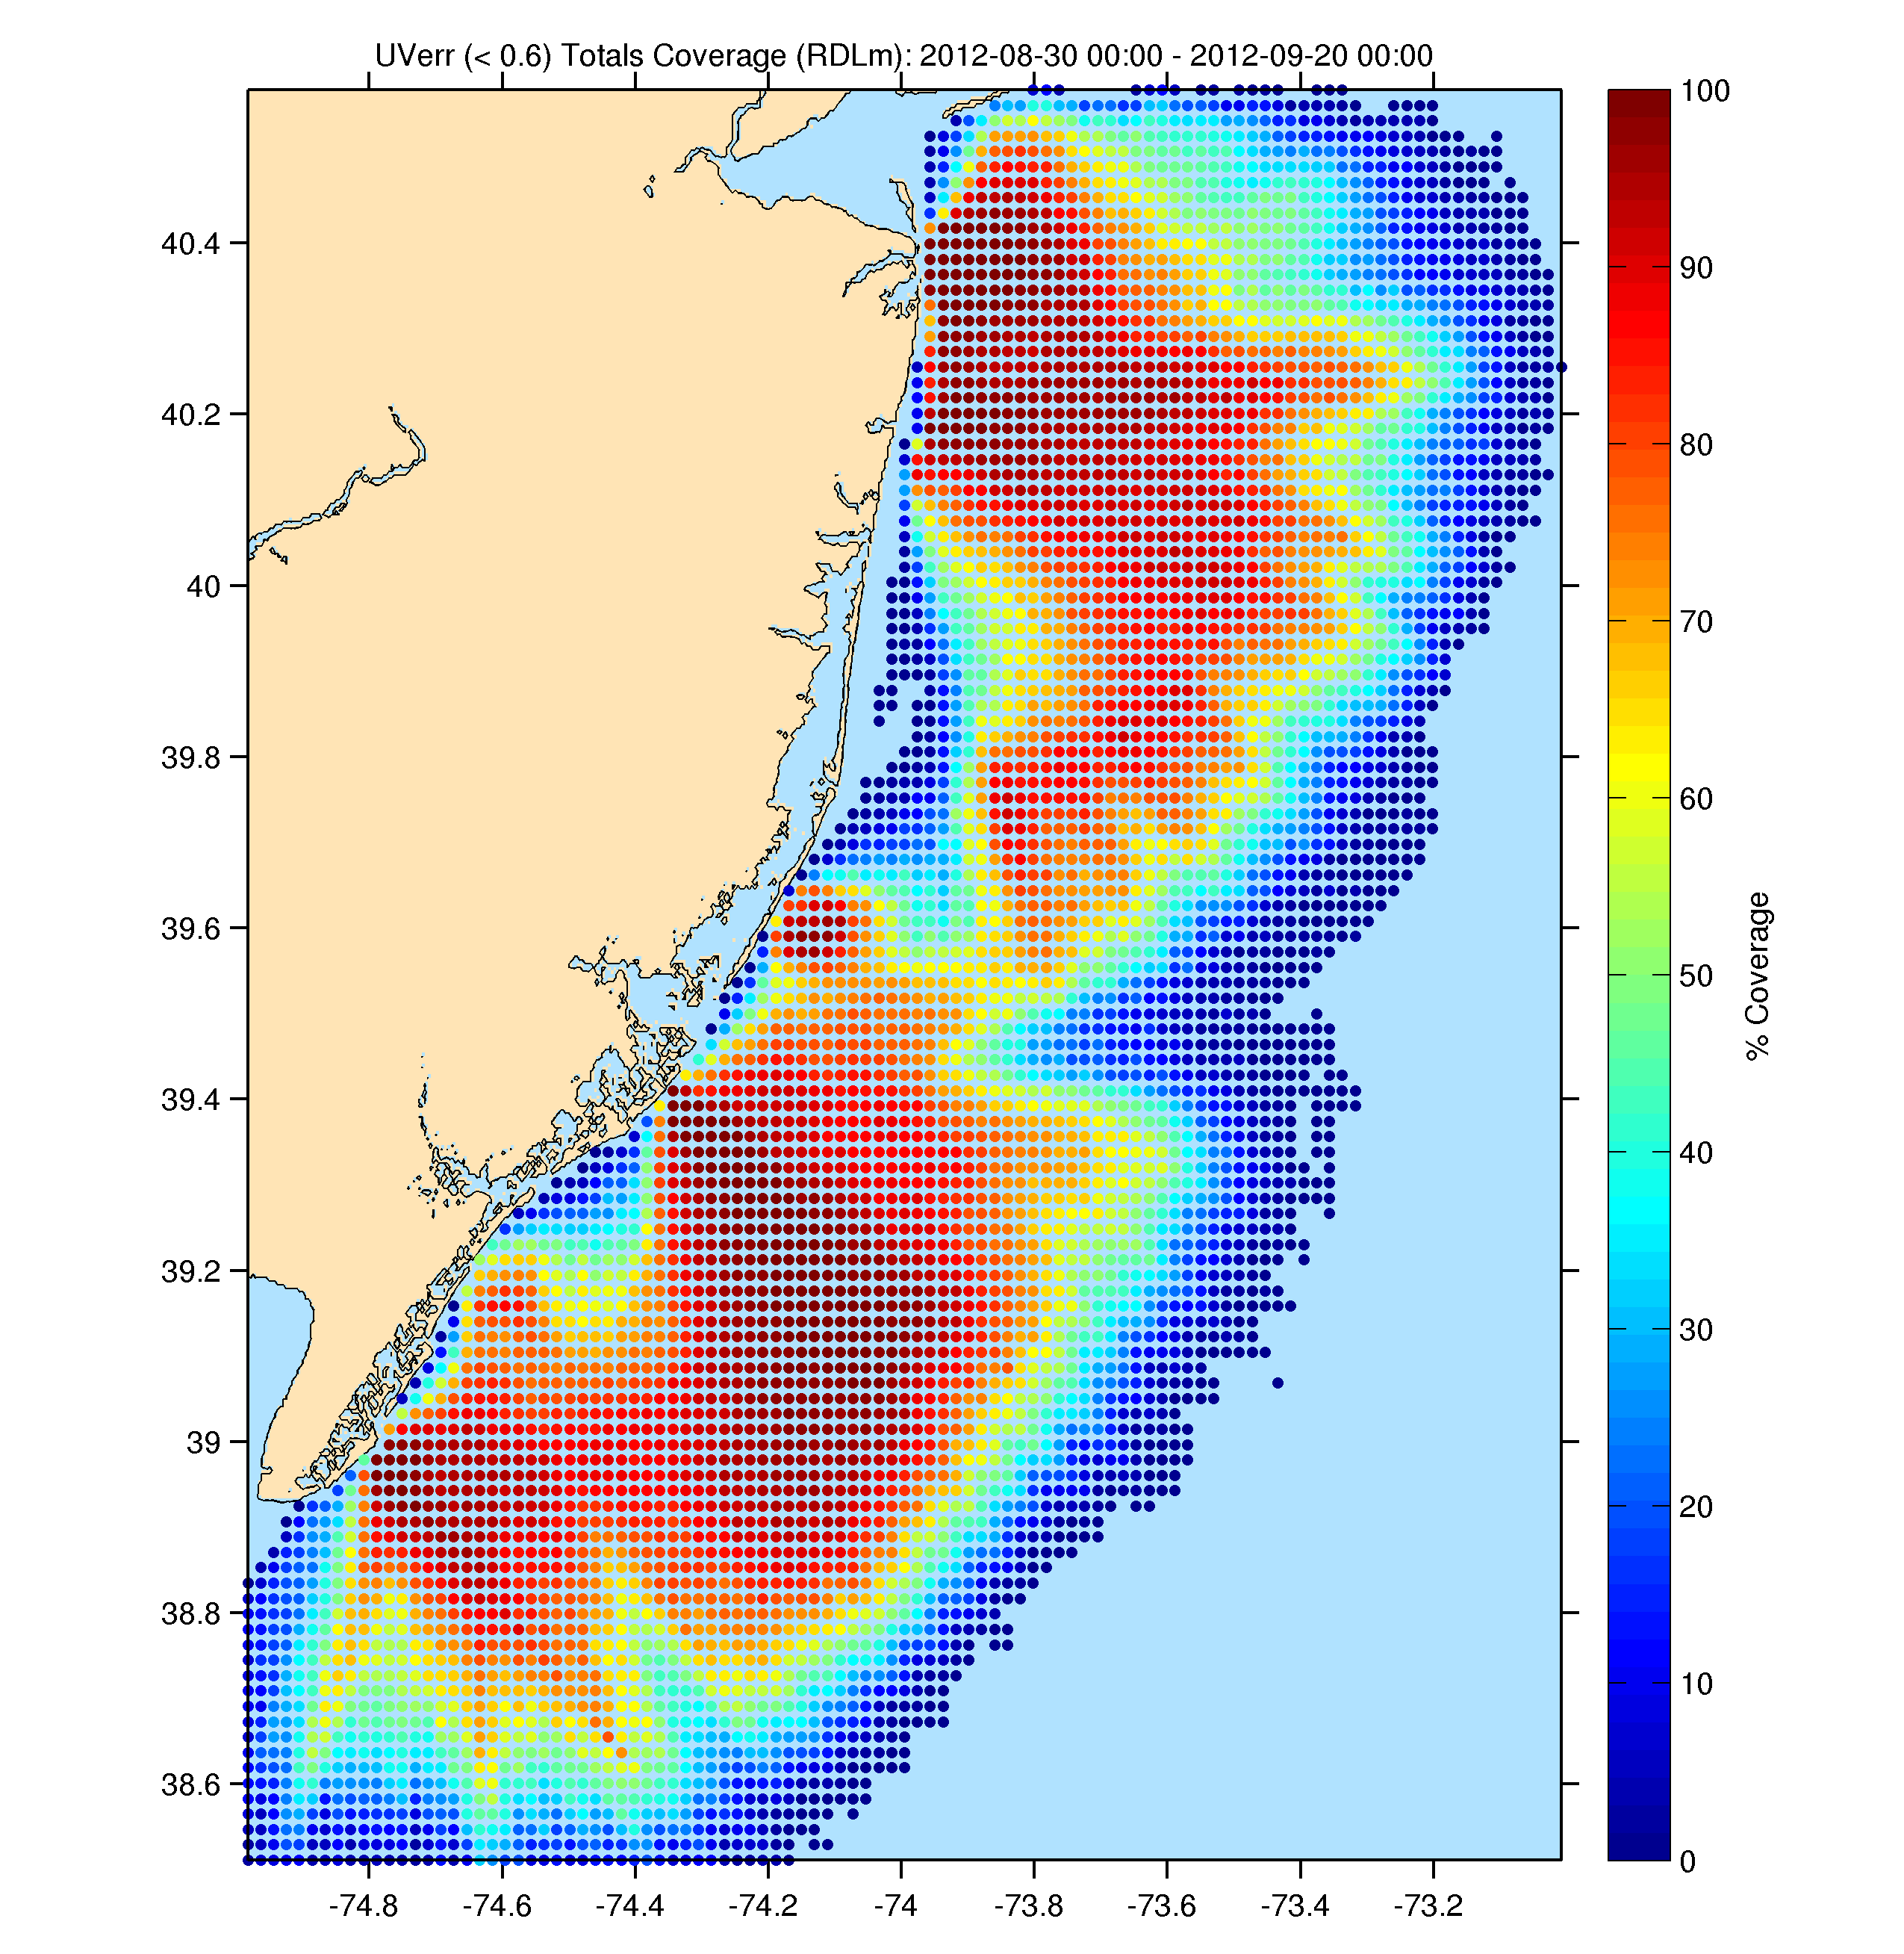
Total Surface Currents
Three Weeks
August 30 – September 20, 2013
Radials Only

Slide 15
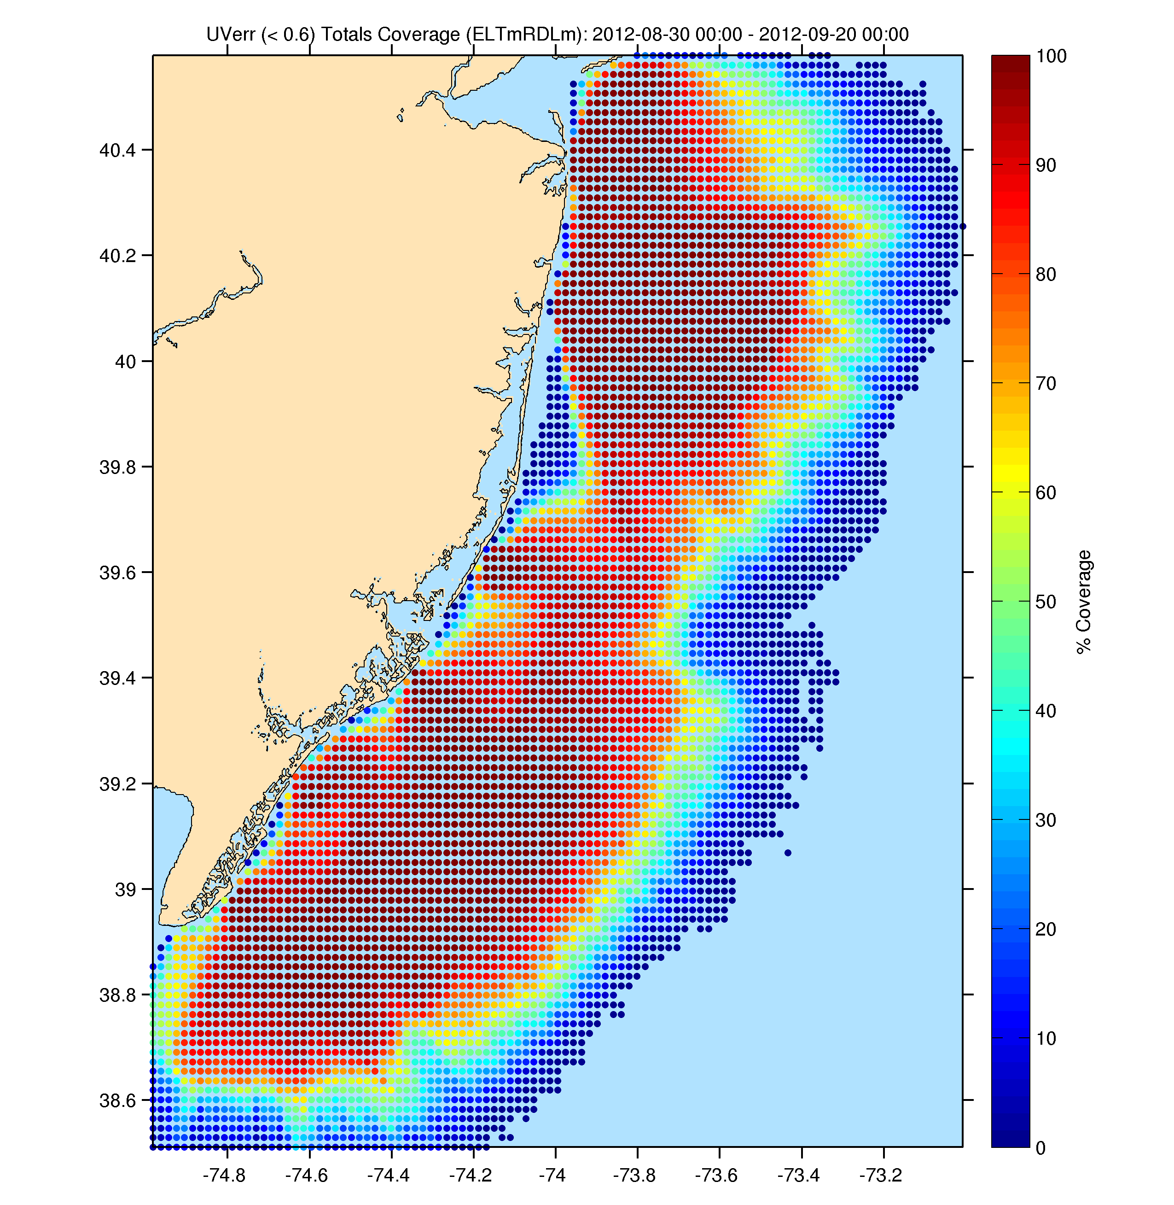
Total Surface Currents
Three Weeks
August 30 – September 20, 2013
Radials &
Ellipticals

Slide 16
Application:
Vessel Detection

Slide 17
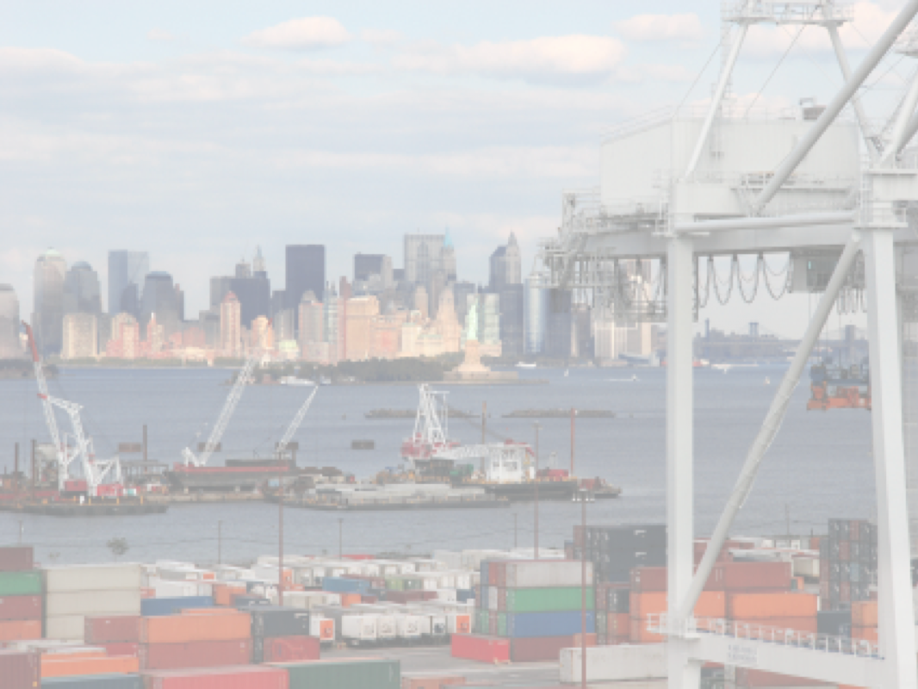






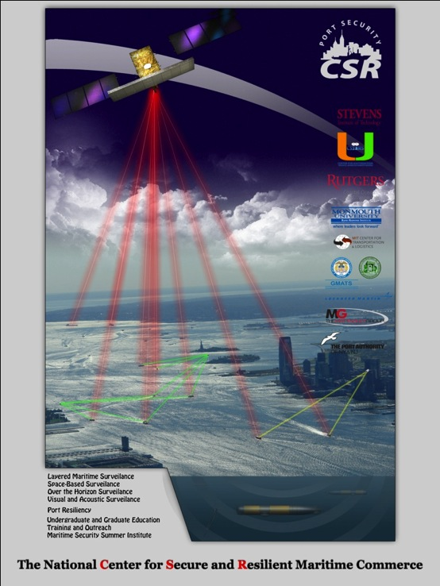






The Center for Secure and Resilient Maritime Commerce (CSR)
DHS Center of Excellence for Port Security
10 Institutions – Maritime Domain Awareness & Resiliency
Maritime Domain Awareness
Approach –
Dual Use Technologies
Demonstrate Nested Vessel Detection
Global > Approaches > Port
University of Miami –
Global Satellite Coverage,
Visible & Microwave
Rutgers University –
Over-the-Horizon Compact
High Frequency Radar Networks
Stevens Institute of Technology –
Local High-Resolution Optics &
Shallow Underwater Acoustics

Slide 18
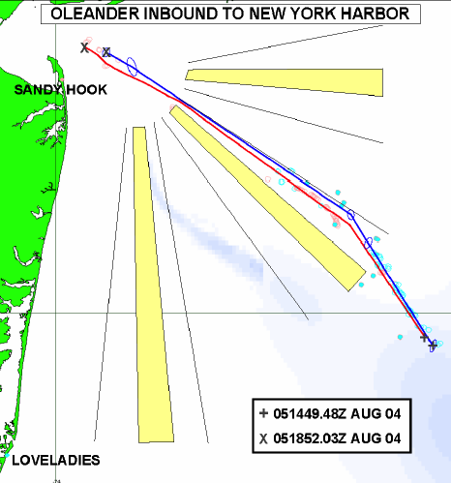
The Center for Secure and Resilient Maritime Commerce (CSR)
HF Radar Team
Rutgers University -
Scott Glenn, Josh Kohut, Hugh Roarty,
Mike Crowley, John Kerfoot, Ethan
Handel, Mike Smith, Colin Evans
CODAR Ocean Sensors -
Don Barrick, Pete Lilleboe, Chad Whelan
Belinda Lipa, Bill Rector, Jimmy Isaacson
University or Puerto Rico – Mayaguez
Jorge Corredor, Julio Morell, Miguel Canals
Applied Mathematics, Inc -
Bill Browning
University of Alaska –
Tom Weingarter, Hank Statscewich
Ocean Power Technologies –
Debbie Montagna, Bruce Downie
Naval Research Laboratory
Michael Lovellette, Dan Newton
Norwegian Defence Research Establishment (FFI)
Terje Johnsen, Walther Asen
CODARNor
Anton Kjelaas
Rutgers University – CODAR Ocean Sensors
Academic – Industry Partnership since 1998
ONR - 2004

Slide 19
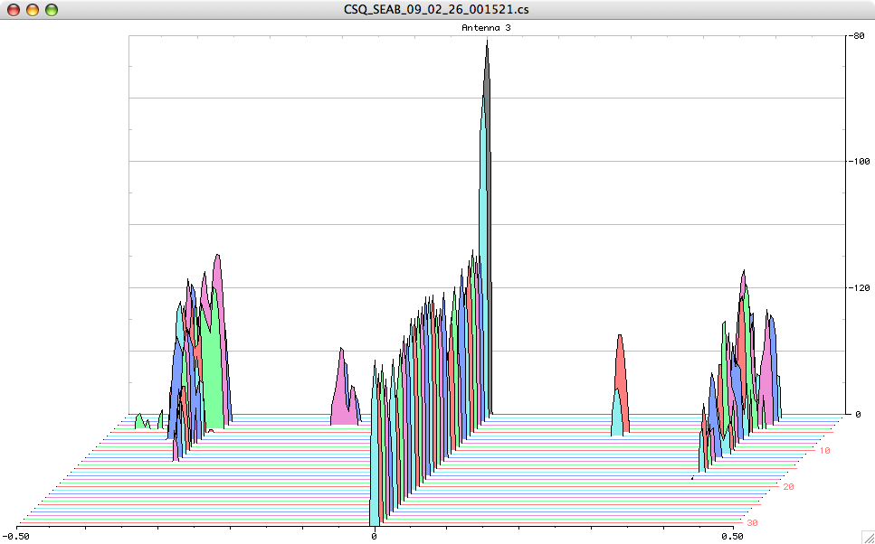
Doppler Spectra from all Range Cells
with Detection Threshold above Background Applied
Fixed Objects & Direct Signals
Bragg Waves
Bragg Waves
Vessel
Vessel
Range
Doppler Frequency
(Target Speed)

Slide 20
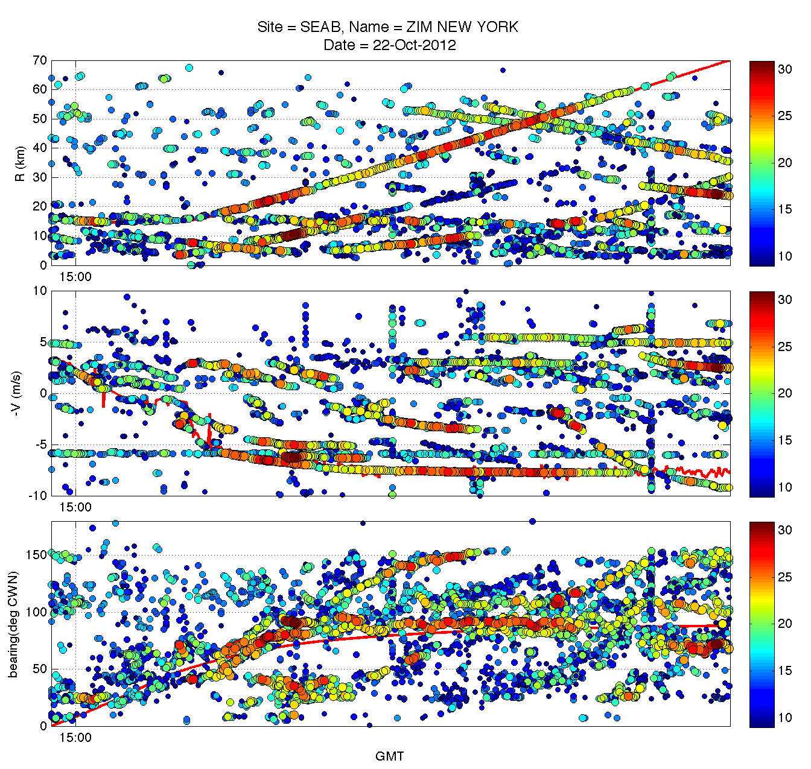
Step 1
Raw Detections
From each HFR:
Radial Velocity (most accurate)
Range
Bearing (least accurate)
Range (km)
Radial Velocity (m/s)
Bearing (°CWN)

Slide 21
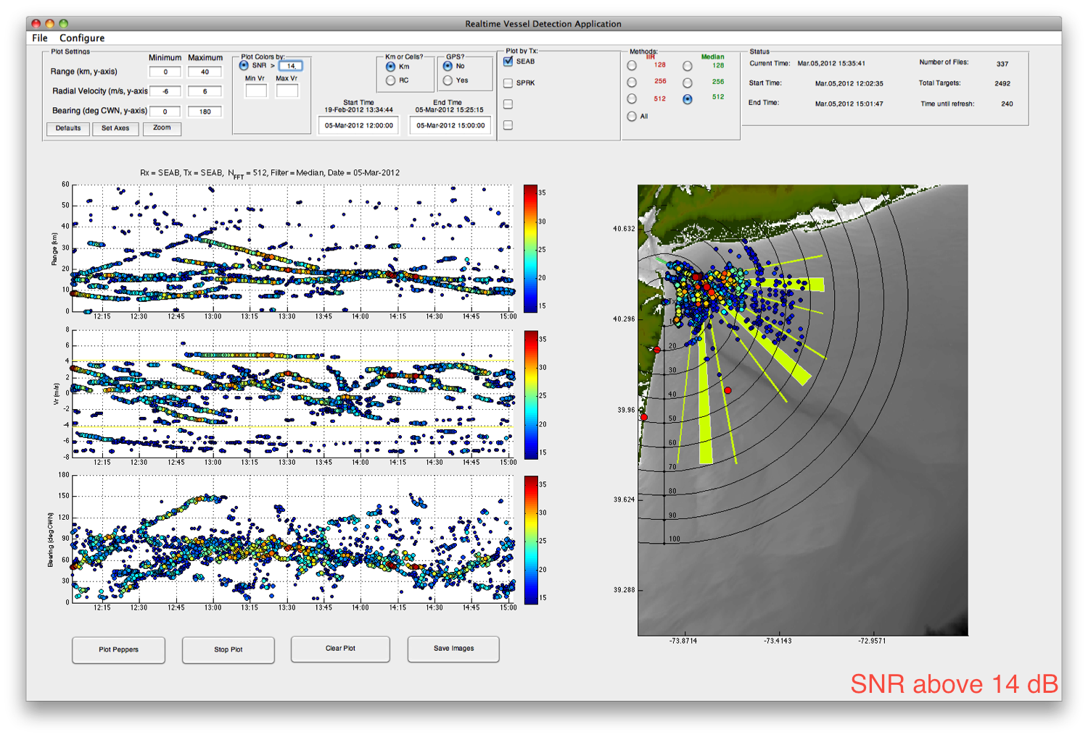
Adjusting the Signal to Noise

Slide 22
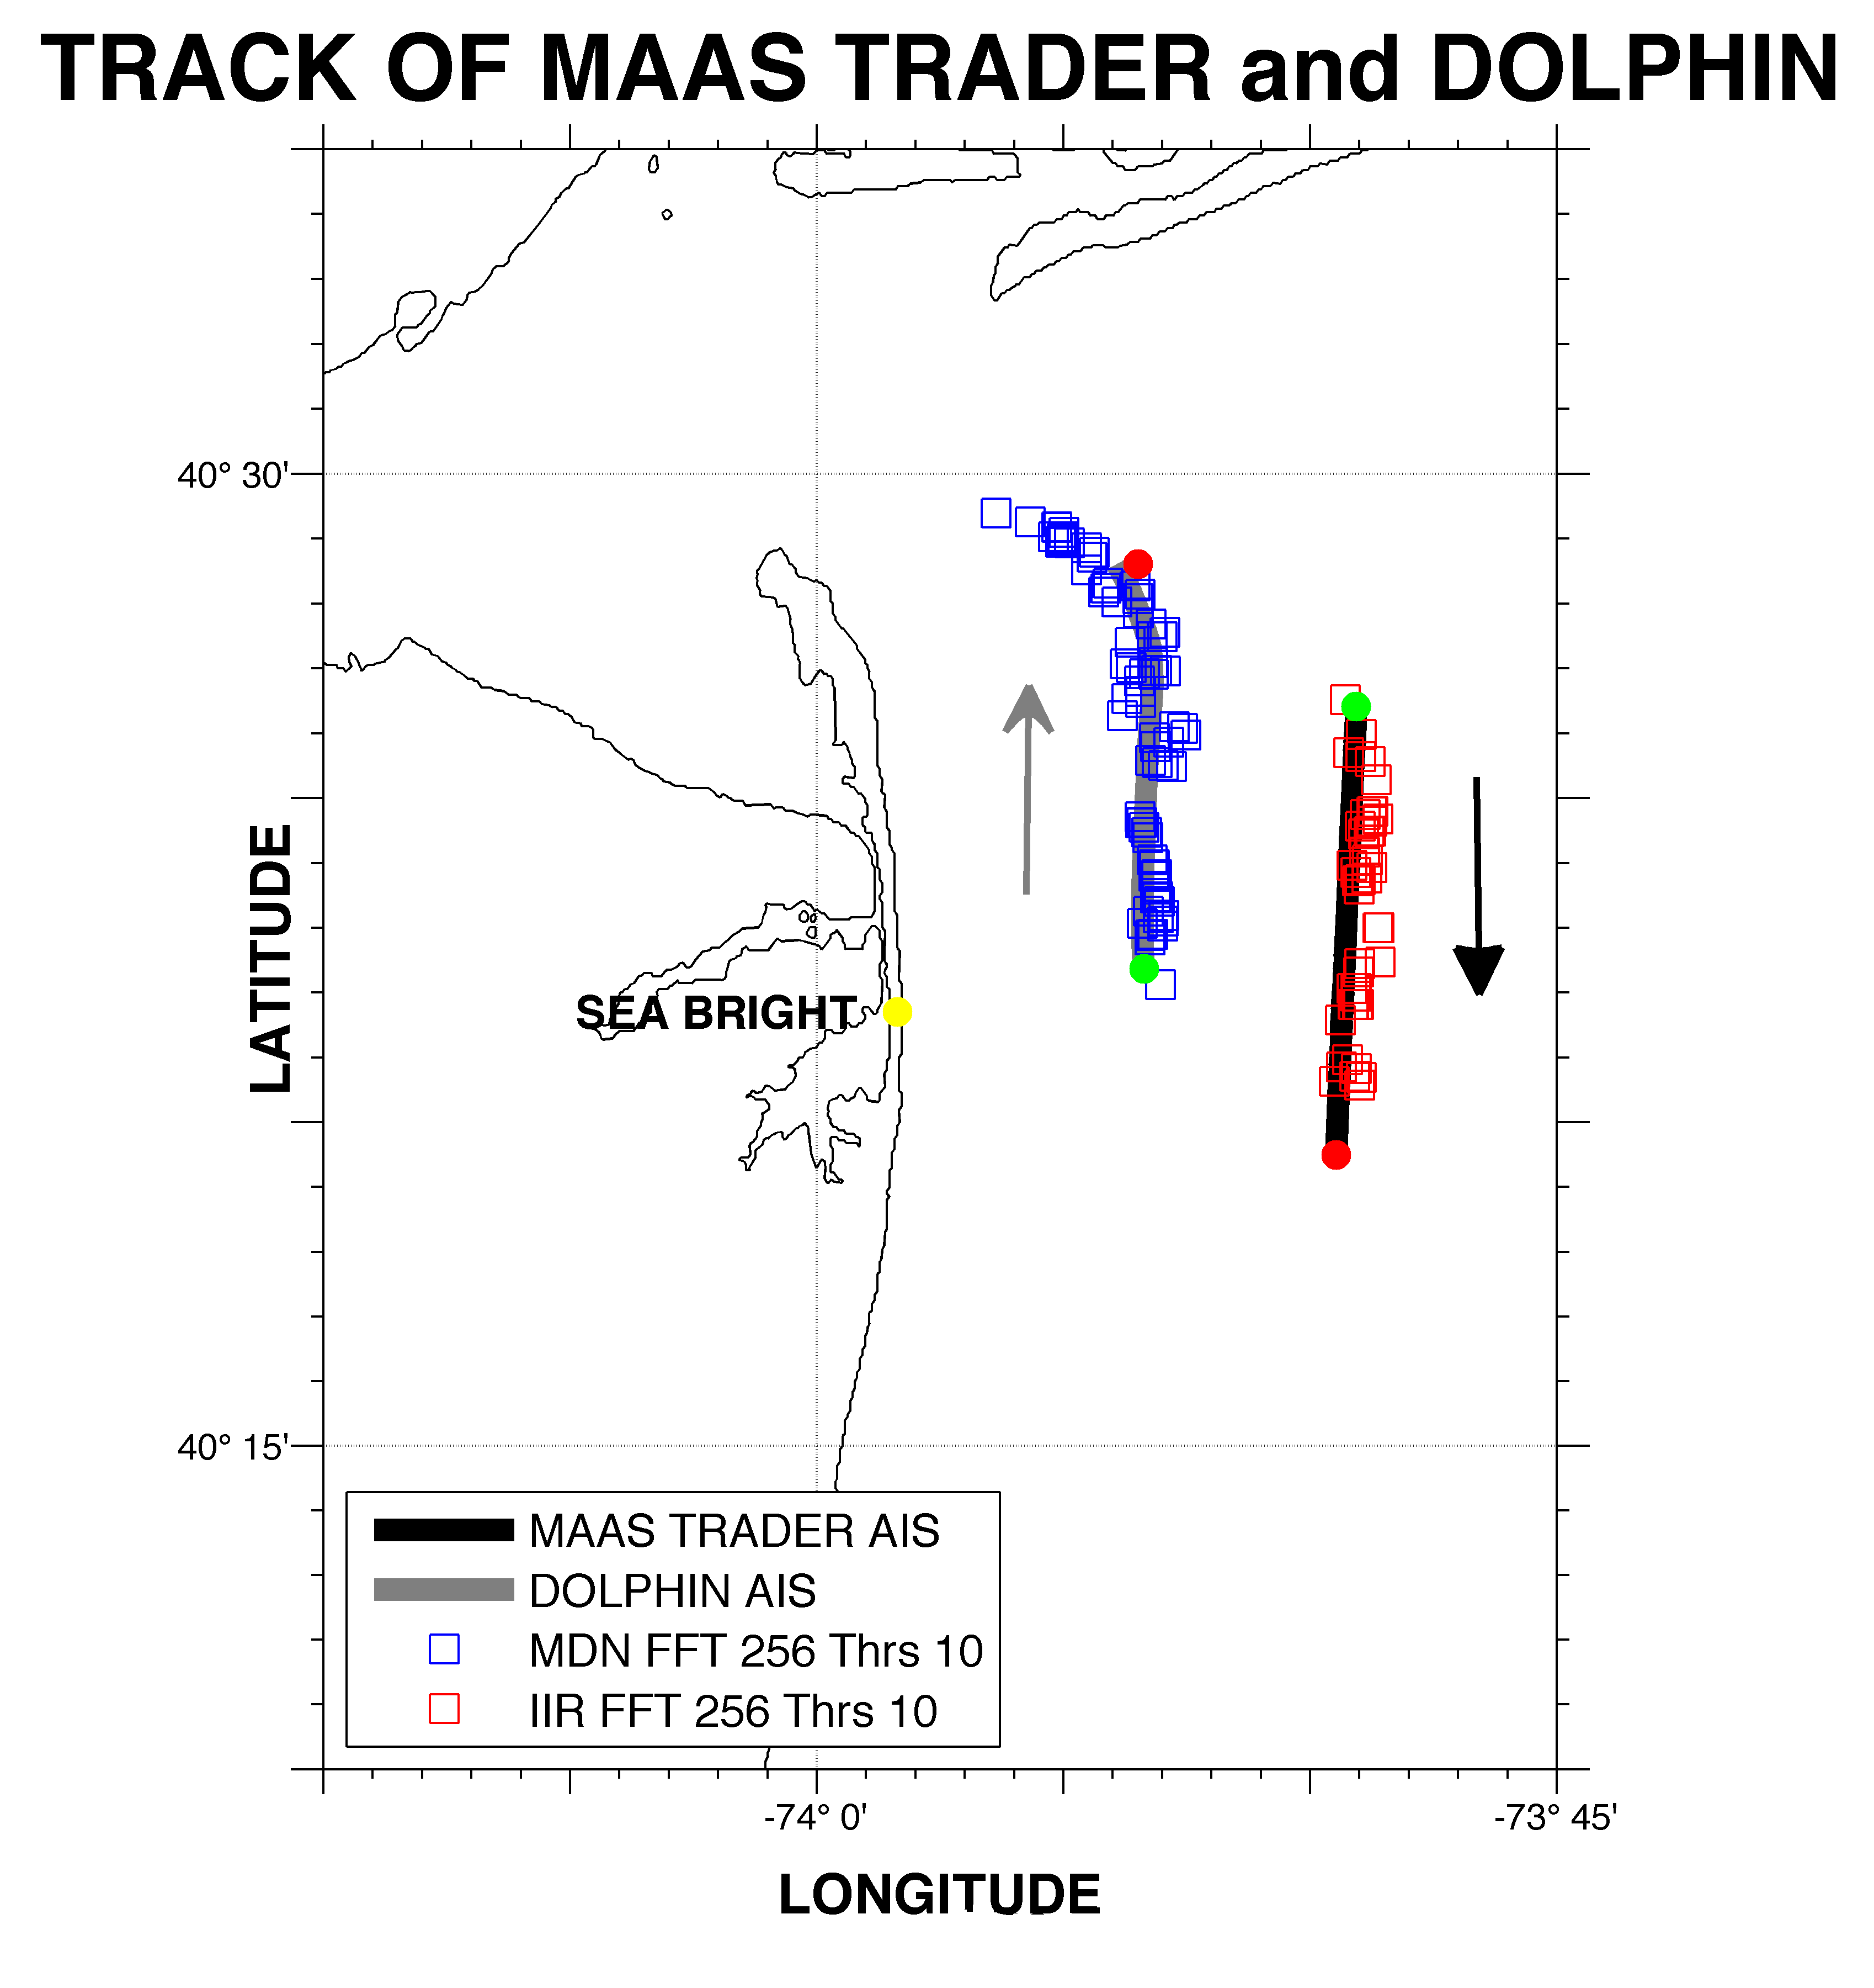
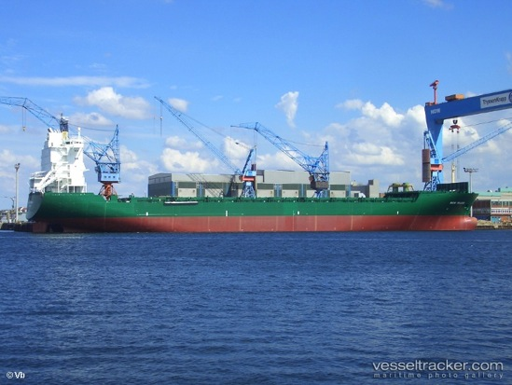
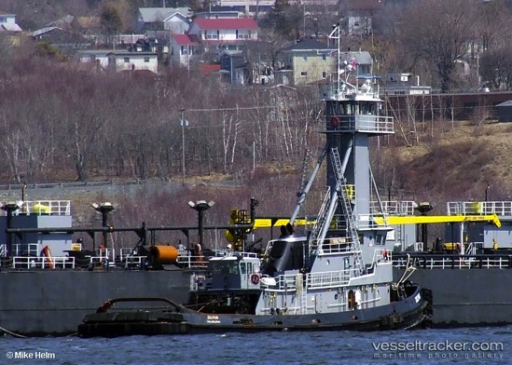
Step 2 Association:
MAAS TRADER
DOLPHIN

Slide 23
Level 1 Association
Occurs at radar station
Combines multiple FFT lengths and dual backgrounds into a single product

Slide 24
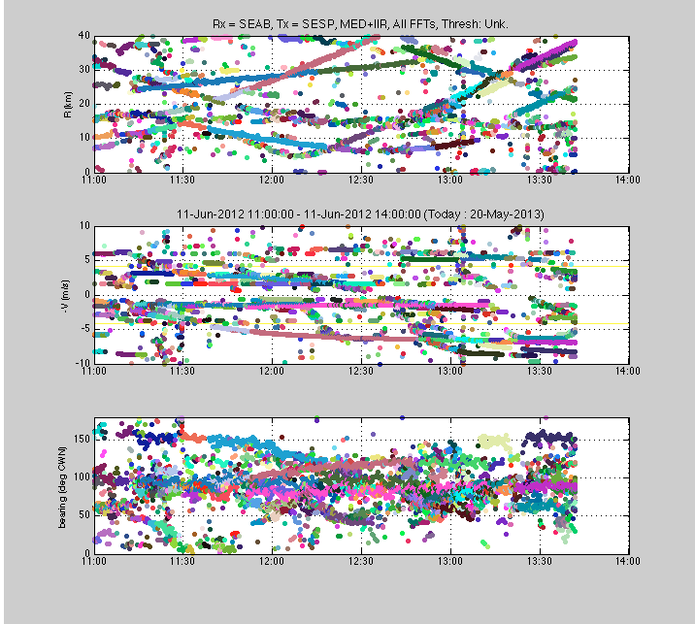
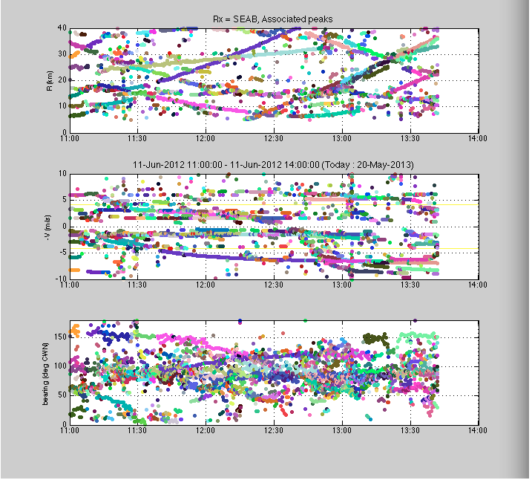
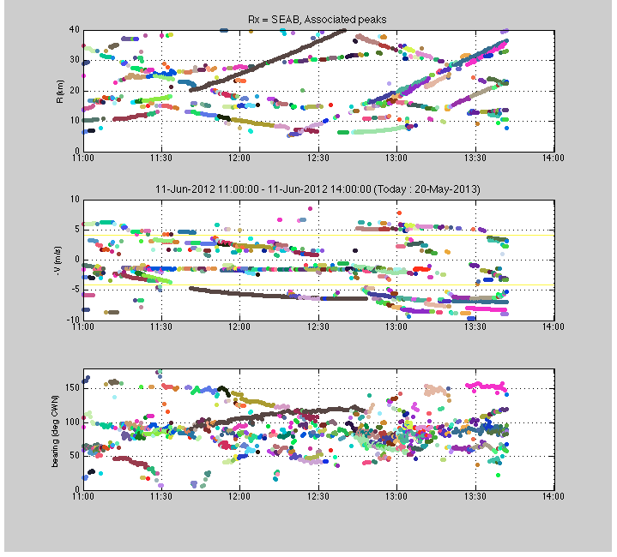
Number of Radar Detections
11:00 to 14:00 June 11, 2012
FFT Length | IIR | Median
128 | 739 | 291
256 | 777 | 1349
512 | 757 | 2089
All 3 FFT Lengths | 2273 | 3729
IIR + Median
6002 detections
Level 1 Association
1823 detections
Singletons Removed
~ 1000 detections

Slide 25
Level 2 Association
Occurs at central station
Combines monostatic and bistatic detections from multiple radars into common operating picture
Utilize intersecting range estimates to decrease position error
Combines radial velocities into total velocity and heading

Slide 26
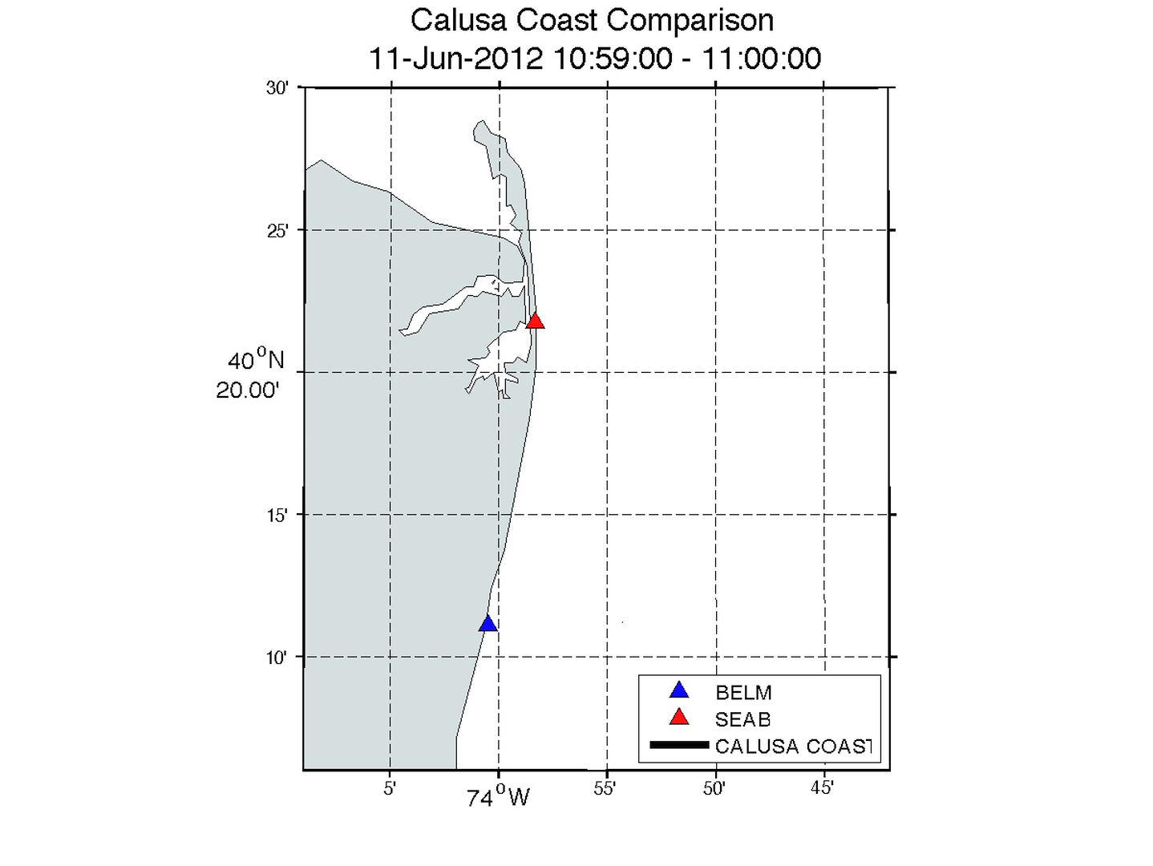
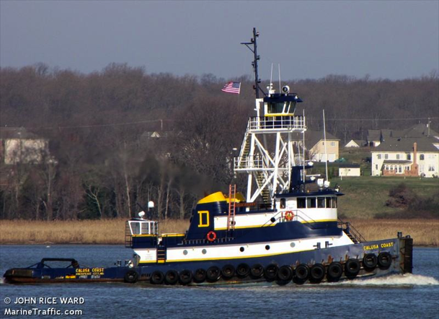
Calusa Coast Test Case

Slide 27
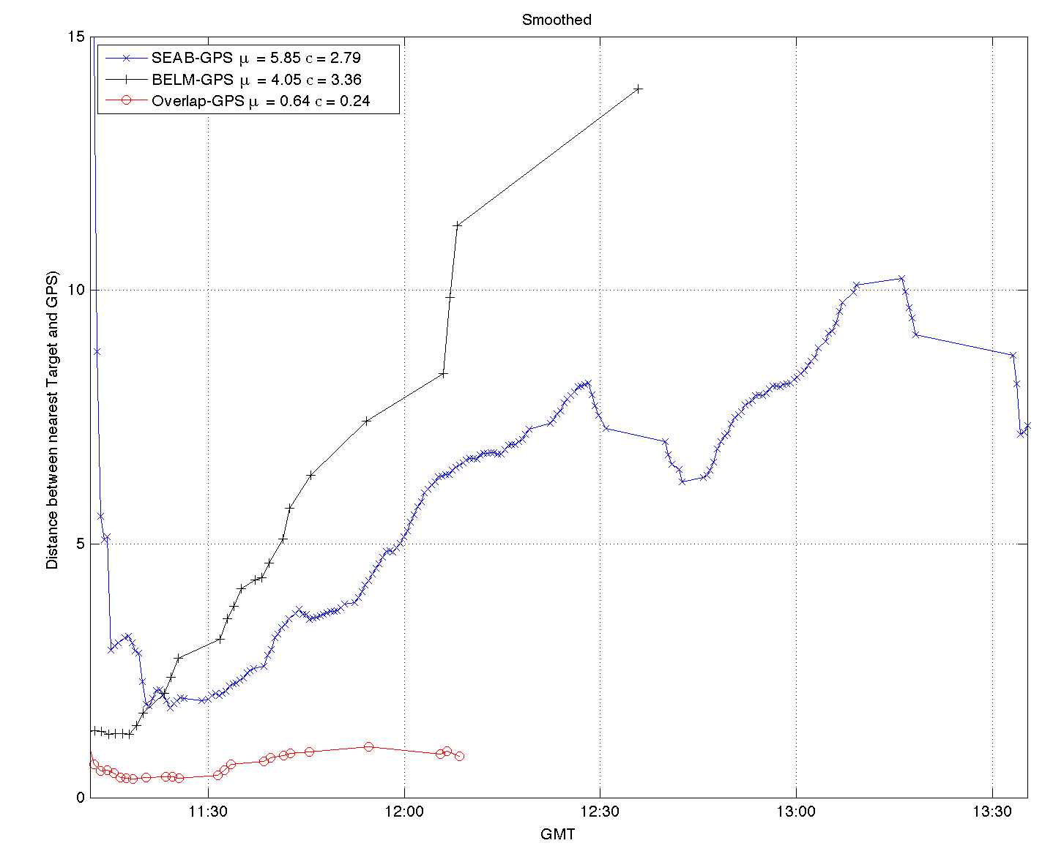
15
BELM
10
Location Error (km)
SEAB
5
Intersecting Ranges
0

Slide 28
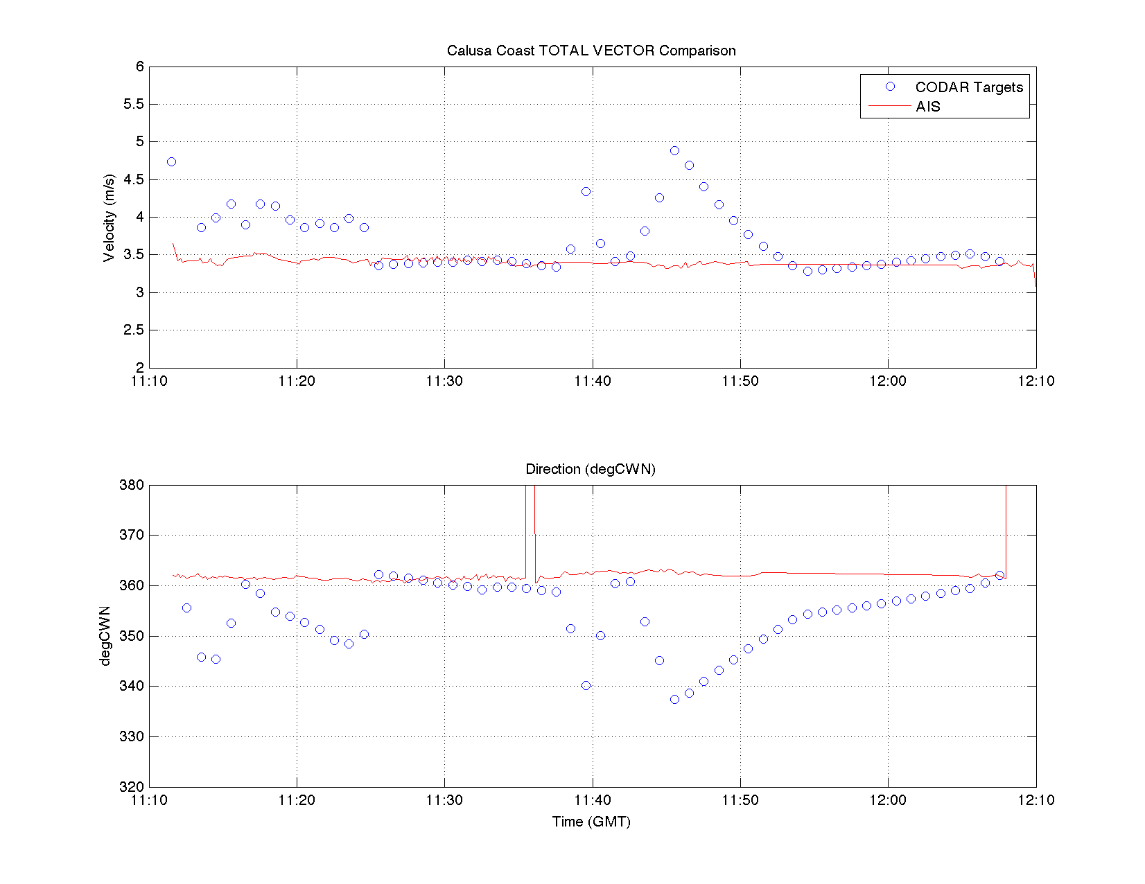
Total Velocity and Heading
Velocity (m/s)
3.5 m/s =
7 knots
Heading (deg CWN)

Slide 29
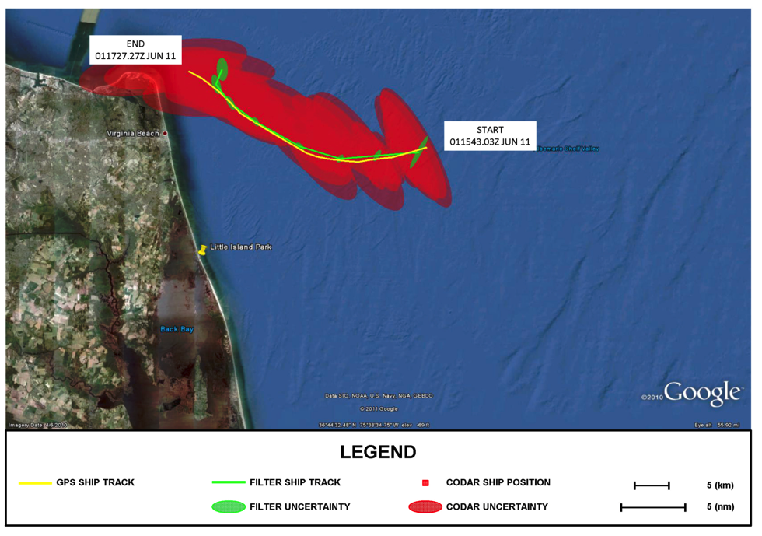
Step 3 Track Fitting: M/V Victorius
M/V VICTORIOUS: GPS Track, CODAR Data, and Ship Tracker Solution with Uncertainty Ellipses

Slide 30
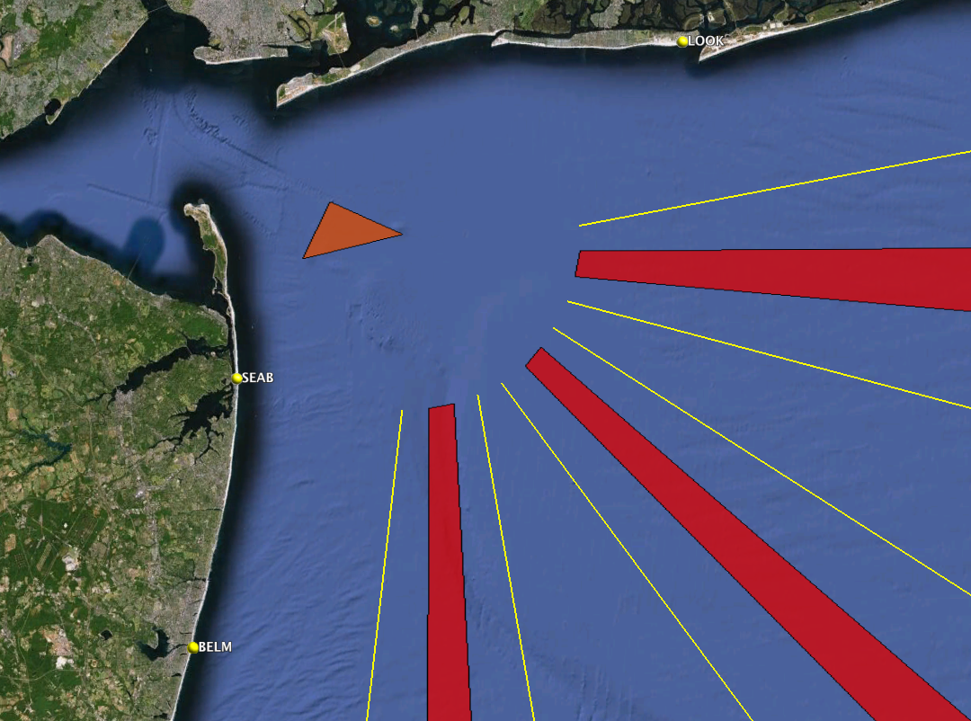





31% of
HF Radar Detections NOT on AIS
Approaches to New York Harbor
16 Vessels per Hour in HFR
5 Vessels NOT on AIS

Slide 31
Bistatics for
Vessel Detection

Slide 32
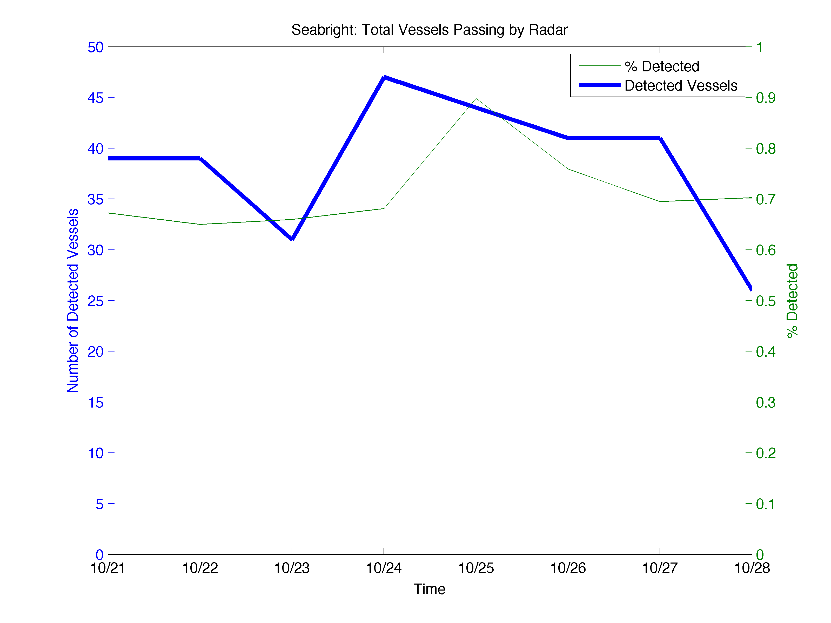
Monostatic Detections

Slide 33
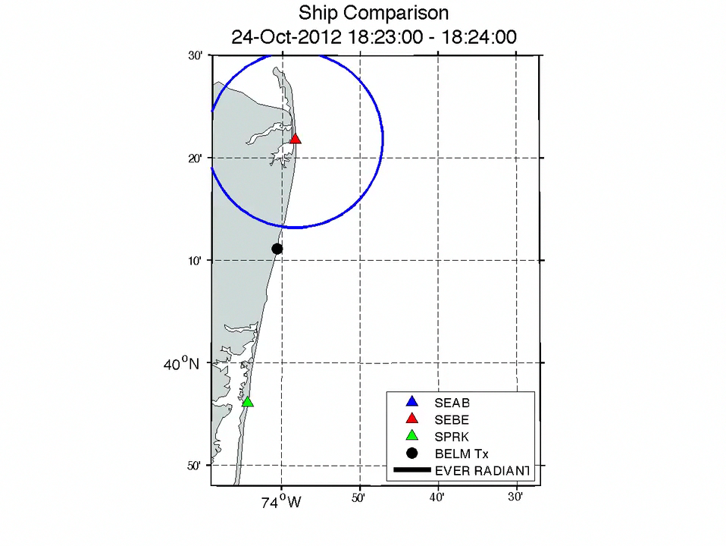
SEAB – monostatic
SEBE – bistatic
Rx SEAB
Tx BELM
SPRK – monostatic

Slide 34
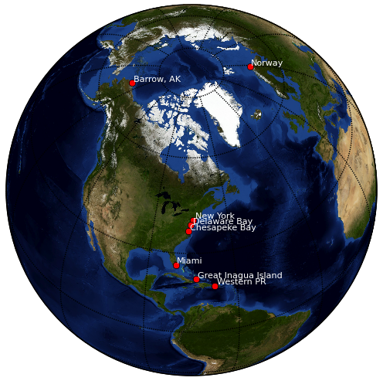
Vessel Tracking
Research Areas
Current Testbeds
New York Harbor
Delaware Bay
Chesapeake Bay
Port of Miami
Western Puerto Rico
Barrow Alaska
Proposed Testbeds
Great Inagua
Norway
San Diego

Slide 35



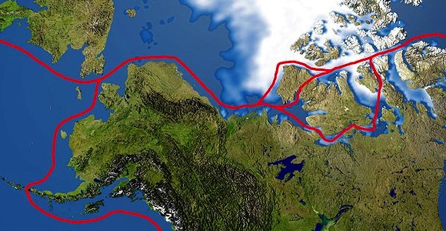
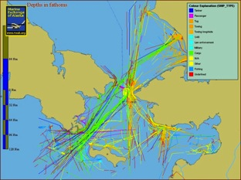
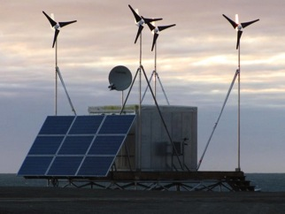
HF Radar Testbed at High Latitudes
5
Objective:
Test the capability of the SeaSonde HF Radar as a detection and surveillance sensor at high latitudes in anticipation of the polar ice cap melting and the increased usage of the Northwest Passage.
Sponsor:
Participants:
Remote Power Module
AIS traffic near Barrow, AK
Northwest passage routes

Slide 36
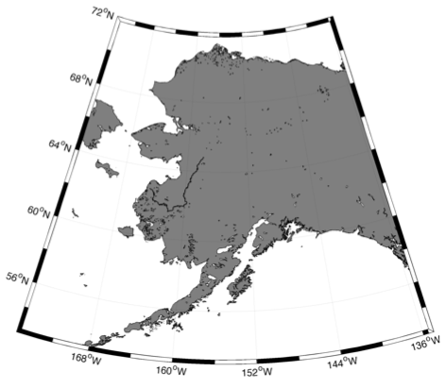
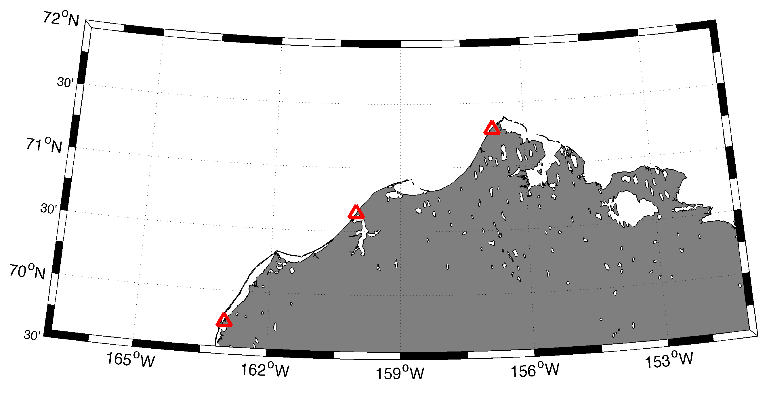
Alaska

Slide 37
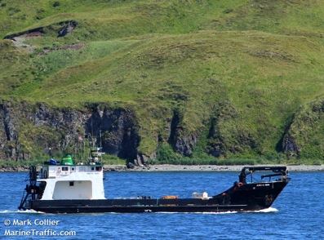
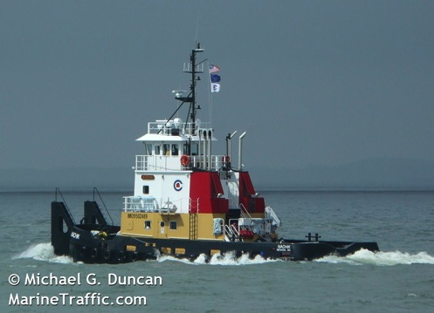
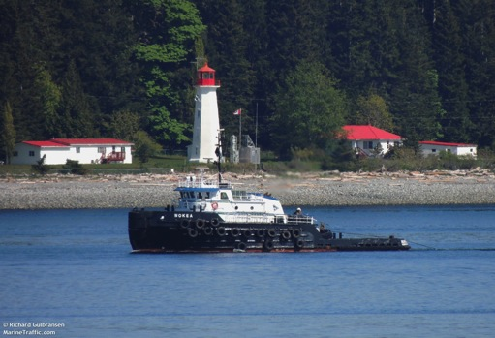



Vessels Detected During Sept 9 &10

Slide 38


21 hours of Detection for Tug Boat Nokea

Slide 39




Slide 40
conclusions

Slide 41







Transition Objective – Operational Dual Use through
(a) DHS SAROPS, (b) DoD Open Mongoose & (c) DoC PORTS
Surface Currents
Vessel
Detections

