Slide 1
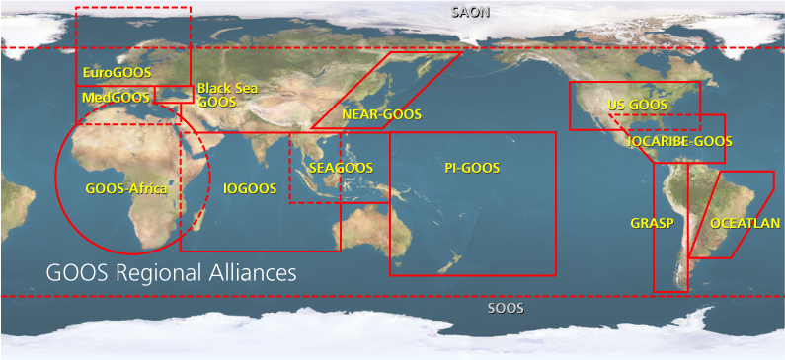

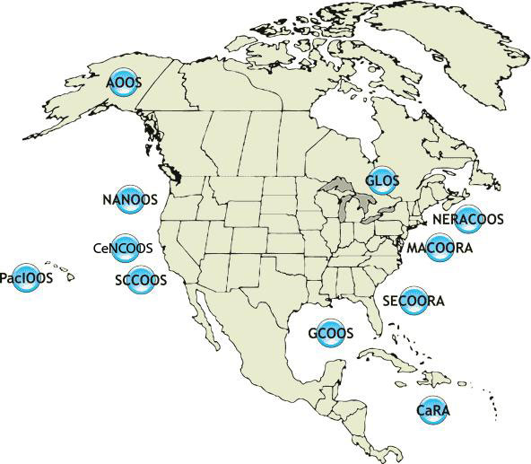
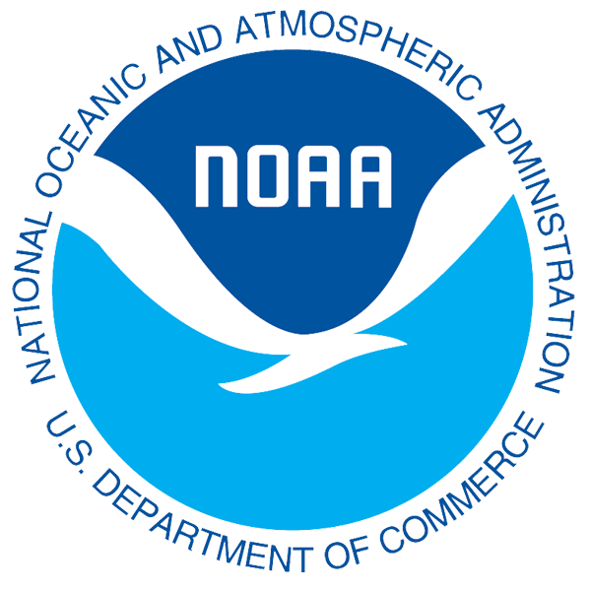

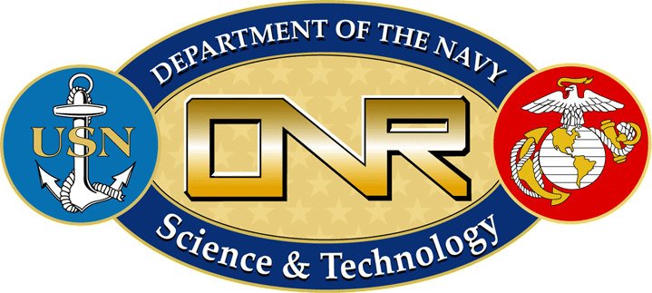


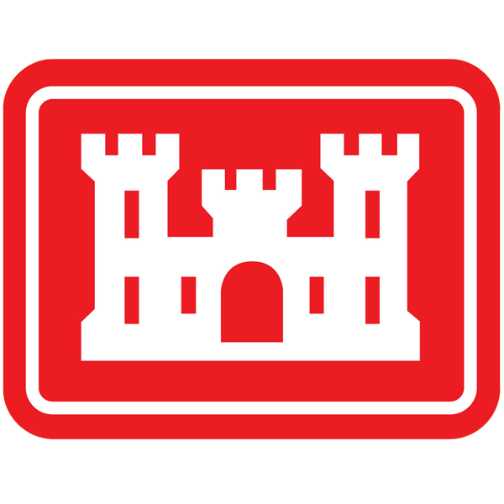
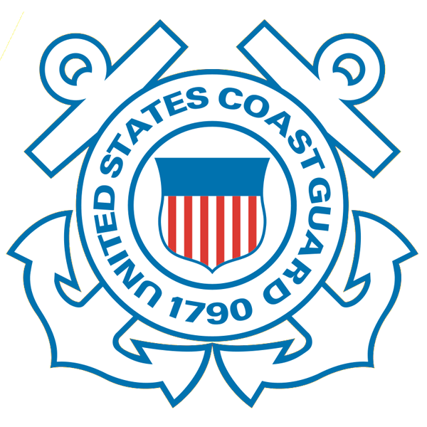







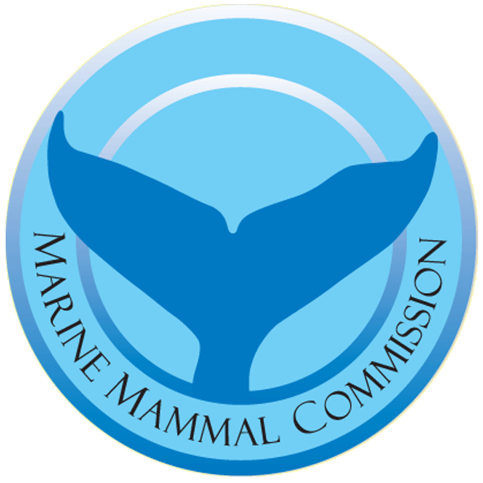
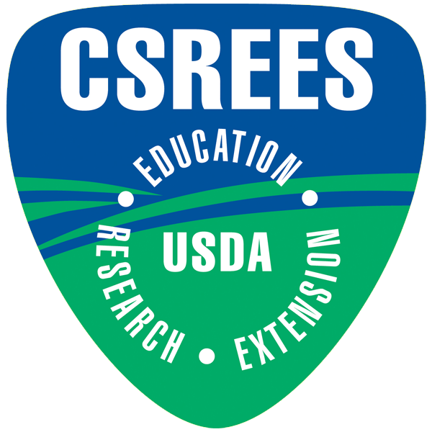
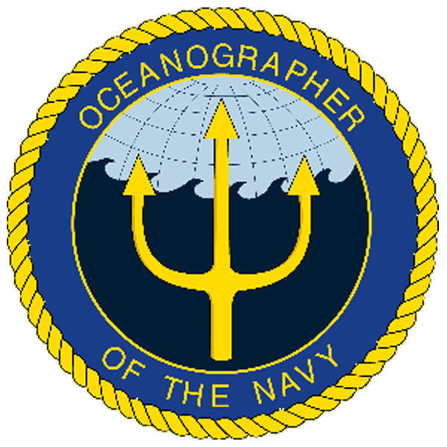
U.S. Integrated Ocean Observing System
IOOS Relationships
International Component
National Component
Regional Component
Global Ocean Observing System
Vessels -
Satellite
Satellite
CODAR
Ships/ Vessels
Glider
REMUS
Data Vis.
Modeling
Security
Leadership
Education
11 Regional Associations
17 U.S. Federal Agencies
http://ioos.gov

Slide 2


Middle Atlantic
Regional Association
Coastal
Ocean Observing System
1000 km
Cape to Cape
CT
RI
Cape
Cod
MA
NY
10 States
111 Congressional Districts
¼ U.S. Population
PA
NJ
MD
DE
MARACOOS 2011-2016:
From Observations to Forecasts
Scott Glenn, Carolyn Thoroughgood,
Larry Atkinson, Bill Boicourt, Wendell Brown
Plus >40 Additional Co-PI’s from >20 Institutions
Today’s HF Radar Themes:
Surface Current Maps for SAR
Vessel Tracks For MDA
VA
NC
Cape
Hatteras
To seek, discover and apply new knowledge & understanding of our coastal ocean
To seek, discover and apply new knowledge & understanding of our coastal ocean
Notes:
The Mid-Atlantic Bight extends 1000 km alongshore from Cape Cod, MA to Cape Hatteras, NC.
It includes 5 major urban estuarine systems (Narragansett Bay, Long Island Sound, Hudson-Raritan River, Delaware Bay, and Chesapeake Bay) and a wide continental shelf cut by a deep cross shelf valley and multiple shelf-break canyons.
The footprint includes 10 states, the District of Columbia, and approximately 76 million people or 25% of the US population.
The nation’s highest coastal population density makes increasingly competing demands for marine and coastal resources.
Ports in the region also handle 23% of the total US waterborne commerce and include one of the the nation’s largest petroleum product hubs and the world’s largest Naval base.

Slide 3
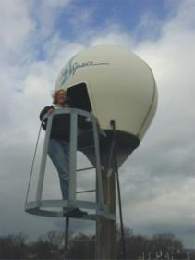
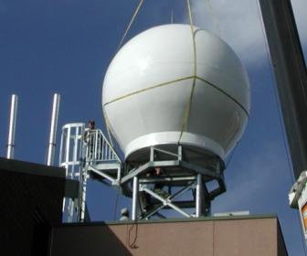
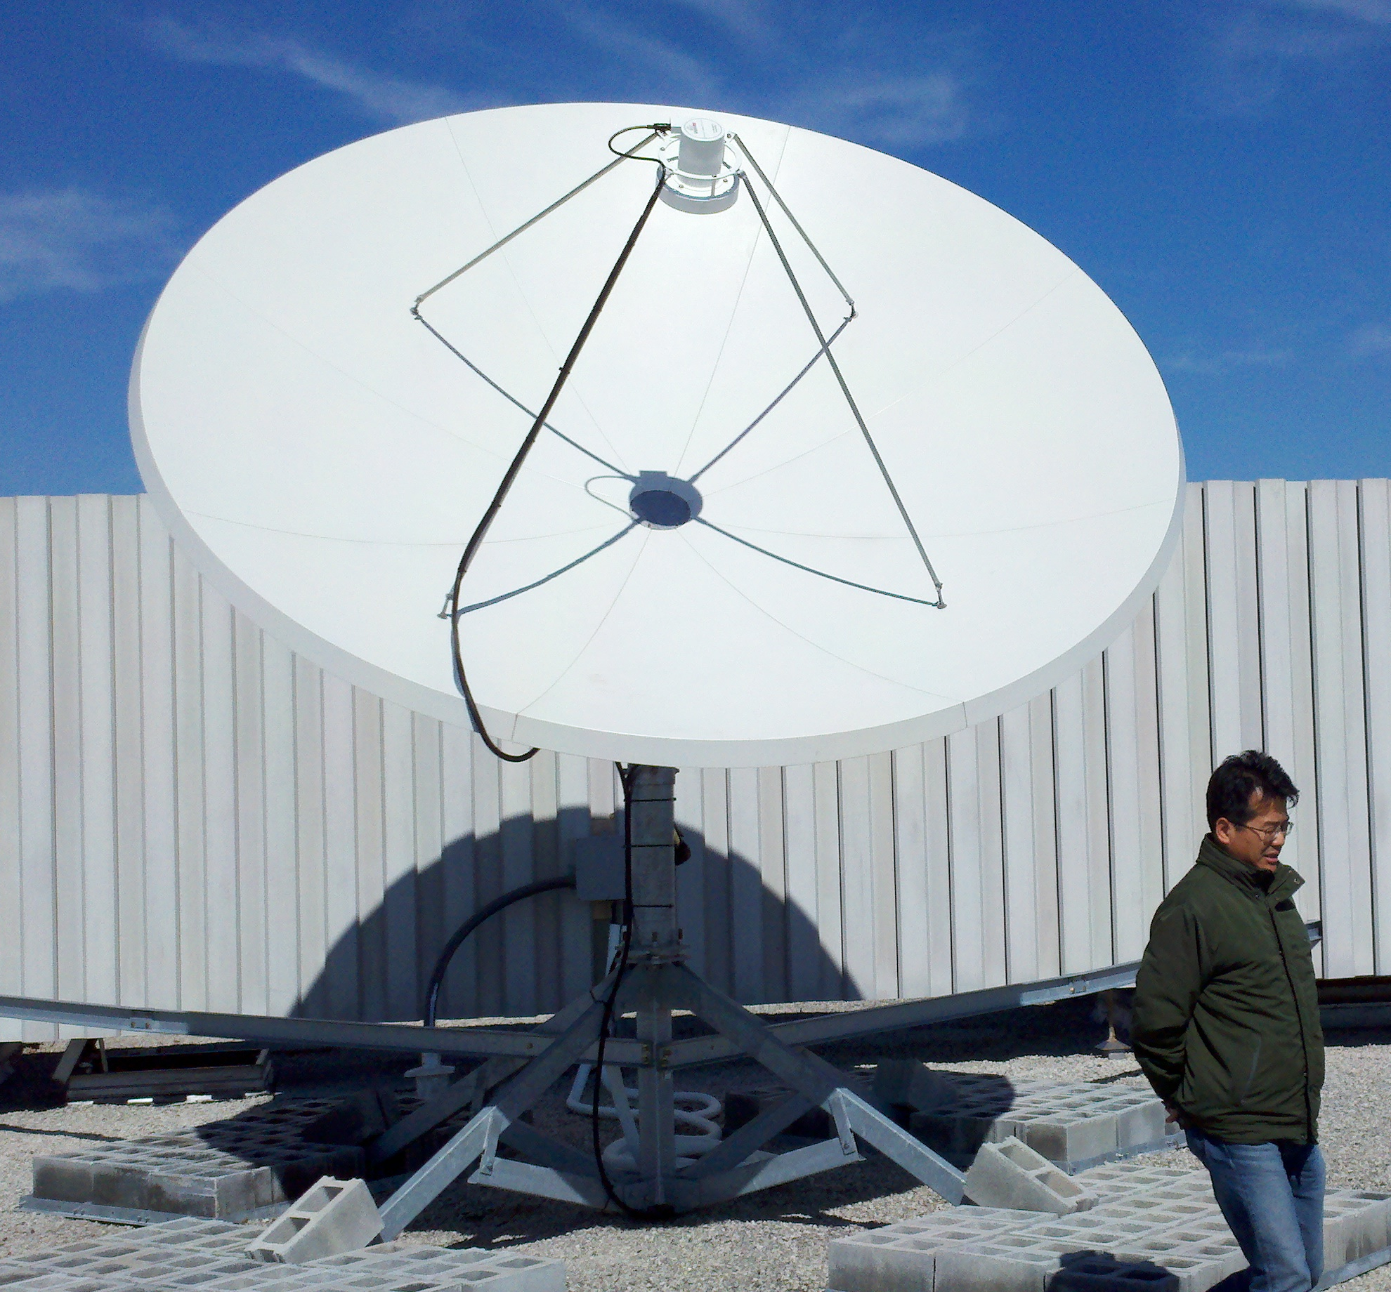
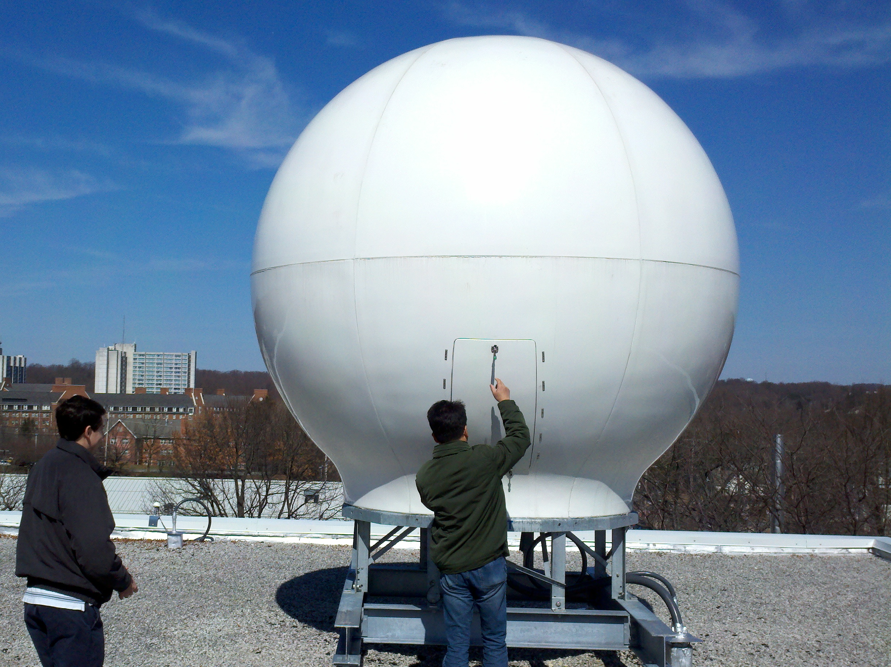
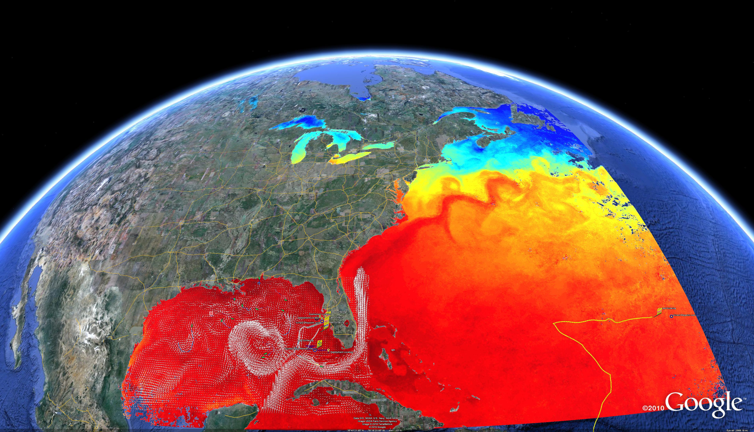
Satellite Testbeds
Corporate Partner:
SeaSpace
Since 1992
SST/Weather
SST & OC
SST
SST & OC
U. Delaware
Rutgers

Slide 4
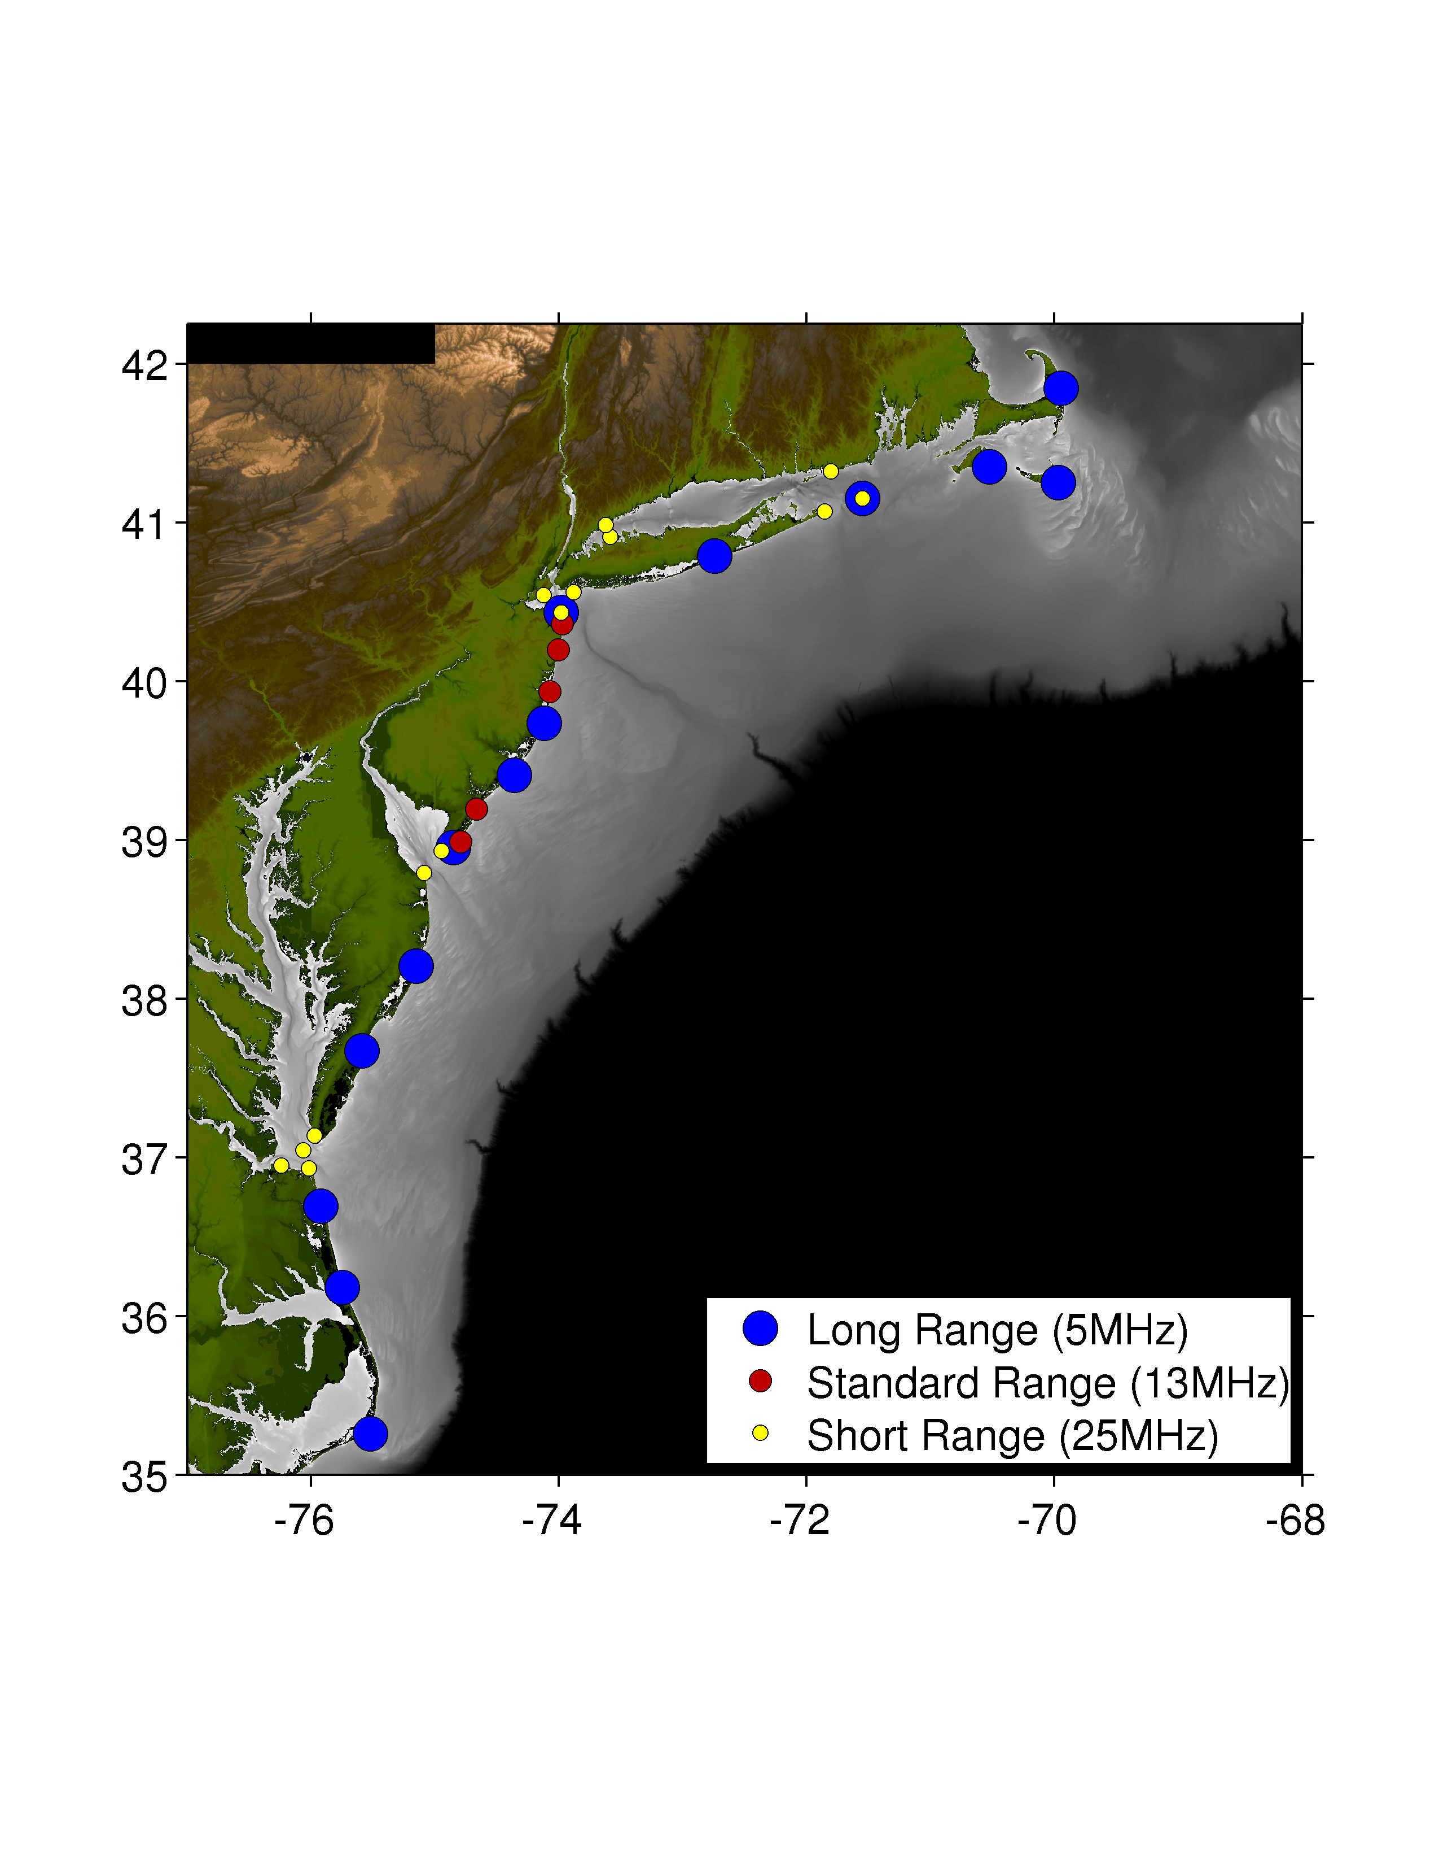
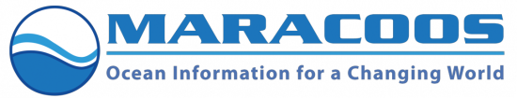
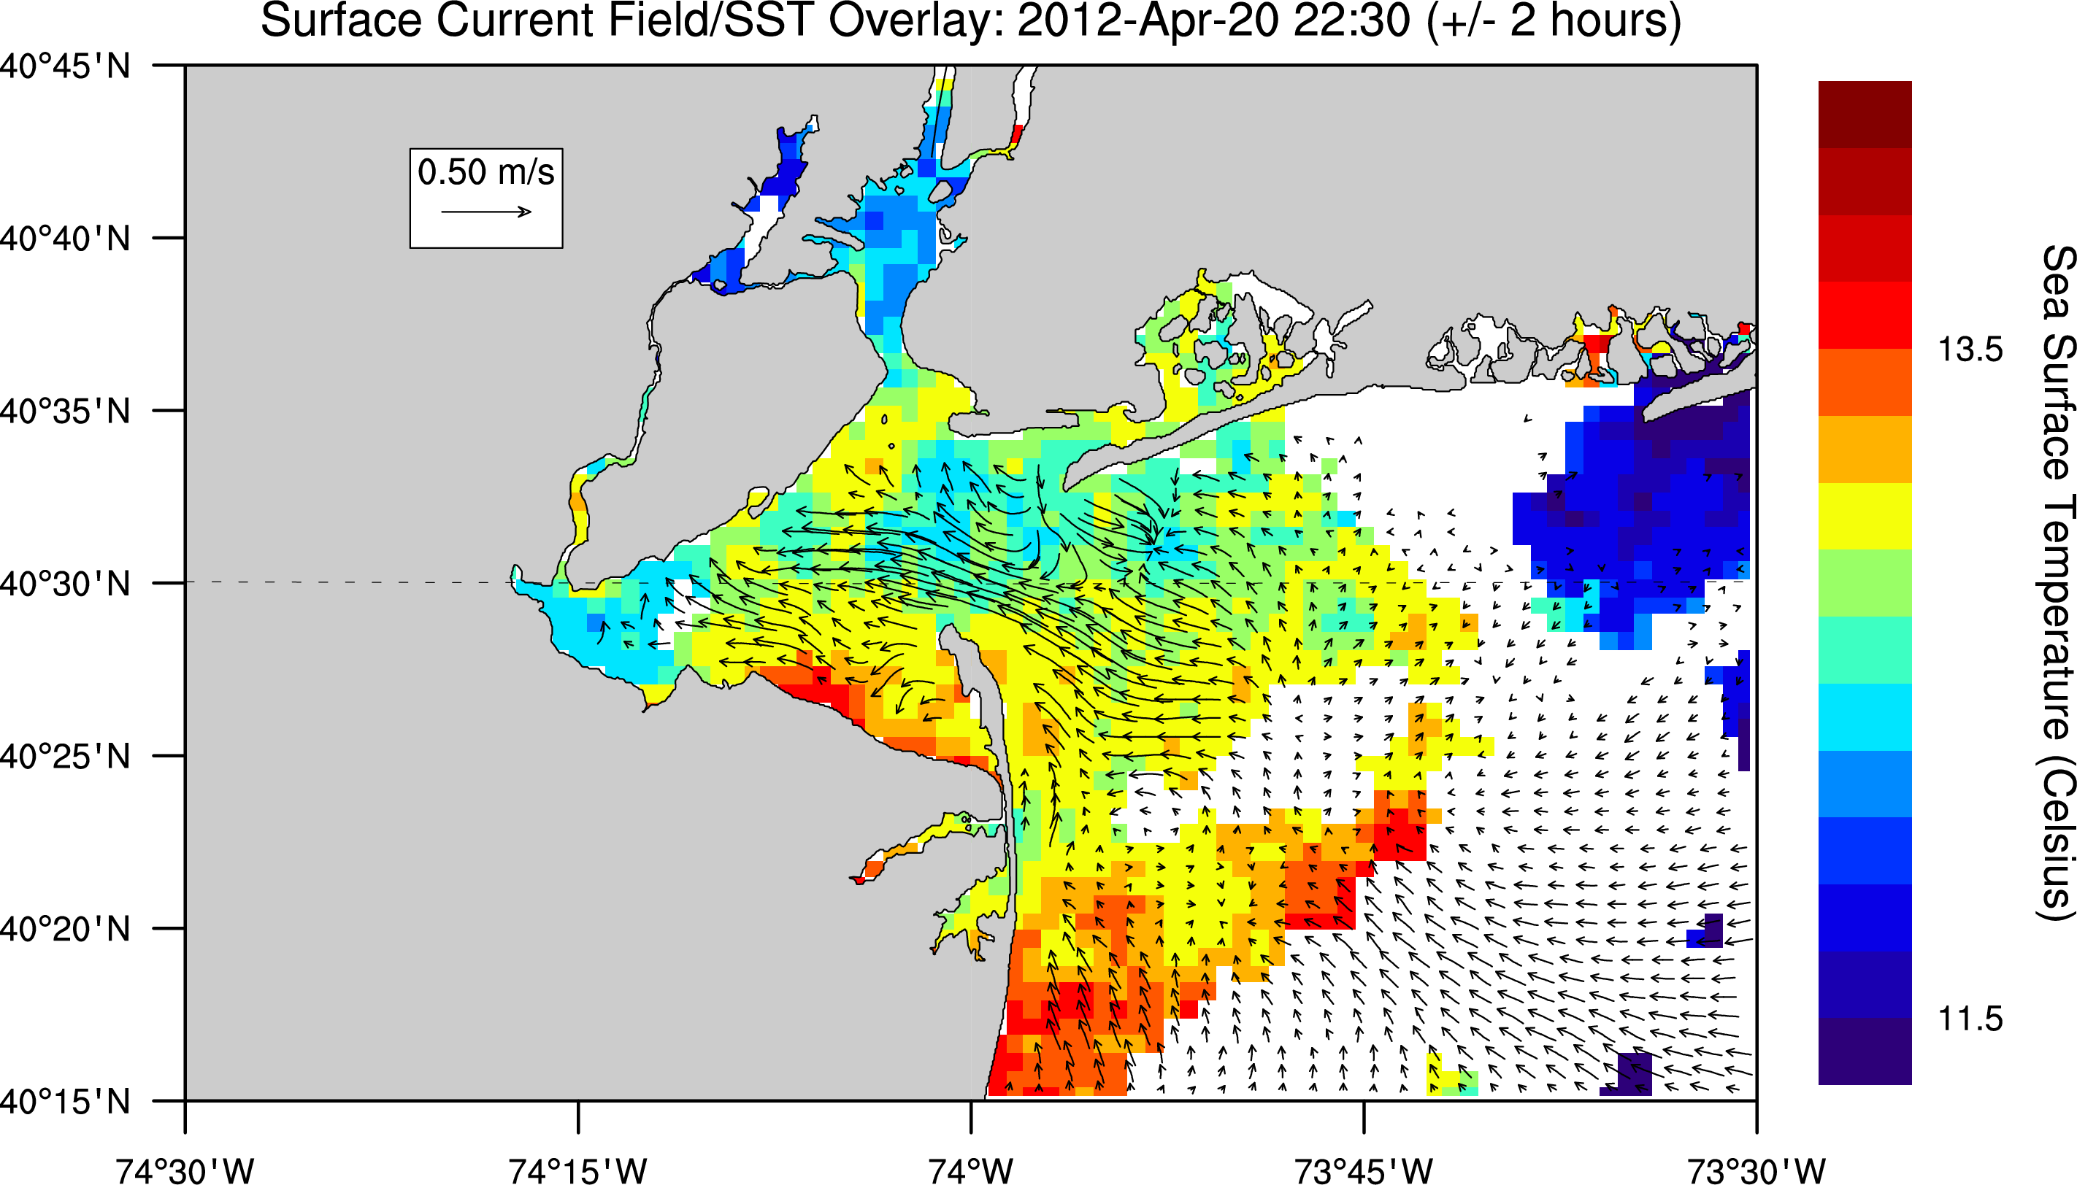
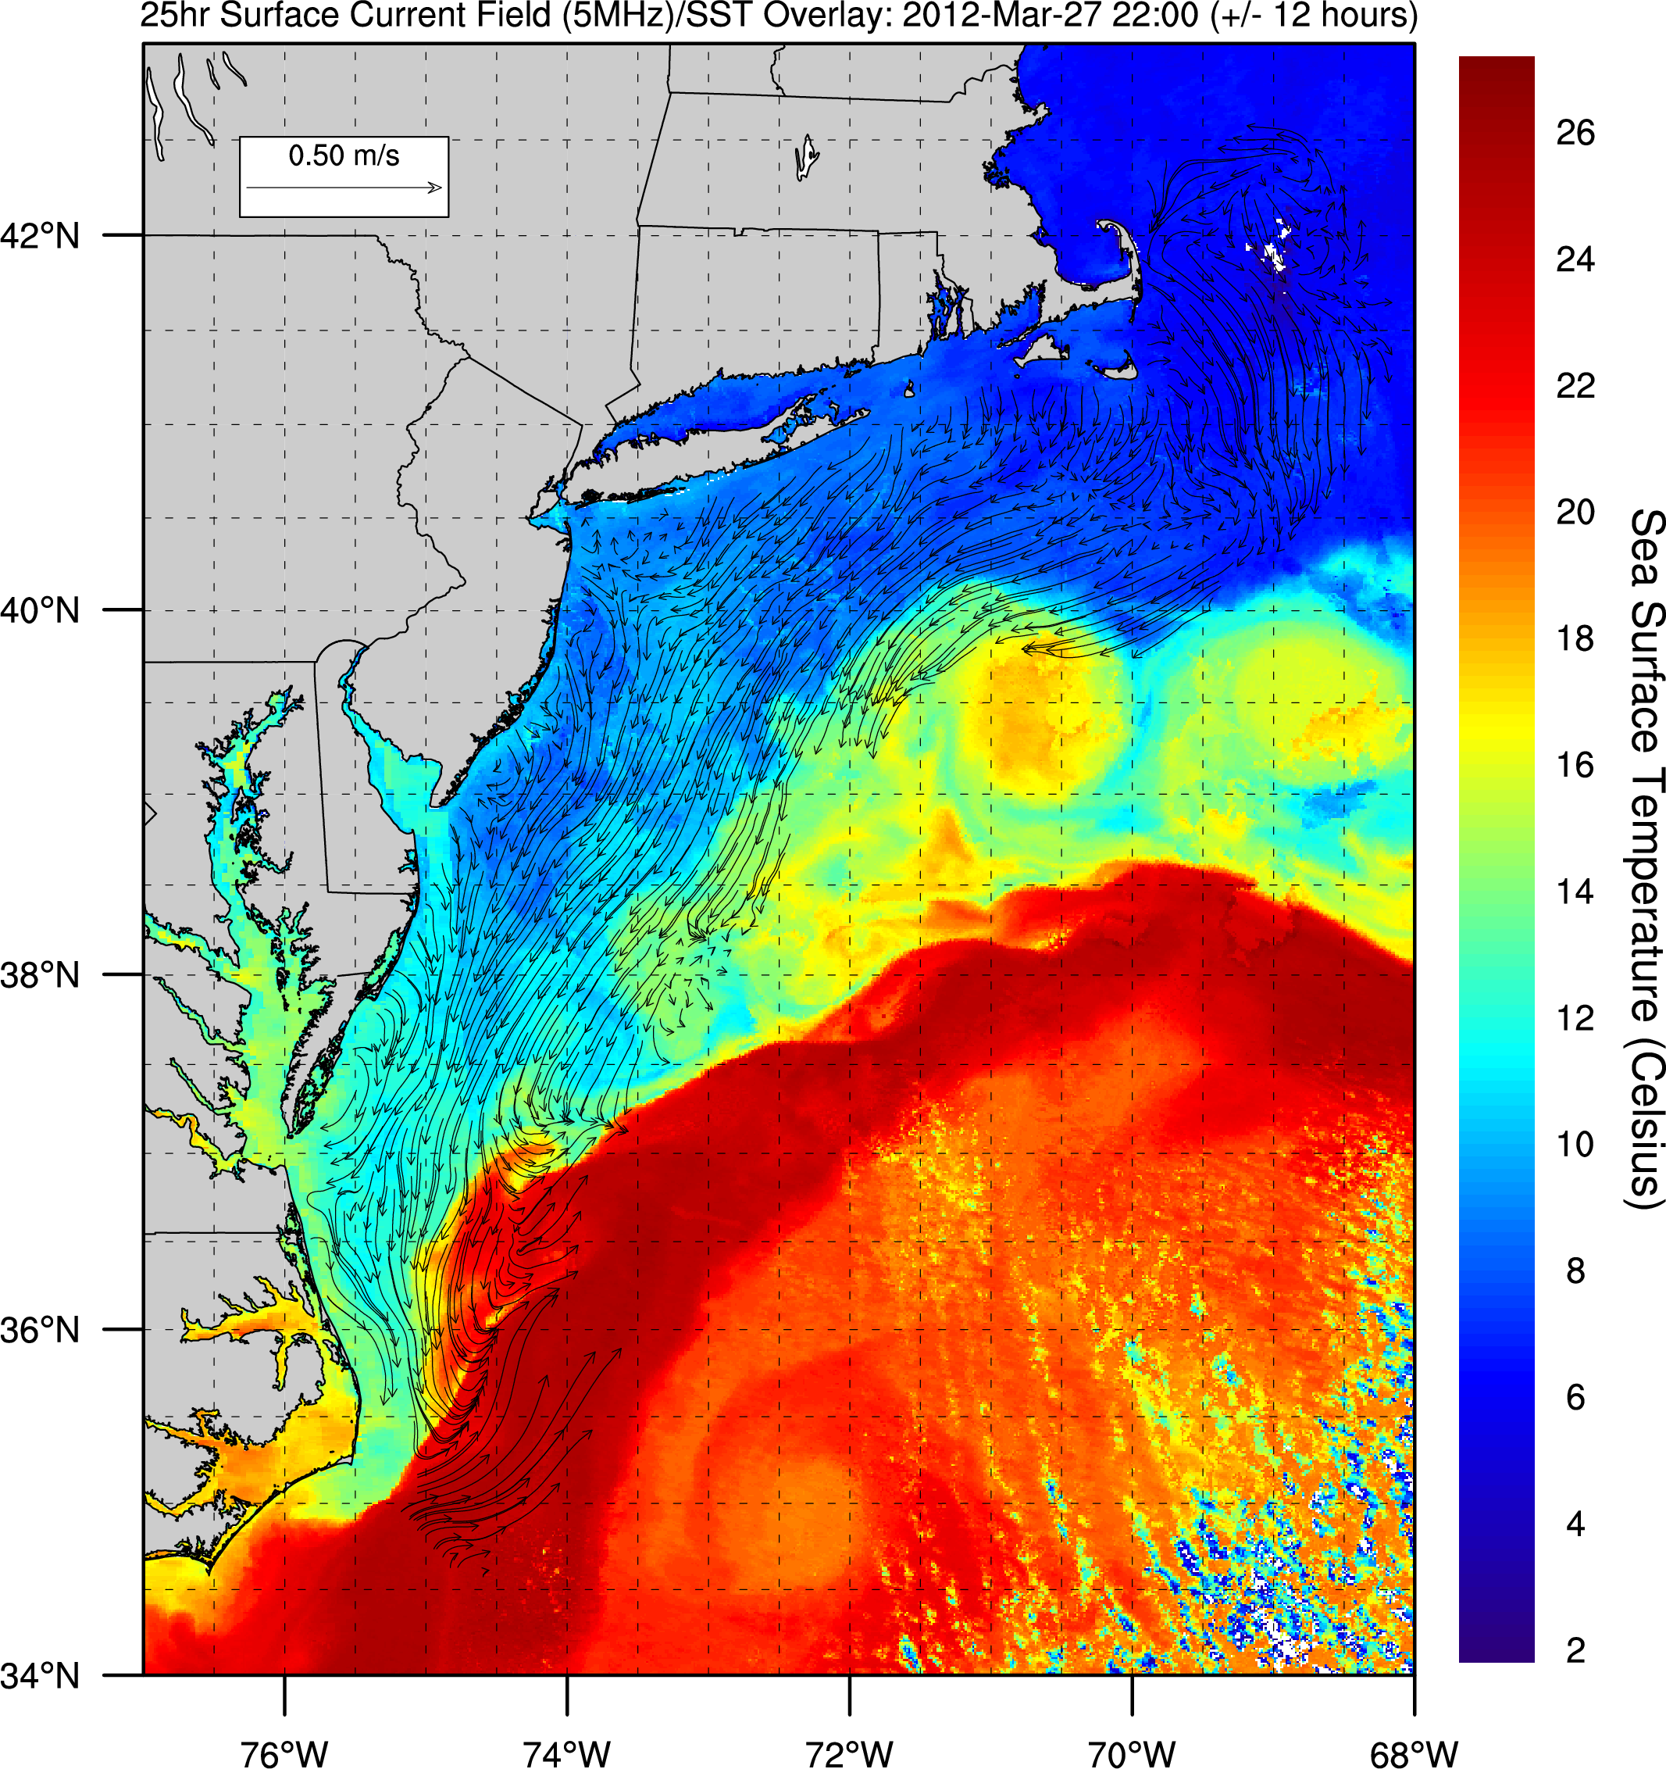
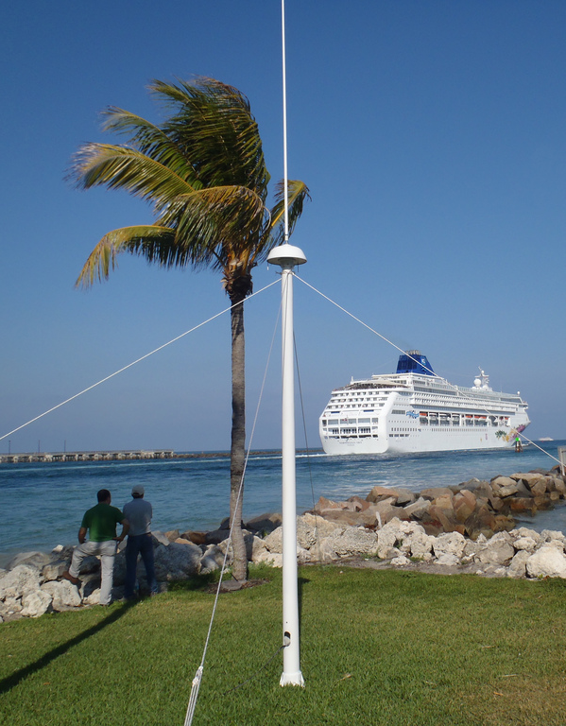
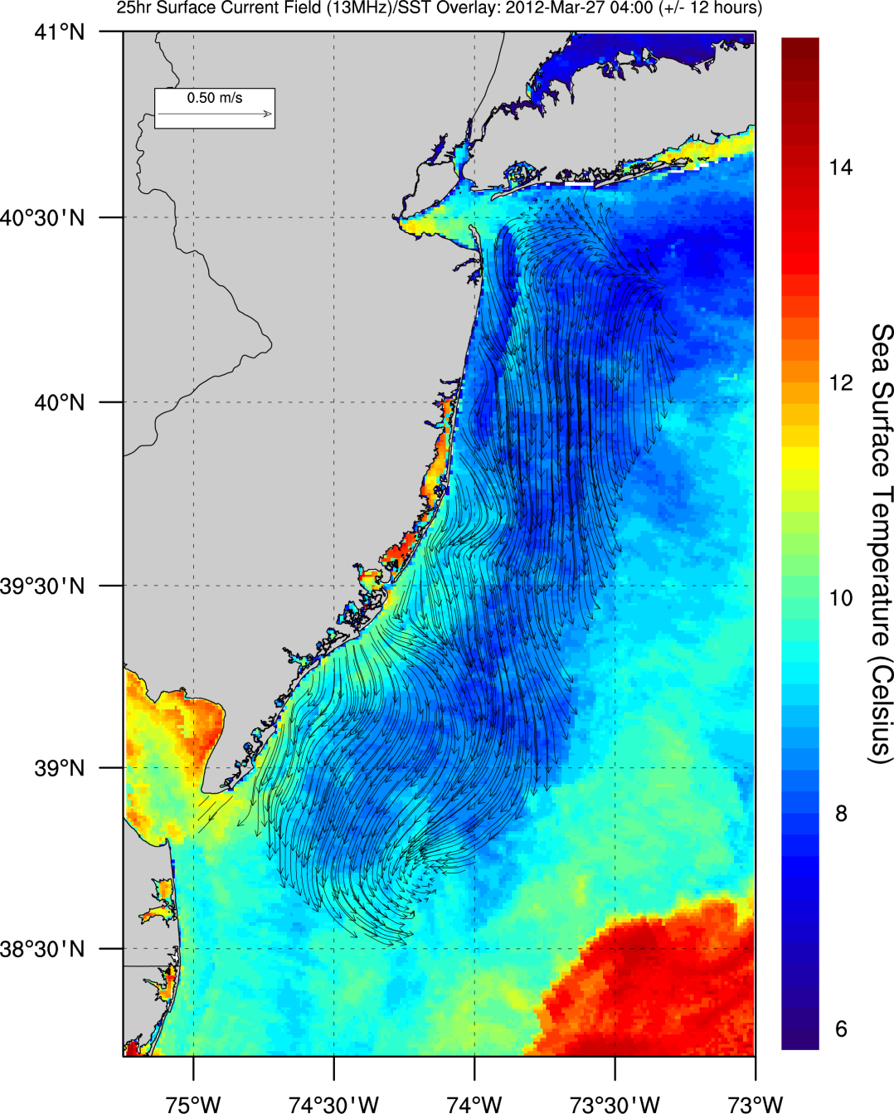
HF Radar Testbeds
Corporate Partner:
CODAR Ocean Sensors
Since 1997
36 Sites
Short Range
25 MHz
Long Range
5 MHz
Multi-Static
Triple Nested
Medium Range
13 MHz

Slide 5
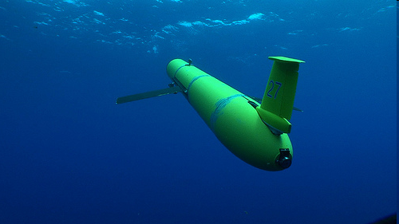
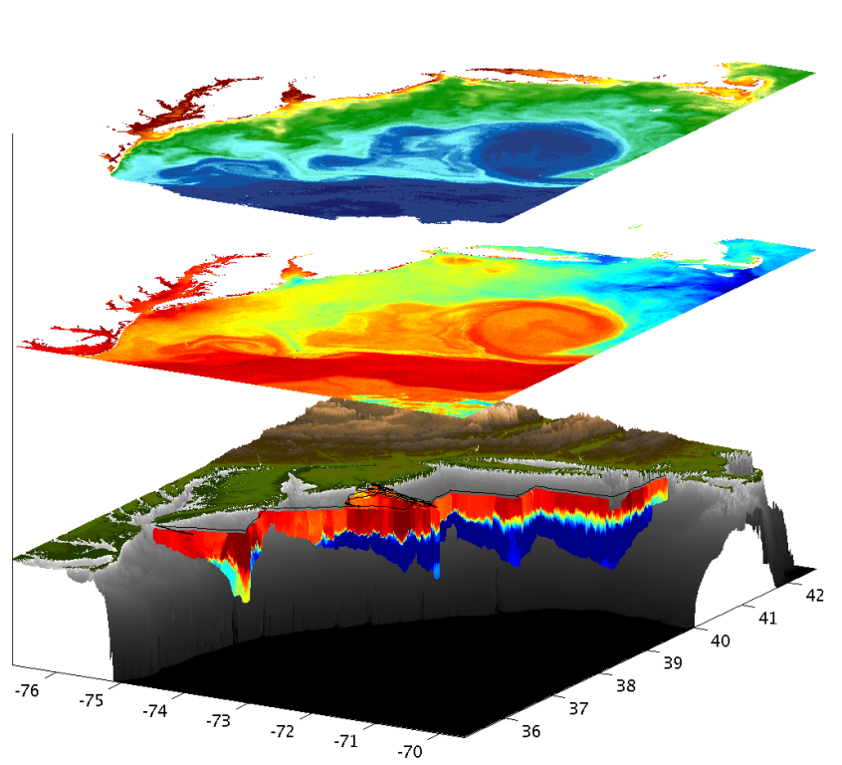
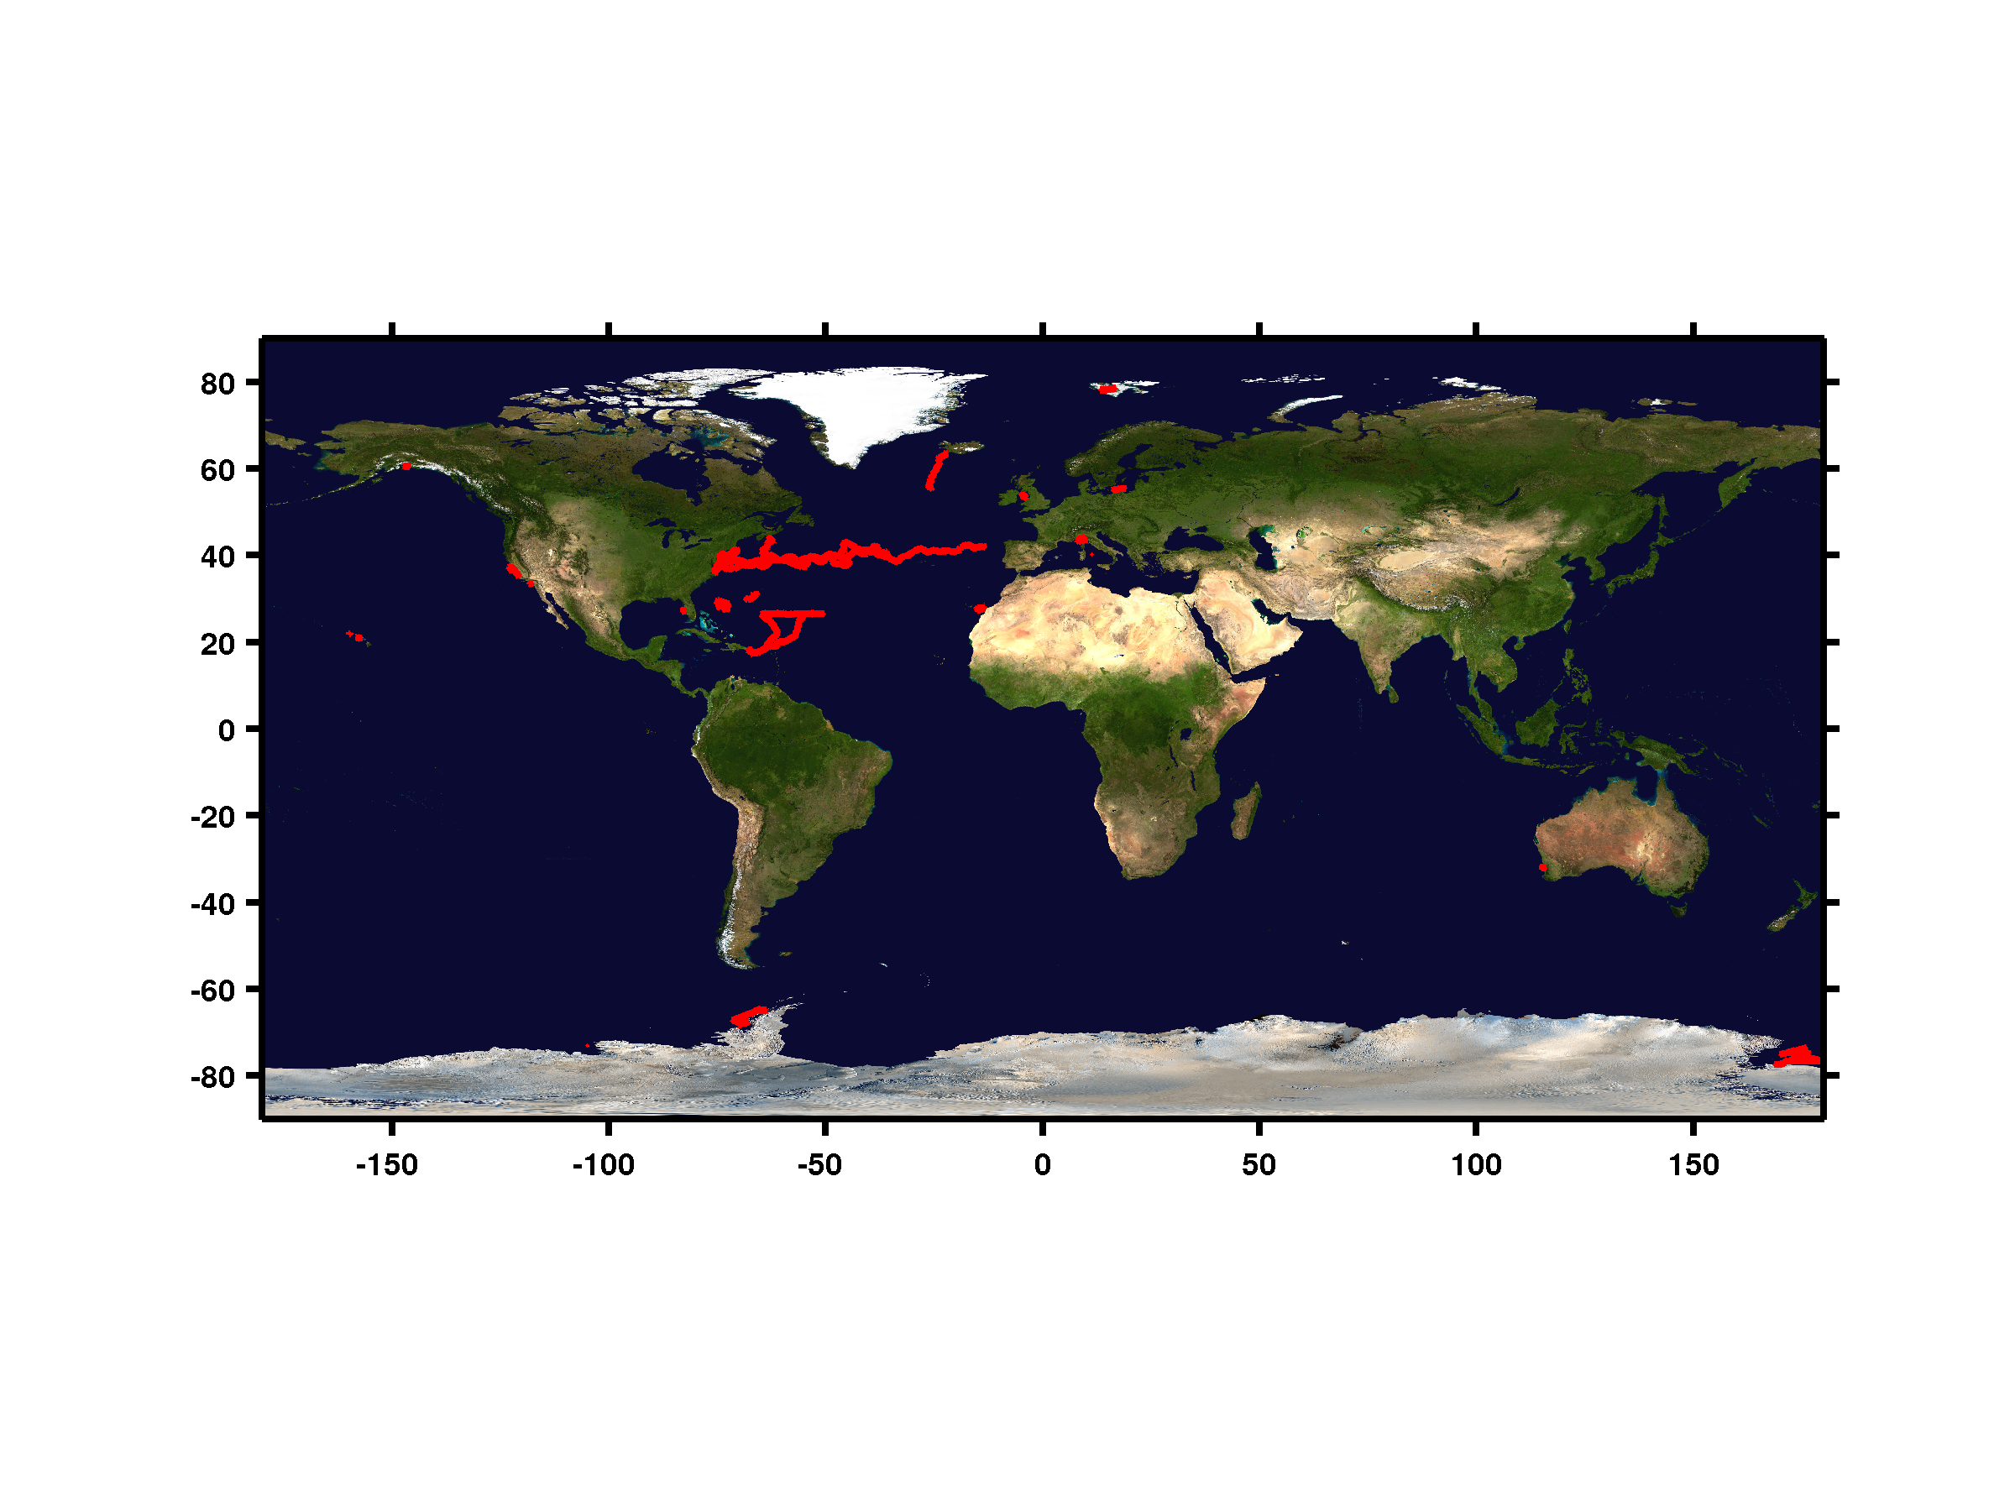
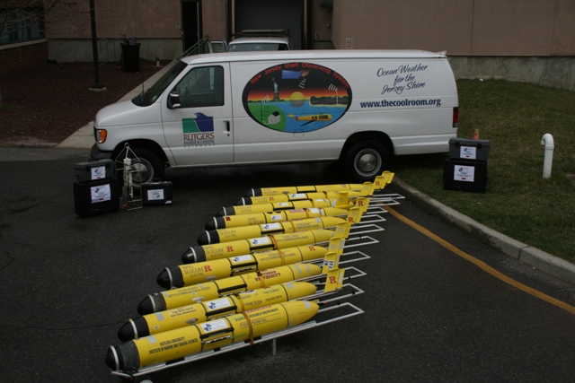
MARACOOS - Autonomous Underwater Gliders – Since 1998
Satellite Ocean Color
Satellite SST
Subsurface
Glider
Data
Corporate Partner: Teledyne Webb Research
< Regional
Glider Fleet
With Global Reach >
>270 Missions

Slide 6
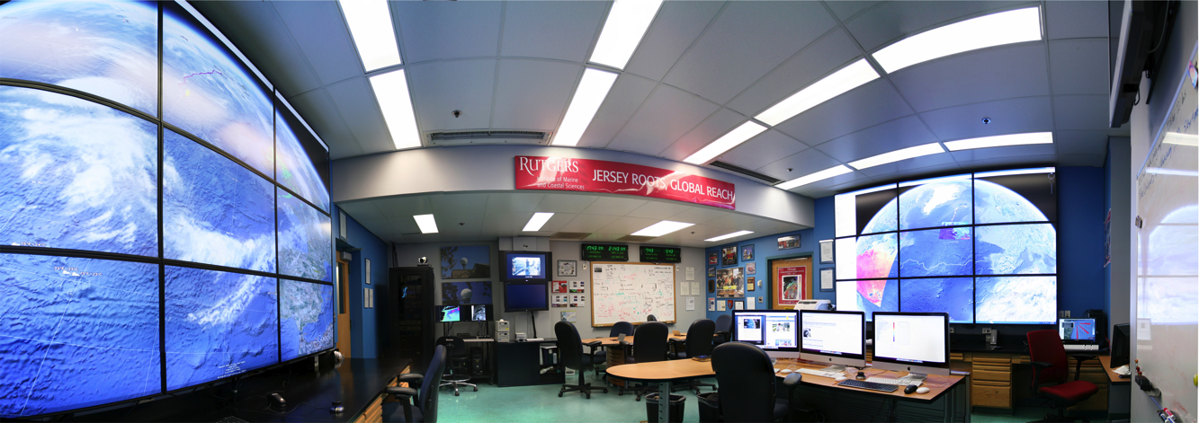
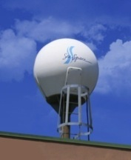
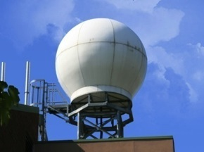
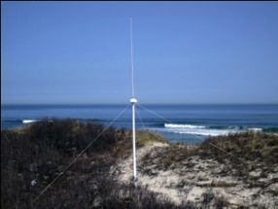
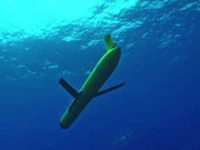
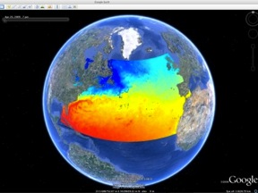
Rutgers University - Coastal Ocean Observation Lab
Operations, Research & Education Center
Vessels -
Satellite
Satellite
CODAR
Ships/ Vessels
Glider
REMUS
Data Vis.
Modeling
Security
Leadership
Education
Satellite Data Acquisition Stations
CODAR Network
Glider Fleet
3-D Forecasts

Slide 7
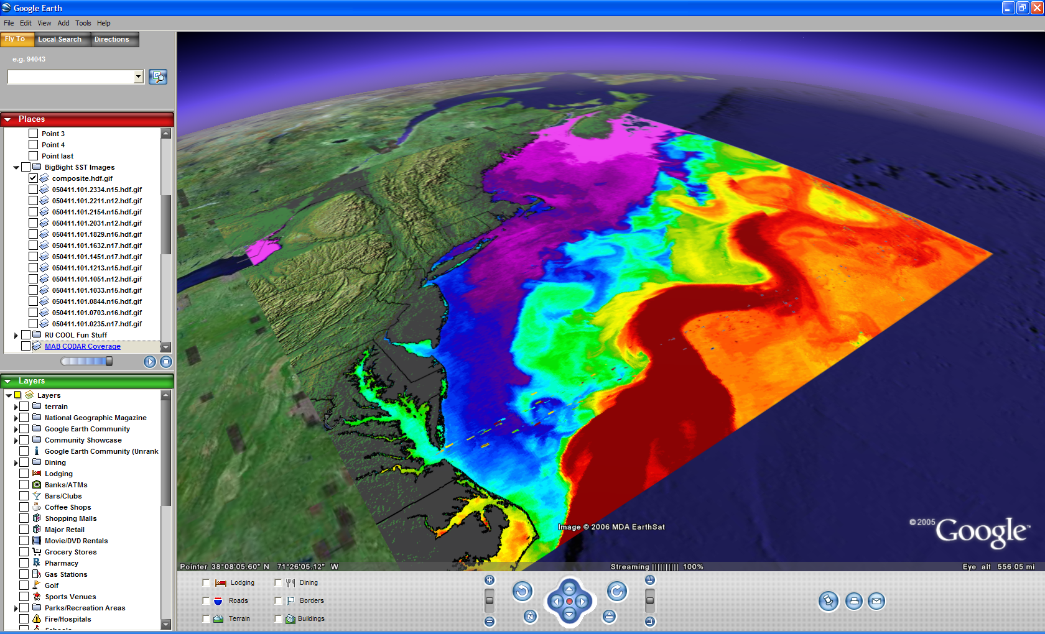

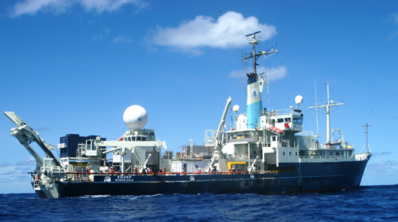
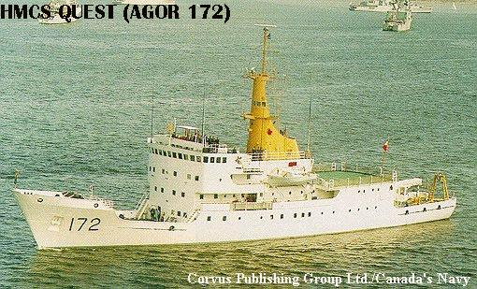
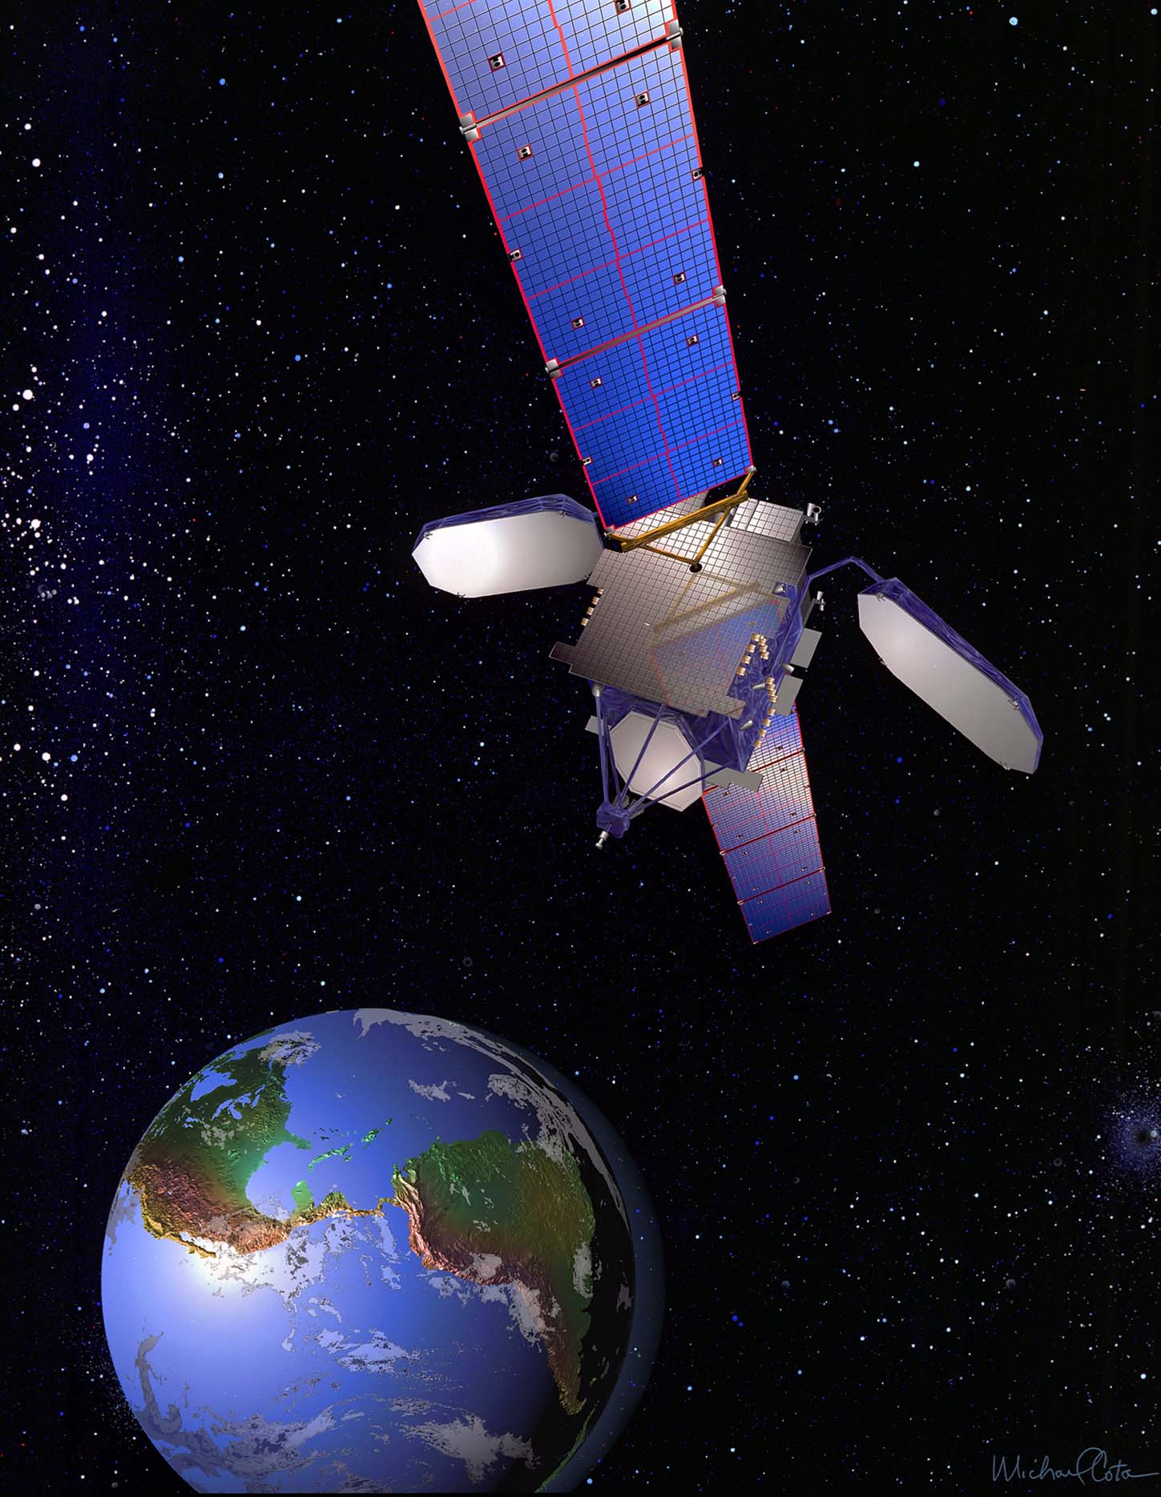
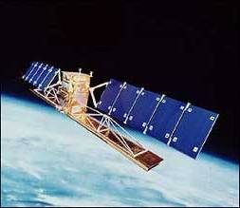
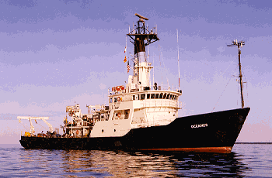
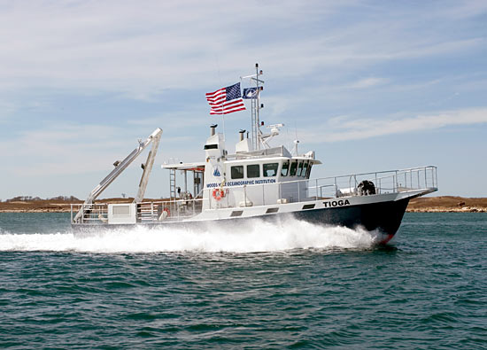
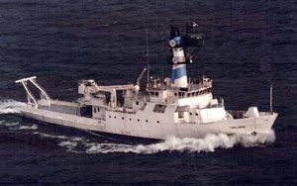
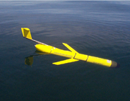
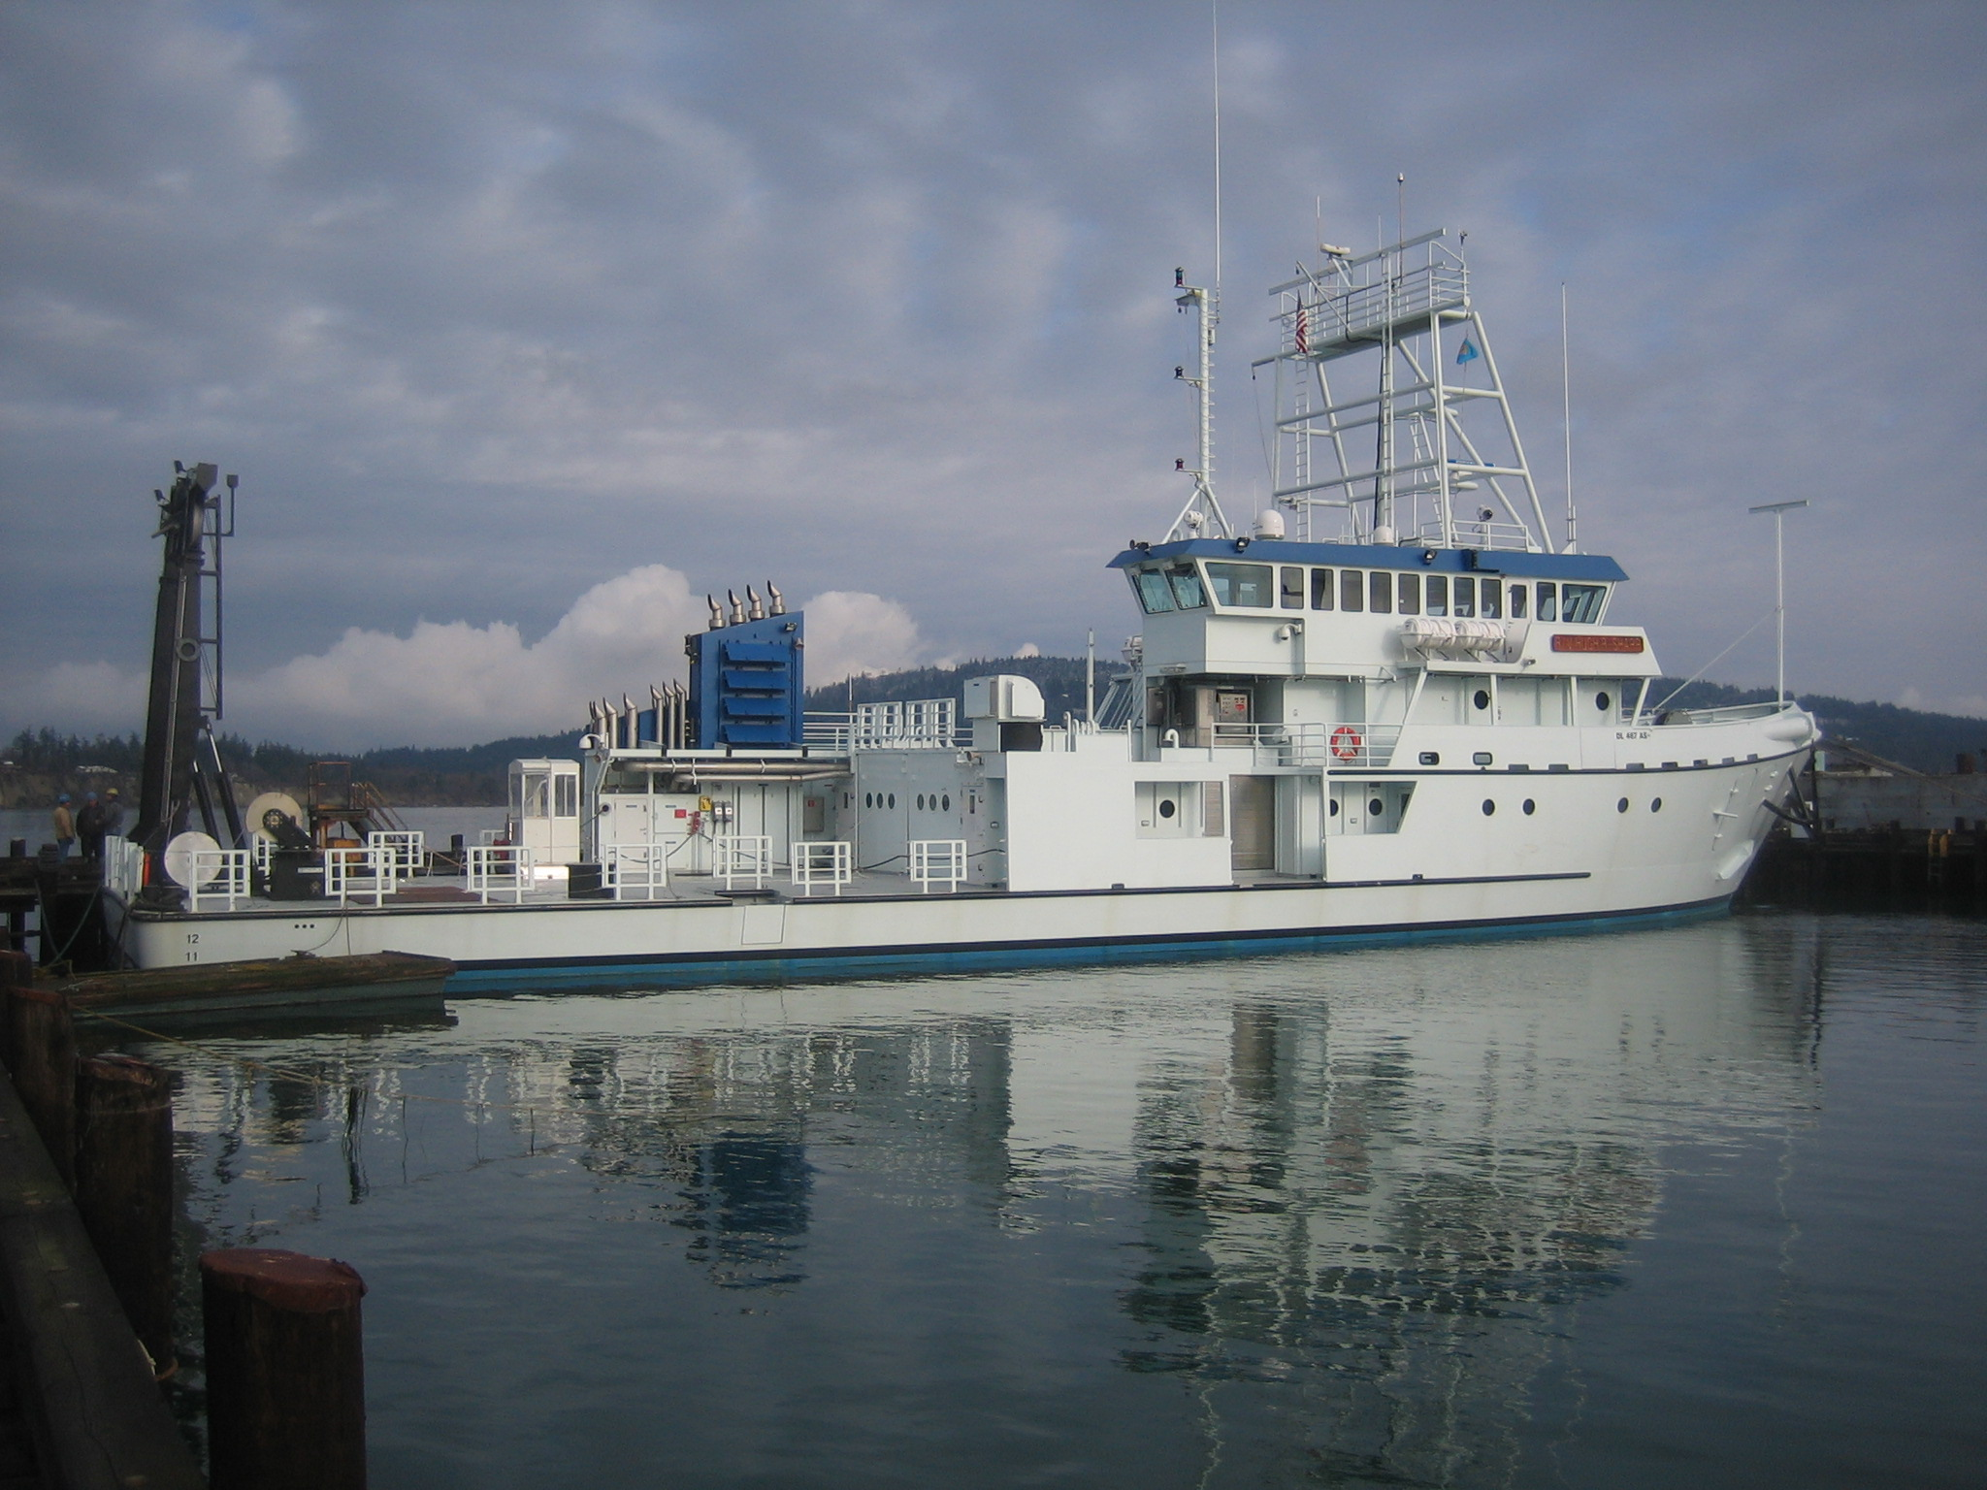
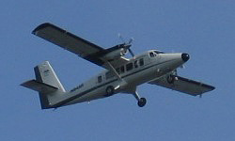
ONR Shallow Water 2006 Joint Experiment
HiSeasNet
>12 Satellites
48 Senior
PI’s & PM’s
Communication
7 Ships
3 Ground- stations
10 Gliders
1 Aircraft
62 Moorings

Slide 8
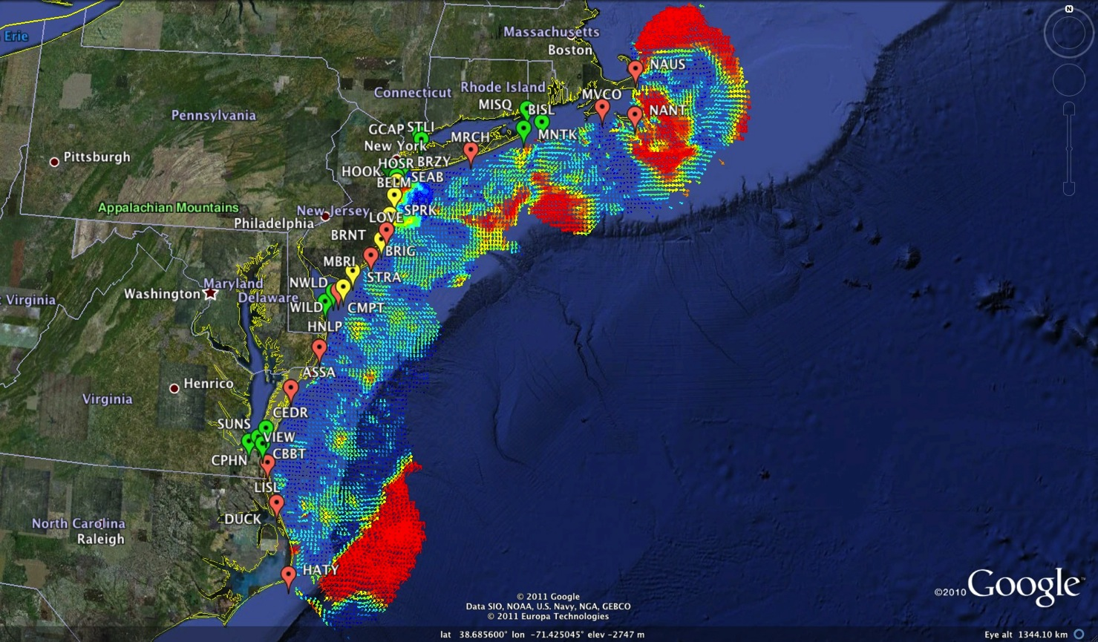
Mid-Atlantic Bight HF Radar Network
1000 km Alongshore Length Scale
Mid-Atlantic HF Radar Network
14 Long-Range CODARs
7 Medium-Range CODARs
15 Short-Range CODARs
36 Total
Triple Nested & Multistatic
Dual-Use:
1) Surface Current Mapping
2) Vessel Tracking

Slide 9
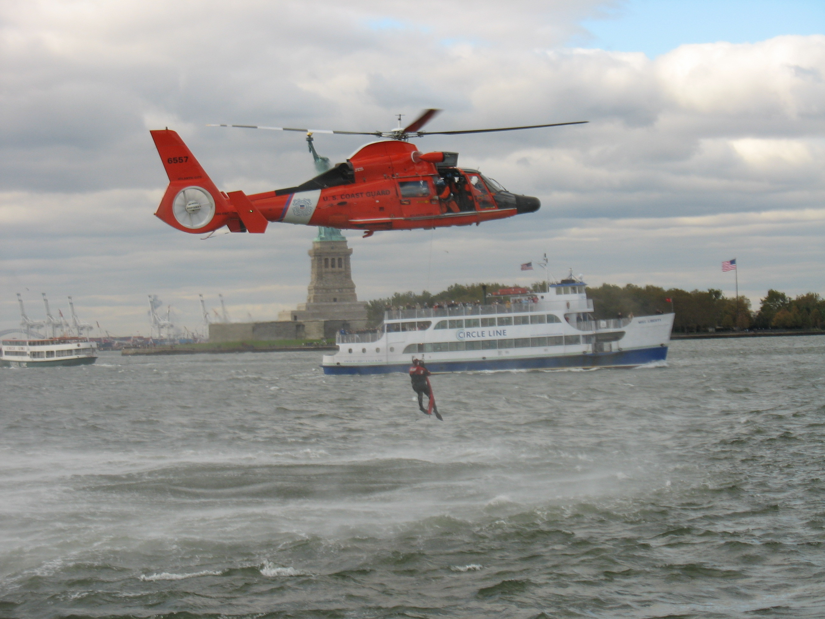

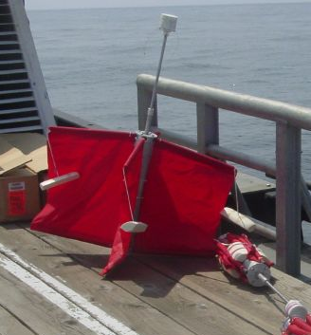
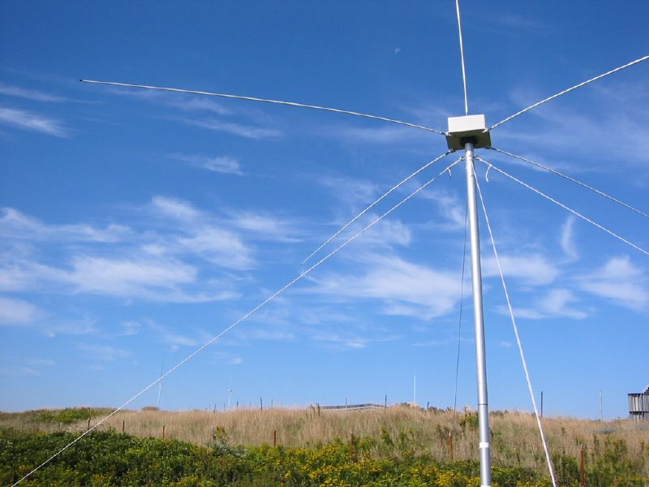
Success Stories – Making a Difference
Optimizing HF Radar for SAR using USCG Surface Drifters
Art Allen
U.S. Coast Guard
Scott Glenn
Rutgers University
Mid-Atlantic Regional Association
Coastal Ocean Observing System

Slide 10
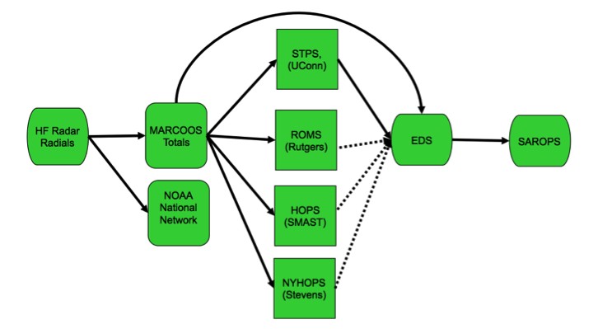
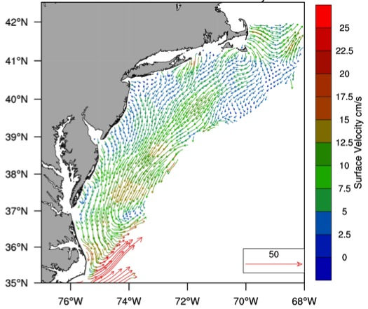
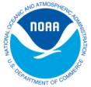
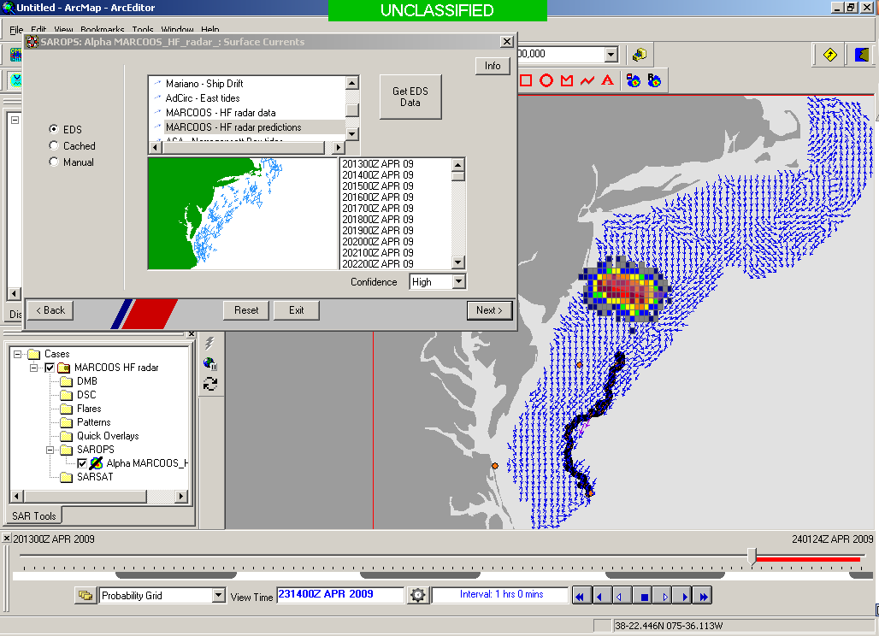
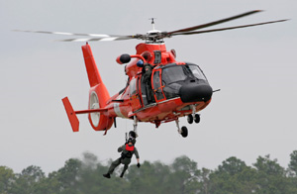


Transition Objective –
Operational Use of HF Radar Surface Currents for Search And Rescue
Surface Currents
Data Acquisition
Data Product Generation & Management
Search And Rescue Optimal Planning System (SAROPS)

Slide 11


5000 Virtual Drifters –
24 Hours Into Search
HYCOM
Low Confidence
CODAR
High Confidence
Notes:
HYCOM, (low Conf) 24 hrs

Slide 12


5000 Virtual Drifters –
48 Hours Into Search
HYCOM
Low Confidence
CODAR
High Confidence
Notes:
HYCOM, (low Conf) 24 hrs

Slide 13


5000 Virtual Drifters –
72 Hours Into Search
HYCOM
Low Confidence
CODAR
High Confidence
Notes:
HYCOM, (low Conf) 24 hrs

Slide 14


5000 Virtual Drifters –
96 Hours Into Search
HYCOM
Low Confidence
CODAR
High Confidence
Notes:
HYCOM, (low Conf) 24 hrs

Slide 15


5000 Virtual Drifters –
Search Area After 96 Hours
154 km
100 km
232 km
123 km
HYCOM
36,000 km²
CODAR
12,000 km²
Notes:
HYCOM (Low Conf) 48 hours

Slide 16

May 4, 2009: After a year of testing, NOAA Announces on
U.S. Department of Commerce Website that
MARACOOS CODAR is Operational in SAROPS
Present Activity:
Bring all
sustained regional-scale HFR networks up to operational status in USCG SAROPS
3 West Coast Regions for
California & Oregon are ready.

Slide 17





Responding to Crisis: Deepwater Horizon
U.S. IOOS partnership demonstrated ability to:
Quickly deploy technologies: Gliders and HF radar, saving resources/improving safety
Data & imagery made available to NOAA/Navy models
Data availability improved spill response decision-making and public understanding
USM HFR
USF HFR
June 2
HFR validation of SABGOM Forecast combined with satellite detected oil slicks
Web Portal
HFR data informed NOAA
trajectory forecasts
Briefing Blog

Slide 18














The Center for Secure and Resilient Maritime Commerce (CSR)
DHS Center of Excellence for Port Security
11 Institutions – Maritime Domain Awareness & Resiliency
Maritime Domain Awareness
Approach –
Dual Use Technologies
Demonstrate Nested Vessel Detection
Global > Approaches > Port
University of Miami –
Global Satellite Coverage,
Visible & Microwave
Rutgers University –
Over-the-Horizon Compact
High Frequency Radar Networks
Stevens Institute of Technology –
Local High-Resolution Optics &
Shallow Underwater Acoustics

Slide 19
The Center for Secure and Resilient Maritime Commerce (CSR)
Rutgers University – CODAR Ocean Sensors
Academic – Industry Partnership since 1998
CSR’s HF Radar Mission:
Develop the HF Radar Dual-Use Capability for Current Mapping & Vessel Tracking.
Transition these Capabilities to Operational Use for Search And Rescue (SAR) and Maritime Domain Awareness (MDA).
Educate the Workforce Required to Operate these National Systems.

Slide 20

The Center for Secure and Resilient Maritime Commerce (CSR)
Rutgers University – CODAR Ocean Sensors
Academic – Industry Partnership since 1998
HF Radar Team
Rutgers University -
Scott Glenn, Josh Kohut, Hugh Roarty,
Mike Crowley, John Kerfoot, Ethan
Handel, Mike Smith, Colin Evans
CODAR Ocean Sensors -
Don Barrick, Pete Lilleboe, Laura
Pederson, Belinda Lipa, Chad Whelan,
Bruce Nyden, Bill Rector, Jimmy Isaacson
University or Puerto Rico – Mayaguez
Jorge Corridor, Julio Morrell
Applied Mathematics, Inc -
Bill Browning
University of Alaska –
Tom Weingarter, Hank Statscewich
Ocean Power Technologies –
Debbie Montangne
ONR - 2004

Slide 21






CSR Research Objective – Develop the Dual Use Capability in 3 Testbeds
Detection Association Track Fitting
Urbanized Harbor Testbed Tropical Testbed Arctic Testbed
CSR – Year 4 Status

Slide 22





CSR 2008 Field Test
Signal present in Loop 2 and Monopole. Signal originated in direction of Stevens anchor site.
Loop 2
Loop 1
Loop 1
Loop 2
Monopole
HF Radar Geometry & Doppler Spectra from Range Cell 8
Bragg Waves
The Center for Secure and Resilient Maritime Commerce (CSR)
22

Slide 23

Rutgers Spring 2009 Field Test – Approaches to New York Harbor:
Doppler Spectra from all Range Cells with Detection Threshold Applied
Fixed Objects & Direct Signals
Bragg Waves
Bragg Waves
Vessel
Vessel
Range
Doppler Frequency
The Center for Secure and Resilient Maritime Commerce (CSR)

Slide 24
The Center for Secure and Resilient Maritime Commerce (CSR)

Slide 25

The Center for Secure and Resilient Maritime Commerce (CSR)

Slide 26

The Center for Secure and Resilient Maritime Commerce (CSR)

Slide 27

The Center for Secure and Resilient Maritime Commerce (CSR)

Slide 28

The Center for Secure and Resilient Maritime Commerce (CSR)

Slide 29

The Center for Secure and Resilient Maritime Commerce (CSR)

Slide 30

The Center for Secure and Resilient Maritime Commerce (CSR)

Slide 31

The Center for Secure and Resilient Maritime Commerce (CSR)

Slide 32

The Center for Secure and Resilient Maritime Commerce (CSR)

Slide 33

The Center for Secure and Resilient Maritime Commerce (CSR)

Slide 34

The Center for Secure and Resilient Maritime Commerce (CSR)

Slide 35

The Center for Secure and Resilient Maritime Commerce (CSR)

Slide 36

Multi-Level Access and Information Sharing with Open Mongoose (MDA CONOP)
(U) Multi-Level Enclaves Provide Appropriate Level Data to Customers

Slide 37

SNR 14 dB

Slide 38

SNR 16 dB

Slide 39

SNR 18 dB

Slide 40

SNR 20 dB

Slide 41

SNR 22 dB

Slide 42

SNR 24 dB

Slide 43

SNR 26 dB

Slide 44

SNR 28 dB

Slide 45

SNR 30 dB

Slide 46






Bohemia AIS Track SNR>9
HF Association one σ
HF Association two σ
HF Association three σ
HF Detection >20dB
20dB>= HF Detection >12dB
AIS Contact
Time: 0:25:00
Distance travelled: 11.3km
7.2km
AIS Bohemia Velocity Range: 10.3KTS up to 10.4KTS. Several HF Radar detections associated by one, two and three standard deviations
Radar Characteristics: SNR>9, Distance from radar when tracked: 7.2 km

Slide 47














Real-Time Dual Use
HF Radar Status:
1) Working in the Mid-Atlantic
2) Summer 2012 Alaska Test
3) Winter 2012-2013 Puerto Rico Test
Hurricane Irene
August 26, 2011
http://maracoos.org

