Slide 1
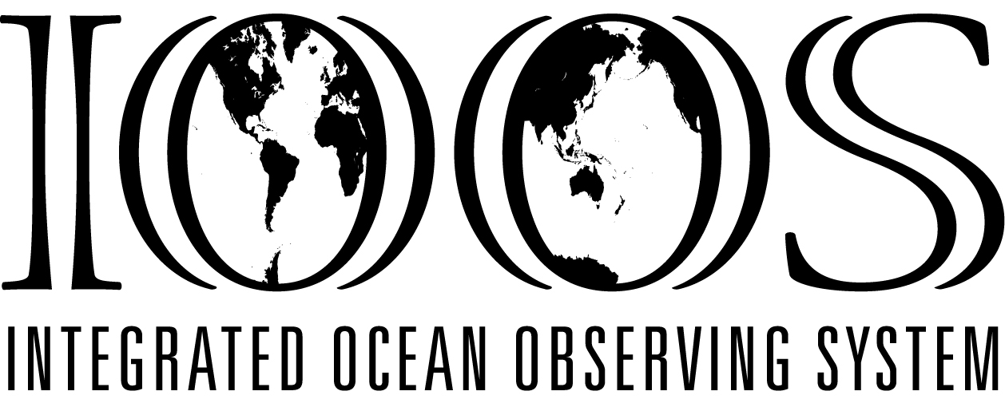
Alaska Ocean Observing System
Molly McCammon
July 27, 2012

Slide 2
IOOS (National) Vision & Goals
VISION: To better detect, assess & predict effects of large-scale changes in oceans on coastal ecosystems, resources & human populations by seamlessly linking observations, models & data, in order to:
Improve prediction of climate change impacts
Improve safety & efficiency of marine operations
More effectively protect & restore healthy coastal ecosystems
Sustain marine resources
Mitigate effects of natural hazards
Reduce public health risks
Improve national security
(adapted from: An Integrated and Sustained Ocean Observing System, Ocean.US 2002)

Slide 3
U.S. IOOS Multi–Scale System
Global Ocean
Climate Component
GOOS/GCOS
Coastal Ocean
Component
Great
Lakes
ALASKA
NorthEast
NW
Mid-Atlantic
Regional
Observing
Systems
Pac
Islands
Southeast
Cen
Calif
Gulf of
Mex
S
Calif
Carrib
National
Backbone
Low
Resolution
High
3
Notes:
7. The IOOS is a multi-scale system consisting of two interdependent components,
one for the Global Ocean and
one for U.S. coastal waters and Great Lakes.
The coastal component consists of a
National Backbone with
Regional Coastal Ocean Observing Systems nested in it.
The global ocean-climate component is primarily concerned with global climate change, natural hazards & marine services.
The coastal component is primarily concerned with the impacts of climate change, natural hazards and human activities on the coastal zone and the Great Lakes.
Plans for the global ocean-climate component were completed in the late 1990’s and implementation is underway.
Plans for the initial coastal component have been completed and approved recently and implementation is just beginning.

Slide 5
AOOS is User-Driven
Stakeholder concerns
Climate change impacts
Increased coastal erosion
Changing marine ecosystems
Unstable sea ice and uncertain freeze/thaw dates
Fewer subsistence resources
More shipping = more oil spill potential
Changing sea state: more fog, storms, winds, waves
Data Management
Integration & Analysis
Information Products Needed
Nowcasts
Warnings & bulletins
Forecasts
Weekly, monthly & seasonal outlooks
Futurecasts
Scenarios & projections
Observations
Satellites
Fixed platforms
Ships
Drifters
Floats
AUVs
Standards
Data discovery
Data transport
Online browsing
Data archive
Outcomes: Meeting Societal Goals

Slide 6
AOOS Founding Board Members
State
Fish and Game
Environ Conservation
Natural Resources
Research
Univ of AK
Sea Grant
AK SeaLife Center
Prince William Sound Science Center/
Oil Spill Recovery Inst.
US Arctic Research Commission
North Pacific Research Board
Barrow Arctic Science Consortium
NOAA AK Fisheries Science Center
Federal
USGS
NOAA
Coast Guard
BOEM (MMS)
Other
Marine Exchange of Alaska

Slide 7
2011-2012 AOOS Officers
Chair –Ed Page, Marine Exchange
Vice-chair – Ed Fogels, ADNR
Secretary – Glenn Sheehan, BASC
Treasurer – Amy Holman, NOAA
Ex officio EXCOM – Tara Jones, ASLC

Slide 8
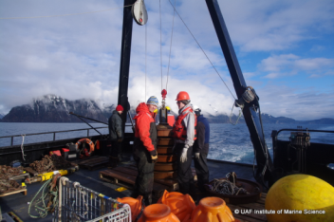
Projects & Programs
What We fund – (examples):
Marine Operations
Circulation and wind modeling, providing daily forecasts in Gulf of AK
Wave modeling (SWAN)
Wave buoys in Cook Inlet & Bering Sea**
Snotel stations in Prince William Sound & CI
AIS & weather sites**
Coastal Hazards
Alaska Harbor Observation Network – Kodiak &
Seward
Sea Ice Atlas**
Water quality
Ocean acidification sensors**
Sea Ice Atlas**
Ecosystems, Fisheries & Climate Trends
Seward Line (long-term data series)
Glider for Arctic research**
Distributed Biological Observatory**
HF radars in Chukchi**

Slide 9
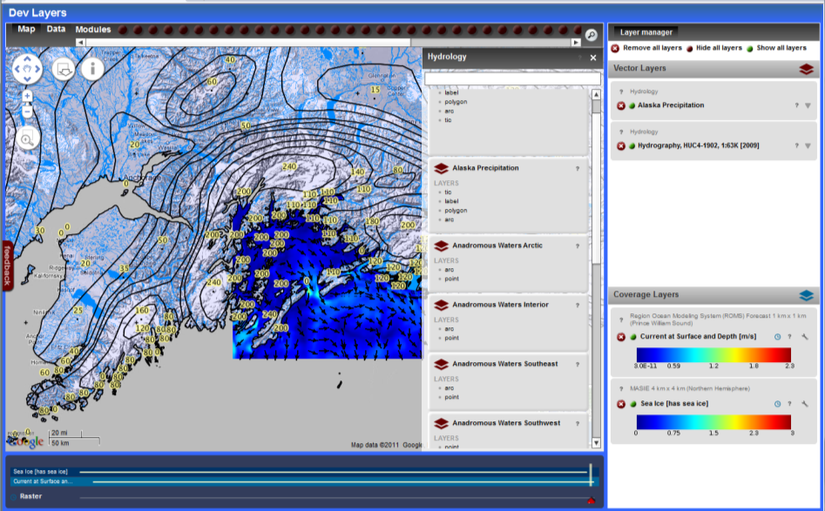
AOOS Ocean Portal
Linking AOOS data applications
View multiple types of
data on one interface
Sensors
Models
Remote Sensing
GIS & project data
In-situ observations
View available time
ranges for each layer
Download data sets
simultaneously
Follow links to data sources
Data management for integrated research projects
Coastal marine spatial planning tools
Public access to industry data
Notes:
This system will allow users to visualize, query and integrate data from multiple source types (sensors, models, remote sensing, GIS data layers and in situ observations) on a single platform.
→planning and management

Slide 10
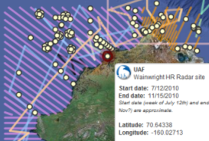
Arctic Research Assets Map
Used for research planning.
Reduce duplication of effort
Identify gaps
Avoid collisions
Opportunities for collaboration
Holistic view of research effort
Includes ship & aircraft tracks
Have added studies; now expanding to western AK and then statewide

Slide 11
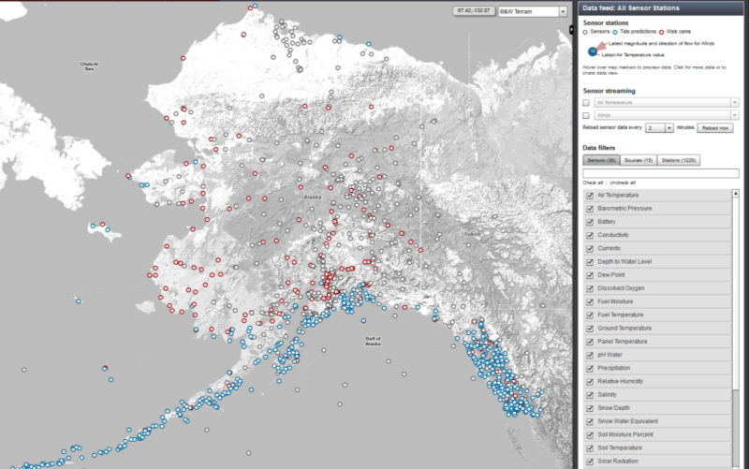
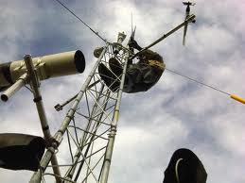
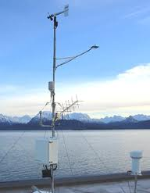
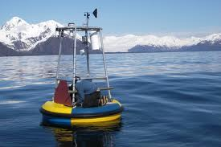
Real-Time Sensor Map
Over 3,000 sensors
Air temp
Barometric Pressure
Currents
Water level
Ground temp
Precipitation
Humidity
Salinity
Snow depth
Stream flow
Stream height
Tides
Water temp
Web cams
Weather
Wind
More….
Notes:
Pulling 3,000+ real-time sensors
Broadest interpretation of “coastal”
Google interface
Zoom in on the Homer area

Slide 12
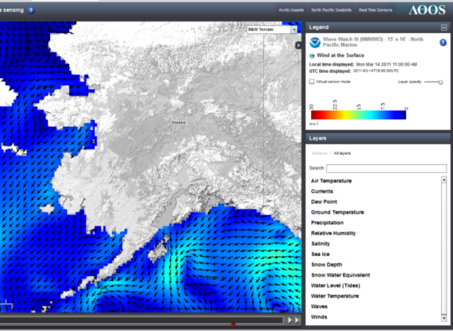
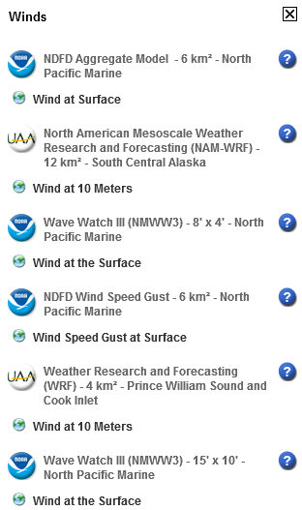
Model Explorer
Useful Parameters
Air Temp
Currents
Dew point
Ground Temp
Precipitation
Relative Humidity
Salinity
Sea Ice
Snow Depth
Snow Water Equivalent
Water Level (tides)
Water Temperature
Waves
Wind
Notes:
Have list of models

Slide 13
Currents
Drop your own virtual sensor
Notes:
Have list of models

Slide 14
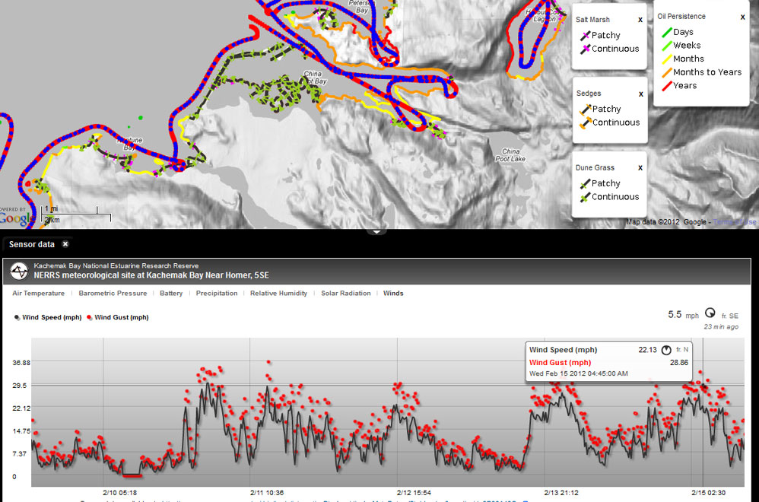
Ocean Portal: Cook Inlet Demonstration

Slide 15
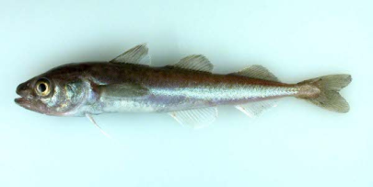
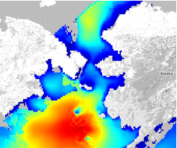
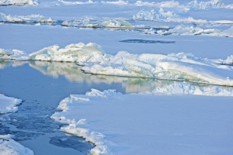
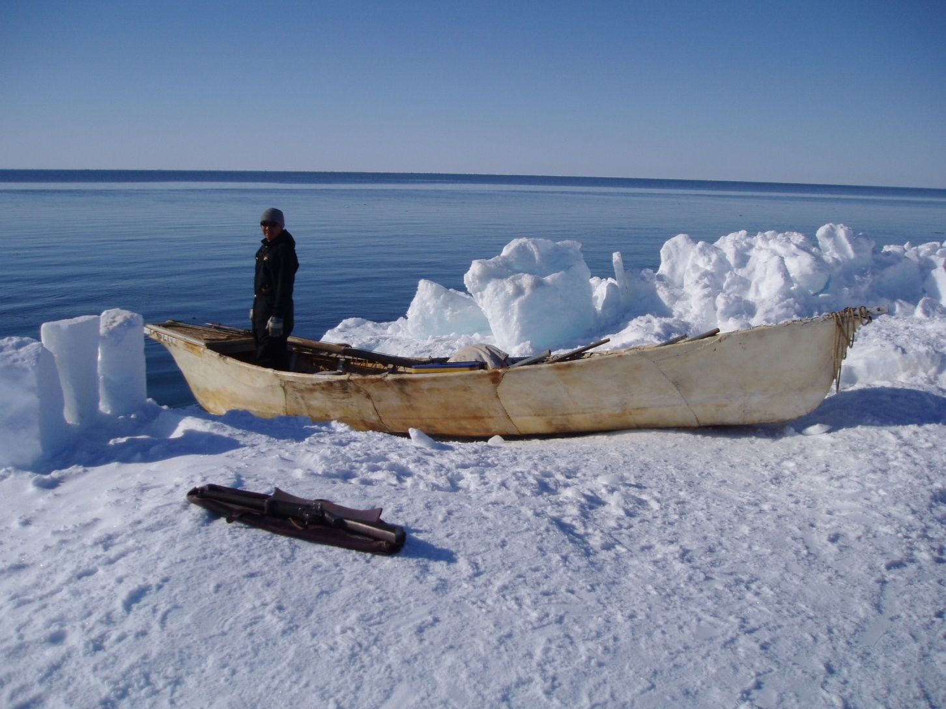
STAMP Project Spatial Tools for Arctic Mapping & Planning
Strong state support for data integration
Focus on identifying needs for data layers for decision support: human uses,
20 year climate scenarios, environmental (physical, biological, chemical)
What info do stakeholders need to plan for
potential commercial fisheries in Arctic?
What tools do decision-
makers need? Scenarios?
Cumulative impacts?
1.5 year, $760k
Partners: AOOS, UA, TNC

Slide 16
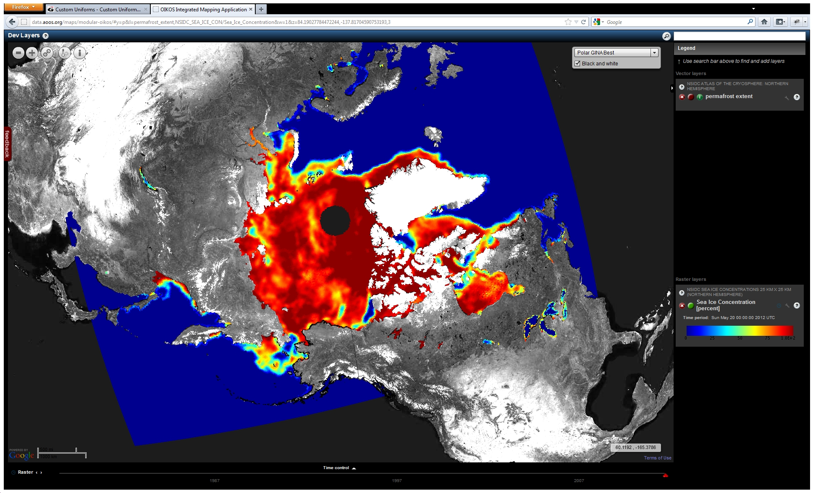
STAMP: Sea Ice Concentration (Daily Snapshot 1978-Current)
D

Slide 17
Industry/NOAA Data Sharing MOA
Signed in August by NOAA & 3 companies: Shell, Statoil & ConocoPhillips
Umbrella agreement committing industry to sharing data with government and public
1st priority: Annex #1, met ocean data in real-time to assist weather forecasting & sea ice images for forecasting – now signed
2nd priority: Annex #2, historic met-ocean data and non-real time environmental studies data
3rd priority: Annex #3, hydrographic & bathymetry surveys for charting, habitat mapping
AOOS Data Portal: public access to industry data
NOAA data centers: archives and access

Slide 18
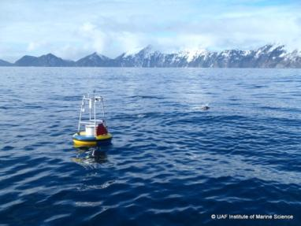
Thanks
www.aoos.org
Acknowledgements:
Axiom Consulting & Design, and many, many other partners on the federal, state, regional, and local level
Notes:
AOOS is a network of partners

