Slide 1
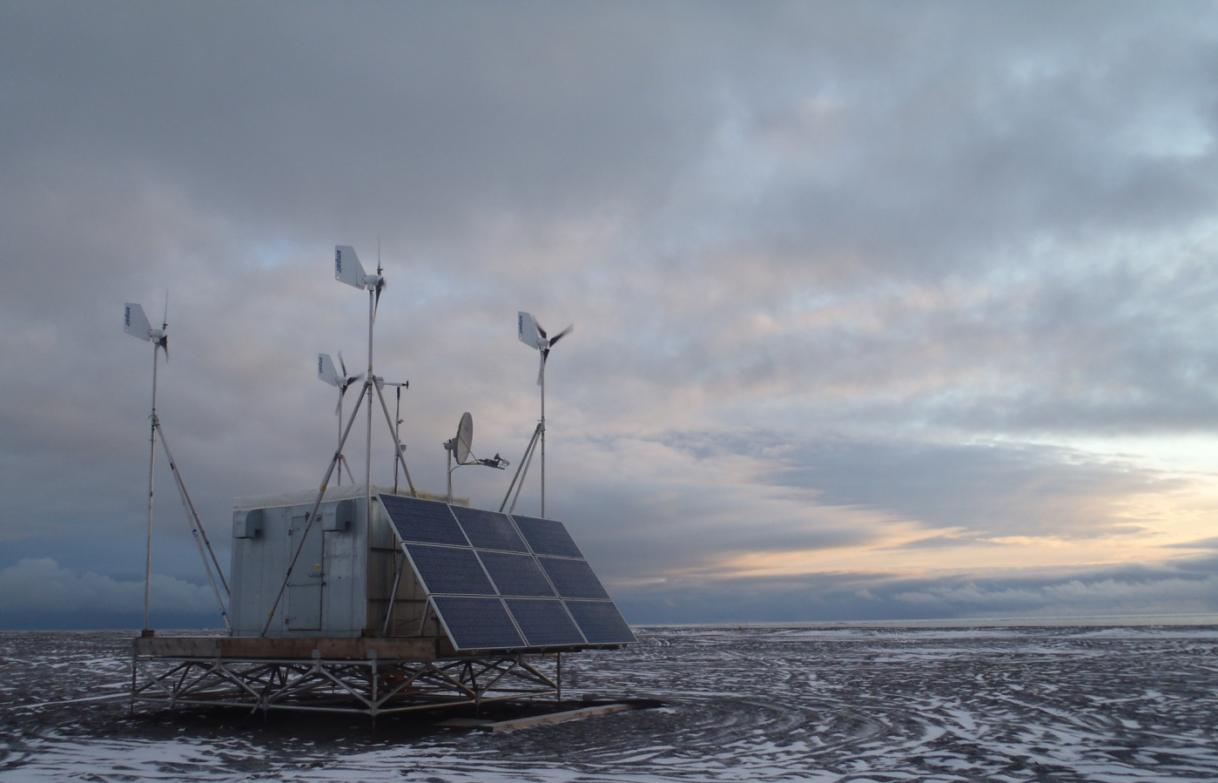
New Technology Developments for Increased Maritime Domain Awareness In the Chukchi Sea
Hank Statscewich and Tom Weingartner
USCG Debrief
Juneau, AK
July 27, 2012
Presented by
Hank Statscewich
University of Alaska Fairbanks

Slide 2
Objectives
Provide overview of UAF Arctic Ocean Observing Activities
Increase US Arctic MDA with new technologies
Inform CG of synergistic partnerships
Collaborate and Integrate data streams within an Arctic COP
SAROPS
Spill Response
Homeland Security

Slide 3
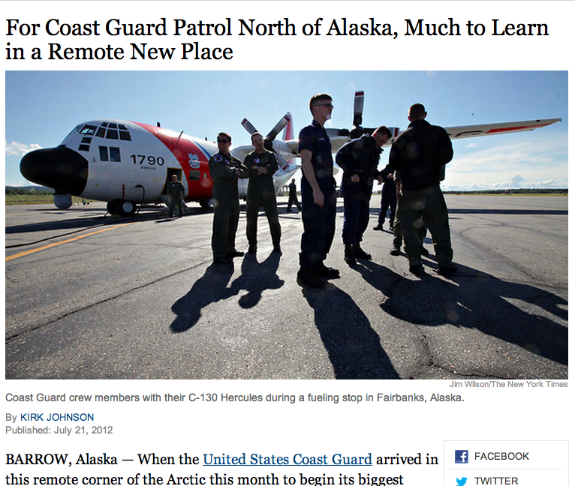
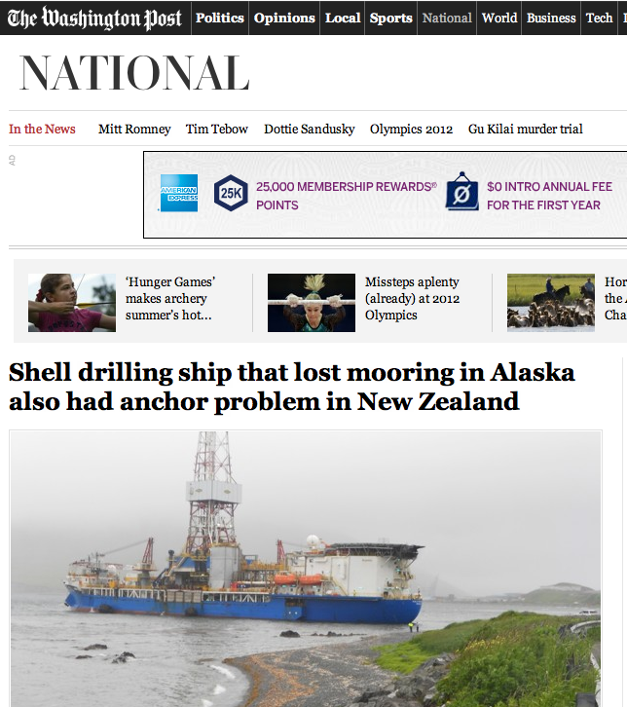
New York Times July 21, 2012
CNN
May 24, 2012
Washington Post July 16, 2012

Slide 4
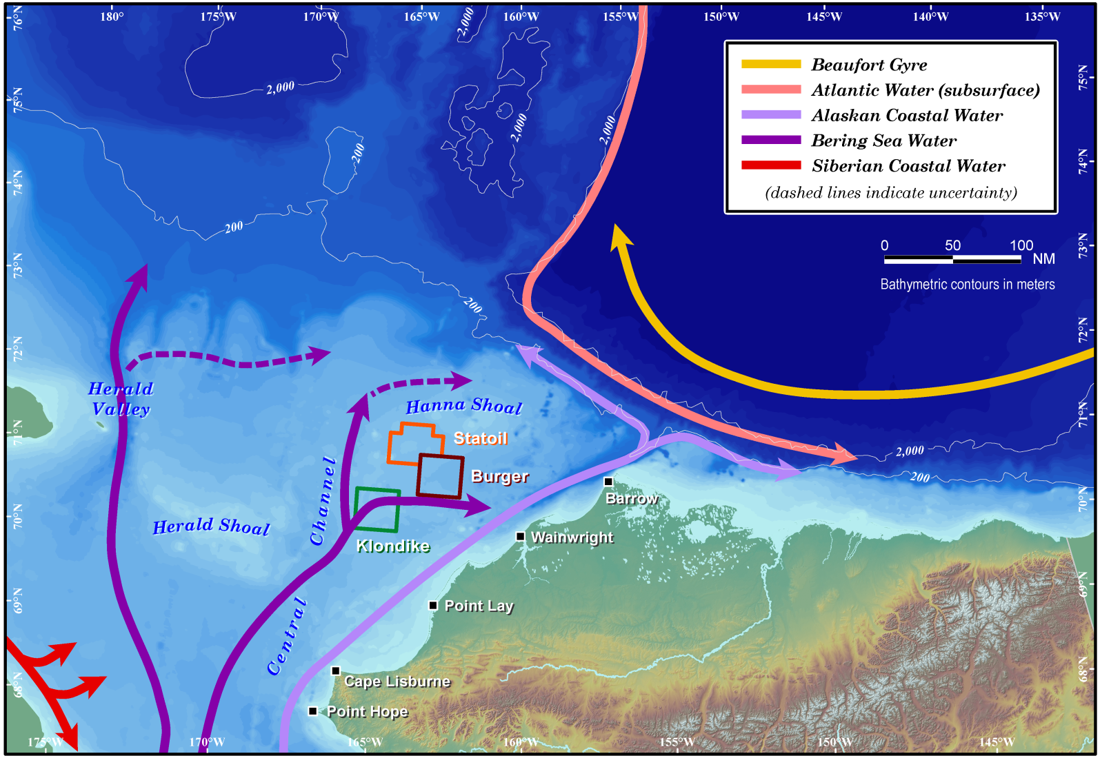
Scientific Mission
Study area
IOOS-AOOS
Glider survey line
Exchange with the Arctic proper is not well known. Schematic advection pathways, but details are largely missing
~1.0 Sv mean transport through Bering Strait
Notes:
Background: Science Mission
The overall goal of this SOW is to provide an improved understanding of the physical oceanography of the NE Chukchi shelf and exchanges between the Chukchi/Beaufort shelves and the adjacent continental slope

Slide 5
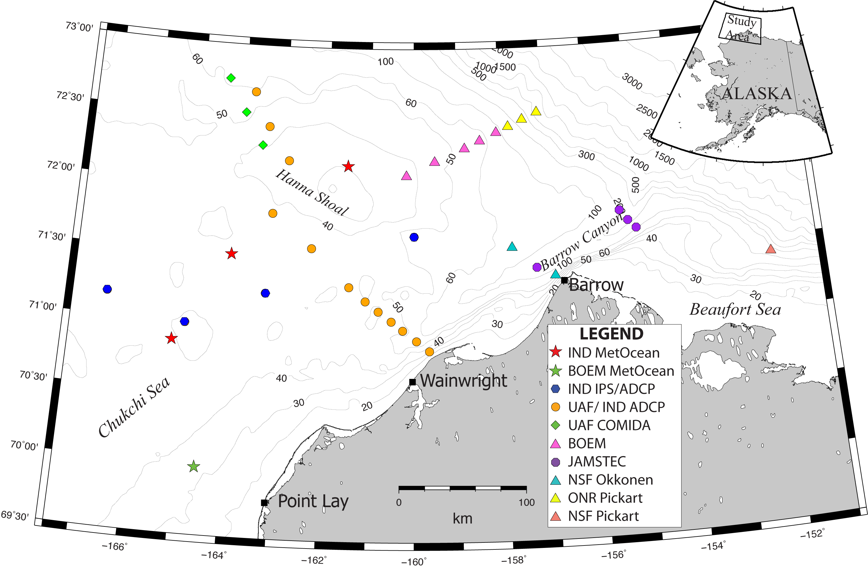
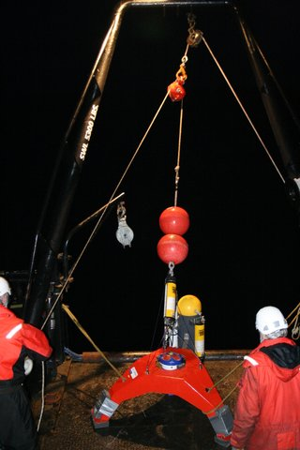
37 Underwater Moorings

Slide 6
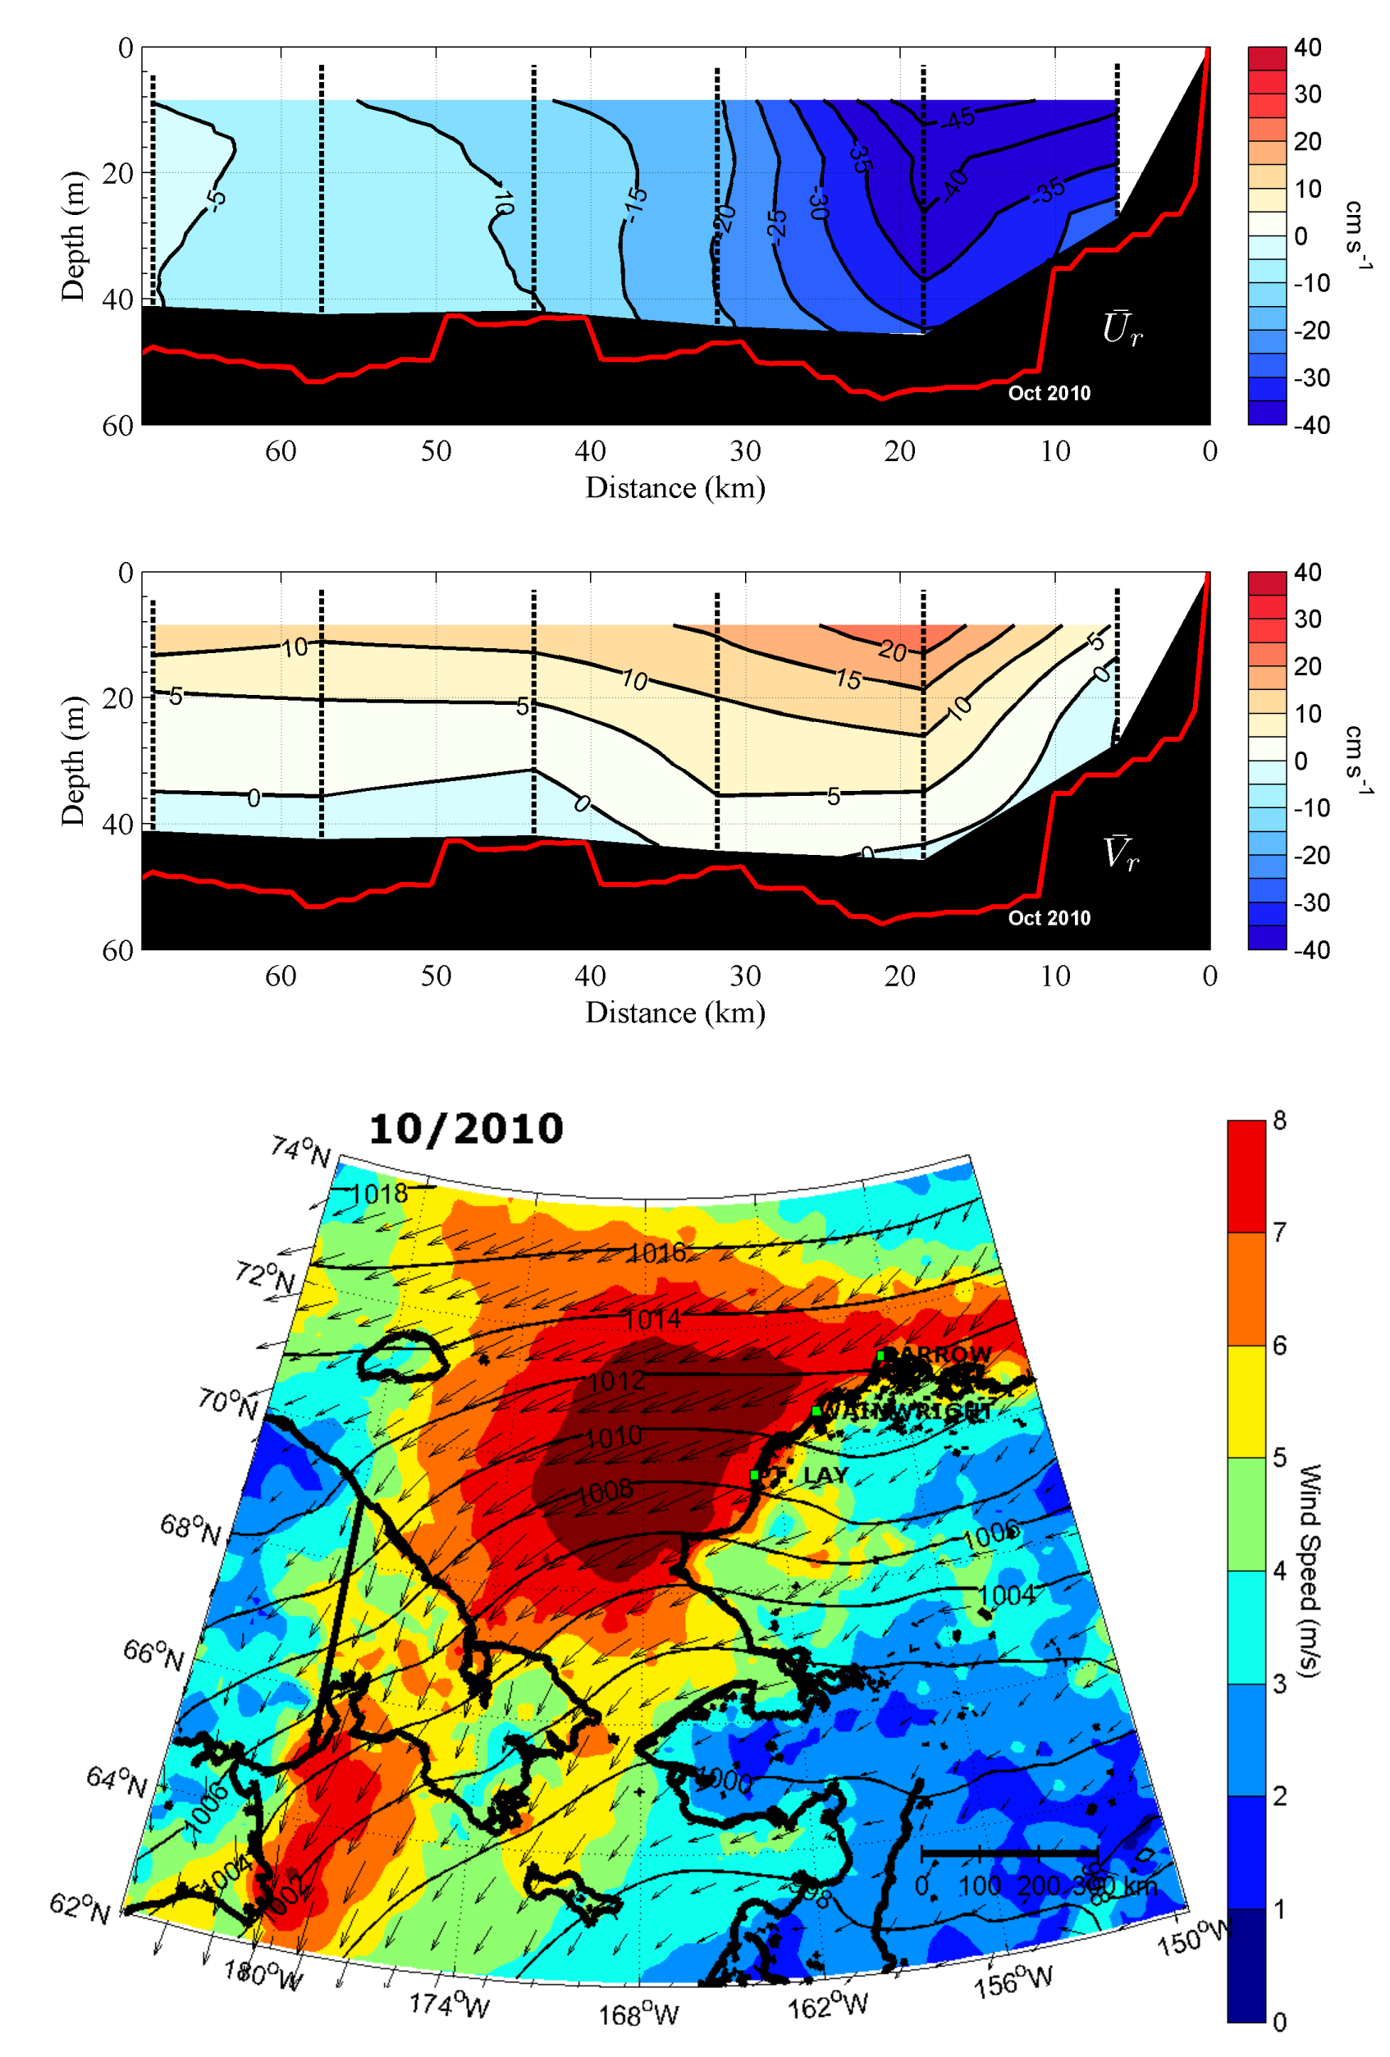
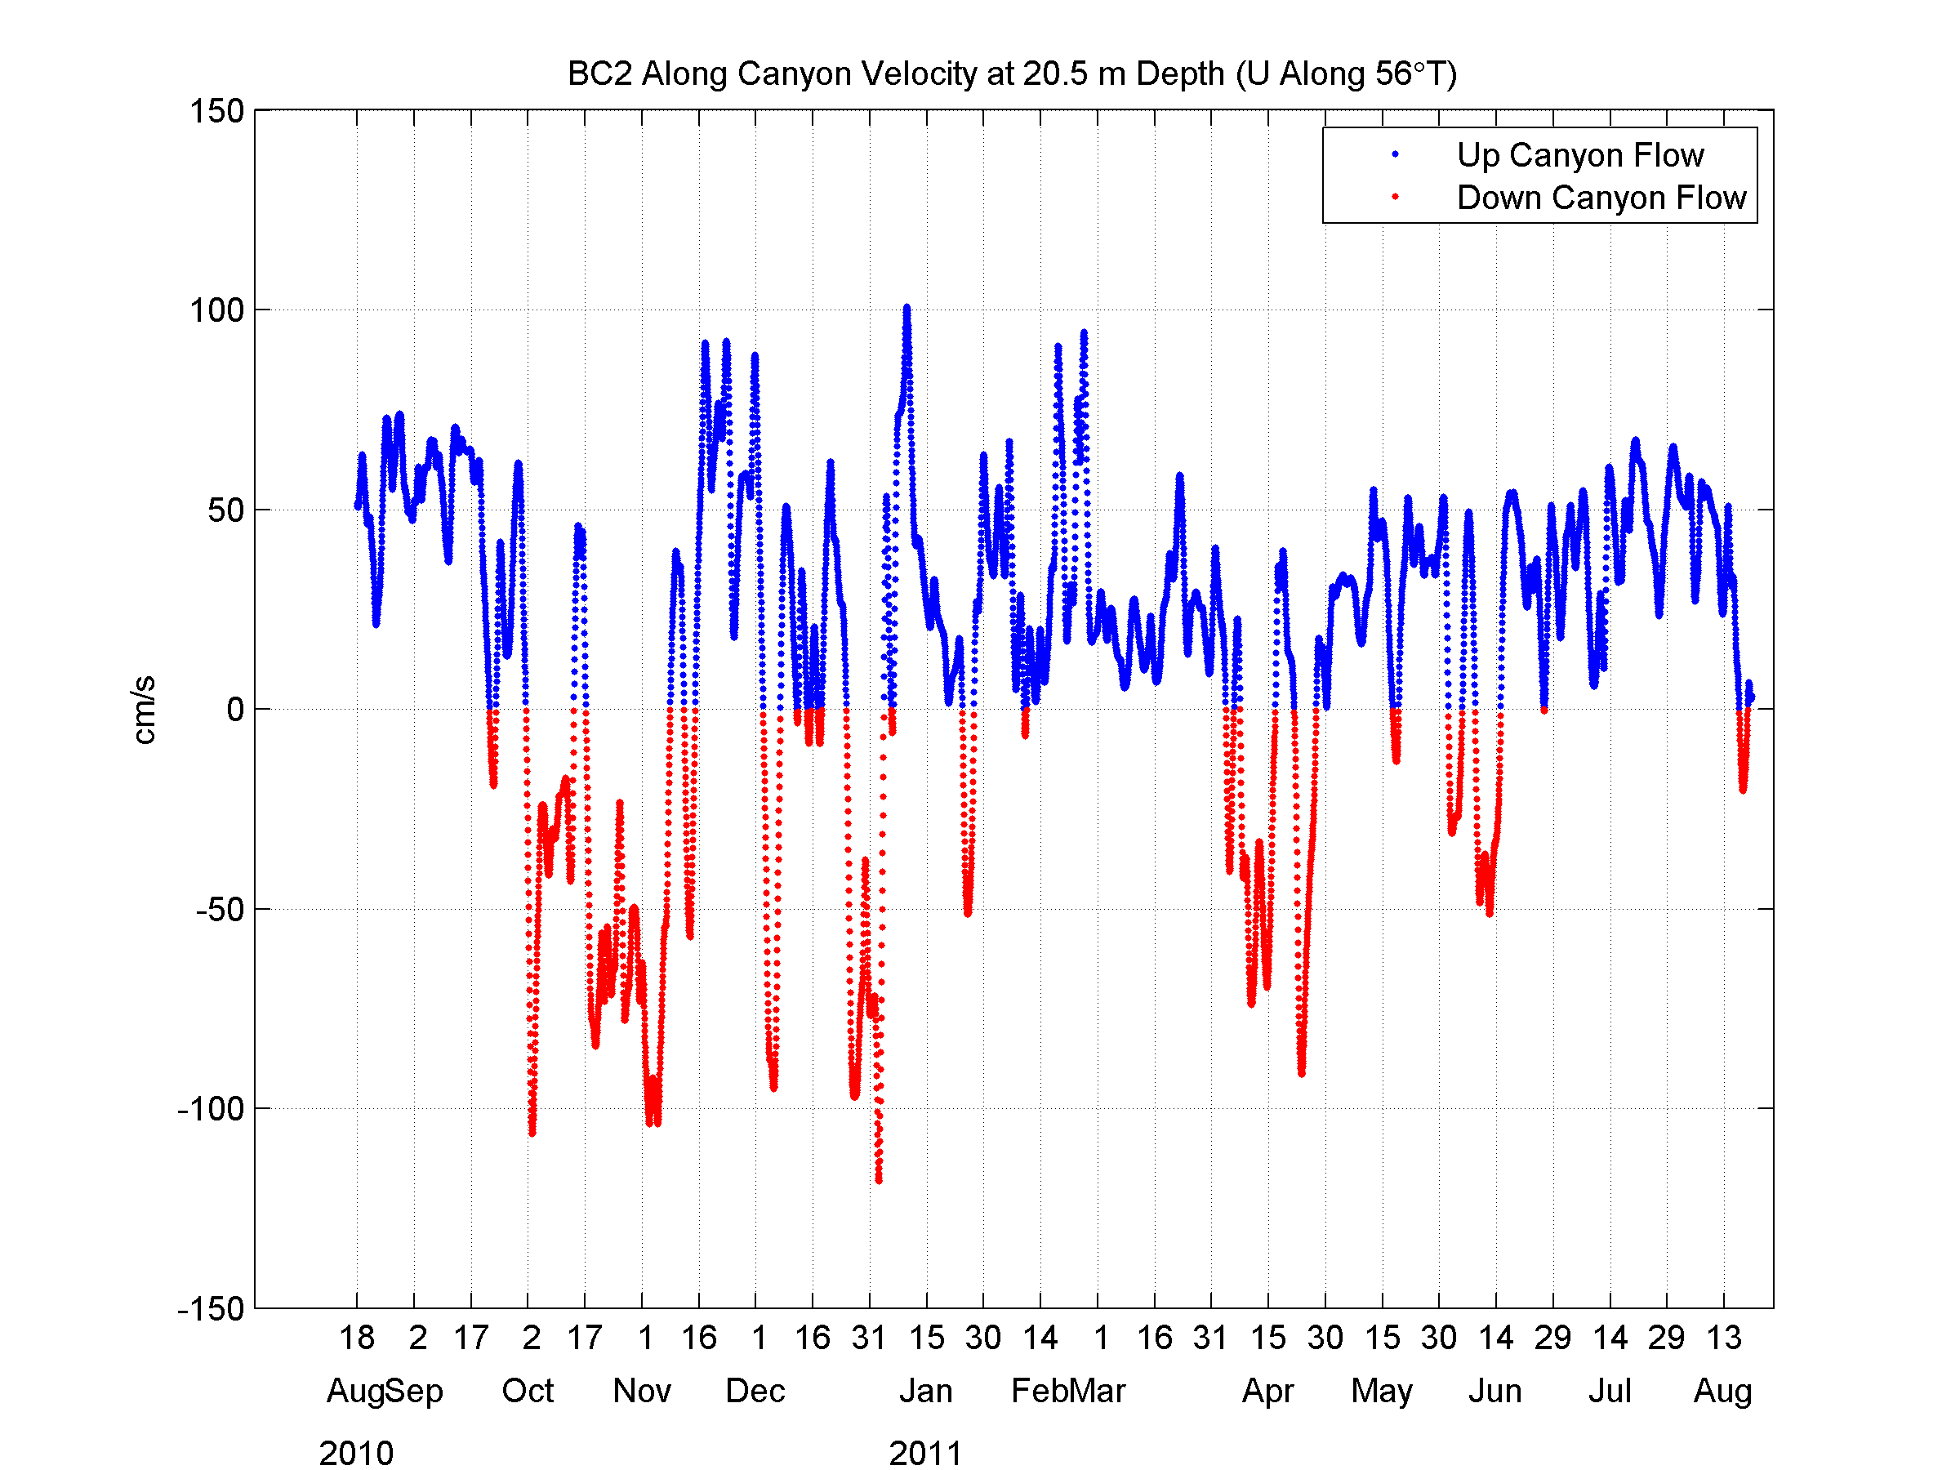
←October 2010 storm event
Alongshore
Year-long along-canyon velocities
Crossshore
Wind speed
Notes:
What is happening in response to the wind field

Slide 7
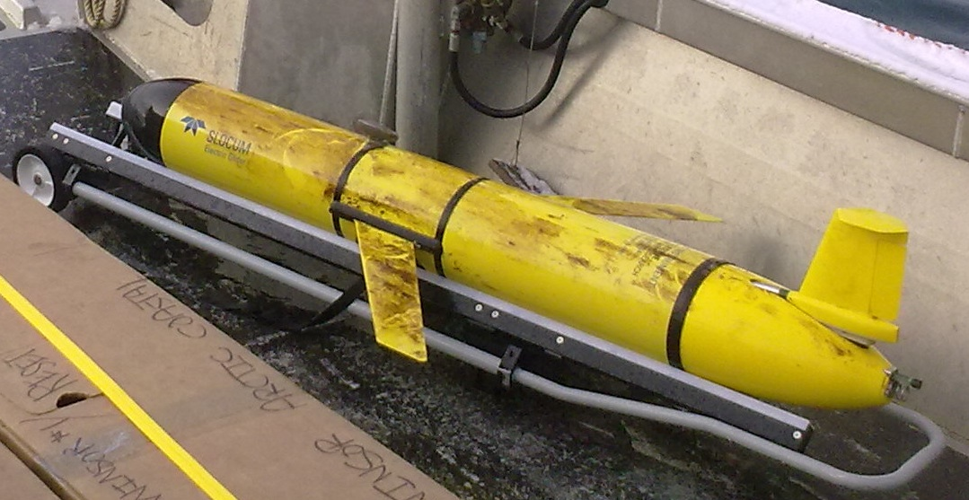
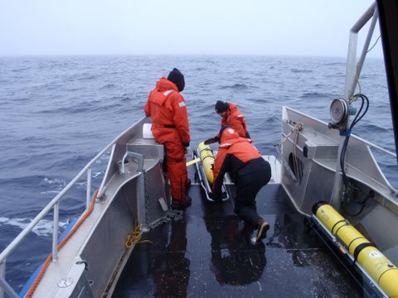
AUV operations in 2010 and 2011 using 3 Webb Slocum gliders performing > 6000 km of track length, collecting >20,000 CTD profiles. All are equipped with optical sensors for sampling hydrocarbon/CDOM and chlorophyll
Longest single mission duration 2.5 months using lithium batteries. Small 30’ fast local landing vessel for deployments and recoveries.
Sea-ice melt water, strong coastal jets and biology can be challenging…
Above: Webb Slocum G2 glider after a 2.5 month mission
Above: Deploying gliders of the 32’ vessel “Tukpuk”, Wainwright, Alaska

Slide 8
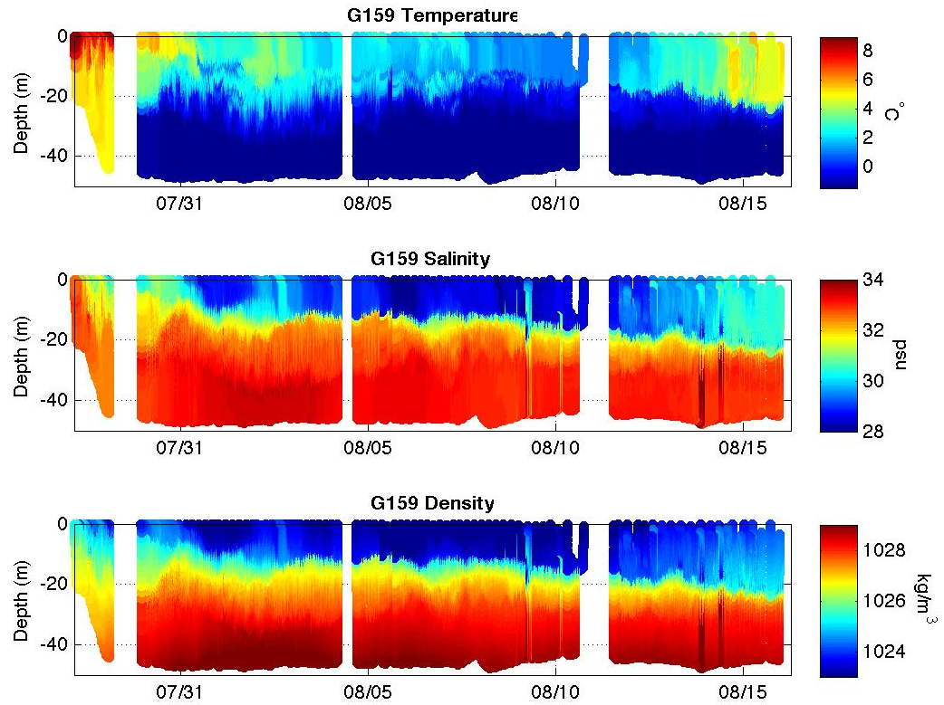
1. Warm, moderately salty water from Bering Strait
Cold, salty winter water (local and remotely formed)
Cold, fresh surface water from ice melt
1
3
1
2
1
3
1
2

Slide 9
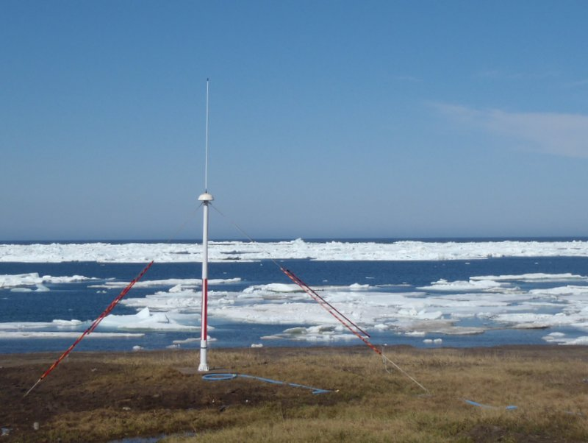
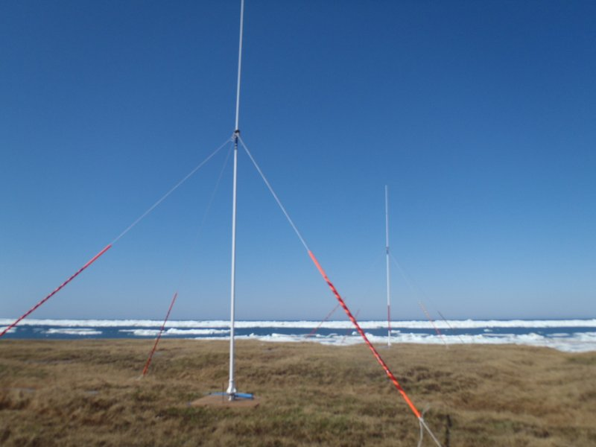
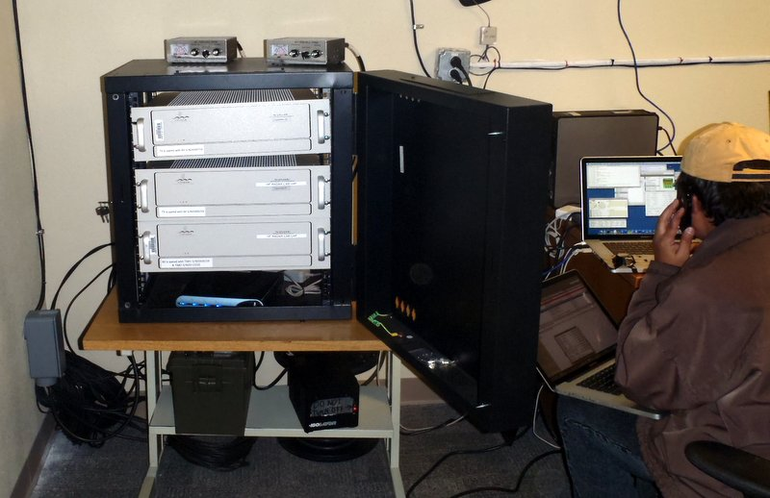
CODAR HF Radar
Hourly 2-D current vectors over ~200 km offshore.
Operated 5 units 2009-2011 in remote Arctic Alaskan regions (Barrow, Wainwright and Point Lay) from June to October.

Slide 11
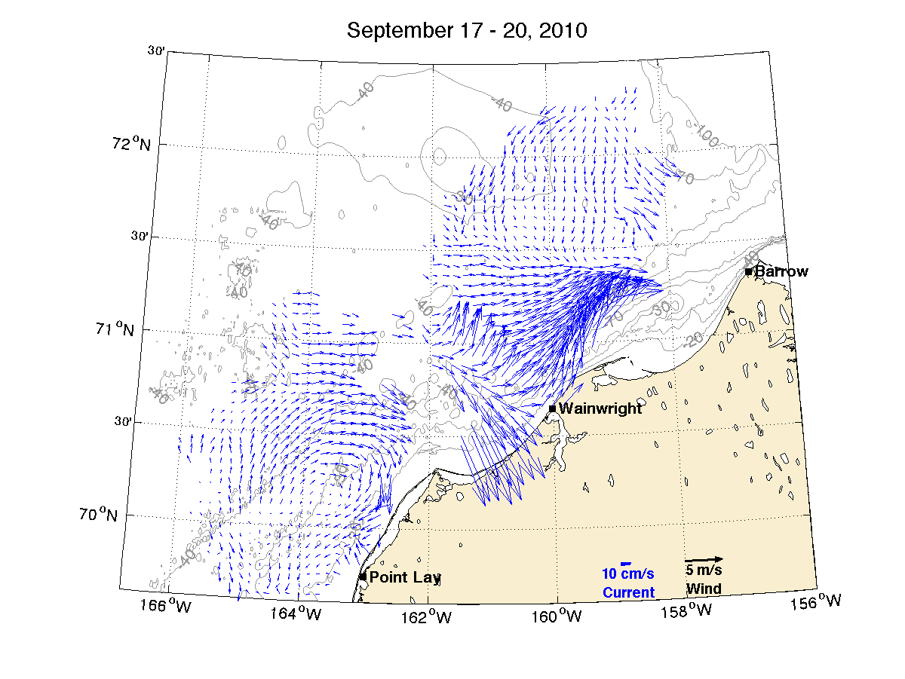
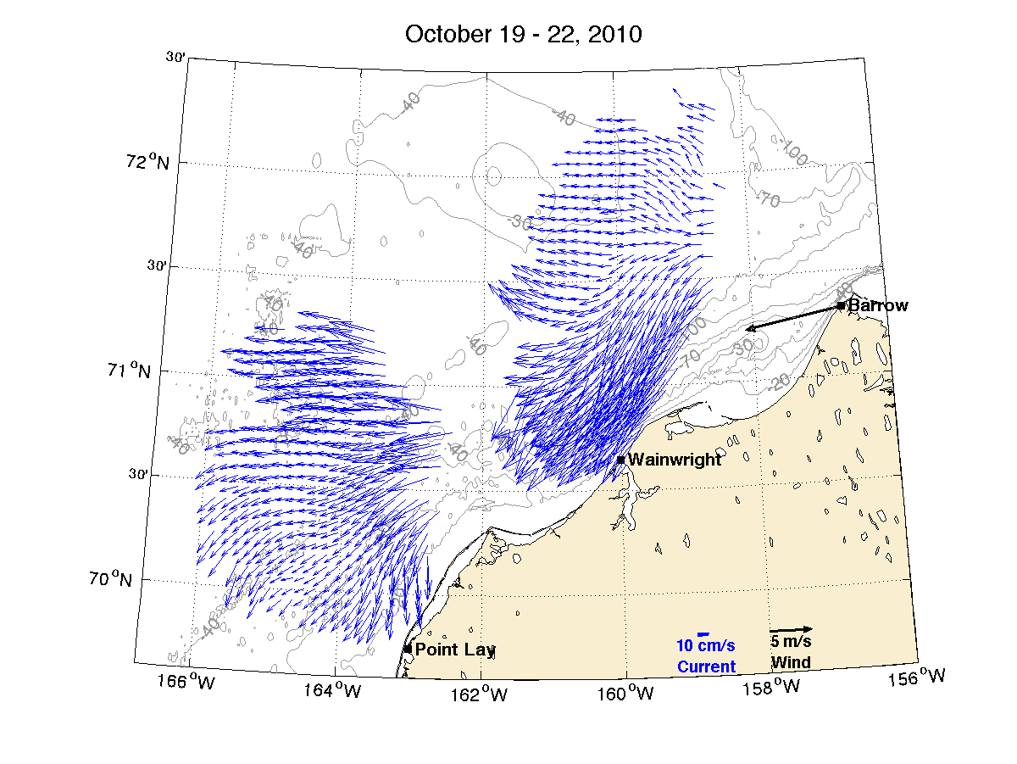
Two main circulation modes:
Four-day average HF radar surface current vectors
Divergent mode Continuous (reversed) mode

Slide 12
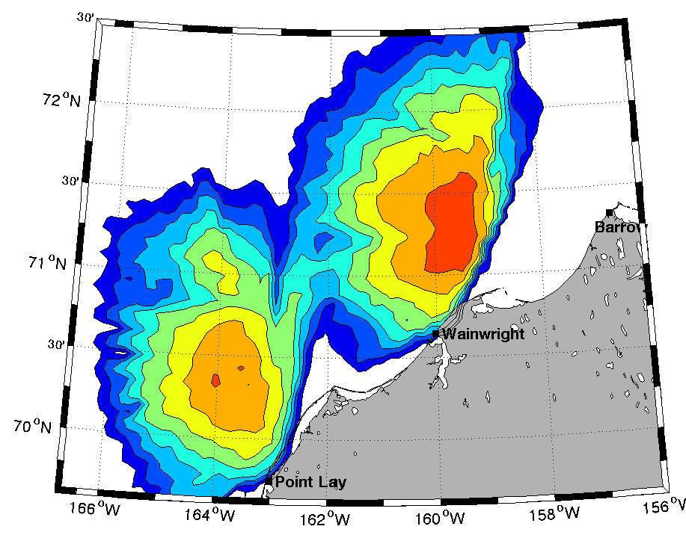
Operational Difficulties:
Shore-based AC power
Sub-optimal coverage
Consumes ~8kWH/day
Permitting
Maintenance
Logistics
???
Percent Coverage
Shore-based power available
Solution: Develop an autonomous power supply
The Remote Power Module (RPM)

Slide 13
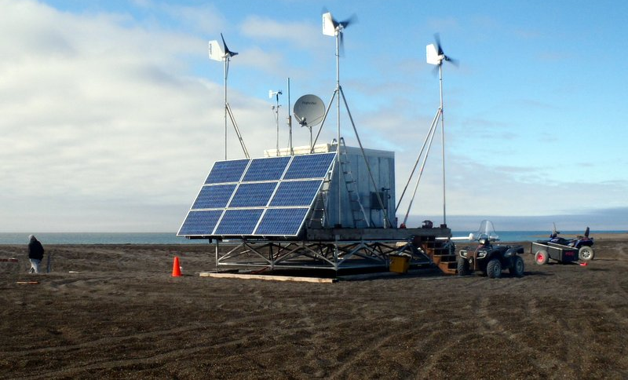
Remote Power Module (RPM): 2012 ➔ Yr 3 Operational Test
Fully-automated, renewable (solar and wind) hybrid power station provide power & coms to HF radars. Designed to operate in arctic and sub-arctic maritime environments.

Slide 14
Point Barrow

Slide 15
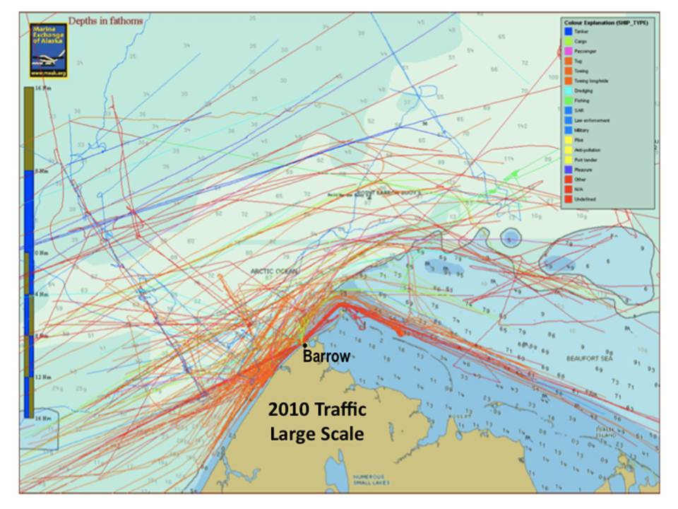
Vessel Traffic Identified by AIS

Slide 16
Simulated HF Radar Derived Ship Detections
Range, Range Rate and Bearing

Slide 17
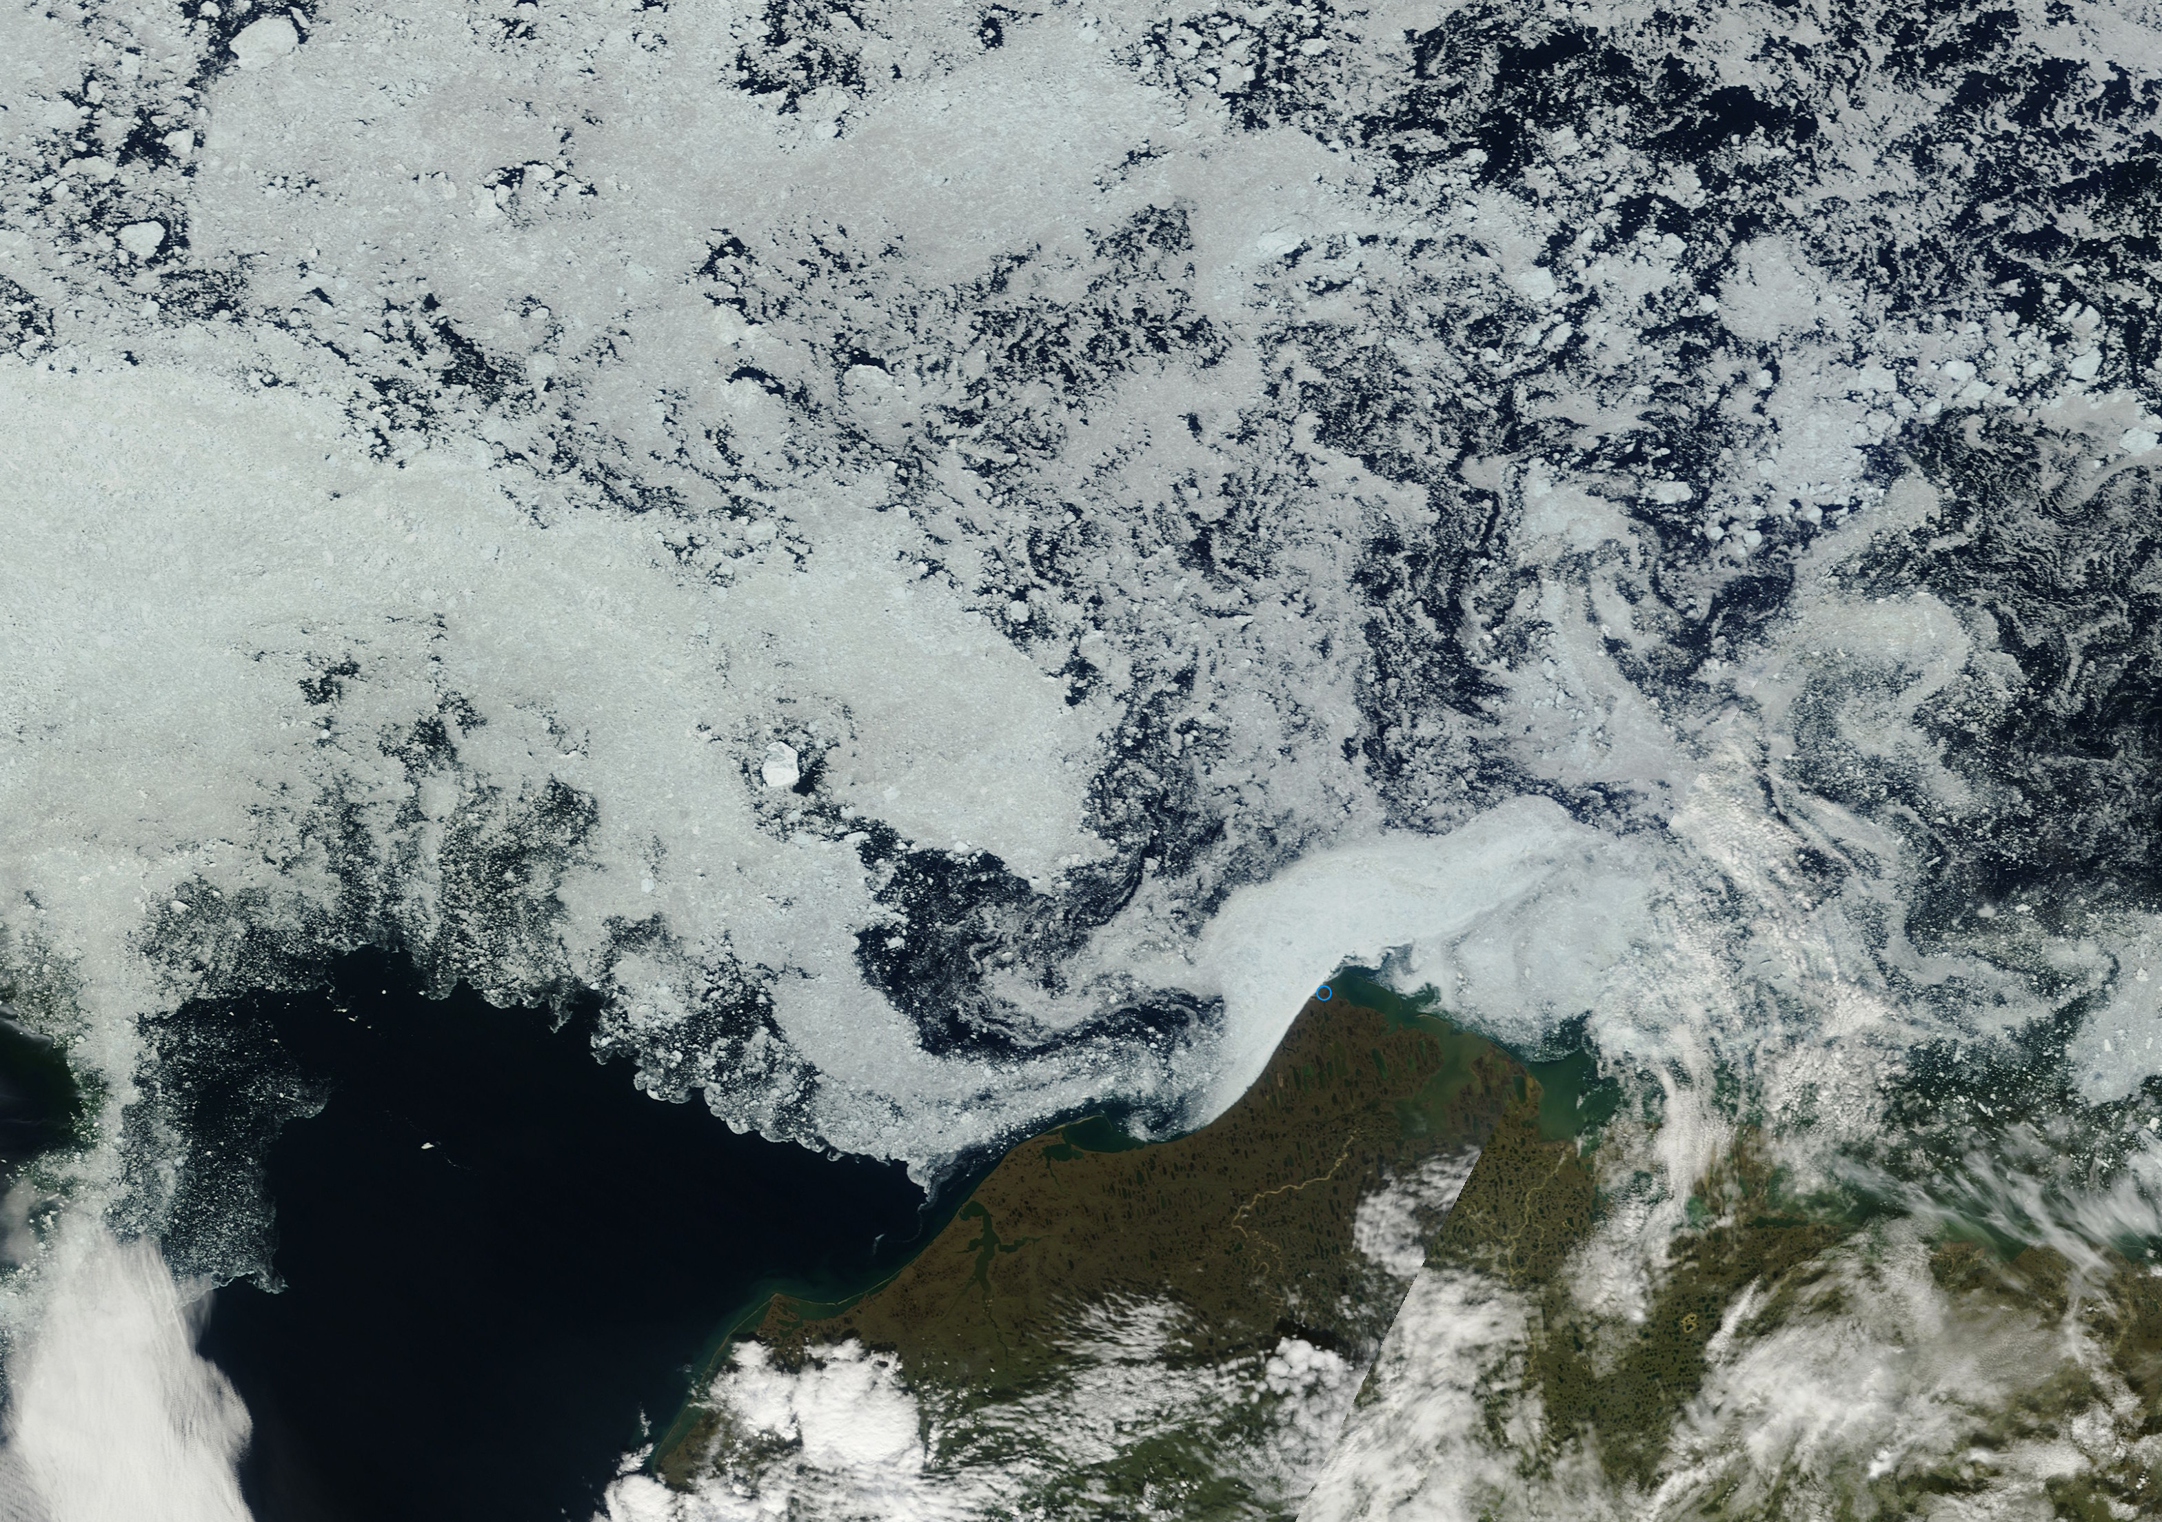
Point Barrow
Modis July 23, 2012 Image

Slide 18
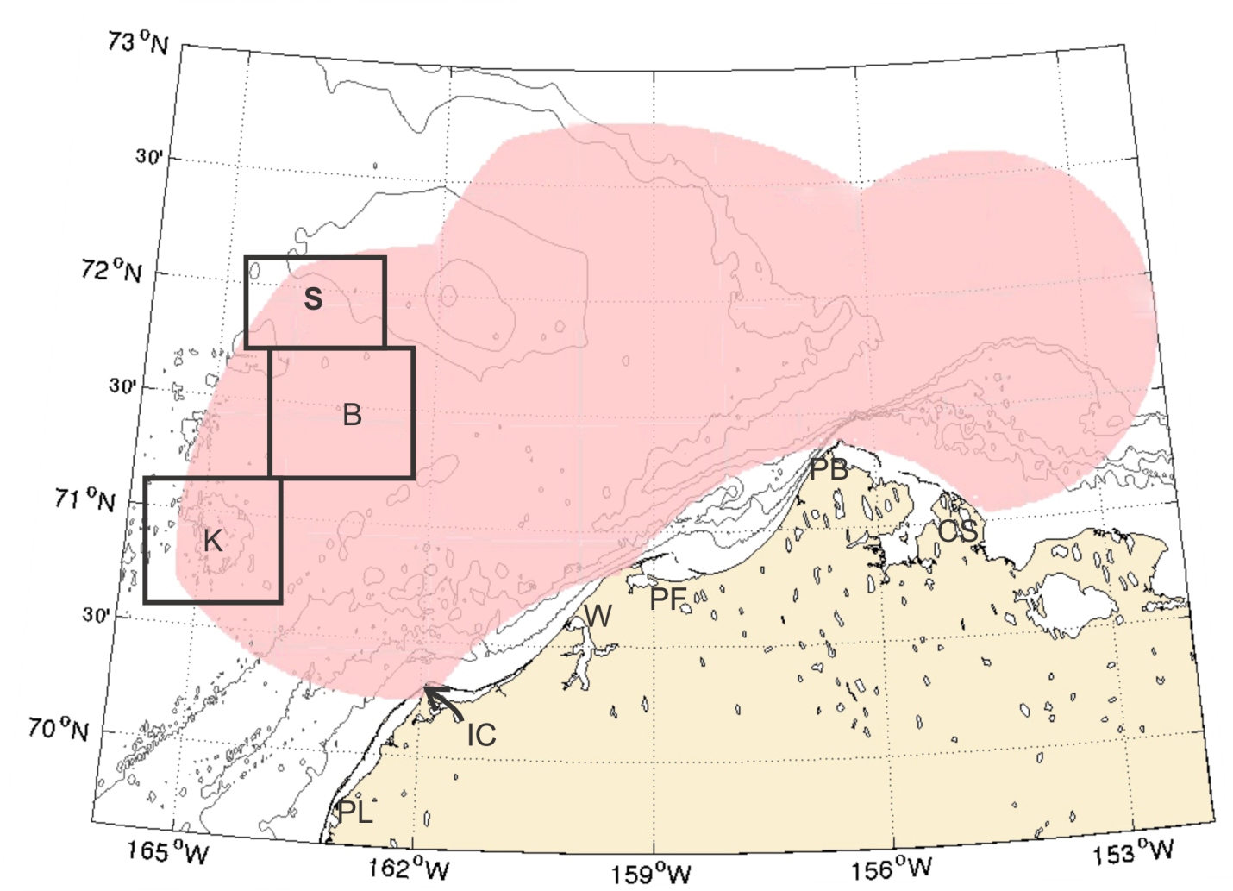
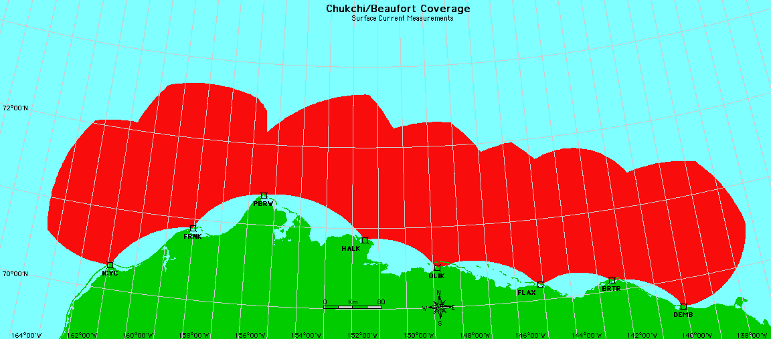
Future Direction
Example Radar Mask: 8 Long-Range HF-RPM systems
Coverage: 800 km x 175km = 1.4x10⁶ km²
2013 HFR Coverage Map
Industry & State (CIAP) Funded
Icy Pt. Pt. Cape Oliktok Flaxman Barter Demarcation
Cape Franklin Barrow Halkett Pt. Is. Is. Bay

Slide 19
Synergistic Activities
AOOS + UAF + Rutgers + AKMX + CODAR OS
Private Industry
Offshore Oil Exploration
Alaska Owners and Pilots Assoc. (AOPA)
Autonomous weather monitoring
High Latitude Research Centers
Australian Antarctic Survey
British Antarctic Survey
Norwegian Polar Institute
University of Hokkaido
Japan Marine Science and Technology Center (JAMSTEC)
USCG
District 17

Slide 20
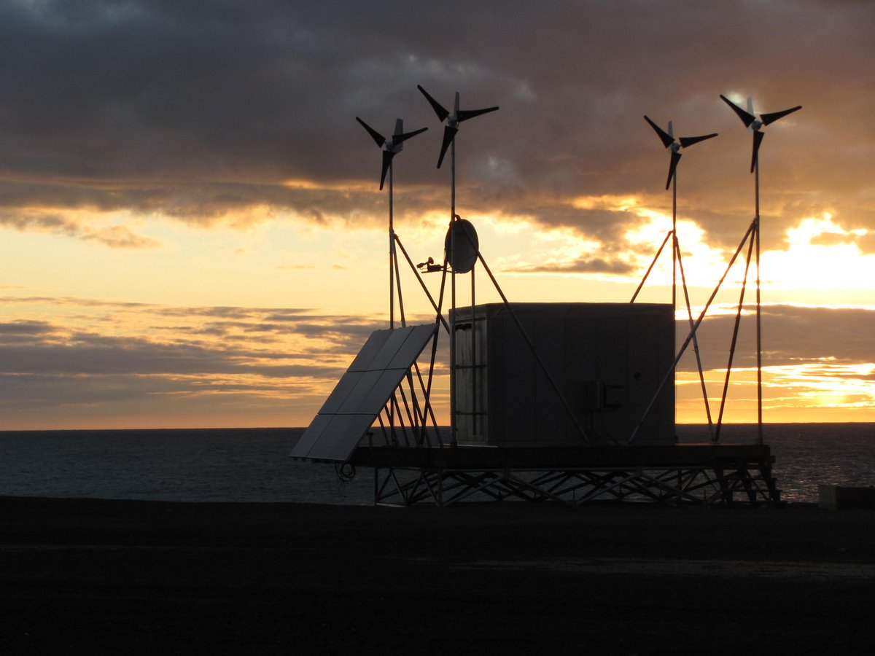
Thank You
hank.stats@alaska.edu
www.chukchicurrents.org
www.ims.uaf.edu/artlab/

