Slide 1



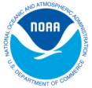




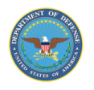

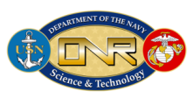
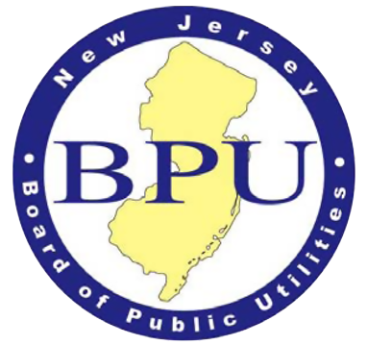
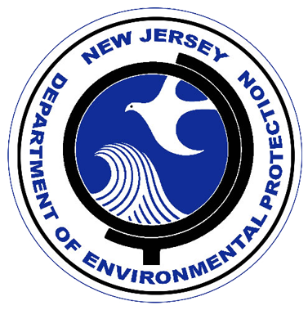




Development of the U.S. National HF Radar Network:
Current Mapping Applications &
Gulf Oil Spill Response
Rutgers
CODAR
Group:
Scott Glenn,
Josh Kohut,
Hugh Roarty.
John Kerfoot,
Ethan Handel,
Mike Smith, &
Colin Evans

Slide 2
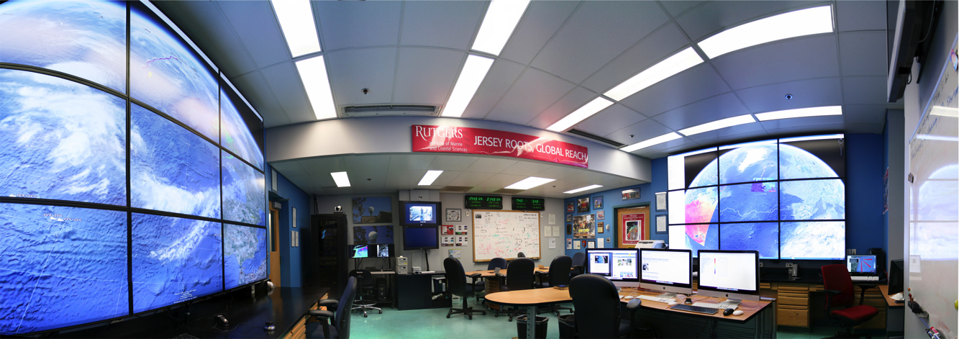
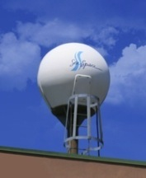
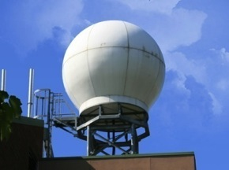
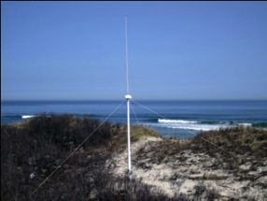
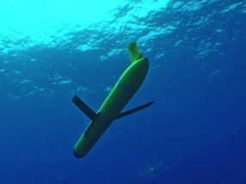
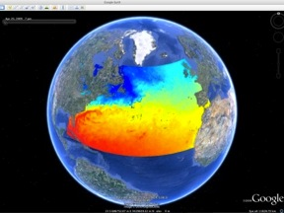
Rutgers University - Coastal Ocean Observation Lab
Operations, Research & Education Center
Vessels -
Satellite
Satellite
CODAR
Ships/ Vessels
Glider
REMUS
Data Vis.
Modeling
Security
Leadership
Education
Satellite Data Acquisition Stations
CODAR Network
Glider Fleet
3-D Forecasts

Slide 3
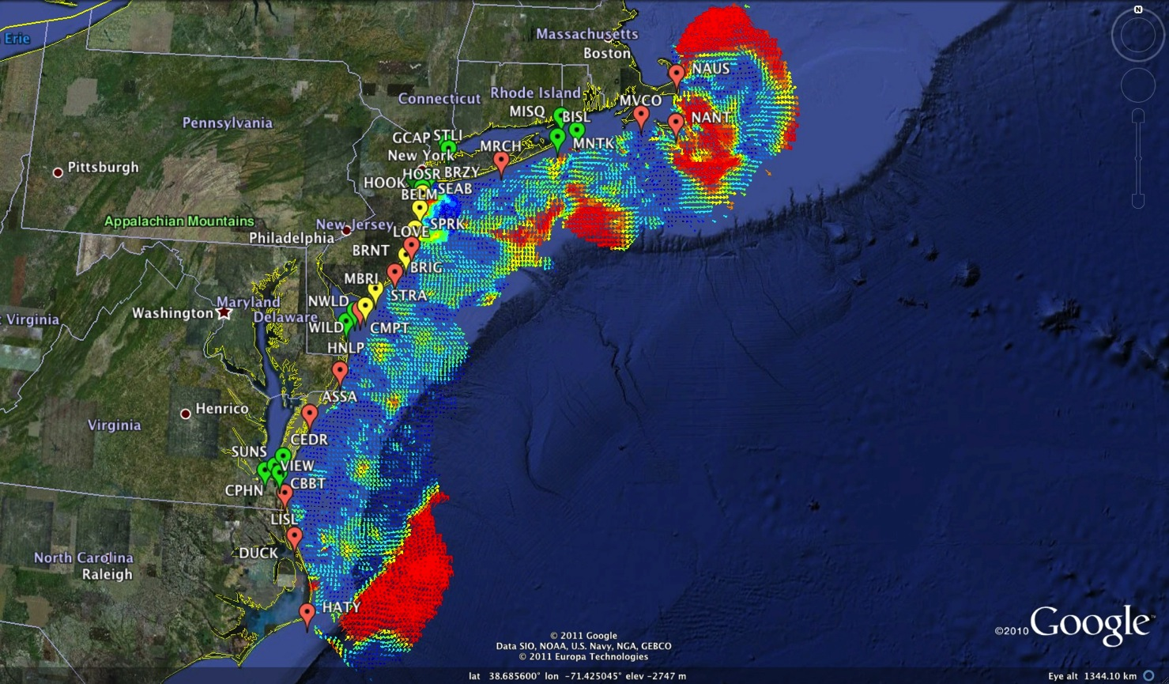
Mid-Atlantic Bight HF Radar Network
1000 km Alongshore Length Scale
Mid-Atlantic HF Radar Network
14 Long-Range CODARs
7 Medium-Range CODARs
15 Short-Range CODARs
36 Total
Triple Nested & Multistatic

Slide 4

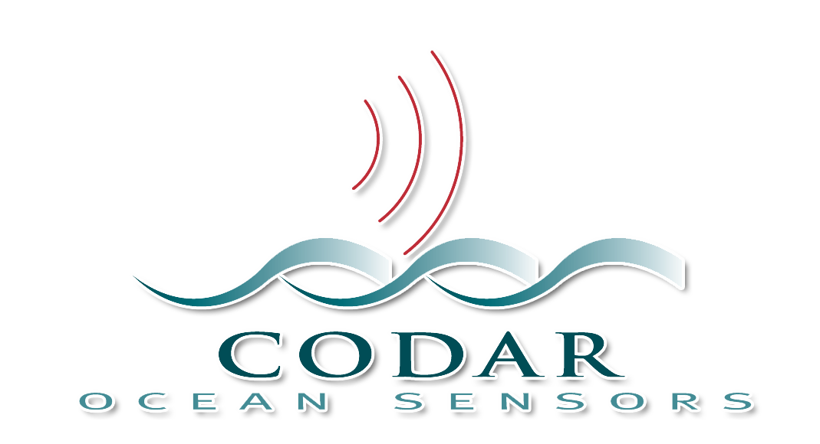
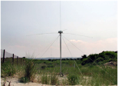
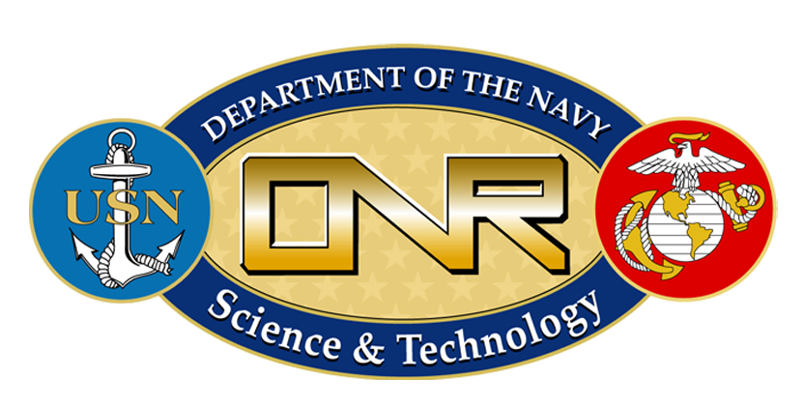
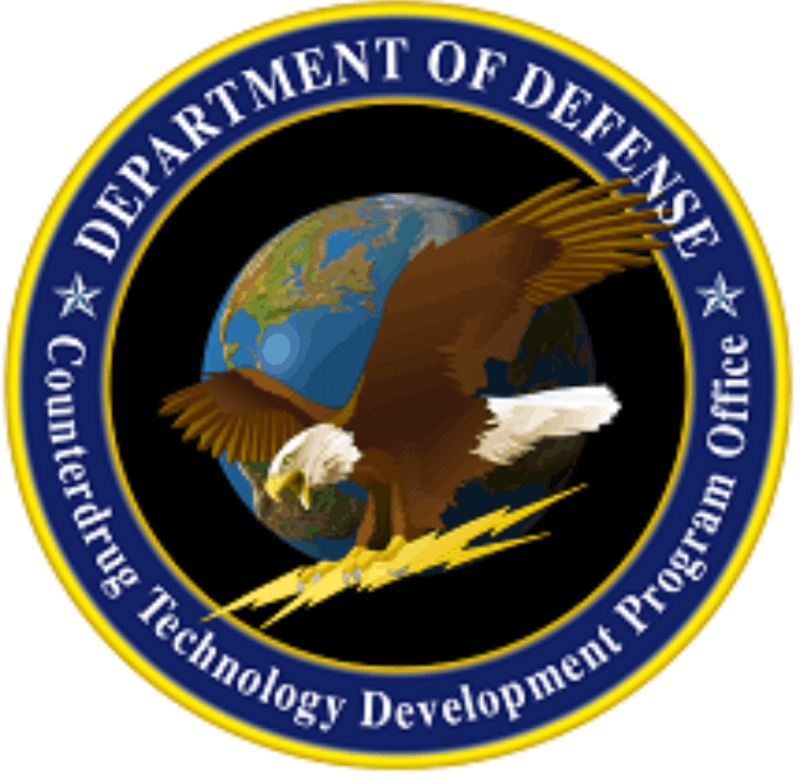
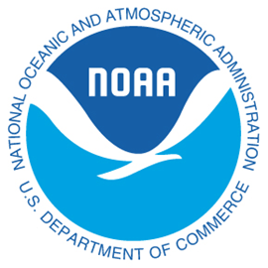

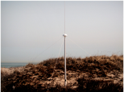


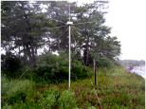





Technology Development Road Map of HF Radar for SAR and Vessel Detection
Long Range
First long range system installed
Ship detection program partnering with AMI
CODAR develops enhanced blanking waveform for ship detection
NWRA applies SIFTER algorithm to CODAR data, SRI develops tracker for SIFTER output
Mid Atlantic HF Radar Network becomes operational with US Coast Guard
National HF Radar Network become operational with US Coast Guard
CODAR patents GPS timing for frequency sharing
Bistatic spar buoy deployed 100 nmi off Atlantic City, NJ
Test Study of CODAR data into SAROPS
Medium Range
First system installed at Sandy Hook, NJ
DHS bistaic buoy deployed near Ambrose
DHS COE begins
Bisatatic transmitter installed at SeaSide, NJ for testing
SuperDirective system installed at Sandy Hook, NJ
Second shore station added as part of Navy LEAP program
Bistatic transmitter integrated with OPT PowerBuoy
Short Range
Initial test install off Atlantic City, NJ
Bistatic Buoy Installed off Atlantic City, NJ
Small Boat Program
Coordinated field exercise for DHS COE
HF Radar become operational with US Coast Guard
Permanent Install
System Relocated to NY Harbor for NSF CoOP Program
1998
1999
2000
2001
2002
2003
2004
2005
2006
2007
2008
2009
2010
2011

Slide 5
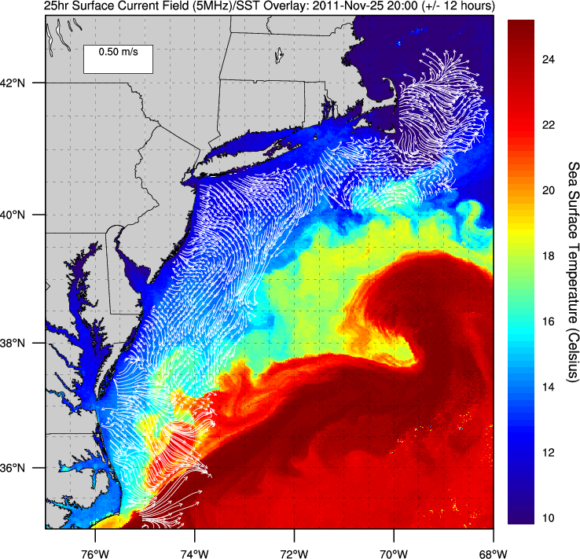
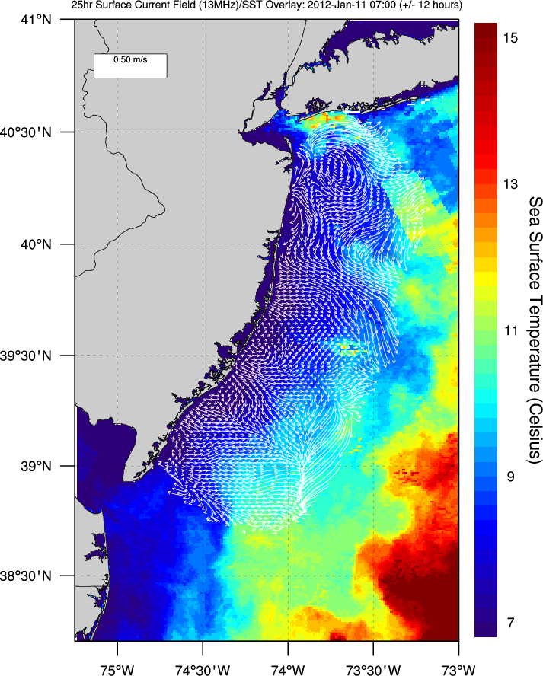
Mid-Atlantic Bight Testbeds – Long Range and Medium Range
5 MHz Testbed for Current Mapping
Both are Dual Use
Both are Multistatic
13 MHz Testbed for Vessel Tracking

Slide 6
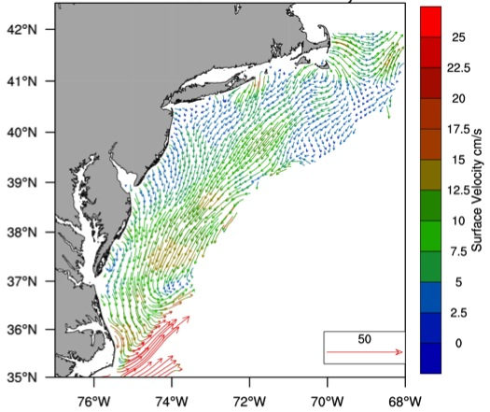
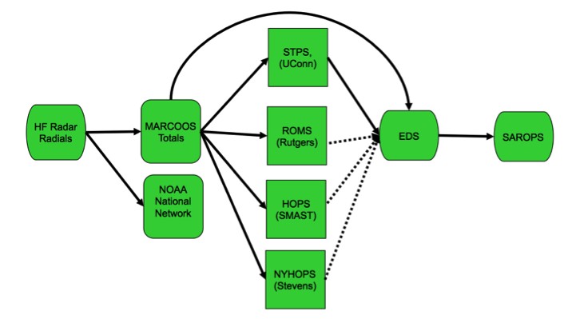
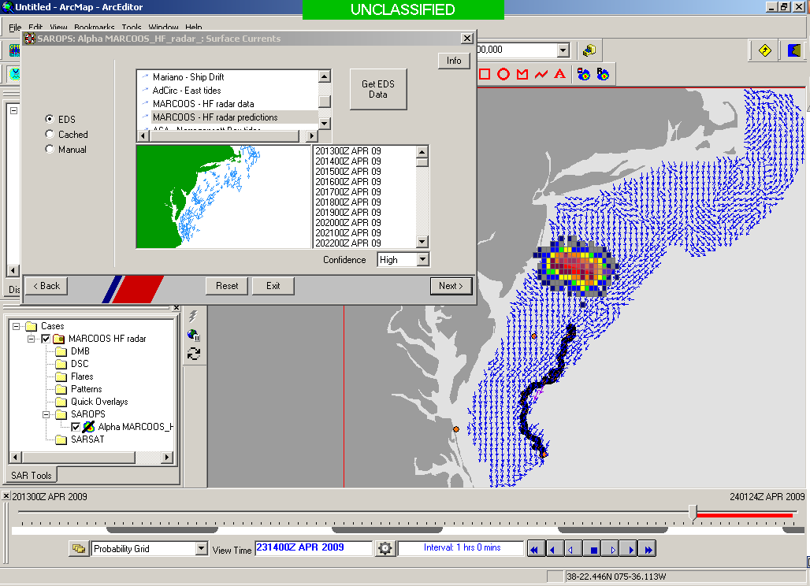

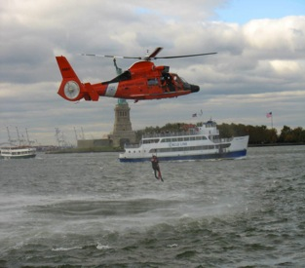
Transition Objective – Operational Dual Use through
(a) DHS SAROPS, (b) DoC PORTS
Surface Currents
PORTS
High Resolution
Outer Harbor Currents

Slide 7
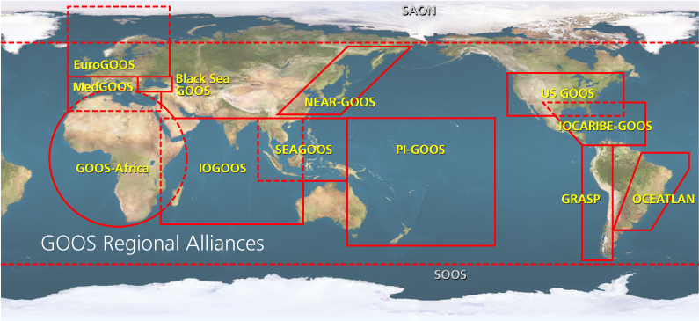

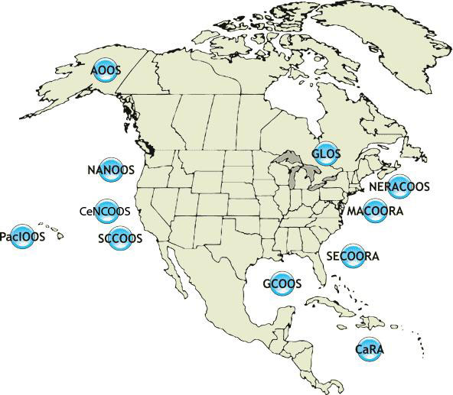
U.S. Integrated Ocean Observing System
IOOS Relationships
Global Component
Federal
Backbone
Regional Component
Global Ocean Observing System
Vessels -
Satellite
Satellite
CODAR
Ships/ Vessels
Glider
REMUS
Data Vis.
Modeling
Security
Leadership
Education
11 Regional Associations
18 U.S. Federal Agencies

Slide 8










U.S. Integrated Ocean Observing System
IOOS Relationships
Global Component
Regional Component
Global Ocean Observing System
Vessels -
Satellite
Satellite
CODAR
Ships/ Vessels
Glider
MARACOOS
REMUS
Data Vis.
Modeling
Leadership
Education
11 Regional Associations
8 Universities in MARACOOS contribute to HF Radar Network

Slide 9

HFR Current Mapping Product Development
Road Map for Search and Rescue
First Standard Range Codar deployed on East Coast near Atlantic City, NJ
Mid Atlantic HF Radar Network Operational with US Coast Guard
Long Range Network Shown to be Effective in Second Coast Guard SAROPS tool
“A Plan to Meet the Nations Surface Current Mapping Needs” Implemented
Hurricane Floyd Simulation Predicts Factor of 4 Reduction in Search Area Using Field of Currents vs. Point Measurement
MARCOOS Establishes First Regional High Frequency Radar Network
Radial and Total Sensitivity Study Undertaken to Provide Best Data to Environmental Data Server
Standard Range Network Proves to be Useful in Coast Guard Research and Development Pilot Study
Optimal Interpolation Combination Method Effective in Filling Spatial Gaps in Mid Atlantic Tests
National HF Radar Network Operational with US Coast Guard
1998
1999
2000
2001
2002
2003
2004
2005
2006
2007
2008
2009
2010
2011
2012
2013
2014
2015

Slide 10
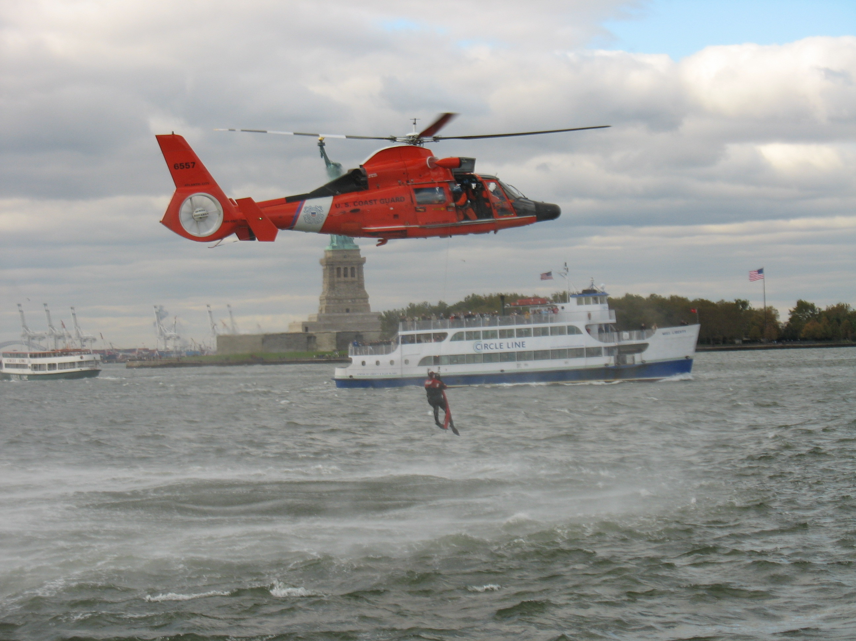

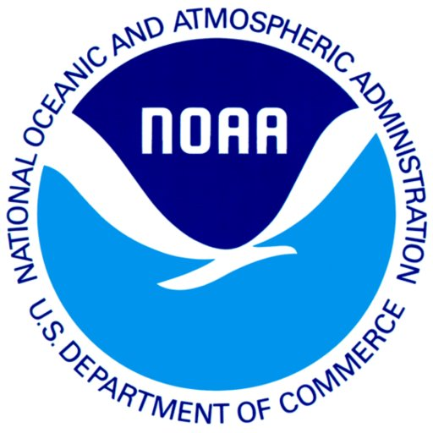
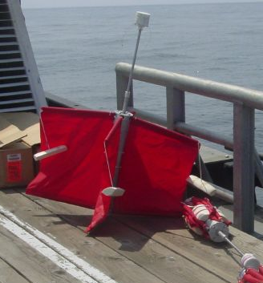
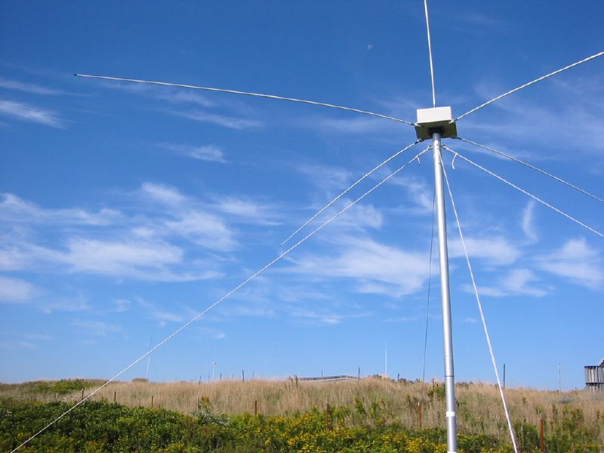
Success Stories – Making a Difference
Optimizing HF Radar for SAR using USCG Surface Drifters
Art Allen
U.S. Coast Guard
Scott Glenn
Rutgers University
and the Mid-Atlantic Regional
Coastal Ocean Observing System

Slide 11

CODAR and
HYbrid Coordinate Ocean Model or (HYCOM)
Currents in SAROPS
Date | Time
22 July 2009 0000 Z | 00
23 July 2009 0000 Z | 24
24 July 2009 0000 Z | 48
25 July 2009 0000 Z | 72
26 July 2009 0000 Z | 96
High Confidence (HF Radar)
  sigma (1 std dev) = 0.22 knots
  Tau (half life) = 264 minutes
Low Confidence (HYCOM)
  sigma (1 std dev) = 0.37 knots
  Tau (half life) = 264 minutes
Number of particles = 5000
SLDMB 39029

Slide 12
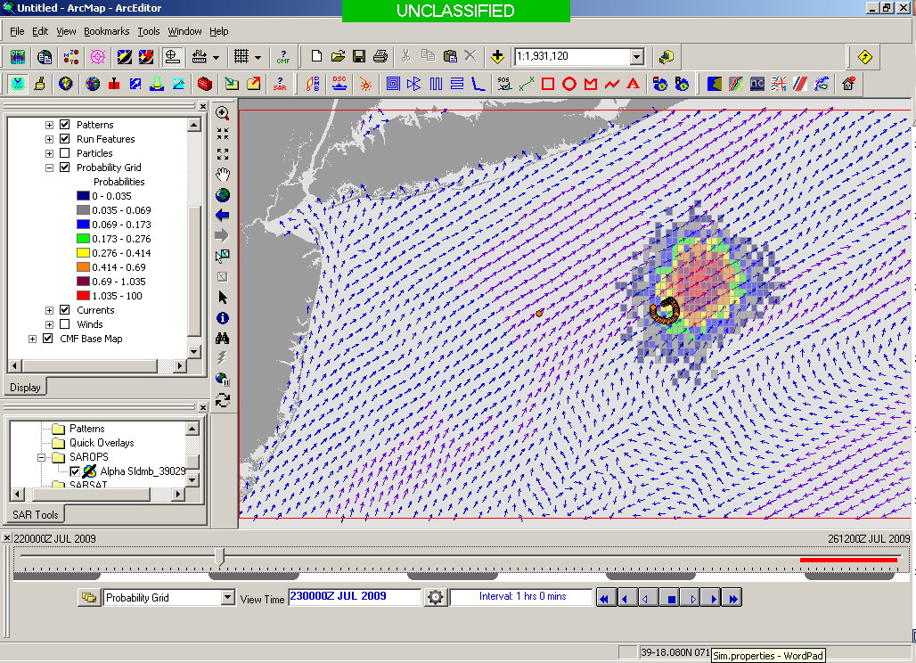
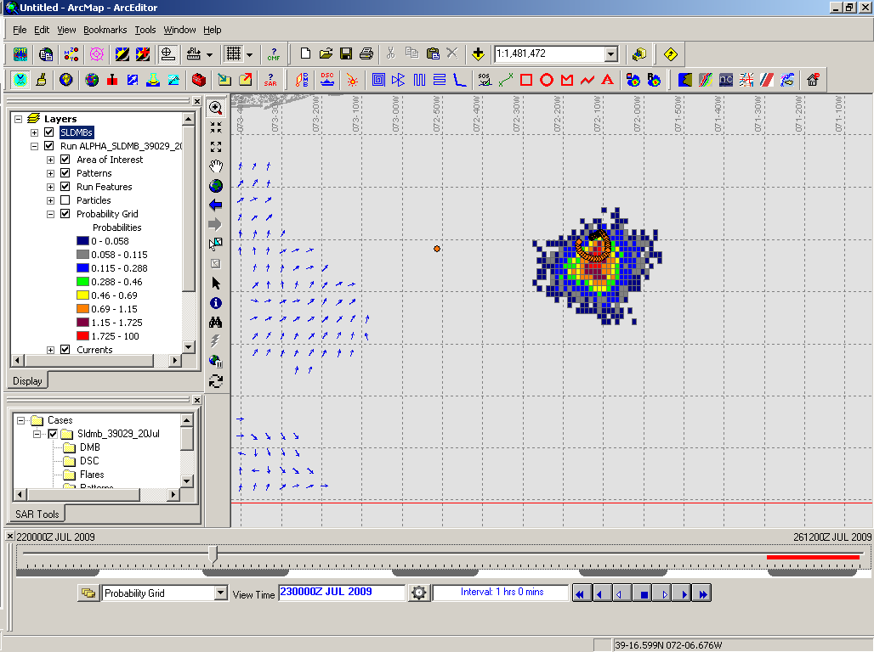
24 Hours Into Search
HYCOM
Low Confidence
CODAR
High Confidence
Notes:
HYCOM, (low Conf) 24 hrs

Slide 13
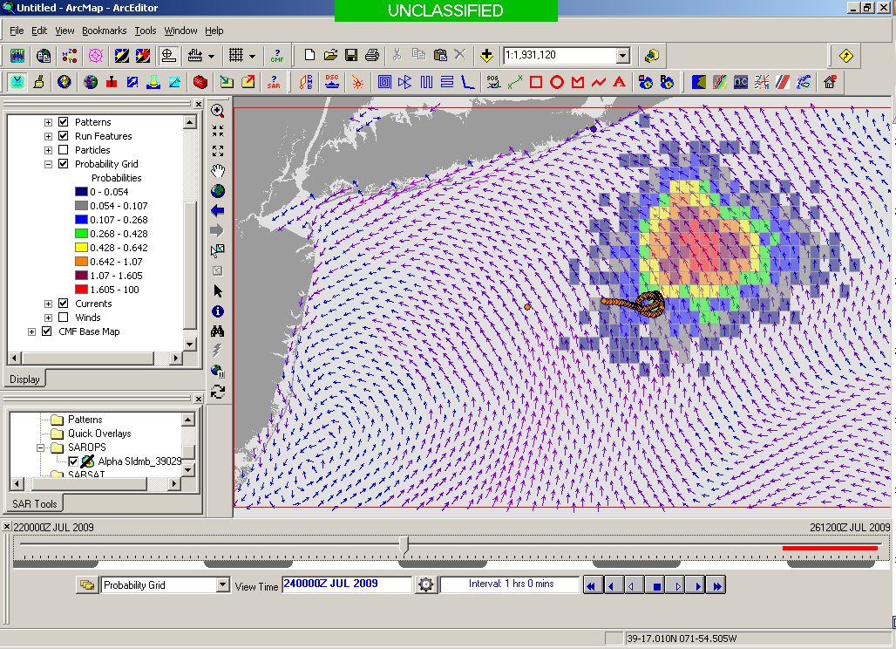
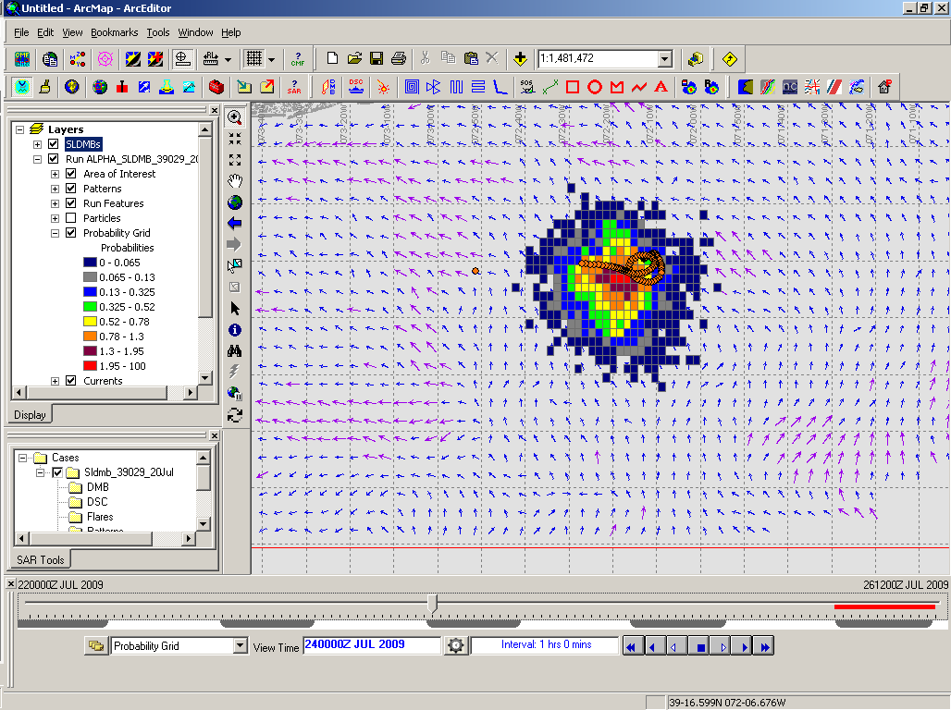
48 Hours Into Search
HYCOM
Low Confidence
CODAR
High Confidence
Notes:
HYCOM, (low Conf) 24 hrs

Slide 14
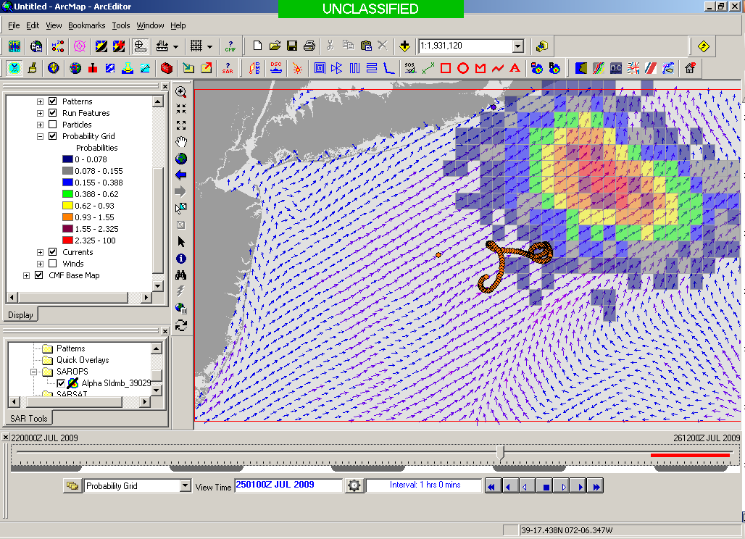
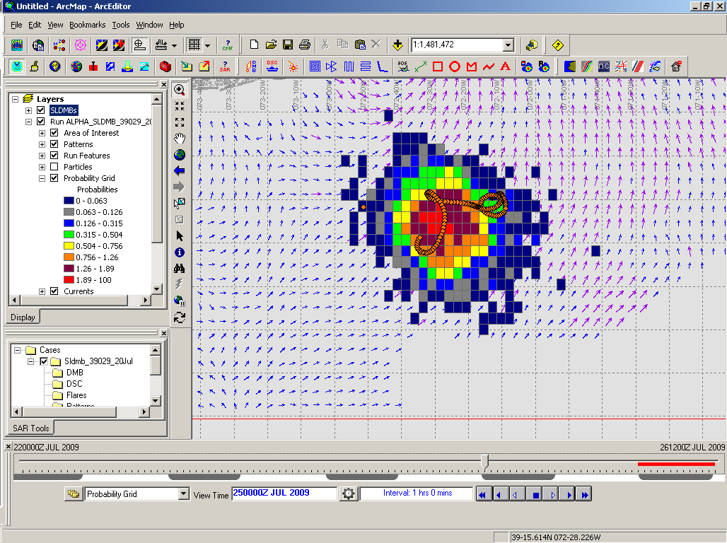
72 Hours Into Search
HYCOM
Low Confidence
CODAR
High Confidence
Notes:
HYCOM, (low Conf) 24 hrs

Slide 15
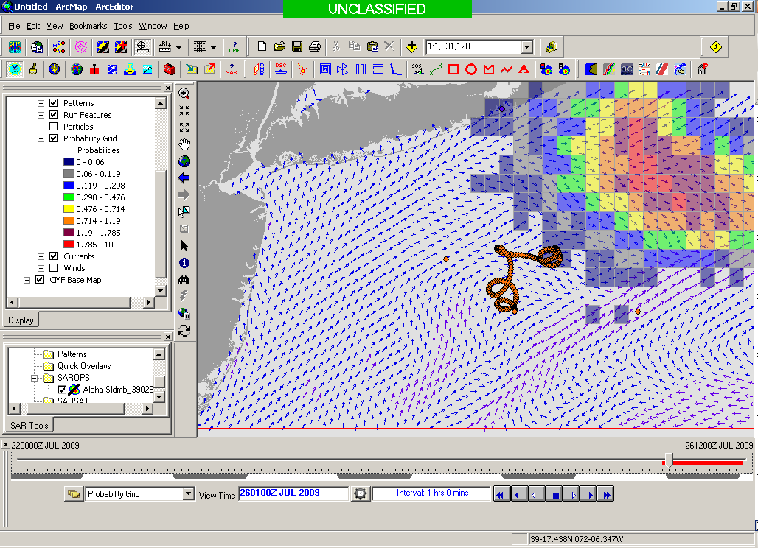
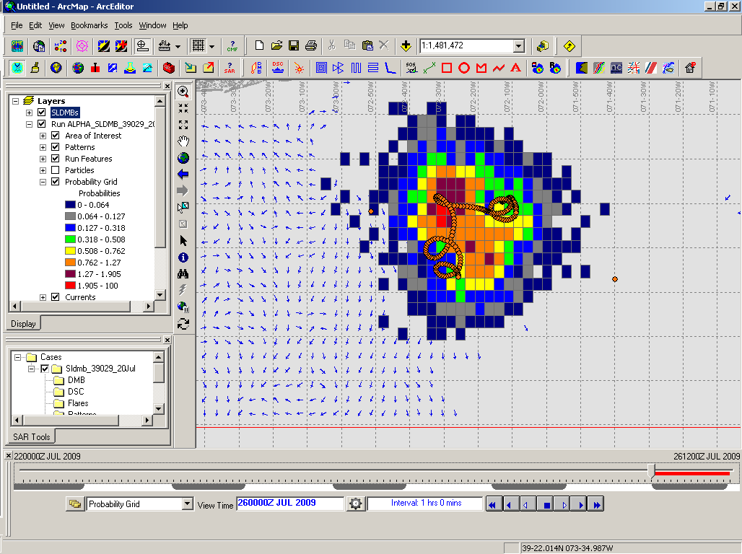
96 Hours Into Search
HYCOM
Low Confidence
CODAR
High Confidence
Notes:
HYCOM, (low Conf) 24 hrs

Slide 16
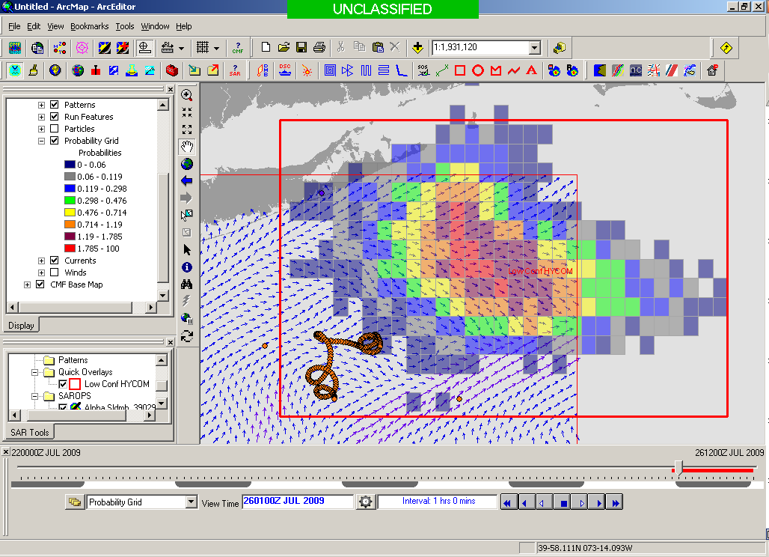
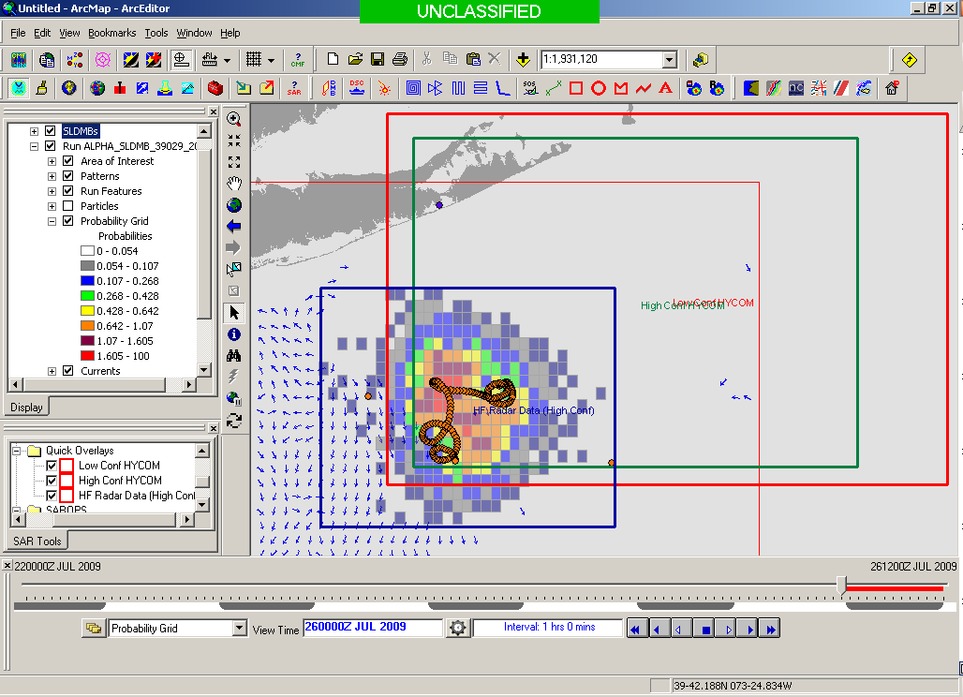
Search Area After 96 Hours
154 km
100 km
232 km
123 km
HYCOM
36,000 km²
CODAR
12,000 km²
Notes:
HYCOM (Low Conf) 48 hours

Slide 17
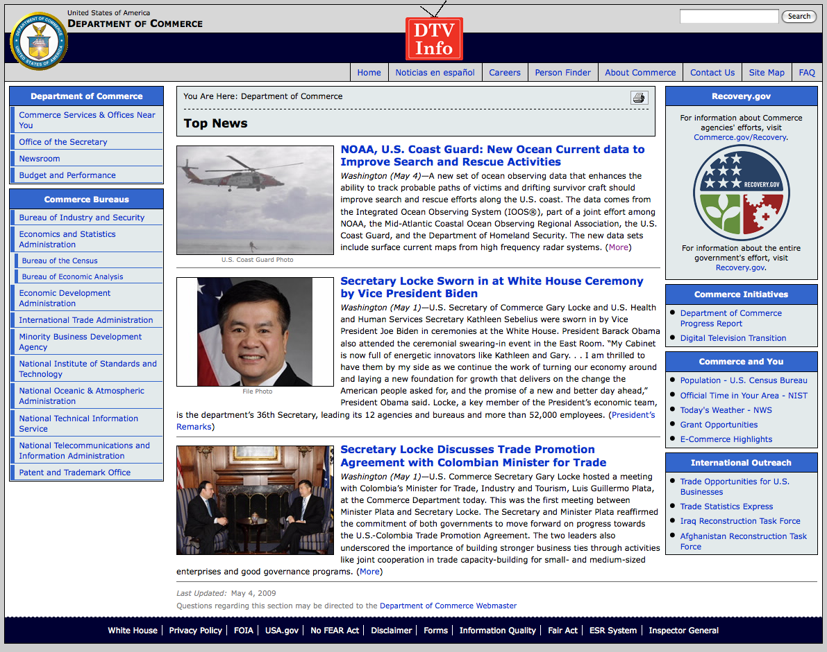
May 4, 2009: After a year of testing, NOAA Announces on
U.S. Department of Commerce Website that
MARACOOS CODAR is Operational in SAROPS
U.S. IOOS Goal for 2010-2011:
Bring all
sustained regional-scale HFR networks up to operational status in USCG SAROPS
3 West Coast Regions for
California & Oregon

Slide 18
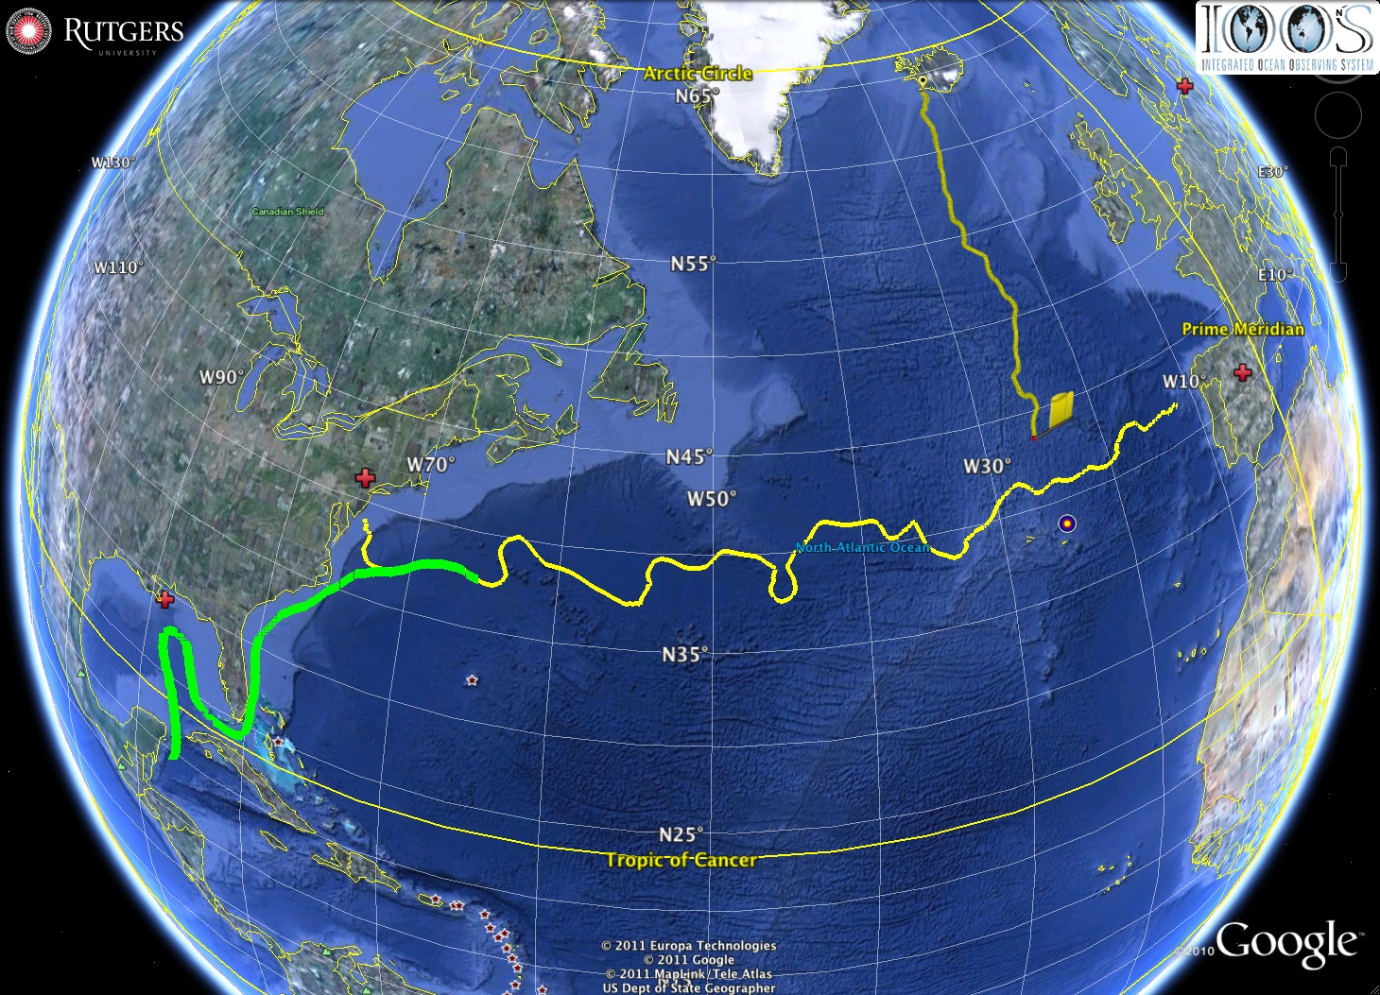



Sopot
U.S. IOOS Response to the Gulf of Mexico Oil Spill:
The Critical Role of Modern Ocean Observing Networks
Madrid
Silbo
Rutgers
RU27
Deepwater
Horizon
Scott Glenn,
Representing
Many IOOS &
DHS Partners
Loop Current -----> Gulf Stream
National Center for
Secure and Resilient
Maritime Commerce
Many
Sponsors,
Including

Slide 19
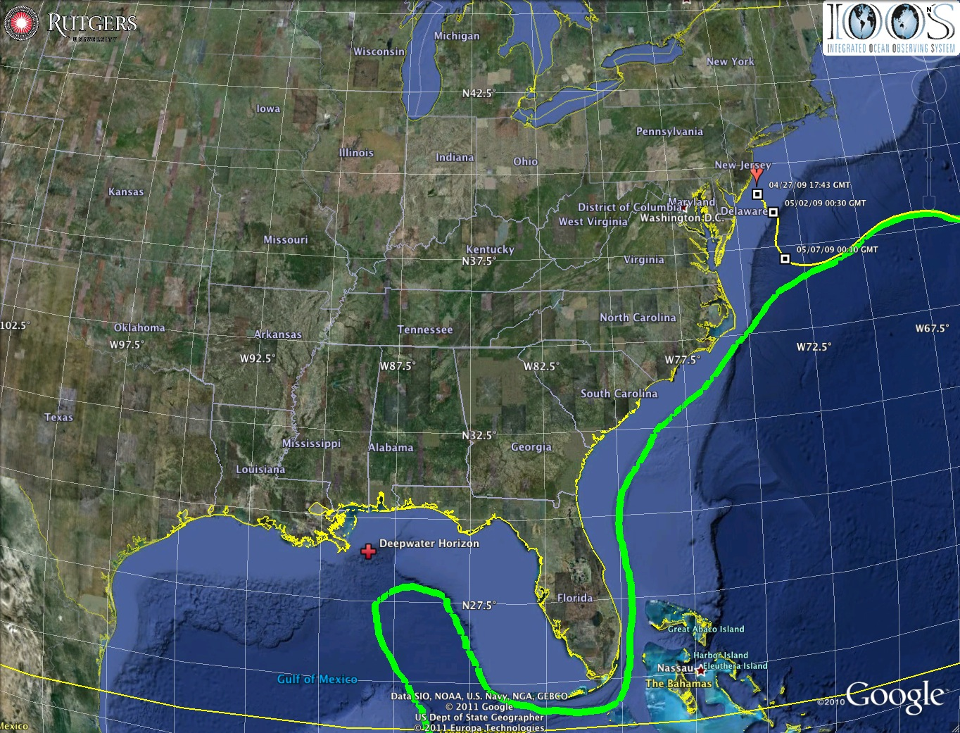
Oil Transport Questions: Will the oil….
Come ashore in Louisiana?
Spread east to Texas or west to Mississippi, Alabama and Florida pan handle in the wind-driven coastal currents?
Enter the Loop Current and be transported downstream?
Hit the Florida Shelf and be driven shoreward by winds?
Ride the Loop Current south and hit the Florida Keys?
Be transported out of the Gulf of Mexico by the Gulf Stream and impact the East Coast?
Is there oil below the surface? Where? How much?
Gulf of Mexico

Slide 20
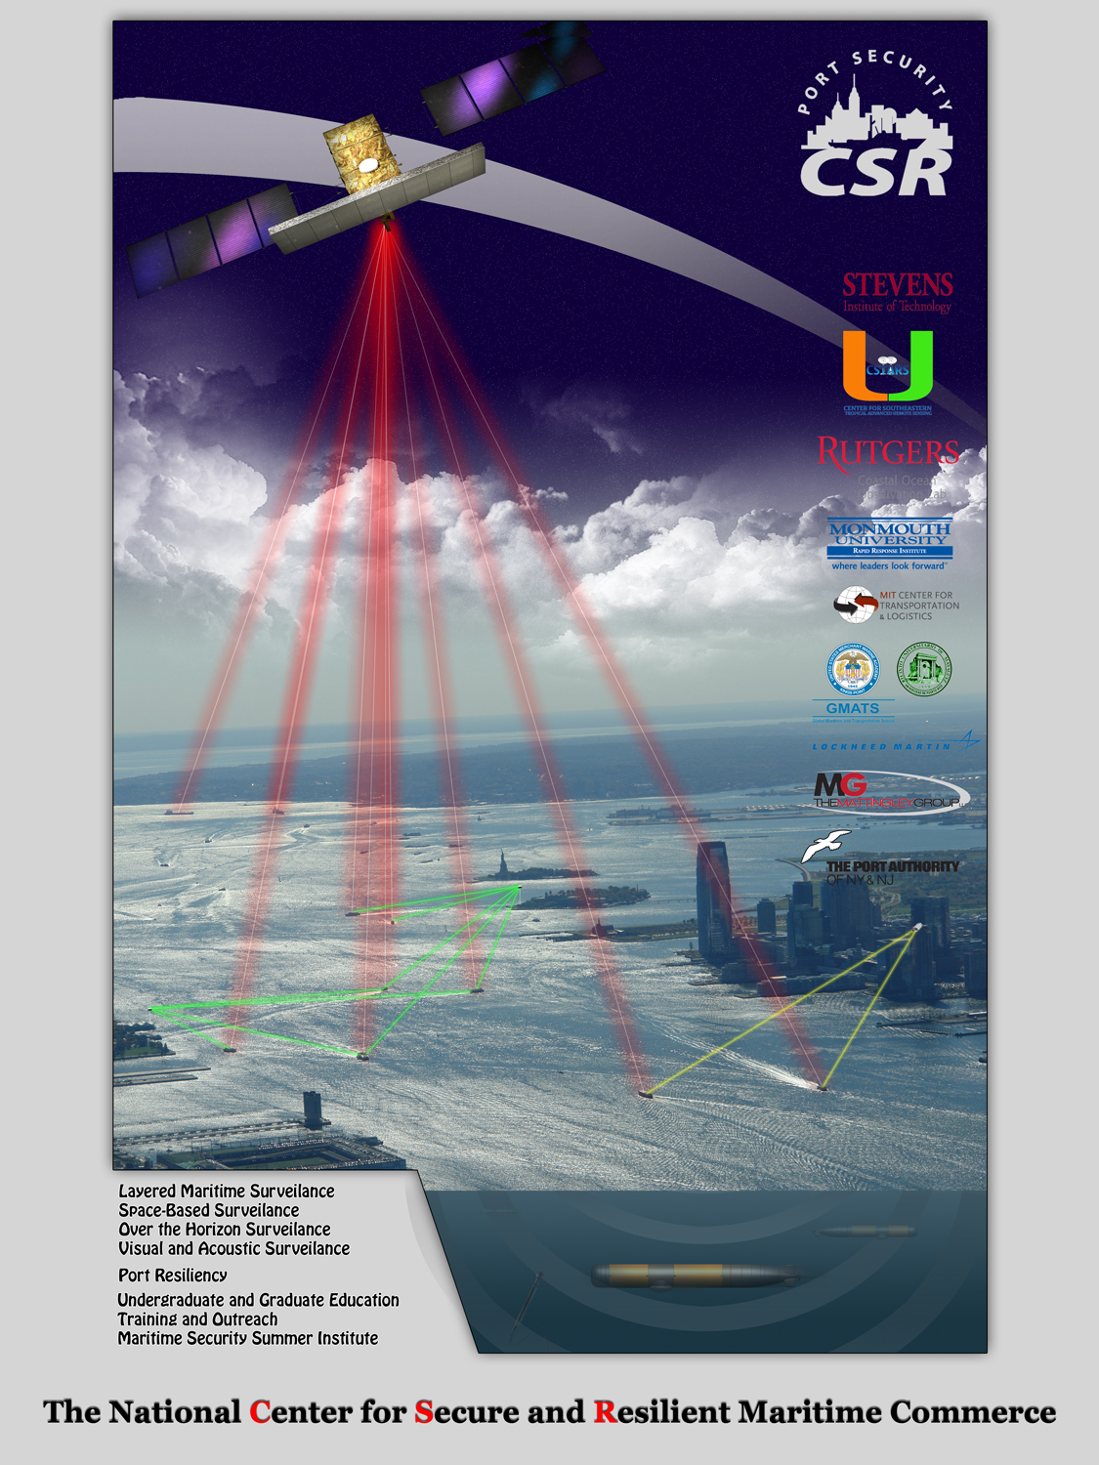
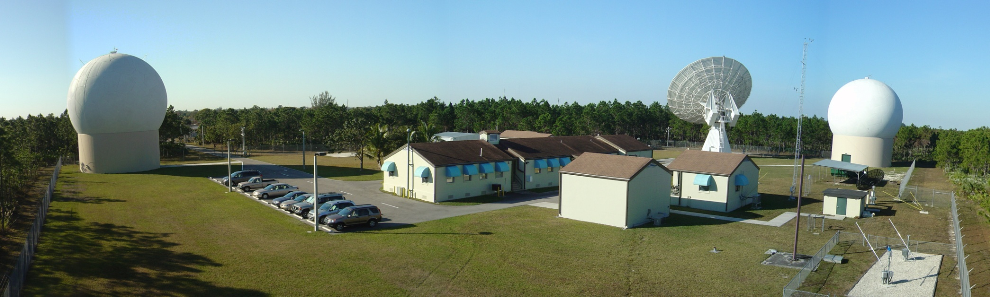

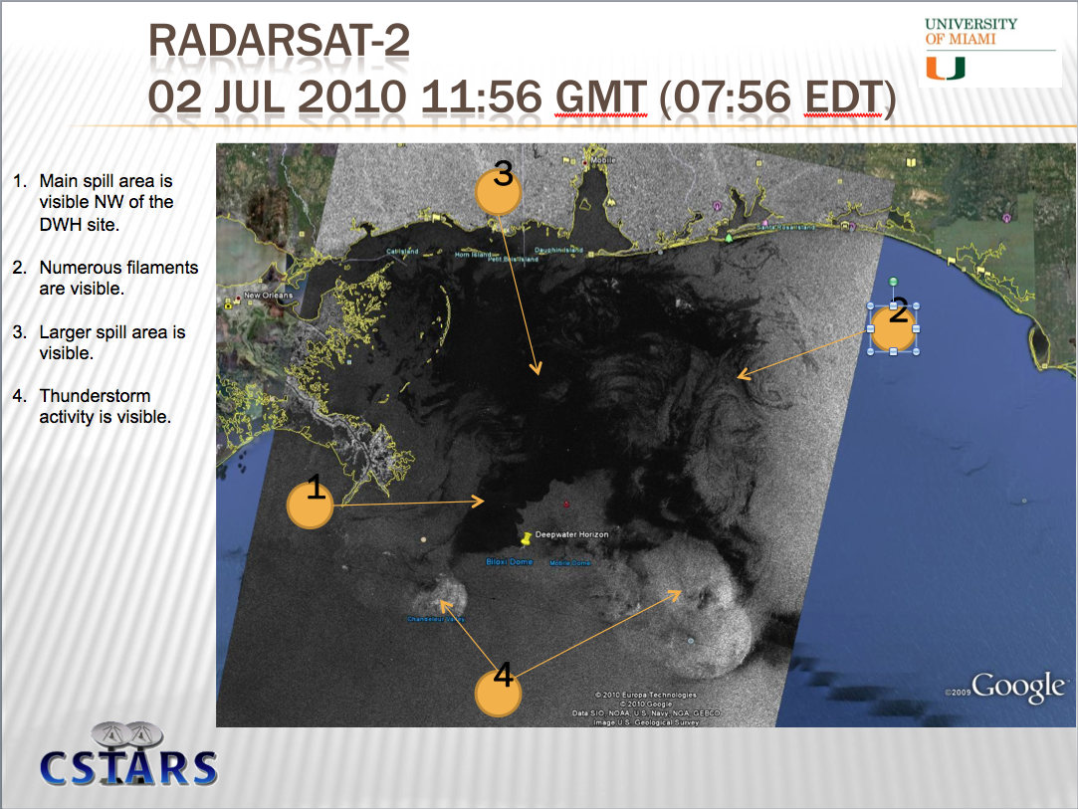

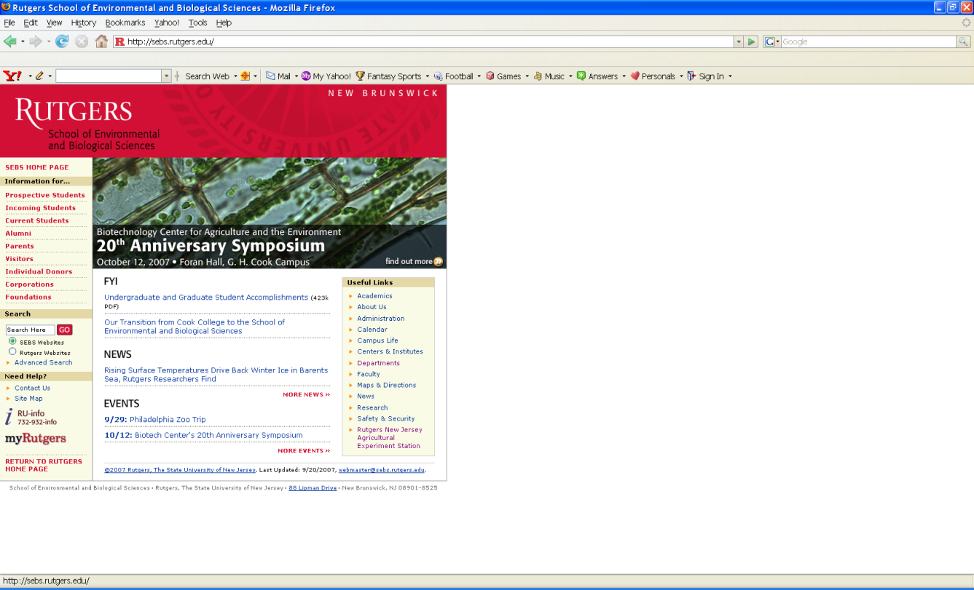


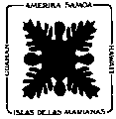





National Center for Secure and Resilient Maritime Commerce
A U.S. Department of Homeland Security Center of Excellence

Slide 21
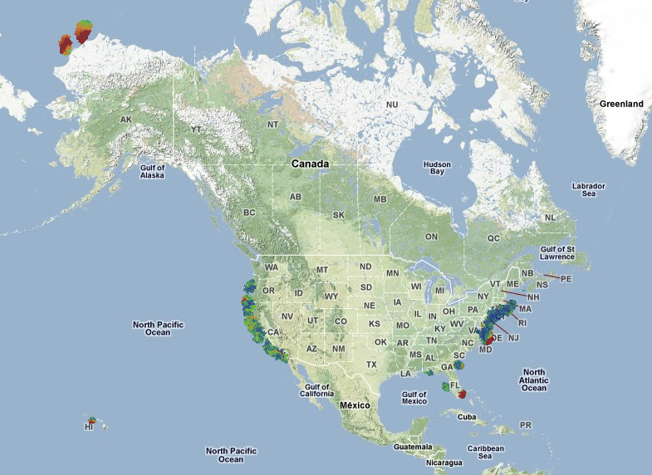


U.S. National HF Radar Network
Data Flow Since 2007
2004 Plan
Today’s Coverage
131 Radars

Slide 22




MARACOOS - Autonomous Underwater Gliders – Since 1998
Satellite Ocean Color
Satellite SST
Subsurface
Glider
Data
Corporate Partner: Teledyne Webb Research
< Glider Fleet
With Global Reach >

Slide 23


U.S. National Glider Network Components (2010)
Everyone’s
^
European Gliding Observatories
ONR Glider Technology Centers
Slocum Gliders – Rutgers
Seagliders – U. Washington
Spray Gliders – Scripps I.O.
U.S. Navy
Littoral Battlespace Sensing - Gliders

Slide 24





MARACOOS - Composite Data & Forecast Products
+
=
Remote Sensing
Gliders
3-D Nowcasts
+
=
3-D Nowcasts
Nested Models
4-D Forecast Ensembles

Slide 25








>80 Investigators
>40 Institutions
Cyberinfrastructure Dashboard

Slide 26






Rutgers University - Coastal Ocean Observation Lab
MARACOOS Operations Center
Vessels -
Satellite
Satellite
CODAR
Ships/ Vessels
Glider
REMUS
Data Vis.
Modeling
Security
Leadership
Education
CODAR Network
L-Band & X-Band Satellite Receivers
Glider Fleet
3-D Nowcasts
& Forecasts

Slide 27












ONR Shallow Water 2006 Joint Experiment
HiSeasNet
>12 Satellites
48 Senior
PI’s & PM’s
Communication
7 Ships
3 Ground- stations
10 Gliders
1 Aircraft
62 Moorings

Slide 28




Trans-Atlantic Education
Social networking tools developed to enable collaboration between scientists and students in the U.S., Canada, Spain and Portugal
PLOCAN
Universidad de Las Palmas de Gran Canaria
Google Earth
Interactive Interface
Web Portal
Briefing Blog

Slide 29



Deepwater Horizon Information Flow
Tools developed for education during the trans-Atlantic mission of RU27 adapted to coordinate response to the oil spill:
Collaborative web portal established as an aggregation center for information
Google Earth data/model interactive interface used for environmental analysis & glider path planning
Blog established to share analyses and provide comments – 127 briefs posted
Google Earth
Interactive Interface
Web Portal
Briefing Blog

Slide 30



Deepwater Horizon Oil Spill: Coordinated Rapid Response
Contributed Assets:
HF Radar Networks
USF, USM
Gliders
iRobot, Mote, Rutgers,
SIO, UDel, USF, Navy
Drifters & Profilers
Horizon Marine, Navy
Satellite Imagery
CSTARS, UDel, Rutgers
Ocean Forecasts
Navy, NCSU
Data/Web Services
ASA, Rutgers, SIO
Tropical Storm Bonnie crosses the Gulf of Mexico
USM HFR
TS Bonnie
USF HFR
USM HFR validation of SABGOM Forecast
in region with satellite detected oil slicks
HFR used for Oil Slick Forecasts by NOAA/NOS/OR&R

Slide 31

Deepwater Horizon Glider Data Flow
Individual glider operators provided, at minimum, Time, Lat & Lng time series.
Available CTD data forwarded to NOAA National Data Buoy Center.
Transmitted over the Global Telecommunication System for assimilation by models.
Glider | Owner | Deployed | Tot Days | Tot Dist (km)
RU21 | Rutgers | 1 | 35 | 607
RU23 | Rutgers | 5 | 87 | 1582
UD 134 | U of Delaware | 3 | 51 | 1111.5
Bass | U of South Florida | 3 | 31 | 552
Waldo | Mote Marine Lab | 4 | 74 | 1476
Sam | U of South Florida | 2 | 39 | 677
SG135 | NAVOCEANO | 1 | 86 | 1353
SG137 | NAVOCEANO | 1 | 86 | 970
SG515 | iRobot/U of Washington | 1 | 69 | 1500
Spray0040 | SIO | 1 | 106 | 3000
TOTALS: |  | 18 | 317 | 6005.5
Rutgers aggregation center
NOAA distribution center

Slide 32




Deepwater Horizon Oil Spill Response: Near Field Environmental Analyses
July 3
June 29
July 4
July 7

Slide 33




Deepwater Horizon Oil Spill Response: Far Field Environmental Analyses
June 6
June 6
June 6
June 6

Slide 34


Deepwater Horizon Oil Spill Response: Approach to West Florida Shelf
June 3
June 4

Slide 35





July, 2009
Deepwater Horizon
Response: East Coast Assessments of Risk
July 6
August, 2009
September, 2009
June 25

Slide 36

18 July 2010 Blog Entry - 2010-2020: The Ocean Forecasting Decade

Slide 37

18 July 2010 Blog Entry - 2010-2020: The Ocean Forecasting Decade

Slide 38

18 July 2010 Blog Entry - 2010-2020: The Ocean Forecasting Decade

Slide 39

18 July 2010 Blog Entry - 2010-2020: The Ocean Forecasting Decade

Slide 40

18 July 2010 Blog Entry - 2010-2020: The Ocean Forecasting Decade

Slide 41

18 July 2010 Blog Entry - 2010-2020: The Ocean Forecasting Decade

Slide 42

18 July 2010 Blog Entry - 2010-2020: The Ocean Forecasting Decade

Slide 43

18 July 2010 Blog Entry - 2010-2020: The Ocean Forecasting Decade

Slide 44

Feedback from the Deepwater Horizon
Incident Command Center
Composite of Satellite Observed Oil Spill Locations
“All - Greetings from Unified Area Command in New Orleans. I couldn't agree more - the IOOS community has acquitted itself very well during this entire incident. Not only has everyone provided valuable information - you have done it without getting in the way of the ongoing operations. It's been a pleasure to represent IOOS here and see all the great contributions from the larger IOOS community. “
- Sam Walker (IOOS representative to Deepwater Horizon Unified Command Center), June 18, 2010
“… AWESOME JOB - that call that we had last week was a very good thing. You are taking a huge burden off of the team here who is trying to simply capture the deluge of assets now being deployed. “
- Sam Walker (IOOS representative to Deepwater Horizon Unified Command Center), July 2, 2010
“…Thanks to everyone for all of your efforts to support the Response and the very professional and competent manner in which you have executed your efforts. IOOS has played a huge role in informing the modeling teams and the Unified Command through your extraordinary service. “
- Sam Walker (IOOS representative to Deepwater Horizon Unified Command Center), August 6, 2010

Slide 45
Feedback from the Deepwater Horizon
Incident Command Center
Composite of Satellite Observed Oil Spill Locations
“All - Greetings from Unified Area Command in New Orleans. I couldn't agree more - the IOOS community has acquitted itself very well during this entire incident. Not only has everyone provided valuable information - you have done it without getting in the way of the ongoing operations. It's been a pleasure to represent IOOS here and see all the great contributions from the larger IOOS community. “
- Sam Walker (IOOS representative to Deepwater Horizon Unified Command Center), June 18, 2010
We did not get in the way
“… AWESOME JOB - that call that we had last week was a very good thing. You are taking a huge burden off of the team here who is trying to simply capture the deluge of assets now being deployed. “
- Sam Walker (IOOS representative to Deepwater Horizon Unified Command Center), July 2, 2010
We reduced the burden
“…Thanks to everyone for all of your efforts to support the Response and the very professional and competent manner in which you have executed your efforts. IOOS has played a huge role in informing the modeling teams and the Unified Command through your extraordinary service. “
- Sam Walker (IOOS representative to Deepwater Horizon Unified Command Center), August 6, 2010
We informed modeling teams & leadership

Slide 46

From Page 10:
Also in support of oil spill response, NOAA requests a $5.0 million increase to implement the U.S. Integrated Ocean Observing System (IOOS®) Surface Current Mapping Plan using high frequency (HF) radar surface current measurements. HF radar provides information vital to oil spill response, national defense, homeland security, search and rescue operations, safe marine transportation, water quality and pollutant tracking, and harmful algal bloom forecasting.
www.legislative.noaa.gov/Testimony/Lubchenco033111.pdf

Slide 47


Transformations:
U.S. Gliding Observatories Initiated EGO + USGO + Others = GGO
2) National HF Radar Network in Budget Global HF Radar Network Initiated
3) Competitive Science to Collaborative Societal Impact
4) Education to Applications
HMS Challenger Voyage
World Ocean Circulation Experiment

