Slide 1
















IMPACT OF
OCEAN OBSERVATIONS
ON HURRICANE IRENE
INTENSITY FORECASTS
S. Glenn, O. Schofield,
J. Kohut, H. Roarty, J. Kerfoot, M. Oliver, H. Seim, G. Seroka,
L. Palamara, W. Boicourt,
W. Brown, L. Atkinson

Slide 2

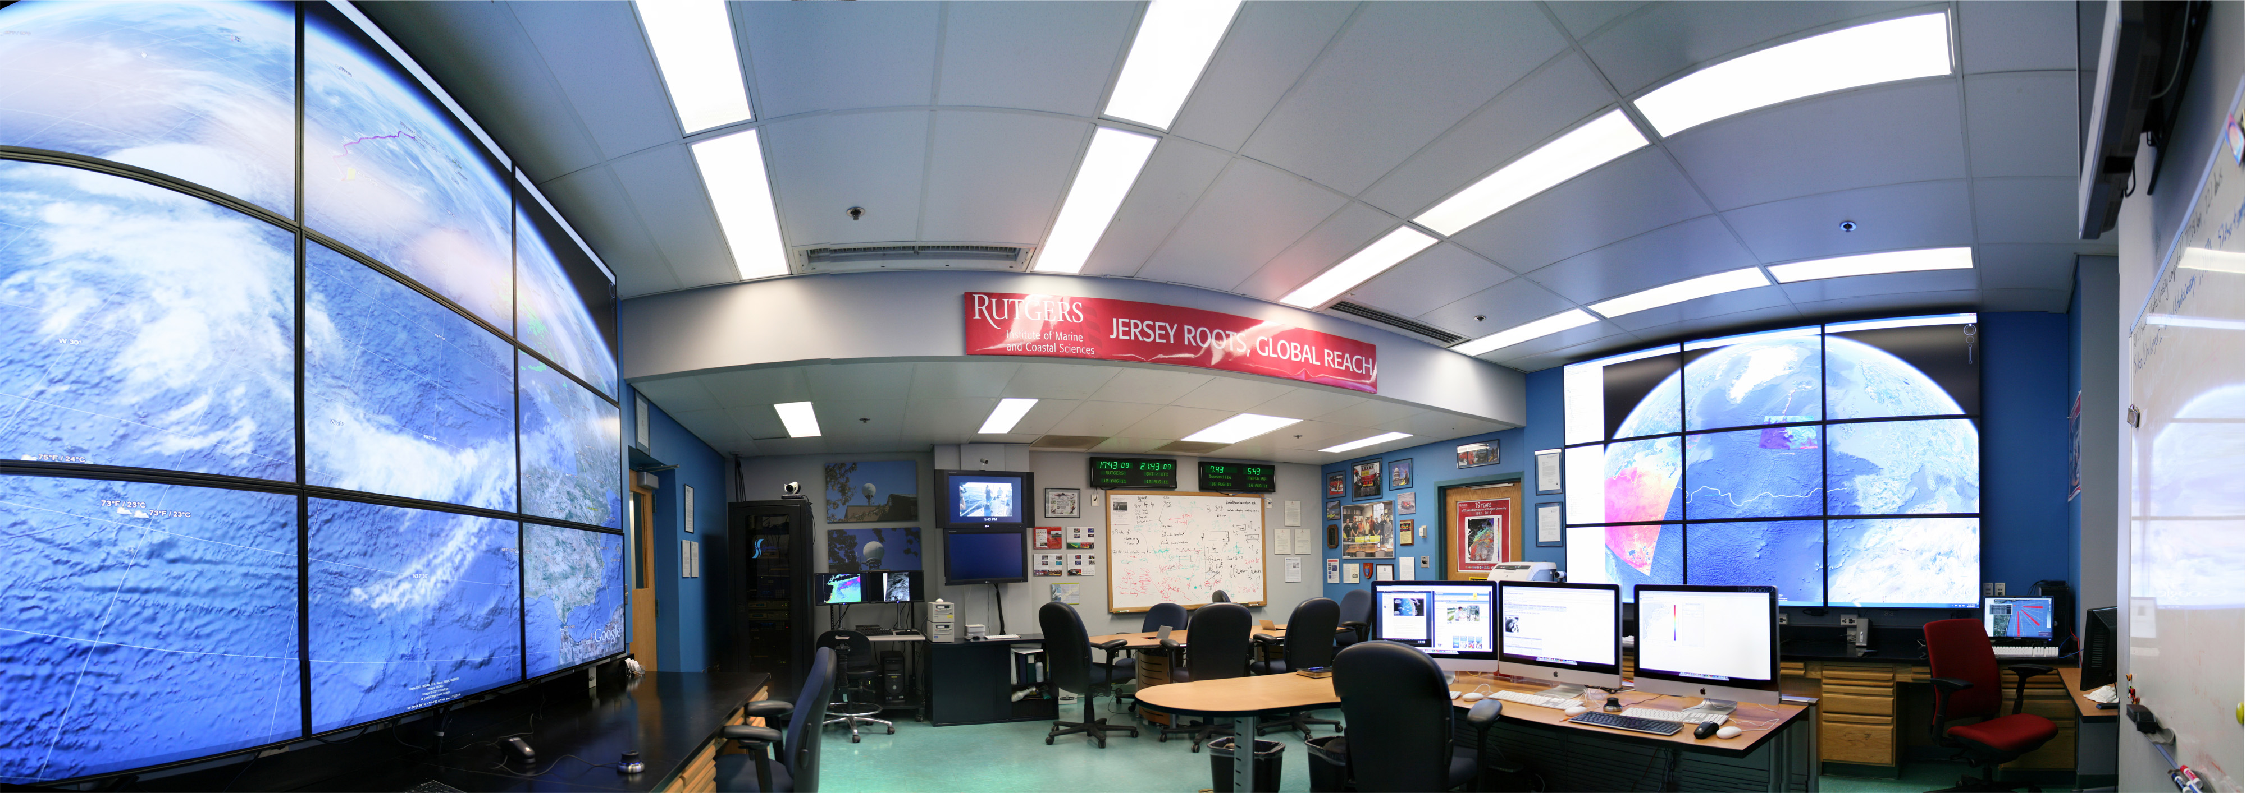
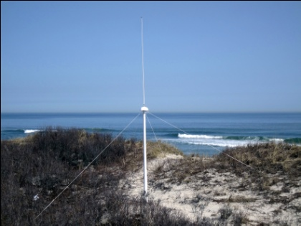
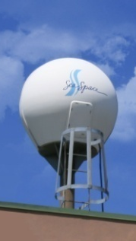
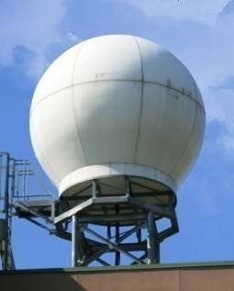
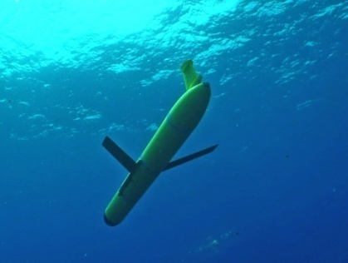
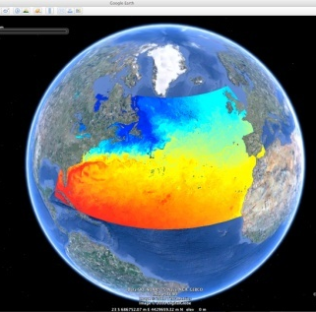
U..
Middle Atlantic
Regional Association
Coastal
Ocean Observing System
1000 km
Cape to Cape
CT
RI
Cape
Cod
MA
NY
10 States
PA
NJ
MD
DE
Regional Association – 2004
Regional Coastal Ocean Observing System – 2007
VA
NC
Cape
Hatteras
Gliders
CODAR
L-Band
Forecasts
X-Band
Notes:
2

Slide 3
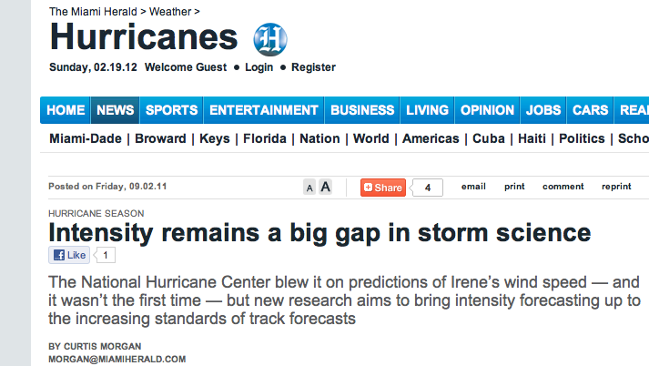
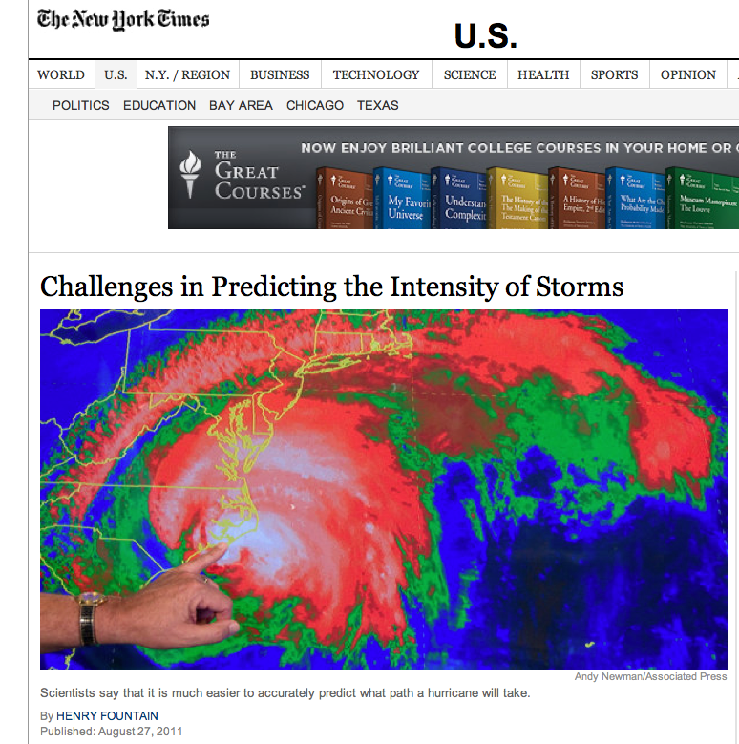
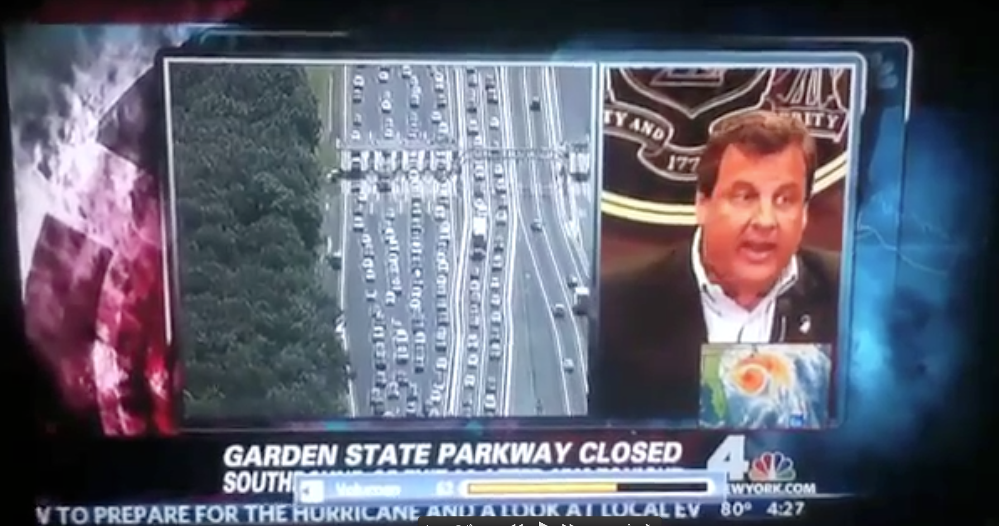

Slide 4
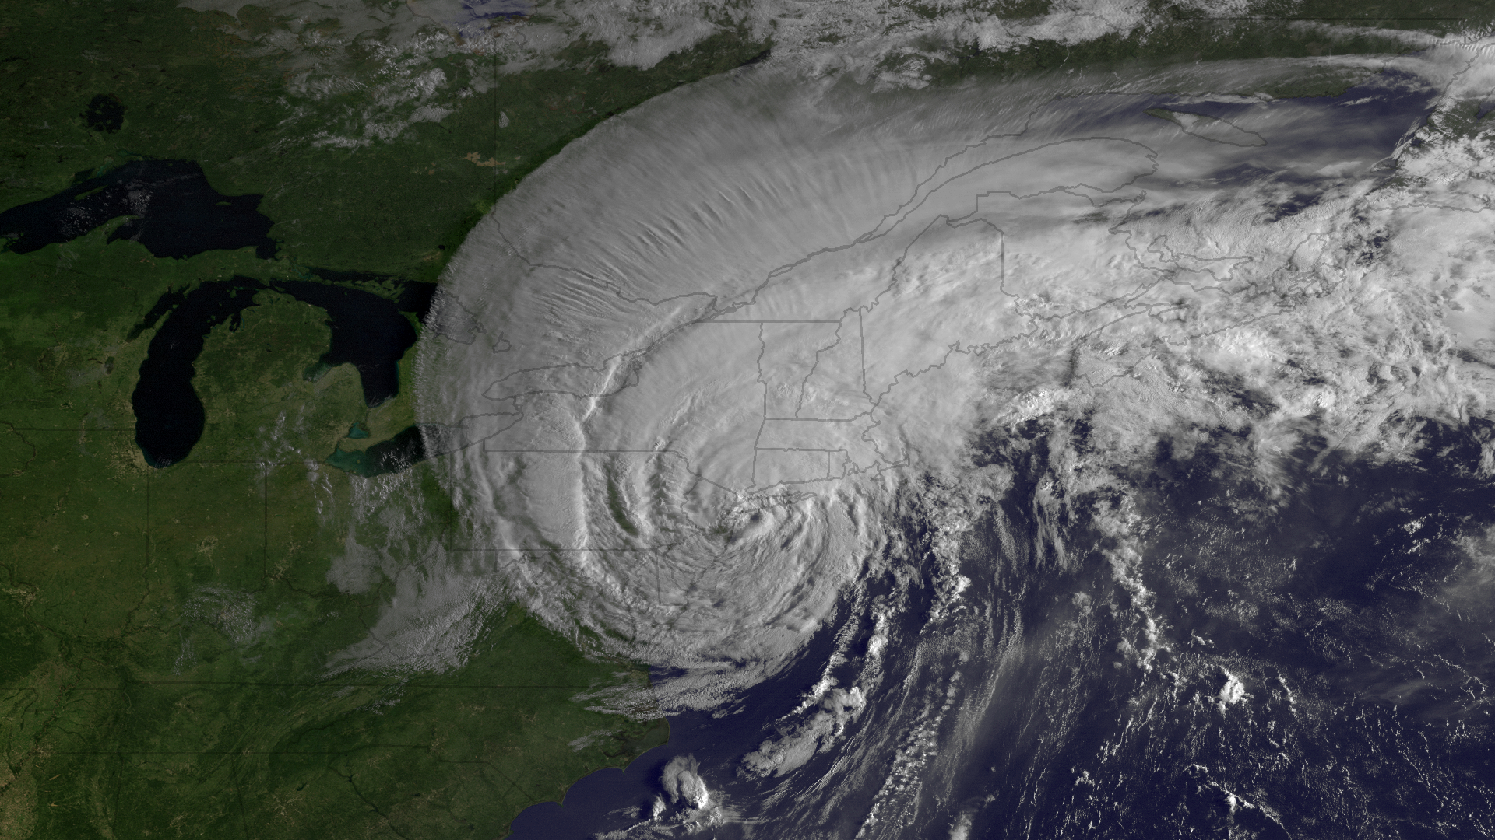
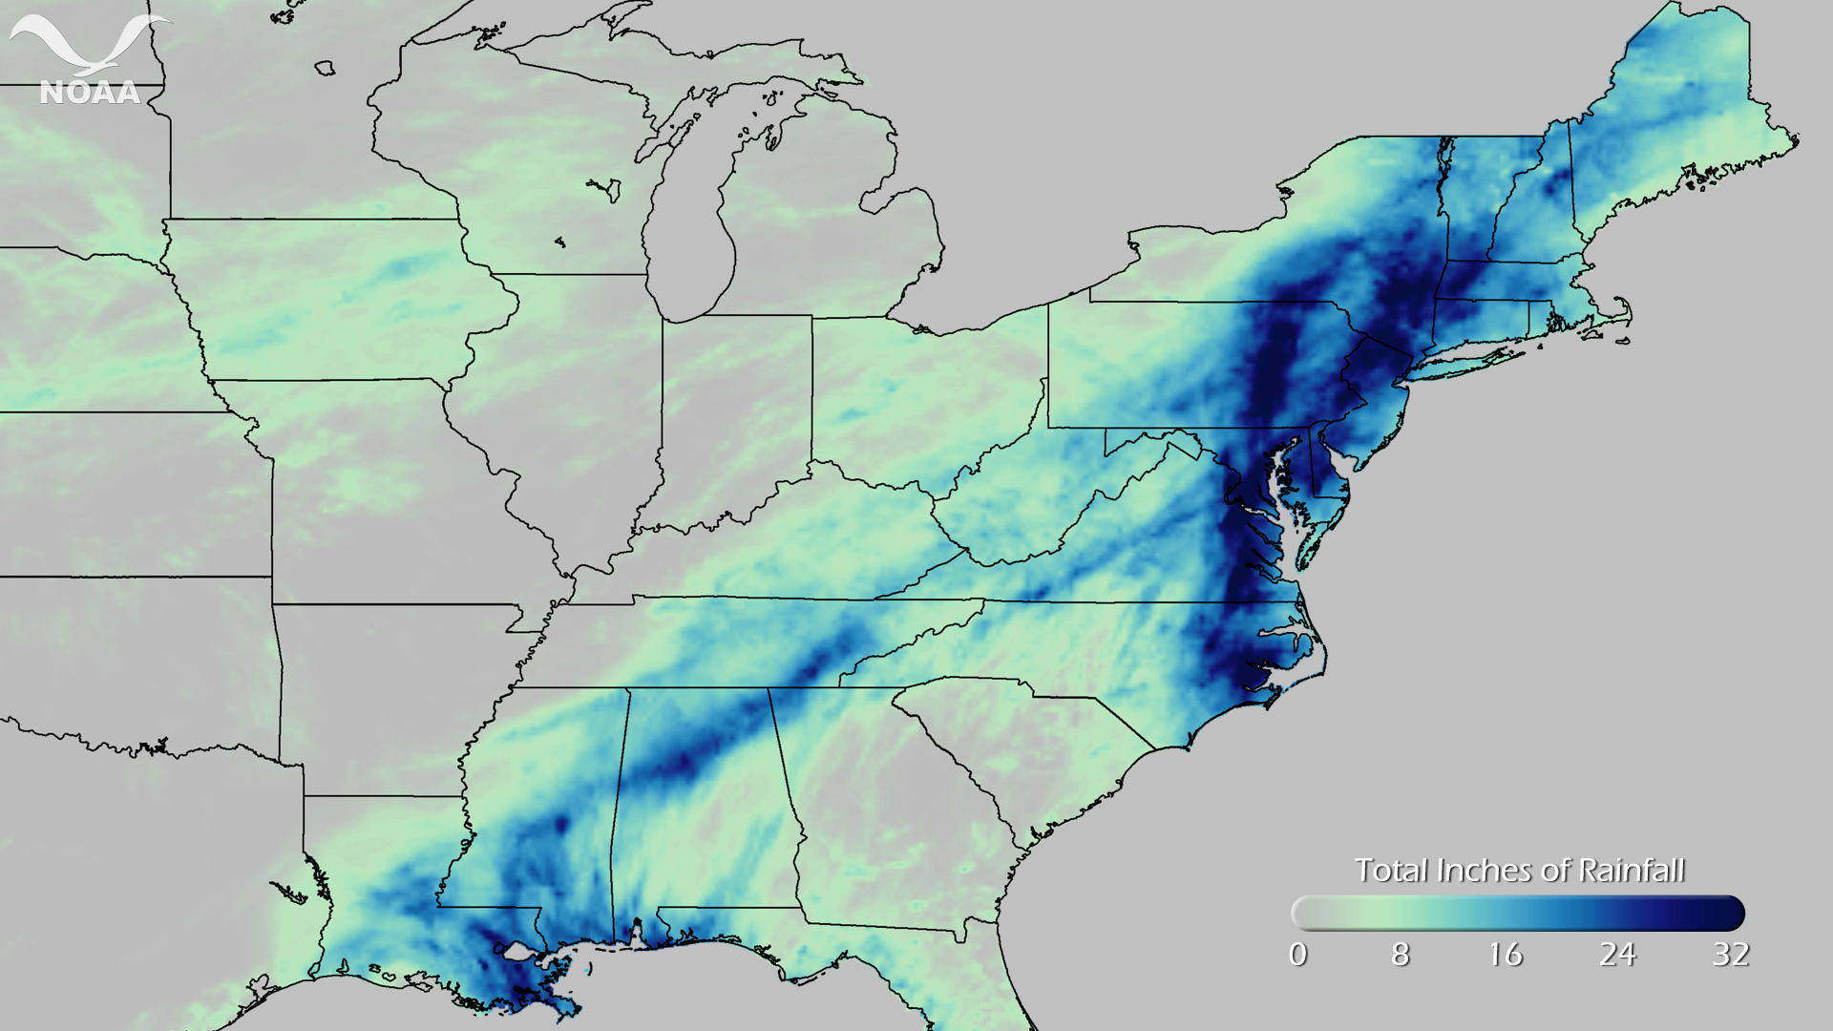
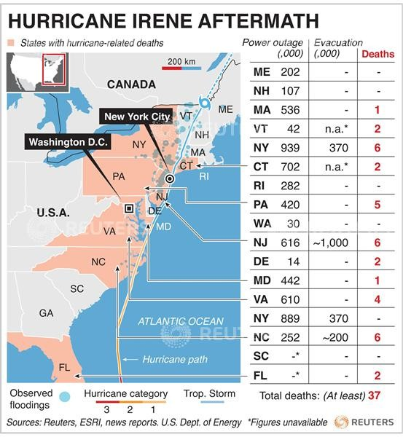

Hurricane Irene
Aug 20-29
Total inches of rainfall
0
32
First tropical storm to threaten NYC since Hurricane Gloria in 1985
Flooding records broken in 26 rivers
Caused at least 56 deaths
Damage nearly $8 billion

Slide 5
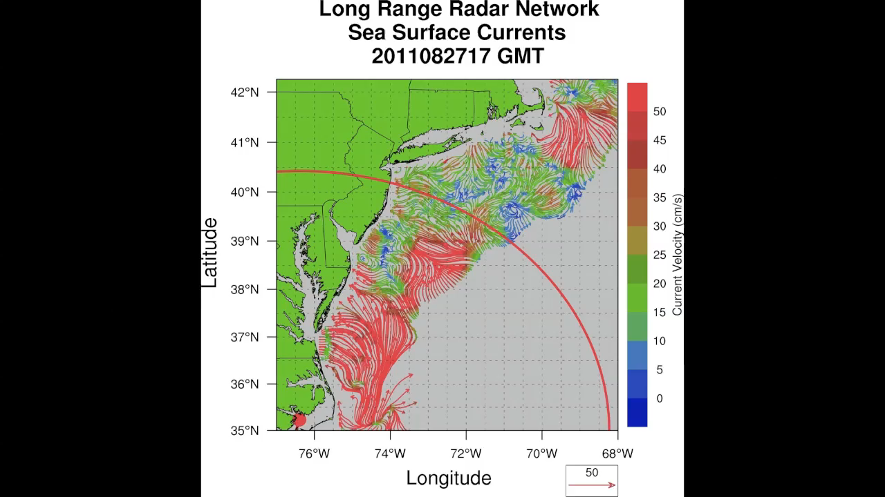
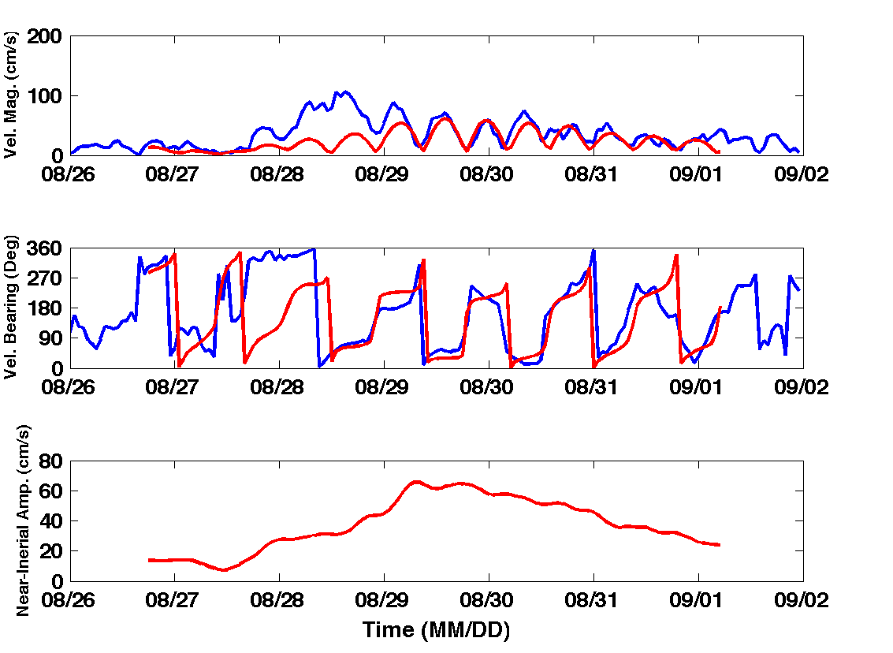
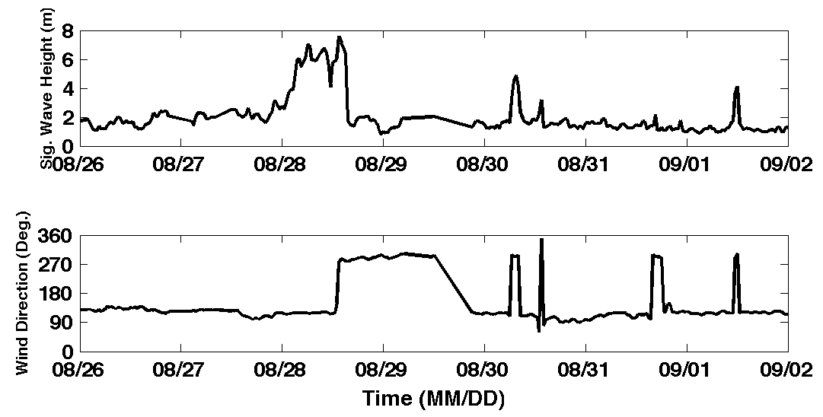
Hurricane Irene
39.5N 73W Surface Current Time Series
Total Current Near-Inertial Current
Wave & Wind Direction Time Series

Slide 6
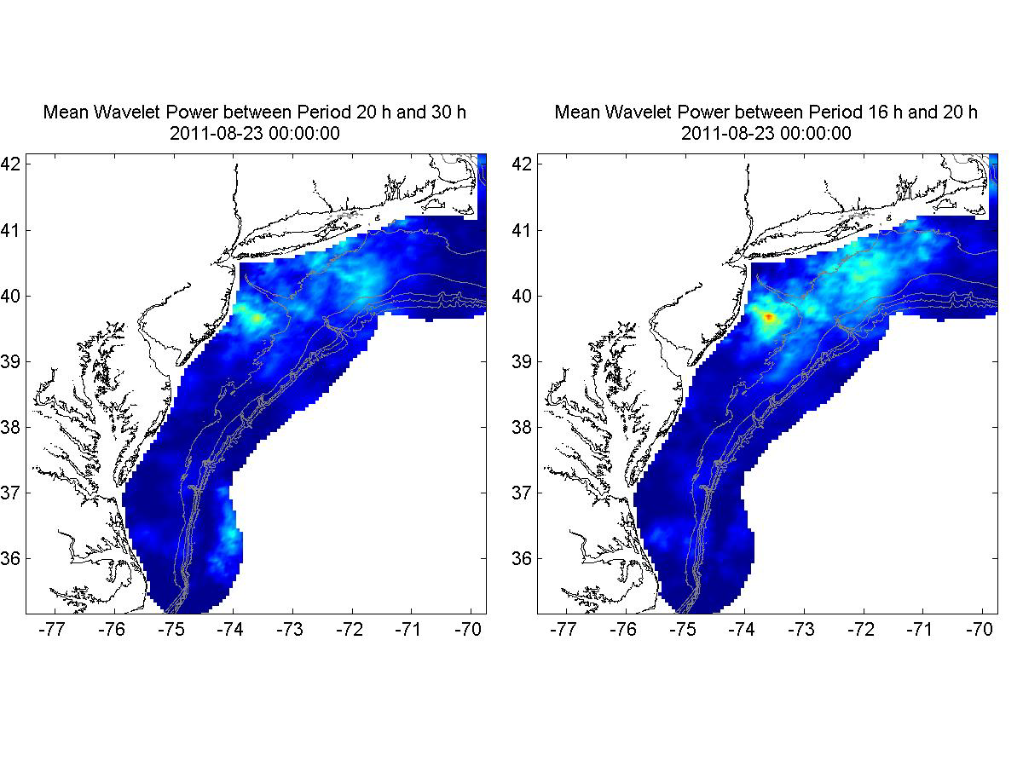
Hurricane Irene
Direct Wind Forcing
Inertial Response

Slide 7
Two Gliders
Deployed by MARACOOS
in Hurricane Irene
RU23
Deployed for MARACOOS.
Map subsurface T/S structure for fisheries.
Damaged early - drifter
Recovered by fisherman
Provided data on inertial currents during storm.
RU16
Deployed for EPA.
Map bottom dissolved oxygen.
Provided data on mixing during storm.

Slide 8
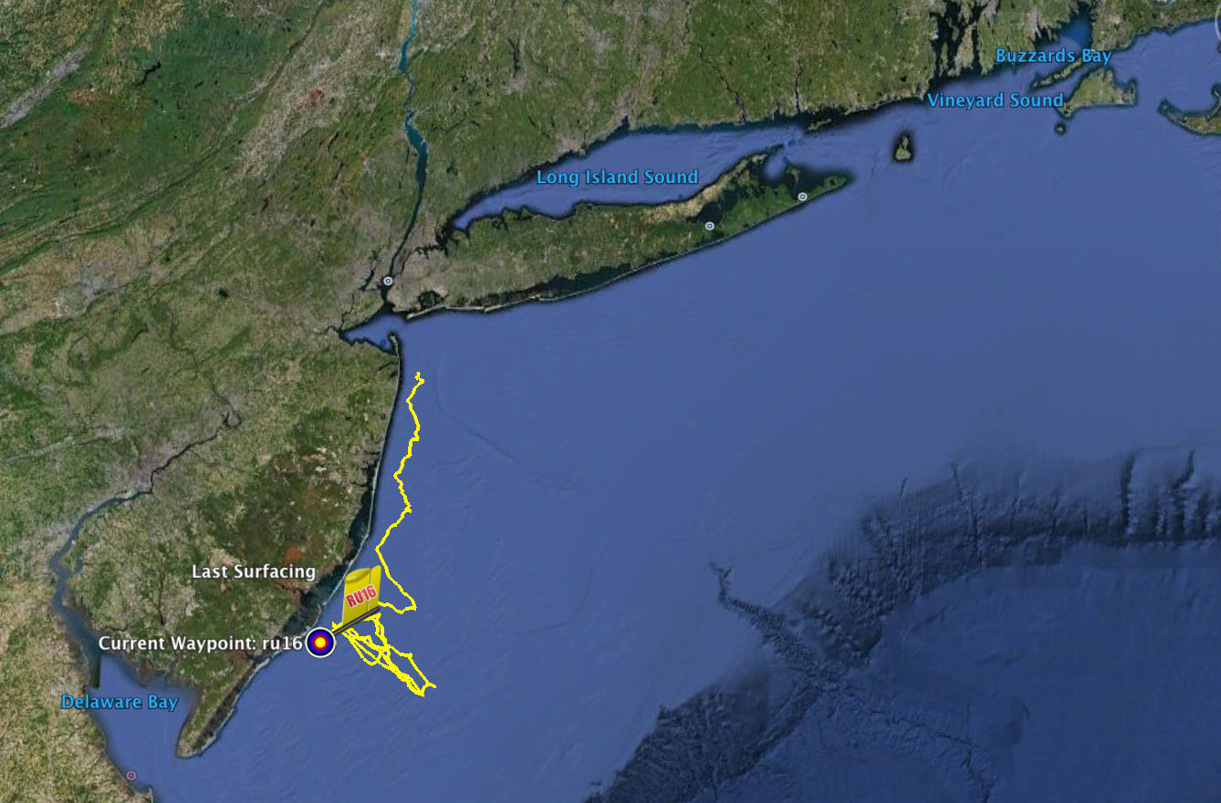
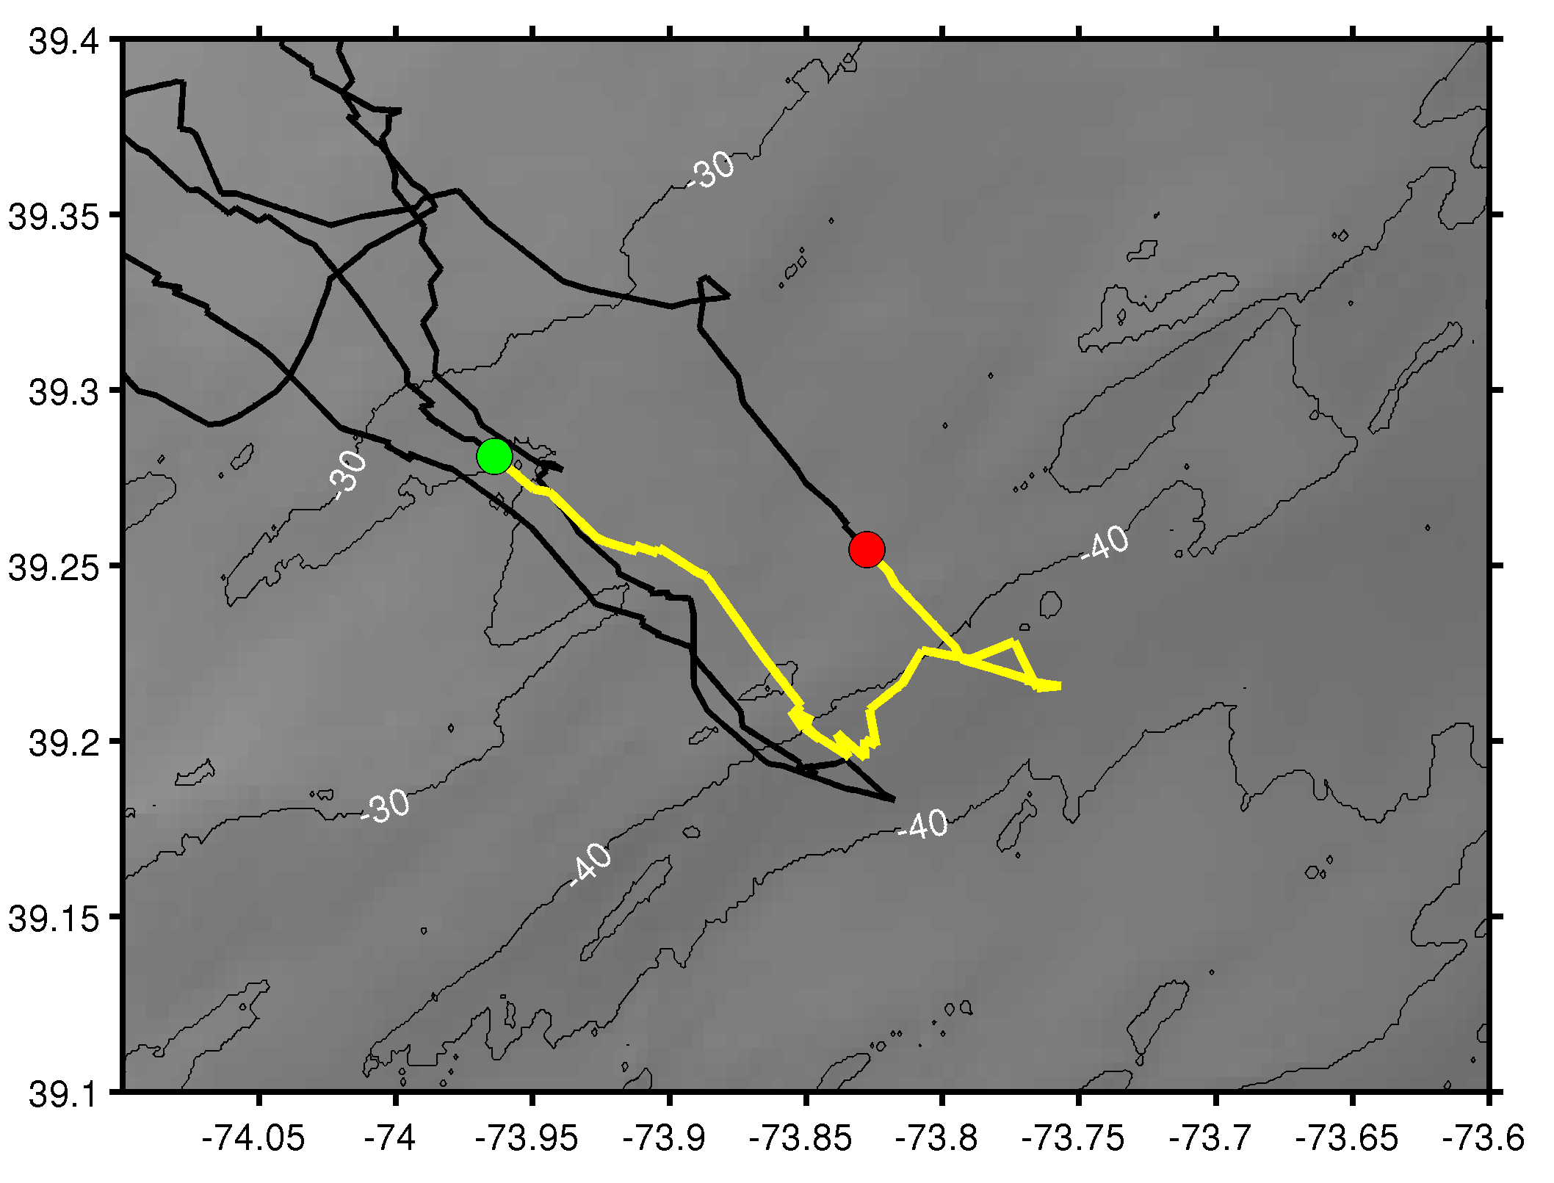
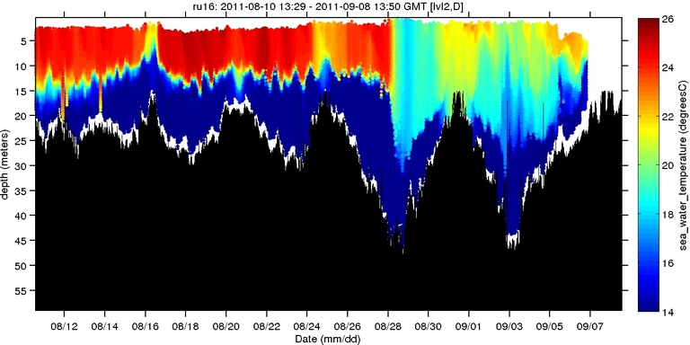
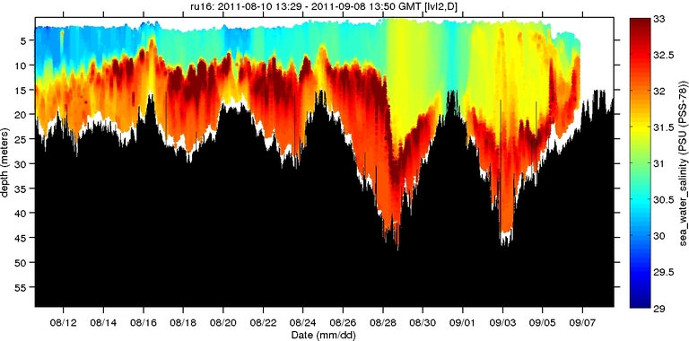
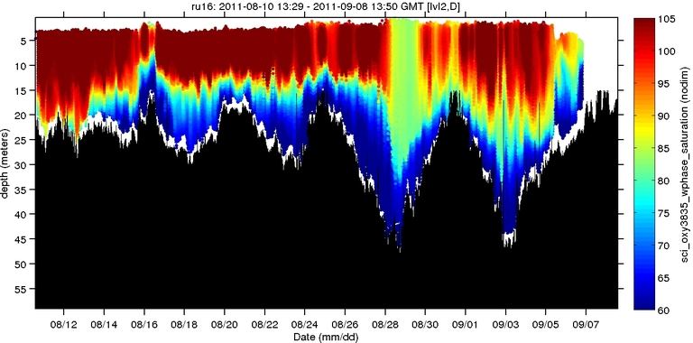
Hurricane Irene
Hurricane Irene
0
26
depth
temperature
55
14
0
33
depth
salinity
55
29
0
105
depth
% oxygen
55
60
8/12
date
9/07

Slide 9
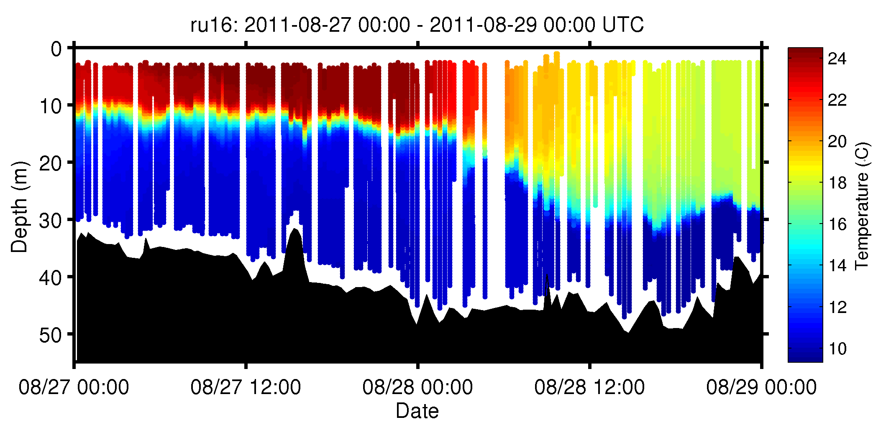
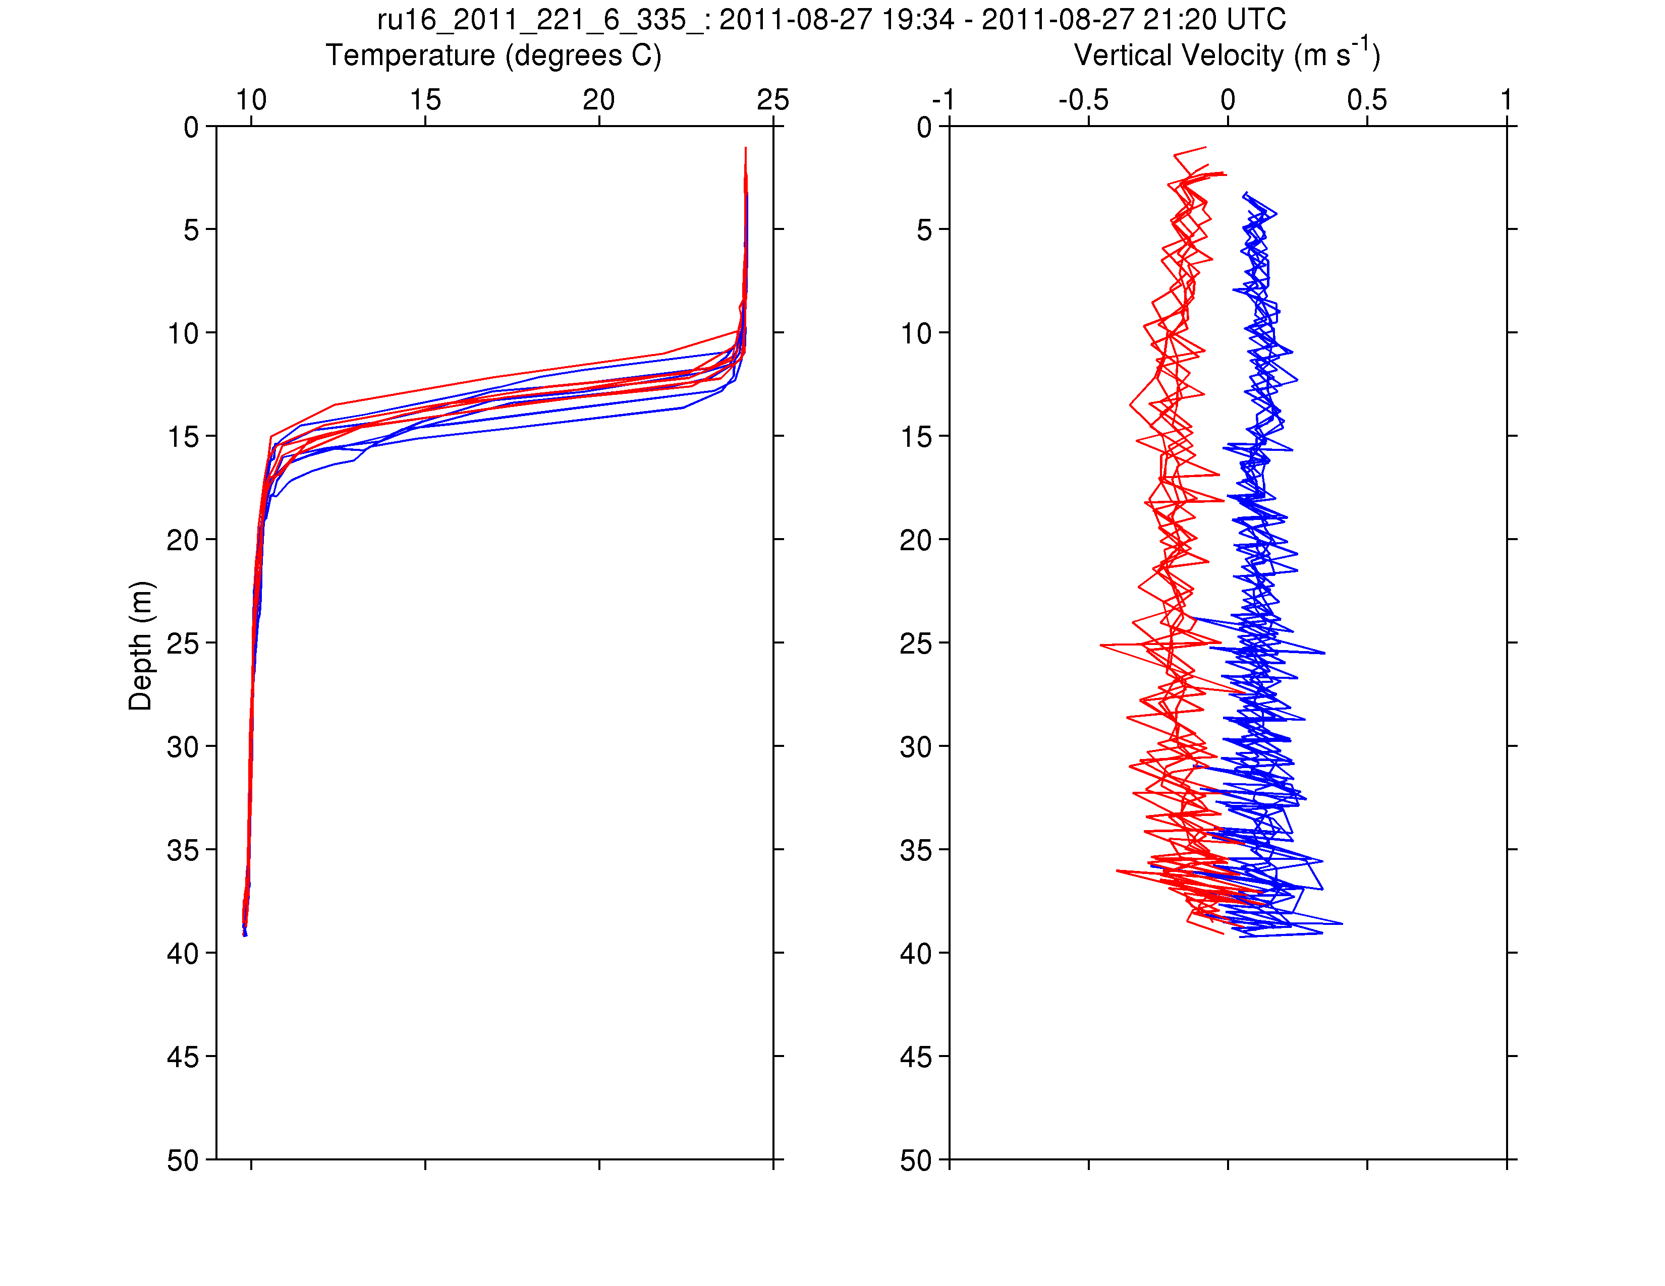
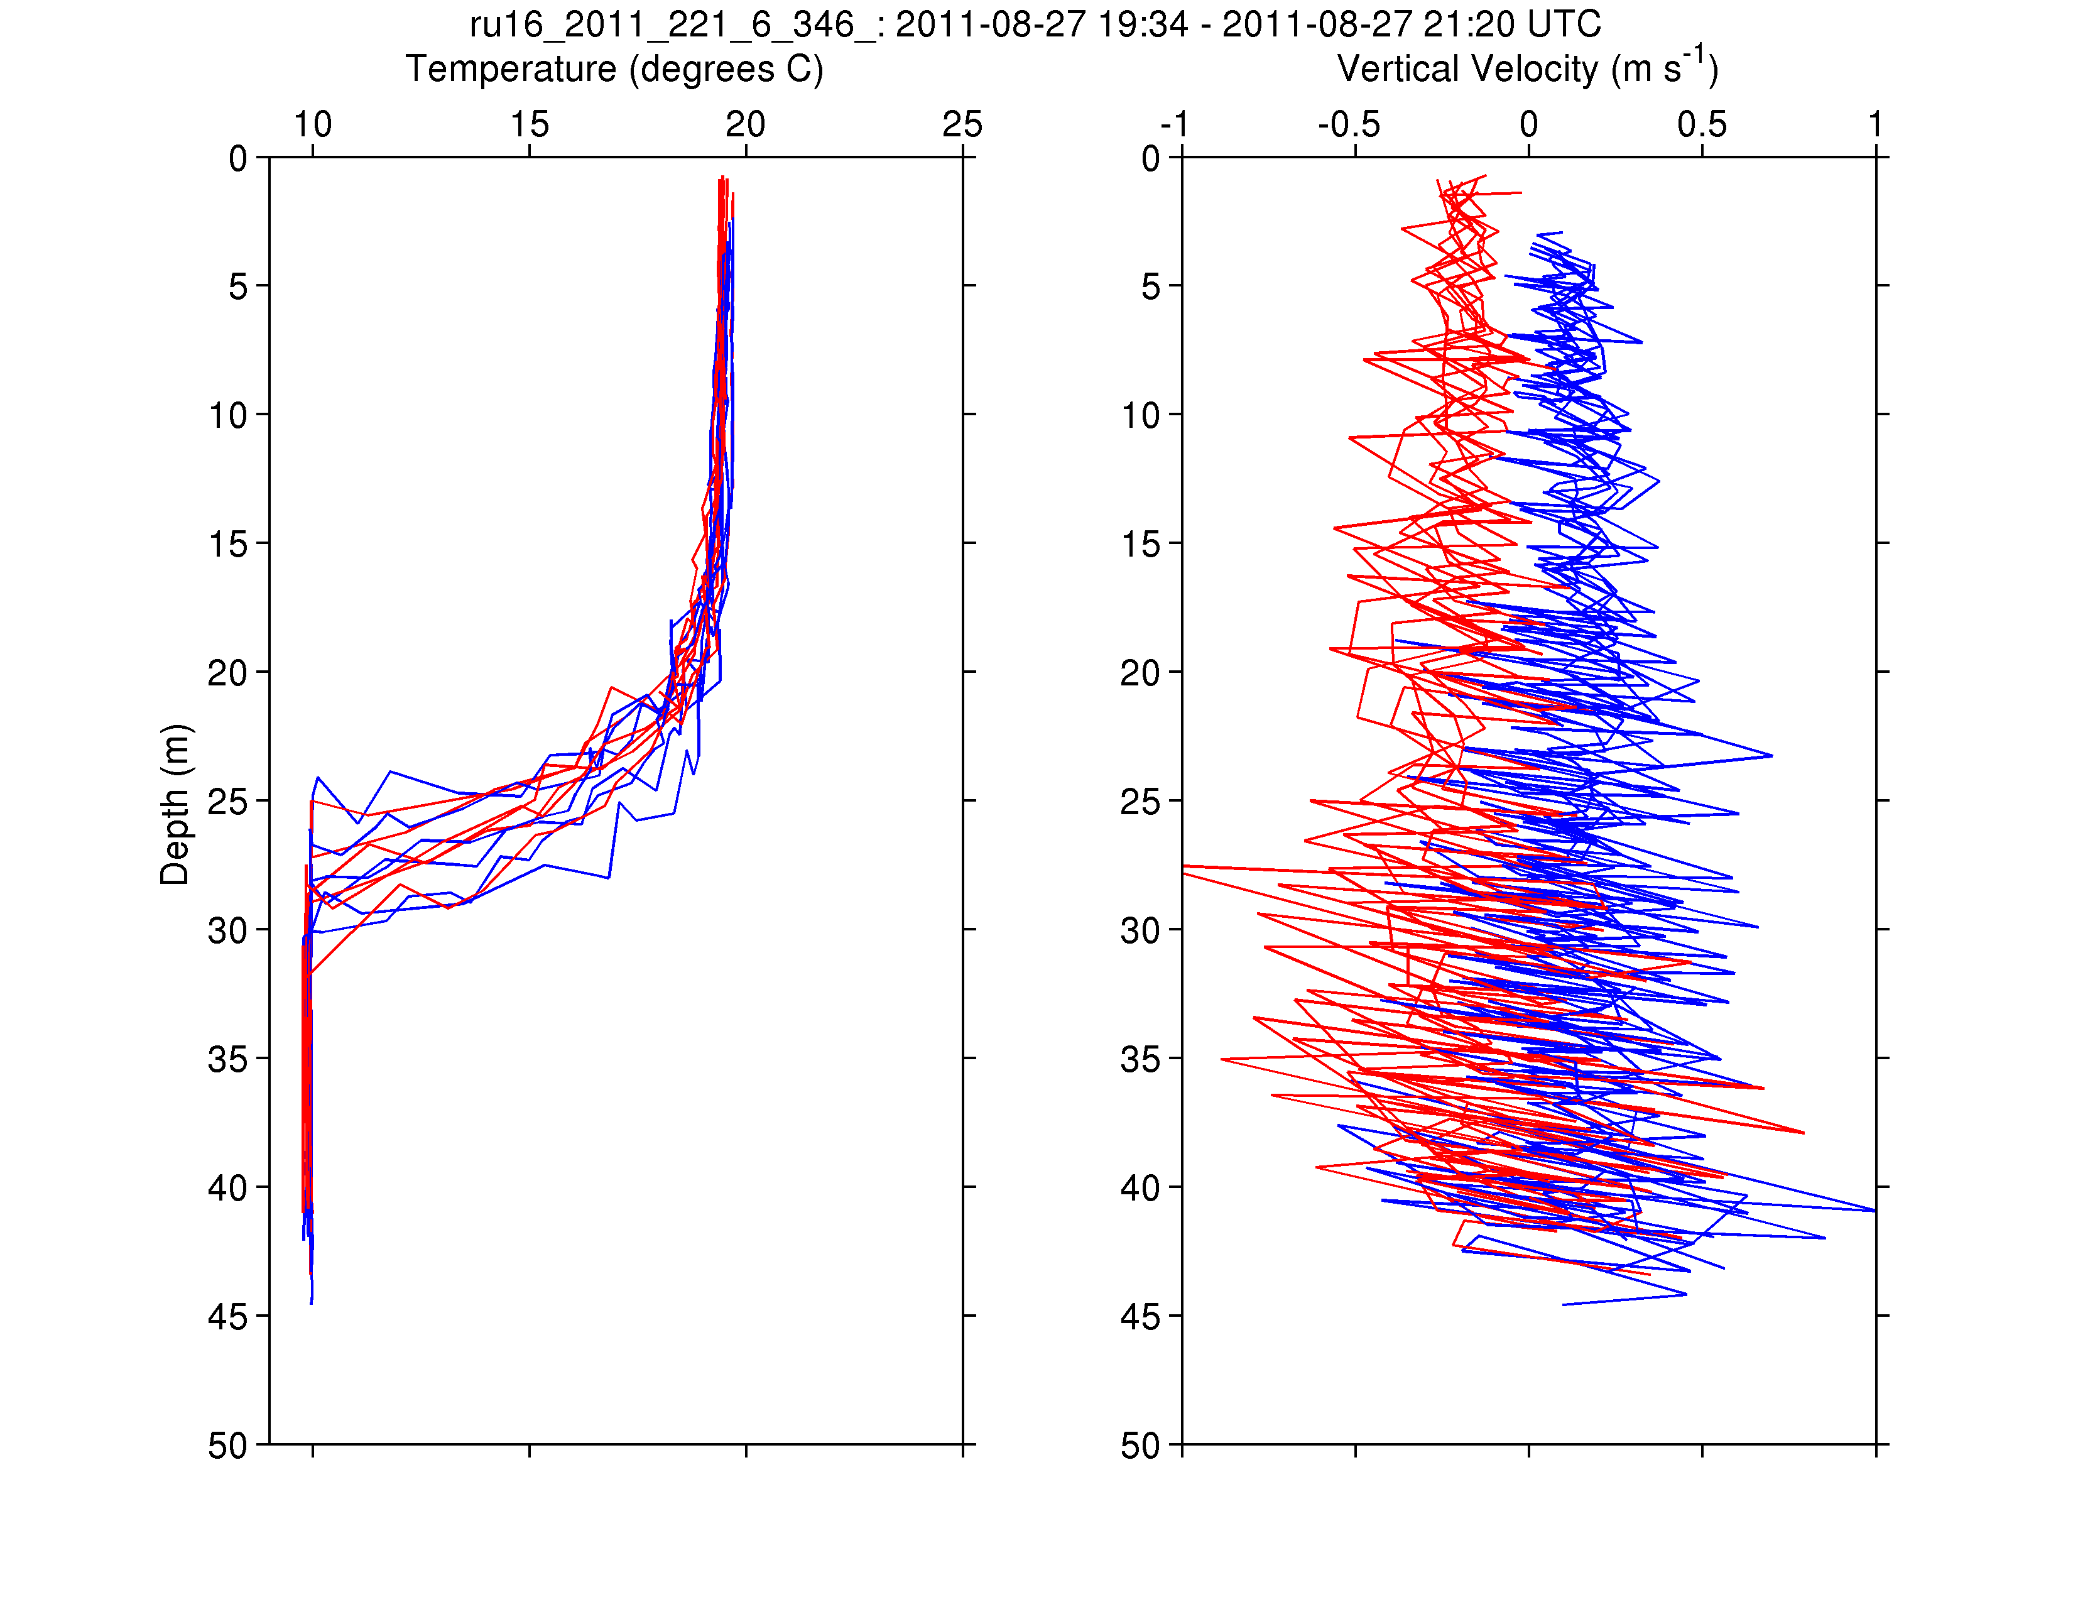
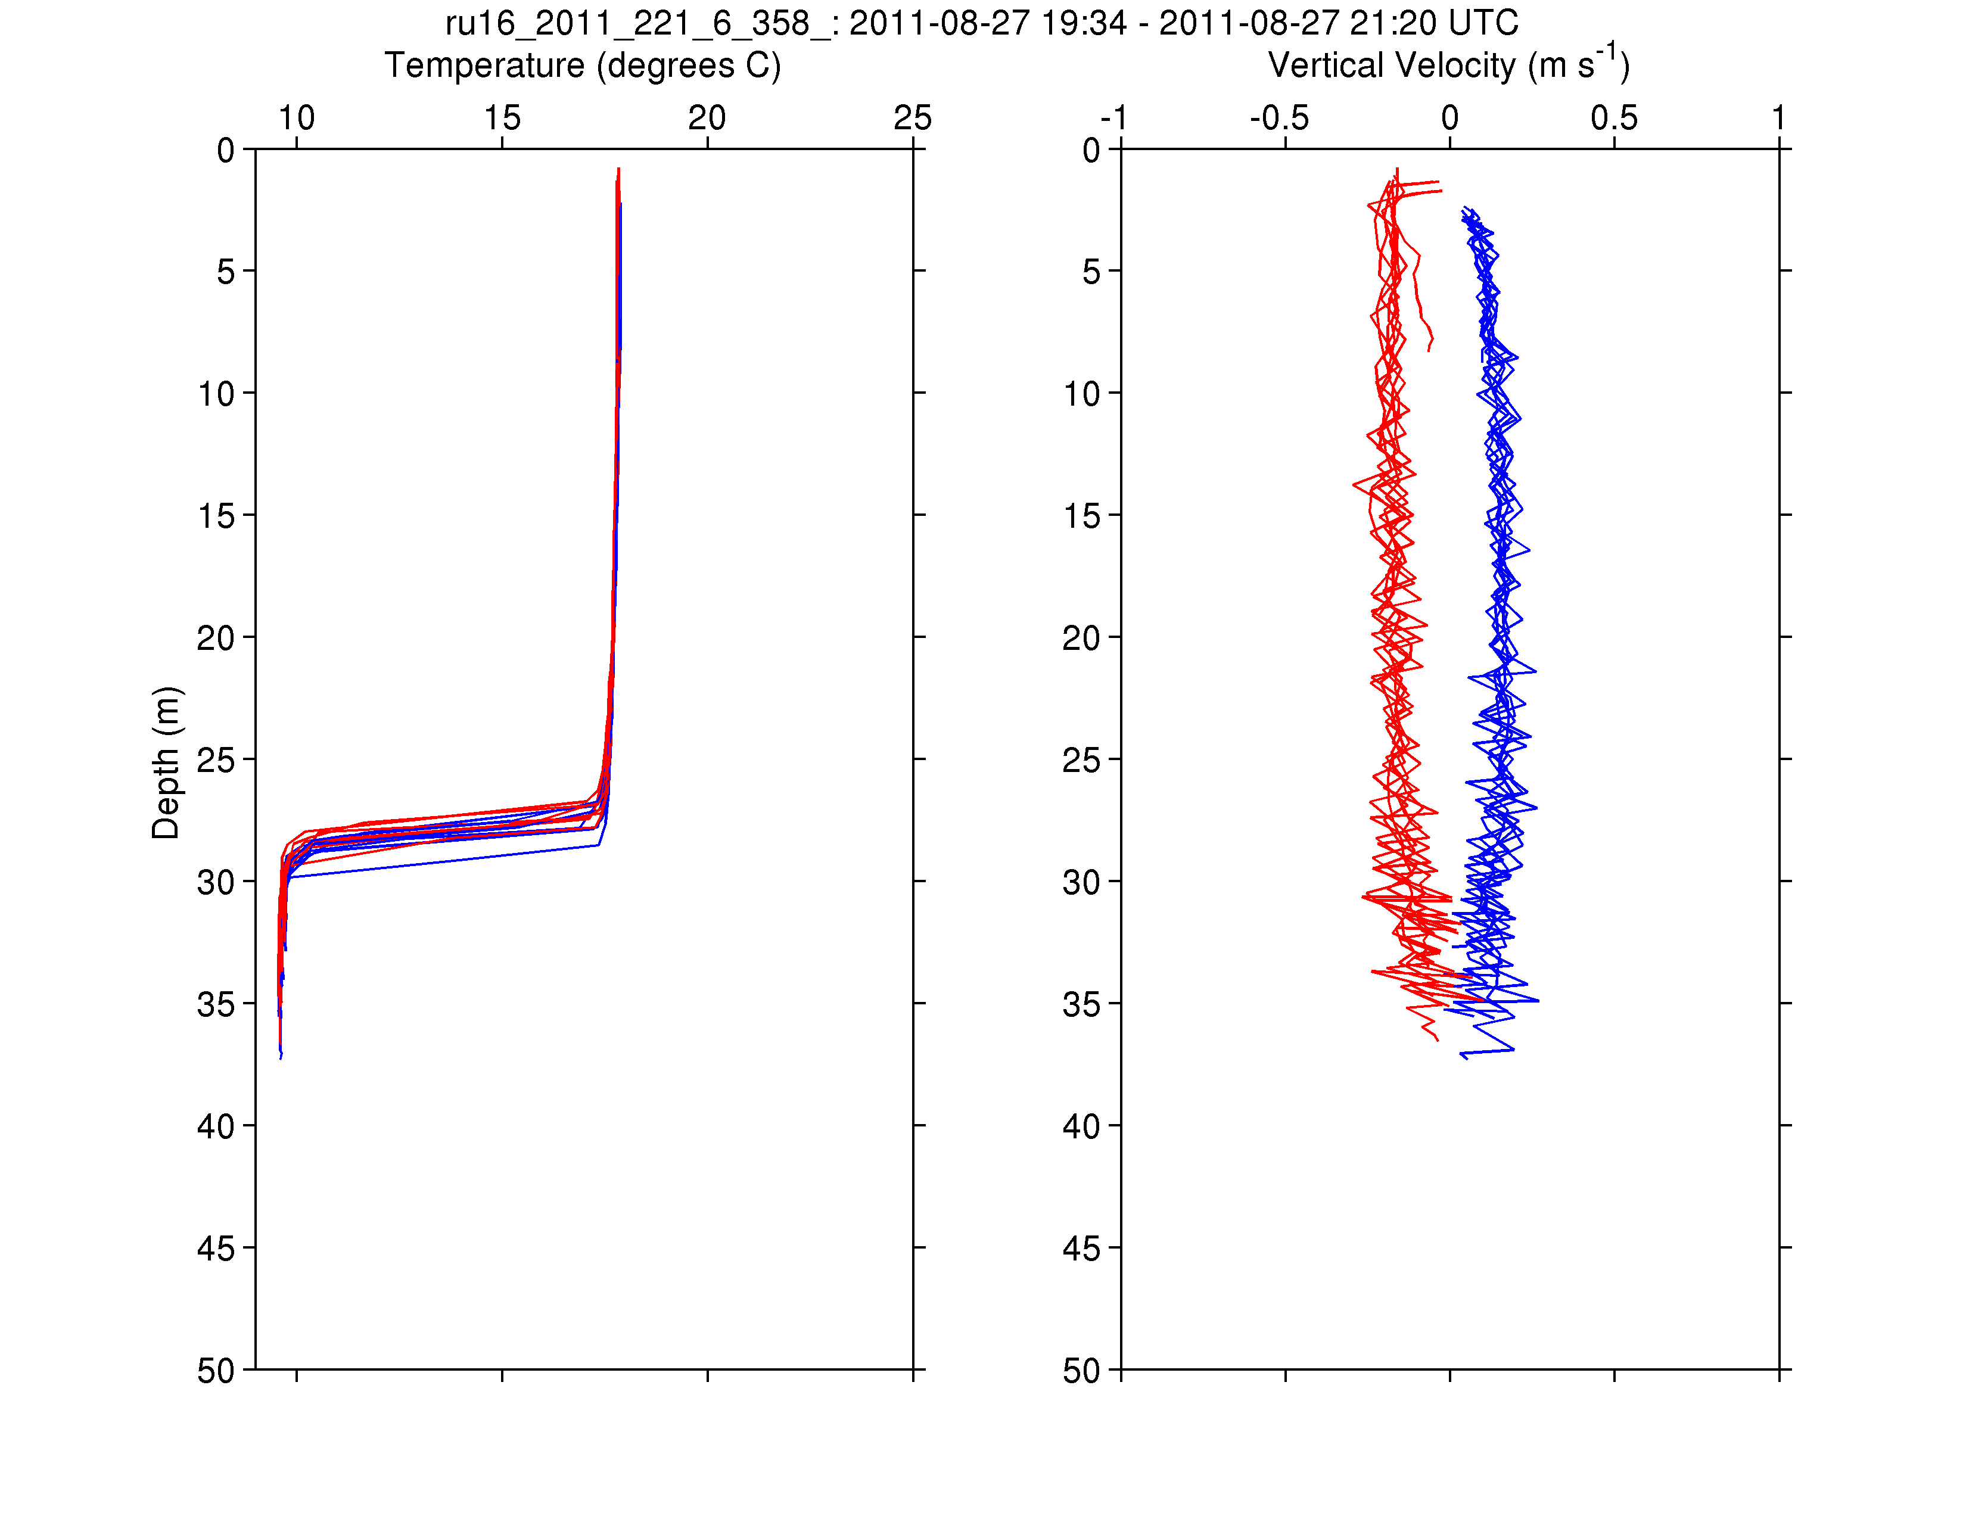
RU16
Temp.
Section
Upcast
Downcast
Temp. Vert. Vel.
Temp. Vert. Vel.
Temp. Vert. Vel.

Slide 10
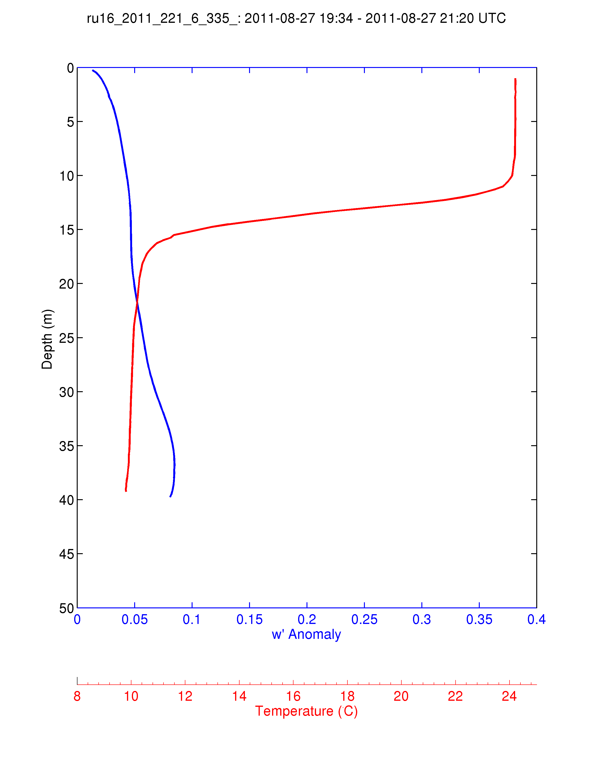
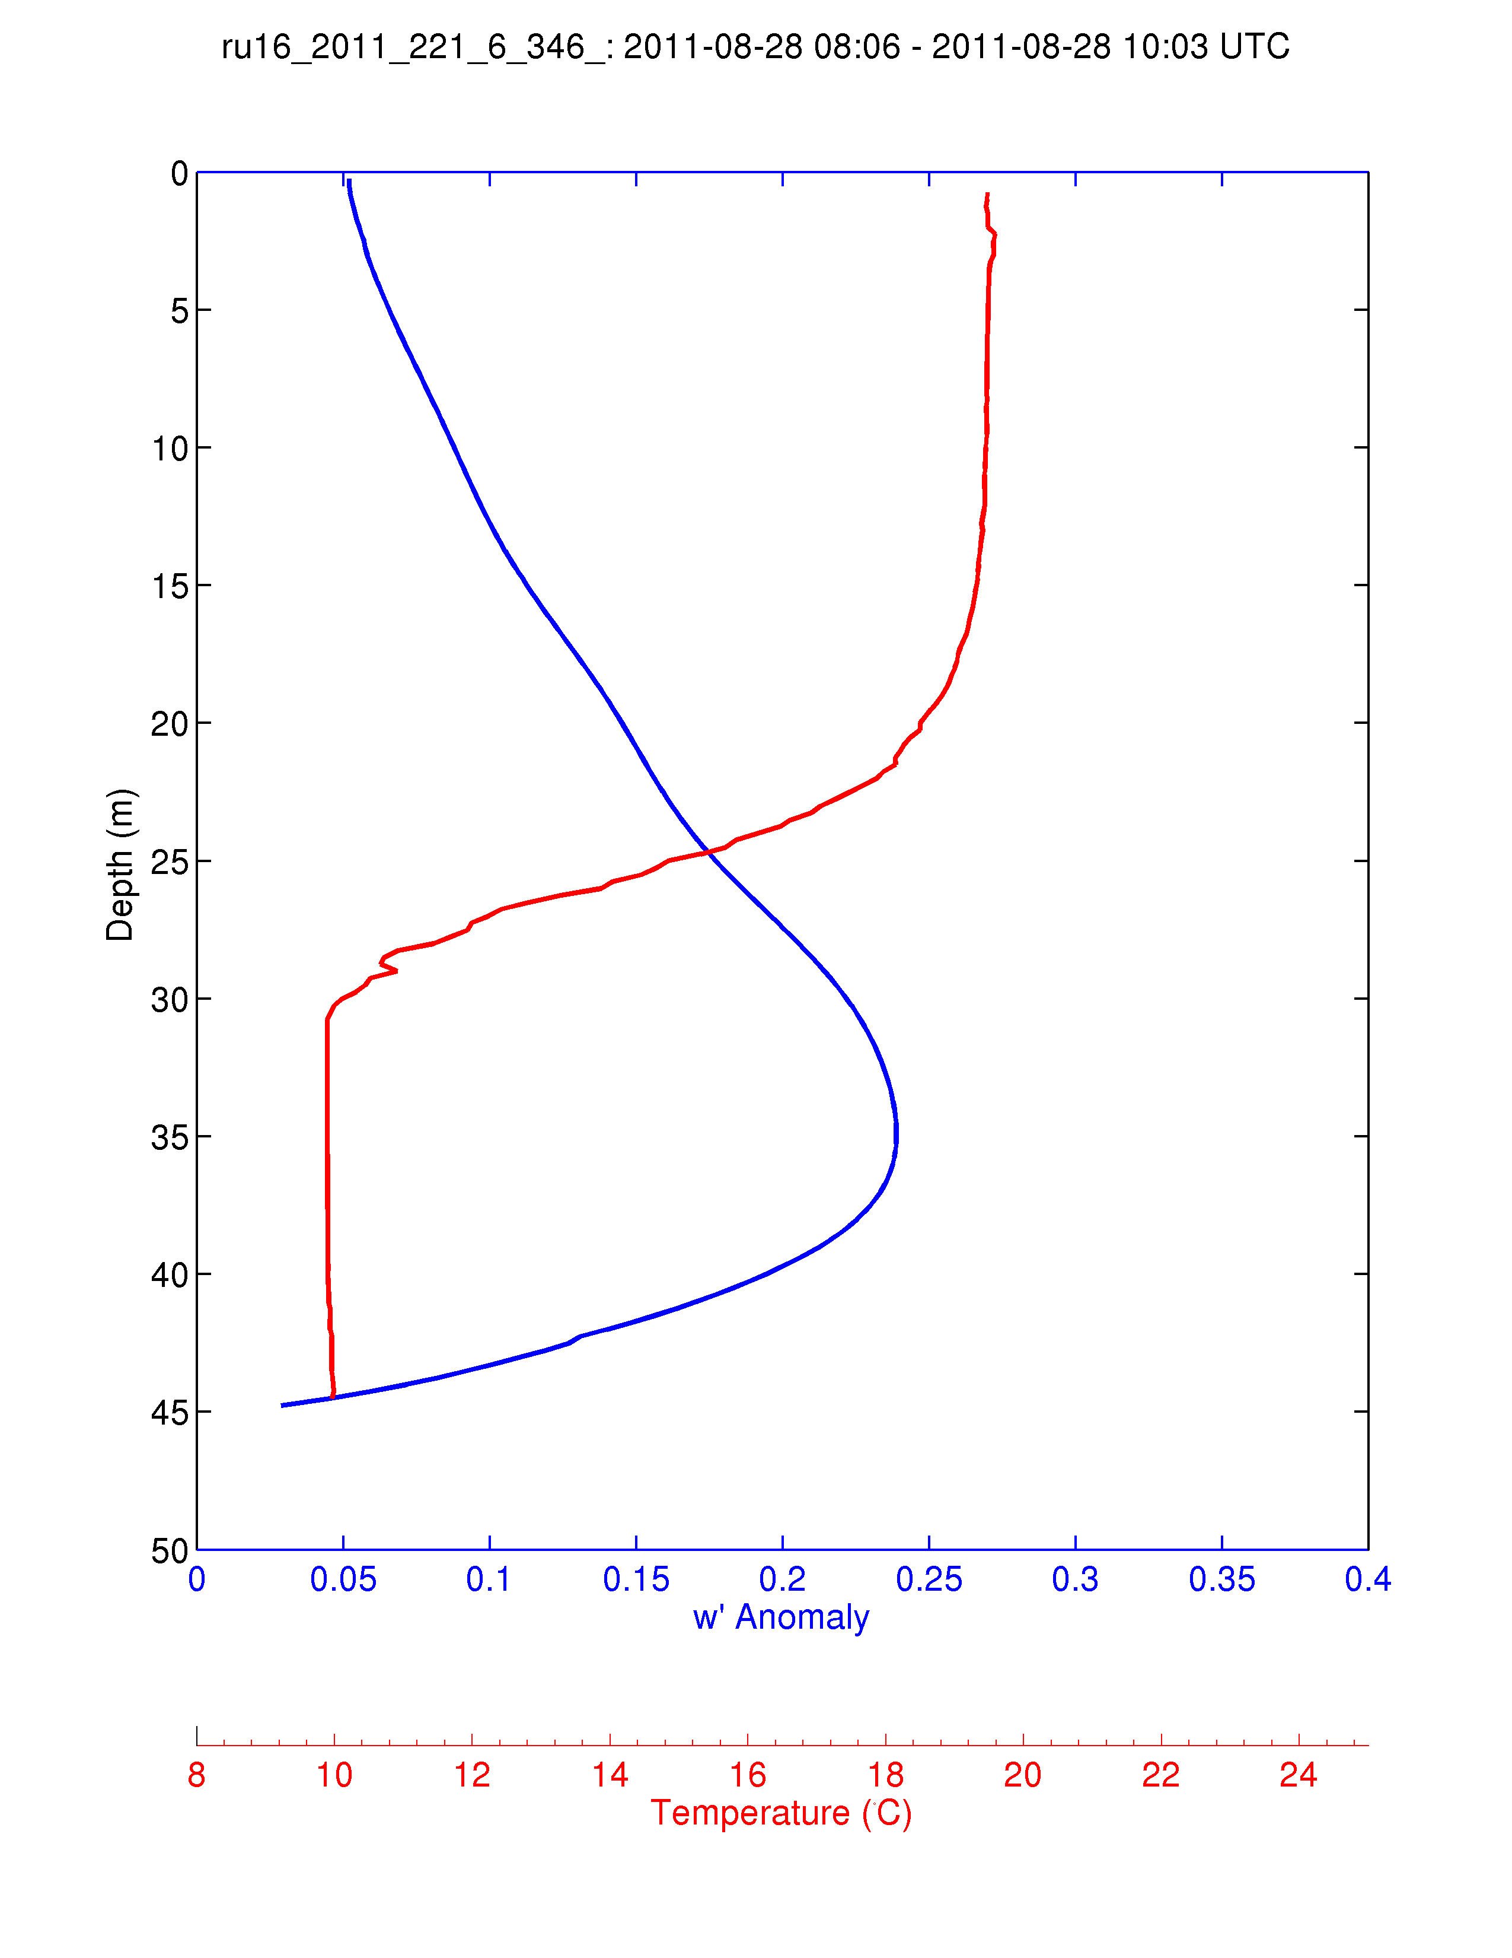
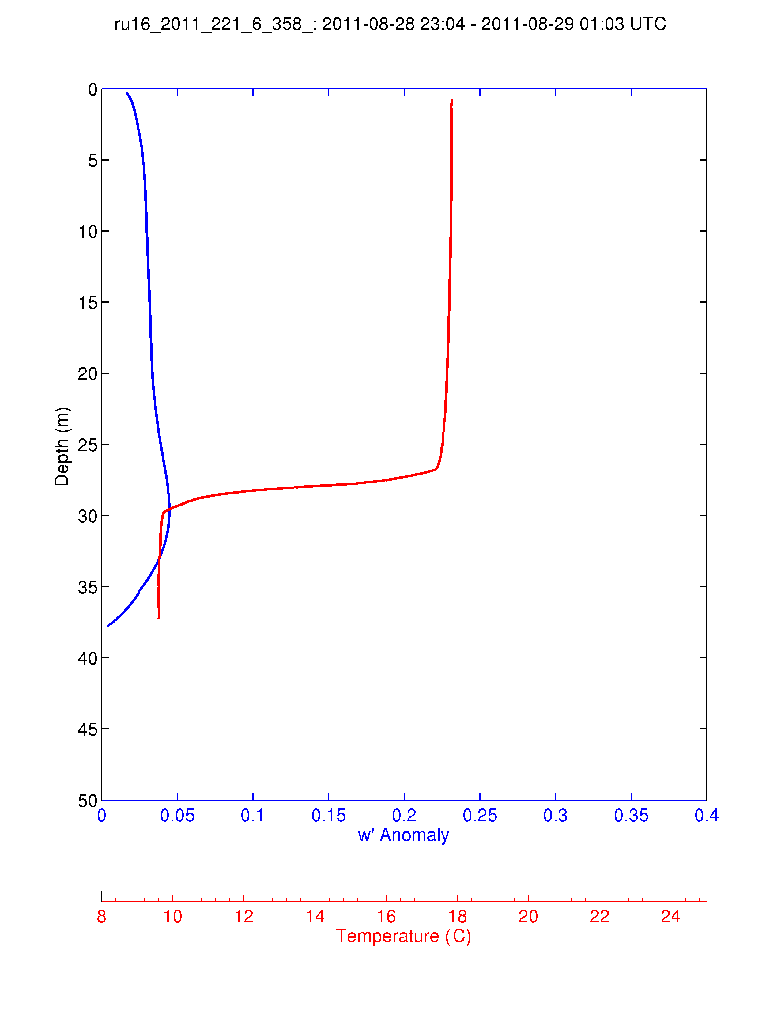
For Each 2-hour Segment:
1) Calculate the Average Temperature Profile
2) Calculate the Vertical Velocity Standard Deviation Profile and Smooth Vertically.
Temp
S.D. w’
Pre-Irene
During Irene
Post-Irene

Slide 11
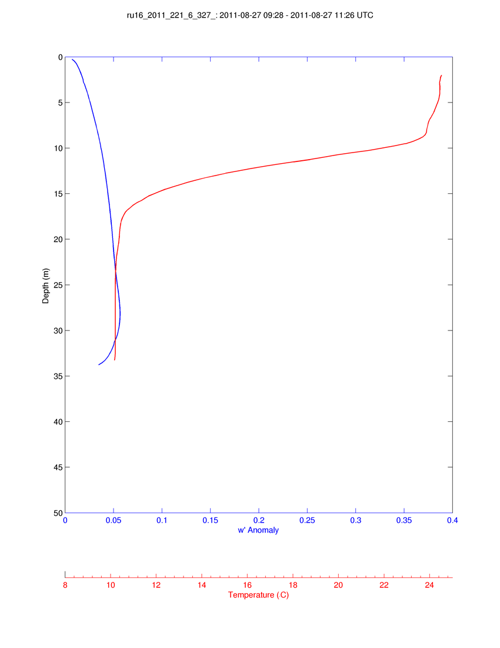
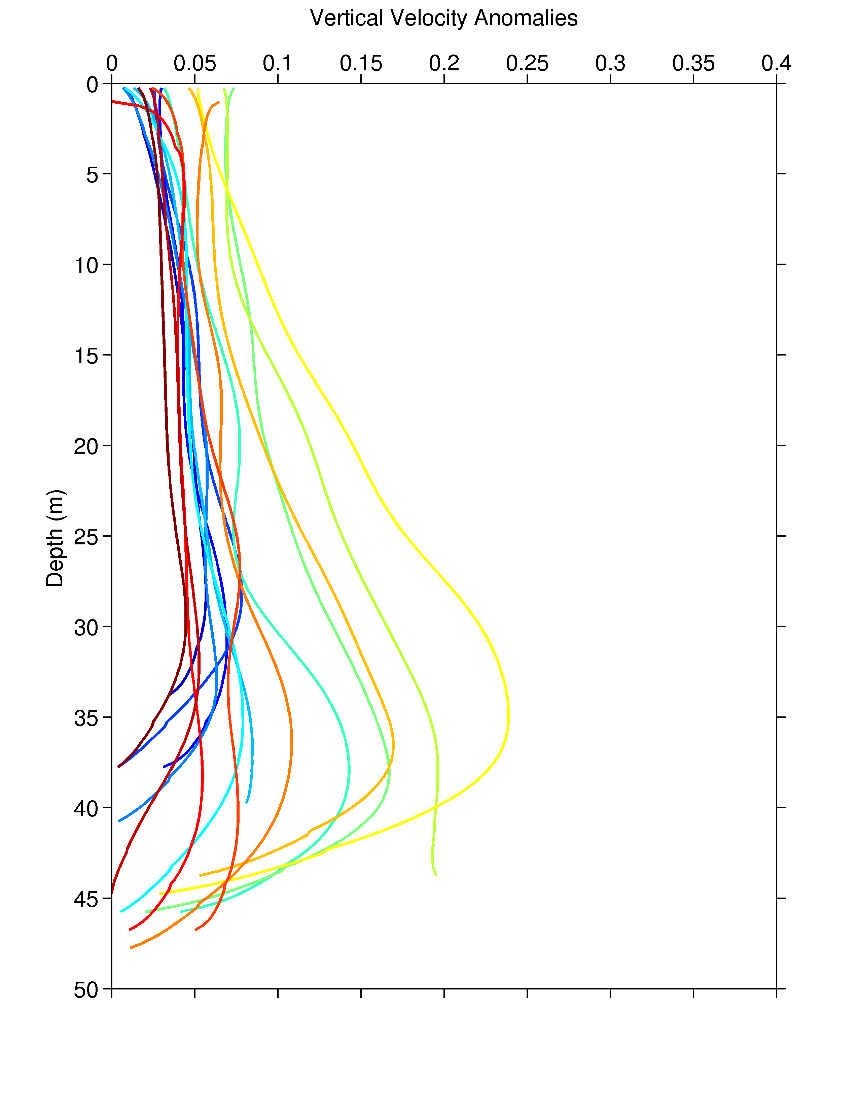
Time History of Mixing During Irene:
Profiles of the Standard Deviation
Vertical Velocity Profile
Temp
S.D. w’
Time Progresses from Red to Blue

Slide 12
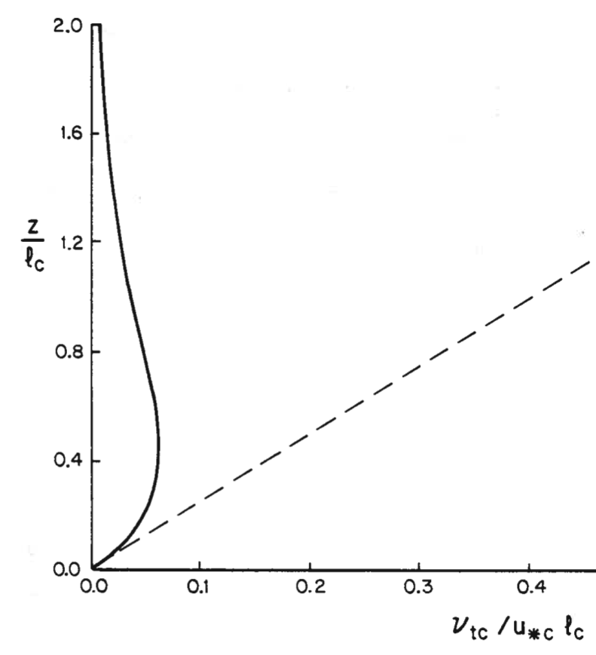
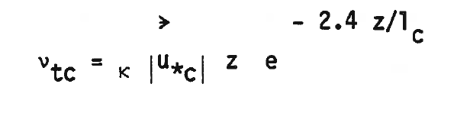

Time History of Mixing During Irene:
Profiles of the Standard Deviation
Vertical Velocity Profile
Eddy viscosity
Linear * Exponential Decay
Linear
Time Progresses from Red to Blue

Slide 13
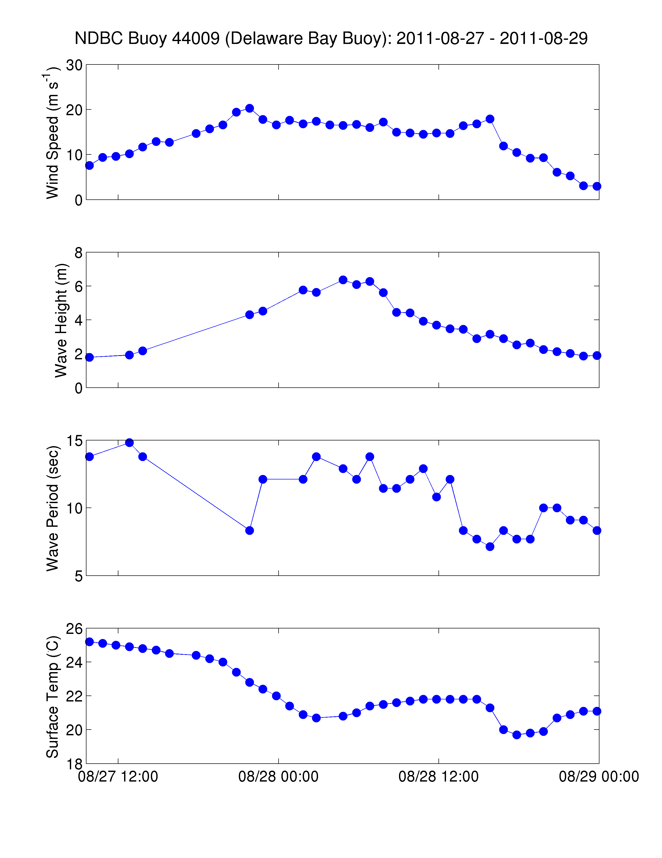
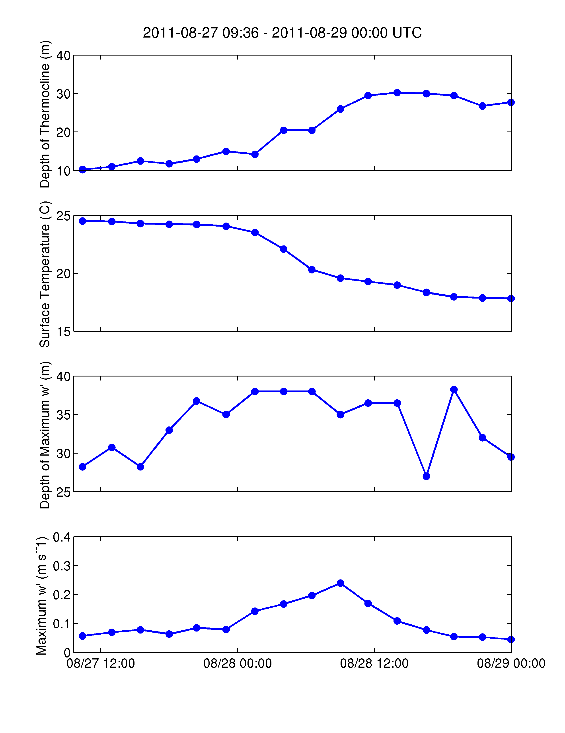
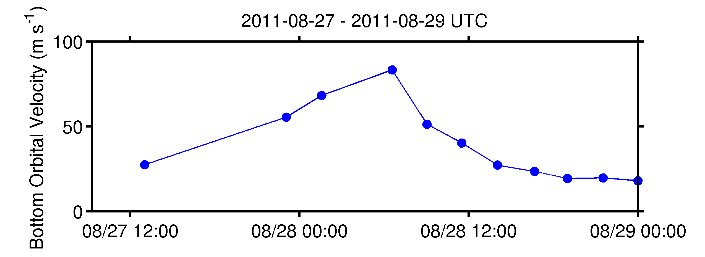
Time Series of Derived Parameters
NOAA Delaware Bay Buoy
Glider RU16
Thermocline Depth
Wind Speed
Surface Temp
Wave Height
Max S.D. w’ Depth
Wave Period
Max S.D. w’
Wave Bottom Orbital Velocity

Slide 14
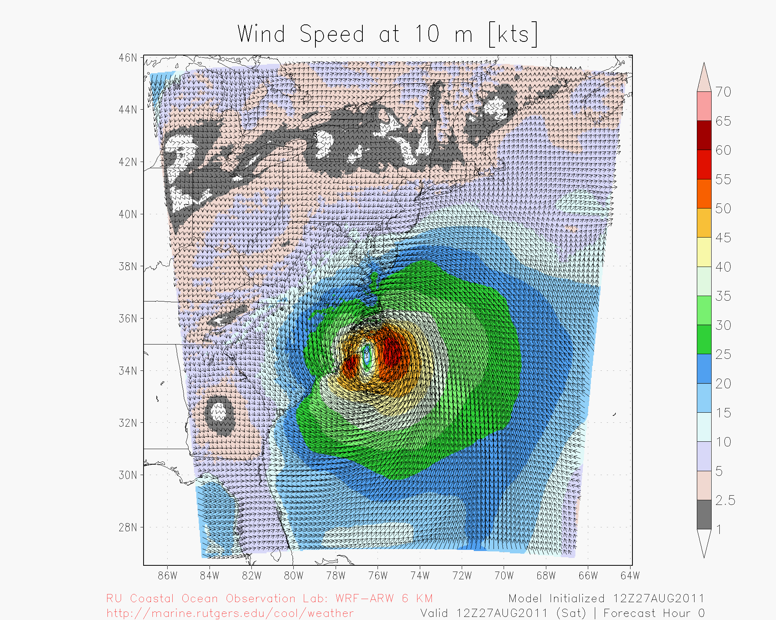
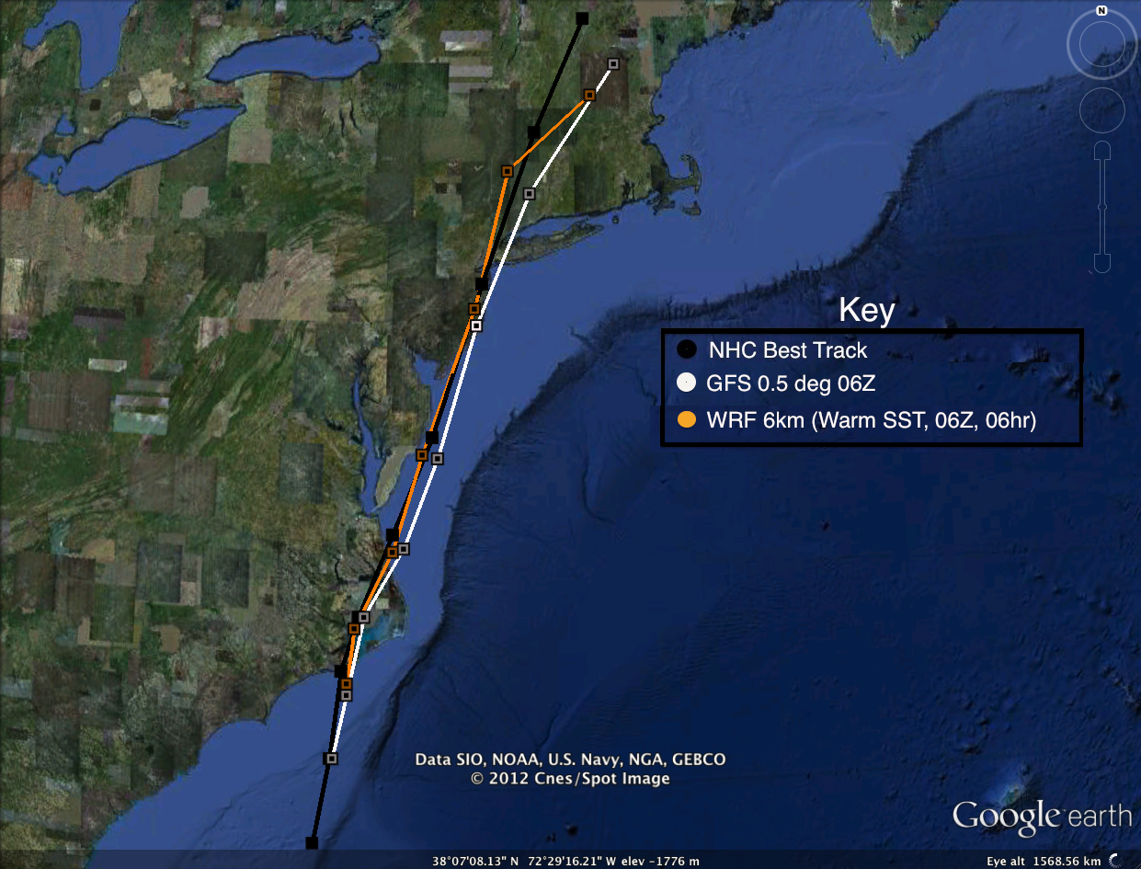
RU-WRF Atmospheric Forecast Model

Slide 15
WRF Model Run: SST Update
27/1200→28/0600
28/0600→29/0600

Slide 16
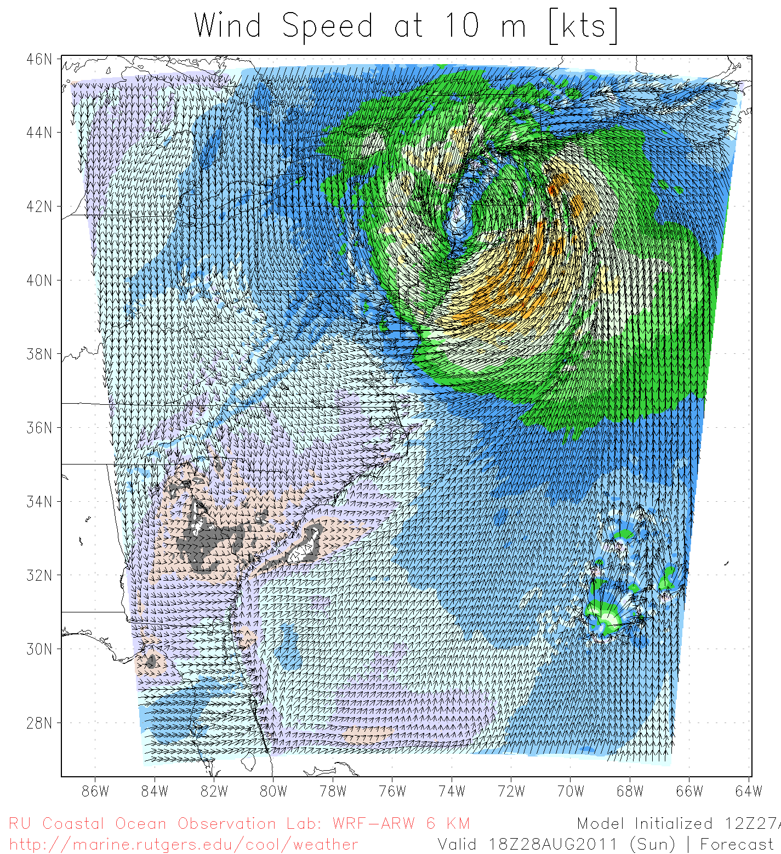
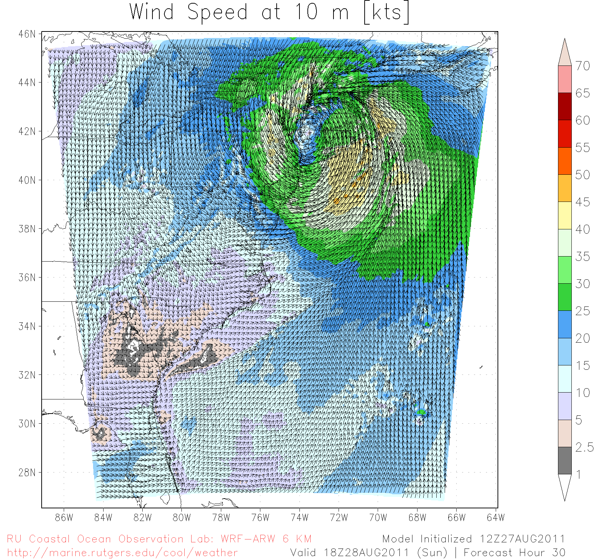
Run Comparison
WARM (RTG only)
COLD “Update” (AVHRR)
Notes:
-little change in track (still good!)

Slide 17
Maximum Wind Speed Error (knots)
Date/Time (UTC) | NHC Forecast | Warm (RTG only) | Warm (RTG only, OML Model) | Cold “Update” (AVHRR)
27/1200 | 5 | -17.22 | -17.23 | -6.17
27/1800 | 10 | 4.1 | 4.2 | 5.88
28/0000 | 10 | 1.39 | -2.14 | 3.96
28/0600 | 5 | -1.2 | -1.04 | -1.21
28/1200 | 15 | 2.39 | 4.79 | 0.5
28/1800 | 15 | 4.97 | 3.51 | -2.67
29/0000 | 15 | 3.62 | 1.93 | -0.89
29/0600 | 10 | 10.48 | 9.84 | 4.52
Sum of Squares | 800 | 457 | 452 | 118
RMSE | 9.43 | 7.13 | 7.09 | 3.61
Notes:
-RMSE much better than NHC forecast, better than Warm RTG only, Warm RTG w/ OML, and comparable to GFS

Slide 18
Wind Speed Error
Hurricane Irene - U.S. IOOS as it is designed – A multi-agency activity.
Make Observations > Advance the Science > Improve the Forecasts
Date/Time (UTC) | NHC Forecast | Warm (RTG only) | Warm (RTG only, OML Model) | Cold “Update” (AVHRR)
27/1200 | 5 | -17.22 | -17.23 | -6.17
27/1800 | 10 | 4.1 | 4.2 | 5.88
28/0000 | 10 | 1.39 | -2.14 | 3.96
28/0600 | 5 | -1.2 | -1.04 | -1.21
28/1200 | 15 | 2.39 | 4.79 | 0.5
28/1800 | 15 | 4.97 | 3.51 | -2.67
29/0000 | 15 | 3.62 | 1.93 | -0.89
29/0600 | 10 | 10.48 | 9.84 | 4.52
Sum of Squares | 800 | 457 | 452 | 118
RMSE | 9.43 | 7.13 | 7.09 | 3.61
U.S. IOOS interactive observatory network closes a gap in storm science.
Bottom boundary layer mixing is responsible for surface layer cooling.
The cooling occurs rapidly during the peak in the storm waves.
Cooler sea surface temperatures reduce hurricane forecast intensities.
U.S. IOOS could produce better hurricane forecasts now.
Notes:
-RMSE much better than NHC forecast, better than Warm RTG only, Warm RTG w/ OML, and comparable to GFS

