Slide 1
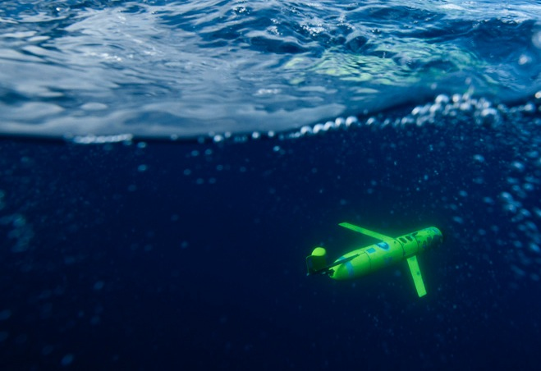
Small-scale variability of the cross shelf flow over the coastal shelves of Antarctica as measured by a fleet of underwater gliding robots.
Josh Kohut, Oscar Schofield, Scott Glenn
Rutgers University
Clayton Jones
Teledyne Webb Research
Matt Oliver
U. Delaware AND MANY MORE……..

Slide 2
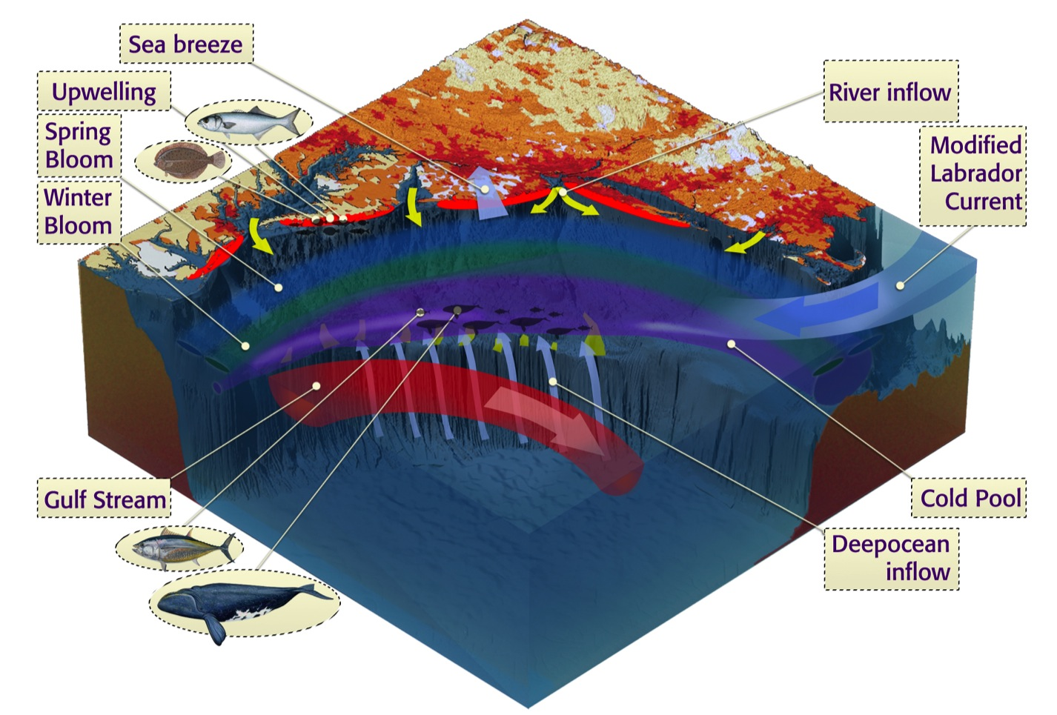
The Mid-Atlantic Bight

Slide 3
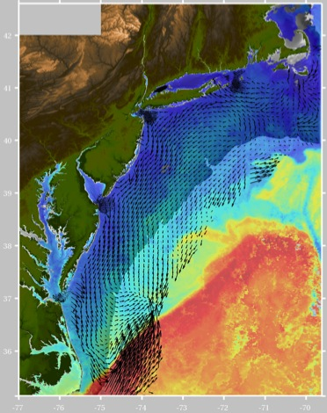
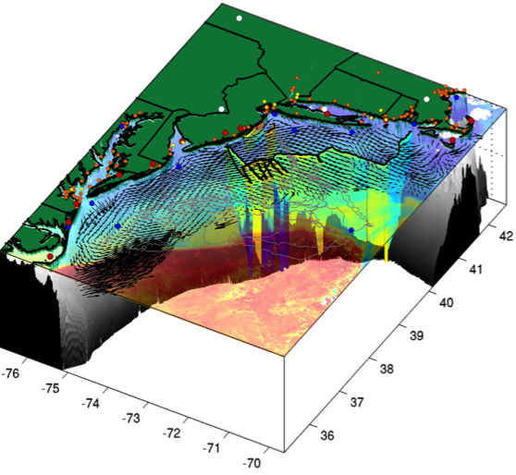
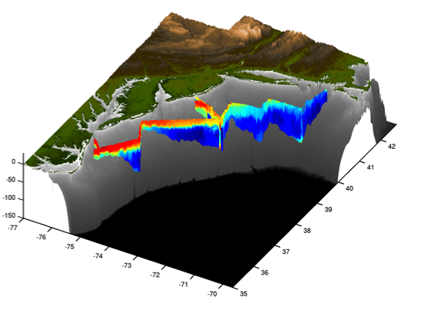
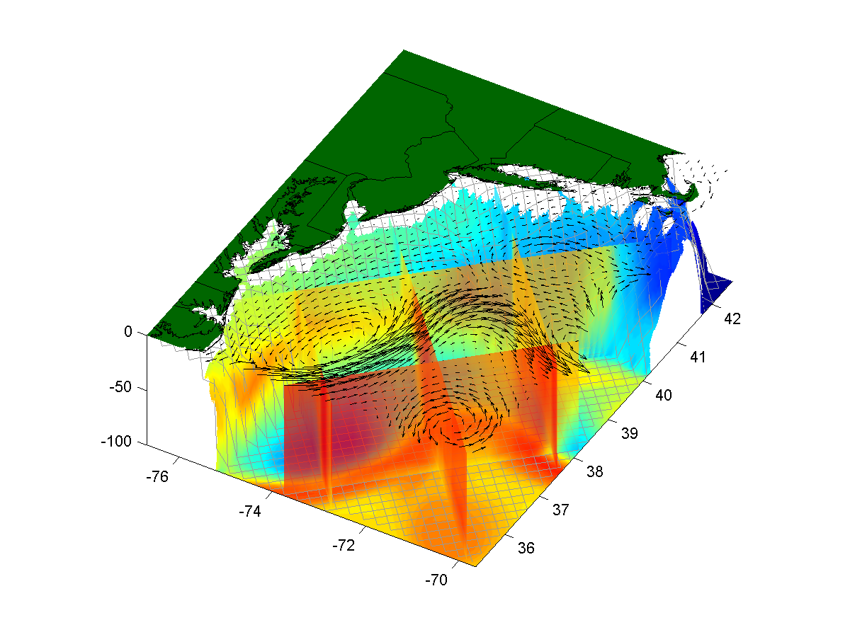
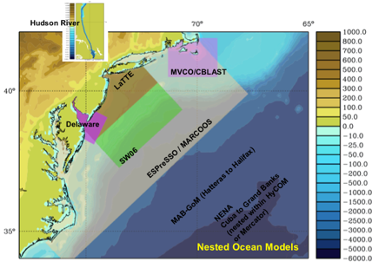
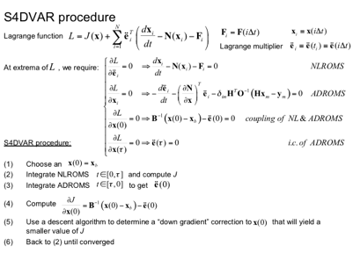
+
=
Remote Sensing
AUVs
Spatial Nowcasts
+
=
Nested Models
Data Assimilation
4-D Forecasts

Slide 4
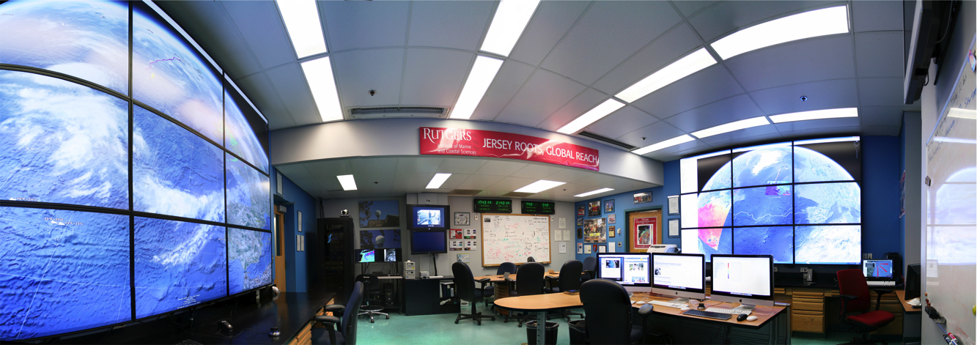
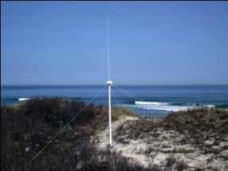
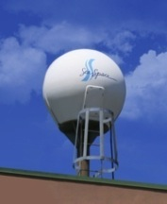
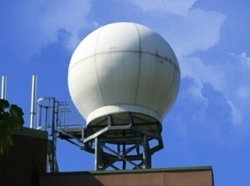
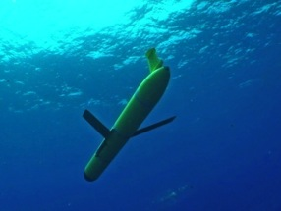
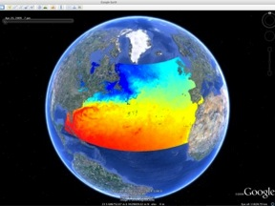
Rutgers University - Coastal Ocean Observation Lab
MARACOOS Operations Center
Vessels -
Satellite
Satellite
CODAR
Ships/ Vessels
Glider
REMUS
Data Vis.
Modeling
Security
Leadership
Education
CODAR Network
L-Band & X-Band Satellite Receivers
Glider Fleet
3-D Nowcasts
& Forecasts

Slide 5
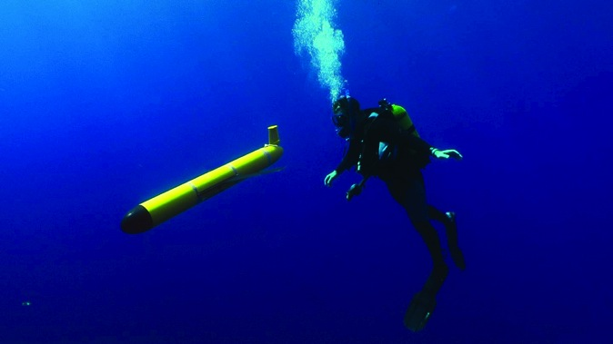
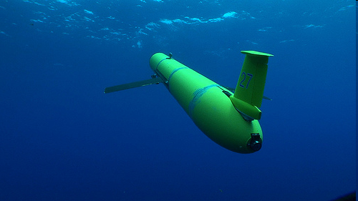
What is a glider?
Autonomous Underwater Vehicle (AUV)
Propels itself without a propeller
Moves slowly through the water collecting data as it goes

Slide 6
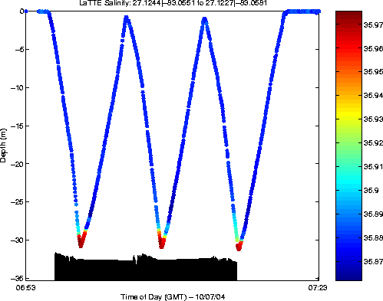
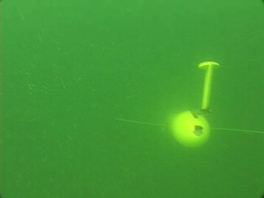
How gliders “fly”
Buoyancy pump in ← the glider pulls in 0.5 L of water
When surfacing to connect glider inflates air bladder
Glider begins to dive downward
Push pump out → glider inflects and begins to climb to the surface

Slide 7
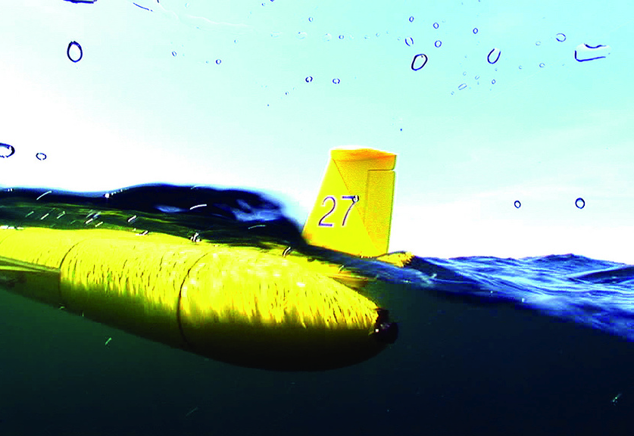
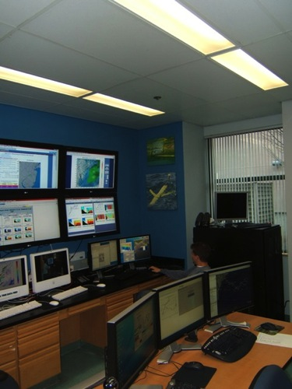
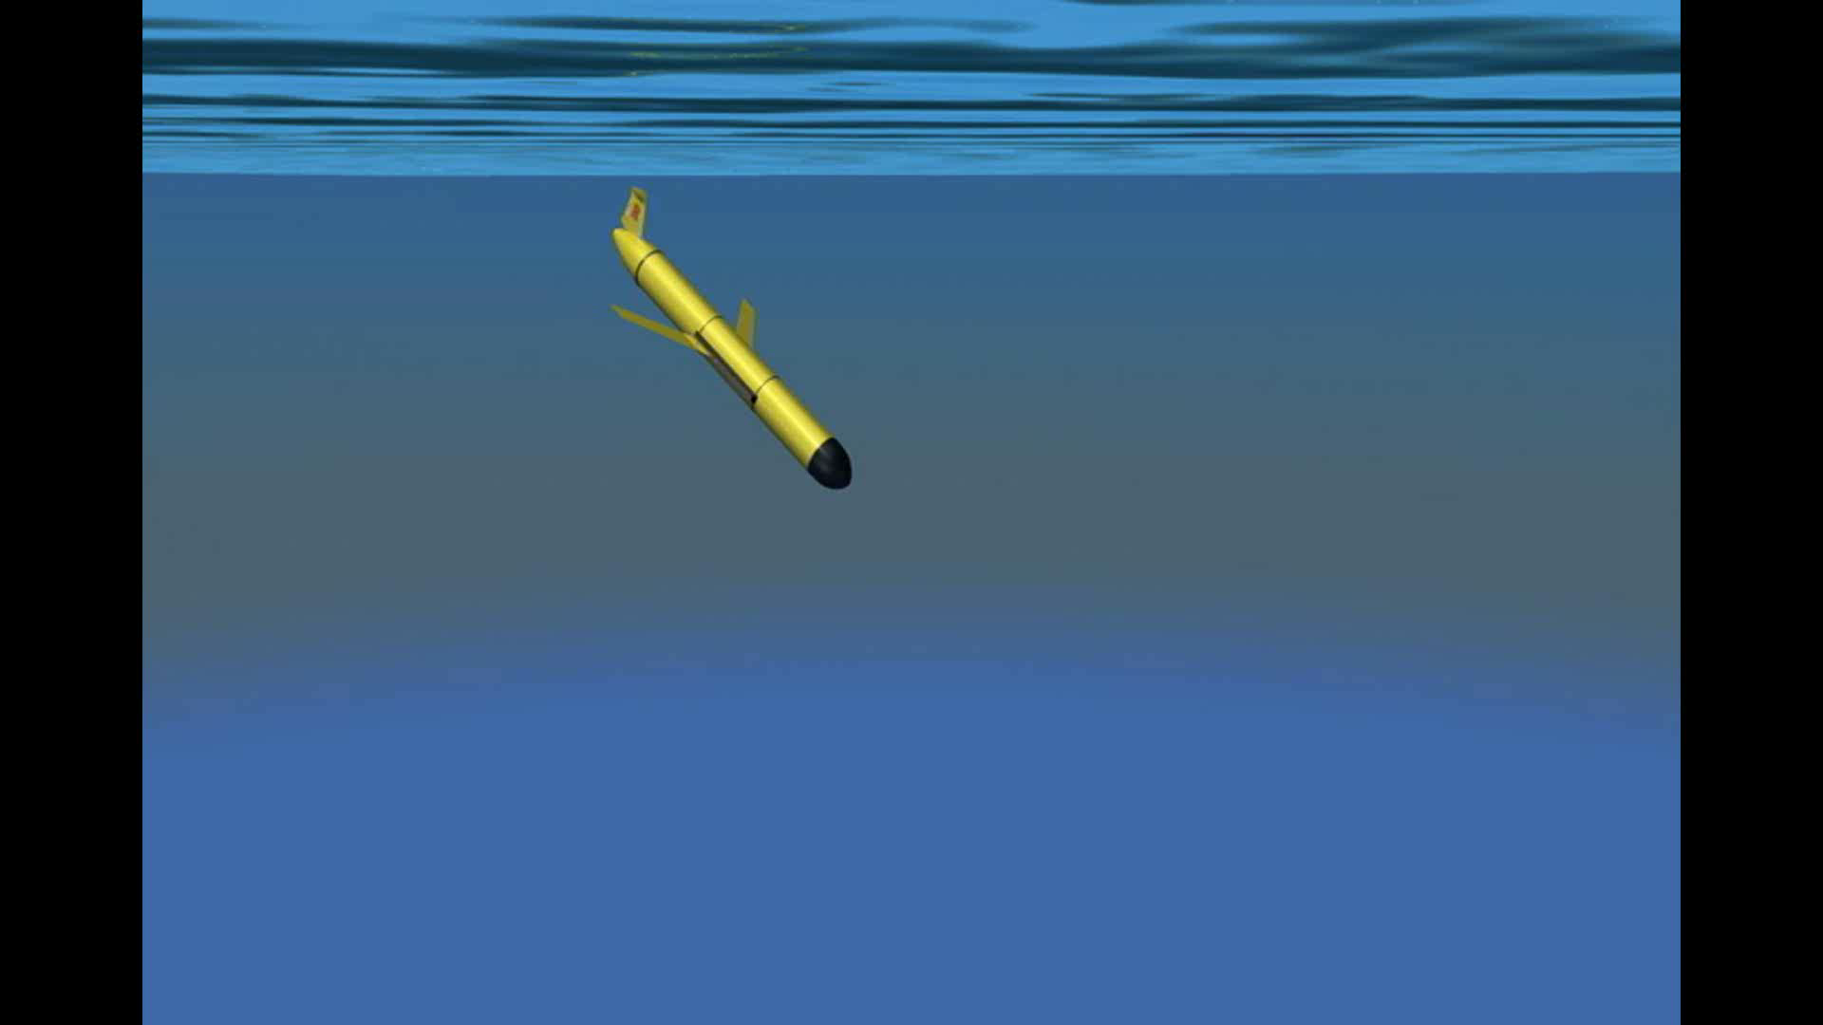
Slocum Electric Glider Communication
Iridium Antenna
ARGOS and FreeWave Antennas

Slide 8
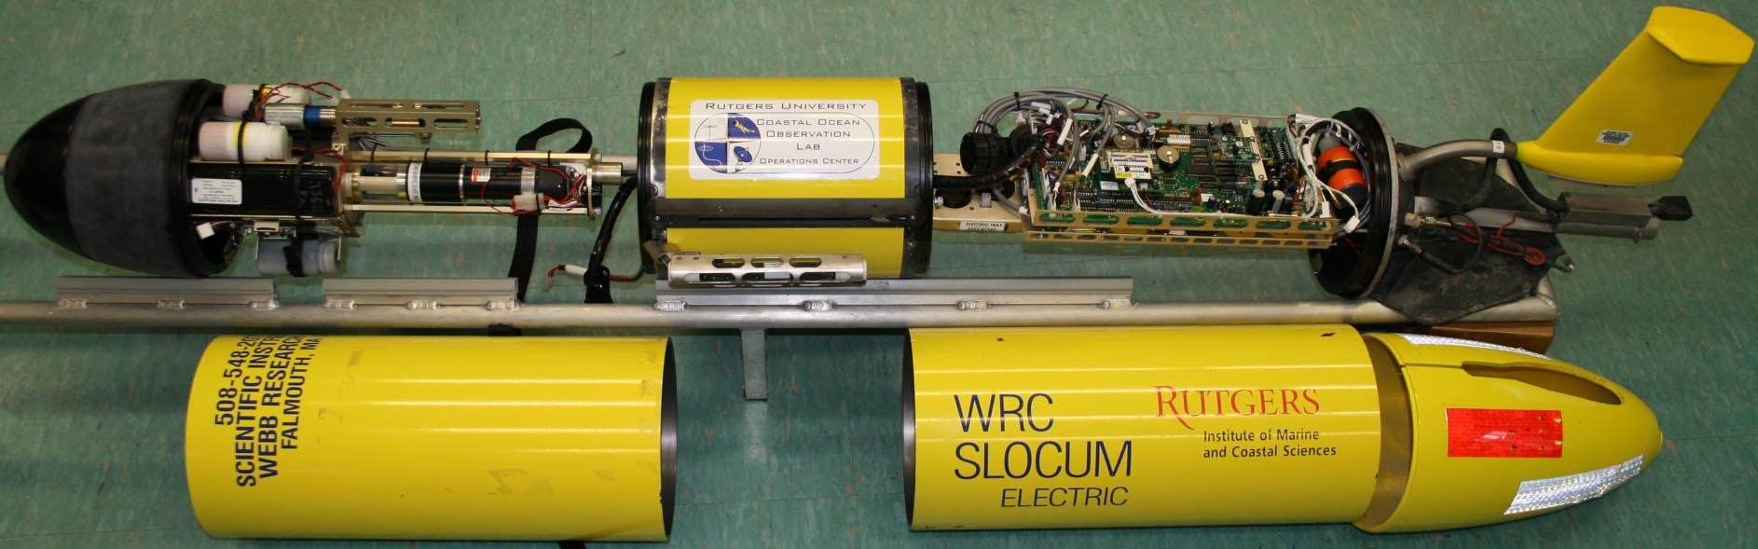
Anatomy of a Glider
Antenna (Iridium, Freewave, GPS & Argos)
Science Payload Bay
Control Board
Buoyancy Pump
Air Bladder
Fin
Altimeter
CTD
Fore Hull
Aft Hull
Cowling

Slide 9
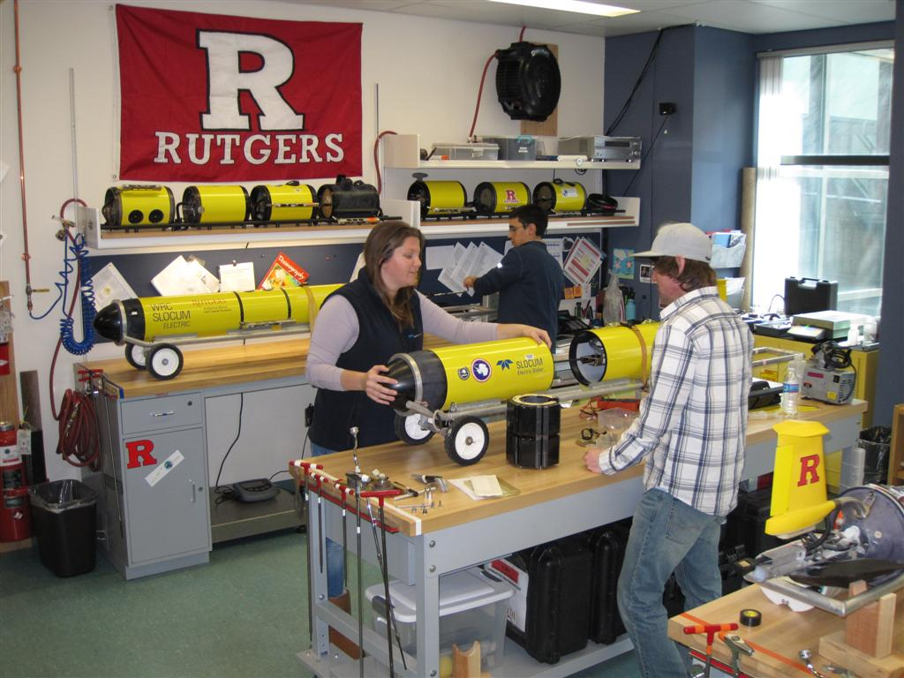
Rutgers Glider Facilities
Modular Science Payloads
Sea-Bird CTD (un-pumped)
Sea-Bird CTD (pumped)
TRDI ADCP
OSU Turbulence Chi-pod
URI Bioprobe
Wetlabs pucks (5 configurations)
Hobi Labs hydroscat-2
Sony camera
Mote Marine Lab breve buster
RU/Satlantic FIRe
Satlantic radiometer
Aanderraa optode
Vemco fish receiver
Wetlabs SAM
Wetlabs BAM
Licor PAR

Slide 10
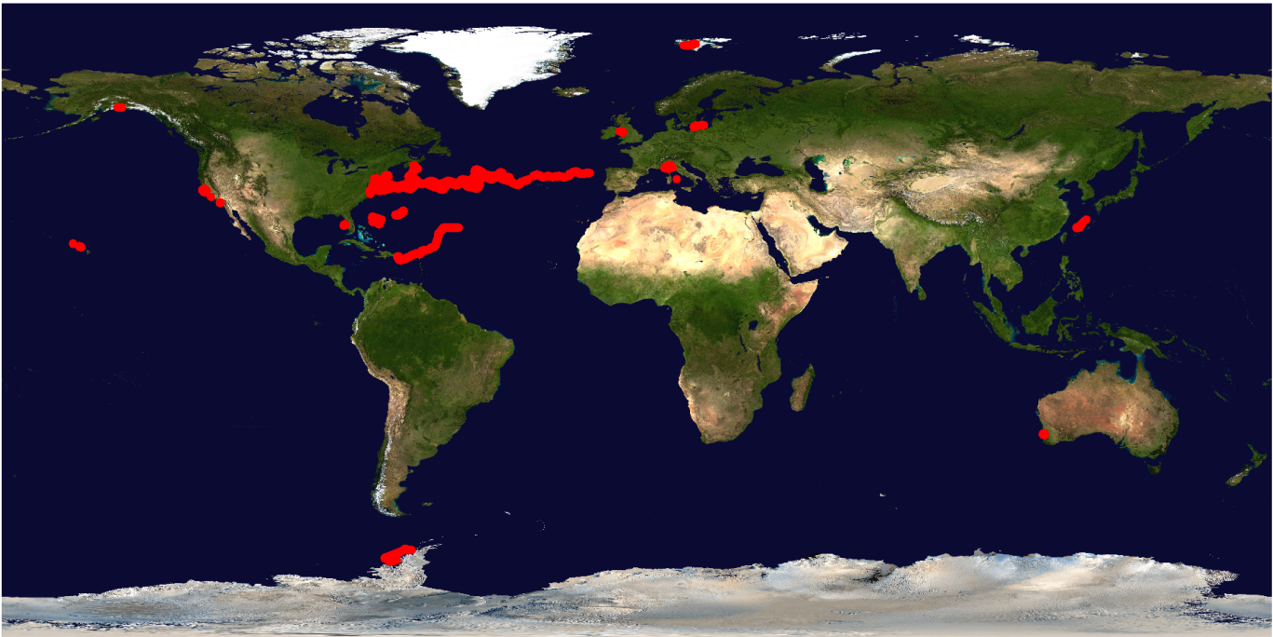
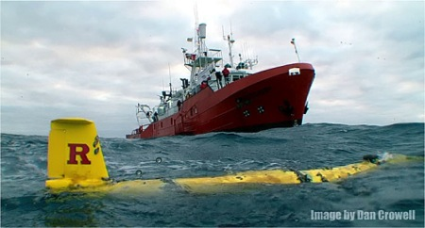
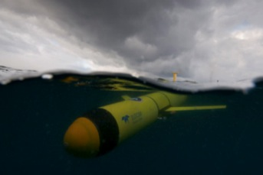
RU-COOL Global Slocum Glider Fleet Deployments
Fleet Deployments:
Mid-Atlantic Bight Testbed
Extreme Environments – Antarctica

Slide 11
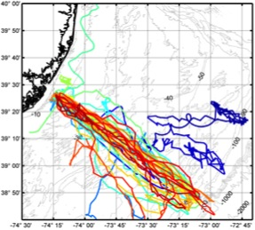
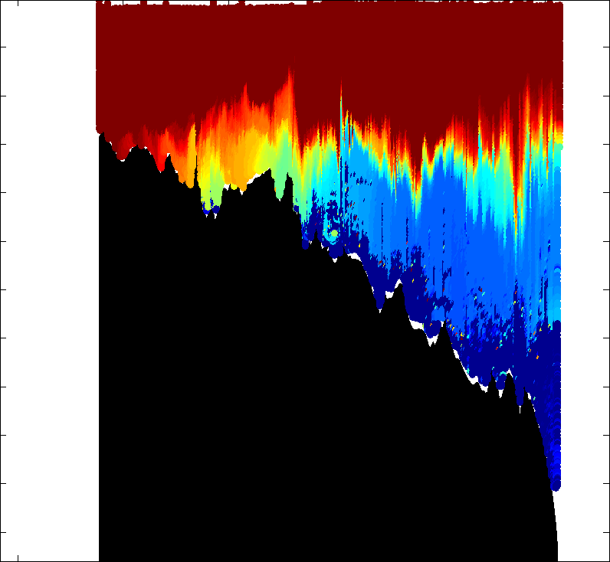
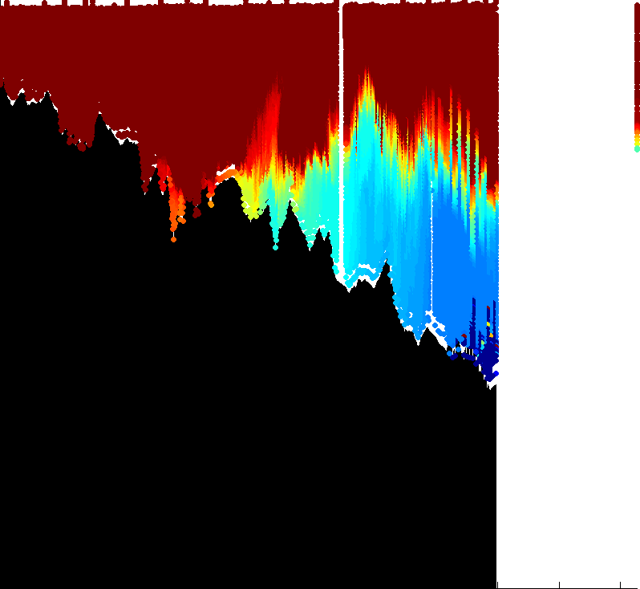
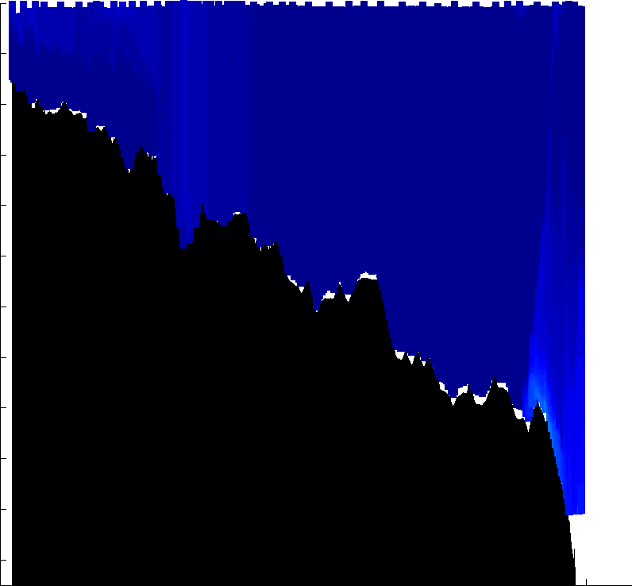
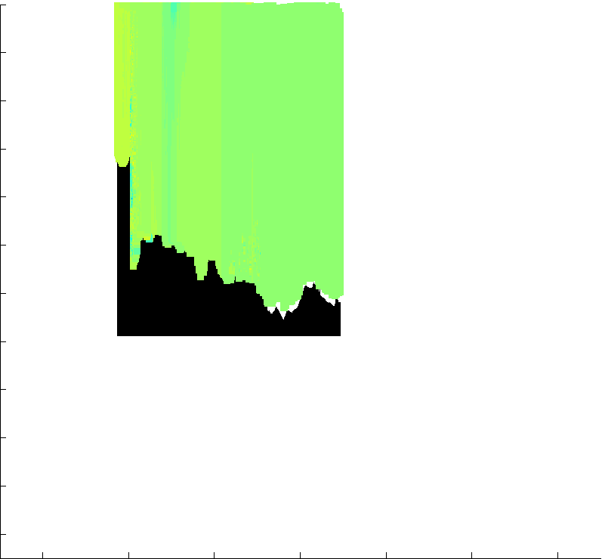
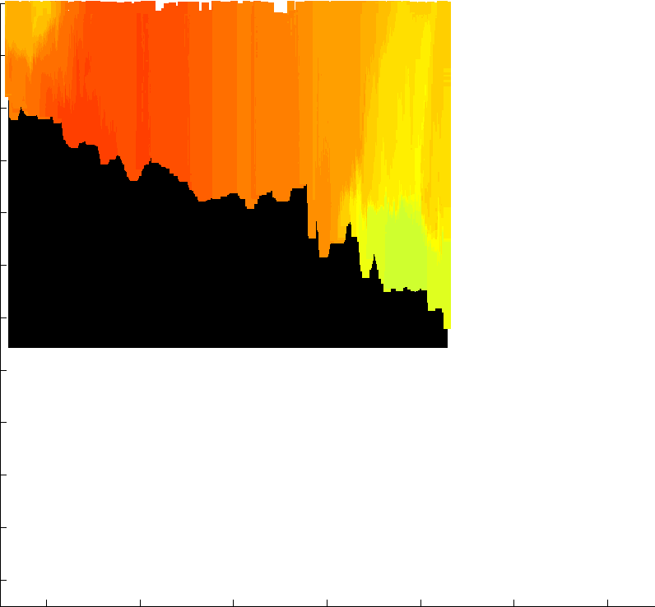
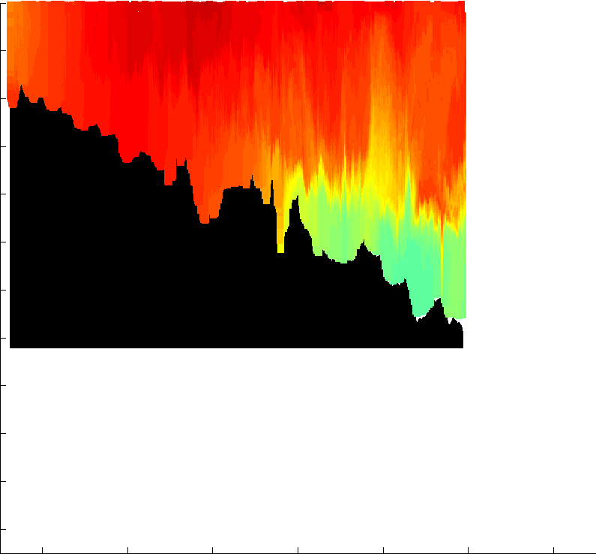
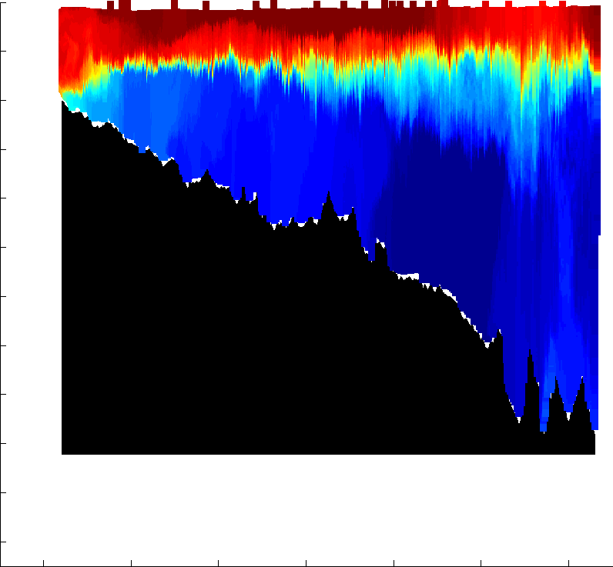
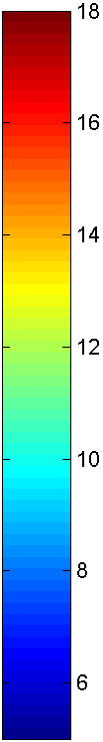
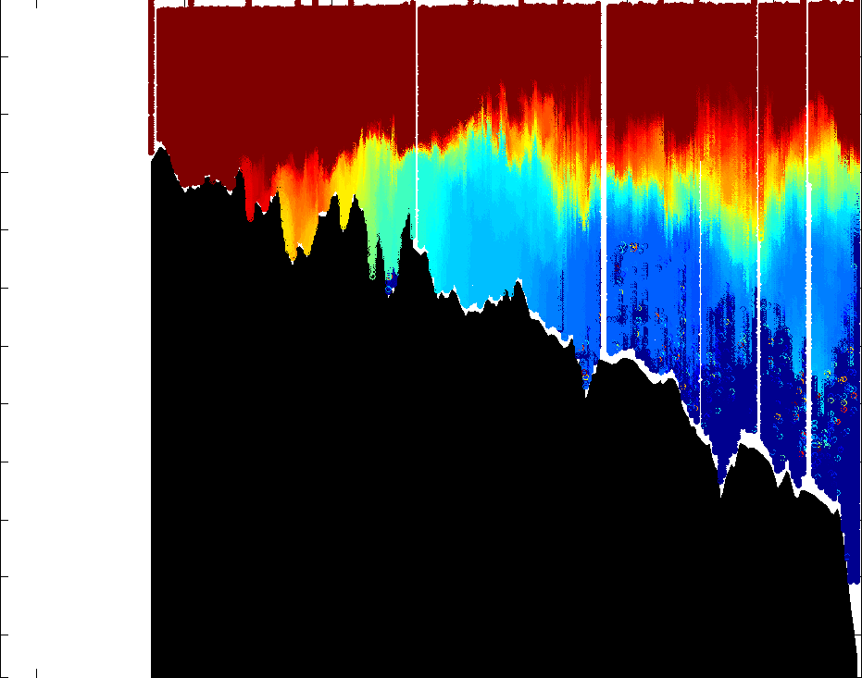
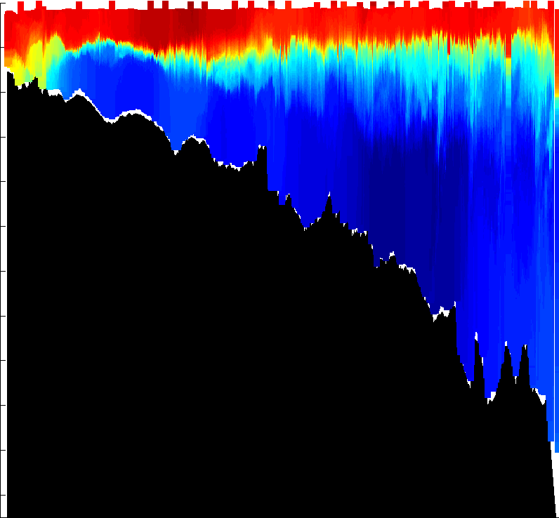
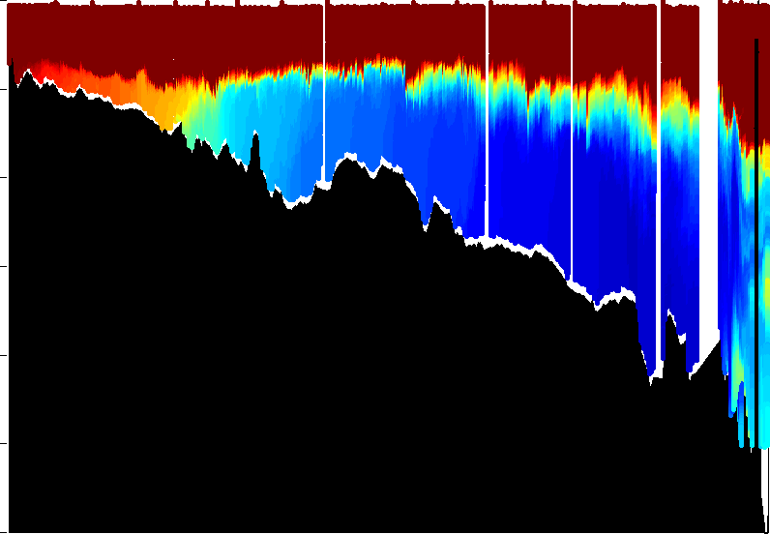
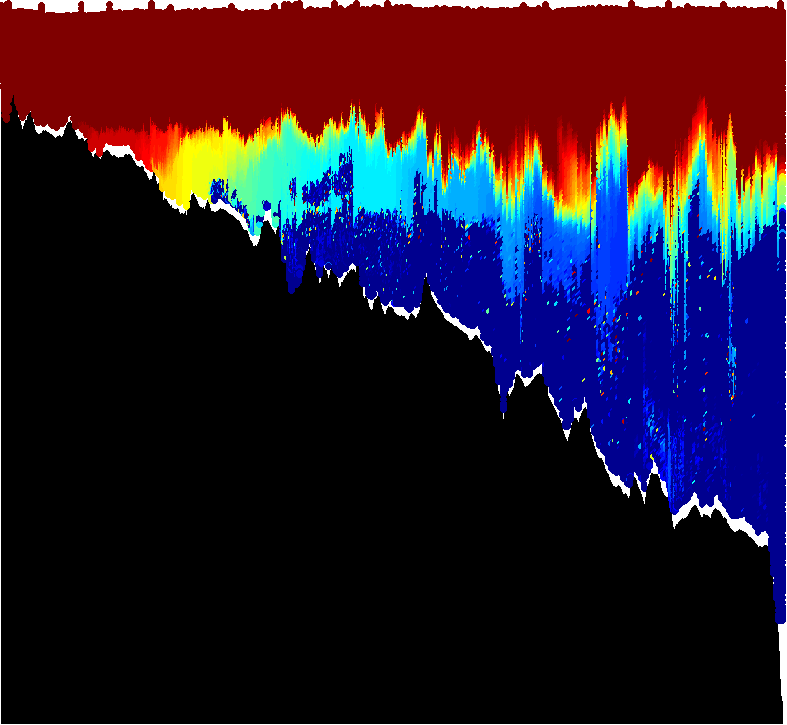
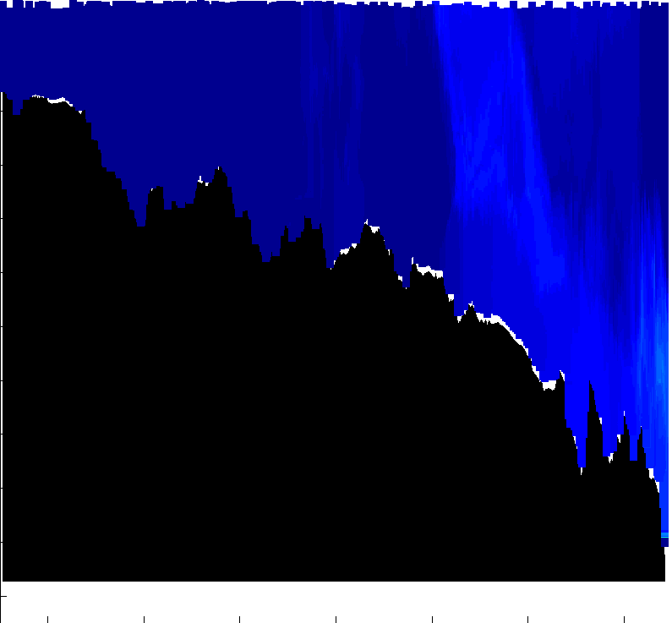
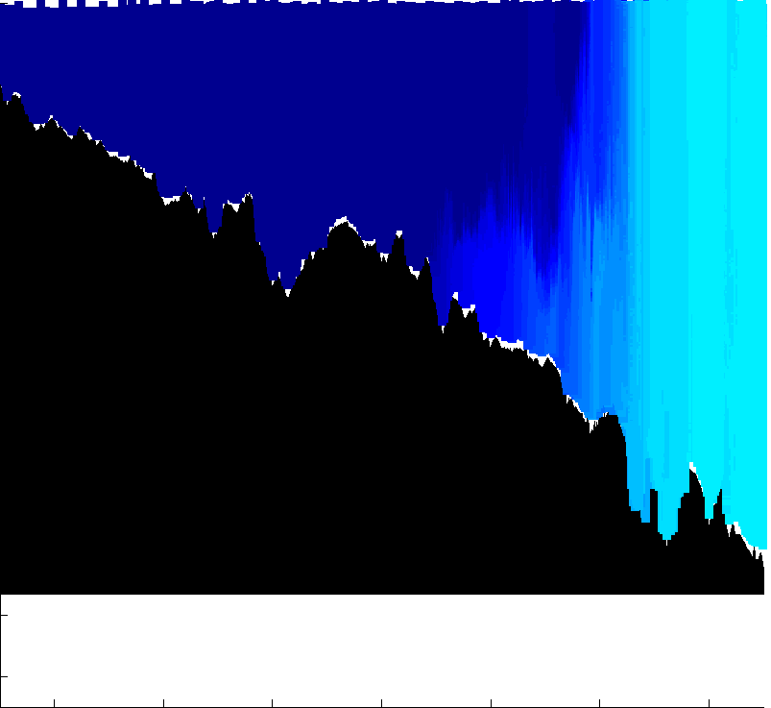
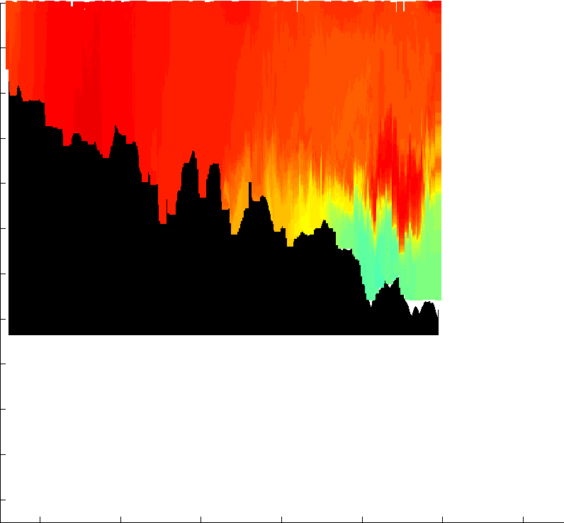
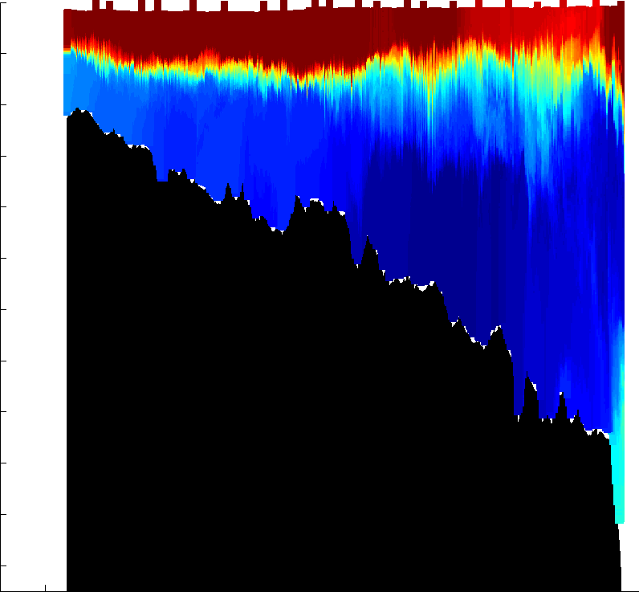
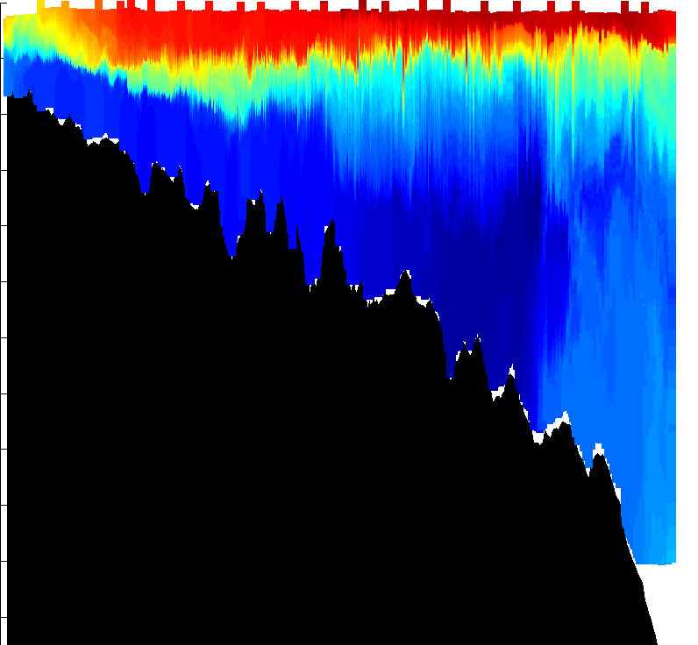
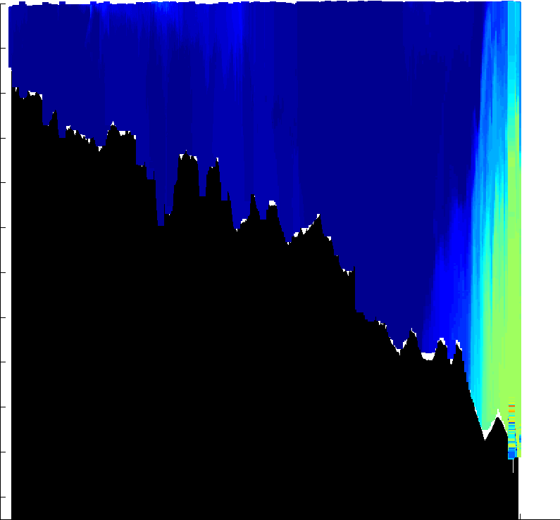
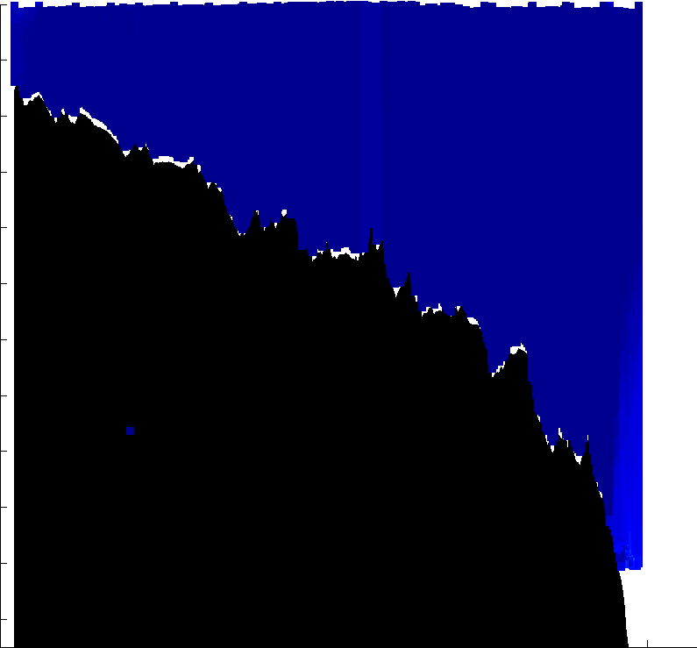
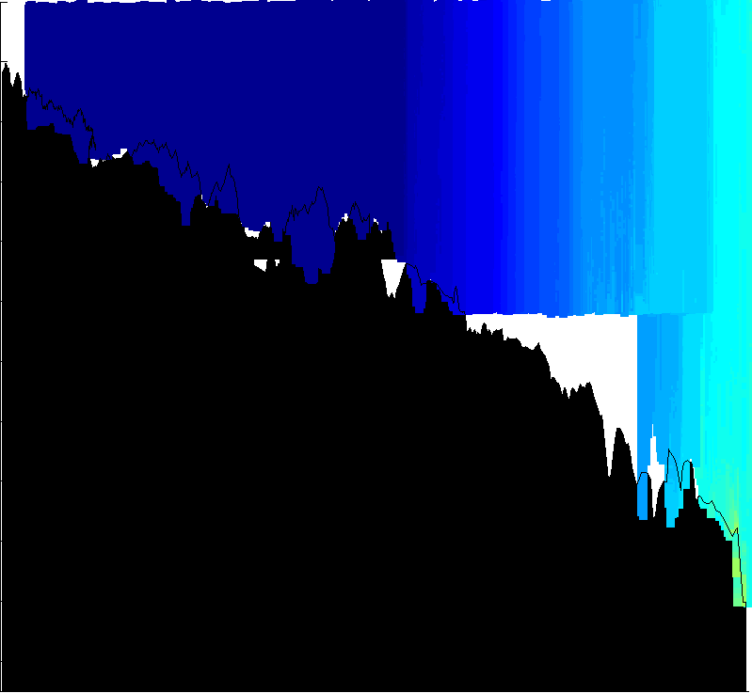

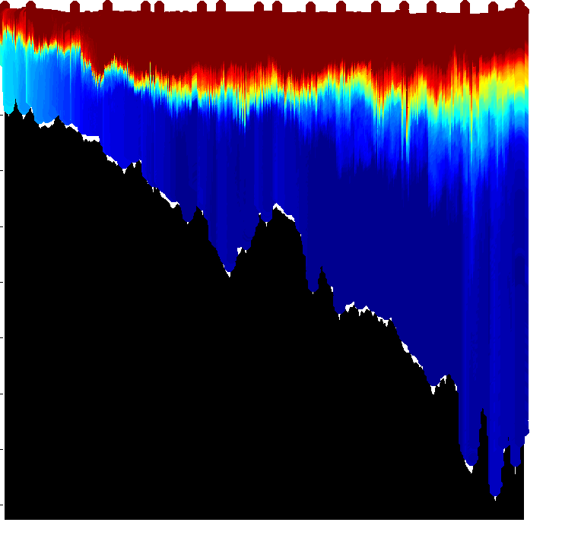
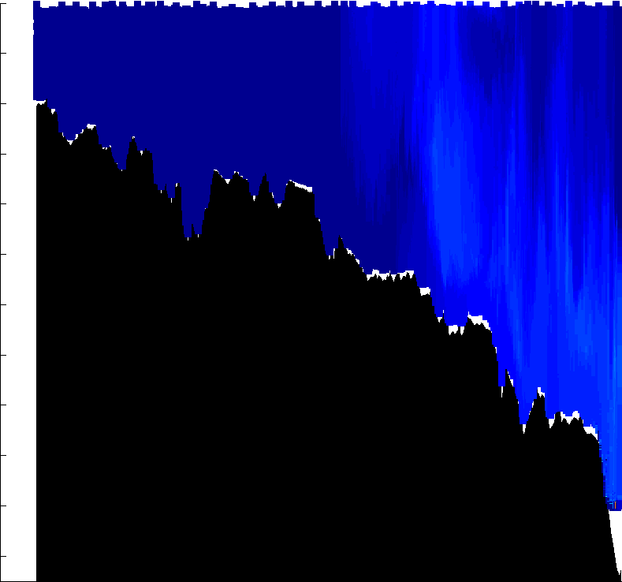
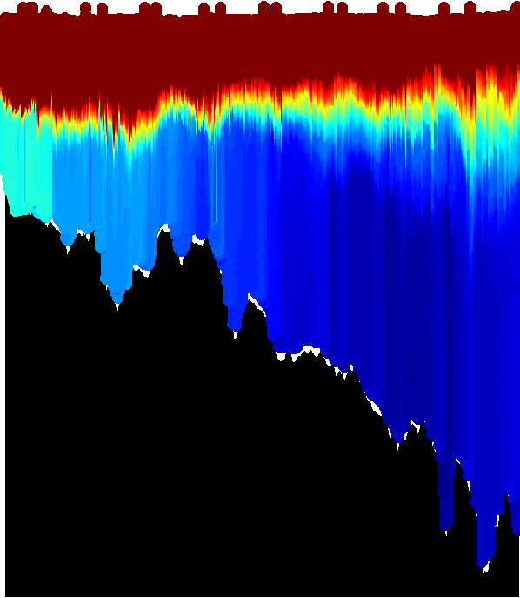
A Year in the Life of the Mid-Atlantic Bight
October 2003 – October 2004
0
110
10
10
10
30
Oct. 03
30
30
Jun. 04
50
Mar. 04
70
50
50
90
70
70
110
28-Oct-2003 16:59:50 - 02-Nov-2003 20:21:03
90
03-Mar-2004 05:48:27 - 15-Mar-2004 16:55:18
90
29-Jun-2004 13:26:55 - 04-Jul-2004 02:19:47
10
110
110
30
10
10
30
30
50
Nov. 03
Mar. 04
70
50
50
Jul. 04
90
70
70
110
90
26-Mar-2004 17:03:27 - 02-Apr-2004 14:22:39
90
04-Jul-2004 02:36:44 - 09-Jul-2004 07:19:43
10
02-Nov-2003 20:39:08 - 09-Nov-2003 04:18:36
110
110
30
10
10
50
Nov. 03
30
Apr. 04
30
70
50
50
Aug. 04
90
70
70
ºC
110
90
90
17-Aug-2004 15:05:56 - 22-Aug-2004 22:51:44
10
10-Nov-2003 07:54:12 - 18-Nov-2003 01:12:44
110
02-Apr-2004 15:18:51 - 08-Apr-2004 21:44:16
110
30
10
10
30
30
50
50
Apr. 04
Sep. 04
Depth (m)
Dec. 03
50
70
70
70
90
03-Dec-2003 18:05:17 - 12-Dec-2003 15:35:37
90
90
16-Sep-2004 15:00:53 - 23-Sep-2004 11:57:27
110
110
08-Apr-2004 21:48:17 - 15-Apr-2004 23:11:24
110
10
10
10
30
30
30
Sep. 04
50
May. 04
Jan. 04
50
50
70
70
70
90
90
90
23-Sep-2004 11:57:27 – 27-Sep-2004 16:50:57
110
14-Jan-2004 18:32:09 - 20-Jan-2004 05:19:02
110
19-May-2004 14:30:59 - 25-May-2004 08:12:51
110
74:00
73:50
73:40
73:30
73:20
73:10
10
10
10
74:00
73:50
73:40
73:30
73:20
73:10
30
30
May. 04
30
50
Jan. 04
50
50
Sep. 04
70
70
70
90
20-Jan-2004 05:24:33 - 30-Jan-2004 13:38:55
90
90
110
110
25-May-2004 20:43:12 - 03-Jun-2004 02:55:56
110
27-Sep-2004 16:50:57 – 02-Oct-2004 09:37:02
10
10
10
30
Feb. 04
30
Jun. 04
30
50
50
Oct. 04
70
70
50
90
90
70
110
11-Feb-2004 03:10:59 - 18-Feb-2004 20:06:59
110
08-Jun-2004 14:49:09 - 12-Jun-2004 22:31:42
90
02-Oct-2004 11:57:27 –10-Oct-2004 23:59:27
10
74:00
73:50
73:40
73:30
73:20
73:10
10
110
74:10
74:00
73:50
73:40
73:30
73:20
73:10
30
Feb. 04
30
Longitude
50
50
Jun. 04
70
70
90
26-Feb-2004 20:10:30 - 03-Mar-2004 05:11:02
90
13-Jun-2004 05:16:59 - 18-Jun-2004 11:14:00
110
74:10
74:00
73:50
73:40
73:30
73:20
73:10
110
74:10
74:00
73:50
73:40
73:30
73:20
73:10
Longitude
Longitude
Mountain JGR 1998
Nor. E. Fish. Sci. Ctr.

Slide 12





Cold Pool Trends
July-October, 2007-2011
Temperature
10
7
Warming at 0.34 deg C/yr
Salinity
33.3
32.6
Freshening at 0.97 psu/yr
2007 2011

Slide 13





Tracking Hurricane Irene
Temperature
Temperature

Slide 14


Polar Ecosystems

Slide 15


-0.2
Temperature trends per year
0.2

Slide 16


There are indications in changes in the primary production
Remote Sensing (Decadal changes)
Ship Observed (Decadal changes)
Montes-Hugo et al. 2009
Vernet et al. 2008

Slide 17



Slide 18




Sampling Challenges
in the Southern Ocean

Slide 19



Western Antarctic Peninsula (2007):
Alongshore Variability
~400 km

Slide 20

Western Antarctic Peninsula (2007):
Alongshore Variability
~400 km

Slide 21


RU-COOL Glider Fleet: Antarctic Deployments: 2007 – 2012
- Number of Deployments: 33
- In-water days: 412
- Distance flown: 7,656 km

Slide 22






RU-COOL Palmer Peninsula Glider Deployments: 2007 - 2011
PALmer Long-Term Ecological Research
PAL-LTER

Slide 23


Antarctic Circumpolar Current
Weddell gyre
Bellingshausen Sea
Amundsen
Sea
ASE
Ross gyre
ACC based on
climatological dynamic topography of Orsi et al., DSR, 1995
Notes:
Doug Martinson; Lamont-Doherty Earth Observatory, Columbia University
23
Doug Martinson; Lamont-Doherty Earth Observatory, Columbia University
23
First, let me remind you that the ocean (at any temperature) is a strong source of heat. But in the WAP it is particularly so because of UCDW (characterized by T_{max}), supplied to the region by the ACC.
From figure it is clear that the ABS shelves are so unique in the Antarctic because they are only location where the ACC lies close to the broad continental shelf. Elsewhere the shelves are buffered by the expansive polar gyres (and as a consequence of this isolation, the waters on those shelves have the opportunity to cool and grow saltier from brine release during sea ice formation, to form the global Antarctic Bottom Waters).
Note that most of our understanding of the ocean heat comes from sampling in the LTER grid. BUT, because the primary drainage of WAIS has a similar continental shelf, and is downstream of where the ACC meets the shelf break, we assume that the LTER processes are representative of the WAIS processes (we are working with WAIS people to confirm or refute this).

Slide 24


Role of ‘Events’ delivering warm water to the WAP
8
8
8
7
8
Courtesy of Doug Martinson, LDEO
Notes:
Specifically, we see that the change in Q is consistent in a number of transients in mooring Q, likely due to direct passage of the eddies of similar size and drift velocity over the mooring, situated at the trough edge. Clearly this would likely result from topographic steering of the eddies along the trough edge (also consistent with the low modal form of the eddies expected from the 2-layer water column stratification).
So consistent change and transient nature suggests eddies, but even more convincing is the fact that the core of each event is warm water that only exists at the slope where pure UCDW, as delivered by the ACC exists. Nowhere else in the grid is there water this warm.
In fact, from our T-S plots, pure UCDW delivered to the slope break by the ACC is water warmer than 1.7˚ C, and from this several more events enter the category of eddies. In fact the core waters are down right HOT, only possible by moving slugs of pure UCDW onto the shelf.
I am currently working out the estimated eddy heat flux by estimating drift rates (eddies at the slope correlate with those at mid shelf at a 33-day lag), and then assuming that all of the ΔT is dissipated in the region showing the largest fraction of UCDW.

Slide 25



Western Antarctic Peninsula (2011):
Alongshore Variability
0
1000
2
0
Temperature (°C)
0 300 600
0
1000
0.25
-0.25
Across-path Velocity (m/s)
Distance (km)

Slide 26



Western Antarctic Peninsula (2011-2012)
Alongshore Variability
Temperature
Chlorophyll-a

Slide 27





Adaptive Sampling of Penguin Habitats
Penguin
Foraging
locations
Kahl et al., 2010

Slide 28



Mapping Phytoplankton Physiology
Rutgers /Satlantic FIRe Sensor

Slide 29



RU-COOL Ross Sea Slocum Glider Deployments: 2011
Slocum Enhanced Adaptive Fe Algal REsearch in the Ross Sea
SEAFARERS
Mike Hiscock, Adam Kustka, Phoebe Lam, Chris Measures, Allen Milligan, and Josh Kohut

Slide 30



Modified Circumpolar Deep Water and the Ross Sea Ecosystem
Ross Sea Climatology
Ross Sea Model
Temperature – 250m
Orsi et al.
Dinninman et al.

Slide 31




Deep Glider Mapping of Ross Sea Water Masses
December 2010-February 2011
RU26D
- Lithium Primary
- 1000m Pump
- CTD
- Optode
- Triplet Puck
~300 km

Slide 32



Deep Glider Mapping of Ross Sea Water Masses
Cross bank section identifies peak MCDW

Slide 33


Time Variability
Single Station
0.0 hours
+ 8.5 hours
+12.5 hours
Jan 31, 2011 – 17:36 GMT
Feb 01, 2011 – 02:15 GMT
Feb 01, 2011 – 06:00 GMT

Slide 34


Intense Sampling
in Time
Courtesy of Bruce Huber, LDEO

Slide 35


Line of Sight Glider Missions
RVIB Nathaniel B. Palmer

Slide 36



Small Scale Water Mass Variations
Relative to ship sampling
12 km
12 km
Temperature
Chlorophyll

Slide 37




Slide 38
Across-Bank Sections
CTD Stations
8 Sections

Slide 39

Across-Bank Sections
ADCP Velocity (m/s)

Slide 40




Small Scale Water Mass Variations (Time and Space)

Slide 41


Small Scale Water Mass Variations (Time and Space)

Slide 42

Contrasting response across the banks

Slide 43


Shallow Gliders Cover the Banks
RU07
- Alkaline
- 100 m pump
- CTD
- 2 Triplet Pucks
Mawson Bank
RU06
- Alkaline
- 100 m pump
- CTD
- 2 Triplet Pucks
Pennell Bank

Slide 44




Mawson Bank
Pennell Bank
Temperature
Temperature
Chlorophyll
Chlorophyll
Deeper Shallower
Deeper Shallower

Slide 45

Summary
Gliders are well suited for required flexible sampling requirements of the Antarctic coastal seas.
Gliders provide a unique view of important coupled process over small time and space scales allowing us to view the polar seas as we have never been able to before.
Small scales in time (hours to days) and space (10s of meters to kilometers) play an important role in the coupled processes of polar ecosystems.

Slide 46


Slide 47


Slide 48




We were not alone on the ship
Students follow along back on campus

Slide 49


The Ross Sea Connection
Many beyond the science team
participate in the science
Daily Blog Entries
- Science
- Technology
Materials for teachers
9 live phone calls from
the ship to the
26 classrooms
Over the 28-day cruise…
- 11,000 Visitors
- 340 Comments

Slide 50


LADCP
Sea Bird CTD – pumped
Sea Bird CTD – not pumped
Wetlabs – EcoTriplet
Aanderraa DO
Sea Bird DO
Wetlabs – AC-9
20 bottle sampler (12 L each)

