Slide 1
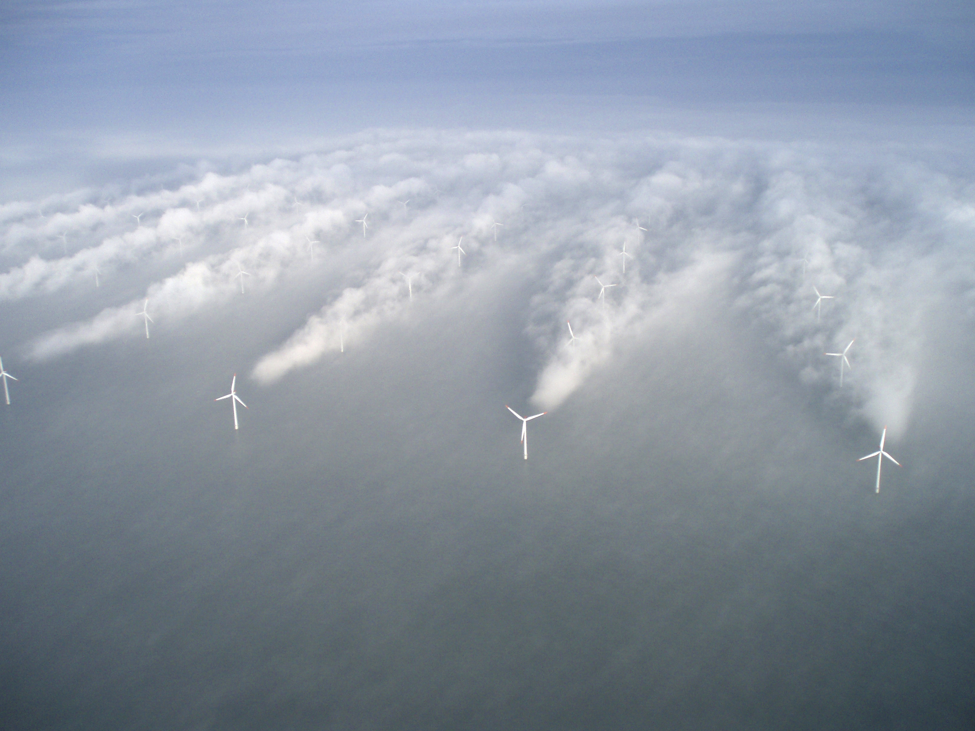
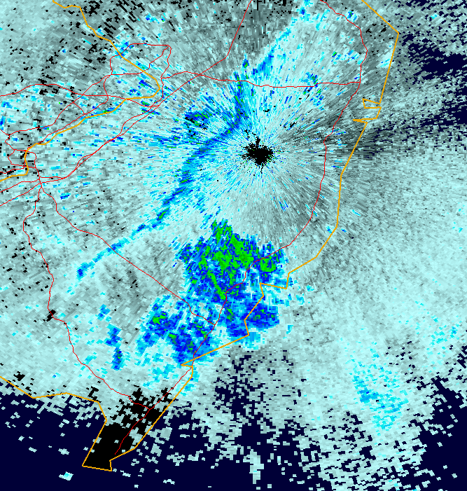
Rutgers University Coastal Ocean Observation Laboratory (RU-COOL) Advanced Modeling System Developed to Cost-Effectively Support Offshore Wind Energy Development and Operational Applications:
Investigating the NJ Sea/Land Breeze
Greg Seroka, Rich Dunk, Scott Glenn, Louis Bowers, John Kerfoot, Michael Crowley, Hugh Roarty, Laura Palamara
October 17, 2012
Oceans 2012 MTS Meeting

Slide 2
Background
Significant cost reductions for offshore wind energy development from high-res numerical weather prediction
Determine variability in offshore wind resource along NJ coast, minimize “risks”
Synoptic weather patterns known
Less known about mesoscale sea breeze→ peak energy demand periods
Notes:
-NWP is cost-effective way to achieve accurate wind resource assessments and representative wind forecasts→ cost reductions
-minimize “risks” by determining variability in offshore wind resource
-mesoscale and local influences of sea breeze- one of primary microclimate circulations that affect offshore environment, during peak energy demand periods with ACs running on hot summer afternoons

Slide 3
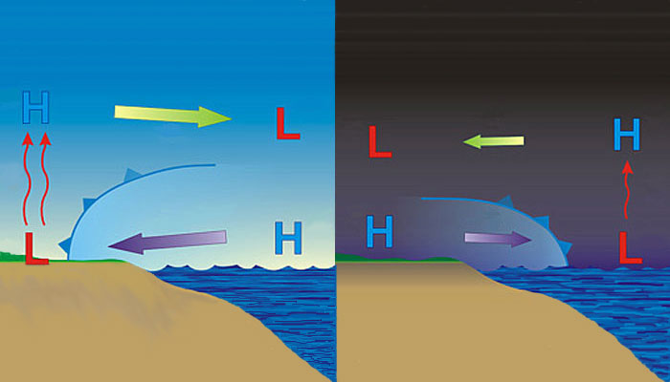
Sea breeze
Land breeze
Cold
Little known
Little known
→ Modeling can be used to investigate little known offshore component
Notes:
-day: warmer over land, cooler over water→ seabreeze
-night: cooler over land, relatively warmer over water→ landbreeze
-little known about offshore component of sea/land breeze due to dearth of observations/monitoring
-coastal upwelling changes dynamics

Slide 4
Model Setup
Weather Research and Forecasting (WRF) model, Advanced Research core (ARW) (Michalakes et al., 2001)
Horizontal Resolution: 3km
Vertical Resolution: 32 levels, focused near surface
Lateral B.C.: North American Mesoscale (NAM) 12km
Microphysics: Thompson (6-class with graupel)
Planetary Boundary Layer (PBL) scheme: Mellor-Yamada-Janjic (MYJ)
Land surface model: Rapid Update Cycle (RUC)
Longwave radiation: Rapid Radiative Transfer Model (RRTM)
Shortwave radiation: Dudhia
Bottom B.C. (Sea Surface Temperature, SST): Variant
Notes:
-NWP is cost-effective way to achieve accurate wind resource assessments and representative wind forecasts→ cost reductions
-minimize “risks” by determining variability in offshore wind resource
-mesoscale and local influences of sea breeze- one of primary microclimate circulations that affect offshore environment, during peak energy demand periods with ACs running on hot summer afternoons

Slide 5
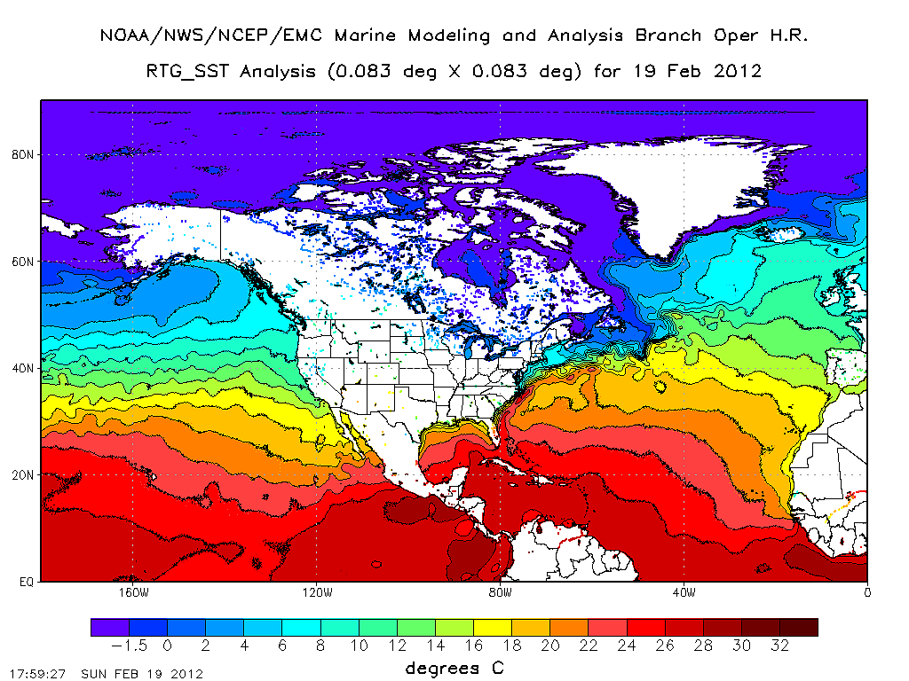
Previous Satellite SST Products
Real-Time Global (RTG)
1/12 degree (~9.25 km)→(low spatial resolution)
Most recent 24 hrs of in situ (buoys, ships) and satellite (AVHRR and METOP) data
Gemmill et al. (2007)
Notes:
-spatial resolution low, especially coastal waters
-NAM, GFS, for example, use this

Slide 6
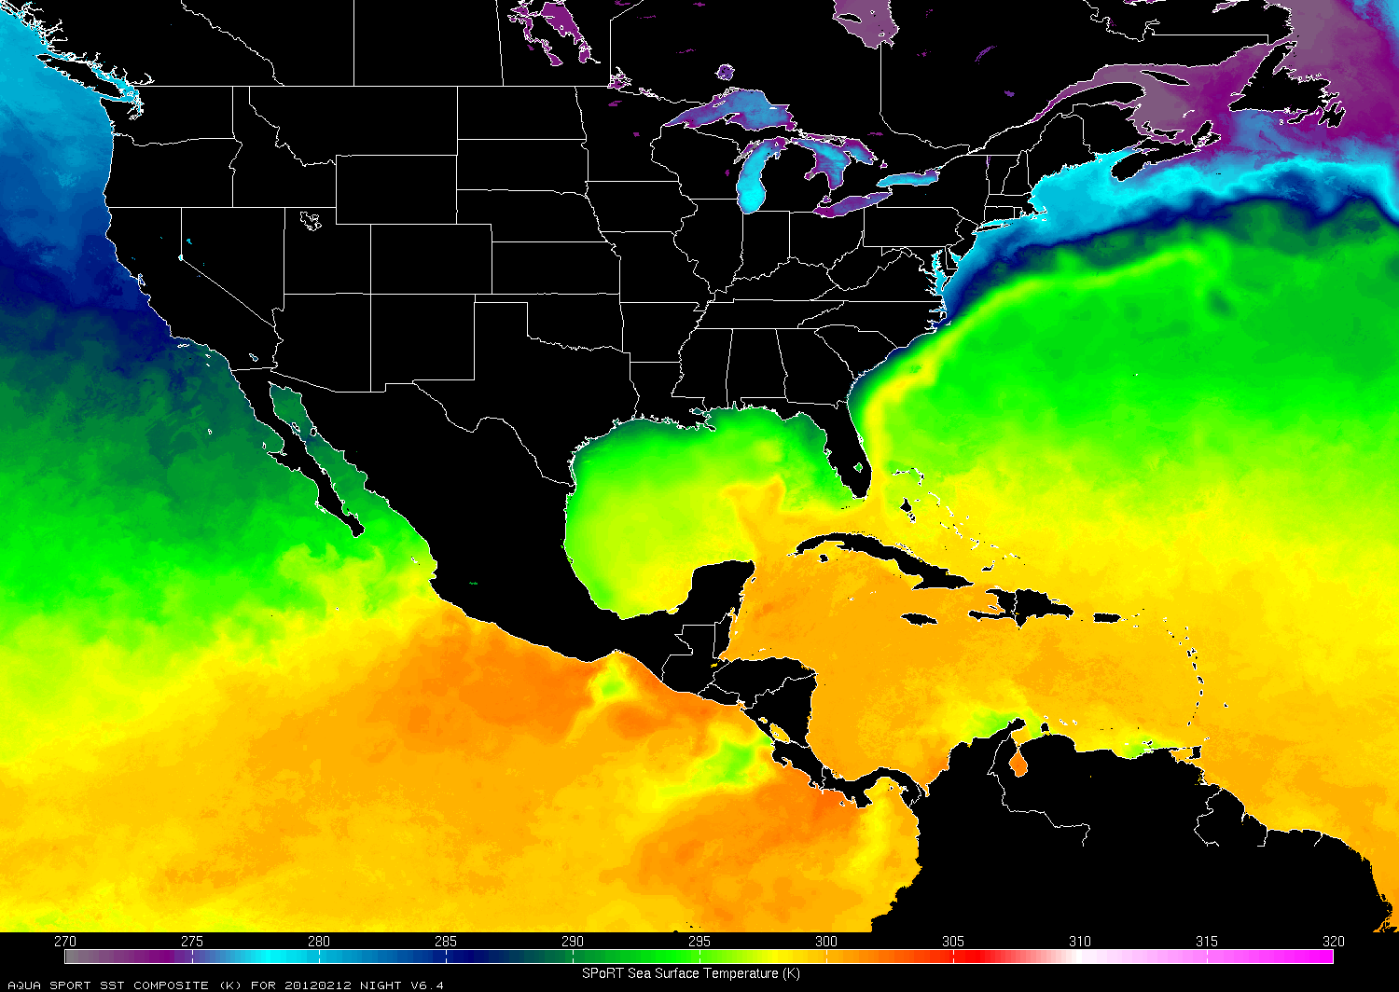
Previous Satellite SST Products
NASA Short-term Prediction Research and Transition Center (SPoRT) SST
2 km resolution
7-day (weighted) blend of MODIS, AMSR-E, GOES/POES, OSTIA→(low temporal resolution)
Haines et al. (2007)
Notes:
-temporal resolution is low (cannot capture upwelling, mixing response from storms)
-weighted based on quality and latency
Operational SST and Sea Ice Analysis (OSTIA) (UK MET)

Slide 7
New RU-COOL De-clouded Composite
De-cloud 1-km resolution AVHRR data using various temperature and near IR thresholds
3-day coldest pixel composite of de-clouded AVHRR scans
Then, coldest pixel composite with SPoRT SST to fill in remaining cloudy gaps
Notes:
-warmest pixel composites used in the past to remove cloudy signals (usually colder than ocean surface)→ can eliminate upwelling, storm mixing
-3-day coldest pixel composite with SPoRT retains upwelling and storm mixing
(-5km smoothing over 3-day composite of AVHRR before composited with SPoRT data… smoothing is being used to smooth out any discontinuities between AVHRR and SPoRT data)

Slide 8
Case Study: Sept. 12, 2012: Upwelling
Sept. 4-8: persistent southerly winds→ NJ coastal upwelling

Slide 9
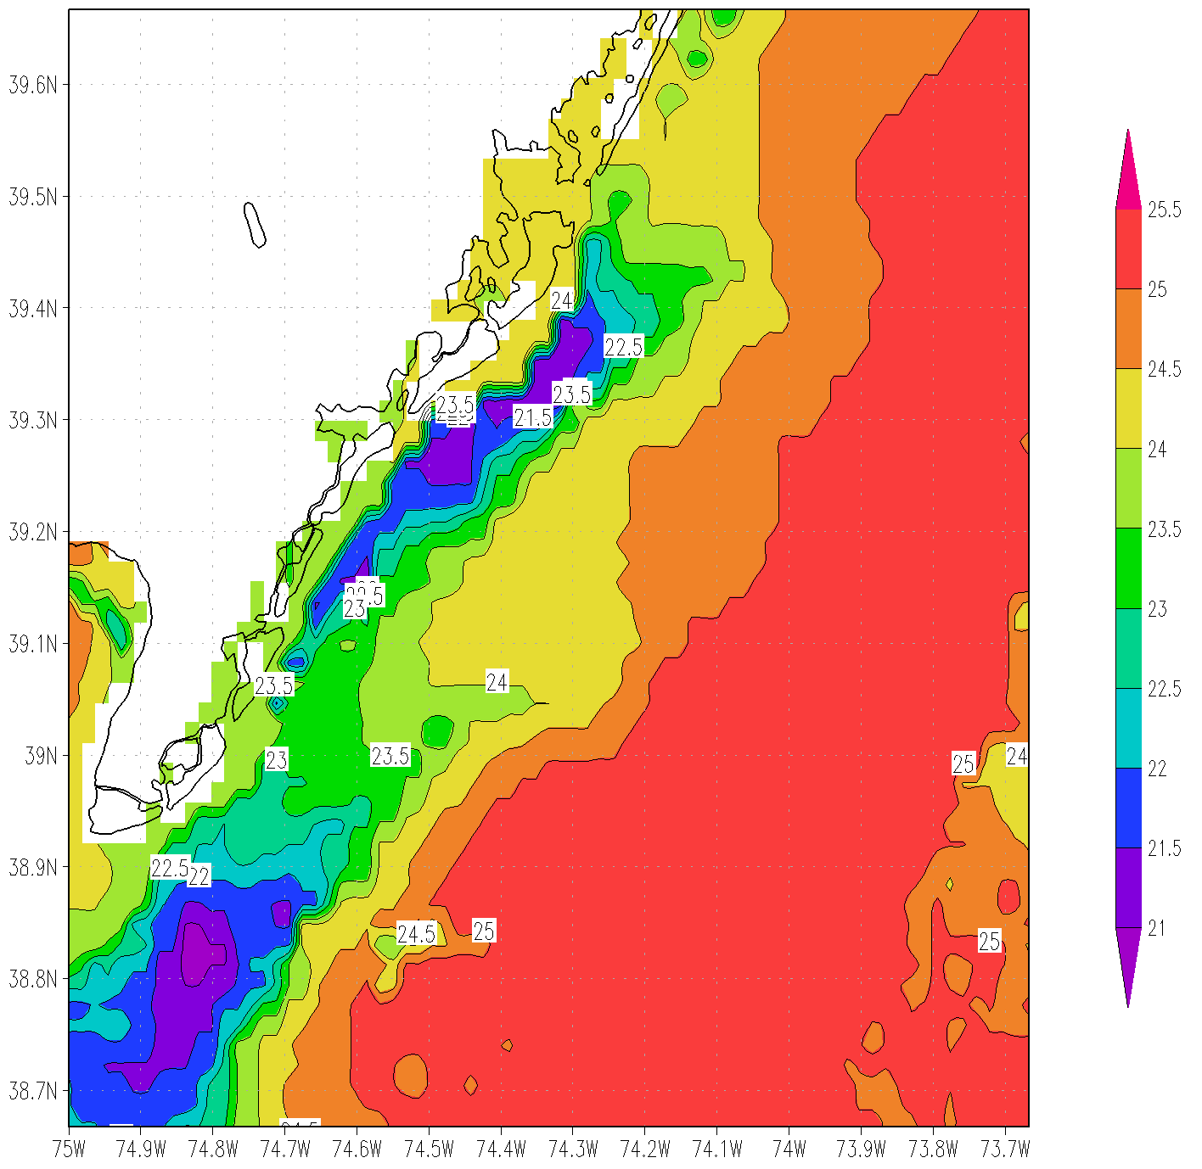
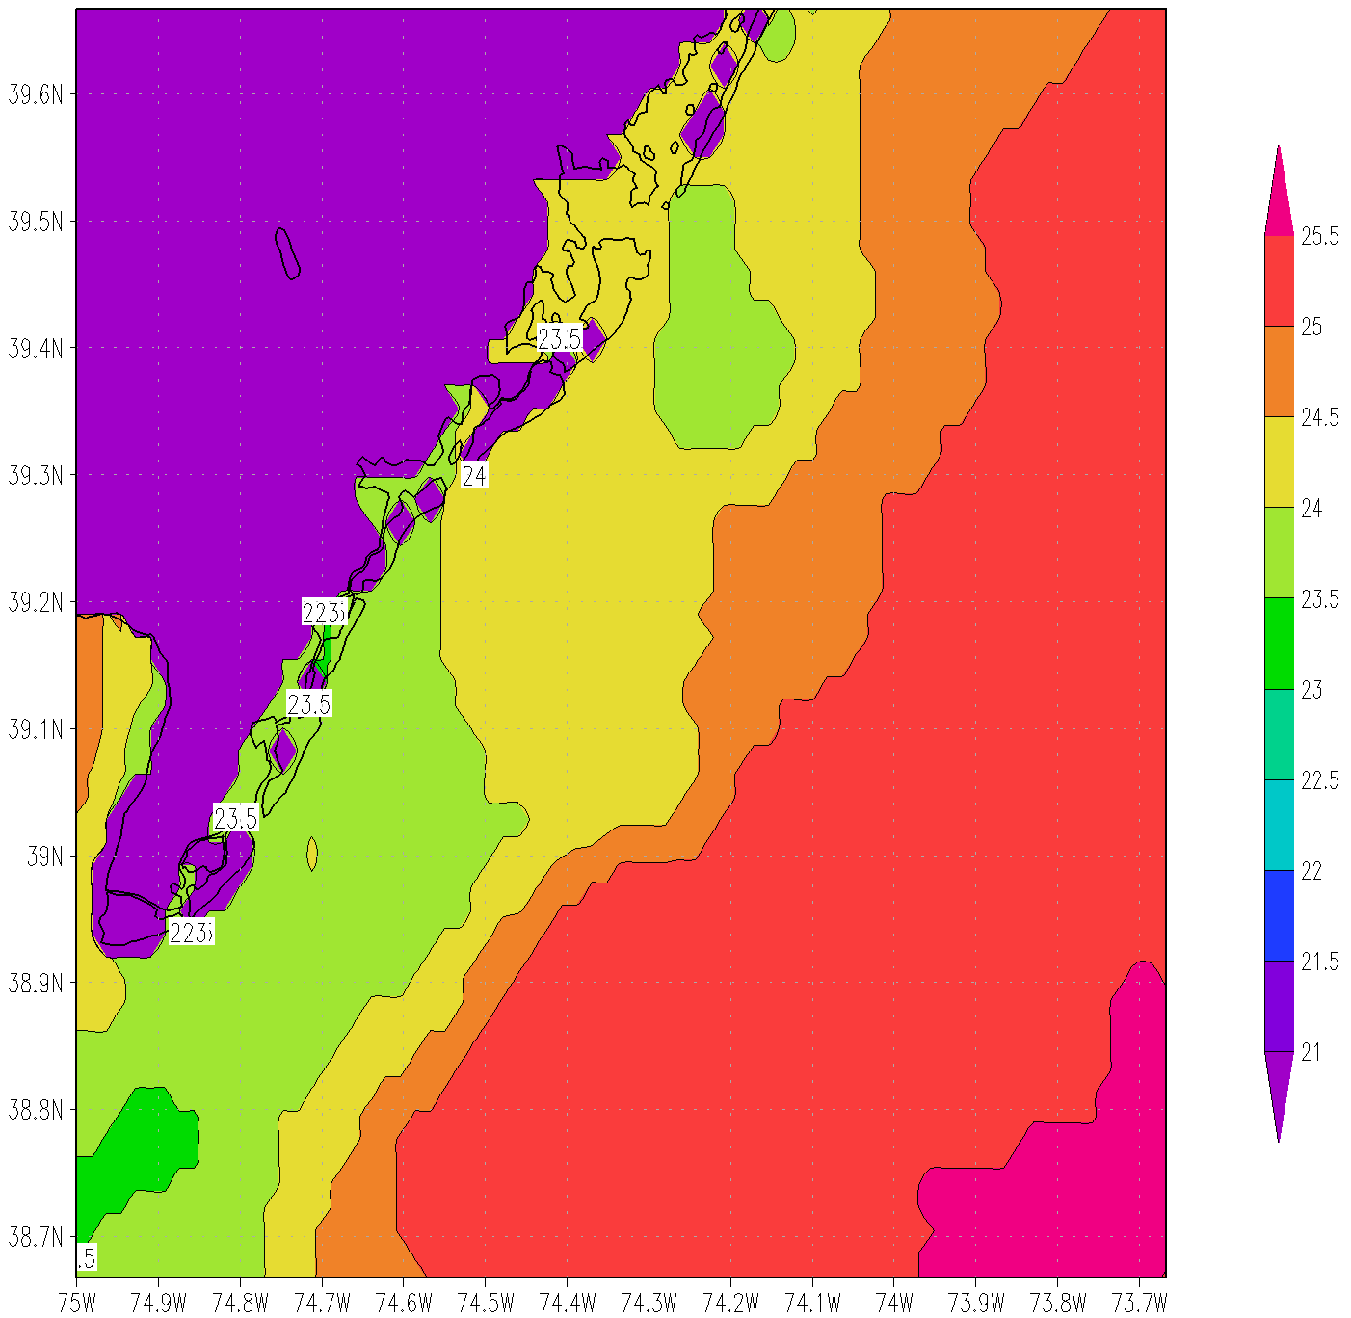
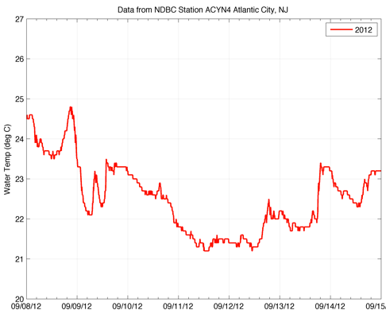
RU-COOL SST
SPoRT SST
~21°C
~24°C

Slide 10
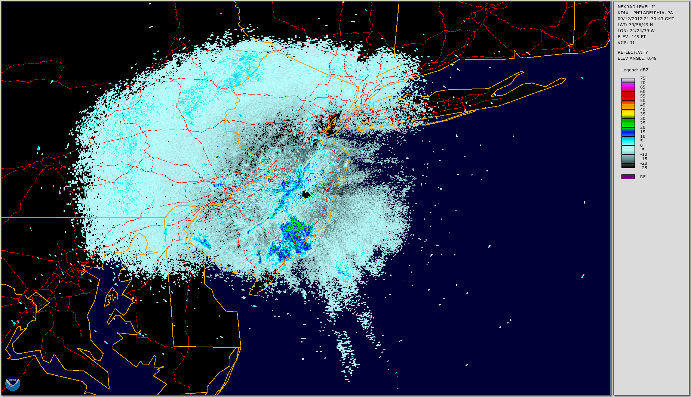
Case Study: Sept. 12, 2012: Sea breeze

Slide 11
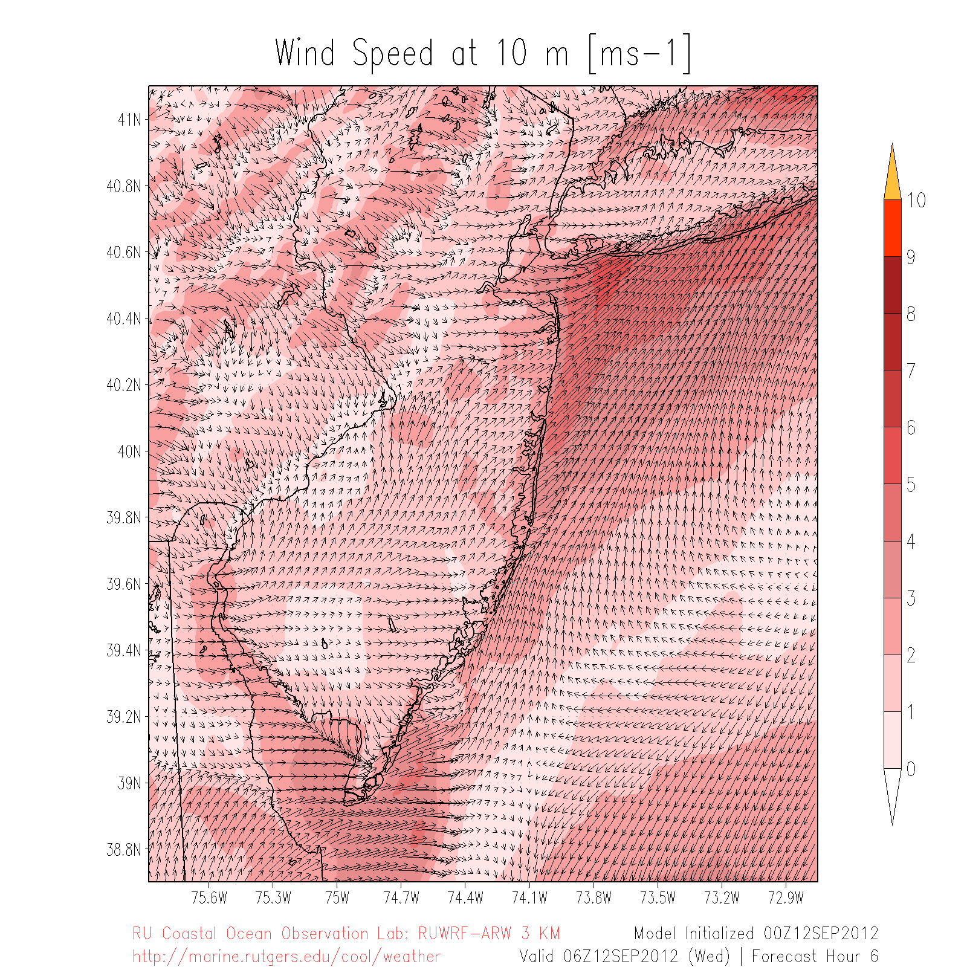
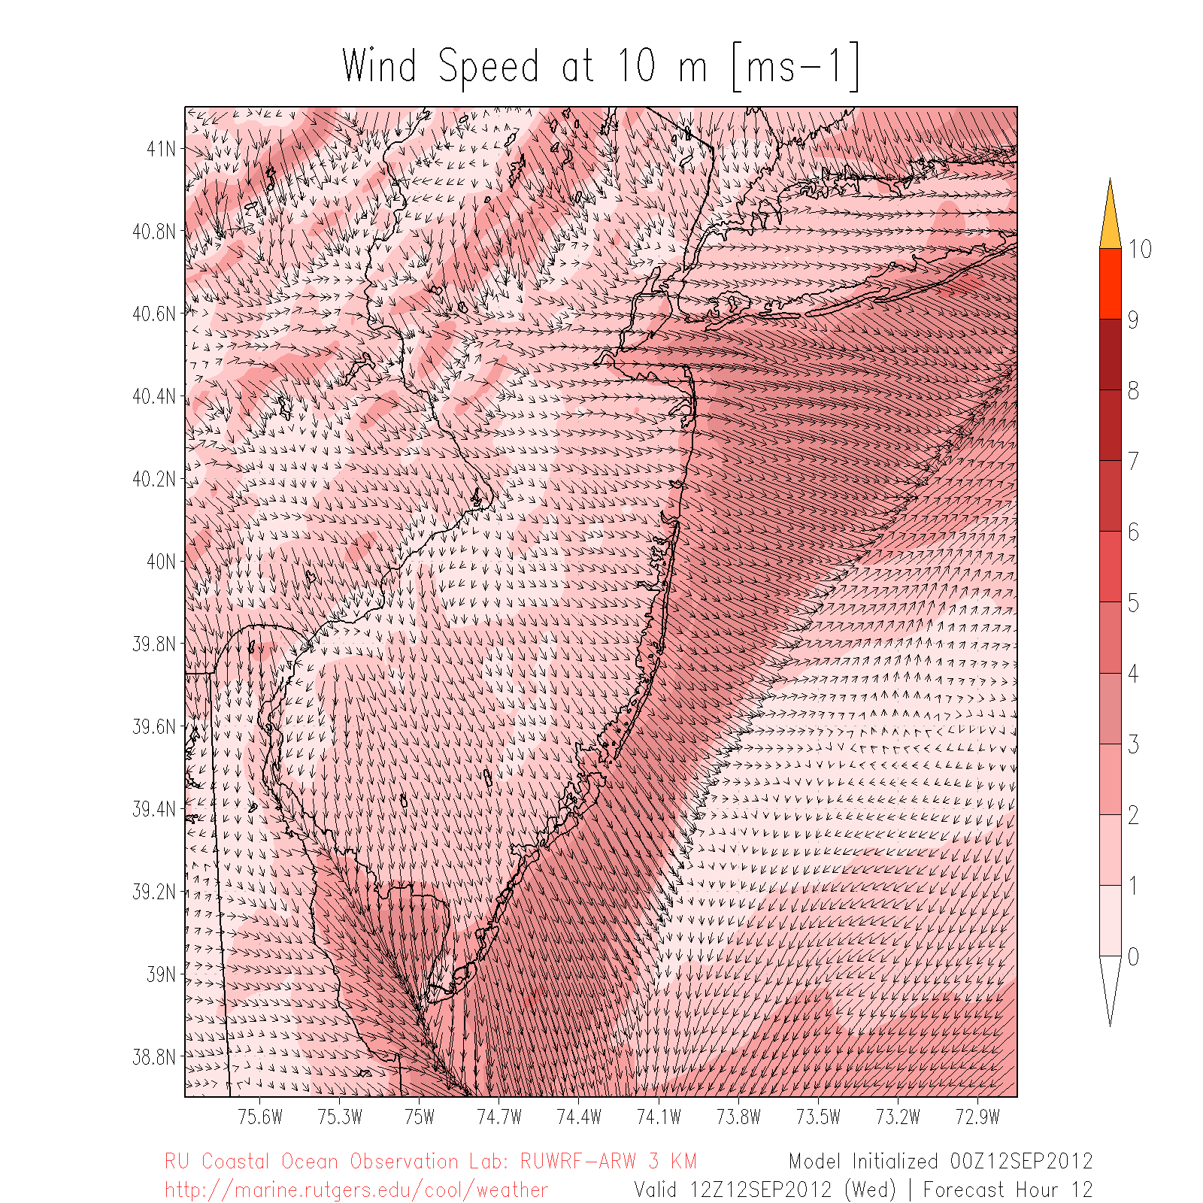
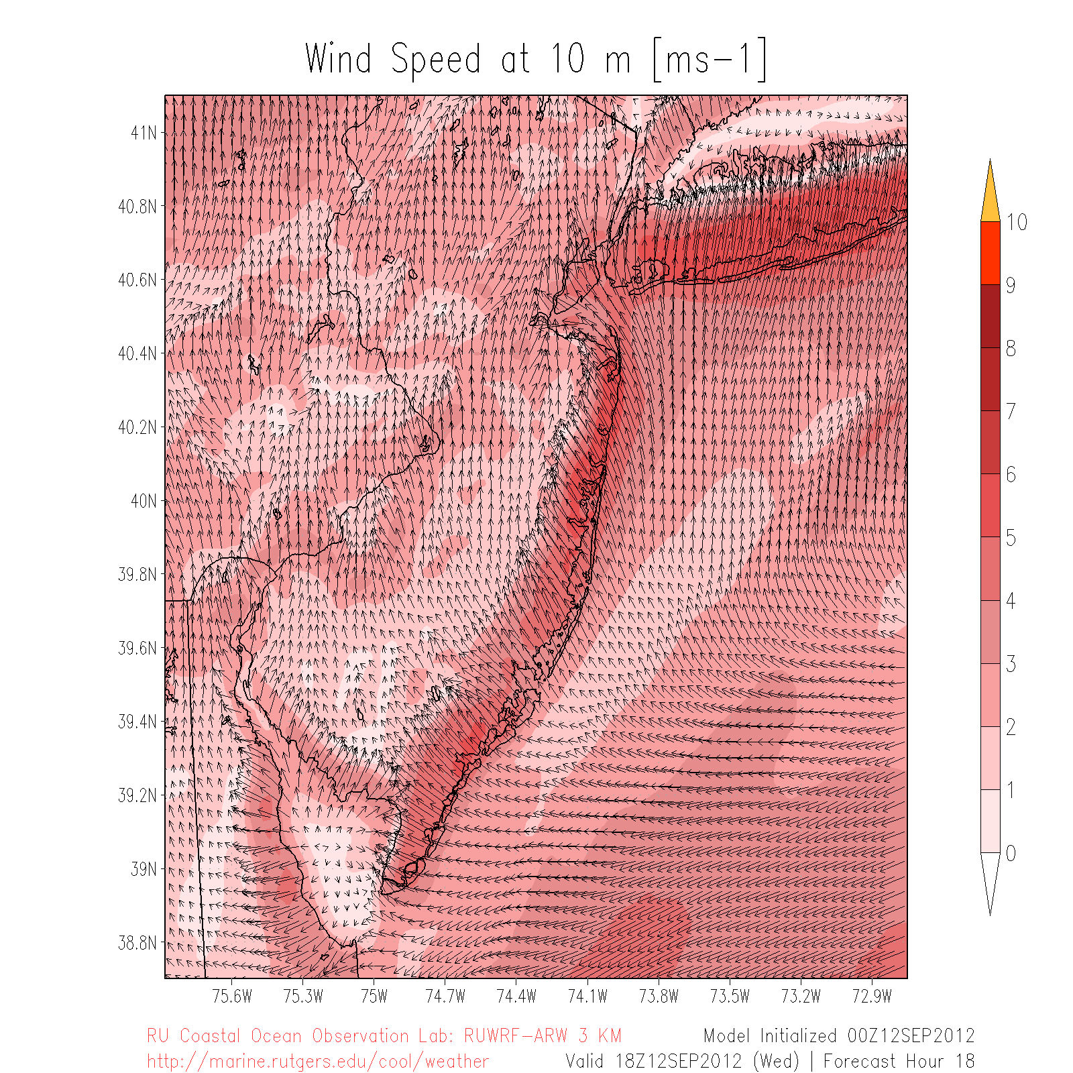
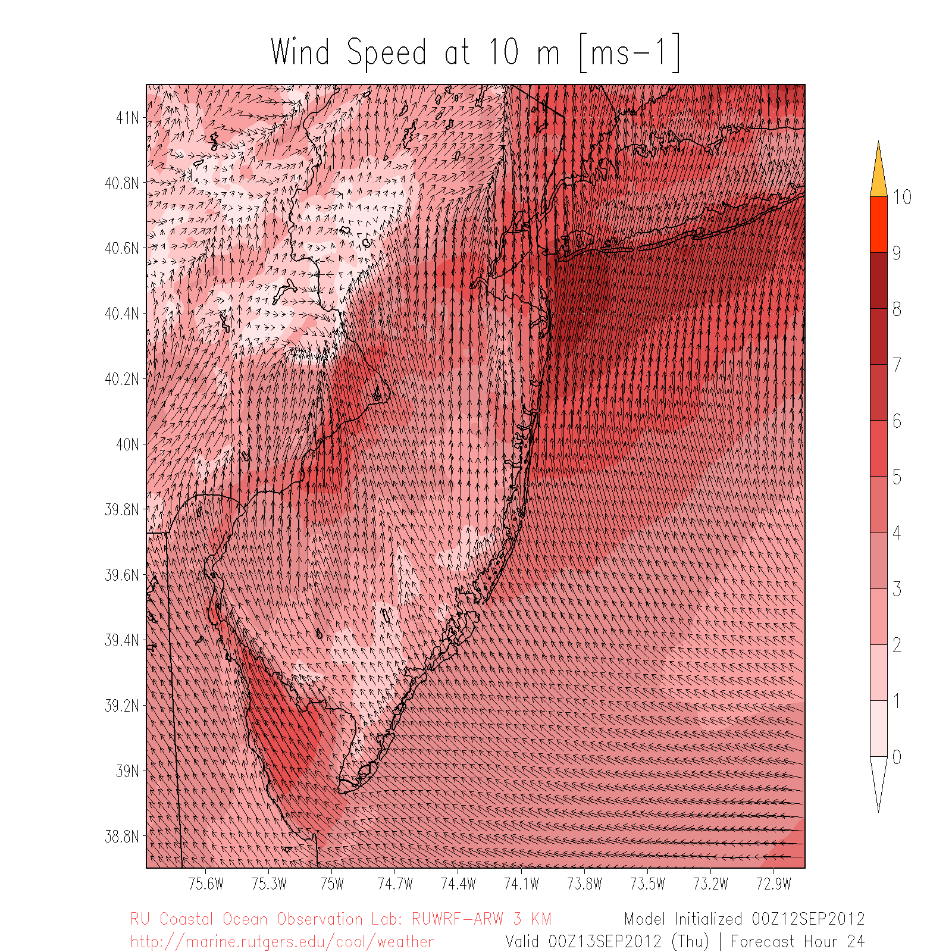
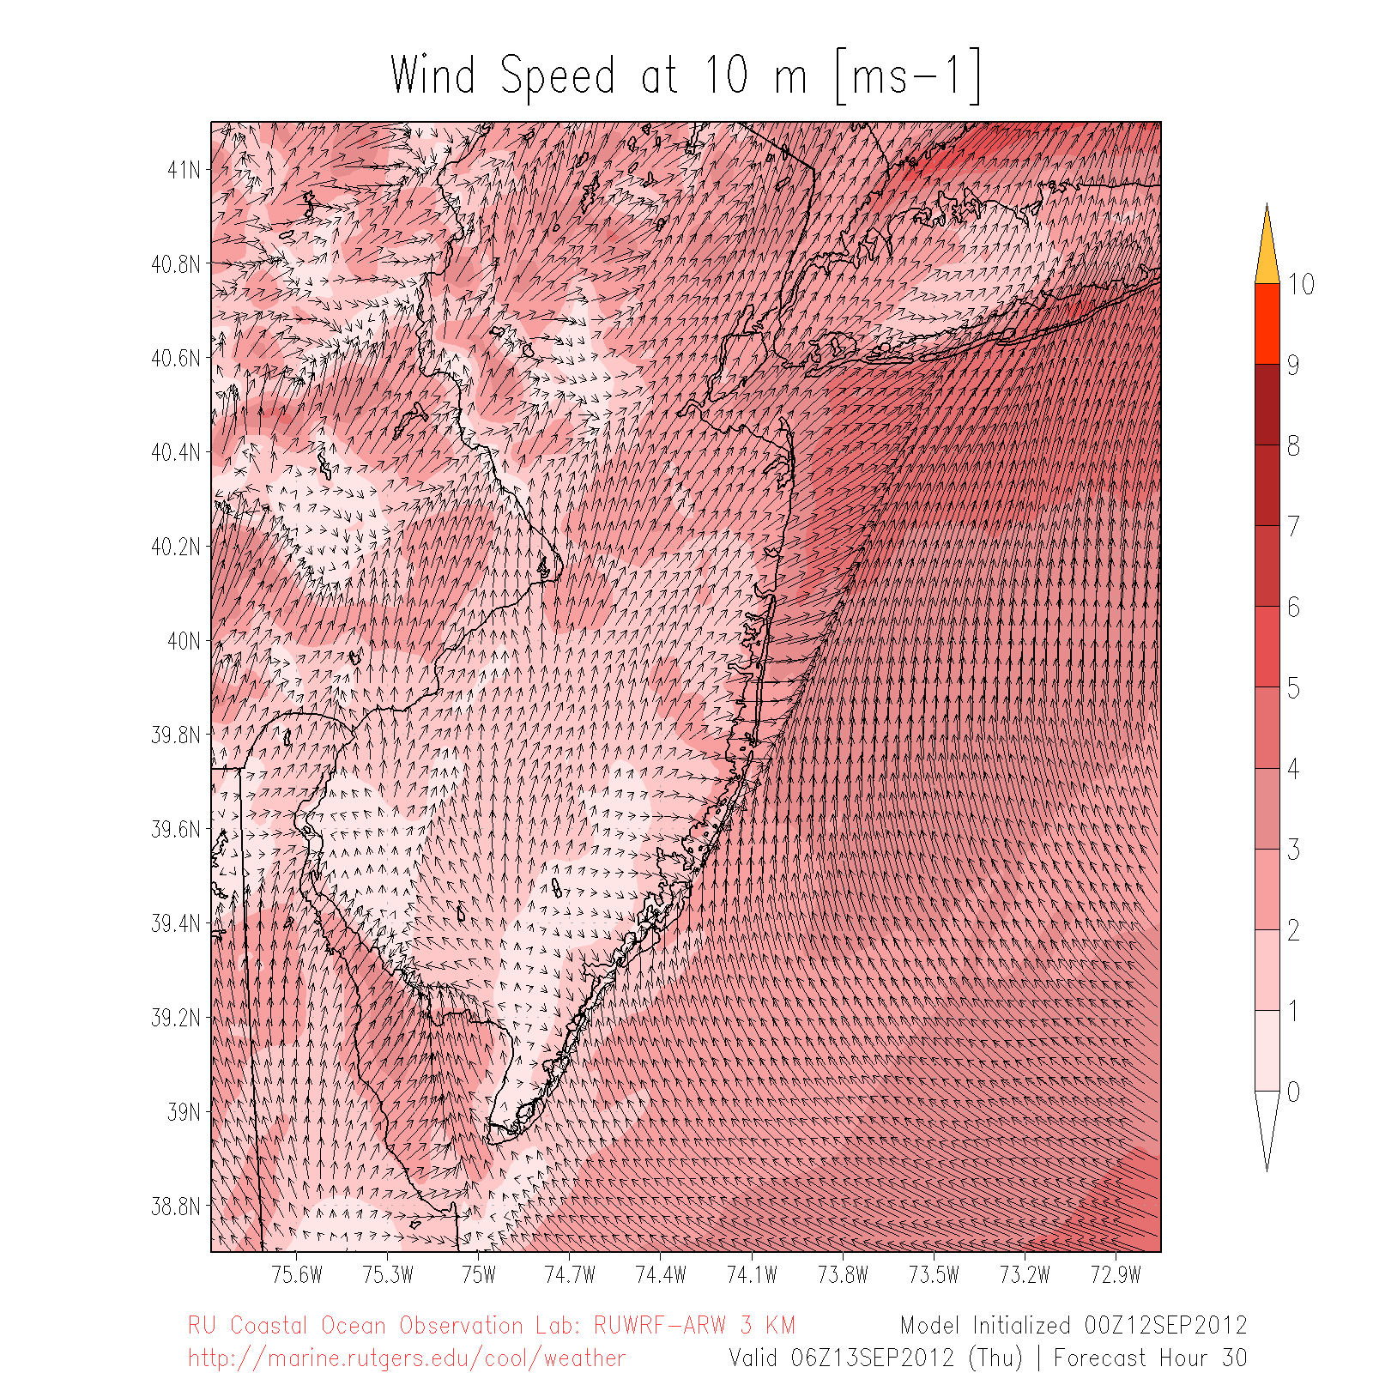
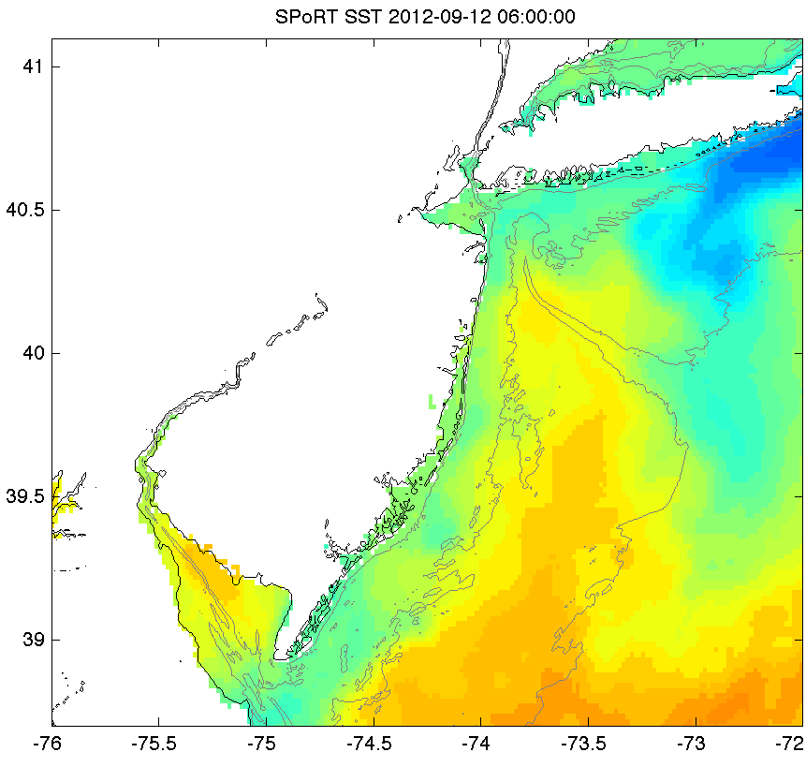
SST Sensitivity
Only change SST: RU-COOL SST vs. SPoRT SST
Sept 12
06Z
12Z
18Z
Sept 13
00Z
06Z

Slide 12
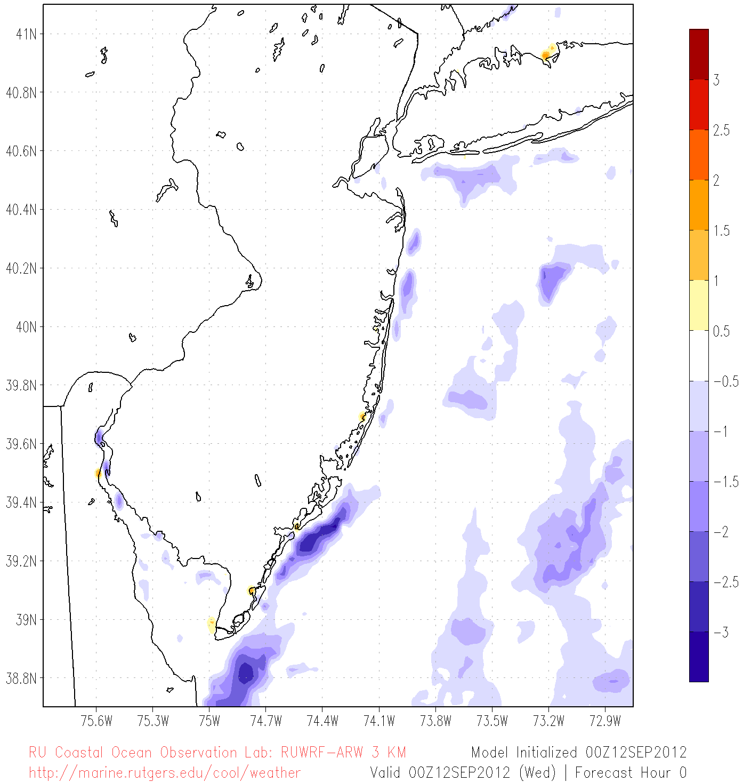
Skin T Diff (°C): RU-COOL SST run – SPoRT SST run

Slide 13
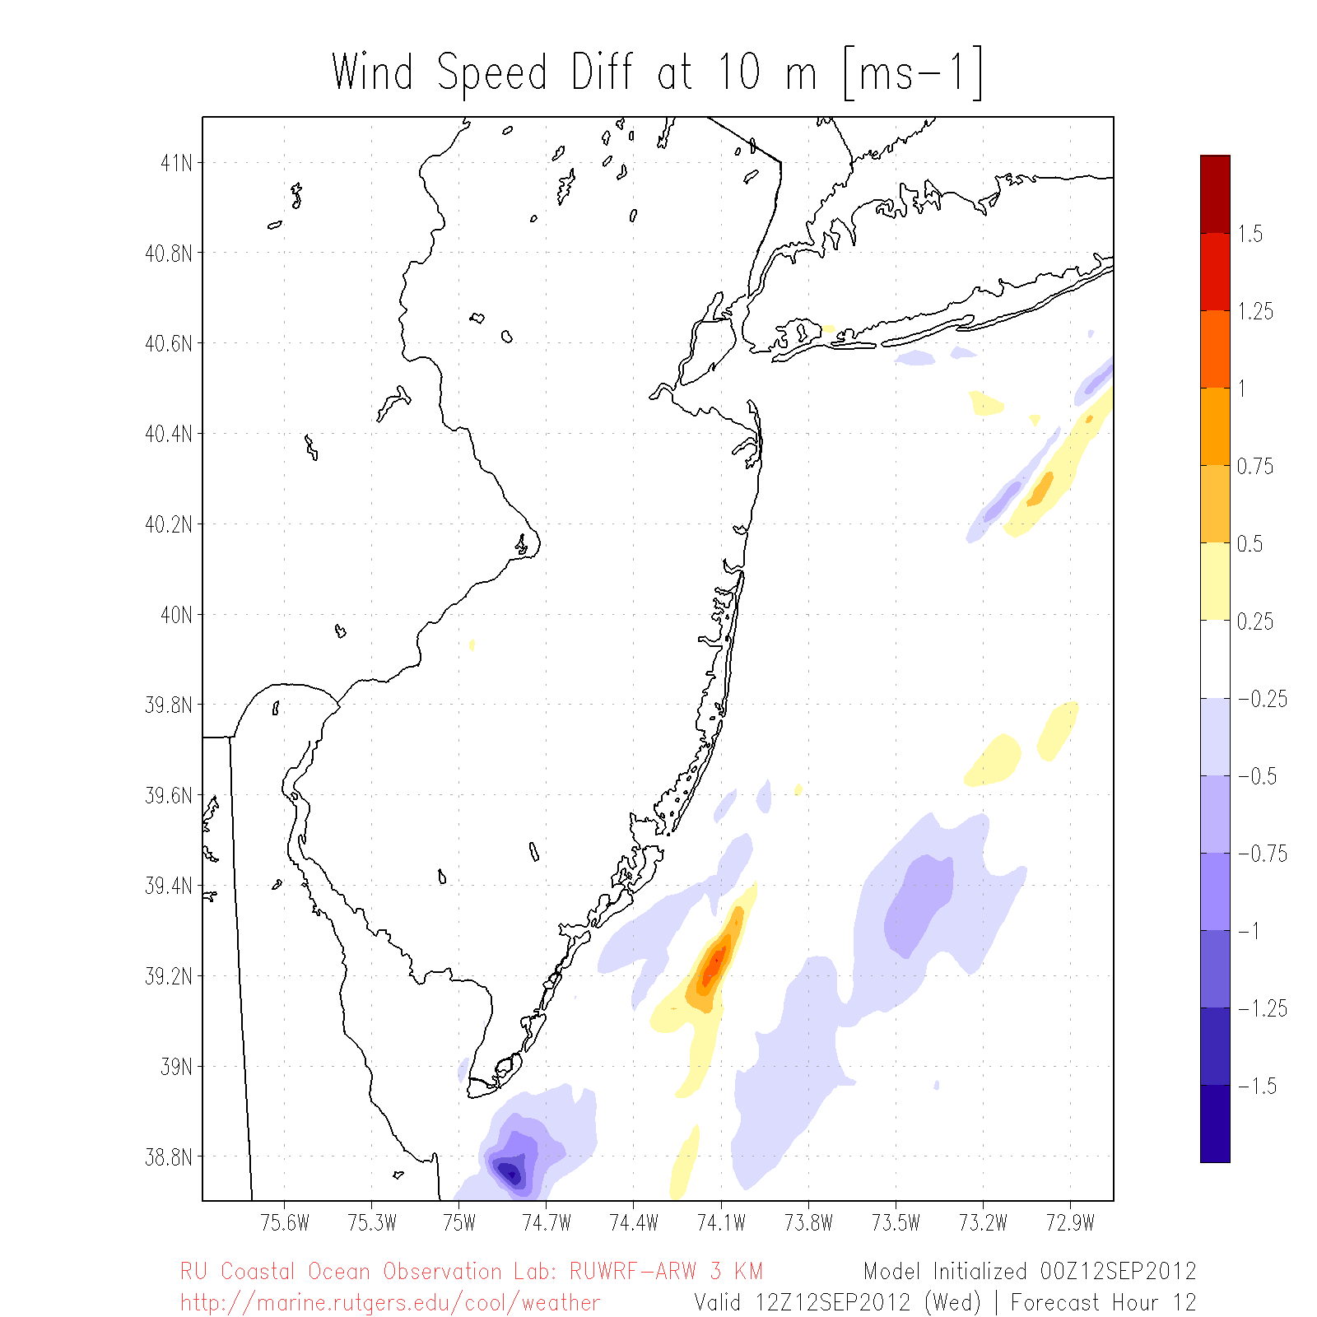
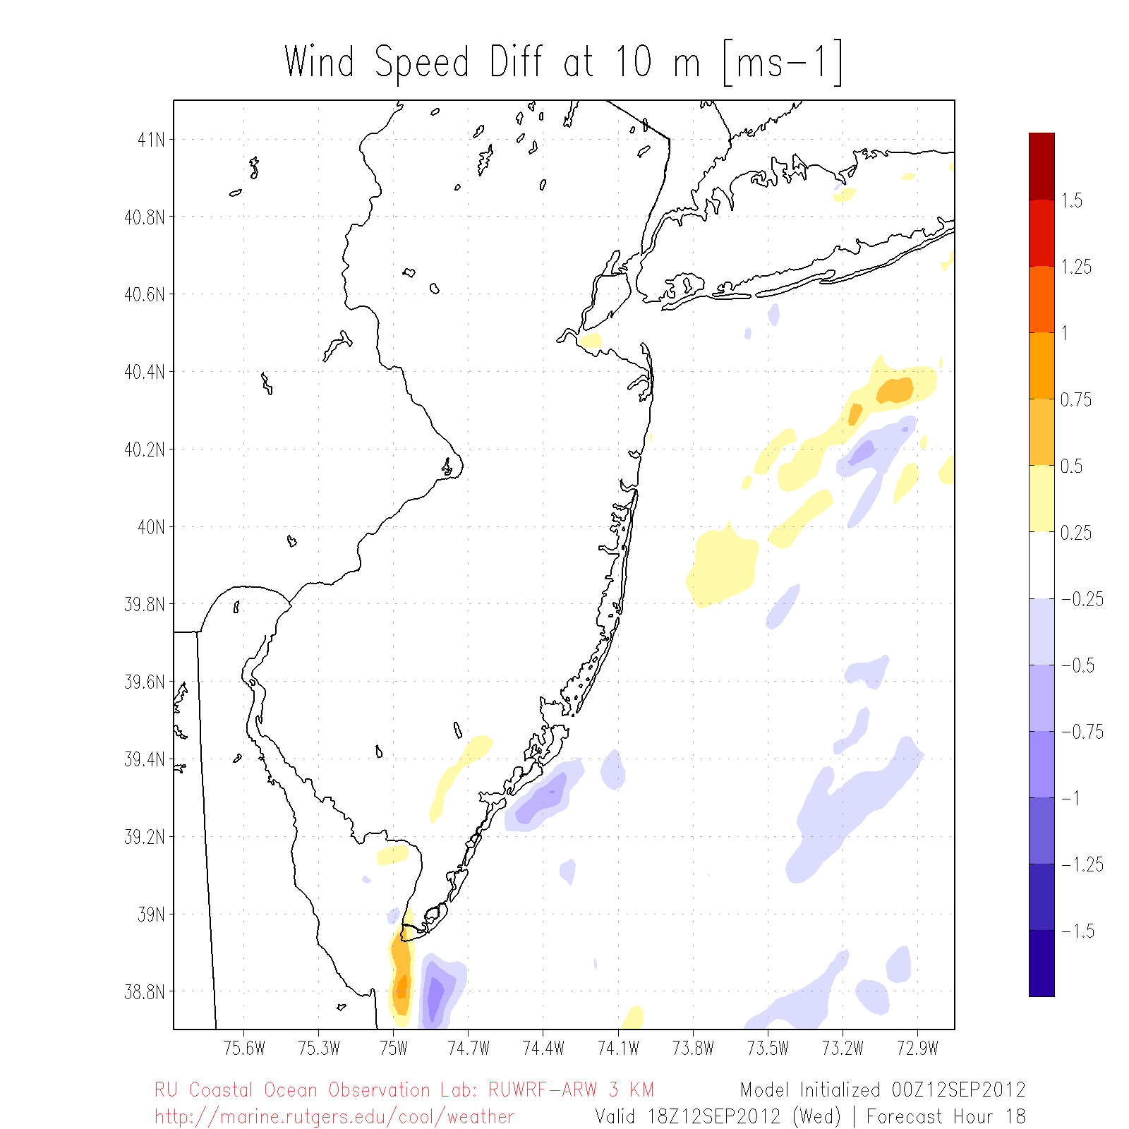
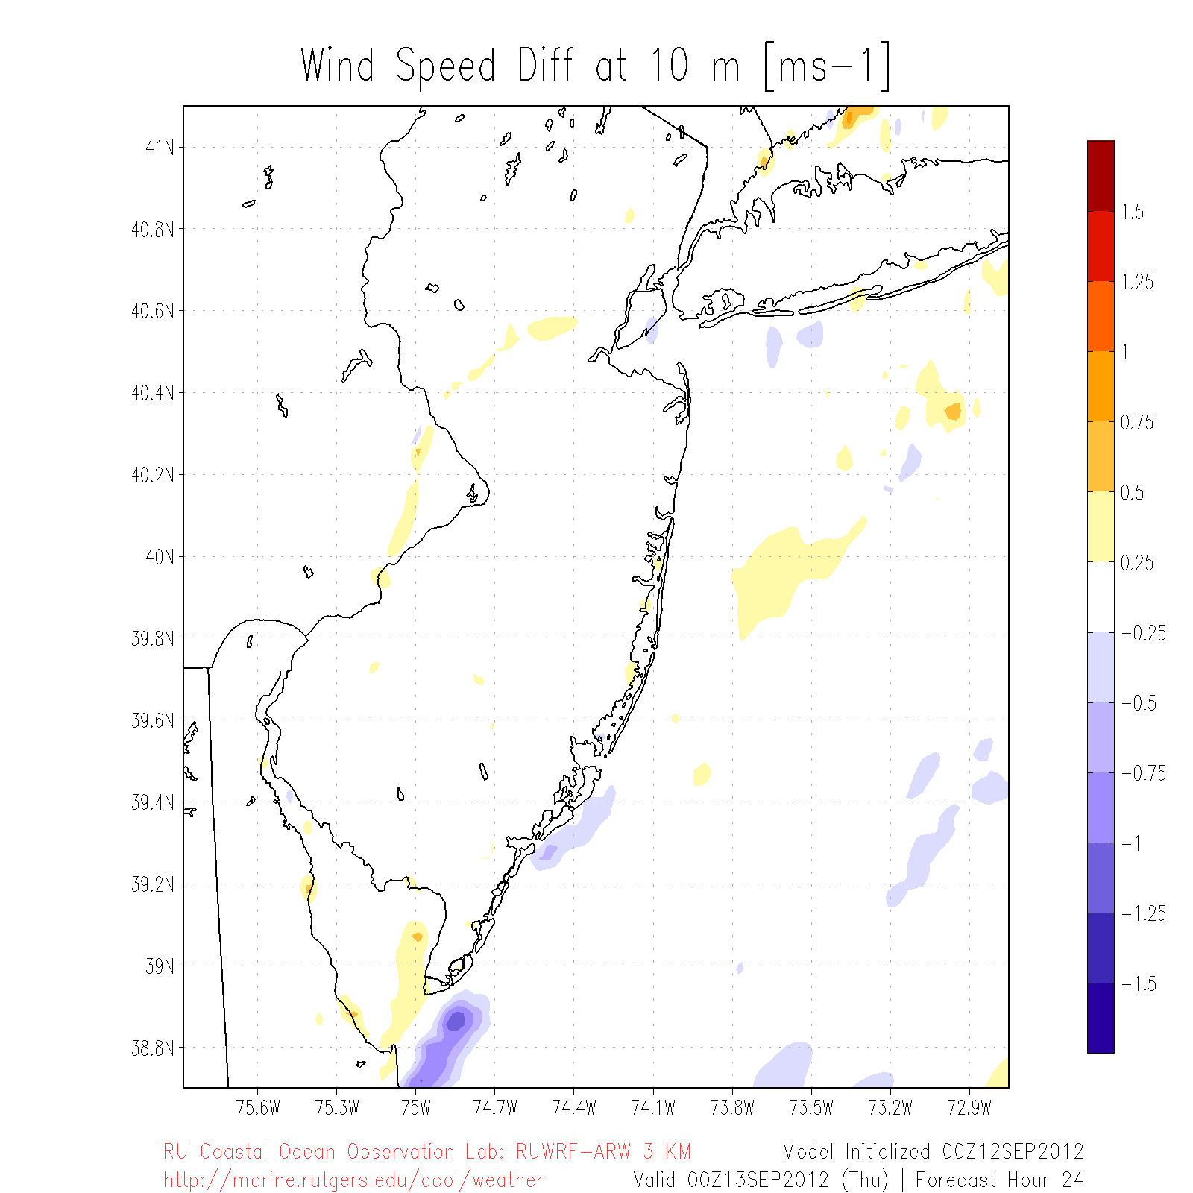
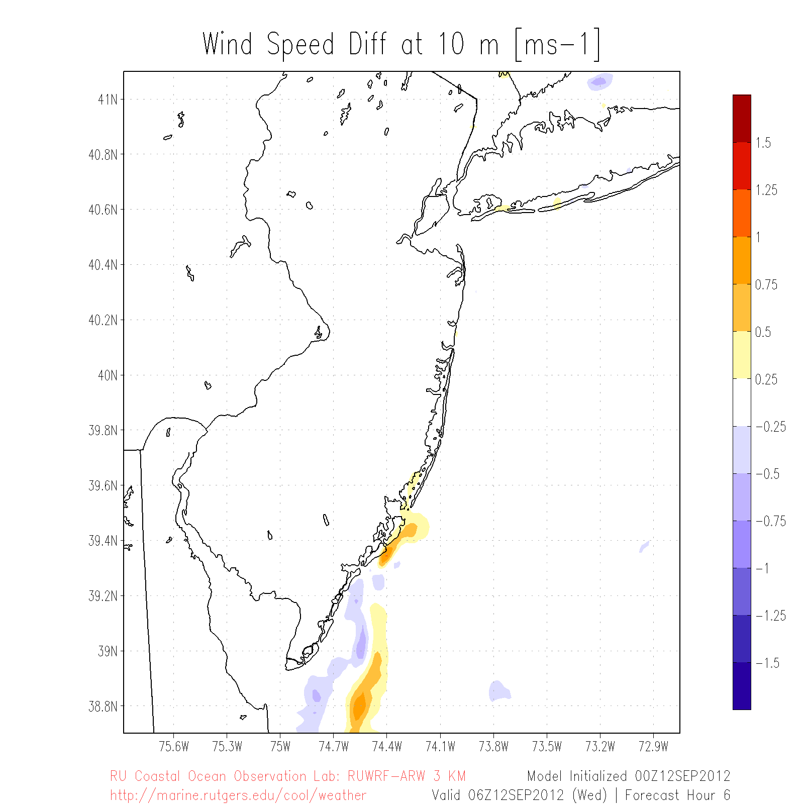
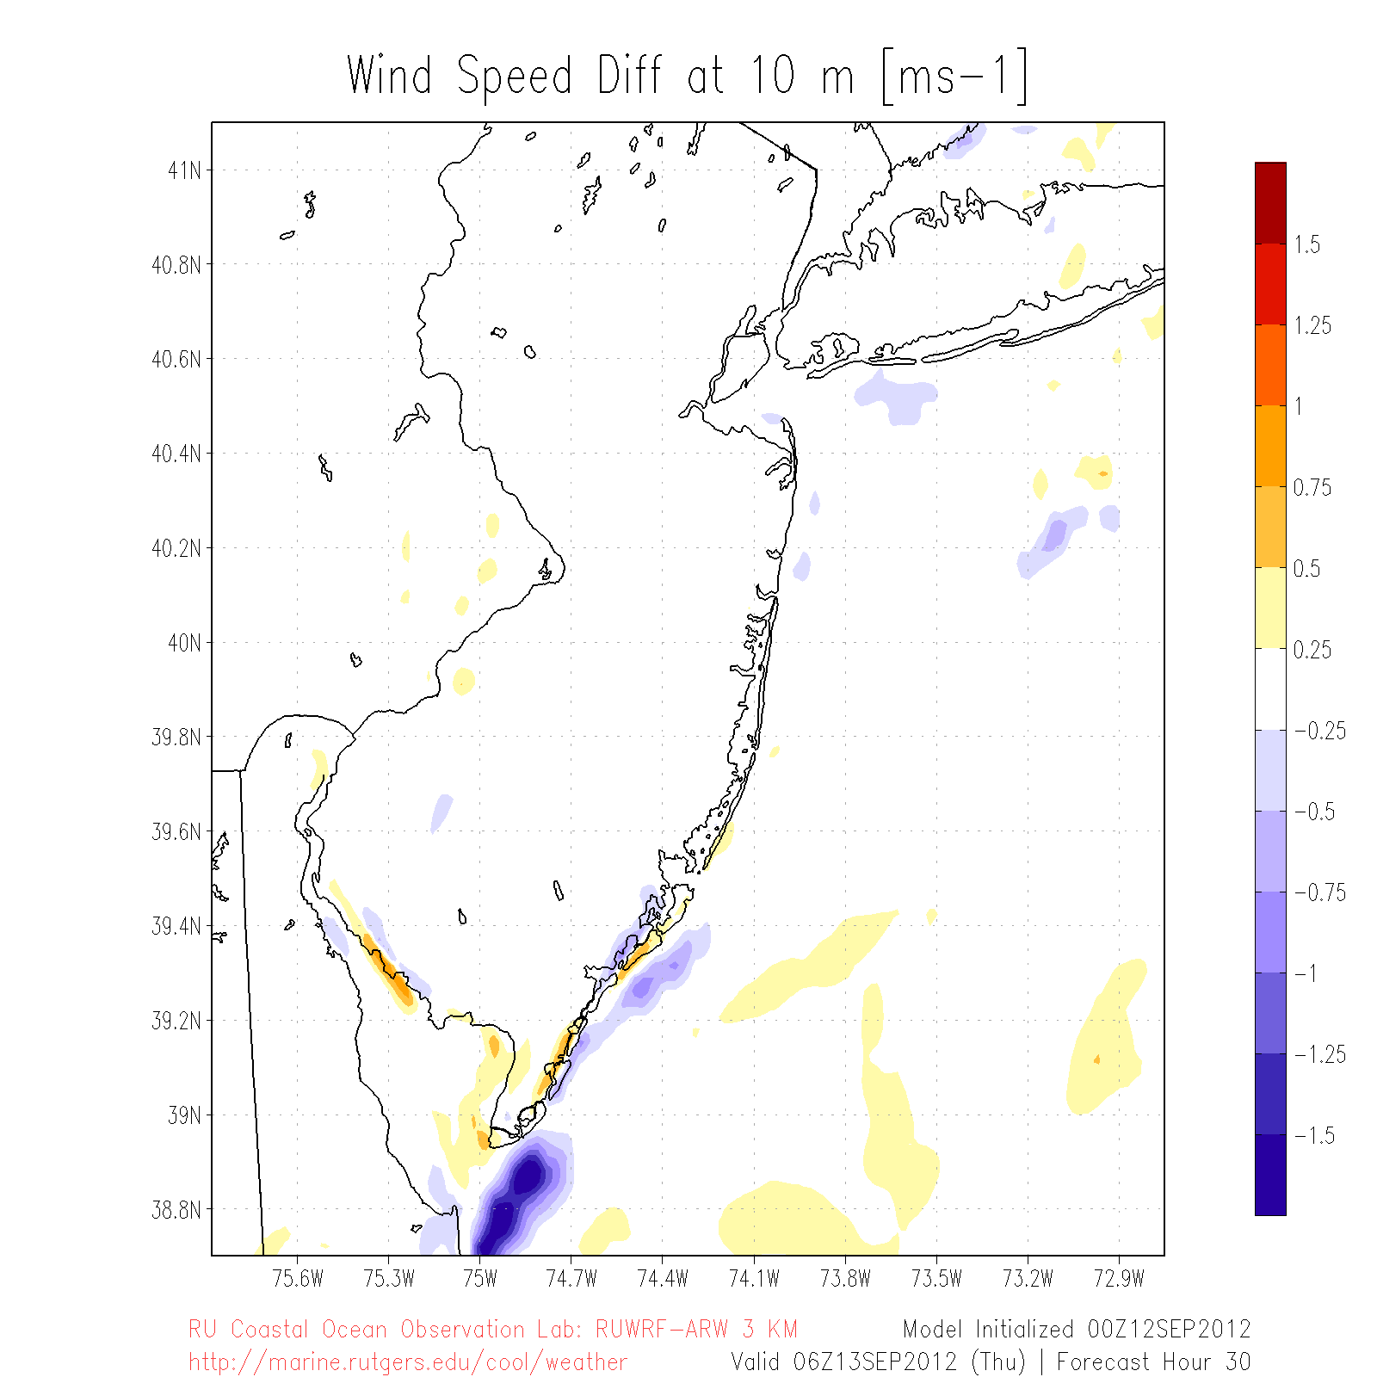
10m Wind Spd Diff (m s⁻¹): RU-COOL SST run – SPoRT SST run
Sept 12
06Z
12Z
18Z
Sept 13
00Z
06Z
Cross section

Slide 14
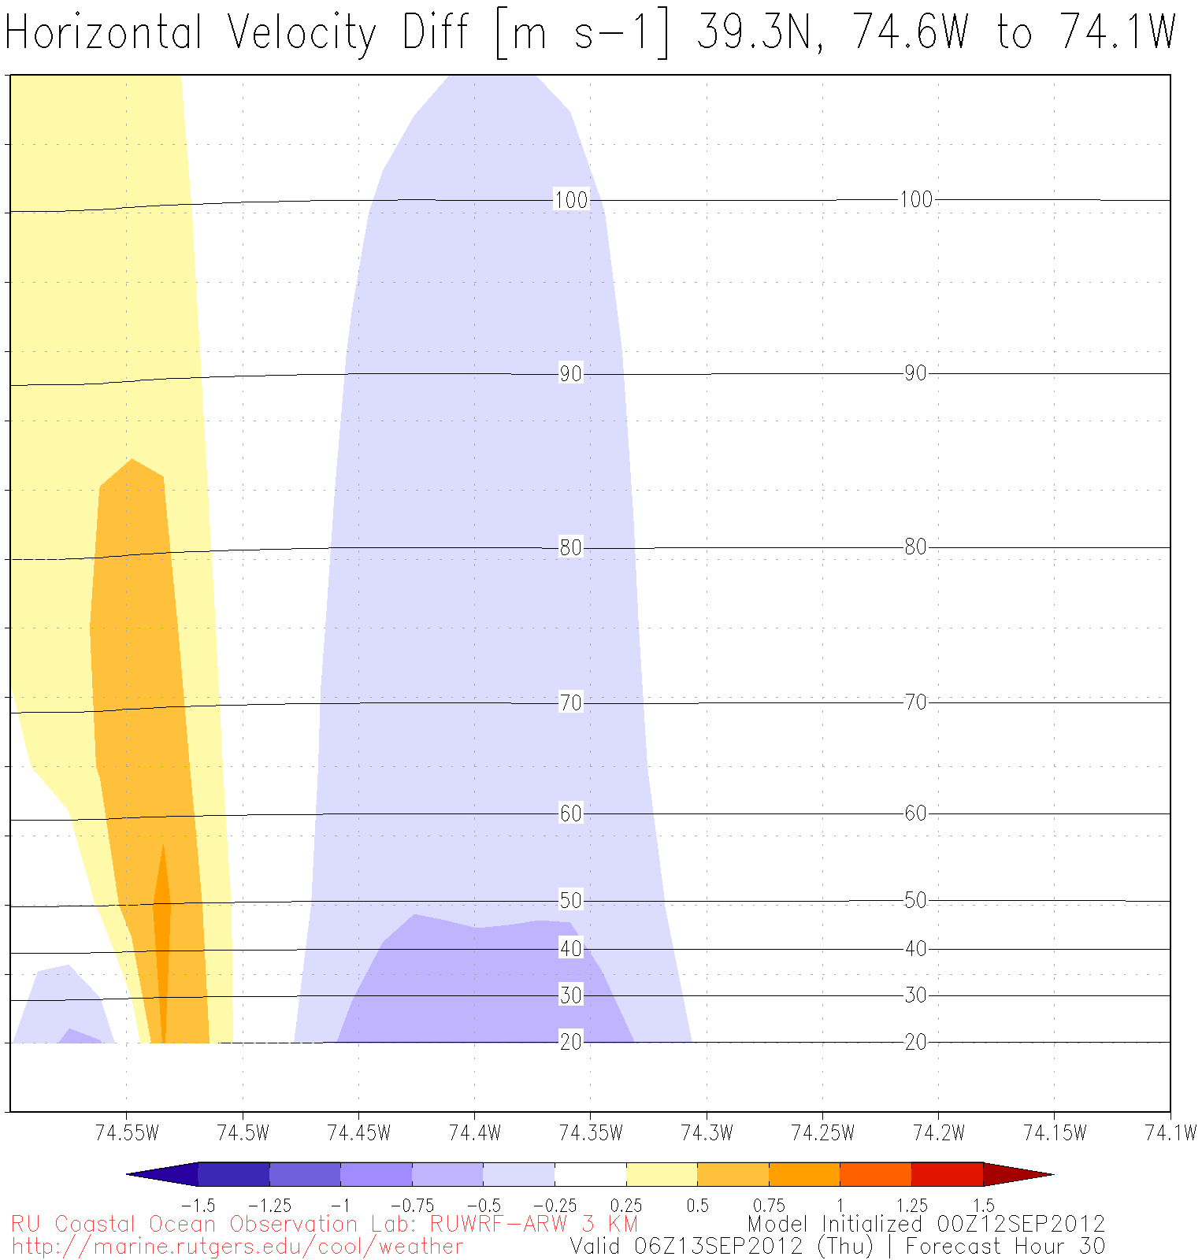
110+ m
40 m

Slide 15
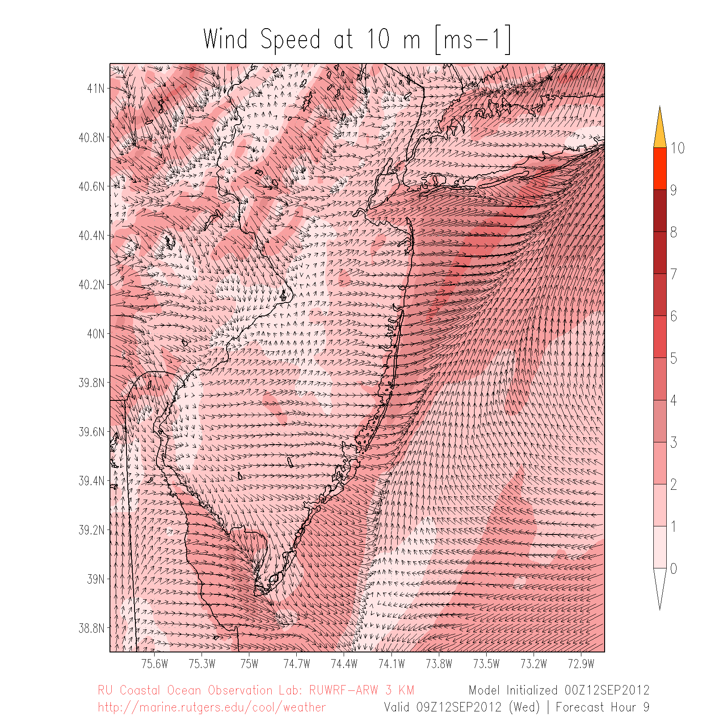
Skin T Difference
Cross section

Slide 16
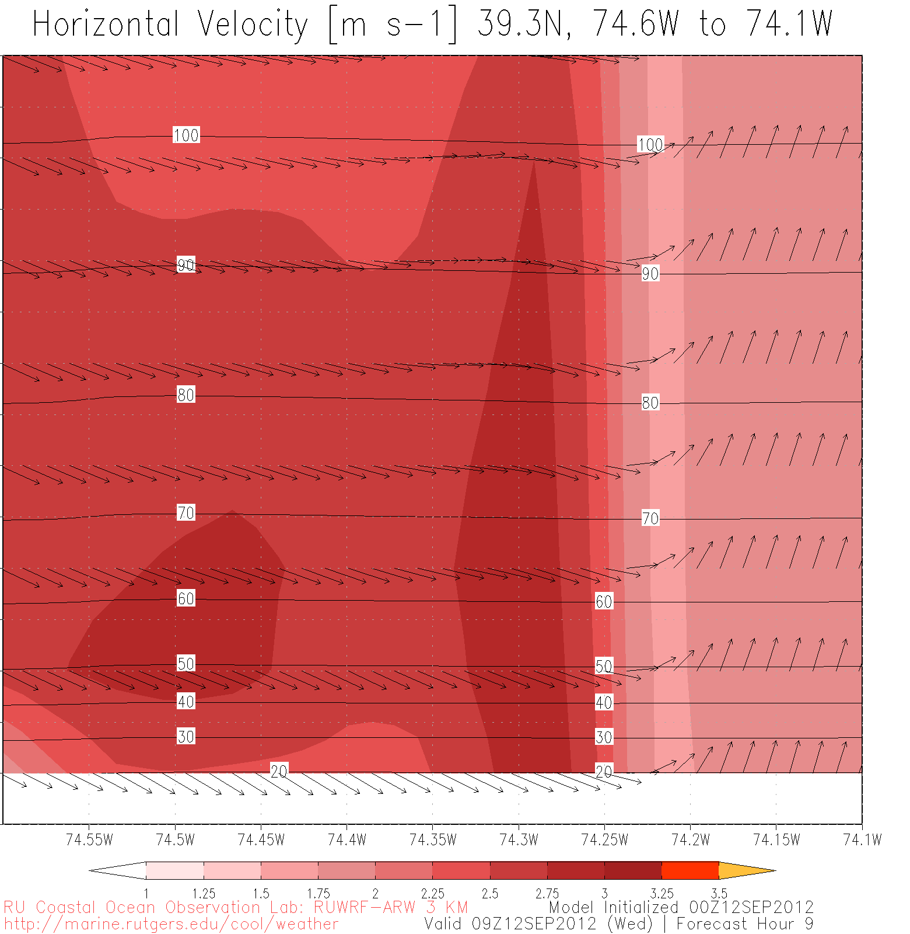
110+ m
40 m
Front

Slide 17
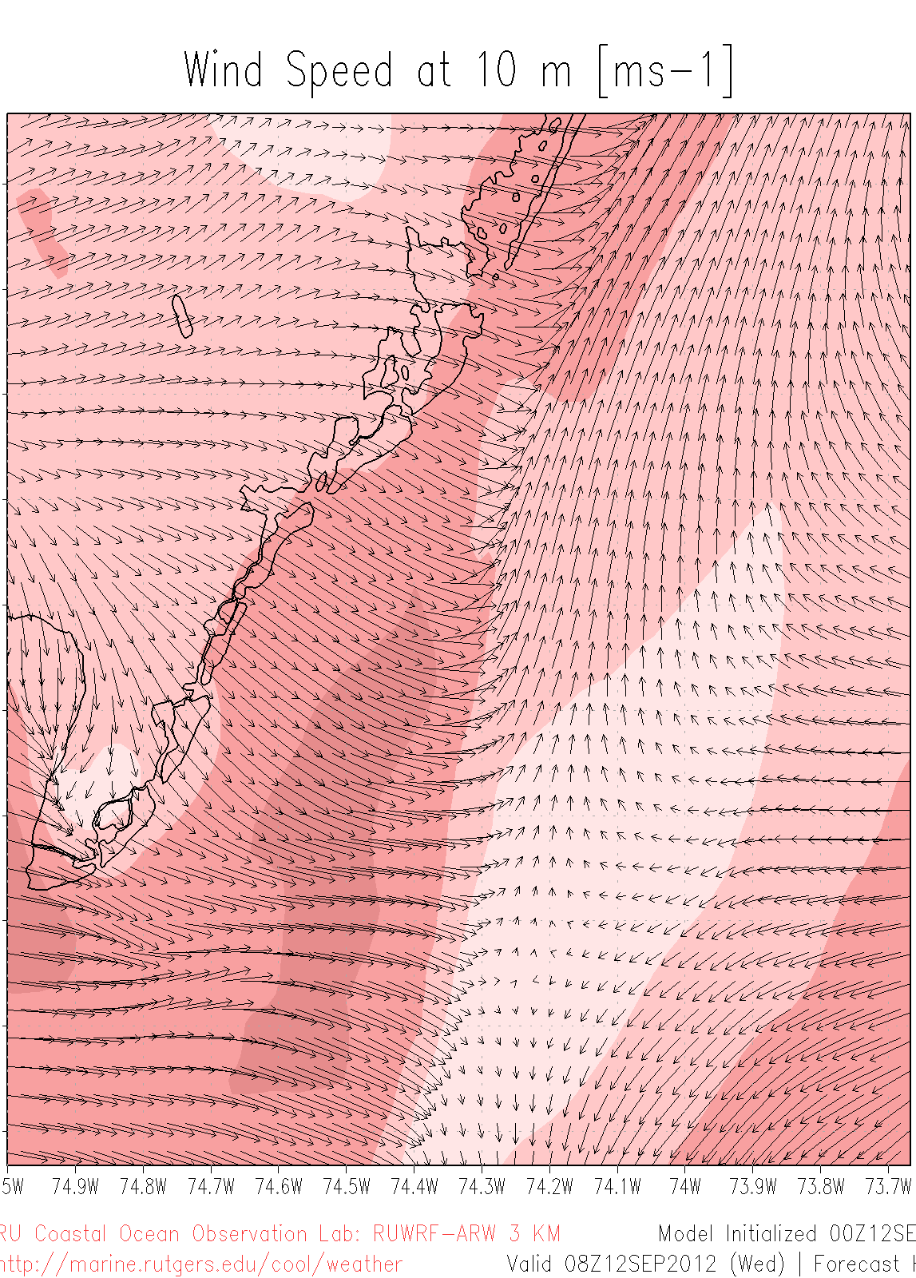
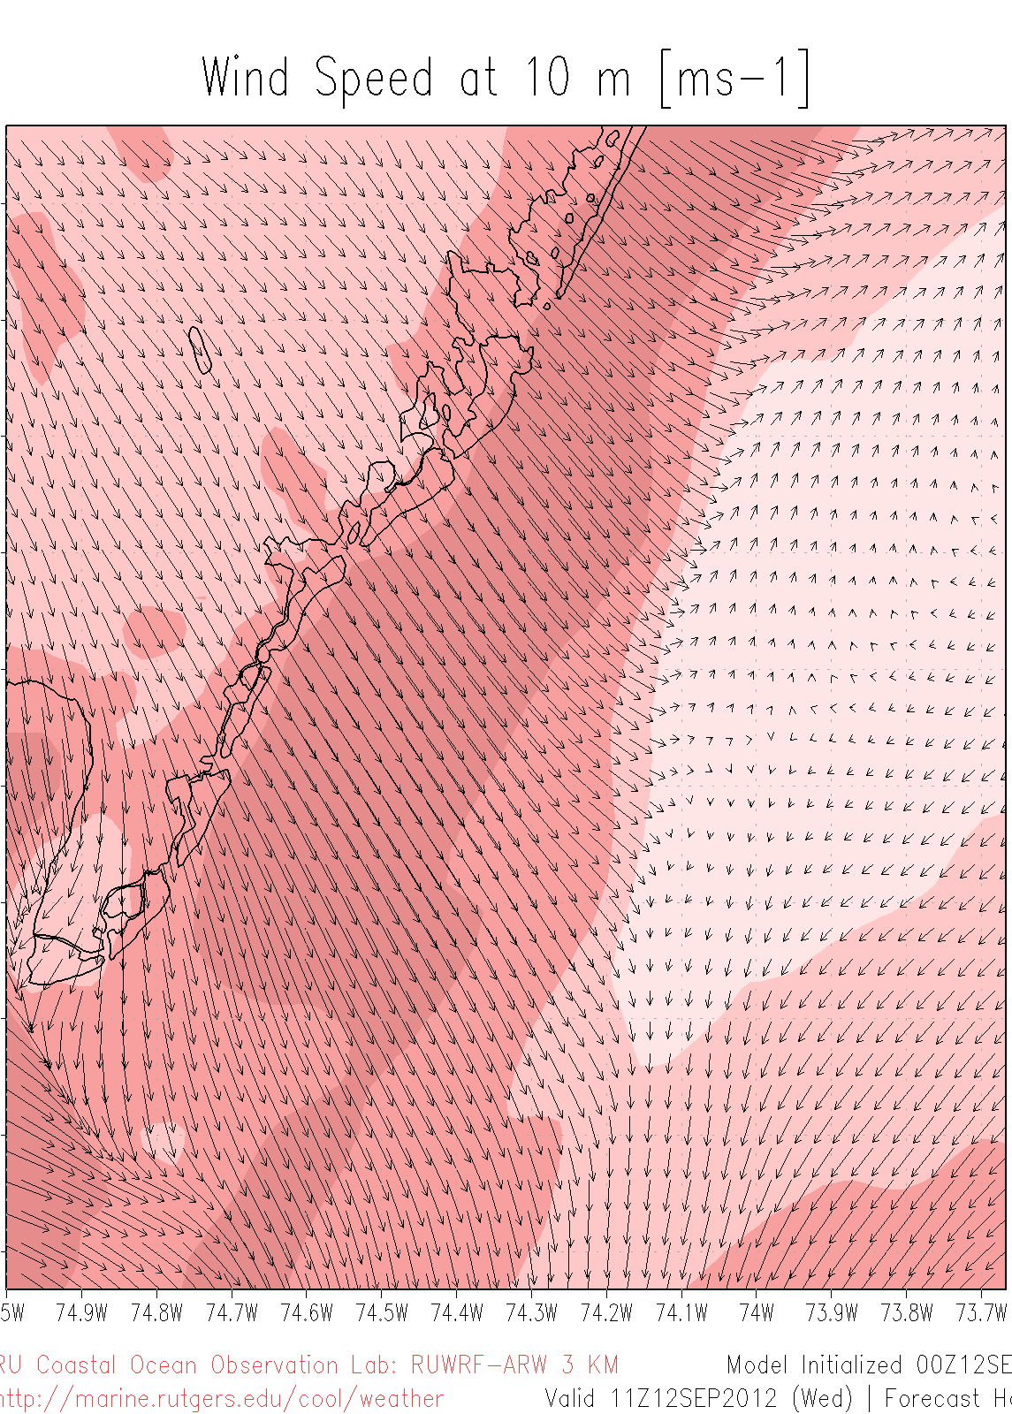
08Z
11Z
~15 km/3 hr = 5 km hr⁻¹

Slide 18
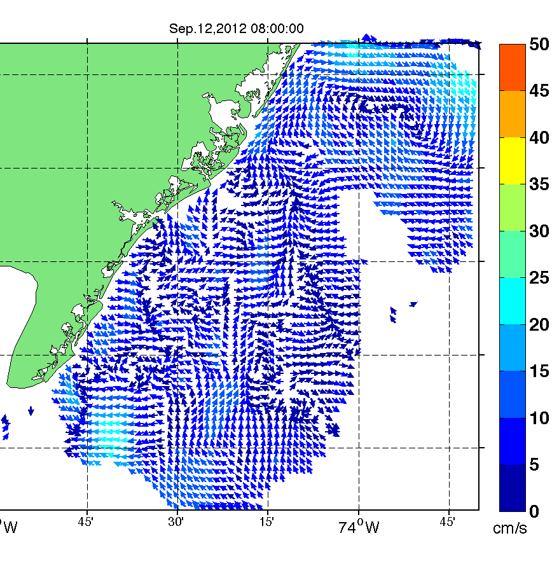
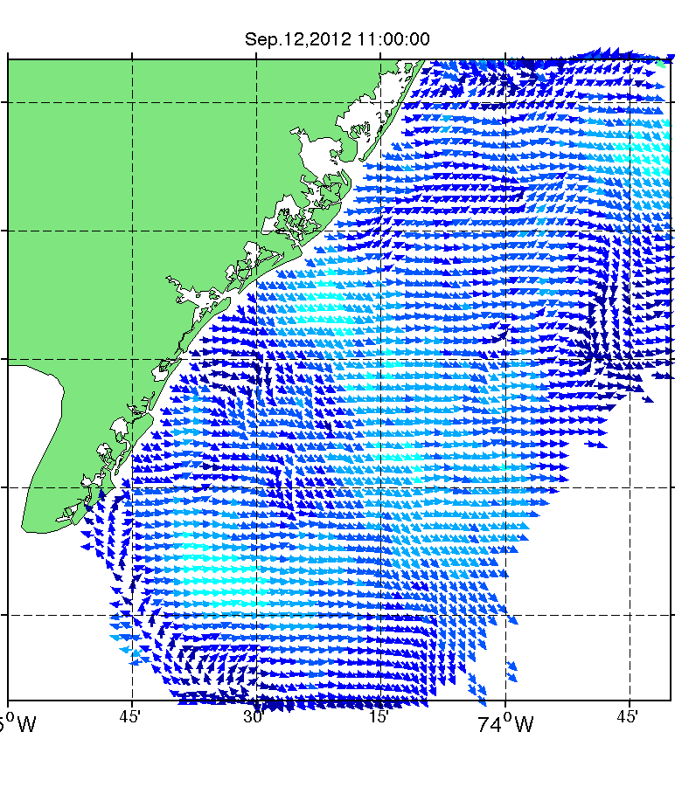
Raw CODAR Currents
08Z
11Z
~21 km/3 hr = 7 km hr⁻¹

Slide 19
Conclusions
Modeling allows the study of little known offshore component of land/sea breeze circulation
New de-clouded satellite SST product preserves coastal upwelling
Significant sensitivity of winds to SST forcing
Effects extend vertically through PBL, across wind turbine blade heights
CODAR currents can be used to horizontally validate modeled offshore surface wind fields

Slide 20
References
Gemmill, William, Bert Katz and Xu Li, 2007: Daily Real-Time Global Sea Surface Temperature - High Resolution Analysis at NOAA/NCEP. NOAA / NWS / NCEP / MMAB Office Note Nr. 260, 39 pp
Haines, S. L., G. J. Jedlovec, and S. M. Lazarus, 2007: A MODIS sea surface temperature composite for regional applications. IEEE Trans. Geosci. Remote Sens., 45, 2919-2927
Michalakes, J., S. Chen, J. Dudhia, L. Hart, J. Klemp, J. Middlecoff, and W. Skamarock, 2001: Development of a next-generation regional weather research and forecast model. Developments in Teracomputing, W. Zwieflhafer and N. Kreitz, Eds., World Scientific, 269–296.

Slide 21
RU-COOL De-clouding Thresholds
Visible and near IR thresholds empirically derived by season and location
E.g. Mid-Atlantic Bight, summer/fall:
<10°C removed (cloud)
near IR albedo >2.3% removed (clouds)
Other tests on changes (within ~3km X 3km grid boxes) of SST (1°C) and near IR albedo (0.15%)

