Slide 1
Expanding the Coverage of HF Radar Through the Use of Wave Powered Buoys
Hugh Roarty, Michael Smith, Ethan Handel and Scott Glenn
Don Barrick

Slide 2
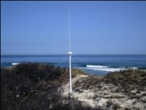
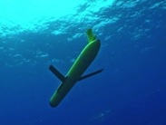
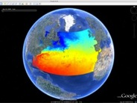
Rutgers University - Coastal Ocean Observation Lab
Operations, Research & Education Center
Vessels -
Satellite
Satellite
CODAR
Ships/ Vessels
Glider
REMUS
Data Vis.
Modeling
Security
Leadership
Education
Satellite Data Acquisition Stations
CODAR Network
Glider Fleet
3-D Forecasts

Slide 3
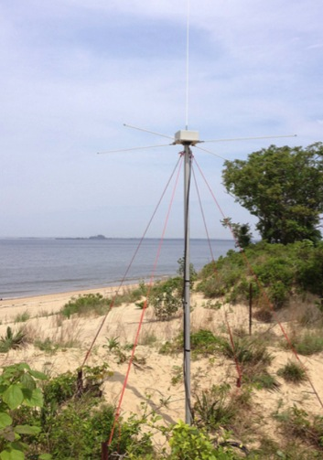
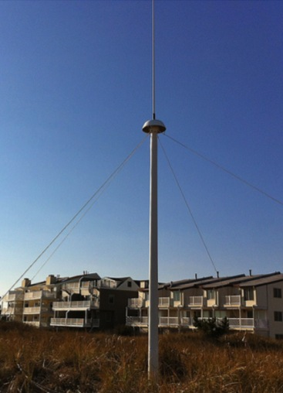
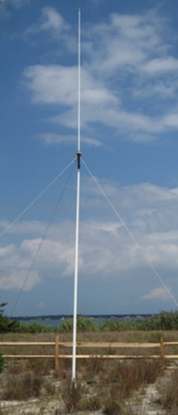
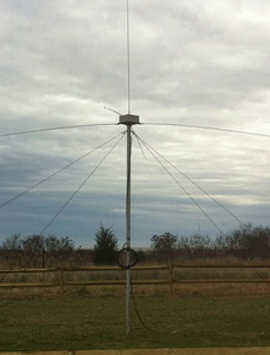
CODAR Compact HF Radar Antennas
25 MHz
13 MHz
5 MHz
Combined Transmitter & Receiver
Separate Transmitter & Receiver

Slide 4
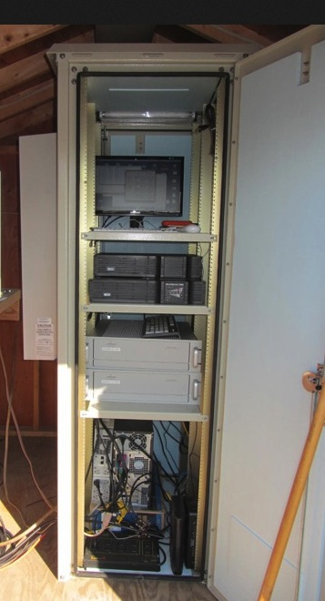
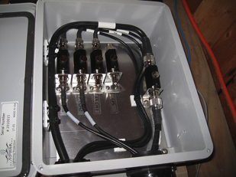
Shed and Enclosures
monitor
computer & external hard drive
A.C. unit
UPS system
transmitter
receiver
Two lines of Communication
Shed
Enclosure
Lightning Protection

Slide 5
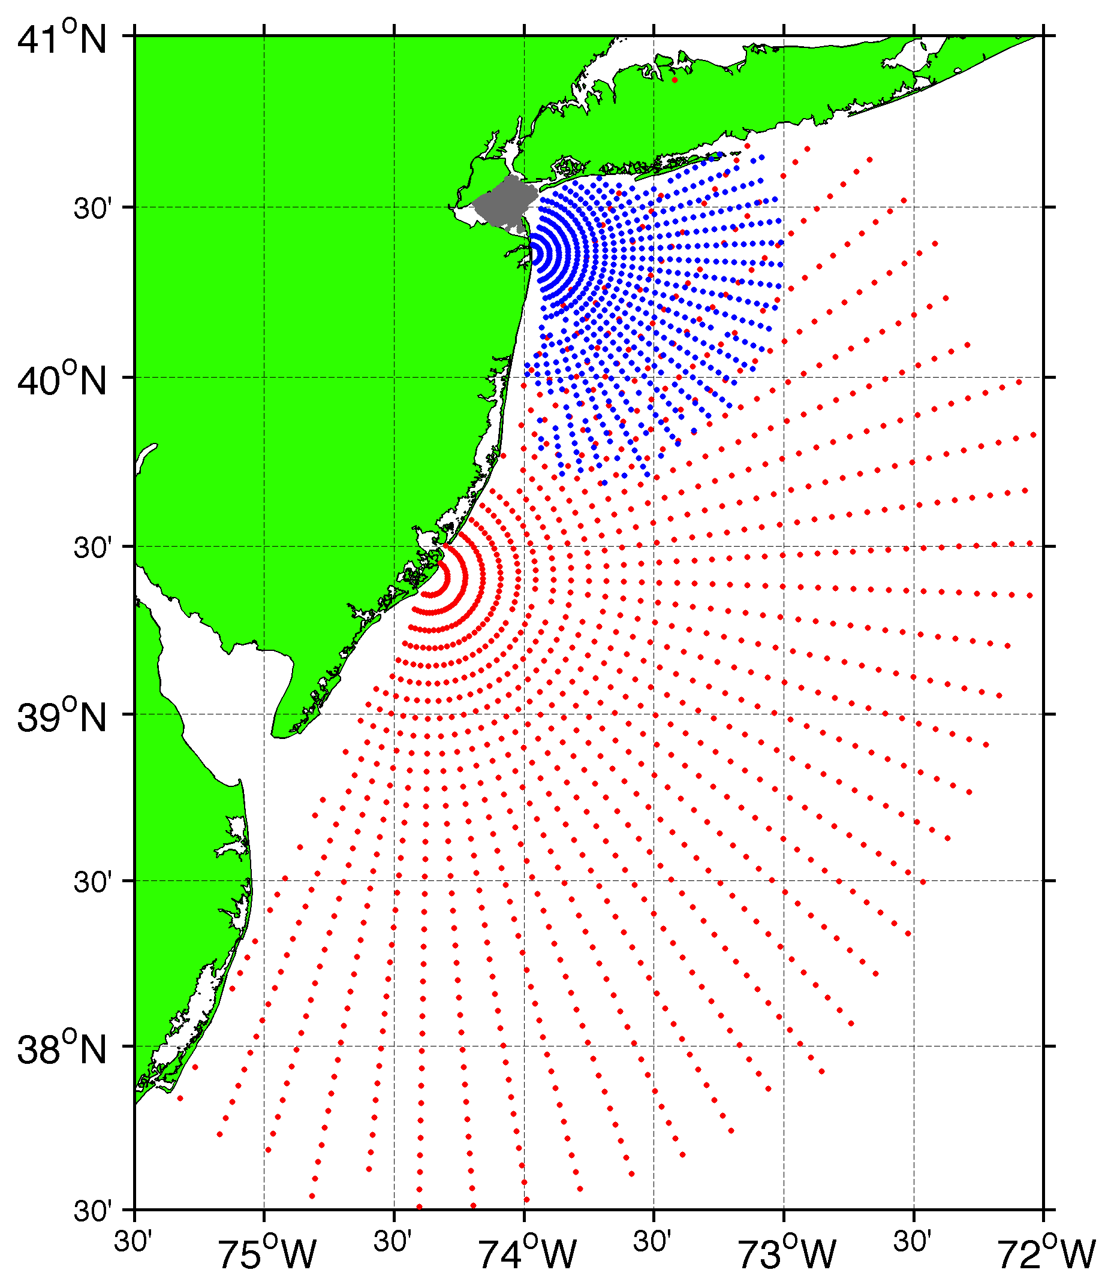
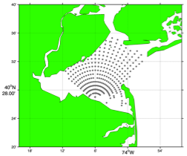
Surface Current Mapping Capability
25 MHz
Radar λ: 12 m Ocean λ: 6 m
Range: 30 km Resolution: 1 km
13 MHz
Radar λ: 23 m Ocean λ: 12 m
Range: 80 km Resolution: 3 km
05 MHz
Radar λ: 60m Ocean λ: 30 m
Range: 180 km Resolution: 6 km

Slide 6
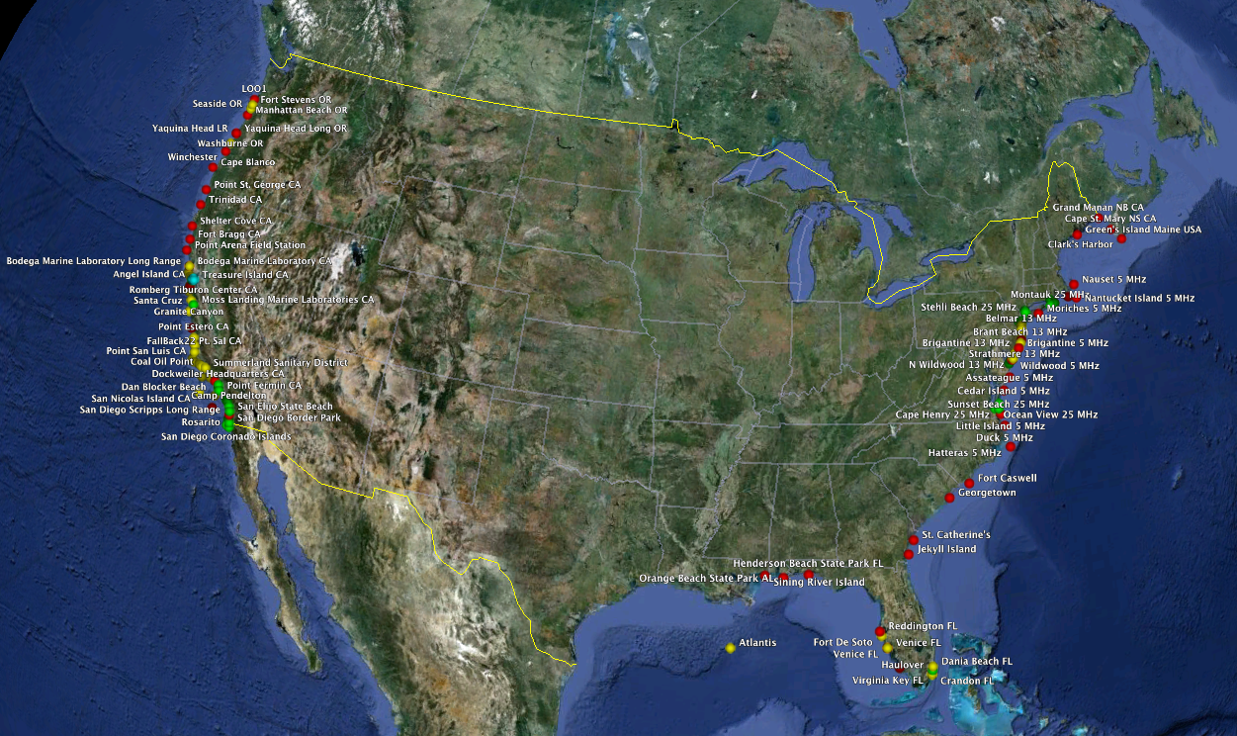
133 Sites in the USA

Slide 7
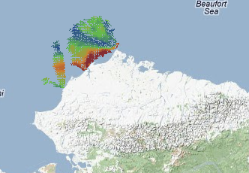
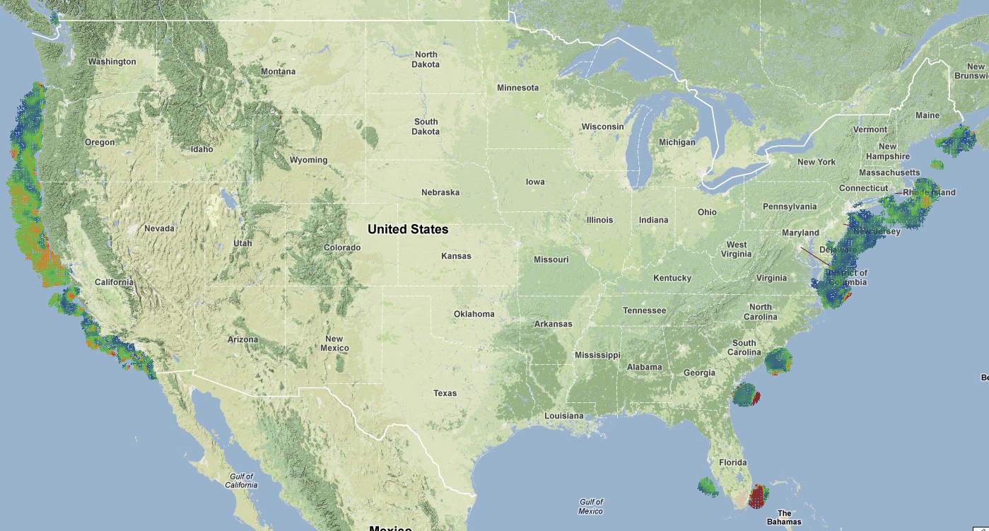
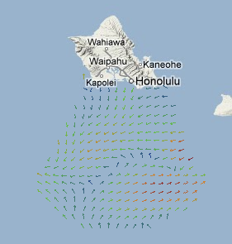
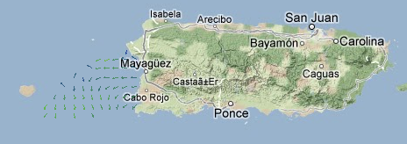
This Mornings Coverage
100 km
150 km

Slide 8
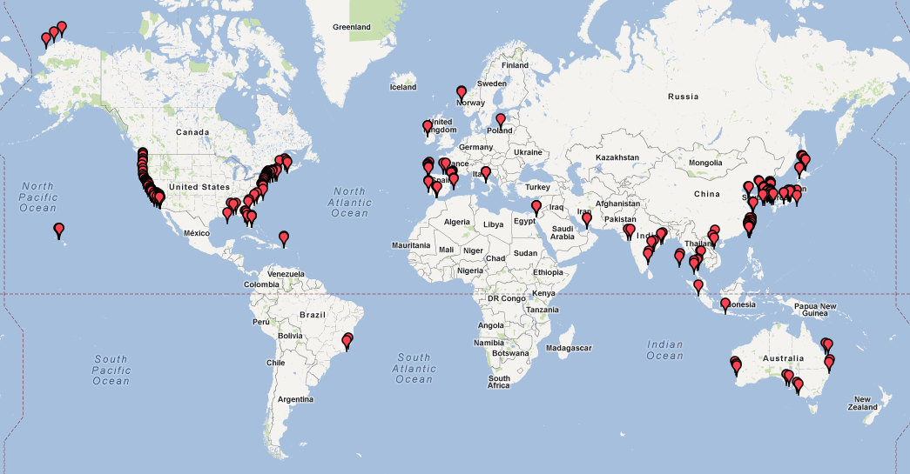
261 Stations Globally
261 Stations in 21 Countries

Slide 9
Enhancing the Network with Bistatics

Slide 10
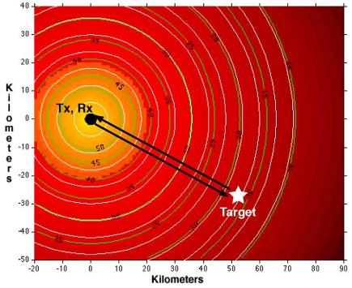
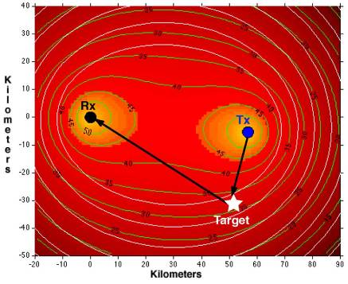
Littoral Expeditionary Autonomous PowerBuoy (LEAP)
SNR 17 dB
SNR 32 dB
Monostatic Geometry
at 13 MHz
Bistatic Geometry
at 13 MHz

Slide 11
Enhancing the Network with Bistatics
4 radars can provide
9 measurements

Slide 12
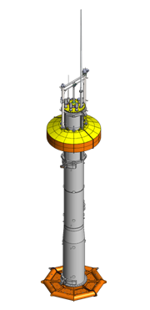
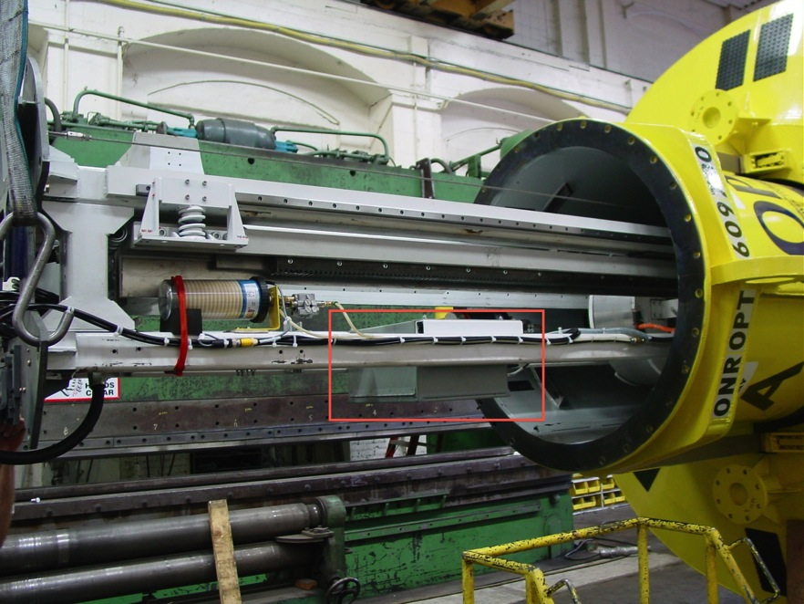
Wave Powered Buoy
HF Radar Antenna
Float
Spar
HF Transmitter Inside Buoy
Heave Plate
Buoy provided: 300 watts
Tx consumed: 100 watts

Slide 13
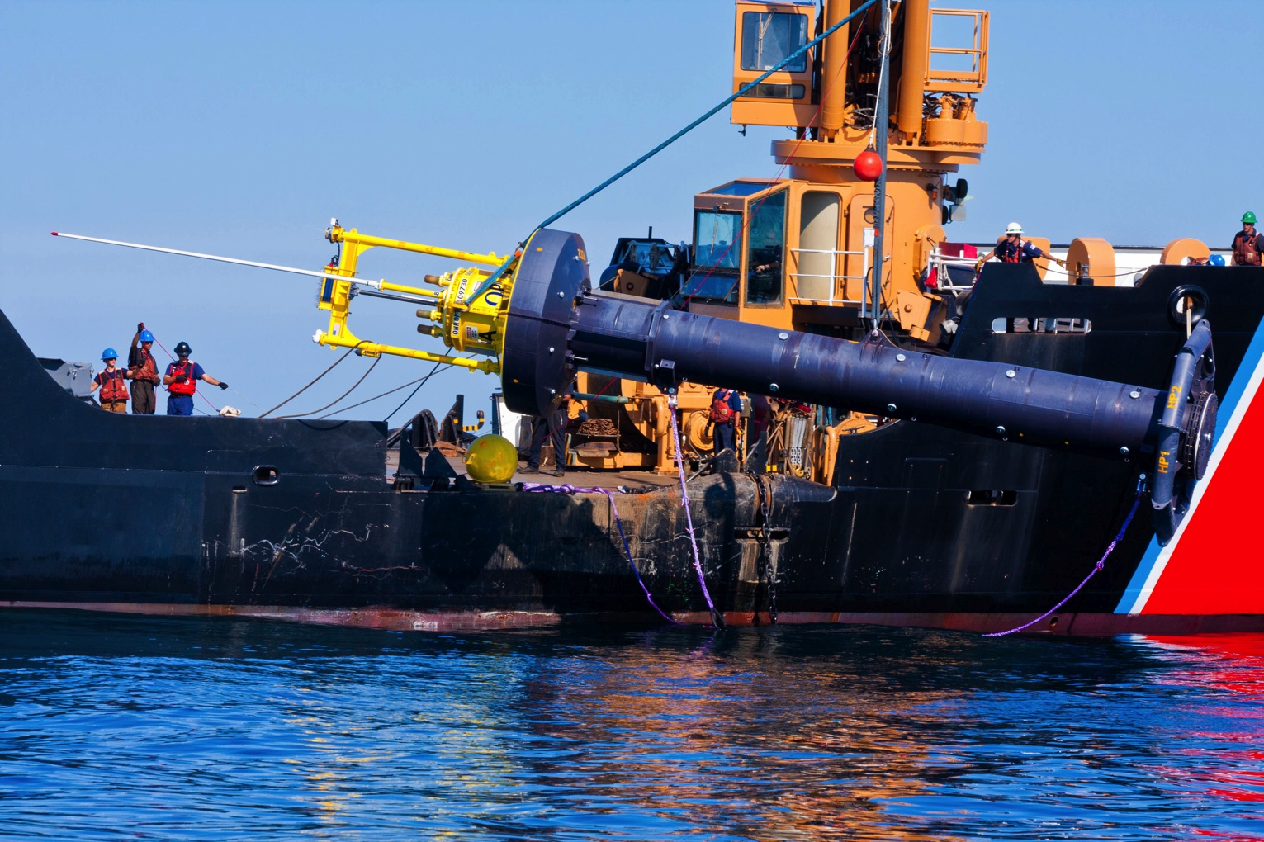
Deployment
USCGC Juniper

Slide 14
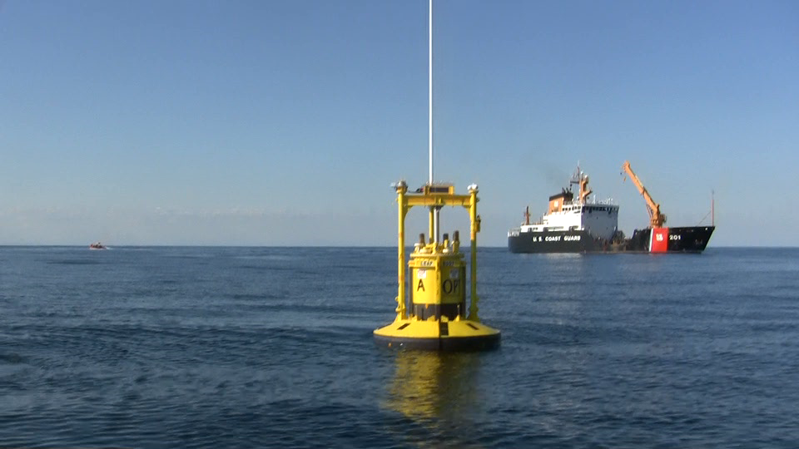

Slide 15
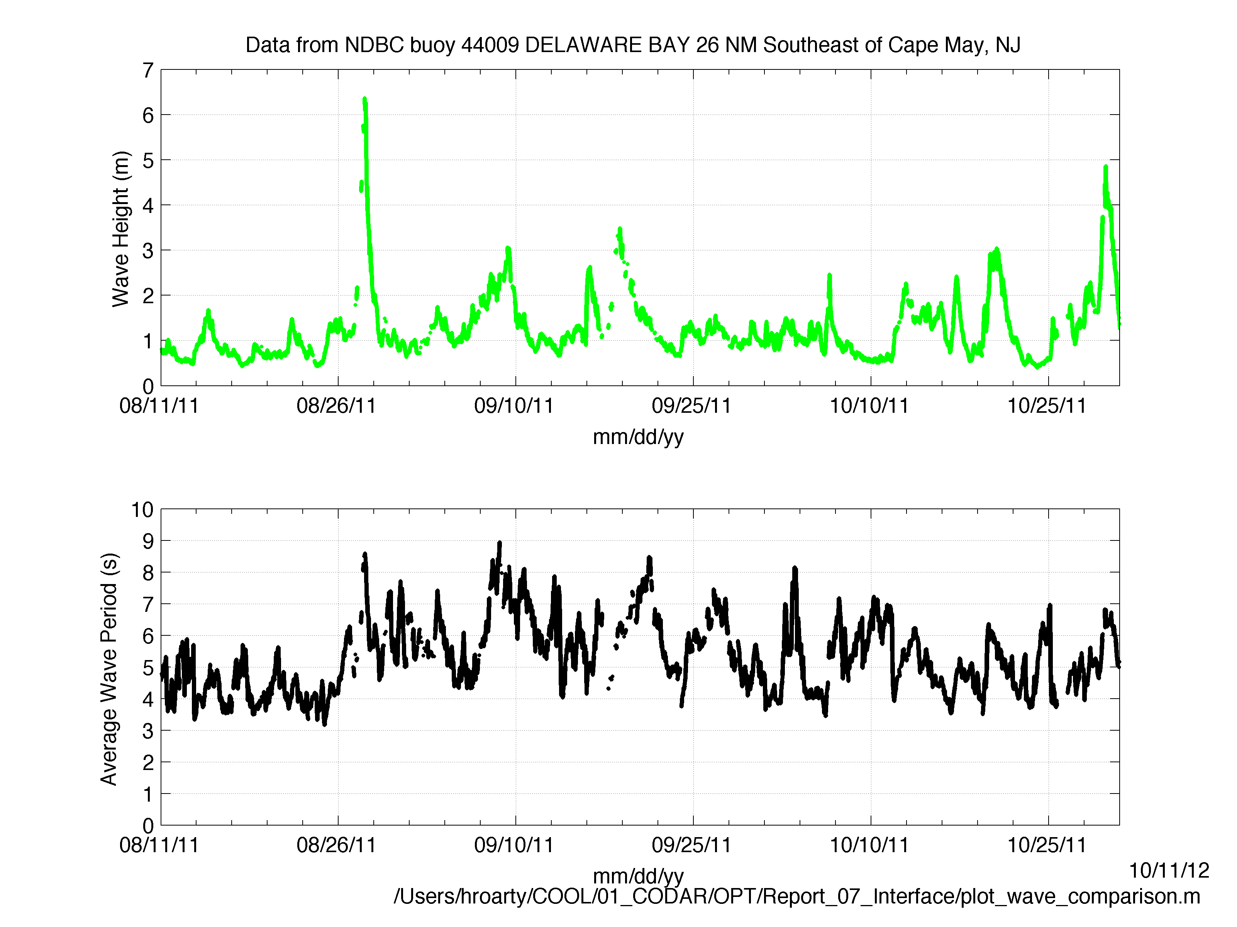
Wave Environment During Deployment

Slide 16
Coverage Improvements

Slide 17
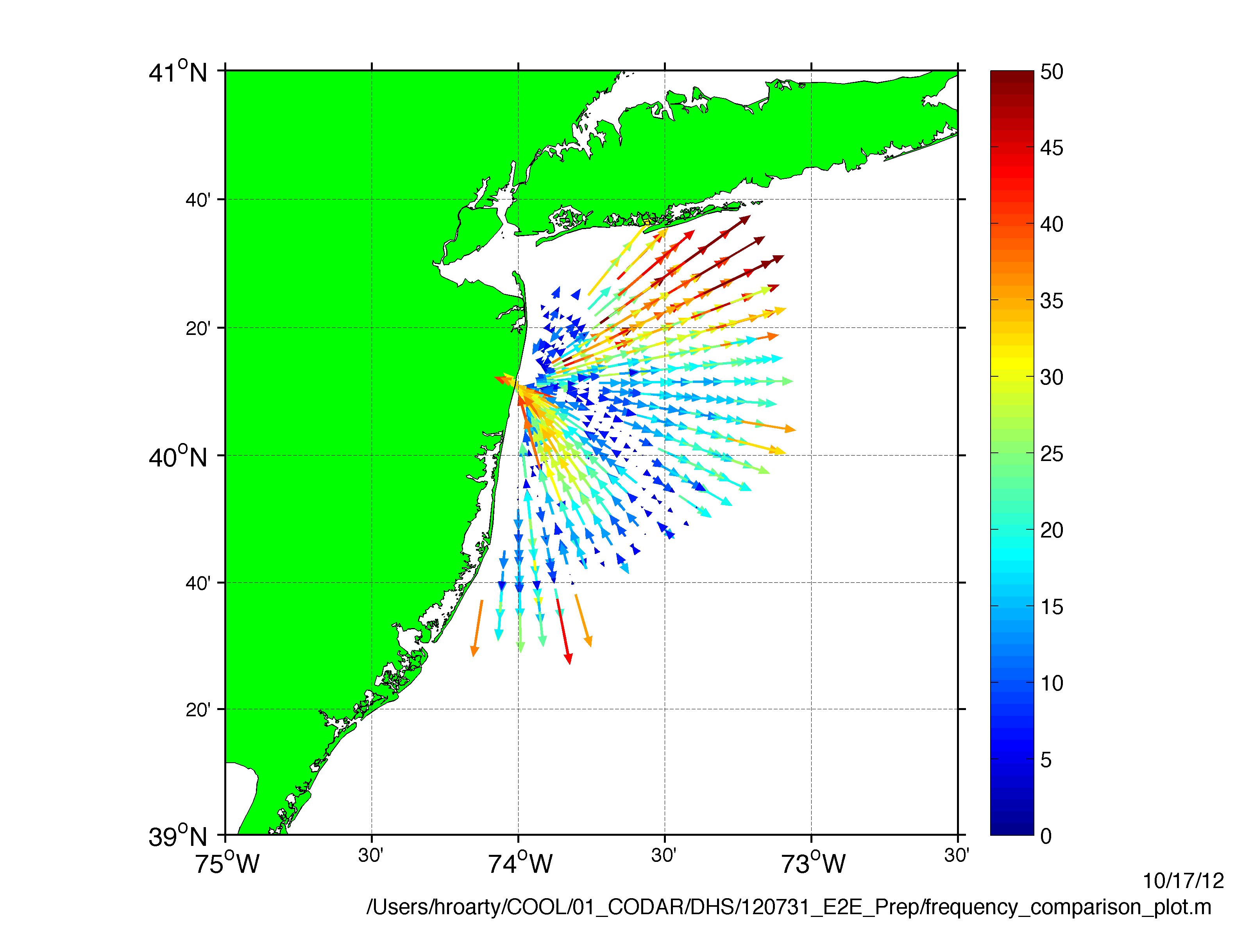
Plot of One Radial File

Slide 18
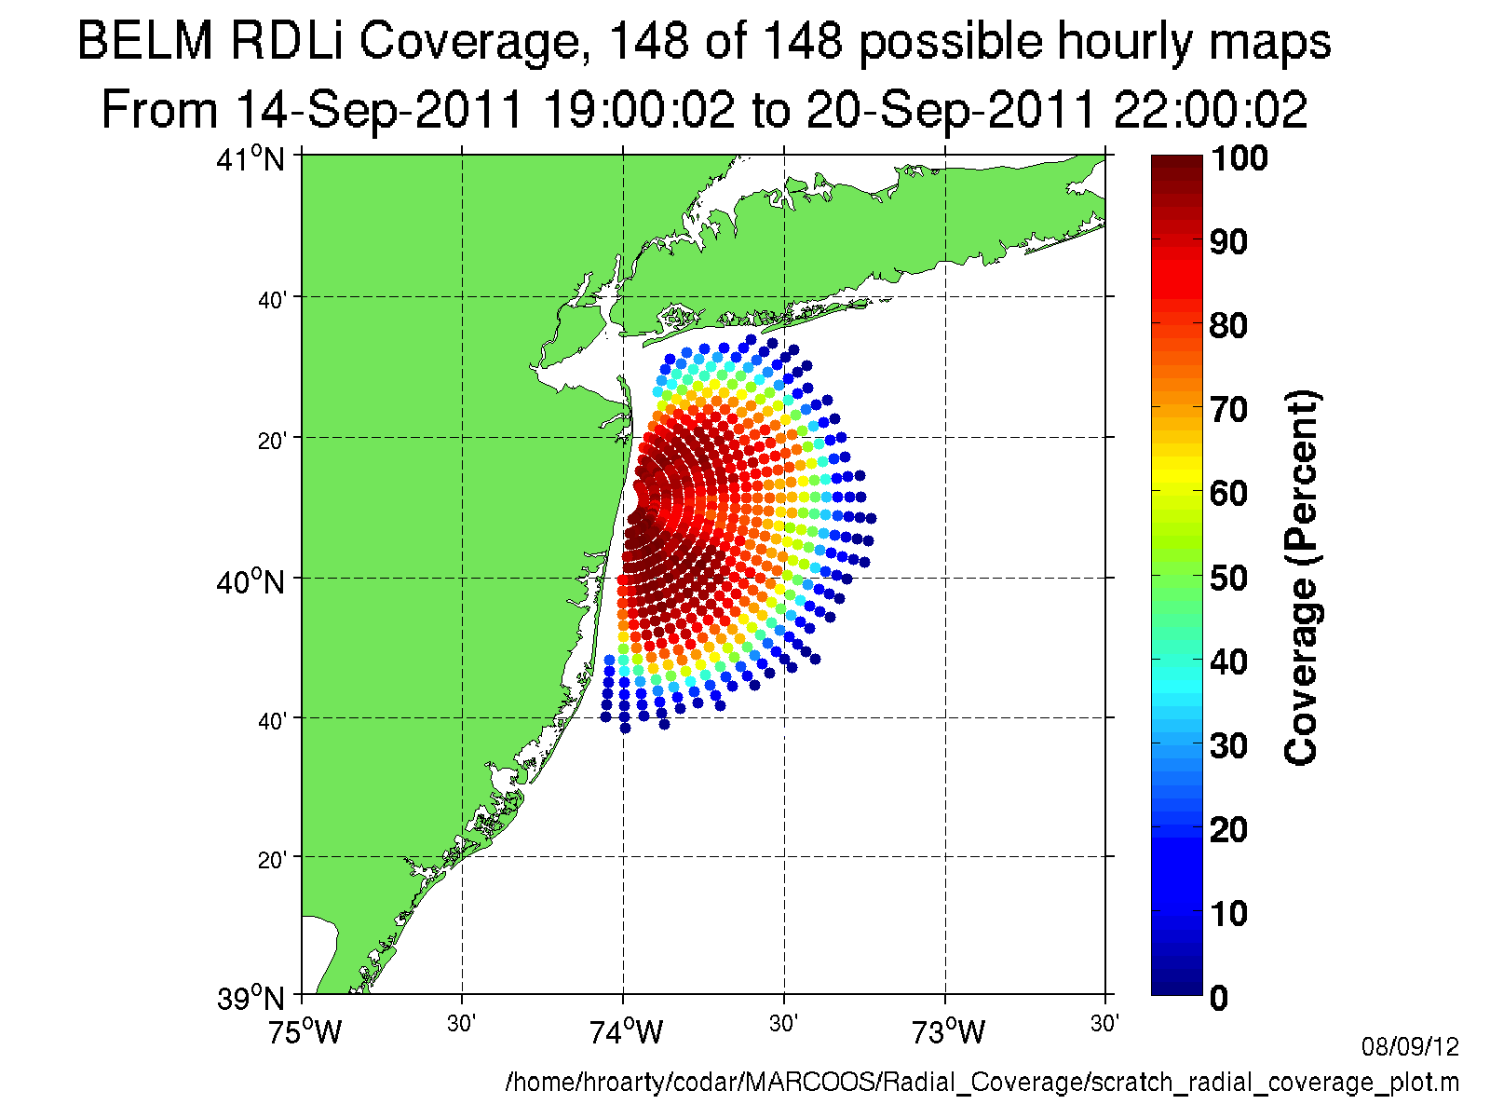

Slide 19
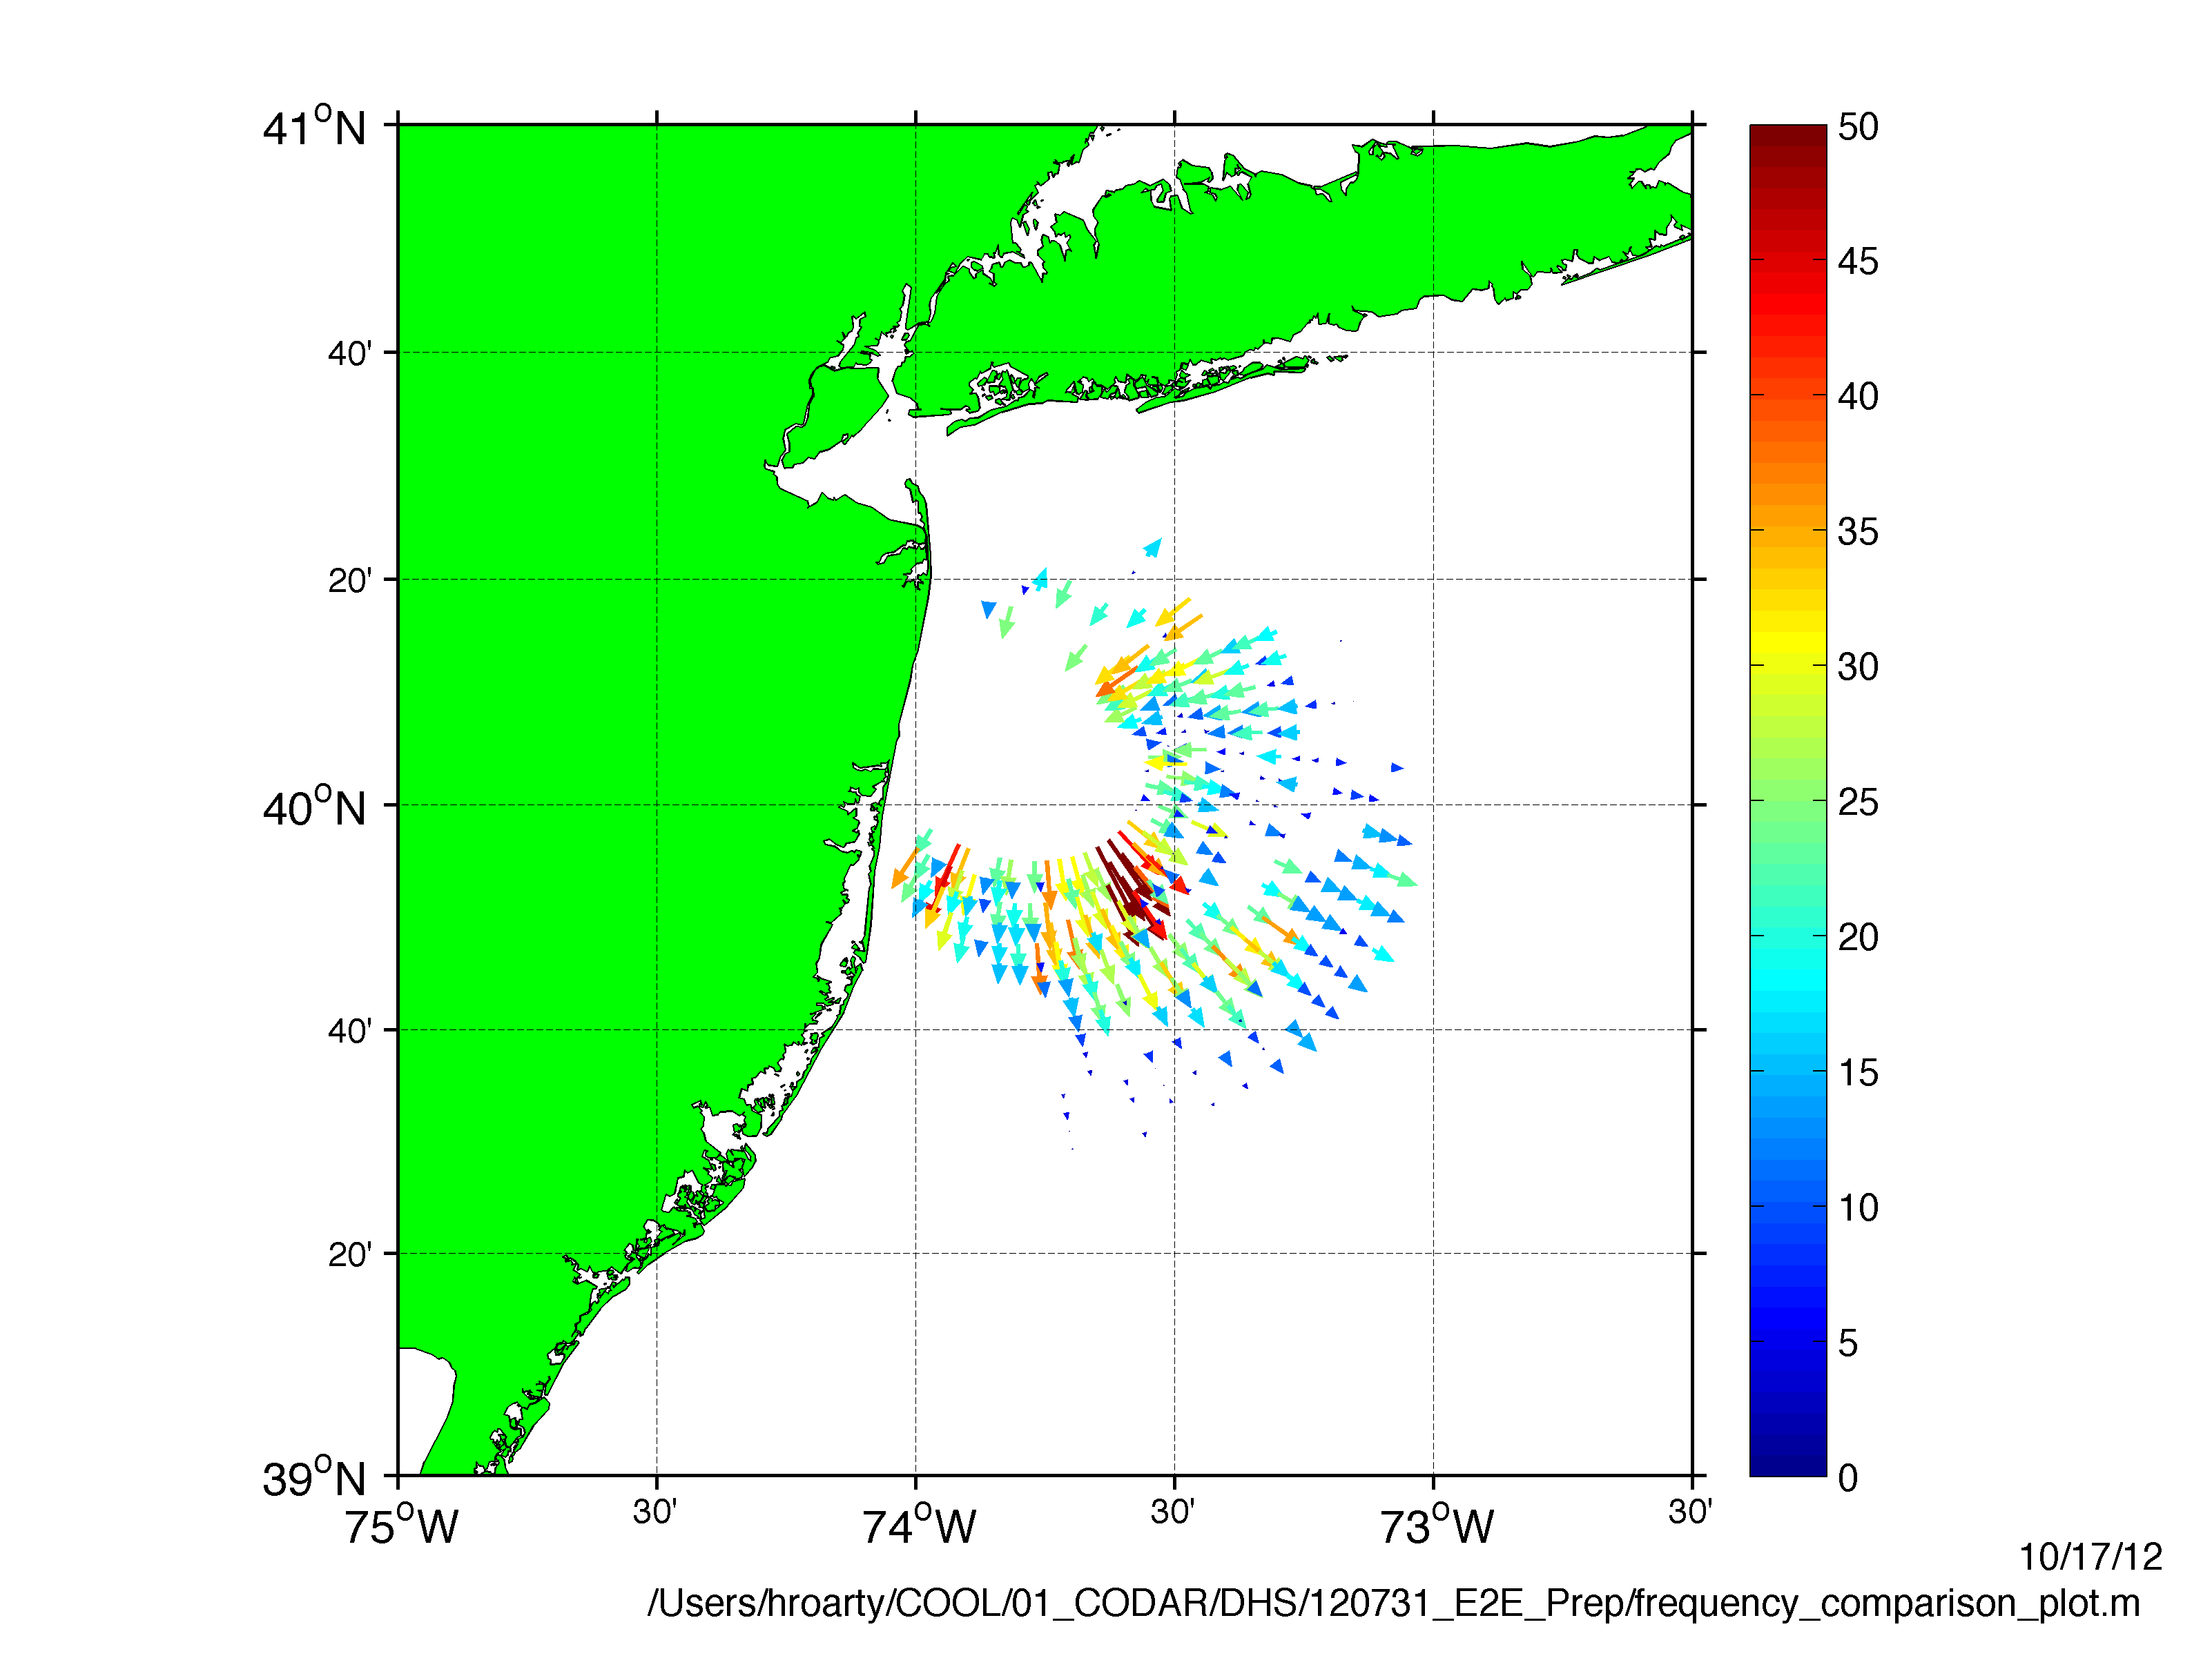
Plot of One Elliptical File

Slide 20
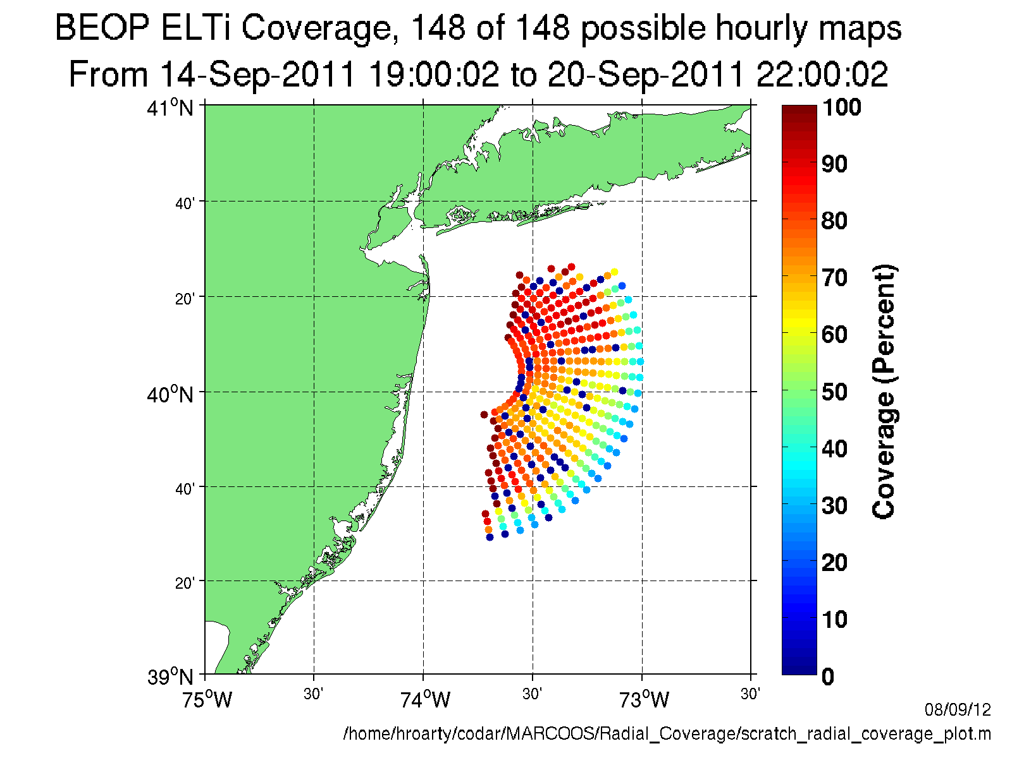

Slide 21
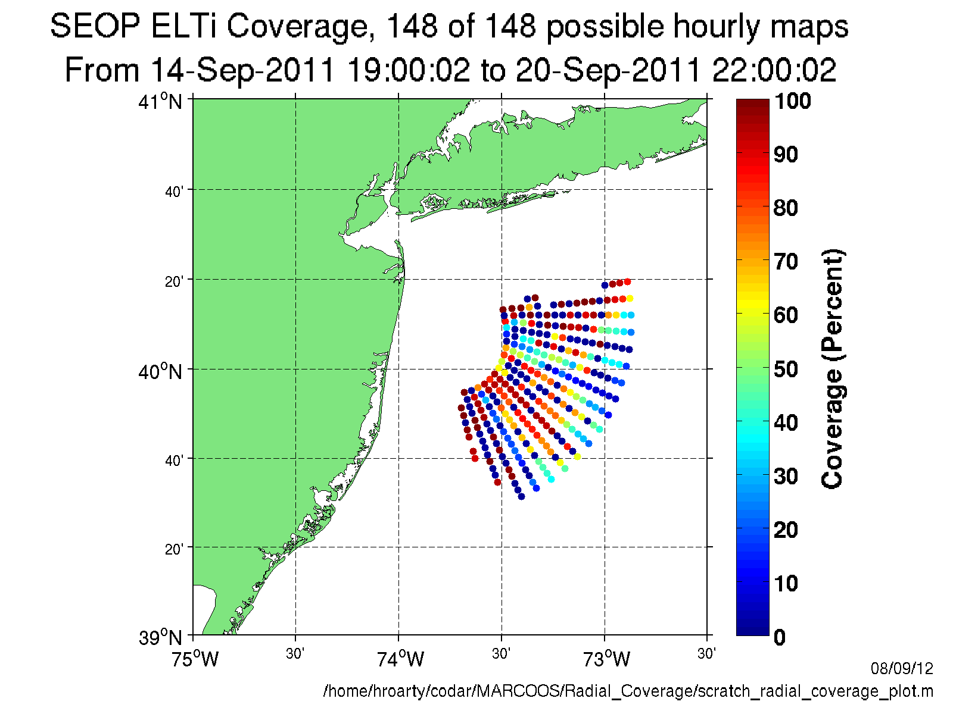

Slide 22
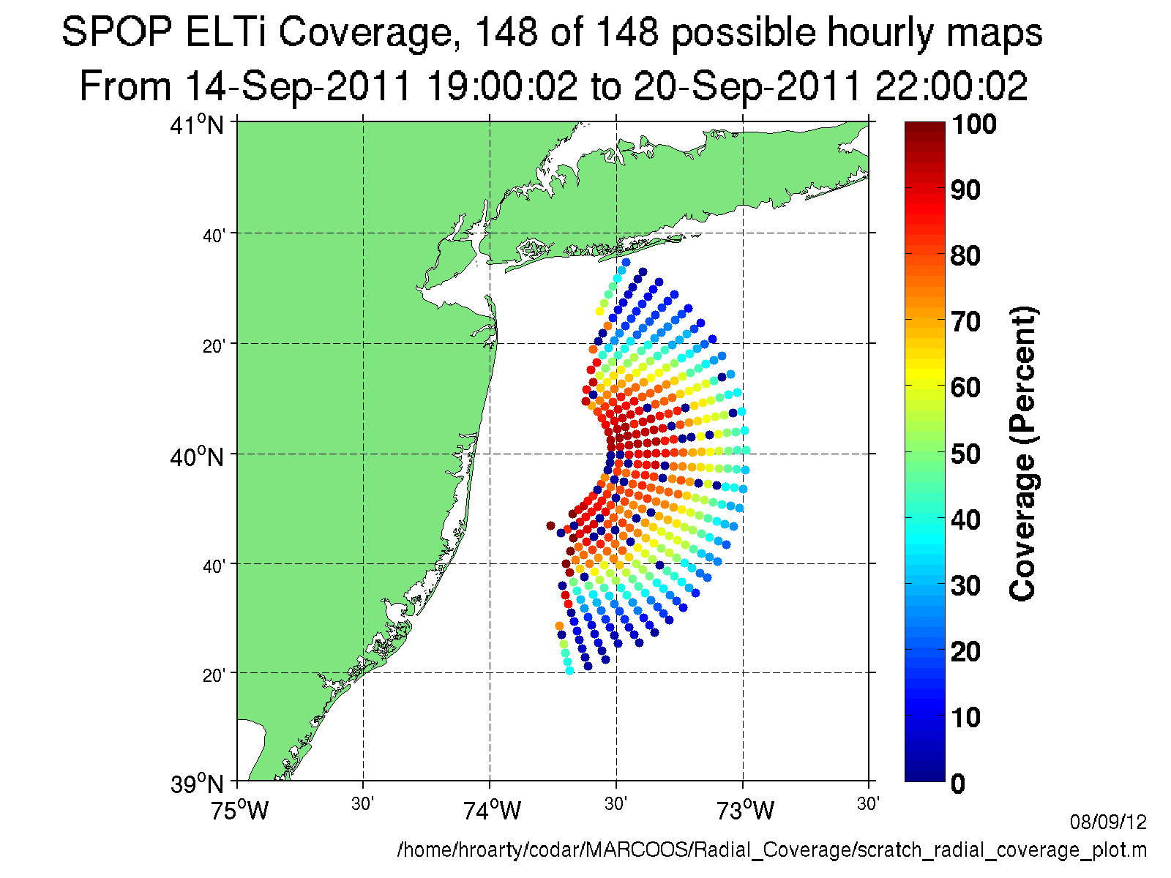

Slide 24
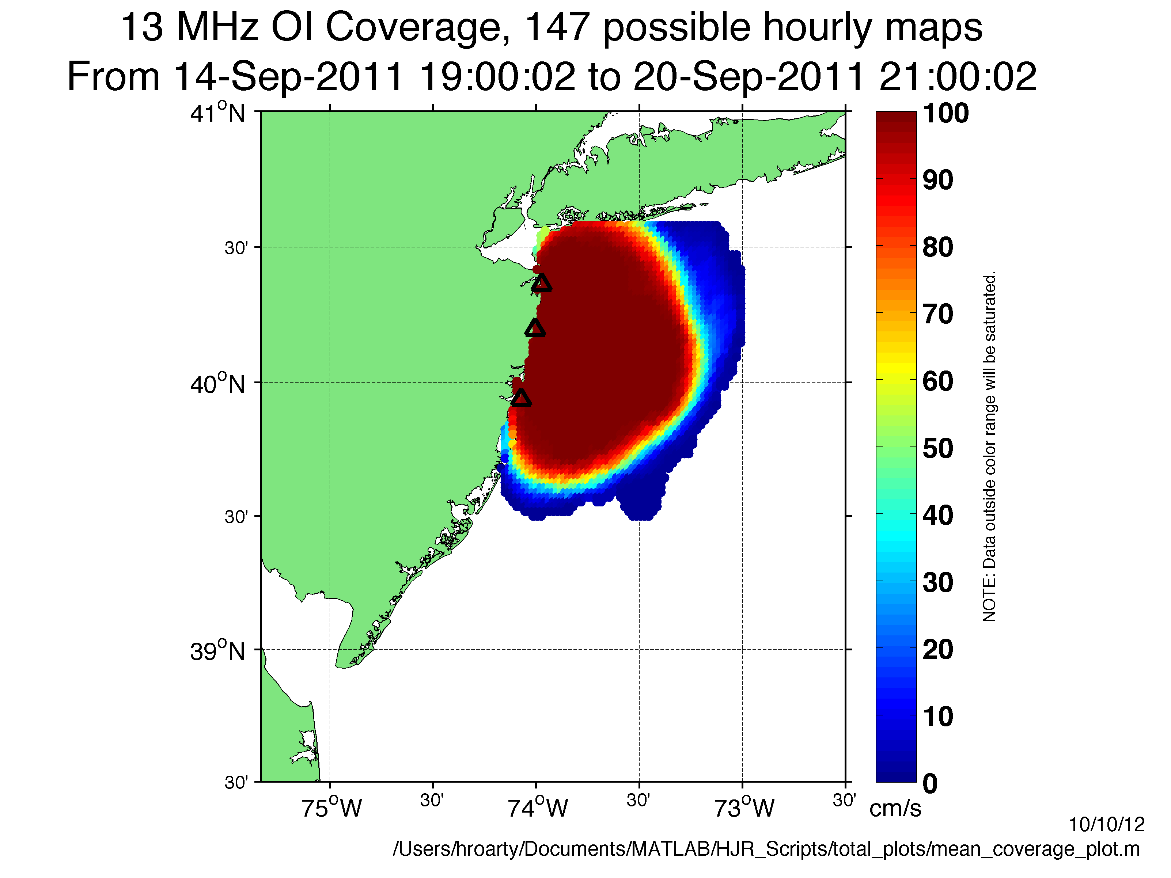
Three Radial Site Coverage

Slide 25
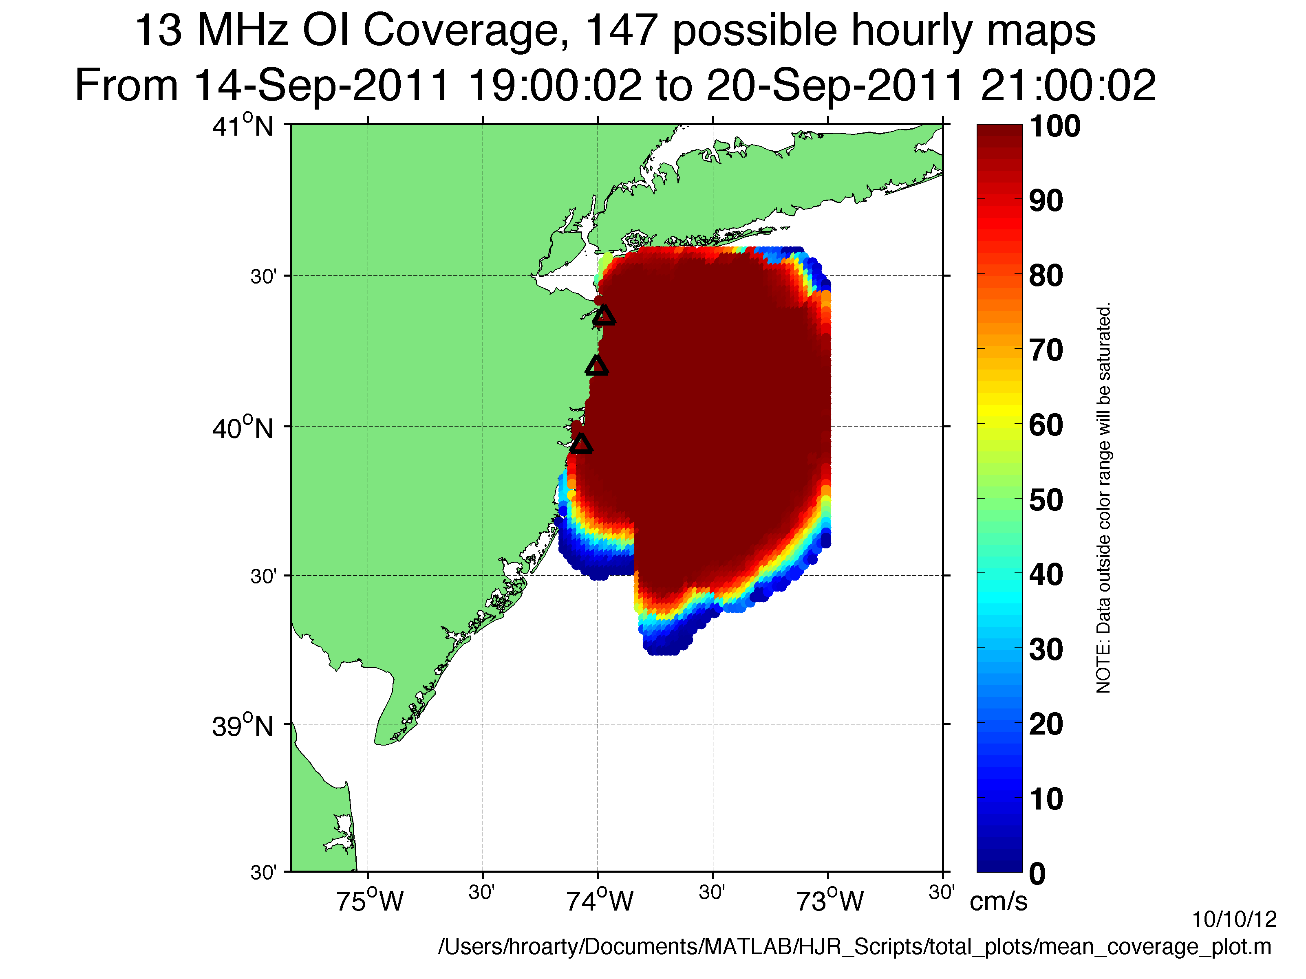
Three Radial Site Coverage with
Three Signals From Bistatic Transmitter

Slide 26
Conclusions
Bistatics increase coverage and look angles
Bistatics can make the National HF Radar Network more robust
Wave powered buoy is a robust and stable platform for at sea bistatic transmitter

