Slide 1
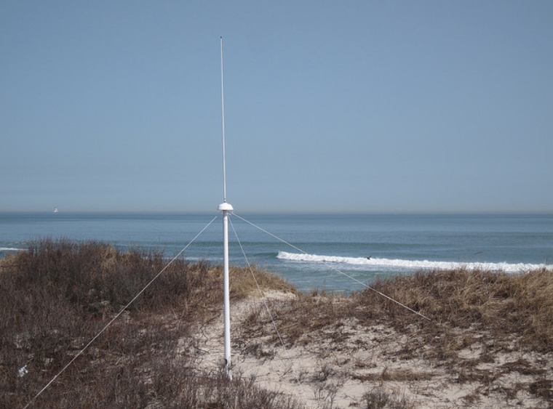


Examination of the SeaSonde Wave Processing Parameters and the Effects of Shallow Water on Wave Measurements
Colin Evans, Hugh Roarty, Scott Glenn, Josh Kohut

Slide 2
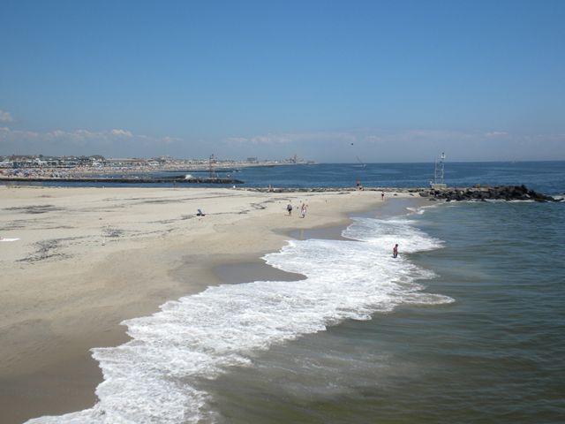
Motivation
Aid in the understanding of coastal ocean dynamics.
Determine if HF Radar can be used as a “filler” between in situ wave measurements.
Potential use of sea-roughness as input to WRF (Weather Research & Forecasting) model.

Slide 3
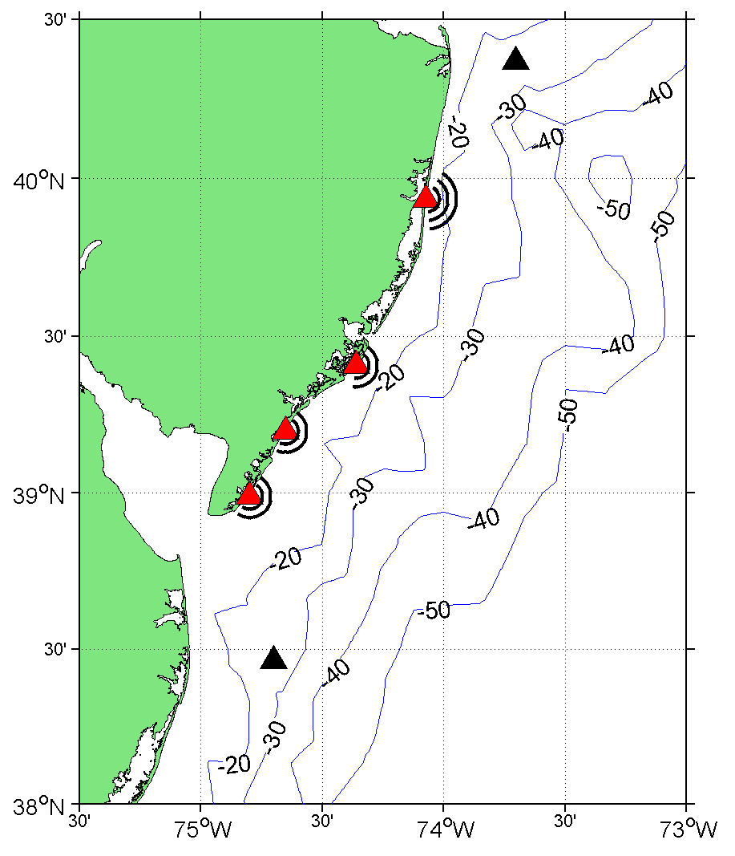
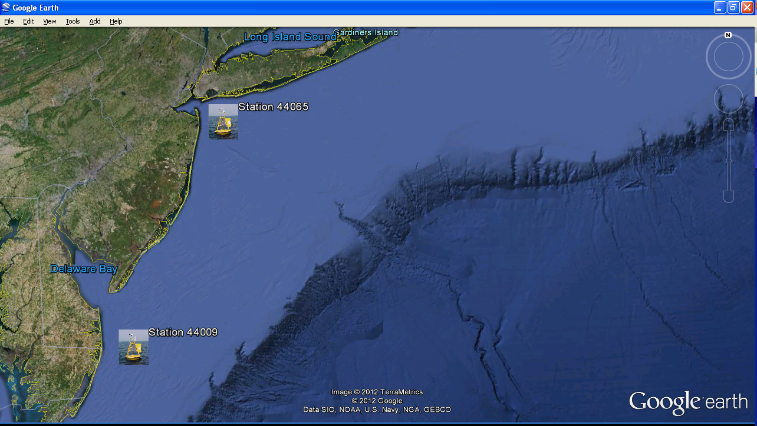
Study Grid
44065
SPRK
BRMR
90 yd. watch radius
RATH
WOOD
70 yd. watch radius
44009
*Radar range cells and NDBC buoy locations within 30 m. isobaths.

Slide 4
Shallow Water Thresholds
25 MHz SeaSonde
13 Mhz
2nd Order Bragg
1st Order Bragg
*For 13 MHz, wave height for radar saturation about 7.5 m.
Lipa et al. (2008).

Slide 5
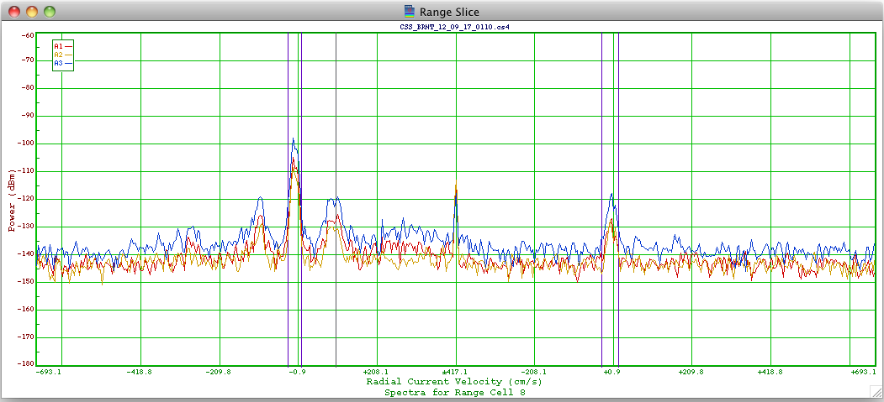
2nd Order Bragg – No Shallow Water Effects
Range Cell 8, ~24 km
1st Order Bragg
Ratio of 1st Order to 2nd Order.
2nd Order Bragg scatter from sea-echo.
* Spectra from Range Cell 8 showing evidence of waves.

Slide 6
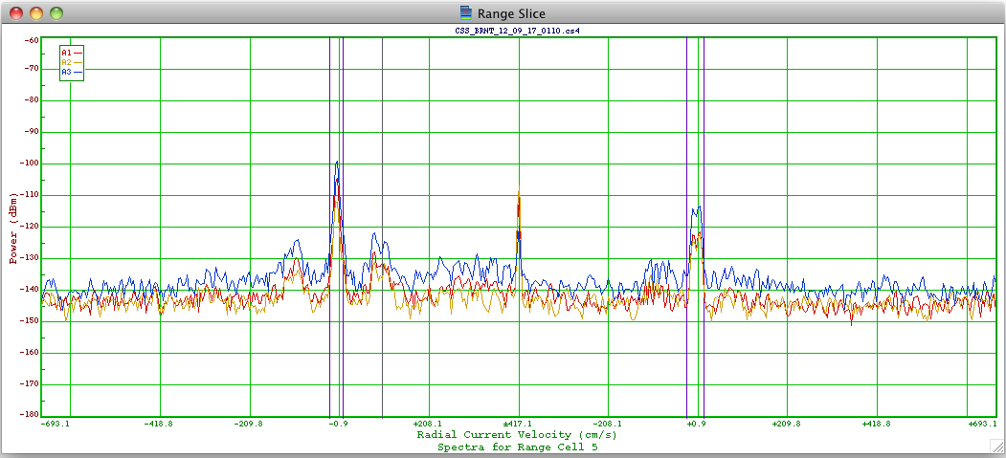
2nd Order Bragg – No Shallow Water Effects
Range Cell 5, ~15 km
Ratio doesn’t change as depth decreases.

Slide 7
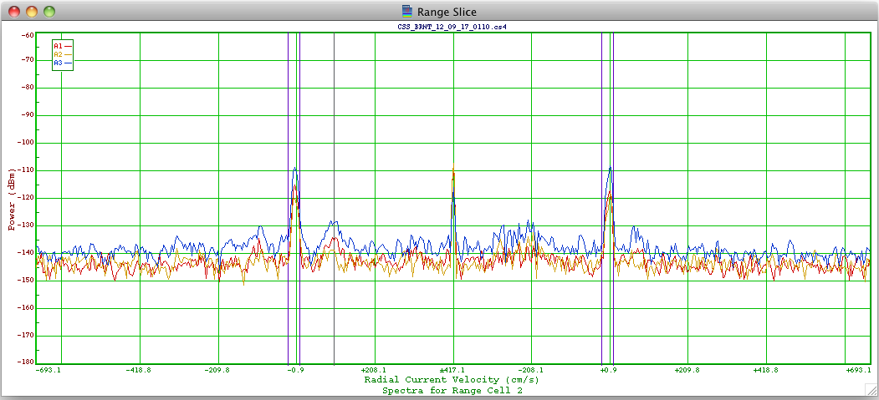
2nd Order Bragg – No Shallow Water Effects
Range Cell 2, ~6 km
*Range cell 2 spectra. Shallow water does not effect wave measurements.

Slide 8
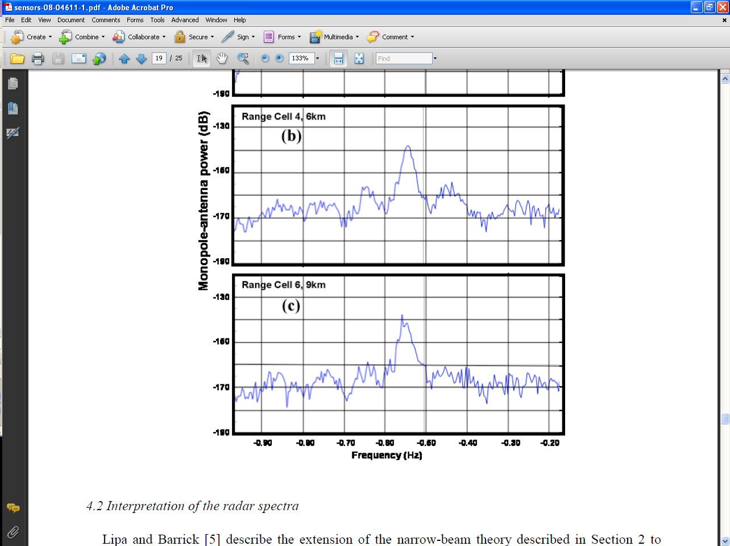
2nd Order Bragg – Shallow Water Effects
*Breezy Point, NY – 25 MHz operating frequency

Slide 9
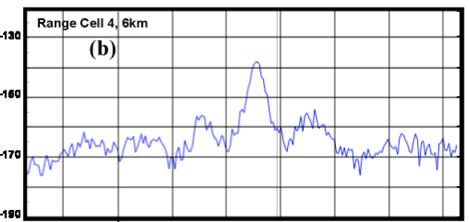
2nd Order Bragg – Shallow Water Effects
2nd Order: 1st Order increasing with decreasing water depth.

Slide 10

2nd Order Bragg – Shallow Water Effects
Magnitude of 2nd Order still increasing relative to 1st Order Bragg scatter (~10db increase).

Slide 11
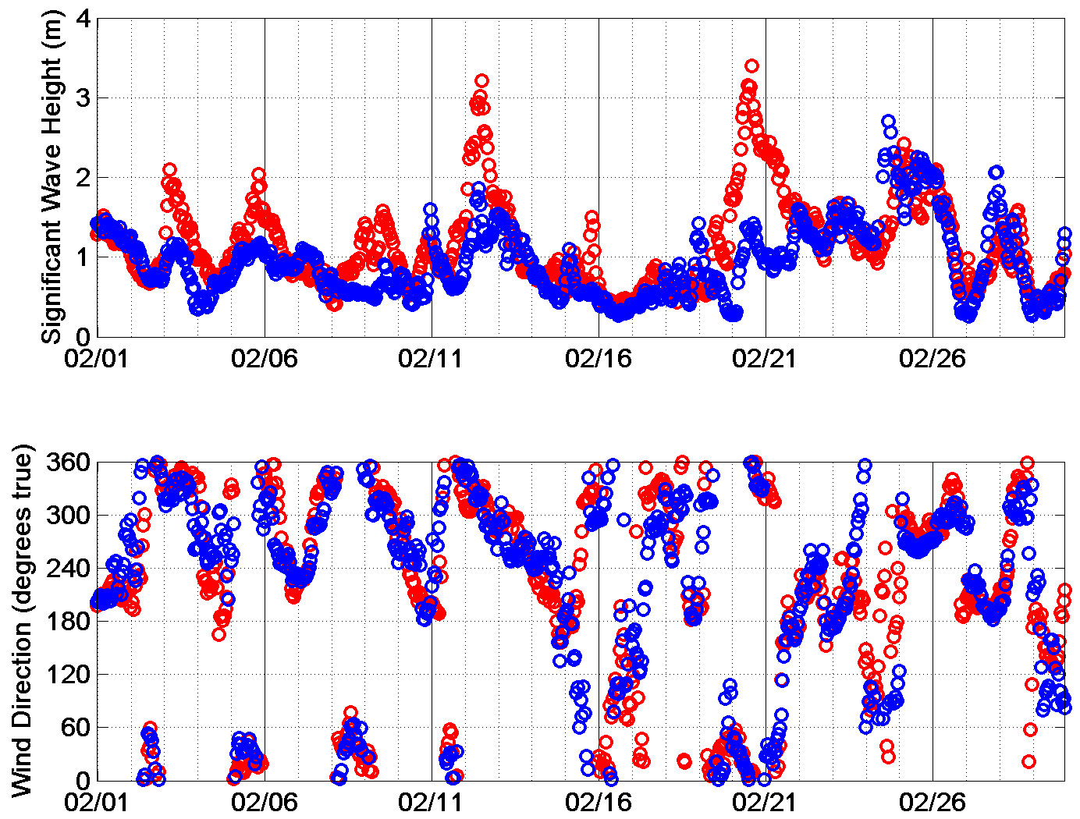
NDBC Buoy Station Comparisons
Big difference in wave height measurements between buoys.
Could be due to varying ocean conditions at different locations for that timestamp.
February, 2012
Station 44065
Station 44009

Slide 12
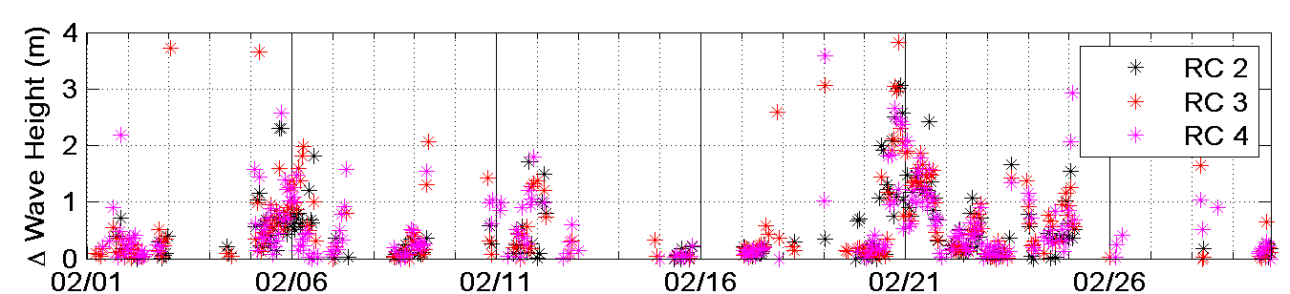
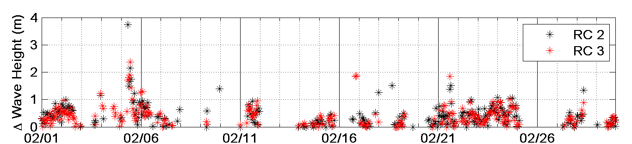
Radar/Buoy Wave Height Comparison
SPRK
BRMR
Note: SPRK was compared with NDBC station 44065.

Slide 13
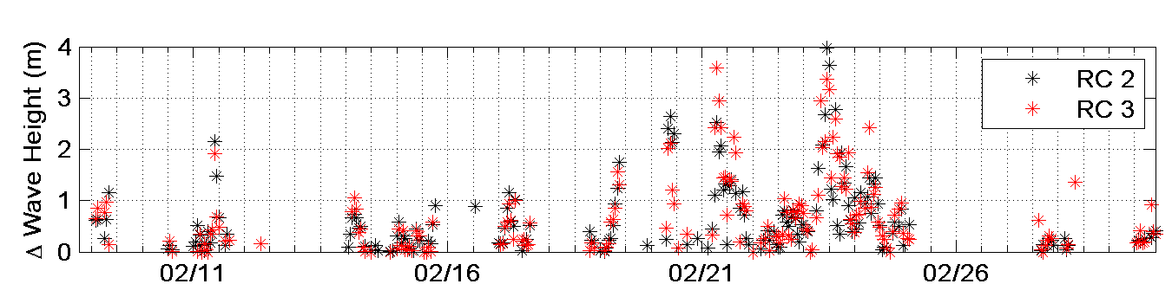
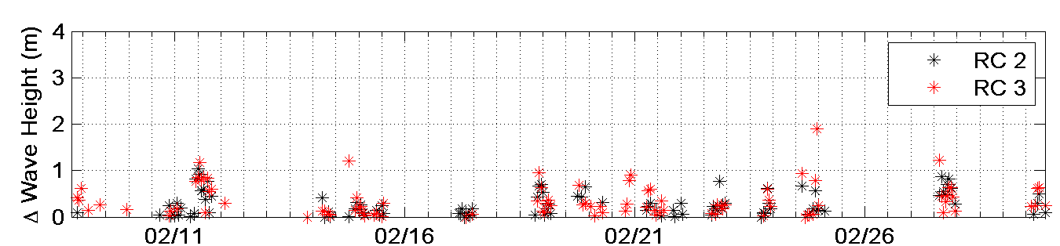
Radar/Buoy Wave Height Comparison
RATH
WOOD

Slide 14
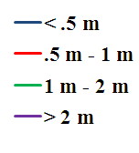
Wave Height Differences between SeaSonde and In Situ NDBC buoys
* - R.C. 2
- R.C. 3
453:696
526:696
298:511
270:511

Slide 15
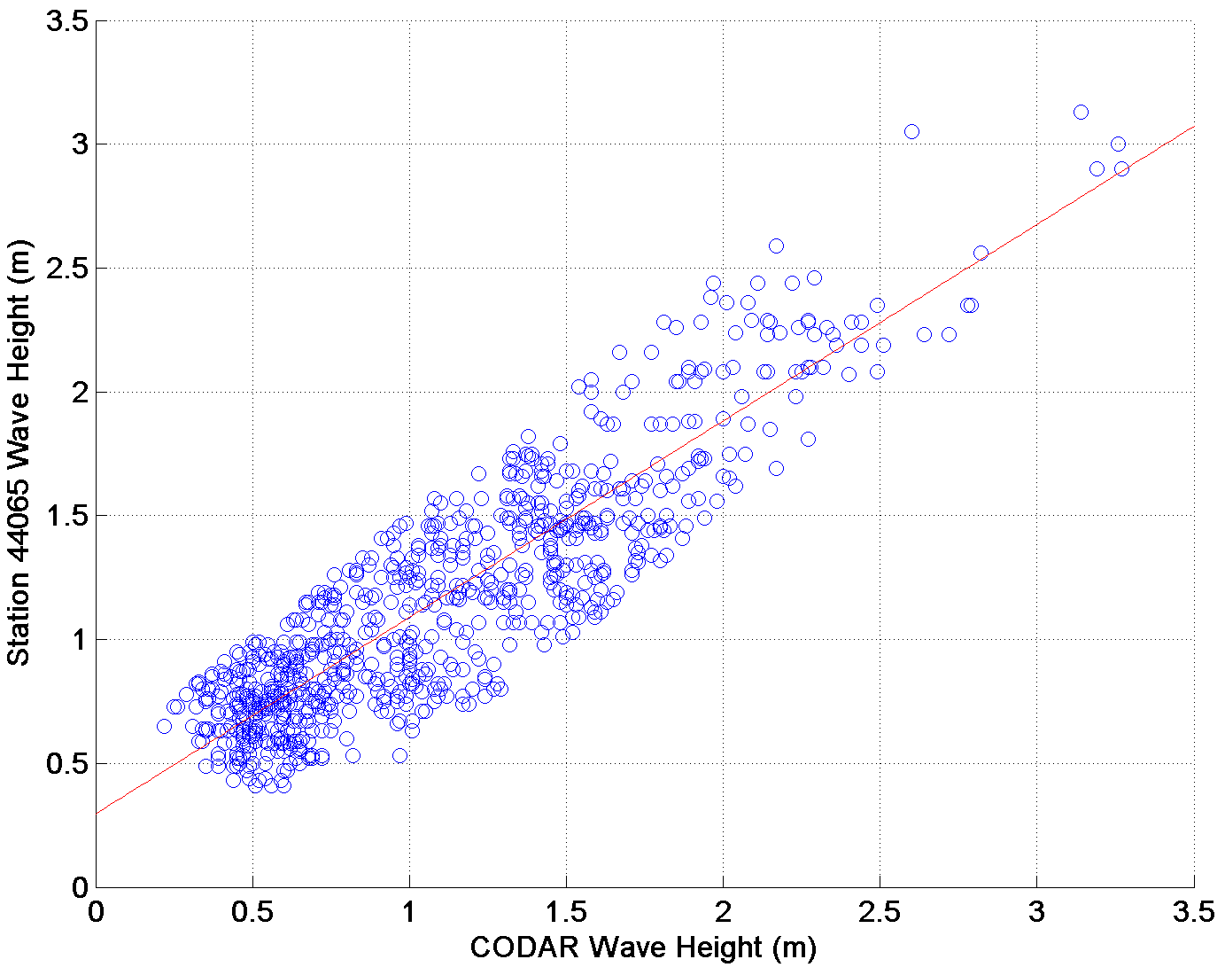
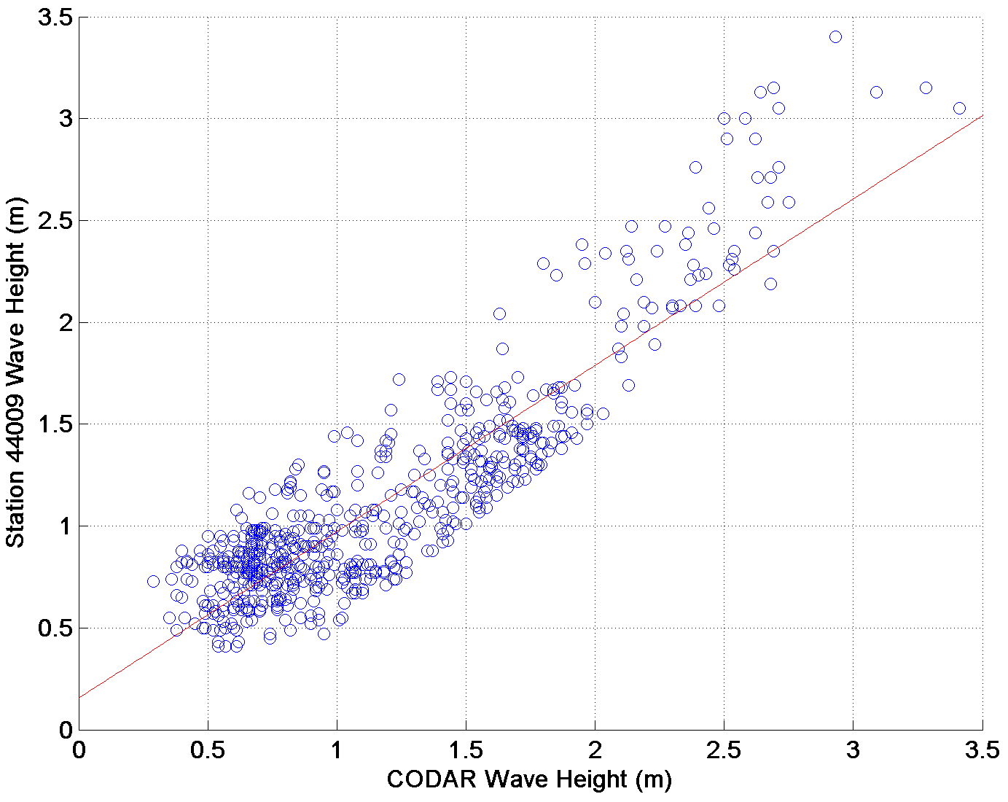
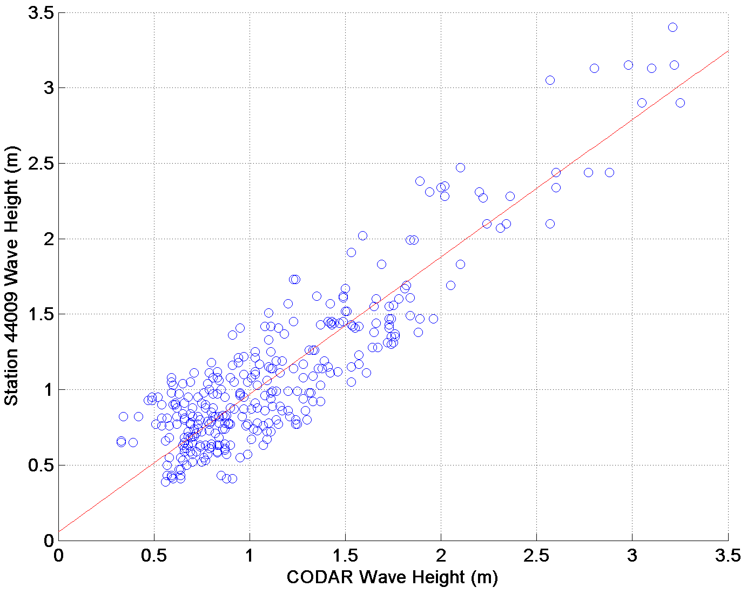
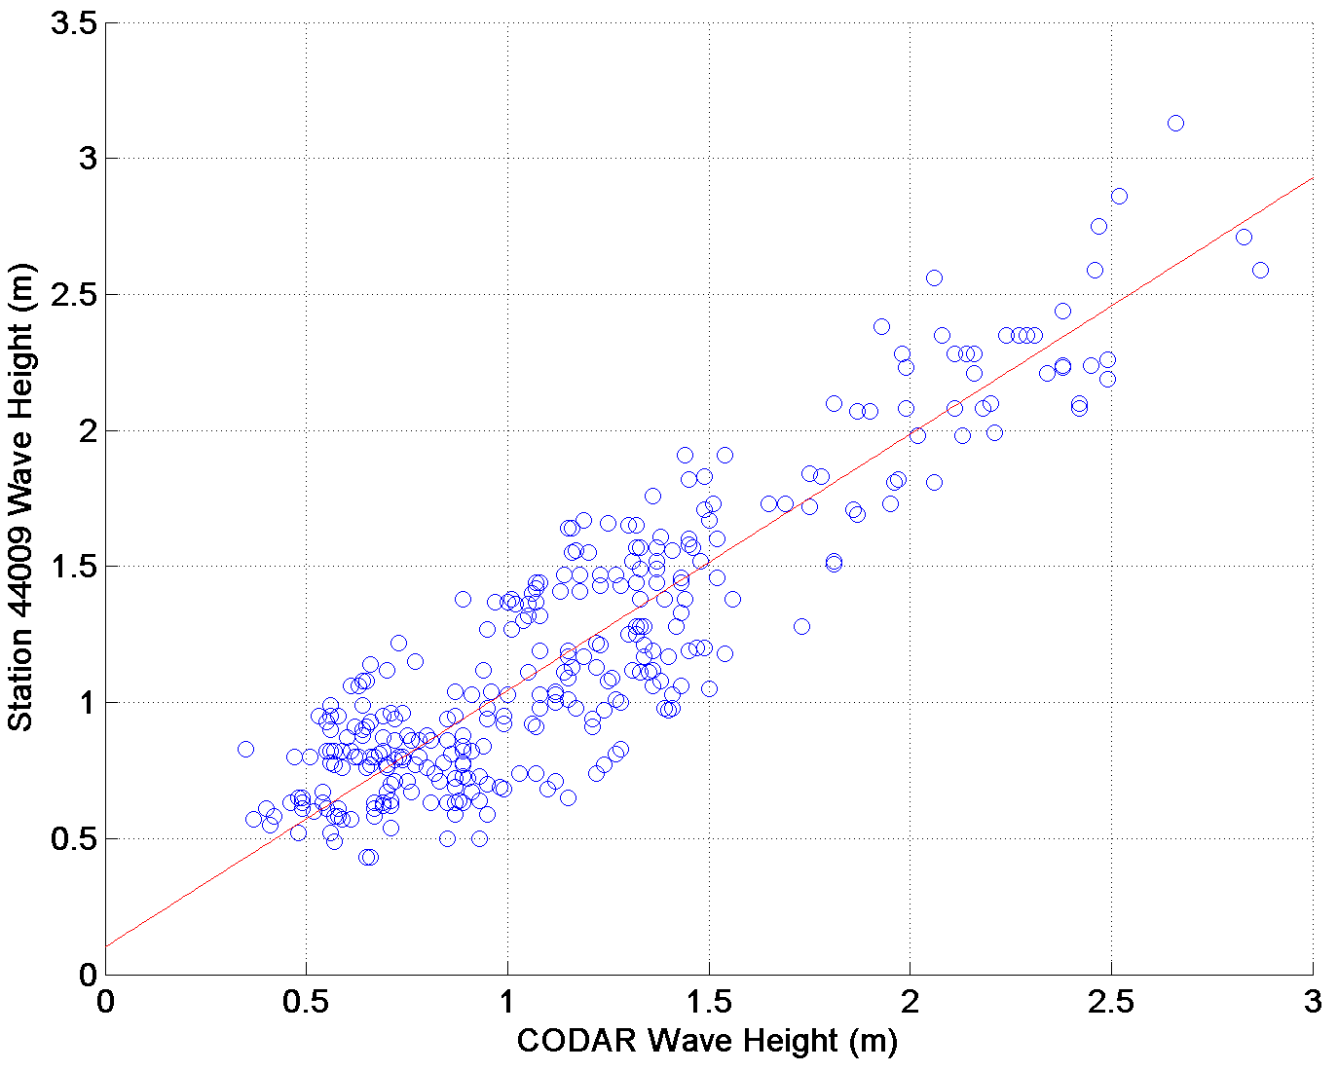
Correlations: Wave Height differences < 0.5 m
1. SPRK
2. BRMR
R values ranged from 0.86 to 0.91 when the wave height differences were < 0.5 m compared with NDBC buoys.
3. RATH
4. WOOD

Slide 16
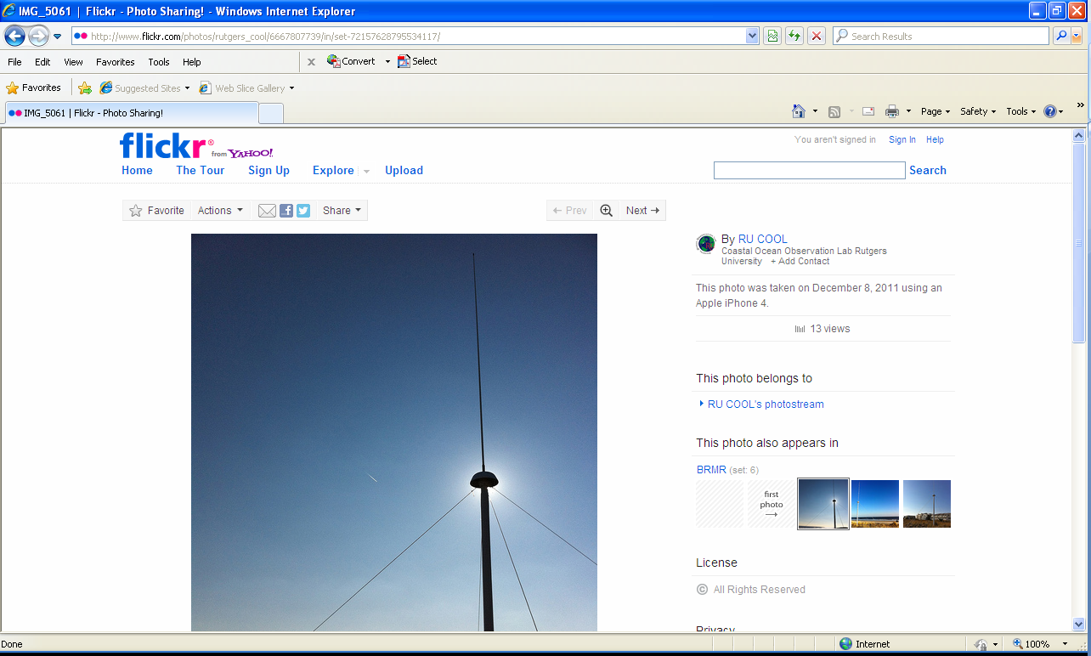
Concluding Remarks
60% of the data points were within 0.5 m or less when compared to NDBC discuss buoy measurements.
R correlation values ranged between 0.86 and 0.91 when the wave height differences were < 0.5 m.
Shallow water effects did not significantly influence wave height measurements for the SeaSonde 13 MHz system during February, 2012.
CODAR currently working on shallow water software.
Questions and comments?

