Slide 1



Middle Atlantic
Regional Association
Coastal
Ocean Observing System
1000 km
Cape to Cape
CT
RI
Cape
Cod
MA
NY
10 States
111 Congressional Districts
¼ U.S. Population
PA
NJ
MD
DE
MARACOOS 2011-2016:
From Observations to Forecasts
Scott Glenn, Carolyn Thoroughgood,
Larry Atkinson, Bill Boicourt, Wendell Brown
Plus >40 Additional Co-PI’s from >20 Institutions
Today’s Themes:
MARACOOS Approach
History of Glider Activities
Operational Environment
VA
NC
Cape
Hatteras
To seek, discover and apply new knowledge & understanding of our coastal ocean
To seek, discover and apply new knowledge & understanding of our coastal ocean
Notes:
The Mid-Atlantic Bight extends 1000 km alongshore from Cape Cod, MA to Cape Hatteras, NC.
It includes 5 major urban estuarine systems (Narragansett Bay, Long Island Sound, Hudson-Raritan River, Delaware Bay, and Chesapeake Bay) and a wide continental shelf cut by a deep cross shelf valley and multiple shelf-break canyons.
The footprint includes 10 states, the District of Columbia, and approximately 76 million people or 25% of the US population.
The nation’s highest coastal population density makes increasingly competing demands for marine and coastal resources.
Ports in the region also handle 23% of the total US waterborne commerce and include one of the the nation’s largest petroleum product hubs and the world’s largest Naval base.

Slide 2
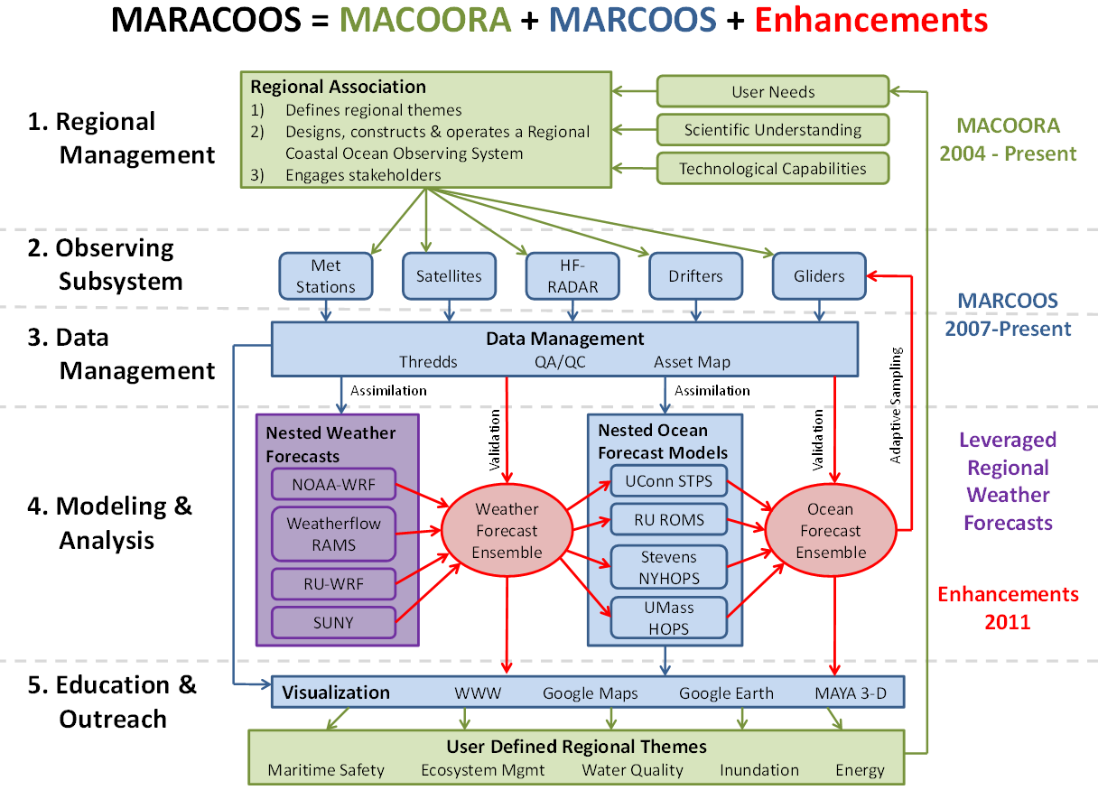
MARACOOS Approach
IOOS Subsystems

Slide 3
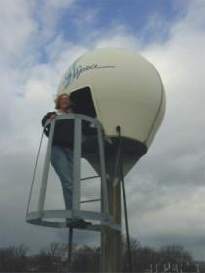
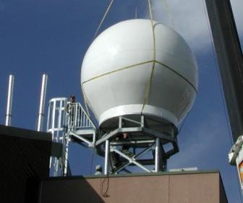
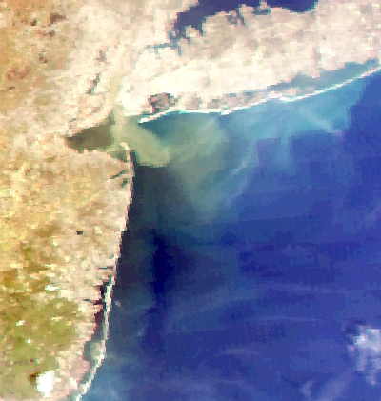
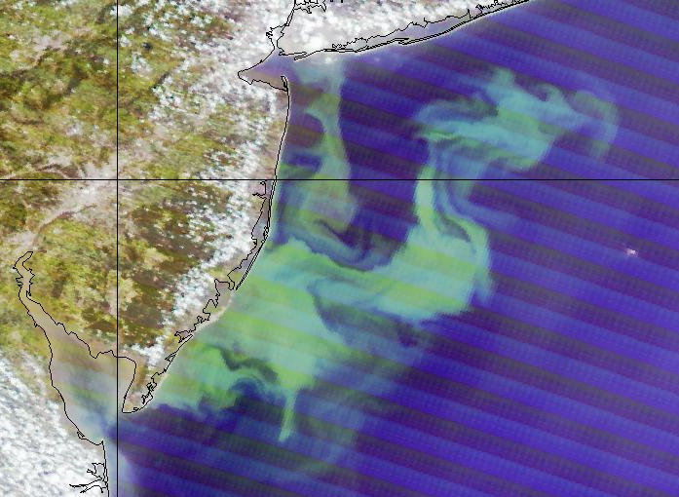
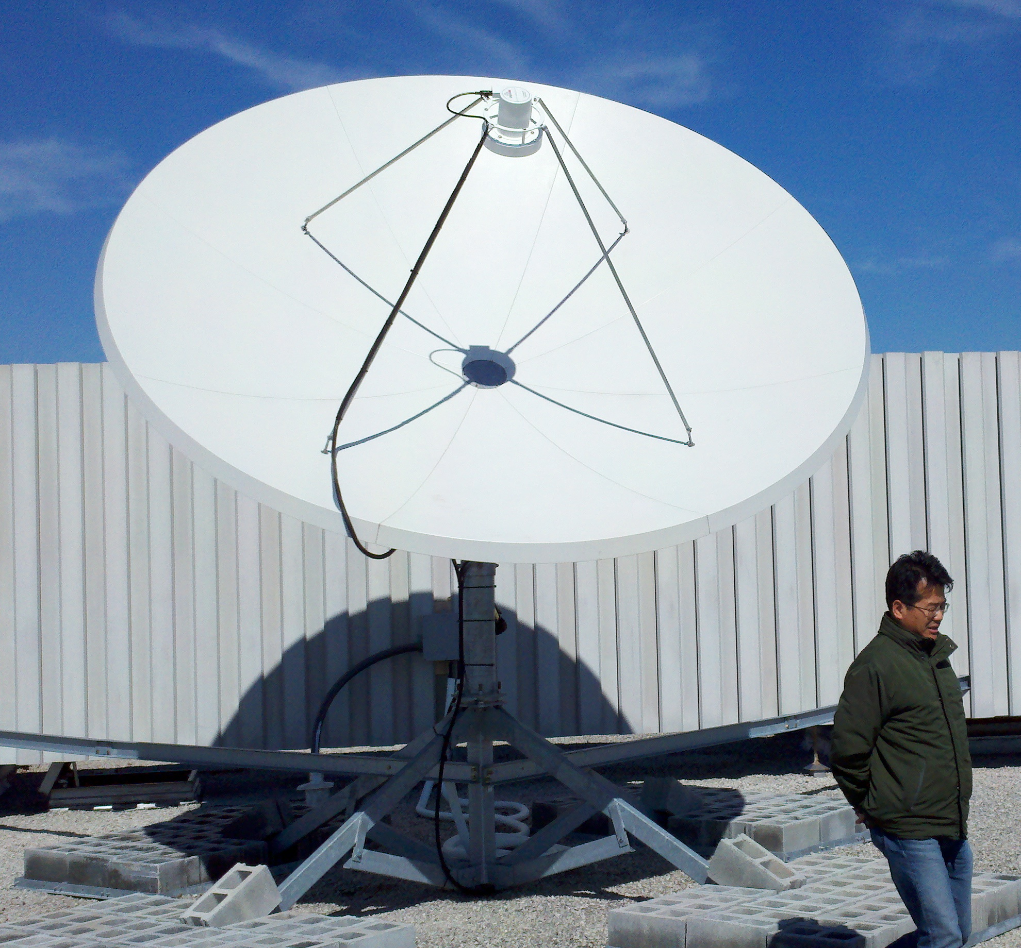
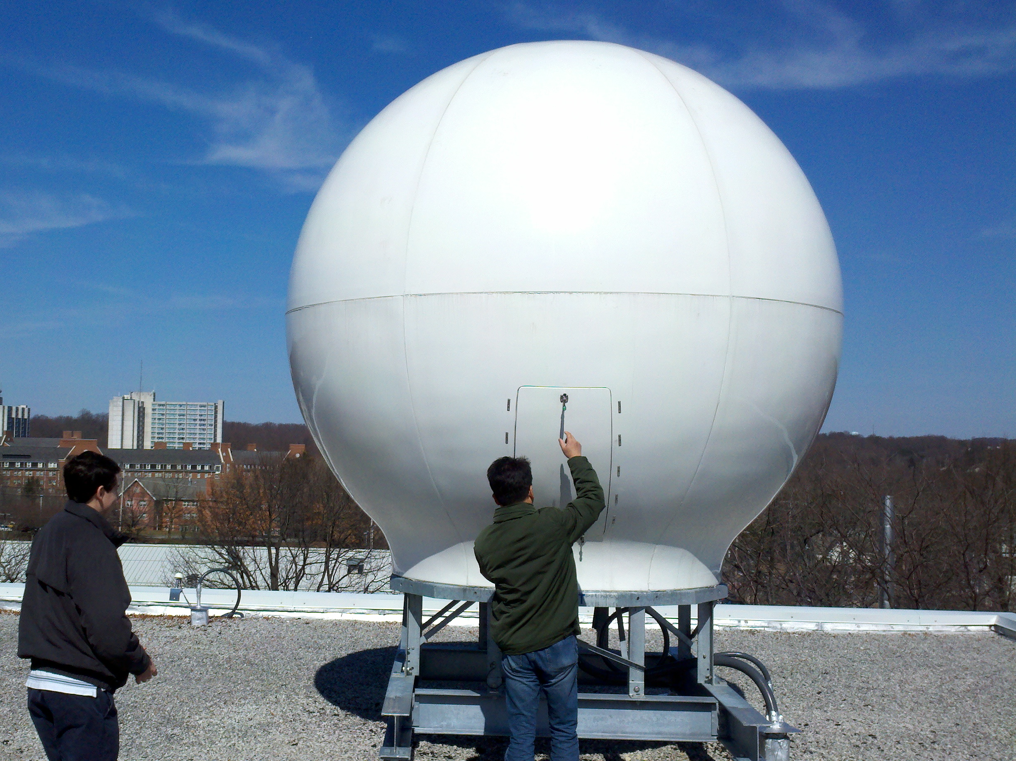
Satellite Data Acquisition Network - Since 1992
Plankton Blooms
River Plumes
SPoRT + RTG SST
MARACOOS
Declouded SST
SST Difference

Slide 4
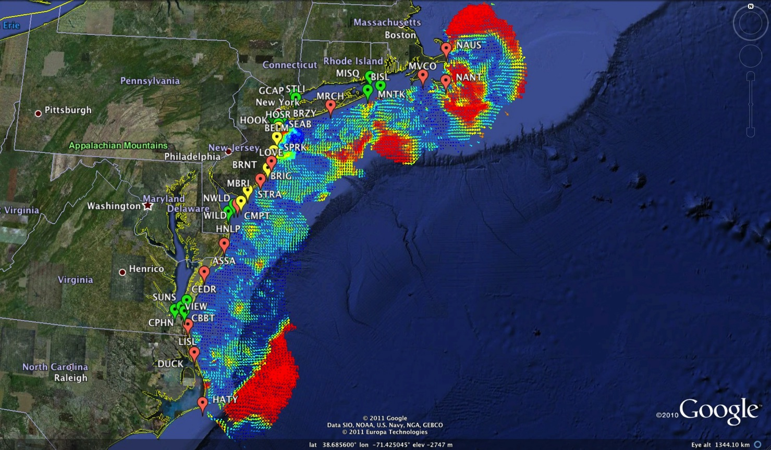
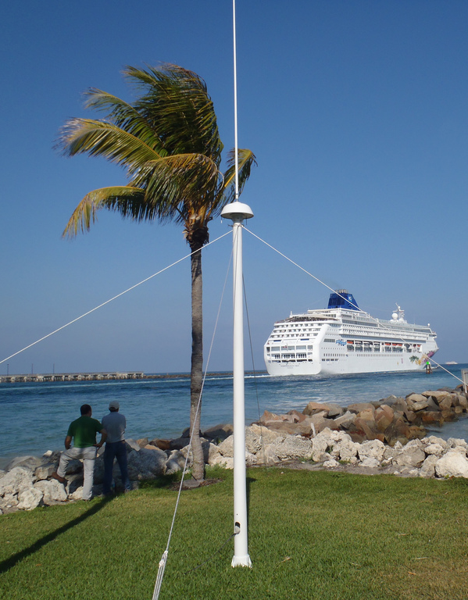
HF Radar Network - Since 1996
1000 km Alongshore Length Scale
Mid-Atlantic HF Radar Network
14 Long-Range CODARs
7 Medium-Range CODARs
15 Short-Range CODARs
36 Total
Triple Nested & Multistatic
Dual-Use:
1) Surface Current Mapping
2) Vessel Tracking
Corporate Partner – CODAR Ocean Sensors

Slide 5

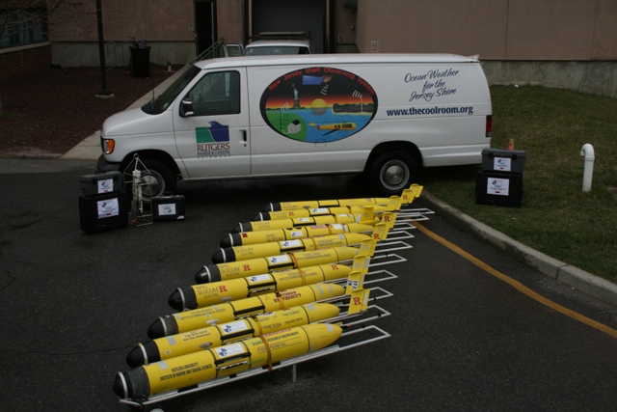
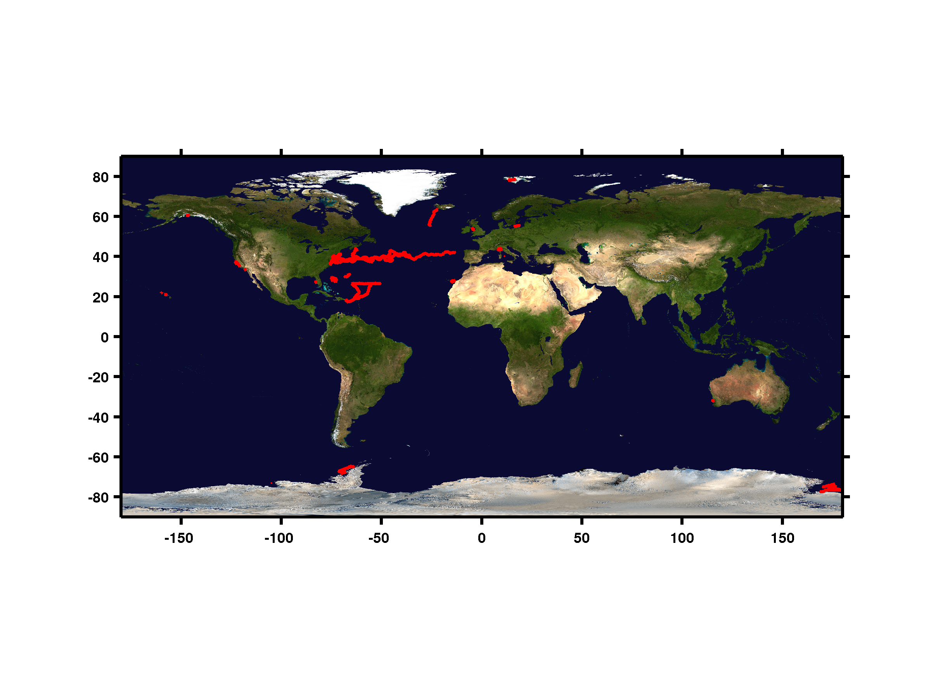
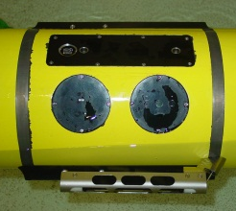
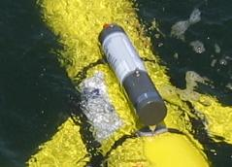
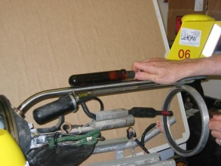
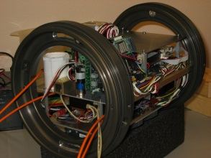
Autonomous Underwater Gliders - Since 1998
Deployments by Year Since 2005
Year | Number | Distance (km) | Days
2012 | 19 | 5054.31 | 290.3
2011 | 37 | 11975.53 | 624
2010 | 46 | 17003.36 | 876.6
2009 | 30 | 18114.34 | 761.1
2008 | 28 | 16642.28 | 604.7
2007 | 27 | 10277.99 | 462.9
2006 | 38 | 9745.88 | 538
2005 | 16 | 4113.87 | 207.1
Totals | 241 | 92927.56 | 4364.8
Corporate Partner – Teledyne Webb Research
Since 2003: >270 Missions

Slide 6
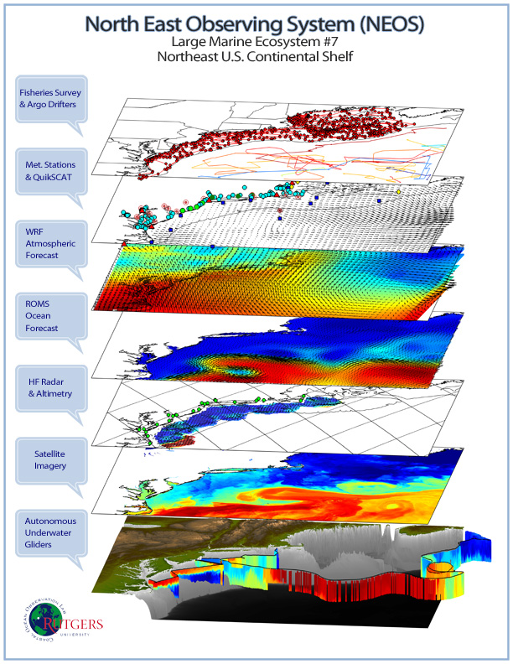
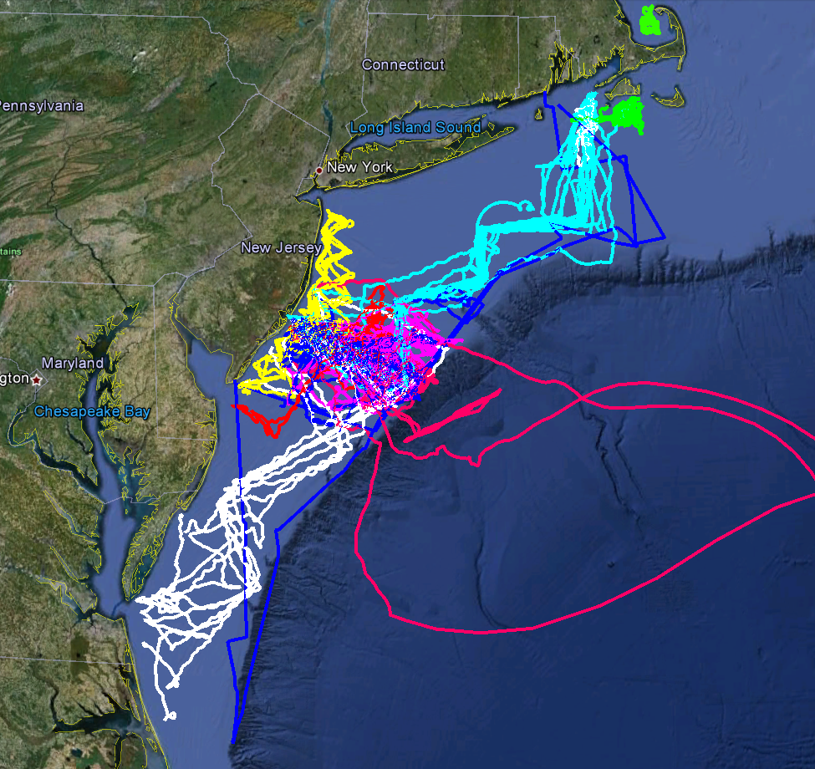
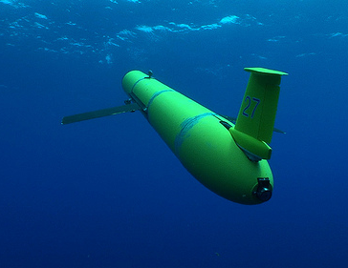
Mid-Atlantic Glider Deployments: 2005 to Present
MARACOOS
MURI
Intl. Missions
EPA & NJDEP
Cblast
Endurance
OSSE
SW06
Endurance
>270 Missions
Since 2005: 149 Mid-Atlantic deployments totaling 52,187 km over 2628 days

Slide 7
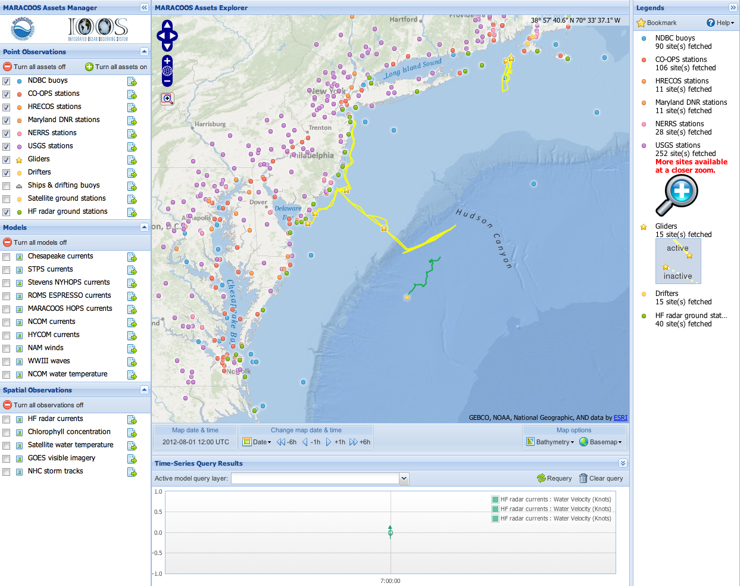
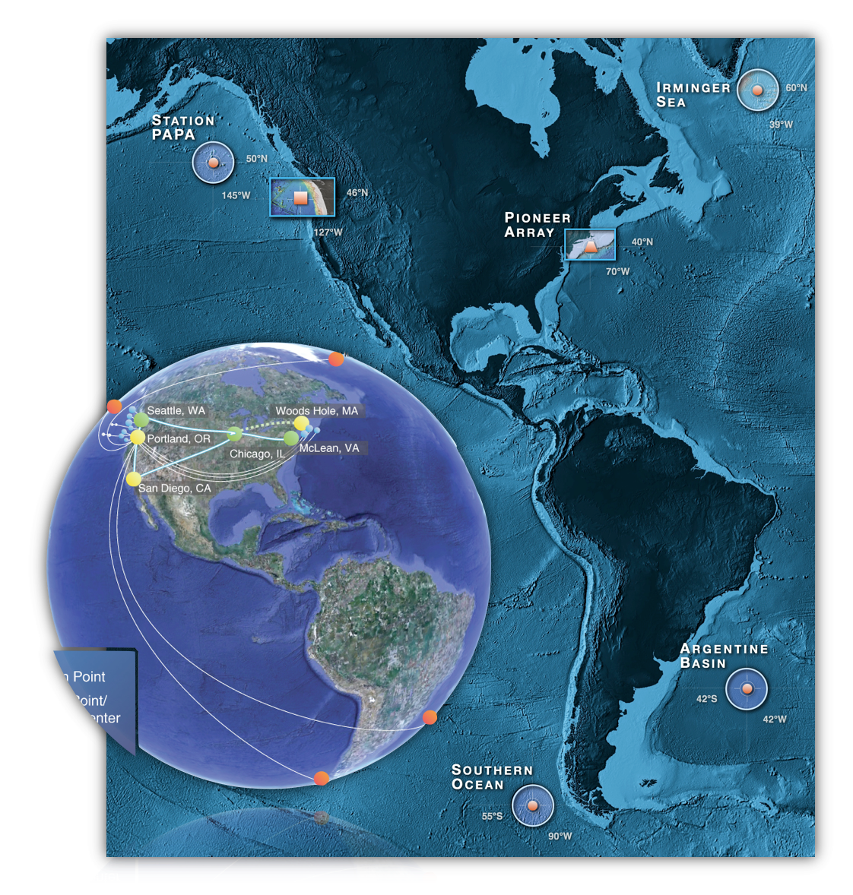
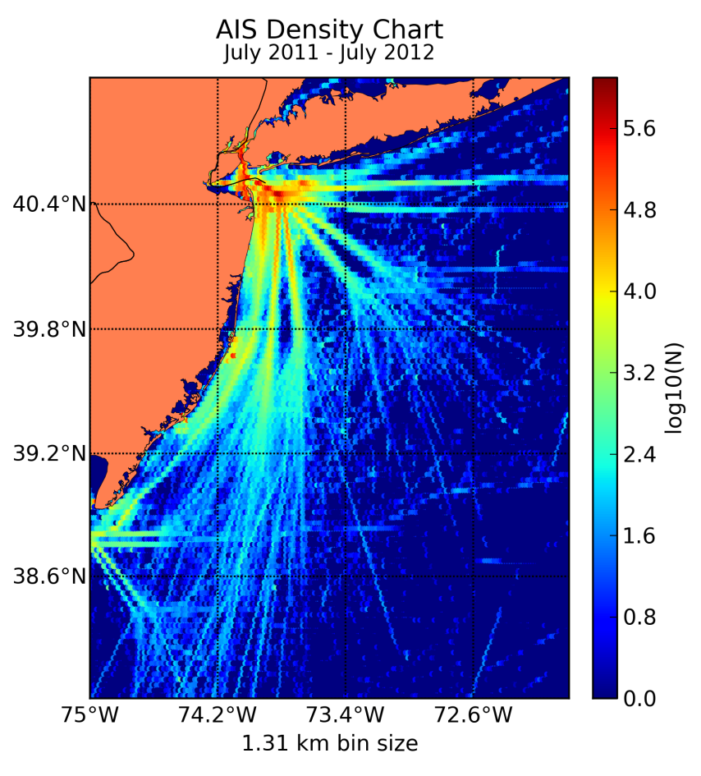
MARACOOS
Leveraged
DMAC Activities
NSF OOI Cyber Infrastructure
Implementing Organization
IOOS Asset Maps
DHS Maritime Domain Awareness

Slide 8
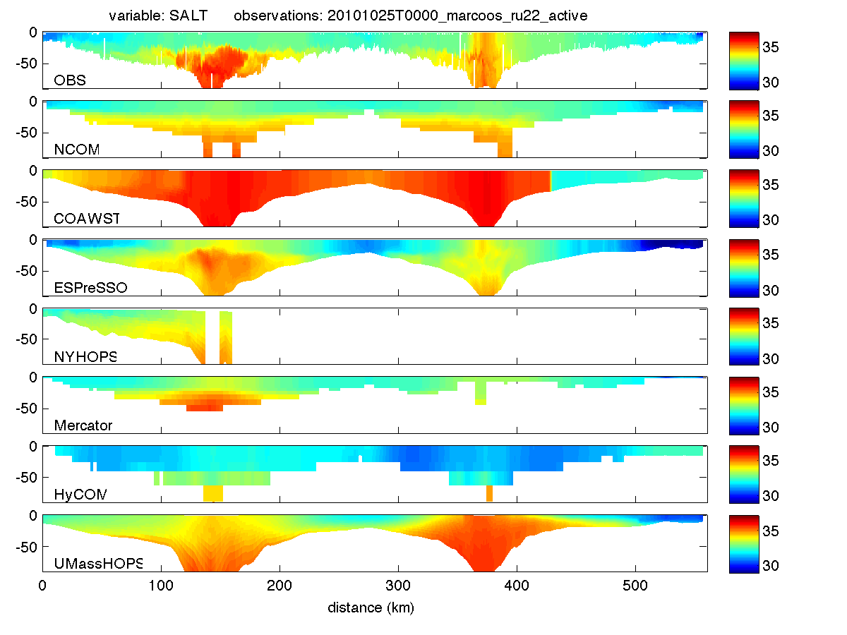
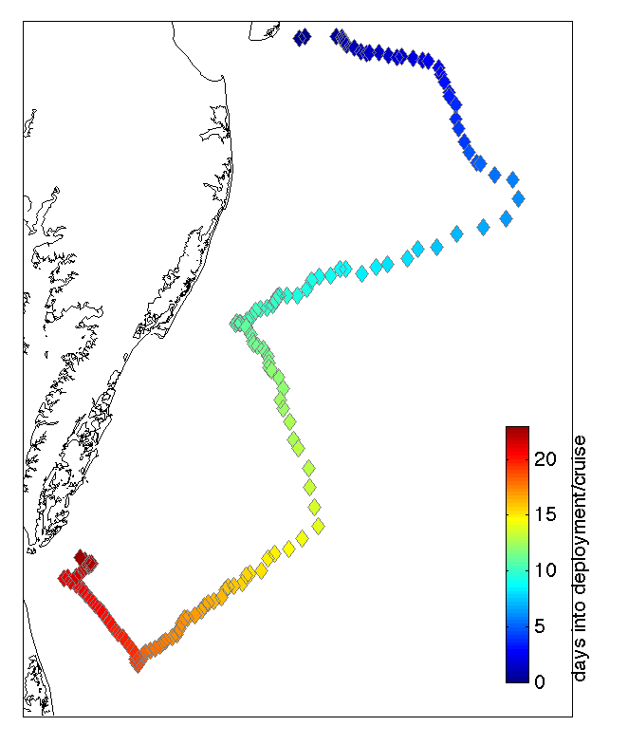
Forecast Model Comparison with Subsurface Glider Data: Salinity

Slide 9
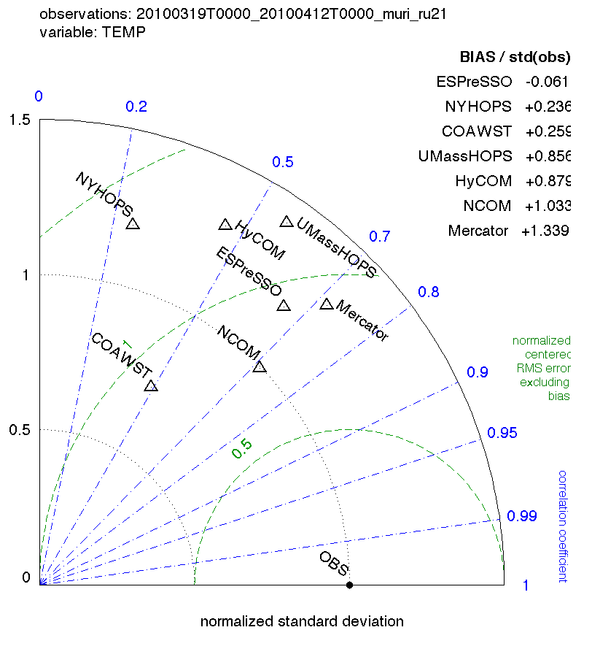
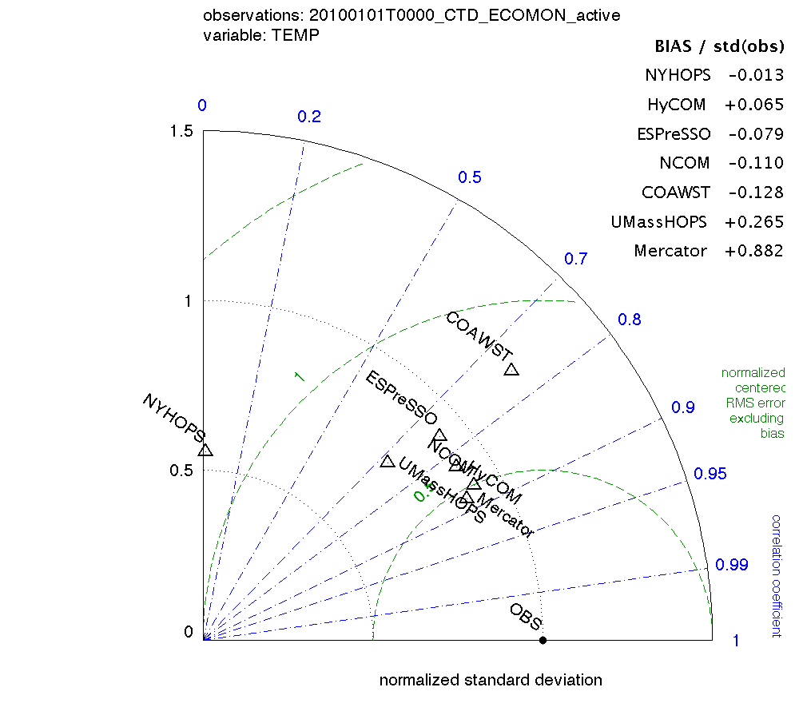
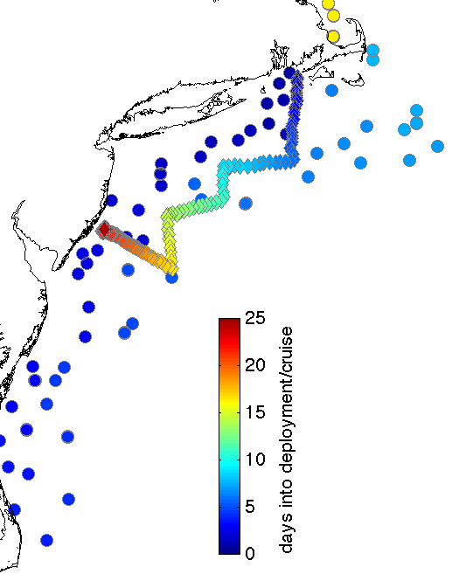
Two example validation data sets: Glider RU21 and NOAA ECOMON ship survey CTDs
In Taylor diagrams, distance from OBS to MODEL (green dashed contours) depicts centered (bias removed) root mean squared error RMSE’ normalized by observation standard deviation.
BIAS is tabulated separately in order of decreasing skill.
Comparison is for all operational models that include Mid-Atlantic Bight.
Global: HyCOM, NCOM, Mercator
Regional: NYHOPS, ESPreSSO, UMassHOPS. COAWST

Slide 10
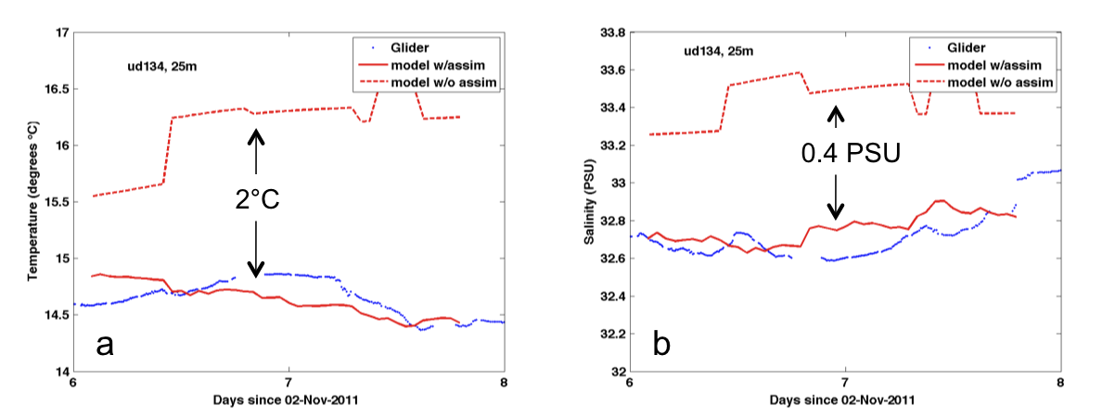
Multiscale Forecast Validation Glider data (t, s) assimilation
Independent Glider (UD134) data at 25-m for (a) temperature and (b) salinity, compared to the SMAST-HOPS 02 Nov 2009 runs. Only RU05, RU21 and RU23 data were assimilated (UD134 was not) during the first week. Glider data are shown with blue the model run with glider assimilation is shown with a red solid line, and the model run with no glider assimilation is shown with a dashed red line. Note the difference between assimilation and non-assimilation runs for temperature is about 2°C; while that for salinity is about 0.4 psu.

Slide 11
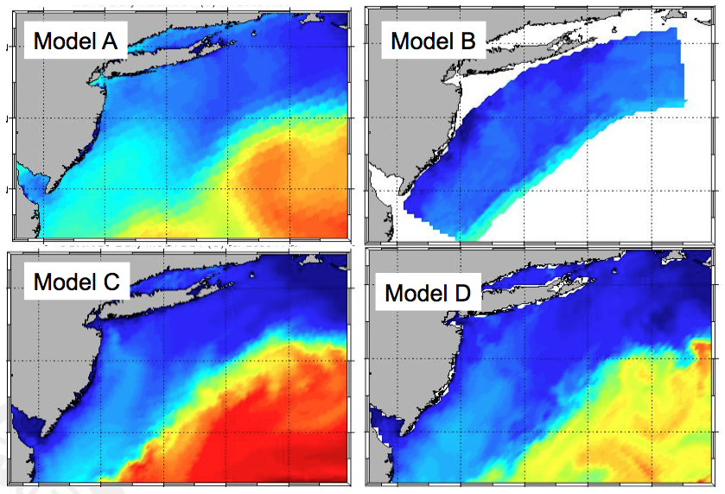
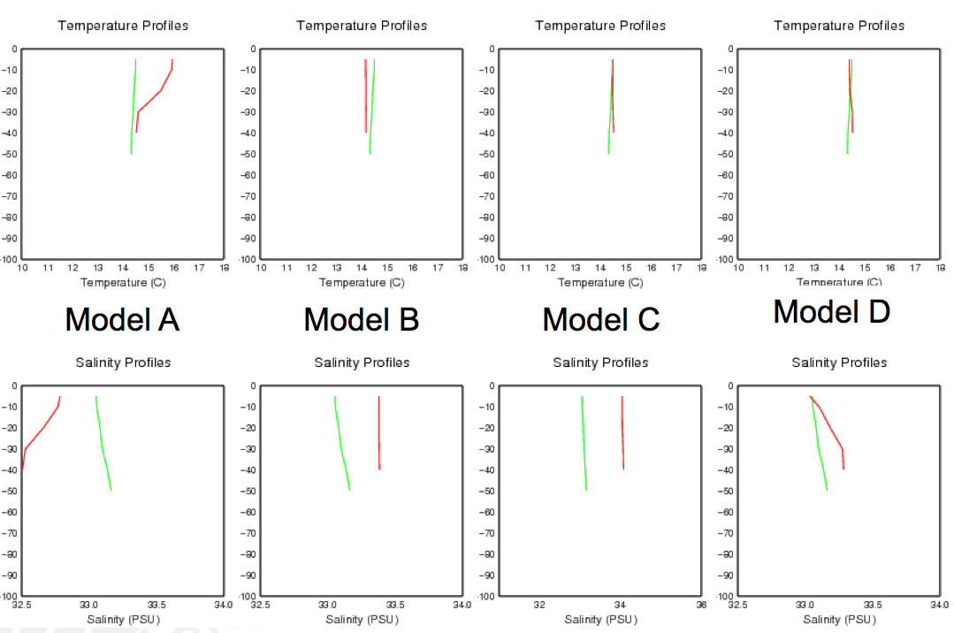
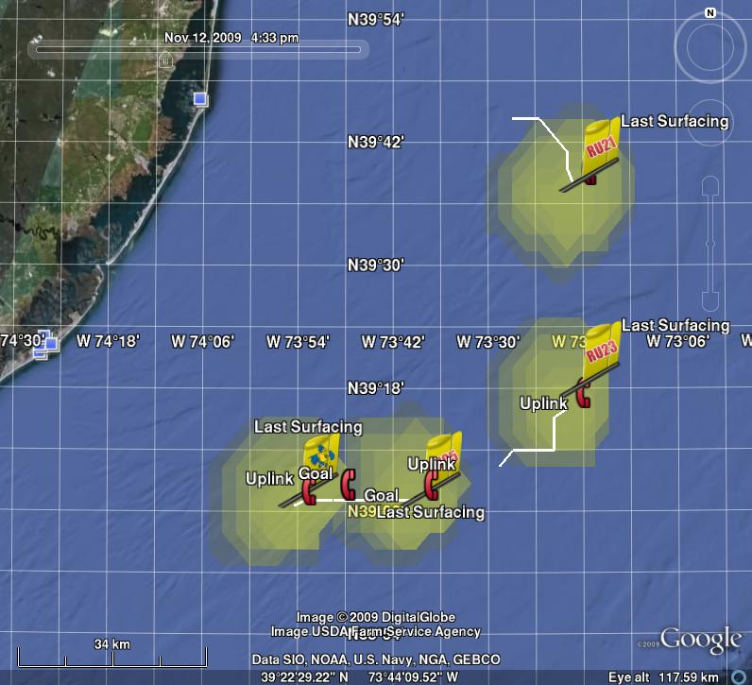
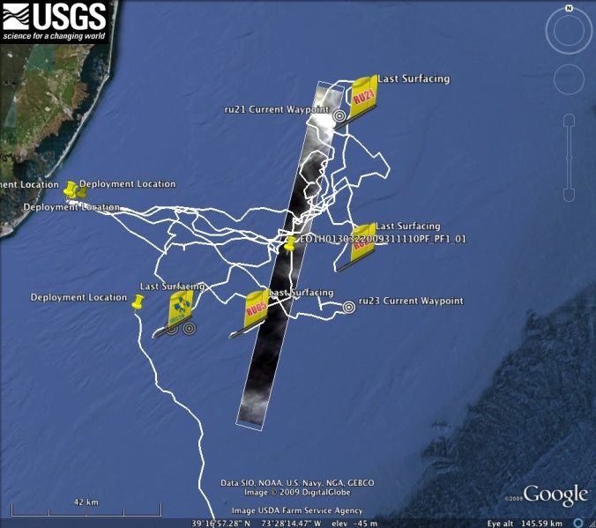
OOI Glider Adaptive Sampling based on Ensemble of Ocean Forecasts
Ensemble of 4 Forecasts
Model-Data Profile Comparisons
Forecast Currents determine Glider Range
Gliders Retasked based on Objectives

Slide 12
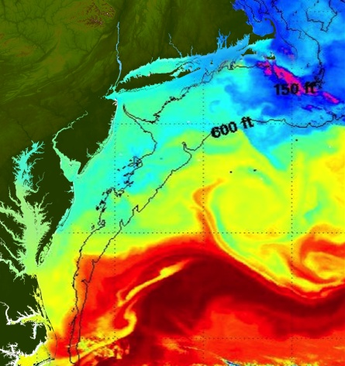
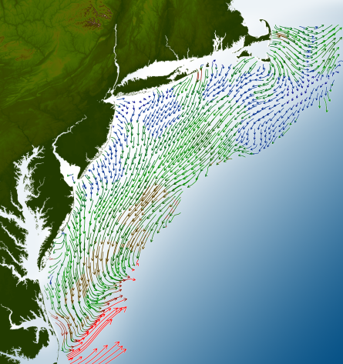
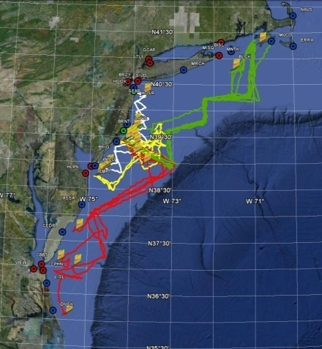
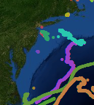
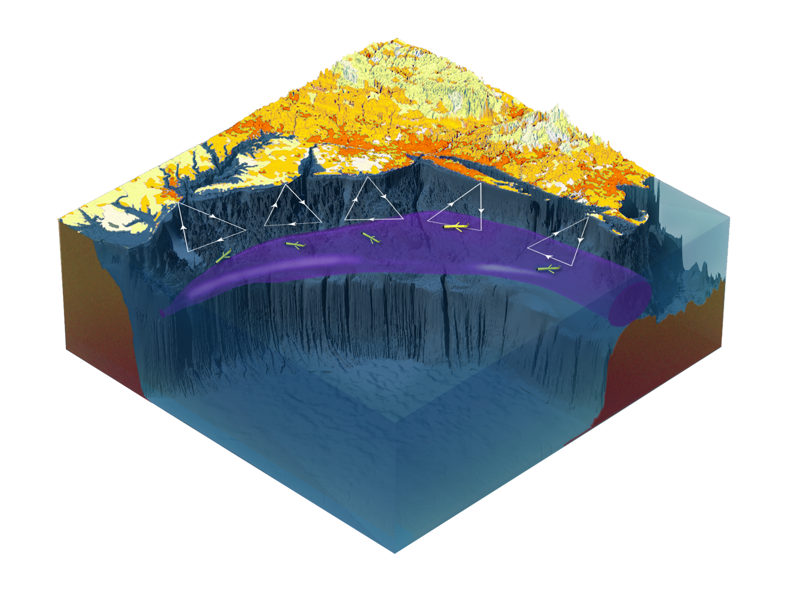

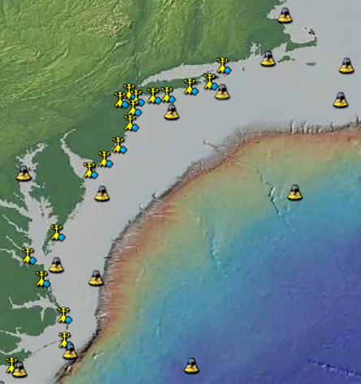
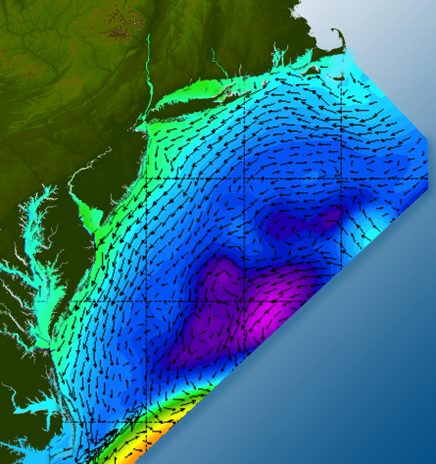

Proposed Future Regional Glider Sampling
Satellites
HF-Radar
Gliders
Drifters
Population Density
To seek, discover & apply
new knowledge & understanding
of our coastal ocean
Weather Stations
Ocean Forecast Ensemble

Slide 13
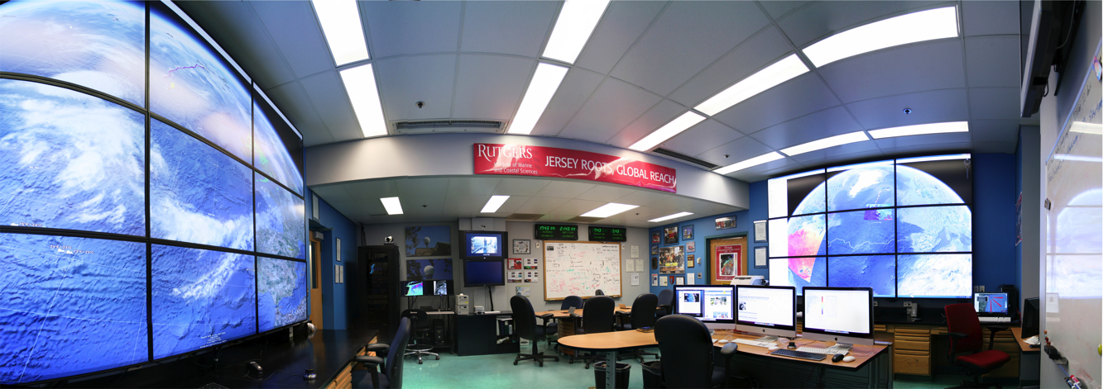
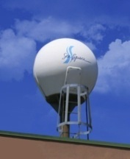
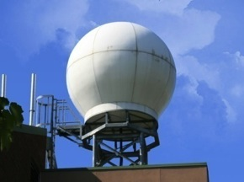
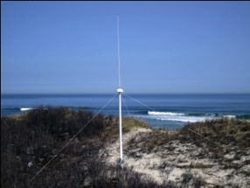
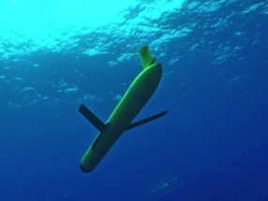
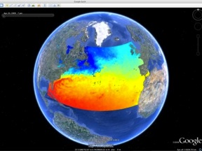
MARACOOS Operations Center
Rutgers University - Coastal Ocean Observation Lab
Vessels -
Satellite
Satellite
CODAR
Ships/ Vessels
Glider
REMUS
Data Vis.
Modeling
Security
Leadership
Education
Satellite Data Acquisition Stations
CODAR Network
Glider Fleet
3-D Forecasts

Slide 14
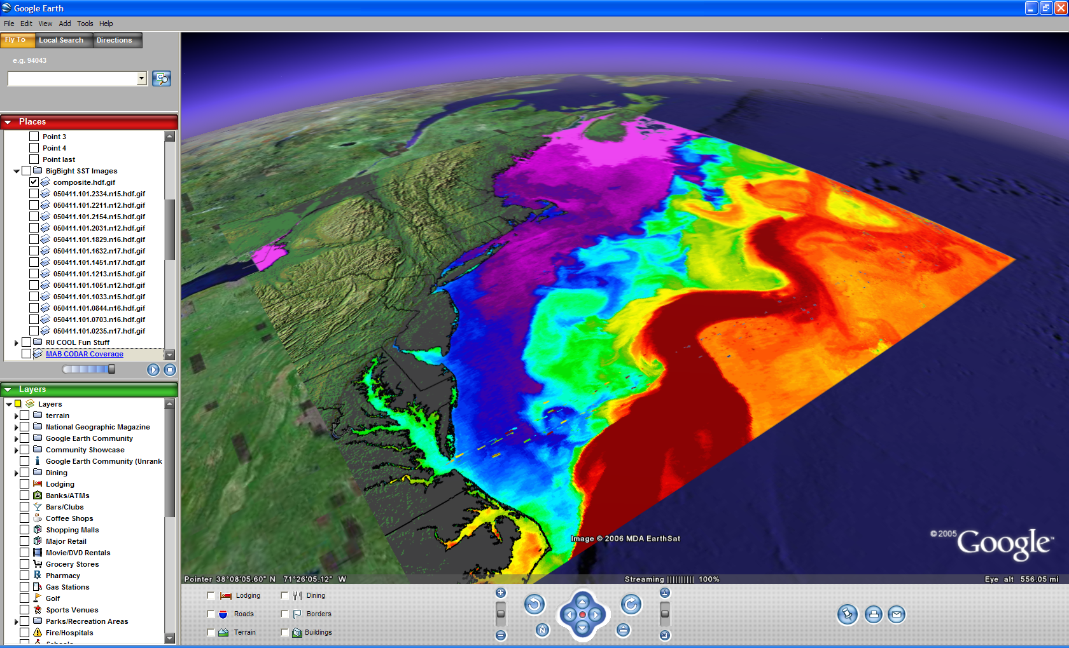

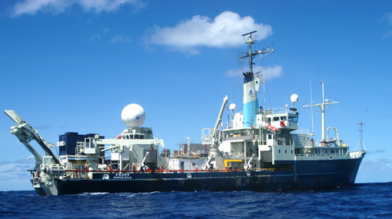
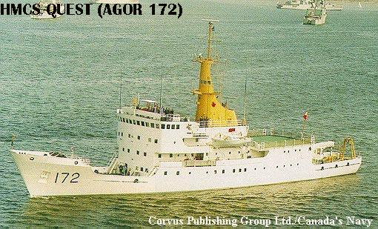
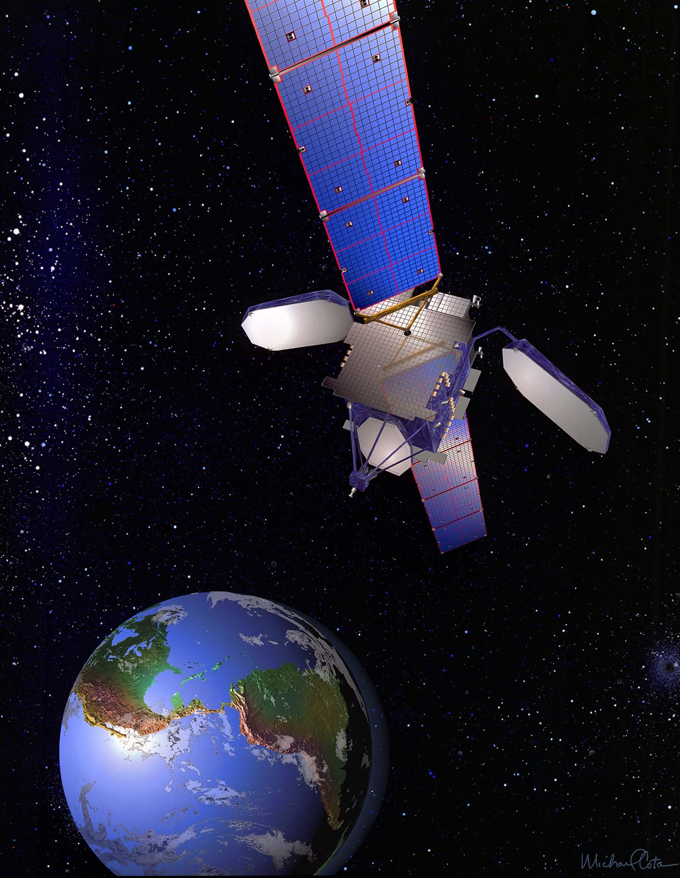
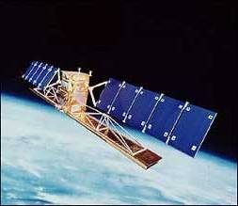
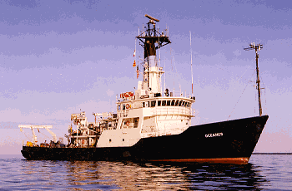





ONR Shallow Water 2006 Joint Experiment
HiSeasNet
>12 Satellites
48 Senior
PI’s & PM’s
Communication
7 Ships
3 Ground- stations
10 Gliders
1 Aircraft
62 Moorings

Slide 15

ONR Shallow Water 2006 Joint Experiment
HiSeasNet
>12 Satellites
48 Senior
PI’s & PM’s
Communication
7 Ships
3 Ground- stations
10 Gliders
17 Deployments
>6,500 km
>50,000 CTD Profiles
365 Glider Days
1 Aircraft
62 Moorings

Slide 16



Deepwater Horizon Oil Spill: Coordinated Rapid Response
Contributed Assets:
HF Radar Networks
USF, USM
Gliders
iRobot, Mote, Rutgers,
SIO, UDel, USF, Navy
Drifters & Profilers
Horizon Marine, Navy
Satellite Imagery
CSTARS, UDel, Rutgers
Ocean Forecasts
Navy, NCSU
Data/Web Services
ASA, Rutgers, SIO
Tropical Storm Bonnie crosses the Gulf of Mexico
USM HFR
TS Bonnie
USF HFR
USM HFR validation of SABGOM Forecast
in region with satellite detected oil slicks
HFR & Glider Data used for Oil Slick Forecasts by NOAA/NOS/OR&R

Slide 17
















Storm Research
In the Mid-Atlantic:
Hurricane Irene Approaches the MARACOOS Network
Hurricane Irene
August 26, 2011
http://maracoos.org

Slide 18
Two Gliders
Deployed by MARACOOS
in Hurricane Irene
RU23
Deployed for MARACOOS.
Map subsurface T/S structure for fisheries.
Damaged early - drifter
Recovered by fisherman
Provided data on inertial currents during storm.
RU16
Deployed for EPA.
Map bottom dissolved oxygen.
Provided data on mixing during storm.

Slide 19





Hurricane Irene
Hurricane Irene
0
26
depth
temperature
55
14
0
33
depth
salinity
55
29
0
105
depth
% oxygen
55
60
8/12
date
9/07

Slide 20




RU16
Temp.
Section
Temp. Vert. Vel.
Temp. Vert. Vel.
Temp. Vert. Vel.

Slide 21



For Each 2-hour Segment:
1) Calculate the Average Temperature Profile
2) Calculate the Vertical Velocity Standard Deviation Profile and Smooth Vertically.
Pre-Irene
During Irene
Post-Irene

Slide 22


Time History of Mixing During Irene:
Profiles of the Standard Deviation
Vertical Velocity Profile
Time Progresses from Red to Blue

Slide 23



Time History of Mixing During Irene:
Profiles of the Standard Deviation
Vertical Velocity Profile
Eddy viscosity
Linear * Exponential Decay
Linear
Time Progresses from Red to Blue

Slide 24




MARACOOS Network Observations:
Hurricane Irene
NDBC Winds
Thermocline Depth
NDBC Waves
Bottom Orbital Velocity
Surface Temp
Max S.D. w’ Depth
Max S.D. w’
Glider, CODAR &
Calculated Bottom Currents
Glider RU16

Slide 25
WRF Model Run: SST Update
27/1200→28/0600
28/0600→29/0600

Slide 26




Regional Observatory –
Mid-Atlantic Bight
Remote Observatory - Antarctic
Global Observatory

Slide 27




Glider-Enabled Team-based
Research Apprenticeships
Course Mechanics:
Marine Science Major requires 6 credits of Research.
Ocean Observatories course is 1.5 credits –one 80-minute class period per week.
Students can sign up multiple times.
What we (the teachers) do:
1) Mentorship Model – Cognitive Apprenticeship – Experiential
Watch One -> Do One -> Teach One
(Observer -> Worker -> Mentor)
2) Grand Challenges can only be achieved through sustained teamwork – research now bridges semesters and summers.
3) We do not fear failure – Undergraduate Education is a time for exploration and risk-taking.
What the students do:
Divide into research teams led by a mentor (teach one), and consisting of a few workers (do one) and a few observers (watch one).
Propose and conduct a team research project based on ocean observatory data.
Communicate results through blogs and presentations.

Slide 28
Formative Assessment –
Continuous Re-evaluation and Redesign of:
Ocean Observatories Research Course
Feeder Courses
Full Class Logistics & Info Sharing
Skills Building
Background Discussions
Team Projects
Repeat Students 3-6 Times
Mentors
Mentors
REG
I
O
N
A
L
RE
M
O
T
E
G
L
O
B
A
L
Repeat Students 1-3 Times
Workers
Workers
Freshman Oceanography House
Observers
Observers
Oceans 101
Freshman Seminar
COSEE Network
OOI EPE Tools
Ocean Observatories
Dark blue are the students in the light blue course

Slide 29


Summative Assessment – Did we have an impact?
Increase in Number & Scope of Research Internships
Locations: Australia, Antarctica, Svalbard, Spain, Canaries, Azores, California, Florida, New Jersey
Sponsors: NSF, DHS, Alumni
Trans-Atlantic Glider Challenge
Spring 2012 Course: >70 Students
Number of Marine Science Majors

Slide 30




FAQ: Is it expandable?
Companion Course at
Plataforma Oceanica de Canarias
Shared Glider Missions – Iceland to Azores to Canaries to Cape Verde to Brazil
Skype Sessions between classes
Two-way International Exchange programs
Students Learn Science from their teachers, culture from their peers.
Students Learn Culture from their peers

Slide 31

A National Glider Network Will:
Enable Pooling of Technical Expertise
Enable Sharing of Cyber Development
Collaboratively Address National Issues
Invigorate a Global Glider Network
Provide Educational Opportunities

