Slide 1
C-MORE 2012: Measuring phytoplankton productivity & biomass
Oscar Schofield
Notes:
1

Slide 2
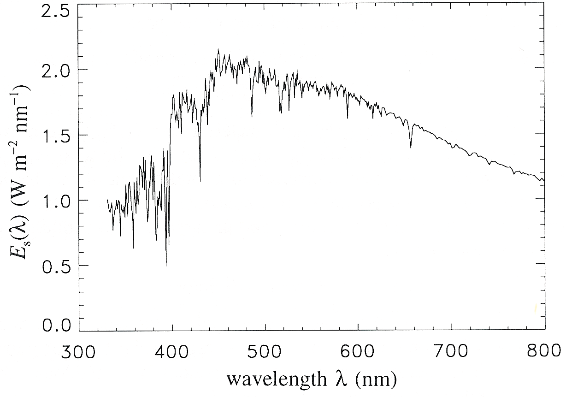

Photosynthesis = PAR * a_{ph} * φ
Scalar visible irradiance
Quantum efficiency of ……..
Absorption
High
Spectrally averaged absorption
Fluorescence
or charge
separation
Irradiance
0.00
0.00
0.20
0.40
0.60
0.80
1.00
oxygen
20.00
Energy that is into the cell
Varies with cell pigmentation,
light history, and size
)
40.00
m
(
carbon fixation
h
t
p
e
60.00
D
80.00
~ 1%
Low
100.00
growth
Energy into the ocean
Varies with depth according to the IOPs
IOPs with radiative transfer eqns describe the AOPS
Efficiency of converting energy into
End product (electrons, oxygen, carbon)
Varies with end product and physiology

Slide 3
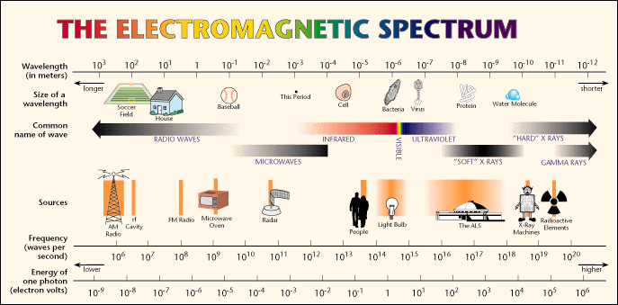
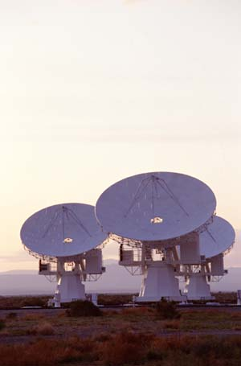
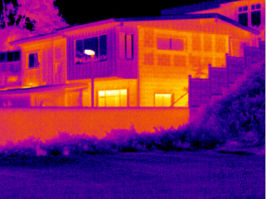
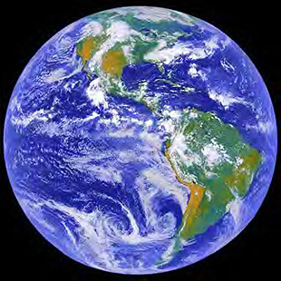

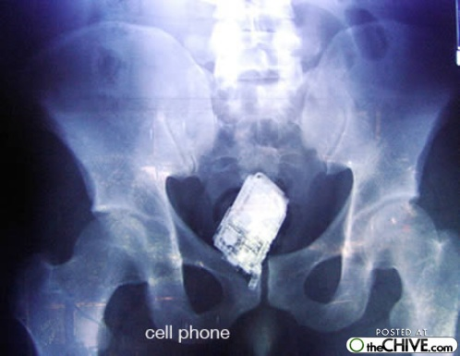

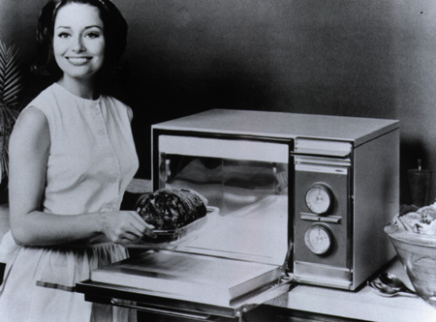
Phytoplankton growth and nutrient assimilation is tied to ambient light levels.
Enough energy to excite
(vibrate a molecule)
Enough energy make something new
(rearrange a molecule)
Enough energy move electrons

Slide 4
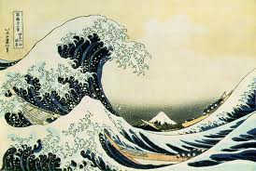
“Every day, the ocean changes colour – or rather, it passes though a variety of hues between the morning, noon and night of a single day. The subtle shapes of clouds, the glittering light of the sun, and the shifts in atmospheric pressure tint the sea with deep tones, cheerful tomes, plaintive tones that would cause any painter to pause in wonder.”
from The Samurai by Shusaku Endo (1980)

Slide 5
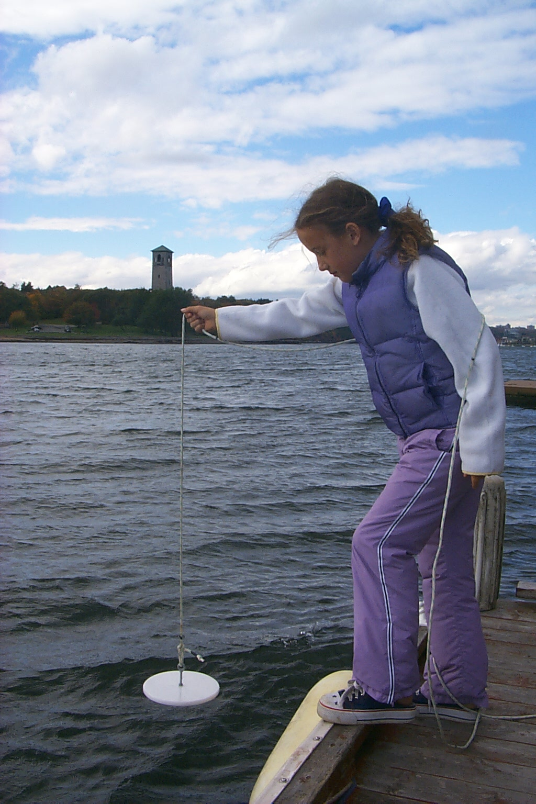
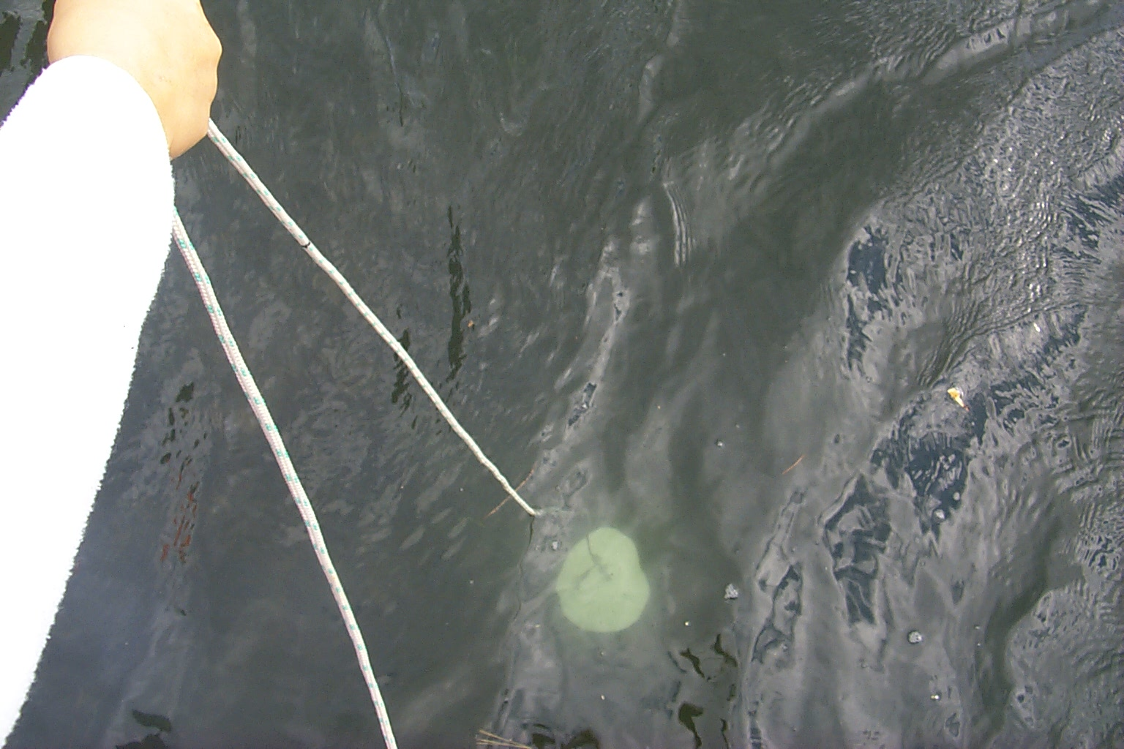
“Eyeball Optics”
The Secchi Disk:
First systematic usage reported in 1866, but observed and remarked upon much earlier.
Early experiments carried out by Commander Cialdi, head of the Papal Navy, and Professor Secchi onboard the SS L’Immacolata Concezione (Cialdi, 1866).
Used operationally for establishing aids to navigation over shallow water.
Thanks to Marlon Lewis

Slide 6
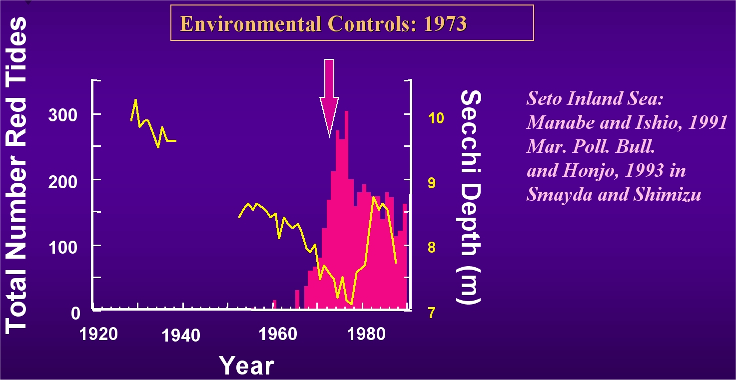
Eyeballs Watch Harmful Algal Blooms
HAB’s

Slide 7
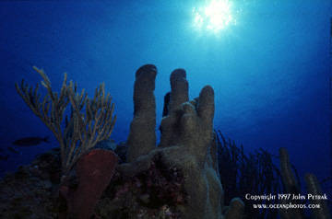
Optical Properties of the Sea
The underwater light field is not a collimated beam. So we define another term(s), the diffuse attenuation coefficient(s), K, to describe the penetration of light in the sea. It is closely related to absorption.
Irradiance
0.00
0.20
0.40
0.60
0.80
1.00
0.00
20.00
)
m
40.00
(
h
t
p
e
60.00
D
80.00
~ 1%
100.00

Slide 8

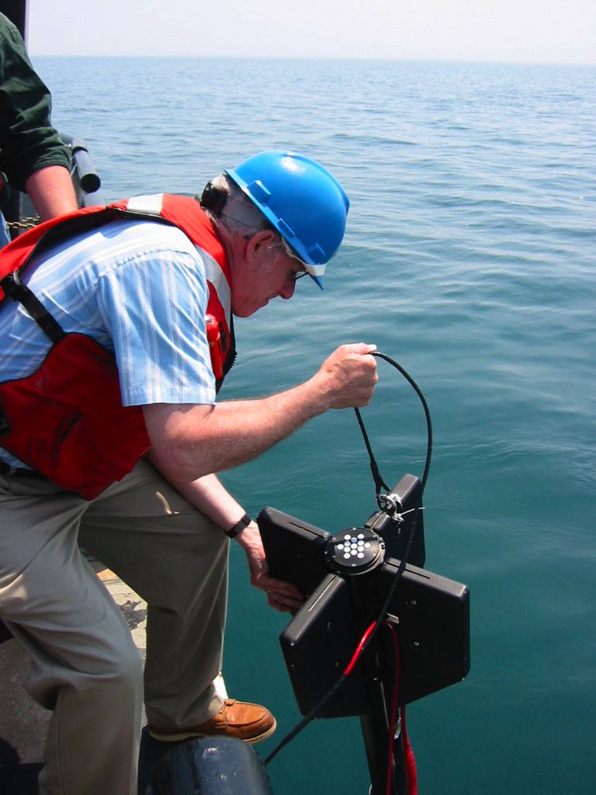
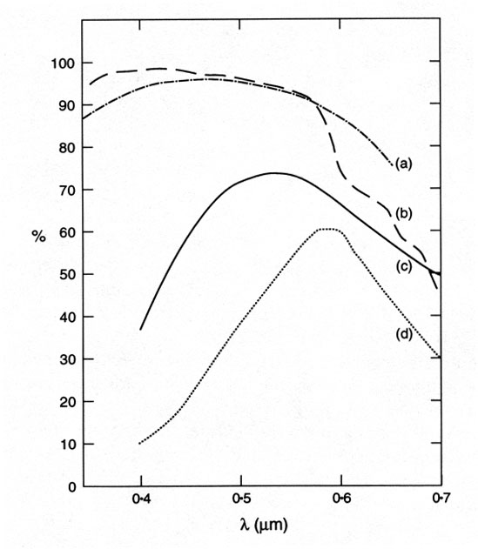
Measuring the light into the system
From John T. O. Kirk’s billabongs

Slide 9
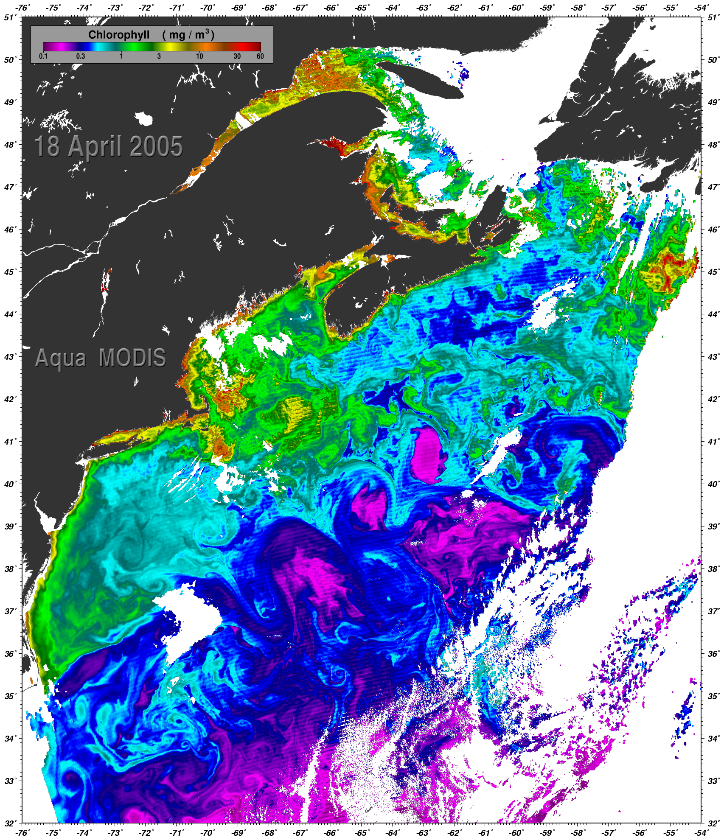
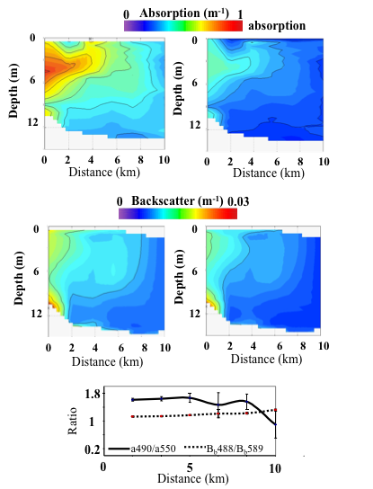
Reflectance(λ) = G* b_{b}(λ)/{b_{b}(λ) +a(λ)}

Slide 10
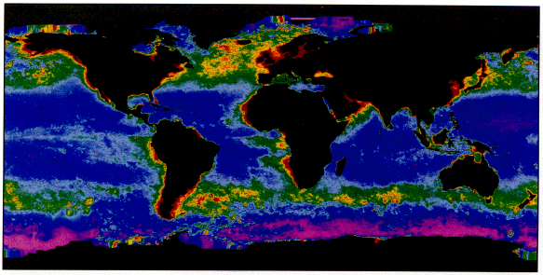
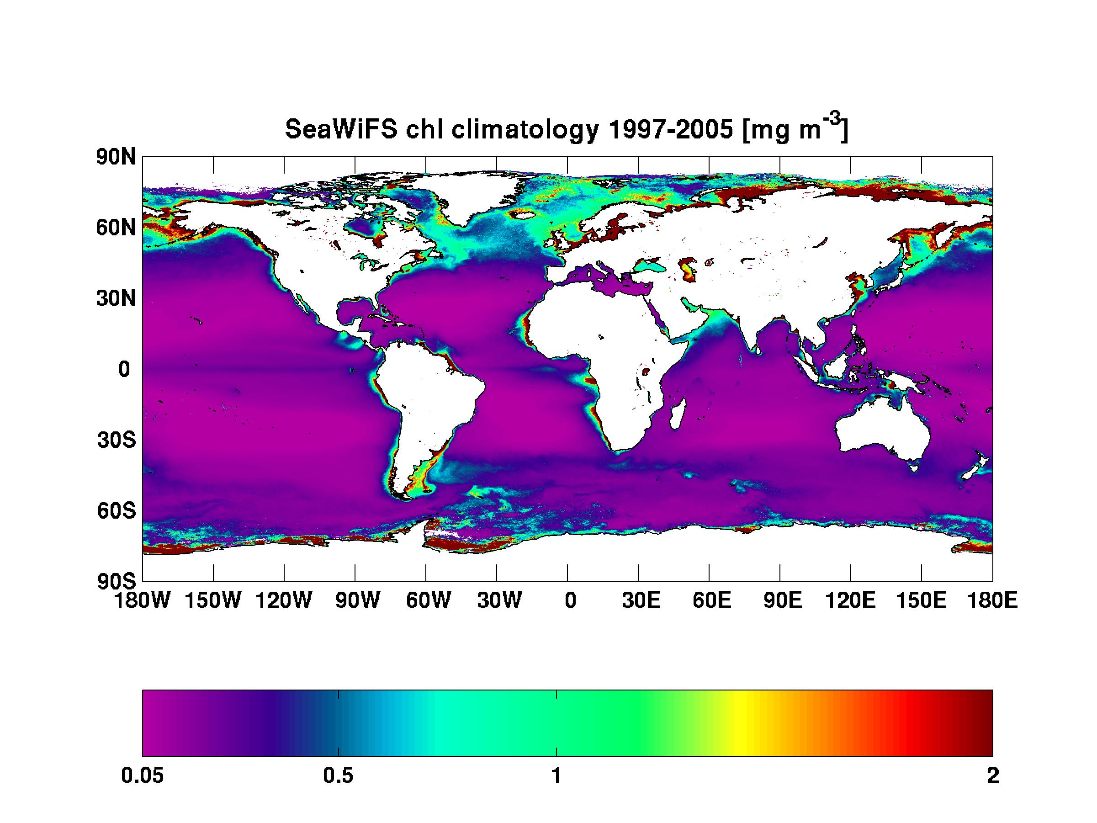
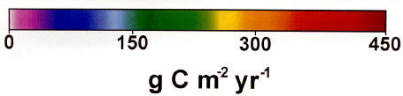
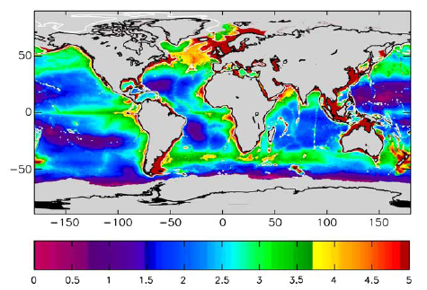
primary productivity
(Behrenfeld and Falkowski, 1997)
or export productivity
(Muller-Karger et al., 2005)

Slide 11
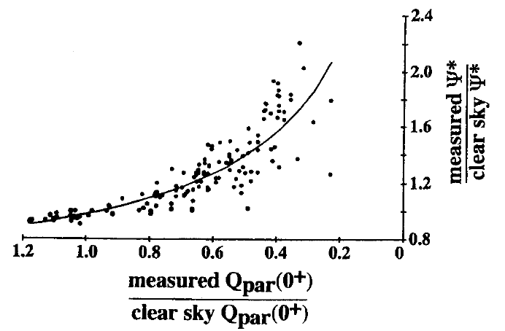
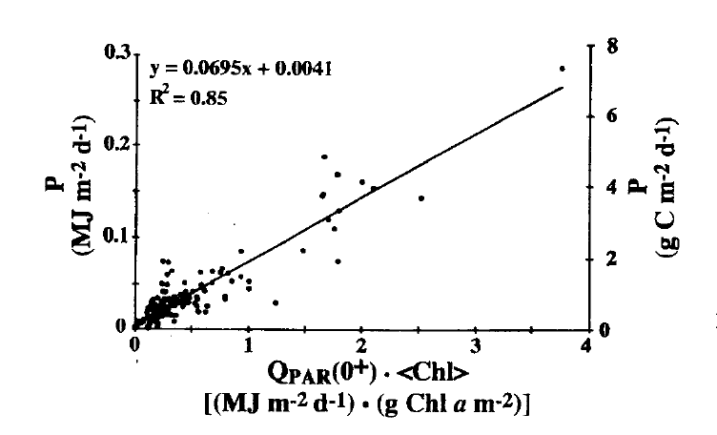
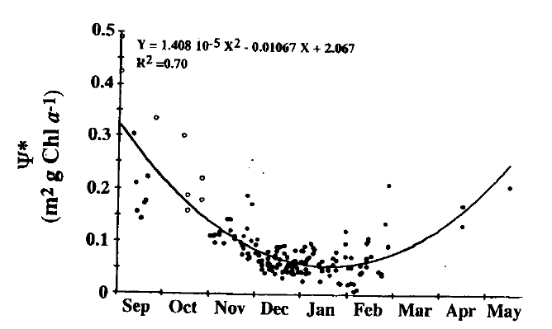
What are some of the classical DIMS?
Local
weather
Ψ∗ = P/(Qpar(0+)<Chl>)
Morel and Platt show Ψ* variability
Of 50% around a value of at specific
chl values
seasonal
Diatoms Ψ 0.114 + 0.051
Cryptophytes Ψ 0.053 + 0.011
Claustre et al.

Slide 12
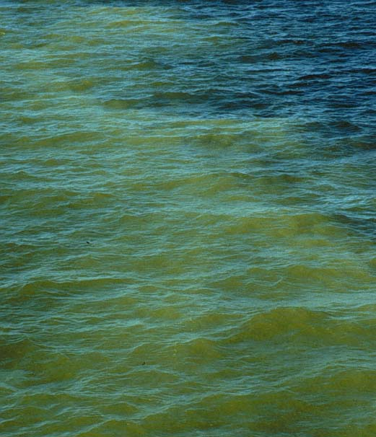
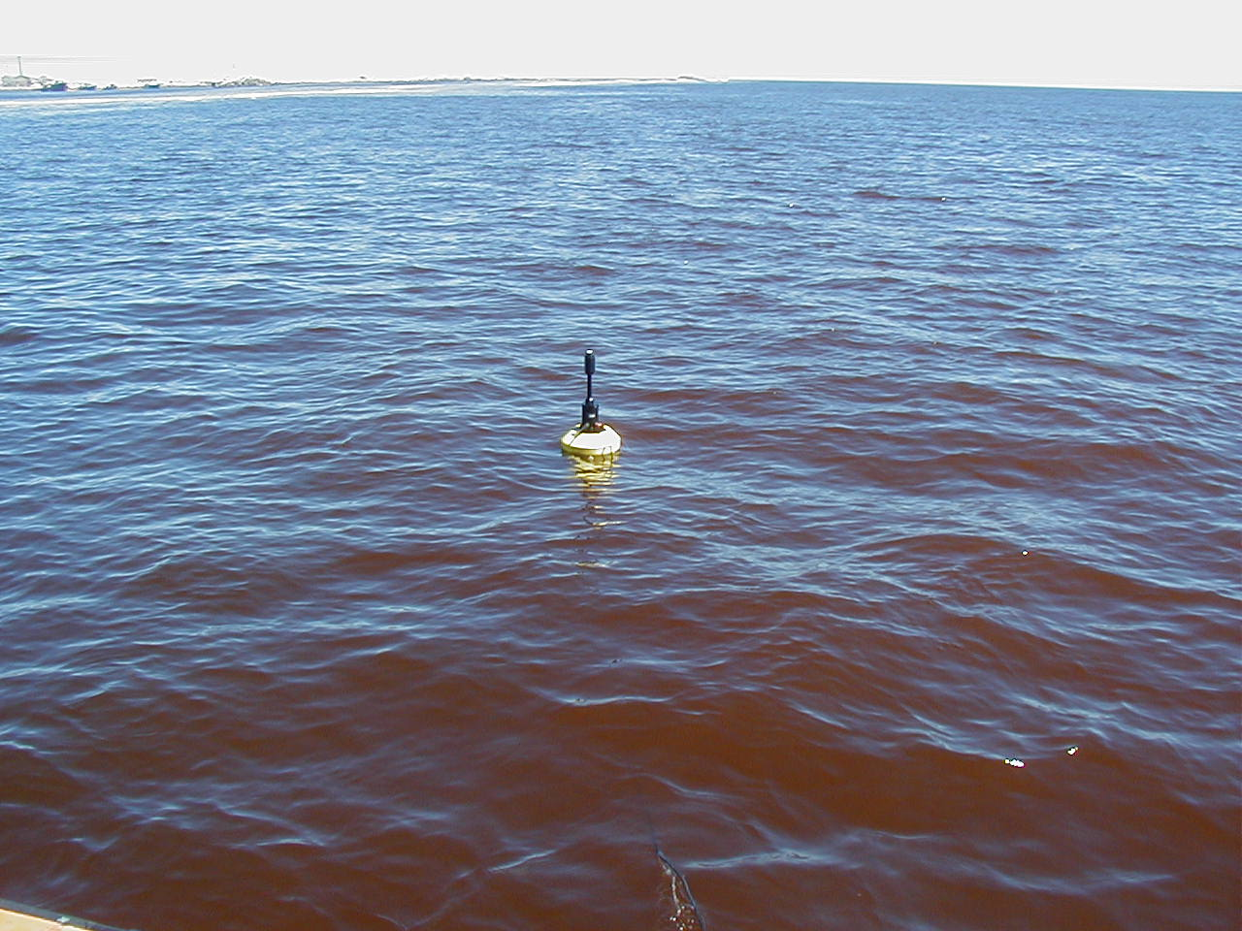
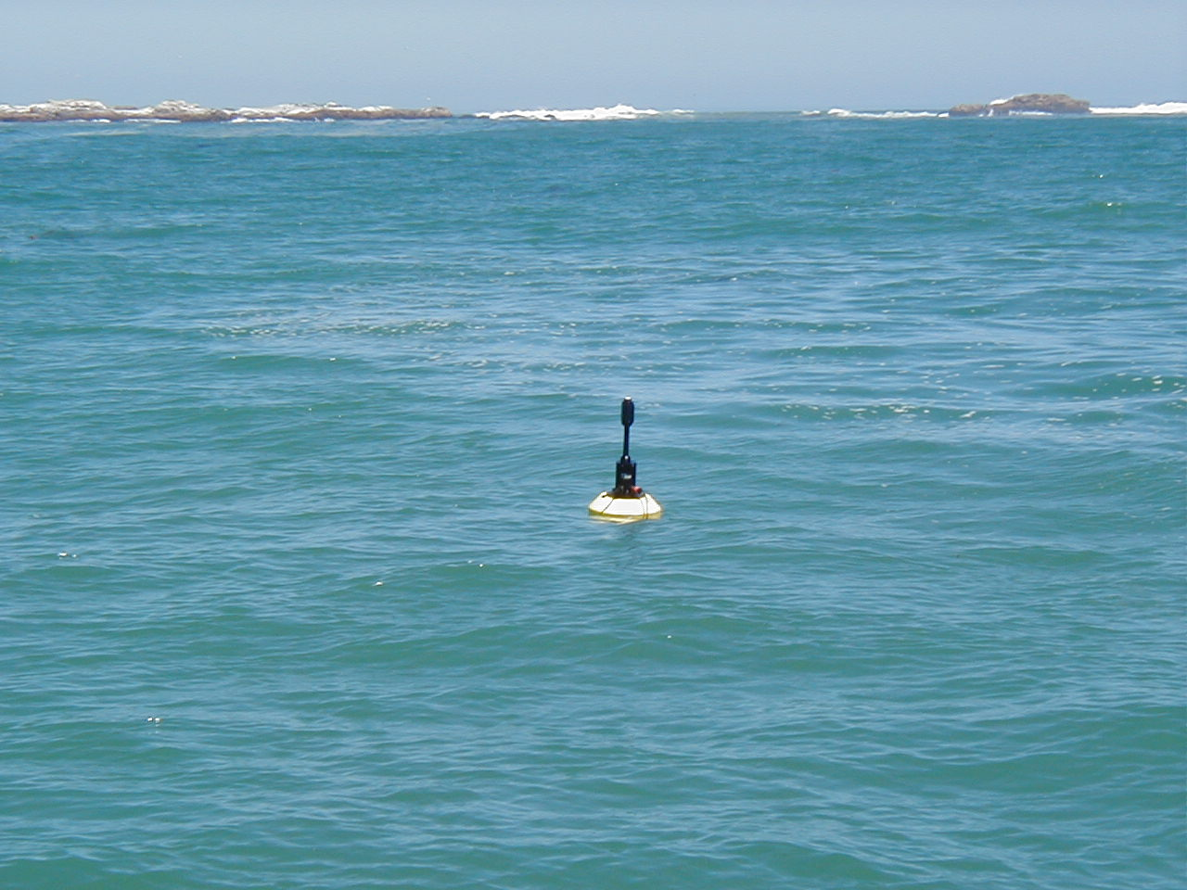
Penetration of light is determined by the material in the water
which is determined by the overall inherent optical properties (IOPs)
Absorption (a) color
Photos by S. Etheridge

Slide 13
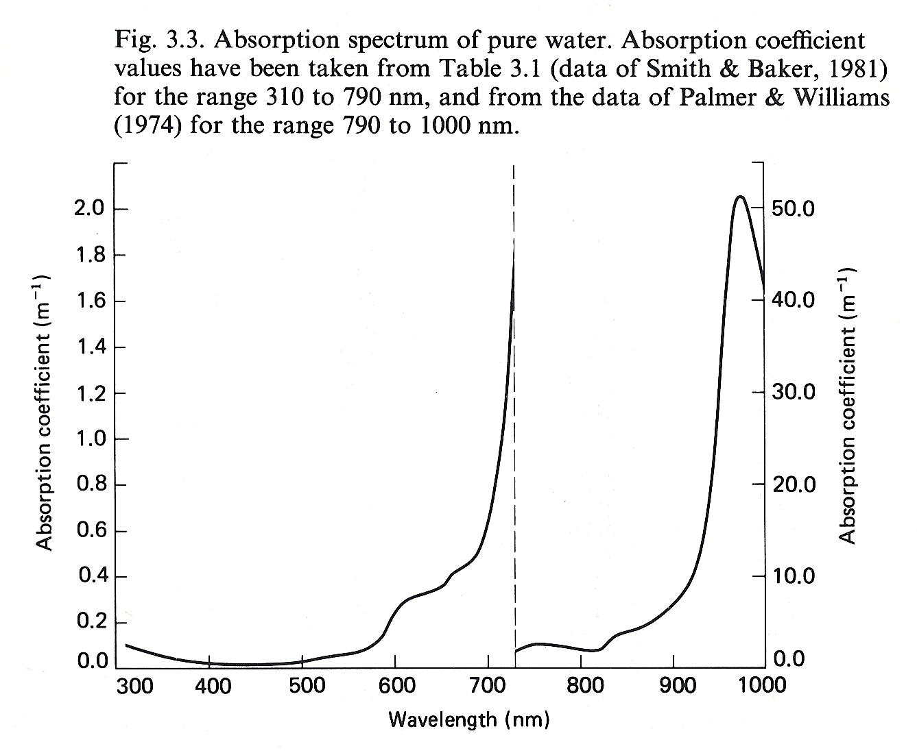
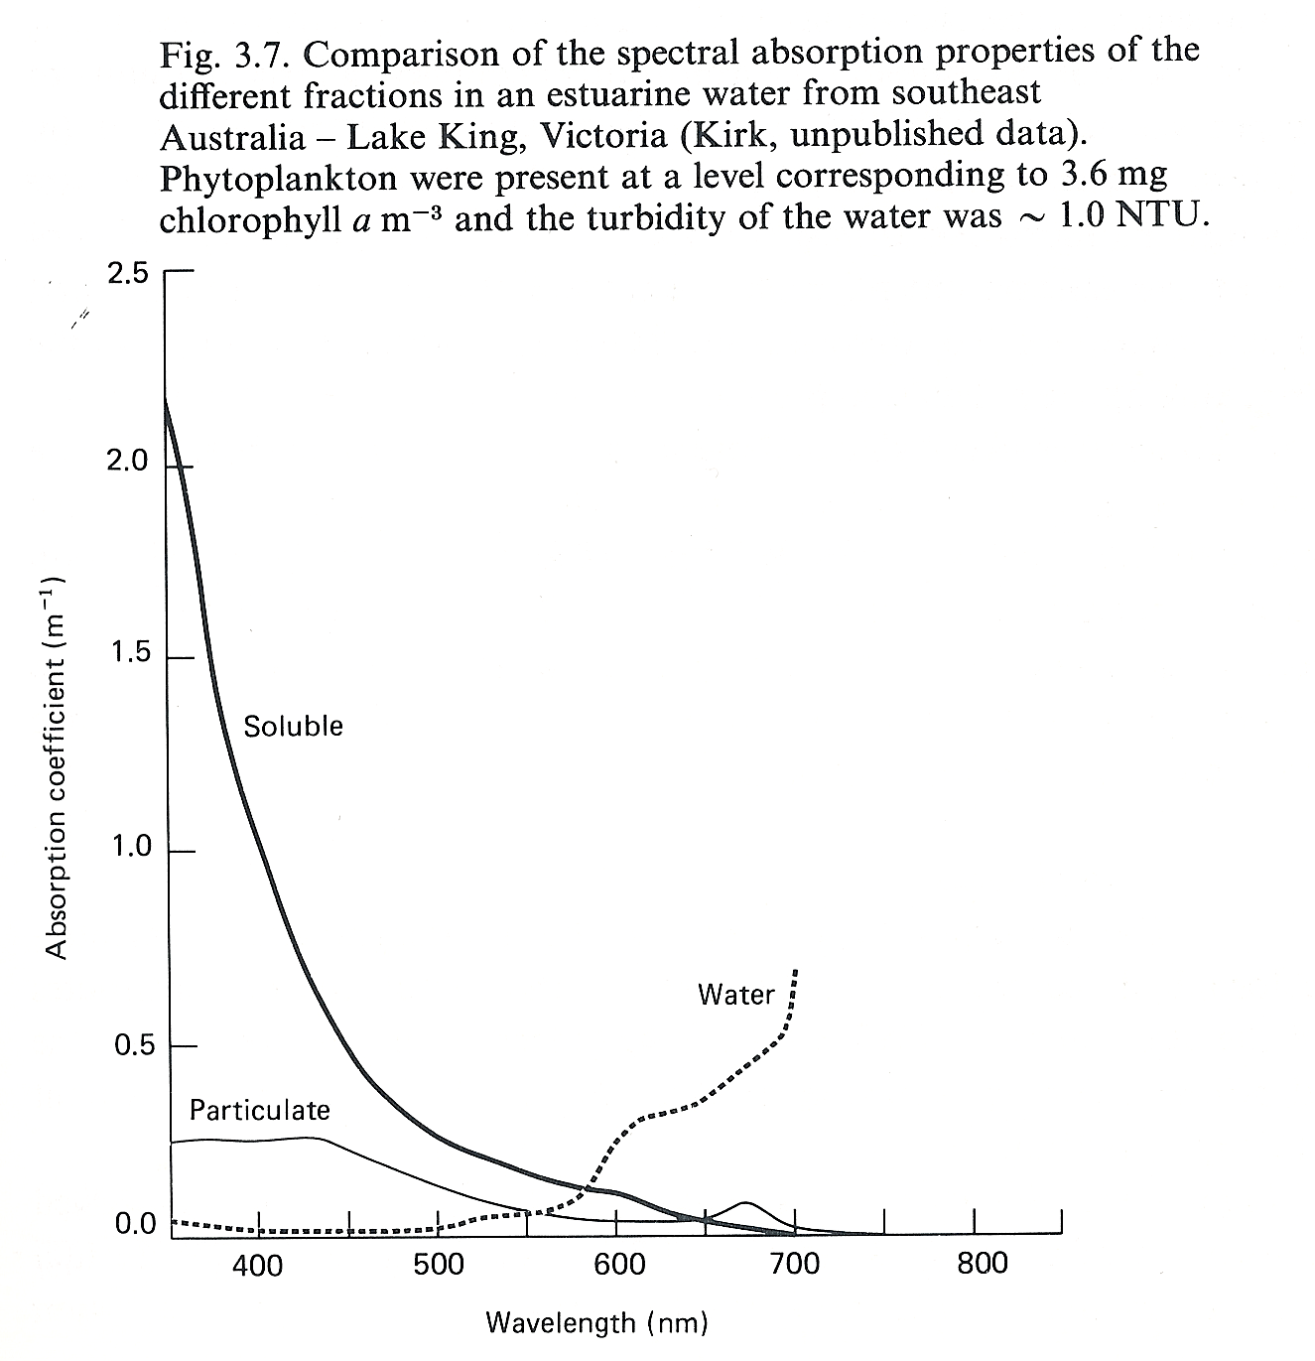

Slide 14
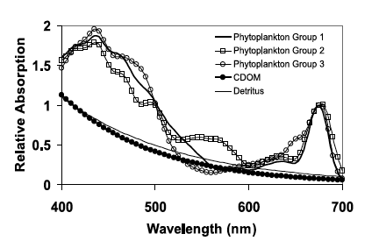

Slide 15
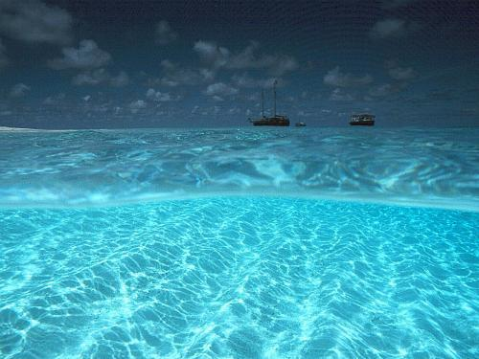
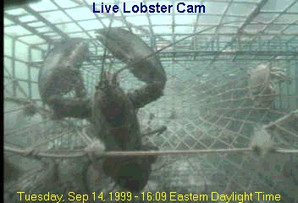
Scattering (b) clarity
a + b = c
c = attenuation
From Collin Roesler

Slide 16

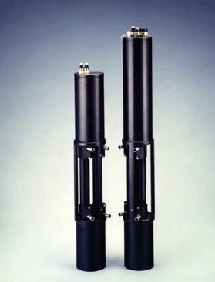
WetLabs
detector
detector
Absorption (a)
Attenuation (b)

Slide 17
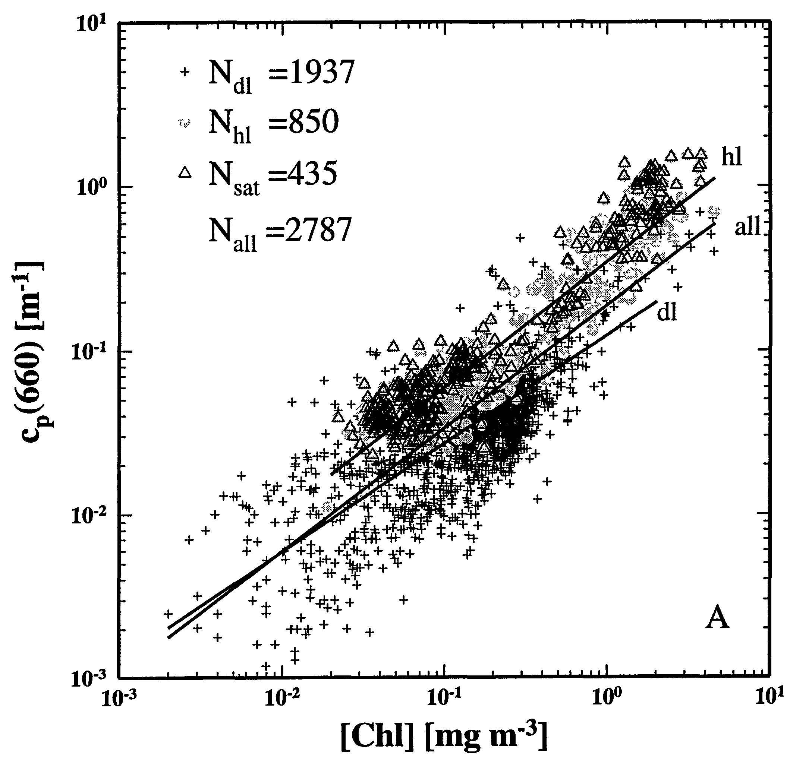
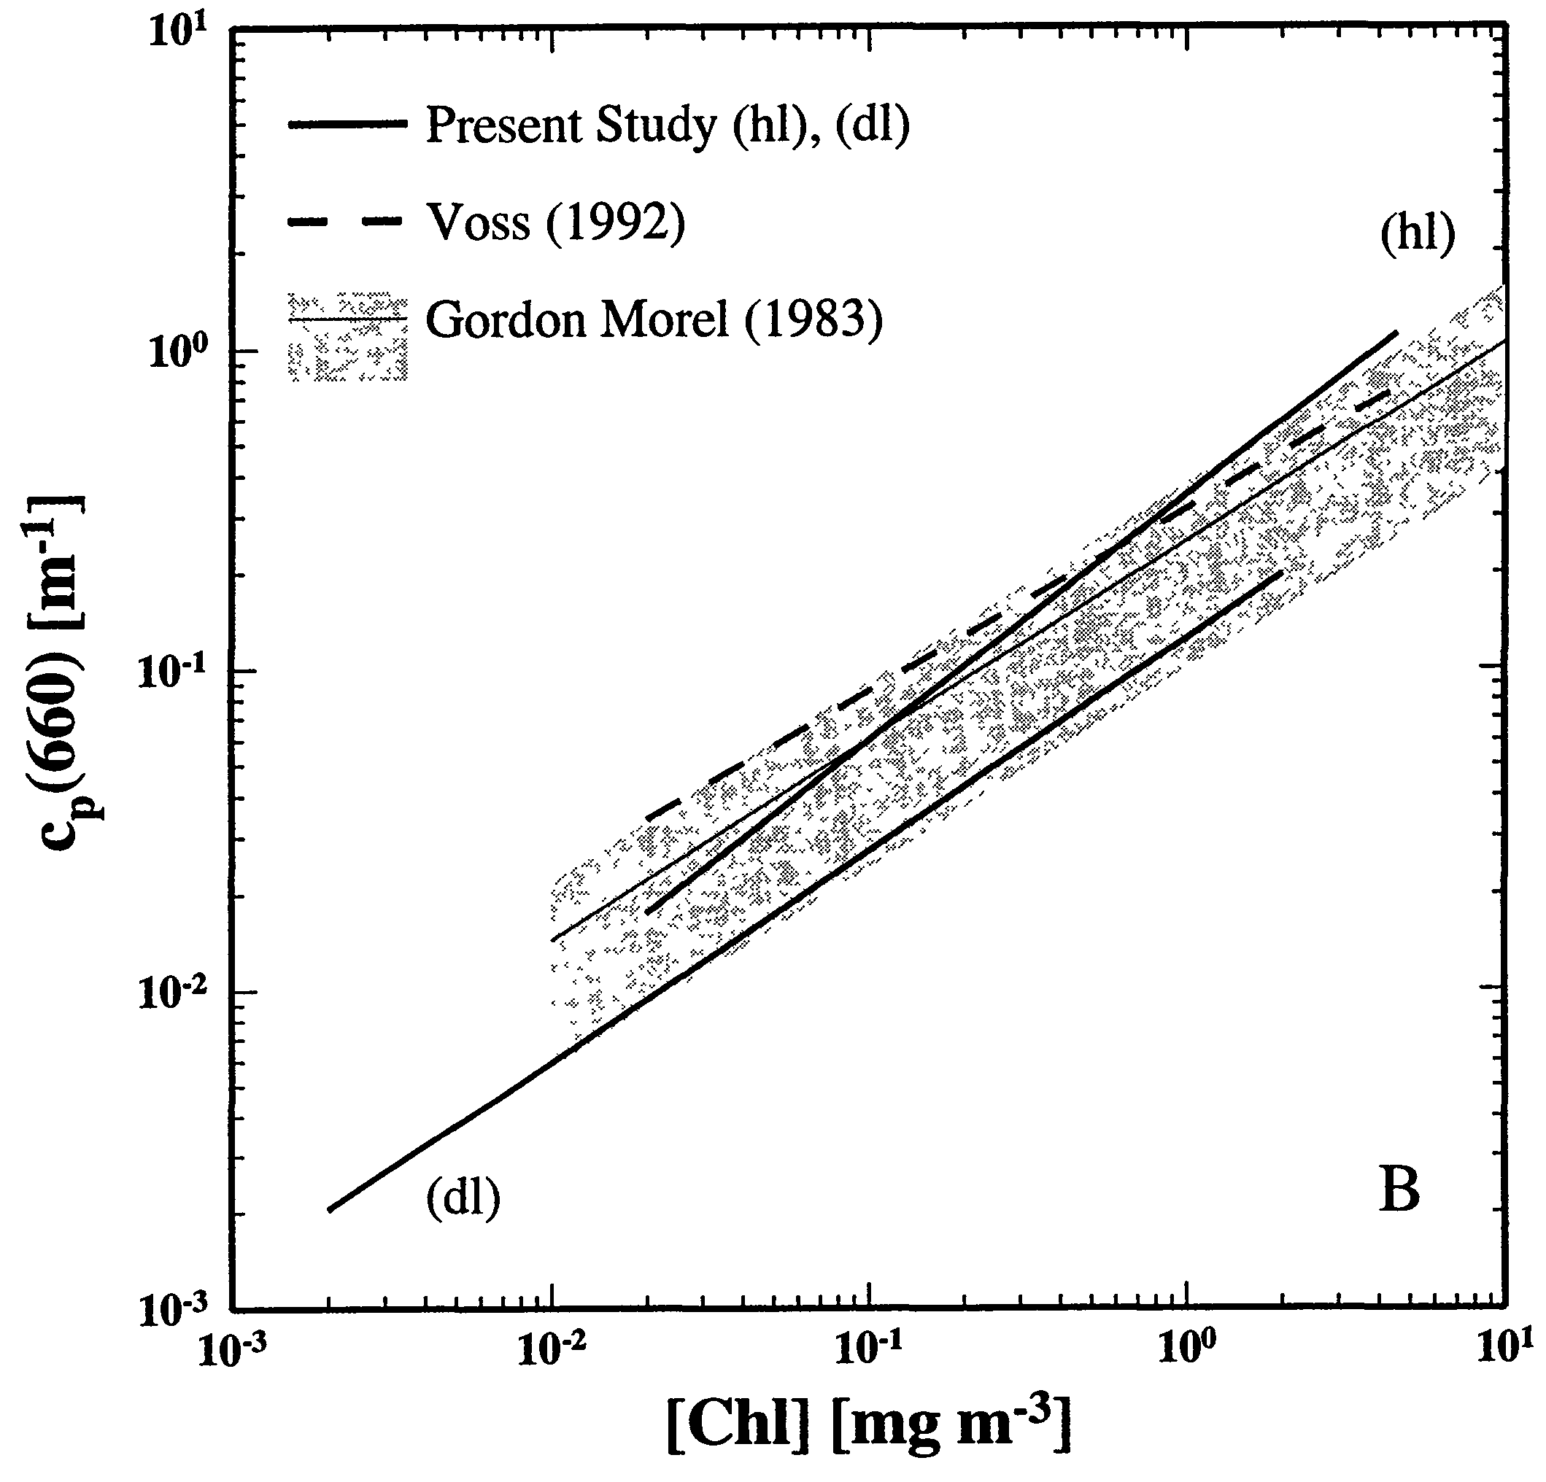
Scattering – Case I waters
c_{p}(660) ≈ b_{p}(660)
        Positively correlated
        Non-linear, B ≈ 0.7
        High unexplained variance
Loisel and Morel 1998

Slide 18
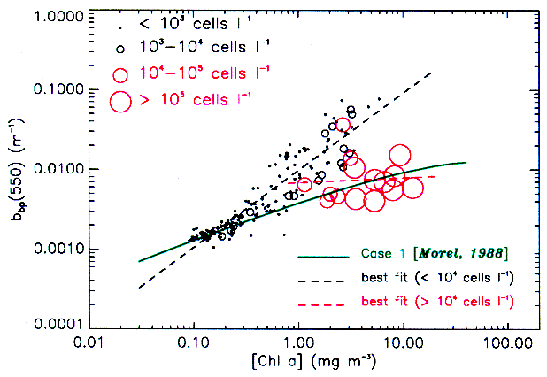
Particle backscattering
West Florida Shelf
Karenia brevis
bloom
Cannizzaro et al. 2002

Slide 19
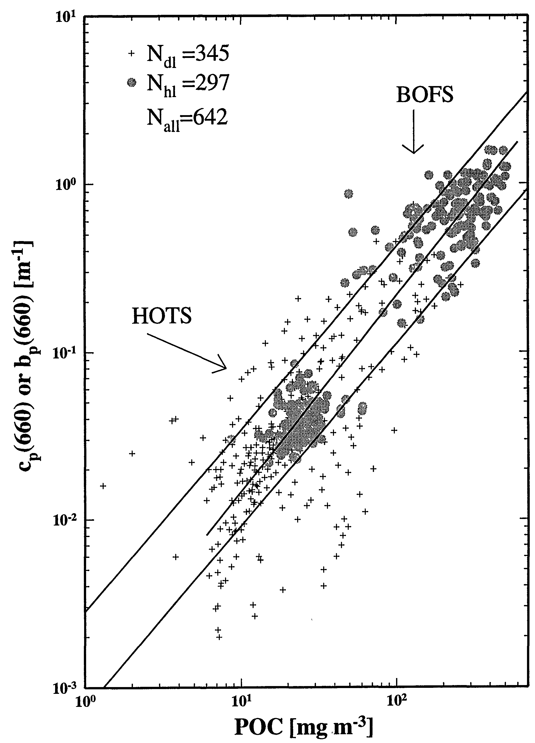
POC – Scattering (Case I waters)
Subtropical Pacific, North Atlantic
B ≈ 1
Contrast with non-linear dependence on Chl
→ POC-Chl variations are important
Loisel and Morel 1998

Slide 20
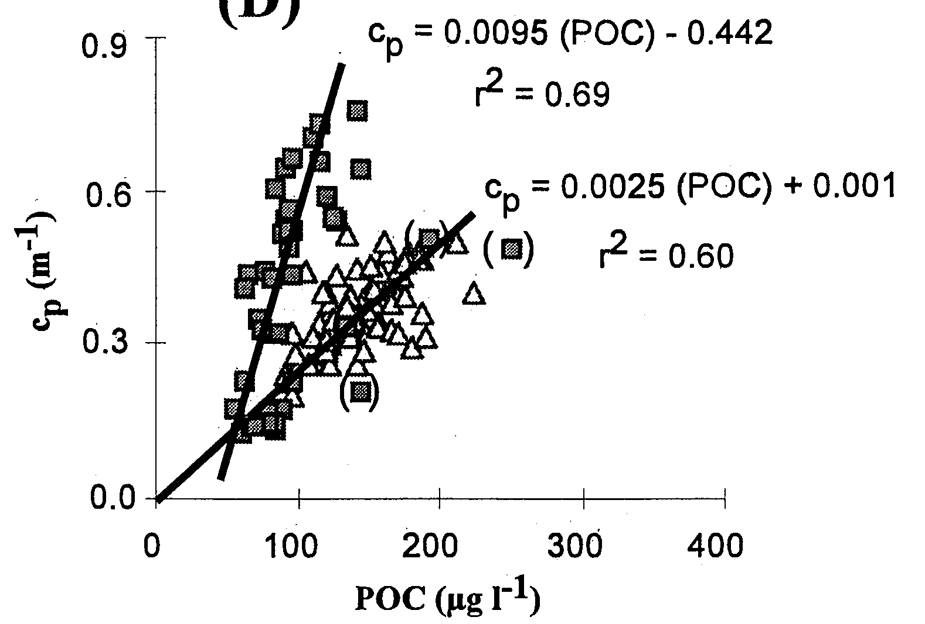
POC-Scattering
New England Continental Shelf
Bottom layer
c_{p}(660)
Surface layer
Gardner et al. 2001
→ Under specific conditions, the c_{p} – POC relationship varies

Slide 21
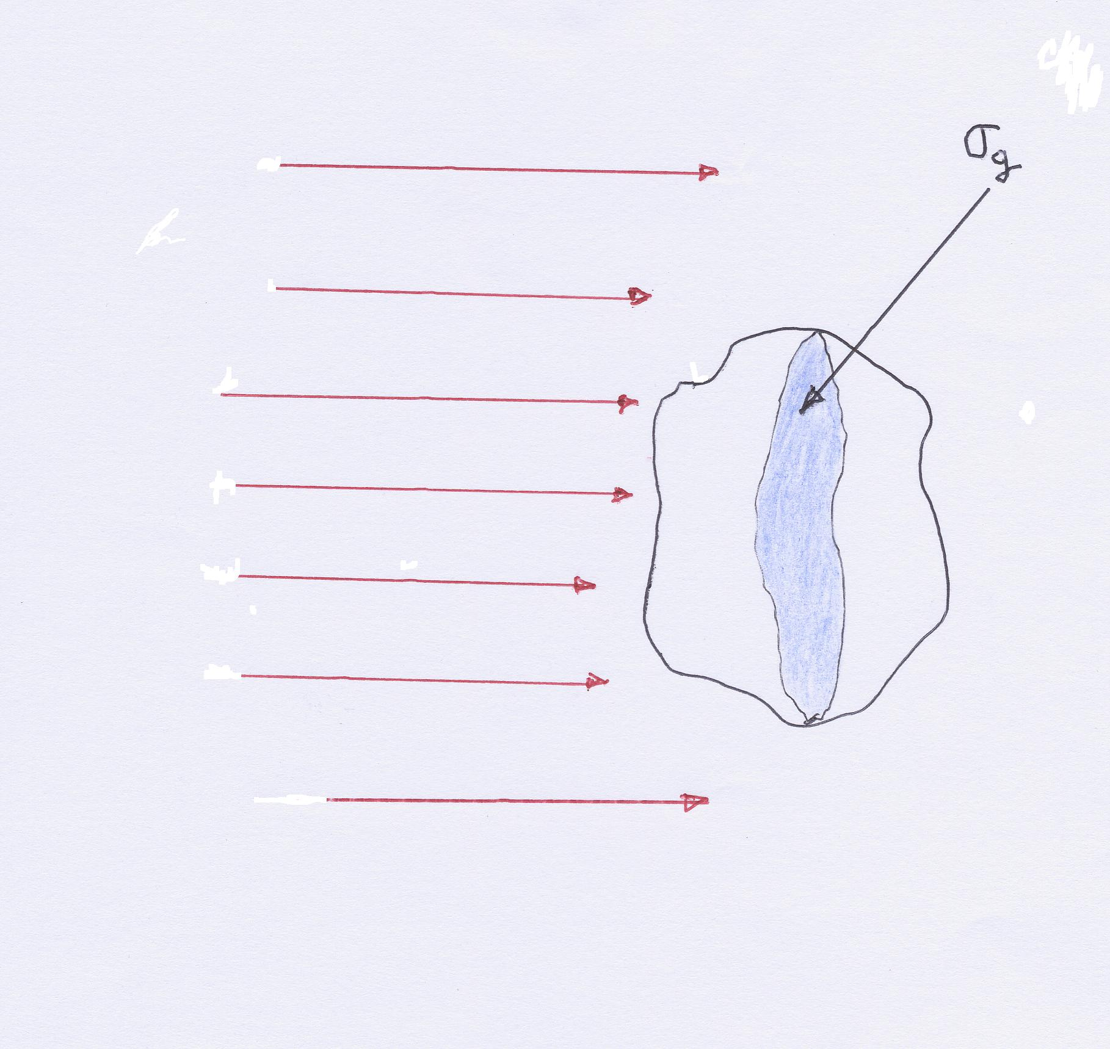
From beautiful work of Morel, Bricaud, and Kirk
E.m. radiation propagating as plane waves; σ_{g} geometric cross section (its « shadow »)
EFFICIENCY FACTORS
Energy absorbed within…
Energy scattered out by..
Divided by
Energy impinging on σ_{g}
_{Qa and Qb, respectively}

Slide 22
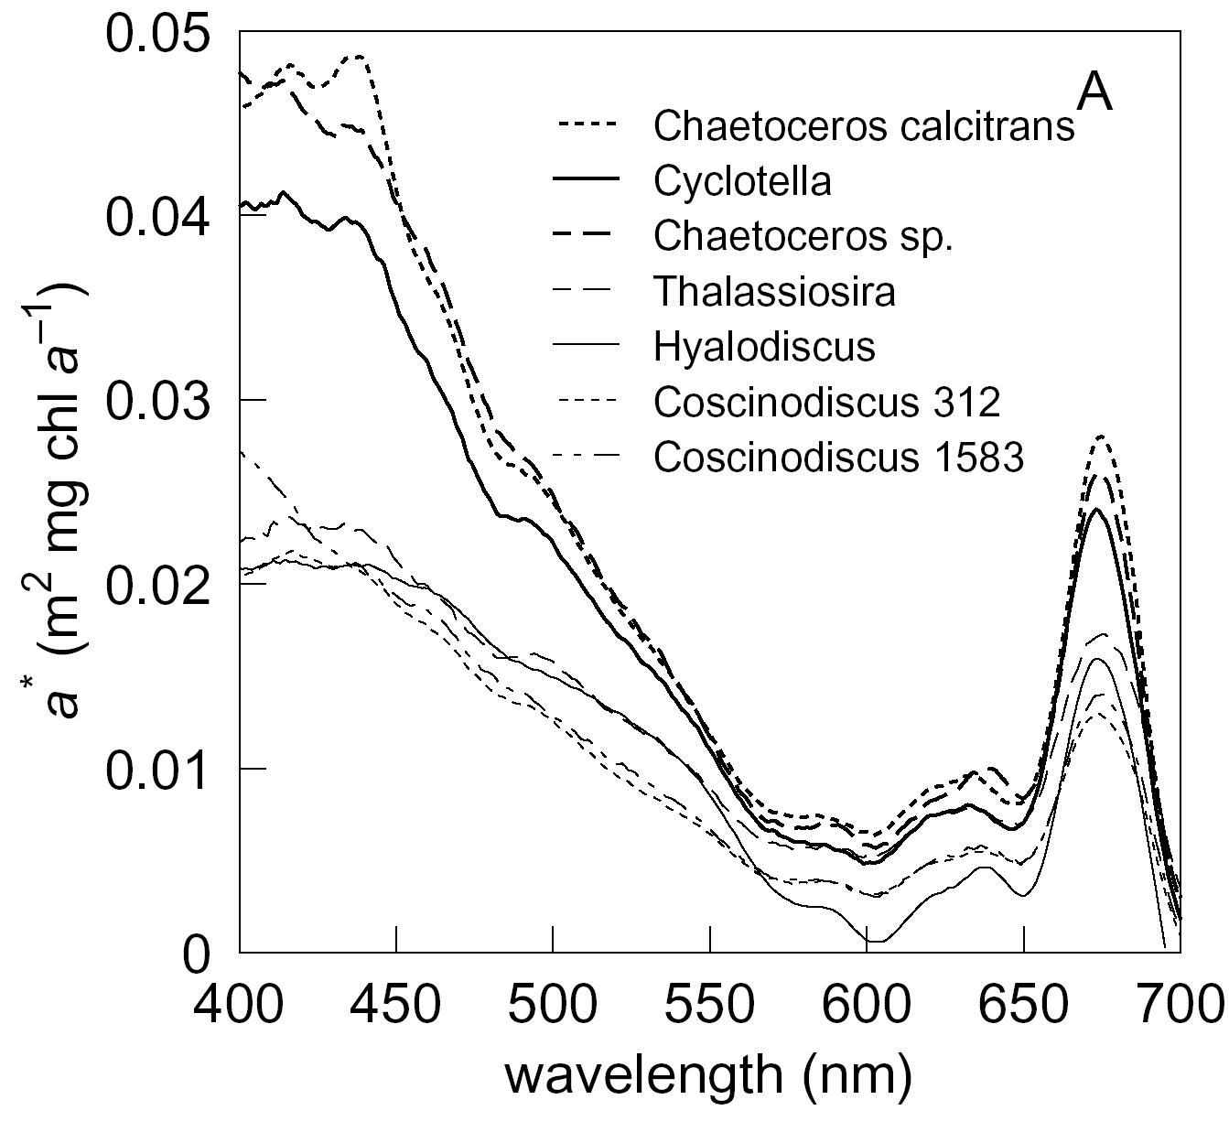
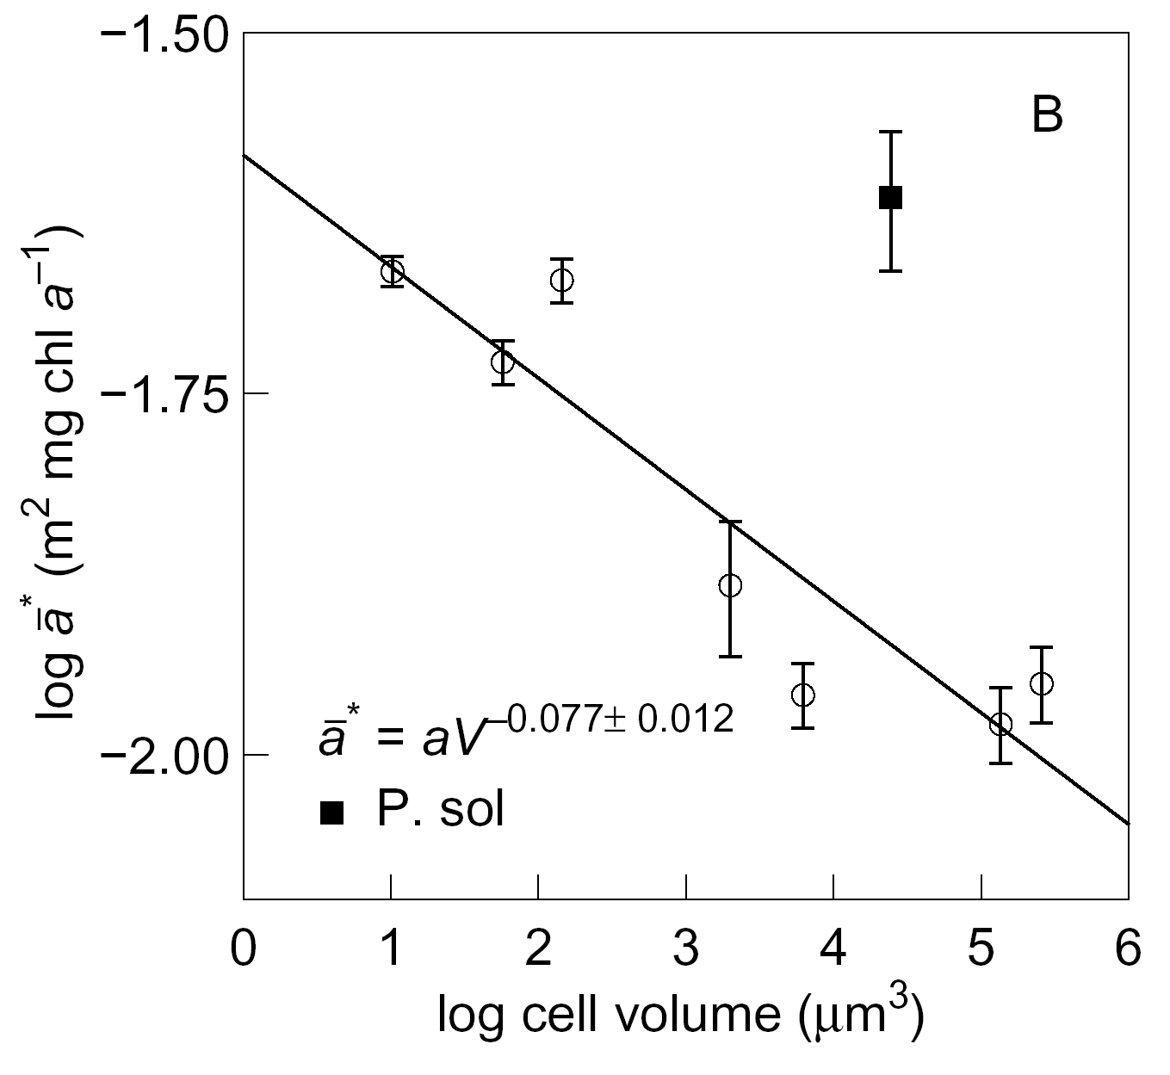
(Finkel 2001)

Slide 23
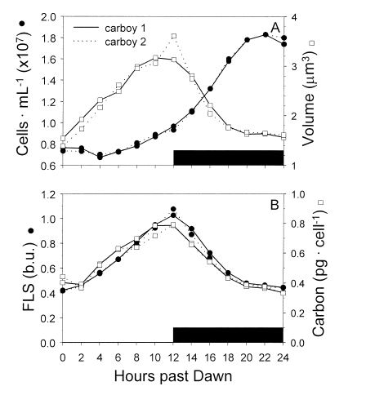
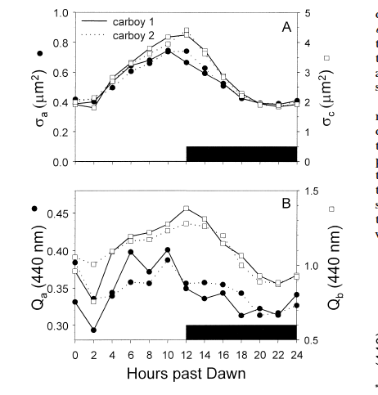
Durand et al. 2002

Slide 24
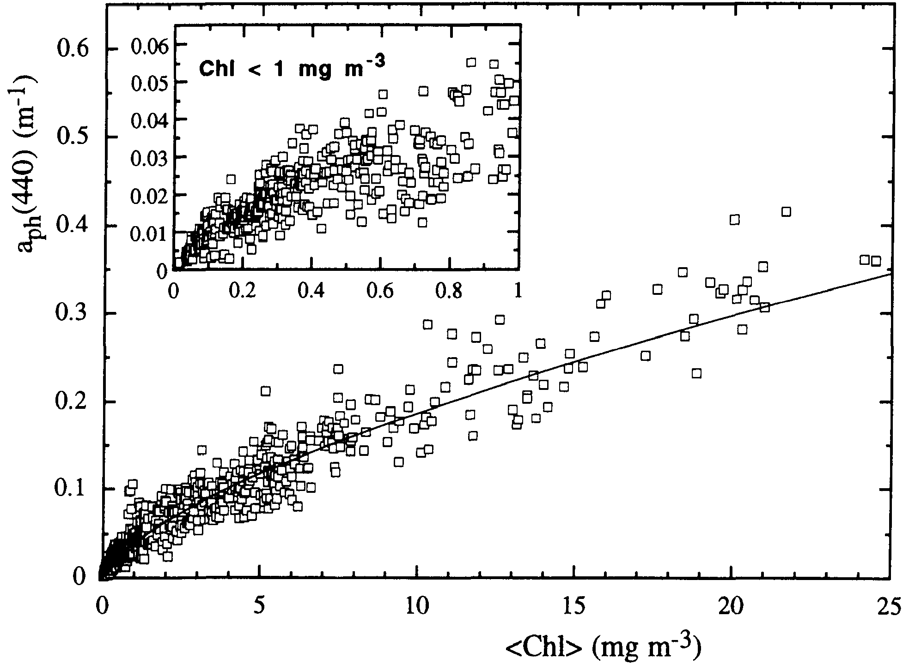
Positively correlated
Chl: 0.02 – 25 mg m⁻³
(eutrophic, mesotrophic, and oligotrophic waters)
➔ Non-linear dependence
Bricaud et al. 1995
Thanks to Heidi Sosik

Slide 25
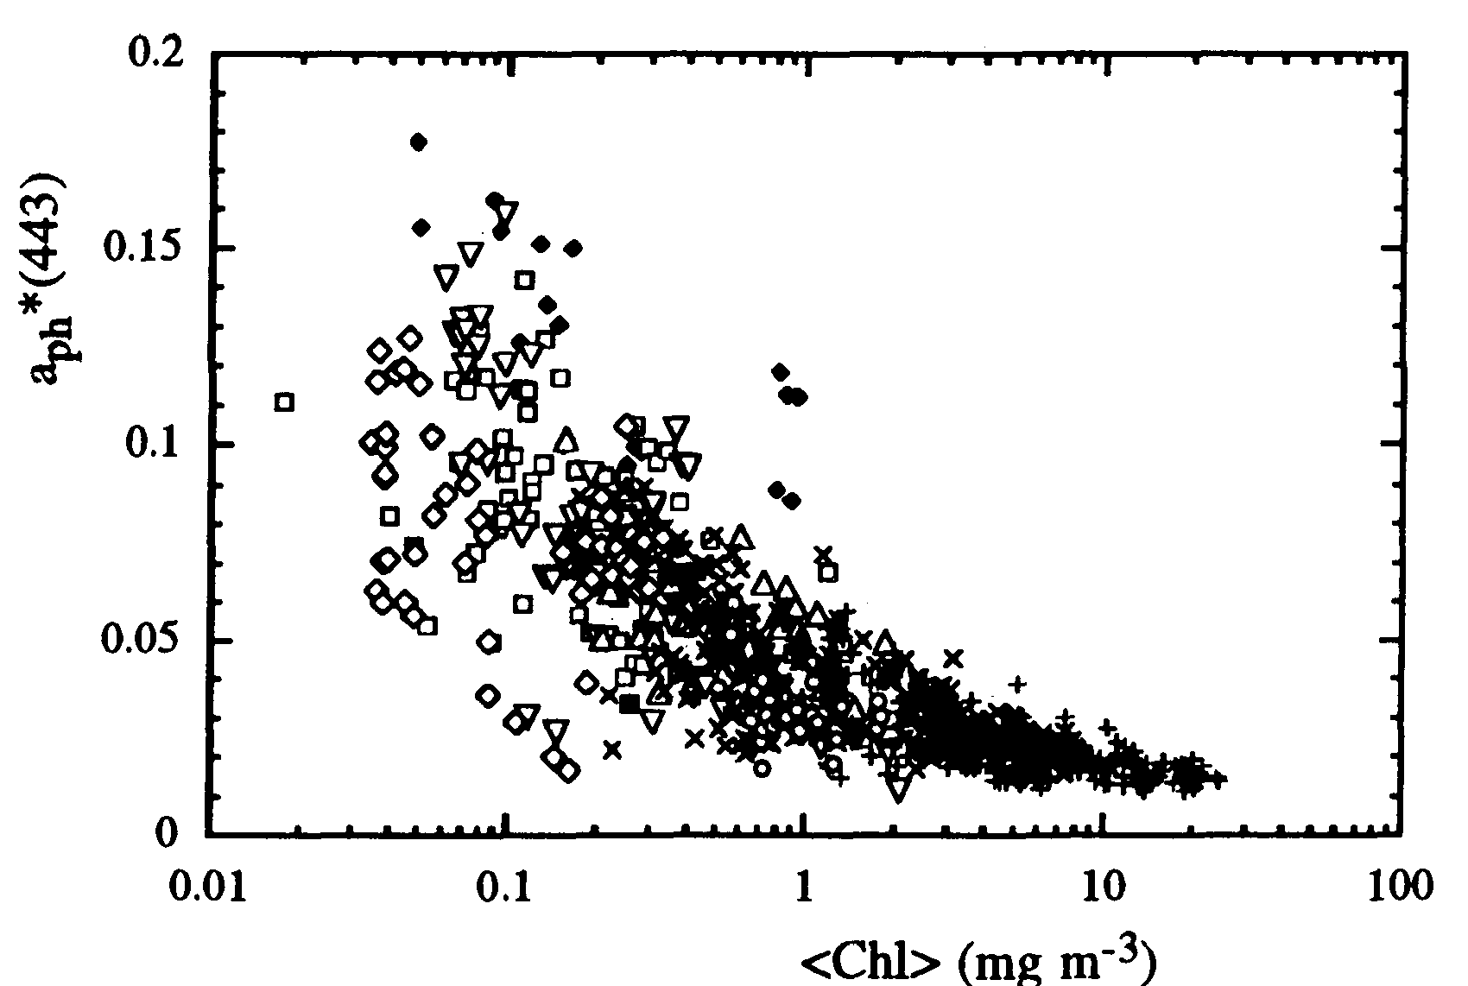
Chl-specific phytoplankton absorption
Second-order variability in a_{ph}(λ)
Negatively correlated
A(λ) and B(λ)
statistically determined
→ This reflects effects of changing growth conditions and community structure with trophic status
Note: unexplained variability

Slide 26
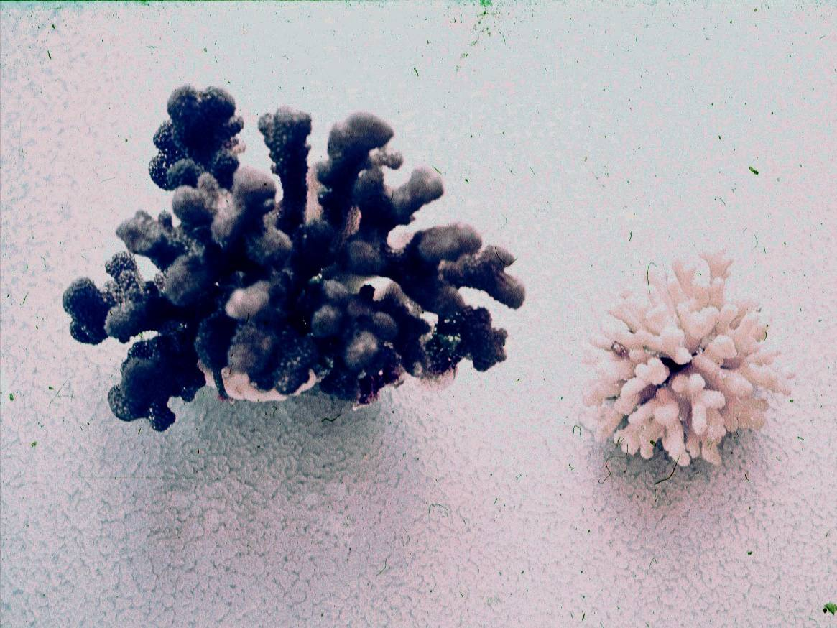
High light
Low light

Slide 27
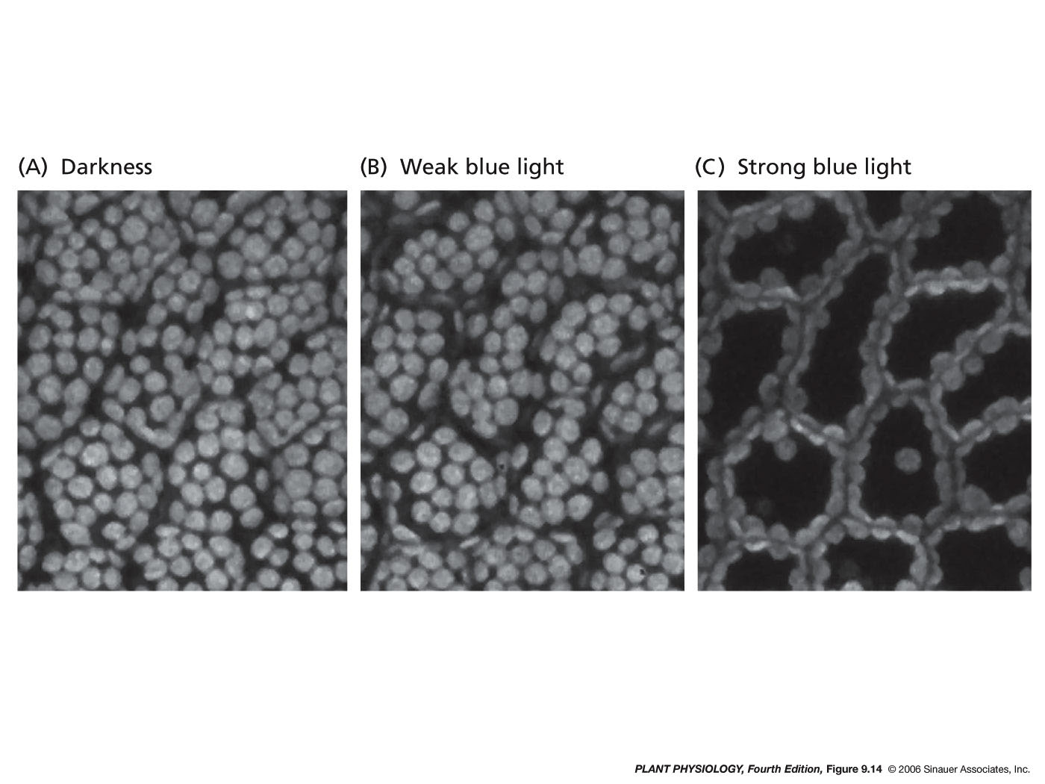

Slide 28
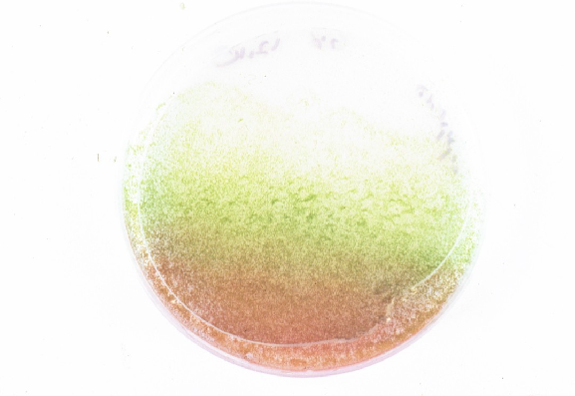
Photosynthetic
pigments
Low light
Photo-protective
pigments
High light
chlorophyte alga Haematococcus pluvialis

Slide 29
chl c
phycobilins
chl b
chl b
chl a
carotenoids
chl a
chl a-chl c-carotenoids
1.25
chl a-chl b-carotenoids
20
chl a-phycobilins
1.0
15
0.75
Relative Absorption
Spectral Irradiance ( μW cm⁻² nm⁻¹)
10
0.50
5
0.25
0
0
400
450
500
550
600
650
700
Wavelength (nm)

Slide 30
2000
1500
surface
μmol photons (m⁻² s⁻¹)
1m
1000
2m
5m
500
13m
A
C
0
Calendar Day
Wavelength (nm)
Depth (m)
Depth (m)
B
D
Calendar Day
Calendar Day
Oliver et al. 2004
μmol photons m⁻² s⁻¹
(m⁻¹)

Slide 31
Individual pigments can be measured on discrete samples biochemically
0.08
chl a
chl b
0.06
chl c
PSC
0.04
PPC
absorption coefficient (m² mg⁻¹)
0.02
0.0
400
450
500
550
600
650
700
wavelength (nm)
From Bidigare

Slide 32
10
0
B)
1
Chl a
1
25
Chl b
Sun stimulated
fluorescence
20
PSC
Chl c
0.1
90
40
Spectral irradiance (μWcm⁻²s⁻¹)
Depth (m)
0.01
60
0.001
0.0001
A)
80
0.00001
Decreasing efficiency
Increasing efficiency
100
400
500
600
700
0
1
2
3
Wavelength (nm)
Relative pigment-specific
spectrally weighted absorption

Slide 33
Heat
Absorbed photon
Charge stabilization &
photosynthesis
Fluorescence

Slide 34
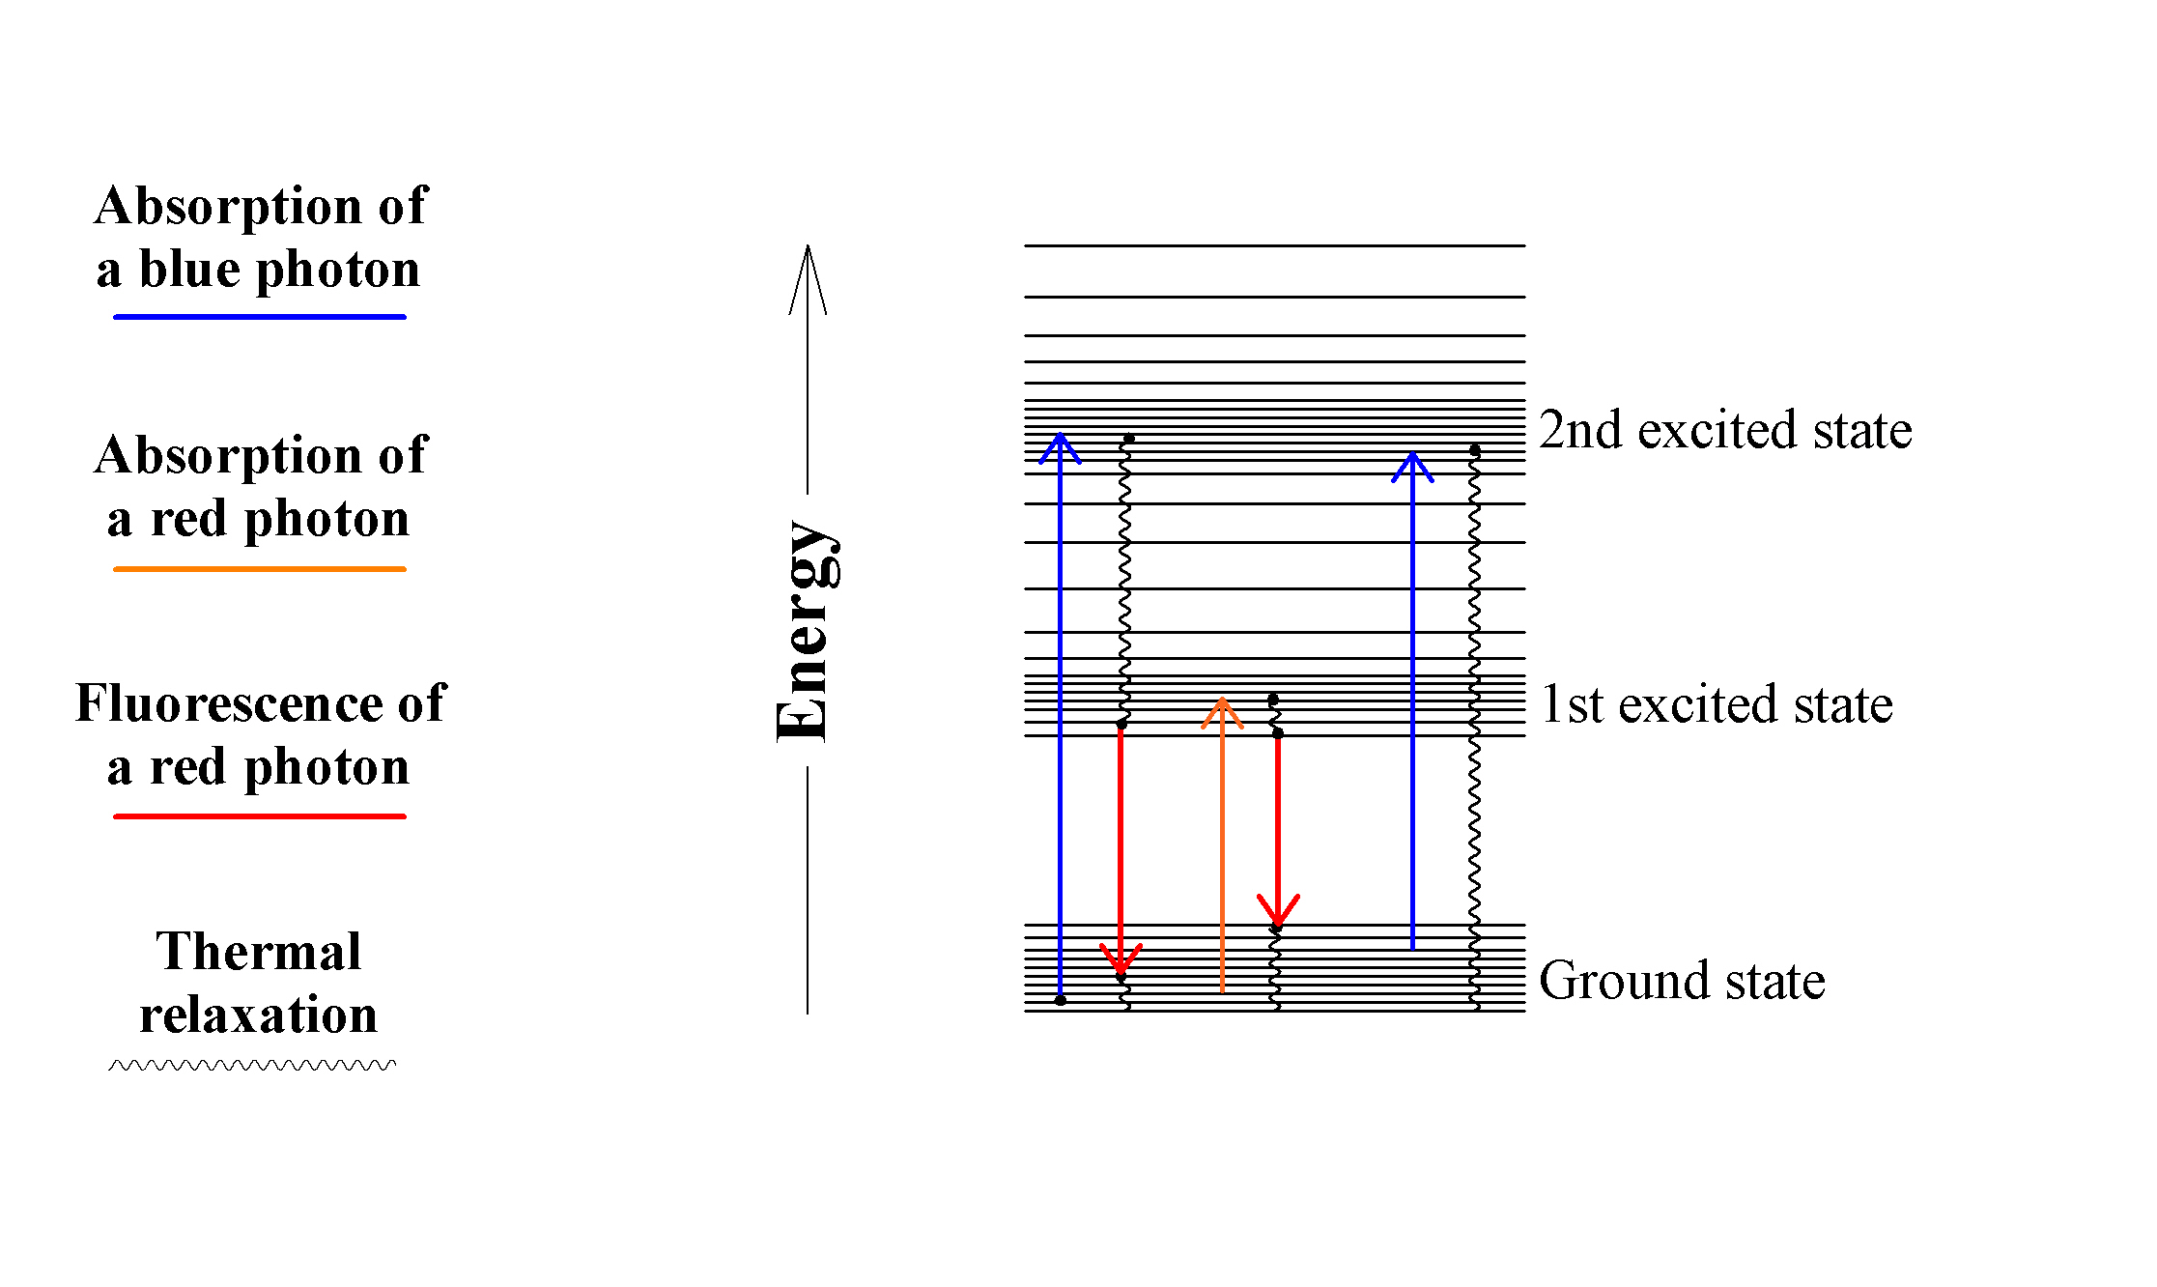
Chlorophyll a - Fate of photons absorbed by an isolated molecule
Diagram of energy states in chlorophyll and possible transitions

Slide 35
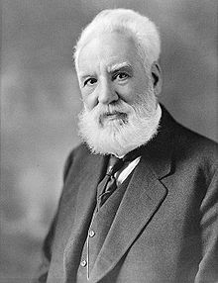
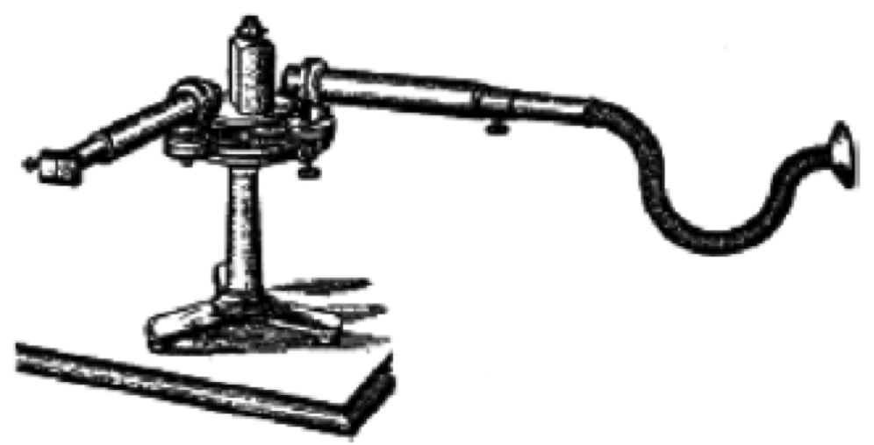
Light Absorption
Heating
Thermal Expansion
Alexander Graham Bell developed “spectrophone”, essentially an ordinary spectroscope equipped with a hearing tube instead of an eyepiece listening to light induced changes in the thermal sound.
Pressure
Wave
Photoacoustic
signal

Slide 36



Strong light flash
Weak light flash

Slide 37
Heat
Absorbed photon
Charge stabilization &
photosynthesis
Fluorescence

Slide 38

Fluorescence

Slide 39

Use of sun-induced chlorophyll fluorescence to estimate the rate of carbon fixation -Example
Pacific
Stegmann et al. (1992)
JGR

Slide 40
Stress
(light, nutrients)
Chlorophyll fluorescence
An ideal world
Chlorophyll concentration

Slide 41


Slide 42


0
0
monospecific
G. breve
community
5
5
10
10
Depth (m)
Depth (m)
15
15
mixed
chromophyte
community
20
20
CDOM
Chl a
8:00
12:00
18:00
22:00
8:00
12:00
18:00
22:00
Local DaylightTime
Local DaylightTime

Slide 43


Slide 44
Physiological response
Environmental Stress
PAR
UVA + PAR
UVB + UVA + PAR
0.75
1600
0.6
800
Visible light downregulation
EPS
1200
600
0.50
0.4
UVB
damage
PAR (μmol m⁻² s⁻¹)
800
Fv/Fm
PAR (μmol m⁻² s⁻¹)
400
0.25
0.2
Fv/Fm
400
200
I_{k}>PAR
I_{k}>PAR
0.00
0
0
0
5:00
9:00
13:00
17:00
21:00
6:00
10:00
14:00
18:00
Local Daylight Time
Local Daylight Time

Slide 45

Falkowski et al. (1991) Nature

Slide 46
Fluorescence: The Basics
F_{m}
F_{m’}
Fluorescence intensity
F_{t}
F₀
Saturating flash
time

Slide 47
Other useful indices
FLUORESCENCE INDUCTION
Integrated area is
reflection of the absorption
cross-section
Photons
Low
light
cells
High
light
cells
Fluorescence rise
Photo-acclimation
Time
Flash is on
RC2

Slide 48
Other useful indices
FLOURESCENCE DECAY CONSTANTS
Light
Flash
Turned
Off
Fluorescence
Fluorescence decay constants
Time
PQ
D2
Qb
Qa
D1
Local time of day
Pheo
RC

Slide 49
Heat
Absorbed photon
Charge stabilization &
photosynthesis
Fluorescence

Slide 50
Light Reactions produce ATP, NADPH₂
Transmission
& light absorption
ATP
& NADPH
Light
Light Reactions
Dark Reactions
Nitrogen,
Phosphorus,
Metals
CO₂
sugars
& carbo’s
Biomass
Increase
Cellular Growth

Slide 51
0.1
10
0.8
φ_{max}
0.08
8
0.7
0.06
6
Carbon Quantum Yield
(mol C mol photons absorbed⁻¹)
P_{max}
Fv/Fm
0.6
Productivity (mg C mg Chl a⁻² h⁻¹)
Environmental
stress
0.04
4
α
0.02
0.5
2
I_{k}
0
0
0.4
0.1
1
10
100
1000
Irradiance (μmol photons m⁻² s⁻¹)

Slide 52
Production = P_{max} . tanh(PAR/I_{k})
4
P_{max}
3
α
oxygen evolution
2
I_{k} = P_{max}/α
1
0
0
50
100
150
200
250
300
PAR (μmol photons m⁻² s⁻¹)

Slide 53
Predicting oxygen evolution from fluorescence
(model assuming FII = 0.5)
6
5
1:1 line
4
measured oxygen evolution
3
2
1
R²=0.92, P<<0.0001
0
0
1
2
3
4
5
6
fluorescence-based predictions of oxygen evolution

Slide 54
Is a cell a puddle or lake?
From Jassby and Platt 1976

Slide 55
Chl-specific alpha
α (mg C mg chl a⁻¹ h⁻¹[μmol photons m-2 s⁻¹]⁻¹)
0.02
0.03
0.04
0.05
0.06
0.07
0.08
0
light-saturated
20
40
depth (m)
60
light-limited
80
α
α
w
100

Slide 56
Photosynthesis a chain of cascading reactions:
Each step sets the upper limit efficiency for each following step down the line
Φm_{psii} (0.65) > φm₀₂ (on the order 0.125)>φm_{co2} (on the order 0.07)
For each use of energy go to one process, it is the expense of
another reaction, this impacts the overall efficiency
Nutrient source φm_{co2}
Ammonium 0.09
Nitrate 0.07
Simplest expression for photosynthesis is
P = φ * a_{ph} * PAR

Slide 57
From Behrenfeld et al.

Slide 58
The conversion efficiency can varies between end products
Light-limited
photosynthesis
12
10
8
Light-saturated photosynthesis
Ratio of Oxygen to Carbon Quantum Yields
6
4
2
0
0
0.5
1
1.5
2
2.5
3
3.5
4
4.5
5
Absorbed Quanta by phytoplankton

Slide 59

While chlorophyll specific absorption varies 3-4 fold
quantum yields vary by an order of magnitude
Even in 1980’s was treated as a constant
From Babin et al.

Slide 60


NUTRIENT LIMITATIONS
Iron-Ex

Slide 61
Rough seas
1
Arabian Sea (SW Monsoon)
2
Arabian Sea (Inter Monsoon)
3
Arabian Sea (NE Monsoon)
4
Antarctic (Bransfield-Bellingshausen water)
5
Antarctic (Bransfield-Weddell water)
6
Antarctic (Ice-Edge water)
7
Antarctic (Weddell-Scotia Confluence waters)
8
Antarctic (Bellingshausen Cold water)
9
Antarctic (Bellingshausen Warm water)
10
Antarctic (Transitional Weddell Water)
11
Antarctic (Palmer Station)
12
Canary Islands (Fall)
13
NE Atlantic Subtropical Gyre (Fall)
14
NW Atlantic Subtropical Gyre (Fall)
φ_{max} (mol C mol photons absorbed⁻¹)
15
Gulf Stream (Fall)
16
NW Atlantic Continental Shelf (Fall)
17
Canary Islands (Spring)
18
NE Atlantic Subtropical Gyre (Spring)
19
NW Atlantic Subtropical Gyre (Spring)
20
Gulf Stream (Spring)
21
NW Atlantic Continental Shelf (Spring)
22
Southern California Bight
23
New Jersey Coastal Region
Oligotrohic
seas
E_{k(PAR)} (μmol photons m⁻² s⁻¹)

Slide 62

Types of satellite models
Empirical: Purely a statistical fit. Earliest ones were simple regression models of measured primary production against satellite derived chlorophyll concentration. These models can explain a lot of the observed variance; however assume that the fraction of productivity per phytoplankton cell is essentially fixed.
Early models were derived by Smith et al. (1982) and Eppley (1985) at Scripps Visibility Labs and Food Chain Working Group
Ck = surface chlorophyll concentration, II or Pt = depth-integrated production
Smith & Baker 1978
Eppley et al. 1978

Slide 63

Types of satellite models
Empirical: It works because, the amount of chlorophyll in a volume of water is proportional to the number of phytoplankton cells and the number of photosynthetic reaction centers. In many ways it provides a good Ockam’s razor for the sophisticated productivity models.
Applying the razor: Back in early 1990’s, many sophisticated bio-optical productivity were being developed. A global comparison of the models at the time indicated that simple correlation models did as well or even sometimes better than more sophisticated and biologically realistic models. This did not sit well with some in the community.
Complexity can add uncertainty
Problems:
l These relationships assume that the conversion of light energy is constant (not true), that the light harvested for within and between phytoplankton is constant (not true).
l Chlorophyll is a concentration, productivity is a rate which has a time dependent variable.
l Scales in which to apply the model?

Slide 64
The overcome the errors associated with the depth-dependent variability
You generate climatalogies and idealized profiles.
Ignoring the vertical behavior can lead to a 30% error
Remember the majority of
phytoplankton biomass is likely light limited, so the importance of the upper water column where light levels are high dominate the integrated productivity estimates.
Platt and Sathyendranath, Science

Slide 65
Relative cloud cover
Biogeographic provinces
Monthly weighted chl
productivity
Platt and Sathyendranath, Science

