Slide 1
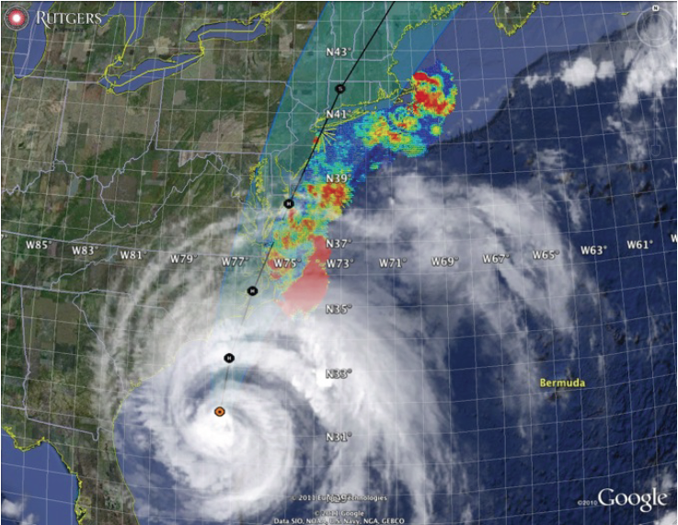
Hurricane Irene: Turbulent Mixing and SST Sensitivity
Greg Seroka
2/20/2012

Slide 2
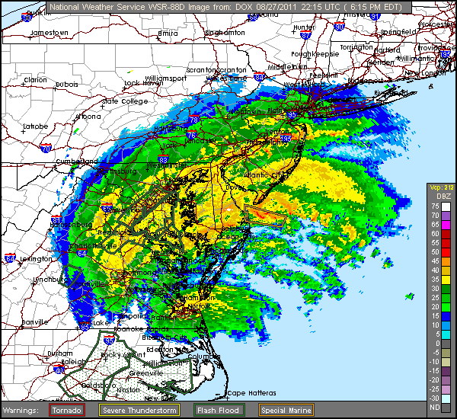
Hurricane Irene Landfalls
Bahamas landfall as Cat 3 hurricane (~105 kt) on August 24, 2011
Second landfall near Cape Lookout, NC on August 28 as Cat 1 (75 kt)
Third landfall very near Atlantic City, NJ as Tropical Storm (60 kt)
Notes:
-third landfall near Little Egg Inlet, winds confined to the waters well to the east of the track of the center

Slide 3
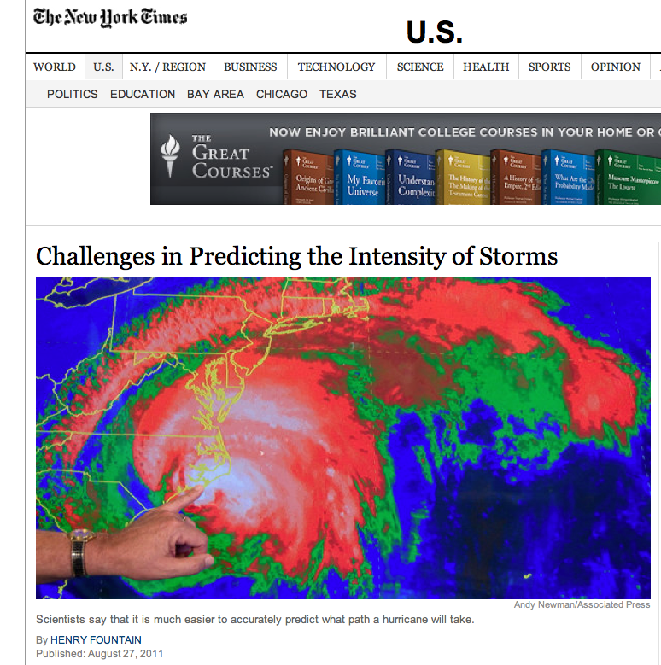
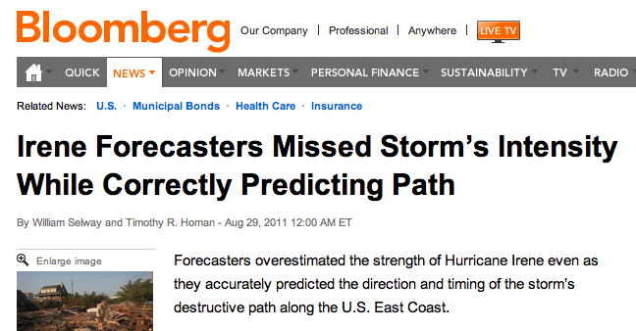
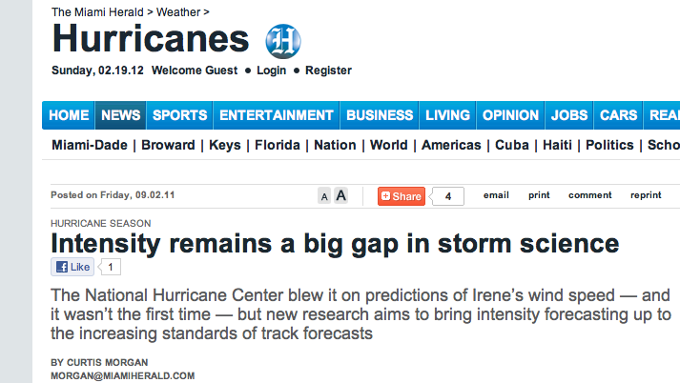
Hurricane Irene Facts
First tropical storm to threaten NYC since Hurricane Gloria in 1985
Flooding records broken in 26 rivers
Caused at least 56 deaths
Damage nearly $8 billion
Notes:
-Rivers: NJ (8), NY (14), Vermont (4)
***Raritan River flood record broken
-Miami Herald: “Irene seemed to defy some basic hurricane rules. With warm water and light wind shear in its path, there was time and fuel to strengthen. Instead, Franklin said, it began an eye wall replacement cycle that will typically temporarily weaken a hurricane before a new eye forms and contracts, rebuilding wind strength.
But Irene’s wall simply collapsed, turning the hurricane into weaker, but still formidable mess of rain bands. Other factors might have come into play – dry air or upwelling of deeper, cooler ocean water might have seeped into its core.”
-NY Times: “Hurricanes also tend to strengthen over water that is warm and deep, and Irene may have passed over areas that are a bit shallower. ‘There are some peculiar aspects to the water in that part of the Atlantic,’ Mr. Kimberlain said. But it is very hard to know how the water may have affected Irene ‘because we don’t have observations everywhere.’”
-Rutgers (RU COOL) had gliders out there, models running, CODAR operating

Slide 4
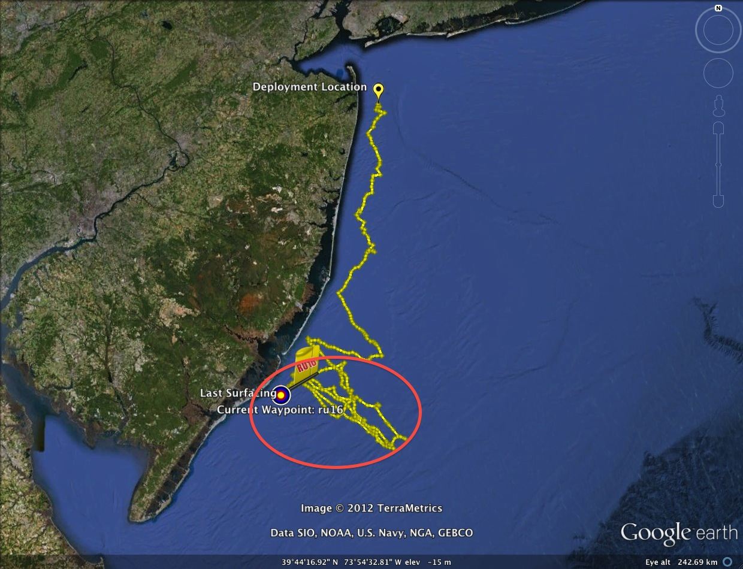
RU16 Glider Track
August 10-September 9, 2011

Slide 5
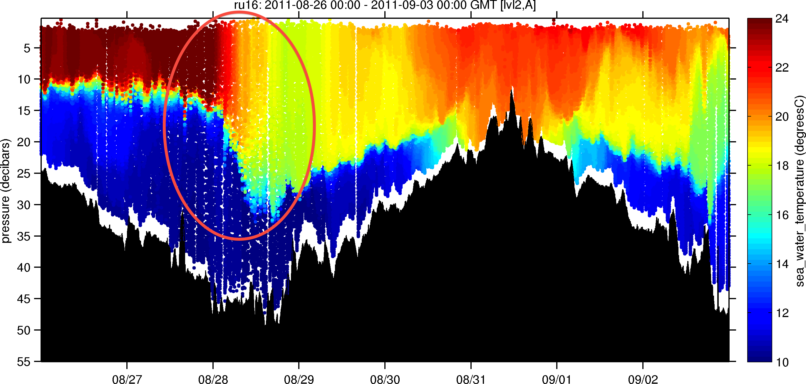
RU16 Water Temperature
Notes:
-mixed much more quickly than anyone imagined (reference of mixing time?)
-24-18C

Slide 6
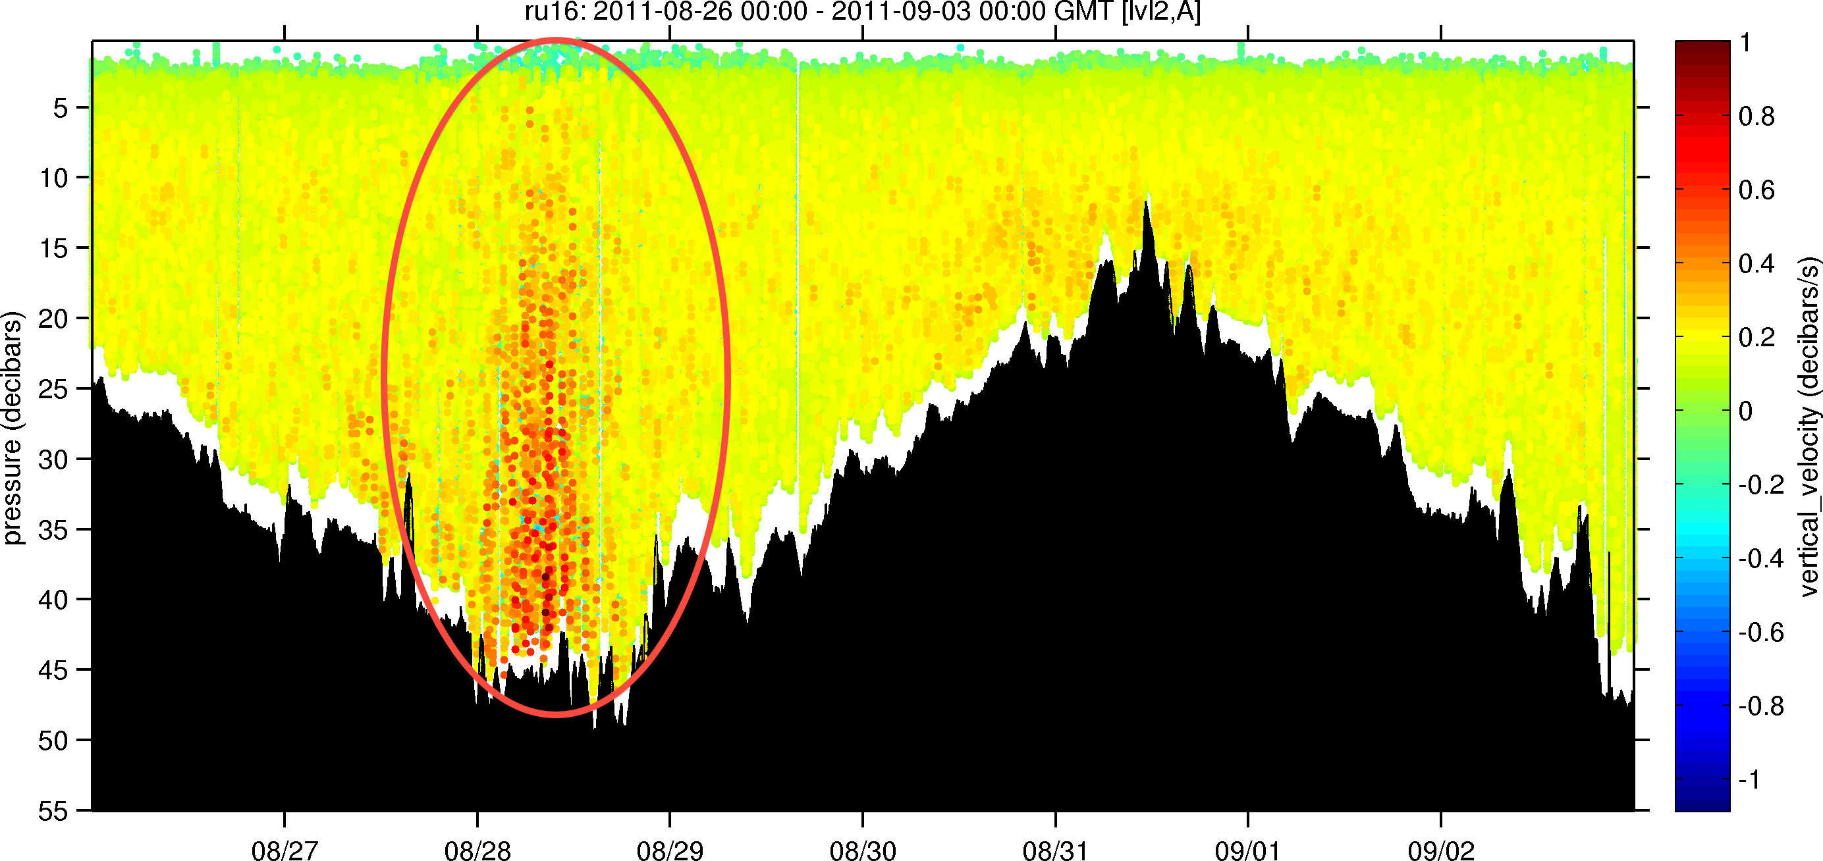
RU16 Vertical Velocity
Notes:
-very high vertical velocities during mixing time
-both positive and negative velocities are high (negative may be hidden)→ much more turbulence during mixing phase

Slide 7
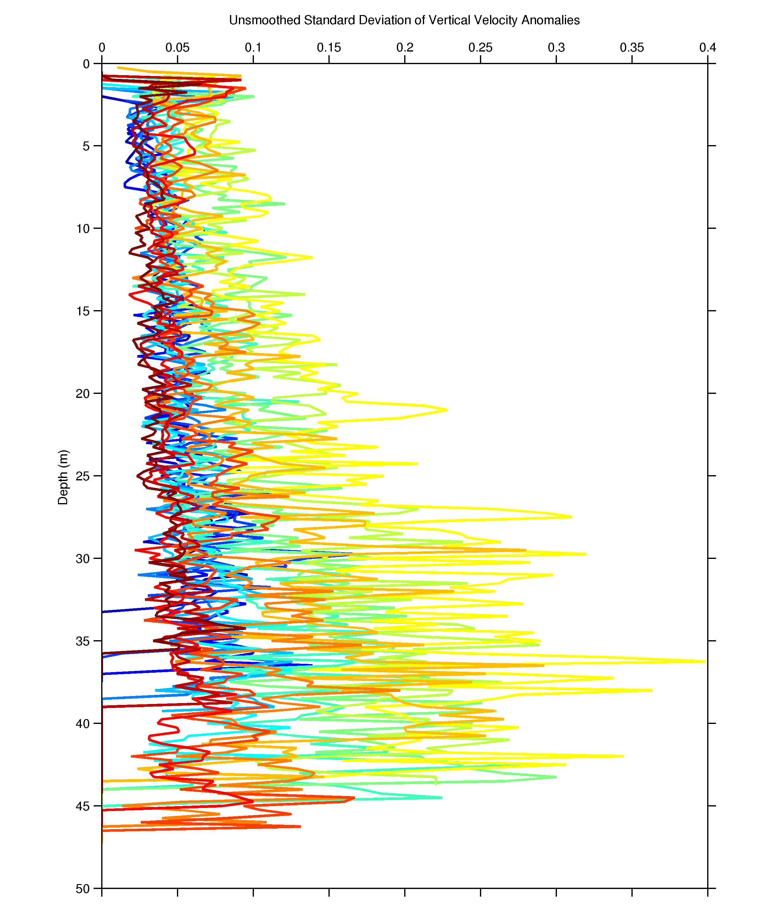
STDEV of vertical velocity anomalies (w’)

Slide 8
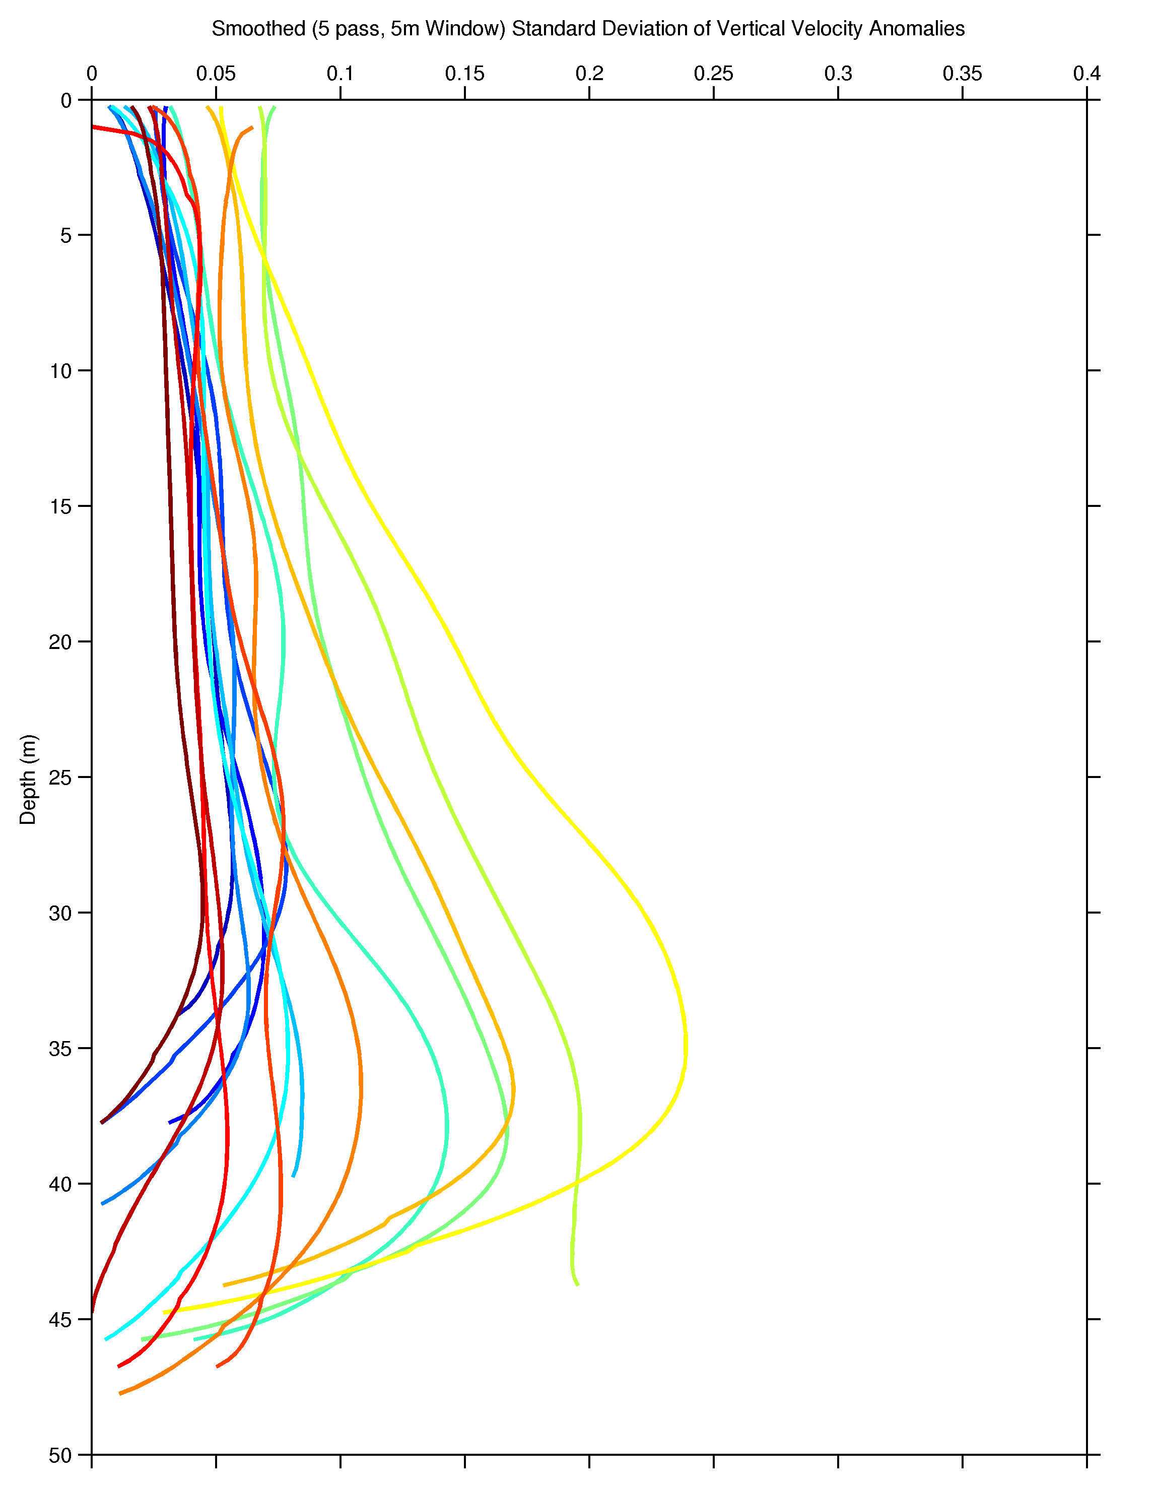
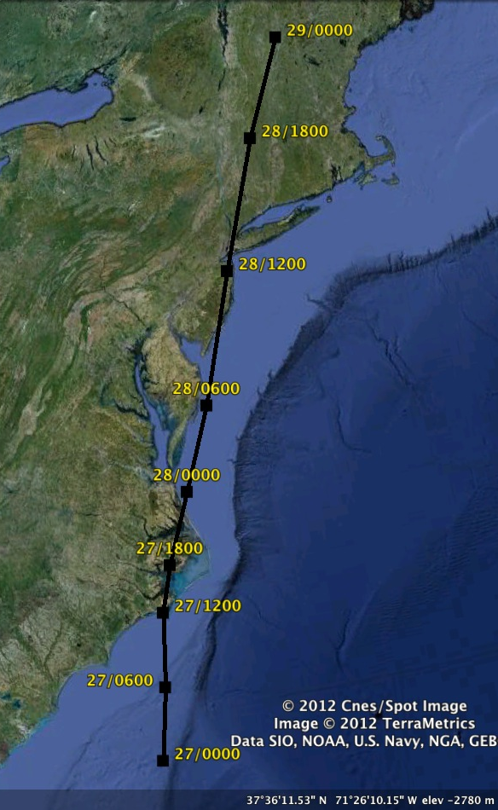
Smoothed STDEV of w’
Continental shelf
Deeper water
Notes:
-start from blue, go to red (8/27 09Z to 8/29 01Z)
-each profile is ~2 hours (1 segment is dive and resurface)
-each profile is standard deviation of w’ (smoothed)
-bottom stress influencing mixing at bottom, not at where wind is inputting surface stress!

Slide 9
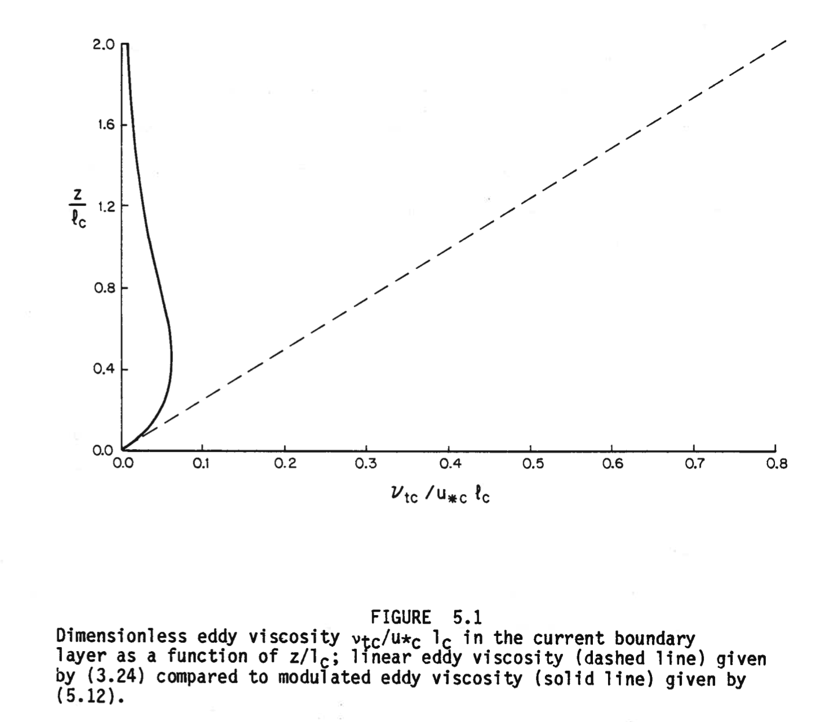
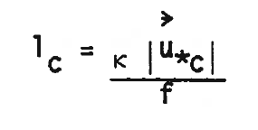


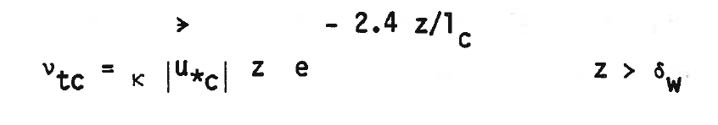
Observations agree with theory
Ekman layer length scale
Linear
Eddy viscosity
Glenn (1983)
Notes:
Within the current boundary layer; dashed line is law of the wall, profile of eddy viscosity decreases exponentially away from wall, goes to zero at wall
u’w’bar = -k (dubar/dz) → turbulence is related to eddy viscosity
Eddy viscosity is a function of the flow, not of the fluid. It is greater for flows with more turbulence.

Slide 10
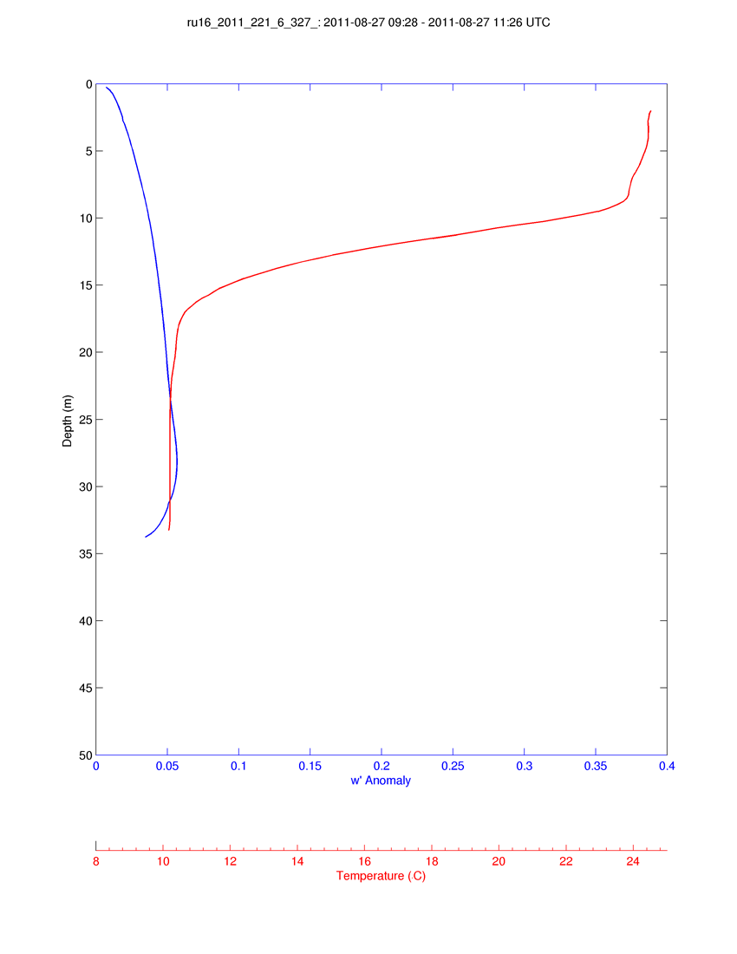
w’ anomaly
temperature

Slide 11
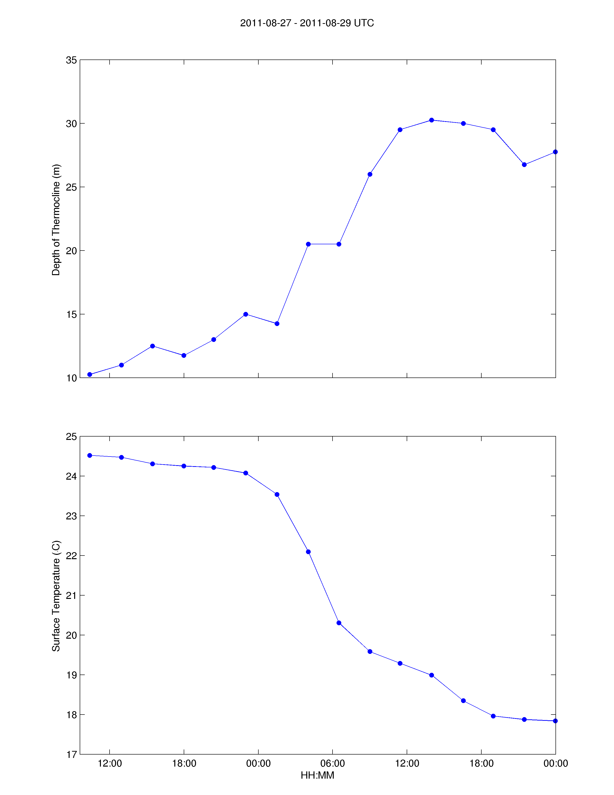
Depth of
thermocline (m)
SST (C)

Slide 12
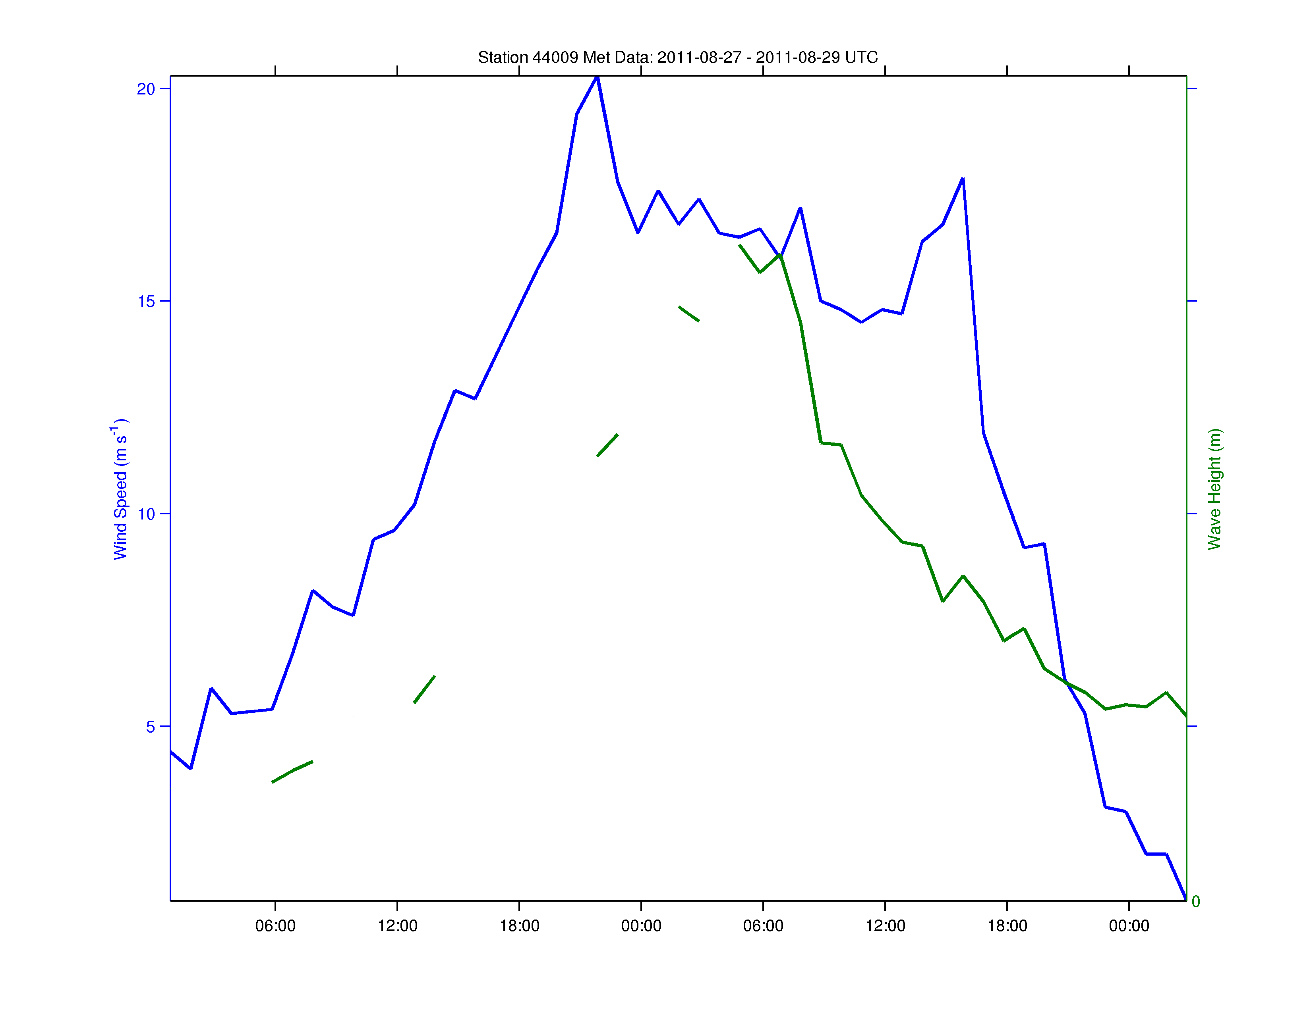
Wind speed (m/s)
Wave height (m)
Notes:
-wave-current interaction, esp. on continental shelf→ increased mixing→ decreased SST, which is not picked up by models

Slide 13
RU16 Water Temperature
Notes:
-atmospheric models do not capture SST change well (non-coupled to ocean)- use the “Real-Time Global” product pre-storm (24C!), and if do capture SST change (using 1D ocean mixed layer model in HWRF), too slow in mixing and not throughout water depth (esp. bottom stress, bottom turbulence, mixing!)

Slide 14
Weather Research and Forecasting (WRF)
-Next generation (circa 2006) mesoscale numerical weather prediction system
-Purely atmospheric model
-Developed by National Center for Atmospheric Research (NCAR), others
-Nonhydrostatic Mesoscale Model (NMM) version operational at the National Centers for Environmental Prediction (NCEP)
-Advanced Research WRF (ARW) used here
Michalakes et al. (2001)

Slide 15
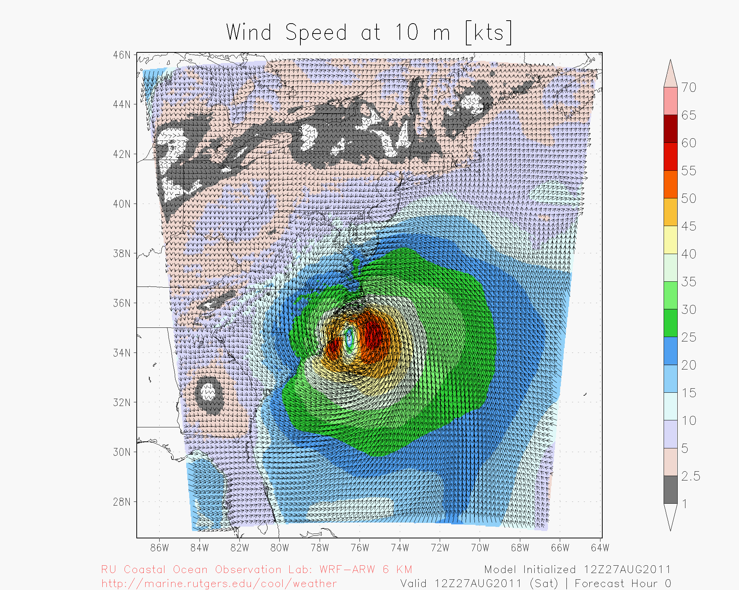
Notes:
-Weather Research and Forecasting (WRF) atmospheric model
-chose initialization to produce best track and timing (including landfall timing and location) in order to facilitate intensity comparison across sensitivity runs

Slide 16
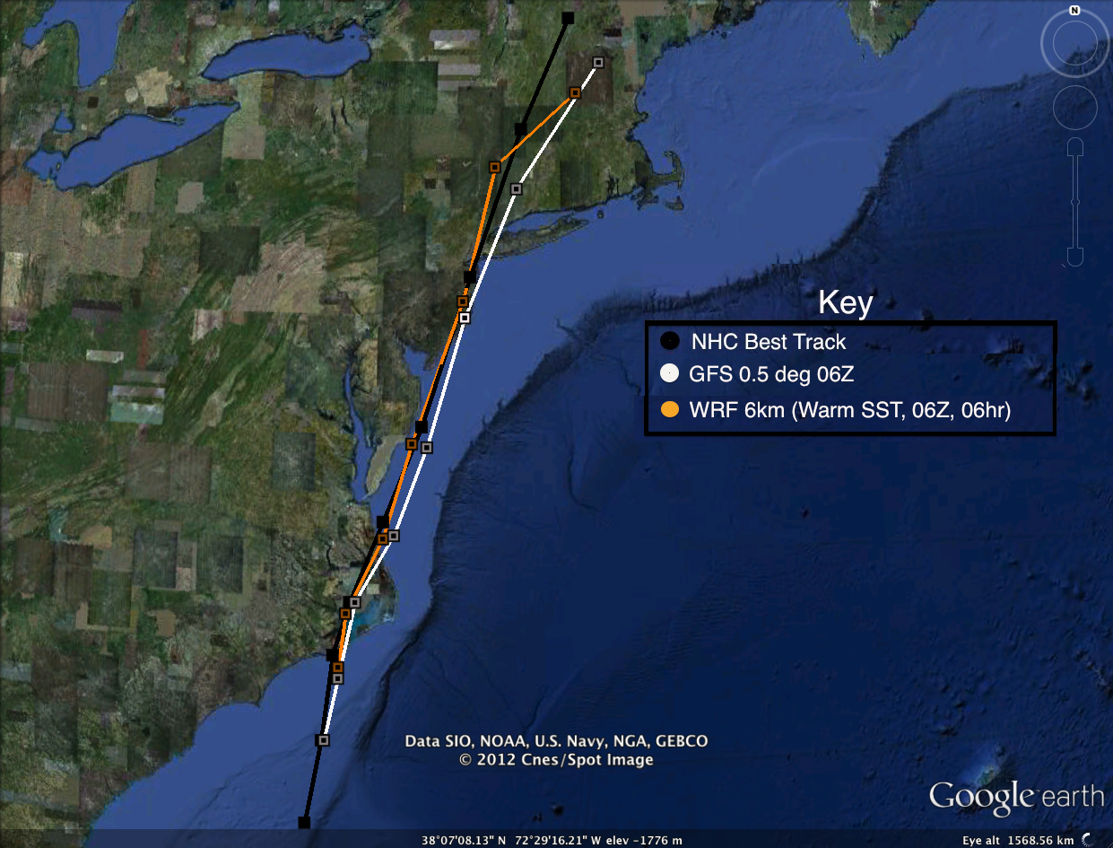

Slide 17
Notes:
-Spin-up issues 27/1200 but Warm SST (RTG only) run consistently high bias for wind
-NHC forecast way over-forecasted wind speed
-GFS was consistently too high as well
-All these use the real-time global product

Slide 18
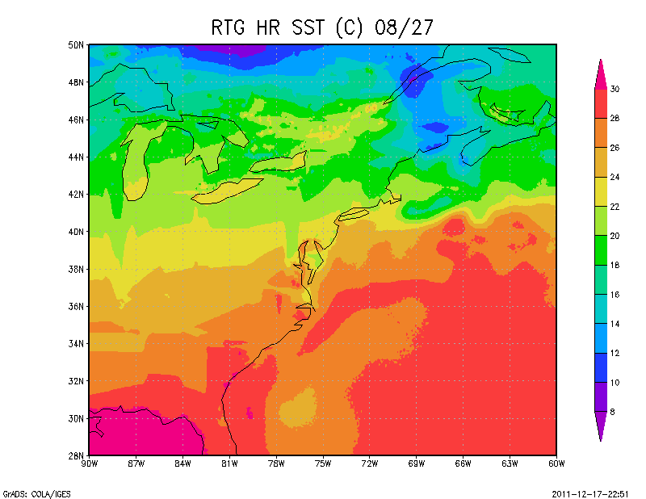

Slide 19
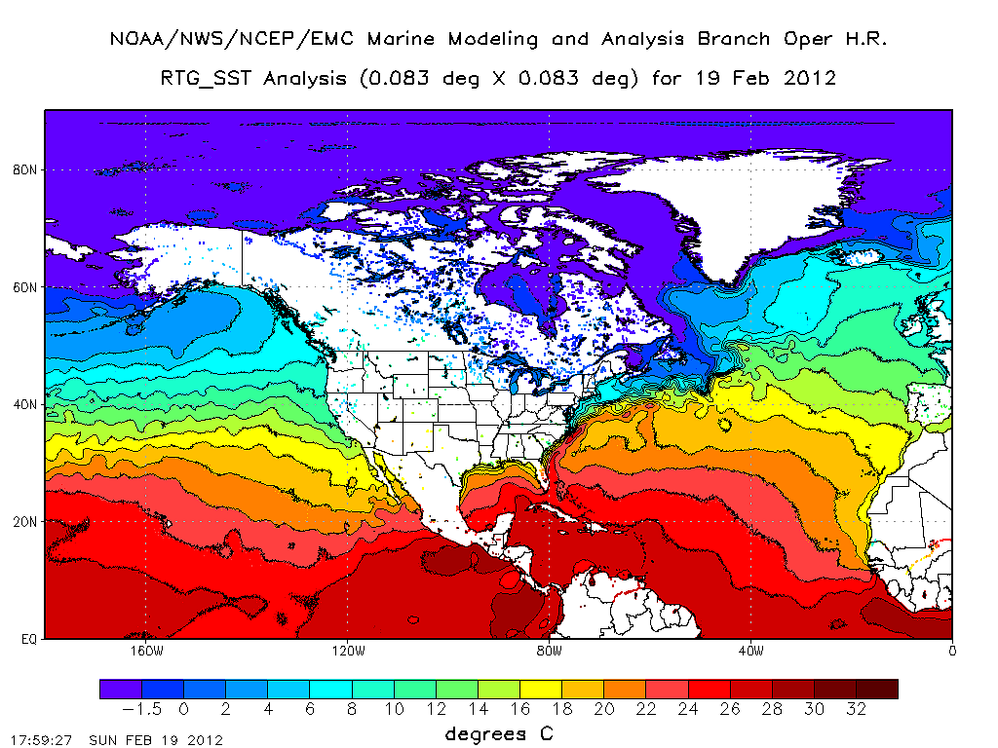
Satellite SST Products
Real-Time Global (RTG)
  1/12 degree (~9.25 km)
  Most recent 24 hrs of in situ (buoys, ships) and satellite (AVHRR and METOP) data
Gemmill et al. (2007)
Notes:
-spatial resolution low

Slide 20
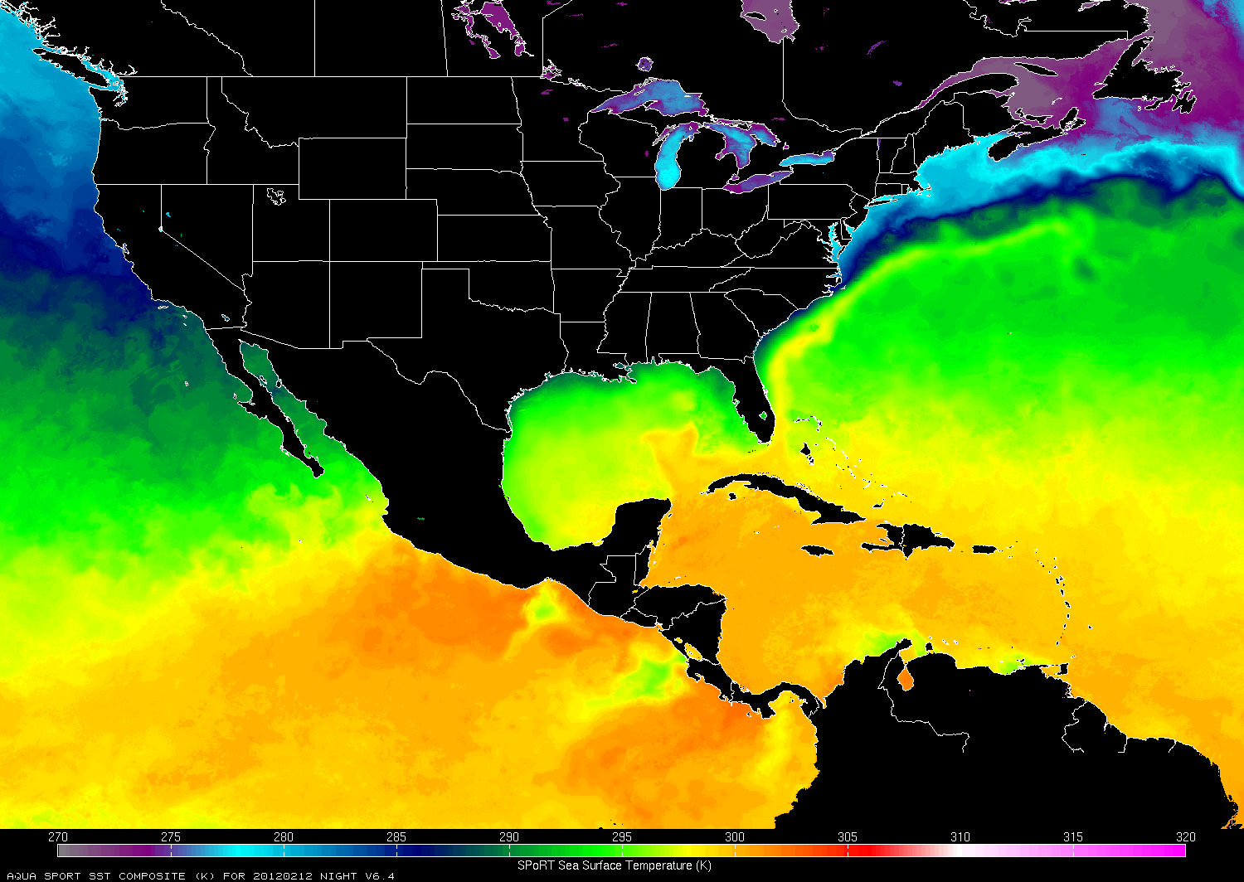
Satellite SST Products
Short-term Prediction Research and Transition Center (SPoRT) SST
  1 km resolution
  Previous 14 days (weighted) of MODIS, AMSR-E, GOES/POES, OSTIA
Haines et al. (2007)
Notes:
-temporal resolution is low (cannot capture upwelling, mixing response from storms)
-weighted based on quality and latency
Operational SST and Sea Ice Analysis (OSTIA) (UK MET)

Slide 21
Proposed AVHRR+SPoRT Composite
AVHRR declouding algorithm specific to Mid-Atlantic Bight, summer (for now)
  <10°C removed (cloud)
  near IR albedo >2.3% removed (clouds)
  Other tests on changes (within ~3km X 3km grid boxes) of SST (1°C) and near IR albedo (0.15%)
Then, coldest pixel composite with SPoRT
Notes:
-coldest pixel composite with SPoRT retains upwelling and storm mixing

Slide 22
AVHRR+SPoRT Composite Example

Slide 23
RU16 Water Temperature
28/0600
Notes:
-atmospheric models do not capture SST change well (non-coupled to ocean)- use the “Real-Time Global” product pre-storm (24C!), and if do capture SST change (using 1D ocean mixed layer model in HWRF), too slow in mixing and not throughout water depth (esp. bottom stress, bottom turbulence, mixing!)

Slide 24
WRF Model Run: SST Update
27/1200→28/0600
28/0600→29/0600

Slide 25
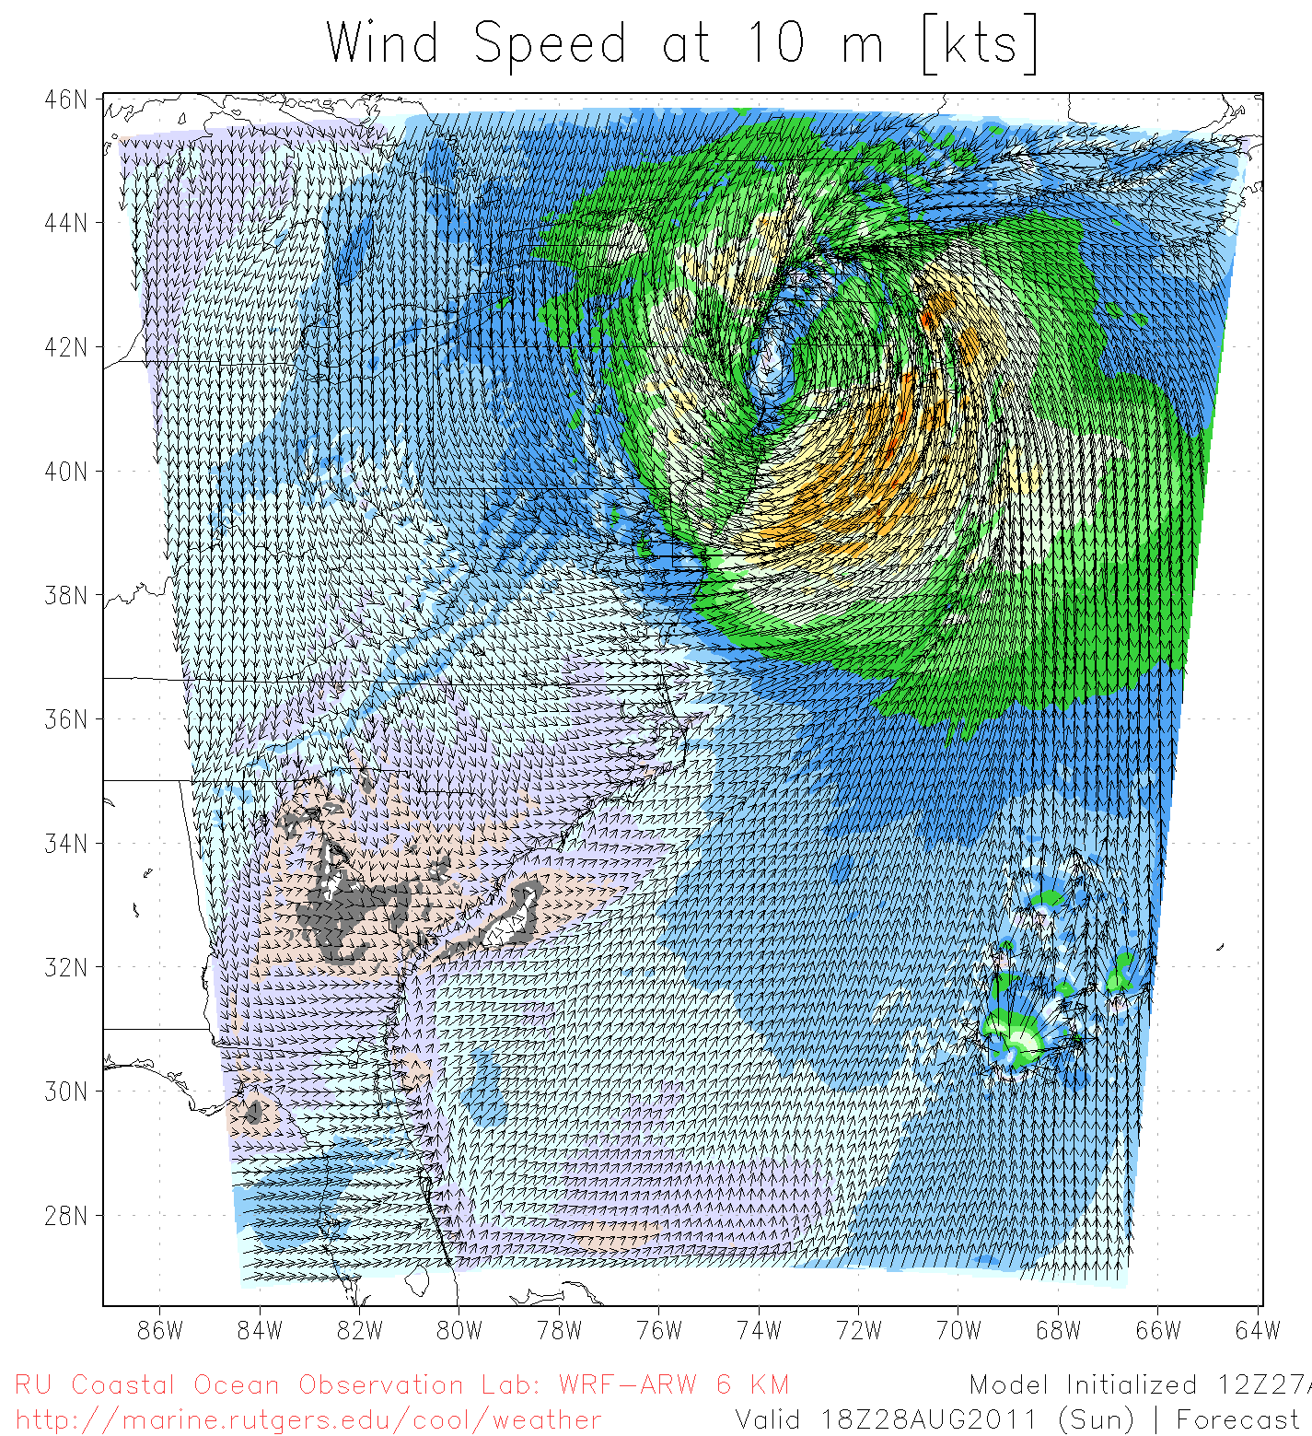
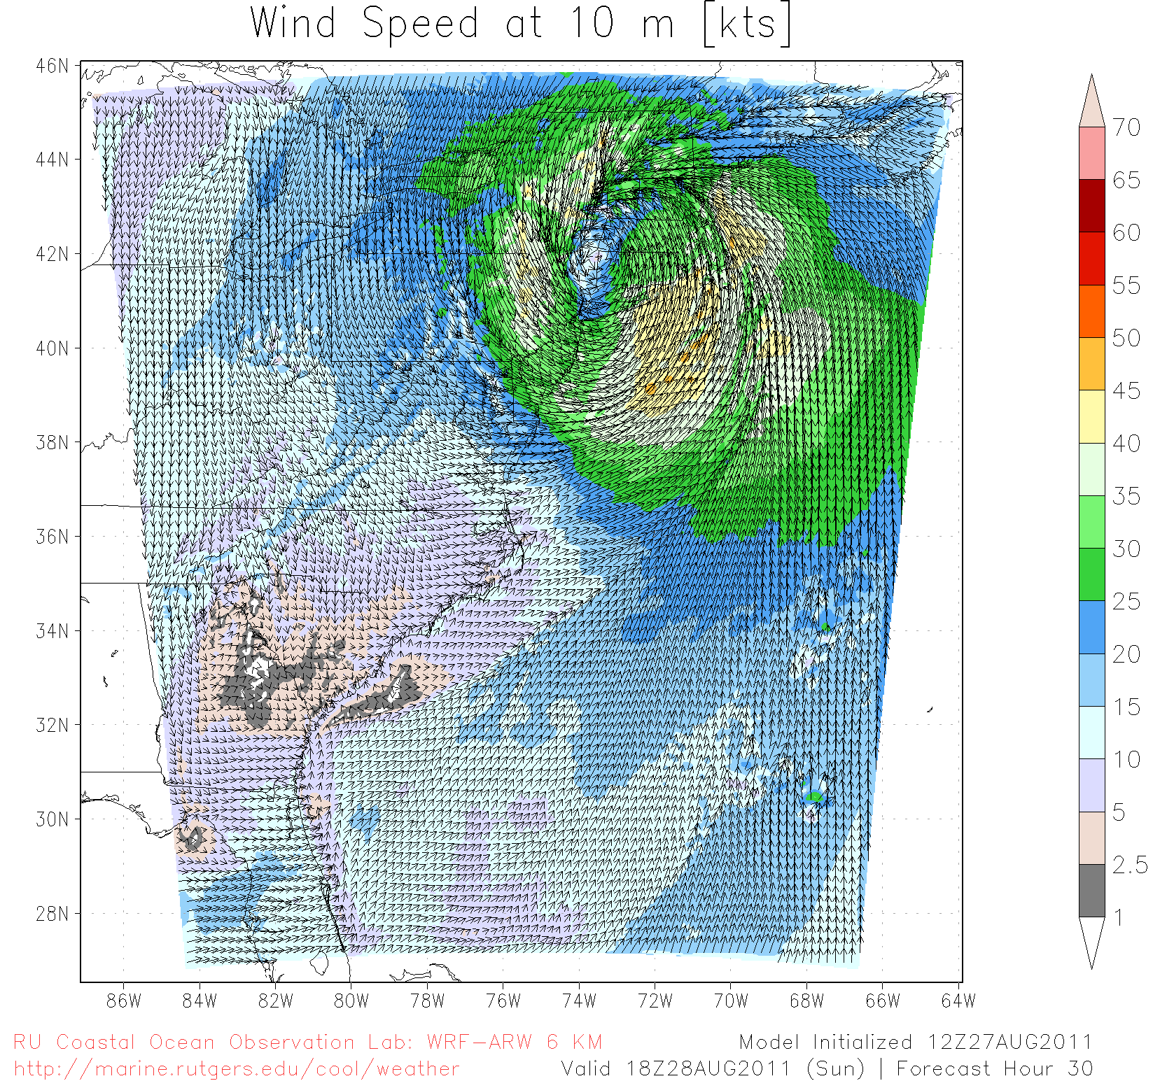
Run Comparison
WARM (RTG only)
COLD “Update” (AVHRR)
Notes:
-little change in track (still good!)

Slide 26
1D Ocean Mixed-Layer Model
1d model based on Pollard, Rhines and Thompson (1973) was added for hurricane forecasts
Purpose is to represent cooling of sea surface temperature due to deep mixing of the oceanic boundary layer with stably-stratified cooler water below
This has a negative feedback on hurricanes which helps to prevent over-prediction
Dudhia (2011)

Slide 27
1D Ocean Mixed-Layer Model
Mechanism
  Stress from strong surface winds generates currents in the oceanic mixed layer (typically 30-100 m deep)
  Currents lead to mixing with cooler water below when Richardson number becomes low enough
  This cools the mixed layer, which changes the SST and hence surface fluxes
Dudhia (2011)

Slide 28
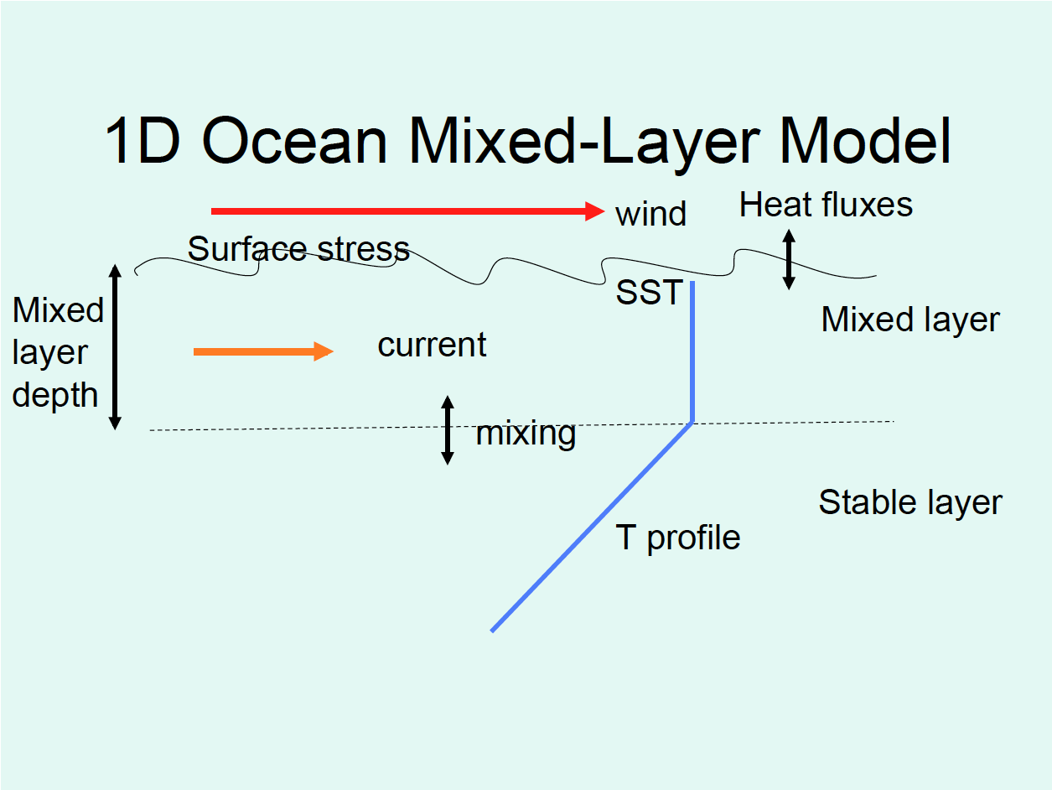
Dudhia (2011)

Slide 29

Dudhia (2011)

Slide 30
Wind Speed Error
Date/Time (UTC) | NHC Forecast | GFS | Warm (RTG only) | Warm (RTG only, OML Model) | Cold “Update” (AVHRR)
27/1200 | 5 | -7.6 | -17.22 | -17.23 | -6.17
27/1800 | 10 | 1.46 | 4.1 | 4.2 | 5.88
28/0000 | 10 | 0.08 | 1.39 | -2.14 | 3.96
28/0600 | 5 | 1.25 | -1.2 | -1.04 | -1.21
28/1200 | 15 | 1.44 | 2.39 | 4.79 | 0.5
28/1800 | 15 | 1.35 | 4.97 | 3.51 | -2.67
29/0000 | 15 | 4.46 | 3.62 | 1.93 | -0.89
29/0600 | 10 | 7.3 | 10.48 | 9.84 | 4.52
Sum of Squares | 800 | 119 | 457 | 452 | 118
RMSE | 9.43 | 3.63 | 7.13 | 7.09 | 3.61
Notes:
-RMSE much better than NHC forecast, better than Warm RTG only, Warm RTG w/ OML, and comparable to GFS

Slide 31
Next steps
Cold “update” (AVHRR) run with OML model on
Gradual SST switchover run
Comparison with more models (e.g. GFDL, ECMWF)
More robust statistics
  gridded statistical comparisons
  multiple point statistics

Slide 32
References
Dudhia, J (2011): Advanced Hurricane WRF (AHW) Physics. WRF Tutorial 2011, MMM Division NCAR.
Gemmill, William, Bert Katz and Xu Li, 2007: Daily Real-Time Global Sea Surface Temperature - High Resolution Analysis at NOAA/NCEP. NOAA / NWS / NCEP / MMAB Office Note Nr. 260, 39 pp
Glenn, S. M. (1983) A continental shelf bottom boundary layer model: The effects of waves, currents, and a moveable bed. ScD thesis, Massachusetts Institute of Technology
Haines, S. L., G. J. Jedlovec, and S. M. Lazarus, 2007: A MODIS sea surface temperature composite for regional applications. IEEE Trans. Geosci. Remote Sens., 45, 2919-2927
Michalakes, J., S. Chen, J. Dudhia, L. Hart, J. Klemp, J. Middlecoff, and W. Skamarock, 2001: Development of a next-generation regional weather research and forecast model. Developments in Teracomputing, W. Zwieflhafer and N. Kreitz, Eds., World Scientific, 269–296.
Pollard, R. T., P. B. Rhines, and R. O. R. Y. Thompson, The deepening of the wind mixed layer, Geophys. Fluid Dyn., 4, 381-404, 1973.

