Slide 1
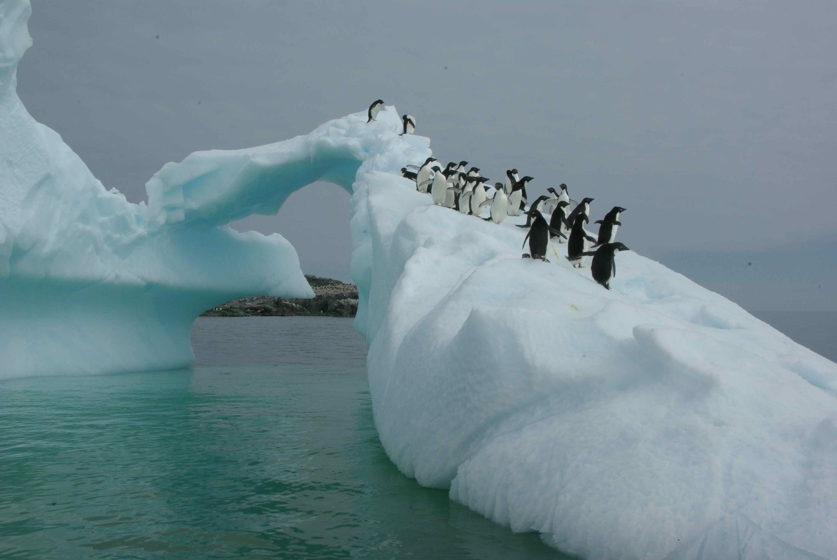




B-019 in four acts
-physical oceanography
-optics
-phytoplankton
-experimental manipulations
Notes:
1

Slide 2
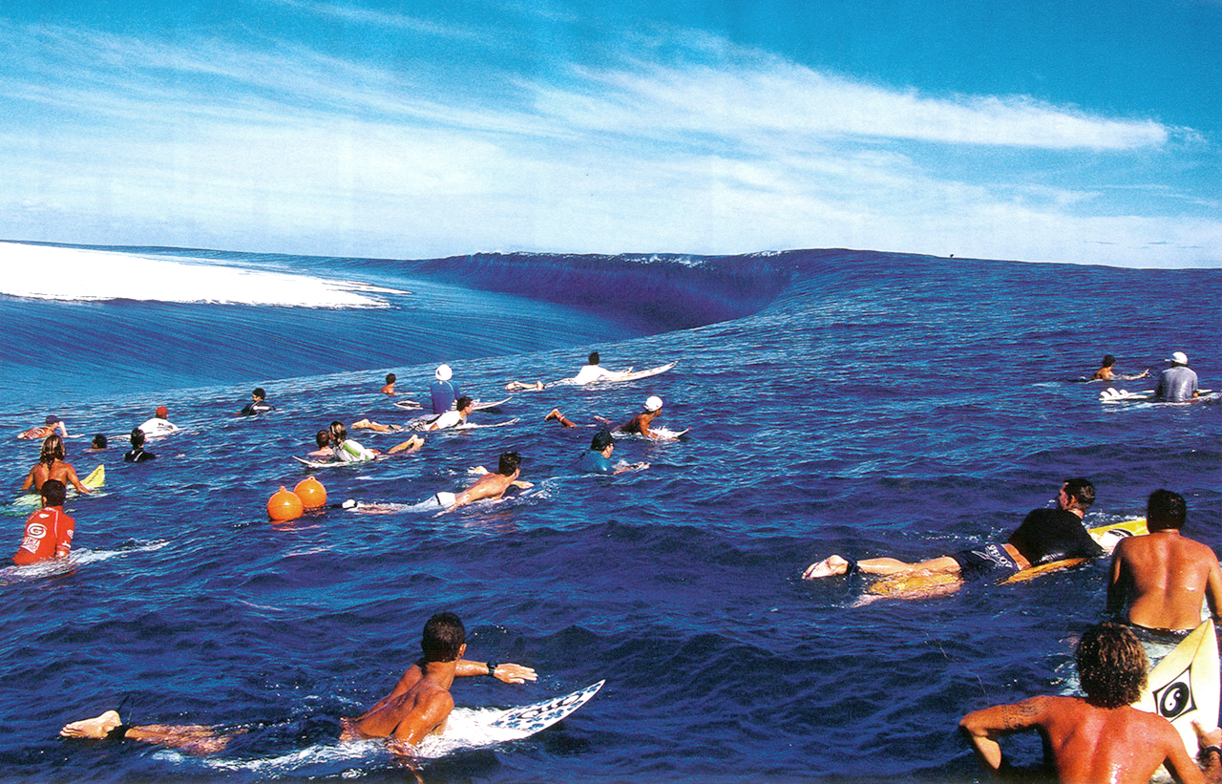
THE PHYSICS
Old Man Ocean, how do you pound
Smooth glass, rough stones round?
Time and the tide and the wild waves rolling
Night and the wind and the long gray dawn.
.
Russell Hoban

Slide 3
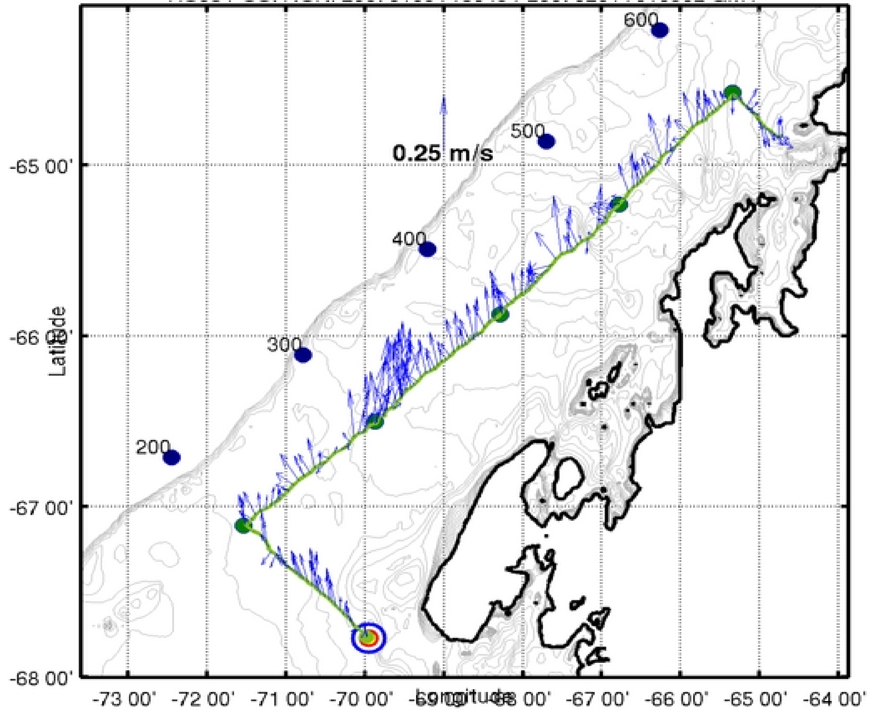
Ekmann transport along WAP (from 2007)

Slide 4
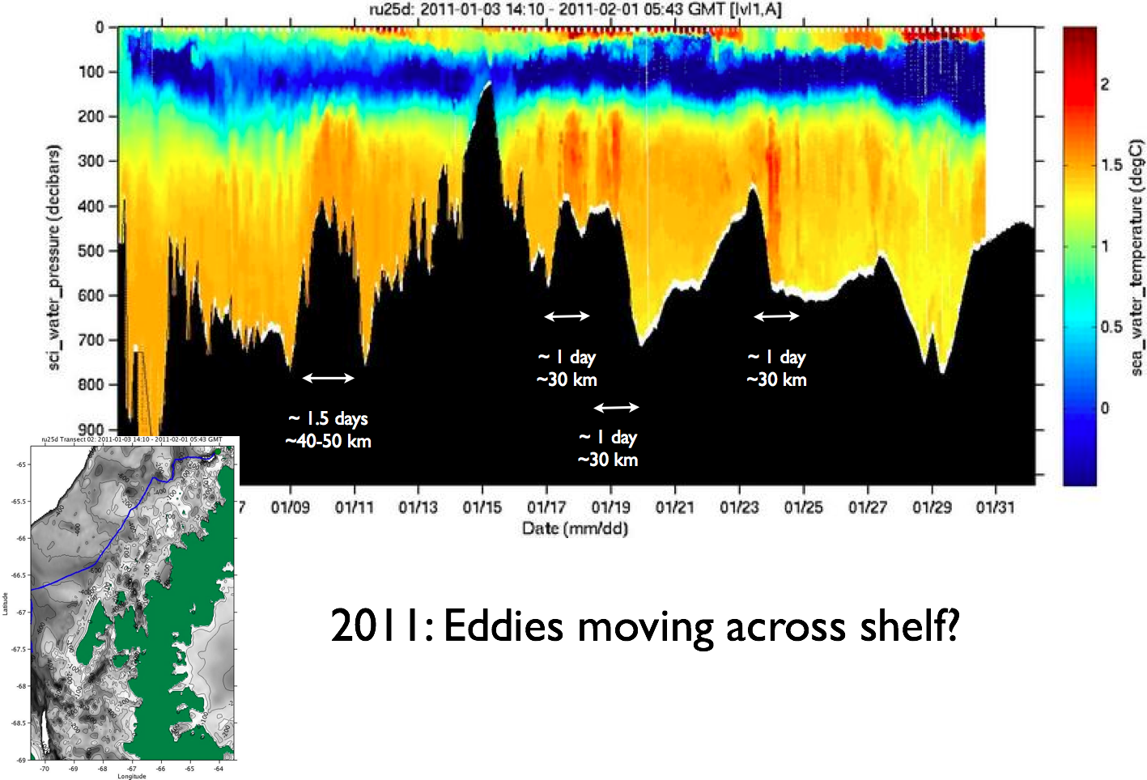

Slide 5
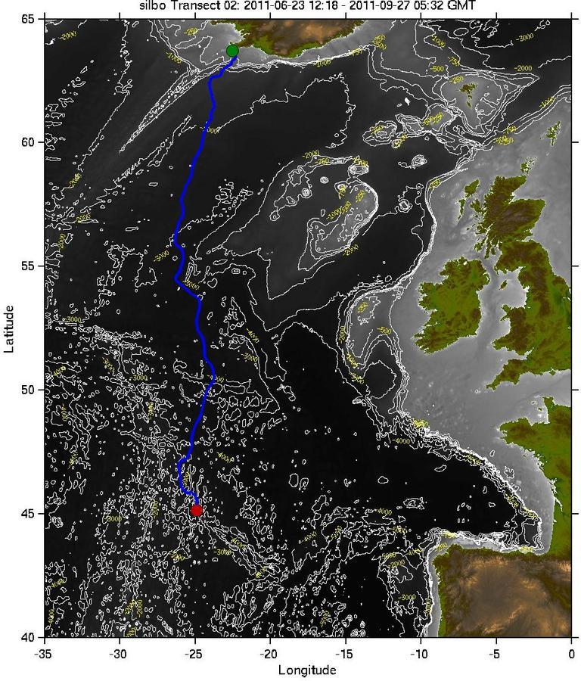
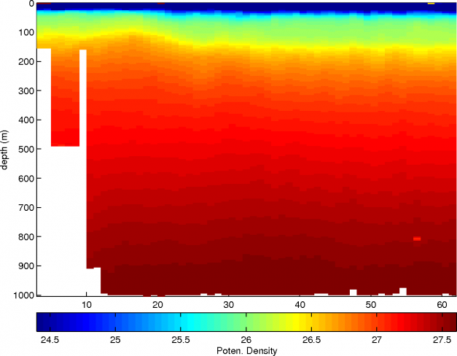
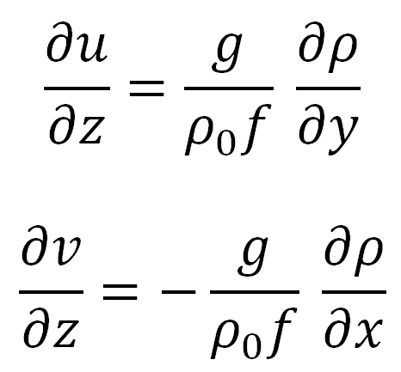
Ruben Marrero Gomez, Juan Alberto Gonzalez Santana, Josh Kohut
Summer project: Need depth resolved currents. Apply the thermal wind calculations to estimate the u and v componets.

Slide 6
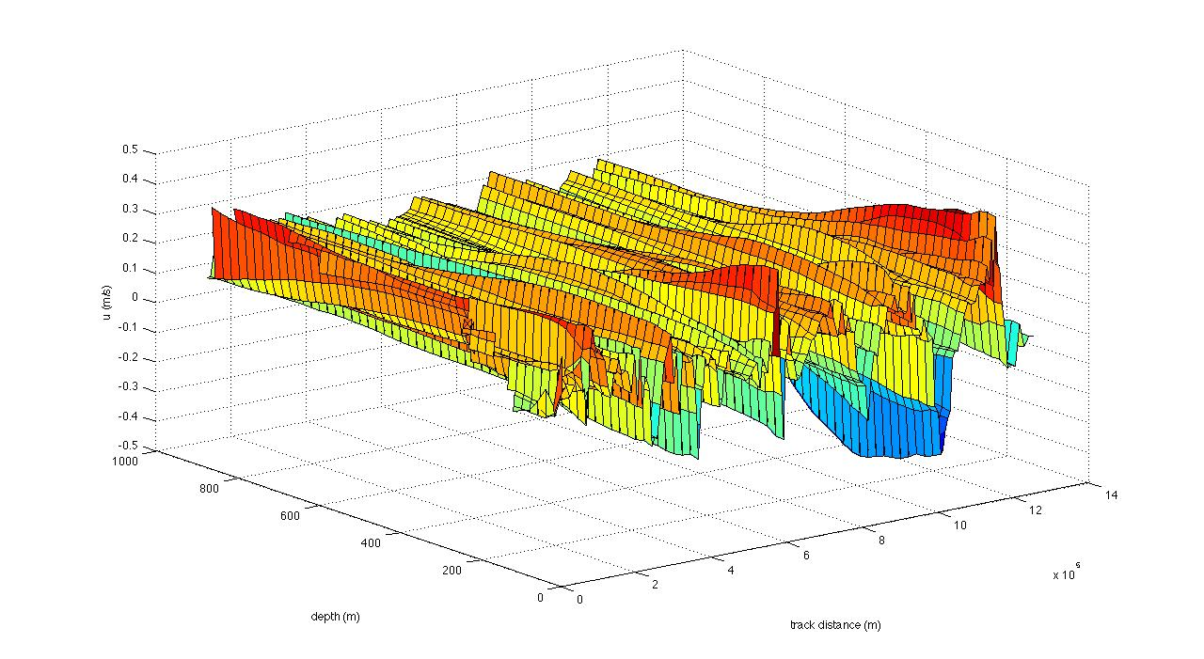
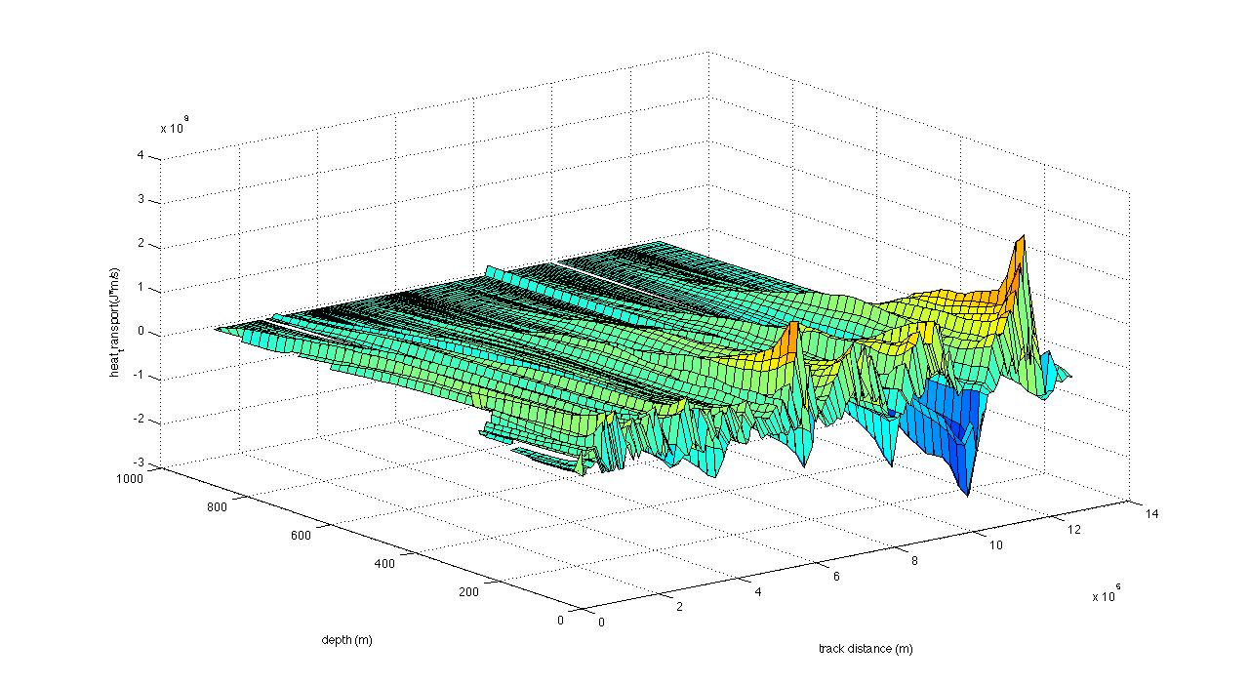
U-velocity
Heat transport

Slide 7
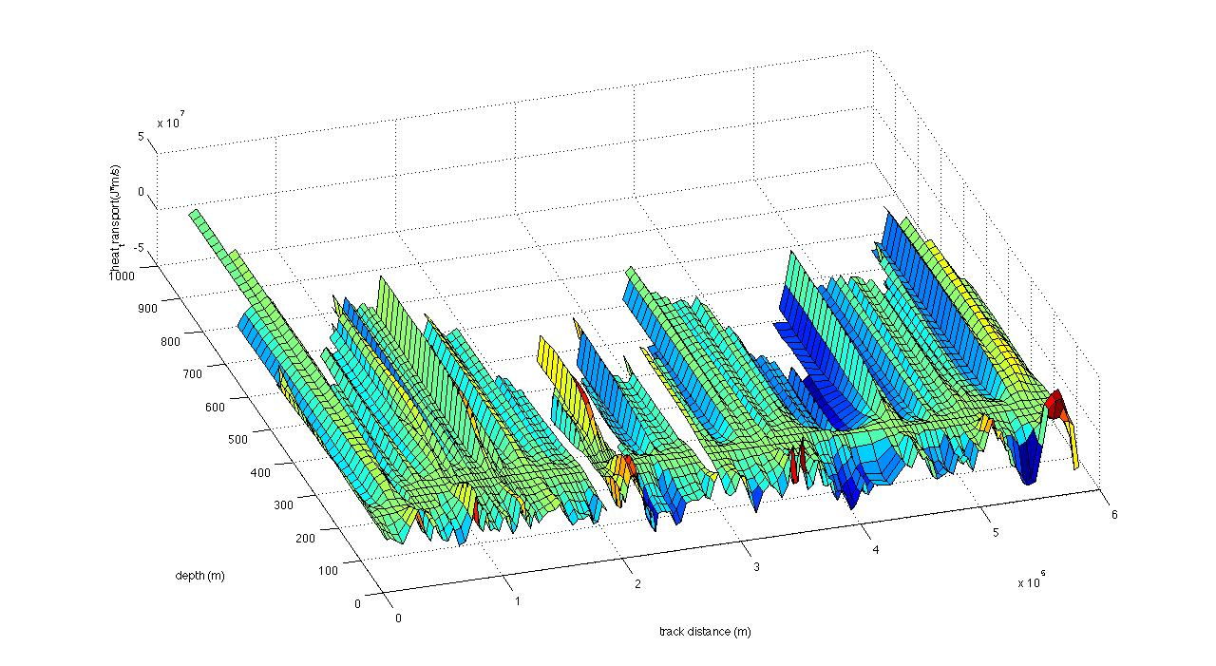


Slide 8
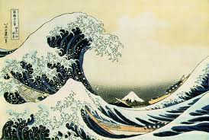
“Every day, the ocean changes colour – or rather, it passes though a variety of hues between the morning, noon and night of a single day. The subtle shapes of clouds, the glittering light of the sun, and the shifts in atmospheric pressure tint the sea with deep tones, cheerful tomes, plaintive tones that would cause any painter to pause in wonder.”
from The Samurai by Shusaku Endo (1980)
THE OPTICS

Slide 9
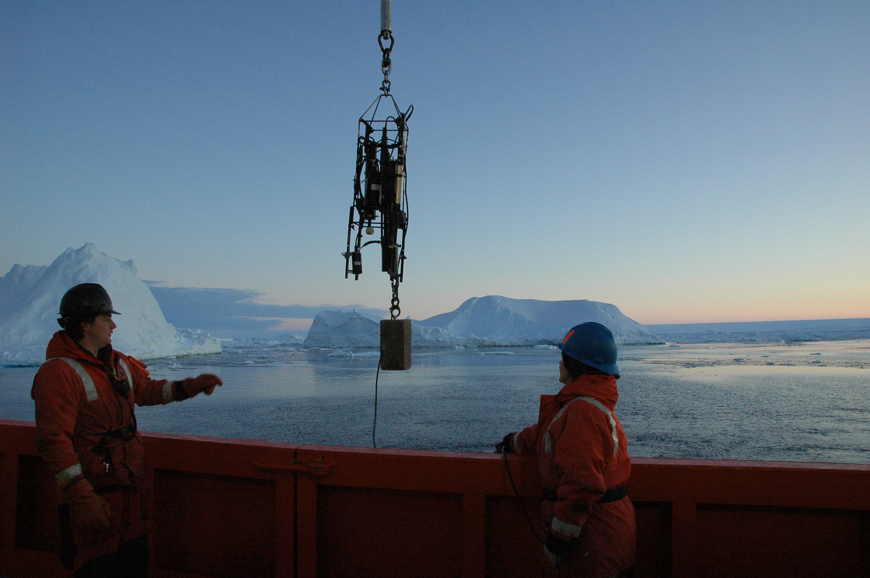
Bio-optics of WAP waters
Absorption-attenuation measurements
Backscatter measurements

Slide 10
December 01, 2009
December 28, 2009

Slide 12
Radiative Transfer Equations
For each
depth interval
light attenuation
c(λ,t) = a(λ,t) + b(λ,t)
absorption
a(λ,t) = a_{water}(λ) + a_{phyto}(λ) + a_{CDOM}(λ) + a_{sed}(λ)
scattering
b(λ,t) = b_{water}(λ) + b_{phyto}(λ) + b_{CDOM}(λ) + b_{sed}(λ)
backscattering
b_{b}(λ,t) = b_{b,water}(λ) + b_{b,phyto}(λ) + b_{b,CDOM}(λ) + b_{b,sed}(λ)
geometric structure of light
μ_{d}(λ) = fxn[b(λ,t),c (λ ,t), μ₀(λ)]
diffuse light attenuation
Κ_{d}(λ) = [a(λ,t) + b_{b}(λ ,t)]/μ_{d}(λ)]
water leaving radiance to a satellite
L_{u}(λ) = fxn[a(λ,t),b(λ ,t), b_{b}(λ ,t),E_{d}(λ,t), μ_{d}(λ), μ_{d}(λ), μ_{u}(λ)]

Slide 13
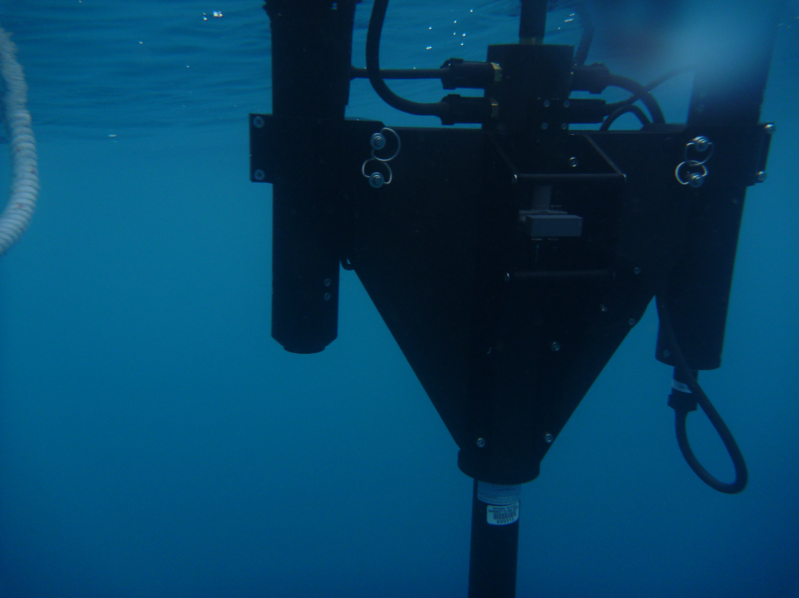
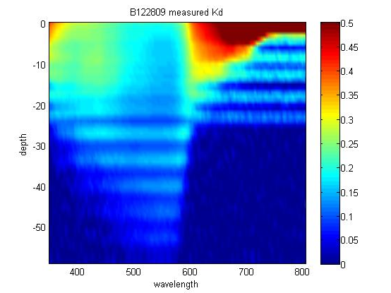
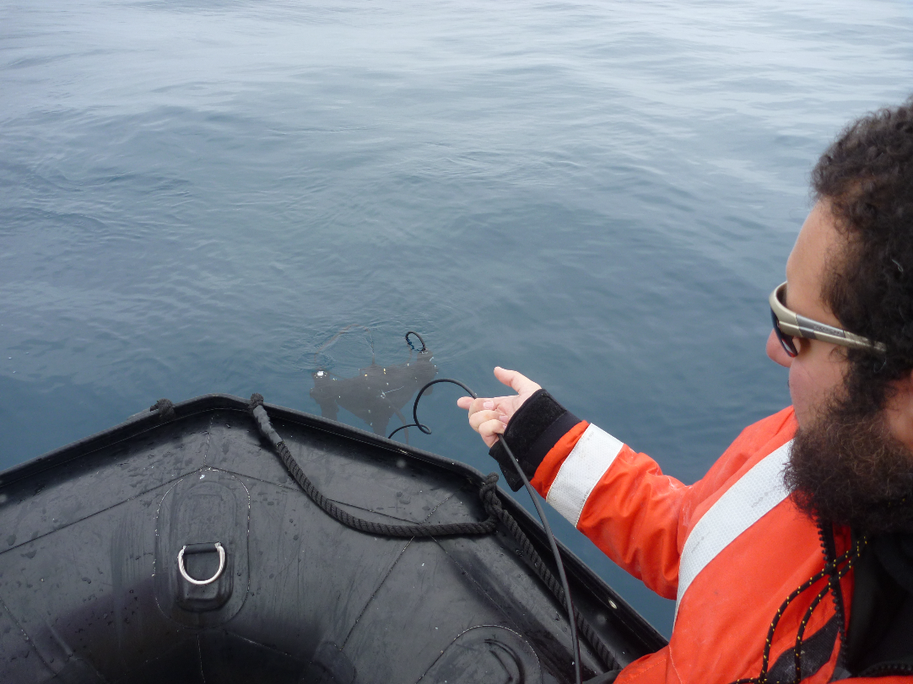

Slide 15
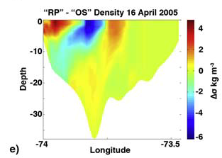
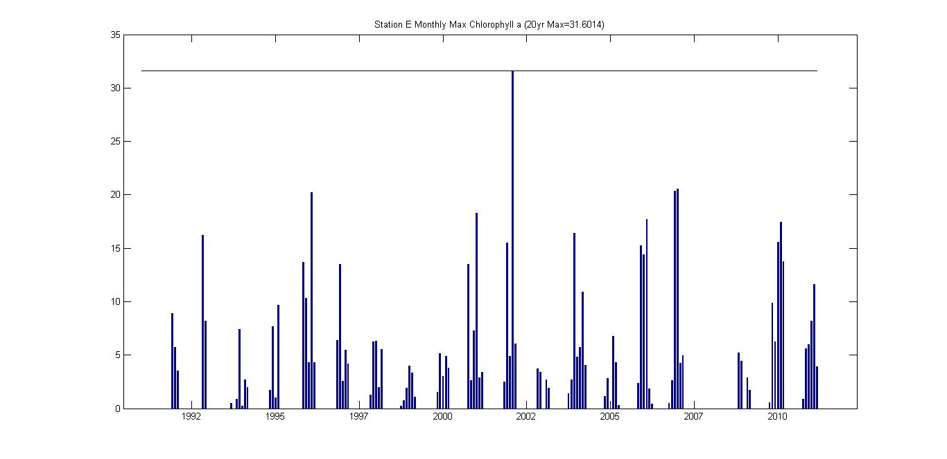
Focus now on the feedbacks on upper ocean heating rates
The impact of model ROMS simulations that
do not get the radiant heating and heat budget right

Slide 16
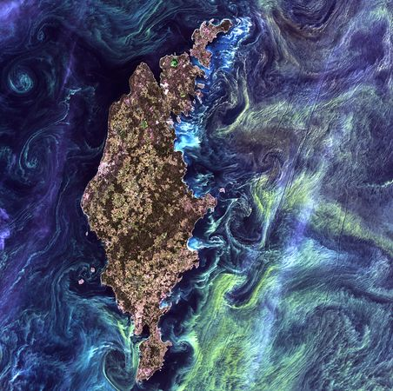
THE PHYTOPLANKTON
The algae awakens,
and joins the mob.
Michael Lipsey

Slide 17
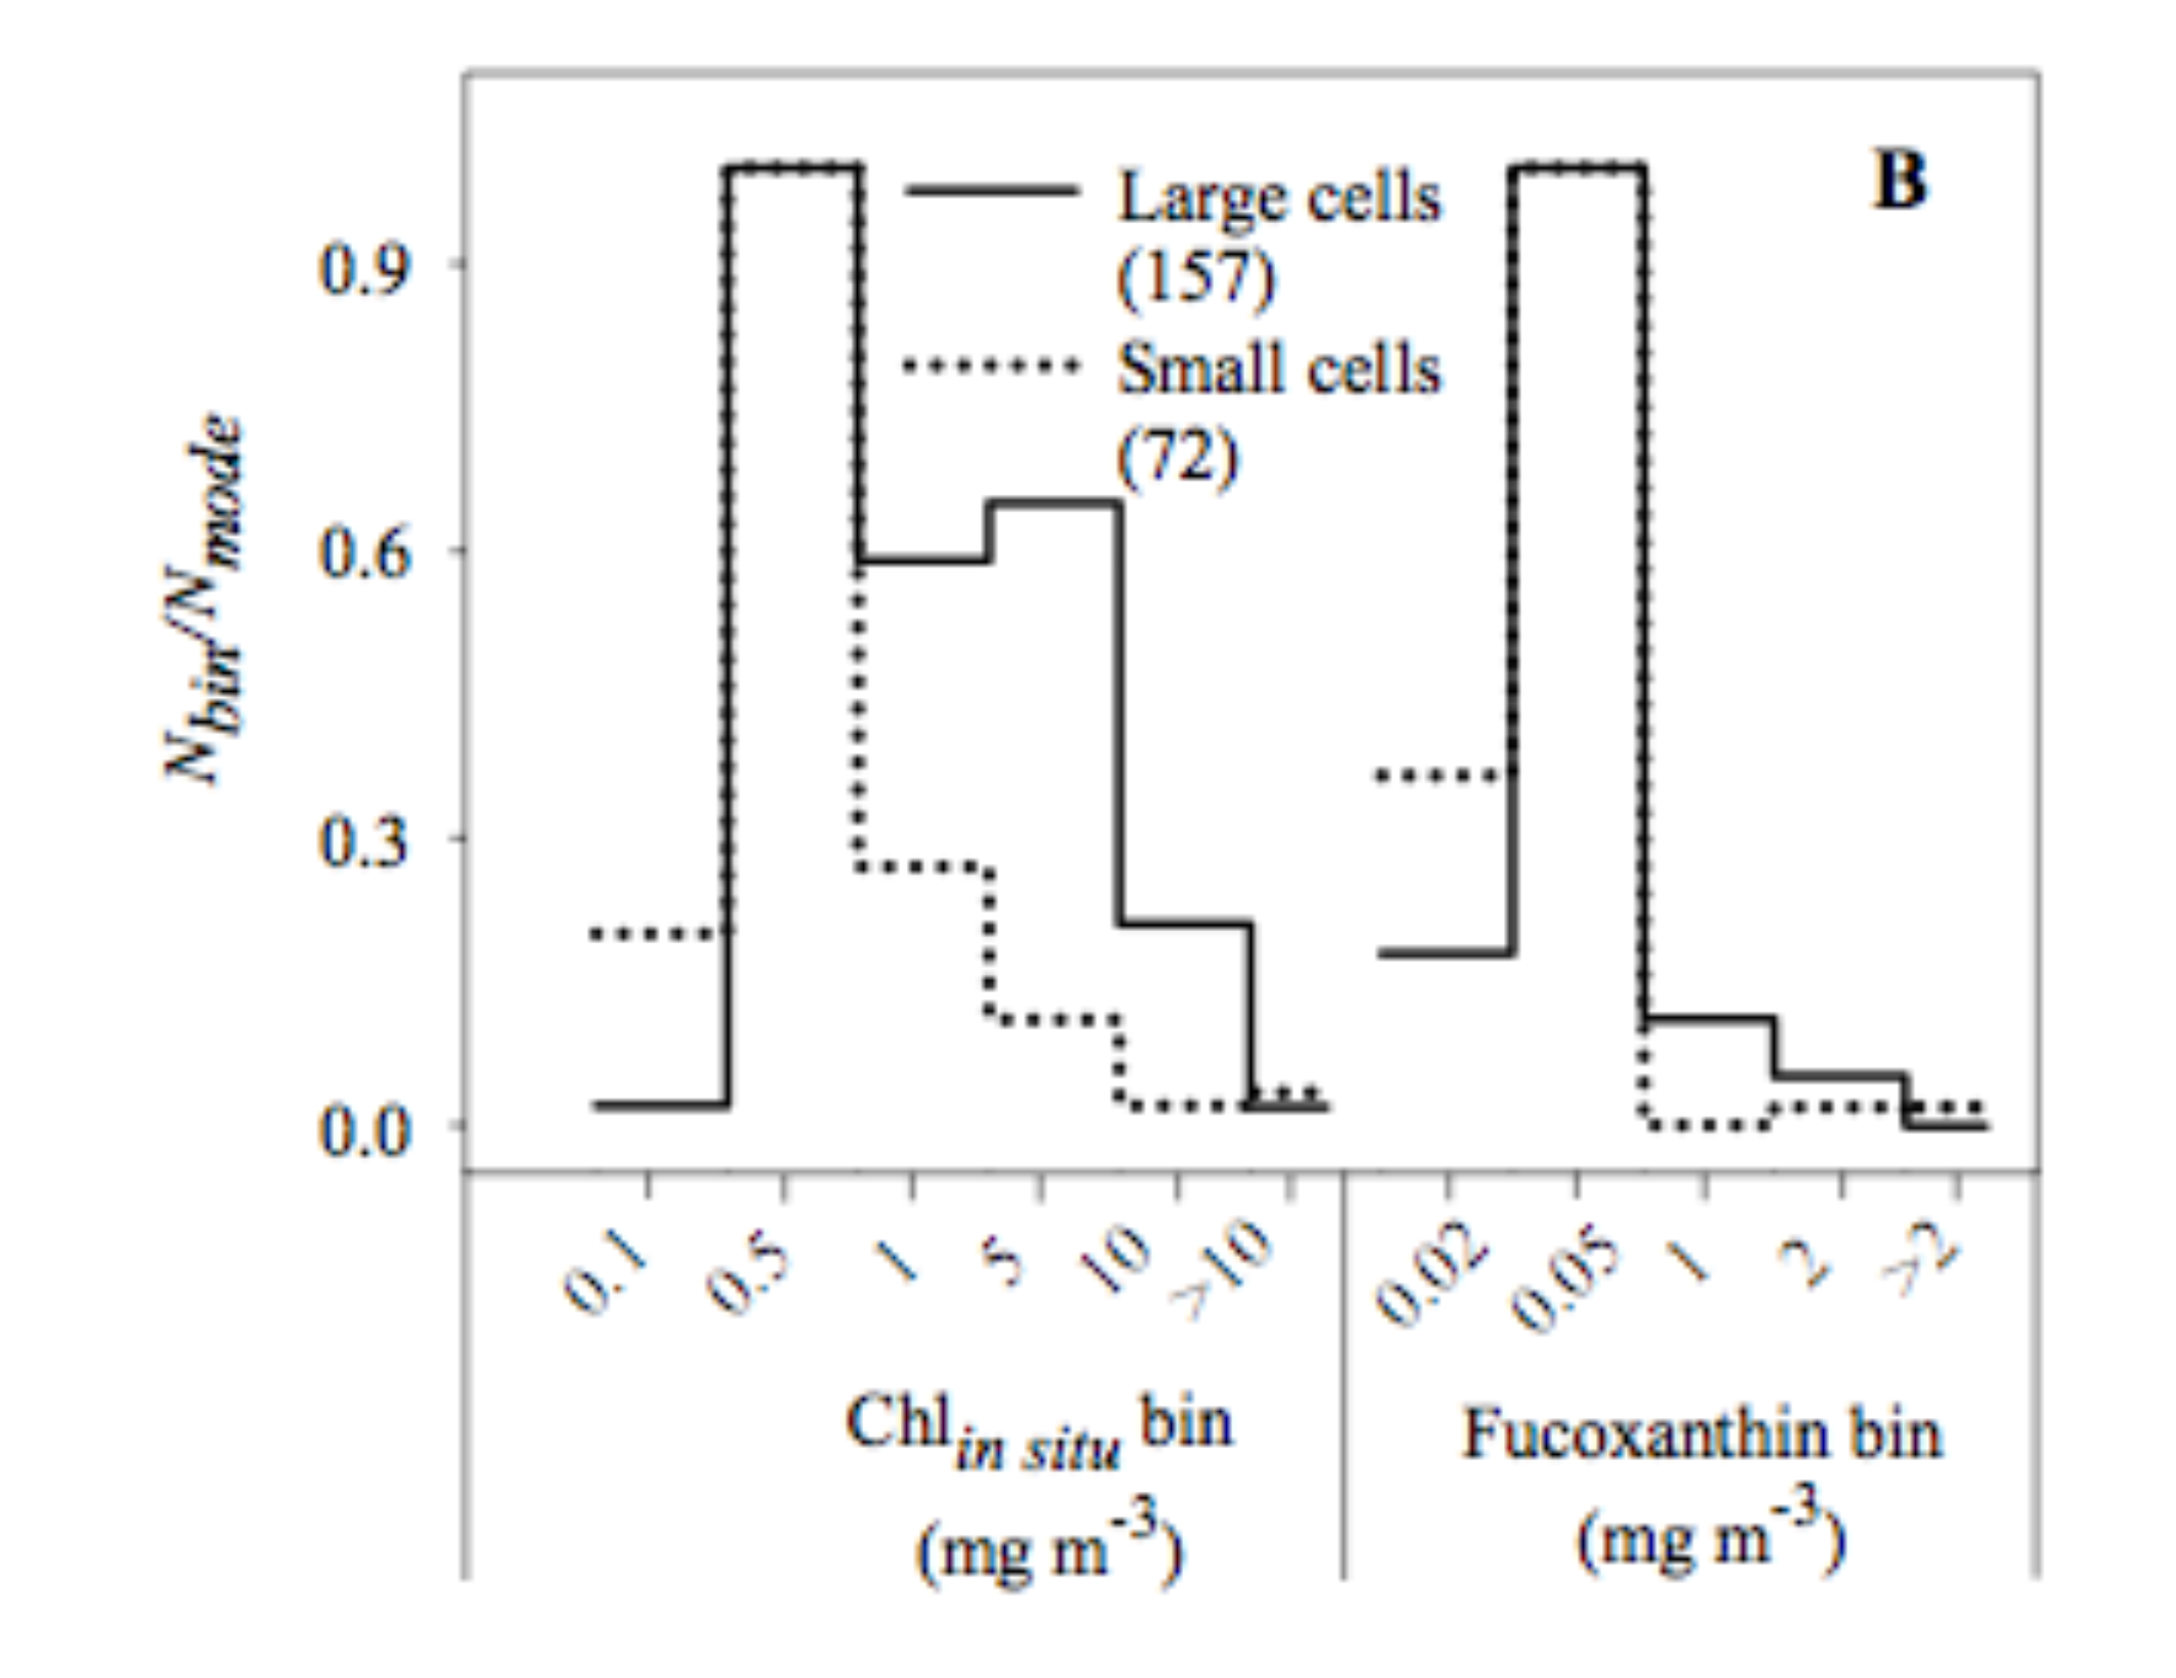
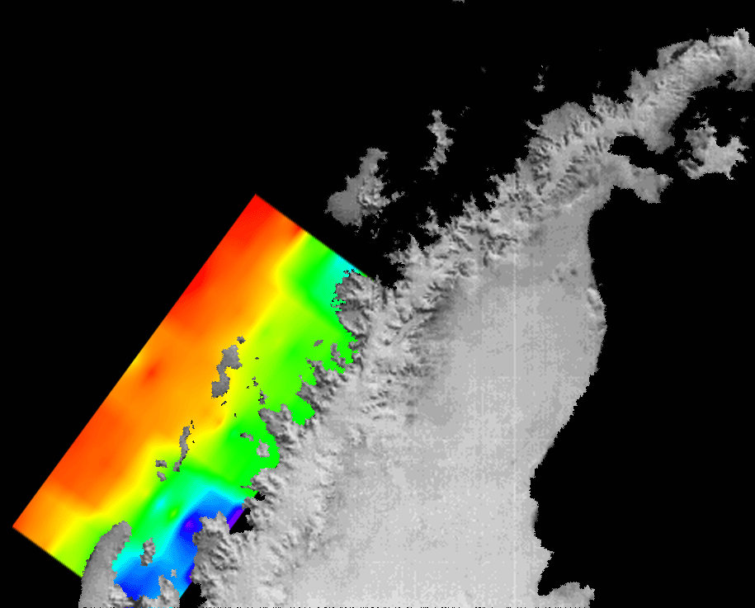

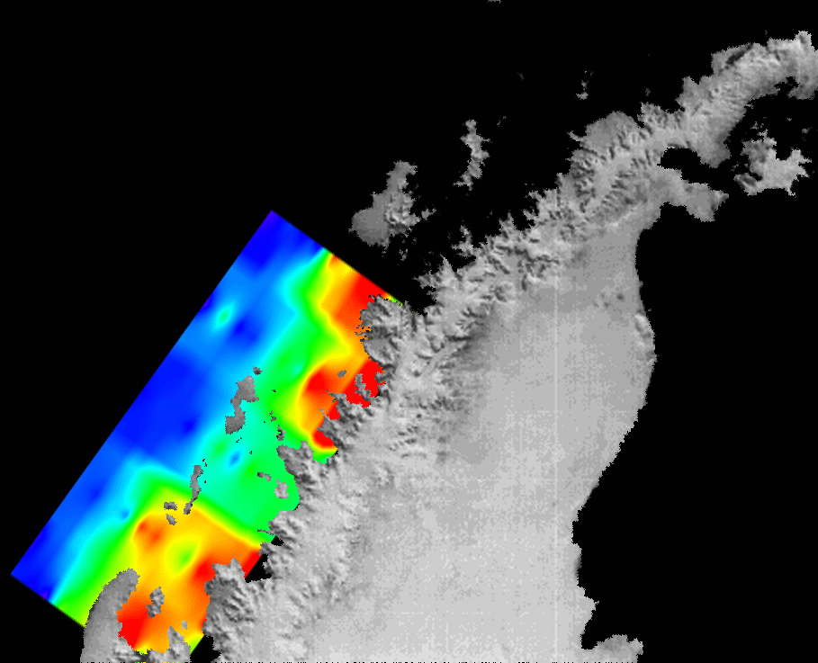
Recent changes in WAP phytoplankton
12% decrease in chl a over past 30 years, particularly northern WAP
Shift from large to small phytoplankton
1970s-1980s
1995-2005
Montes-Hugo et al. 2009
Salinity (p.p.t)
33.3
33.6
33.8
Palmer Station
65°S
Antarctic
Peninsula
64°W
% Cryptophytes
0
25
50
65°S
Notes:
Declines in summertime chl biomass – 12% in 30 years (Montes-Hugo et al): however, this was using surface satellite data – did not incorporate depth-integrated chl. Attributed this change to increased northwesterly winds, increased MLD, changes in phyto composition.

Slide 18
Coupling biology with environmental factors
Montes-Hugo et al. 2009
Salinity (p.p.t)
33.3
33.6
33.8
Palmer Station
65°S
Antarctic
Peninsula
64°W
% Cryptophytes
0
25
50
65°S

Slide 19
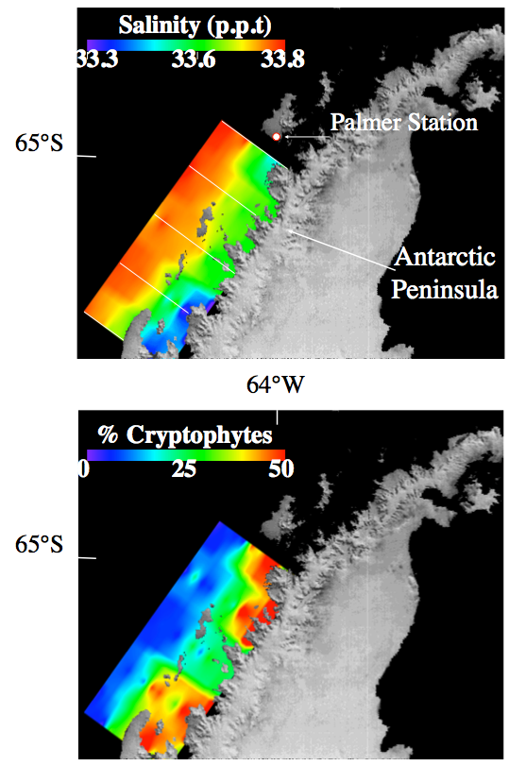
Recent changes in WAP phytoplankton
Shift to cryptophytes associated with decreased salinity from glacial meltwater
10 μm
100 μm
Moline et al.
2004
SEM Micrographs from
McMinn & Hodgson 1993
Salinity (p.p.t)
33.3
33.6
33.8
Palmer Station
65°S
Antarctic
Peninsula
64°W
% Cryptophytes
0
25
50
65°S

Slide 20
What we don’t know
Despite 20 years of data collected via LTER, little knowledge of biology/physics in northern WAP/Palmer region
Current efforts focusing on Palmer LTER data to assess:
  1) The effect of environmental factors and physical forcing on the timing, magnitude, and composition of Palmer blooms (SML, wind direction and speed, sea ice dynamics, cloud cover, irradiance)
  2) If rapid climate change in the region has altered any of these parameters
Notes:
PRELIMINARY DATA!

Slide 21
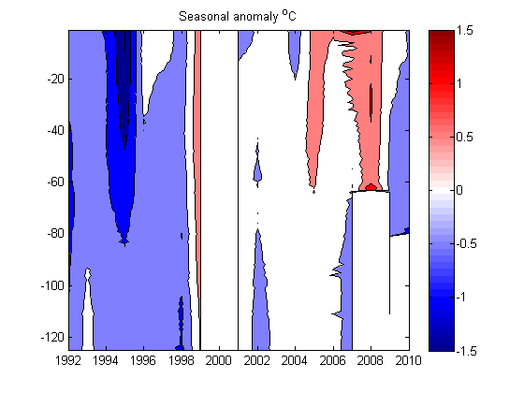
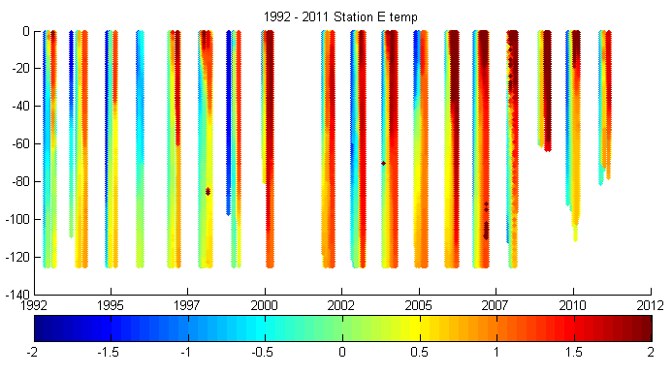
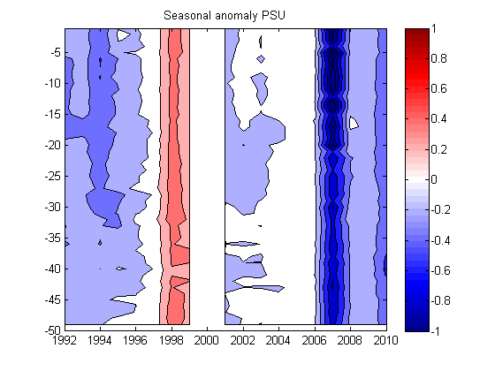
Palmer Station Temperature and Salinity
Warmer and fresher over time
Deepening of warm, fresh water

Slide 22
Chl anomalies, ENSO, and SAM
La Niña/+SAM: Strong warm northerly winds; - sea-ice anomalies; early sea-ice retreat offshore of WAP; high chl anomalies
El Nino/-SAM:Weak cold southerly winds; + sea-ice anomalies; late spring retreat of sea ice; low chl anomalies

Slide 23
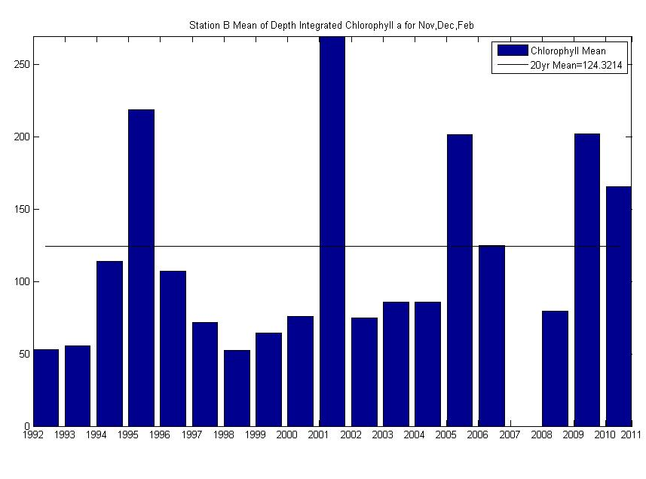
No apparent correlation of chl and ENSO/SAM
* La Niña/+SAM
*
*
*
*
High Chl anomalies:
  95/96: La Nina/neutral SAM
  01/02: neutral ENSO/+SAM
  05/06: La Nina/-SAM
  09/10: El Nino/-SAM

Slide 24
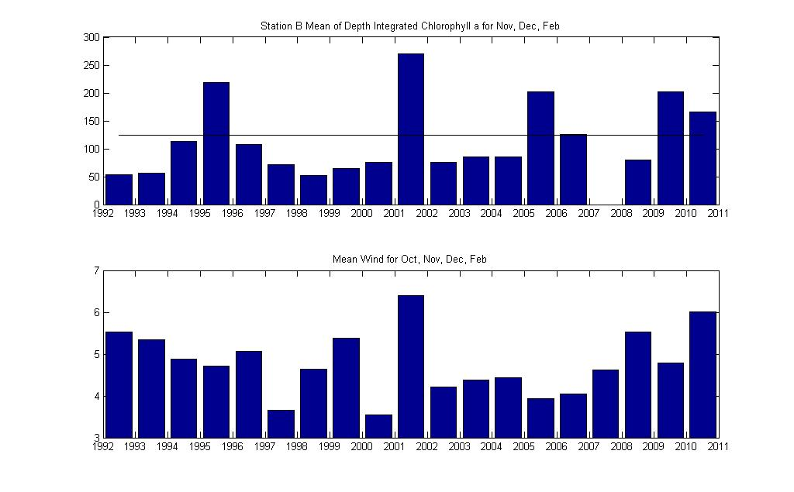
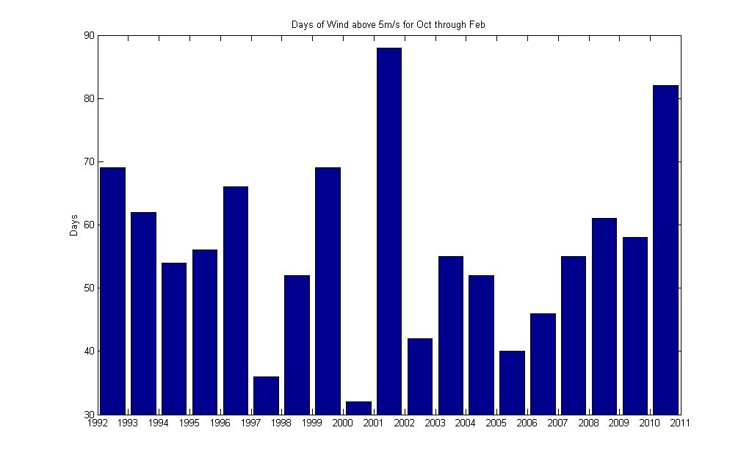
Chl and Wind?
Yes, and no
Start of krill
cohort from
Bill this morning
*
*
*
*
z-int Chl
*
*
Chl anomalies not always tied to wind
Exception: 01-02 season had highest chl, highest windspeed, and highest # of windy days
  Threshold?
  Tied to sea ice dynamics?
Windspeed (m/s)
# windy days (>5m/s)

Slide 25
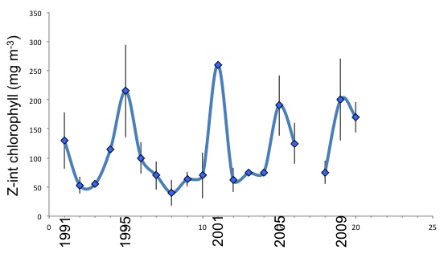

Slide 26
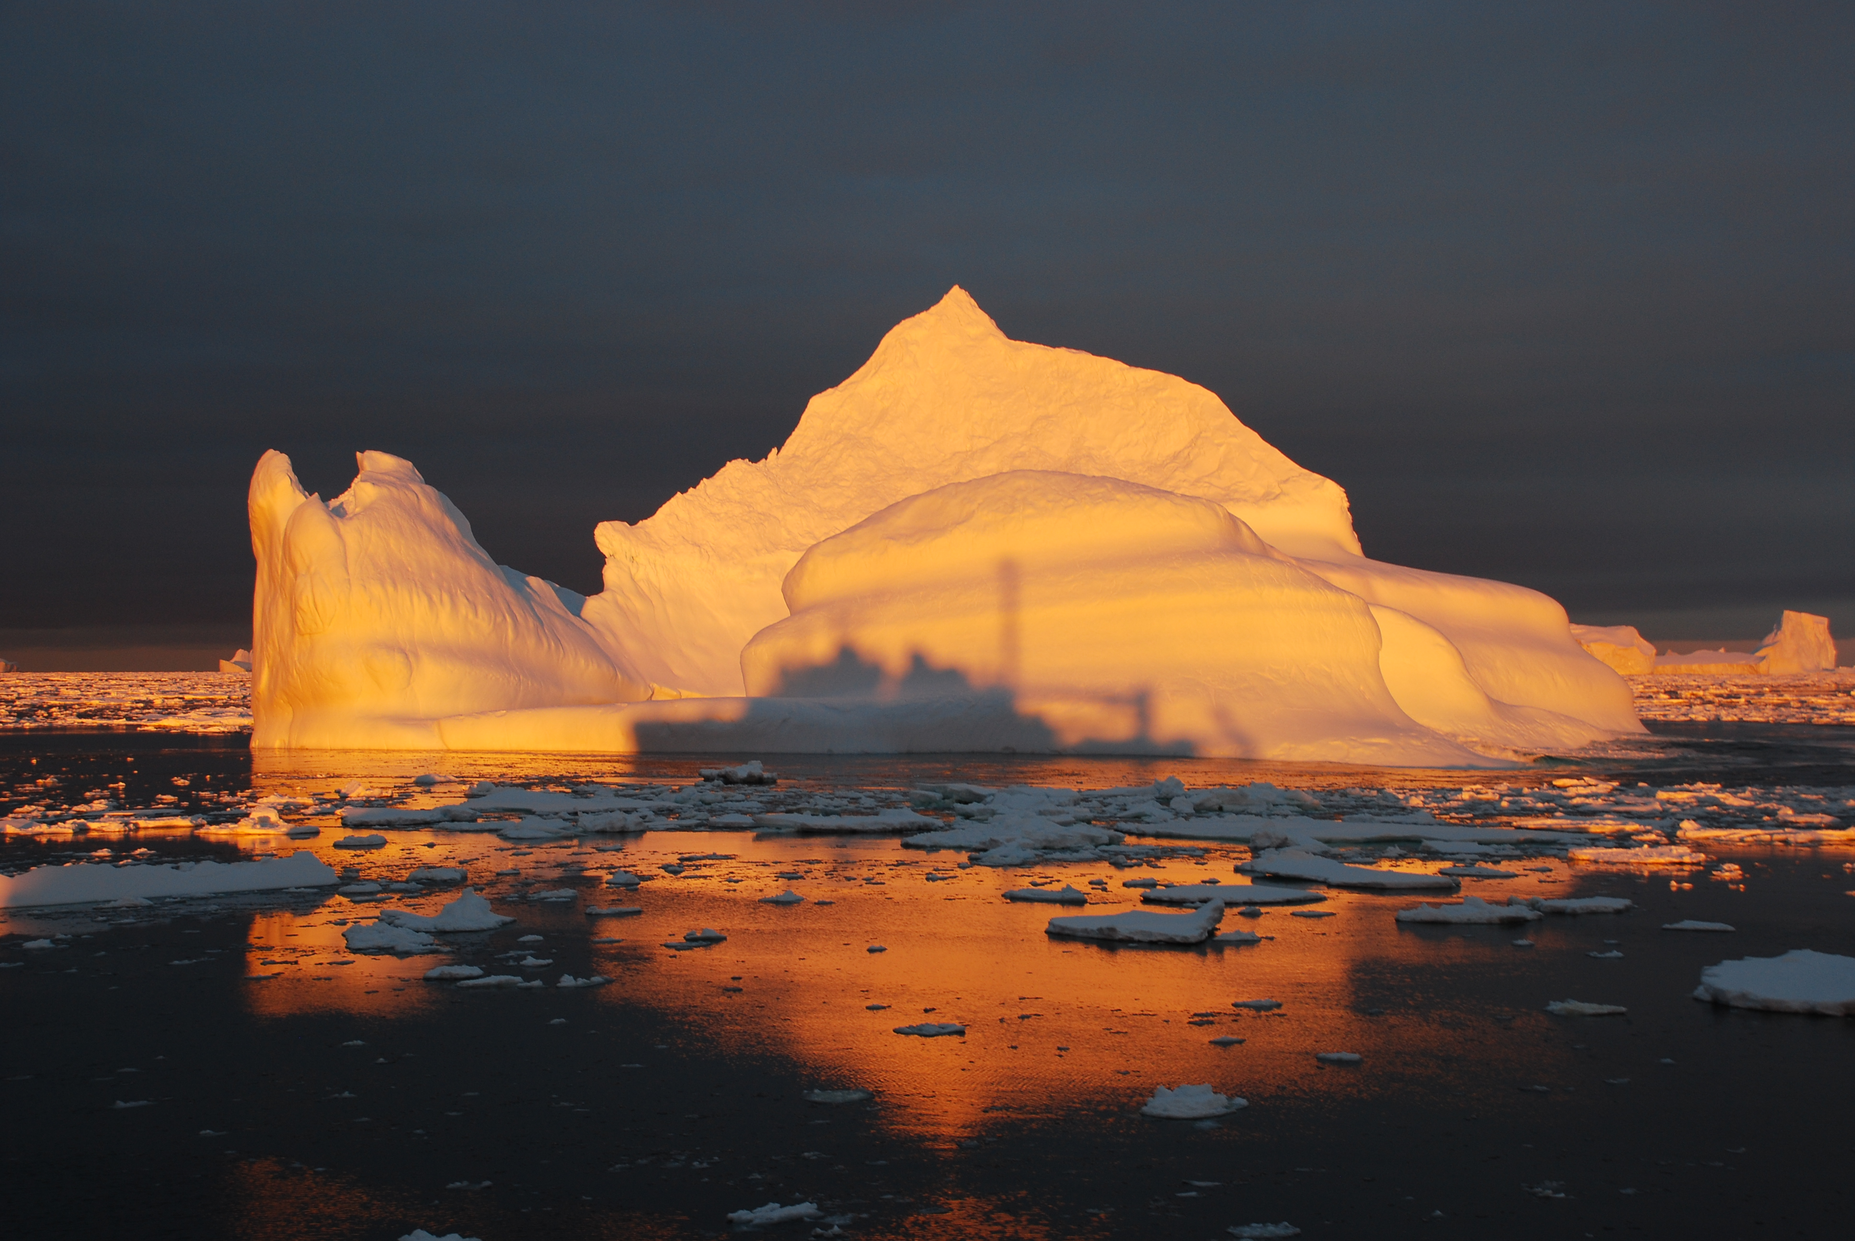
Enhanced carbon dioxide (CO₂): Boil, boil, toils and trouble
THE MANIPULATION

Slide 27
Part 1
Effects of enhanced CO₂ on Antarctic plankton communities and biogeochemistry
  Diatom-dominated Marguerite Bay
  Small phytoplankton (cryptophyte)-dominated Palmer Station
Effects of enhanced CO₂ on Antarctic krill feeding and nutrient excretion
Part 2

Slide 28
CO₂ Scenarios: Effects on phytoplankton community
Low CO₂
High CO₂
Active CCM
CCM efficiency
Efficiency of DIC utilization
Internal DIC storage
Down-regulated CCM
CCM efficiency
Efficiency of DIC utilization
Internal DIC storage
CCM requirements still present, but relaxed, giving fast-growing species a competitive advantage

Slide 29


CO₂ Scenarios: Effects on phytoplankton community
Low CO₂
High CO₂
Active CCM
CCM efficiency
Efficiency of DIC utilization
Internal DIC storage
Down-regulated CCM
CCM efficiency
Efficiency of DIC utilization
Internal DIC storage
Small cells:
Cryptophytes
Large cells:
Diatoms

Slide 30
CO₂ Scenarios: Effects on phytoplankton community
Low CO₂
High CO₂
Active CCM
CCM efficiency
Efficiency of DIC utilization
Internal DIC storage
Down-regulated CCM
CCM efficiency
Efficiency of DIC utilization
Internal DIC storage
Small cells:
Cryptophytes
?
Large cells:
Diatoms

Slide 31
Questions
Do diatom- and cryptophyte-dominated populations in the West Antarctic Peninsula respond differently to enhanced CO₂?
  Phytoplankton, virus, bacteria, microzooplankton community changes?
How does enhanced CO₂ affect phytoplankton biomass, primary production, physiology, and biogeochemistry?

Slide 32
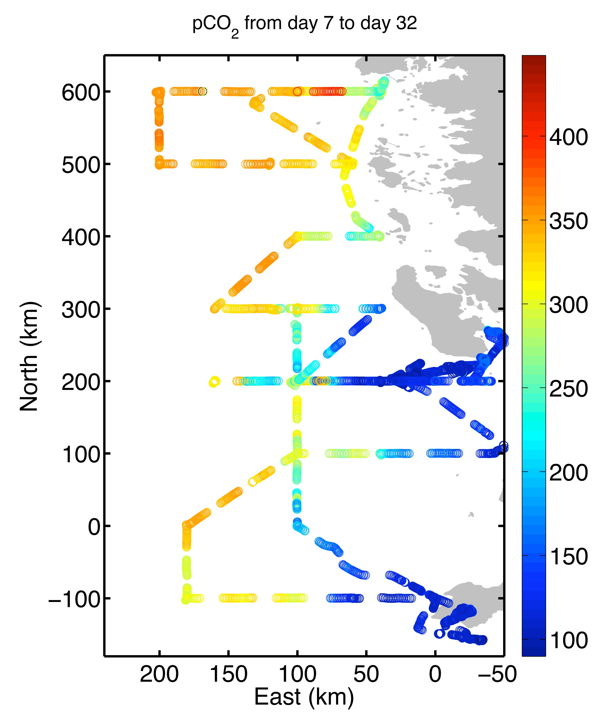
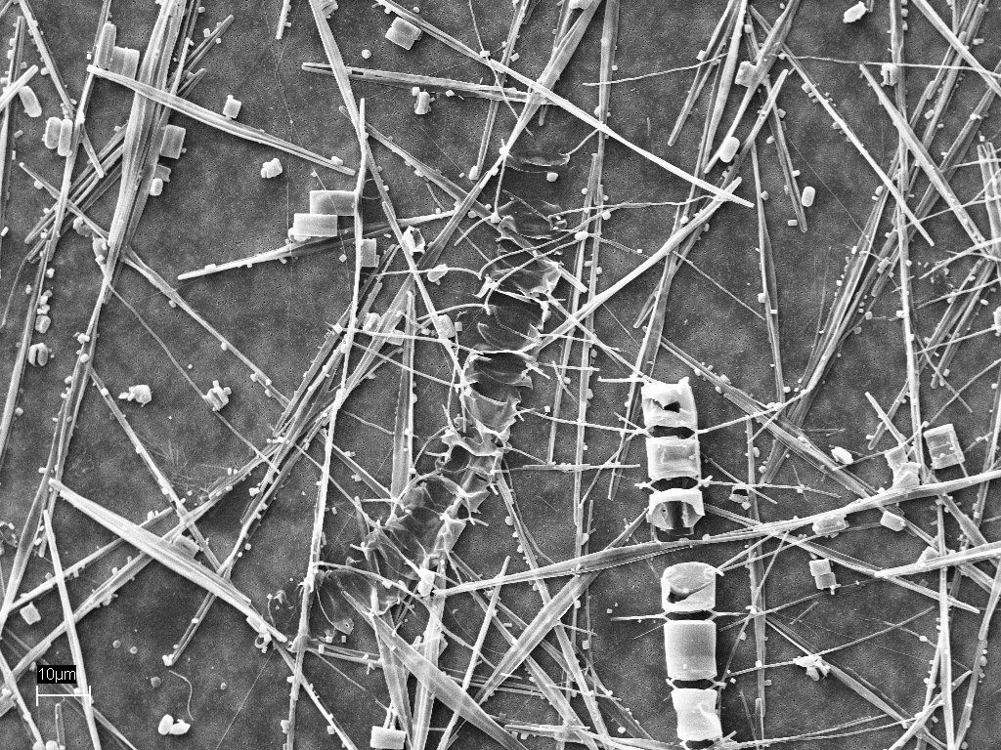
Marguerite Bay Mesocosm
High Chl: 12 mg m⁻³
High Prod: 230 mg C m⁻³ d⁻¹
Diatom bloom:
  Chaetoceros sp.
  Fragilariopsis sp.
  Pseudo-nitzschia sp.
Low surface pCO₂
SEM images from B. Jones
Data from T. Takahashi; Figure from K. Huang

Slide 33
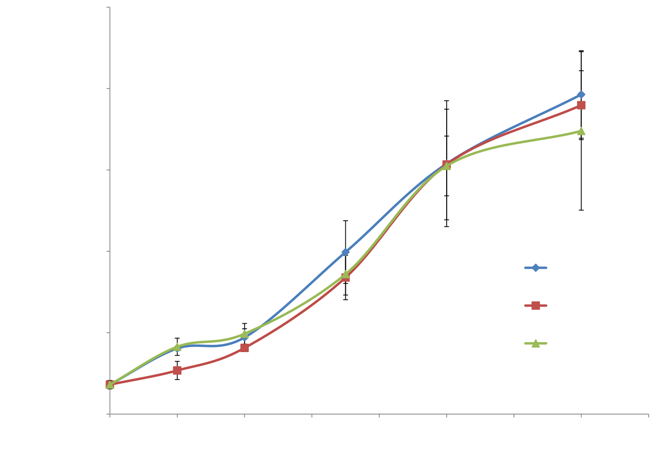
Diatom-dominated Mesocosm
(Saba et al., in prep)
50
40
30
Chlorophyll a (μg L⁻¹)
20
10
0
10-fold increase in chl a & productivity
NO₃ & PO₄ drawdown by day 10 in all mesocosms
No differences between CO₂ treatments
1200
800
Primary Productivity (mg/m³/d)
400
0
6
0
2
4
8
10
12
14
16
Time (days)

Slide 34
Cryptophyte-dominated Mesocosm
(Saba et al., in prep)
2.5
2.0
1.5
Chlorophyll a (μg L⁻¹)
1.0
0.5
*
* p < 0.05
*
*
0
30
Lower biomass & productivity in high CO₂ treatment
No increase in biomass over course of study
25
20
Primary Productivity (mg/m³/d)
15
10
5
*
*
0
8
10
0
2
4
6
12
14
Time (days)

Slide 35
Cryptophyte-dominated Mesocosm
(Saba et al., in prep)
7000
6000
5000
4000
*
Nanophytoplankton (cells mL⁻¹)
3000
* p < 0.05
2000
*
1000
*
*
0
0
2
4
6
8
10
12
14
Time (days)
Lower biomass in high CO₂ treatment due to declines in nanophytoplankton size class

Slide 36
Cryptophyte-dominated Mesocosm
(Saba et al., in prep)
0.8
0.7
0.6
*
*
*
0.5
*
* p < 0.05
0.4
Fv/Fm
0.3
0.2
0.1
0
0
2
4
7
12
Sampling time point (day)
Decrease in Fv/Fm in high CO₂ treatment

Slide 37
CO₂ Scenarios: Effects on biogeochemistry
High CO₂
Cryptophyte-dominated
Diatom-dominated
OR
Biomass
Productivity
N, P, Si, Fe uptake
No change in biomass
No change in productivity
N, P, Fe uptake
C:N, C:P
?
Would diatoms ultimately switch to N, P, Si, and/or Fe limitation?

Slide 38
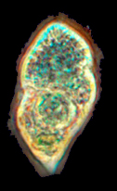

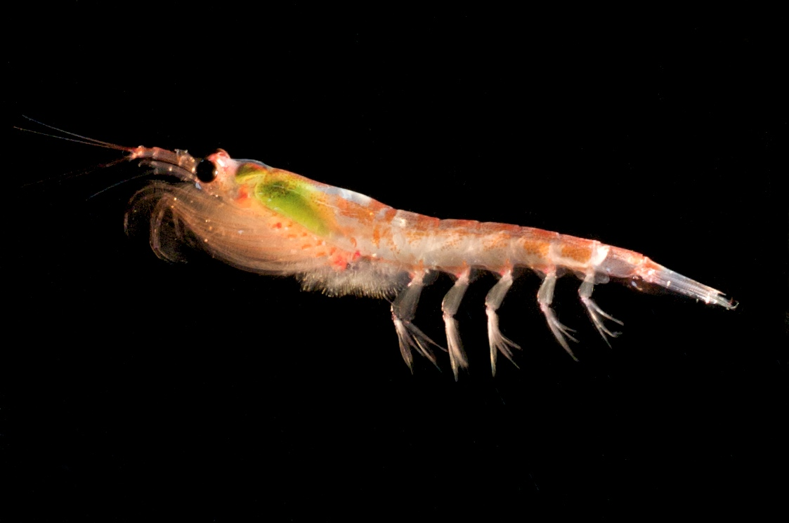
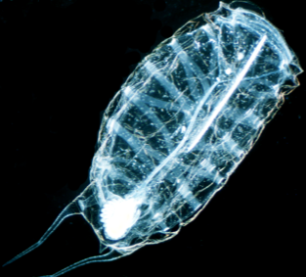
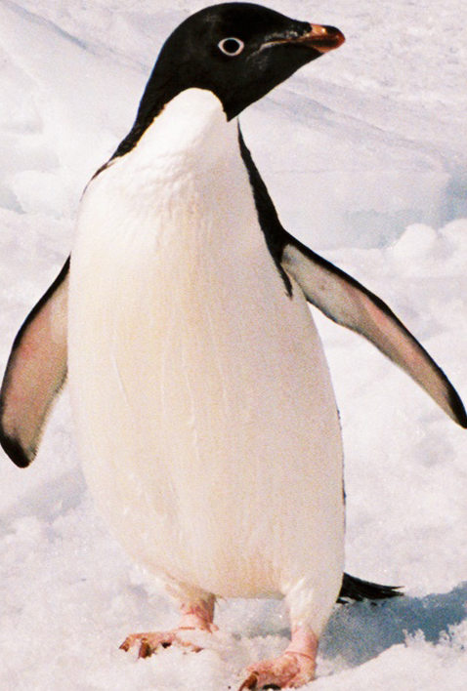
CO₂ Scenarios: Effects on food webs
High CO₂
Cryptophyte-dominated
Diatom-dominated
OR
Increase in biomass
Increase in productivity
microbial
loop
Salp pathway: 40-65% decrease in C transport to higher trophic levels (Moline et al. 2004)

Slide 39
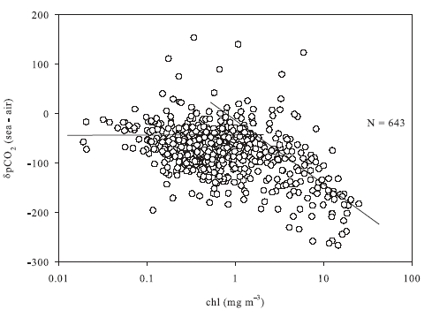
Ocean CO₂ uptake varies with phytoplankton biomass
Montes-Hugo, in prep

Slide 40
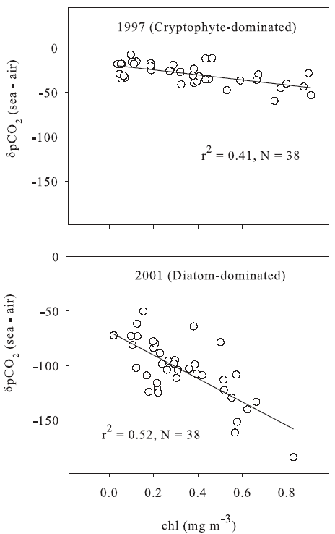
Ocean CO₂ uptake varies with phytoplankton community
10 μm
Montes-Hugo
(in prep)
100 μm
SEM Micrographs from
McMinn & Hodgson 1993

Slide 41
Part 1 Summary and Conclusions
No effect of enhanced CO₂ on diatom-dominated system
  Diatoms were C limited due to undersaturation of surface pCO₂
  Diatoms are weakly regulated by CO₂
  Increased growth and productivity may eventually become nutrient limited
Lower biomass in high CO₂ treatment in cryptophyte-dominated mesocosm
  More data will help to understand physiological mechanisms and ecological implications

Slide 42
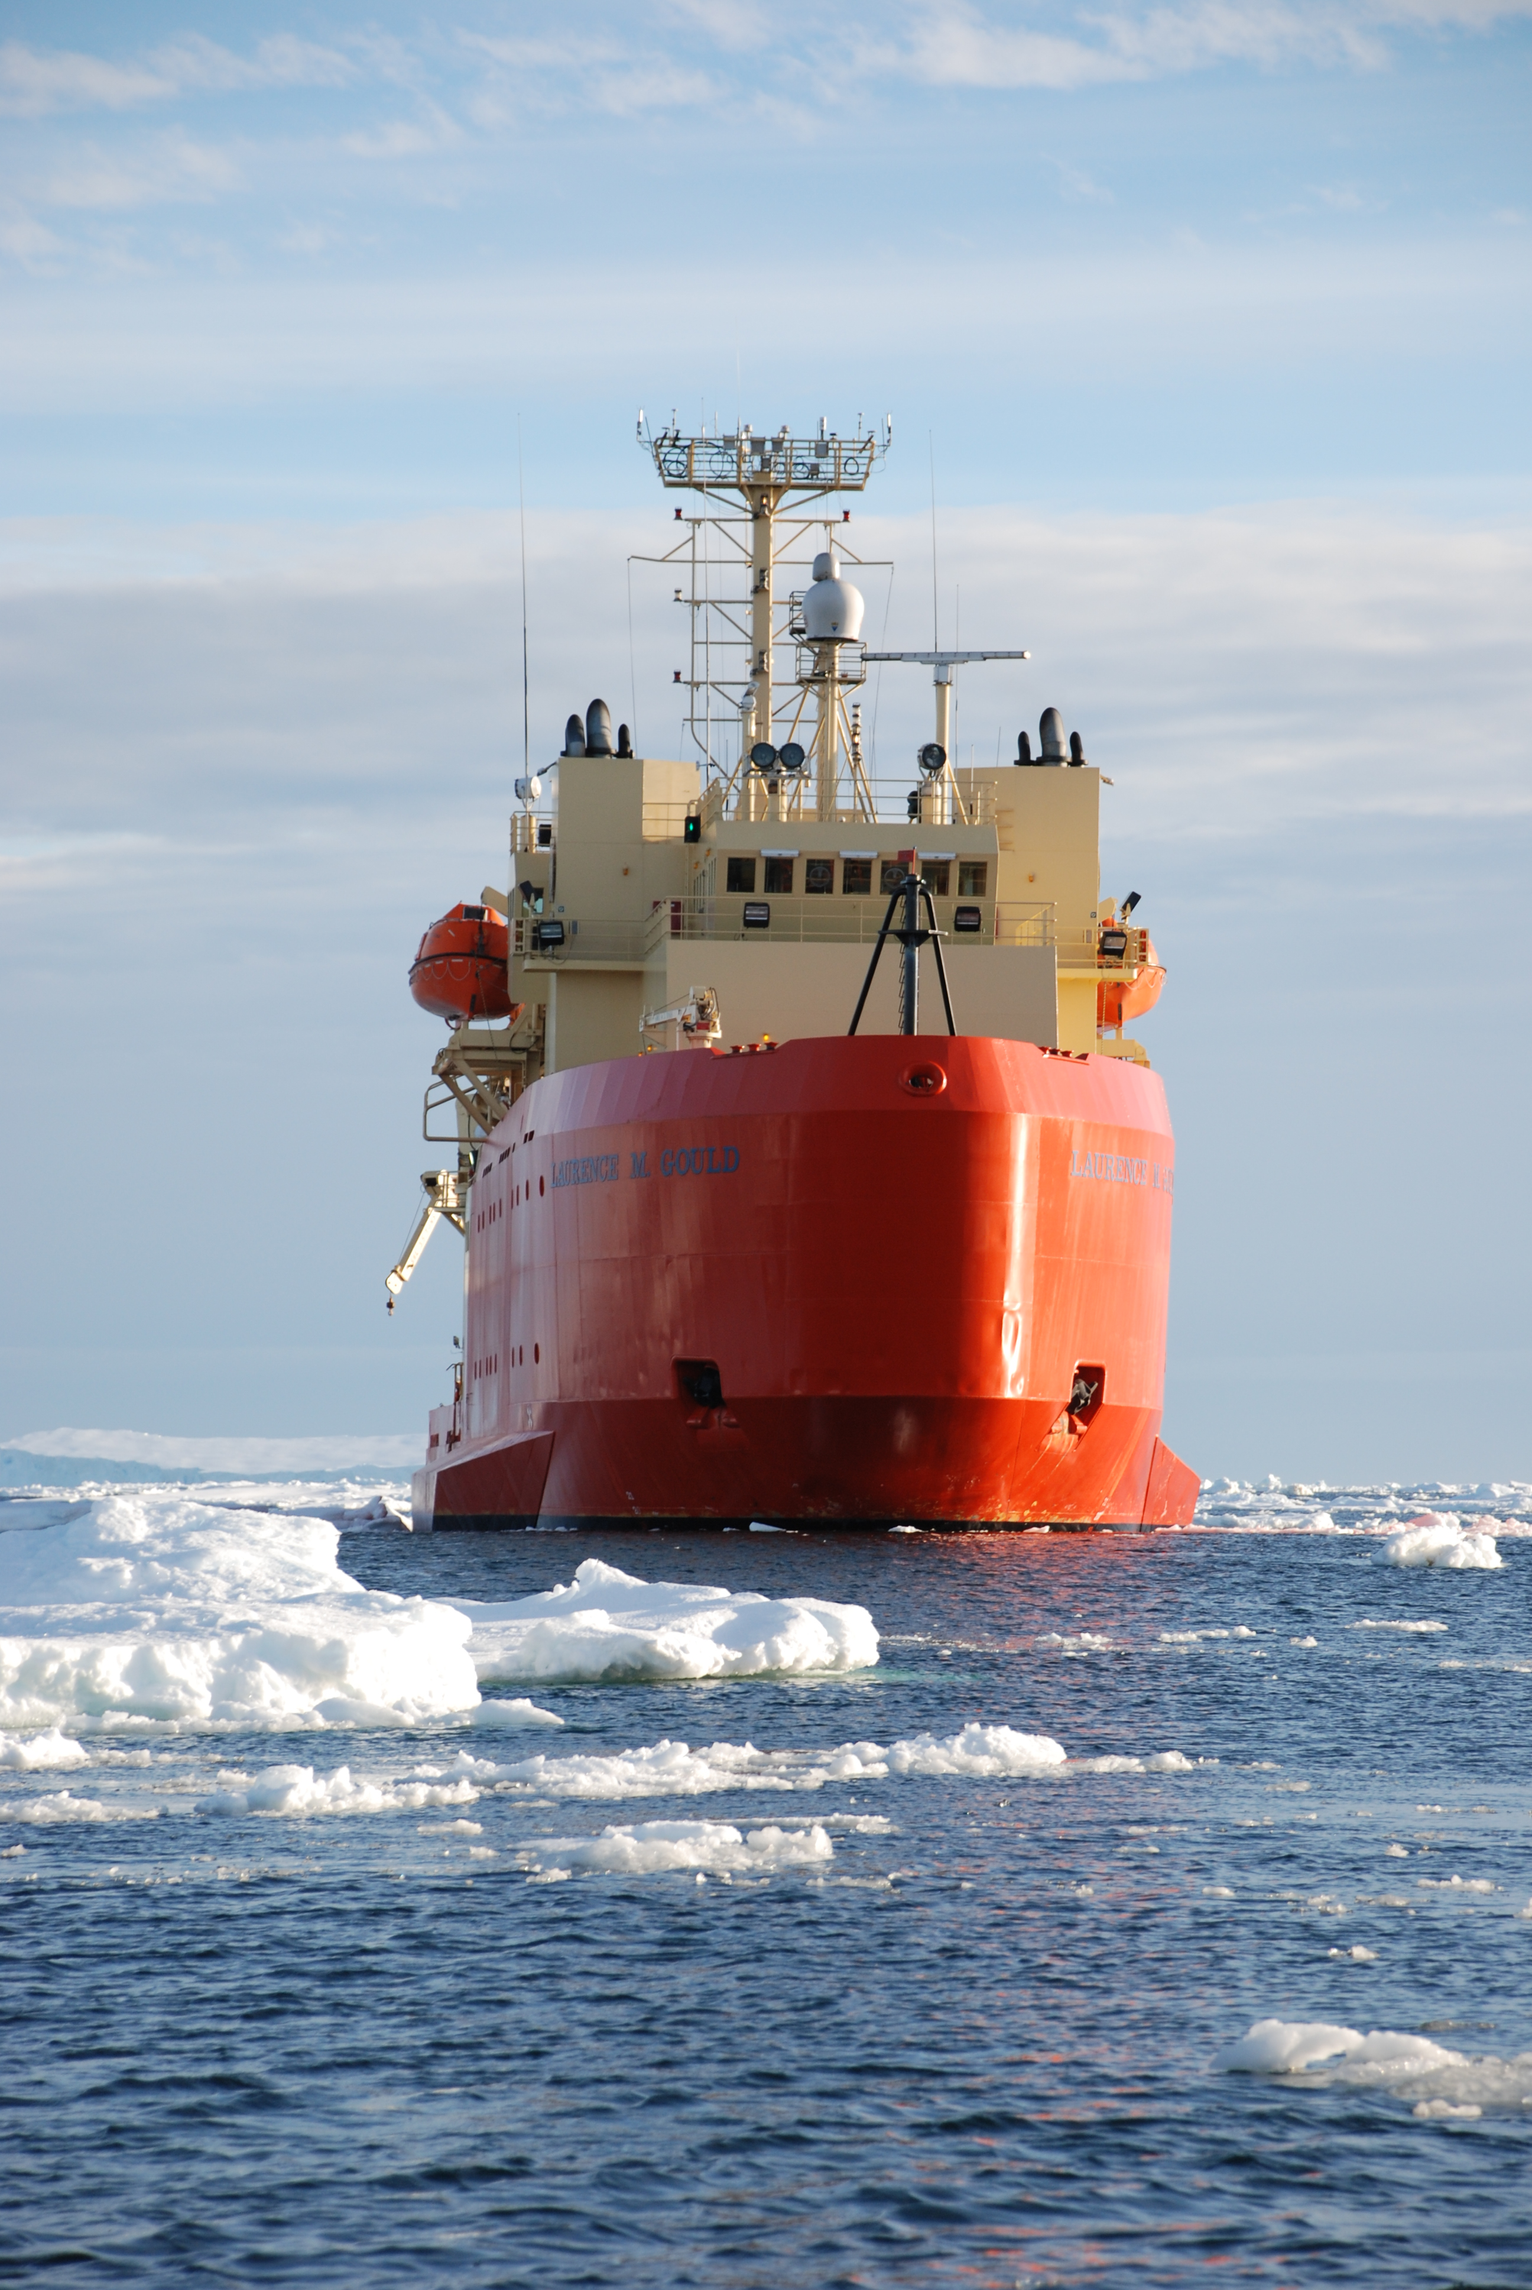
Part 2:
Effects of enhanced CO₂ on Antarctic krill feeding & nutrient excretion
(Saba, Schofield, Steinberg; in prep)

Slide 43
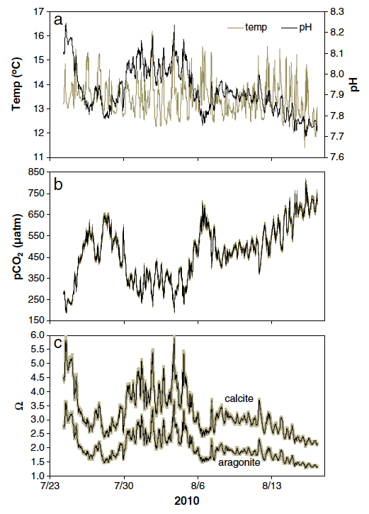
Responses to hypercapnia
Suppress metabolism
Compensation in extracellular fluid pH
  Acid-base/ion equilibria reach new steady state
Yu et al. 2011

Slide 44
Responses to hypercapnia
Suppress metabolism
Compensation in extracellular fluid pH
  Acid-base/ion equilibria reach new steady state
Hampers: metabolism, growth and reproduction in long-term
Yu et al. 2011

Slide 45
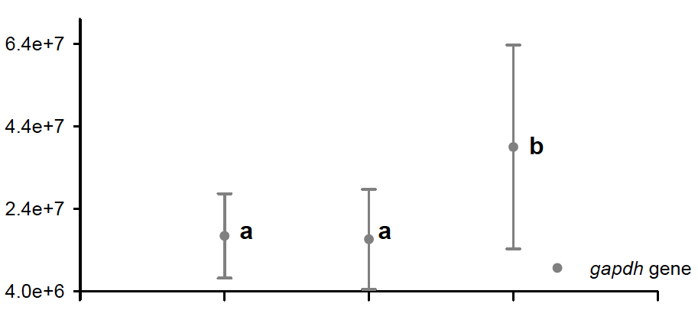
Effects of enhanced CO₂ on metabolism
Increase in expression of metabolic enzyme genes at high CO₂
amphipods
COPIES mRNA. μg total RNA⁻¹
Control
Nom. pH 7.8
(550 ppm)
Nom. pH 7.6
(980 ppm)
Hauton et al. 2009
Increase in ventilatory frequency & effort in some fish, elasmobranchs, cephalopods, and brittle stars

Slide 46
Hypothesis
Extra cost of compensation in krill due to enhanced CO₂ (i.e., boost of oxygen transport system, increased demand for acid-base regulator proteins) will result in an increase krill metabolism, feeding, and nutrient excretion

Slide 47
Krill Grazing Rates on Phytoplankton
(Saba, Schofield, Steinberg; in prep)
*
120
*
80
* p < 0.05
I (μg C krilll⁻¹ d⁻¹)
40
0
All Krill
Non-pregnant
Pregnant
Higher grazing in high CO₂ treatment
Higher grazing in pregnant females in high CO₂ treatment

Slide 48
Krill Nutrient Excretion Rates
(Saba, Schofield, Steinberg; in prep)
25
20
15
NH₄ (μg N krilll⁻¹ h⁻¹)
10
5
* p < 0.05
0
6
30
*
4
20
PO₄ (μg P krilll⁻¹ h⁻¹)
DOC (μg C krilll⁻¹ h⁻¹)
2
10
0
Pregnant
0
Higher krill excretion rates in high CO₂ treatment
All Krill
Non-pregnant
All Krill
Non-pregnant
Pregnant
All Krill
Non-pregnant
Pregnant

Slide 49
Part 2 Summary and Conclusions
Higher chlorophyll ingestion rates and higher excretion rates at higher CO₂
  Analysis of metabolic enzyme activities will provide insight into effect on overall krill metabolism (respiratory ETS, citrate synthase, MDH, LDH, gadph)
Higher grazing rates but similar excretion rates in pregnant vs. non-pregnant females
  Pregnant females demanded & retained more nutrition
Higher metabolism due to increasing CO₂ may negatively impact krill production in long-term
  Prolonged exposure studies necessary to determine possible adaptation of krill

Slide 50
B-019 2011-2012 Update of Goals
B-019 Papers in Prep (each can provide a poster to the site review):
Haskins et al “Photo-physiology at Palmer deep” MEPS (Dec)
Garzio et al “Bio-optical properties of the WAP” GRL (Feb-March)
Oliver et al “Penguin foraging and tides” (Fall)
Saba et al “Phytoplankton community responses to changes ocean PH” (Dec-Jan)
Saba et al “Krill responses to changes in ocean PH” (Fall)
Saba et al “Analysis of Palmer time series” (Spring)
Schofield et al “Carbon quantum yields in the WAP” (Spring)
B-019 Funding Goals in Review:
Under ice glider comms and navigation
Sherell trace metal mapping of WAP
B-019 Funding Goals in Prep:
Time to recharge the glider fleet (Looking to Keck, focus on hotspots)
Plan the NASA2 effort and support planned efforts by Kohut in 2012
NSF MRI, equipment to refurbish the HPLC, cell counters, new optics

