Slide 1



Middle Atlantic
Regional Association
Coastal
Ocean Observing System
1000 km
Cape to Cape
CT
RI
Cape
Cod
MA
NY
10 States
111 Congressional Districts
PA
NJ
MD
DE
To seek, discover and apply new knowledge & understanding of our coastal ocean
Mid-Atlantic Regional
Coastal Ocean Observing System:
From Observations to Forecasts
Scott Glenn, L.Atkinson, A.Blumberg, W.Boicourt, W.Brown, N.Georges, A.Gongopadhyay, E.Howlett, J.Kohut, J.O’Donnell, M.Oliver, O.Schofield, R.Signell, C.Thoroughgood, J.Wilkin,
Plus >30 Additional Co-PI’s from >20 Institutions
VA
NC
Cape
Hatteras

Slide 2
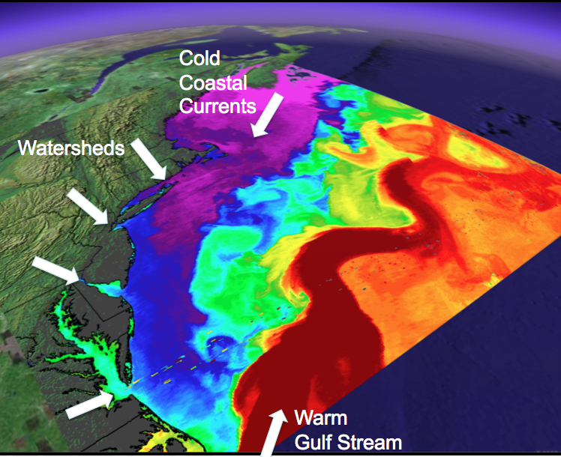
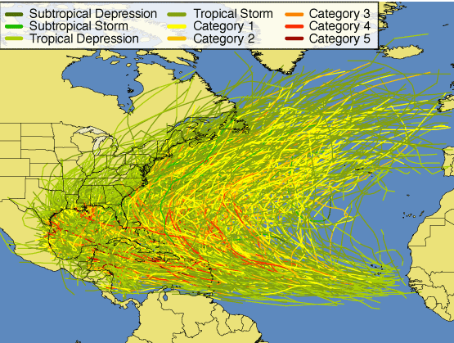
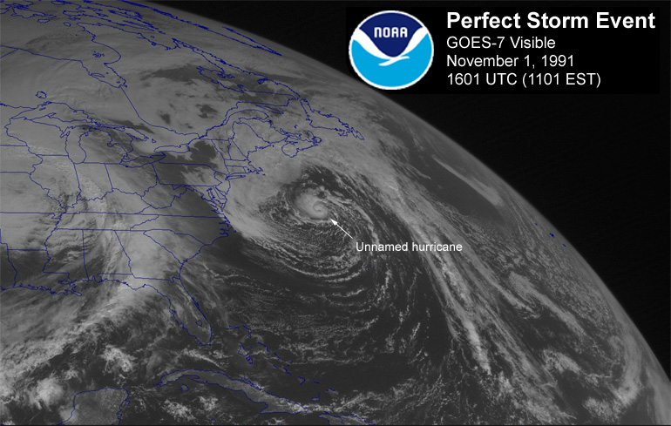
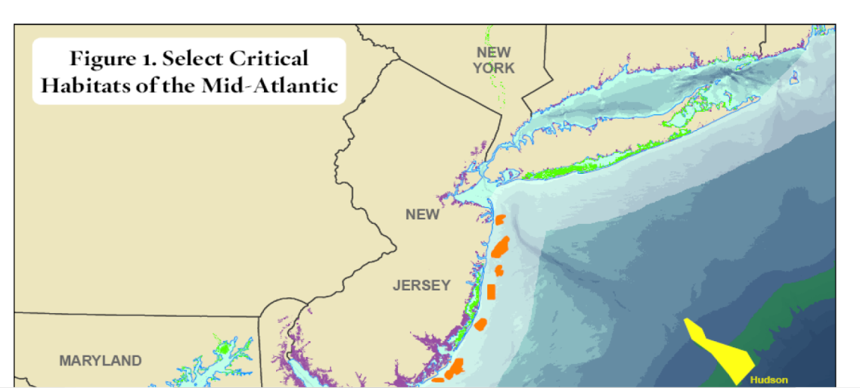
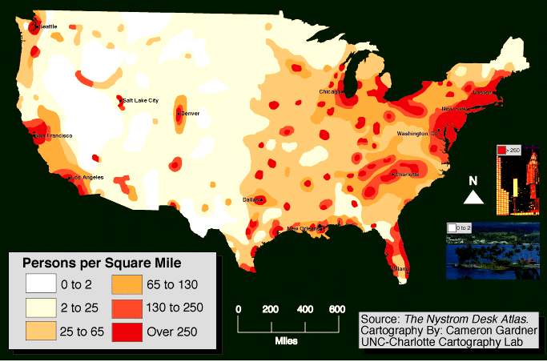
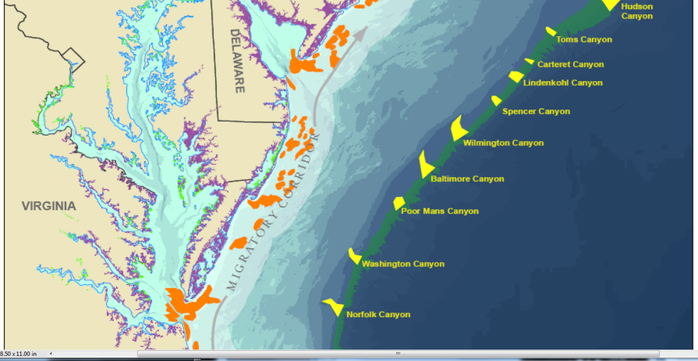
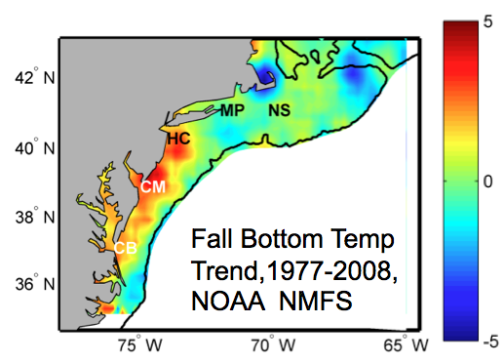
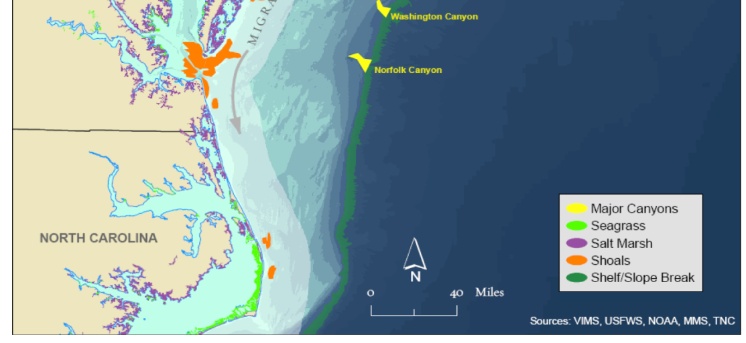
Mid-Atlantic Regional Drivers
Cold
Coastal Currents
Tropical Storms
Watersheds
Ocean Circulation
Critical Habitat
Northeasters
Population
Climate Change
Warm
Gulf Stream

Slide 3
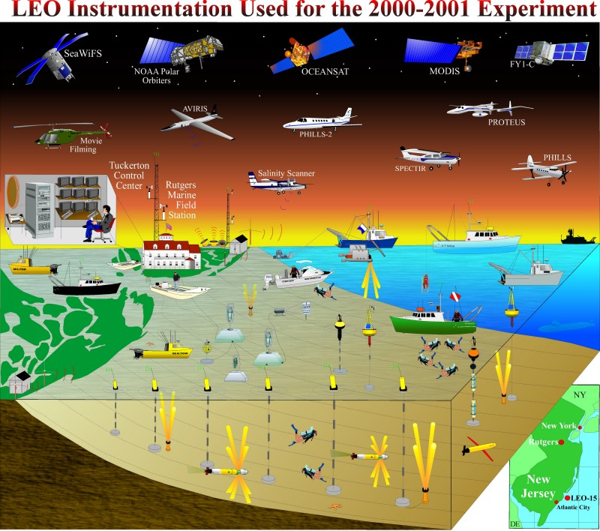
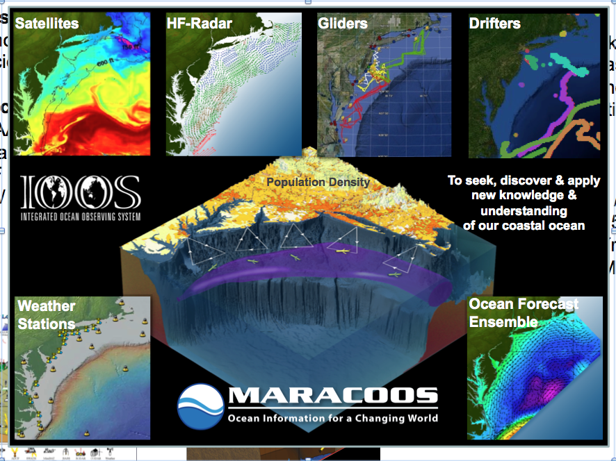
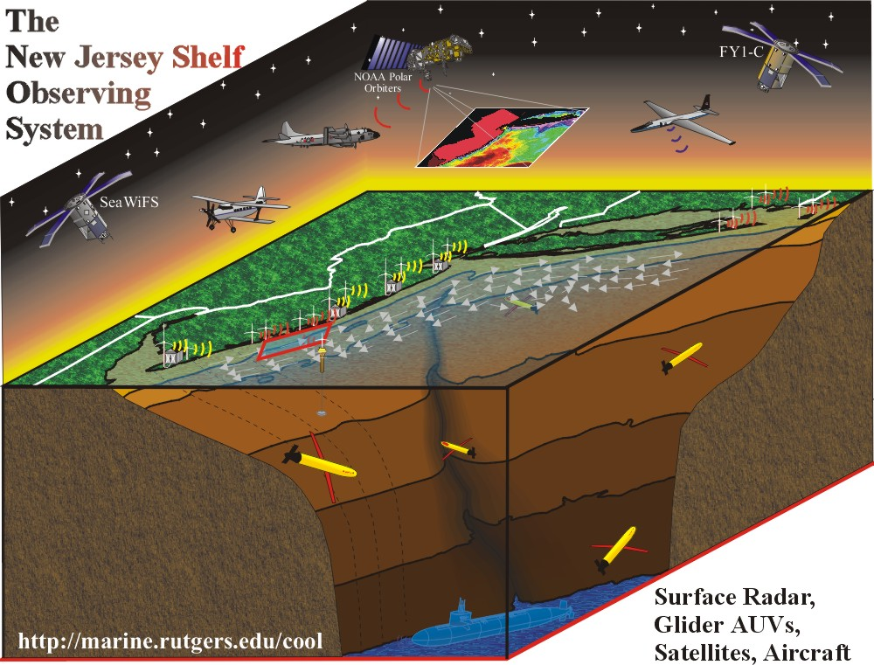
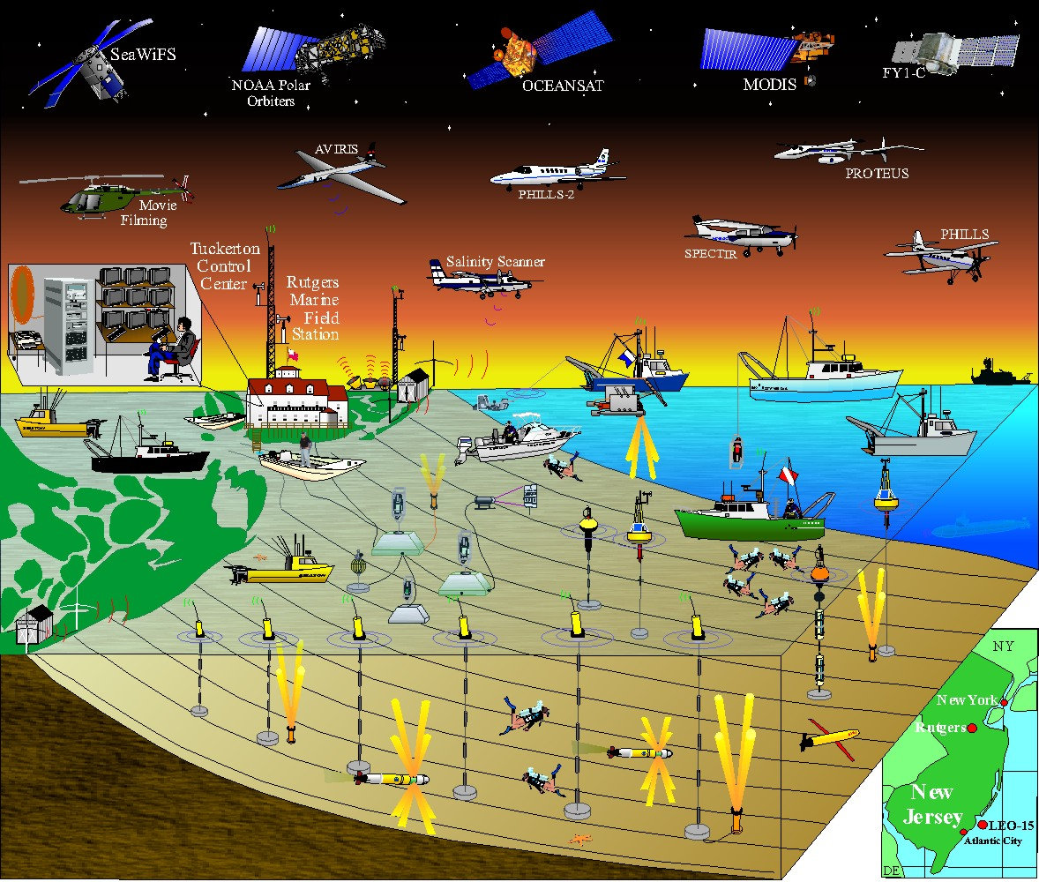
Evolution of Rutgers Major Coastal Ocean Observing Projects
1990’s:
Technology Development for Science Experiments
Projects:
NOAA Undersea Research $2 M / 5 Yr
NSF Upwelling Exp
$1 M / 3 Yr
2000’s:
Observation Network & Forecast Model Development for
Science & Society
Projects:
NOPP/ONR Coastal Predictive Skill Experiments $5 M / 4 Yr
NSF Hudson River Plume Exp $5 M / 3 Yr
NOAA IOOS MARCOOS $8 M / 4 Yr
2010’s:
Observation Network Operations & Forecasting Ensemble Development for Society & Education
Projects:
NOAA IOOS MARACOOS $20 M / 5 Yr
DHS CSR $12 M / 5 Yr
NJ BPU $2 M / 2 Yr
NSF OOI Edu $5 M / 4 Yr
LEO15
New Jersey Shelf

Slide 4
Evolution of the Mid Atlantic Observation & Modeling System

Slide 5
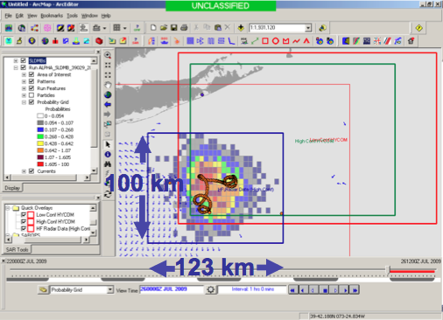
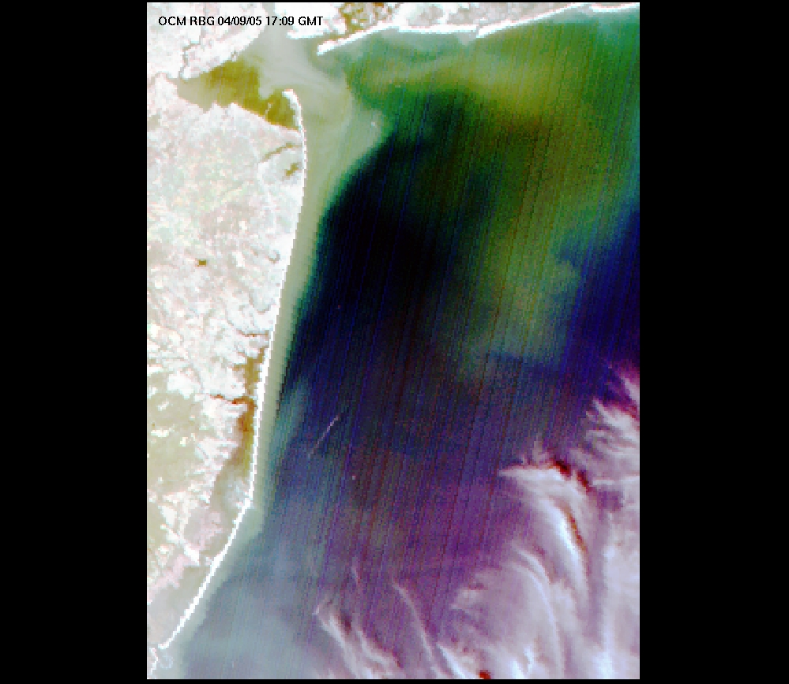
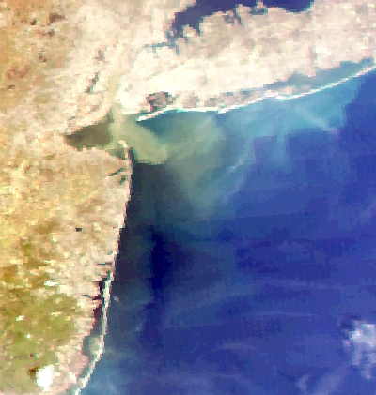
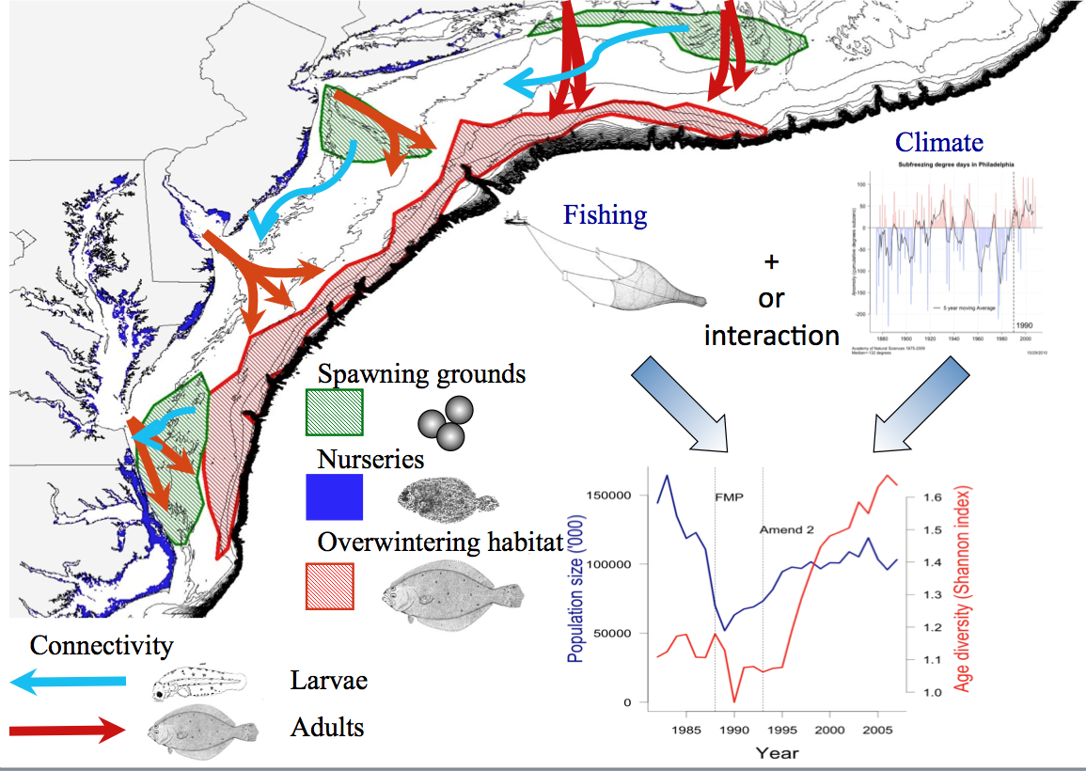
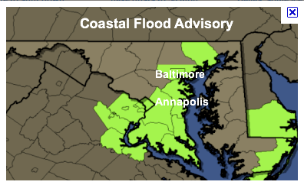
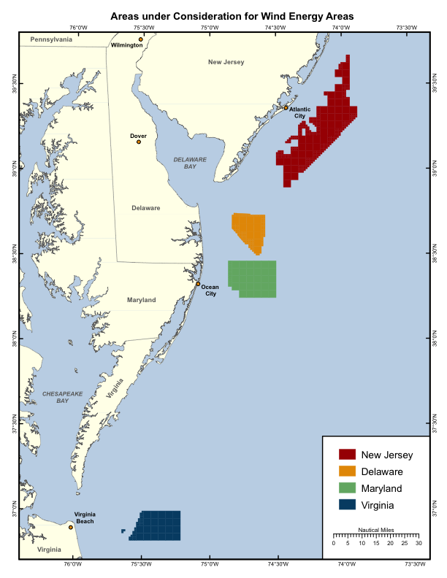
MARACOOS Regional Themes
1) Maritime Operations – Safety at Sea
3) Water Quality – Floatables, Hypoxia, Nutrients
2) Ecosystem Decision Support - Fisheries
5) Energy – Offshore Wind
4) Coastal Inundation - Flooding

Slide 6
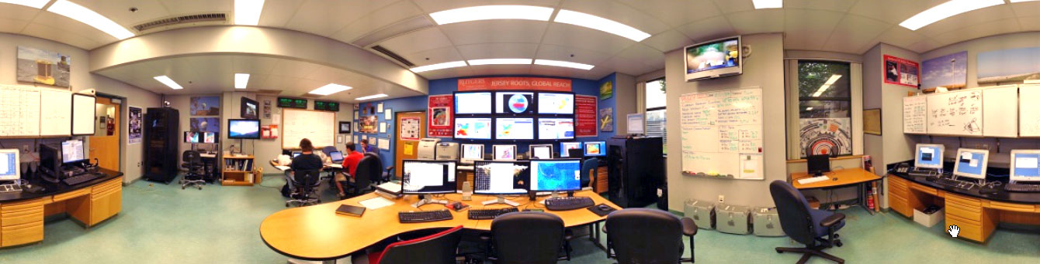
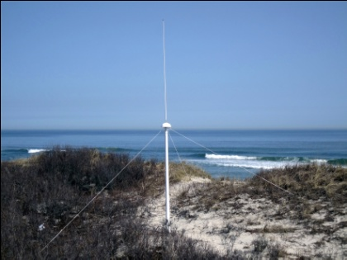
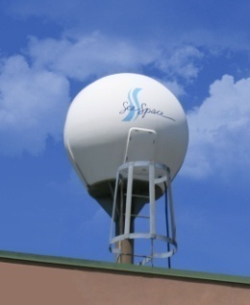

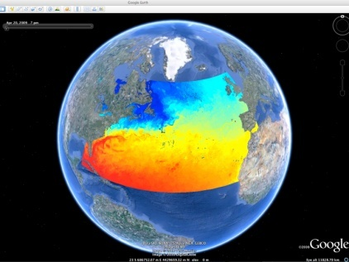
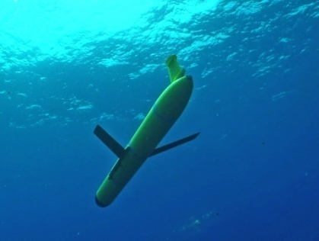











Rutgers University - Coastal Ocean Observation Lab
Observatory Operations & Education Center
CODAR Network
L-Band & X-Band Satellite Receivers
3-D Nowcasts
& Forecasts
Glider Fleet
Notes:
6

Slide 7
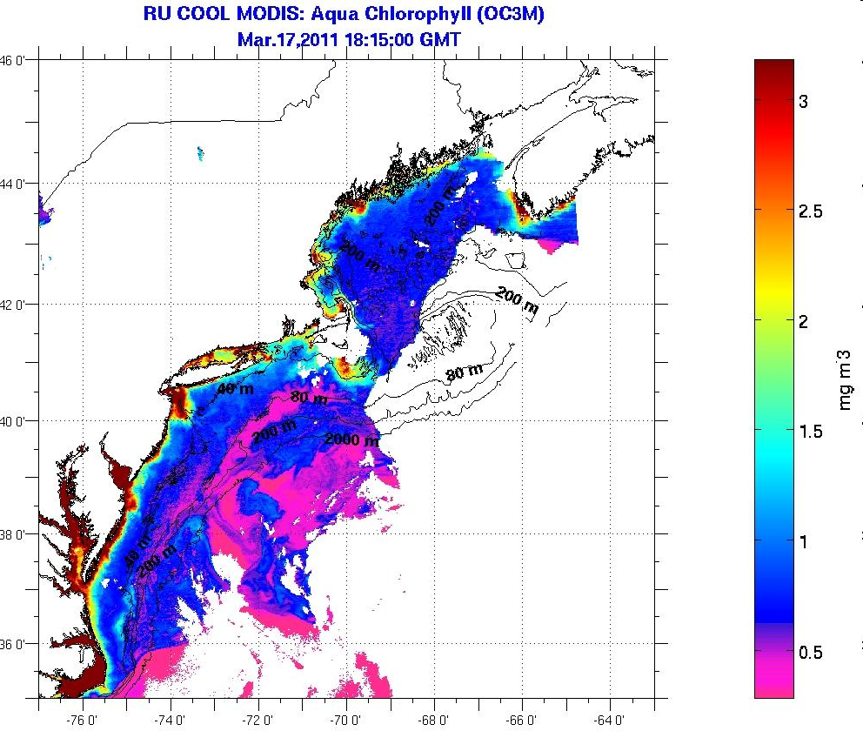
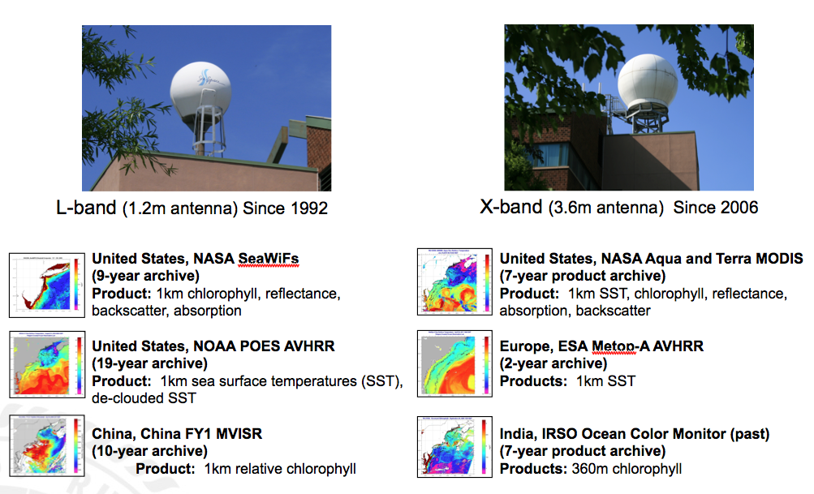
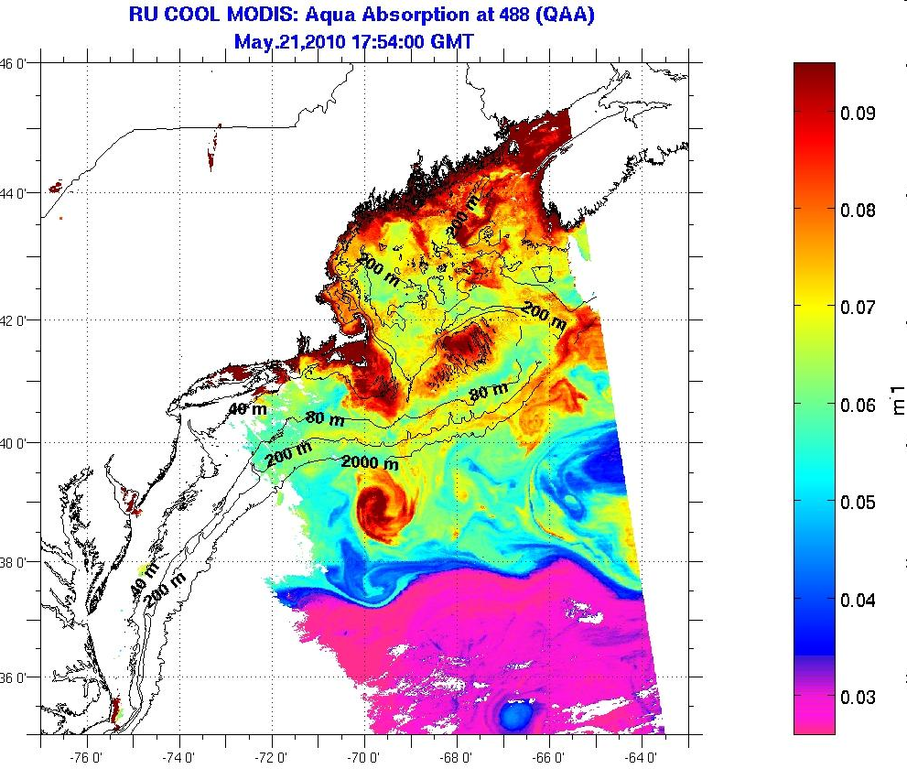
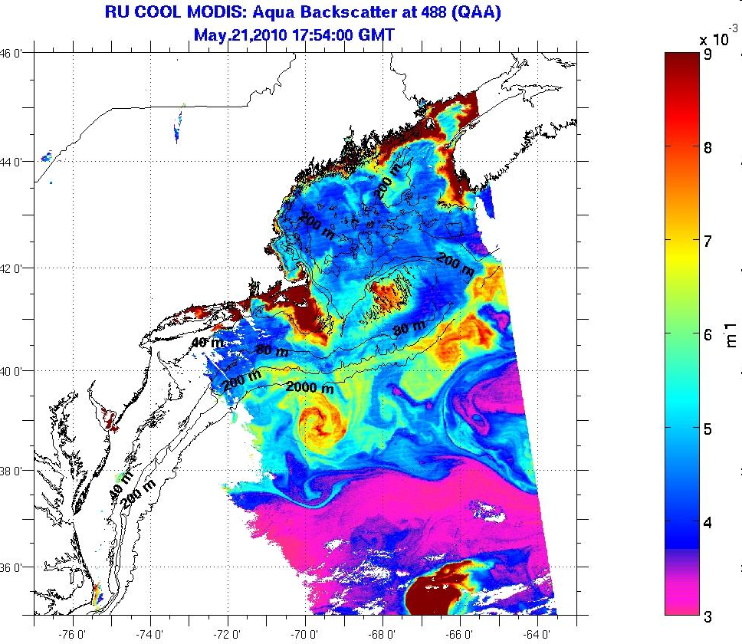
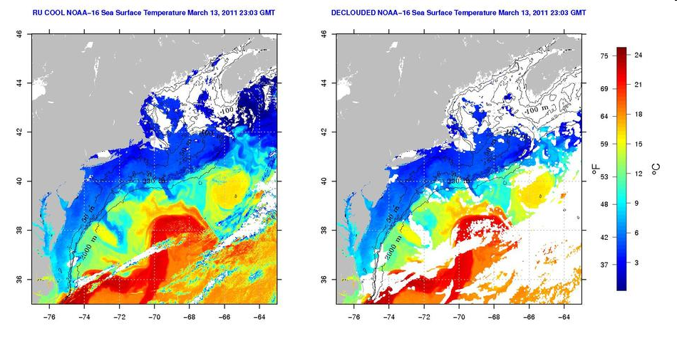
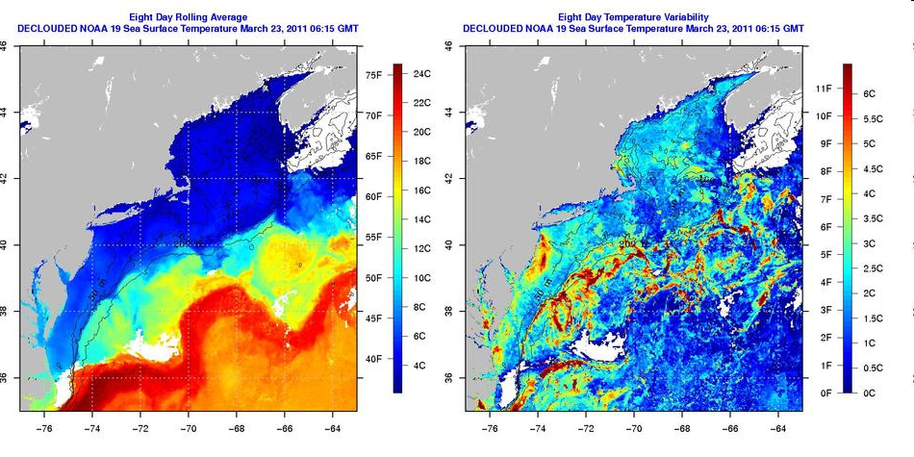
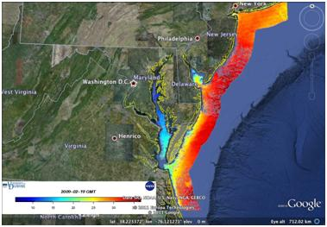
Direct Acquisition Satellite Data Evolution

Slide 8
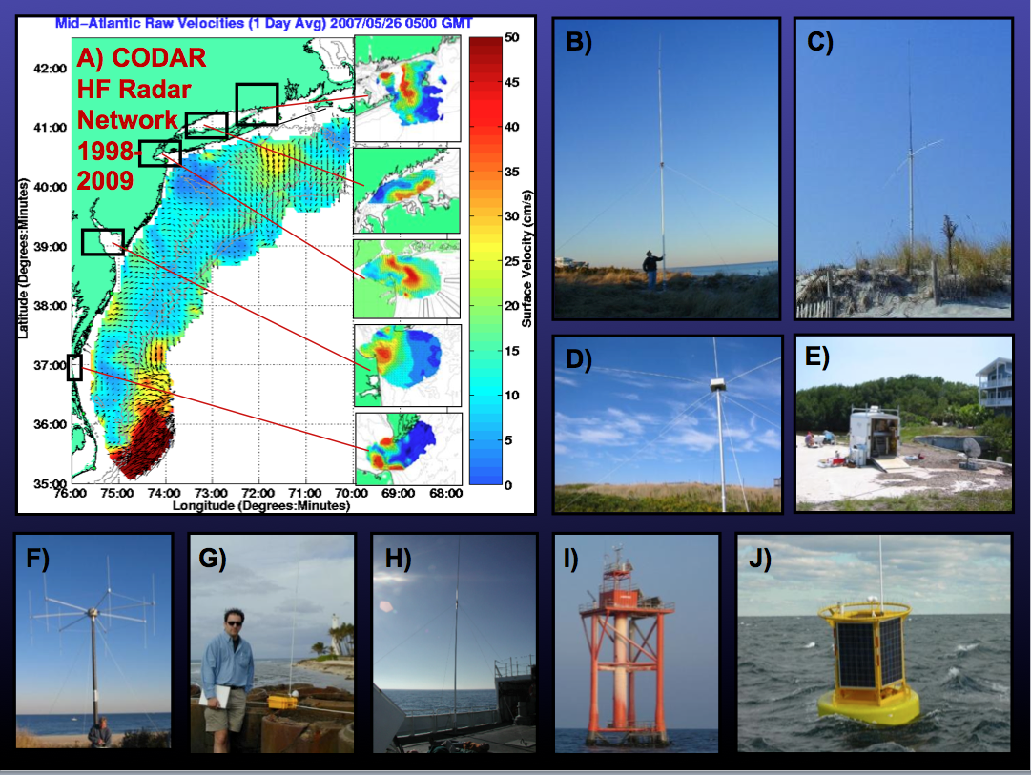
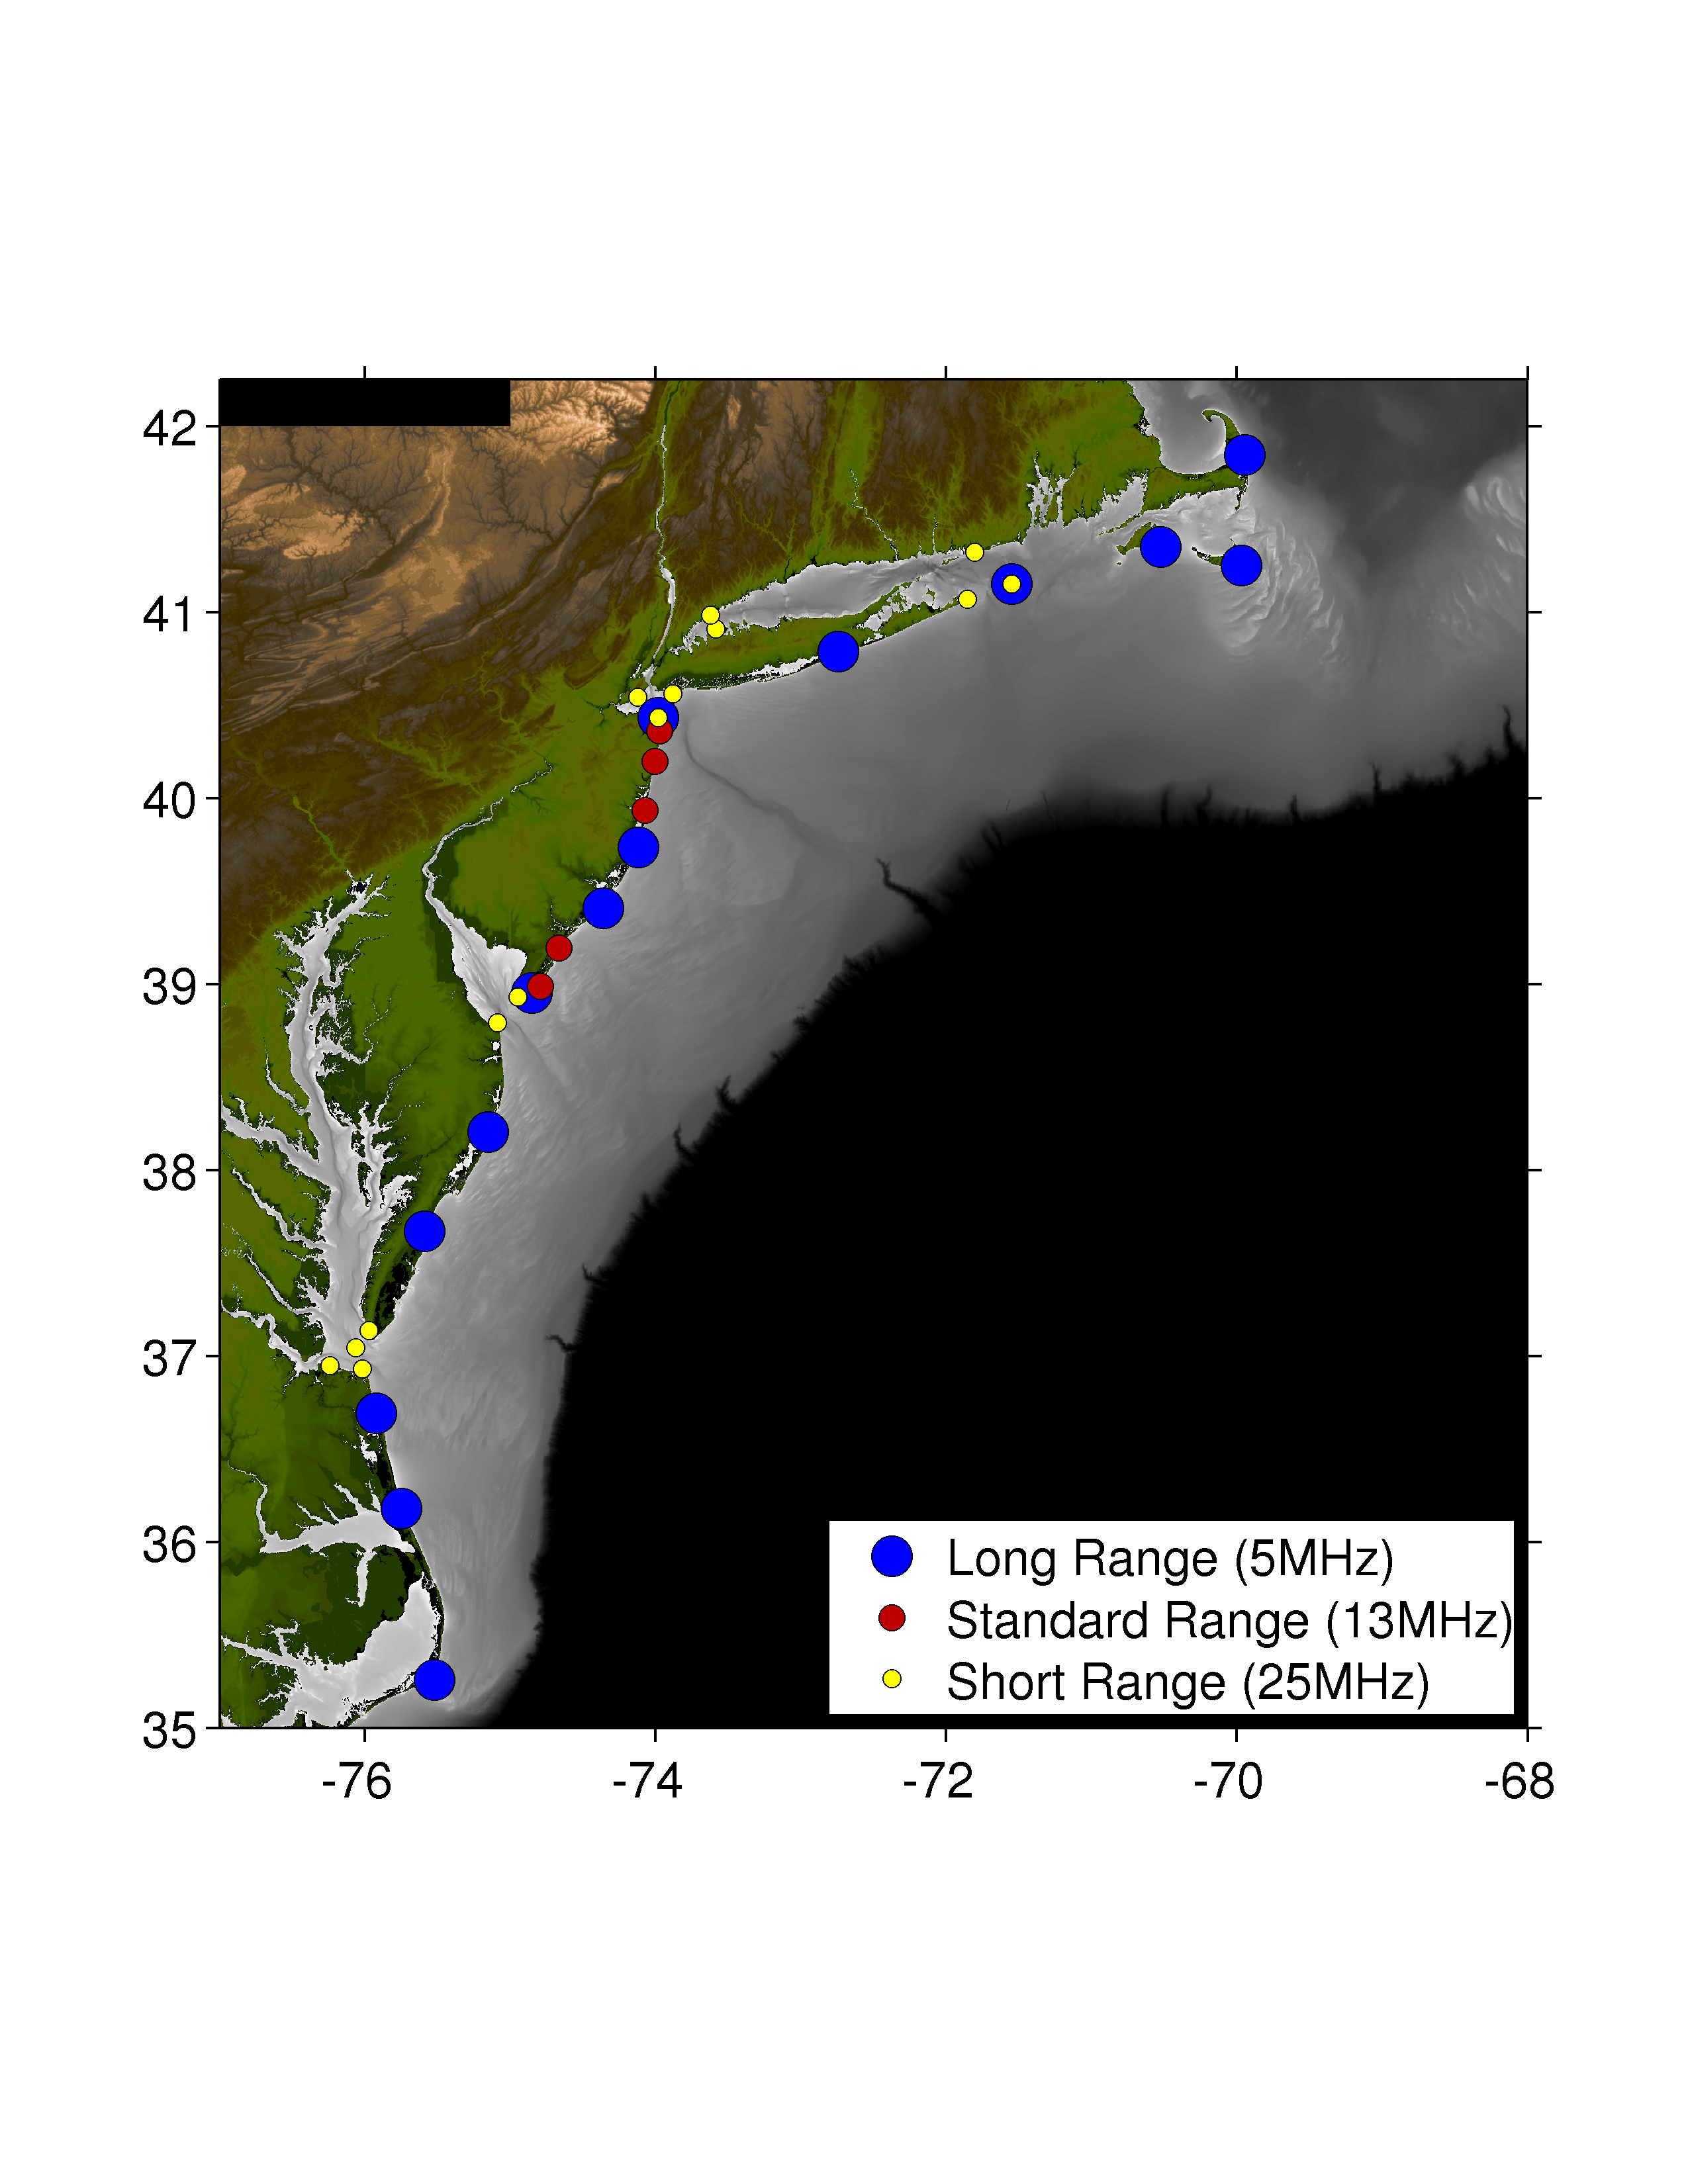

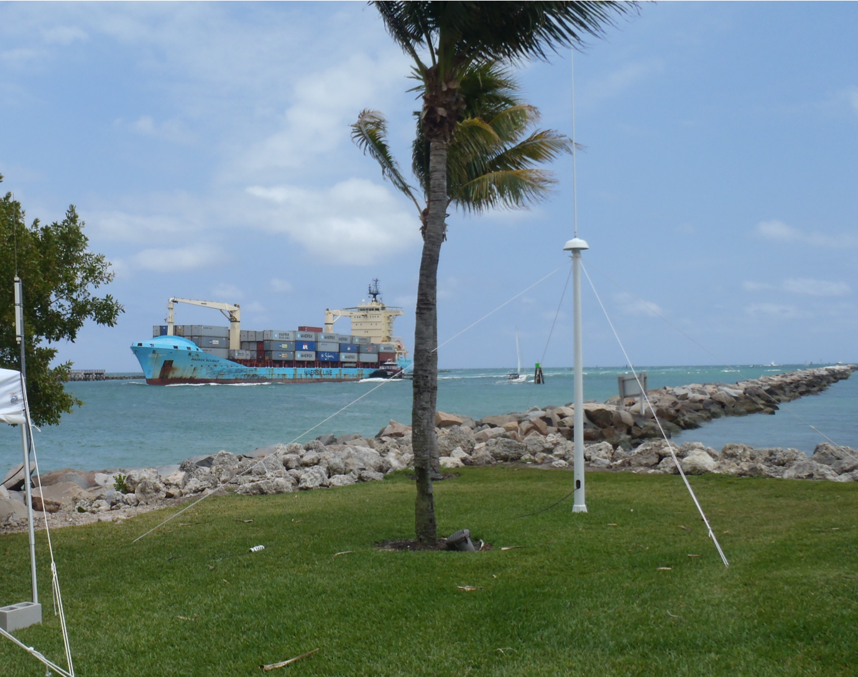
CODAR HF Radar Network Evolution in the Mid-Atlantic
>35 CODAR Sites
Current Mapping
Nearshore Waves
& Currents
Vessel Tracking
National Network
East Coast Hub
E)

Slide 9
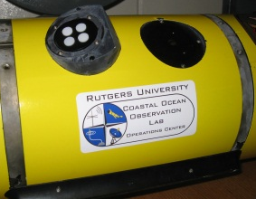
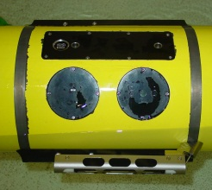


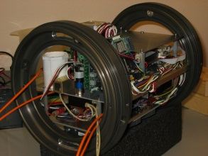
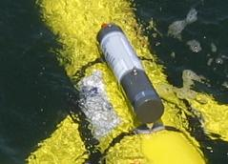
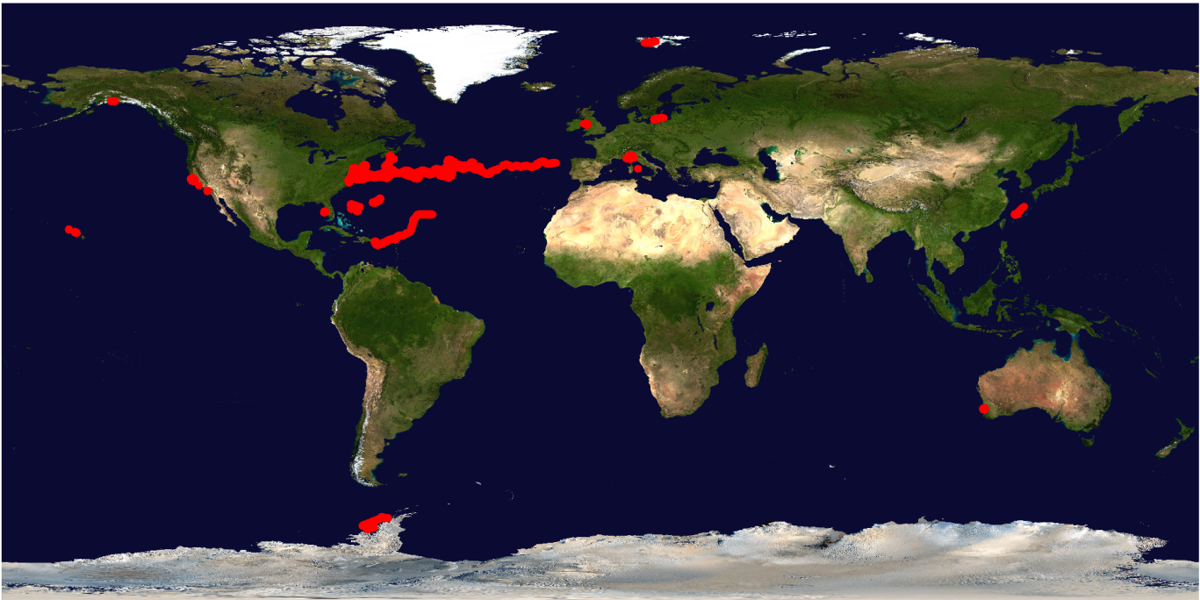
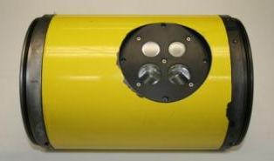
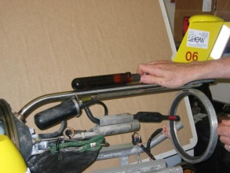
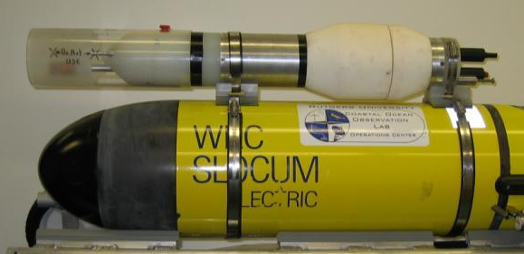
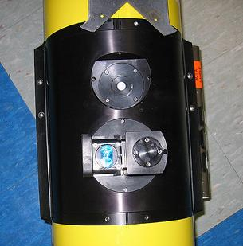
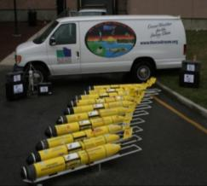
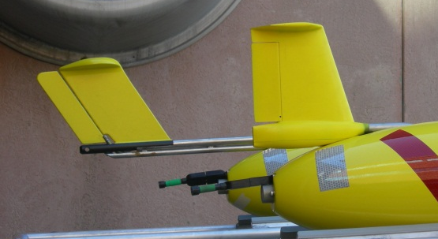
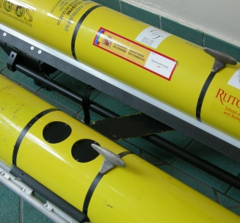
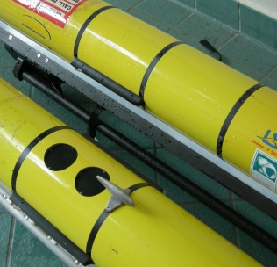
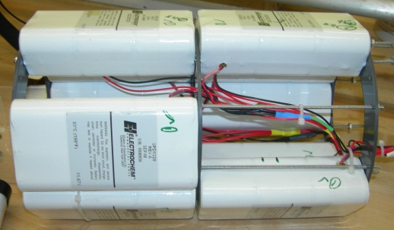
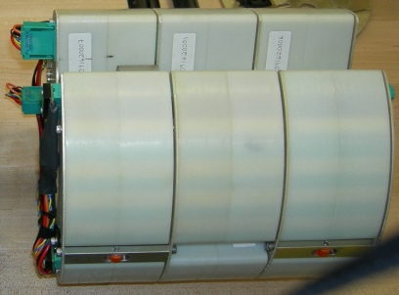
Rutgers Slocum Glider Fleet
Glider Sensors
Global Flight Statistics:
261 Deployments
4,037 In-water days
94,000 km flown
2.3 laps around the Earth
Ruggedized Tail Fin, Modular Payload Bays, Lithium Primary & Rechargeable Batteries

Slide 10
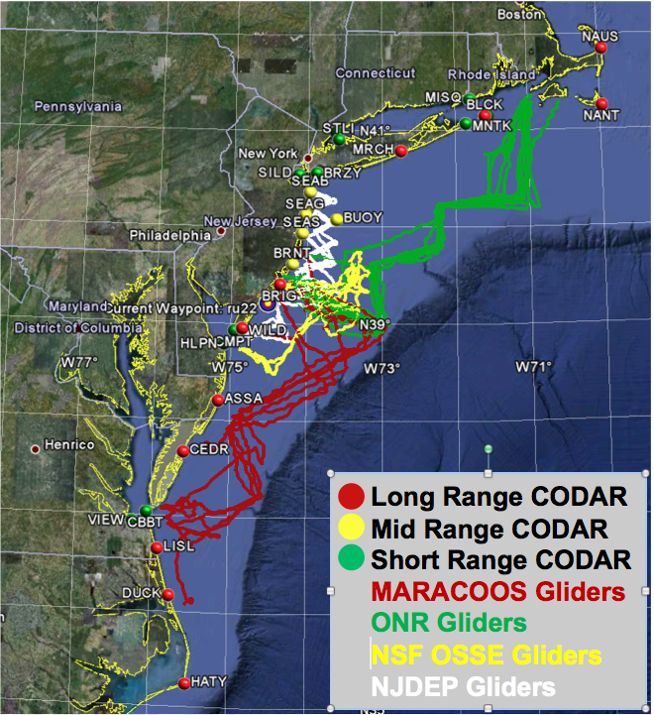
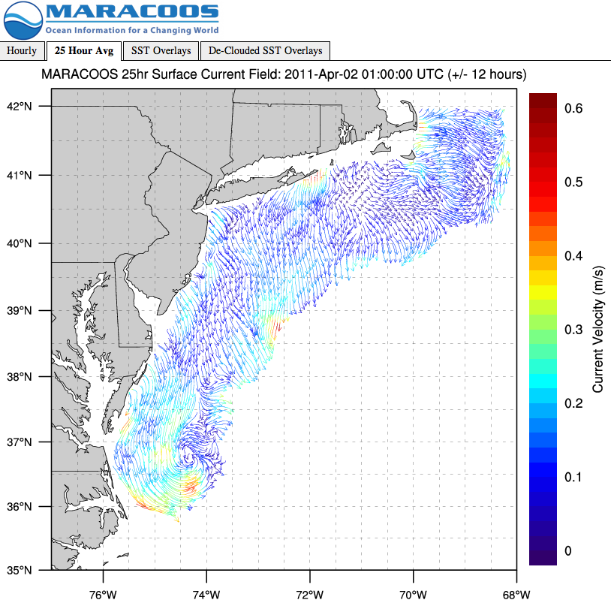

MARACOOS Regional Real-time Data

Slide 11

Combining MARACOOS Spatial Data with Fisheries Distribution Data
New Product: Butterfish Bycatch Reduction Model

Slide 12




MARACOOS Ocean Forecast Models
NY-HOPS
Stevens
Institute
Technology
Short Term
Prediction System
U. Connecticut
ROMS
ESPRESSO
Rutgers
HOPS
U Massachusetts

Slide 13


Ocean Models Still Validated Against Standard Measures
UMass HOPS
NY HOPS Compared to Sea Level Height Observations

Slide 14




Forecast Model Comparisons to Drifters
Uconn STPS
NY HOPS
UMass HOPS

Slide 15


Surface velocity forecast skill improves with assimilation of CODAR
Surface velocity forecast skill improves with CODAR assimilation
This analysis for ROMS LaTTE domain (NY Bight). 2-day forecast skill significantly improved for cross-correlation (submesoscale pattern variability)
MSE = mean squared error
CC = cross-correlation; Sm and So are std. dev. of model and obs
analysis forecast window analysis forecast window

Slide 16


Forecast Model Comparison with Subsurface Glider Data: Salinity

Slide 17



Two example validation data sets: Glider RU21 and NOAA ECOMON ship survey CTDs
In Taylor diagrams, distance from OBS to MODEL (green dashed contours) depicts centered (bias removed) root mean squared error RMSE’ normalized by observation standard deviation.
BIAS is tabulated separately in order of decreasing skill.
Comparison is for all operational models that include Mid-Atlantic Bight.
Global: HyCOM, NCOM, Mercator
Regional: NYHOPS, ESPreSSO, UMassHOPS. COAWST

Slide 18


Two example validation data sets: Glider RU21 and NOAA ECOMON ship survey CTDs
In Target diagrams, distance on y-axis is BIAS and distance on x-axis centered (bias removed) root mean squared error RMSE’ normalized by observation standard deviation.
Comparison is for all operational models that include Mid-Atlantic Bight.
Global: HyCOM, NCOM, Mercator
Regional: NYHOPS, ESPreSSO, UMassHOPS. COAWST

Slide 19




Glider Adaptive Sampling based on Ensemble of Ocean Forecasts
Ensemble of 4 Forecasts
Model-Data Profile Comparisons
Forecast Currents determine Glider Range
Gliders Retasked based on Objectives

Slide 20

Multiscale Forecast Validation Glider data (t, s) assimilation
Independent Glider (UD134) data at 25-m for (a) temperature and (b) salinity, compared to the SMAST-HOPS 02 Nov 2009 runs. Only RU05, RU21 and RU23 data were assimilated (UD134 was not) during the first week. Glider data are shown with blue the model run with glider assimilation is shown with a red solid line, and the model run with no glider assimilation is shown with a dashed red line. Note the difference between assimilation and non-assimilation runs for temperature is about 2°C; while that for salinity is about 0.4 psu.

Slide 21

Conclusions:
Sustained Regional Observing Networks are Proven
Ensemble Ocean Forecast Models are a Useful Tool
Emphasis is Shifting toward support for Societal Goals
Workforce Development is Still Required

