Slide 1
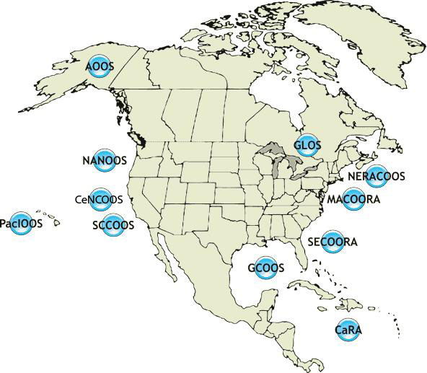


1000 km
Cape to Cape
CT
RI
Cape
Cod
MA
NY
10 States
111 Congressional Districts
PA
11 IOOS Regional Associations
NJ
MARACOOS Coastal
Marine Spatial Planning
Scott Glenn, Carolyn Thoroughgood,
Bill Boicourt, Wendell Brown, Larry Atkinson
Plus 37 Additional Co-PI’s from 20 Institutions
Today’s Outline:
Who is MARACOOS?
What are the CMSP Drivers?
What is our Approach to CMSP?
MD
DE
Middle Atlantic
Regional Association
Coastal
Ocean Observing System
VA
NC
Cape
Hatteras
To seek, discover and apply new knowledge & understanding of our coastal ocean

Slide 2
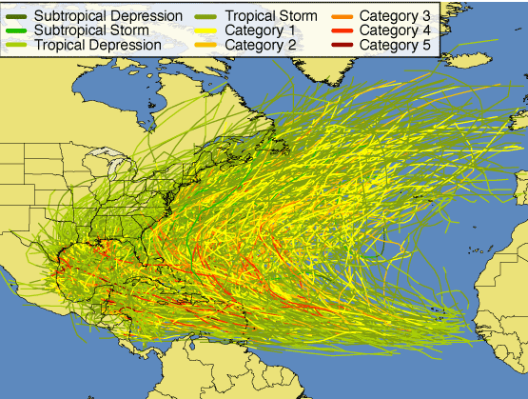
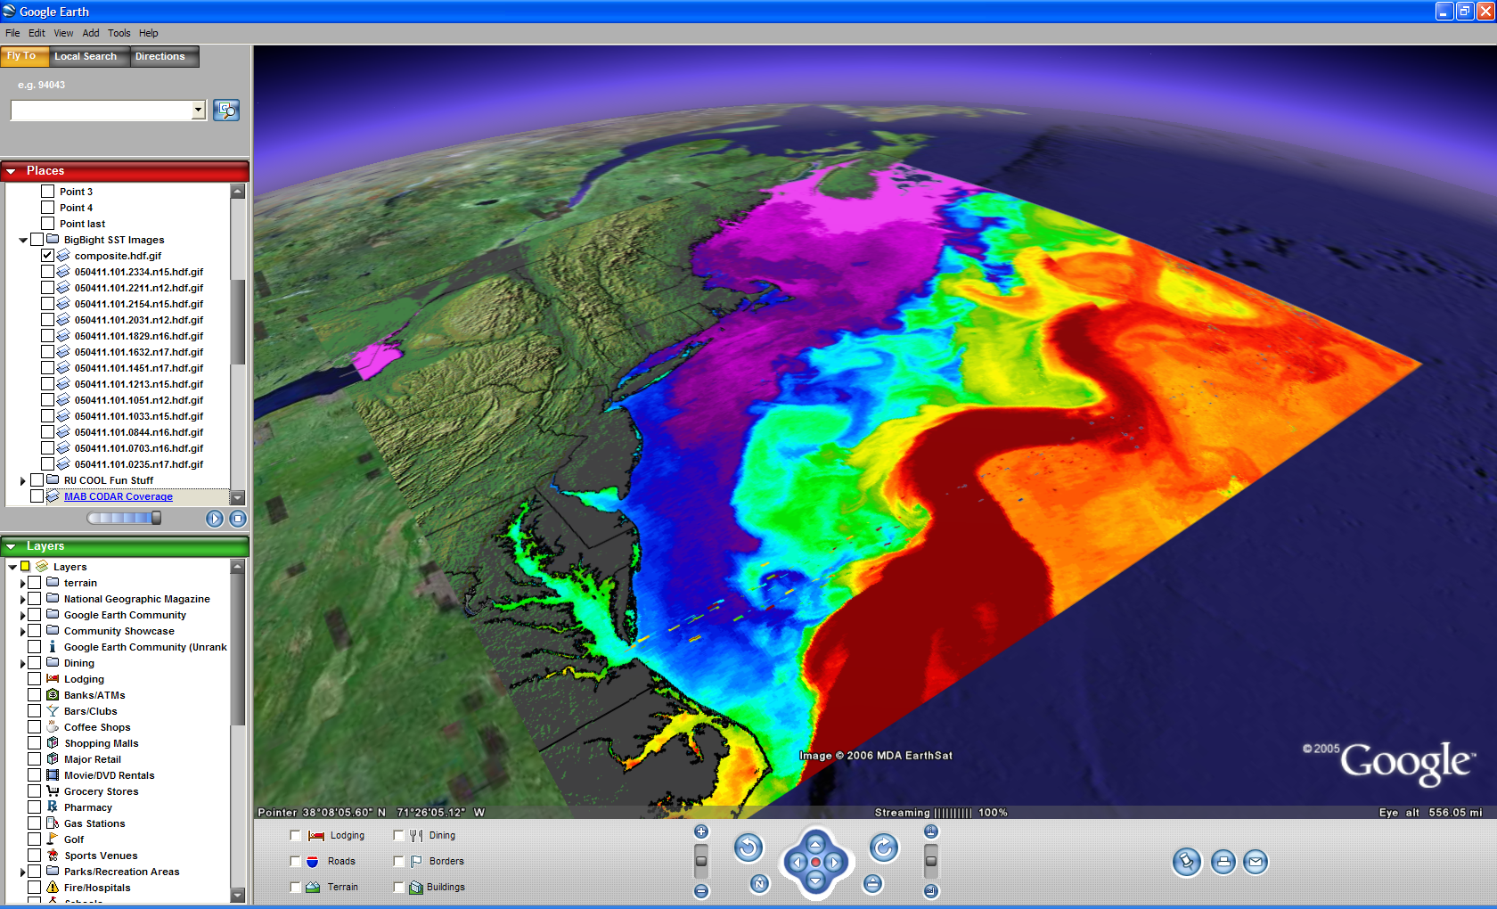
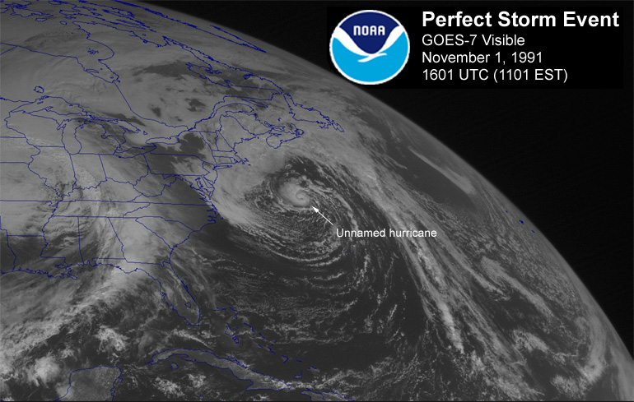
Oceanic & Atmospheric Drivers in the MARACOOS Region
Cold
Coastal Currents
Watersheds
Tropical Storms
Northeasters
Warm
Gulf Stream

Slide 3
MARACOOS Organization and History

Slide 4
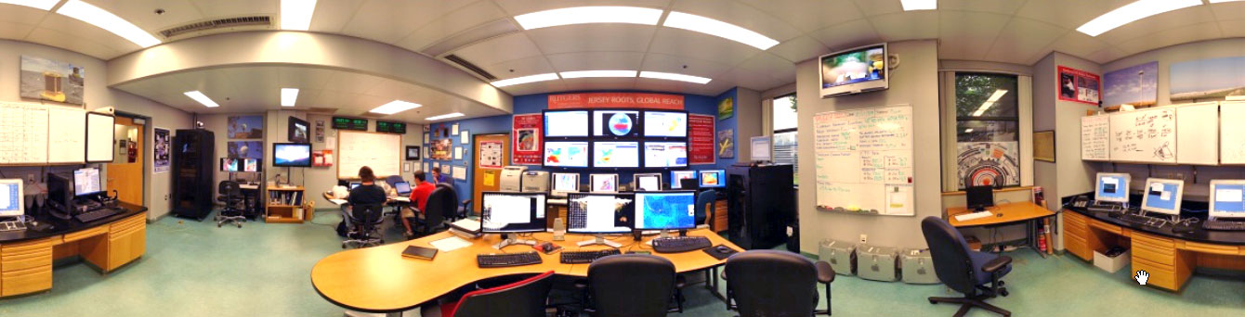
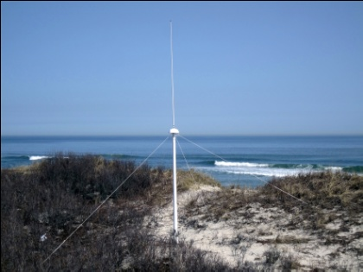
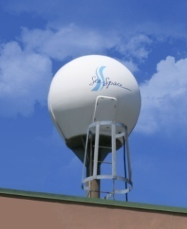
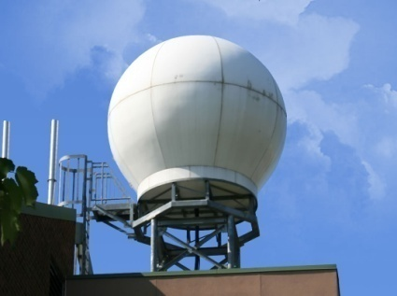
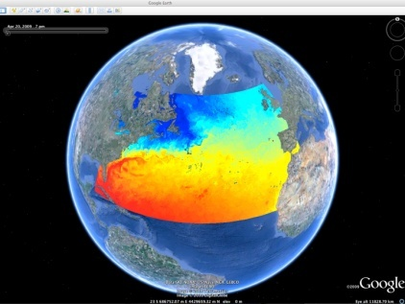
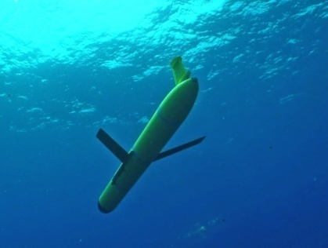












MARACOOS Operations & Data Fusion Center
Rutgers University - Coastal Ocean Observation Lab
CODAR Network
L-Band & X-Band Satellite Receivers
3-D Nowcasts
& Forecasts
Glider Fleet
Notes:
4

Slide 5
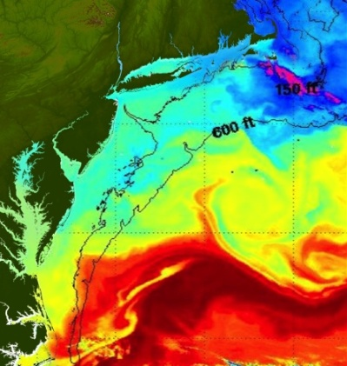
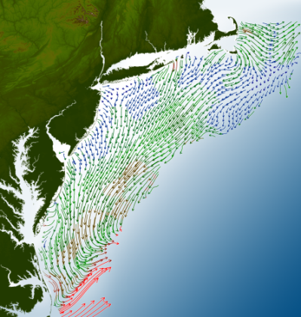
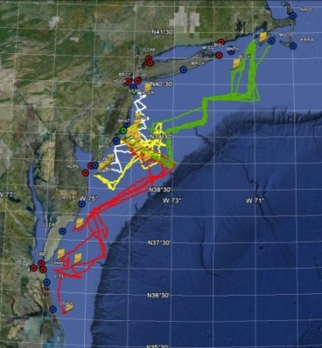
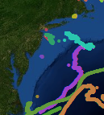
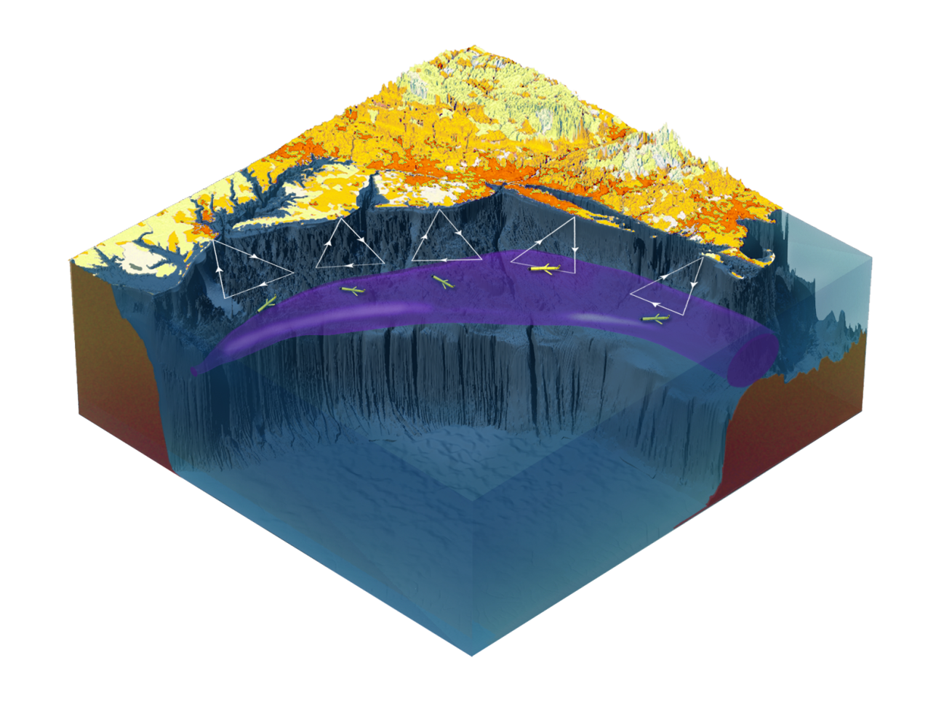

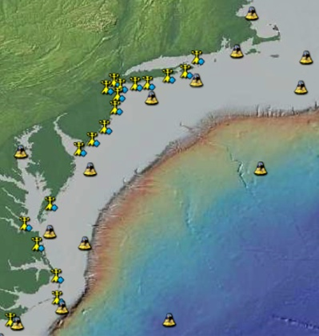
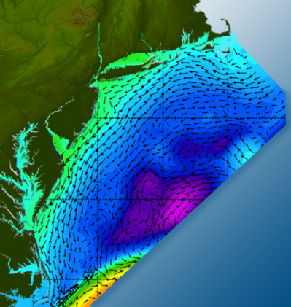
MARACOOS Regional Data & Regional Products
Satellites
HF-Radar
Gliders
Drifters
Population Density
To seek, discover & apply
new knowledge & understanding
of our coastal ocean
Weather Stations
Ocean Forecast Ensemble

Slide 6
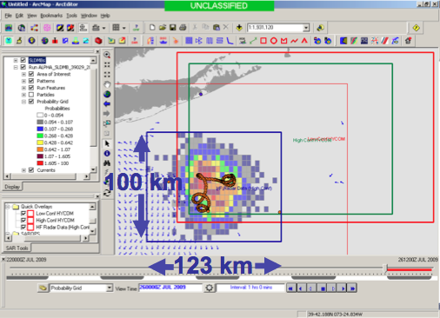
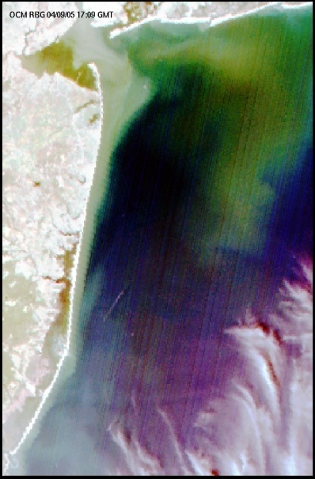
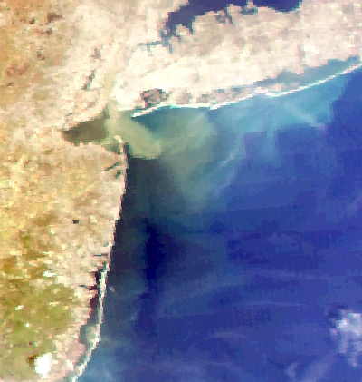
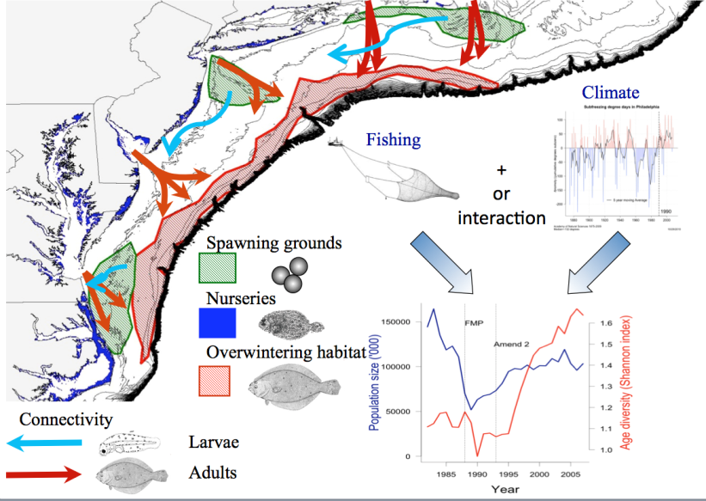
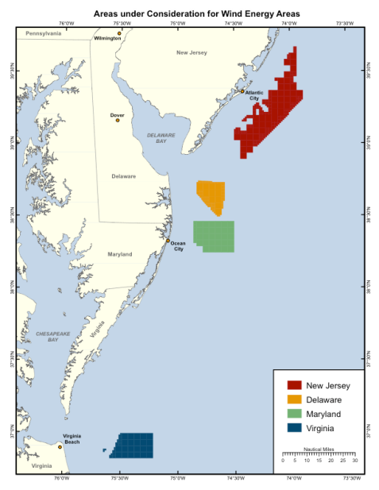
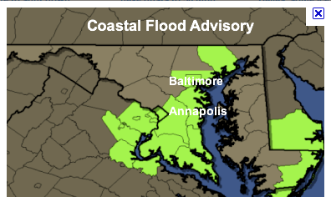
MARACOOS Regional Themes
1) Maritime Operations – Safety at Sea
3) Water Quality – Floatables, Hypoxia, Nutrients
2) Ecosystem Decision Support - Fisheries
5) Energy – Offshore Wind
4) Coastal Inundation - Flooding

Slide 7
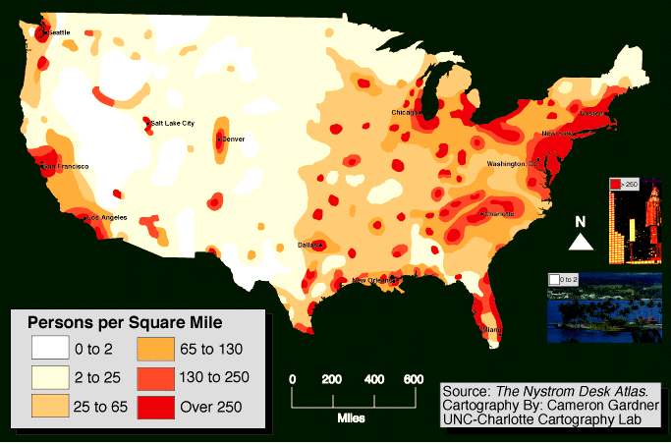
Mid-Atlantic CMSP Drivers: Population Density
MARACOOS Region has 25% of the U.S. Population

Slide 8
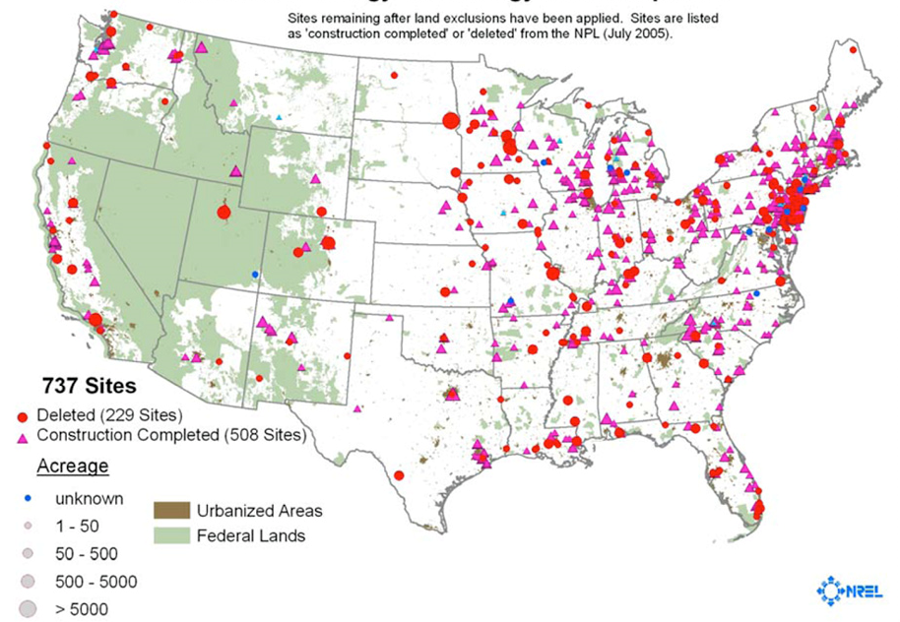
Mid-Atlantic CMSP Drivers: History
U.S. EPA
Superfund
Sites
The National Priorities List (NPL) is the list of national priorities among the known releases or threatened releases of hazardous substances, pollutants, or contaminants. The NPL is intended primarily to guide the EPA in determining which sites warrant further investigation.

Slide 9
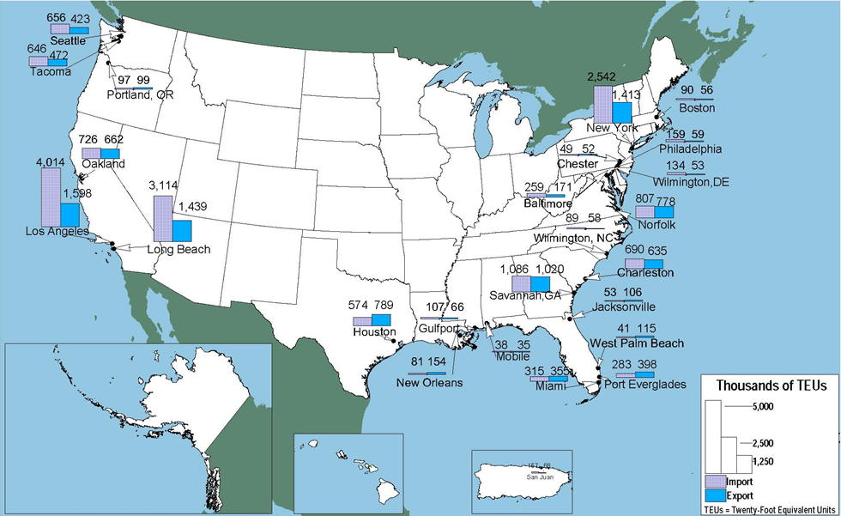
Mid-Atlantic CMSP Drivers: Maritime Commerce
Top 25 Water Ports by Containerized Cargo: 2008
6 of 25 Marine Transportation Hubs are in the MARACOOS Region

Slide 10
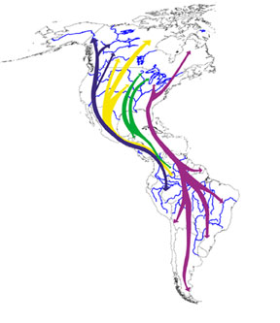
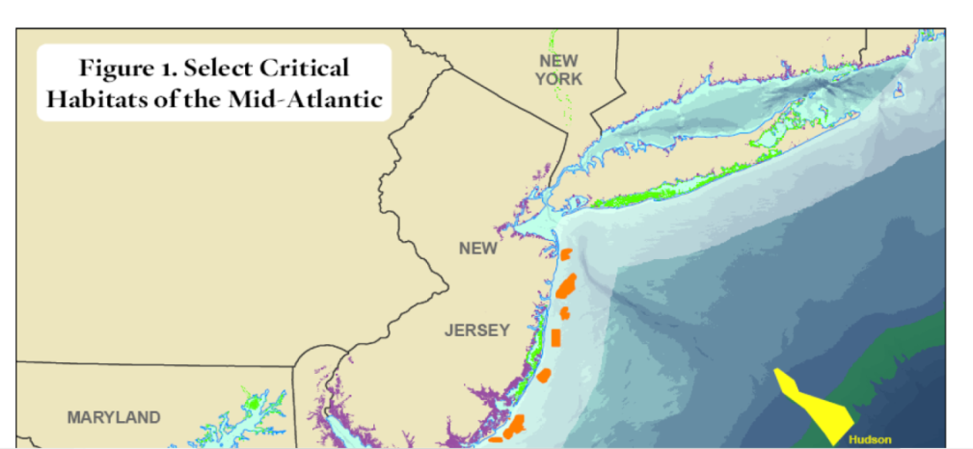
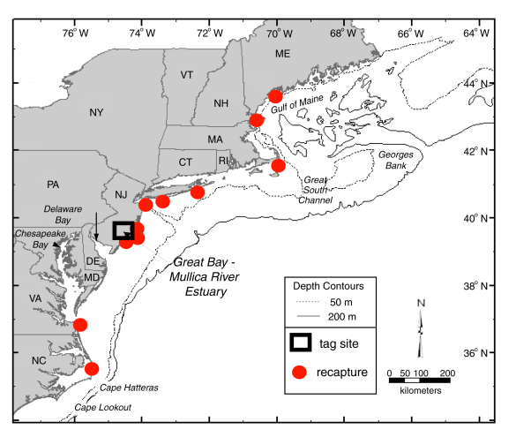
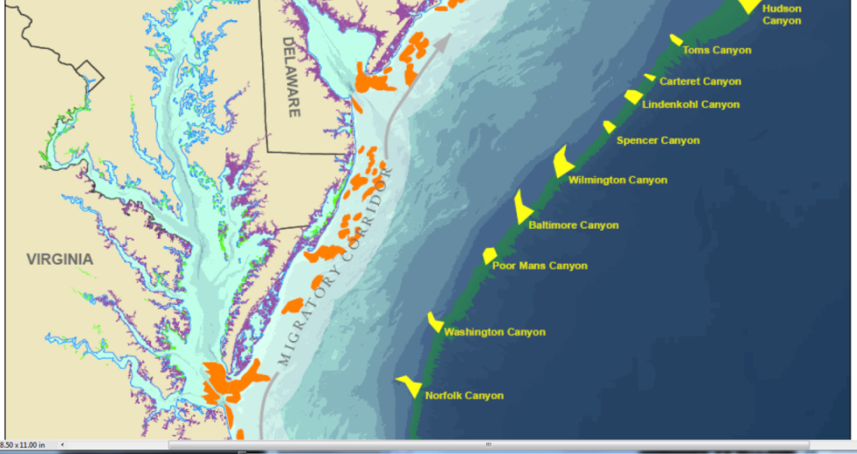
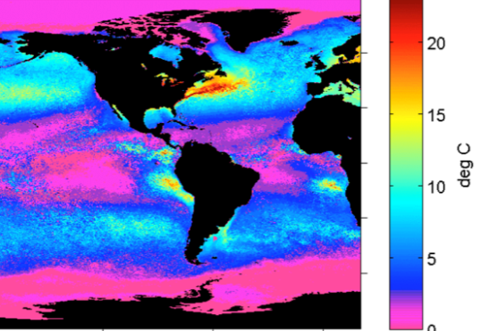
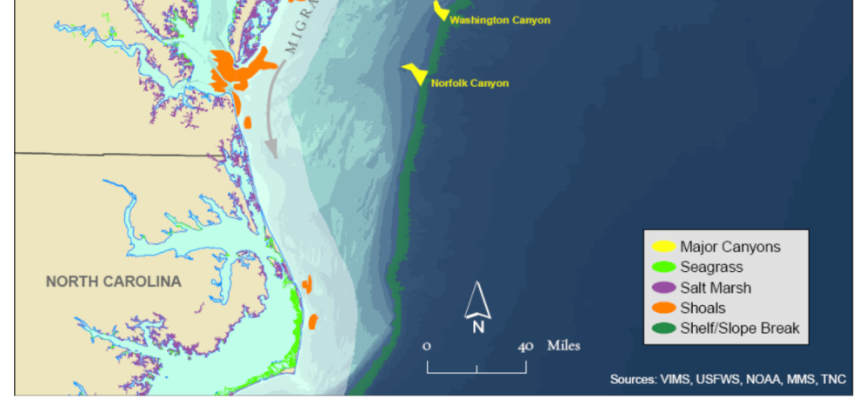
Mid-Atlantic CMSP Drivers: Critical Habitats for Migratory Species
Critical Marine Habitats located Nearshore and at the Shelf Break
US Avian Flyways:
Atlantic Flyway
Migratory Fish Species
Summer-Winter
SST Difference

Slide 11
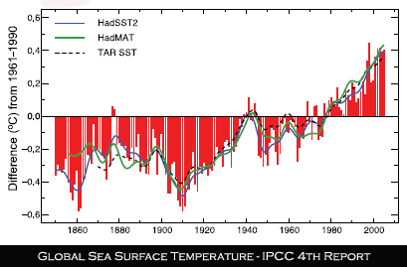
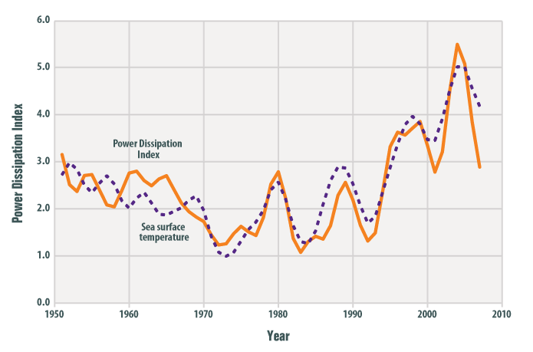
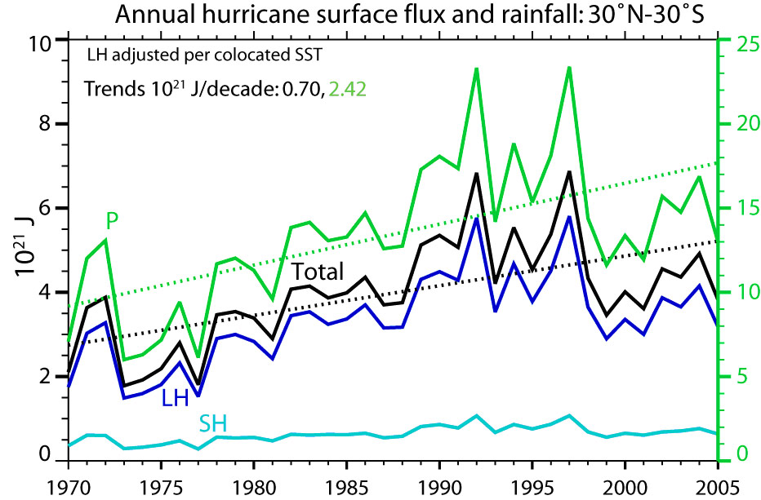
Mid-Atlantic CMSP Drivers: Climate Change
Hurricane Intensity increasing with SST
Global SST is increasing
Summer-Winter SST Difference
Hurricane Rainfall is increasing
Fall Bottom Temp Trend,1977-2008, NOAA NMFS

Slide 12
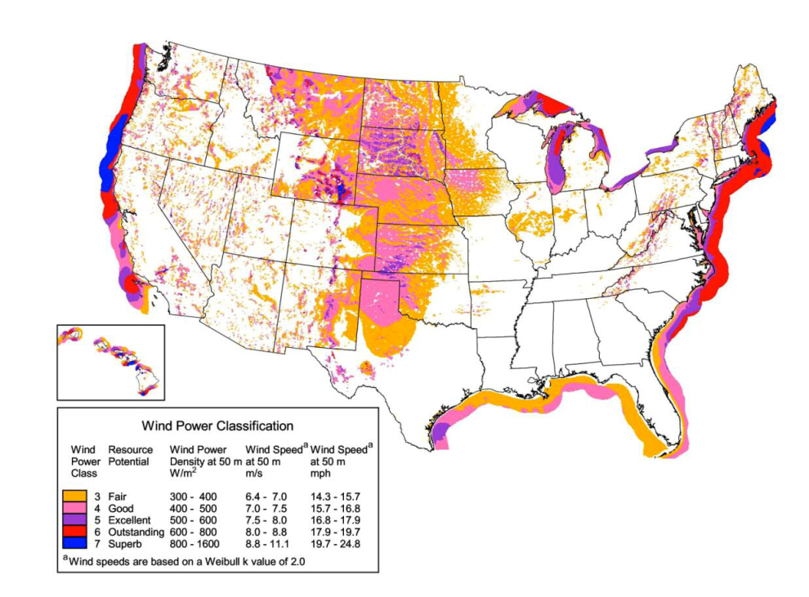
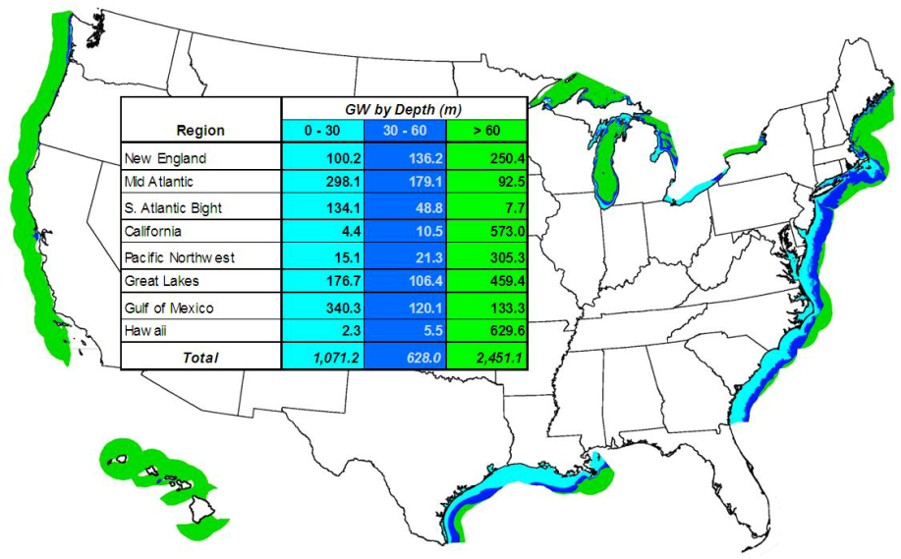
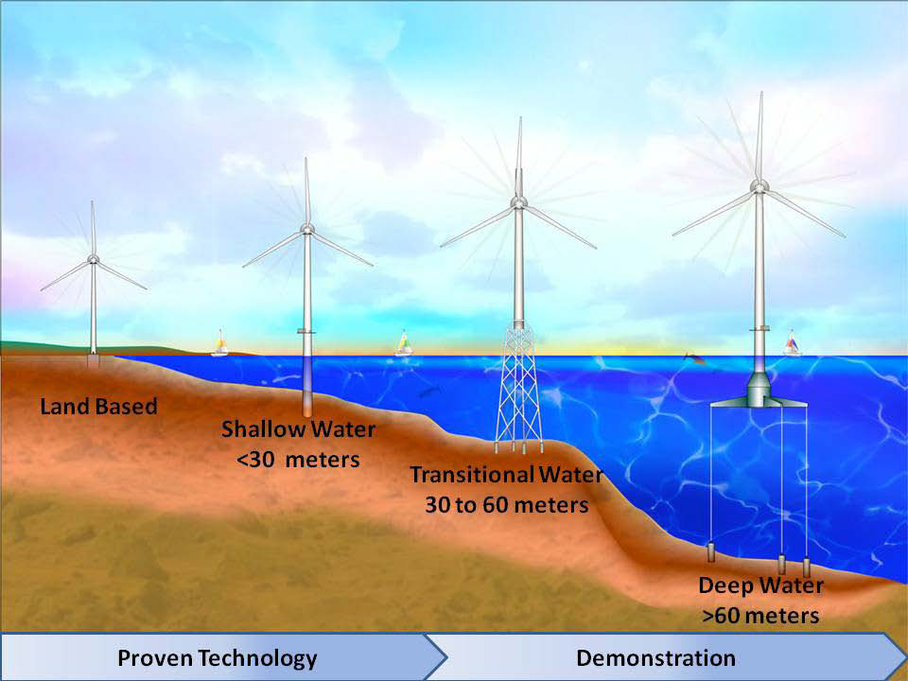
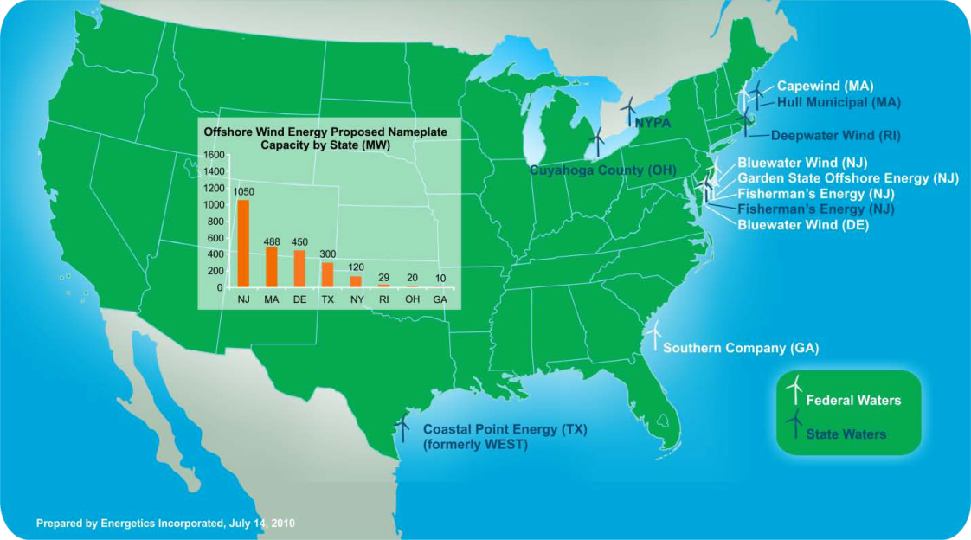
Mid-Atlantic CMSP Drivers: Offshore Wind Energy
Water Depth Zones
Wind Power Classification Zones
Ongoing Offshore Wind Development Projects
Wind Turbine Technology by Water Depth
Over 80% in MARACOOS

Slide 13
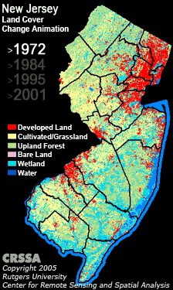
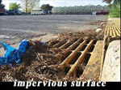
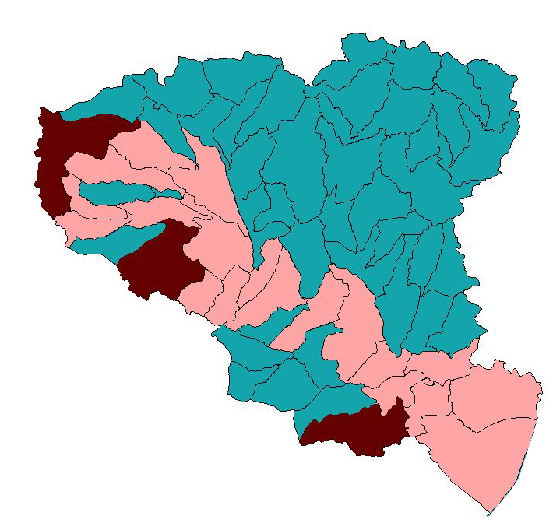
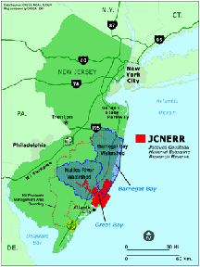
The View from the Land – Extensive State GIS Systems
Watershed Impacts of human land use

Slide 14
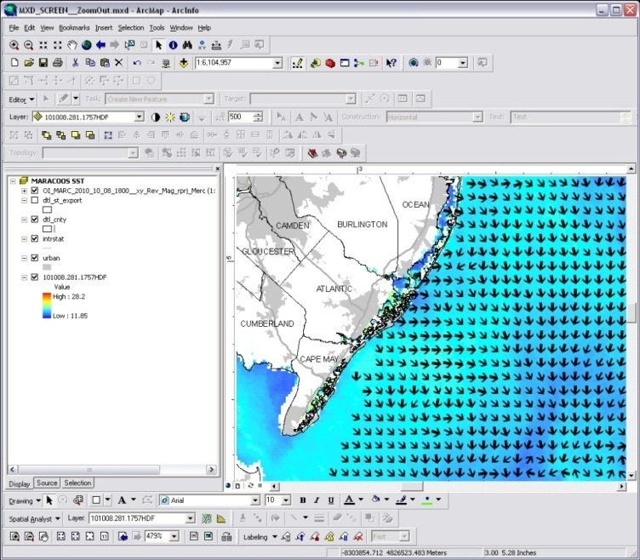
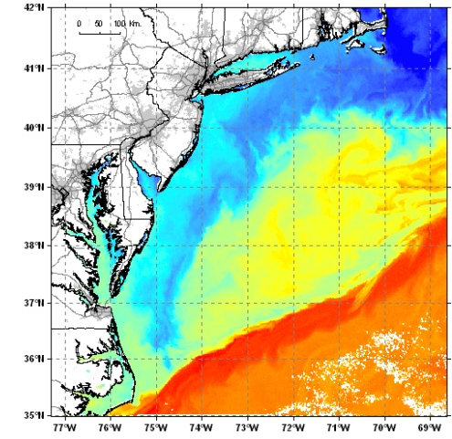


Real-Time Spatial Data Imports into State ArcInfo GIS:
Satellite Imagery & CODAR Currents

Slide 15
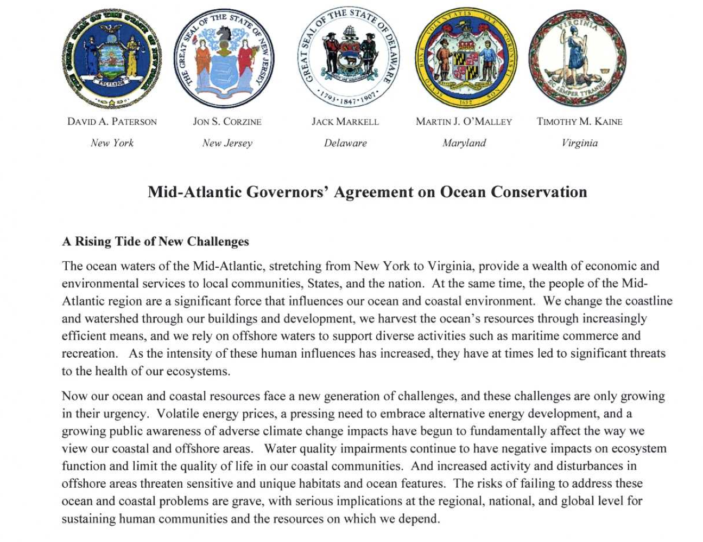
Mid-Atlantic Regional Council on the Ocean - MARCO
Formed by the Governors from New York to Virginia in June, 2009

Slide 16
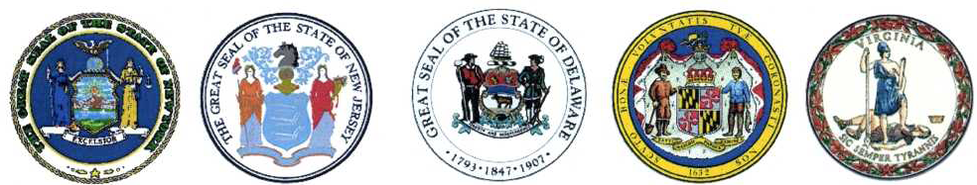
MARCO Priorities
Marine Spatial Planning
The MARCO States are each taking steps that will aid in development of a marine spatial plan for ocean waters of the region and will coordinate through MARCO to ensure the plans are integrated across the Mid‐Atlantic region. As MARCO moves forward, we will also coordinate with, and be responsive to, the Ocean Policy Task Force’s Coastal and Marine Spatial Planning (CMSP) process.
Habitat Preservation
Ensure that key ocean habitats of the Mid‐Atlantic are protected from activities that threaten their sensitive and unique features, marine populations, and ecological processes.
Development of Offshore Renewable Energy
Promote sustainable development of offshore renewable energy resources by addressing regulatory barriers and regional issues regarding potential impacts of development.
Climate Change Adaptation
Prepare the region for the impacts of climate change, primarily sea level rise impacts on regional infrastructure, coastal habitat, and shoreline management.
Water Quality Improvement
Protect human and environmental health and increase the ocean‐related economic value of the region’s coastal waters by maintaining and improving the region’s water quality.

Slide 17


Regional Themes / Regional Priorities
MARACOOS MARCO
Data Providers Data Users
1) Maritime Operations 1) Marine Spatial Planning
2) Ecological Decision Support 2) Habitat Protection
3) Offshore Energy 3) Offshore Energy Development
4) Coastal Inundation 4) Climate Change Adaptation
5) Water Quality 5) Water Quality Improvement

Slide 18
What Data & Products can MARACOOS provide
to inform CMSP Activities?
Metocean Data & Synthesis at multiple time/space scales:
Meteorology (Observations and Models)
Sea Surface Temperature (Satellite-Derived and Models)
Ocean Color (Satellite)
2-D Surface Current Maps (HF Radar & Statistical Forecasts)
3D OceanHeight, Currents, Temperature & Salinity (Obs & Models)
Waves (Observations and Models)
Oxygen (Proposed)
With NOAA NMFS -> Habitat
With DHS -> Vessel Traffic
Enabled by data interoperability bridges between typical oceanographic data formats and GIS formats used in CMSP tools

Slide 19
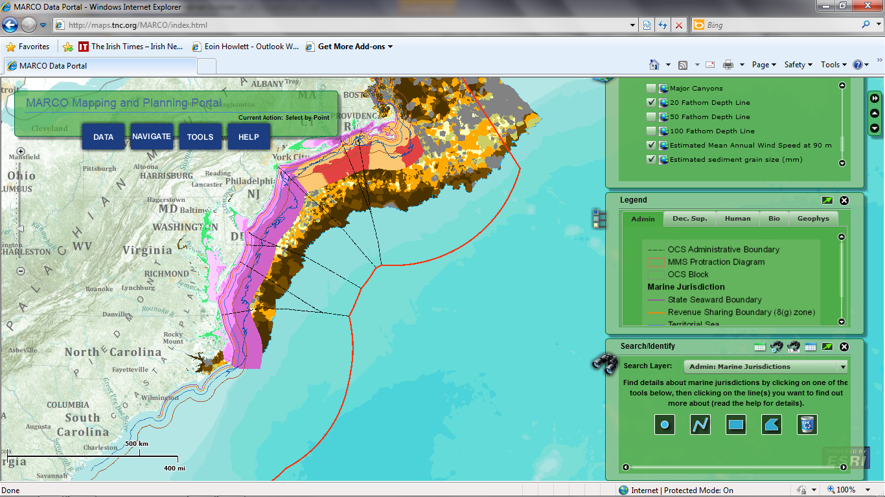
MARCO Data Portal
(by Applied Science Associates)
MARACOOS + NERACOOS = Northeast U.S. Large Marine Ecosystem (LME #7)

Slide 20
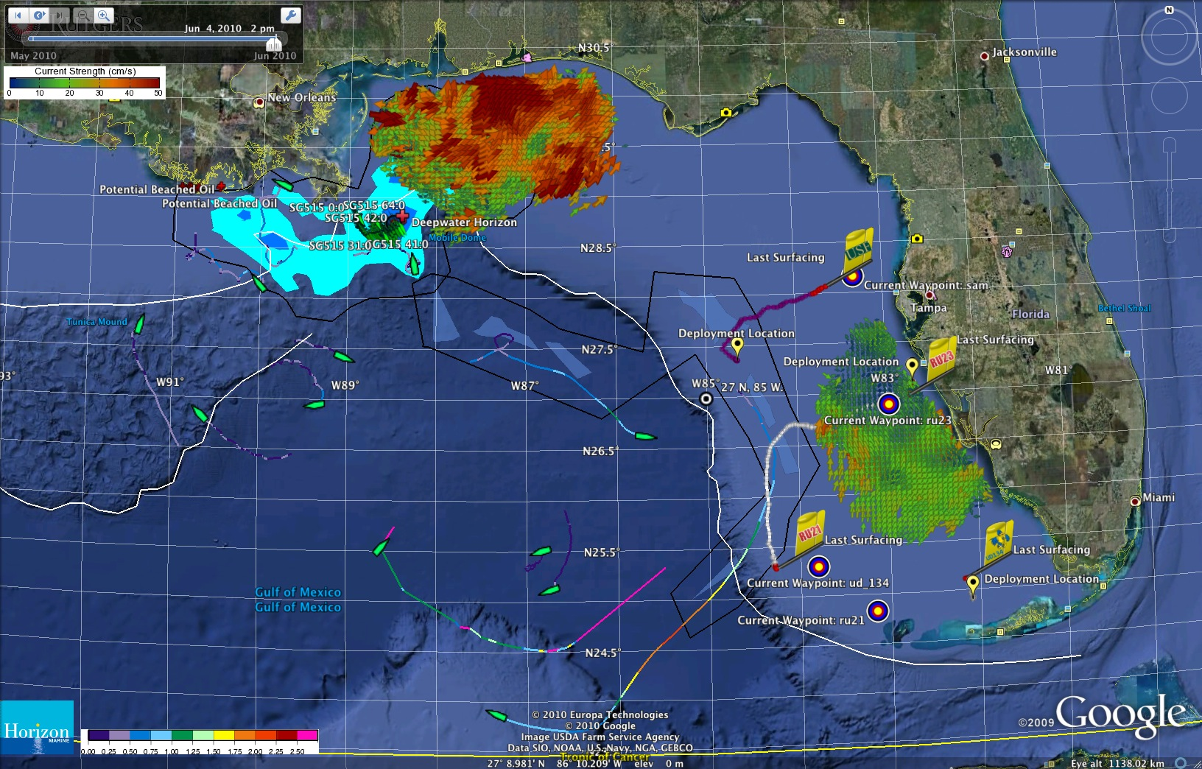
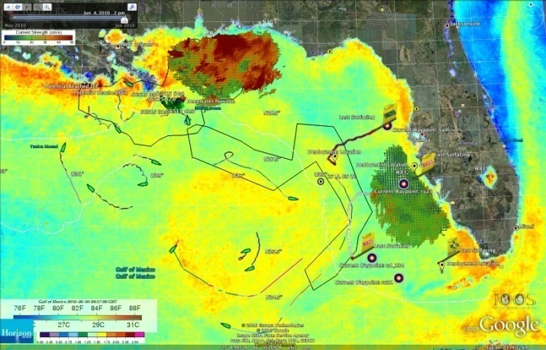


Supporting IOOS Activities in the Gulf Oil Spill
Same Google Earth Interface & Datasets for Glider Mission Planning used for Marine Spatial Planning

Slide 21



GIS Type Data for the Public: Google Earth & Maps
Google Earth:
MARACOOS Aggregation Portal for kmz files.
Google Maps:
Interactive NOAA IOOS Asset Map
Gliders, CODAR, Satellites, Models, Buoys, Weather Stations, etc

Slide 22

Conclusions:
MARACOOS data and forecasting capabilities map directly onto MARCO CMSP needs
Challenges – matching the time scales, formats, analysis tools and visualization interfaces used by the two existing communities
Solutions – Continue building bridges for data interoperability and broader access

